Slide 1
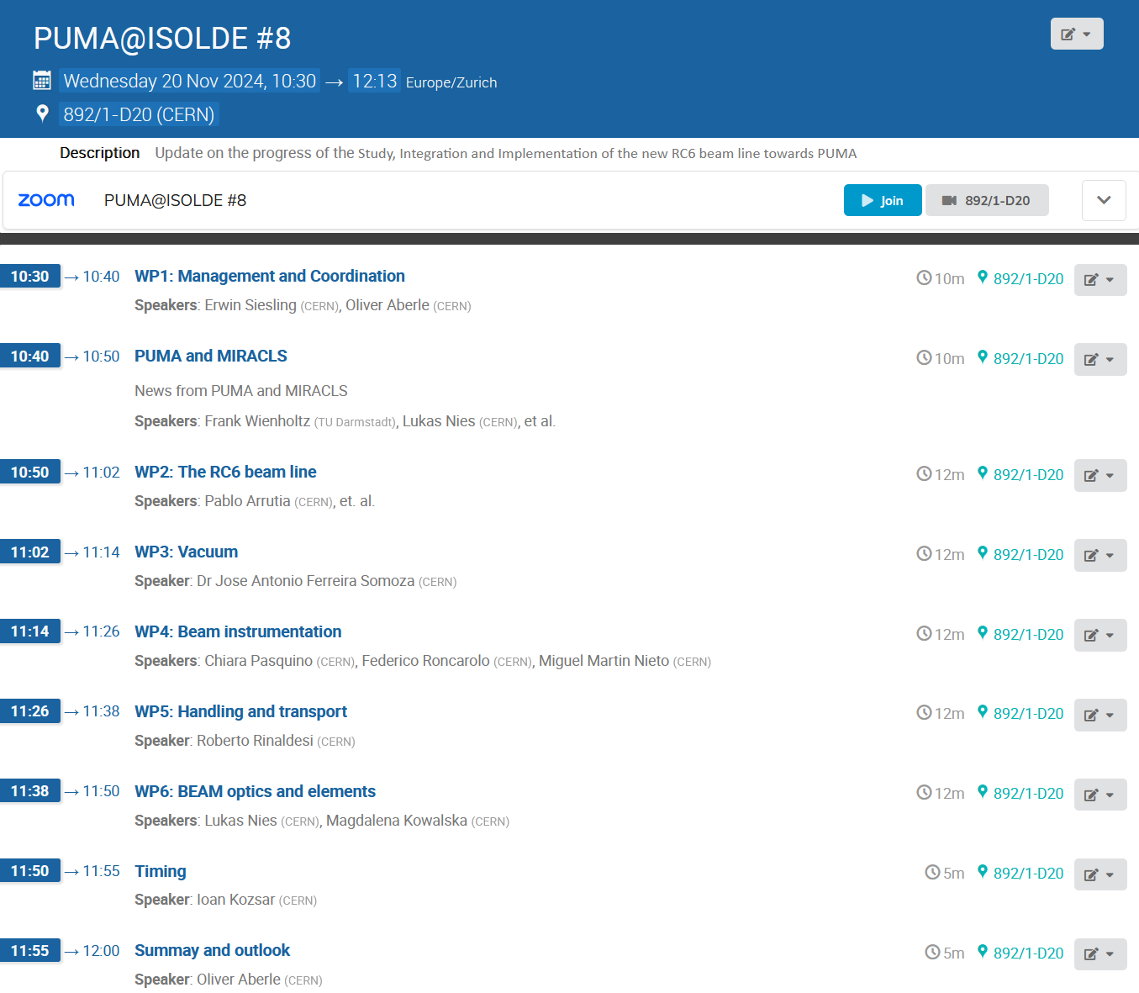
Today's agenda
Updating form September's meeting, thanks to everyone for your effort and shortness
More dedicated meetings - ongoing
Goal of today's meeting:
Update everyone on the progress of the project
Verify and share information between teams (What is still missing? Do you need input from others?)
Budget:
Please revise the 2023 numbers
Layout
Project timeline

Slide 2
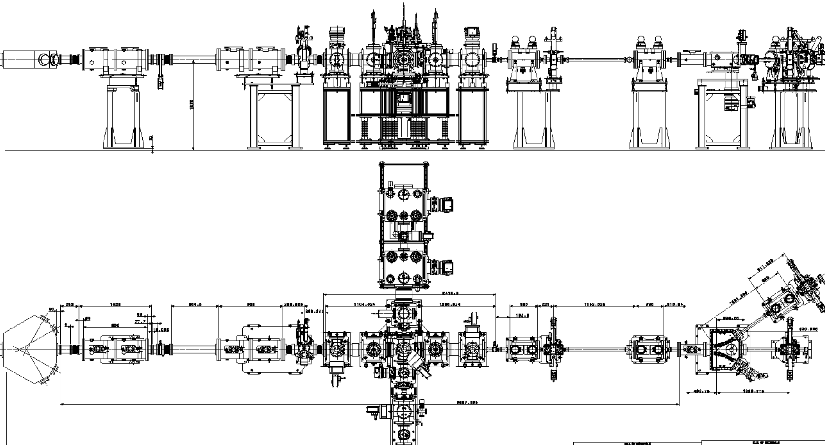
Layout

Slide 3
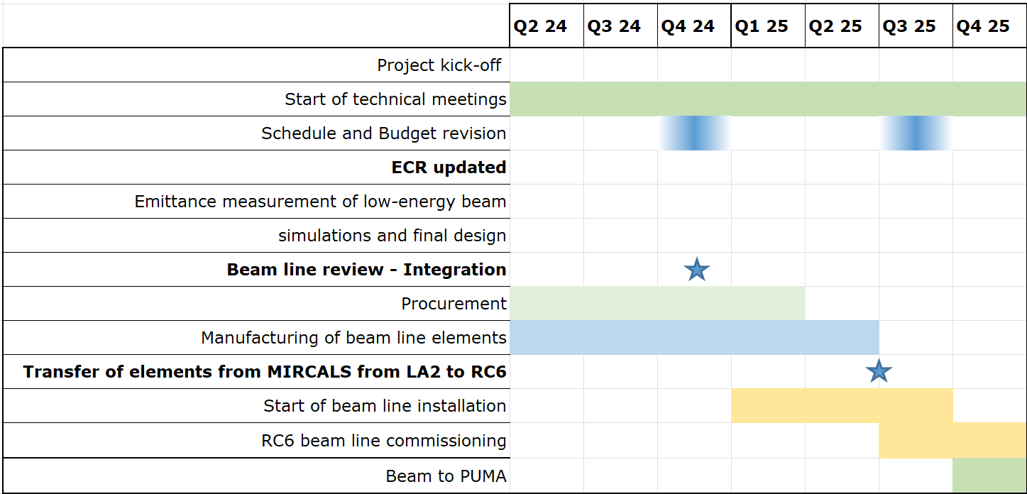
Schedule

