Slide 1
WP2: the RC6 beam line
P. Arrutia
PUMA@ISOLDE #8
20/11/2024

Slide 2
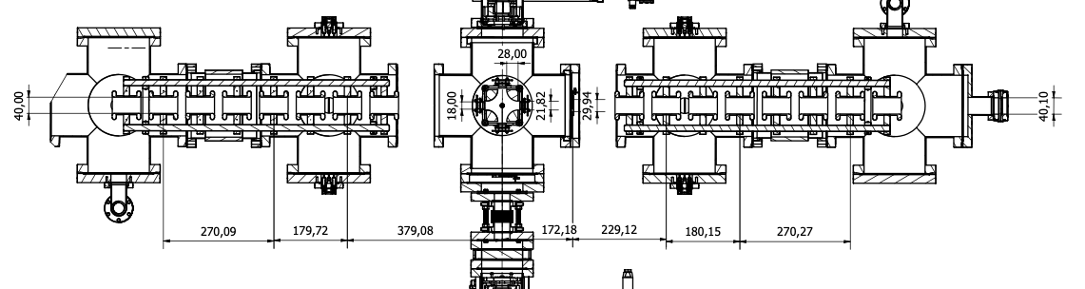
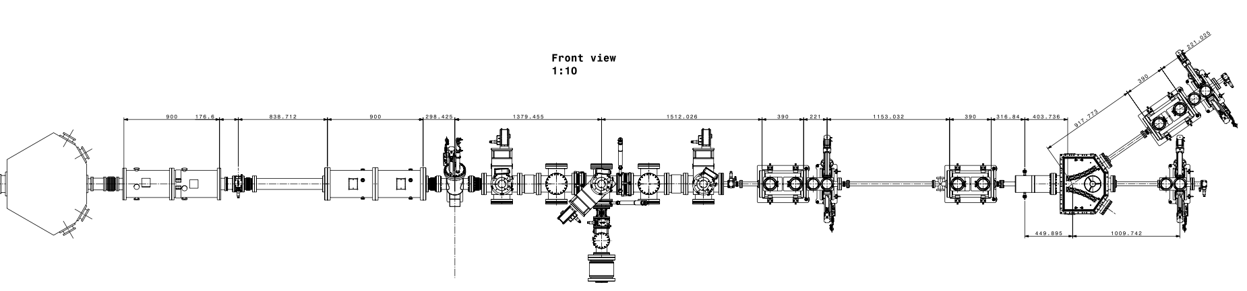
Optics model
Updated optics model with most recent integration drawings:

Slide 3
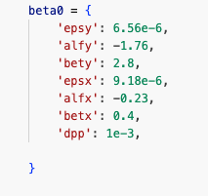
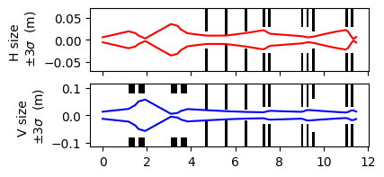
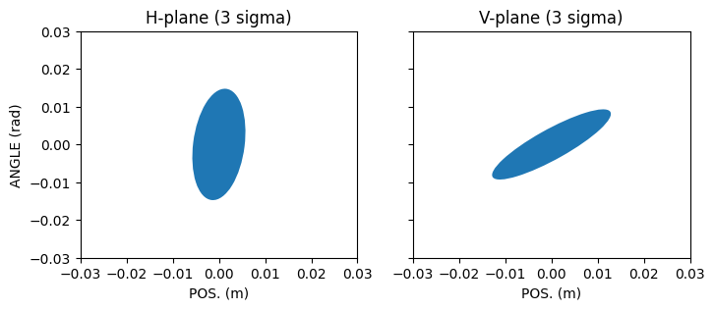
Optics model (ii)
Verified that good transmission can be obtained at 60 KeV, when bypassing the MRToF.
Initial conditions (courtesy of L. Nies, measurements by N. Bidault*):
*Details here

Slide 4
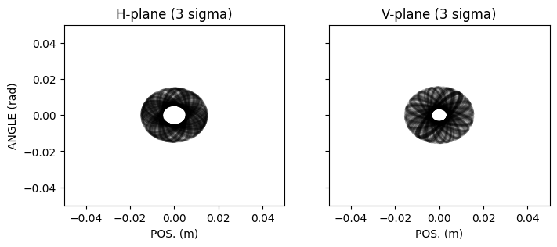
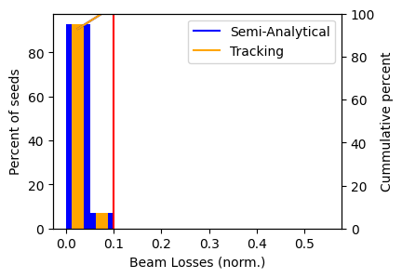
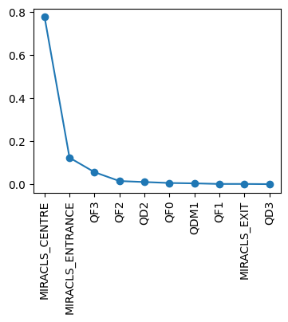
Optics model (ii)
Verified that good transmission can be obtained at 60 KeV, when bypassing the MRToF.
“Error study”: rotated initial conditions and re-optimised quad strengths.
Able to recover >90% transmission -> MIRACLS bender remains main bottleneck.
Beam loss locations
*Details here

Slide 5
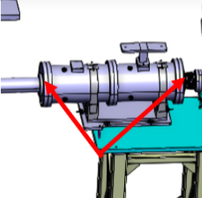
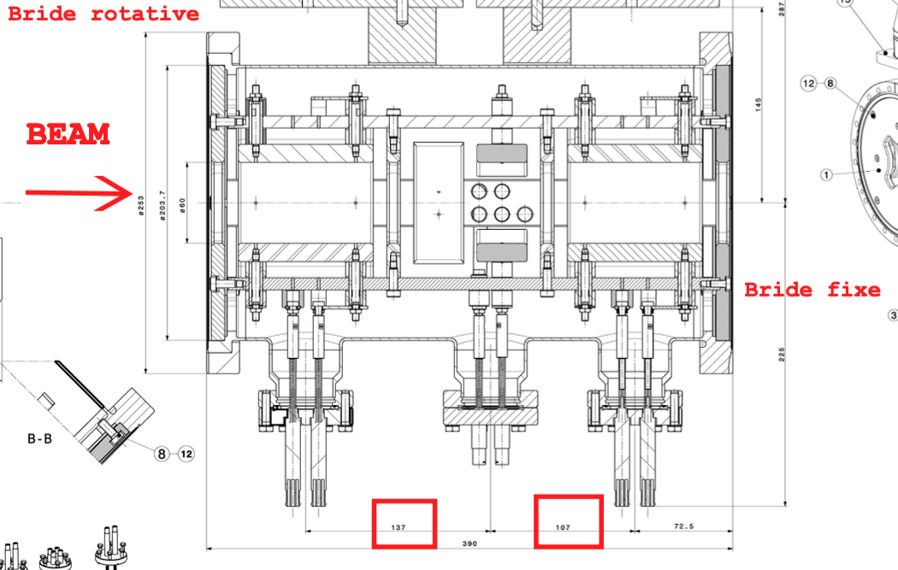
ZQNAs
ABT is providing 3 ZQNA doublets for PUMA@ISOLDE:
4 spares in total (both for the 57 ZQNAs in ELENA and the 3 ZQNAs in PUMA) -> Possibly manufacture 1 extra ZQNA in 2025 (already budgeted within PUMA).
Transitions between quad and pipe need to be manufactured (not provided by ABT)
Final discussion about supports and metrology ongoing.
Careful when installing: assembly not symmetrical (AD_ZQNA_0003).

Slide 6
Conclusion
Beam transport at 60 KeV modelled, achieving good transmission.
  Emittance measurements performed last week in RC2 via quad scan -> to be compared to previous measurements.
ZQNAs almost ready for installation. Might produce 1 spare in 2025.
From ABT: 0.1 FTE, includes beam physics (P. Arrutia) and hardware work for ZQNAs (A. Prost).

Slide 7
Extra slides

