Slide 1
Beam Instrumentation for Puma@Isolde
M. Martin Nieto , P. Martins, J. Tassan-Viol
W. Andreazza, S. Bart Pedersen
C. Pasquino, F. Roncarolo
Puma@Isolde Day – 20-Nov-2024

Slide 2
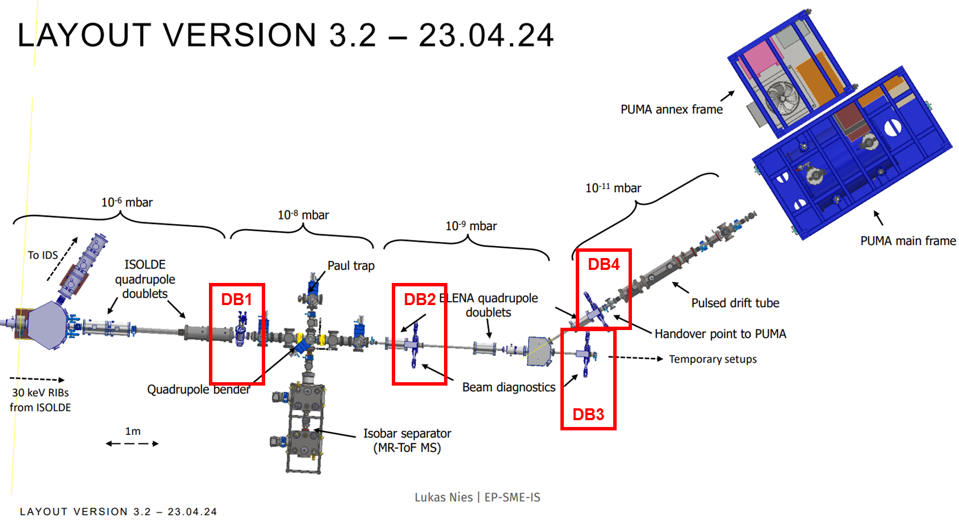
Beamline Layout – Beam instrumentation
Continuous beam from ISOLDE:
- 30-60keV
- Current of 1pA to a maximum of 1nA in rare cases
- Transversal emittance of 30 pi mm mrad (tbc)
Pulsed beam (after Paul trap/separator):
- Expected energy spread and bunch length tbc, a maximum DeltaE of 5%
- bunch length of 100ns-100mus
- Expect 1 (for unstable ions) to 10^5 (for stable ions) ions per bunch
BI work kind of boosted recently, meetings organized by Puma@Isolde
https://indico.cern.ch/category/15189/

Slide 3
Diagnostics Boxes (BD) - Overview
DB1 :
  Standard low energy ISOLDE DB equipped with 1 FC and 1 scanner
  DAQ : continuous acquisition
    signal acquisition with integration time can be changed from 200ms to 1s. Max rep rate 5Hz.
    FC signal via low noise high sensitivity electronics – Pico Ampere Meters (PAM).
    Scanner acquisition correlated to motor movement, via dedicated VME electronics.
DB2,3,4 :
  Standard (long) HIE DBs with multiple ports.
    Faraday cup + scanner for low energy ISOLDE mode.
    Magnetof + slits for pulsed mode.
    DAQ: detector signals sync to pulsed beam.

Slide 4
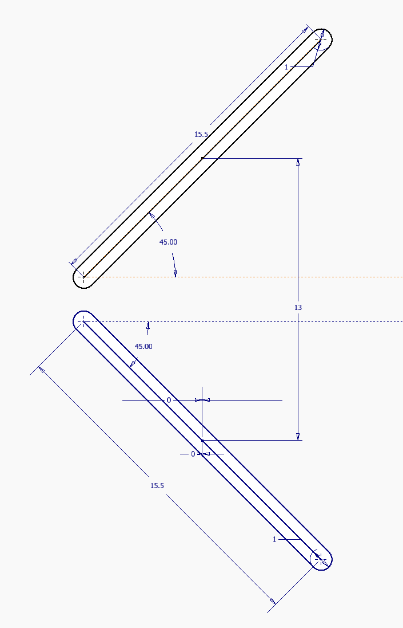
DB2,3,4 – Layout + Use cases / modes of operation
All 3 DBs with
1 (ISOLDE-type) scanner (to be compatible with the option of having FC IN at the same time).
1 H+V slit, 45 degrees actuator.
  1 mm aperture.
  Profile measurement in pulsed mode.
1 FC (IN-OUT).
1 MagneTOF (IN-OUT).
  Also in combination with slits.
Smaller beam in pulsed mode.
  Ø10 mm pulsed.
  Ø26 mm DC.
Operation Mode | Beam Mode | Scanner | H+V Slit | FC | MagneTOF
#1 | DC | OUT | OUT | IN (fixed) | OUT
#2 | DC | IN (scan) | OUT | IN (fixed) | OUT
#3 | DC | IN (scan) | OUT | OUT | OUT
#4 | Pulsed | OUT | IN (scan) | OUT | IN (fixed)
#5 | Pulsed | OUT | OUT | OUT | IN (fixed)

Slide 5
Status & Plans of DBs:
Mechanical design, Integration and Procurement

Slide 6
DB1
1x Scanner & Faraday cup, 1E-8 mbar for DC beam (low energy ISOLDE)
  New design from Standard Models with CF Flange. 2 Instruments SC+FC on same Flange.
  Study finished.
  X,Y, Z adjustment box table added to the instrument.
  Material has been ordered. Components to be jointly purchased with other projects for bulk discounts.
  Drawings to be finished in next 2 weeks.
  Collaboration with EN-MME Design Office.
20 Nov 2024

Slide 7
DB2,3,4
3 (+1) HIE Isolde (Long) DBs, 1E-9 mbar / 1E-11 mbar for DC and Pulsed Beam
  1 Instrument per flange.
  Study finished.
  X,Y, Z Adjustment box table added to the instrument.
  Materials ordered.
  MagneToF, supplied by the collaboration.
  2D drawings being done (2 weeks).
  Main Workshop to handle machining.
  Critical standard components (gaskets & bellows) ordered, or orders being sent soon.
  Great collaboration with EN-MME design office.
20 Nov 2024

Slide 8
Mechanical Production Planning
Raw material purchasing – Ordered.
Design completed – Drawings ready in 2 weeks.
Production with MME (subcontractor…) – Delivery Q3 2025.
Metrology, cleaning, assembly, calibration, vacuum acceptance done by end of year.
Budget envelope: 200+20 kCHF for the mechanical production and MME study (to be confirmed when order is passed). This was based on the previous estimates without the MagneToF, adjusted for current costs: +45 kCHF extra to be added to this envelope (see previous presentation).
20 Nov 2024

Slide 9
Status & Plans of DBs:
Electronics architecture, cabling, racks…
20 Nov 2024

Slide 10
DB1
Standard ISOLDE FC-Scanner electronics.
IN-OUT and FC charge measurement via PLC.
PAM (Pico-Ampere Meter) via profinet communication. PAM connected on free channels in rack 50 continuing ones in RC6.
Scanner driven by stepping motors, read out ISO-SCANNER VME boards.
DB2,3,4
Slit control via Standard HIE ISOLDE electronics and motor drivers.
Baseline specs → only MagneTOF expected to be used with pulsed beam, but to cope with uncertainty about absolute signal levels and signal/noise:
  FC DAQ: recently agreed to prepare both low energy FC DAQ (spare channels available as for DB1) and HIE Isolde readout to cope.
MagneTOF signal via TDC (next slide).
Initial design with 2 sets of slits changed to a single set.
20 Nov 2024

Slide 11
MagneTOF – DAQ via TDC
Needed resolution is ~1ns, for 10 ns to 5 µs windows
Choice of TDC done, waiting on budget/procurement
  PicoQuant MultiHarp 150 8P
  Standardised model with LHC BSRL and ISOLDE upgrades.
    Simplified management of spares, software development…
    Negligible dead-time, critical for ion counting.
  ~16 kEUR for system (spare channels)
FESA class to be developed to adapt to this TDC.
20 Nov 2024

Slide 12
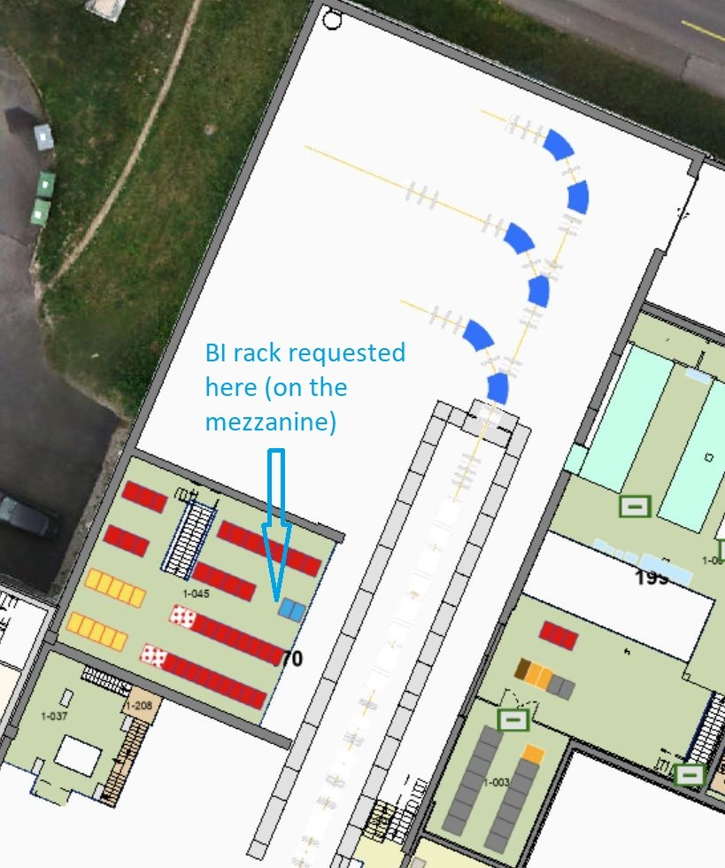
Cables and Rack
Requests submitted and being processed:
RQF2634357 DIC
RQF2597896 Rack
RQF2749174 - Electrical connection of the rack
RQF2783961 - Installation d'un chassis VME
20 Nov 2024

Slide 13
Schedule and budget (electronics)
Rack installed already.
Chassis and components being prepared / procured. Plan to be ready for end of the year
Budget: 70k foreseen in initial envelope may not be enough, depends on real cable costs (EN-EL to answer ticket) and TDC choices.
(Also related to HV platform plates, see next slides):
+15-20k for additional PAMs + DSS work for procurement, reception, chassis assembly/tests
20 Nov 2024

Slide 14
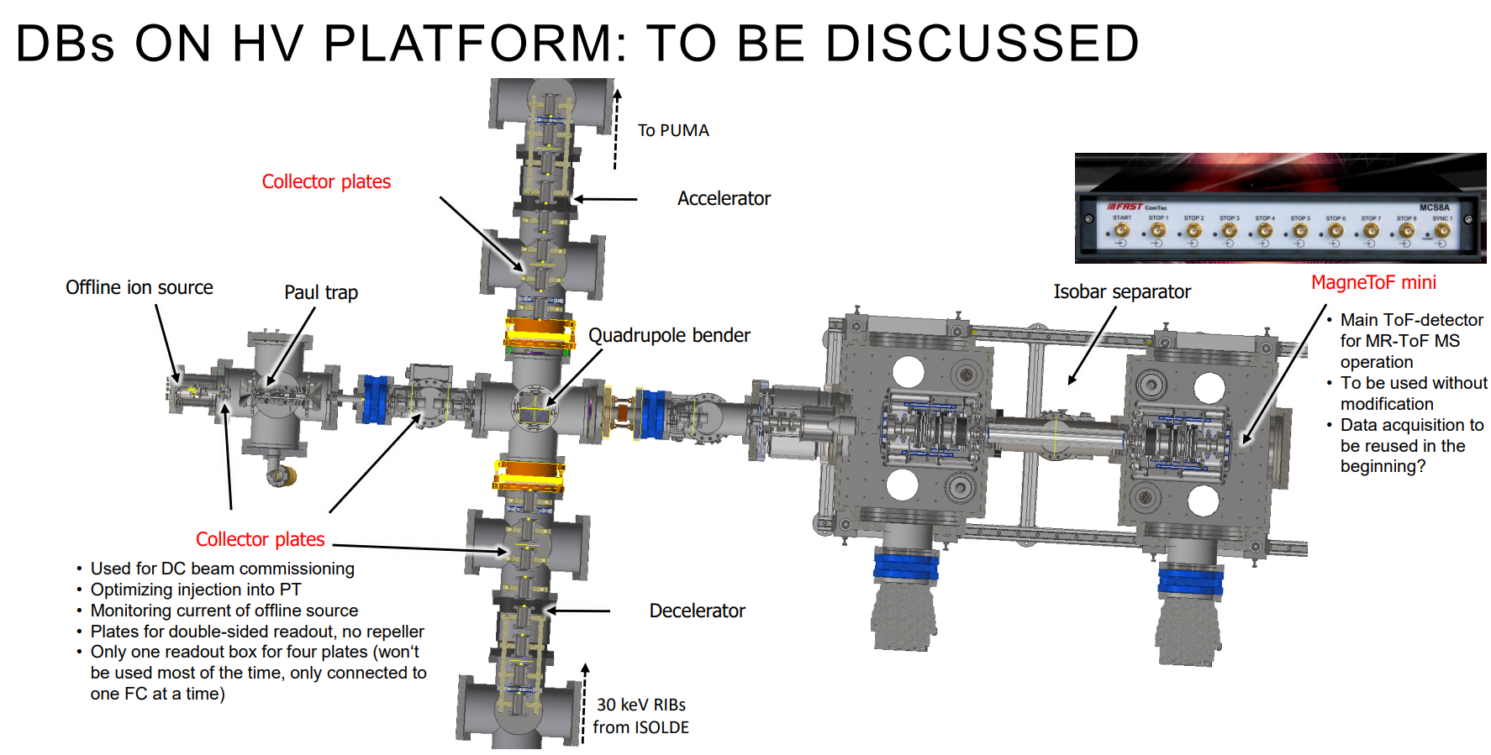
Collector Plates – Additional request
4 Collector Plates + 1 MagneToF mini:
  Pneumatically actuated.
  Study to be checked together with Lukas.
  Design by mid-January.
  MagneToF supplied by the collaboration.
  Budget: 15X5 KCHF (75 KCHF) to be added to the previous envelope.
  To be delivered after DBs. Last minute request, low priority.
  Production to be launched end of 2025.
20 Nov 2024

Slide 15
Outlook
DBs study finished, integration completed, procurement in progress, manufacturing to start Q1 2025.
Both DAQ types (low energy Isolde and HIE Isolde version) will be prepared.
Rack installed; cabling will be pulled during YETS.
Expected schedule:
  Q3 2025: mechanical parts ready.
  End of 2025: metrology, assembly, cleaning, calibration, vacuum acceptance finished.
Budget:
  Initial budget estimate (270k CHF)
  Added previous presentation: 65k for MagneTof + electronics, 75k for HV platform collector plates, 20k for PAMs.
  Need to add Design Office work (20k CHF, slide 8).
Software:
  We still need to look at details about SW solutions to combine Low energy ISOLDE and HIE control + DAQ (e.g sync DB2-3-4 scanners DAQ with motor movements).
  TDC SW development in parallel to new LHC LDM and HIE Isolde Si detectors – Procurement is currently the block.
20 Nov 2024

