Slide 1
PUMA-RC6 Beam Manipulation
Beamline optics and elements
2024-11-20
Lukas Nies (EP-SME-IS)

Slide 2
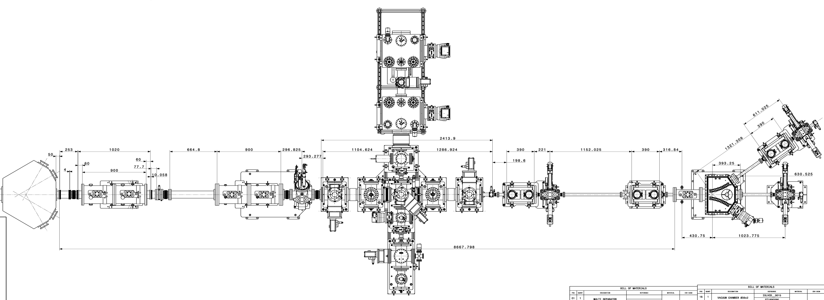
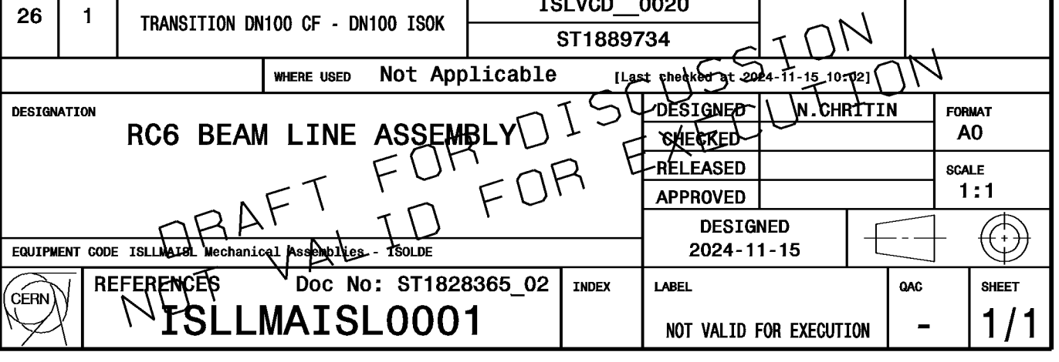
(almost) FINAL LAYOUT– ISLLMAISL0001
15/12/2023
15/12/2023
ST1828365_02

Slide 3
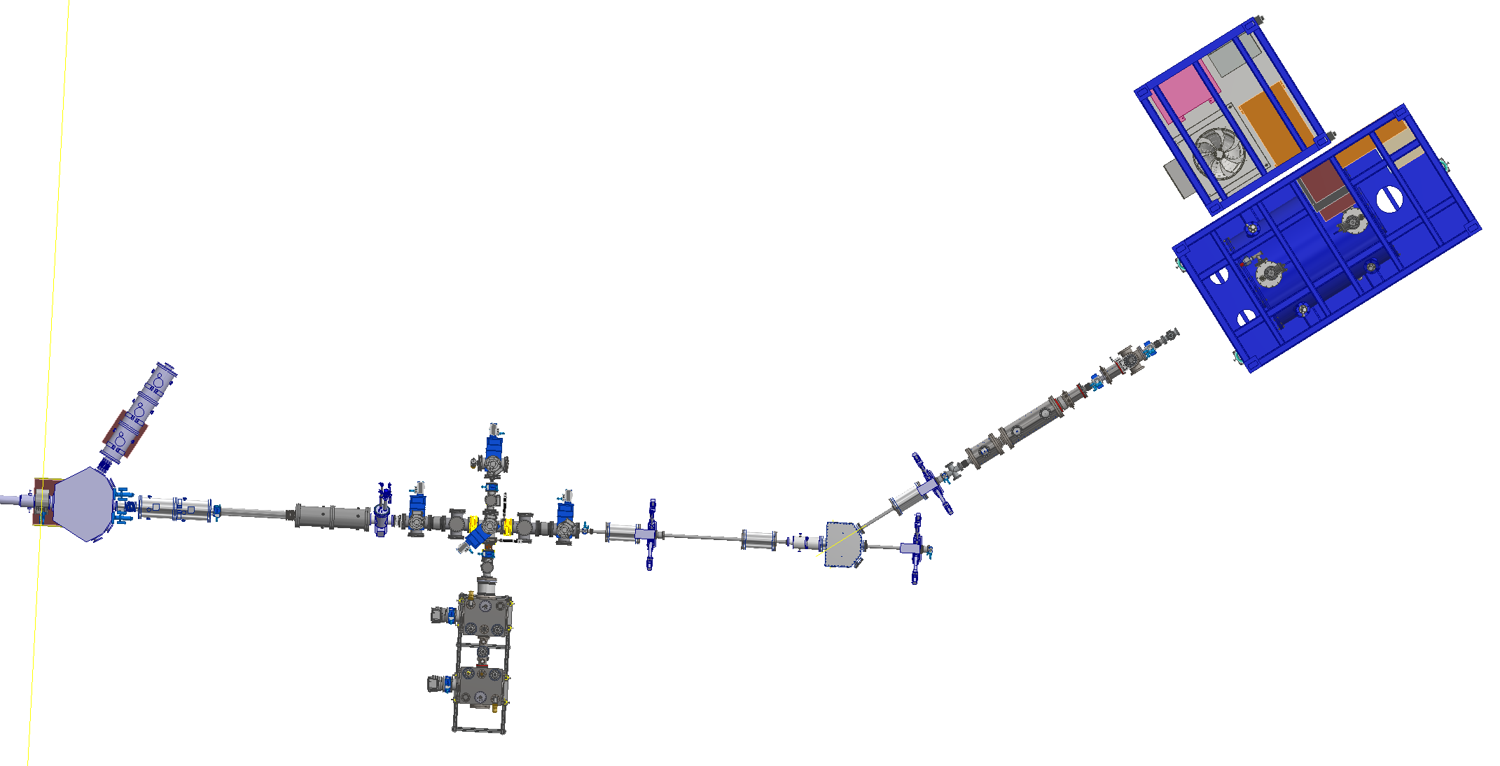
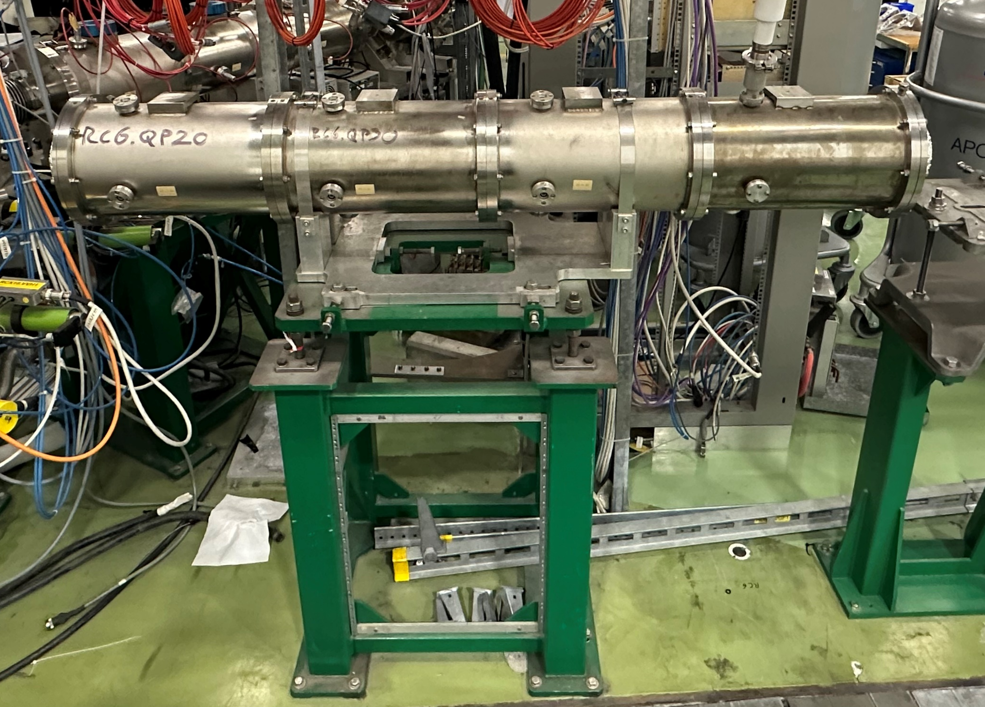
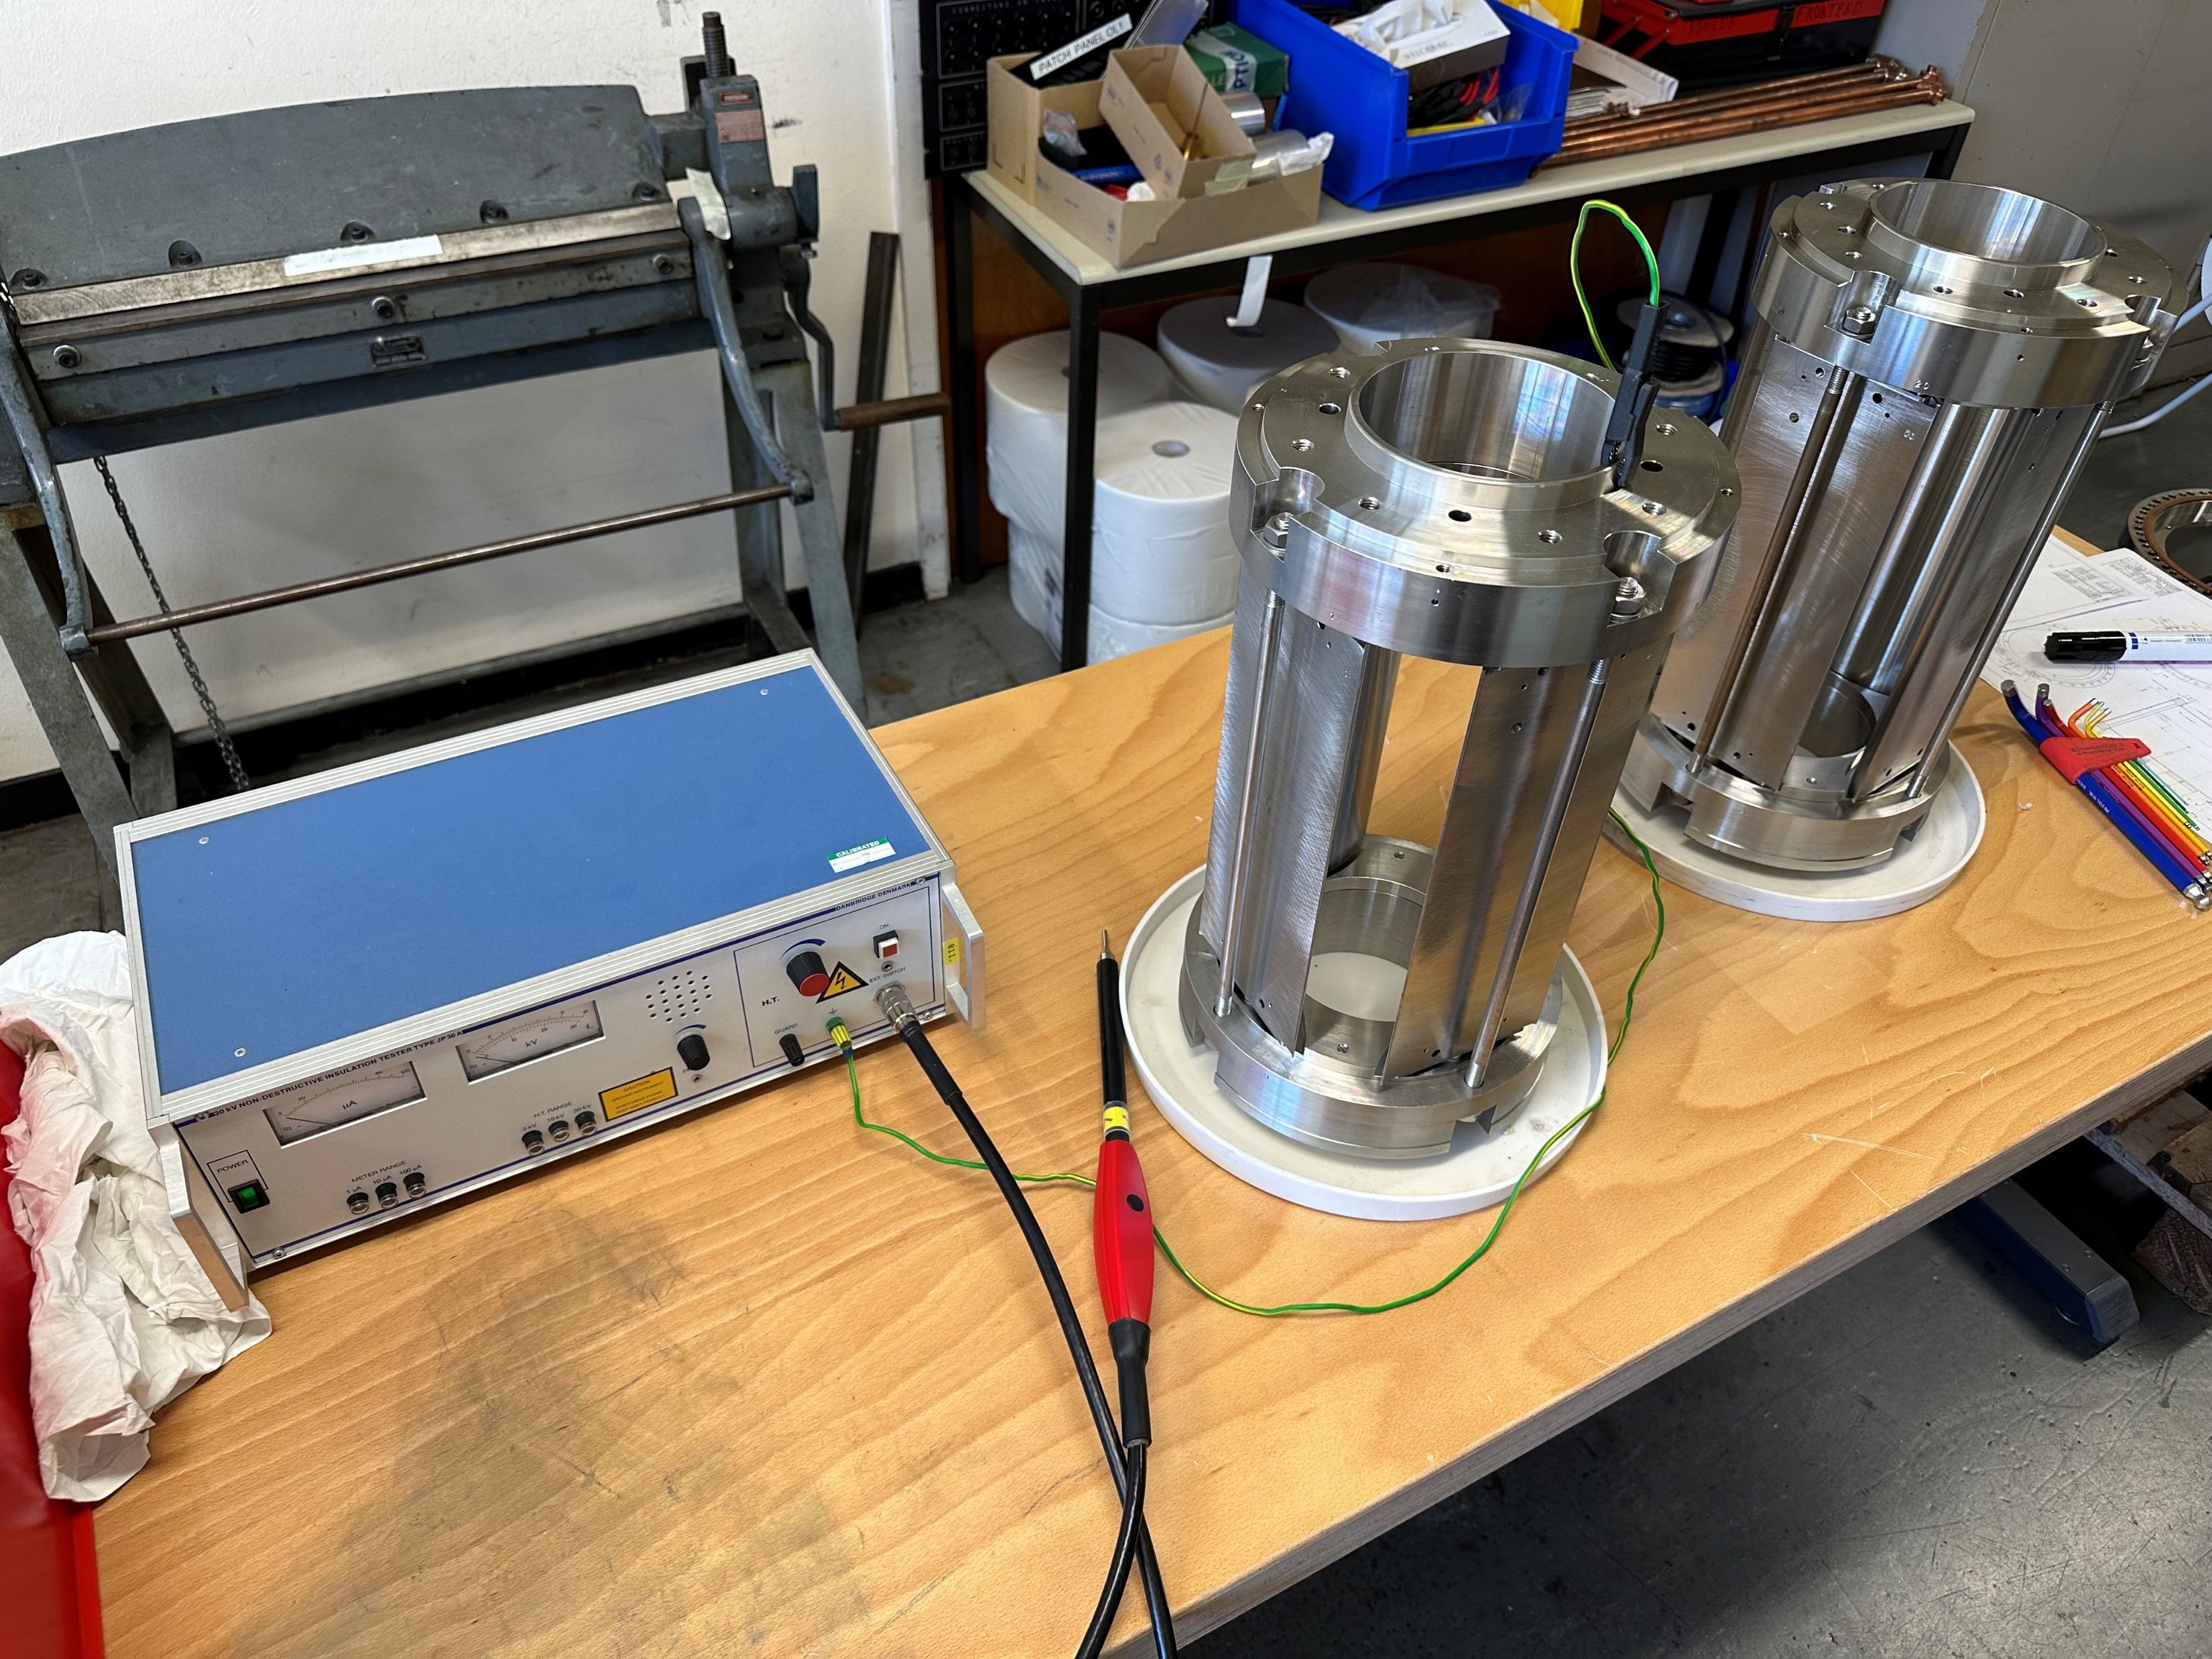
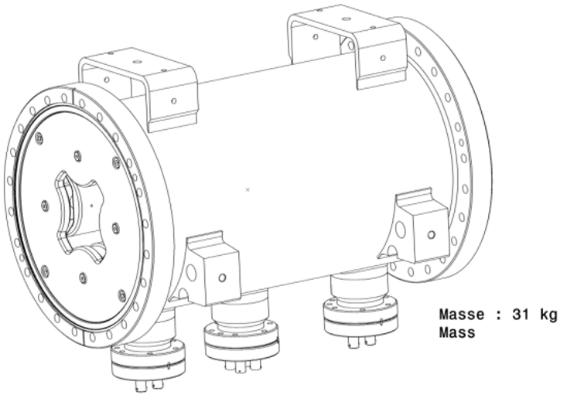
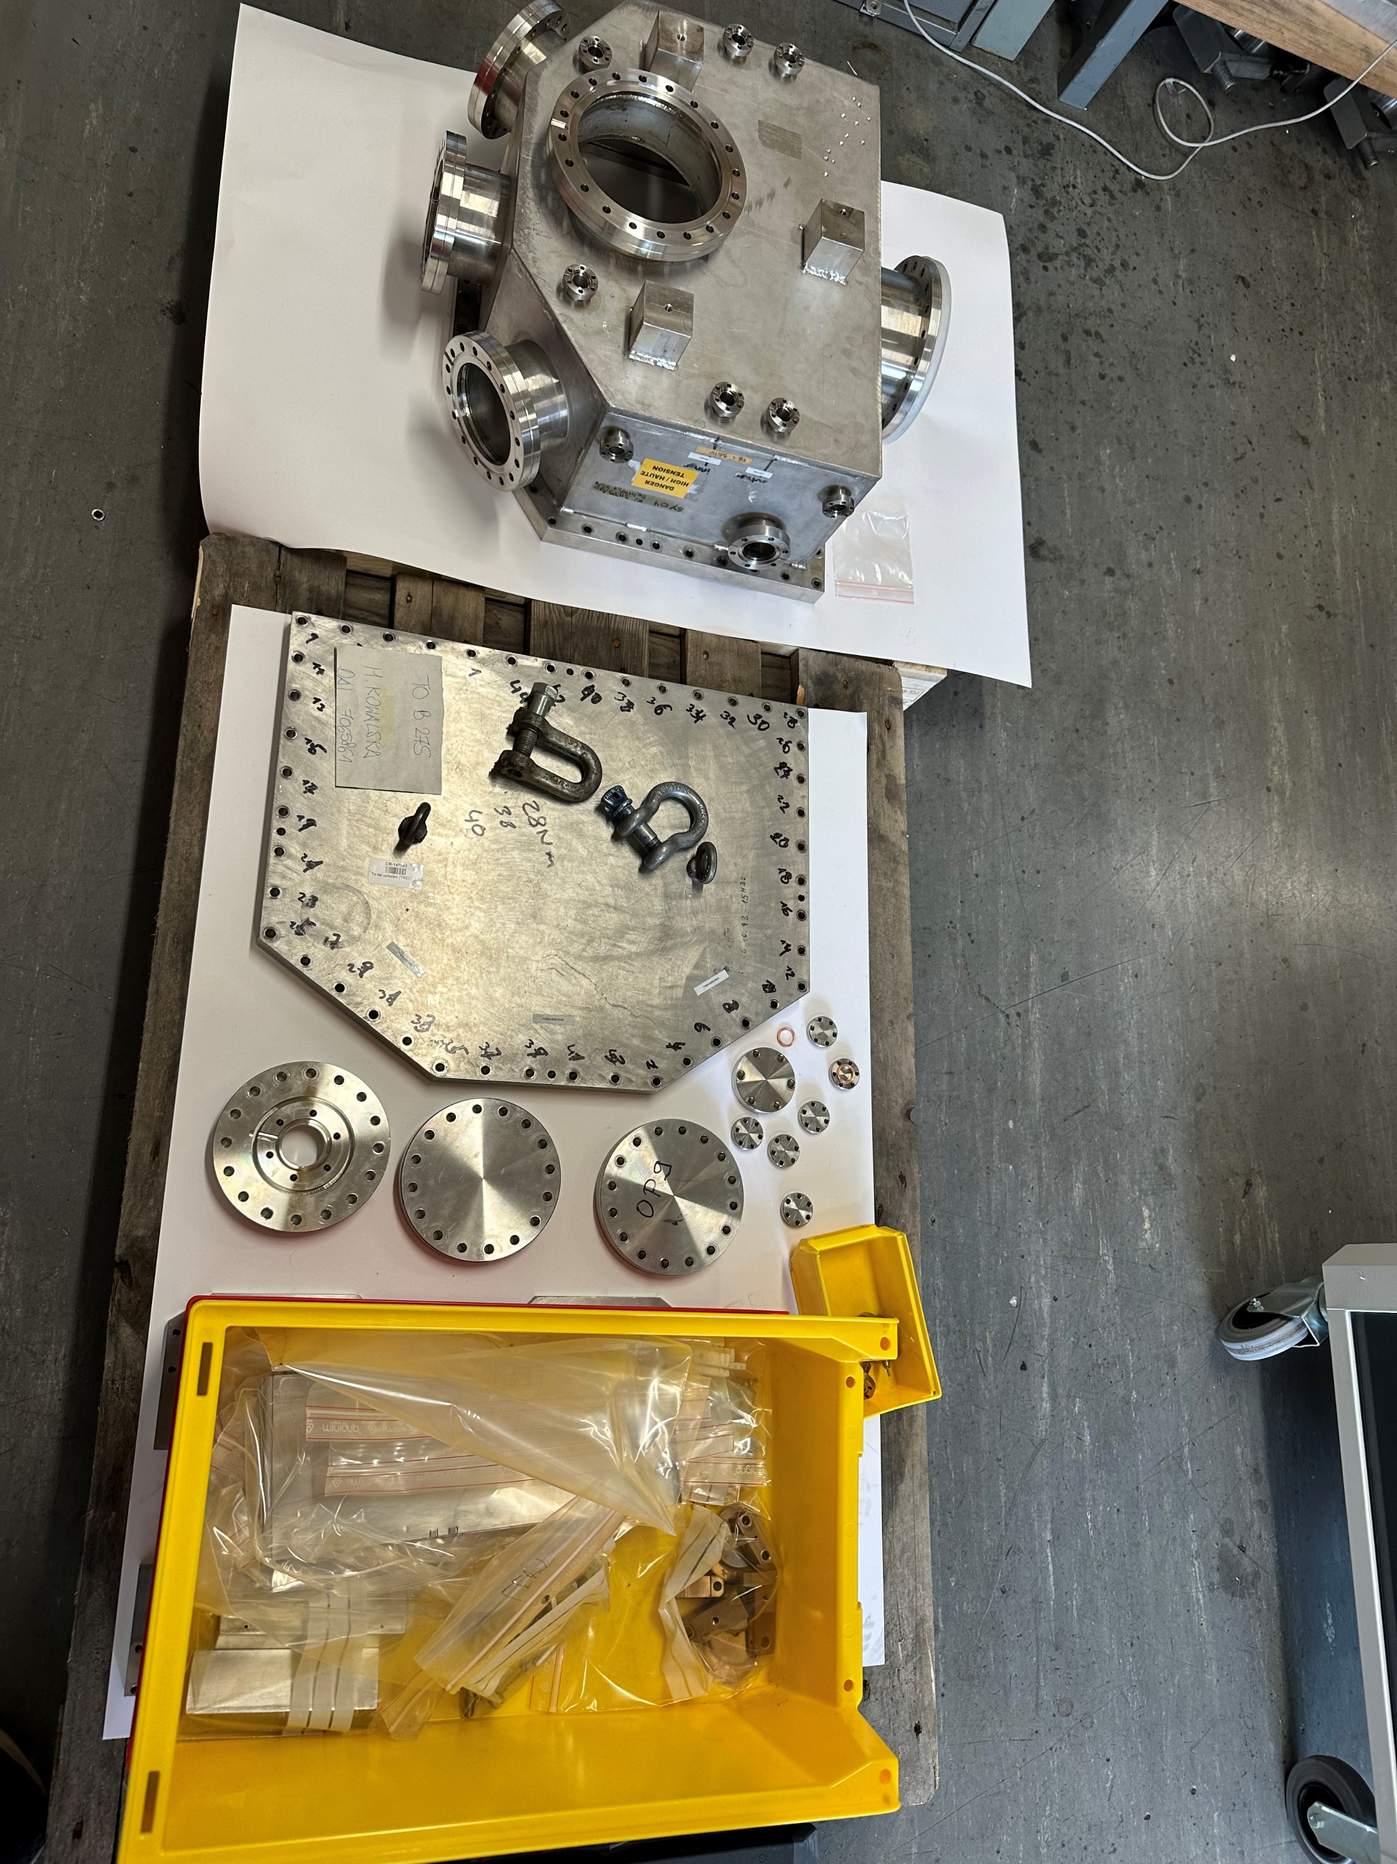
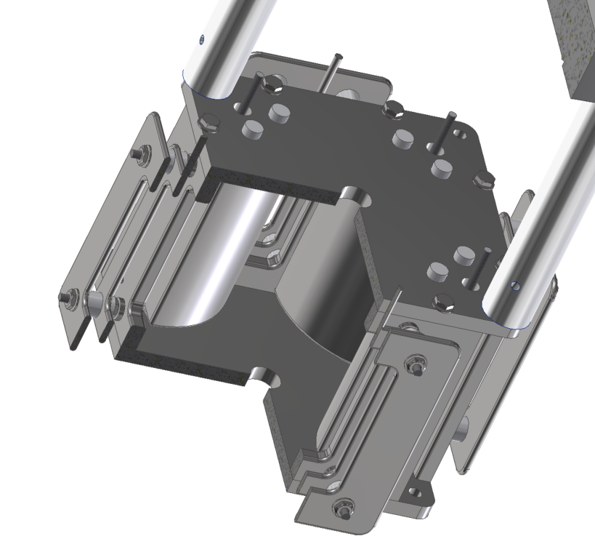
ION OPTICS: OLD MEETS NEW
ISOLDE QPs, refurbished, A. Boucherie (SY-STI-RBS)
ELENA ZQNA, new
QPB Doublets
Einzel lenses
QP bender, new
LAYOUT VERSION 3.2 – 23.04.24
UHV switchyard, refurbished, A. Boucherie

Slide 4
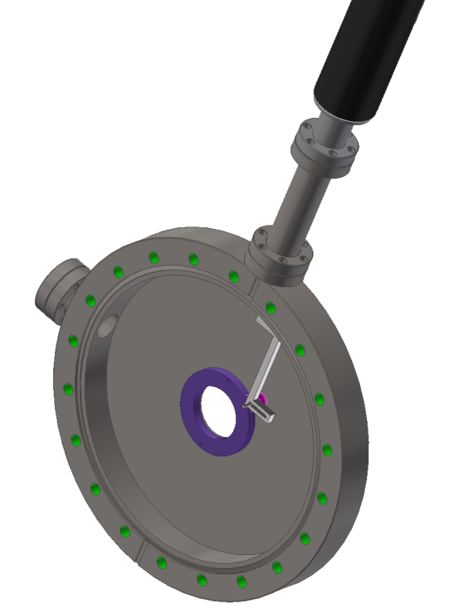
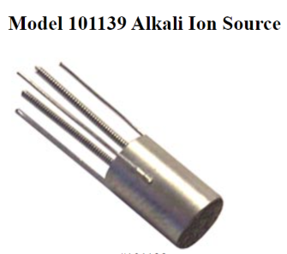
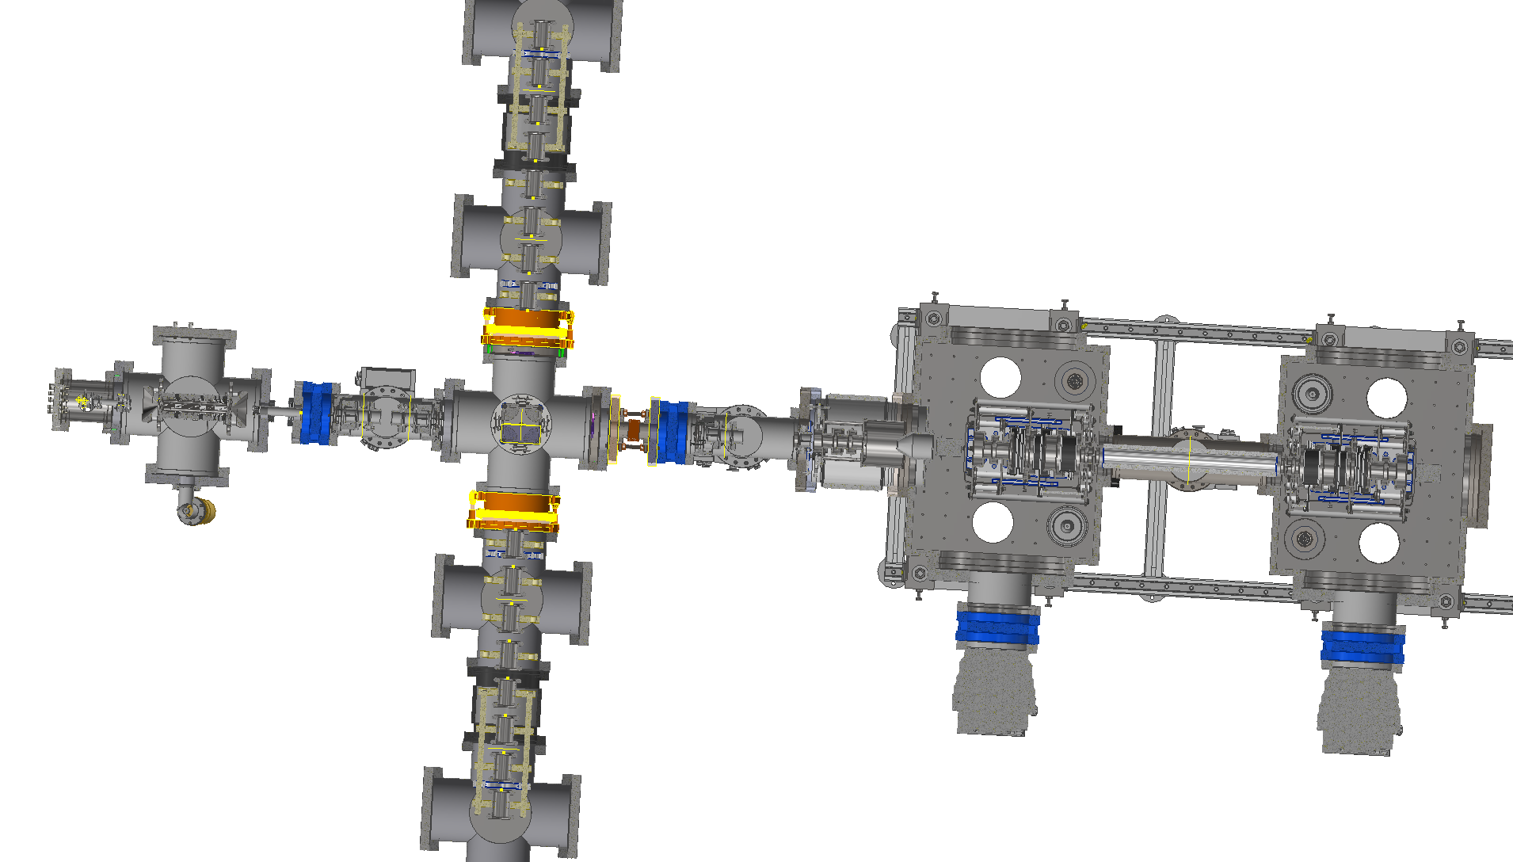
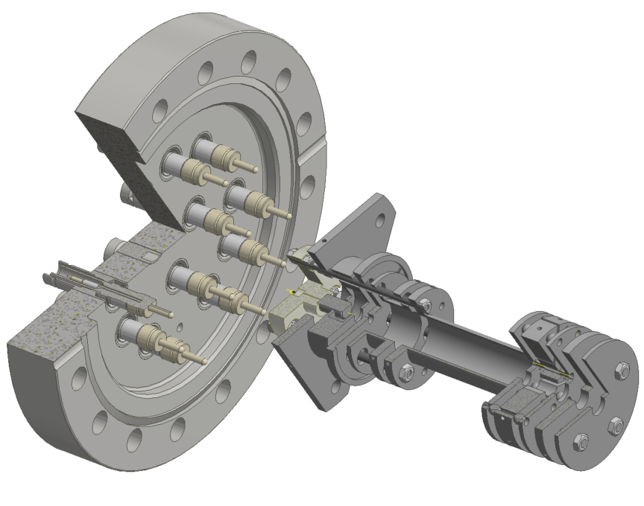
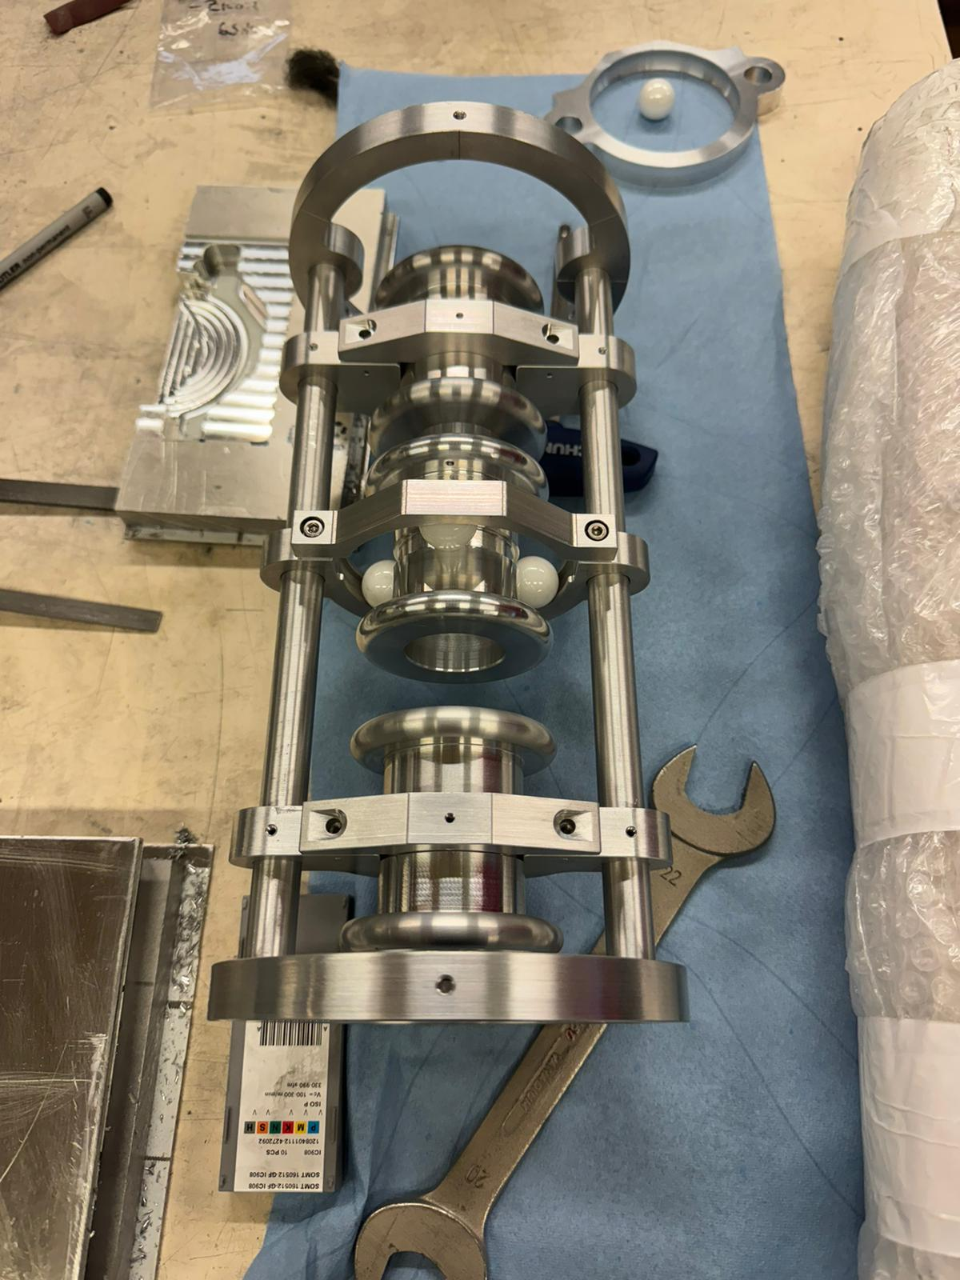
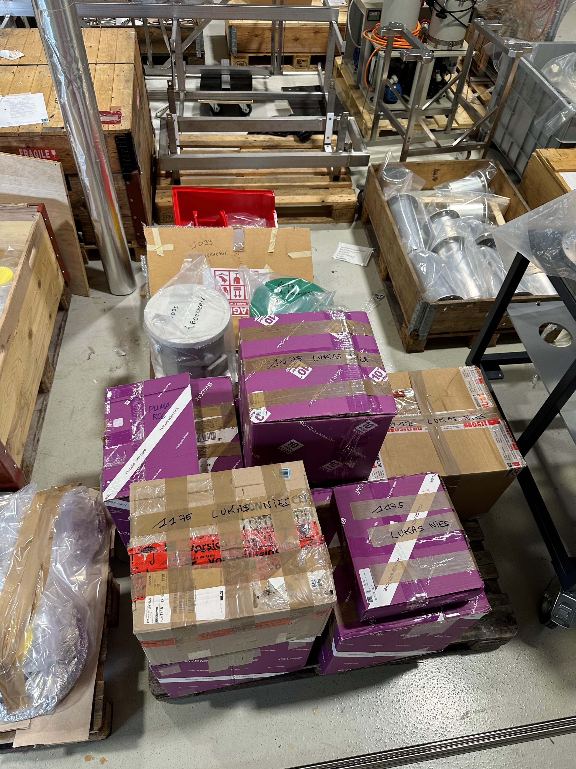
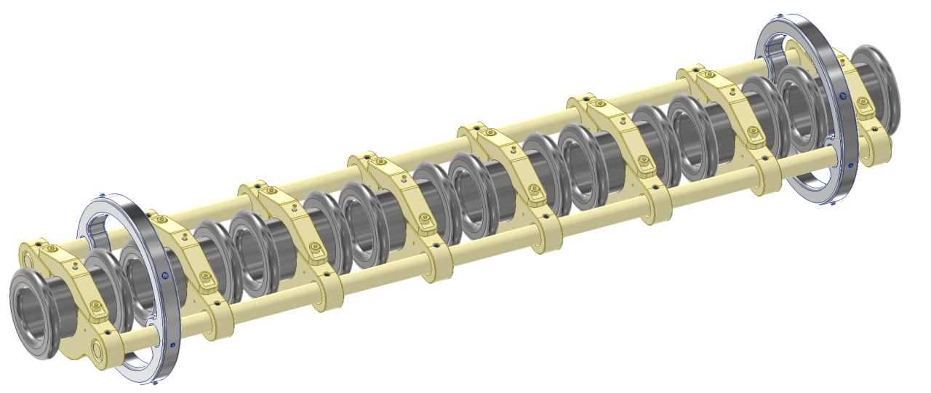
MASS SEPARATOR SECTION
To PUMA
Accelerator
Offline ion source
Paul trap
Irises
Isobar separator
MagneToF mini
Einzel lenses
Main ToF-detector for MR-ToF MS operation
To be used without modification
Data acquisition to be reused in the beginning?
Quadrupole bender
Einzel lenses
Decelerator/Accelerator
30 keV RIBs from ISOLDE
15/12/2023
LAYOUT VERSION 3.2 – 23.04.24

Slide 5
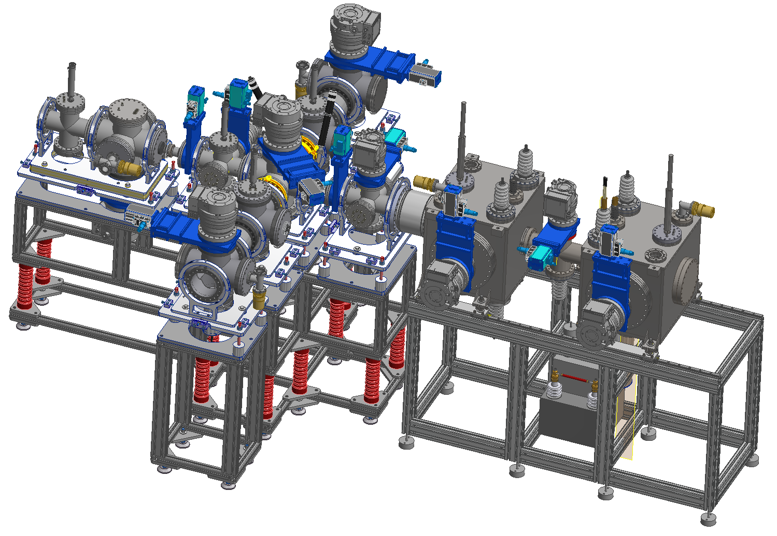
MASS SEPARATOR SECTION SUPPORT
15/12/2023
LAYOUT VERSION 3.2 – 23.04.24

Slide 6
PROCUREMENT FOR MASS SEPARATOR SECTION

Slide 7
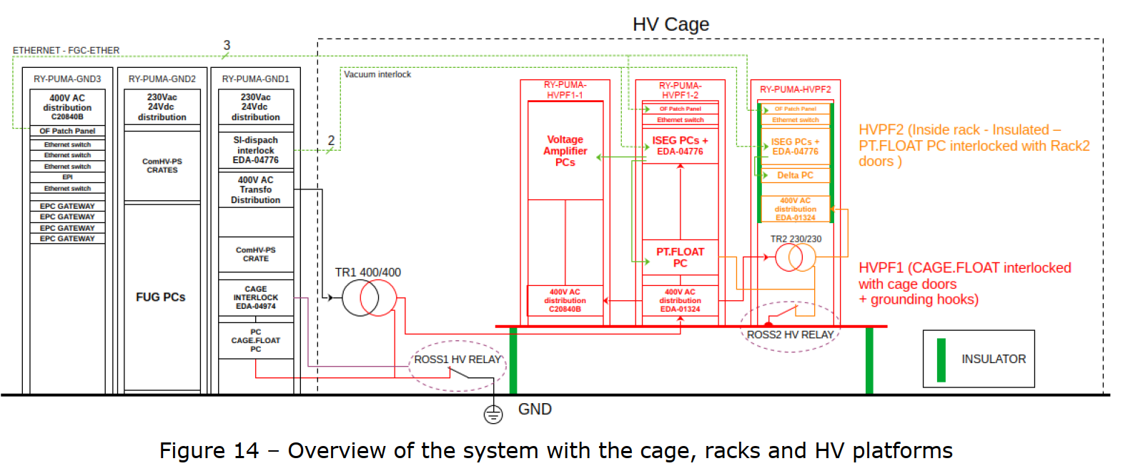
ION OPTICS PLCs
N. David (SY-EPC): PS-ISOLDE-PUMA-MS

Slide 8
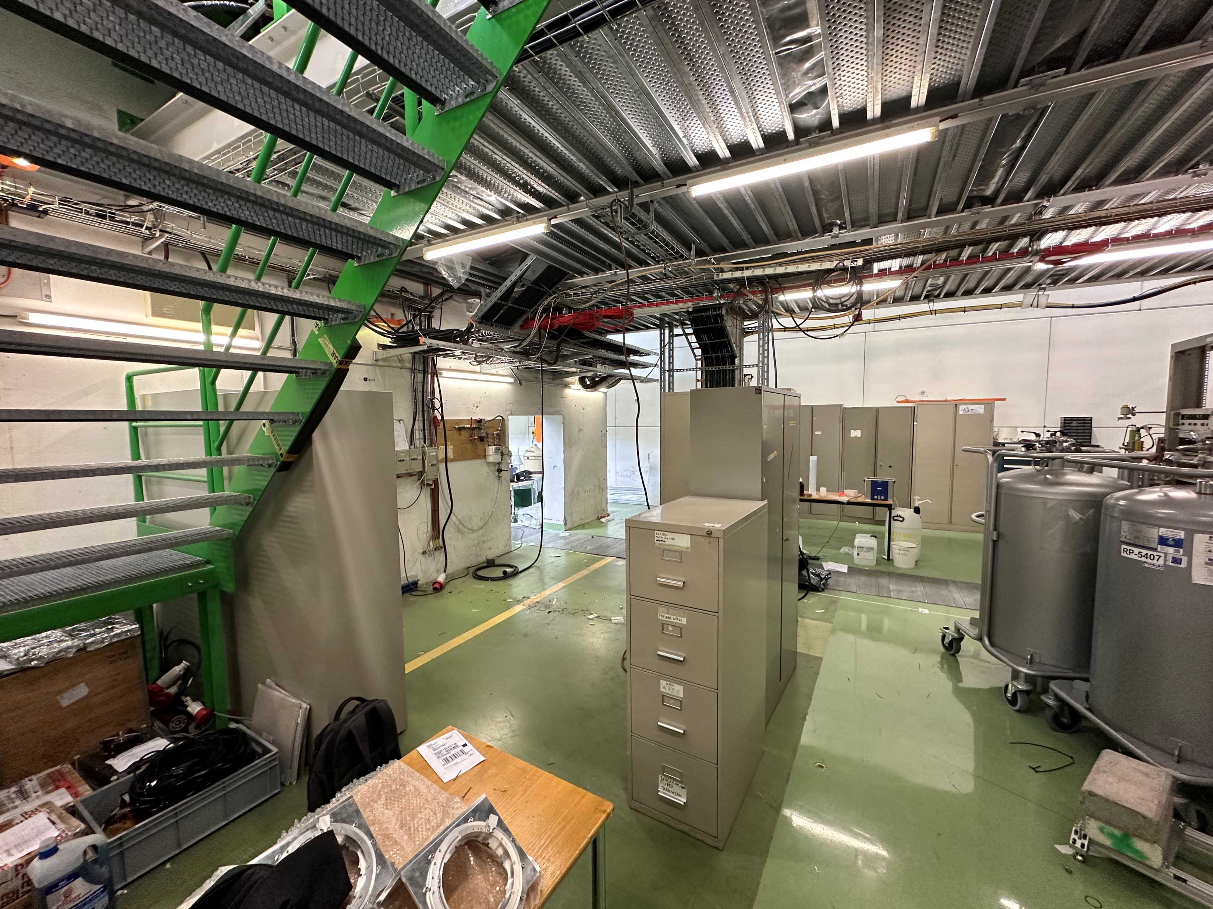
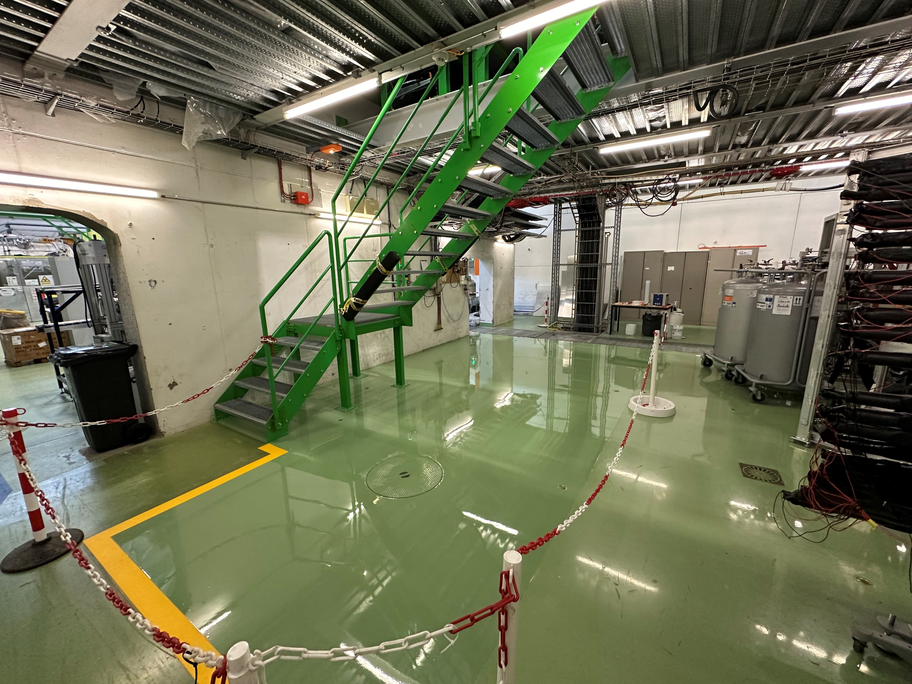
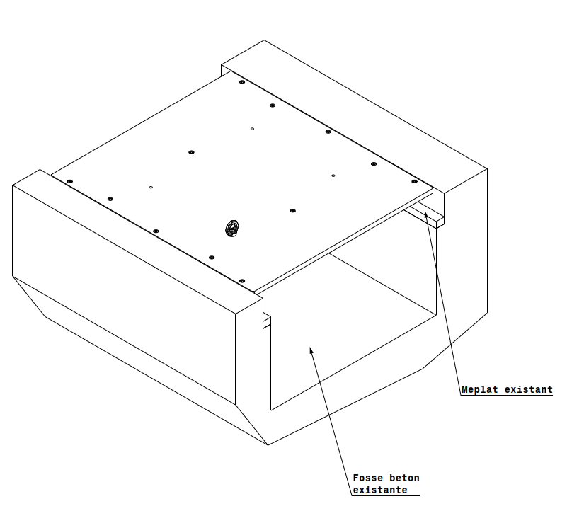
INFRASTRUCTURE
15/12/2023
15/12/2023
C. Moucher (SY-STI)
LAYOUT VERSION 3.2 – 23.04.24

