Slide 1
Timing & Synchronisation
PUMA@ISOLDE
Ioan Kozsar, Benjamin Ninet (BE-CEM), Grzegorz Kruk (BE-CSS), PUMA@ISOLDE #8, November 20th 2024

Slide 2
Overview
Introduction
  White Rabit GMT Distribution
  Hardware
PUMA Requirements
Dependencies & Planning

Slide 3
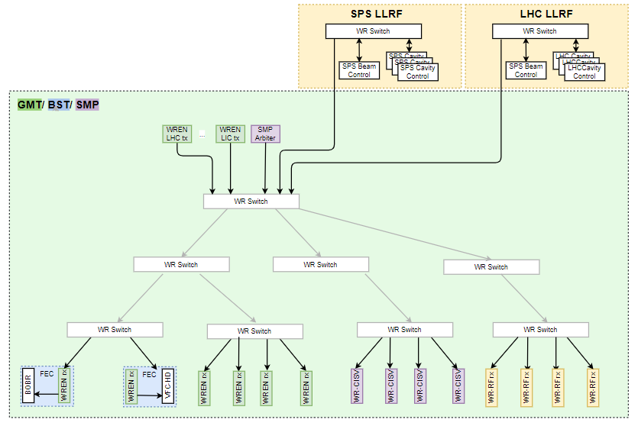
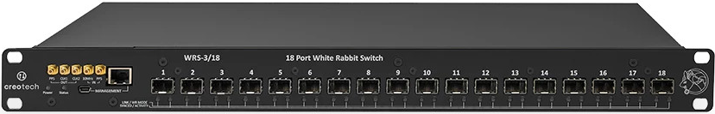
WR GMT Distribution
GMT
  Reception by WREN
SMP
  Reception at 10Hz by WREN
  Reception at 1KHz by CISU
RF Clocks
  Reception by WREN
  Reception by WR2RF (precision)
BST
  WREN as a local BST Master

Slide 4
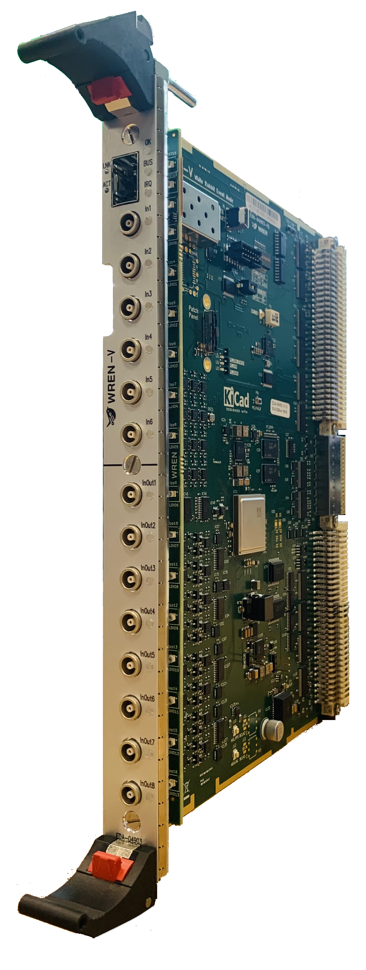
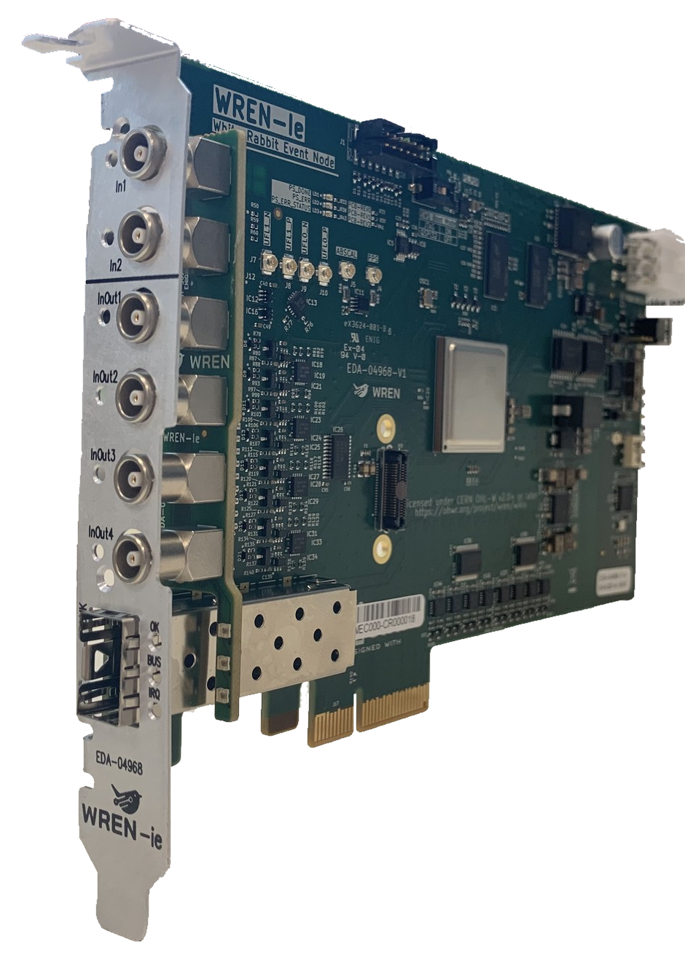
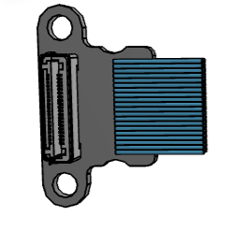
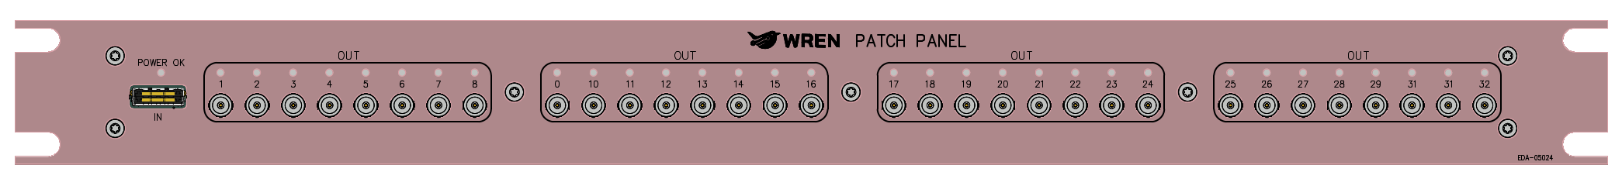
Hardware
VME – prototypes deployed
  6 fixed inputs (In1..In6) [new]
  8 configurable I/Os (InOut1..InOut8)
  BST Outputs (P0, P2)
PCIe – prototypes deployed
  2 fixed inputs (In1..In2) [new]
  4 configurable I/Os (InOut1..InOut4)
Patch Panel – in development
  32 outputs (Out1..Out32)

Slide 5
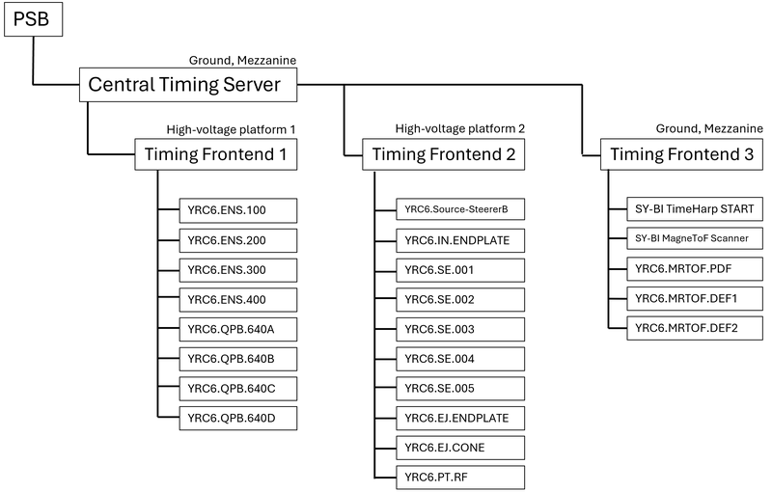
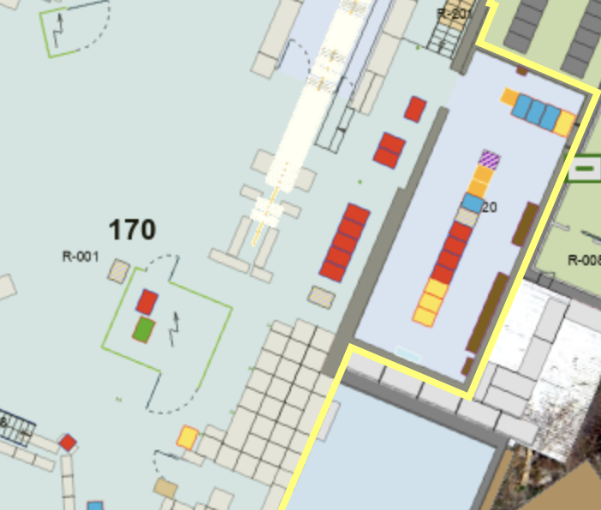
PUMA Requirements
Central Timing – Sequencing
  Dependent on PSB or standalone
  Variable cycle-repetition rate
  Deployed in 170/R-020
    Optical fibers EN-EL hub
    PSB triggers available
Local timing – Triggers
  Few distribution links (optical 👍)
    HV platform
    Mezzanine (170/1-045)
  Little rack space required (2U → 32 triggers)
REX model
Puma White Rabbit network

Slide 6
Dependencies & Planning
Fibre Optics requests (B. Ninet – BE-CEM-IN)
  Eqp. Grp. → CEM-IN → EN-EL
  SNOW (PLAN id) - https://cern.service-now.com/service-portal?id=service_element&name=control-hw-be
CT software (G. Kruk – BE-CSS-FST)
  Projet/OP → CSS-FST
HW deployment & local triggers generation (B. Ninet – BE-CEM-IN)
  Eqp. Grp. → CEM-IN
Planning → S2/2025 preliminary (optimistic) target
  Start in Aug. 2024
  Requirements gathering phase (CT, LT) → initial tests of equipment in stand-alone mode
  Ongoing OF requirement gathering

