Slide 1
BSR activities in YETS 24-25
D. Butti, S. Burger
05/11/2024

Slide 2
Pending activities
Confirmed activities
exchange of BSRT viewports and mirrors (see next slide)
installation of new BSRTMB compact imaging system (pending approval of CERN council and UN general assembly)
deployment of new intensifiers on BSRTs
regular BSRT maintenance (e.g. filter replacement)
upgrade of BSRL optics
final re-alignment
re-commissioning of BSRTMB actuators (on BE-CEM side but may ask for assistance)
Non-confirmed of low priority activities
replacement of BSRT steering motors (especially B1V)
installation of new pneumatics group in BSRT B2 for filter validation
installation of status lights for BSR sensitive devices
replacement of green laser in B2 (lower power solid state as on B1)
changes in BSRH?
upgrade to BSRAN?
anything with BATMON/RADMON?

Slide 3
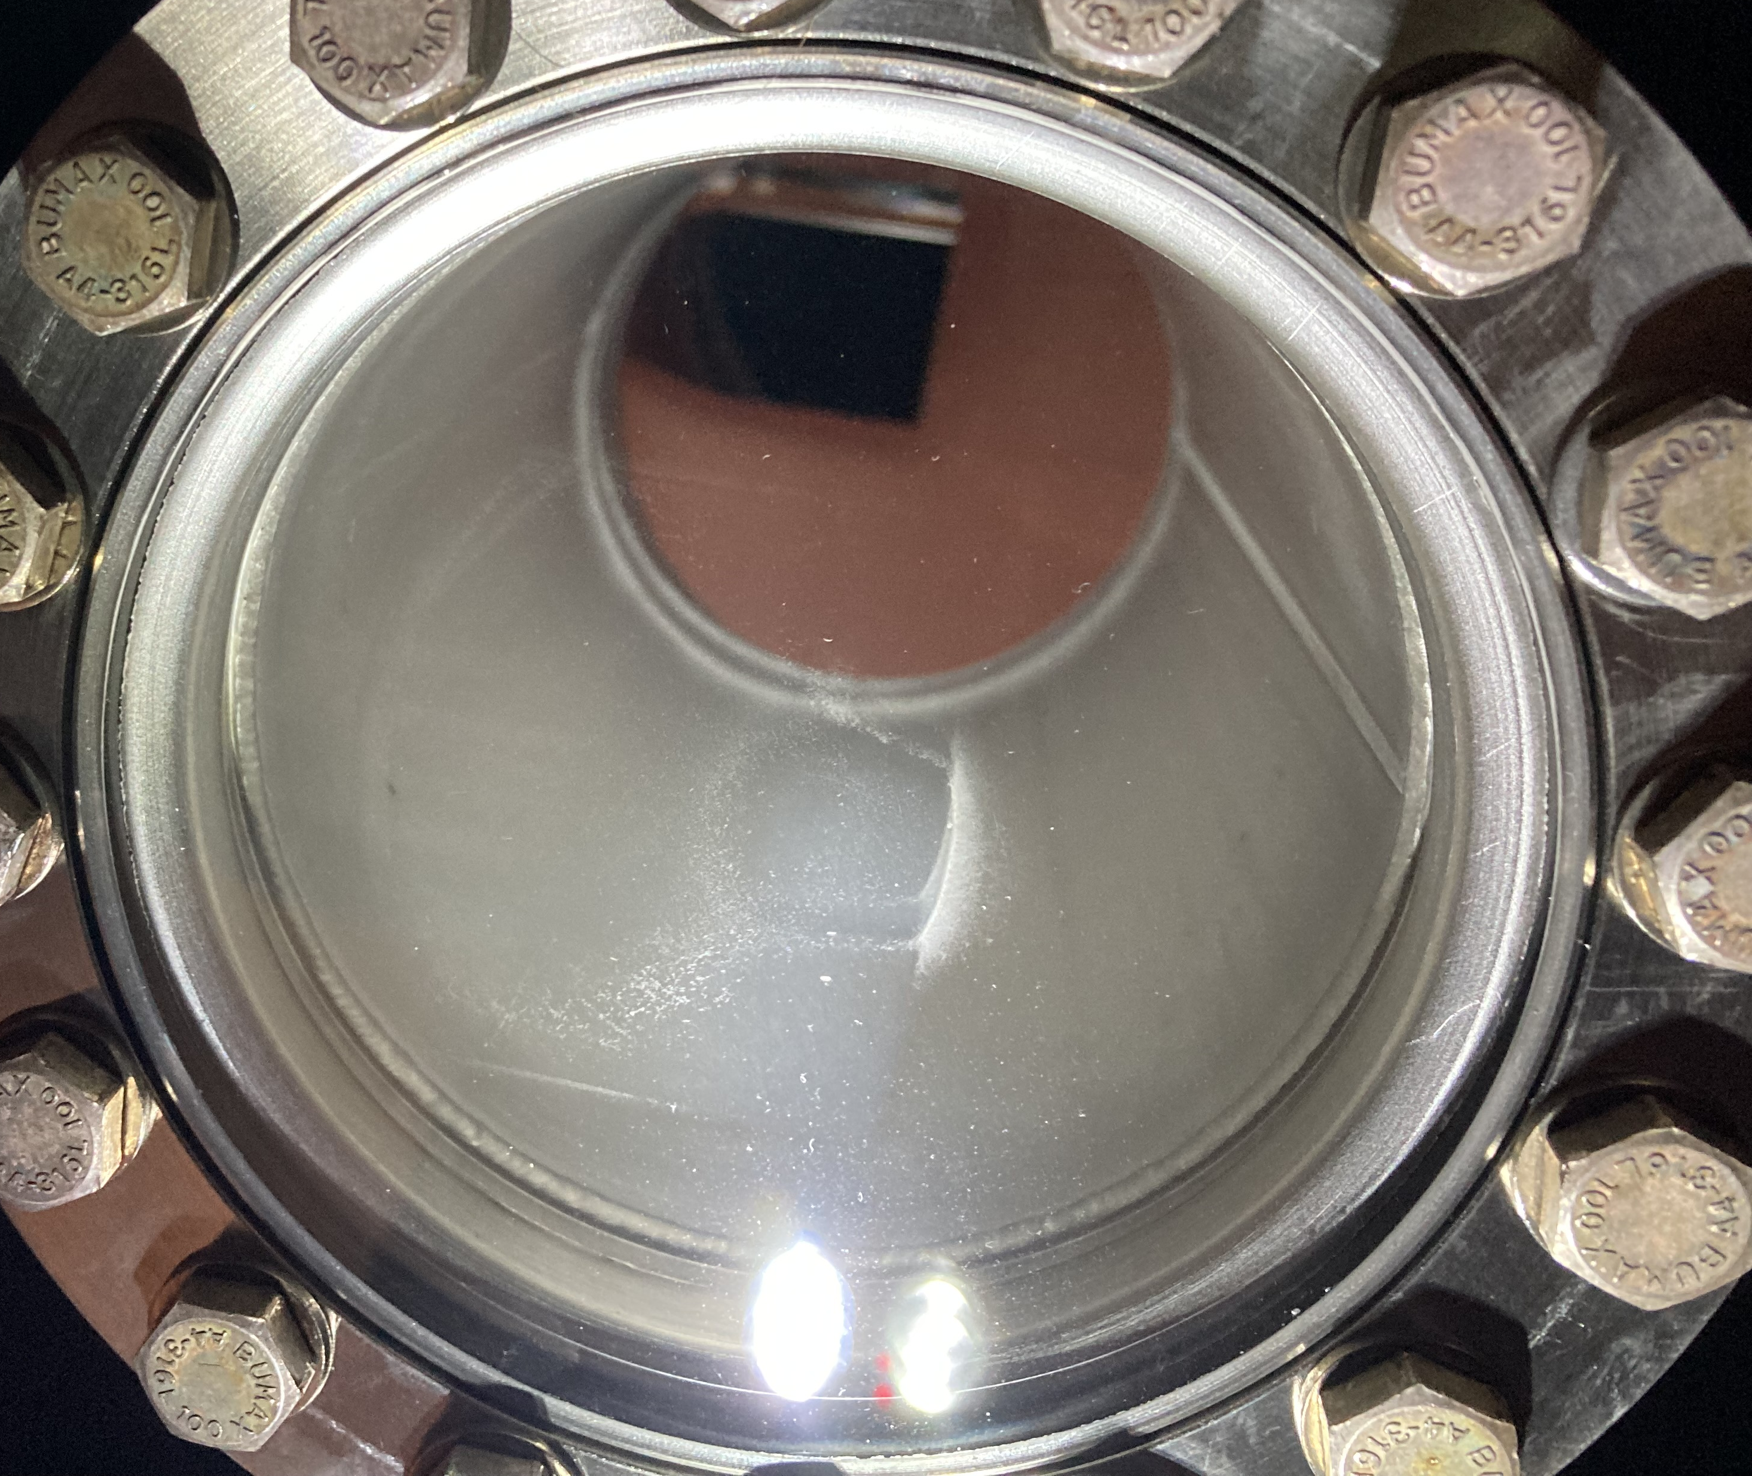
Status of viewports and mirrors
Viewports BSRT
2 spares available in ML storage:
  CRVFWCG005-CR010039
  CRVFWCG005-CR010040
They were properly marked in EAM to location 865-R-B01 A04L (together with the rest of the BSRT material)
2 were order this year (delivery in September). Did they arrive?
Mirrors
BSRT B2:
  Already has new mirror type (installed in YETS 21-22)
  Viewport replacement decision to be taken last moment
BSRT B1:
  Still with old mirror type, should be changed
  Viewport replacement is clearly needed
BSRTMB:
  Mirror should be changed if we want to try to monitor something
  Viewport is already the good type
from https://indico.cern.ch/event/1436415/

Slide 4
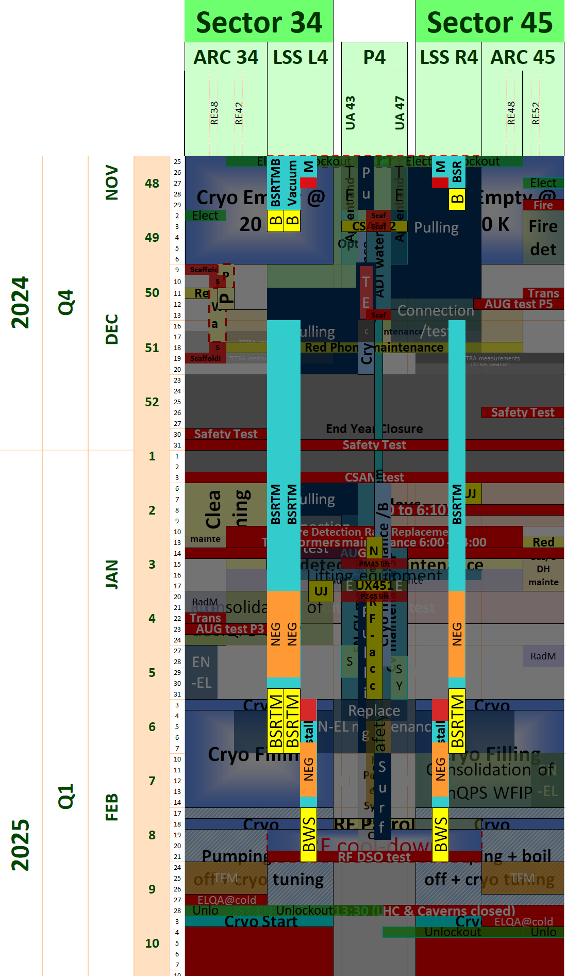

P4 schedule in YETS 24-25
Vacuum preparation
Viewport + mirror BSRTM B1 and mirror BSRTMB [+viewport BSRTM B2?]
Free access for other BSR activities?
Vacuum preparation and bake-out
(limited access, agreed with VSC)
Final BSR re-commissioning and alignment*
*2 days overlapping with BWS re-installation

