Slide 1



Tier-1 Update
Alastair Dewhurst
Notes:
The abstract pattern can be removed or repositioned if required. Be careful to ‘Send to Back’ so that it does not obscure any important information.

Slide 2

Agenda
Financial Status
Platforms and Services
Tier-1 from 2018 – 2025
Plans for this FY
Tier-2 helping Tier-1 meet pledge in FY26/27
Despite STFC cuts Buddy
is living his best life!

Slide 3


Introduction
There is an ongoing financial crisis in STFC.
Large impact on FY24/25 procurements.
  Disk and Tape only just delivered, late to meet this year’s pledge.
Tier-1 expects no Capital this year.
  We will not be able to deliver our pledge
  Must prepare for opportunistic capital just in case.
Swift-HEP funding ending.
Recruitment freeze means that we have been unable to recruit replacement staff.
  Rob Johnson and Oliver (1FTE) from Fabric team
  Jose Caballero from Grid Services
  Katy Ellis is reducing to 50% on GridPP
  Alastair Dewhurst becoming Platforms and Services Theme lead
Toastie thinks everything will be OK
Pasta just doesn’t care

Slide 4
Platforms and Services
Alastair Dewhurst
Theme Lead
James Hannah
JASMIN
Jeremy Spencer
DAaaS
Alastair Dewhurst
Tier-1
Derek Ross
Computing Platforms
Tom Dack
Federating Services
John Good
Head of Service Management
Platforms and Services provides cutting-edge scientific computing platforms to enable world leading research.
The Theme will provide leadership across SCD on IT Service Management.
Theme is split into groups that focus on the community they support.

Slide 5
Tier-1 Group Leader
Tier-1 Group Lead:
This person would be in SCD and report to me (in my new role). They would:
  Line Manage ~8 people in the Tier-1 Group.
  They would be responsible for the operational delivery of the Tier-1 MoU pledges (Tape, Disk, CPU).
  Shared responsibility for development and projects at the Tier-1.
  They would take a leading role in security operations / policy.
In my new role I will:
  Pursue all available options for replacing staff who have left and keeping existing staff.
  Pursue all opportunities for additional funding (both Capital and Resource).
  Look for potential efficiency savings resulting from SC25 changes (e.g. more common services, joint procurements).

Slide 6
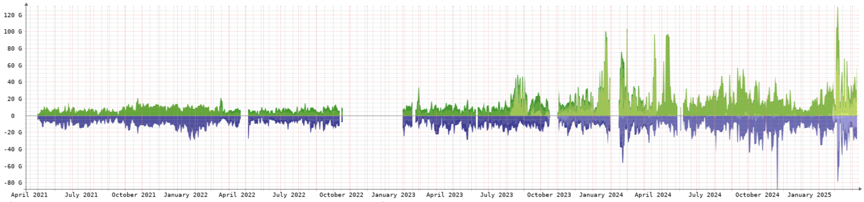
Network 2018 - 2025
One of my first decisions as Tier-1 Manager was to upgrade the LHCOPN link from 20Gb/s to 30Gb/s.
  Increased to 100Gb/s in July 2020
  Increased to 200Gb/s in January 2023
Network has been completely re-designed.
Joined LHCONE (properly) in March 2023.
LHCOPN throughput over last 4 years

Slide 7
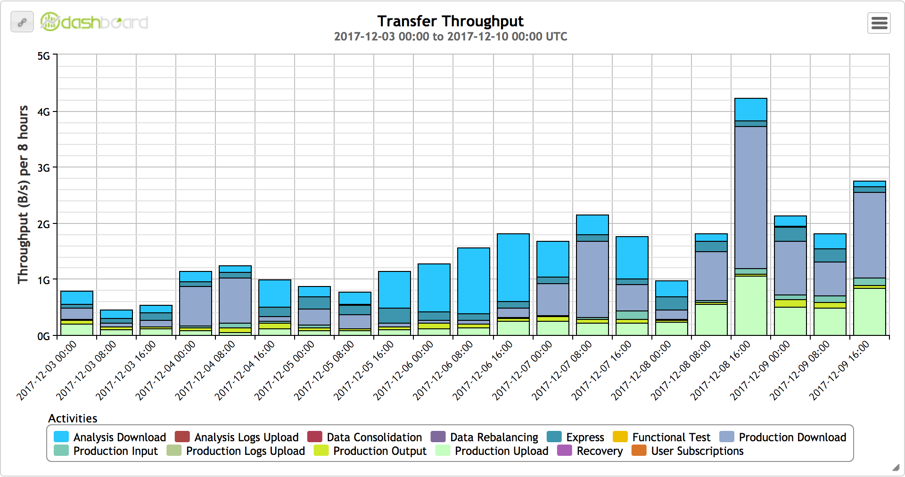
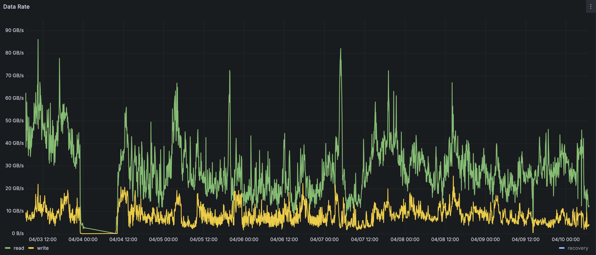
Echo 2018 - 2025
In 2018 only ATLAS had been (partially) migrated to Echo.
  Only GridFTP plugin working
Capacity has grown:
  2018: 193 storage nodes providing 26PB of allocatable capacity.
  2025: 332 storage nodes providing 98PB of allocatable capacity.
External Gateways have grown from 3 to 20+
  Added in XRootD and Webdav support
  Redirectors for load balancing, WN gateways and many other optimisations added.
Throughput has increased factor ~10
Dec 2017
April 2025

Slide 8
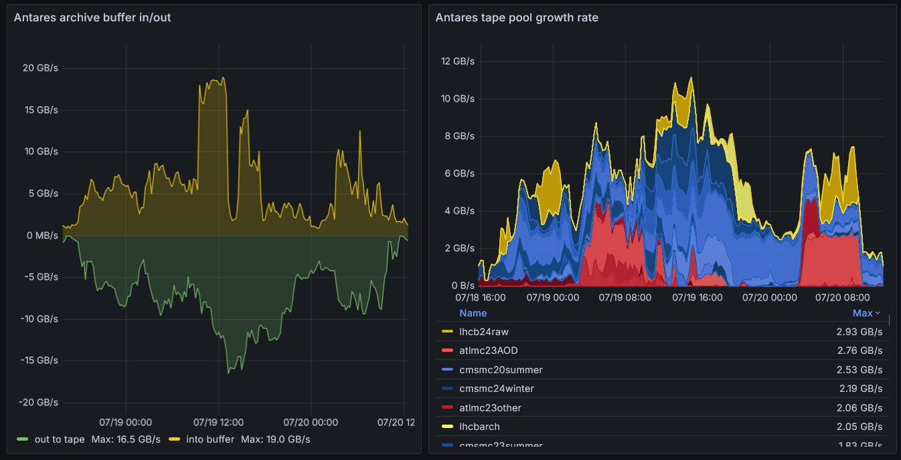
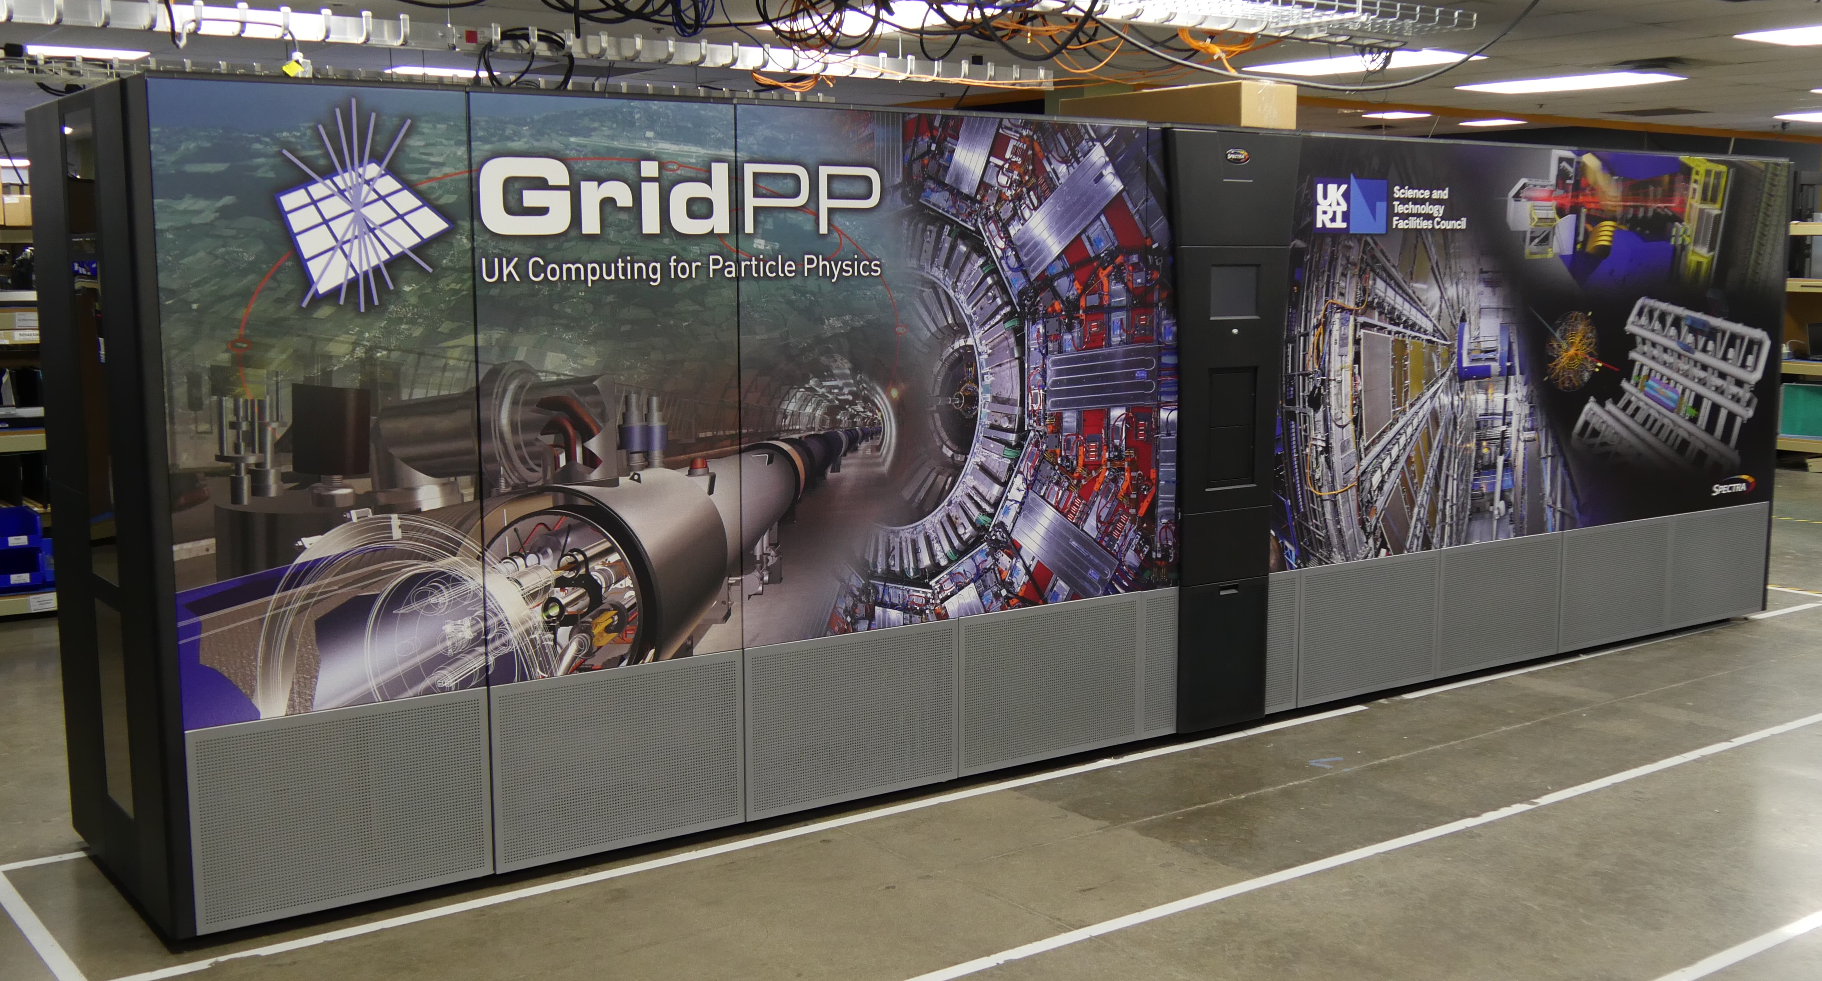
Tape 2018 - 2025
In 2018 we had Castor and the Oracle Tape Library and media.
Decided to migrate to CTA in 2019.
  Antares entered production on 4th March 2022
Purchased new Tape Robot in February 2020
  Installation complete just before Covid!
  Finished migration from old Robot in May 2021
Capacity has grown from 43PB in 2018 to 256PB today.
  Throughput has only ~doubled.

Slide 9
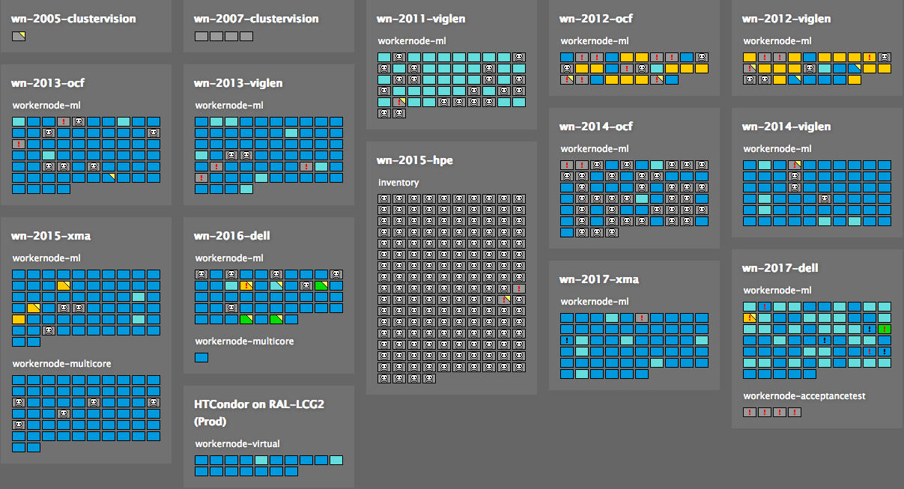
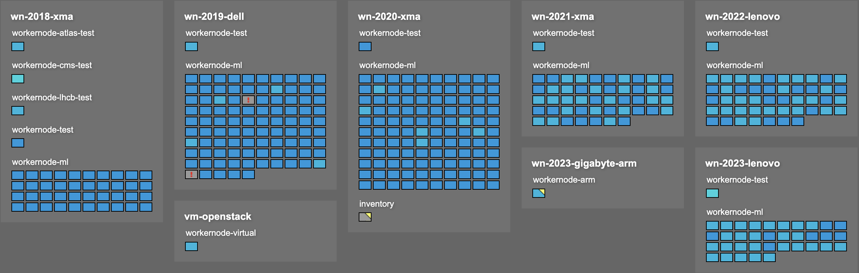
Batch Farm 2018 - 2025
Batch farm has remained on HTCondor + ARC CE since well before 2018.
  Many version upgrades.
Hardware is evolved rapidly
  We have purchased AMD since 2019 and core counts have gone from 64 - 384
  2018 – HDD, 2019 – SSD, 2021 – Separate OS SSD, 2022 – NVMe(s)
In 2018 we had 824 WN providing 29,664 slots.
In 2025 we have 384 WN providing 67,840 slots.
WN out of production have dropped significantly!

Slide 10
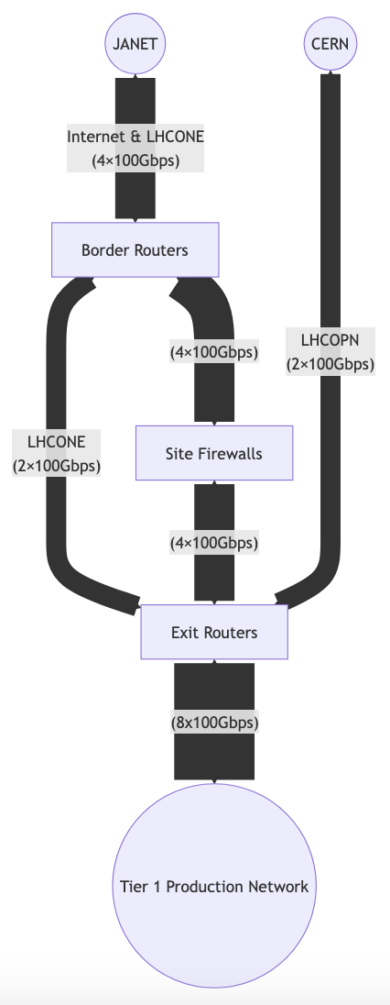
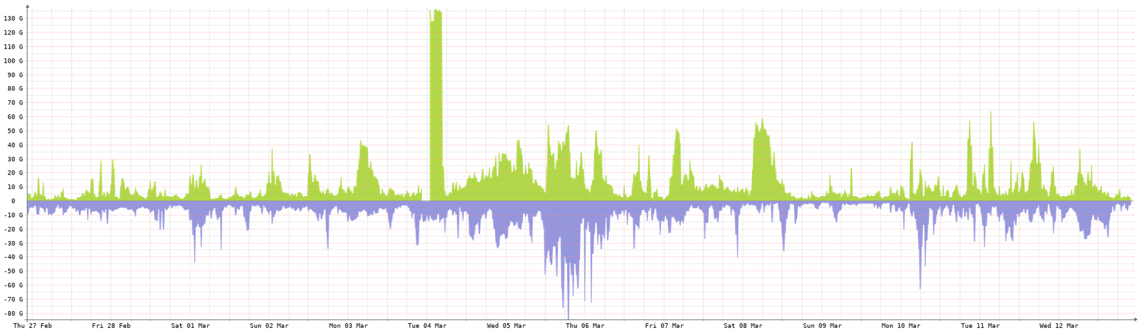
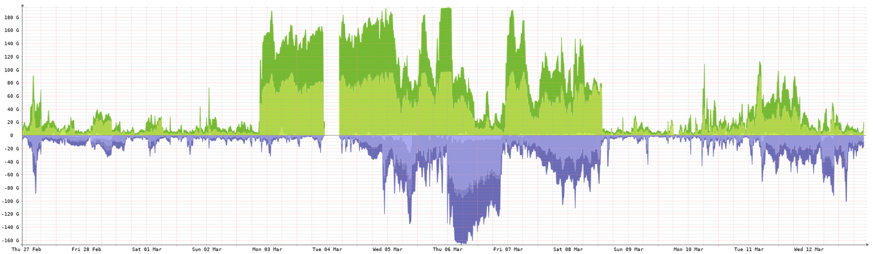
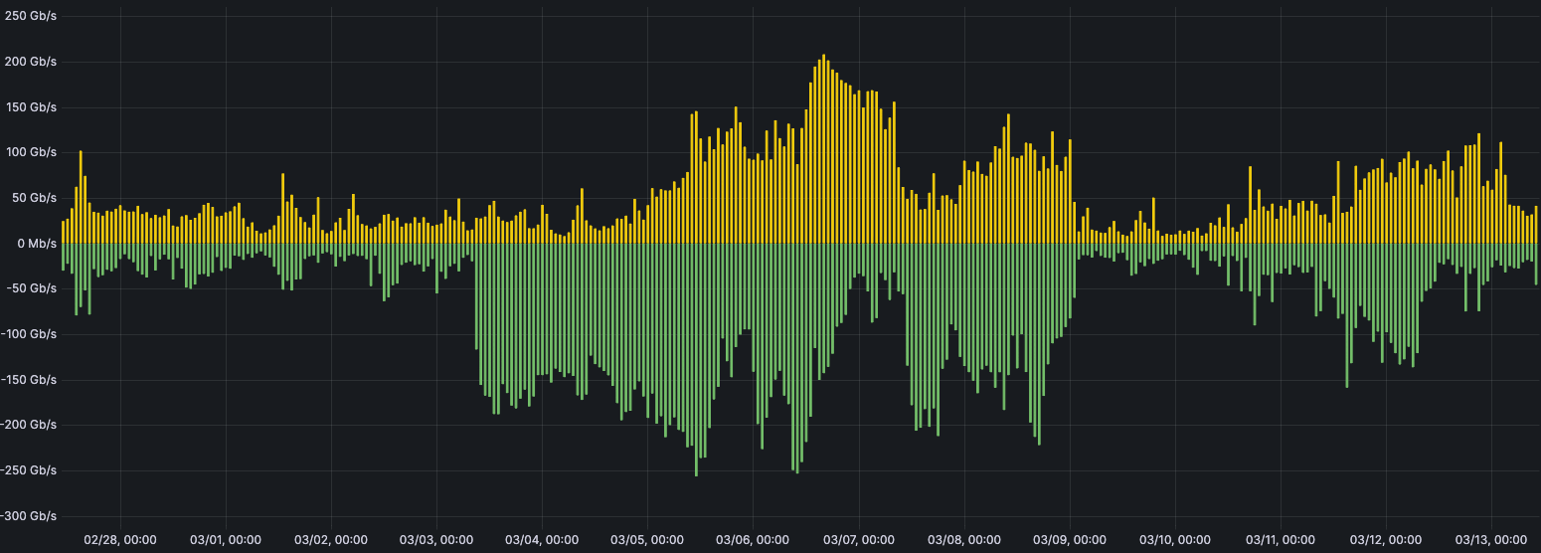
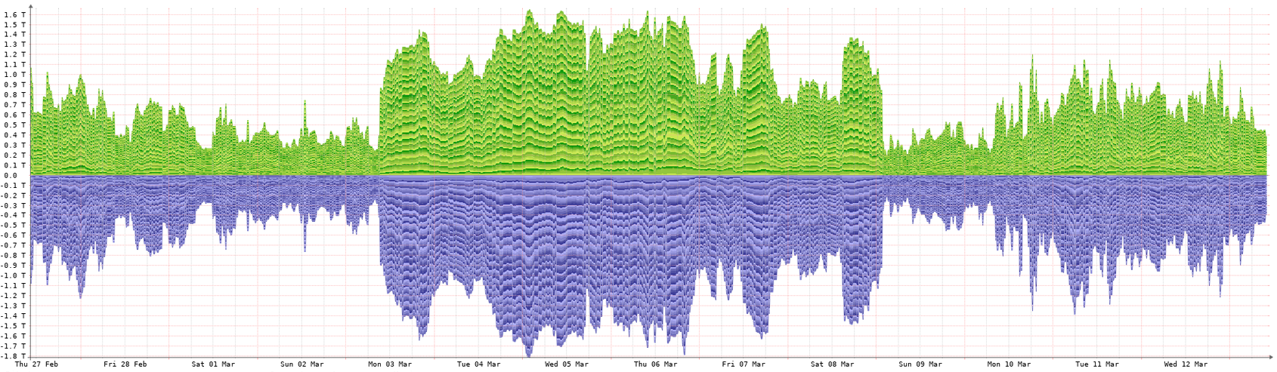
Tier-1 Data Challenge 2025
The Tier-1 provides computing resources for the LHC experiments. From the 3rd to 7th March we ran a data challenge (in addition to production work) to test our external network links and disk storage (Echo).
Successful failover test
The LHCONE is a VPN which allows us to bypass the site firewall when transferring data to other sites also on the LHCONE.
The LHCOPN is a dedicated 2 x 100Gb/s link to CERN. We were able to saturate this link!
< Data Challenge >
The internal Tier-1 network sustained over 1.5Tb/s during the challenge.
The total peak throughput from external sources was 256Gb/s ingress and 208Gb/s egress.

Slide 11
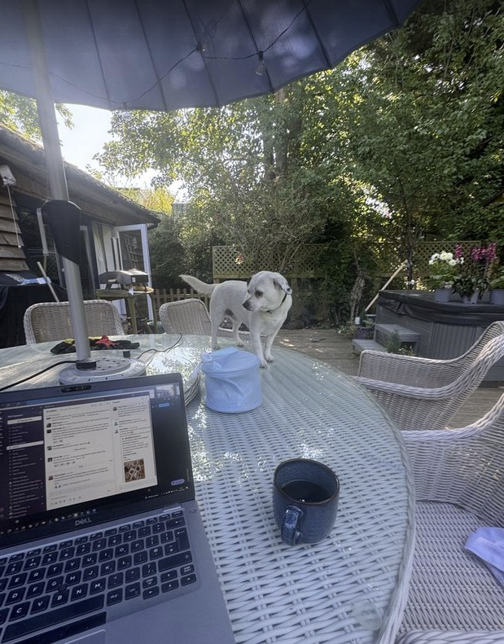
Plan for the year
Deployment of FY24/25 procurements into production:
  Disk
  Tape
Development opportunities
  Opportunistic CPU resources
  XRootD throughput improvements
  SSD developments
  New data centre room
When stressed Pico likes to touch Grass

Slide 12
Disk procurement
43PB raw capacity upgrade to Echo, changes from last year include:
  Single socket CPU on storage nodes.
  High Frequency CPU on Monitor
  100GB NIC on Gateways
 | Storage | Ceph Monitor | XRootD Gateway
Number | 64 | 2 | 4
Chassis | Dell PowerEdge R760xd2 | Dell PowerEdge R6615 | Dell PowerEdge R6615
CPU | 1 x Intel® Xeon® Silver 4514Y (16C/32T) | 1 x AMD EPYC 9374F (32C/64T) | 1 x AMD EPYC 9354P (32C/64T)
Memory | 8 x 32GB DIMMs | 12 x 16GB DIMMs | 12 x 16GB DIMMs
OS Disk | 1 x 480GB SSD | 2 x 480GB (RAID 1) SSD | 2 x 480GB (RAID 1) SSD
Capacity | 28 x 24TB HDD | 1 x 3.2TB Mixed use NVMe – for LevelDB | 1 x 3.84TB Read Intensive NVMe – for logging
Network | Nvidia 25GB/s NIC | Nvidia 25GB/s NIC | Nvidia 100GB/s NIC

Slide 13
Tape Upgrades
Majority of Tape service hardware was purchased in 2019 / 2020.
  Ongoing upgrade and replacement project.
83,250 TB capacity upgrade using 8 x IBM TS1170 drives and media.
  We will continue to use our 16 x LTO-9 and 20 x TS1160 drives for majority of writes for new data.
  TS1170 will be repacking old data continuously in background.
7 x new EOS nodes for tape (pipeline) buffer:
  16C/32T CPU, 192GB memory, 480GB NVMe OS disk, 8 x 7.68 NVMe (1 DWPD), 1 x 1.6TB NVMe (3 DWPD), 100Gb Nvidia NIC.
  New nodes will be dual stack and accessible via LHCOPN and LHCONE.

Slide 14
Repack Problem
EOS Buffer
8 x TS1170 Drives
16 x LTO-9 Drives
20 x TS1160 Drives
3.2GB/s
6.4GB/s
8.0GB/s
83.25PB
71.64PB
101.7PB
71.64PB
101.7PB

Slide 15
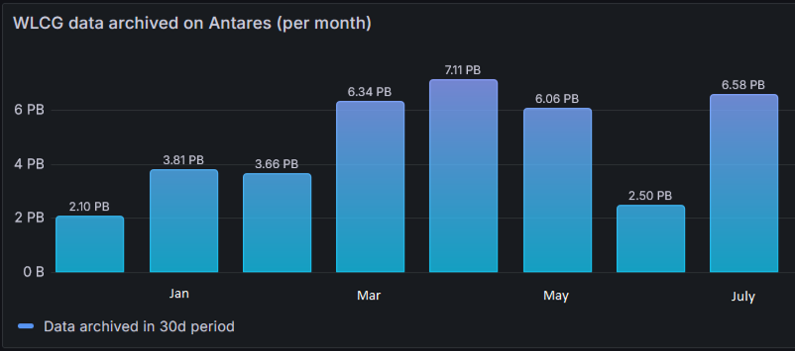
Tape Upgrades
Tape writes rates can peak at >10GB/s.
We can repack at 1.5PB a week.
Last year during data taking there were sustained periods where we exceeded that.
Plan was to purchase Tape upgrade early so we could do several months of repacking…

Slide 16
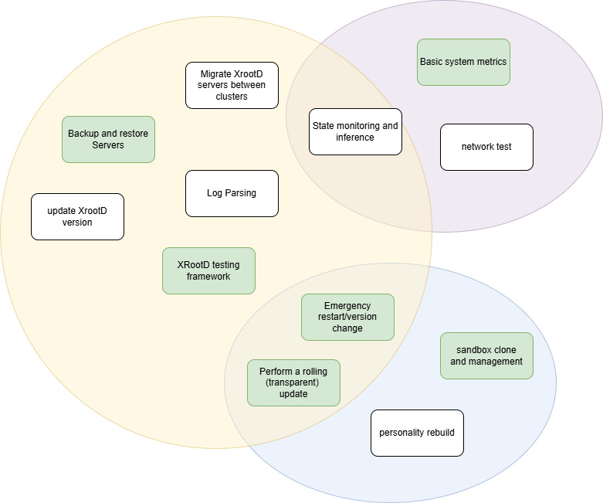
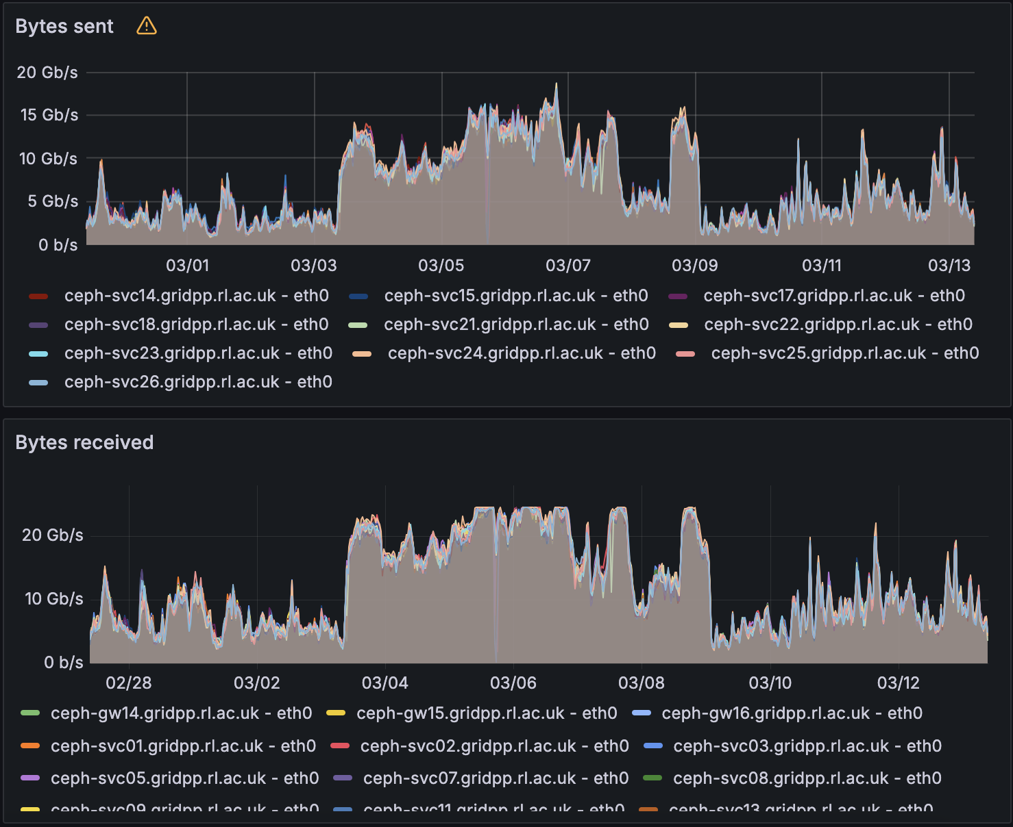
Data Transfer improvements
100Gb/s gateways now available for deployment.
  We don’t really know where to expect the bottlenecks to appear when we try scaling up.

Slide 17
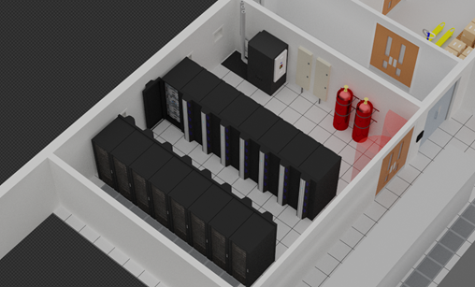
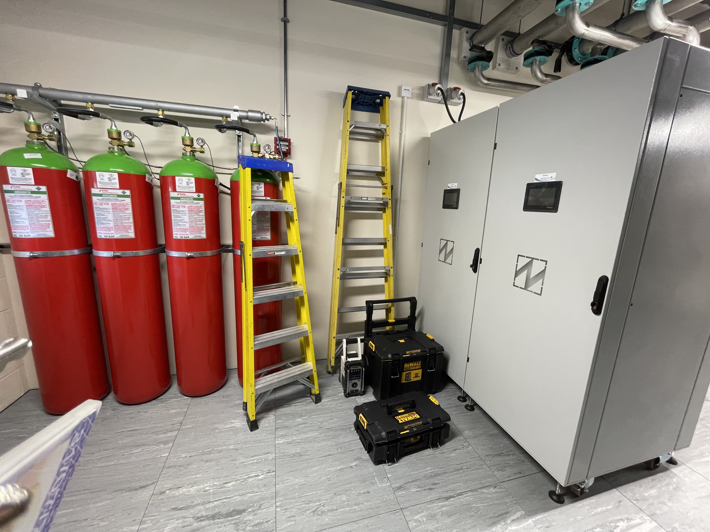
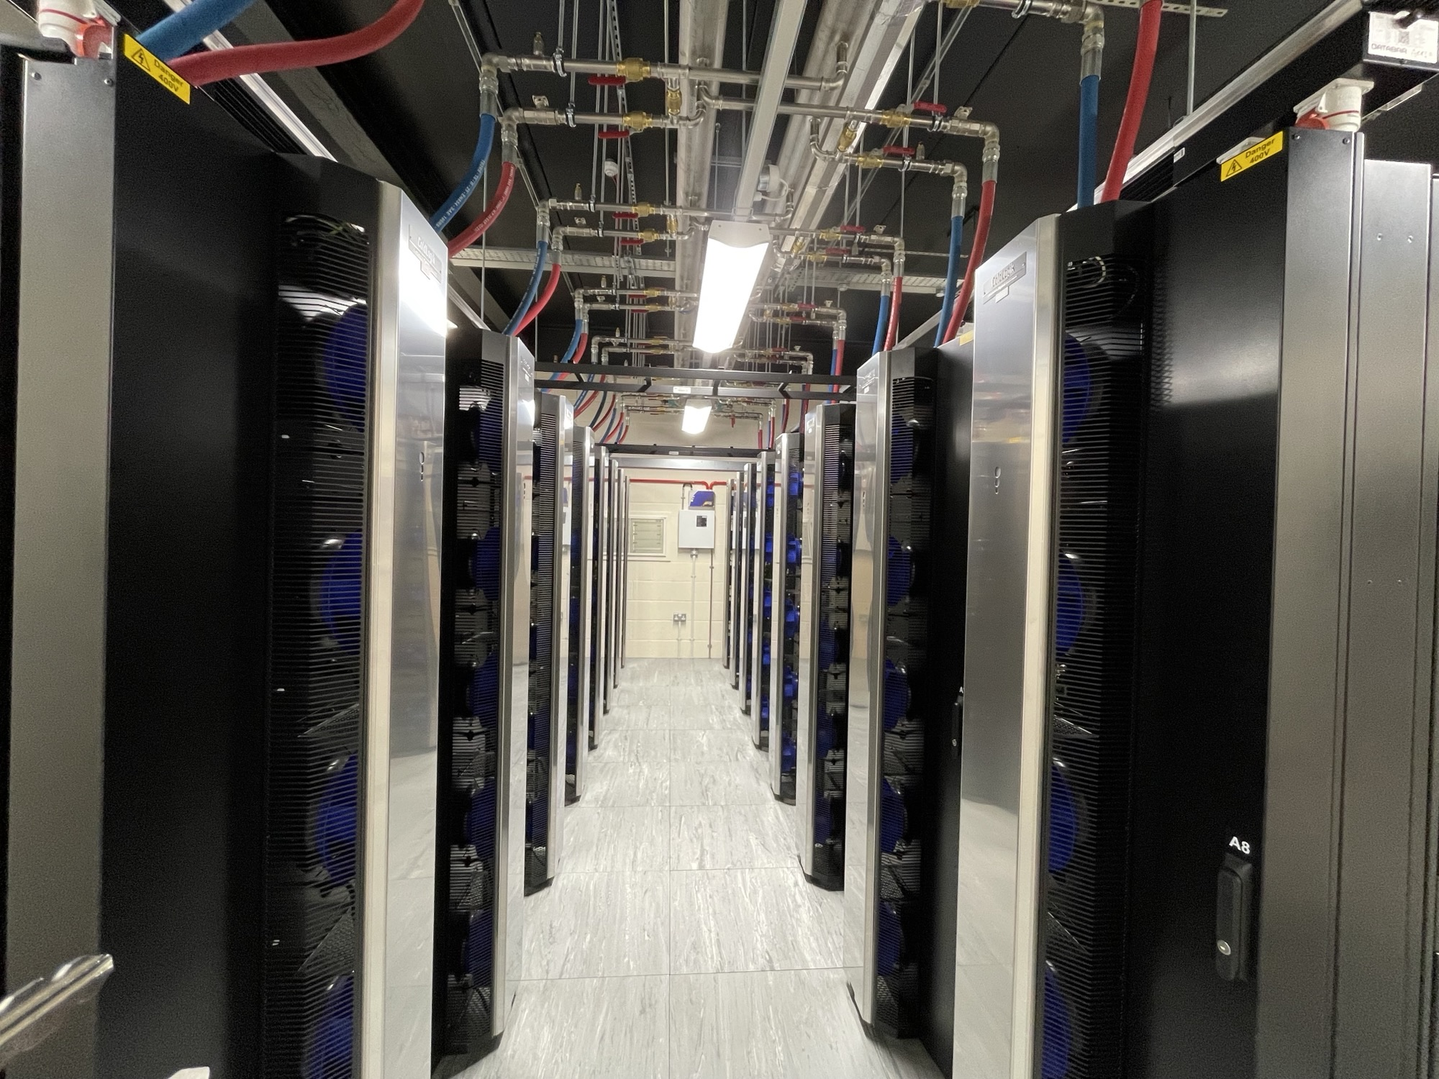
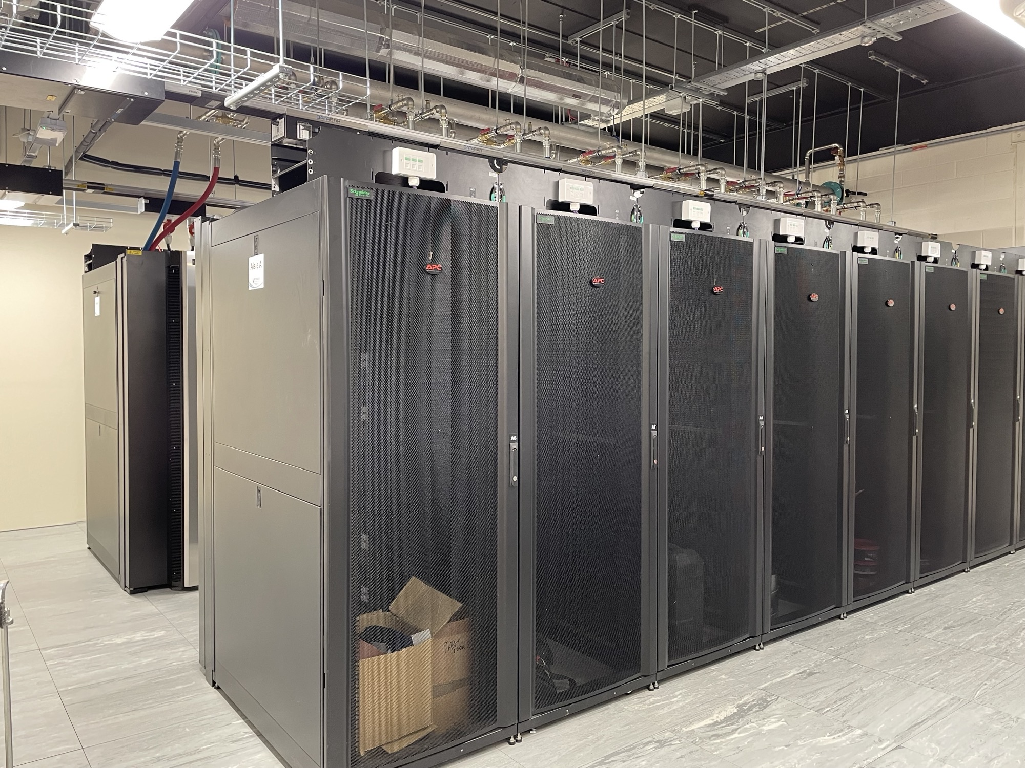
Net Zero & new data centre
New “Ultra High Power” Data Centre Room has been built at RAL.
  600kW capacity.
  PUE of 1.2 expected.
Proposal: Move existing Tier-1 batch hardware to this room.
ΔPUE = 0.1
£ / kWh = 23p
gCO₂ / kWh = 143
Batch Farm ~200kW
Potential saving:
£40k / year
25,000 kgCO₂ / year

Slide 18


Slide 19
Where can Tier-2s help?
Tier-1 pledges are dominated by ATLAS and LHCb.
  We want help with the hard stuff, not the MC simulation
Networking is very important!
  Join LHCONE?
I am always worried about the backend storage.
  The Data Intensive work really stresses it.
  Make sure you have spare capacity if something fails.
It’s always your fault, even when its not you still have to fix it.

Slide 20



Notes:
The abstract pattern can be removed or repositioned if required. Be careful to ‘Send to Back’ so that it does not obscure any important information.

