Slide 1
Ceph & Xrootd Sites Status

Slide 2
A recap
RAL
  Ceph Pacific (migrated from Nautilus), migrating to Squid??
  Xrootd 5.7.x currently
  “ECHO style”
Glasgow
  Ceph Nautilus (migrating to Pacific… and then Squid??)
  Xrootd 5.6.x and 5.7.x (external, internal)
  “ECHO style” [ATLAS] + cephfs [everyone else]
Lancaster, Manchester, Bristol, Brunel, Durham…
  Ceph Reef (the problematic one) [probably moving to Squid??]
    Bristol is on Squid just recently
  Xrootd 5.7.x
    Except for a brief period when Manchester autoupdated to 5.8.0 which broke everything by segfaulting…
  cephfs

Slide 3
Ceph (Reef+Squid) issues
“Rebuilding load” [Manchester, Lancaster] (Reef)
  When OSDs [==HDDs] are lost, Ceph prioritises resilience over user experience.
“Nearfullness” [Manchester] (Reef)
  Ceph clusters use their OSDs for both data-at-rest and transient buffers.
“MDS Cache sizing” [Bristol] (Squid)
  The defaults for the MDS [“filesystem metadata service”] cache are intended for much smaller filesystems than ATLAS or CMS directory structures.
  Cache thrashing [and huge eviction load] if you don’t tune them effectively (and Squid introduces additional tuning needed)
Some of these are “learning the quirks of the system”

Slide 4
Cephfs + Xrootd Notes (Lancaster)
Xrootd servers “flatten” authn/z to a filesystem to the xrootd user/group/role. This conflicts with also allowing wns to locally mount as a filesystem (with authn/z by the fs not xrootd)
filesystem
Auth
client
User’s username, group etc
Currently Lancaster allow both to work for ATLAS with backend processes to make sure the ACLs are all correct for files written by xrootd.
A better solution should be the multiuser Xrootd plugin…
Auth
X509 etc
xrootd
Auth
xrootd user
Mapping for auth

Slide 5

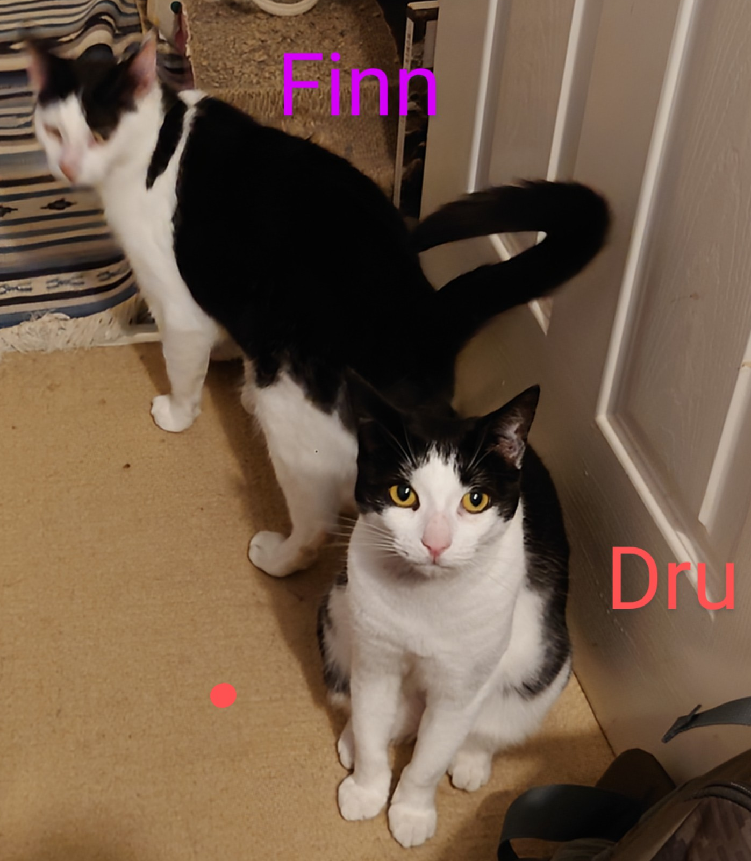
Xrootd Issues [see Jyothish next!]
Checksum calculation overhead
General instability
  Glasgow + Lancaster find that their xrootd services will just “get stuck”
  Possibly related to xrootd being very weird about connection handling – often leaving dangling connections (which cephfs does not like)
  5.8.0 was released with an actual segfault causing bug in the packet marking. (fixed 5.8.1, which is not released yet)
Xrootd servers are still much more like Pets than Livestock

