Slide 1


Update from the Federating Services Group at RAL
Greg Corbett

Slide 2
Platforms and Services
Alastair Dewhurst
Theme Lead
James Hannah
JASMIN
Jeremy Spencer
DAaaS
Alastair Dewhurst
Tier-1
Derek Ross
Computing Platforms
Tom Dack
Federating Services
John Good
Head of Service Management
Platforms and Services provides cutting-edge scientific computing platforms to enable world leading research.
The Theme will provide leadership across SCD on IT Service Management.
Theme is split into groups that focus on the community they support.
As presented by Alastair yesterday.
https://indico.cern.ch/event/1476120/contributions/6238385/

Slide 3
What is the Federating Services Group?
Formerly the Grid Tools team (as presented at GridPP51)
STFC Scientific Computing group operating and developing services to facilitate federating distributed research infrastructures for our partner communities.
Currently APEL, GOCDB, FTS and IAM
Tom Dack is the Product Owner and Group Leader, providing a consistent contact for stakeholder engagement, reporting, and requirement identification
Slide repurposed from “Grid Infrastructure Projects” at GridPP51.
https://indico.cern.ch/event/1366954/contributions/5852558/

Slide 4

Agenda
1 Updates on our operations
2 Updates on our services
APEL
  HEPscore accounting
  Token accounting
  General update
GOCDB
File Transfer Service (FTS)
Identity and Access Management (IRIS IAM and SKA IAM)
UK Certificate Authority

Slide 5
Updates on our operations

Slide 6

Operations - Before
In 2024, operational service support rotated around the four service managers.
A good first step, but in practice resulted in a varied level of support week to week.
Essentially, the service of the service manager on duty probably got the best support that week.

Slide 7

Operations - Now
In Jan 2025, split into a Helpdesk and Service Manager on duty.
Helpdesk
Performs daily health checks of the services and provide first response ticket management, resolutions to standard issues, escalating internal for more complex issues.

Slide 8
Operations - Now
On Duty Service Manager
Handles support requests that are non-standard, more complex or require elevated privileges.
This is supported by the service managers ring fencing some of their time each week to working collaboratively on service operation, communication and knowledge sharing.

Slide 9
Updates on our services

Slide 10
APEL update
“APEL client & Accounting Repository” in GGUS
Slides on behalf of Adrian Coveney

Slide 11
HEPscore Accounting
HEPscore support was deployed to the Repository w/c 24th March, meaning the new benchmark is accepted at the Repository.
The Accounting Portal had issues rolling out the associated changes.
These are now resolved, but currently no HEPscore related changes visible in the Portal.
Portal should be updated imminently. After that, we will broadcast that the new record format can be accepted and work with WLCG and EGI Ops on a campaign for sites to switch to publishing with HEPscore23
Documentation to start publishing HEPscore23 can be found here: https://twiki.cern.ch/twiki/bin/view/LCG/AccountingClientHEPscoreDeployment

Slide 12
Post-X.509, non-VOMS, token accounting
This is our next priority for WLCG accounting
Issue around getting VO attributes without VOMS
The central accounting system needs these attributes to properly aggregate data and expects them in the records sent from sites
As such, the changes needed is in the accounting client (APEL, ARC, custom scripts etc.)
We are working with the WLCG AuthZ group, as well as Daniela Bauer and Simon Fayer, to understand the issue and find an interim solution that works with the various accounting systems, clients and token profiles currently in use by WLCG and EGI.

Slide 13
General updates
EL7 migration
All central APEL Repository hosts were migrated before Christmas
The log and host services monitoring were updated as part of this
Database and APEL server split to simplify operations and maintenance.
APEL packages available in CERN repo and UMD-5
Backlog
There are various improvements and changes that were put on hold during HEPscore accounting development which will now be tackled as part of ongoing development

Slide 14
GOCDB update
“Configuration and Topology Database (GOCDB)” in GGUS

Slide 15
GOCDB
Rollout of GOCDB 5.11.{0,1} and, 5.12.{0, 1, 2} bringing privacy enhancements and quality of life improvements.
Working with EGI to investigate a Read Only Failover in the EGI Federated Cloud. Improving resilience at RAL against database issues in the meantime.
Over the next year, improvements around our integration with EGI CheckIn:
Reworking to use OpenID Connect to match other services run in the group
Encouraging more users to link EGI CheckIn identifiers with their X.509 based GOCDB account
Allowing API access via tokens, retrieved via technologies like oidc-agent
Notes:
Add restrictions on who can create ServiceGroups
Add mechanism to manage API credentials
Add support for pre selecting endpoints on Downtime pages
Add ServiceTypes page for non-admins

Slide 16
FTS update
Federating Services JIRA Service Desk
On behalf of Rose Cooper

Slide 17
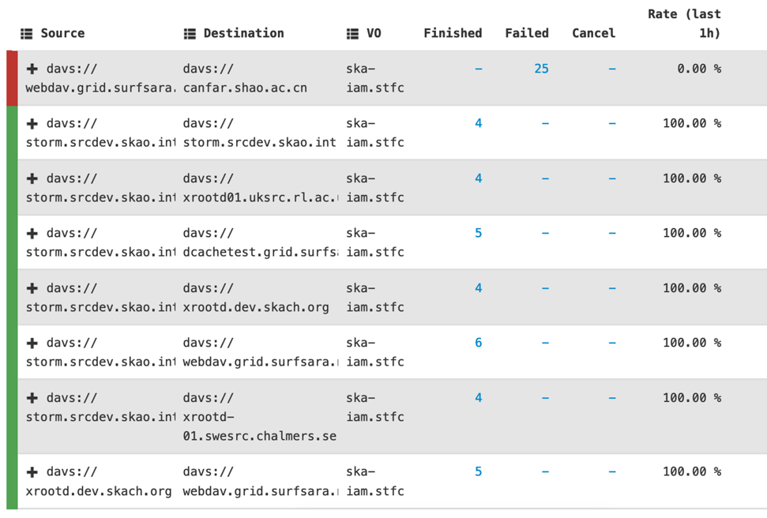
FTS update
Main users currently are:
  SKA, LSST, snowplus
SKA have been using one of the RAL FTS instances since September 2024
  Integrated with the SKA IAM and SRCNet Rucio
  Data test campaigns started on 7 April 2025
  In process of adding SKA IAM auth to FTS web monitoring & logs
LSST intending to use RAL FTS as a back-up instance
  Currently using RAL FTS for testing whilst setting up their primary FTS instance at SLAC

Slide 18
IAM update
Federating Services JIRA Service Desk
On behalf of Donald Chung

Slide 19
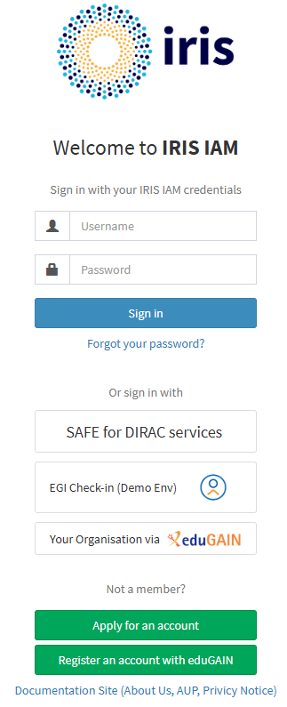
IRIS IAM and SKA IAM Overview
All-in-One solution for Authentication Access Management that allows sign-in with home institution account.
Supported community: IRIS and GridPP & SKA (SRCNet): >940 users
Achieve >99.9% availability per hour for IAM services during the working day. Work to support that includes:
  Deploying IAM on a Geographically distributed federation of K8s cluster
  Adapting IAM to use high performance distributed database to overcome performance bottleneck

Slide 20
UK Certificate Authority update
support@grid-support.ac.uk
Slides c/o Manoj Garai

Slide 21
Certification Authority (CA)
In the last three months, Manoj Garai has been providing some of his time towards software fixes to the CA toolset. The CA service continues to be looked after by Tom Birkett.
Aim over the next year is to bring the CA fully into the Federating Services Group at RAL and looking at ways to onboard new team members to take ownership of the CA going forward.
Completed development tasks
Local setup to run and debug the CA web portal, resulting in a fix to JavaScript issues
Add unit test cases to facilitate future work
Ongoing tasks
Investigate issues faced by Mac user to use the portal and CertWizard application

Slide 22
In conclusion
Improved operational processes bolster support across a growing portfolio of services.
SL7 “pets” are a distant memory – all our services are now under configuration management.
HEPscore23 is accepted by the Accounting Repository and will be visible once the Portal has updated.

Slide 23


Notes:
The abstract pattern can be removed or repositioned if required. Be careful to ‘Send to Back’ so that it does not obscure any important information.

Slide 24


sc.stfc.ac.uk
Notes:
The abstract pattern can be removed or repositioned if required. Be careful to ‘Send to Back’ so that it does not obscure any important information.

