Slide 1


WP1 Intelligent Data Management
Timothy Noble
GridPP53 / Swift-HEP
11 Apr 2025
Notes:
The abstract pattern can be removed or repositioned if required. Be careful to ‘Send to Back’ so that it does not obscure any important information.

Slide 2
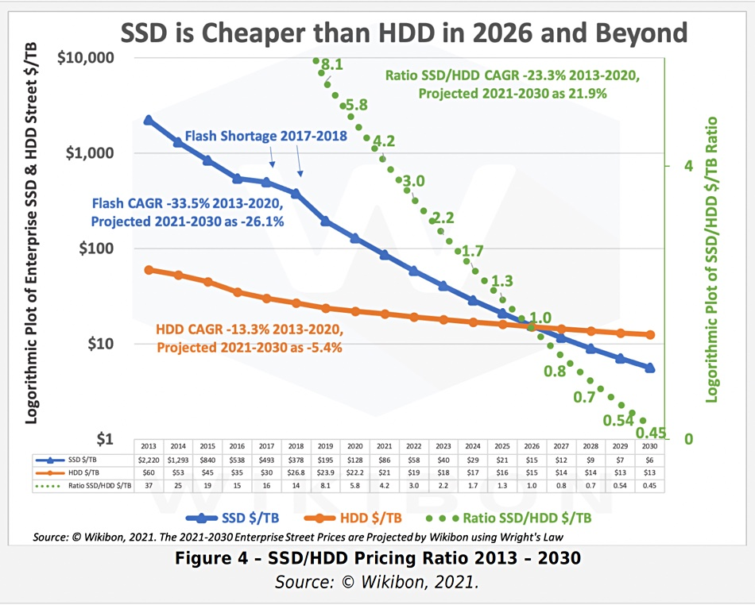
Work package 1 Vison
To optimise the use of the diverse Digital Infrastructure available to HEP experiments in the UK
HEP experiments record and produce more than 100 PByte of data every year, and is expected to increase to more than 1 EByte/year soon.
  Storage is evolving, and much like compute resources, we need to adapt storage to a more heterogeneous environment
  Individual transfers need to be completed faster, and not just horizontally scale storage
The data-lake will be based on the Rucio data management tool

Slide 3
Work package 1
Intelligent Data Management
Set up a UK data-lake prototype.
Implement QoS information in Rucio
Produce recommendations to sites for data access
Integrate with the Analysis Facility

Slide 4
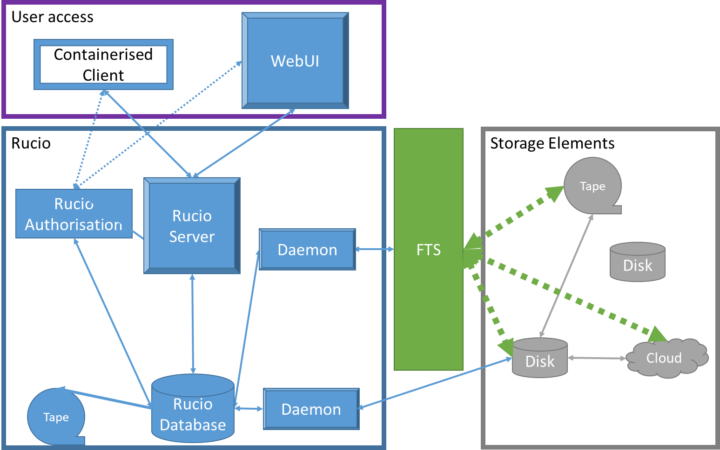
Rucio
WP5
Distributed data management tool
Used by several large experiments
  Handles Petabytes of data and Exabytes of data movement
  Treats different storage types with various behaviours
Adds a layer of abstraction
Distributed components work together to orchestrate data movement as required
Tokens (Expected end Mar-2026)
Image © STFC John Dawson
Notes:
PLEASE DELETE/REPLACE PHOTO CREDIT IF CHANGING THE IMAGE.

Slide 5
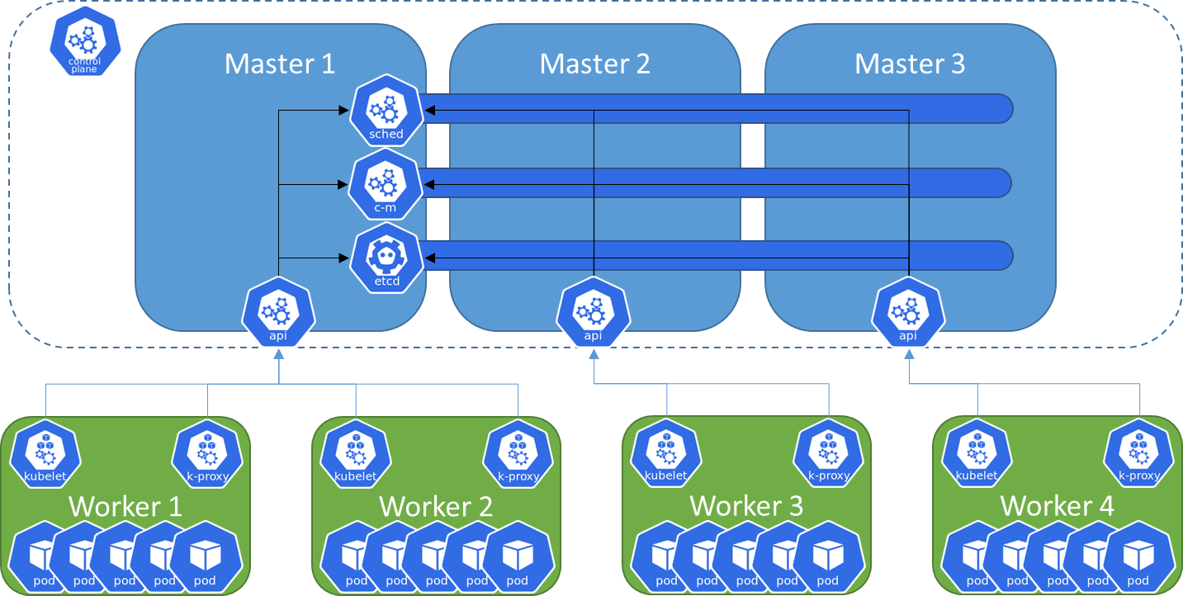
Kubernetes
Container orchestration system for automating scaling and management
Deployments environments described in easy-to-read and write YAML files
Containers are self contained units of software, that allow the software to be deployed anywhere
K8S orchestrates not just container deployment but networking, persistent storage, security, secret management

Slide 6
Challenges for WP1
Deploying a Rucio instance that is flexible but robust for development and testing
Token authentication for data management – extending to the Analysis Facility
Maximising the SSD storage endpoints
Prioritising the data movement depending benefits

Slide 7

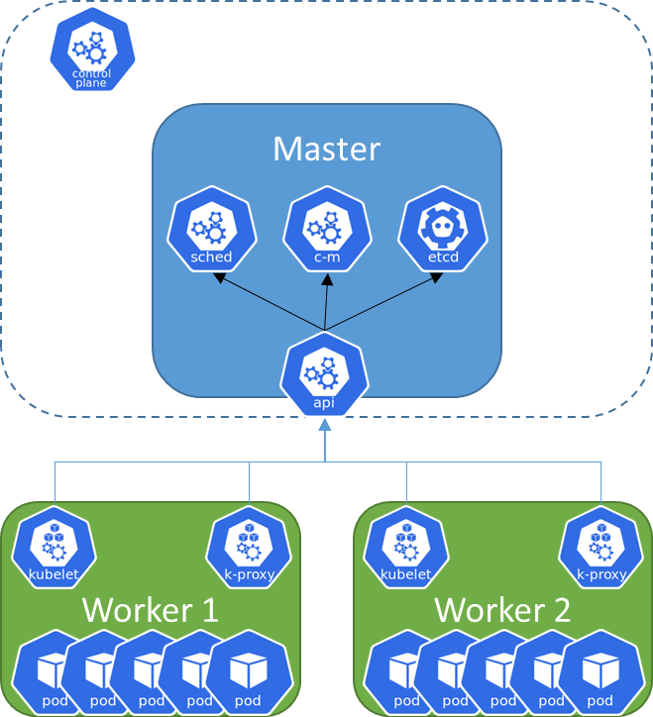

Kubernetes work
Rancher Container
Evolution of Kubernetes cluster from a simple deployment to something that is production-ready
Deployment and iteration on K8S cluster deployment to make the cluster more reliable
Development of a production-ready K8S cluster, with Highly Available Master nodes
Move from a container used to create a cluster to a self-monitoring cluster using RKE2

Slide 8
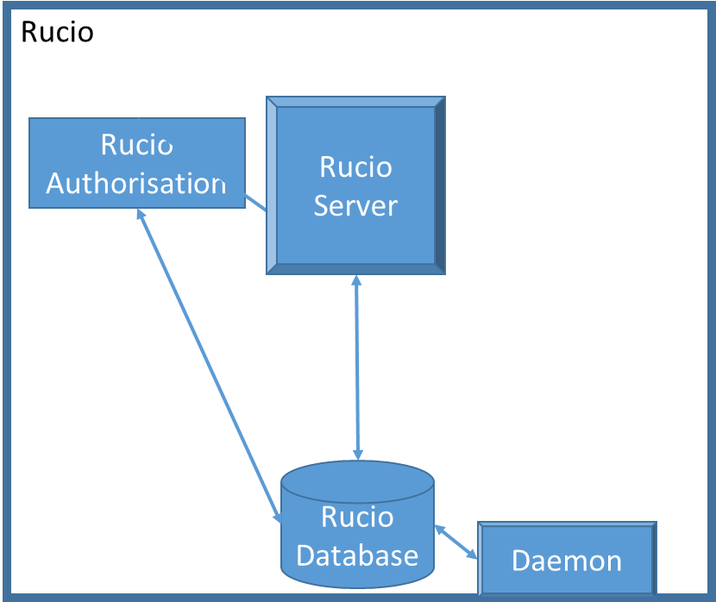
Kubernetes Deployment
GitLab Repo
ArgoCD
Rucio support shifted to K8S as the preferred way
Rucio is now deployed on the K8S cluster
Described in a GitHub Repository for a single source of truth and CI/CD integration to allow for development and deployment testing

Slide 9
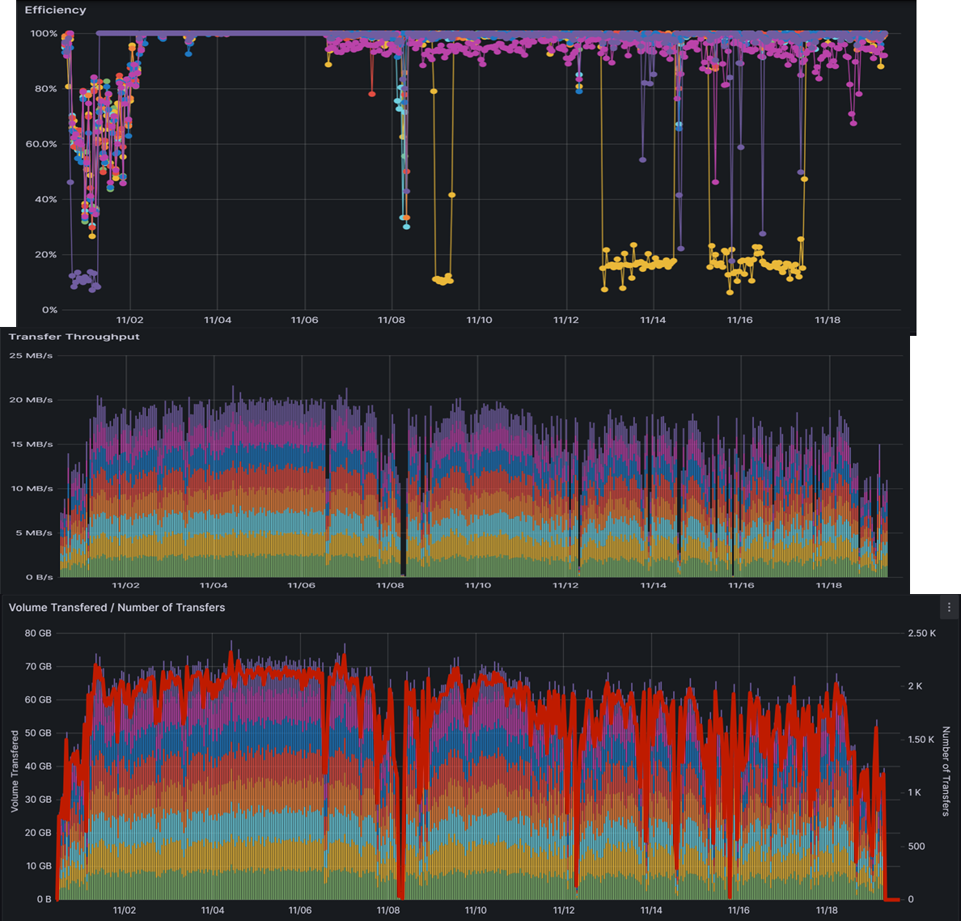
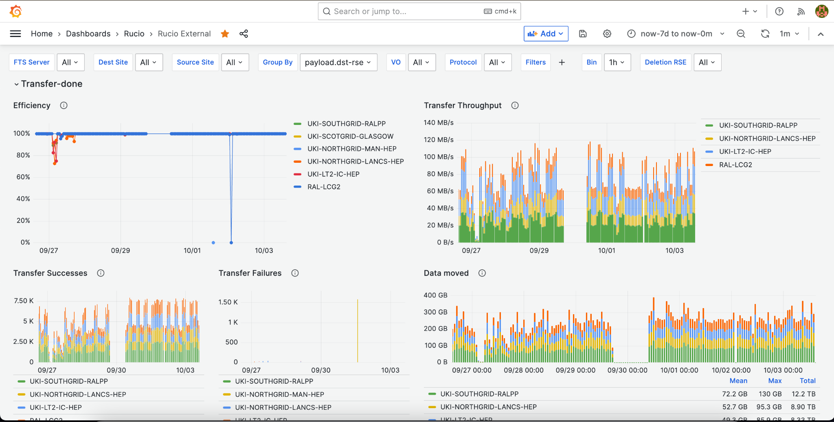
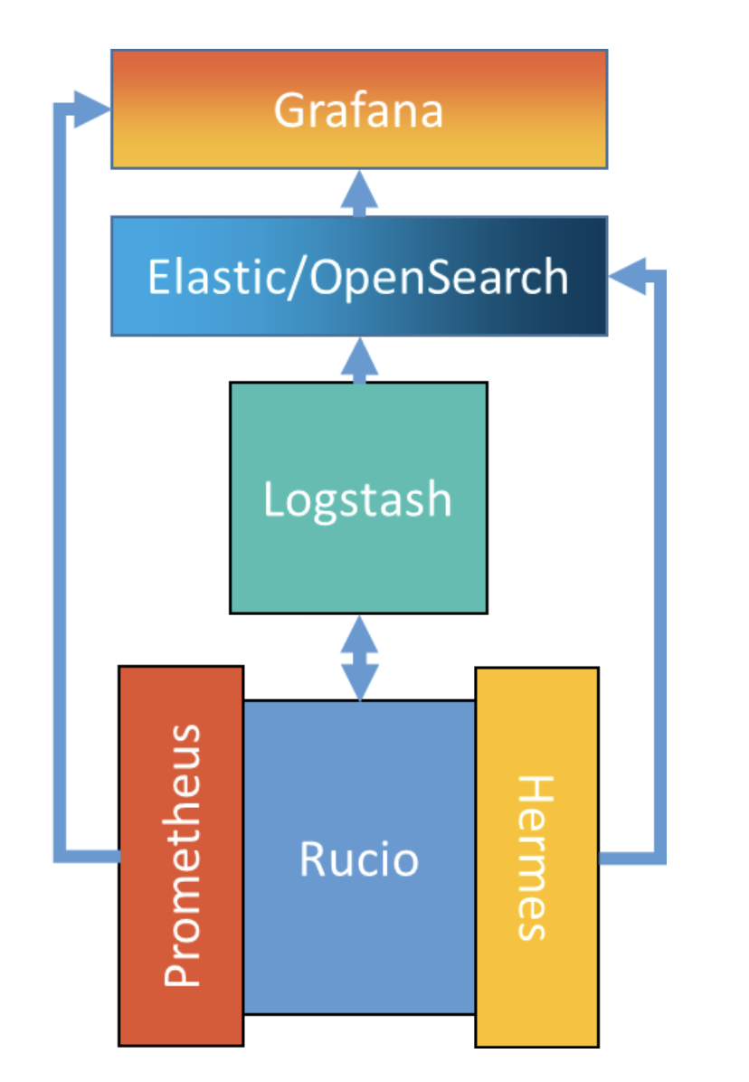
Monitoring of Functional Tests
Monitoring deployment written and included as a minimum viable monitoring stack in the Rucio repository
As few components as
possible to get metrics
Modelled on the FTS
monitoring for the base
dashboard
Deployed for LSST
https://indico.cern.ch/event/1343110/contributions/6096503/

Slide 10
Storage pools at RAL
ECHO: Ceph-based (RADOS) object store with data access provided through XRootD:
XrdCeph OSS plugin – originally developed by S. Ponce (CERN) using ceph’s libradostriper
Provides the interface between XRootD and ceph at the OSS layer
Also deployed for UK Tier-2 site: Glasgow for ATLAS
98PB raw storage
8+3 Erasure Coding
~ 240 Storage Nodes (SN), with ~ 5000 OSDs
Host level failure domain (i.e. OSDs from placement group placed across different SNs).
2 service nodes (e.g. XRootD Gateway, Ceph Mon) + several storage nodes per rack, with ToR routers.
RAL also provides CephFS, S3 and SWIFT endpoints, etc.
SSDs
  138 SSDs
  480 TB
HDDs
  6162 HDD
  98PB
More information on Echo
https://indico.jlab.org/event/459/contributions/11324/

Slide 11
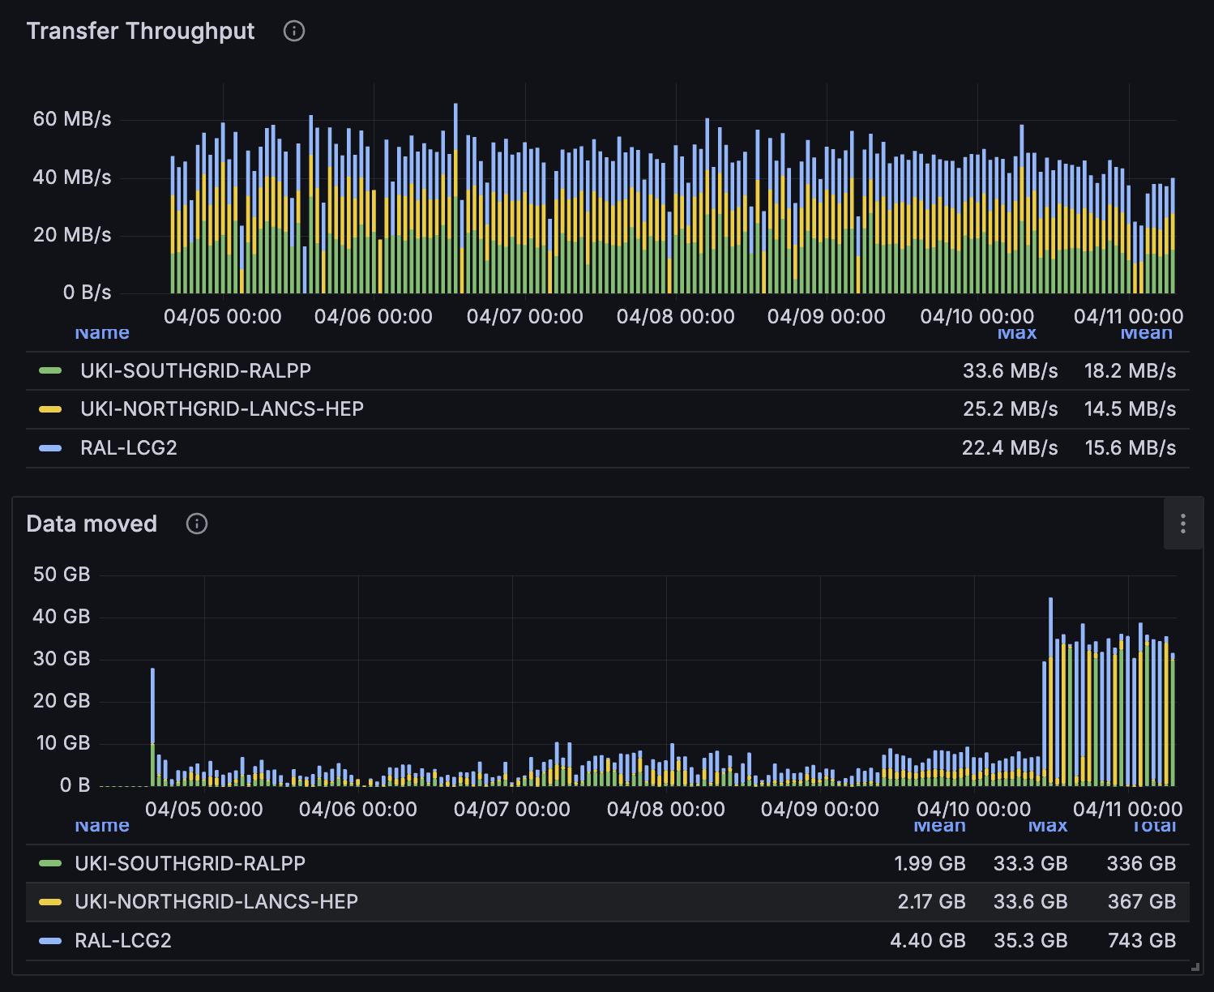
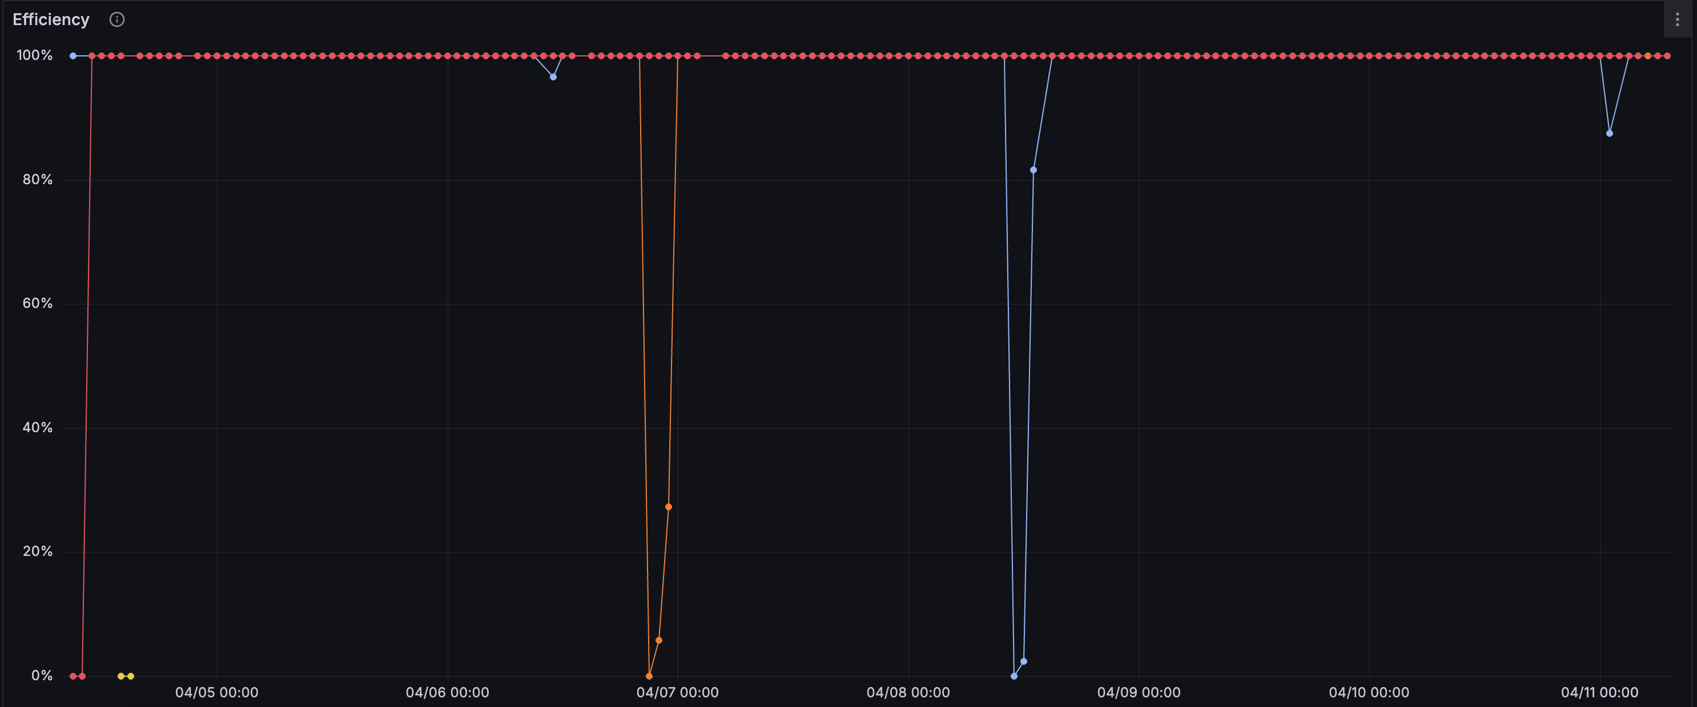
Testing the SSD
To SSD pool
  81.2Mb/s Max
  47.7Mb/s Mean
To Echo
  22.4 Mb/s Max
  15.2 Mb/s Mean
To Lancs
  40.1 Mb/s Max
  27.07 Mb/s Mean

Slide 12
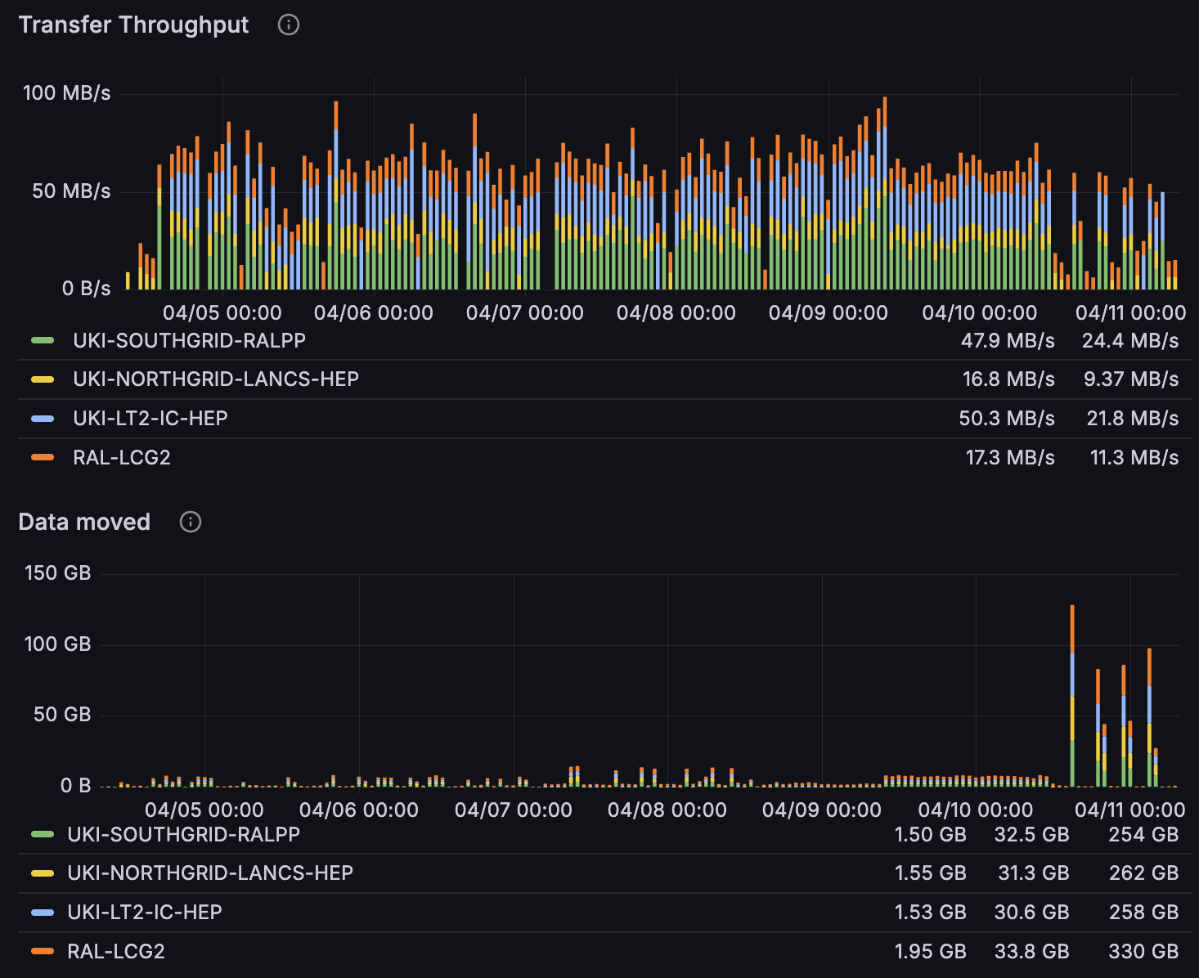
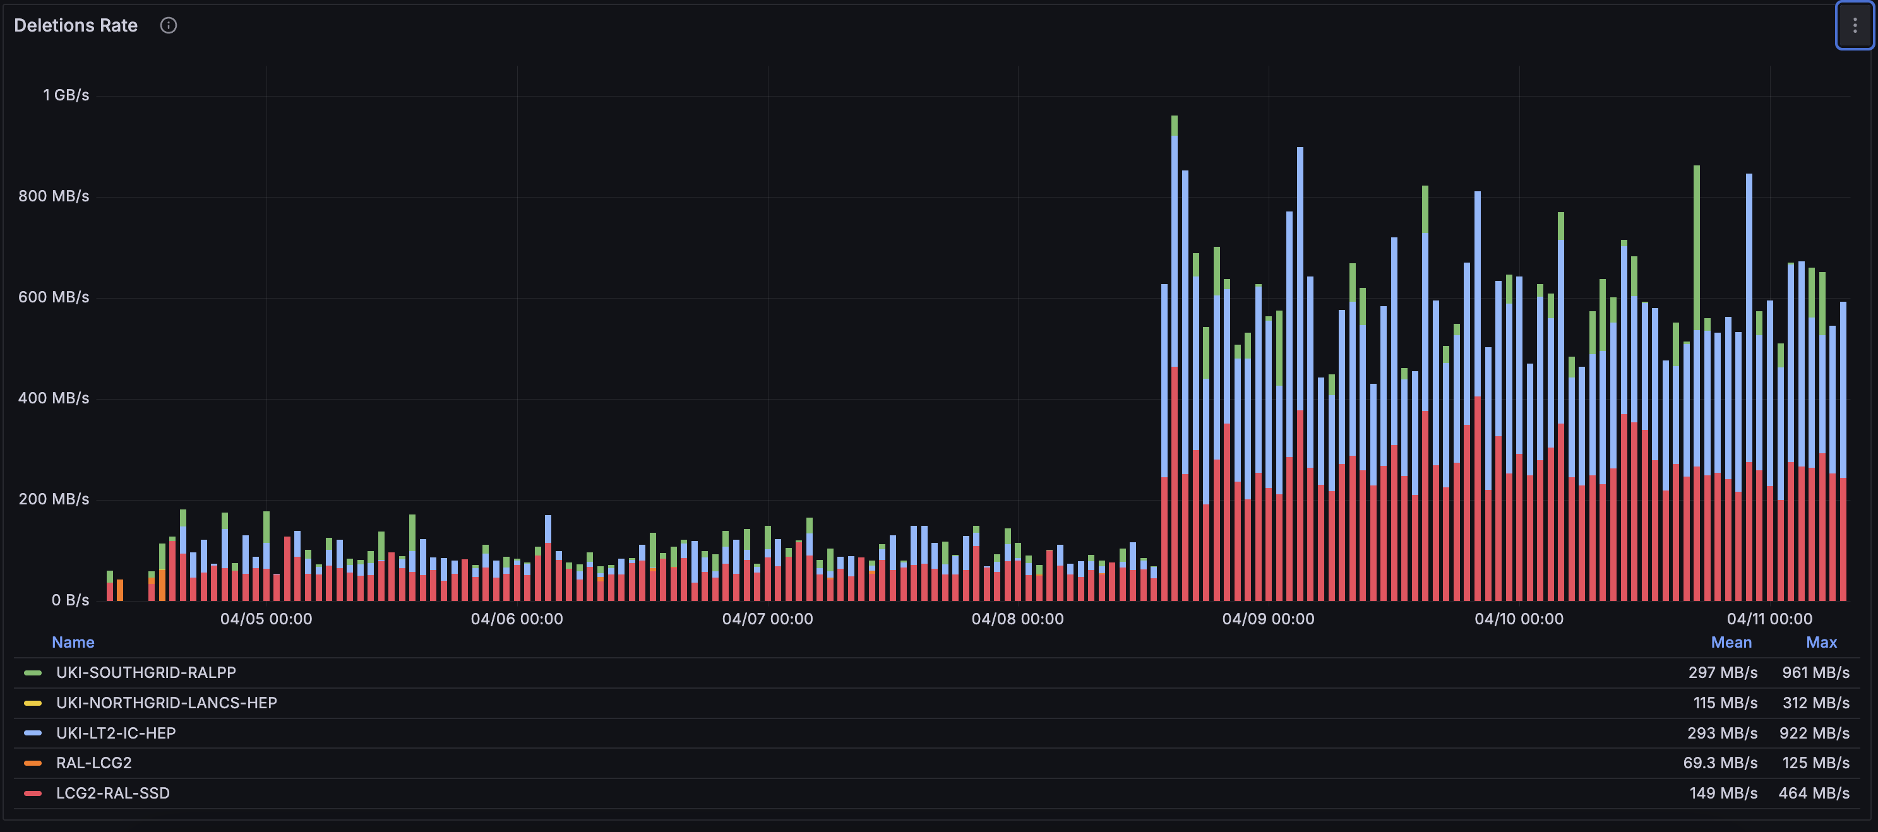
Testing the SSD
From SSD pool
  Mean of 67 Mb/s out
  62mb/s from RAL
  62Mb/s from Lancs
Deletions
  274Mb/s Mean SSD
  590Mb/s from RALPP
  213Mb/s from Lancs
  97.5Mb/s from Echo
What does this mean?

Slide 13
Testing the SSD
Increased data throughput did not increase the data rates
Should be two data sizes, of 32Mb and 2Gb files

Slide 14
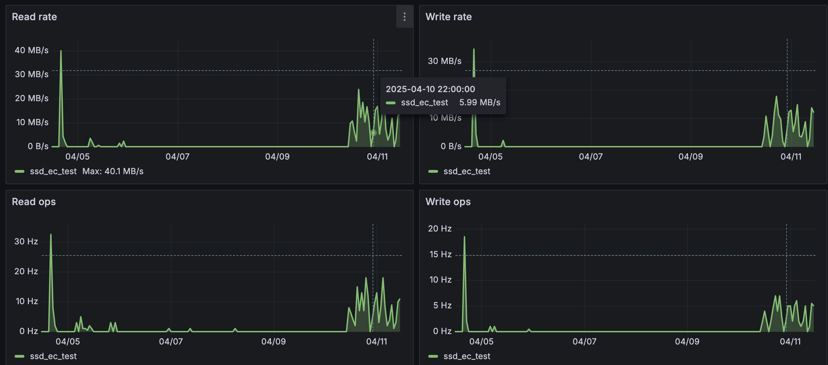
Testing the SSD
These metrics from Echo directly match the Rucio / FTS monitoring

Slide 15
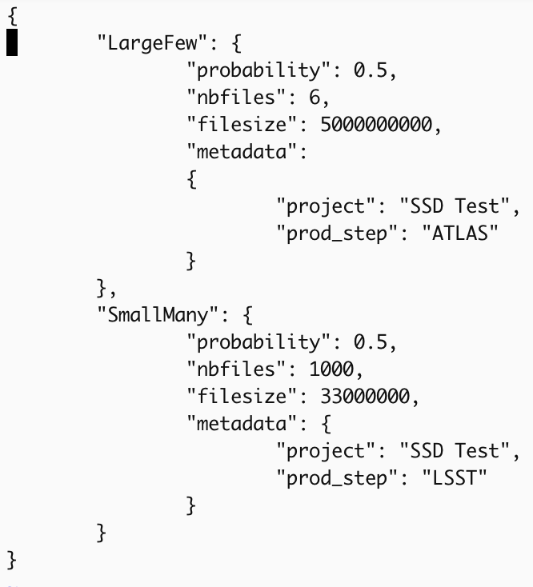
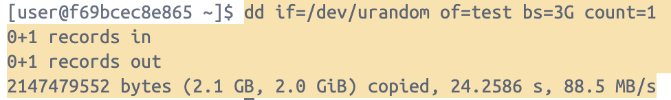
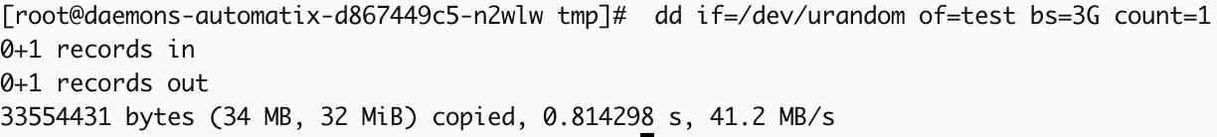
Interesting twist
A 32M file was generated despite configuration changes
dd is used to create the test files in the Rucio
dd buffer, preventing larger files from being created by the Rucio Automatix daemon (I discovered this yesterday morning).

Slide 16
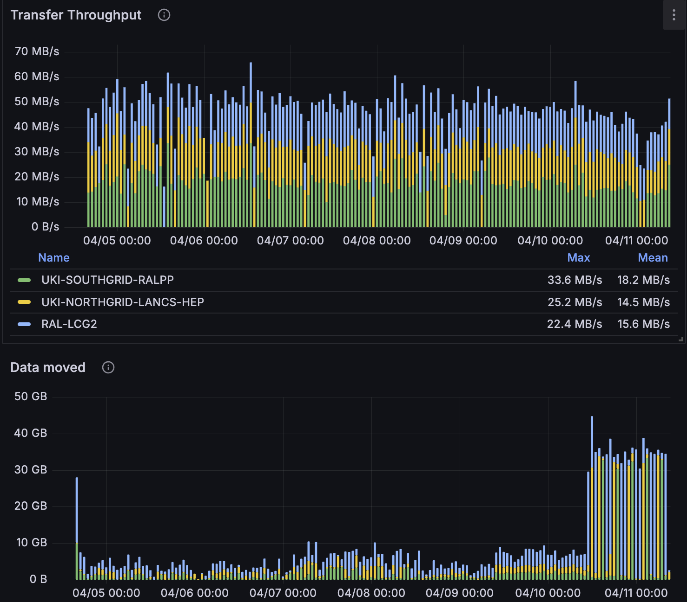
Testing the SSD
Small files are not great for this kind of test
Connections being maxed out in FTS and transfer speeds not being reached

Slide 17
Plans for future testing
Create a patch for Automatix to create larger files as needed (and cleaning up after itself)
  Actually having large files
S3 endpoint testing for comparison (webdav vs s3 protocols)
Looking at I/O from jobs that may require higher access speeds
Create a report/recommendation on when SSD storage is useful
Look at any development needed in Rucio to support the SSD usage better (or maybe its enough already)

Slide 18
Work package 1
Intelligent Data Management
Set up a UK data-lake prototype. - ✅
Implement QoS information in Rucio - ✅
Produce recommendations to sites - In progress
Integrate with the Analysis Facility - In progress

