Slide 1
Bunch Shape Monitor for Pedestrians
Jocelyn TAN
XEI section
BI Day, 13th December 2024

Slide 2
Outline
A guided tour of the Linac4
Bunch Shape Monitor: how does it work ?
Diagnostics with a BSM
Conclusion

Slide 3
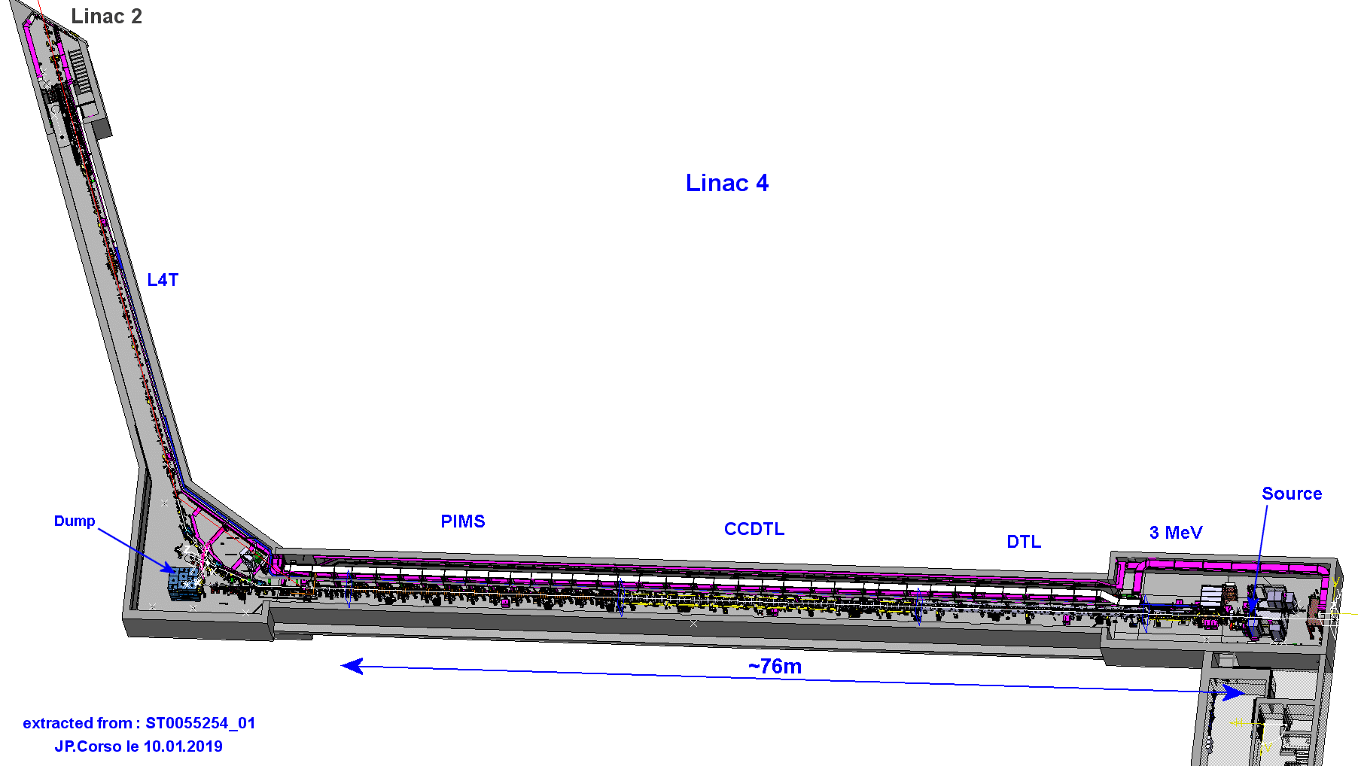
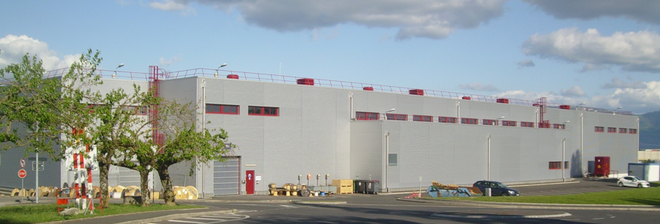
Linac4 : 1st link in the LHC accelerator chain
Linac2: 40 yo+, a bottleneck for LIU
2006: pre-studies, 2008: Approved, 2021: PSB injector
76 m long, normal-conducting Linac
180 m long transfer line to the Proton Synchrotron Booster (PSB)
Building 400
source

Slide 4
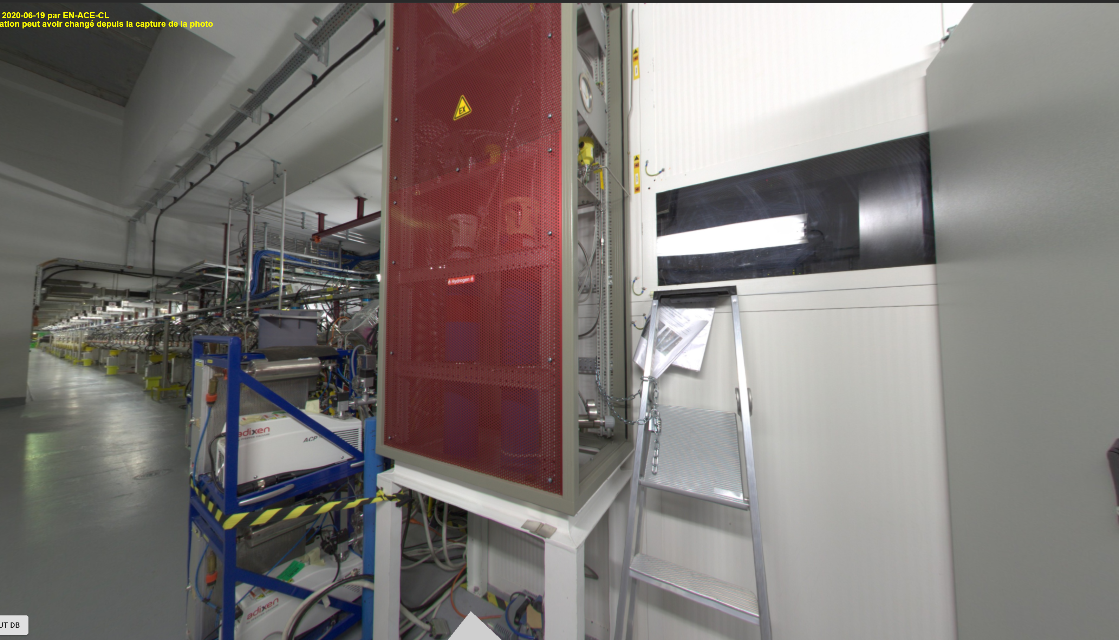
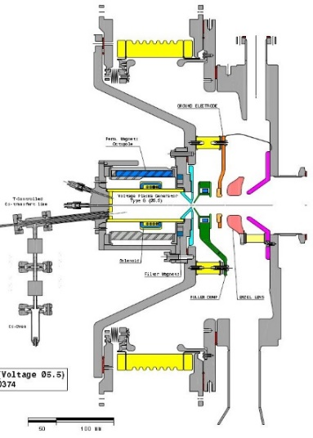
A machine for H- ions
H- ion source 45 keV
Hydrogen gas bottle

Slide 5
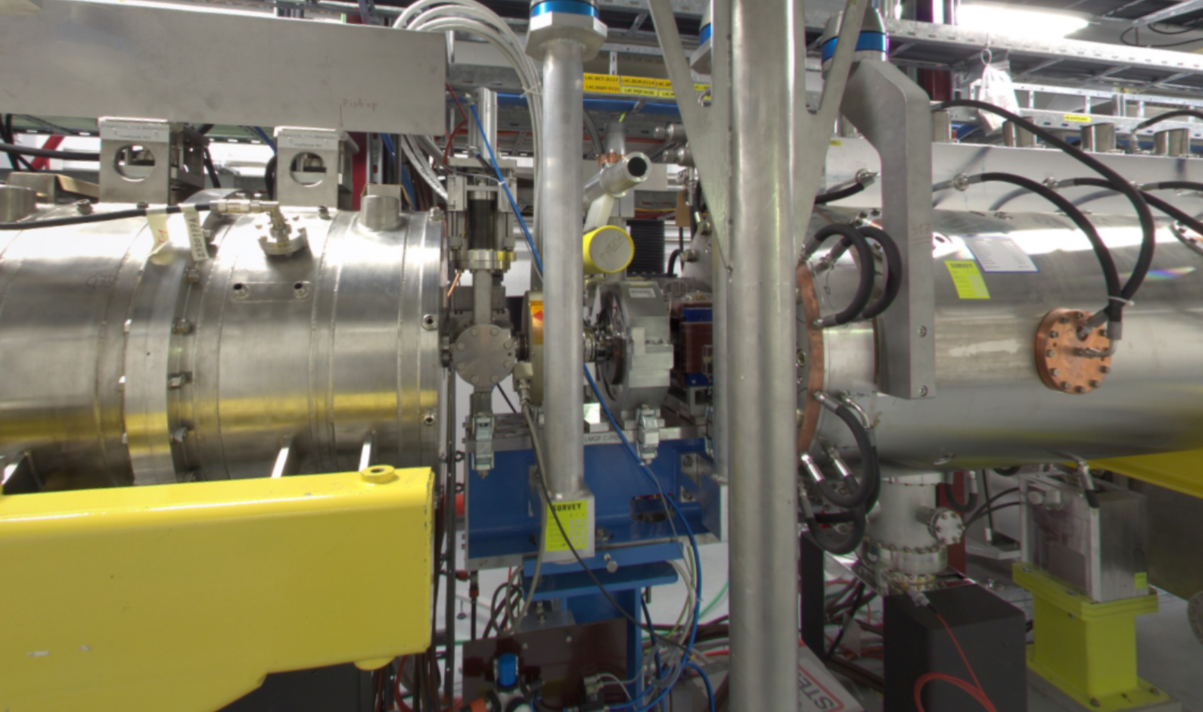
Elements for transverse optics
 | Data
Magnets | PMQ 128 inside DTL tanks EMQ 24 intertanks drift tube Steerers 21 ‘’
Transverse plane | Beam size rms < 3 mm
1 EMQ
1dual plane steerer
DTL-CCDTL drift : 615 mm only !
1 dual plane steerer
1 EMQ
1 vacuum sector valve
4 Monitors: BPM, BLM, BCT, SEM

Slide 6
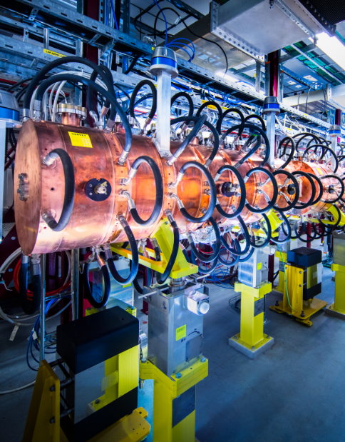
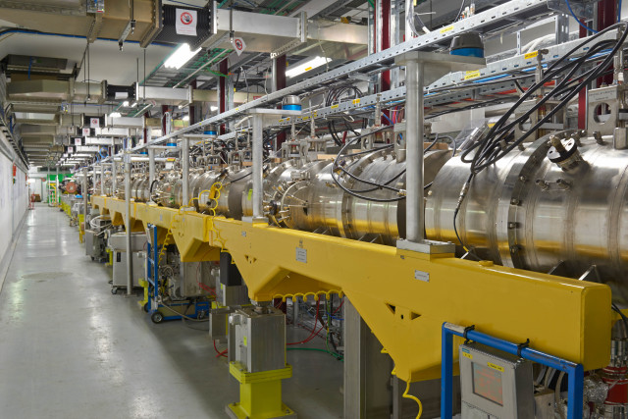
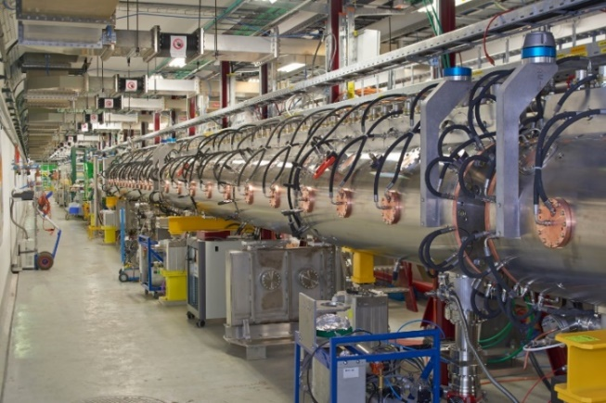
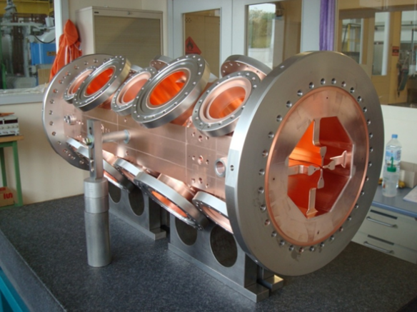
The Lion’s share for RF cavities
160 MeV, the beam velocity is at 50% of c
Total of 150 accelerating cavities
Bunching frequency of 352 MHz
PIMS modules: 14 cells
E_{kin} = 160 MeV
CCDTL modules: 21 cells
E_{kin} = 102 MeV
DTL modules: 111 cells
E_{kin} = 50 MeV
RFQ + bunchers: 4 tanks
E_{kin} = 3 MeV
H- ion source 45 keV

Slide 7




Close-up view of the Linac4 beam
7
A bunch train
Up to 600 μs long
Bunches spaced every 2.84 ns (f_{rf} = 352 MHz)
Optimum duty cycle: 2 – 3 %
T = 2.84 ns
A non-relativistic point charge, moving in a metal pipe
$$≈\frac{R\sqrt{2}}{γ}$$
$Δt≈\frac{R\sqrt{2}}{cβγ}$ ~ 163 ps
Physical bunch length = 60 ps
$$v=βc$$
$$2R$$
Direct signal acq., with 10 samples:
System with ΔF = 83 GHz

Slide 8
Outline
A guided tour of the Linac4
Bunch Shape Monitor: how does it work ?
Diagnostics with a BSM
Conclusion

Slide 9
Secondary electron emission
Secondary
electrons
φ = 100 μm Tungsten wire
at -10kV
H- bunches
Bunching frequency f_{RF} = 352 MHz
Time distribution

Slide 10

Collecting SE beam
Electron multiplier
Secondary
electrons
Secondary
electrons
Target
at -10kV
Output
collimator
Input collimator
H- bunches
Bunching frequency f_{RF} = 352 MHz
Time distribution

Slide 11
Steering SE beam
Electron multiplier
Secondary
electrons
Target
at -10kV
Output
collimator
Electrostatic plates *Steering scan
Input collimator
H- bunches
Bunching frequency f_{RF} = 352 MHz
Time distribution

Slide 12
Focusing SE
Electron multiplier
Secondary
electrons
Target
at -10kV
Output
collimator
Electrostatic plates
*Steering scan
*Focusing
Input collimator
H- bunches
Bunching frequency f_{RF} = 352 MHz
Time distribution

Slide 13
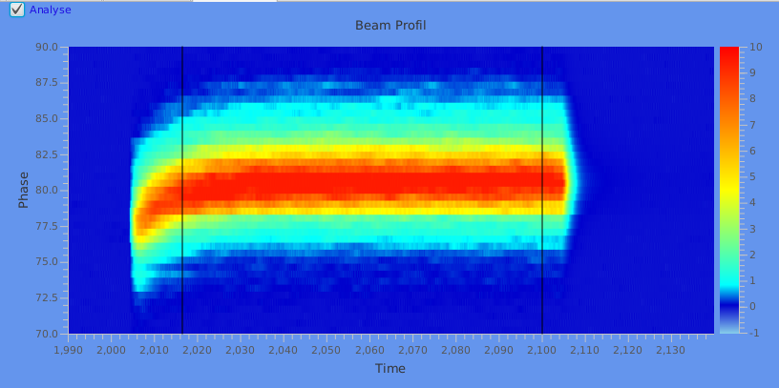

Phase scan
Electron multiplier
Secondary
electrons
Target
at -10kV
Spectrometre effect
Time
Phase
Superpose 352 MHz signal
*phase scan
Linac4 bunch train [μs]
Longitudinal bunch length
Phase [°]
bunch length
H- bunches
T_{RF} = 2.84 ns ⇔ 360°
Linac4 bunch train [μs]
Time distribution
σ = 1.8° ⇔ bunch length = 56 ps !!

Slide 14
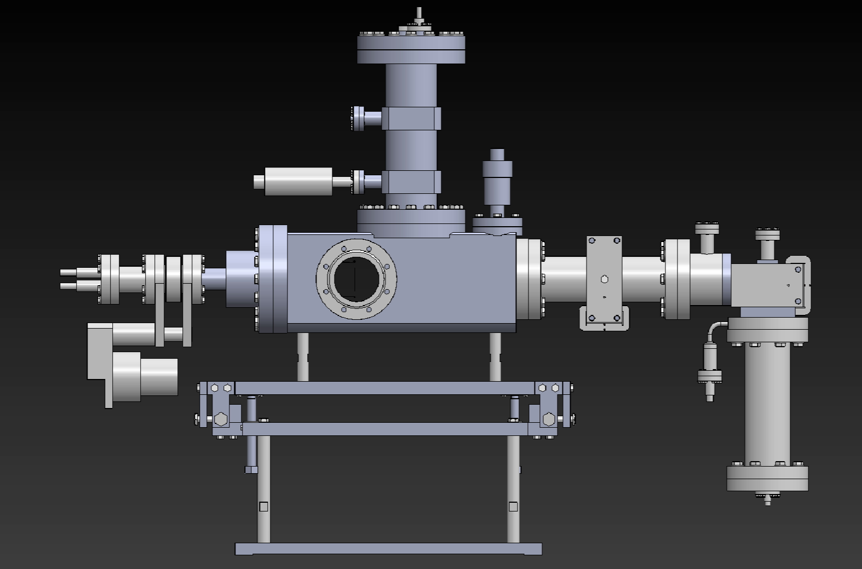
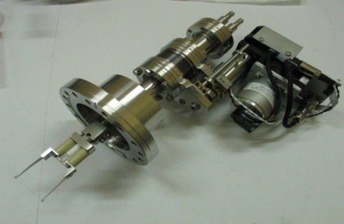
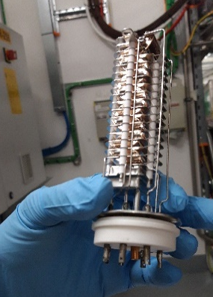













BSM aka Feschenko Monitor
Institute for Nuclear Research RAS (INR), Moscow
International experience on BSM manufacturing:
A. Feschenko: father of the BSM based on SE emission
Linac4 technical specifications (U. Raich)
INR built two BSMs, turn-key system
  NI aqn. chain & Labview SW
  Provide support for beam commissioning & training
  Fix some teething issues
Wire actuator
Electron multiplier
Courtesy: S. Gavrilov, ARIES workshop, Jan. 2021

Slide 15
Outline
A guided tour of the Linac4
Bunch Shape Monitor: how does it work ?
Diagnostics with a BSM
Conclusion

Slide 16
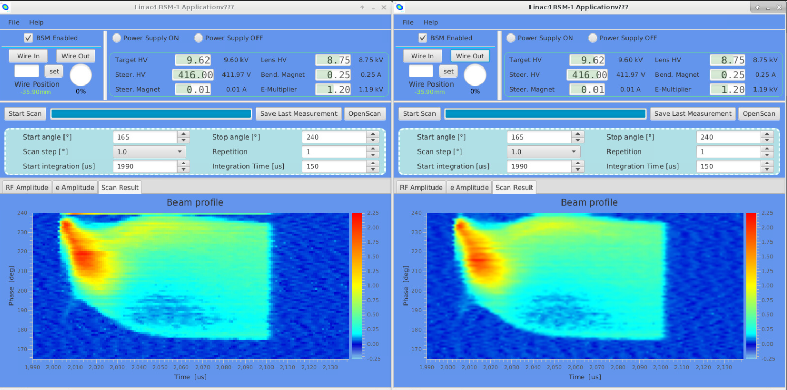
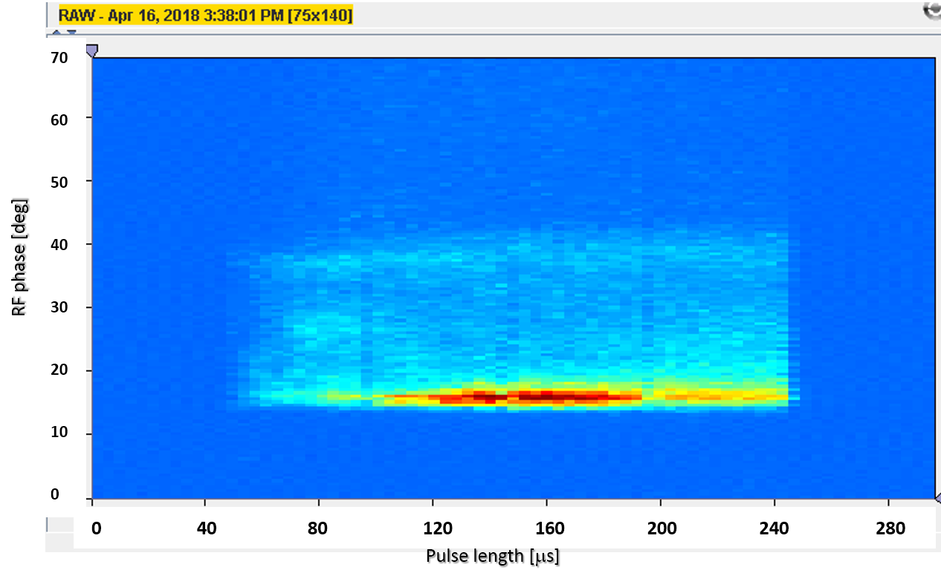
RF cavity issues
Lost RF settings on 1 CCDTL cell: Debunched beam
Wrong cavity phase: Distribution with tail
13th Dec 2024

Slide 17
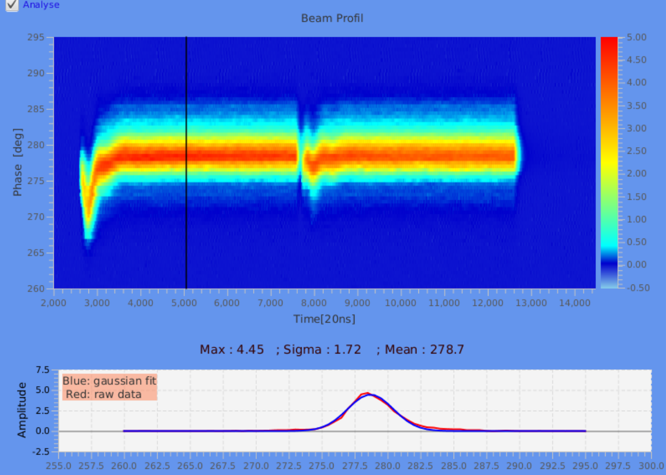
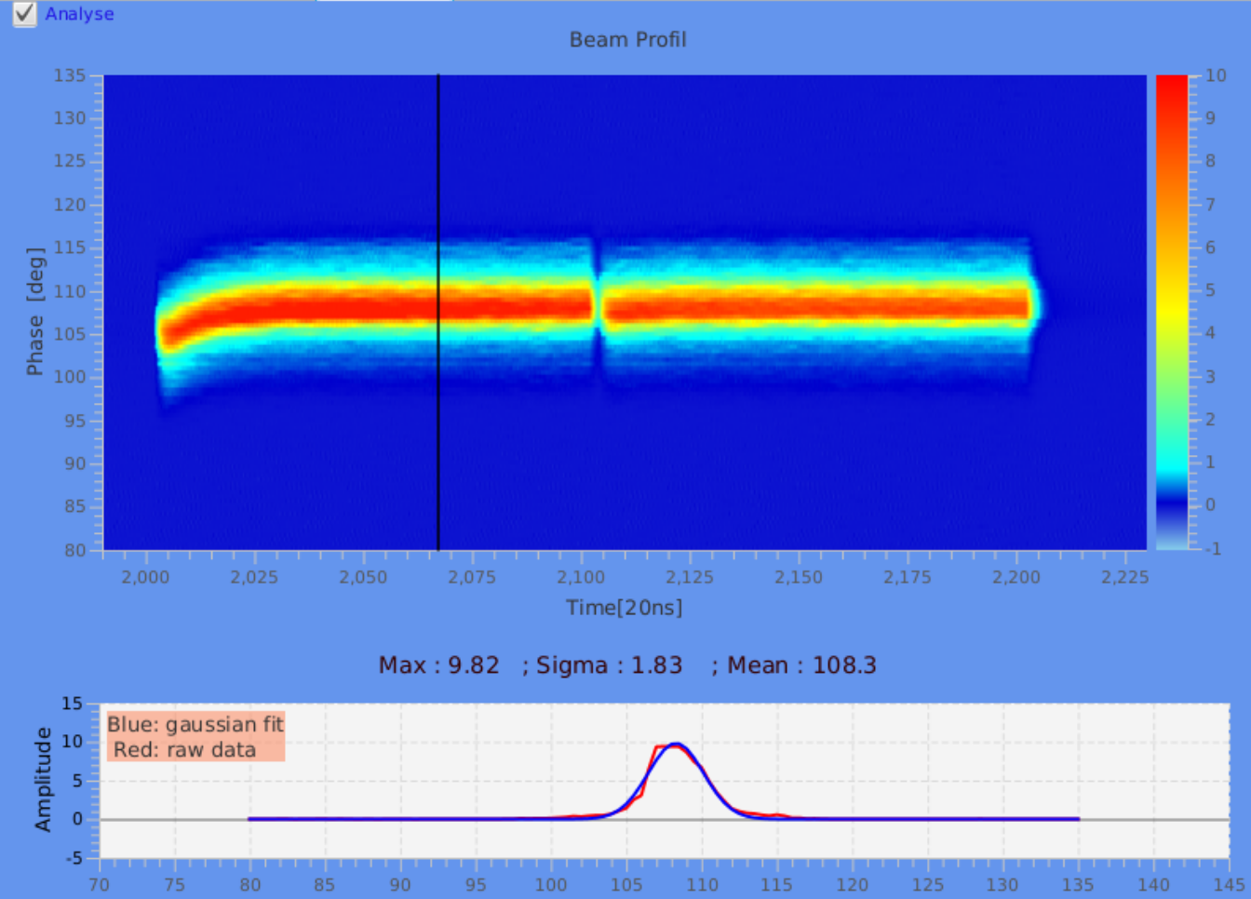
Pulse flatness
Linac4 pulse is chopped to feed 2 PSB rings
Beam loading effect: transition from drift tube to a cavity. Affects energy distribution of the pulse head
Feed-forward algorithm reduces the transients by a factor 5-6.
phase [deg of 352 MHz]
phase [deg of 352 MHz]
time [ns]
time [ns]

Slide 18
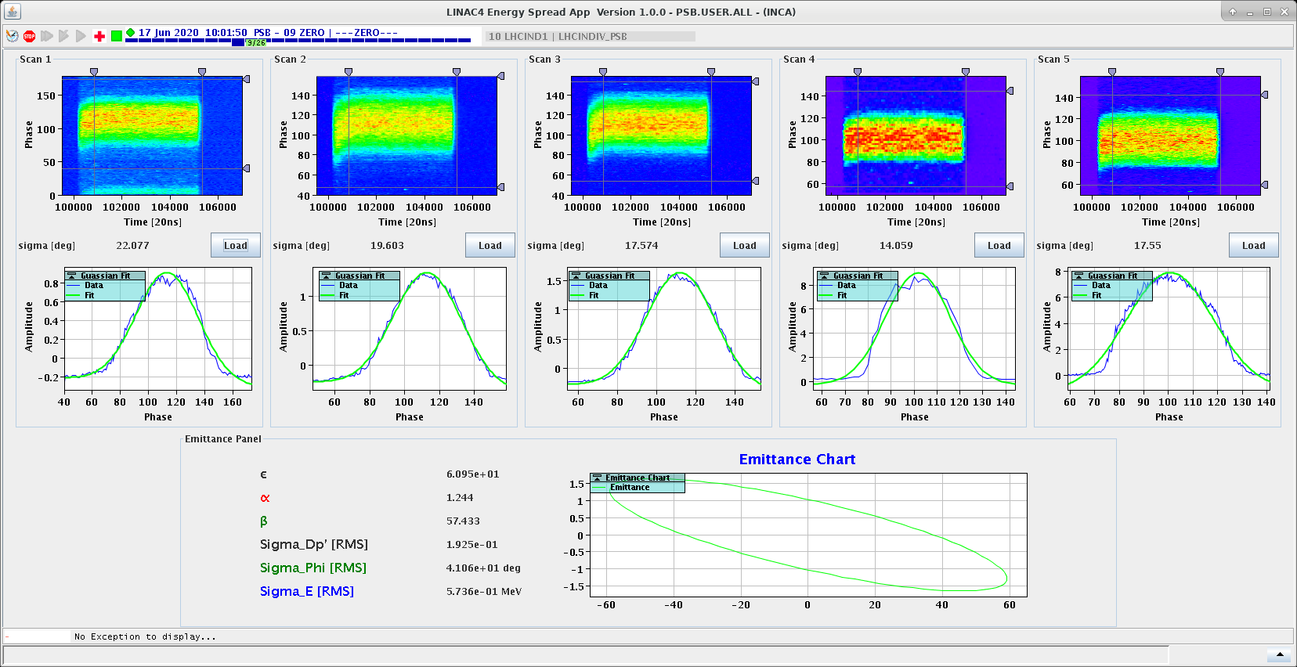
BSM2: Longitudinal emittance reconstruction
BSM2: 64 m in the Linac transfer line
Data obtained by variation of the debuncher cavity amplitude
With inverse matrix processing, Long. Emittance is reconstructed

Slide 19
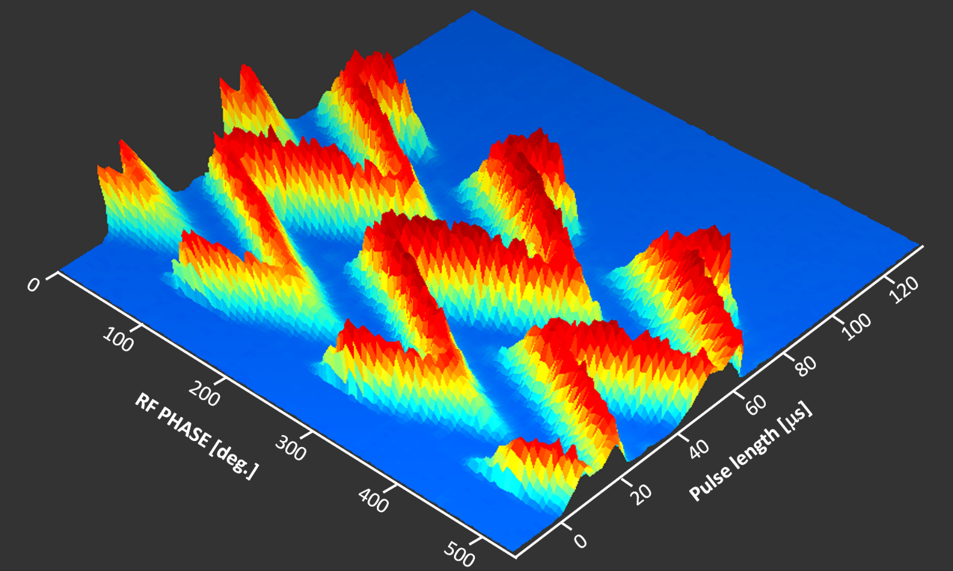
BSM2: Energy Ramping
First successful step to commission longitudinal painting
  Energy ramping around 160 MeV
  Successfully performed with last 2 PIMS cavities ( modulation +/-1 MV)
  Required for high intensity beams in the PSB (e.g. Isolde)

Slide 20
Conclusion
Principle: transfer the temporal bunch structure information in a local region of space
Versatile design: for a wide range of ion type, beam energy and intensities, RF freq.
Physics domains: Electrostatics, HV, RF, Beam dynamics, Solid State physics, Electronics
Phase resolution limit: 0.5 °, i.e. ~4 ps (Equivalent BW of 125 GHz)
The Feschenko monitor has been an international success for Linac facilities
A must for longitudinal beam diagnostics

Slide 21

Thank you
The BSM team
Jocelyn Tan
Mark McLean
James Storey
Stephane Bart Pedersen
Yu Wu (BE-OP)

Slide 22
References
Energy and longitudinal emittance
  J. Tan, et al., Results from the CERN Linac4 longitudinal bunch shape monitor, Proc. of IBIC2018, paper WEPA19, Shanghai, China, 2018
  V. A. Dimov et al., Emittance reconstruction techniques in presence of space charge applied during the Linac4 beam commissioning, Proc. of HB2016, paper WEPM1Y0, Malmö, Sweden, 2016
  G. Bellodi et al. , Longitudinal beam profile measurements in Linac4 commissioning, Proc. of LINAC2014, paper MOPP025 Geneva, Switzerland, 2014
  A. Feschenko, Technique and instrumentation for bunch shape measurements, Proc. of RUPAC 2012, paper FRXOR01, Saint-Petersburg, Russia, 2012,
  S. Gavrilov, Bunch shape monitors for hadron LINAC commissioning, https://agenda.ciemat.es/event/1229/contributions/2278/, ARIES workshop, Jan. 2021
  J. Tan and W. Yu, The Linac4 Bunch Shape Monitor, Linac4 training, EDMS 2213651, Rev.2, 2020

Slide 23
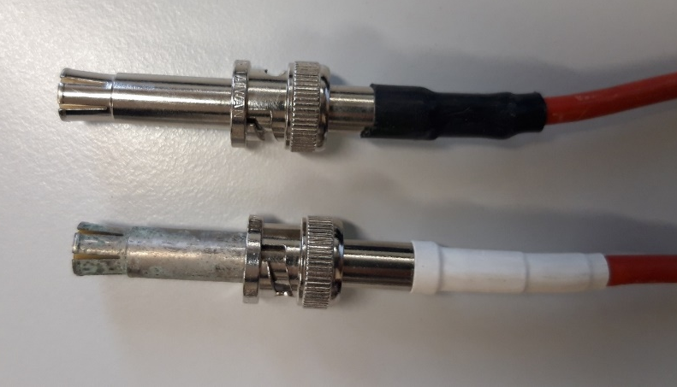
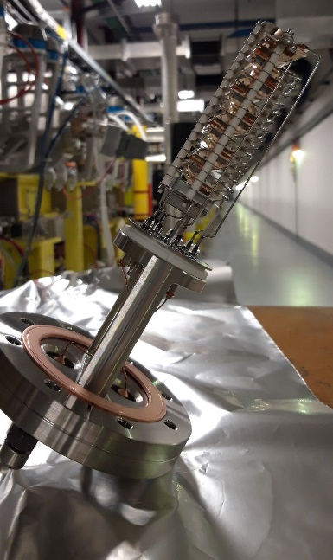
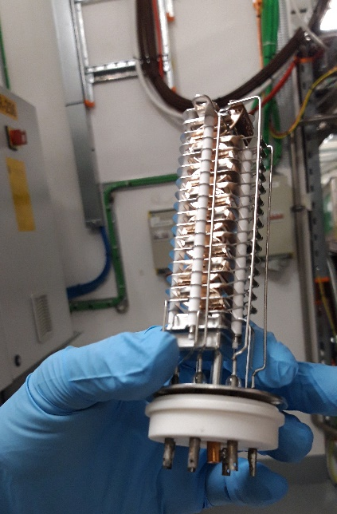
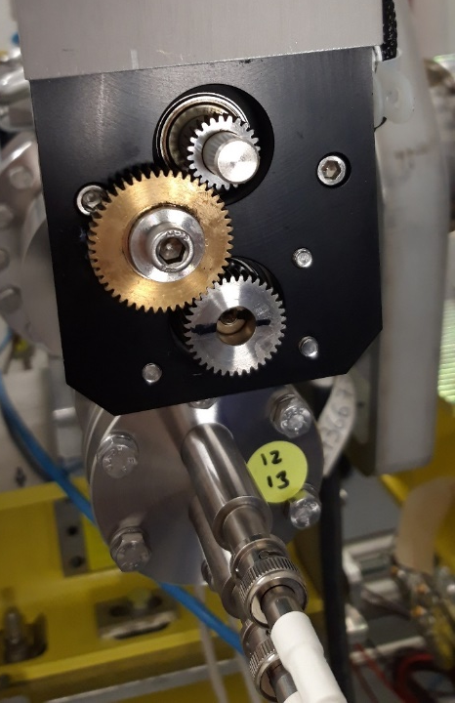
Past issues
2019: CV work nearby, spreading water on HV connectors
Vacuum sector venting without N2 flux: reduction electron multiplier lifetime
2021: wire stuck in the beam due to frictions on the brass wheel gear
Electronics parts ageing: VMOD TTL boards, capacitors
Target interaction with beam: still operating with the genuine wire thanks to
  SW protection against overheating
  Operators awareness and training

Slide 24
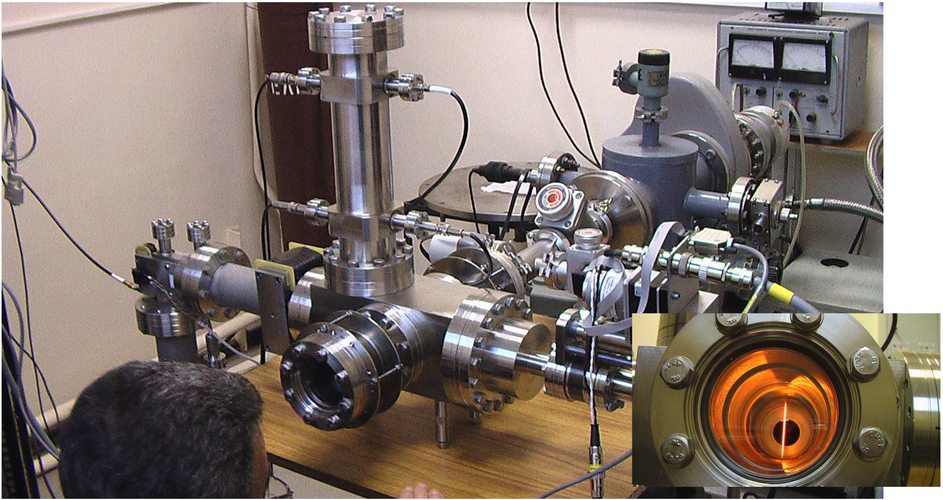
Linac4 BSM tests in Moscow

Slide 25
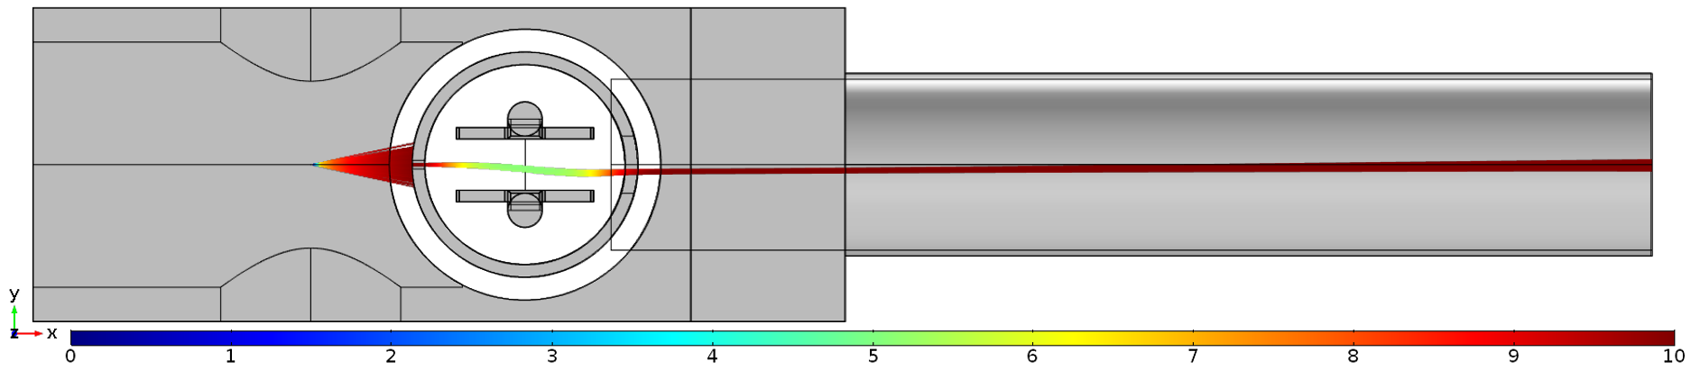
Focusing effect

Slide 26
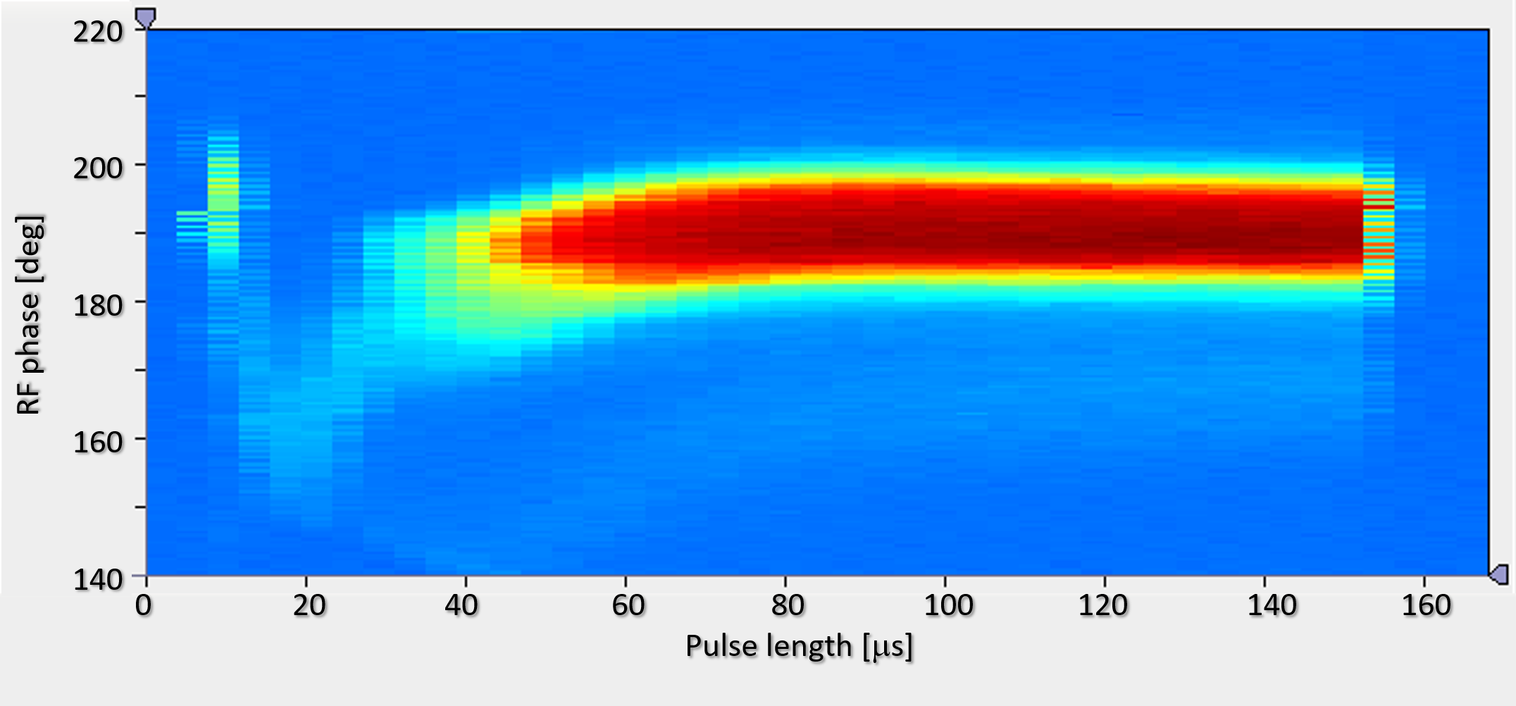
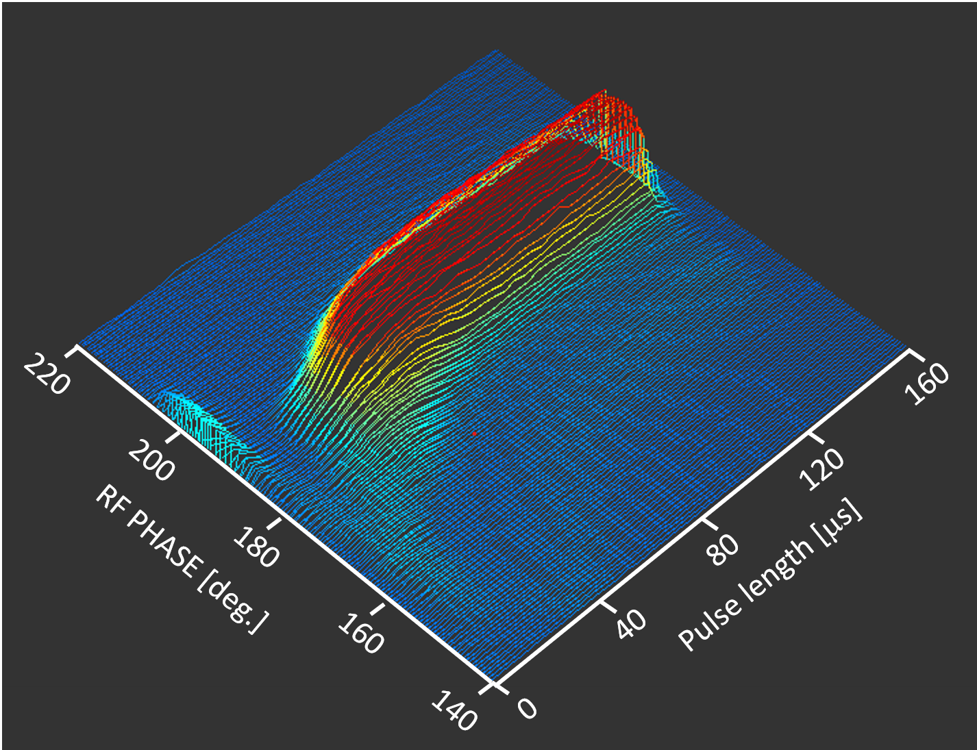
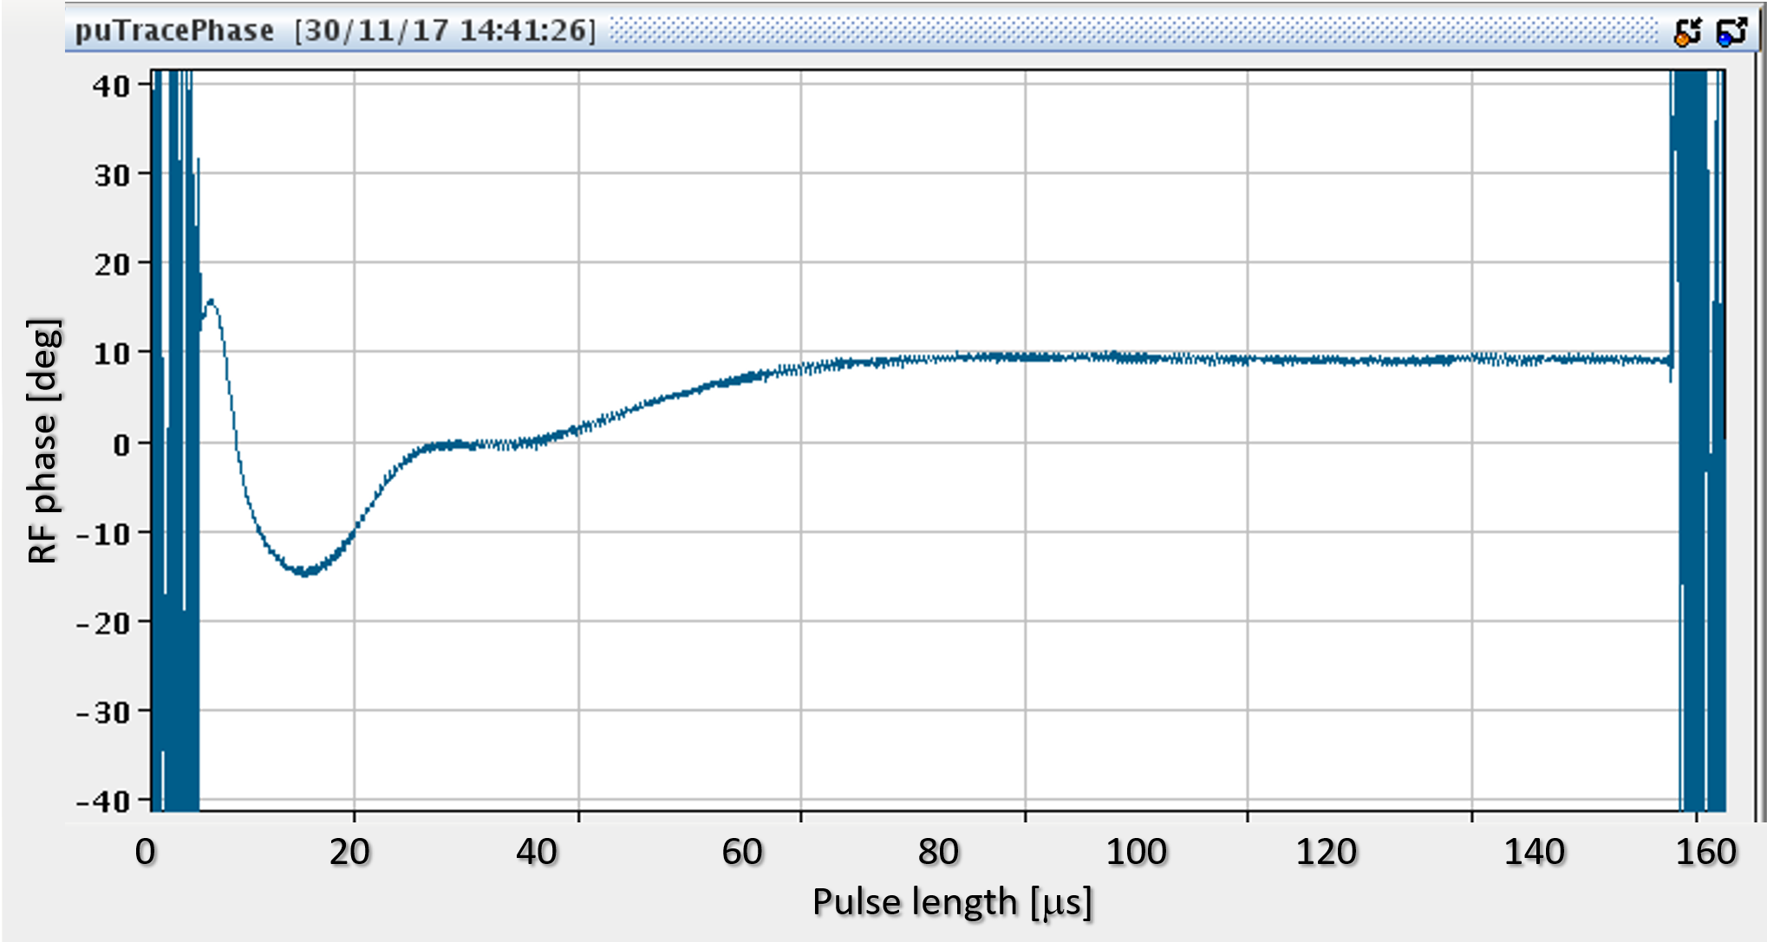
BSM vs BPM

Slide 27
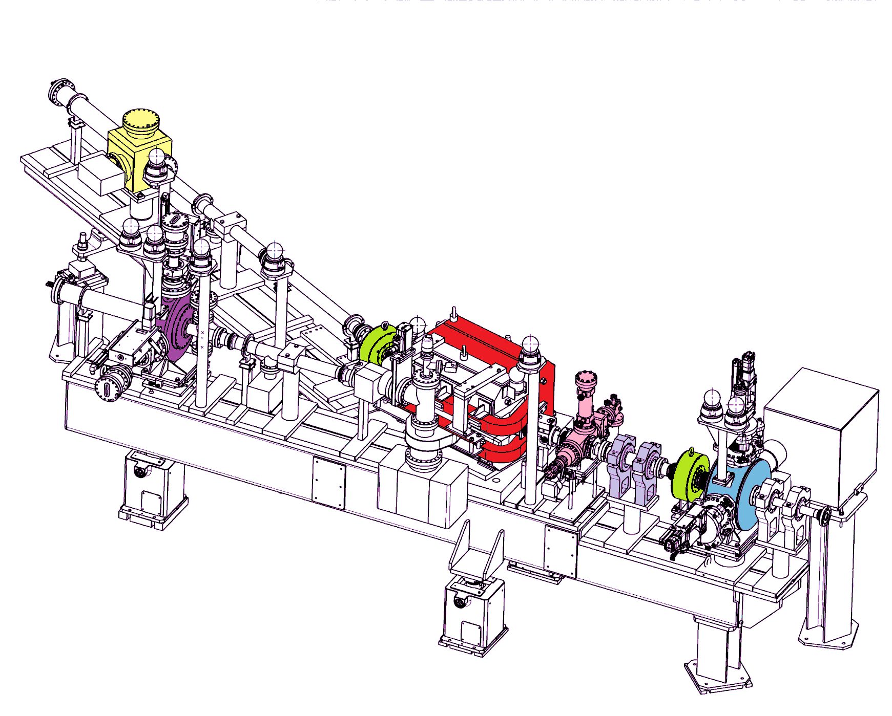
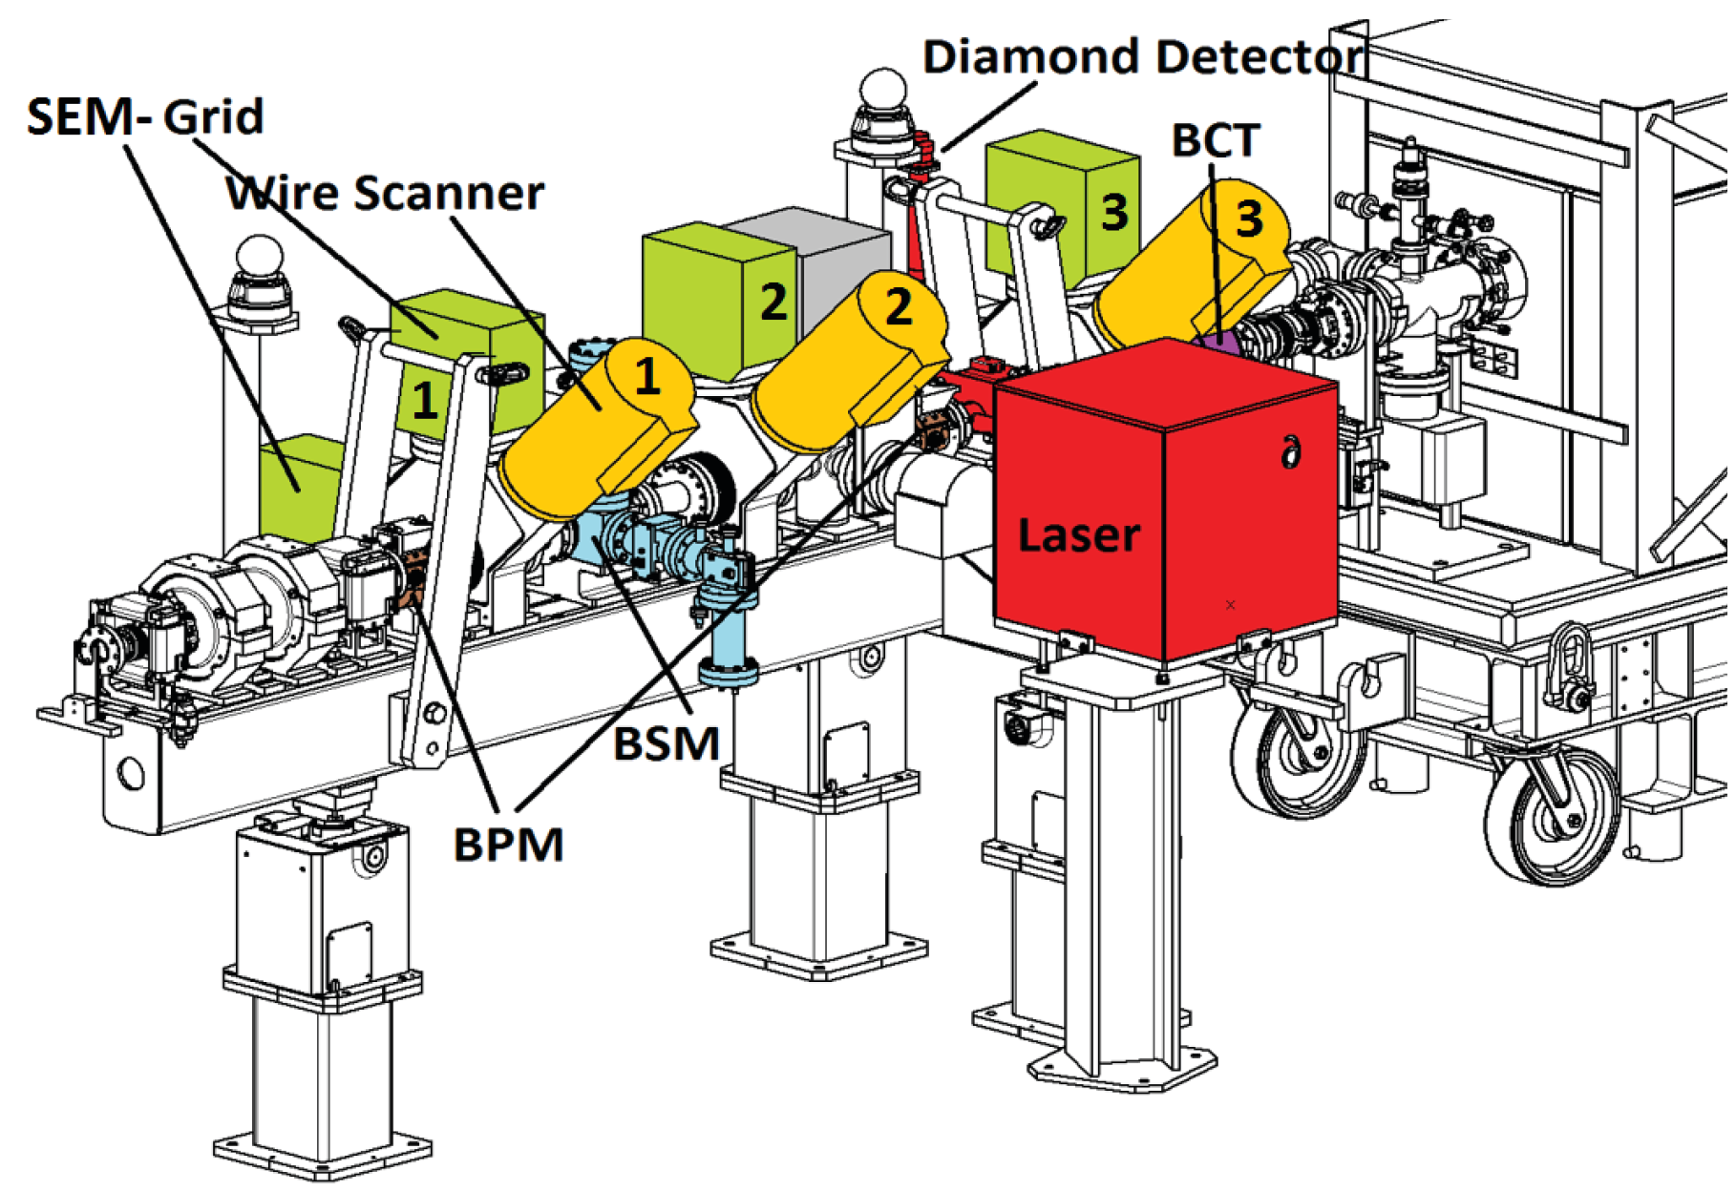
Temporary movable test bench for staged commissioning
Modular commissioning during machine installation : validation of machine parameters
Transverse : profiles, emittances by slit & grid, wire scanners, laser, halo, position
Longitudinal : transmission, energy, ΔE/E, bunch length
Low energy test bench at 3 and 12 MeV
High energy test bench at 50 and 107 MeV

Slide 28
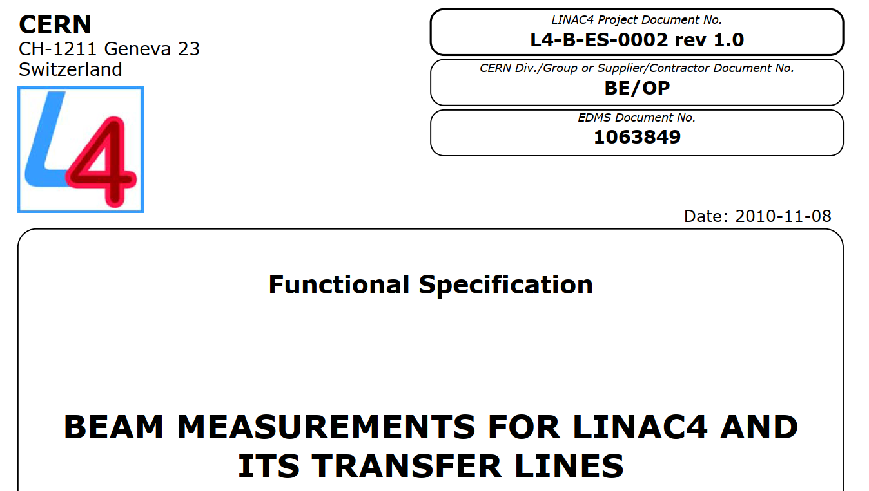
Beam instrumentation : operators’ eyes
Ensure safe and efficient during commissioning and operation
A wide variety of devices at convenient locations along the Linac and new TL defined in this document (2010)
Diagnostics for routine operation:
  Beam intensity & transmission efficiency : 16 Beam Current Transformers & 1 Faraday cup
  Losses and Machine Protection Monitors : 19 Beam Loss Monitors
  Beam position and Energy : 25 Beam Position Monitors
  Longitudinal emittance, energy spread : 2 Bunch Shape Monitors
  Transverse profile :
    SEM Grids: 16 hor. and 16 ver.
    Wire Scanners: 15
    Laser Emittance Meter: 2 stations around first horizontal bend (for long beam pulses)
    BTV Scintillating screen : 1 for the stripping foil test stand

Slide 29
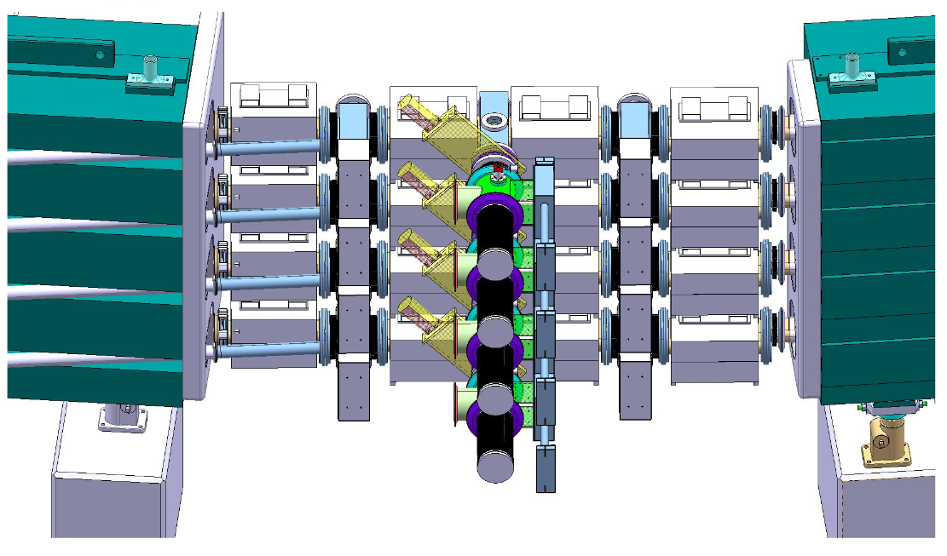
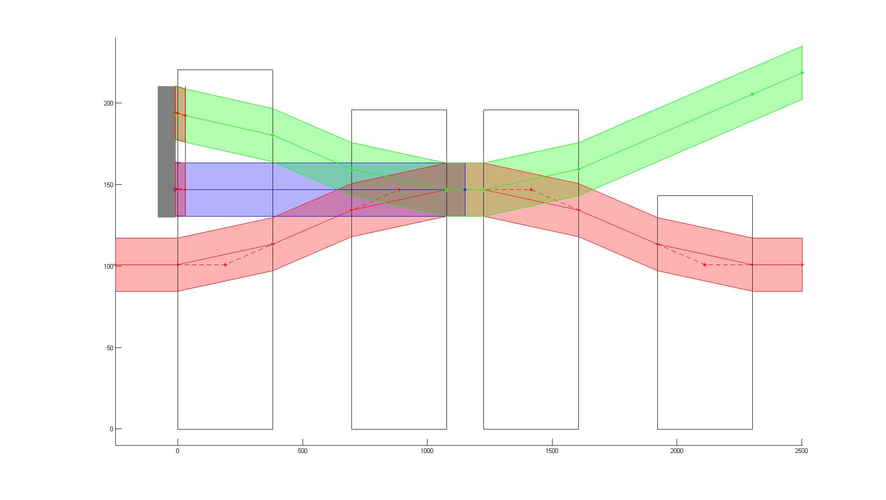
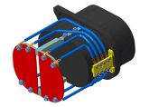
Introduction to new PSB injection region
Stripping foil
(x% efficiency)
H-
BSW1 BSW2 BSW3 BSW4
P+ Circulating beam
P+
H0
Dump
H-
H-
(=1 proton+2electrons)
To electronics
Need to measure H0 and H- charges !
On line monitoring of SF degradation
Protect dump in case of foil breakage
Courtesy Jean Tassan-Viol

Slide 30
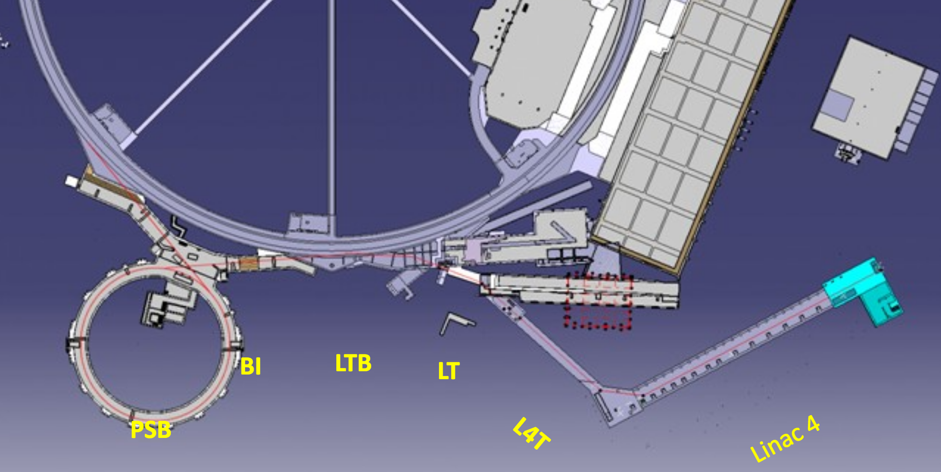
Linac4 Layout
LBE
Cell-Coupled Drift Tube Linac
100 MeV
7 Modules
6 Klystrons
7 EMQ
7 steerers
14 PMQ
25 m
Π-mode Structure
160 MeV
12 Modules
6 Klystrons
12 EMQ
12 steerers
23 m
Drift Tube Linac
50 MeV
3 Tanks
3 Klystrons
1 EMQ
2 steerers
114 PMQ
19 m
Pre-injector
3 MeV
Source(s) @ 45 kV
2 solenoids
RFQ (1 Klystron)
11 EMQ
3 Buncher Cavities
2 Chopper units
+ dump
LIU Workshop, 20-22 January 2020, https://indico.cern.ch/event/847980/
B. Mikulec

Slide 31
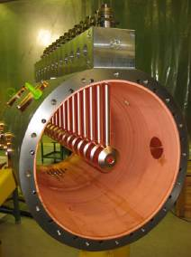
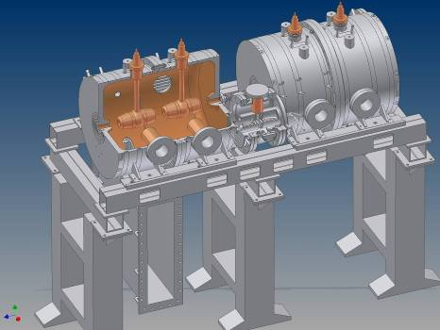
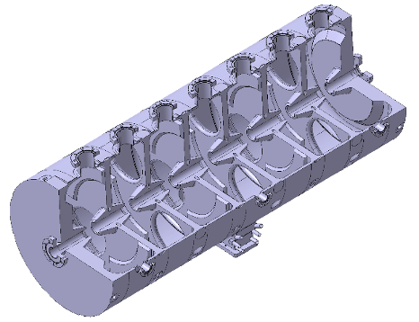
Linac4 accelerating structures
DTL, 3 – 50 MeV
CCDTL, 50 – 100 MeV
PIMS, 100 – 160 MeV
M. Vretenar, IFMIF commissioning workshop, Tokyo, Japan, 17.09.2009
https://edms.cern.ch/document/1028126/1
Cell-Coupled Drift Tube Linac (7 modules)
  Modules of 3 DTL-type cavities (2 drift tubes), connected by coupling cells.
  Prototypes built and tested, construction starts in 2009
  Drift Tube Linac (3 tanks)
  Prototype built, under testing.
  Construction starts in 2009
7-cell cavities in p-mode (12 cavities)
  Prototype in construction

