Slide 1
INSIDE THE EXPERIMENTAL AREAS:
WORK OF THE XEI SECTION
Wilfried DEVAUCHELLE SY-BI-XEI
13/12/2024

Slide 2
OVERVIEW
Our mission.
Overview of the East & North Experimental Areas.
Overview of beam instrumentation in the Experimental Areas.
Some interventions.

Slide 3
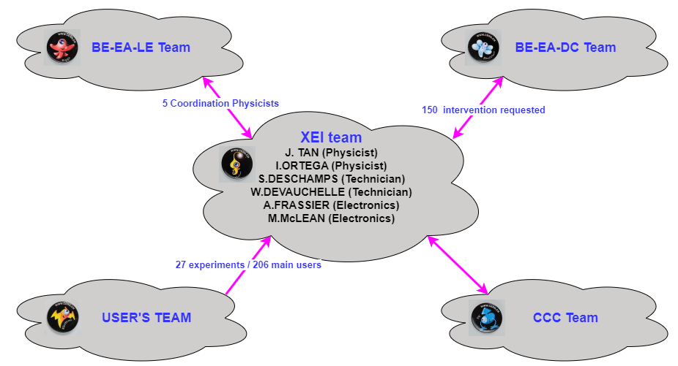
OUR MISSION
Provide diagnosis instruments and support for the secondary beamlines.
Observables :
Profile / position.
Intensity / Trigger / Time Of Flight.
Beam composition.
Support :
Support the beam physicists and experiments during operation.
    Weekly experiment turnover.
Adapt instruments to the needs of the physics program.
We are responsible for all instrumentation in the secondary beamlines.

Slide 4
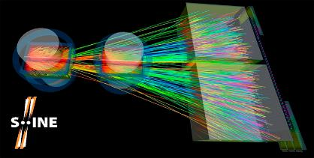
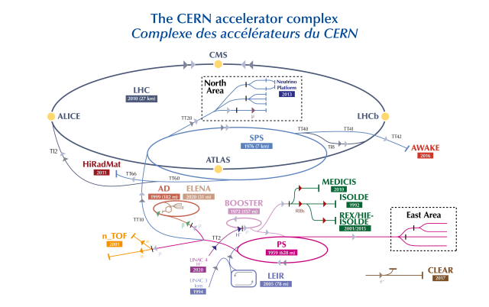
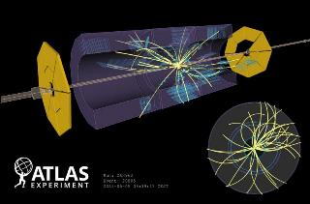
THE EXPERIMENTAL AREAS
Secondary beam
Intensity: 10³ to 10¹⁰ part/second.
Slowly extracted: 400 ms -> 4,6 s.
Unbunched.
Primary beam
Experimental areas with fixed target
East area Building 157
Higher intensities.
2556 bunches per ring.

Slide 5
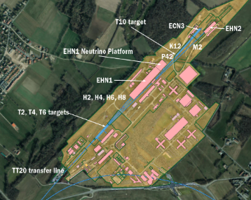
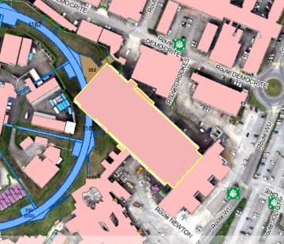
WHERE ?
East area Building 157

Slide 6
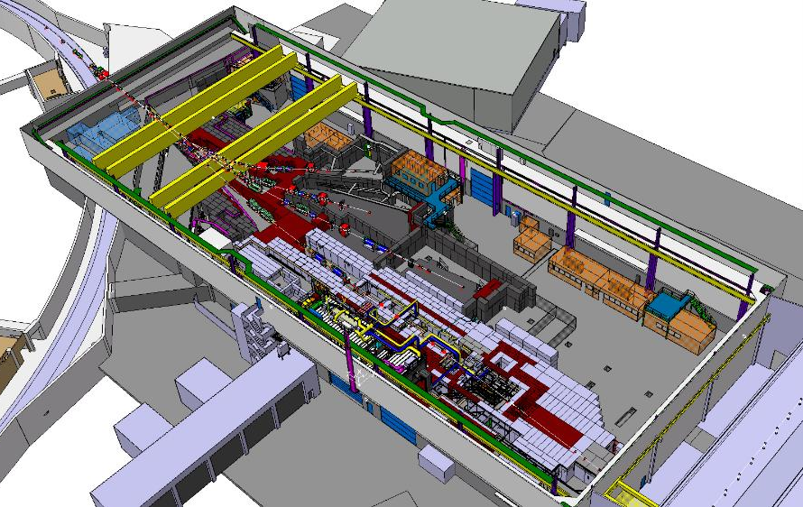

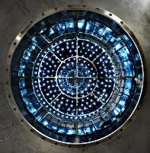



EAST AREA
Built in 60’s and renovated during LS2.
250 meters beamlines.
2 permanent EAs.
2 versatile EAs.
~50 Main Users.
T11
T10
T09
T08
13/12/2024
W. Devauchelle - BI Day 2024
6

Slide 7
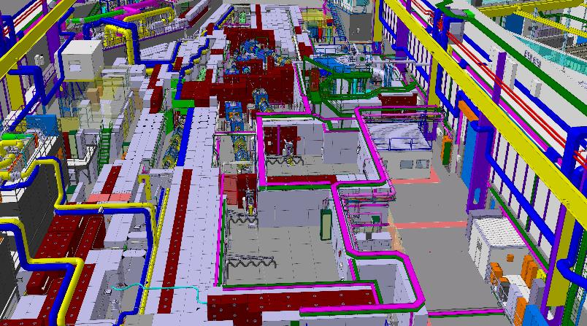
EAST AREA
DIVERSE ACTIVITIES
04 Users barrack.
01 BI barrack.
T11
10 Profile monitors.
05 Intensity / trigger / Time Of , Flight monitors (T.O.F.).
T10
04 Particle identification , , , monitors.
T09
T08
W. Devauchelle - BI Day 2024

Slide 8
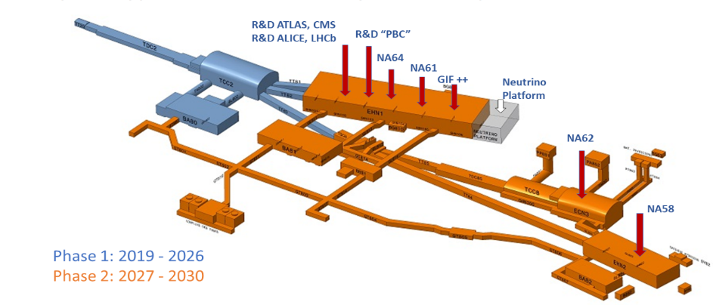
NORTH AREA
Built in the 70’s.
Three experimental halls, service buildings and underground tunnels.
60,000 m2.
Six secondary beam lines (~7 km).
Four fixed targets fired from SPS.
~160 Experiments & 2000 users for 2023.
NA-CONS
Phase 1: 2019 - 2029
Phase 2: 2029 - 2035
W. Devauchelle - BI Day 2024

Slide 9
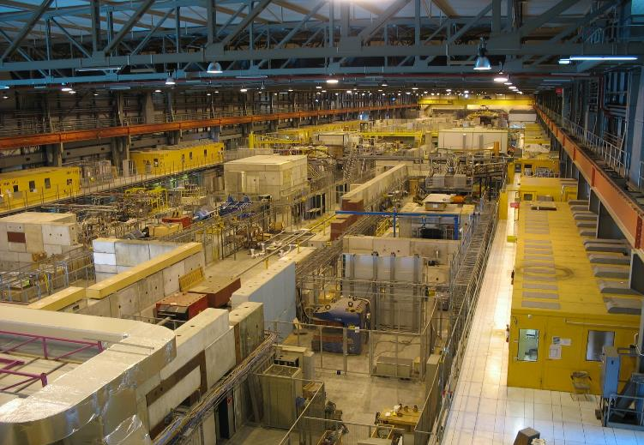
NORTH AREA
DIVERSE ACTIVITIES
Served by four secondary beam lines, running simultaneously
Houses two Neutrino Platforms : NP02, NP04 (ProtoDUNE)
045 Test areas.
029 User’s barrack.
009 BI barrack.
114 Profile monitors.
049 Intensity / trigger / Time Of , Flight monitors.
021 Particle identification , , monitors.
W. Devauchelle - BI Day 2024

Slide 10
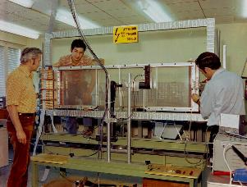
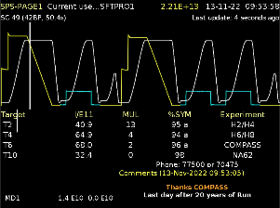
Overview of beam instrumentation in the Experimental Areas
PROFILE / POSITION MONITOR.
INTENSITY / TRIGGER.
FOR PARTICLES IDENTIFICATION.

Slide 11

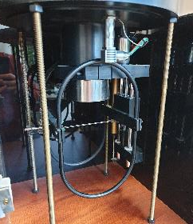
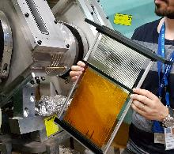
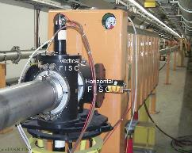

PROFILE / POSITION MONITOR
Finger scintillator scanner (FISC)
(1990’s)
Beam profile fiber monitor (XBPF)
(2018)
beam
~56 units
~20 units
W. Devauchelle - BI Day 2024

Slide 12
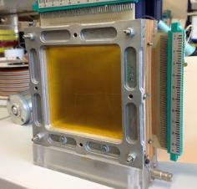
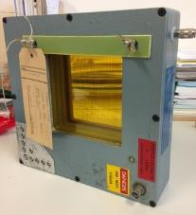
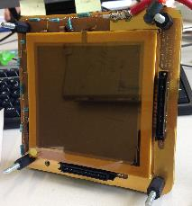
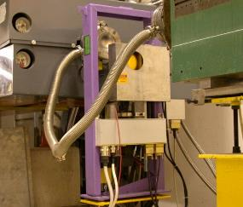
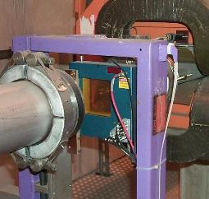
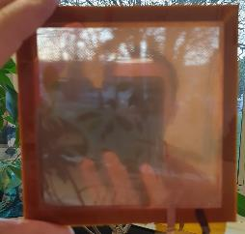
PROFILE / POSITION MONITOR
Multi-wire proportional chamber (MWPC)
(1970’s)
Delay wire chamber (DWC)
(1990’s)
Gas electron multiplier (GEM)
(2010’s)
~50 units
~35 units
~6 units
W. Devauchelle - BI Day 2024

Slide 13
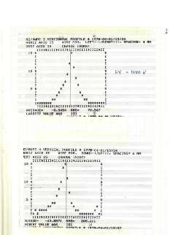
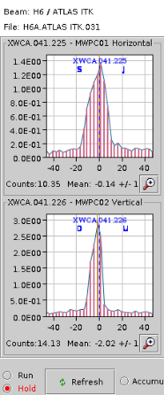
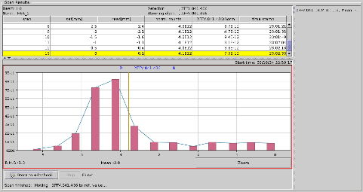
PROFILE / POSITION MONITOR
Very first beam profile in
East Area
Wire Chamber today
FISC angle scan in the H6 beamline
W. Devauchelle - BI Day 2024

Slide 14
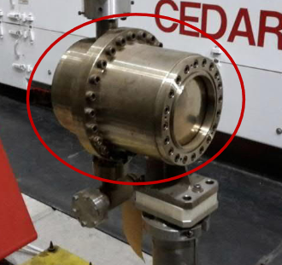
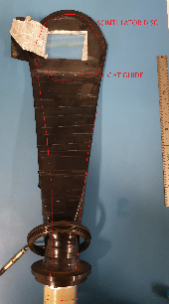
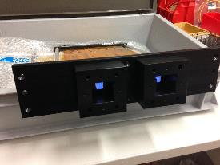
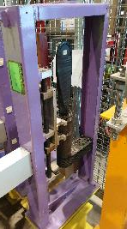
INTENSITY / TRIGGER / TIME OF FLIGHT
Ionisation chamber (XION)
(1960’s)
Scintillator paddle (XSCI)
(1970’s)
Beam Trigger Fiber (XBTF)
(2018)
~5 units
~5 units
~52 units
W. Devauchelle - BI Day 2024

Slide 15
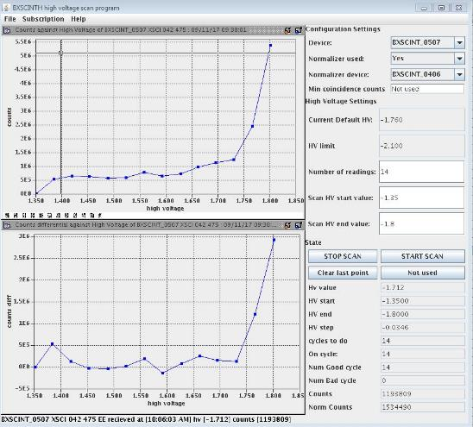
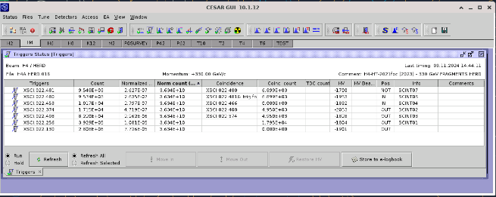
INTENSITY / TRIGGER
High voltage Scan of photomultiplier
Scintillator Data in CESAR GUI
W. Devauchelle - BI Day 2024

Slide 16
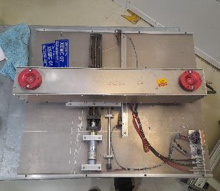
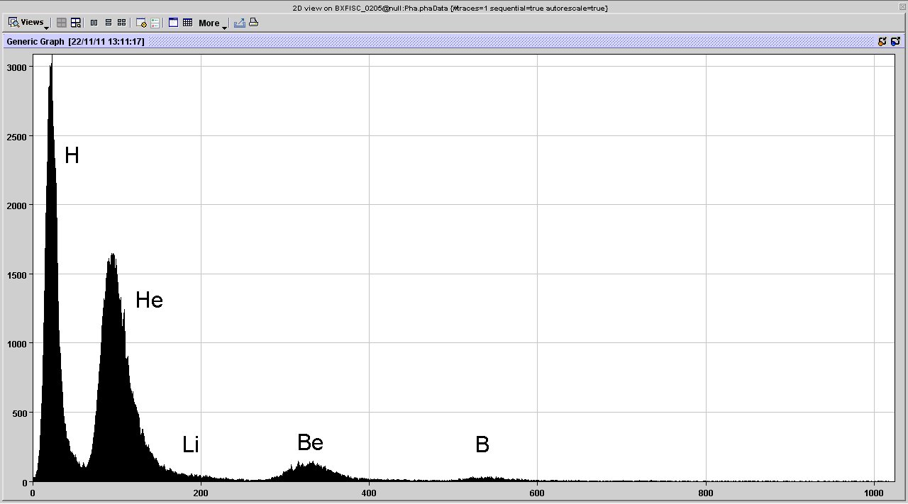
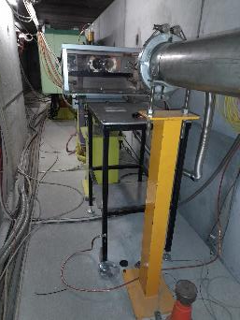
PARTICLE IDENTIFICATION
Electro-Magnetic Calorimeter (XEMC)
(1970’s)
Pulse High Analysis
Pulses Count
~3 units
High of pulses

Slide 17
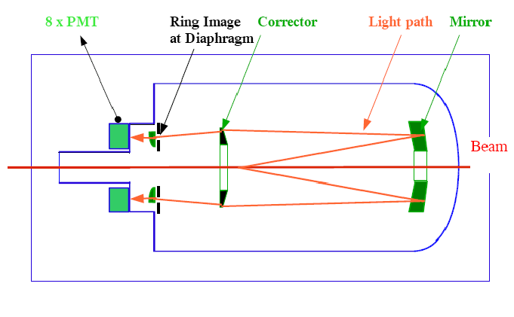
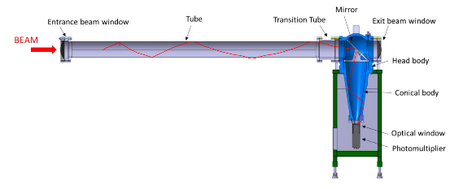
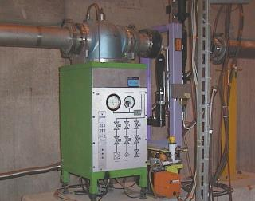
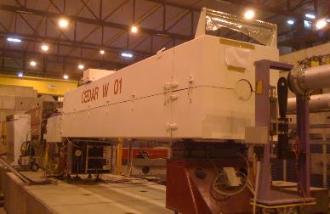
PARTICLE IDENTIFICATION
Cherenkov differential counter with achromatic ring focus (CEDAR)
(1970’s)
Cherenkov threshold counter (XCET)
(1970’s)
~16 units
~10 units
W. Devauchelle - BI Day 2024

Slide 18
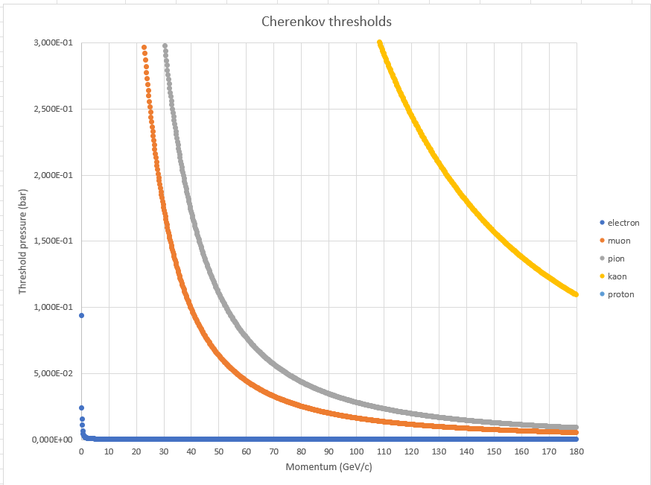
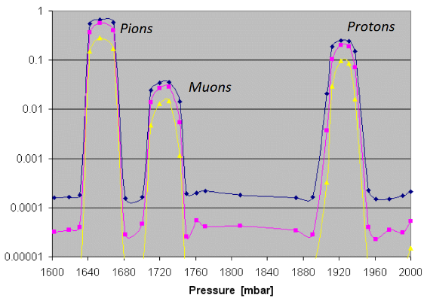
PARTICLE IDENTIFICATION
CHERENKOV THRESHOLDS
PRESSURE SCAN WITH CEDAR
(4)
W. Devauchelle - BI Day 2024

Slide 19

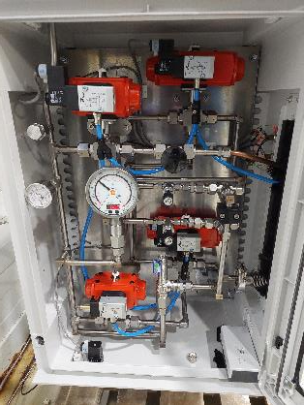
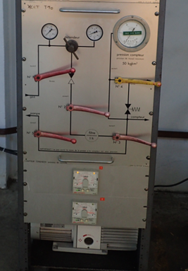
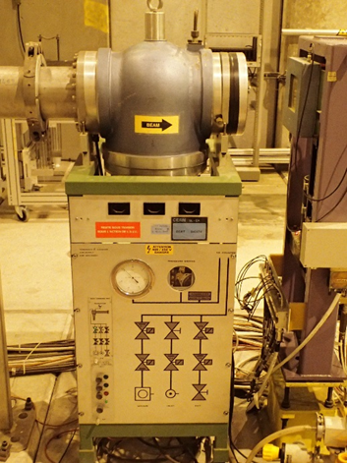
PARTICLE IDENTIFICATION
Cherenkov threshold counter (XCET)
GAS CONTROL RENOVATION
Older gas control panel
of East Area
Older gas control panel
of North Area
~5 units
New gas control panel

Slide 20
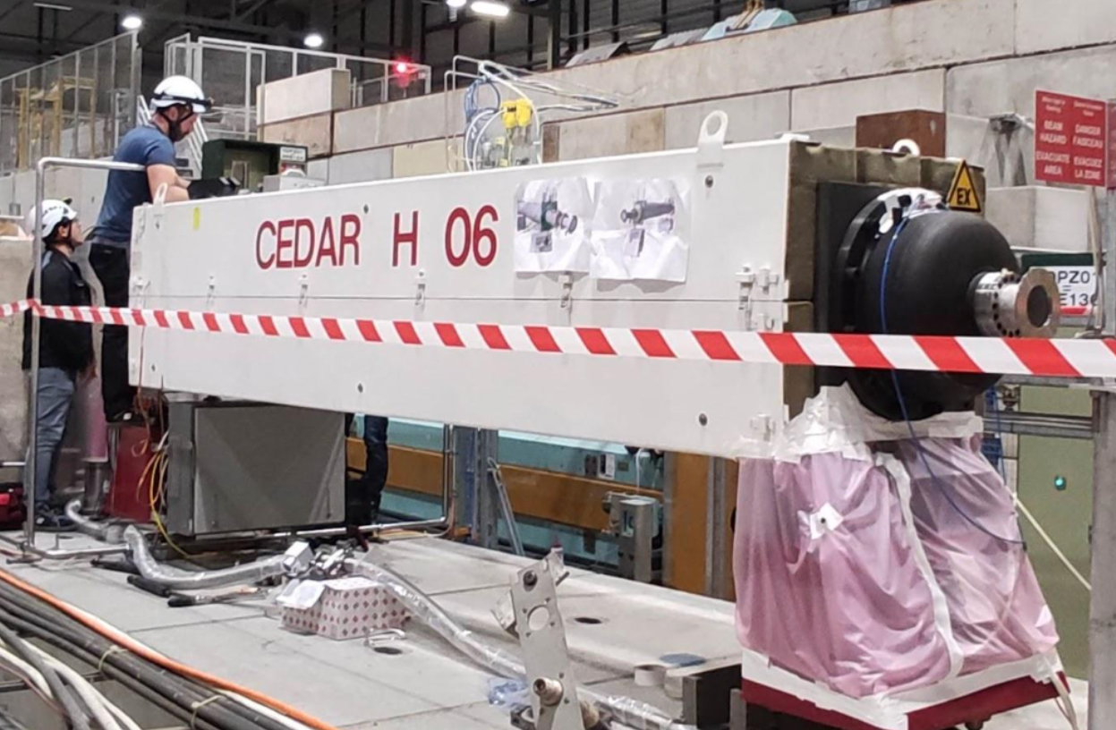
Examples of some interventions
CEDAR-Hydrogen beam test in 2022.
New request to fill a CEDAR with H₂ gas at high pressure.
Critical for the NA-62 Experiment (ECN3).
Extremely challenging due to high risk of explosion.
Need to adapt 40-year old system.
SY-BI responsible for motors, diaphragm, PMTs, control, acquisition & commissioning.
Cross-collaboration with many CERN teams (HSE, gas systems, integration, beam physicists, controls, users…).
Successful experiment! – today is a key instrument in NA62.
Our team performing some tests in the CEDAR-H installed in the H6 beamline for testing.

Slide 21
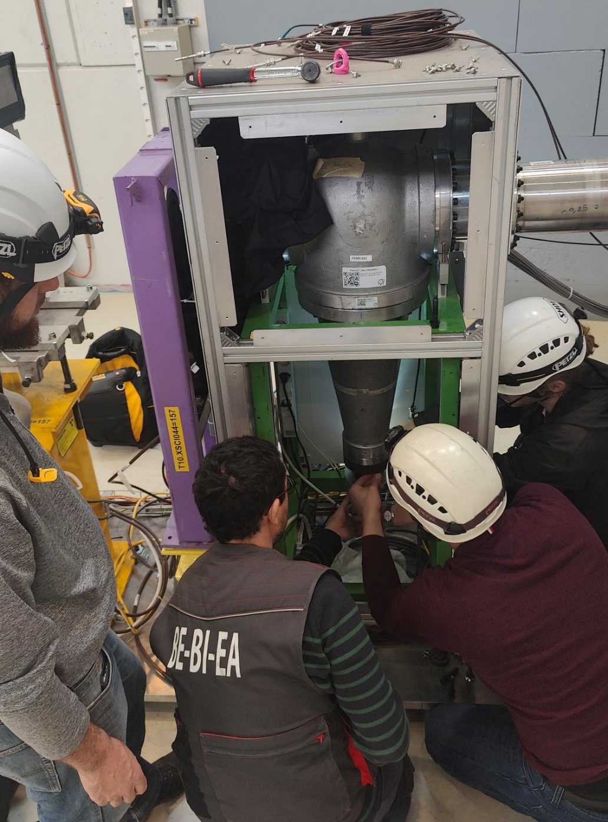
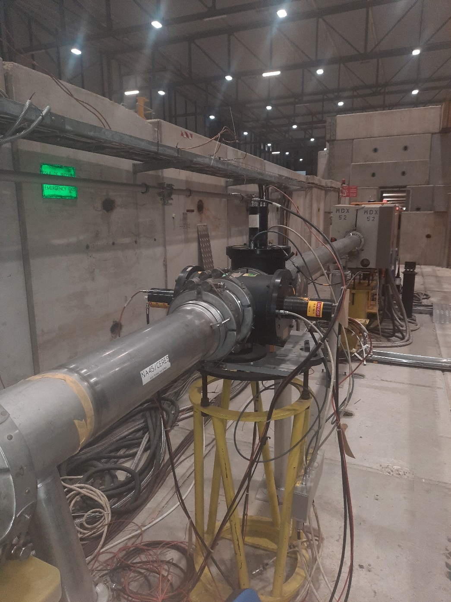
SOME INTERVENTIONS
XCET PMT replacement
FISC Removal
HV lock down.
Disconnection.
Dismount socket.
Replace PMT.
Remount socket.
Reconnection.
HV unlock & Scan.
Adjust Delay’s.
HV lock down.
Disconnection.
Remove cable from the beam.
Update database.

Slide 22
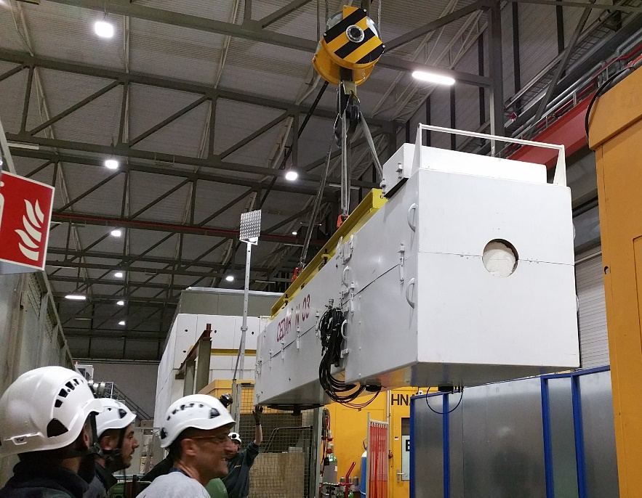
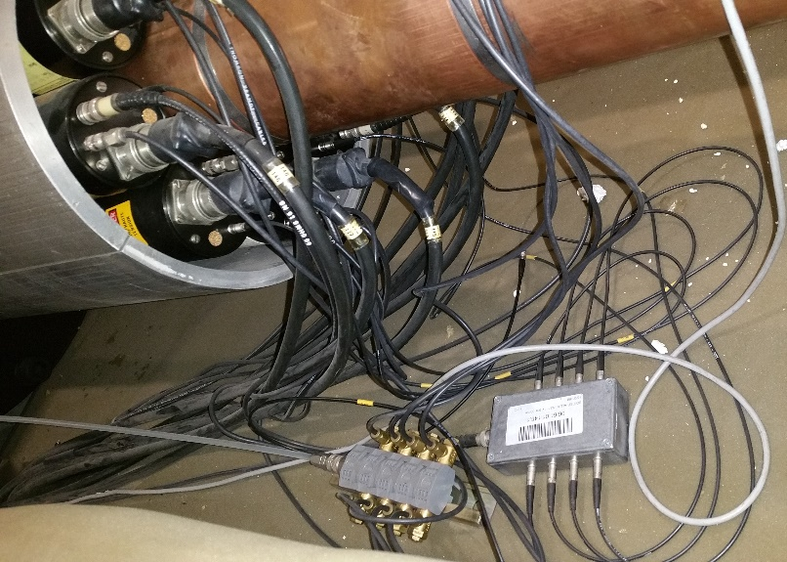
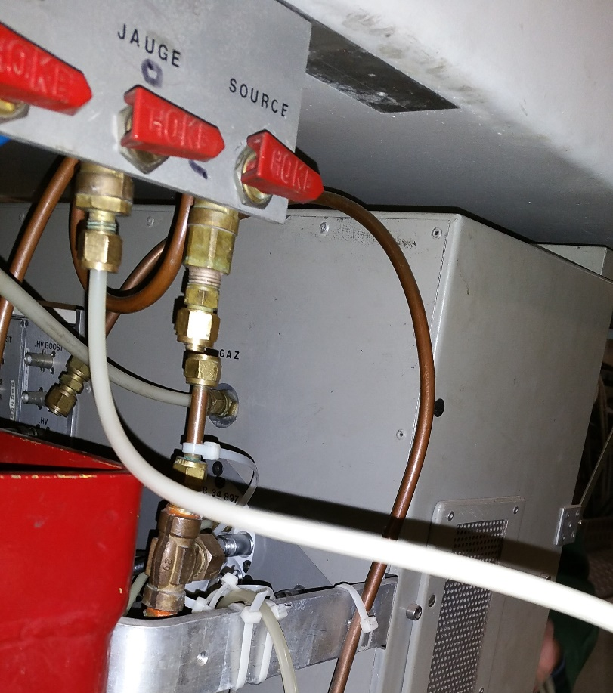
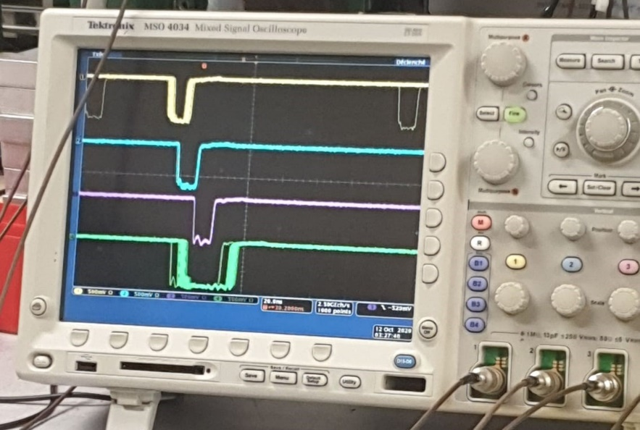
SOME INTERVENTIONS
CEDAR INSTALLATION
Mechanical installation (transport).
Electrical connections.
Gas connections (BE-EA-EC).
Setting.
Calibration.
PMT HV adjust.
Delay synchronization for trigger coincidence.
Movement limit.
Transport and placement
Delay’s scan
Cabling Electrical & Gas

Slide 23
SUMMARY
Secondary Beams from fixed Target, slowly extracted, not bunched, low intensity.
XEI section: responsible of beam diagnostics for secondary beams.
11 different type of instruments, 200+ devices – all necessary for operation!
40+ years old equipment in many cases – urgent consolidation needed.
To be maintained up until NA-CONS Phase 2.

Slide 24
AKNOWLEDGEMENT
(1) From I. ORTEGA – SY-BI-XEI
(2) From D. BANERJEE – P Shutdown Lectures – BE-EA-LE
(3) From J. TAN – SY-BI-XEI
(4) From M. VAN DIJK – BE-EA-LE
(5) From B. HOLZER – EP-SME-62
(6) From J BUESA ORGAZ– BE-EA-EC

Slide 25




Cherenkov threshold counter (XCET)
Mirror refurbishment
W. Devauchelle - BI Day 2024

Slide 26


TIME OF FLIGHT
(3)

Slide 27
NORTH AREA BEAM CHARACTERISTICS
Proton beam characteristics
Primary beam momentum | 400 GeV/c
Spill intensity range | 2 x10¹² – 4.2 x10¹³ ppp
Spill duration | typ 4.8 s (1 to 10 s)
Extracted intensity /year | ~1 x10¹⁹
Ion beam characteristics
Particle | Pb⁸²⁺
Spill intensity range | >1 x10⁷
Spill duration | <10 s
Secondary beams characteristics
EHN1 | 205 – 360 GeV/c | p, e⁻, e⁺, μ, π
EHN2 | 250 – 280 GeV/c | h, μ
ECN3 | 75 GeV/c | K
Spill intensity range | 10⁵ – 3 x10⁸ ppp
(3)

Slide 28

EAST AREA BEAM CHARACTERISTICS
Primary Beam (T8)
Parameter | Value
Proton beam momentum [GeV/c] | 24 (requests to go lower for longer spills)
Maximum flux per PS spill | 3E11 for T09-T11 8E11 for T08
Maximum # protons per second (individual limits for RP) | 3.3E10 for T09-T11, 6.6E10 for T08, 4.4E10 for F6D
Secondary Beam
Parameter | T09 Target | T10/T11 Target
Beam Line | T09 | T10 | T11
Max Momentum (GeV/c) | 15 | 11.5 | 3.5
Δp/p (%) | $±$0.7 to $±$15.0 | $±$0.7 to$±$15.0 | $±$0.7 to$±$15.0
Maximum intensity/spill | ~few x 10⁶ | ~few x 10⁶ | ~few x 10⁶
Available particle types | Pure electrons (T09) or mixed/pure hadrons or pure muons
W. Devauchelle - BI Day 2024

Slide 29
Multi-user lines PS East Area and SPS North Area beam time requests
Average overbooking of the SPS EHN1 lines about the same as in 2021 (and much more than in 2022!)
  2021 we had only 18 weeks protons in EHN1 (2023 22 weeks) and had the first beam since 2018
More calorimeter and exclusive main user requests now compared to 2021
 |  | Weeks requested by SPSC related user | Weeks requested for LHC experiments R&D | Weeks requested by other users | Total Requested | Weeks available
PS T9 & T10 | protons | 8 main 0 parasitic | 22 main 0 parasitic | 19 main 0 parasitic | 49 main 85% | 58
SPS H2, H4 | protons | 28 main 0 parasitic | 28 main 1 parasitic | 13 main 7 parasitic | 69 main 157% | 44
SPS H6, H8 | protons | 0 main 0 parasitic | 64 main 22 parasitic | 24 main 18 parasitic | 88 main 200% | 44

