Slide 1


BI Day
Design and Production of the Front-End Electronics of the oBLM
Jose C. Esteban on behalf of SY-BI-BL
SY-BI-BL

Slide 2

Outline
Development
Our Needs
Future steps
Jose C. Esteban | oBLM electronics | jose.carlos.esteban.felipe@cern.ch
13.12.2024
2

Slide 3
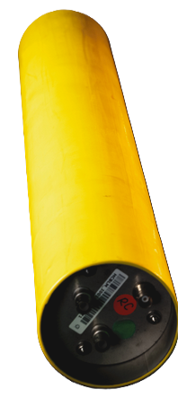
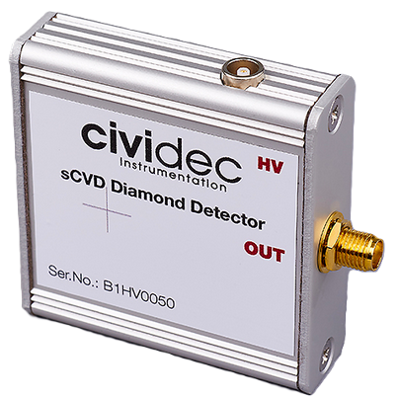
Motivation
There is the wish to develop a long Beam Loss Monitor able to measure beam losses along distances of the order of 200 meters.
Beam Losses are measured by:
  Ionisation chambers
  SEM detectors
  Diamond Detectors
  Diamond Detectors
They are used to measure LOCAL beam losses
  Ionisation chambers
Jose C. Esteban | oBLM electronics | jose.carlos.esteban.felipe@cern.ch

Slide 4

Optical Beam Loss Monitor
Cherenkov Radiation
Several persons are working on it:
  Belen Salvachua – Project leader physicist
  Ewald Effinger – Main electrical engineer
  Montague King – PhD on physics
  Jean Michel Meyer – Fiber expert
  J.C Esteban - Electrical engineer assistant
  Sara Benitez – from BI-PM as collaborator
Optical fiber (silica)
Photosensor
Photosensor
Cherenkov photons will travel to the photo-sensor
Particle shower
Beam
Beam pipe and accelerator components
Cherenkov Optical Beam Loss Monitor (OBLM)
Investigating the use of quartz silica optical fibres coupled to photo-sensors in order to detect Cherenkov light produced by secondary charged particles with the aim of providing a global measurement of instantaneous beam losses (and possible loss localisation after post-processing)

Slide 5
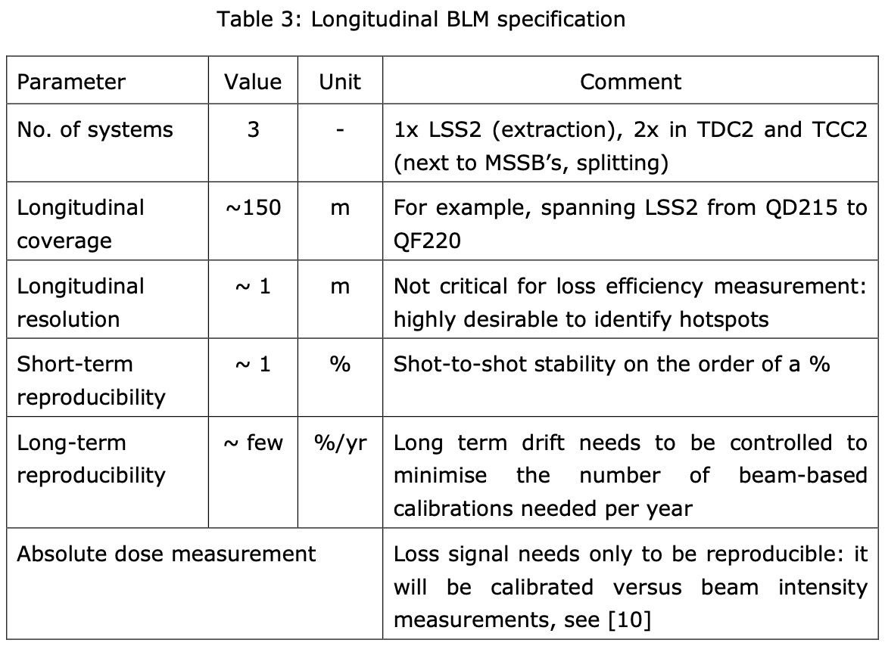
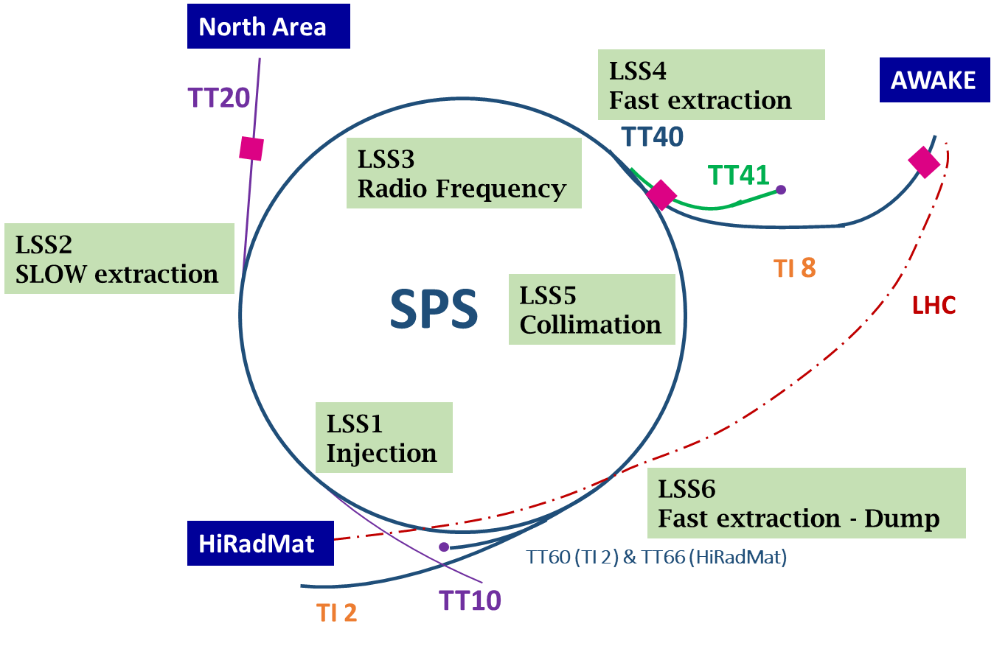
SPS & North Area
The SPS Slow extraction to the North Area is the perfect candidate for such type of detectors.
For high intensity proton beam, losses activate heavily the machine and limit its performance.
Beam Losses need to be measured along the full line (and not locally only) in order to optimize the extraction.
Jose C. Esteban | oBLM electronics | jose.carlos.esteban.felipe@cern.ch

Slide 6
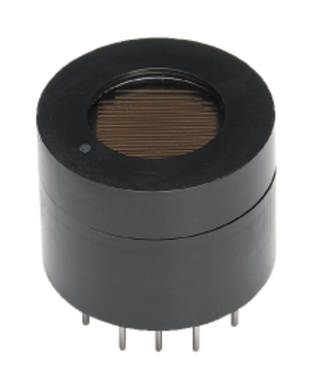
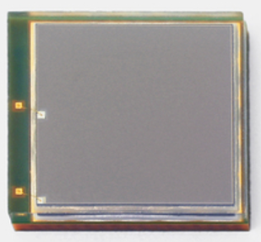
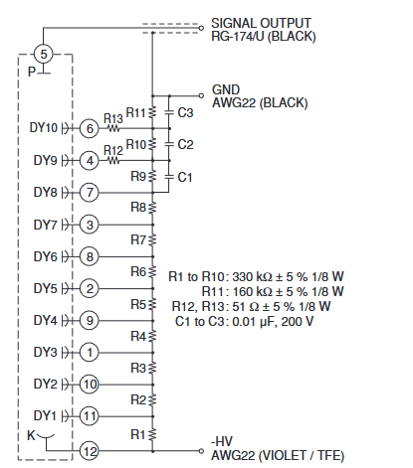
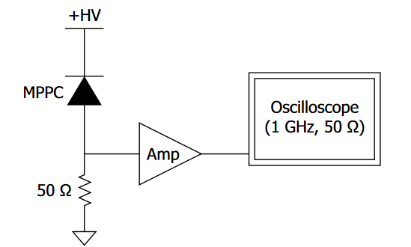
Photosensors
SiPM
PMT
A SiPM (Silicon Photomultiplier) is a compact semiconductor device designed to detect extremely low levels of light, even single photons.
Main advantages:
  Cheaper
  Lower bias voltage
  Insensitivity to magnetic field
A PMT (Photomultiplier Tube) is a highly sensitive optical detector that converts light into an amplified electrical signal. It uses a photocathode to generate electrons from photons and a series of dynodes to amplify the signal.
Main advantages:
  Radiation Tolerant
  Higher sensitivity
  Fast rise and fall time of the signal
Photosensitive area
Photosensitive area
Jose C. Esteban | oBLM electronics | jose.carlos.esteban.felipe@cern.ch

Slide 7
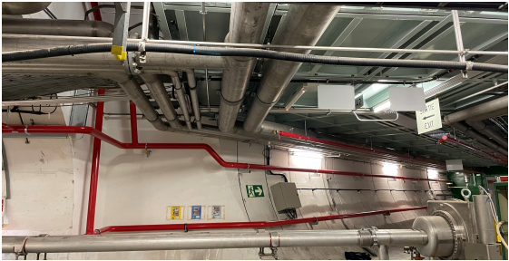
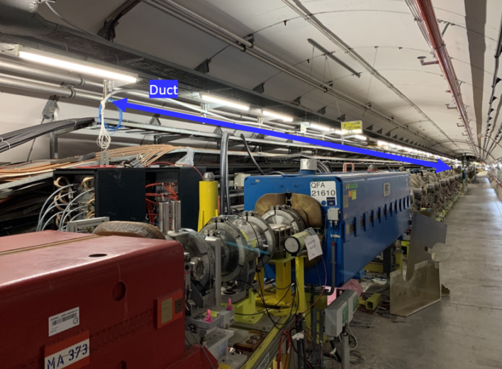
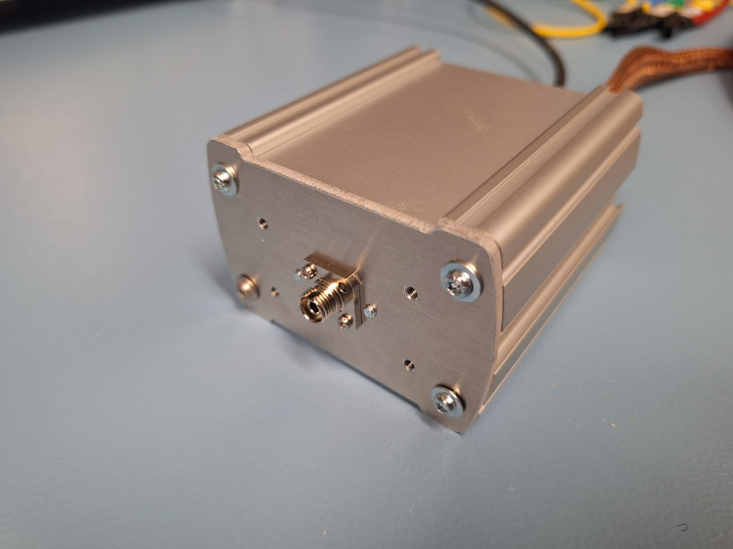
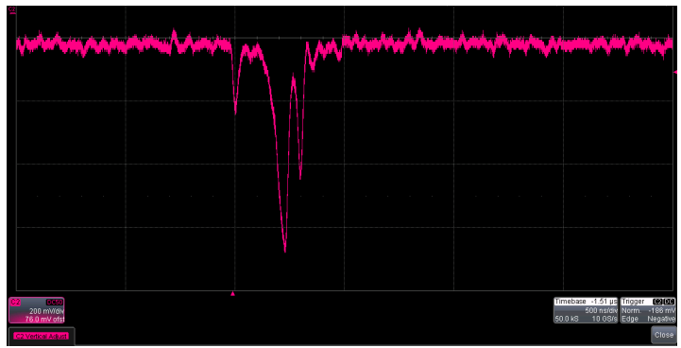
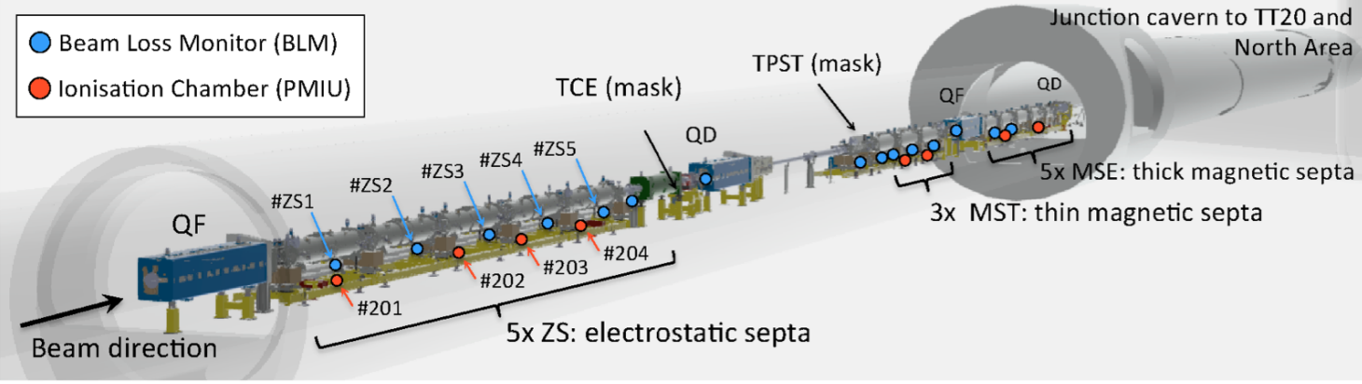
SPS Prototype Installation
During LS2 to profit from the reduction of radiation
Installation of Optical Fiber Beam Loss
200 µm fibre, 2 x 100 m long, readout with SiPMs, ~ 2.4 m away from beam line
Duct
SiPM Read-Out Electronics
Scope Signal
Jose C. Esteban | oBLM electronics | jose.carlos.esteban.felipe@cern.ch

Slide 8
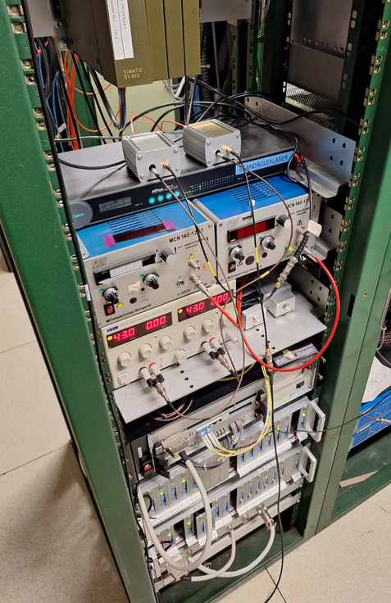

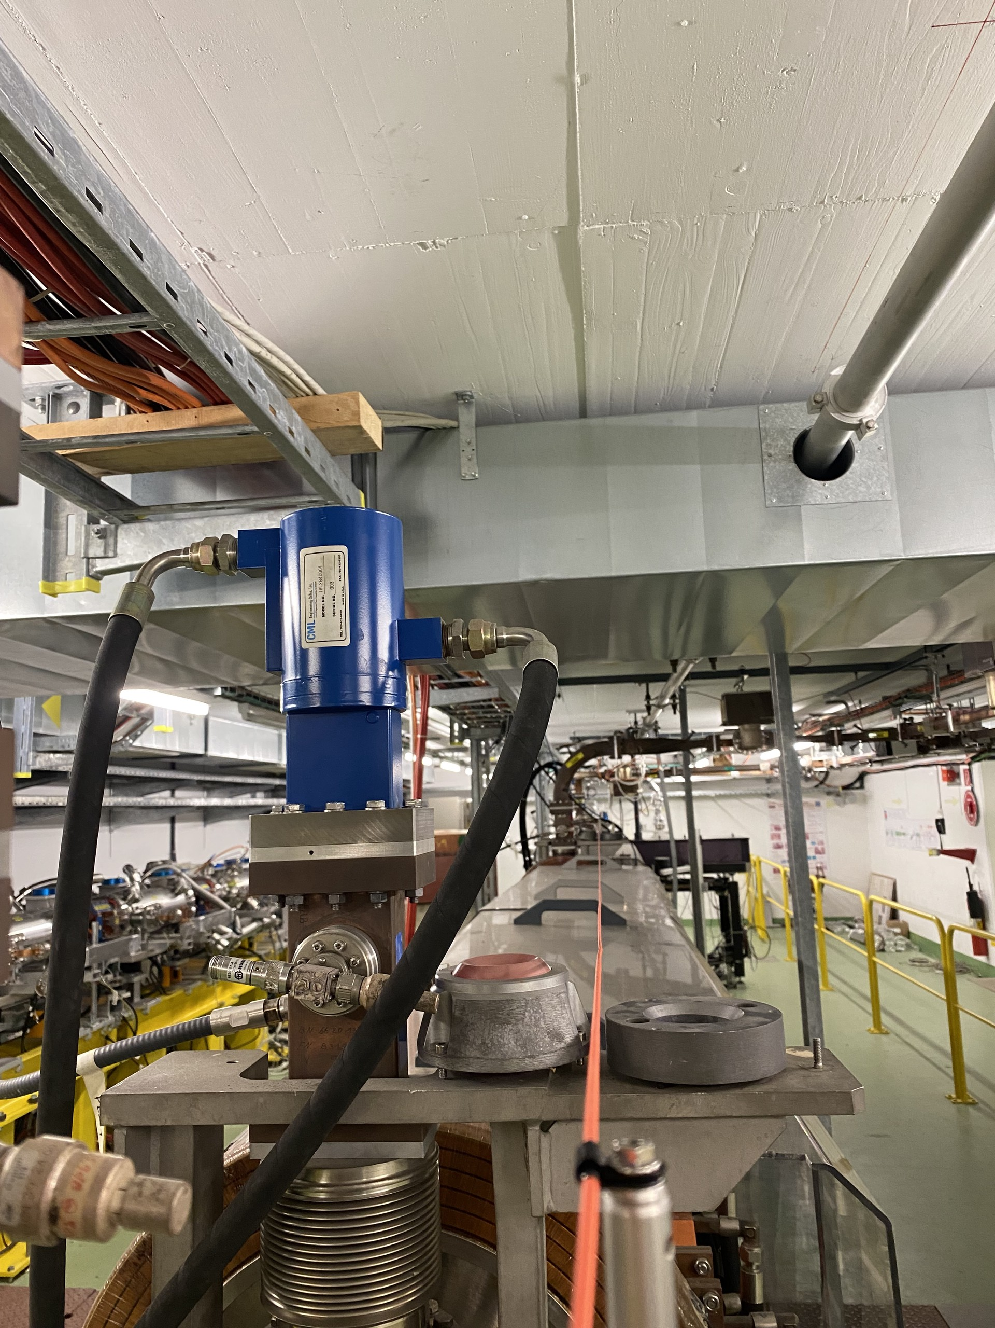
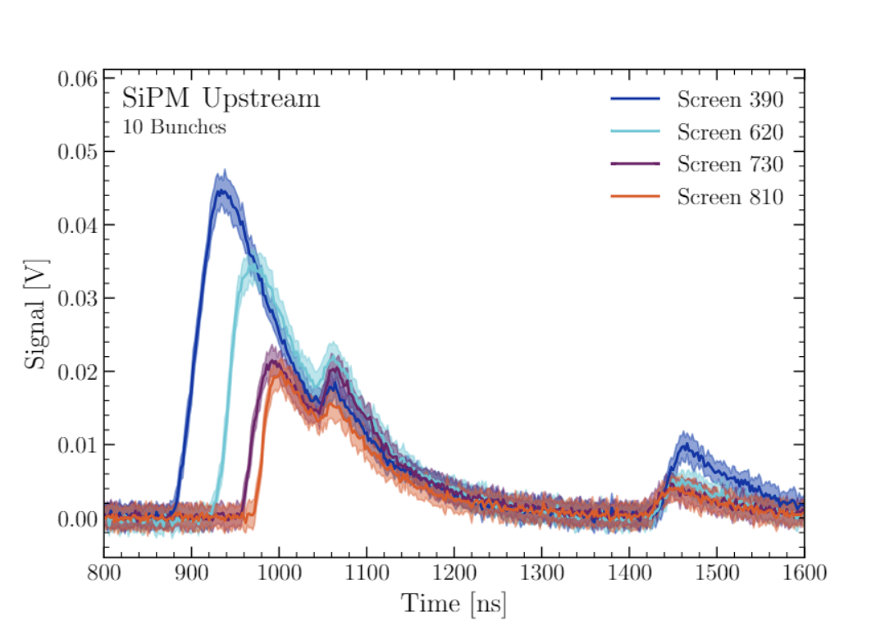
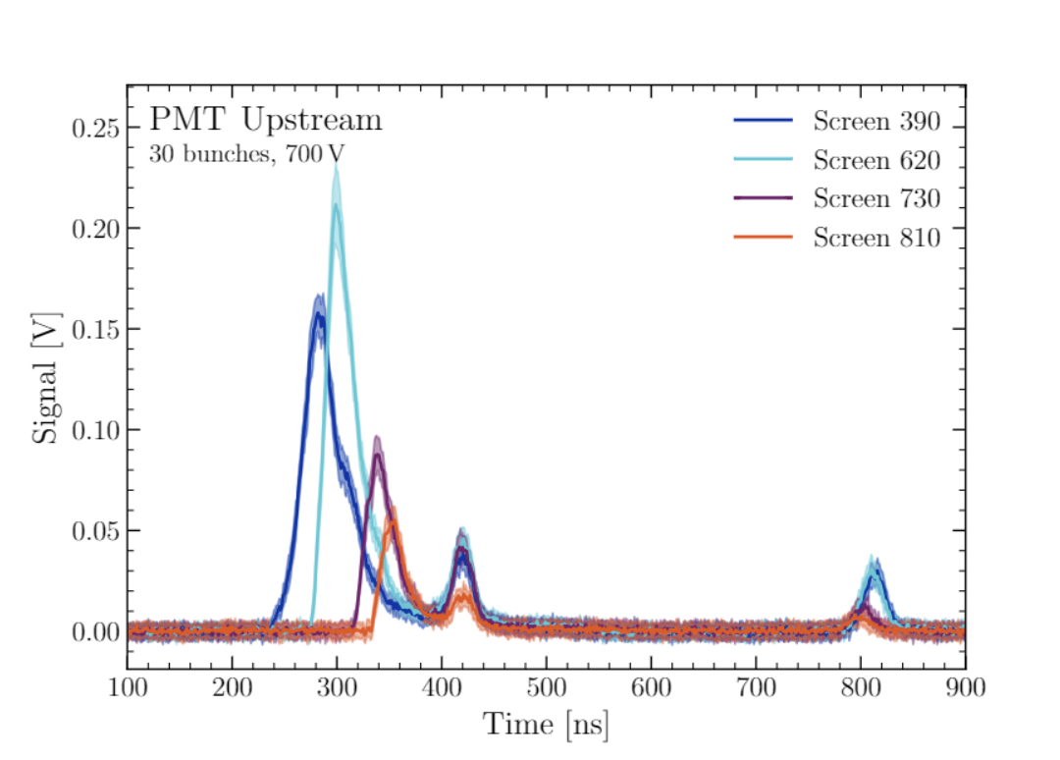
Where We Test our oBLM
SiPM + Power Supply
PMT + Power Supply's
Permanent Installation at CLEAR was installed in summer 2023
Perfect place to test
Installation is accessible
Ability to create a control loss
Electronics in surface that means easy to change
Fiber
-By Montague King-
-By J.M.Meyer-

Slide 9

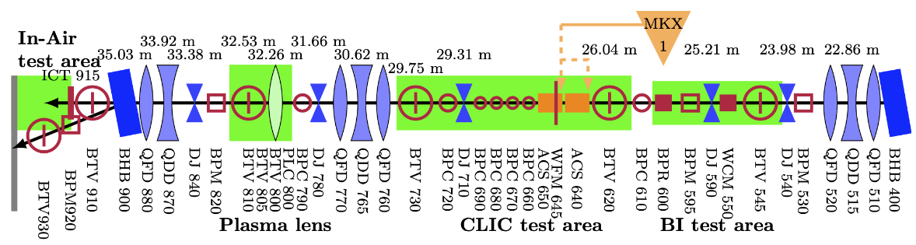
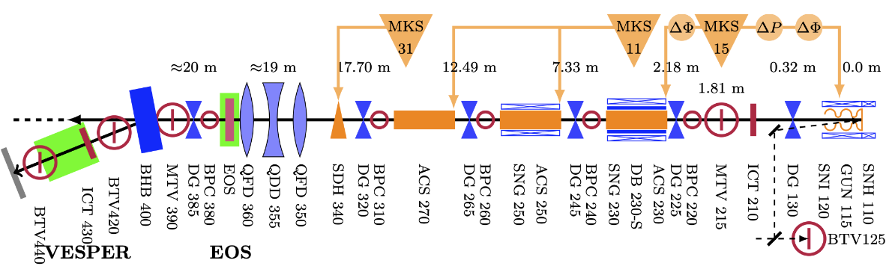
Fibers Map CLEAR
Service loop
-By J.M.Meyer-
Service loop
OASIS system
MATLAB script
1st Floor
Beam direction
Fiber installation at CLEAR by J.M. Meyer and M. King
Old prototype installation was replaced by a permanent installation in 2023
Ground floor
Jose C. Esteban | oBLM electronics | jose.carlos.esteban.felipe@cern.ch
9
14/12/2023
13.12.2024
9
Jean Meyer | Cherenkov BLM (oBLM) | BI Days 2023

Slide 10
Outline
Development
Our Needs
Future steps
Jose C. Esteban | oBLM electronics | jose.carlos.esteban.felipe@cern.ch
13.12.2024
10

Slide 11
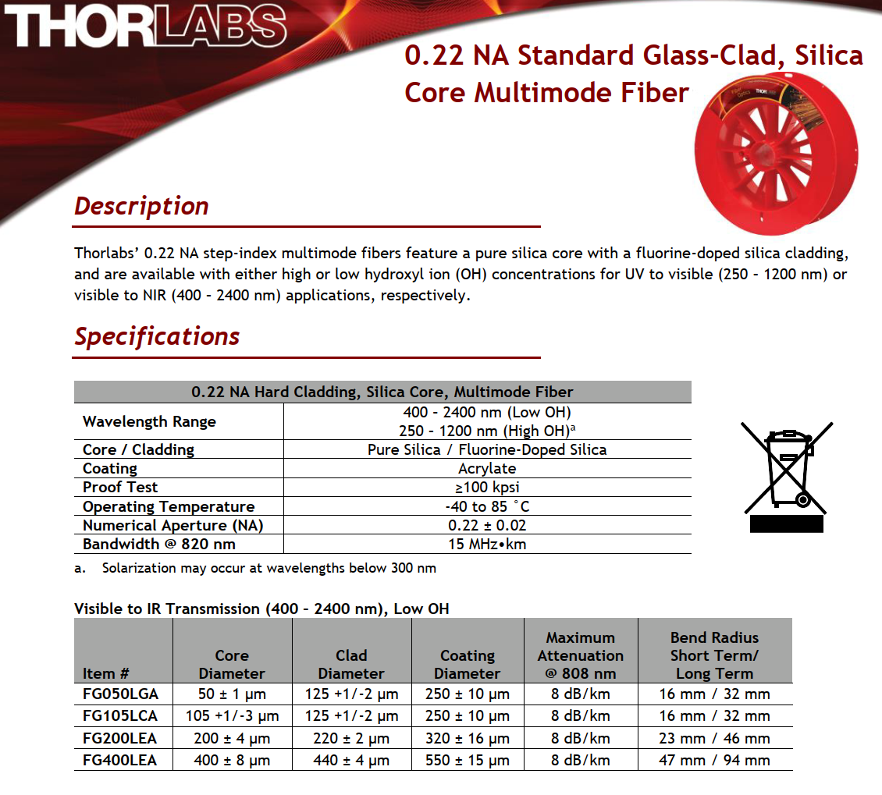
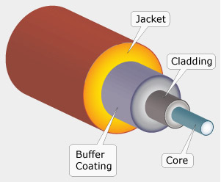
Fibers
Fiber thickness determine the captured signal
200 µm was chosen in the first installation of SPS and CLEAR
200 µm will be changed for 600 µm in order to increase the captured signal in SPS
Thorlabs FG200LEA | Multi-Mode (OM1) | Multi-Mode (OM2/3/4) | Single Mode (OS1/2)
200 µm | 62.5 µm | 50 µm | 9 µm | Core
220 µm | 125 µm | 125 µm | 125 µm | Cladding
320 µm | 250 µm | 250 µm | 250 µm | Buffer
Jose C. Esteban | oBLM electronics | jose.carlos.esteban.felipe@cern.ch
13.12.2024
11

Slide 12


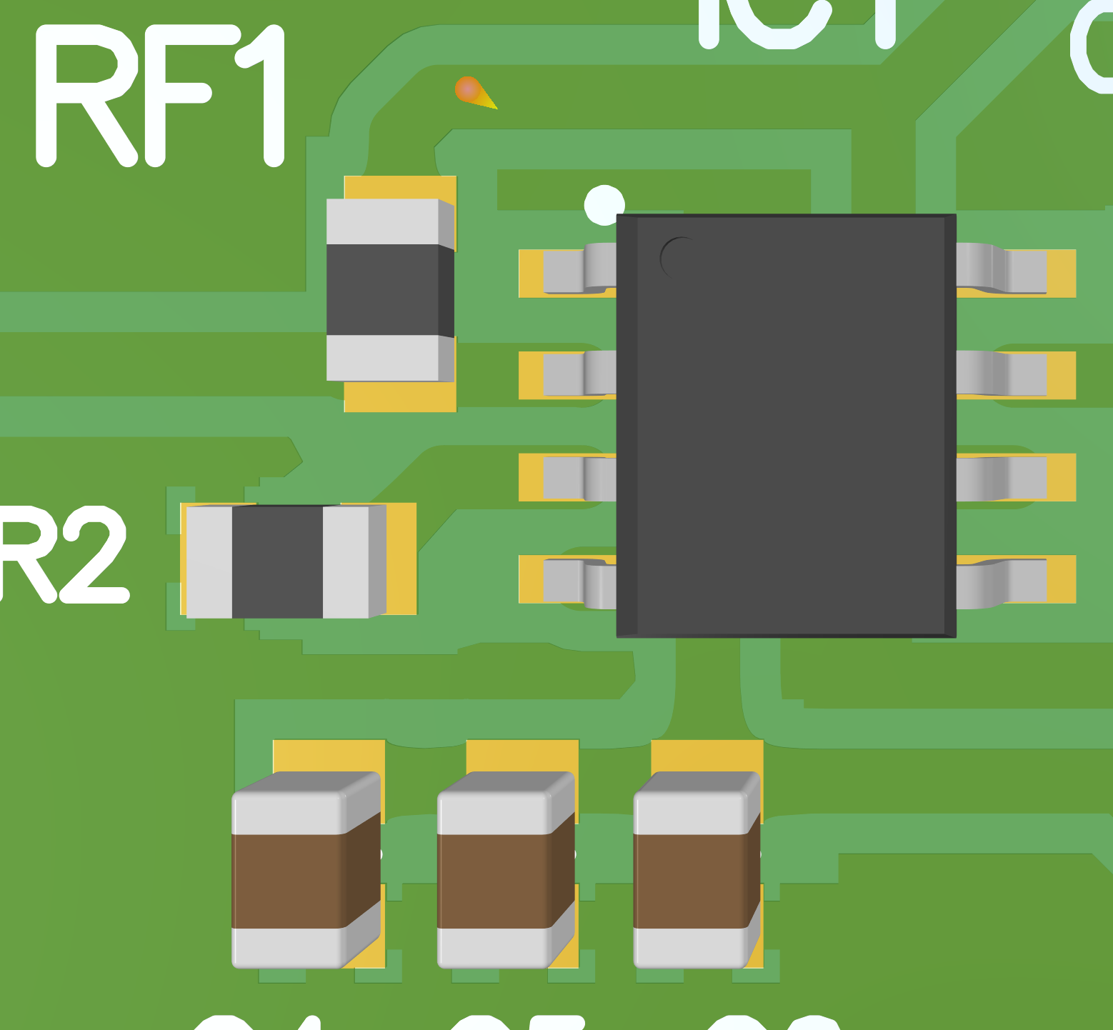
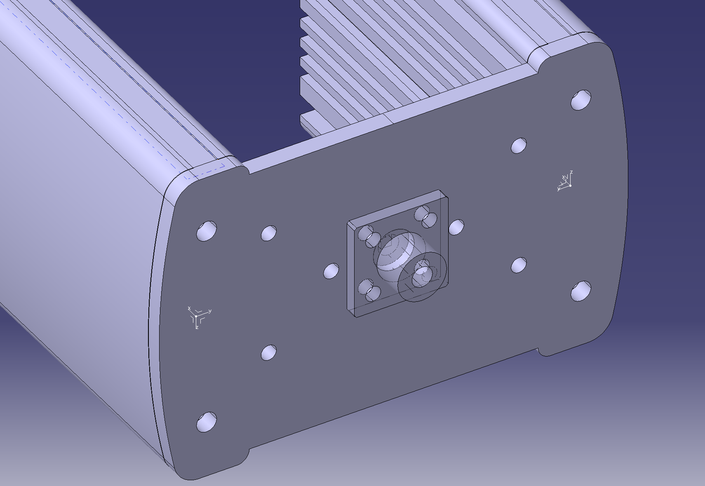
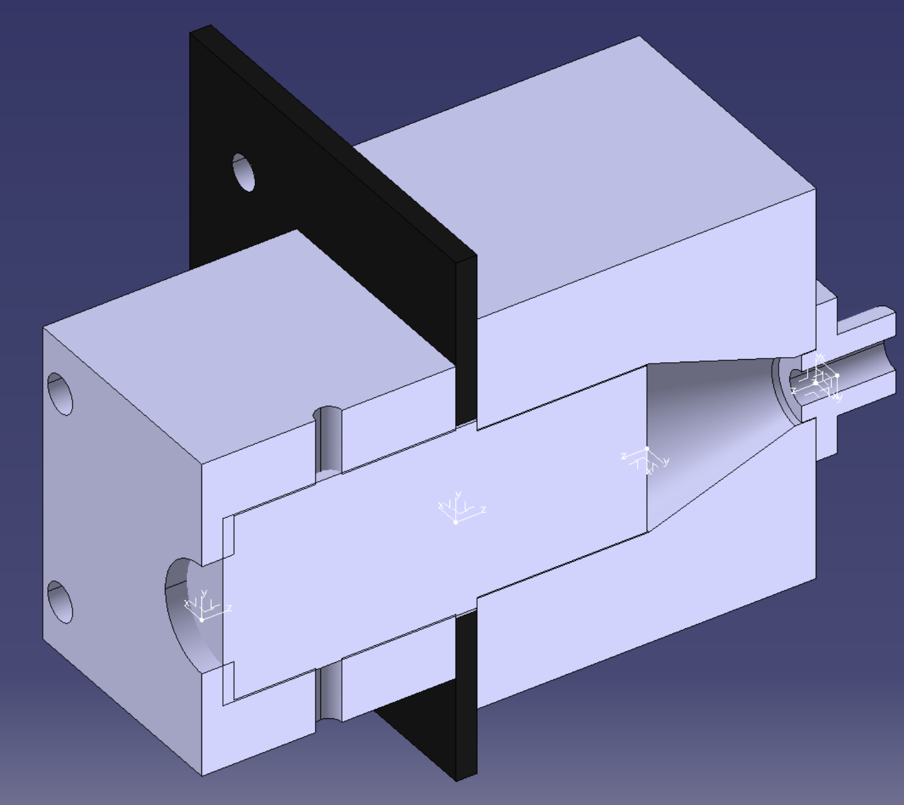
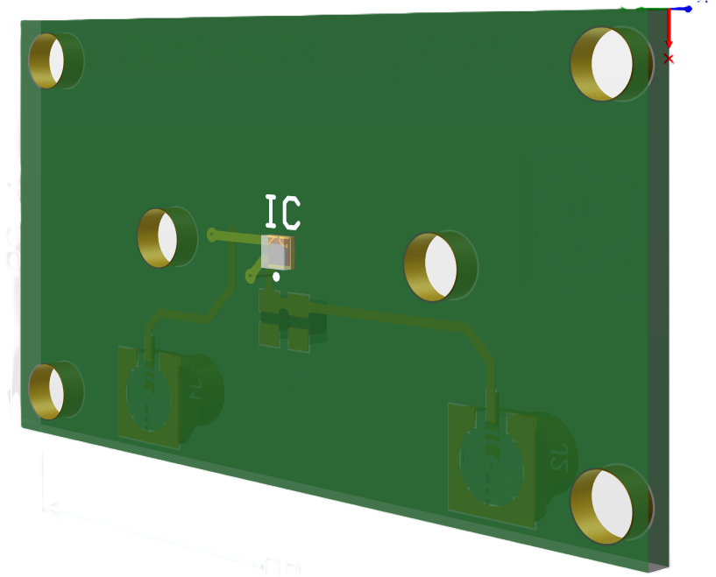
Electronics & Mechanics
How do we do it?
Electronics
Mechanical
Common electronics
Easy to change detector
Easy assembly
Precise assembly

Slide 13
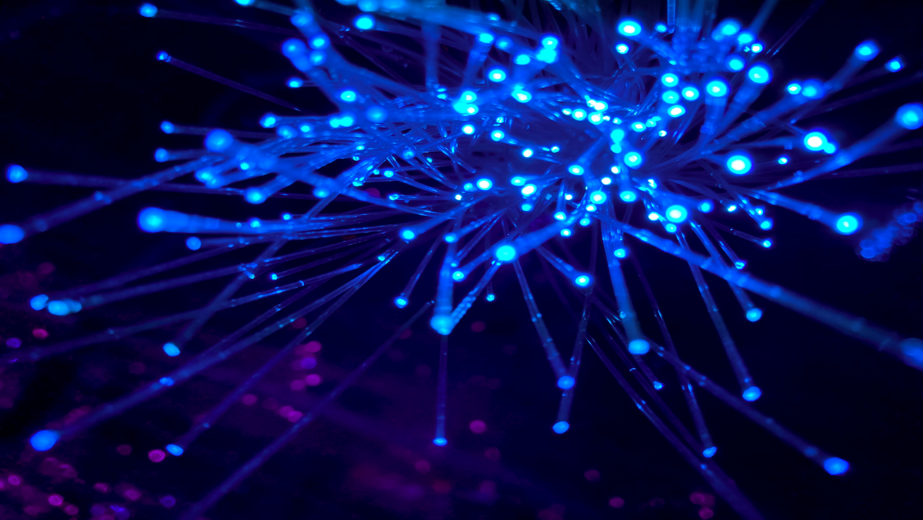

Electronics

Slide 14
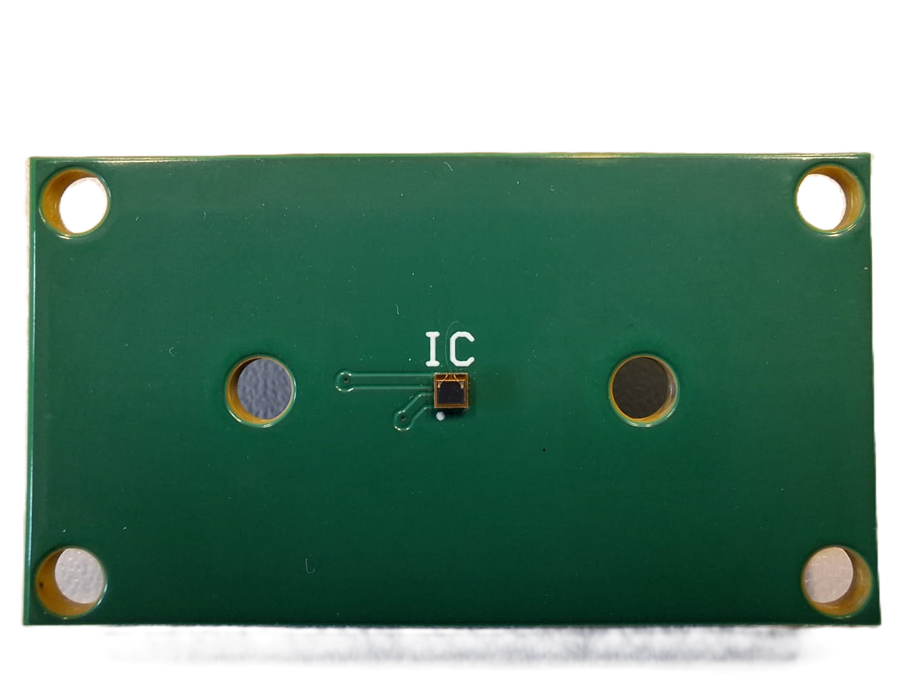
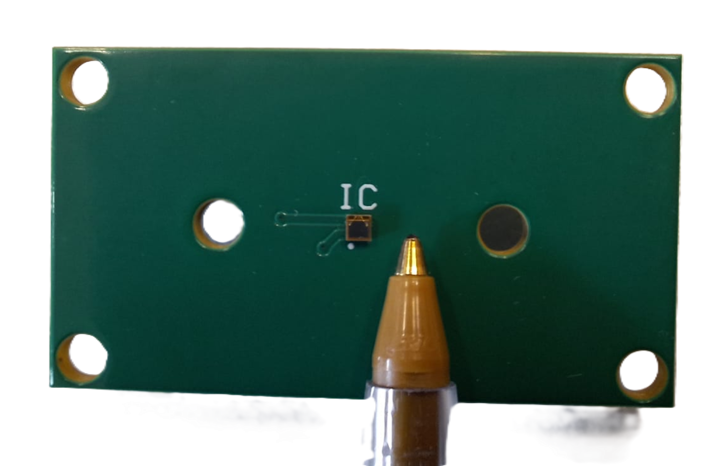
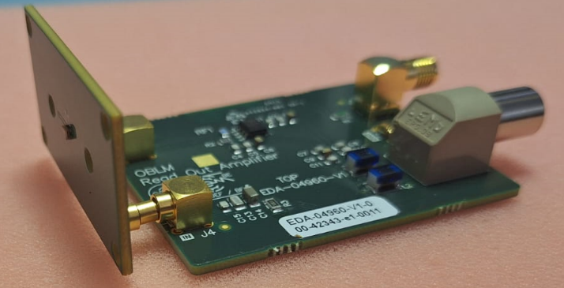
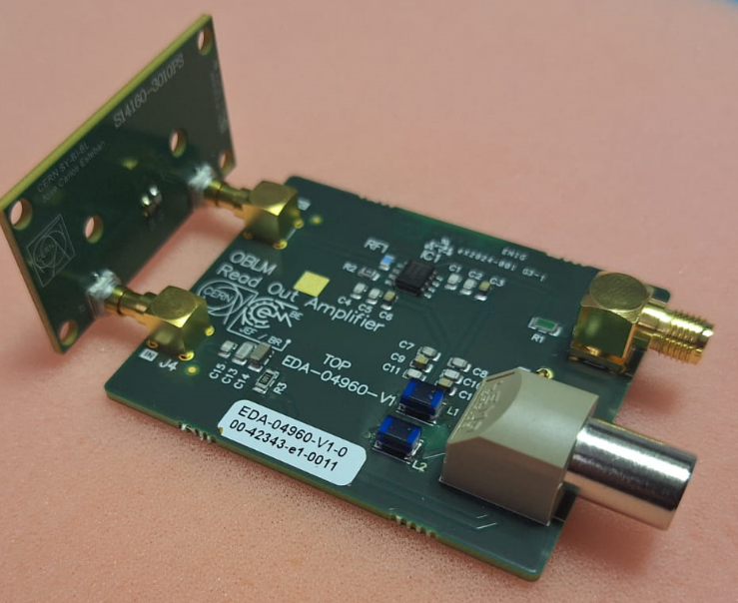
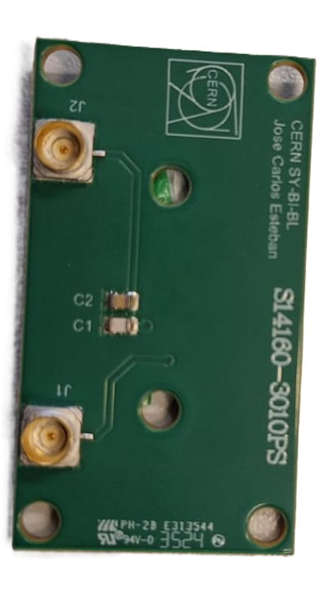
SiPM
Part numbers:
S14160-3010PS – Photosensitive area = 3 x 3 – Pixels 89984 – λp = 460nm
S14160-3015PS – Photosensitive area = 3 x 3 – Pixels 39984 – λp = 460nm
S15639-1325PS – Photosensitive area = 1.3 x 1.1 – Pixels 2120 – λp = 660nm
Photosensitive area
SiPM are assembly in the electronics workshop
Front
All SiPMs PCB’s and Read-Out PCB’s have exactly
the same connector system. Like this we can easily
change detector and read-out every time we need.
Back

Slide 15
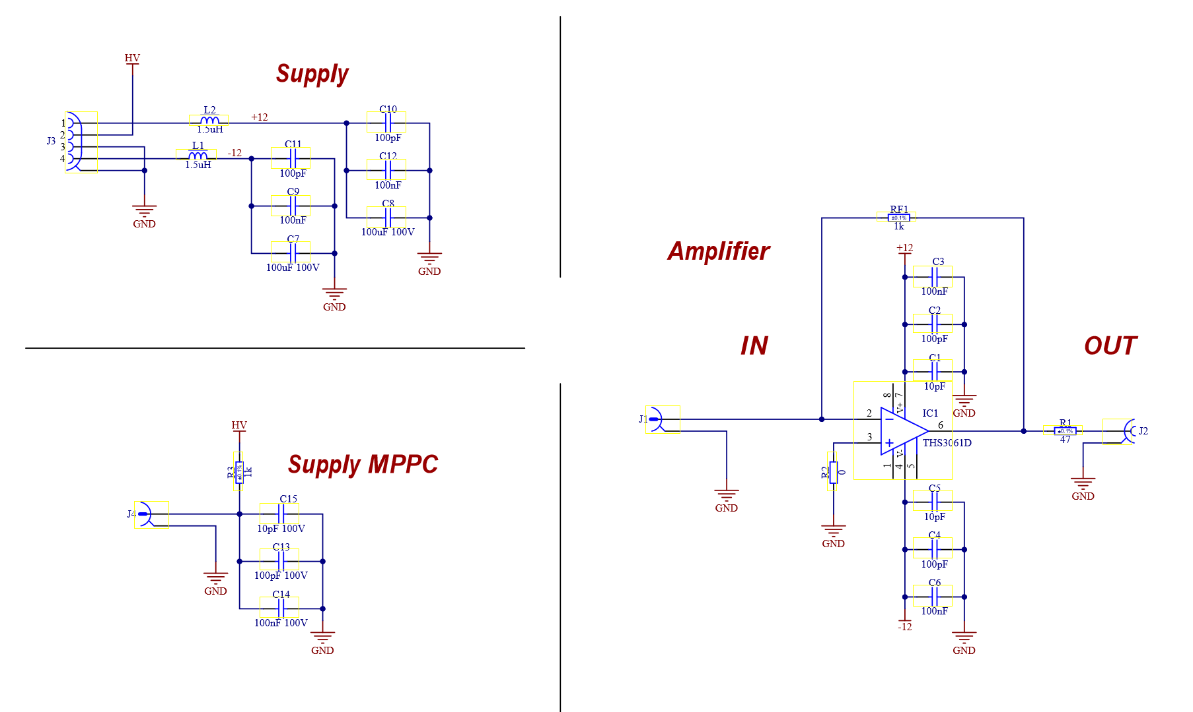
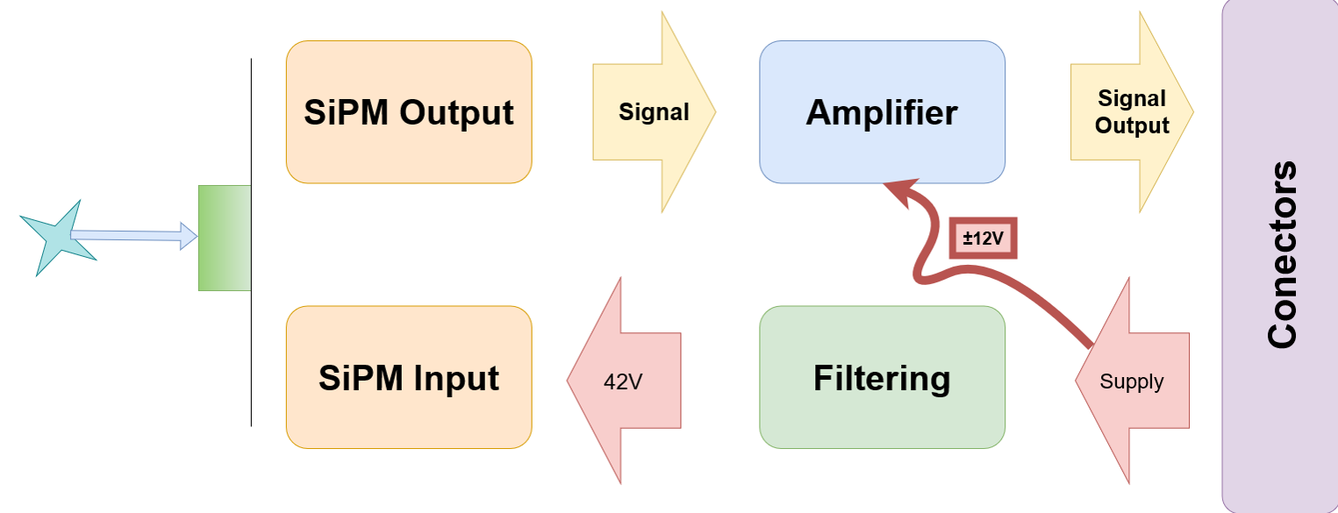
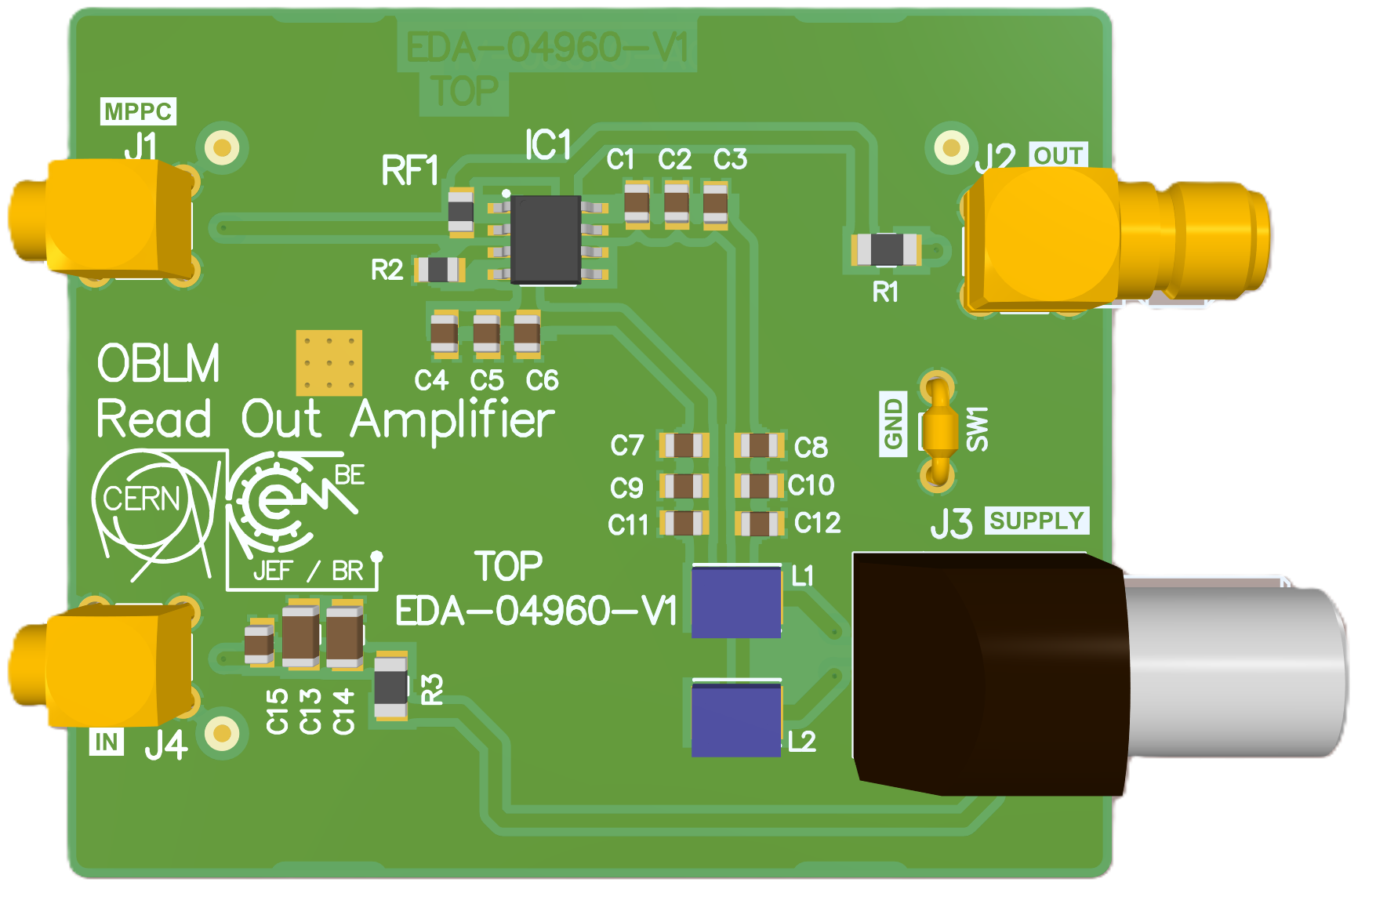
Amplified
EDA-04960-V1

Slide 16
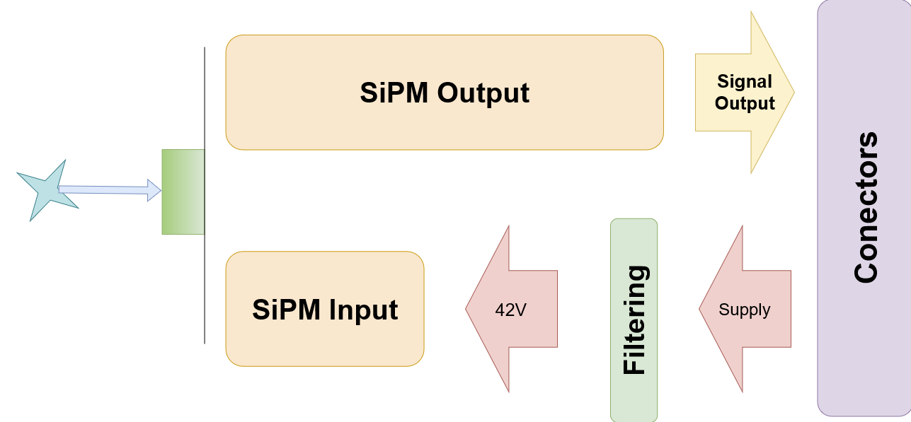
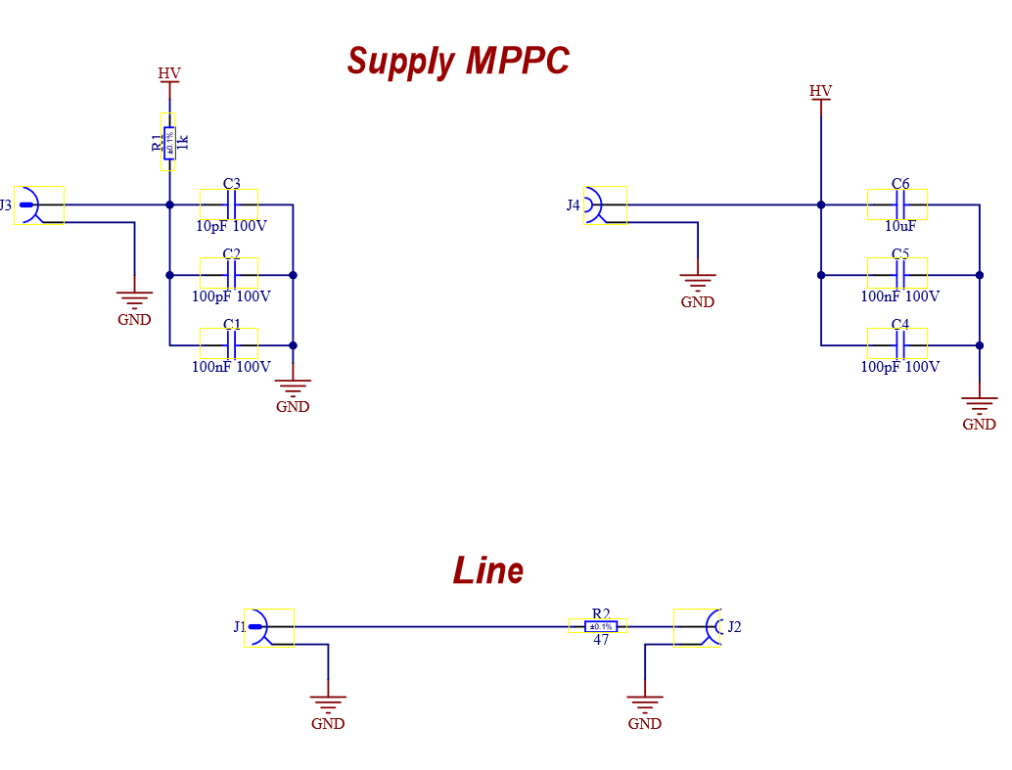
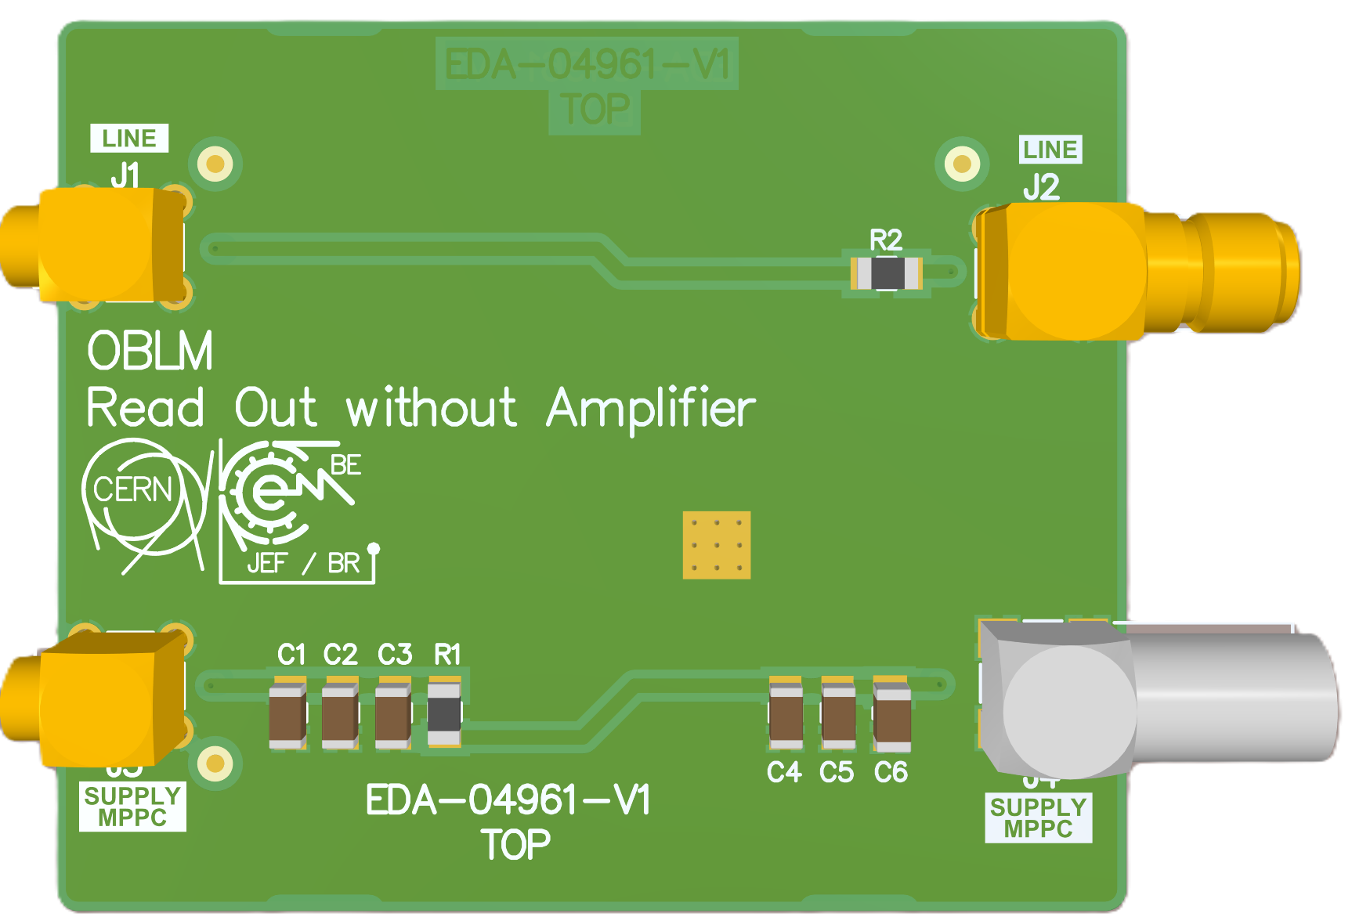
Non-Amplified
EDA-04961-V1

Slide 17
Mechanics

Slide 18
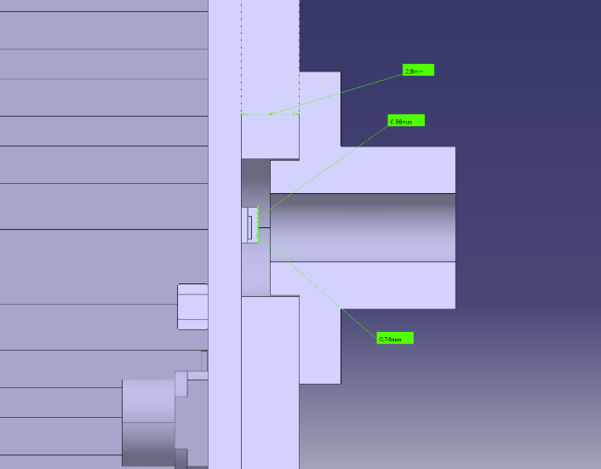
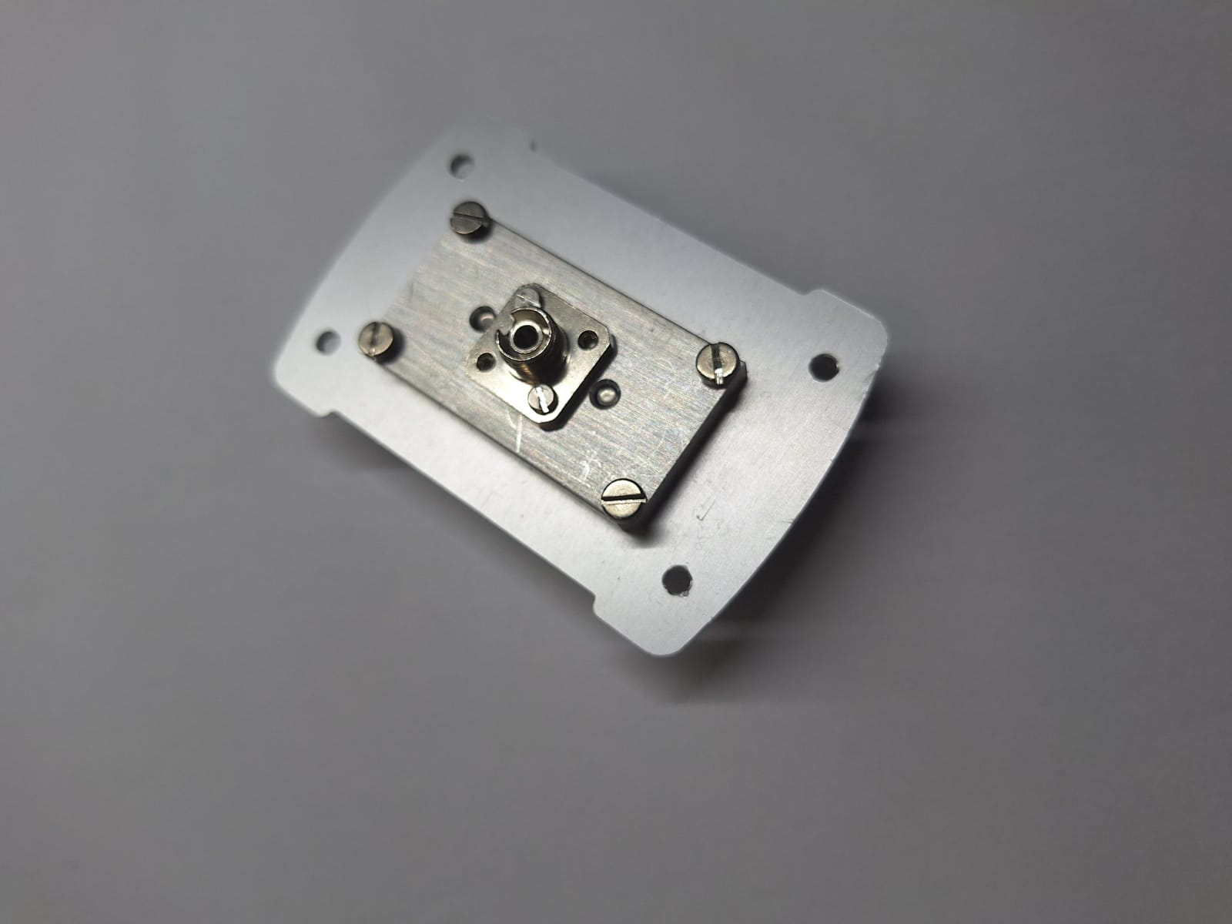

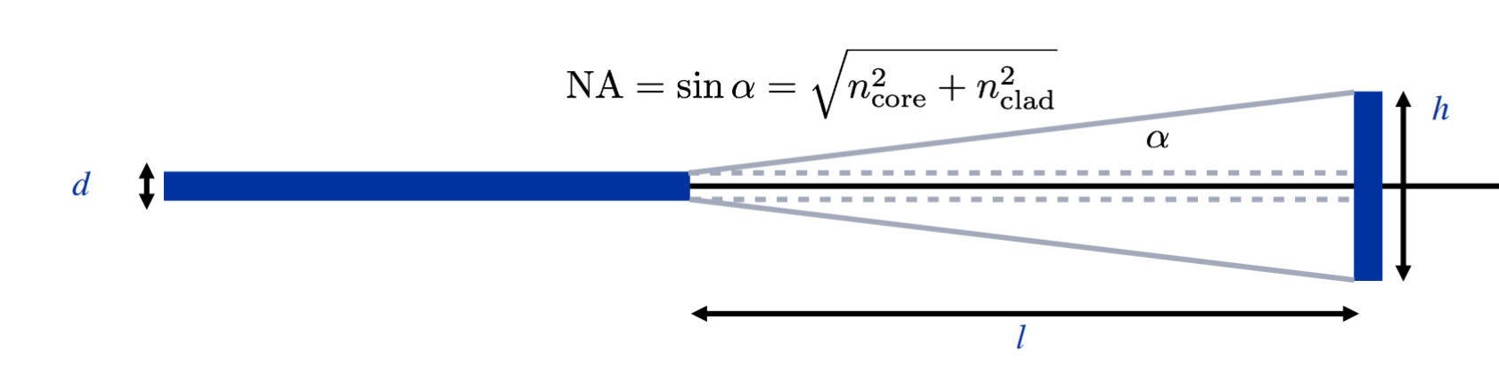
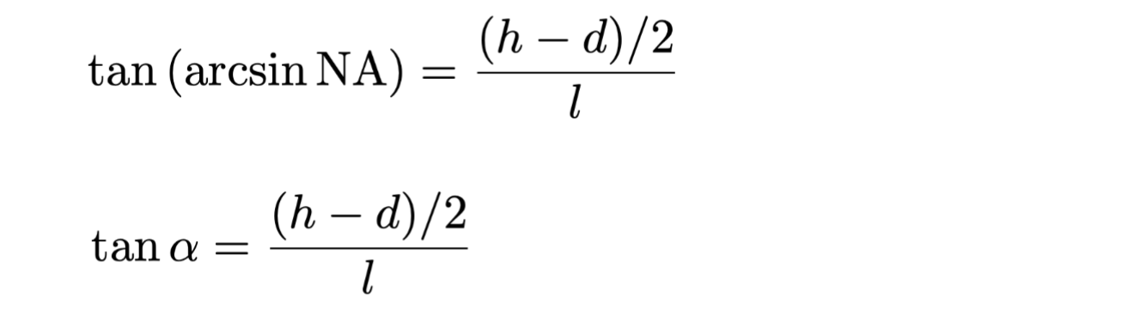
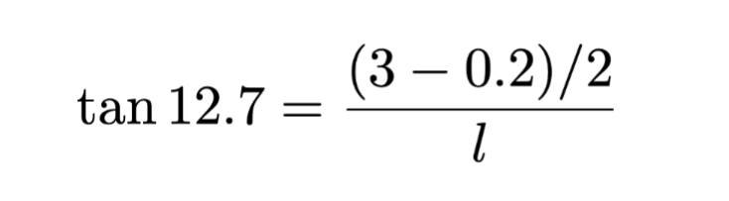
Mechanics Development SiPM
SiPM
Different detectors, different panels
Fiber Light
S14160-3010PS – L = 6.2mm
S14160-3015PS – L = 6.2mm
S15639-1325PS – L = 2.3mm
Signal
Distance between detector and fiber connector

Slide 19
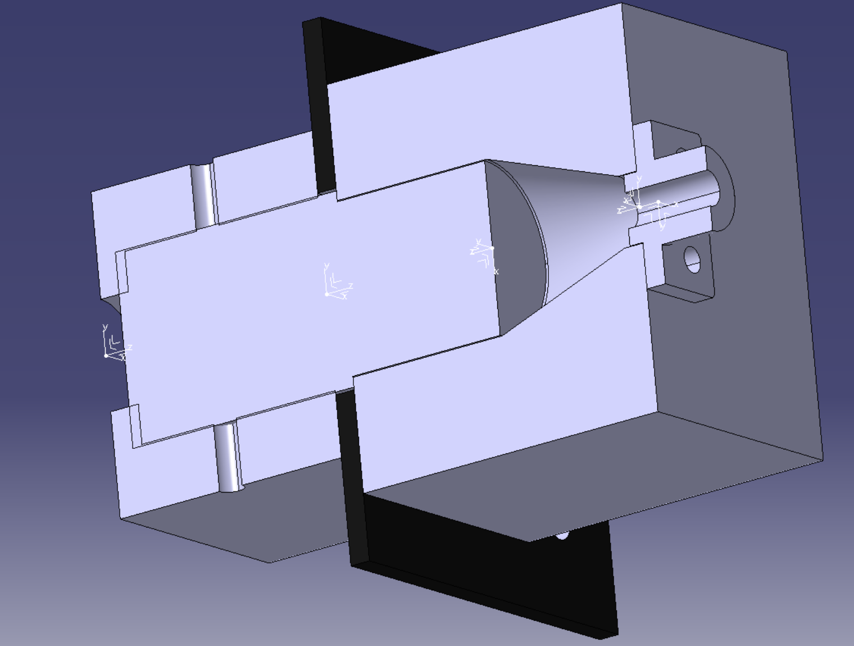
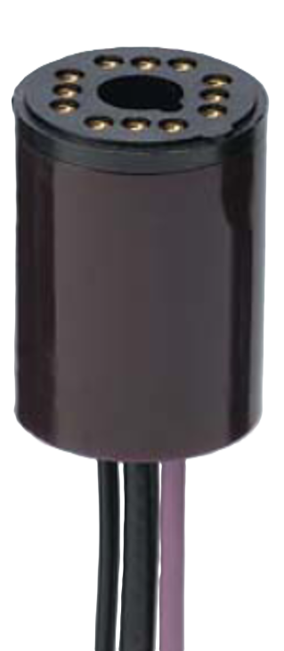
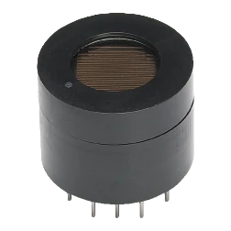
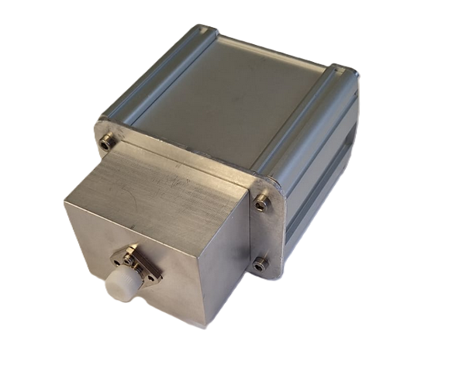
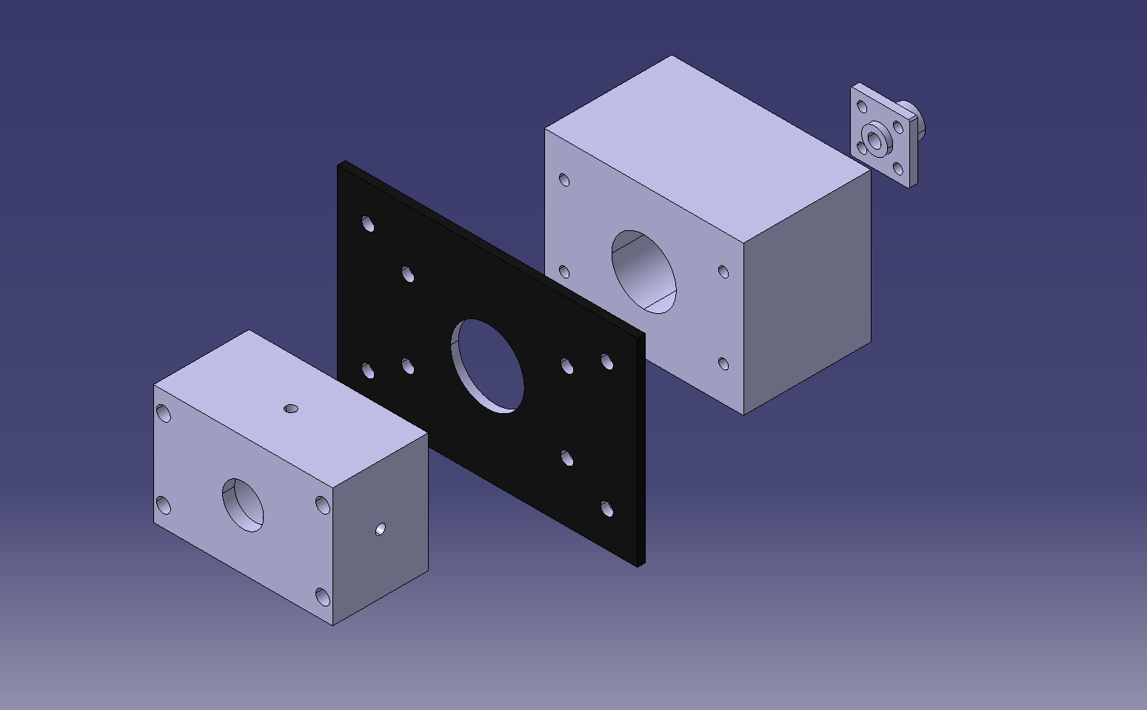
Mechanics Development PMT
Easy to change detector
Avoid light coming in
Mechanics done at CERN by SY-BI-ML
Fiber light
Light
Design Jose C. Esteban and Lucas Limonet
The detector is assembled from the back to the front with 4 screws, which makes assembly easier and prevents light from entering through the front panel.

Slide 20
PMTs
R9880U-116
R9880U-20
λp = 160 to 700nm
Window material in quartz
λp = 230 to 920nm
Window material in borosilicate
R9880-20-Y001
Customized PMT
Wavelength from -20
Window material from -116

Slide 21
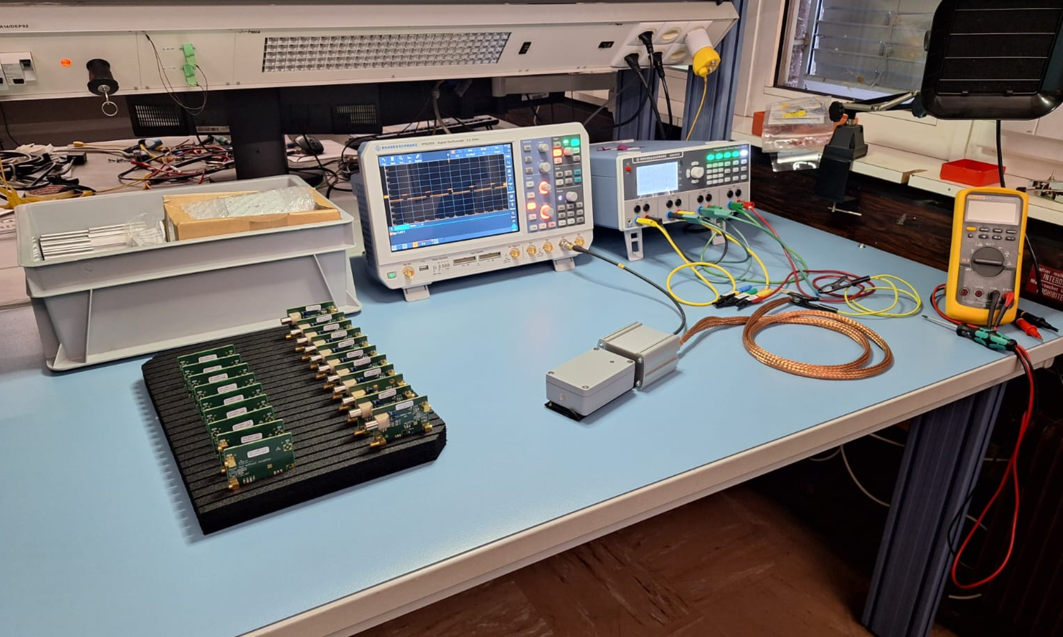
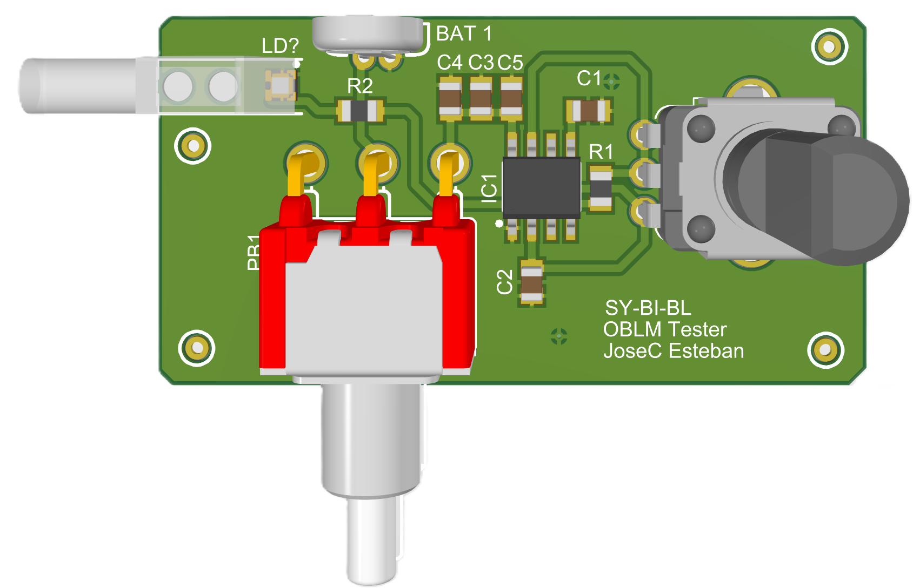
Functional Test
Function test done in the lab
Test using NE555
Tester is an easy way to verify the detector in the tunnel
Oscilloscope
Mechanic cases
Power Supply
Tester
SiPM Detector
oBLM Eectronics

Slide 22
Outline
Development
Our Needs
Future steps
Jose C. Esteban | oBLM electronics | jose.carlos.esteban.felipe@cern.ch
13.12.2024
22

Slide 23
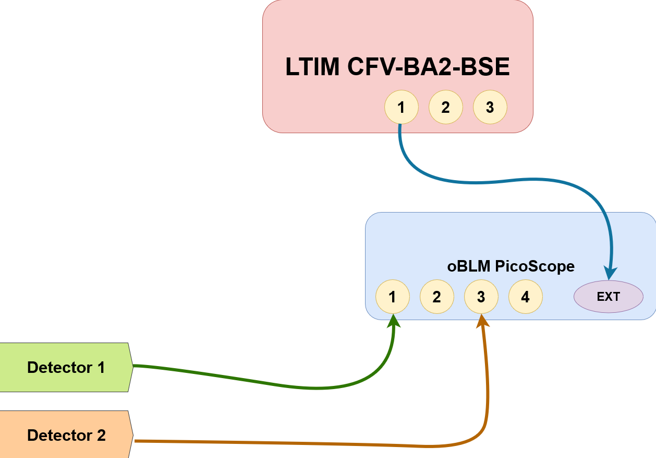



Improvement Read-Out System in the SPS
Old read-out system was a ROSY box at SPS
Oscilloscope wave runner
We want a standard installation read-out with FESA
  Status on-going
  Pico Scope + FEC at BA2
Power supplies
Pico Scope
Patch Pannel coming from the detectors

Slide 24

Planned Works during EYETS
200 µm fiber will be replaced by 600 µm
SiPMs will be replaced by PMTs at SPS
New FEC will be installed at SPS
Passive dosimeters will be installed in order to analyze the radiation around the detectors for a better location

Slide 25
Components for Present and Future installation
 |  | Units | Installed | Lab | Total
SiPM | S14160-3010PS | 12 | 2 | 10 | 30
 | S14160-3015PS | 12 | 2 | 10
 | S15639-1325PS | 10 | 0 | 10
Read-Out | EDA-04960-V1-0 | 22 | 2 | 20 | 40
 | EDA-04961-V1-0 | 22 | 2 | 20
PMT | R9880U-116 | 5 | 0 | 5 | 5
 | R9880U-20 | 3 | 0 | 3 | 3

Slide 26
Summary
oBLM allowed us to cover a long distance
All electronics got an EDA number
New mechanics have been developed in order to cover the needs of the oBLM
Everything was made to be able to easily change photodetectors and electronics
All photodetectors and electronics have been checked to cover our future test
New Read-Out system will be installed

Slide 27
Questions ?
Thank you for your attention!
Acknowledgments
Ewald Effinger
Belen Salvachua
Sara Benitez
Jean Michel Meyer
Montague King

