Slide 1
The ATS System-on-Chip framework: an introduction to the project
Irene Degl’Innocenti – SY-BI-BP
BI Day 2024 - 13/12/2024

Slide 2
Outline
Introduction
The ATS SoC framework taskforce: how SoCs are used in ATS
The ATS SoC framework project: towards a standard framework to use SoCs in ATS
Conclusions

Slide 3
Introduction
Let’s clarify some of the acronyms

Slide 4
SoC Definition
System-on-Chip
in the scope of this initiative, we define SoC an integrated circuit containing a CPU or a multi-processor system, memory interfaces, input/output devices interfaces and FPGA-like programmable logic

Slide 5
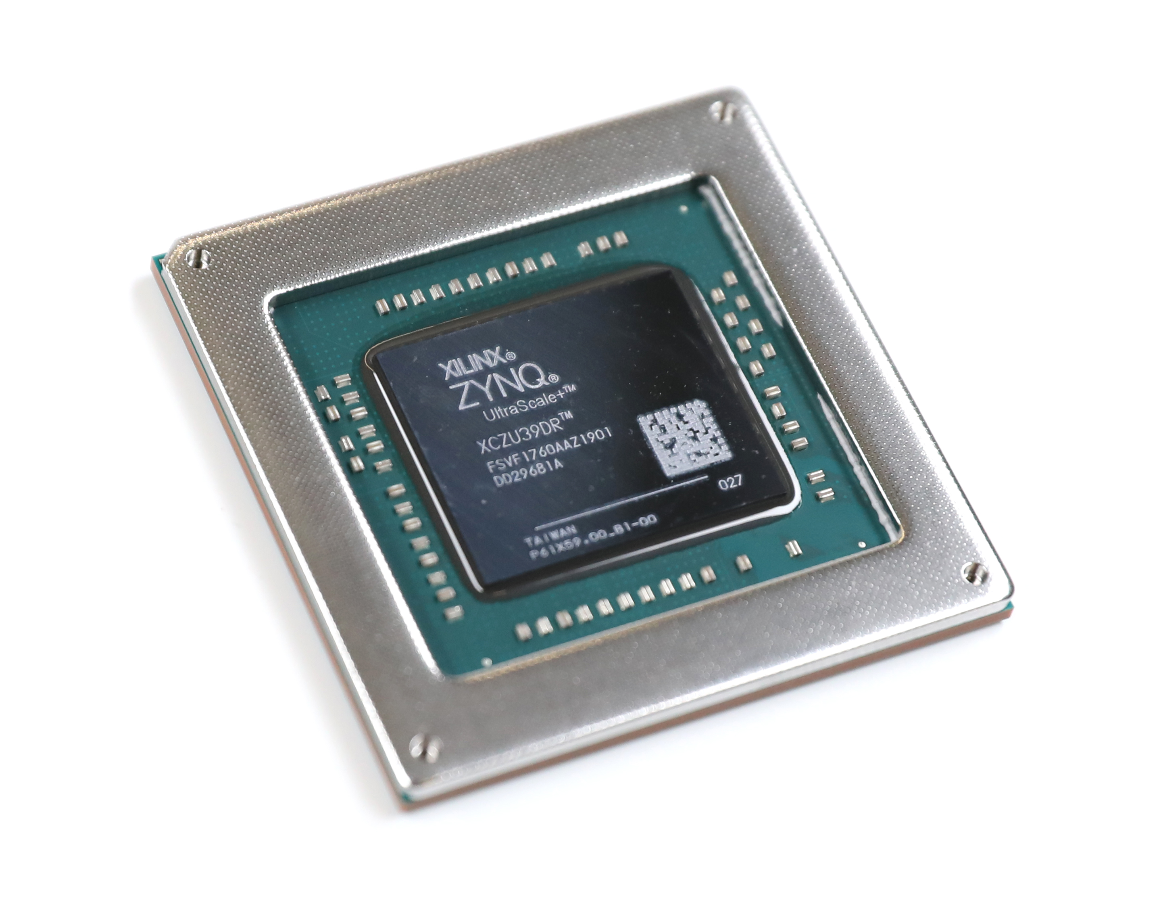
Example of SoC: Xilinx Zynq US+ MPSoC
Example of SoC: Xilinx Zynq US+ RFSoC
Connectivity
Processing System
Application Processing Unit
Multi Arm Cortex-A53
Real-Time Processing Unit
Multi Arm Cortex-R5
Memory Controller
DDR4/3 Support
High-speed
USB3.0, SATA 3.0, PCIe Gen2…
General
GigE, UART, SPI, SD/eMMC…
Integrated bus and high speed ports
Programmable Logic
ADCs
Connectivity
100G Ethernet MAC
PCIe Gen4…
FPGA fabric
Logic elements
DSP
BlockRAM
DACs
Notes:
First of all, the chip has a Processing System block,
that includes 4 Application Processing Units
And 2 Real Time Processing Units.
the RFSoC has also a Programmable Logic block,
connected to the Processing System
And which has FPGA fabric for the implementation of custom logic.
Part of the Programmable Logic block are also the RF components, that are up to 16 high sampling rate ADC
And up to 16 DAC. Speed and number of components depend on the chip generation and type.
Finally, both the Processing System and the Programmable Logic are largely equipped with peripherals and connectivity options.

Slide 6
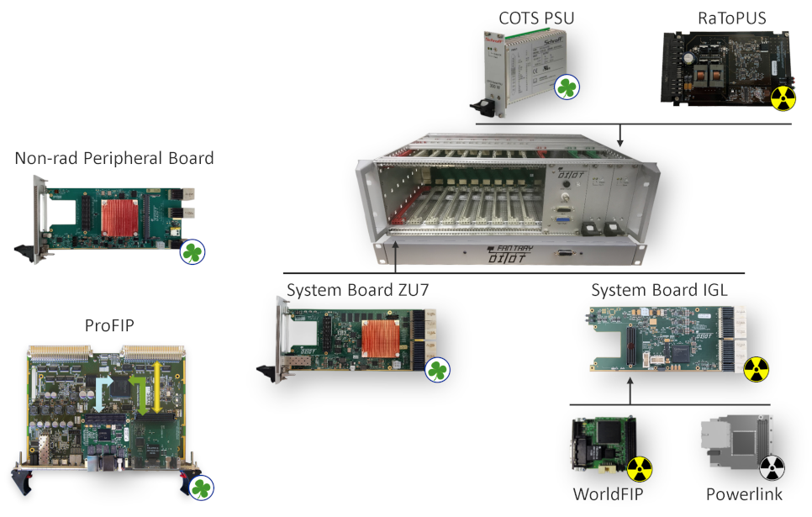
Example of HW using a SoC: DI/OT
Distributed I/O Tier:
  modular electronics platform developed by BE-CEM group
  System Board v3 with Xilinx Zynq US+ MPSoC
    Tools, libs, OS
Modular and reusable Distributed I/O Tier hardware kit from DI/OT Wiki page

Slide 7
ATS Sector and CTTB
ATS: Accelerators and Technology Sector at CERN
  Beam (BE)
  Engineering (EN)
  Accelerator Systems (SY)
  Technology (TE)
CTTB: Common Hardware & Software Technologies Technical Board (2021, indico)
  Analyses common hardware & software activities to avoid duplication of work or services
  Stimulates a common approach & strengthens standardisation effort of hardware & software solutions
  Reports to the CTSB (Common Hardware & Software Technologies Strategic Board) which takes decision
Controls groups (CEM & CSS): central services and support
Big variety of electronics and software systems integrated in the same accelerator control infrastructure
SoC technology identified as target for fruitful standardization

Slide 8
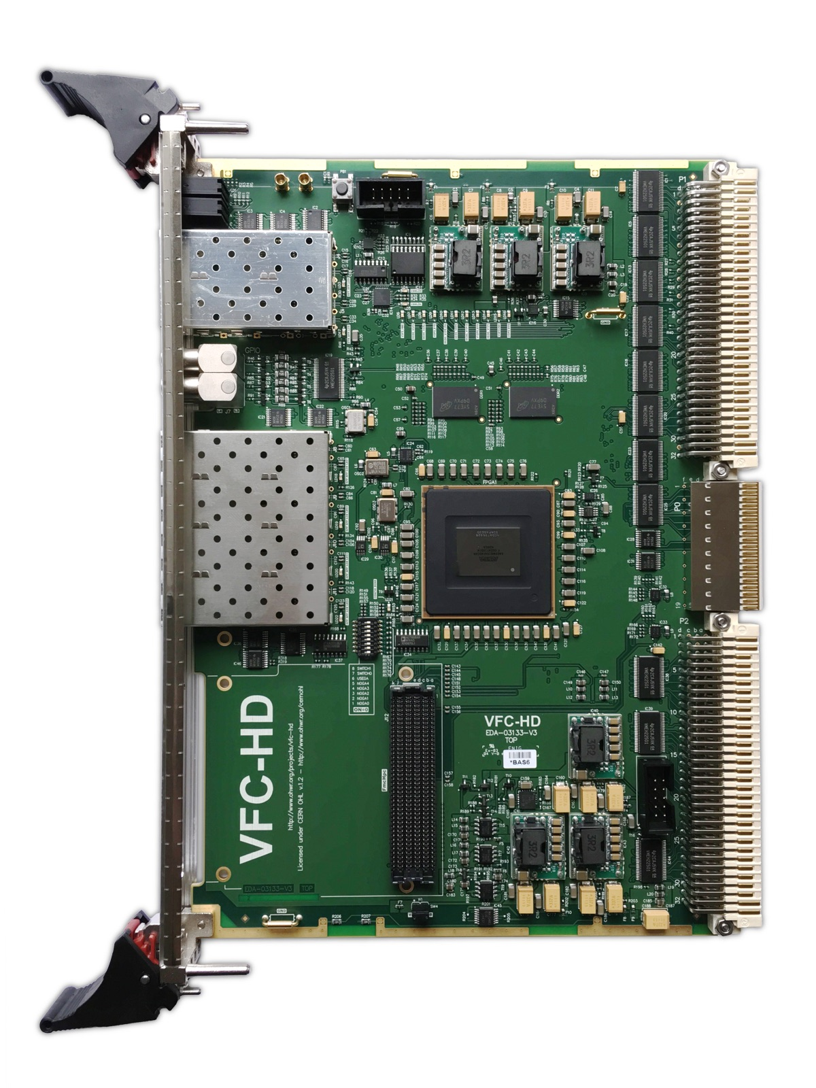
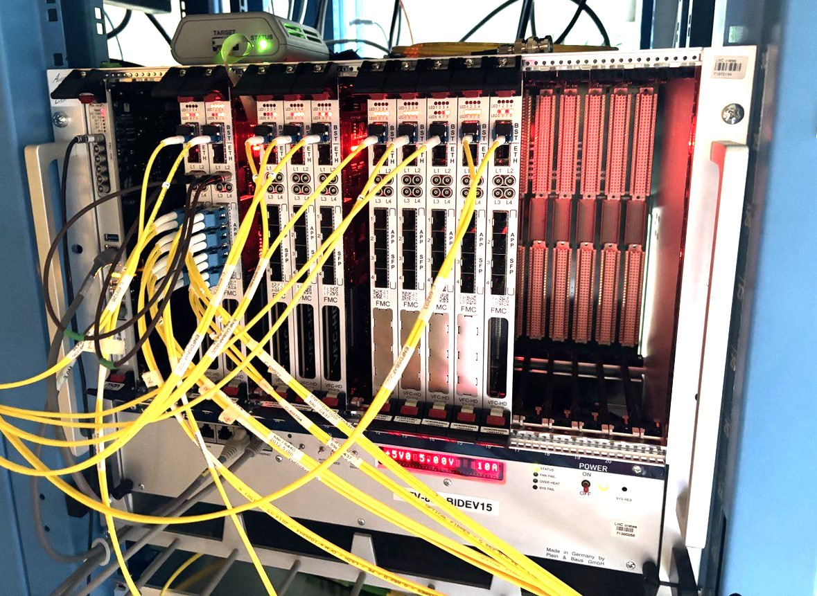
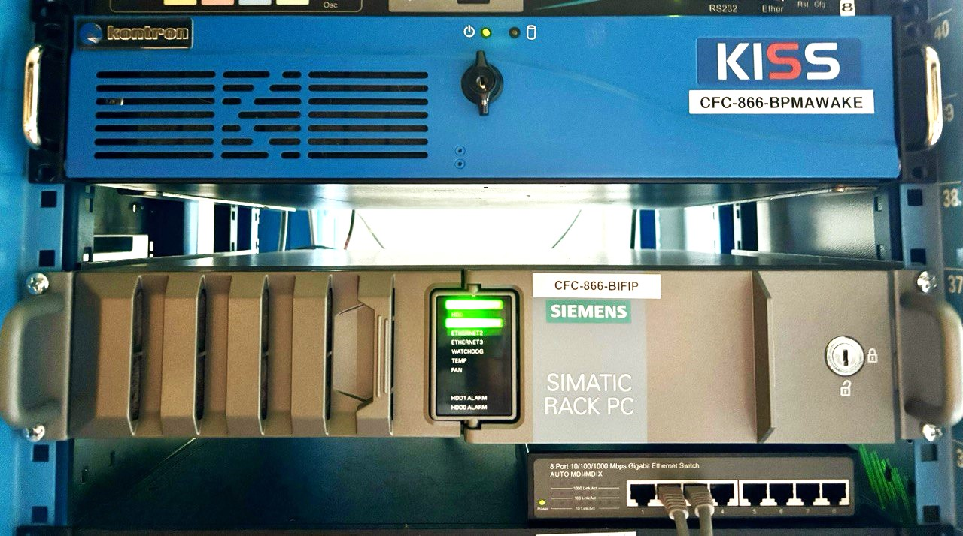
FPGA, FEC, FESA and TN
FPGA: Field Programmable Gate Array (Ex: VFC-HD board has an FPGA chip)
Where do SoCs sit in this infrastructure?
FEC: Front End Computer
  there is a set officially supported by BE
  standard Linux Operating System (CERN CentOS 7, new to come FEC-OS)
FESA: Front End Software Architecture defines standard software classes for FECs
TN: Technical Network through which FECs are integrated in the accelerator control system

Slide 9
The ATS SoC framework taskforce
How SoCs are used in ATS

Slide 10
Taskforce for SoC Framework
Rising number of SoC applications in ATS (Electronics-forum #9)
Taskforce mandated in October 2023 (31st CTTB)
Goal
  Identify a generic architecture, common services and a proper integration in the accelerator control system to converge towards a common SoC framework, starting from the current SoC applications in ATS
Scope
  All the ATS SoC applications and users in radiation free environment
Final reporting at CTTB February 2024 (23/02/2024)
Irene Degl’Innocenti (SY-BI) | Greg Daniluk (BE-CEM)
Dariusz Zielinski (SY-EPC) | Greg Kruk (BE-CSS)

Slide 11
Inventory and survey
ATS
DG
BE
SY
TE
EN
+ HSE
HDO
ABP
ASR
CEM
CSS
EA
GM
ICS
OP
ABT
AR
BI
EPC
RF
STI
CRG
MPE
PE
MI
EP
MSC
LMF
VSC
VSM
ICM
AA
ACE
CV
EL
HDO
HE
IM
MME
PAS
No SoC projects
SoC projects identified

Slide 12
Inventory and survey
17 SoC projects (15 surveys)
Group | Project
SY-ABT | DKFC
 | FIDS
SY-BI | HL-LHC BPM / AWAKE
 | LHC BPM Cons
 | BIPXL Readout (BGI)
 | MIM^{[1]}
 | MCOI
SY-EPC | FGC4
SY-RF | - (FBM section)^{[2]}
 | SPS RF Beam Control
BE-CEM (GM) | FSI
 | Sambuca
 | Sambuca Motor Driver
 | White Rabbit WREN
 | White Rabbit WRS
TE-MSC | New MSC platform
HSE | CROME
5 BI Projects
Notes:
[1] Legacy system with two units.
[2] Might use AMD Zynq UltraScale+ RFSoC and uTCA architecture.

Slide 13
Status and deadlines
Most projects target LS3 for deployment
LS3 identified as time horizon for the ATS SoC Common framework

Slide 14
SoC vendor and family
All projects on AMD Xilinx SoCs
Most of projects using US+ MPSoC (or planning to)
1-2 RFSoC projects, SoC with same Processing System cores as US+ MPSoC (identical from the software stack point of view)
Xilinx Zynq US+ family candidate for common framework support

Slide 15
Integration with accelerator control system
SoC as FEC (FEC-OS) → FEC-like services libraries potentially available to SoCs if required
  Configuration, databases, layout
  FESA, or other FEC SW frameworks
  Drivers (EDGE)
  System monitoring and diagnostics
  Network booting with fall-back strategy
  CMW/RDA
  Post-mortem
  Remote console and tools
  General Machine Timing
SoC as HW modules (no OS):
Integration through FEC
PCIe (SPEXI7U model, RF uTCA systems)

Slide 16
Outcome: list of tasks and a draft of a milestone plan as baseline for a
ATS SoC framework project proposal (EDMS)
Year | Month | No. | Milestone | CEM | CSS
2024 | Jul | 1 | DI/OT build system for HDL and SW improved and generalised. | X
 | Sep | 2 | Reference hardware design extracted from the DI/OT System Board | X
 | Oct | 3 | Proposal and development of remote power cycle and console | X
 | Nov | 4 | Timing Front-End library for reception of events via CMW/RDA |  | X
 | Dec | 5 | Provide distribution image for DI/OT |  | X
 |  | 6 | Validate FECOS boot sequence for DI/OT |  | X
2025 | Feb | 7 | Booting with fail-safe image | X
 | Mar | 8 | Adoption of application-specific device tree overlays or alternative | X
 |  | 9 | Beta version of the FESA framework |  | X
 | Apr | 10 | Debian packages for GW/SW updates | X
 |  | 11 | DI/OT library plug-ins for custom sensors and diagnostic parameters | X
 | Jun | 12 | Integration with COSMOS | X | X
 | Jul | 13 | Common IP repository set up | X
 | Sep | 14 | PTP support on SoC | X
 |  | 15 | Pro version of FESA framework and dependencies validated (full integration tests) for SoC |  | X
 | Oct | 16 | Proposal and development of tools/methods for SoC operational troubleshooting | X | X
 |  | 17 | Remote logging for DI/OT |  | X
 | Nov | 18 | Timing Front-End library and FESA supporting SoC LTIMs |  | X
 | Dec | 19 | Integration with remote CSS access tools |  | X
 |  | 20 | Provide distribution image for “hosted” SoCs |  | X
 |  | 21 | Validate FECOS boot sequence for “hosted” SoCs |  | X
2026 | Feb | 22 | Application of SoC framework to “hosted” SoCs | X
 | Dec | 23 | Scaling remote logging for “hosted” SoCs |  | X

Slide 17
The ATS SoC framework project
Towards a standard framework to use SoCs in ATS

Slide 18
The ATS SoC framework project
Project based on the outcome of the ATS SoC Taskforce (EDMS)
Stakeholders:
  Equipment groups with SoC applications in ATS (BI, EPC, ABT, RF, MSC) and HSE
  Standard libraries and tools support teams: BE-CEM, BE-CSS, MPE Post-mortem
  Related projects:
    DI/OT Project
    System-on-Module (SoM) Project
    FEC related projects: FECOS project, New Hardware Module project
Collaboration effort between departments and groups:
  Shared development of the control groups and the equipment groups, with shared responsibilities
  SoC users involved in the requirement definition and testing

Slide 19

Project structure
Workunit N
WU Holder
WU dev members
WU test members
Regular meeting
(~ bi-weekly)
Regular reports
(~ 2-3 months)
Workunit N
WU Holder
WU dev members
WU test members
Workunit N
WU Holder
WU dev members
WU test members
Stakeholders
Users
CTSB
CTTB
DI/OT
SoM Project
FEC Projects
Workunit
WU holder
WU dev members
WU test members
SoC Project
Coordinator: I. Degl’Innocenti
Milestone plan
Resources requests
Coordination
Keeping stakeholders informed
Test procedures
Beta version delivery
Final version delivery
Maintenance proposal
Documentation
Documentation in Confluence page
ATS SoC Common Framework Project
Subscribe to update e-group: ats-soc-update

Slide 20
Workunits
What: Build scripts, diagnostics libraries, etc.
Holder: Alen Arias Vazquez (BE-CEM)
Who: DI/OT team,
  2 shared SY-BE grads
WU1 – SoC Base Project
WU2 – SoC platform management
WU3 – FESA and timing
WU4 – OS and sysadmin

Slide 21
Workunits
WU1 – SoC Base Project
WU2 – SoC platform management
WU3 – FESA and timing
WU4 – OS and sysadmin
What: Remote console and reset, IP repository,
  EDGE
Holder: Steen Jensen (SY-BI)
Who: Mathieu Saccani (BI-BL),
  Tom Wlostowski (BI-BP),
  DI/OT team

Slide 22
Workunits
WU1 – SoC Base Project
WU2 – SoC platform management
WU3 – FESA and timing
WU4 – OS and sysadmin
What: Timing, CMW, FESA on SoC
Holder: Greg Kruk (BE-CSS)
Who: FESA team, with collaboration from BI
  Elif Balci (BI-SW) will spend ~3 months in CSS-FST

Slide 23
Workunits
WU1 – SoC Base Project
WU2 – SoC platform management
WU3 – FESA and timing
WU4 – OS and sysadmin
What: Linux distribution image (FECOS),
  system administration
Holder: Ioan Kozsar (BE-CEM)
Who: FEC-OS team (BE-CEM)
  Sysadmin team (BE-CSS)
  2 additional GRADs funded by BE

Slide 24
Workunits
CEM
BI
WU1 – SoC Base Project
WU2 – SoC platform management
WU3 – FESA and timing
WU4 – OS and sysadmin
1
2
4
3
CEM
CSS

Slide 25
Conclusions
Summary and outlook of future activities

Slide 26
Project summary and outlook
SoC are a rising technology in BI and in the ATS sector;
SoC taskforce and project started as a CTTB initiative;
Development and testing collaboration:
  development responsibility of each workunit assigned to specific groups;
  commitment to tests and validation for users, granularity to the specific task.
Workunit activity started with regular meetings and documented on ATS SoC Wiki;
Milestone plan in the making:
  to be adapted based on updated dependencies and available support for each workunit;
  tests and validation to be included in the milestones;
  agreement on beta version in summer 25 and readiness by LS3:
    aligned with milestone plan of current BI SoC projects (HL-LHC BPM and BGI).

Slide 27
Acknowledgements
ATS SoC Taskforce team: Dariusz Zielinski, Greg Daniluk, Greg Kruk.
ATS SoC Project WU team: Greg Kruk, Alen Arias Vazquez, Steen Jensen, Ioan Kozsar.
And all the colleagues participating to development and discussion: Arruat Michel, Balci Elif, Barros Marin Manoel, Belohrad David, Bielawski Bartek, Blantos Konstantinos, Boccardi Andrea, Boukabache Hamza, Burdzanowski Lukasz, Byszuk Adrian, Cabrera Castellano Gabriela, Colinet Antoine, Da Silva Pinho Andre, Di Capua Vincenzo, Fargier Sylvain, Garnier Jean-Christophe, Gonzalez Berges Manuel, Gonzalez Cobas Juan David, Gousiou Evangelia, Hoguin Frederic William, Hulley Christopher Ashley, Jackson Stephen, Joul Juri, King Quentin, Krupa Michal, Laforge Clyde, Lefevre Thibaut, Lettrich Michael, Levens Tom, Lipinski Maciej Marek, Locci Frank, Magnin Nicolas, Marquet Alexis, Masi Alessandro, Mclean Mark, Montabonnet Valerie, Nappi Valerio, Nisbet David, Oulevey Thomas, Podzorny Tomasz, Roderick Chris, Saccani Mathieu, Sanchez Gustavo Enrique, Sliwinski Wojtek, Spierer Arthur, Storey James, Strobino Lea, Todd Benjamin, Tsipinakis Nikos, Urbaniec Bartek, Vaga Federico, Valuch Daniel, Van Trappen Pieter, Wlostowski Tomasz, Wollmann Daniel.

Slide 28
Read about: ATS SoC Wiki

