Slide 1


Overview of the AWAKE programme and related BI challenges for the coming years
Collette Pakuza, BI and AWAKE teams
BI Day, Friday 13 December 2024

Slide 2
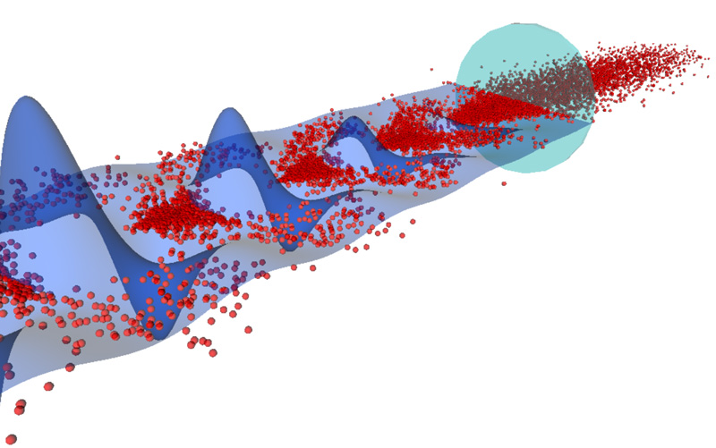
Contents
Ionising laser pulse
Motivation
AWAKE
Overview of the AWAKE programme
Run 2a/b beam instruments
Preparing for Run 2c
Instrumentation challenges
Proton microbunches
Plasma wakefield

Slide 3
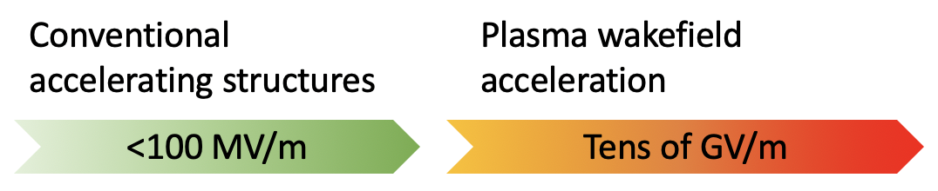
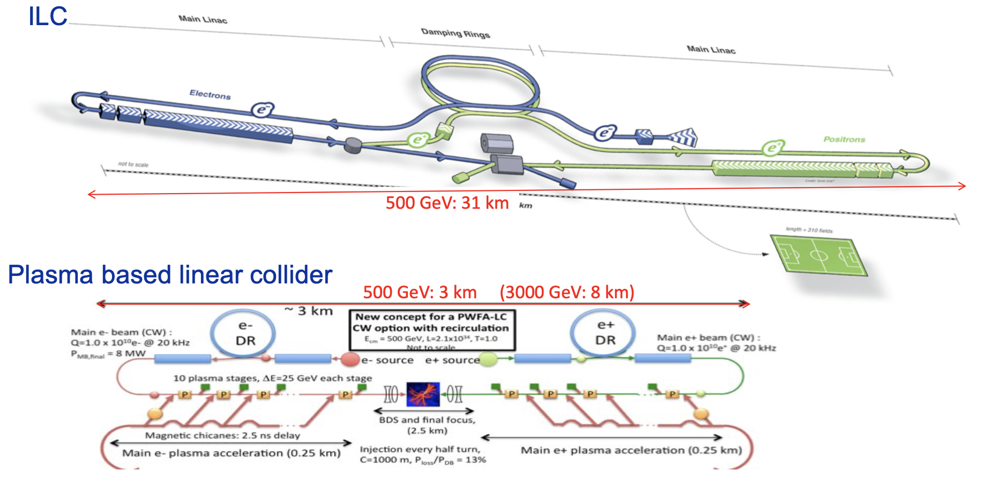
Motivation
Proposed future colliders are increasing in collision energy, therefore increasing in footprint
New accelerating technologies are being studied to make accelerators more compact to reach same energies in a fraction of the size
One area of study is plasma wakefield acceleration
International Linear Collider (ILC)
Plasma-based linear collider

Slide 4
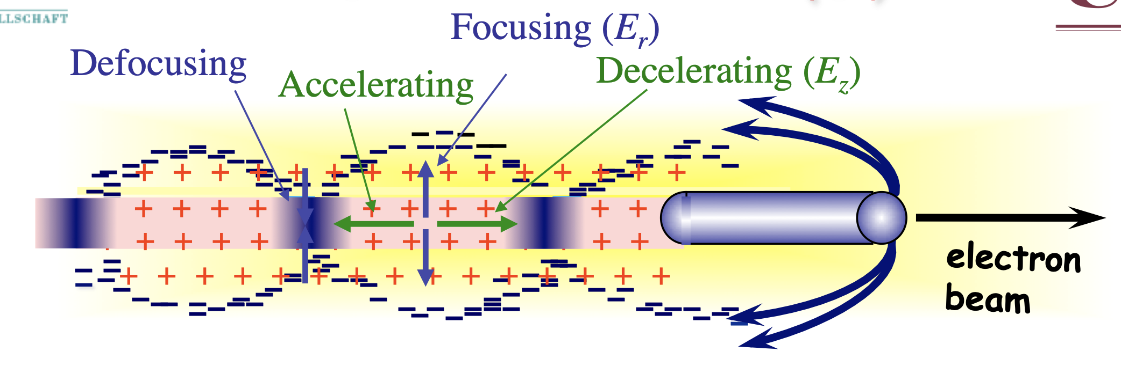
Motivation
Schematic of wakefield acceleration concept
How does it work?
  Plasma wakefield created in two ways
  Laser pulse or particle bunch propagating in plasma
  Creates density perturbation of the plasma electrons
  Plasma electron wave created behind the initial driver
  Spatial separation of plasma electrons and stationary ions
  Sets up longitudinal and transverse fields
  Particle bunch injected at the correct phase can be accelerated
Plasma wakefield acceleration using electrons
Table of existing wakefield acceleration studies
Type of acceleration | Experiments
Laser wakefield acceleration | BELLA (LBNL, USA), CLF (Harwell, UK), LUX (DESY, Germany)
Plasma wakefield acceleration driving with electrons | FACET II (SLAC, USA), FLASHForward (DESY, Germany)
Plasma wakefield acceleration driving with protons | AWAKE (CERN, Switzerland)

Slide 5
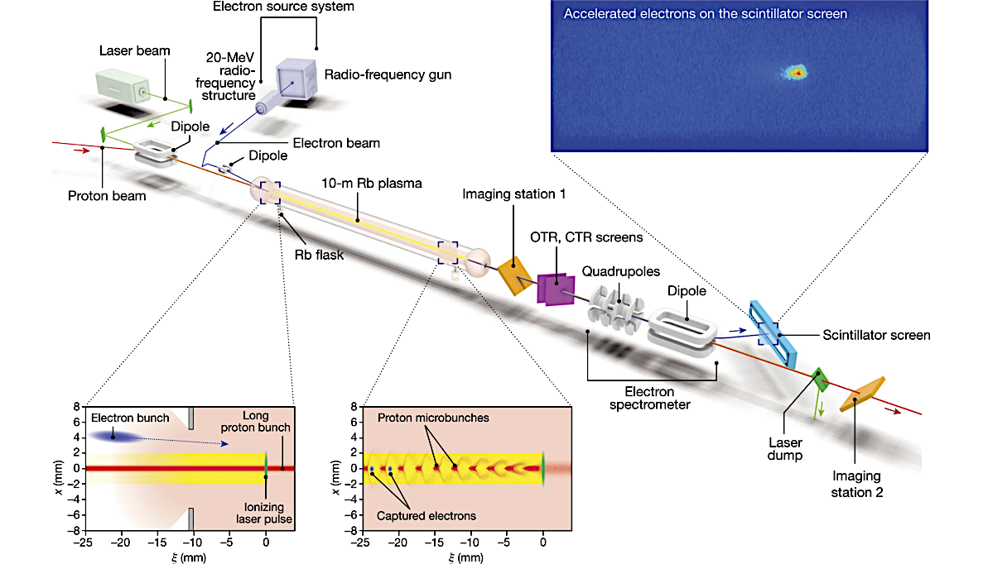

AWAKE
AWAKE Run 1, 2a, 2b layout:
CERN accelerator complex:
Proof-of-principle experiment that uses protons from the SPS to drive wakefields in 10 m rubidium plasma for electron acceleration
Condition to drive large-amplitude wakefields: $σ_{z}\sim λ_{p}$, but 6-12 cm vs $\sim$mm
Relies on a process called self-modulation where long proton bunch is divided into train of microbunches to resonantly drive the wakefields and this is seeded by the relativistic ionization front of a short laser pulse
AWAKE is located at the end of $\sim$1 km transfer line from the SPS

Slide 6
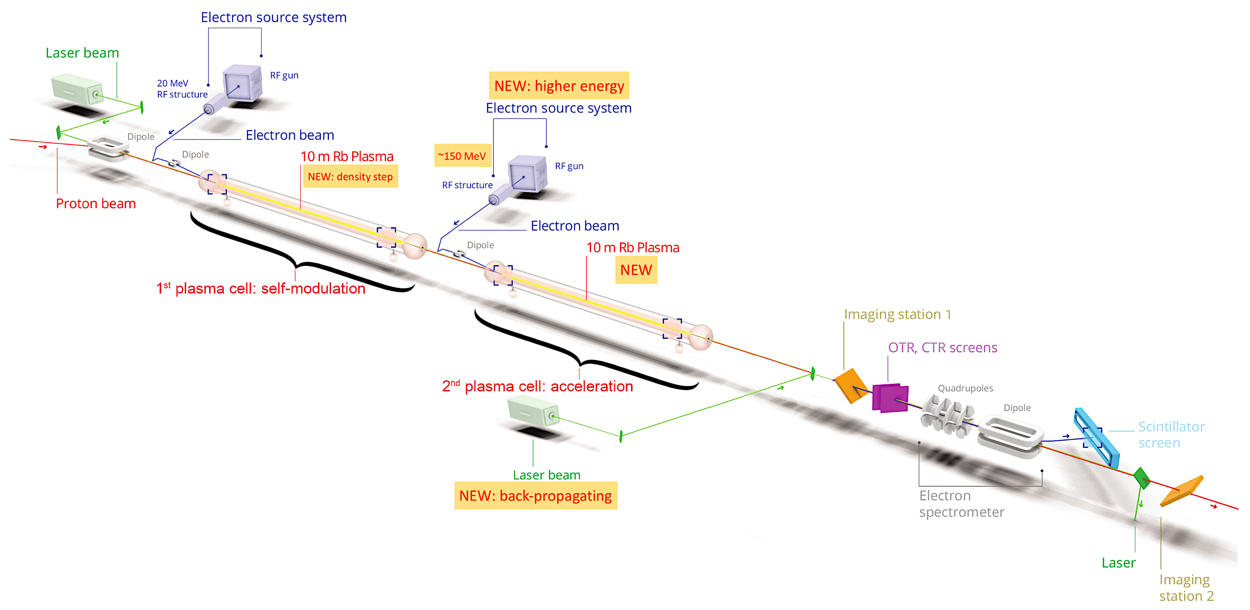
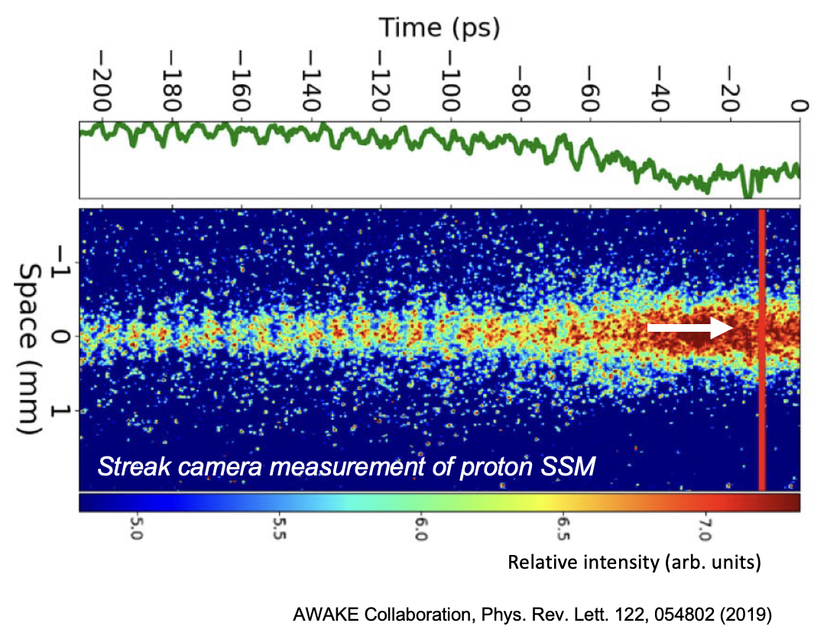
Overview of AWAKE programme
Now we are in Run 2 – Split into several stages:
  Run 2a 2021-2022 – Demonstrate proton bunch SM with electron-bunch seeding
  Run 2b 2023-2025 – Demonstrate the stabilization of the micro-bunches with a density step
  Run 2c After LS3 in 2029 – Demonstrate electron acceleration with electron-bunch quality
  Run 2d – Demonstrate scalable plasma source
Includes: additional plasma source and 150 MeV electron line
First source will be used to create the modulated proton bunch, this time, seeded by the 20 MeV electron bunch rather than RIF
The second plasma source will be for acceleration of 150 MeV electrons only
Run 1 started Q4 of 2016 till 2018 – Saw results of SSM with RIF, and electron acceleration 18 MeV to 2 GeV
Proton microbunches
Relativistic ionisation front (RIF)
AWAKE Run 2c, 2d layout

Slide 7
Overview of AWAKE programme
Now we are in Run 2 – Split into several stages:
  Run 2a 2021-2022 – Demonstrate proton bunch SM with electron-bunch seeding
  Run 2b 2023-2025 – Demonstrate the stabilization of the micro-bunches with a density step
  Run 2c After LS3 in 2029 – Demonstrate electron acceleration with electron-bunch quality
  Run 2d – Demonstrate scalable plasma source
Includes: additional plasma source and 150 MeV electron line
First source will be used to create the modulated proton bunch, this time, seeded by the 20 MeV electron bunch rather than RIF
The second plasma source will be for acceleration of 150 MeV electrons only
Run 1 started Q4 of 2016 till 2018 – Saw results of SSM with RIF, and electron acceleration 18 MeV to 2 GeV
Proton microbunches
Relativistic ionisation front (RIF)
AWAKE Run 2c, 2d layout

Slide 8
Overview of AWAKE programme
Now we are in Run 2 – Split into several stages:
  Run 2a 2021-2022 – Demonstrate proton bunch SM with electron-bunch seeding
  Run 2b 2023-2025 – Demonstrate the stabilization of the micro-bunches with a density step
  Run 2c After LS3 in 2029 – Demonstrate electron acceleration with electron-bunch quality
  Run 2d – Demonstrate scalable plasma source
Includes: additional plasma source and 150 MeV electron line
First source will be used to create the modulated proton bunch, this time, seeded by the 20 MeV electron bunch rather than RIF
The second plasma source will be for acceleration of 150 MeV electrons only
Run 1 started Q4 of 2016 till 2018 – Saw results of SSM with RIF, and electron acceleration 18 MeV to 2 GeV
Proton microbunches
Relativistic ionisation front (RIF)
AWAKE Run 2c, 2d layout

Slide 9
Overview of AWAKE programme
Now we are in Run 2 – Split into several stages:
  Run 2a 2021-2022 – Demonstrate proton bunch SM with electron-bunch seeding
  Run 2b 2023-2025 – Demonstrate the stabilization of the micro-bunches with a density step
  Run 2c After LS3 in 2029 – Demonstrate electron acceleration with electron-bunch quality
  Run 2d – Demonstrate scalable plasma source
Includes: additional plasma source and 150 MeV electron line
First source will be used to create the modulated proton bunch, this time, seeded by the 20 MeV electron bunch rather than RIF
The second plasma source will be for acceleration of 150 MeV electrons only
A lot of work and support needed from BI!
Run 1 started Q4 of 2016 till 2018 – Saw results of SSM with RIF, and electron acceleration 18 MeV to 2 GeV
Proton microbunches
Relativistic ionisation front (RIF)
AWAKE Run 2c, 2d layout

Slide 10
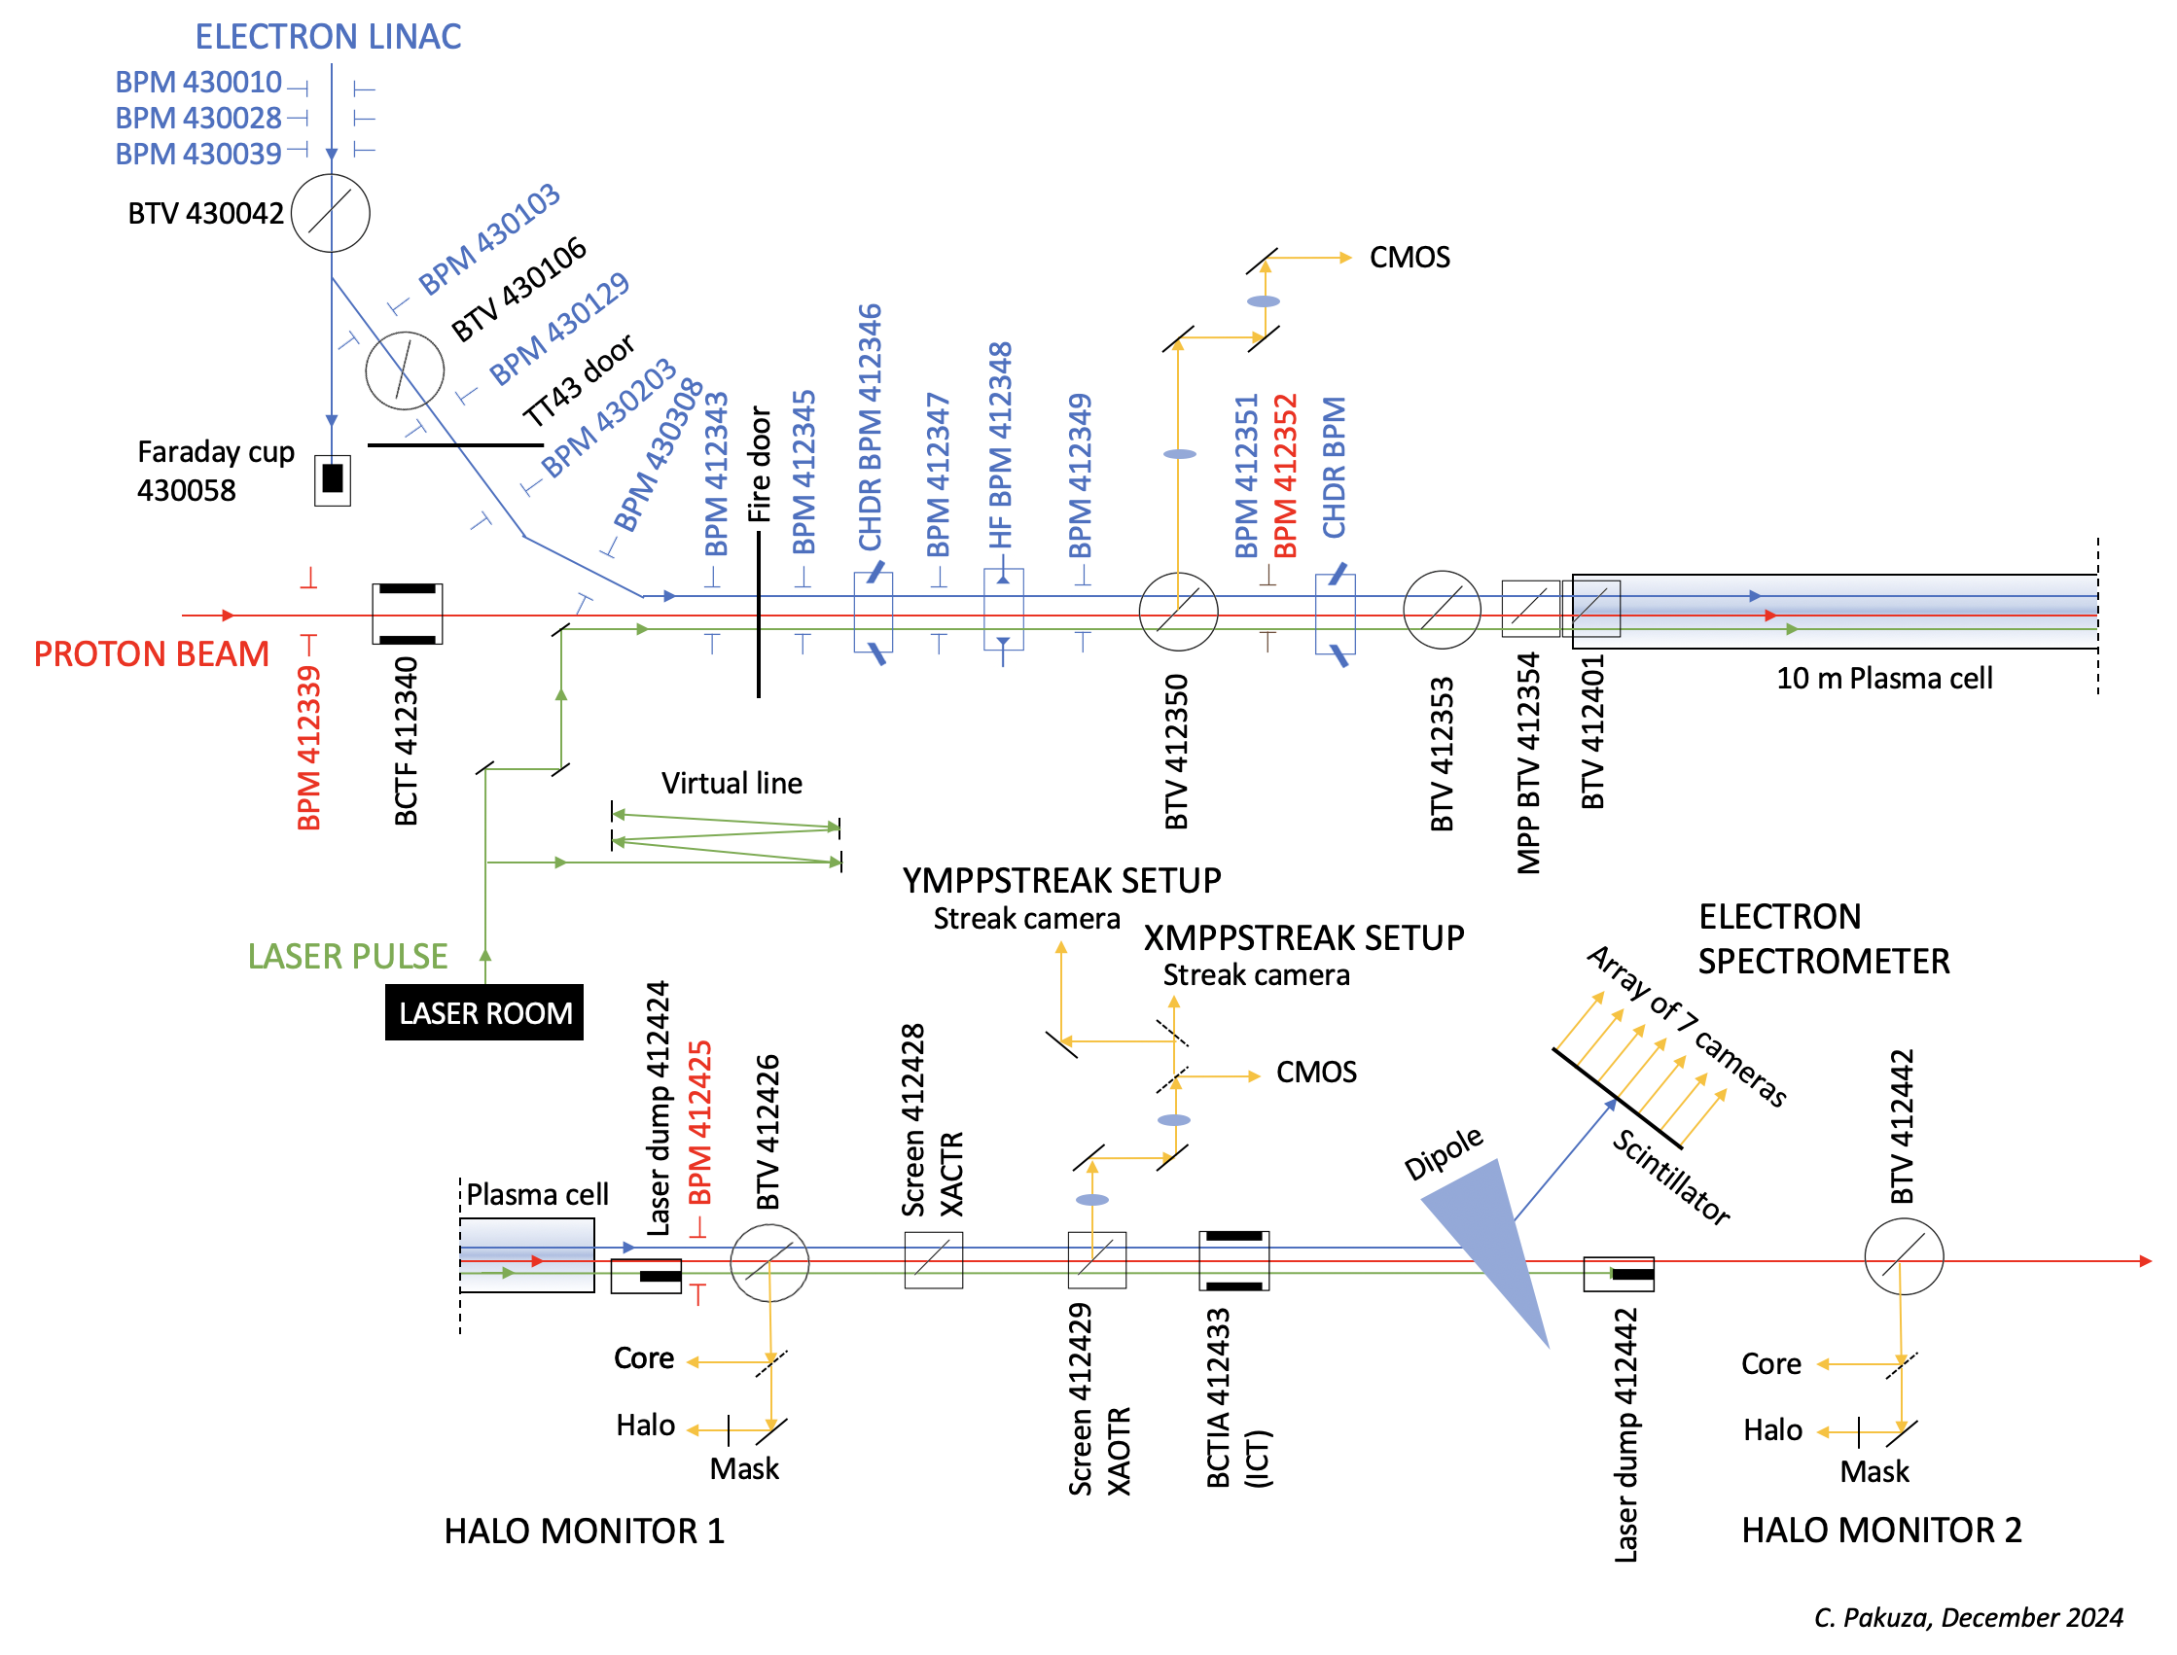
Run 2a/b beam instruments
Beam position monitors:
Electrons
7x 40 mm ID TRIUMF stripline BPMs in the e-line
5x 60 mm ID TRIUMF stripline BPMs in the common line
2 ChDR and 1 HF BPM in the common line (more in next slide)
Protons
20 button BPMs from SPS extraction to AWAKE
Profile measurements:
2+4 standard BTVs (Beam TVs) in the e and common line
Additional BTVs installed by MPP
Intensity:
Faraday cup
2 CTs
Electron energy:
Spectrometer imaging systems
Plus a lot of digital cameras, motors, software
Overview of existing instruments at AWAKE

Slide 11
Run 2a/b beam instruments
Beam position monitors:
Electrons
7x 40 mm ID TRIUMF stripline BPMs in the e-line
5x 60 mm ID TRIUMF stripline BPMs in the common line
2 ChDR and 1 HF BPM in the common line (more in next slide)
Protons
20 button BPMs from SPS extraction to AWAKE
Profile measurements:
2+4 standard BTVs (Beam TVs) in the e and common line
Additional BTVs installed by MPP
Intensity:
Faraday cup
2 CTs
Electron energy:
Spectrometer imaging systems
Plus a lot of digital cameras, motors, software
Overview of existing instruments at AWAKE

Slide 12
Run 2a/b beam instruments
Beam position monitors:
Electrons
7x 40 mm ID TRIUMF stripline BPMs in the e-line
5x 60 mm ID TRIUMF stripline BPMs in the common line
2 ChDR and 1 HF BPM in the common line (more in next slide)
Protons
20 button BPMs from SPS extraction to AWAKE
Profile measurements:
2+4 standard BTVs (Beam TVs) in the e and common line
Additional BTVs installed by MPP
Intensity:
Faraday cup
2 CTs
Electron energy:
Spectrometer imaging systems
Plus a lot of digital cameras, motors, software
Overview of existing instruments at AWAKE

Slide 13
Run 2a/b beam instruments
Beam position monitors:
Electrons
7x 40 mm ID TRIUMF stripline BPMs in the e-line
5x 60 mm ID TRIUMF stripline BPMs in the common line
2 ChDR and 1 HF BPM in the common line (more in next slide)
Protons
20 button BPMs from SPS extraction to AWAKE
Profile measurements:
2+4 standard BTVs (Beam TVs) in the e and common line
Additional BTVs installed by MPP
Intensity:
Faraday cup
2 CTs
Electron energy:
Spectrometer imaging systems
Plus a lot of digital cameras, motors, software
Overview of existing instruments at AWAKE

Slide 14
Run 2a/b beam instruments
Beam position monitors:
Electrons
7x 40 mm ID TRIUMF stripline BPMs in the e-line
5x 60 mm ID TRIUMF stripline BPMs in the common line
2 ChDR and 1 HF BPM in the common line (more in next slide)
Protons
20 button BPMs from SPS extraction to AWAKE
Profile measurements:
2+4 standard BTVs (Beam TVs) in the e and common line
Additional BTVs installed by MPP
Intensity:
Faraday cup
2 CTs
Electron energy:
Spectrometer imaging systems
Plus a lot of digital cameras, motors, software
Overview of existing instruments at AWAKE

Slide 15
Run 2a/b beam instruments
Beam position monitors:
Electrons
7x 40 mm ID TRIUMF stripline BPMs in the e-line
5x 60 mm ID TRIUMF stripline BPMs in the common line
2 ChDR and 1 HF BPM in the common line (more in next slide)
Protons
20 button BPMs from SPS extraction to AWAKE
Profile measurements:
2+4 standard BTVs (Beam TVs) in the e and common line
Additional BTVs installed by MPP
Intensity:
Faraday cup
2 CTs
Electron energy:
Spectrometer imaging systems
Plus a lot of digital cameras, motors, software
Overview of existing instruments at AWAKE

Slide 16
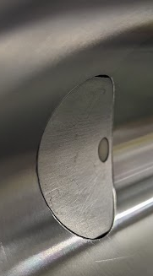
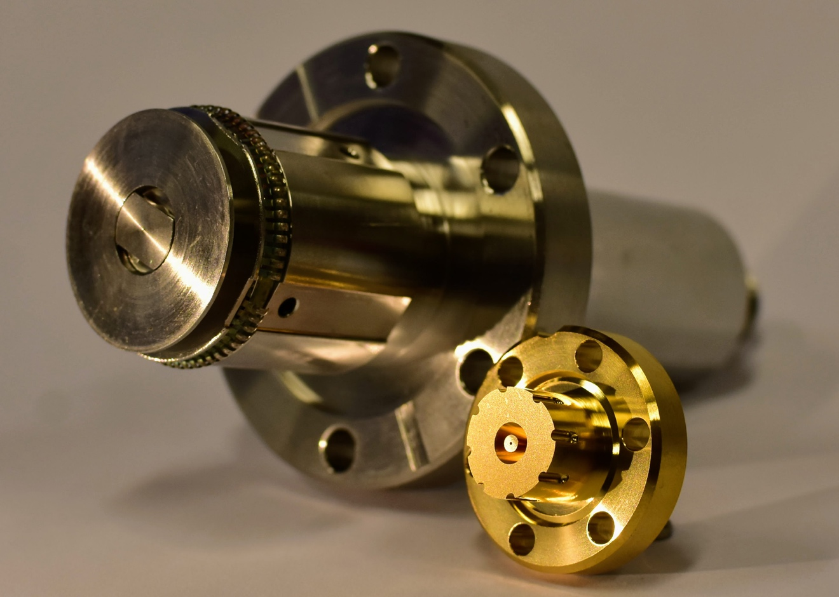
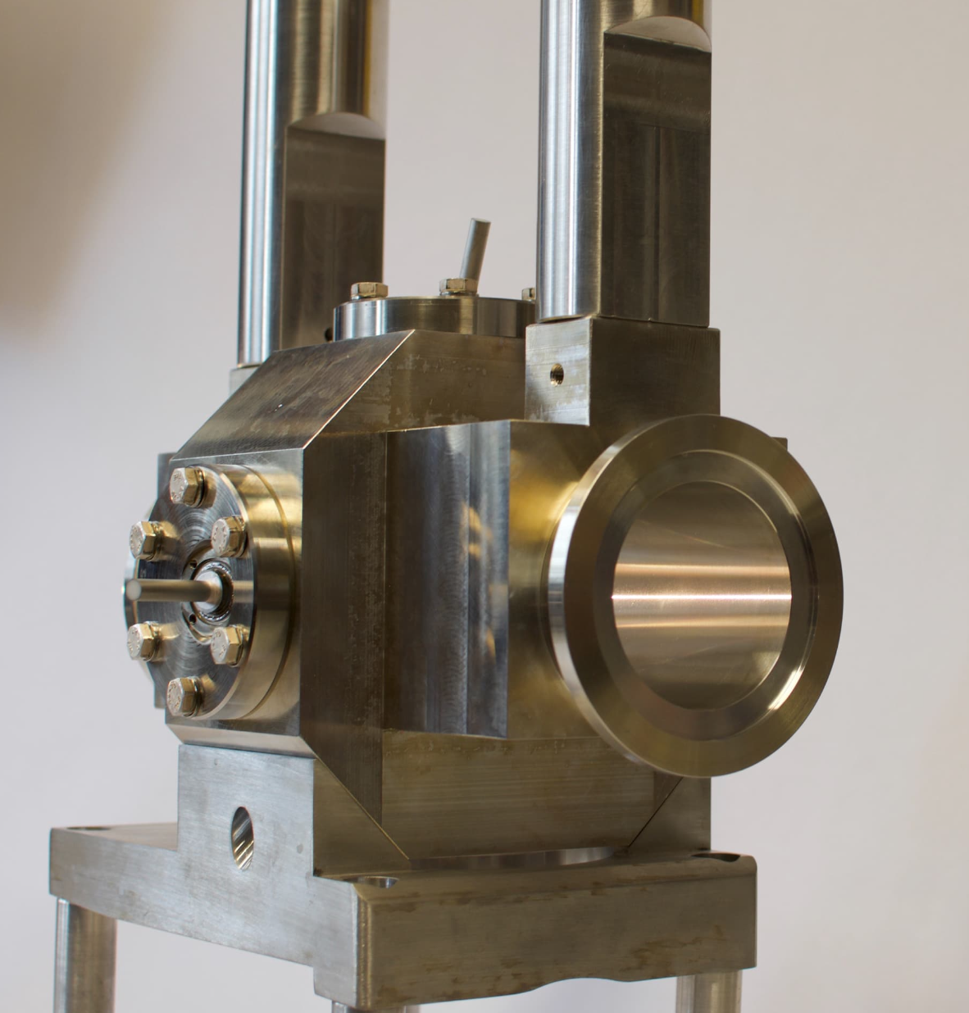
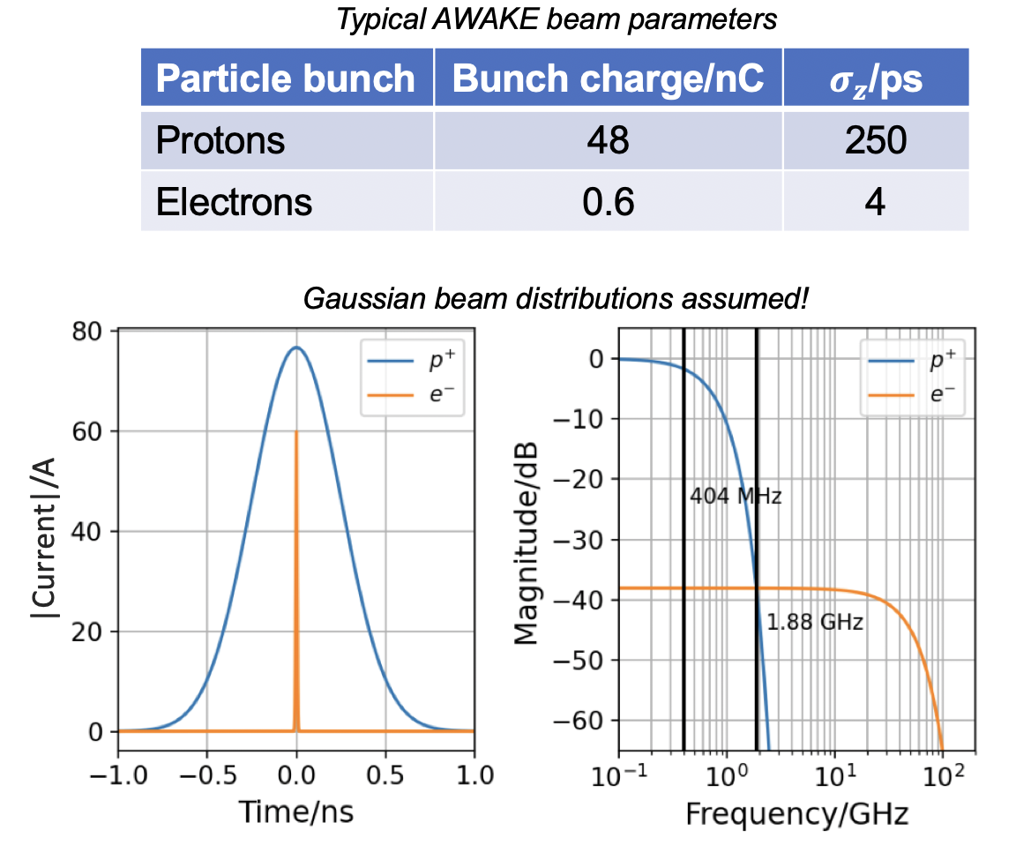
Run 2a/b beam instruments – High frequency PUs
High frequency PUs include:
  BPM based on generation of Cherenkov diffraction radiation (ChDR BPM)
  HF DESY inspired conical shaped button BPM
Designed to operate at sufficiently high frequencies (30 GHz) to isolate only the electron signal to be able to measure electrons in the presence of the more-intense proton bunches
Which the existing stripline BPMs cannot do as they operate in region of the spectrum where proton signal dominates
Alumina rod surface flush to beampipe
Alumina rods
Conical button BPM comparison to LEP-type Button BPM
AWAKE ChDR BPM

Slide 17
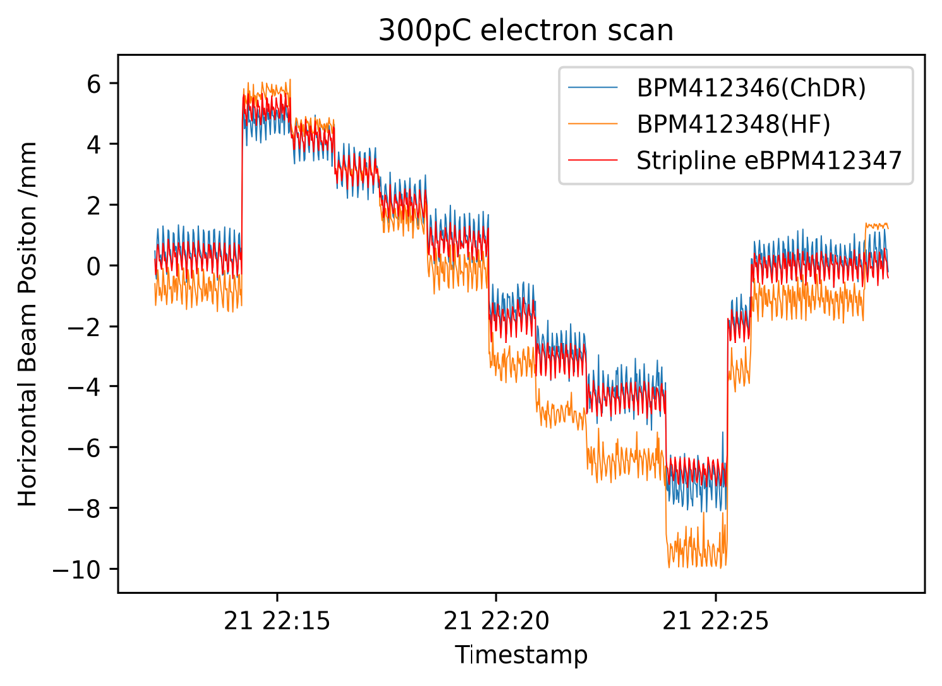
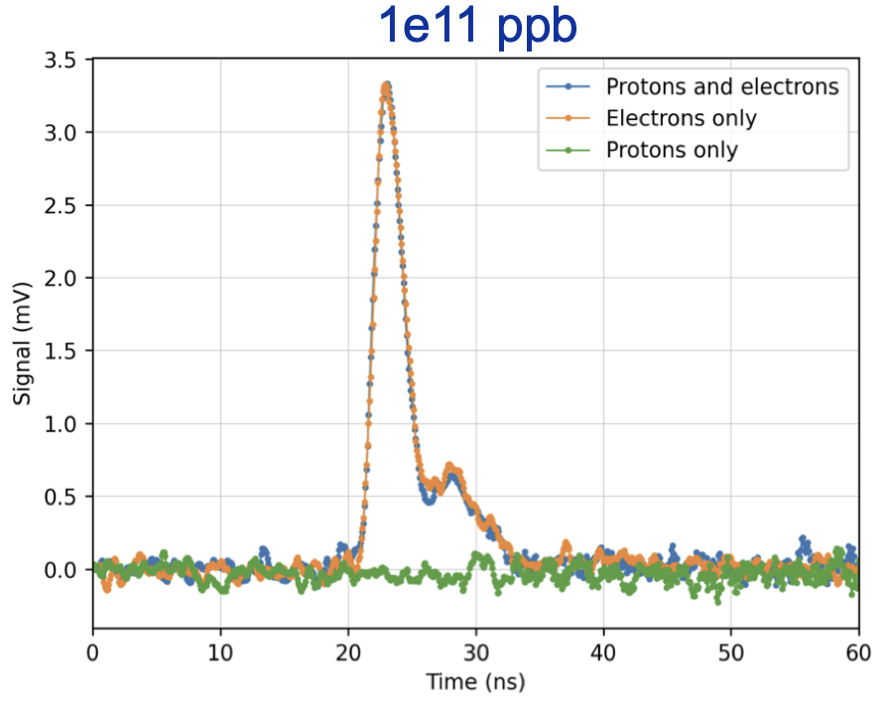
Run 2a/b beam instruments – High frequency PUs
Beam tests at AWAKE showed sensitivity to position and good rejection of proton signal at 1⨉10¹¹ protons/bunch
Electron only position scan, showing position sensitivity and response following closely with neighboring stripline BPM
Example time signals with 30 GHz detection
B. Spear, C. Pakuza, E. Senes, BI team and JAI, Oxford

Slide 18
Run 2a/b beam instruments – Digital cameras
2022, analog cameras replaced by digital cameras
Now, AWAKE utilizes 39 cameras:
  31 in the beamline
  8 laser cameras
  Intense software development in parallel with testing in Run 2a
  System running with no loss of frames
Not only useful for viewing bunch transverse profiles and position on screens in BTVs but also used for:
  Plasma light diagnostics
  10 cameras installed at the viewports along the Rb vapor source
  Viewing the plasma light as it is expected to be proportional to the wakefield amplitude
  Evolution of wakefields along the plasma, studies ongoing
Two plasma light cameras at the viewports along the plasma source
Plasma light cameras

Slide 19
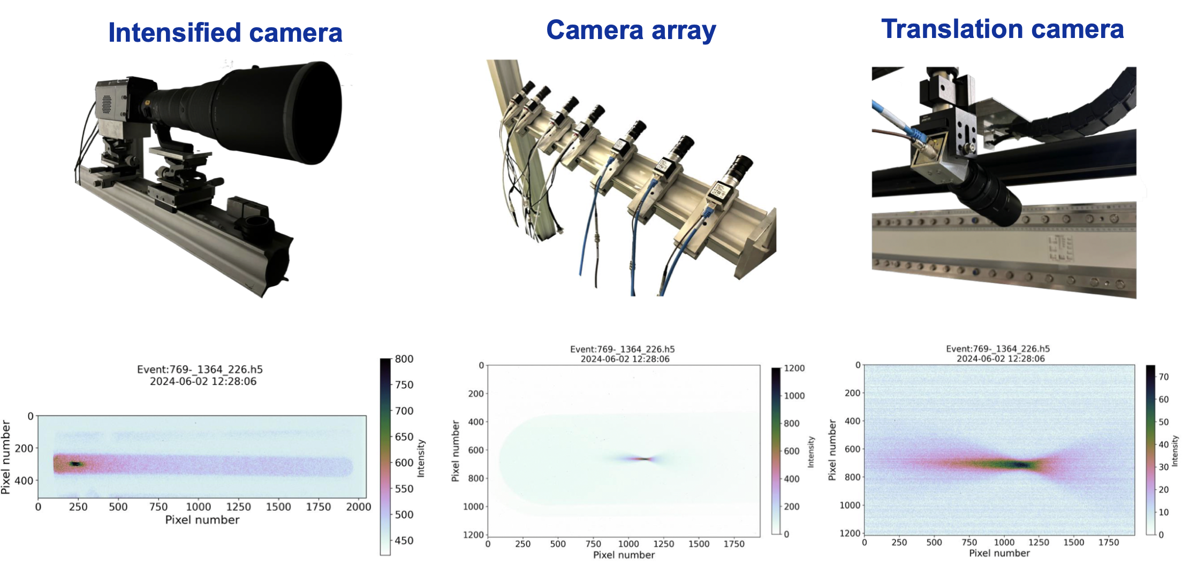


Run 2a/b beam instruments – Digital cameras
F. Pannell, UCL team, AWAKE and BI teams
Special thanks, M. Hamani, L. Limonet, B. Moser
2. Electron spectrometer
Energy and emittance measurement by imaging beam on scintillating screen
Run 2 saw an upgrade of the imaging system from an intensified camera to camera array plus a translation camera
Improved systems allowed first measurements of vertical plane transverse emittance from vertical size measurement of the beam on the screen
17 m from spectrometer screen
1.25 m from screen at -30$°$ below beam plane
0.4 m from screen, +40$°$ above beam plane
Run 1
Run 2
Run 2
Higher resolution

Slide 20
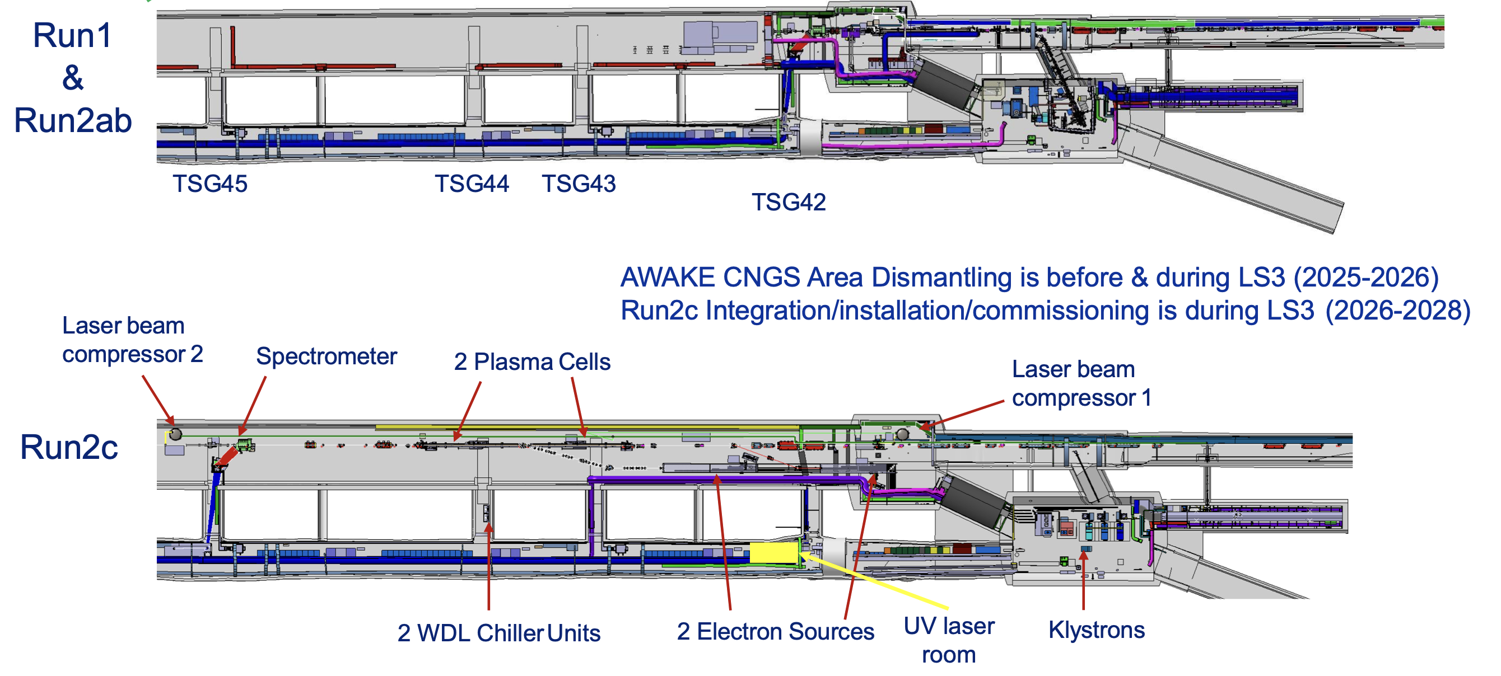
Preparing for Run 2c
Before and after AWAKE dismantling
Beam Instrumentation for Run 2c:
Production of new instruments for the 150 MeV e-line (screens, BPMs, bunch charge)
Refurbishment of electronics of all existing BPMs (stripline, buttons)
Refurbishment of Beam Loss Monitors (SPS consolidation)
‘Special’ diagnostics: 150 MeV e-bunch length (University of Manchester, University of Liverpool), spectrometer upgrade (University College London), emittance (UoL, UoM, UCL)
Re-location of existing instruments

Slide 21
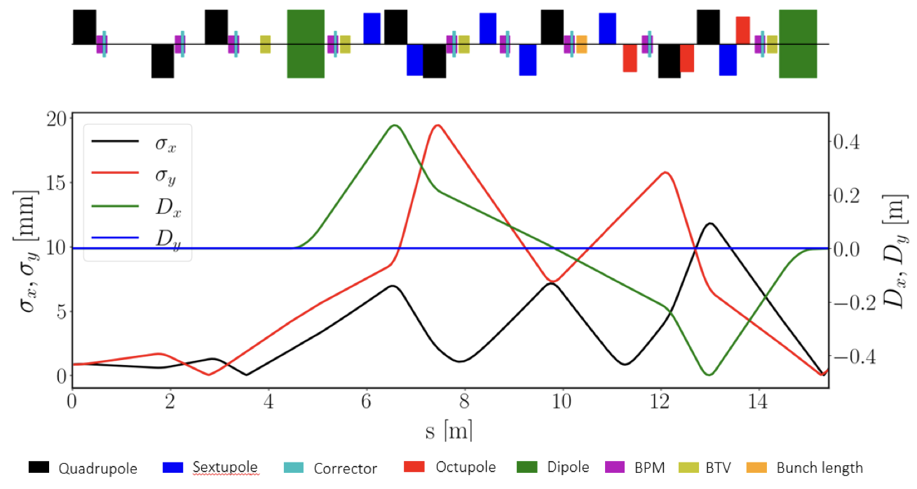
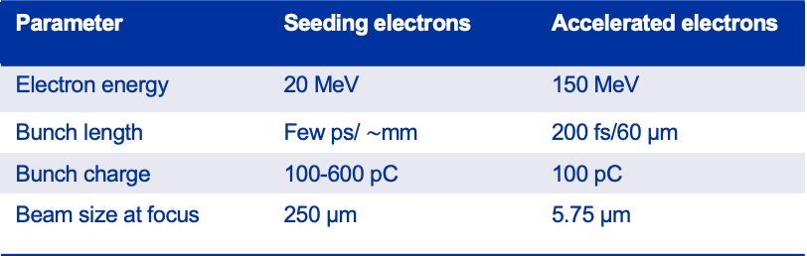
Instrumentation challenges
New electron line beam parameters and specifications pose several instrumentation challenges that need to be studied and addressed
BPMs
Manufacturing the new striplines is a main challenge, which were made externally before
Producing new electronics (as part of an upgrade to all AWAKE BPMs) – see Laurence's talk next
BTVs
Find the right compromise between standardisation and customisation
Bunch length
Able to measure 200 fs (RMS), options are:
  Electro-optic spectral decoding (EOSD)
  Coherent Cherenkov Diffraction Radiation (CChDR) (UoM)
  Machine learning (ML) – analysis of simulated CTR images to estimate longitudinal bunch profile (UoL)
Requires R&D and design/manufacturing of vacuum compatible instruments
Spatial constraints – challenge for integration and to make some instruments as compact as possible
Comparison e-line parameters
Parameter | Seeding electrons | Accelerated electrons
Electron energy | 20 MeV | 150 MeV
Bunch length | Few ps/ $\sim$mm | 200 fs/60 µm
Bunch charge | 100-600 pC | 100 pC
Beam size at focus | 250 µm | 5.75 µm
Layout of 150 MeV beamline and optical functions
Lots of work during the next years to be ready for Run 2c (2029)!

Slide 22

Thank you for listening!

