Slide 2
Performance Analysis of the BSRL and Possible Improvements
Alexander JURY, Manuel GONZALEZ BERGES,
Stefano MAZZONI

Slide 3
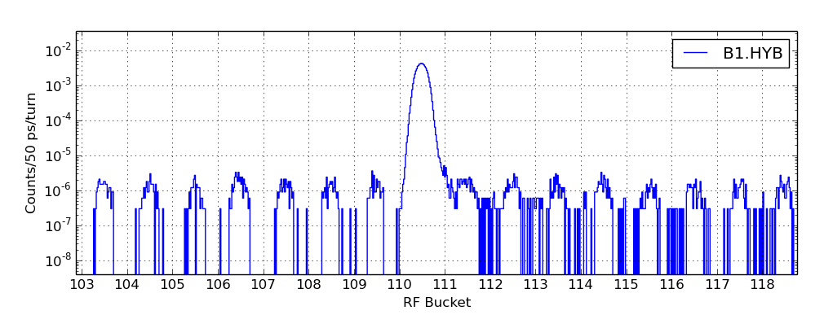

Longitudinal Profile
Slots and Buckets and Bins
Slots are 25ns long
Satellites and Ghosts
A Satellite is any bucket with charge that is not the filled bucket
Made up of 10 RF buckets
Nominally a maximum of 1 bucket per slot can be filled
A Ghost is any bucket with charge in an “unfilled” slot
Motivation
Allows for more accurate luminosity calibration for the experiments
Diagnosis of operation issues
Ghosts/Satellites account for up to 1% of all charge in VdM for p-p
profile around one bunch
Log-scale
Filled bucket
Ghosts
Satellites
(5 buckets)
Satellites
(4 buckets)
Ghosts
10 buckets = 1 slot $≈$ 25 ns

Slide 4
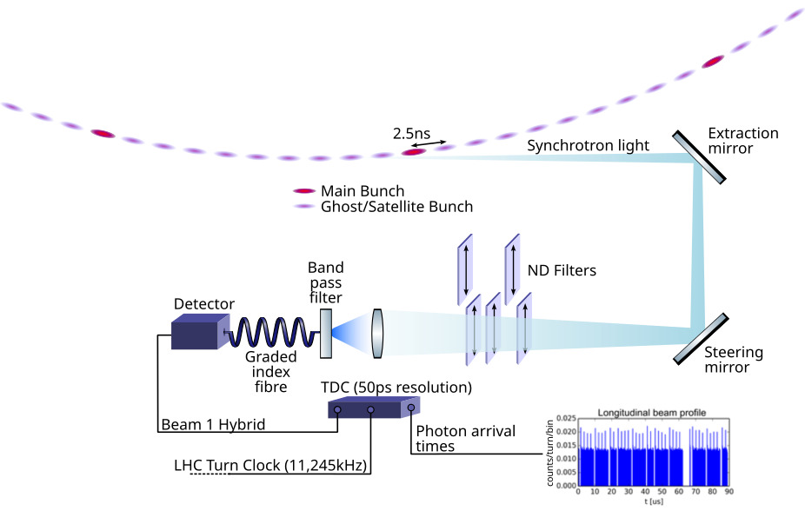
Beam Synchrotron Radiation Longitudinal
Density Monitor (BSRL)
Main Purpose
Longitudinal beam profile monitoring of LHC beams
Measure relative population of Main and Ghost/Satellite bunches
High dynamic range!
Principle
Time-correlated single photon counting of synchrotron light from LHC beams

Slide 5
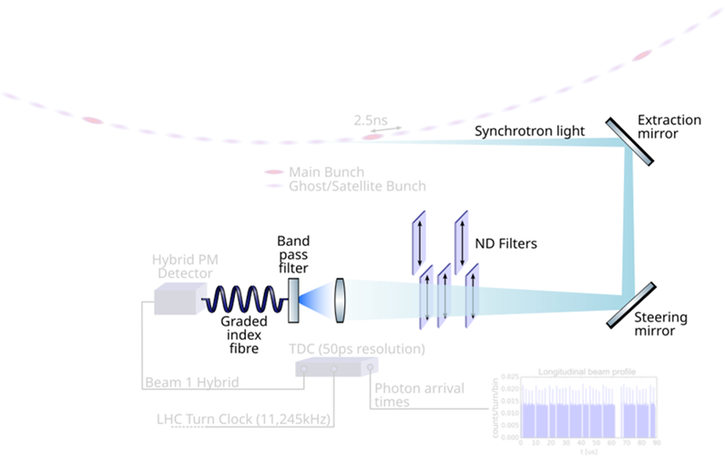

BSRL Components
Optics
Converts photons into measurable electric signal
Detector
Collecting and Controlling rate of photons
Electronics
Give each signal a time stamp relative to the Beam synchronous timing
Analysis
Converts counts in to human readable values e.g.
-relative bunch charge,
-ghost/satellite fraction,
Software
Acquisition of counts
-bunch length
Corrects for detector artefacts
and forms the histogram
Optics
Detector
Electronics
Software
Analysis

Slide 6
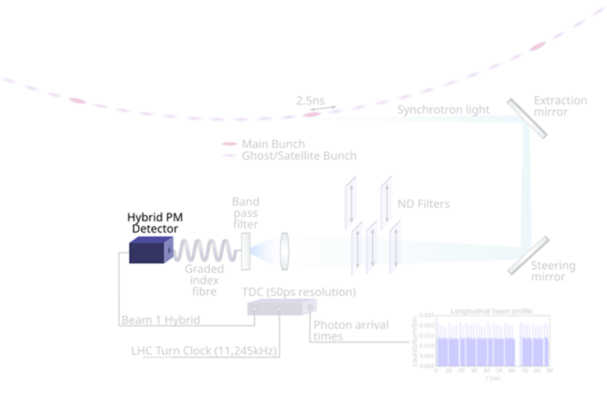
BSRL Components
Optics
Converts photons into measurable electric signal
Detector
Collecting and Controlling rate of photons
Electronics
Give each signal a time stamp relative to the Beam synchronous timing
Analysis
Converts counts in to human readable values e.g.
-relative bunch charge,
-ghost/satellite fraction,
Software
Acquisition of counts
-bunch length
Corrects for detector artefacts
and forms the histogram
Optics
Detector
Electronics
Software
Analysis

Slide 7
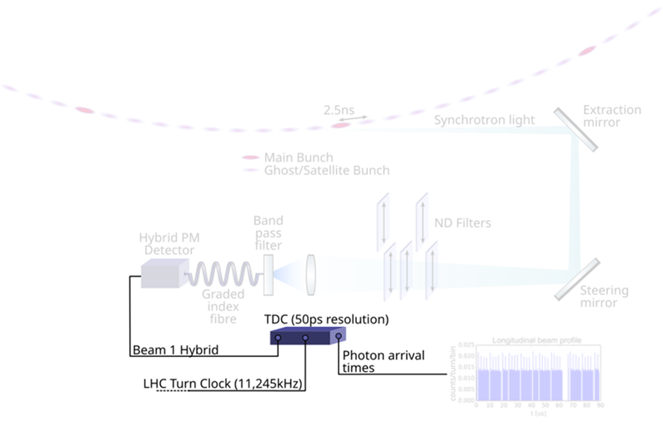
BSRL Components
Optics
Converts photons into measurable electric signal
Detector
Collecting and Controlling rate of photons
Electronics
Give each signal a time stamp relative to the Beam synchronous timing
Analysis
Converts counts in to human readable values e.g.
-relative bunch charge,
-ghost/satellite fraction,
Software
Acquisition of counts
-bunch length
Corrects for detector artefacts
and forms the histogram
Optics
Detector
Electronics
Software
Analysis

Slide 8

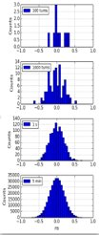
BSRL Components
Optics
Converts photons into measurable electric signal
Detector
Collecting and Controlling rate of photons
Electronics
Give each signal a time stamp relative to the Beam synchronous timing
Analysis
Derive physical quantities e.g.
-relative bunch charge,
-ghost/satellite fraction,
Software
Acquisition of counts
-bunch length
Corrects for detector artefacts
and forms the histogram
Optics
Detector
Electronics
Software
Analysis

Slide 9
Optical Performance
Optics
Detector
Electronics
Software
Analysis
Dispersion
Counting Rate

Slide 10
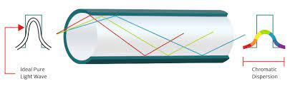
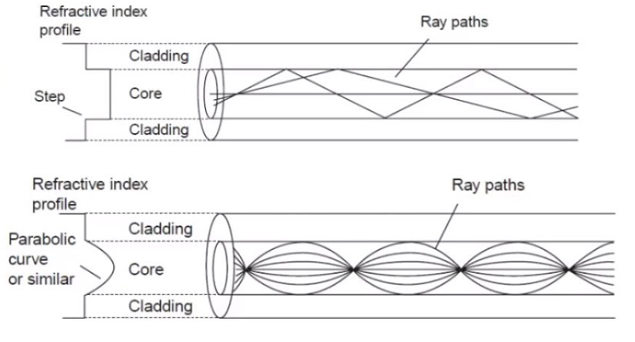
Fibre Dispersion
Optics
Principle
Material dispersion
- Due to light of different wavelength travelling at different group velocities within the fibre
Effect
Dispersion will cause an uncertainty in the arrival time of the photons
Modal dispersion
- Due to different possible paths within the fibre
Broadening measured bunches
Graded fibre is used to reduce Model Dispersion
Step index
Graded index

Slide 11
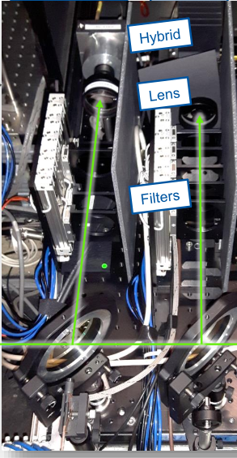
Counting rate
Optics
Principle
The level of light is critical to for the BSRL
Effect
A series of filters on mechanical stages can be introduced reducing the number of photons to an appropriate level
Too low and statistical uncertainty dominates the ghosts/satellites (important at injection)
Too high and the detector/TDC miss counts Distorting the histogram (important at flat top)
The long-term alignment of the optical system is crucial

Slide 12
Detector Performance
Optics
Detector
Electronics
Software
Analysis
Dead Time
After Pulsing

Slide 13
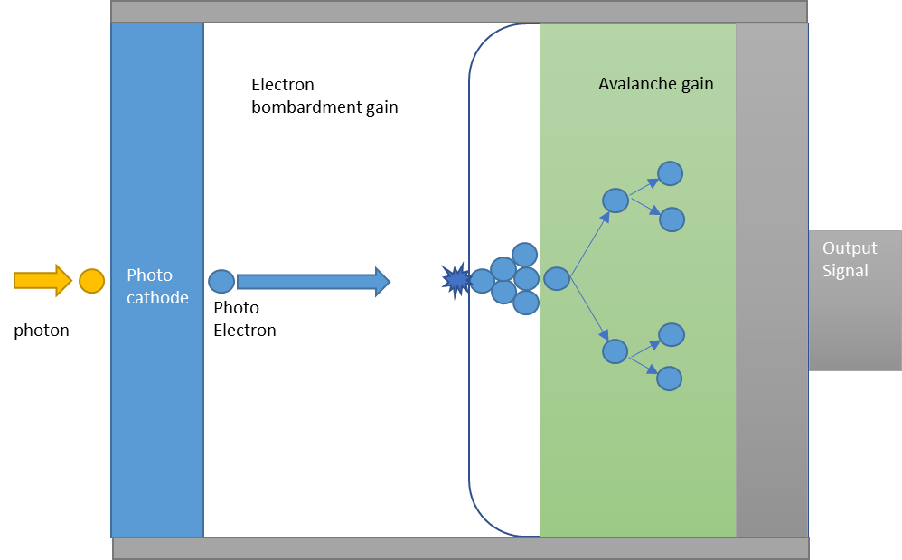
Hybrid Photo Multiplier (HPM)
Detector
Principle
HPM combines
Traditional Photon Multiplier
Avalanche diode
The photons arriving at the HPM liberate a photo electron
Which is accelerated toward an Avalanche diode
Causing the generation of many electron hole pairs
These charge carriers create more electron hole pairs
Further amplifying the signal
Dead Time/Pileup
After pulsing

Slide 14
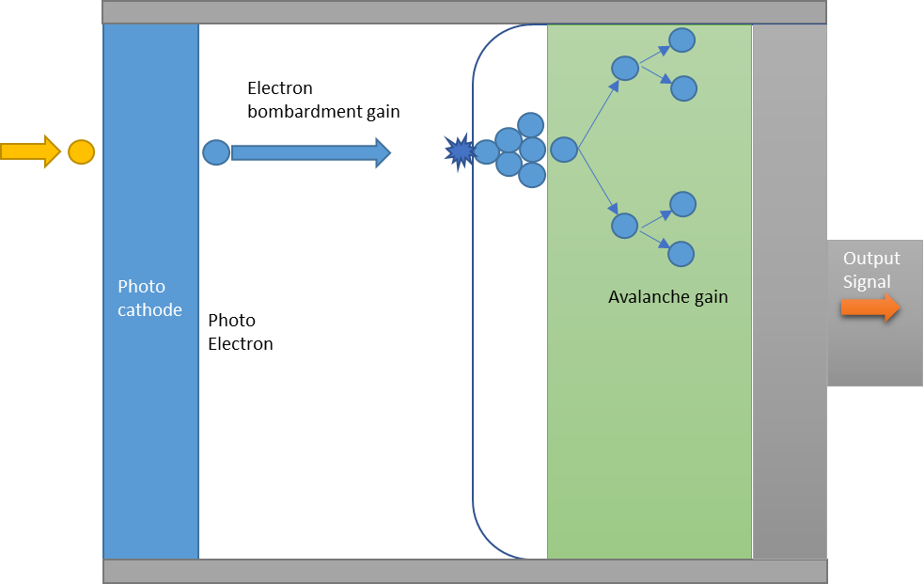
Deadtime
Detector
Principle
While signal is being multiplied the HPM is “unavailable”
Effect
Loss of true counts
More photons won’t be detected
Availability recovers over the ~ 15ns
Can be corrected for if the probability of detection per bunch per turn must be on the order of 1%
photon

Slide 15
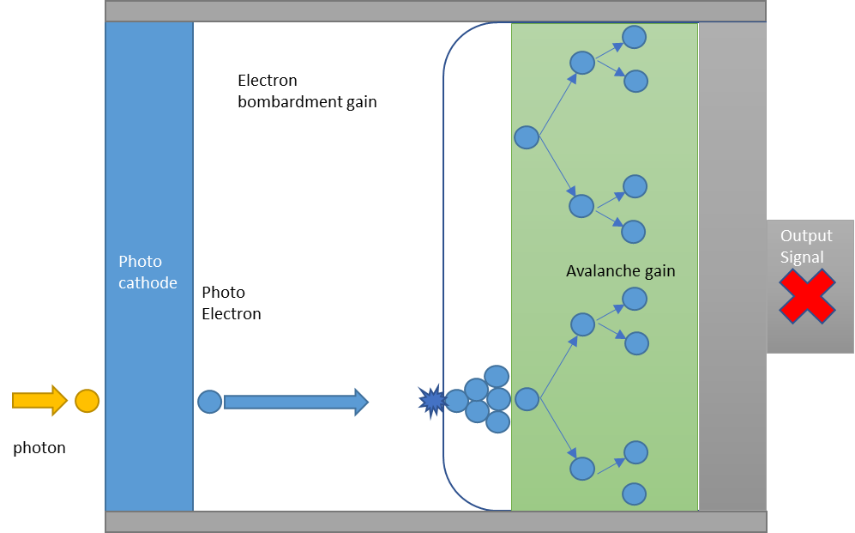
Deadtime
Detector
Principle
While signal is being multiplied the HPM is “unavailable”
Effect
Loss of true counts
More photons won’t be detected
Availability recovers over the ~ 15ns
Can be corrected for if the probability of detection per bunch per turn must be on the order of 1%

Slide 16
Deadtime
Detector
Principle
While signal is being multiplied the HPM is “unavailable”
Effect
Loss of true counts
More photons won’t be detected
Availability recovers over the ~ 15ns
Can be corrected for if the probability of detection per bunch per turn, must be of the order of 1%

Slide 17
After-pulsing
Detector
Principle
Electrons can be backscattered from the bombardment
Effect
False counts propositional to the number of true counts
Still being accelerated toward semi-conductor
Causing a count without a photon
The electron will strike again some time later

Slide 18
After-pulsing
Detector
Principle
Electrons can be backscattered from the bombardment
Effect
False counts propositional to the number of true counts
Still being accelerated toward semi-conductor
The electron will strike again some time later
Causing a count without a photon

Slide 19
After-pulsing
Detector
Principle
Electrons can be backscattered from the bombardment
Effect
False counts propositional to the number of true counts
Still being accelerated toward semi-conductor
The electron will strike again some time later
Causing a count without a photon

Slide 20
After-pulsing
Detector
Principle
Electrons can be backscattered from the bombardment
Effect
False counts proportional to the number of true counts
Still being accelerated toward semi-conductor
The electron will strike again some time later
Causing a count without a photon

Slide 21
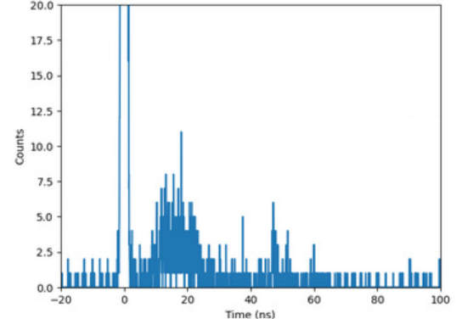
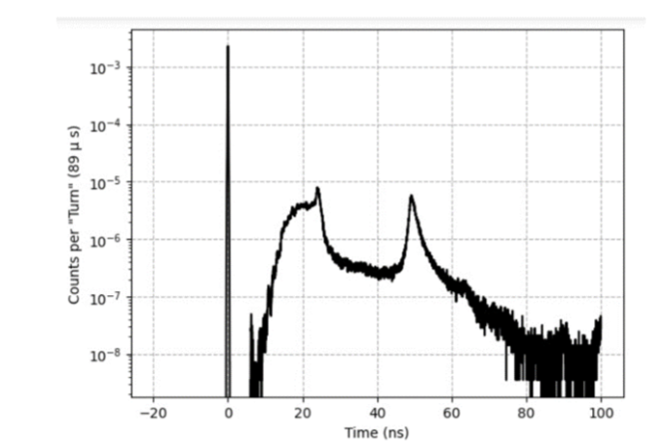
After-pulsing in Raw Histograms
Detector
In raw histogram
Evidence for after-pulsing found in VdM scan fill 8999 (top)
Effect
Only relevant in ghost and satellite buckets following filled bucket
And also observed in lab test (bottom)
Counts of after-pulsing is on the order of ${10}^{−4}$ of the original source
Counts of after-pulsing is on the order of 〖𝟏𝟎〗^(−𝟒) of the original source

Slide 22
Electronics Performance
Optics
Detector
Electronics
Software
Analysis
Timing Source
TDC Internal Time Jitter
Dead Time

Slide 23
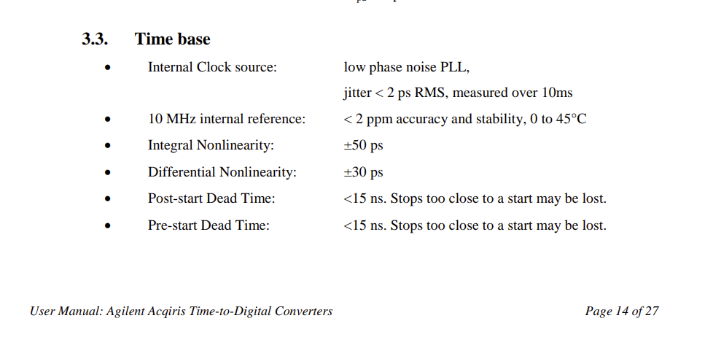
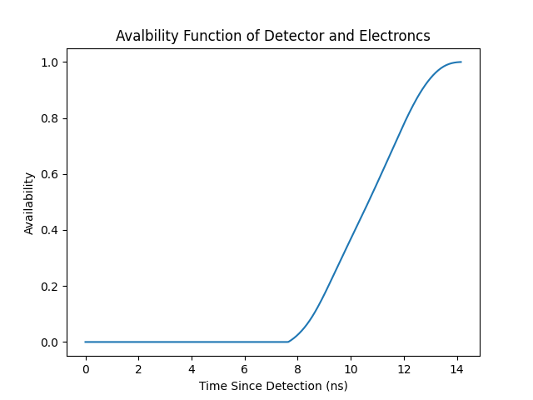
Electronics Dead Time
Electronics
TDC Dead time
This is not expected to be the case with the new TDC*
This is the dominate source of deadtime in the system
A signal arriving shortly after a detection may be lost by the TDC
* See talk of Georgia Sourpi
Measured availability function for the HPM and TDC system

Slide 24
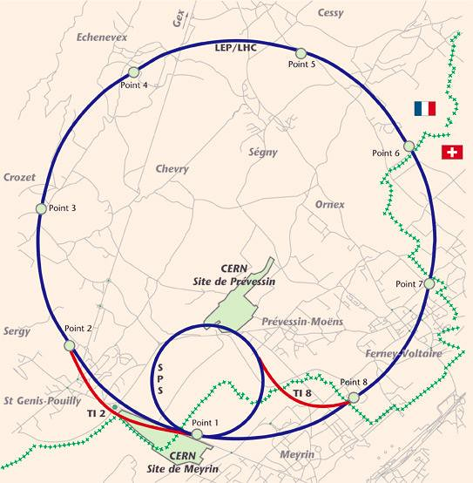
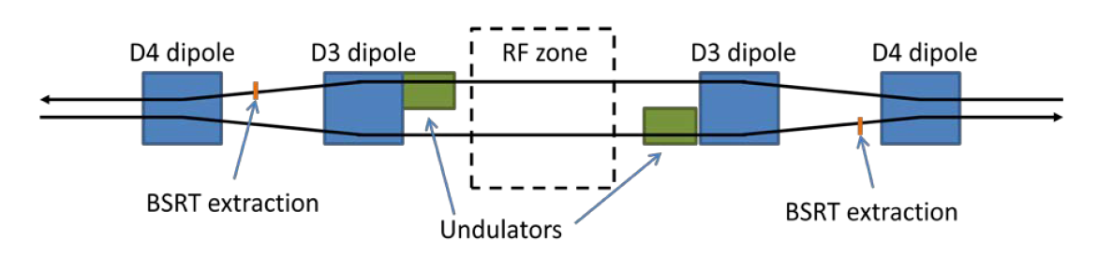
Timing Source
Electronics
Principle
At the start of each turn a signal is transmitted though optical fibre and disseminated throughout the LHC
Timing from the RF
The BSRL and RF systems are both located at Point 4
This timing was estimate to have a jitter of 300ps sigma 1 ns peak-to-peak
To reduce the jitter in the start pulse timing was taken directly from the RF system

Slide 25
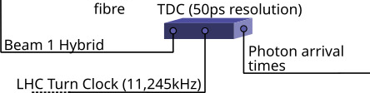
TDC Internal Time Jitter
Electronics
Principle
When a signal is received from the BSRL, the TDC provides a timestamp of the time since the turn start using the 10MHz internal clock which has its own jitter
Effect
An uncertainty in the true arrival time of the photons
Allowing histograms to be constructed over many turns
Measured bunches will be distorted
Bunch length will appear longer

Slide 26
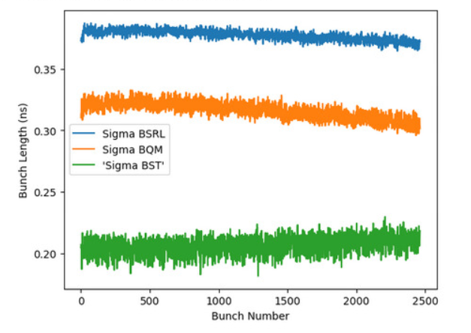

Total Timing Jitter
Electronics
Principle
Calculate what time jitter gaussian best explains the increased bunch length compared to the BQM
Perform fitting on each bunch to get the length in ns
Method
Due to the total time jitter in the system
(fibre, timing source, TDC)
BSRL bunch length measurements are overestimates compared to BQM
We use the difference in bunch length to estimate the total timing jitter in the BSRL
Bunch number
Average bunch length for fill 9055
typical pp-physics fill

Slide 27
Analysis Performance
Optics
Detector
Electronics
Software
Analysis
Deadtime Correction
Background Correction

Slide 28
Deadtime Correction
Analysis
Principle
If the availability function 𝑆 of the detector is well known, then it is possible to correct for deadtime
Effect
Removes the effect of dead time but introduces any errors in the measurement of the availability
Recover the ideal histogram ℎ from the observed counts 𝑐
ℎ=1 −𝑐⊗(1−𝑆)
Measured availability function for the HPM and TDC system

Slide 29
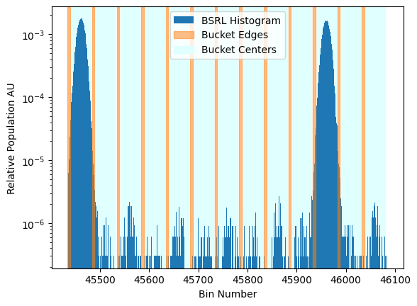
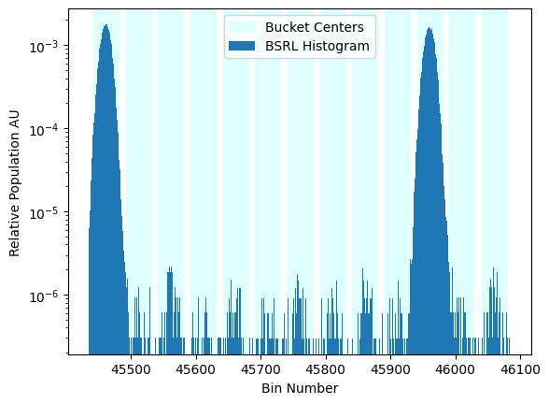
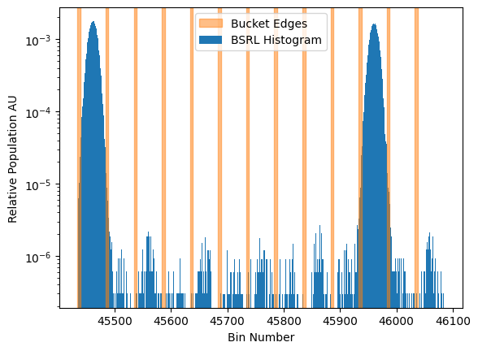
Baseline Correction
Analysis
Bucket edge
Bucket
centre
Principle
Error introduced
If timing errors are large, true counts can enter the edge resulting in corrected buckets with “negative” charge
To estimate the baseline, we calculate the population in the separatrix (charge should be 0 here)
And the main bunch is the integration over bucket centre
We perform a correction for each bucket based on the average of the local baseline

Slide 30
Summary
Issue | Source | Type | Severity | Mitigation Strategy
Dispersion | Optics | Timing | High | Deconvolution Compensation fibre
Count rate | Optics | Counting | Mid/High | Select Integration Time
Dead time | Detector/Electronics | Counting | Mid | Correction Algorithm
After-pulsing | Detector | Counting | Low | Buckets affected are considered invalid
Time jitter | Electronics | Timing | Low | N/A
Time source | Electronics | Timing | Mid | Time taken directly from RF
Dead time correction | Analysis | Counting | Low | measure deadtime for long time
Baseline correction | Analysis | Counting | High | Reduce timing errors

Slide 31
Ongoing Work
Ongoing work
BSRL Performance Simulator Software
Integration Time
Reduction

Slide 32
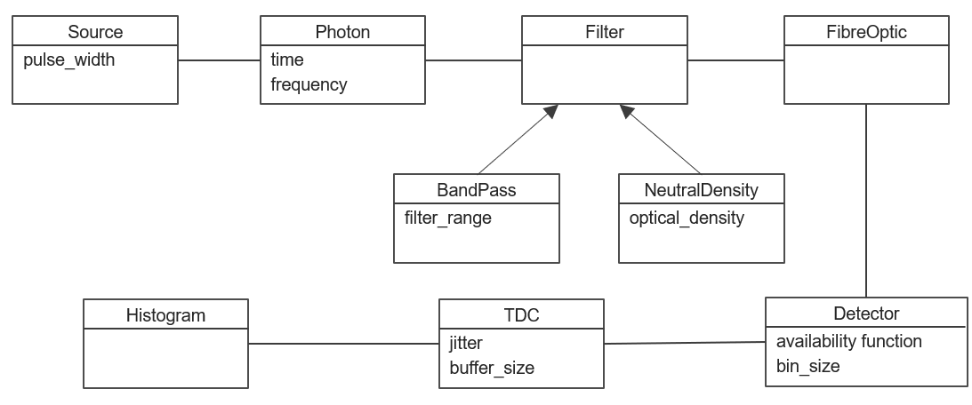
BSRL Performance Simulator Software
Ongoing work
The aim is to create a digital twin of the BSRL with classes representing each of its components
Using Monte Carlo modelling of source, detector, filters and TDC
Future changes beam conditions, or new BSRL designs, can be simulated and their effects on statistical and systematic errors can be evaluated

Slide 33
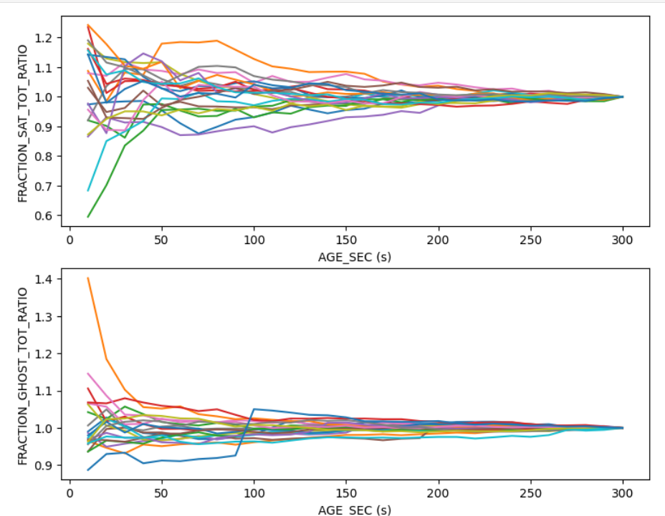
Reducing Integration Time
Ongoing work
Motivation
On Going Work
These values are reported every 5 minutes
We are investigating how the values of derived values converge
There are a number of quantities e.g. bucket charge published by the BSRL
This means the BSRL is blind to many Fast processes
Intermediate histograms are published every 10s
And if the final values can be predicted faster using simple fitting or more advanced machine learning
Run the analysis
Ratio of charge fraction to it’s final 300s value with increasing integration
Data take from the stable beam mode of fill 8999

Slide 34
Conclusion
  We have investigated all error in the BSRL
  Identified those of chief concern
  A simulation suite is being made to evaluate mitigation strategies and new designs e.g. FCC
Ongoing work
  Testing mitigation strategies for dispersion
  Techniques to reduce integration
13/12/2024

Slide 35
Acknowledgements
Manuel Gonzalez Berges, Stephane Bart Pedersen,
Stefano Mazzoni , Miguel Martin Nieto ,Georgia Sourpi
Any Questions ?

Slide 36
Summary
Issue | Source | Type | Severity | Mitigation Strategy
Dispersion | Optics | Timing | High | Deconvolution Compensation fibre
Count rate | Optics | Counting | Mid/High | Select Integration Time
Dead time | Detector/Electronics | Counting | Mid | Correction Algorithm
After-pulsing | Detector | Counting | Low | Buckets affected are considered invalid
Time jitter | Electronics | Timing | Low | N/A
Time source | Electronics | Timing | Mid | Time taken directly from RF
Dead time correction | Analysis | Counting | Low | measure deadtime for long time
Baseline correction | Analysis | Counting | High | Reduce timing errors

Slide 37
Spare slides
(Mitigation Strategies)
13/12/2024

Slide 38
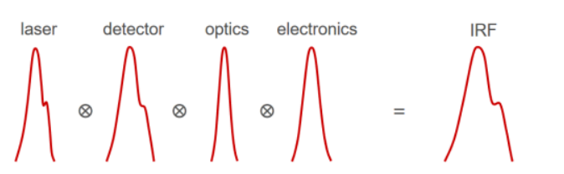
Dispersion Compensation deconvolution
Principle
The bunches measured are a combination of the True bunch size and Instrument Response Function (IRF)
Method
Using iterative Deconvolution, we can estimate the true bunch shape
Improving bunch length, shape and background correction
This technique is used in TCSPC for fluorescence spectroscopy
Timing source
Detector
Optics
Electronics
Total response

Slide 39
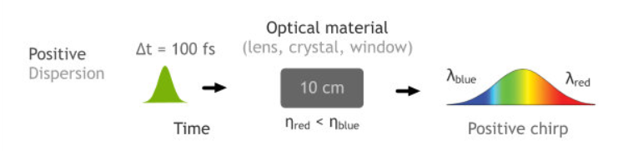
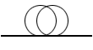

Dispersion Compensation Fibre
Principle
A short fibre can be constructed with opposite dispersion
Allowing all wavelengths to pass though the fibre in the same amount of time
Coupling the fibre leads to loss of light this could be a problem at injection
Long Transport
Fibre
Positive Dispersion
Short Compensation
Fibre
Negative
Dispersion
Compensated
Dispersion

Slide 40
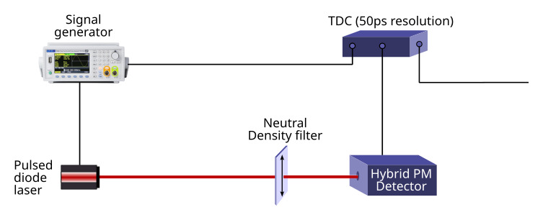
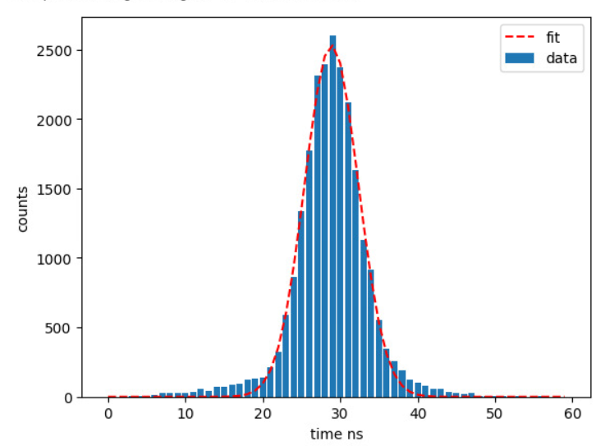
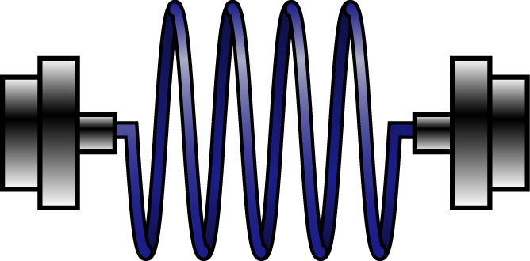
Measuring the effect of the optical fibres
TDC
Fibre optic cable
with coupler

Slide 41
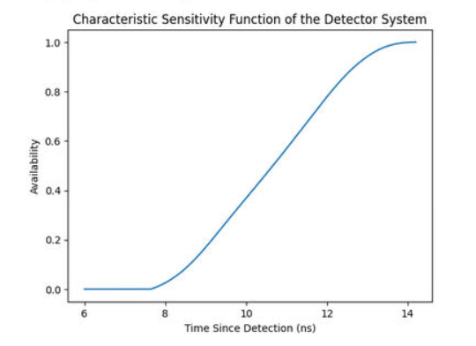
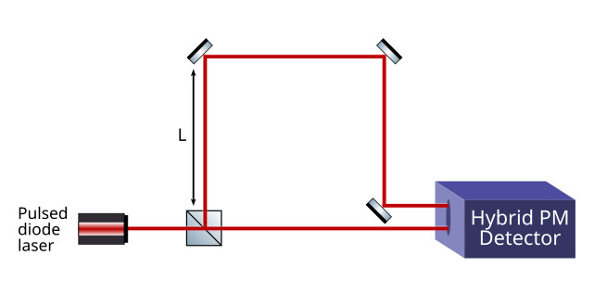
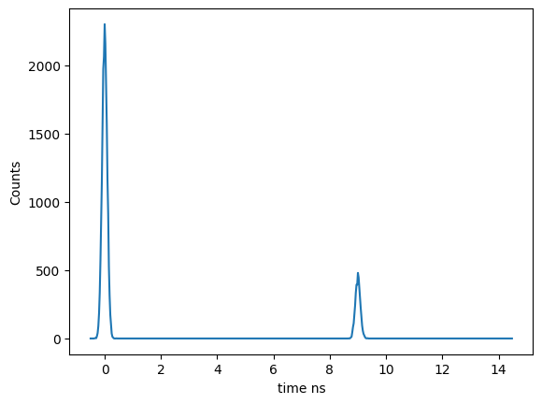
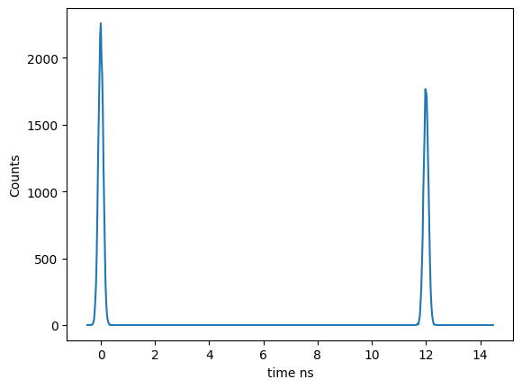
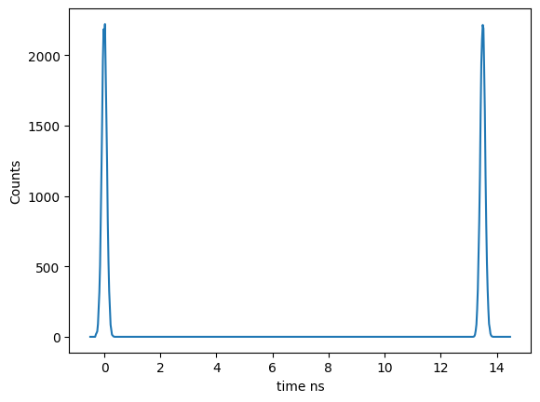





Measuring availability function
Availability function of the detector system
$τ=\frac{2L}{c}$
$$τ$$
$$τ$$
$$τ$$
$$A(τ)=\frac{h_{2}}{h_{1}}$$
h1
h1
h2
h1
h2
h2

Slide 42
Spare slides

Slide 43
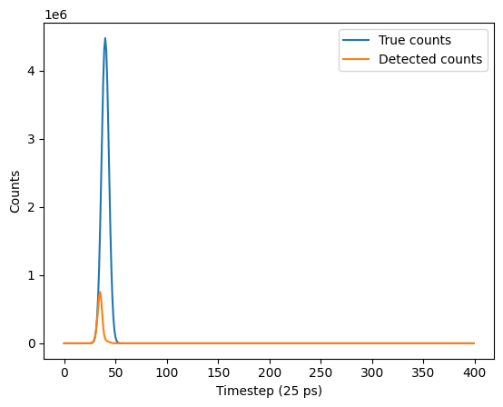
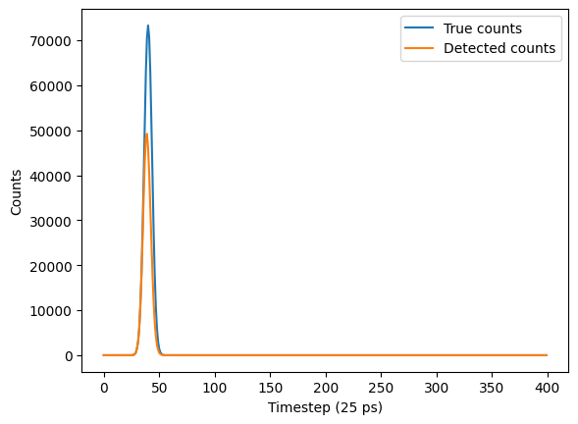
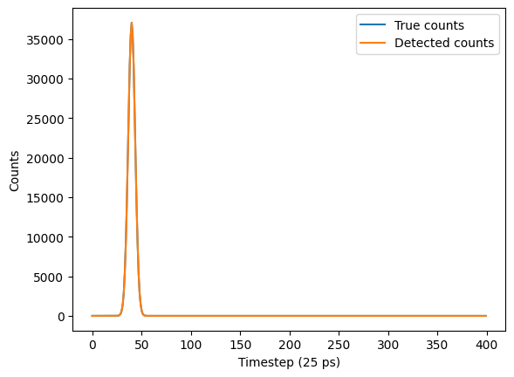
Example: Pile up
1000 photons per pulse
1 photon per pulse
10 photons per pulse
Method
N photon times are drawn from a gaussian distribution
The dead time of the detector causes some counts to be lost (especially at the end of the Pulse)
The effect is worse the more photons per pulse
This illustrates why we must filter the light

Slide 44
Statistical error
Principle
These counts are the sum of poison distributions (divided by the number of turns) and
Error introduced
$k_{lower}=k{\left(1−\frac{9}{k}−\frac{z_{α/2}}{3\sqrt{k}}\right)}^{3}$ $k_{uper}=(k+1){\left(1−\frac{9}{k+1}−\frac{z_{α/2}}{3\sqrt{k+1}}\right)}^{3}$
𝑘_𝑙𝑜𝑤𝑒𝑟=𝑘(1−9/𝑘−𝑧_(α/2)/(3√𝑘))^3 𝑘_𝑢𝑝𝑒𝑟=(𝑘+1)(1−9/(𝑘+1)−𝑧_(α/2)/(3√(𝑘+1)))^3
The confidences interval can be conservatively estimated with the Byar’s method (Rothman and Boice, 1979)[2-3]

Slide 45
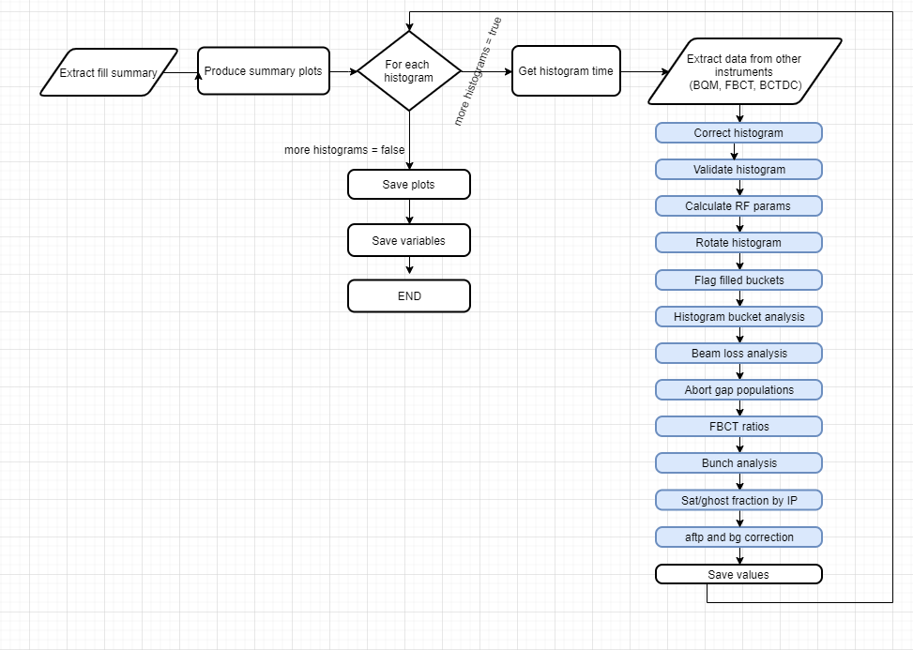
Post Processing
Process
Many steps are necessary to:
I have highlighted those steps relevant to error calculation
Correct for deadtime
Validate histogram
Produce variables such as fractions of ghosts and satellites

Slide 46
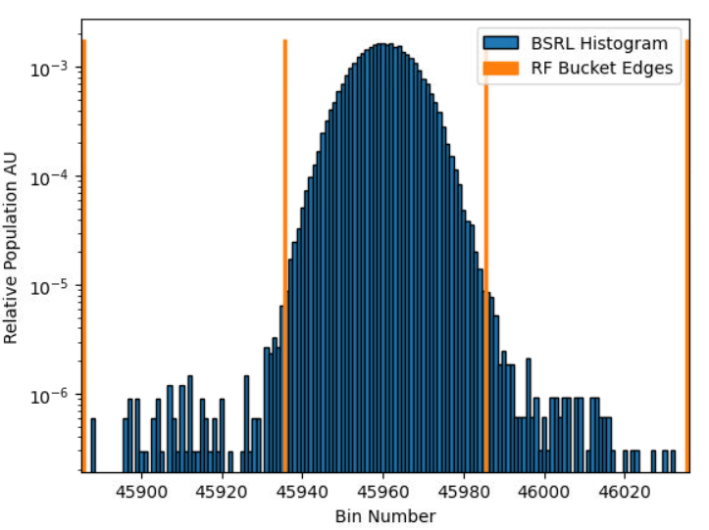
Invalid bucket and bunches
Principle
To account for detector artefacts or optical reflections, some buckets are labelled as invalid
Error introduced
This introduces a systematic error
due to signal spill-over the satellite buckets next to filled buckets are invalidate
Invalidated buckets are replaced with the mean value of their type and parity
$\sqrt{n_{invalid}}σ_{valid }$
where $σ_{valid }$is the standard deviation of all
√(𝑛_𝑖𝑛𝑣𝑎𝑙𝑖𝑑 ) 𝜎_(𝑣𝑎𝑙𝑖𝑑 )
where 𝜎_(𝑣𝑎𝑙𝑖𝑑 )is the standard deviation of all

Slide 47
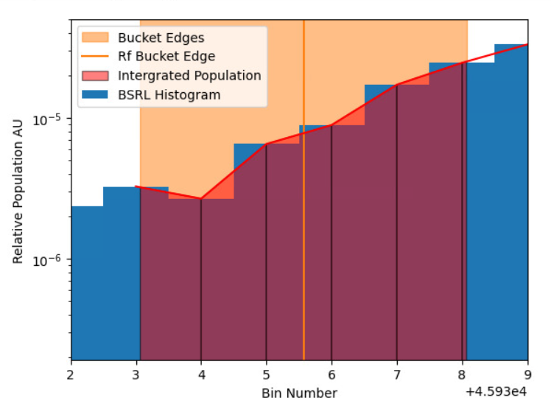
Integration RF buckets
Method
The RF bucket with is not a whole number of bins
The trapezium rule rule to find the charge in each
bucket
bucked edge
and bucket centre

Slide 48
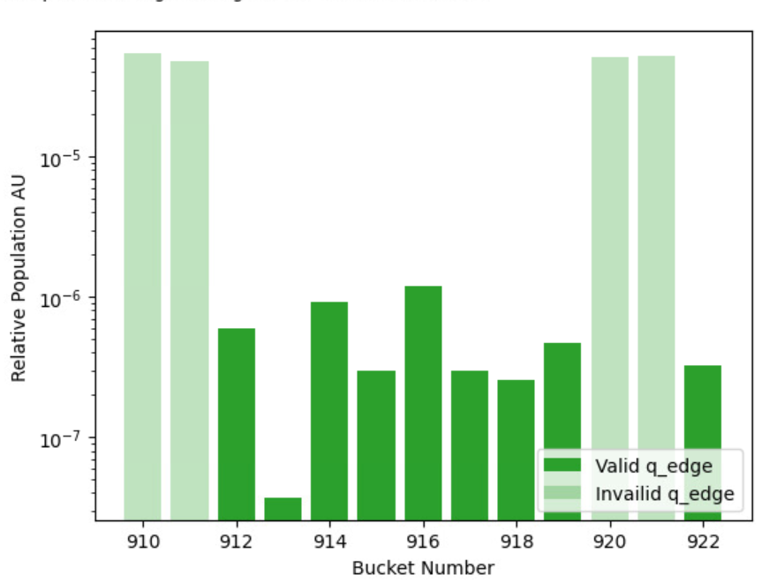
Define Local Baseline
Method
We estimate the background count by averaging the valid edges
in a window around each bucket
Error introduced
$σ_{baseline}=\sqrt{\frac{\sum_{i}^{n}{q_{edges}}}{n_valid}}r$
𝜎_𝑏𝑎𝑠𝑒𝑙𝑖𝑛𝑒=√((∑_𝑖^𝑛▒𝑞_𝑒𝑑𝑔𝑒𝑠 )/(𝑛_𝑣𝑎𝑙𝑖𝑑)) 𝑟
$$q_{basline=}\frac{\sum_{i}^{n}{q_{edges}}}{n_valid}r$$
𝑞_(𝑏𝑎𝑠𝑙𝑖𝑛𝑒=) (∑_𝑖^𝑛▒𝑞_𝑒𝑑𝑔𝑒𝑠 )/(𝑛_𝑣𝑎𝑙𝑖𝑑) 𝑟
$r=\frac{integration width center}{integration width edge}$= $\frac{39}{5}$
𝑟=(𝑖𝑛𝑡𝑒𝑔𝑟𝑎𝑡𝑖𝑜𝑛 𝑤𝑖𝑑𝑡ℎ 𝑐𝑒𝑛𝑡𝑒𝑟)/(𝑖𝑛𝑡𝑒𝑔𝑟𝑎𝑡𝑖𝑜𝑛 𝑤𝑖𝑑𝑡ℎ 𝑒𝑑𝑔𝑒)= 39/5
Window size 11 by default
9 valid edges
8 valid edges

Slide 49
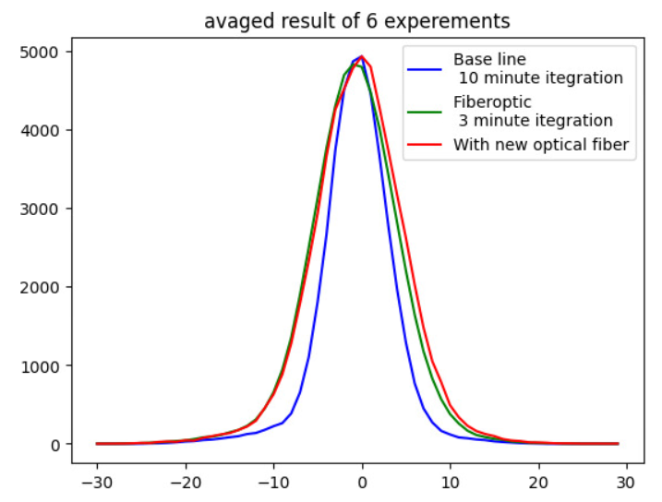
Measuring Dispersion in Optical fibre
FWHM
7.692 bins
10.80 bins 15 m
11.03 bins 5 m
 | FWHM Broadening (ps) | Broadening (ps per m)
Graded index | 77.725 | 5.182
Step Index | 83.275 | 16.655
counts
Material dispersion accounts for 0.717 (per m)
Modal dispersion accounts for less than 57.242 (ps per m)
Time in 25 ps steps

Slide 50
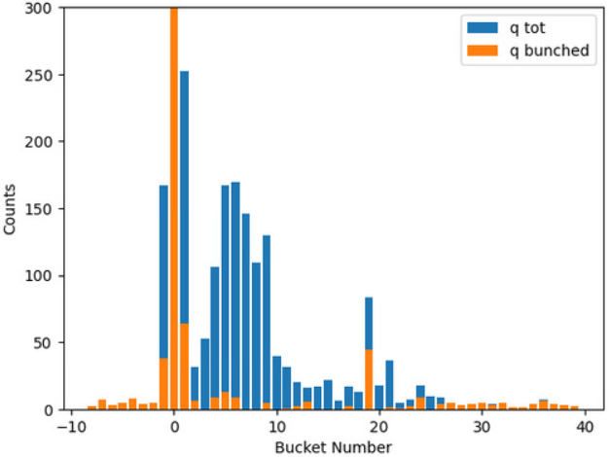
After-Pulsing in Corrected histograms
In corrected histogram
After Converting bin to buckets and correction post processing
After pulsing is still clearly visible in buckets 1-21 after each filled bucket
except for bucket 19, which is labelled as invalid
The existing background process reduces the effect by an order of magnitude
Without baseline subtraction
0.0541% of total charge 41.3% of Satellite charge is accounted for by these after pulsing
The relative heights of these buckets have to be tested for multiple different fills

