Slide 1
EO-BPM: Electro-Optical Beam Position Monitoring for HL-LHC
Daniel Harryman
Contributions: Max Bosman, Stephen Gibson, Thibaut Lefevre, Tom Levens
13/12/2024

Slide 2
Agenda
Concept and Theory
History
Installation
  Position Sensitivity
  Dynamic Range
  Pickup Matching
  Stability
Future Developments:
  Stability
  Dynamic Range
  Matching
Future

Slide 3
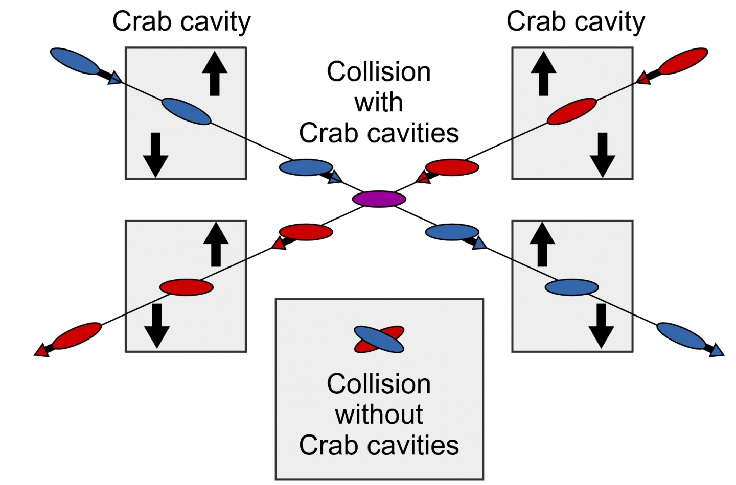
Concept and Theory
Crabbing will be used on HL-LHC bunches to increase luminosity.
Crabbing changes the bunch tilt to increase the overlap area of the two bunches.
Residual crabbing on the bunch is expected to be ~30μm.
Measuring the tilt on the bunches gives difficult requirements:
  Bunch intensity: 3x10⁹ – 2.2x10¹¹
  Bunch length: ~1ns
  Bandwidth: >5GHz
  Time resolution: 50ps
  Position resolution (Pilot/Nominal): 100/10μm

Slide 4
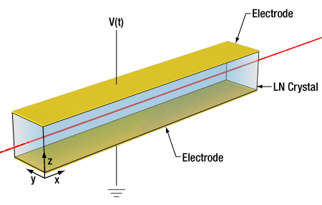
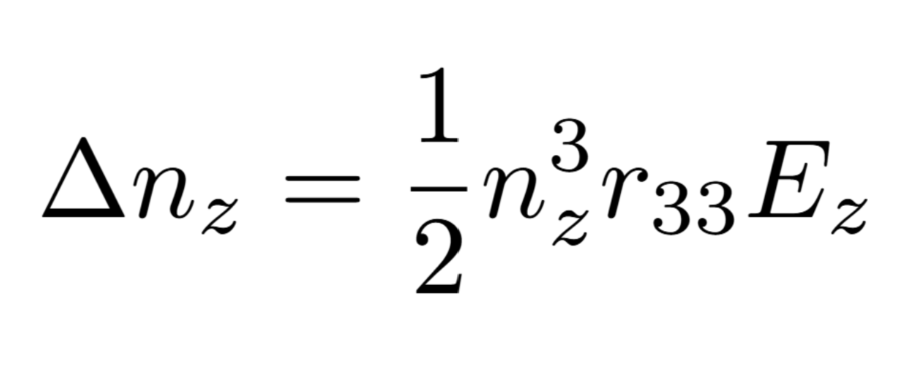
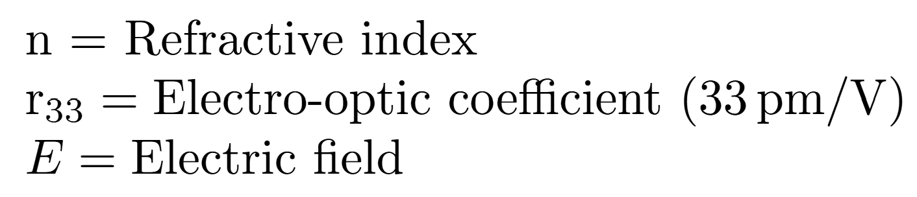
Concept and Theory
Birefringent lithium niobate crystals undergo a linear change in refractive index when subjected to an electrical field.
The change in refractive index induces a linear phase shift in a laser passing through the crystal.
This effect has a rapid time response. COTS modulators can have an analogue bandwidth >30GHz.
Notes:
$V_{\pi}= - \frac{\lambda g}{n_3^3 r_{33} L \Gamma}$
$\Delta \phi = - \frac{\pi L}{\lambda} n_3^3 r_{33} \frac{V}{g} \Gamma$

Slide 5

Concept and Theory

Slide 6


Concept and Theory

Slide 7


Concept and Theory

Slide 8
Concept and Theory

Slide 9
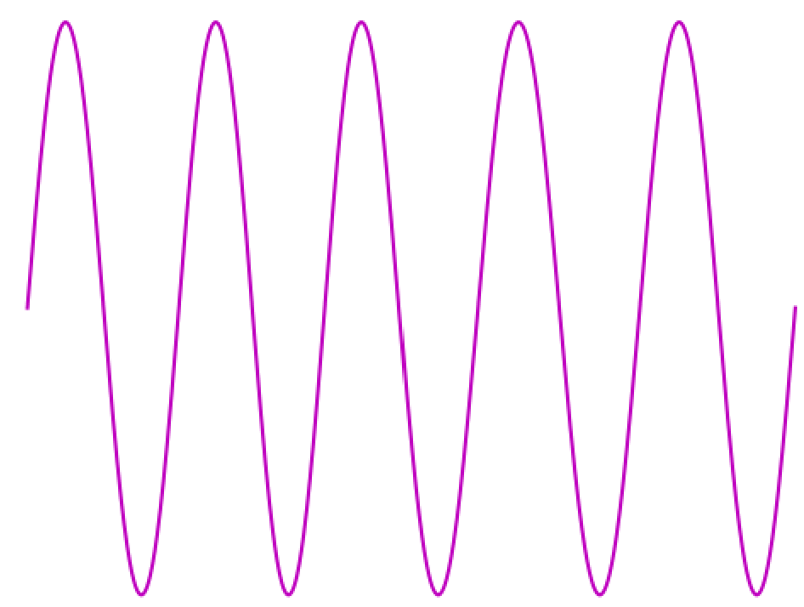
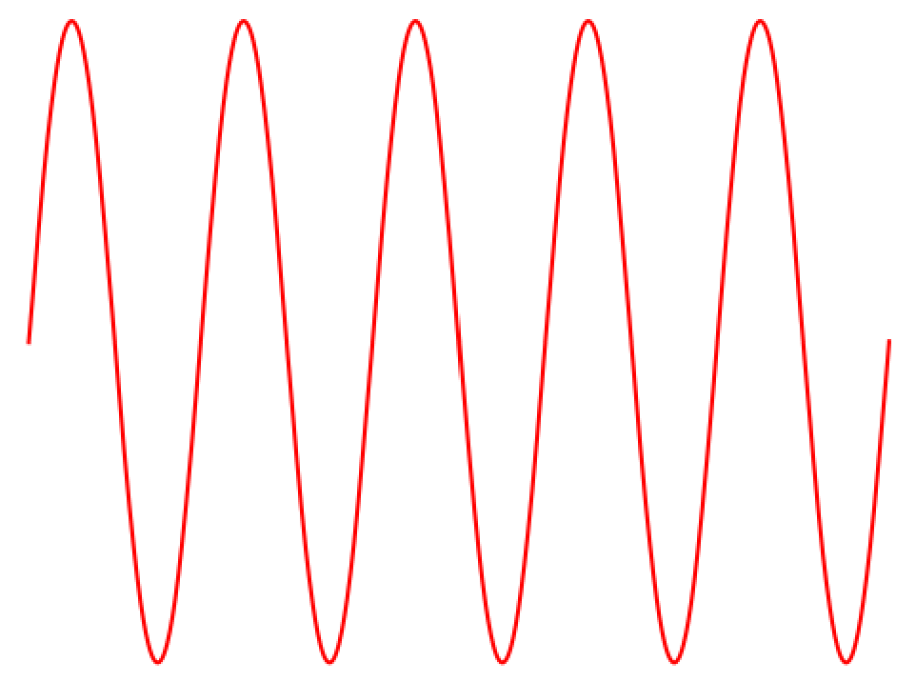
Concept and Theory

Slide 10
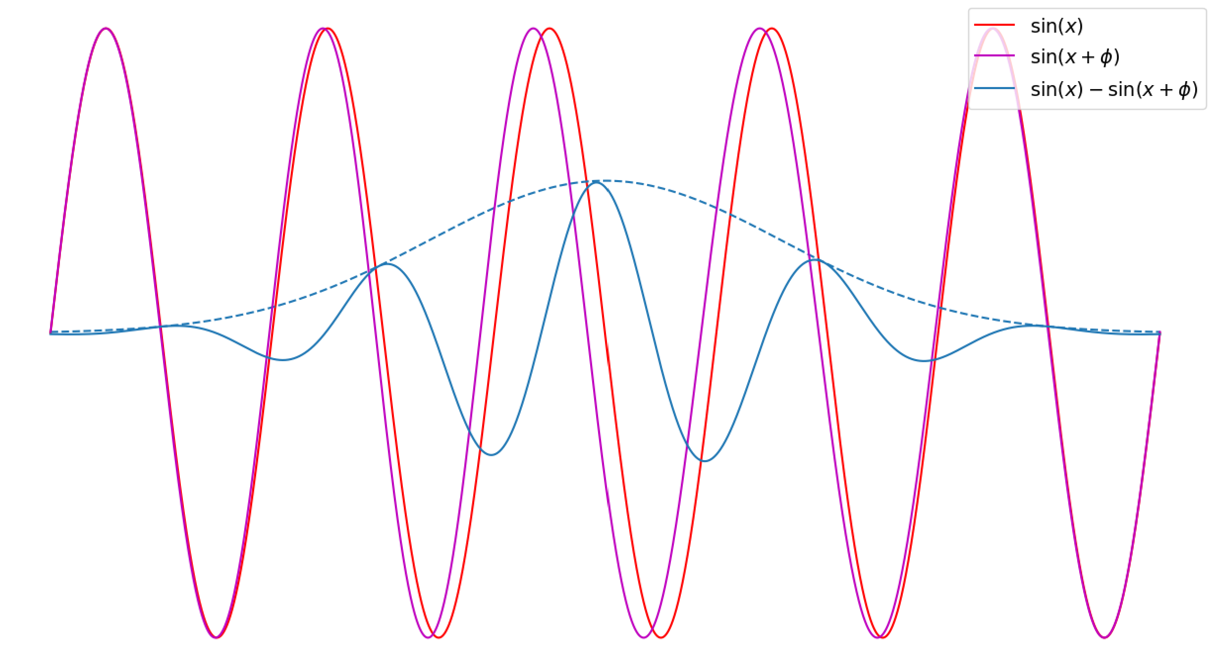
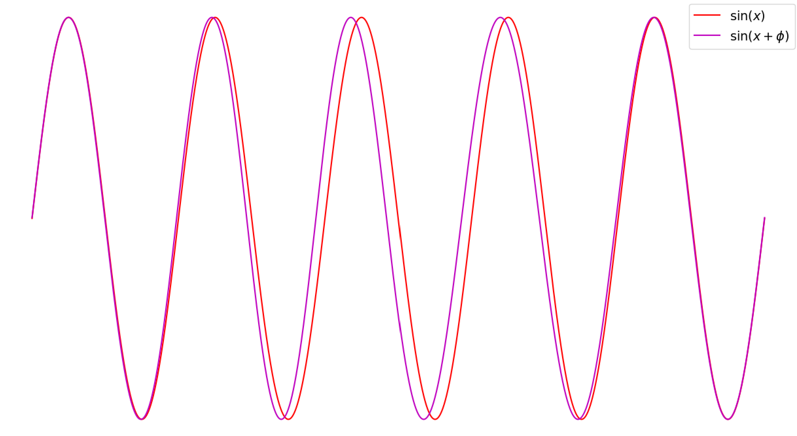
Concept and Theory

Slide 11
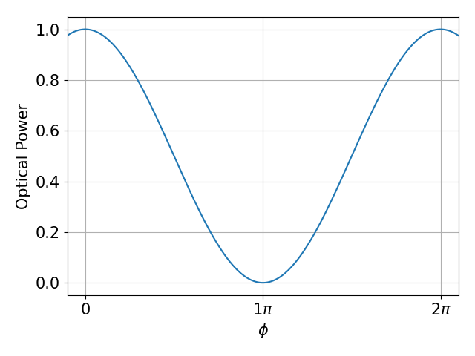

Concept and Theory
Large intensity change
Small intensity change

Slide 12
Installation

Slide 13
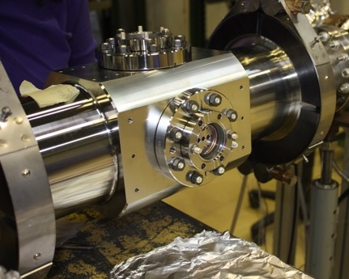
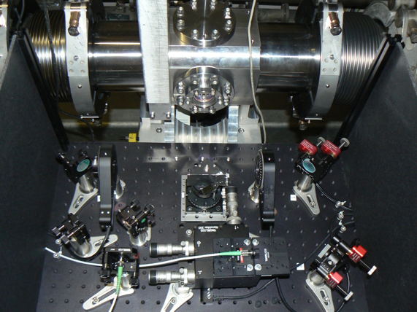
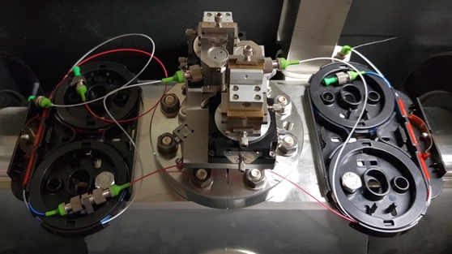
Installation History
2016: Original SPS design using bulky free-space optics with a polariser/analyser
2018: Installation of a compact interferometric design in SPS
2021: Optimised fully fiber-coupled waveguide design
2021: Beam tests in HiRadMat
2022: Beam tests in CLEAR
2024: SPS installation waveguide design

Slide 14
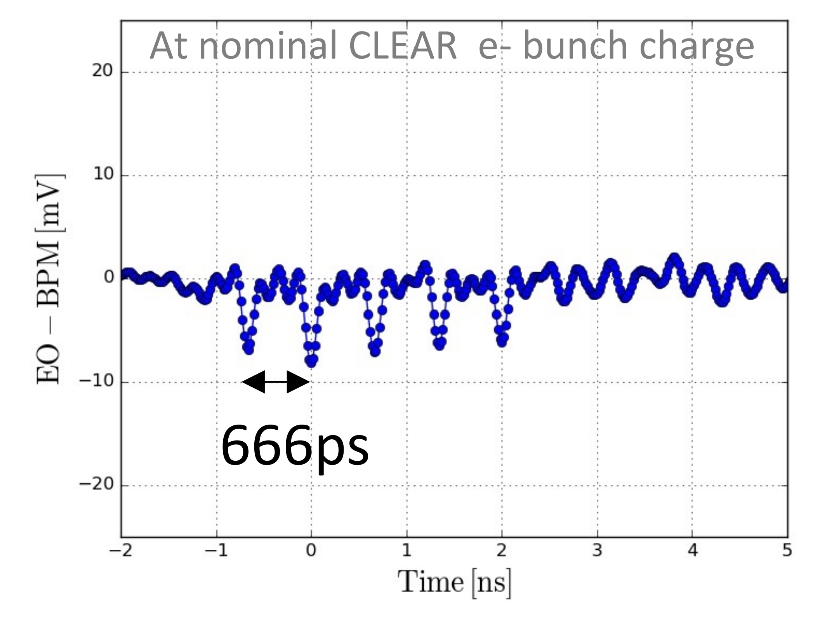
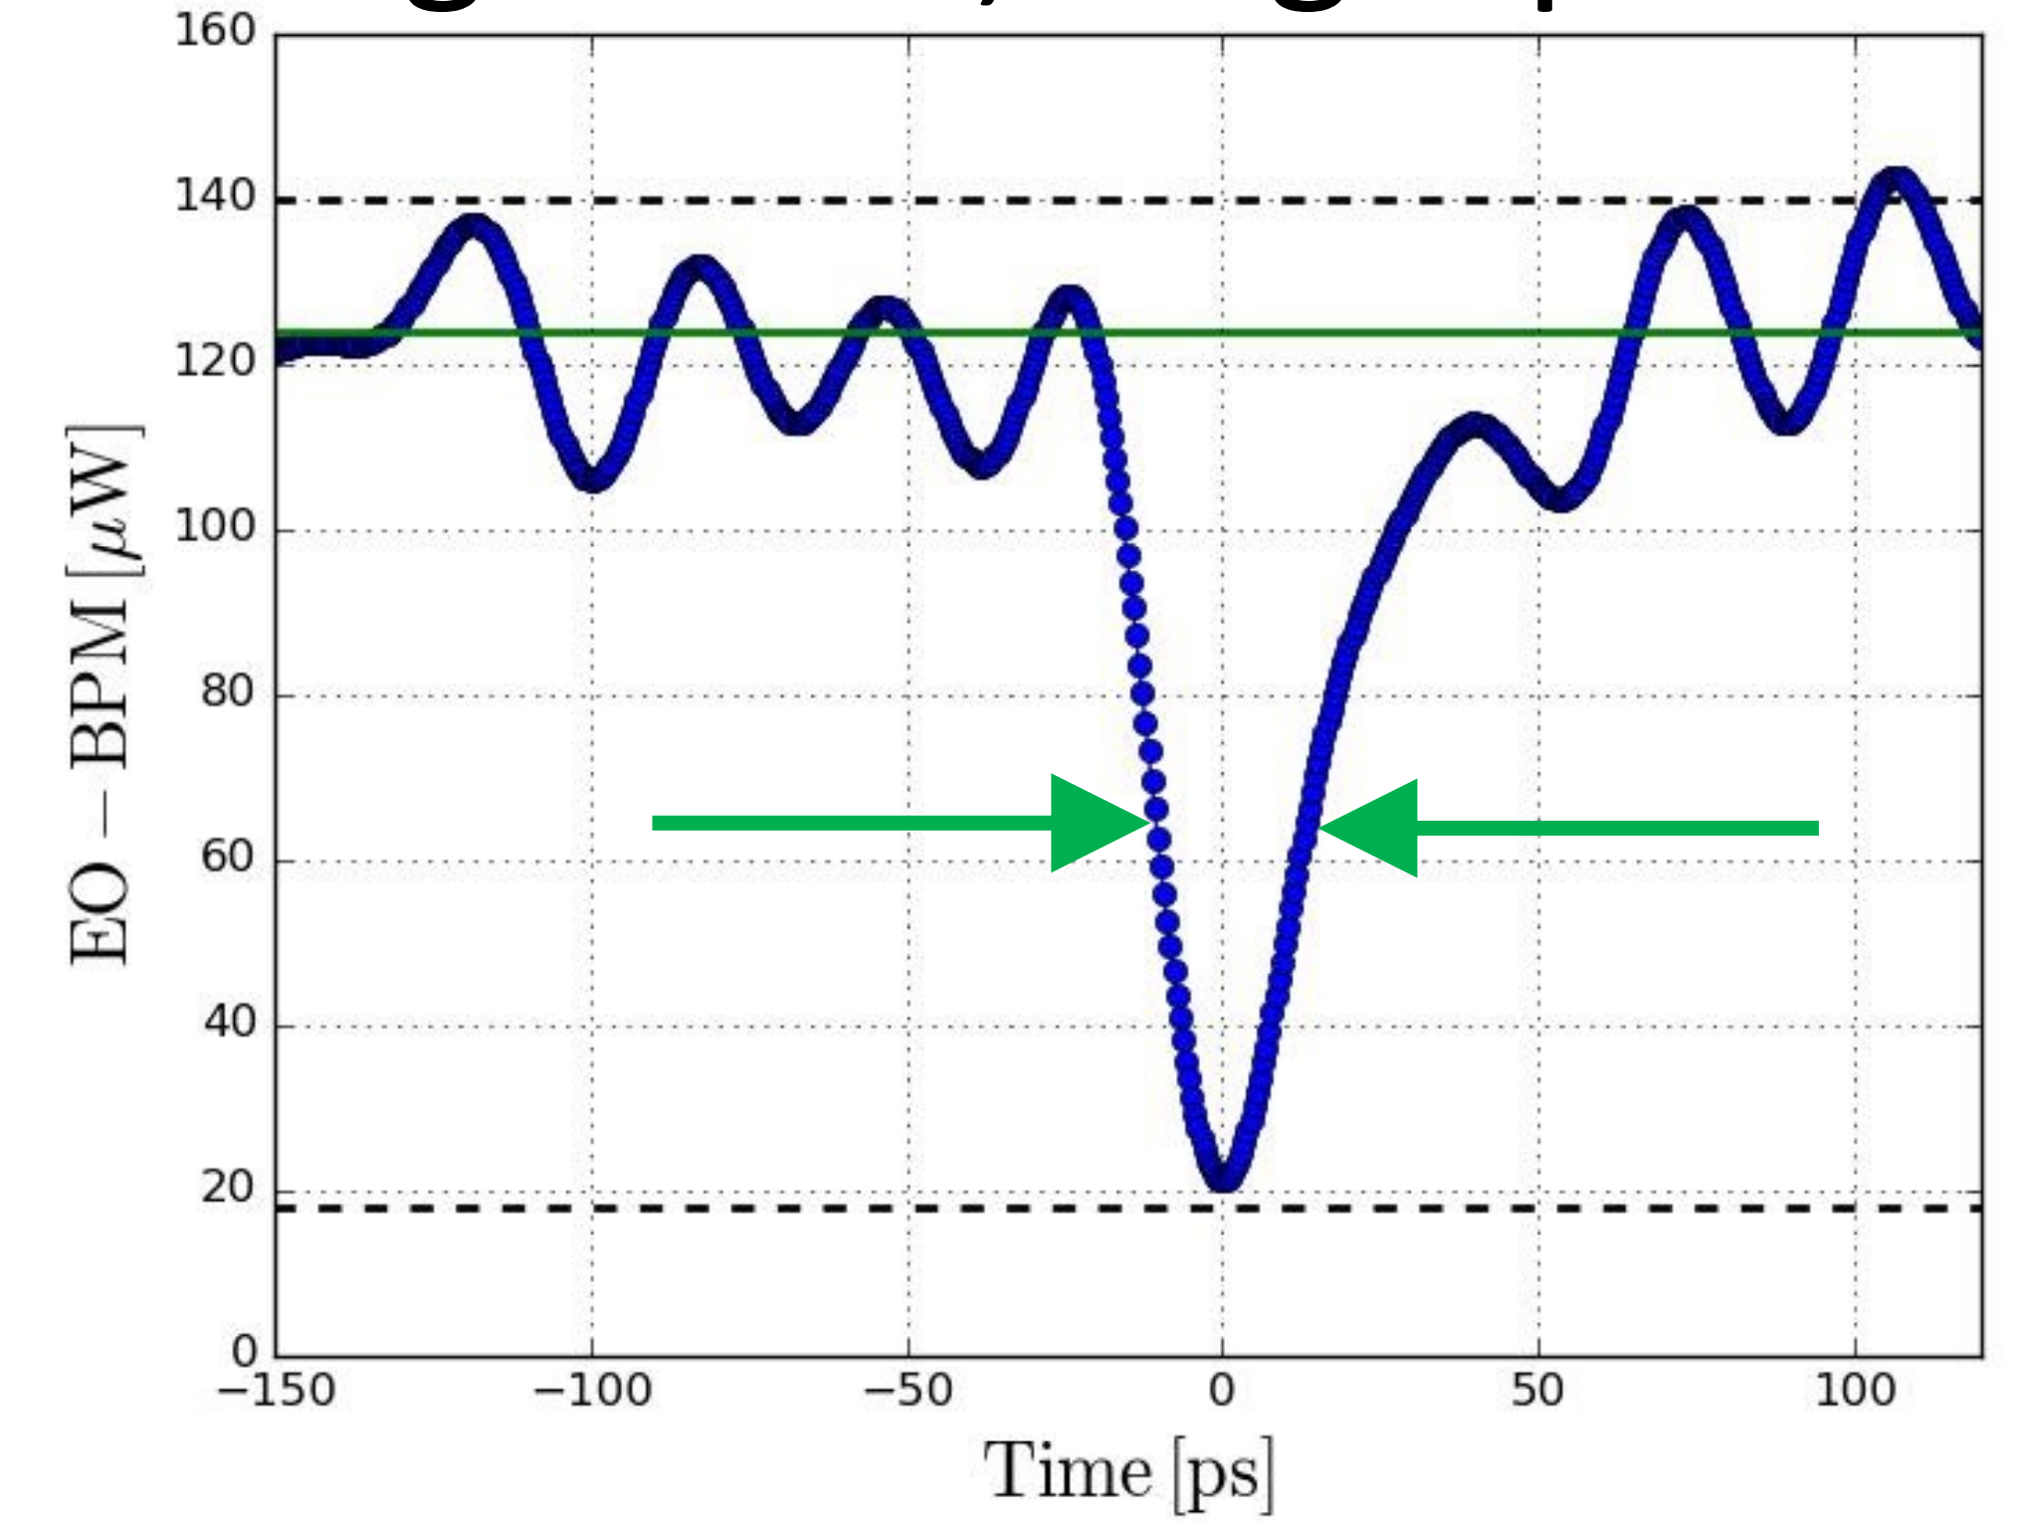
Installation History: CLEAR & HiRadMat
Single Shot, Pulse Train
Measurements from a 5 bunch electron train show that a bunch spacing of 666ps (1.5GHz) was observable.
With an upgraded detector, the pulse width indicates the time resolution of EO pick-up is well within the < 50 ps specification required for the HL-LHC measurement of 1ns bunches
HiRadMat experiments demonstrated a 3GHz response, limited by a 3GHz low pass filter in the detector chain.
Single Shot, Singe Pulse

Slide 15
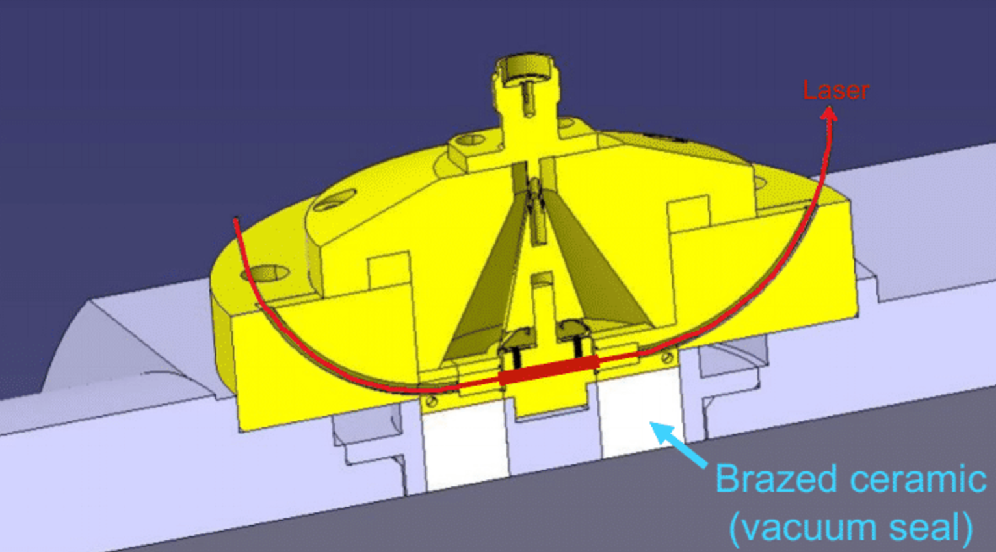
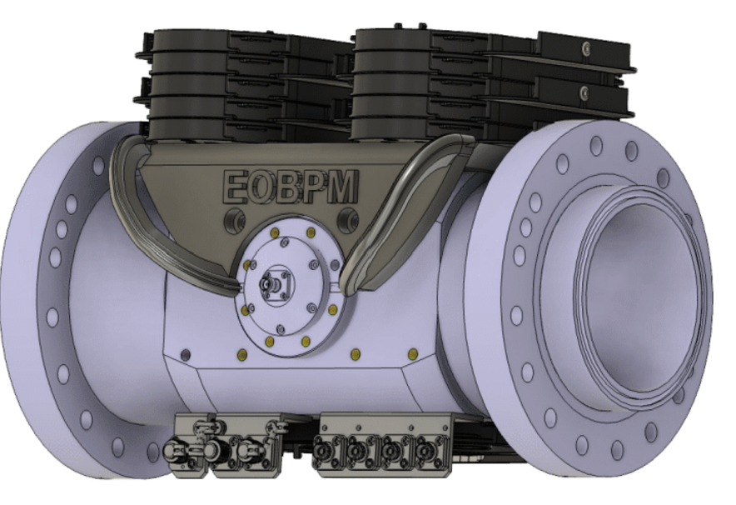
SPS Installation
A button electrode connects to the lithium niobate crystal.
A fibre is passed through the crystal connecting it to the laser and splitter tree.
A waveguide is cut into the top of the crystal to amplify the signal.
A stack if fibre trays are mounted on the top of the instrument to build the splitter tree.

Slide 16
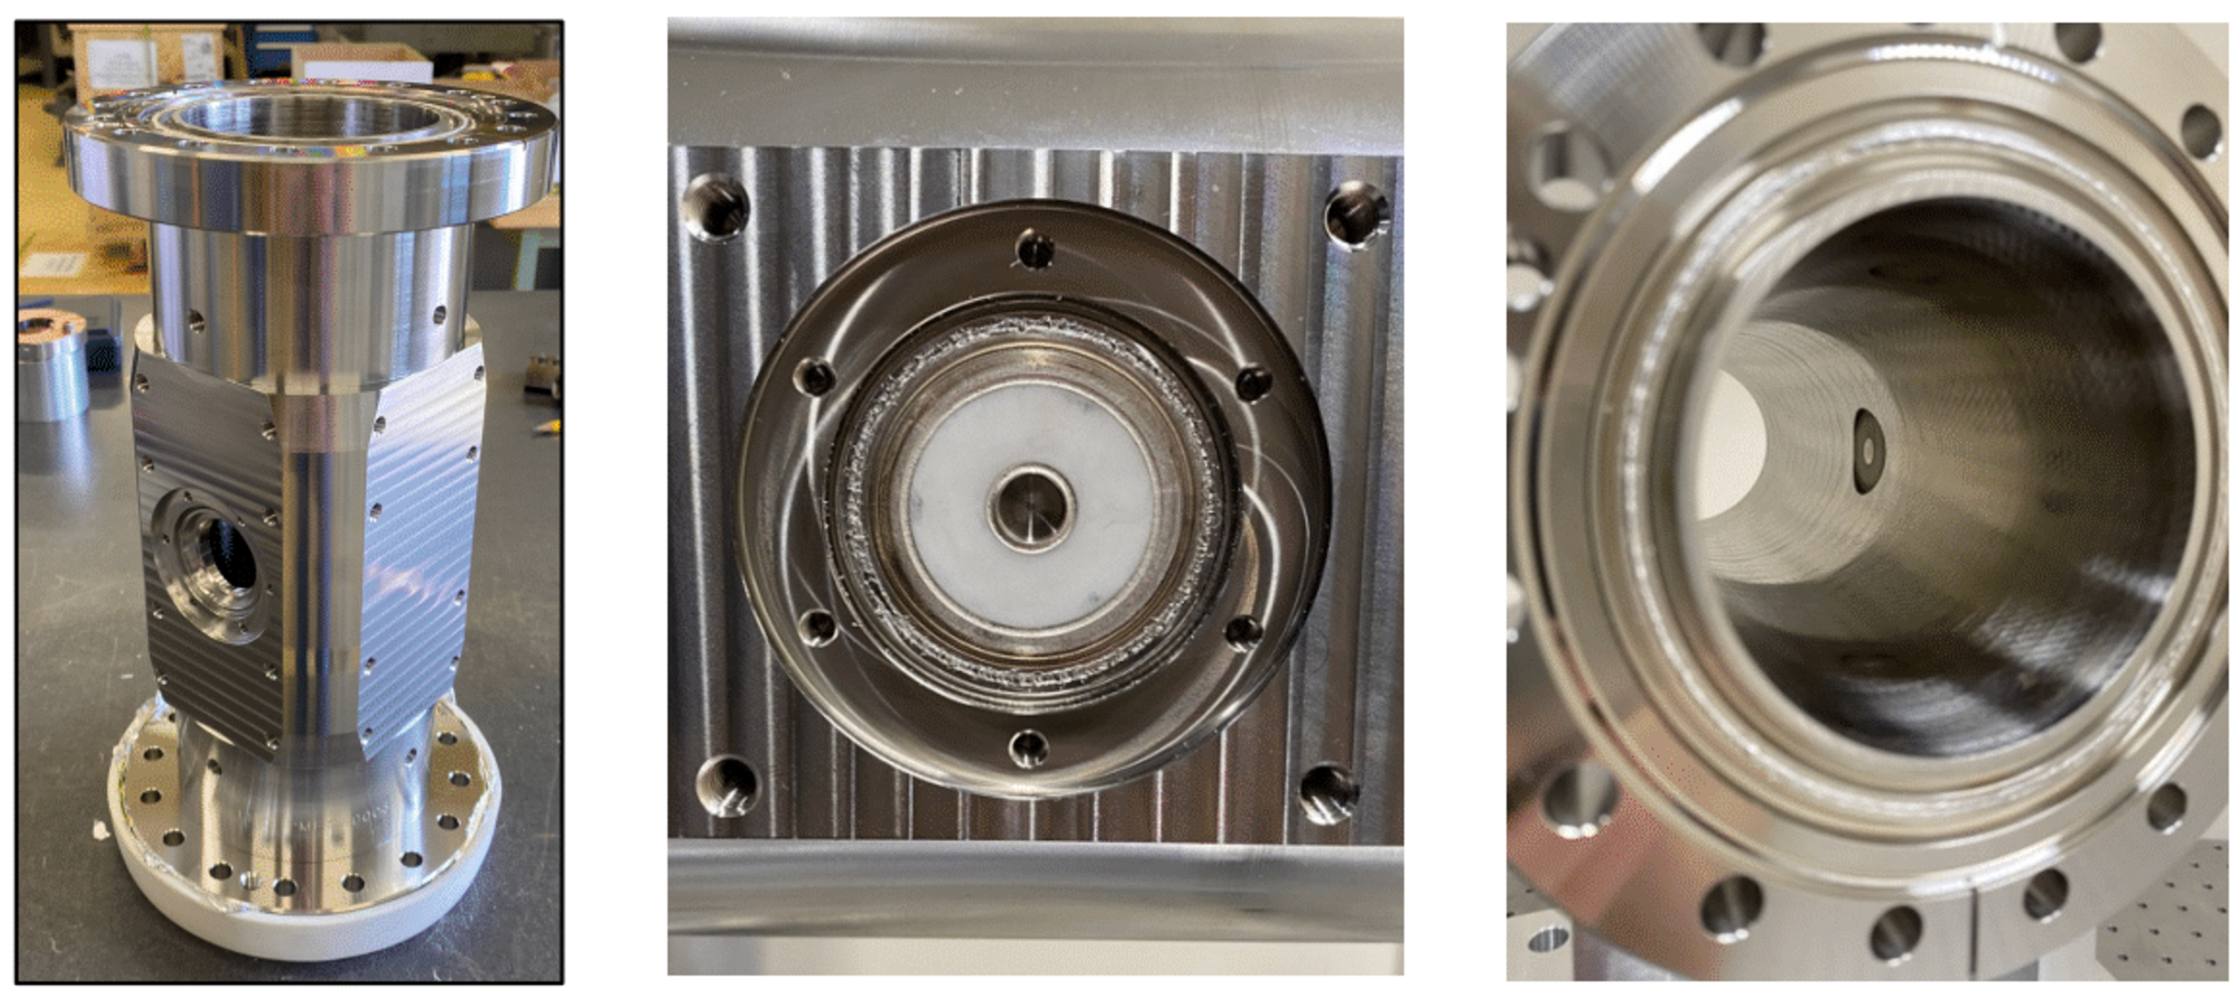
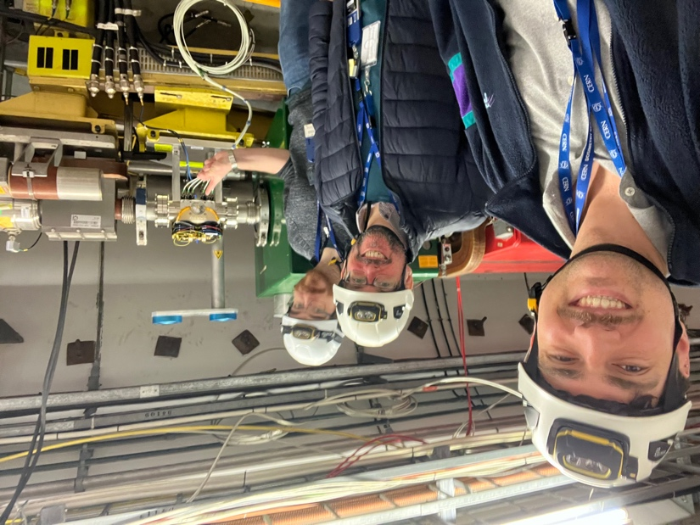
SPS Installation
Installation was delayed (~1 year) due to vacuum leaking in the ceramic seals.
System was finally installed this year (2024) in the SPS.
System is located 18m upstream of a stripline BPM, used as the SPS head-tail monitor.

Slide 17
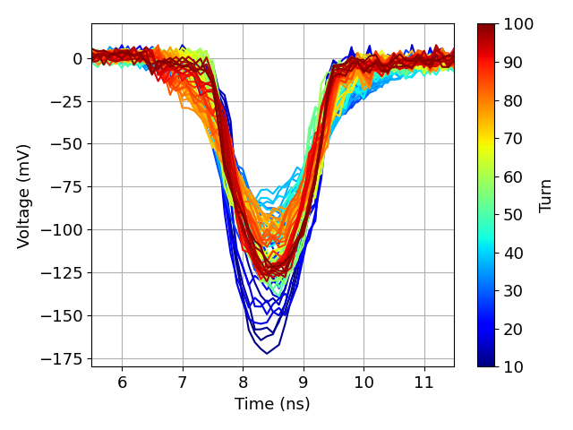
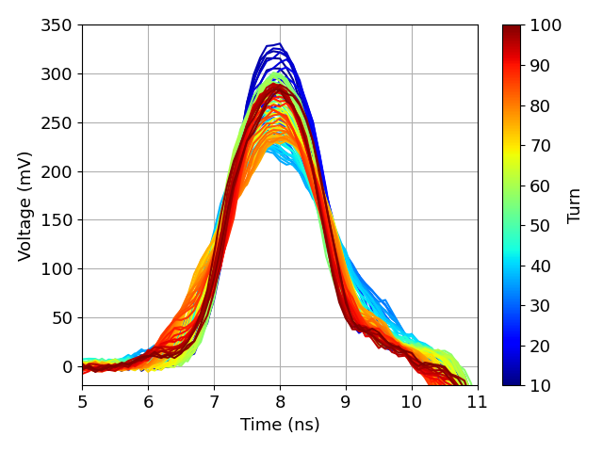
SPS Installation: Raw Data
To examine the performance of the EO-BPM signals are compared between the EO-BP and the stripline BPM.
The raw signals from the EO-BPM exhibit a similar bunch response to the stripline BPM.
EO-BPM Δ
Stripline Σ

Slide 18
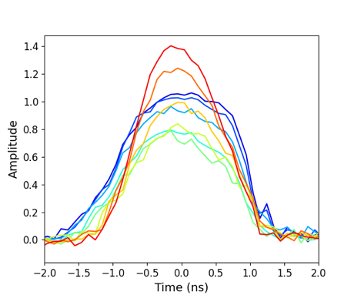
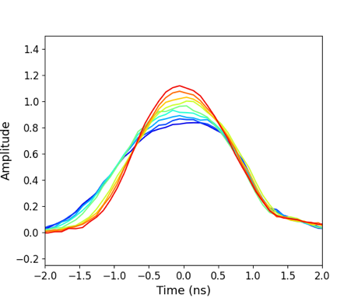
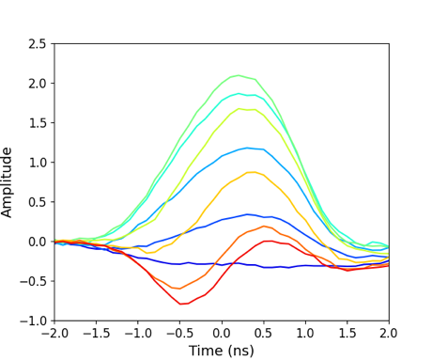
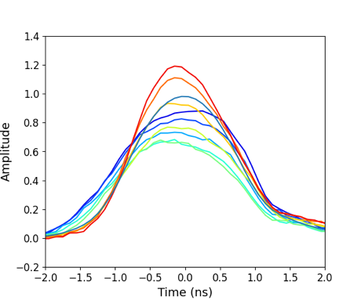
SPS Installation: Raw Data
Examining he signals closer the EO-BPM Δ channel appears as a combination of the Stripline Σ and Δ channels.
This is due to an imbalance between the left and right EO-BPM pickups.
EO-BPM Δ
Stripline Σ
Stripline Δ
Stripline Σ Δ Combination

Slide 19
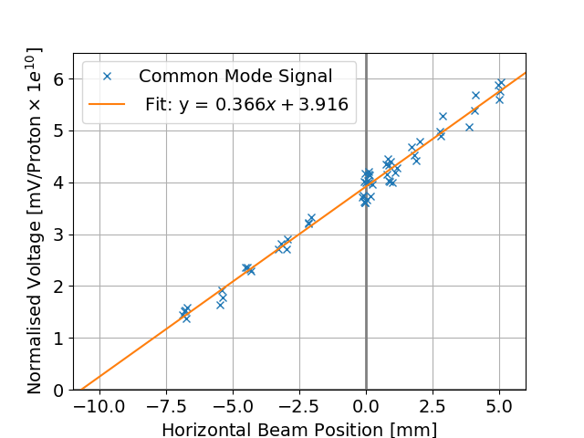
SPS Installation: Position Sensitivity
Bumped beam in the SPS. Correlated EO-BPM Δ response with local BPMs.
10 mm mismatch between optical centre and beampipe
Assembly inconsistencies cause stronger electro-optic response
of the left crystal
Analysis show 3.5 dB difference;
10 μm displacement was 10 dB

Slide 20
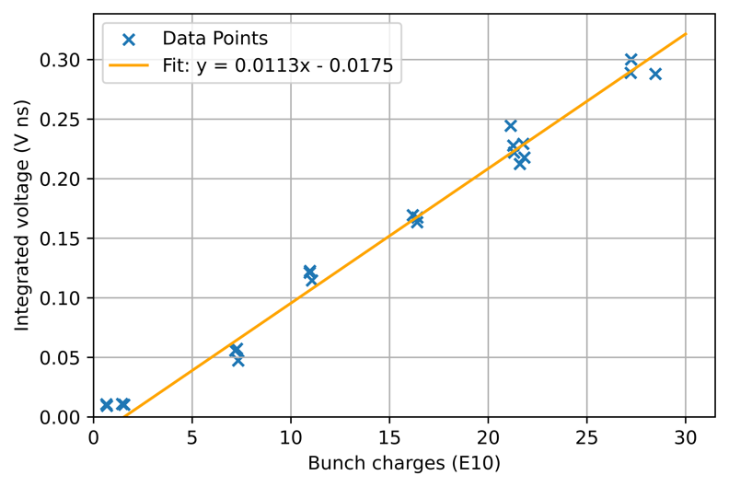
SPS Installation: Dynamic Range
Variability of bunch types requires the EO-BPM to cover the dynamic range of the SPS (3x10⁹ – 2.2x10¹¹)
Each data point is 100 averaged turns of a bunch taken at injection
Data shows a clear linear response in output voltage
Trendline intersects x axis at 1.5x10¹⁰: no signal below this bunch charge

Slide 21
Future Developments

Slide 22
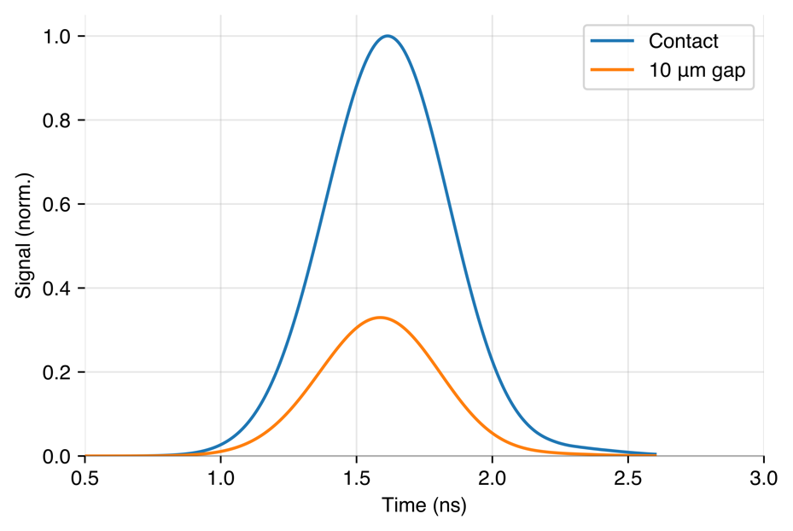
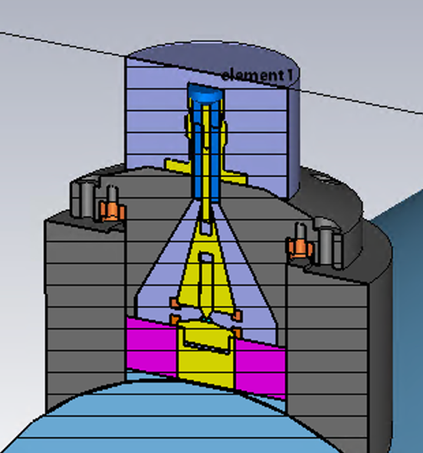
Developments: Matching
Data shows there is a large mismatch between the two pickups.
Simulations show this if an electrode in the mechanical assembly is off by 10μm signal drops 10dB.
10 dB
LNB

Slide 23
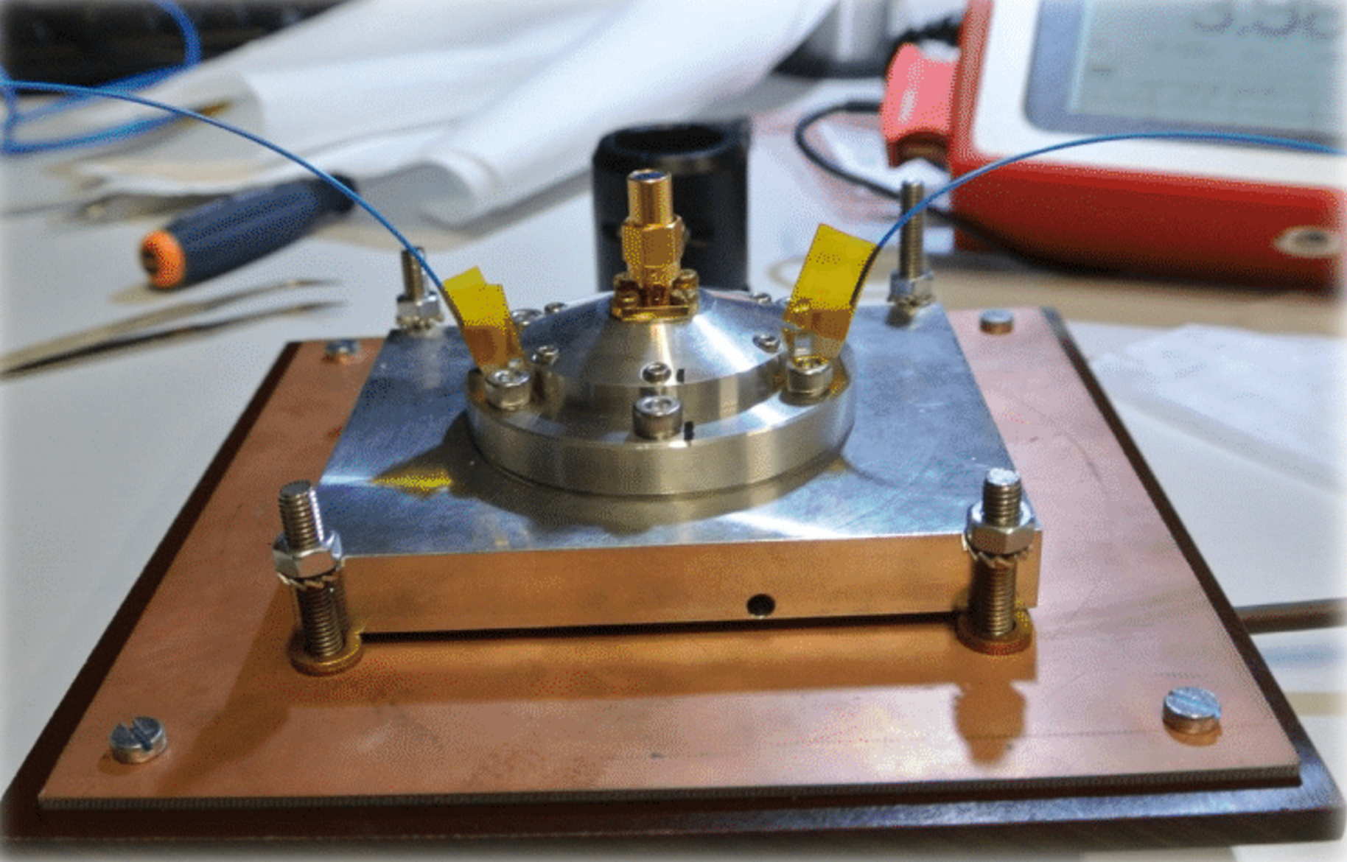
Developments: Matching
Pickups redesigns with mechanical adjustability are currently being simulated.
Lab testing of new pickup housing will ensure matching before installing.

Slide 24
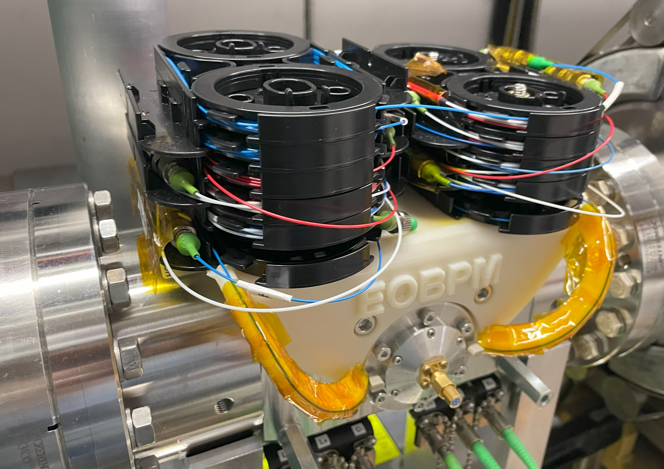
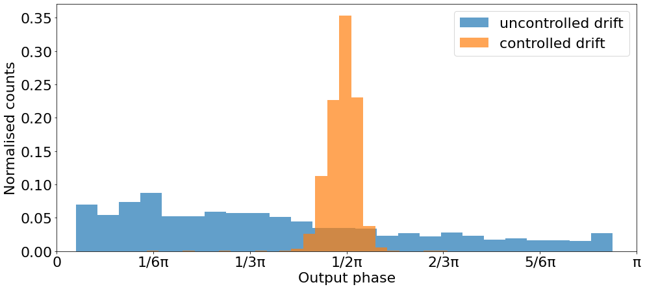
Developments: Stability
The current design suffers from optical drifts in each interferometer arm.
Each arm can be stabilised by tuning the laser wavelength, but only one can be stabilised at a time.
Propose add additional actuators/modulators into the system to stabilise all at once.
Propose to redesign the splitter tree shortening the interferometer arms, using splicing or a PLC.

Slide 25
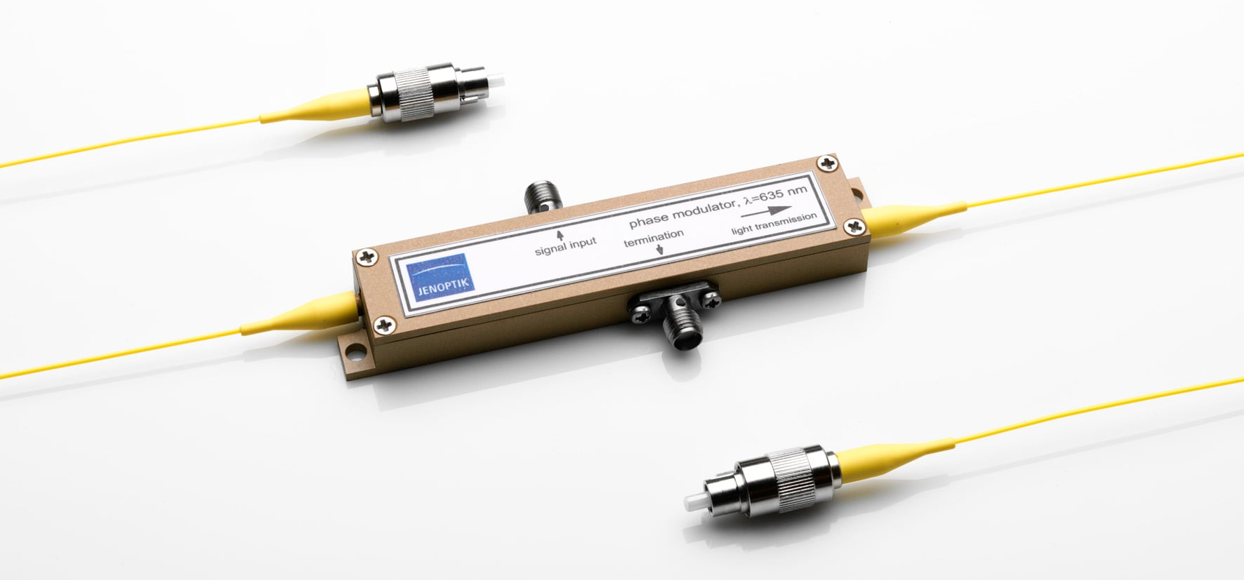


Developments: Stability

Slide 26
Developments: Dynamic Range

Slide 27
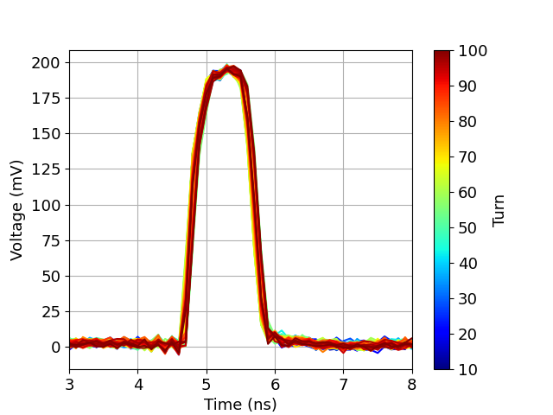
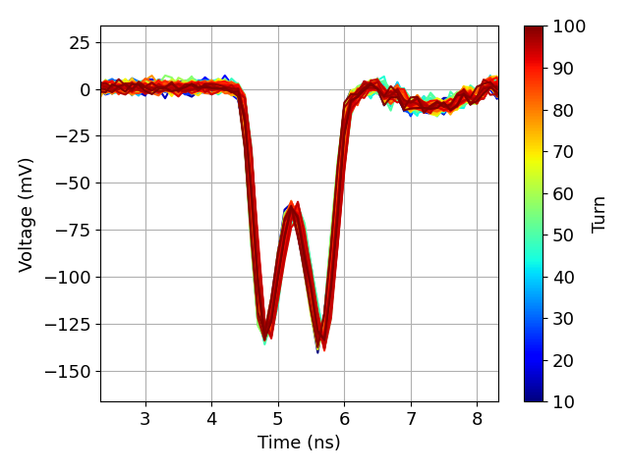
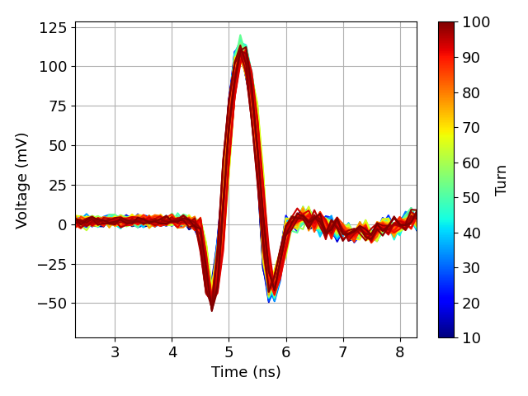
Developments: Dynamic Range
As the phase shift induced gets larger the signal can ‘over rotate’ due to the periodic function of the response.
Hard to deconvolve the phase response from the signals.

Slide 28
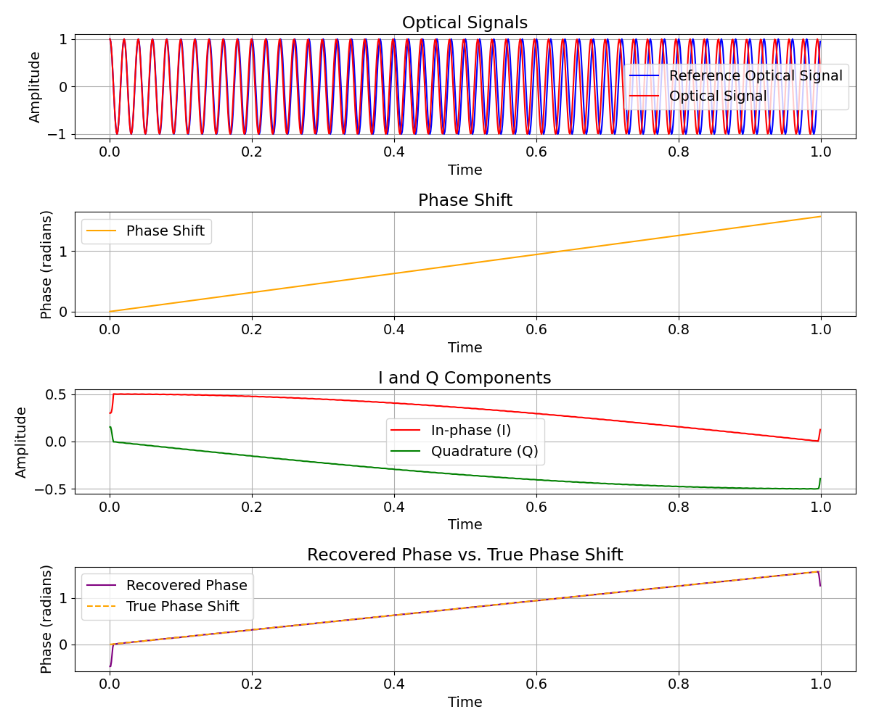
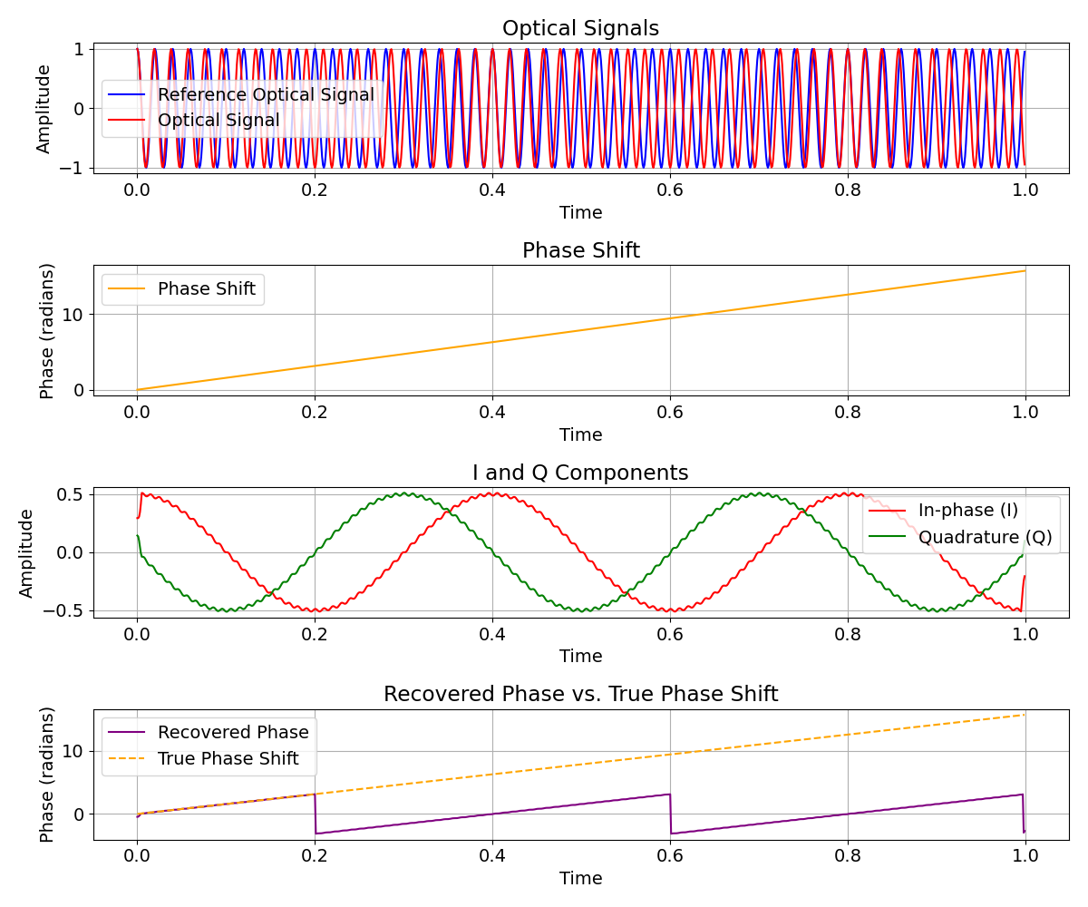
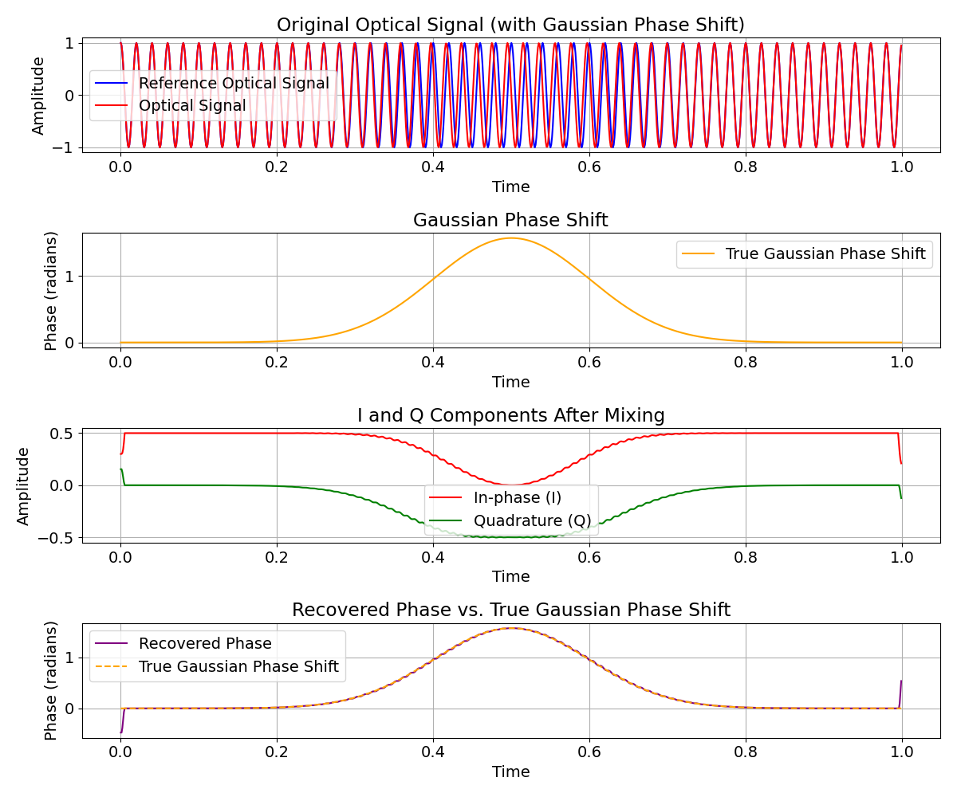
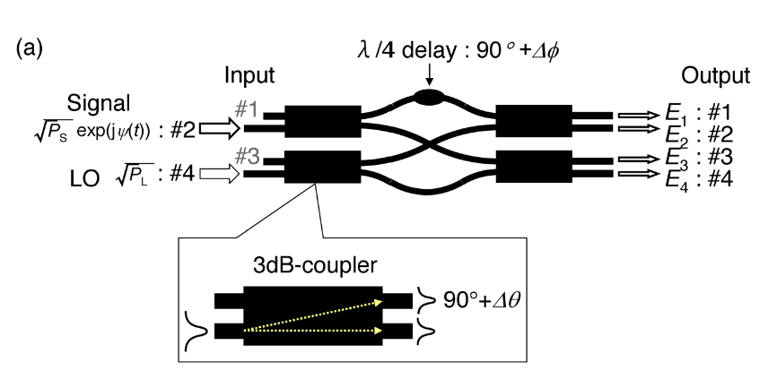
Developments: Dynamic Range
One solution to over-rotation is to linearise the response of the system with a 90-degree optical hybrid.
This performs an optical IQ demodulation between the signal and an optical reference.
Linearises the output but can’t correct for periodic repetition from large phase shifts.

Slide 29
Conclusion

Slide 30
Conclusion
EO-BPM development so far shows promising potential for high-bandwidth development.
The prototype system shows that an EO-BPM can be build and deployed, refinement is still needed to move from an R&D project to an operational system.
Review is scheduled for January 16th to decide which type technology will be selected to build crab cavity diagnostics.

Slide 31
Any questions?

