Slide 1
Integration P42 line
BDF-SHiP
HI-ECN3 Integration
Beatriz Martinez Sutil (BE-EA-DC)
07/11/2024

Slide 2
INDEX
Beam skeleton study:
  Analysis of the madx files for the current layout.
  Analysis of current vs new layout in madx files.
  Analysis of the new layout vs SHiP skeleton.
P42 line changes
  Changes requested.
  New layout.
  Integration of the new layout.

Slide 3
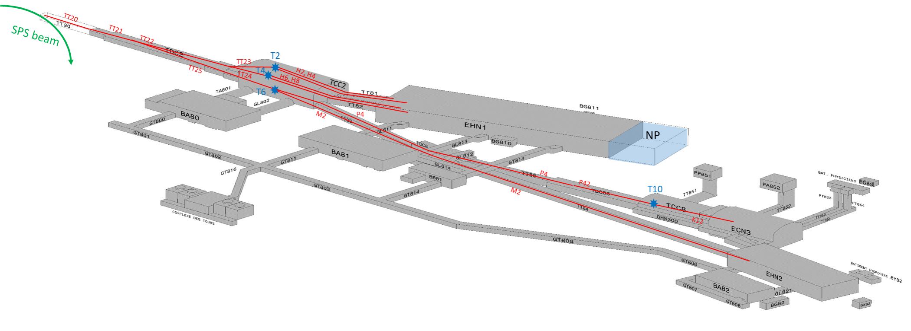
Introduction: Definition of the P42 line
∼1km
S. Girod

Slide 4
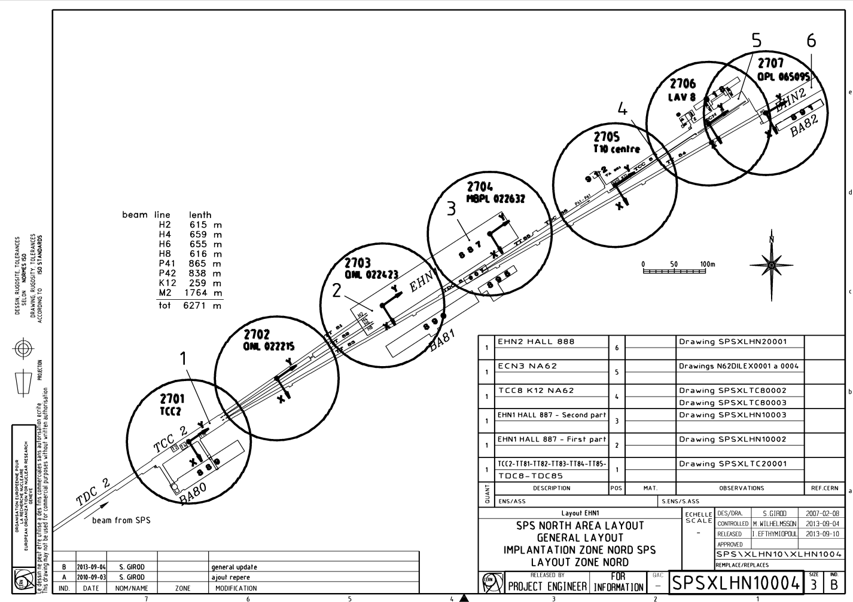
Introduction: NA CATIA coordinate systems
S. Girod

Slide 5
INDEX
Beam skeleton study:
  Analysis of the madx files for the current layout.
  Analysis of current vs new layout in madx files.
  Analysis of the new layout vs SHiP skeleton.
P42 line changes
  Changes requested.
  New layout.
  Integration of the new layout.
Check the accuracy of madx files
Check that the new layout is achieving the objective.
Check the connection P42-SHiP

Slide 6
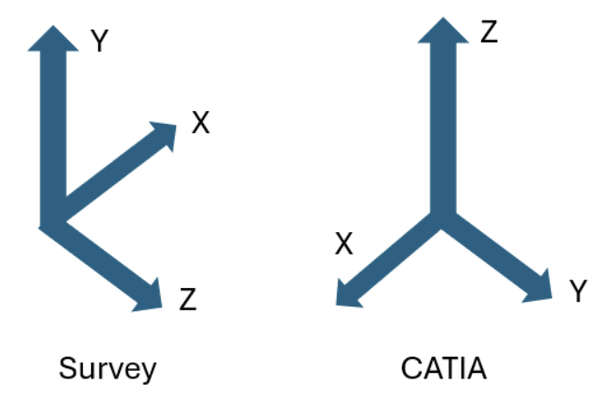
Beam skeleton study: Analysis of the current beam line
Analysis of the accuracy of the madx files respect to the current beatch files:
Old files (beatch, 2021)
New files (madx, 2024)
2 types of data import
ST1940324_01

Slide 7
Beam skeleton study: Analysis of the current beam line
 | Distance (mm) |  |  |  |  |  | Distance (mm) |  |  |  |  |  | Distance (mm)
 | Data import 1 | Data import 2 v1 | Data import 2 v2 | Data import 2 v3 |  |  | Data import 1 | Data import 2 v1 | Data import 2 v2 | Data import 2 v3 |  |  | Data import 1 | Data import 2 v1 | Data import 2 v2 | Data import 2 v3
QNL0430111 | 0.267 | 0.267 | 0.267 | 0.267 | MBN0430565 |  | 0.589 | 0.59 | 0.59 | 0.59 | QNL0450817 |  | 0.965 | 0.965 | 0.965 | 0.965
MCX0430171 | 0.401 | 0.401 | 0.401 | 0.401 | TCX0430631 |  | 0.209 | 0.209 | 0.209 | 0.209 | MCX0450820 |  | 0.901 | 0.902 | 0.902 | 0.902
QNL0430169 | 0.48 | 0.481 | 0.481 | 0.481 | XCHV0430683 |  | 0.584 | 0.548 | 0.548 | 0.548 | MBN.X0430823 |  | 8.467 | 0.92 | 8.647 | 0.92
QNL0430226 | 0.223 | 0.224 | 0.224 | 0.224 | XFFH0430708 |  | 0.583 | 0.583 | 0.583 | 0.583 | MBN0450829 |  | 9.765 | 0.246 | 9.965 | 0.246
MCX0430228 | 0.149 | 0.15 | 0.15 | 0.15 | MCX0430715 |  | 0.182 | 0.182 | 0.182 | 0.182 | MBX0450834 |  | 0.728 | 5.177 | 3.831 | 0.706
QNL0430399 | 0.419 | 0.419 | 0.419 | 0.419 | MBN0430724 |  | 0.792 | 0.792 | 0.792 | 0.792
XFFV0430515 | 0.435 | 0.435 | 0.435 | 0.435 | MBN0430735 |  | 0.357 | 0.357 | 0.357 | 0.357
Data provided by Fabian and Dipanwita
Table 1. Distance in each refence point between the madx and the beatch out files.

Slide 8
Beam skeleton study: Analysis of the new layout
Analysis of current vs future beam skeleton:
Current beam line (madx, 2024).
Post LS3 beam line (madx, 2024).

Slide 9
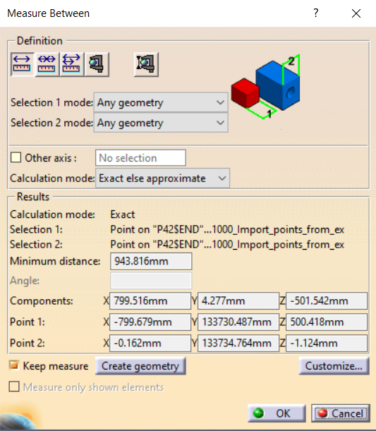
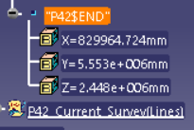
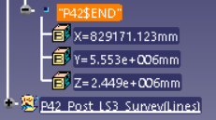
Beam skeleton study: Current (survey) vs Post LS3
P42 beam line end
Offset of 0.5m in Y and 0.8m in X (survey coordinate system)
Madx files
CATIA
Current beam line
Post LS3 beam line

Slide 10
Beam skeleton study: SHiP skeleton
Beam skeleton P42, analysis of the SHiP beam skeleton:
New files (madx, 2024).
SHiP skeleton (?).

Slide 11
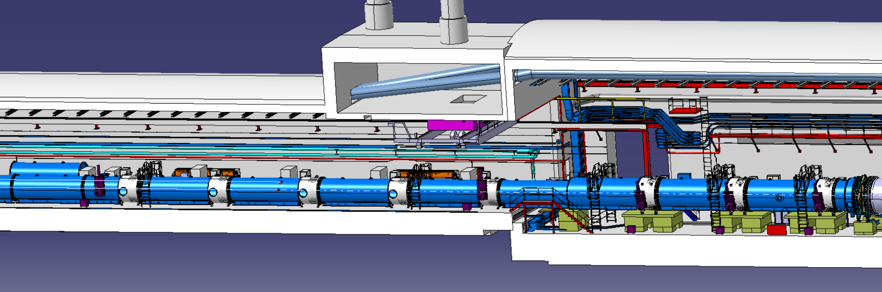
Beam skeleton study
End of P42
Post LS3 P42 line
Current P42 line
Current SHiP line
Beam Skeleton Detector vs P42
Beam skeleton of the detector NOT UPDATED: Needs follow up

Slide 12
INDEX
Beam skeleton study:
  Analysis of the madx files for the current layout.
  Analysis of current vs new layout in madx files.
  Analysis of the new layout vs SHiP skeleton.
P42 line changes
  Changes requested.
  New layout.
  Integration of the new layout.

Slide 13
Changes in the P42 layout
Element | Original position | New position | Original bending angle | New bending angle | Original tilt | New tilt
MSN.X0430029 | 31.030 | 47.8950 | 0.0028 | 0.00311 | -0.0002618 | -0.0002618
MSN.X0430022 | 24.0500 | 24.0500 | 0.0014 | 0.0000441 (for the 10 mm bump case) | -0.0002623 | -0.0002623
MBNH.X0430718 | 720.73013 | 720.73013 | -0.0071455 | -0.0059 | 9.632e-05 | 9.632e-05
MBNH.X0430724 | 726.390146 | 726.390146 | -0.0071455 | -0.0059 | 0.0001617 | 0.0001617
MBNH.X0430730 | 732.050148 | 732.050148 | 0.0029436 | -0.001804 (turned vertical) | 0.000227 | 0.5 * pi
MBNH.X0430735 | 737.710150015 | Not used | 0.0029436 | Not used | 0.0002 | 0.0002
MBNV.X0450823 | 825.56016 | 837.56016 | 0.006963100 | -0.000111 (turned horizontal) | 1.570969525 | 0.0
MBNV.X0450829 | 831.220167 | 843.220167 | 0.006025400 | 0.007300 | 1.5709695 | 1.5709695
MBXGD.X0450834 | 835.928169 | 847.928169 | -0.0033351 | 0.0033351 | 1.5709695 | 1.5709695
TCC2
TDC85
TCC8
Dipanwita Banerjee
BDF / SHiP line design - CodiMD (cern.ch)

Slide 14
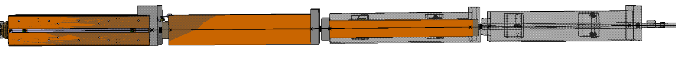
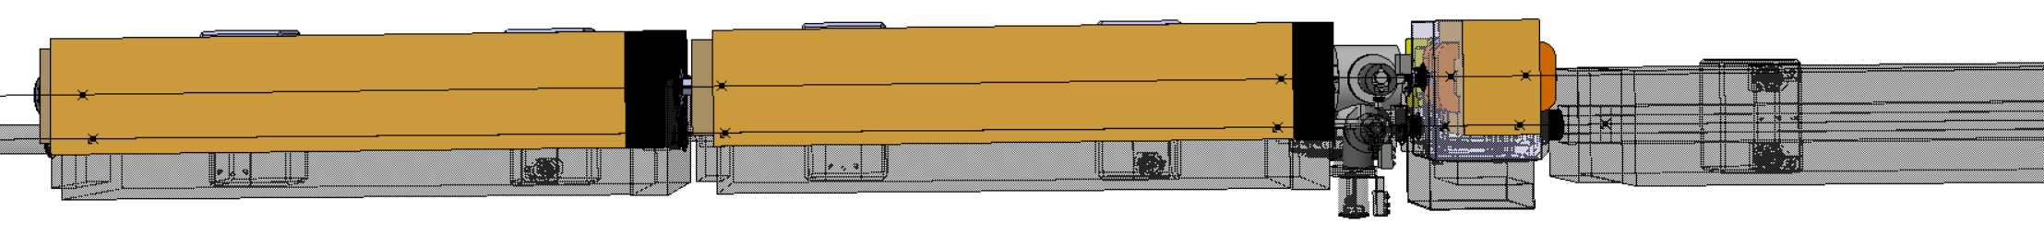
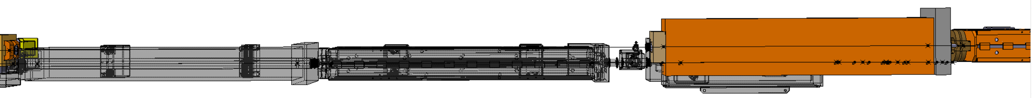
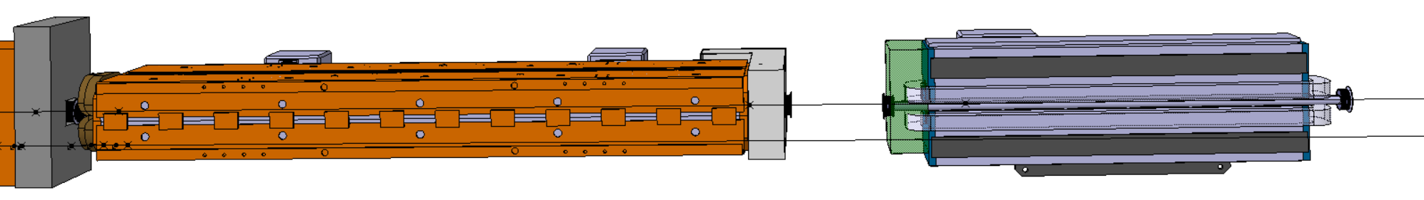
New layout
MBNH.X0430718
MBNH.X0430724
MBNV.X0430730
MBNH.X0430735 removed
BSP.X0430769
QNL.X0450770
MBNH.X0450792
MBNH.X0450795
MBNH.X0450814
MBNH.X0450817
BSM.X0450819
MCXCA.X0450820
Shifted ~12m from MBNV.X0450823
MBNH.X0450835 (MBNV.X0450823)
MBNH.X0450840
MBXGD.X0450846
Old layout

Slide 15
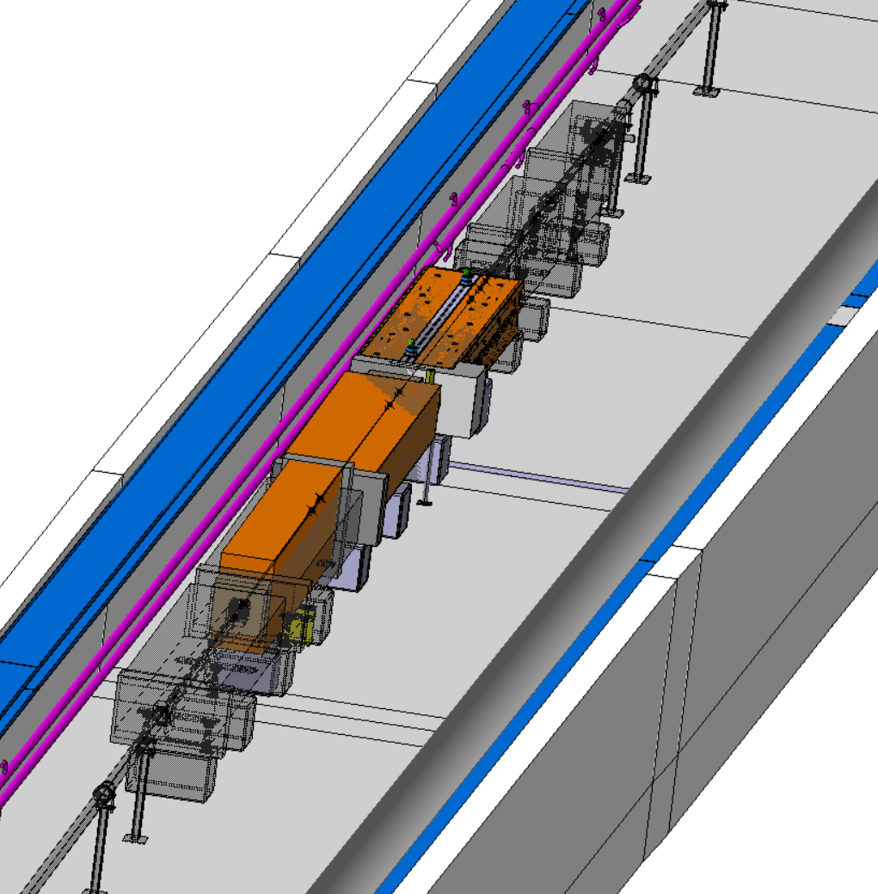
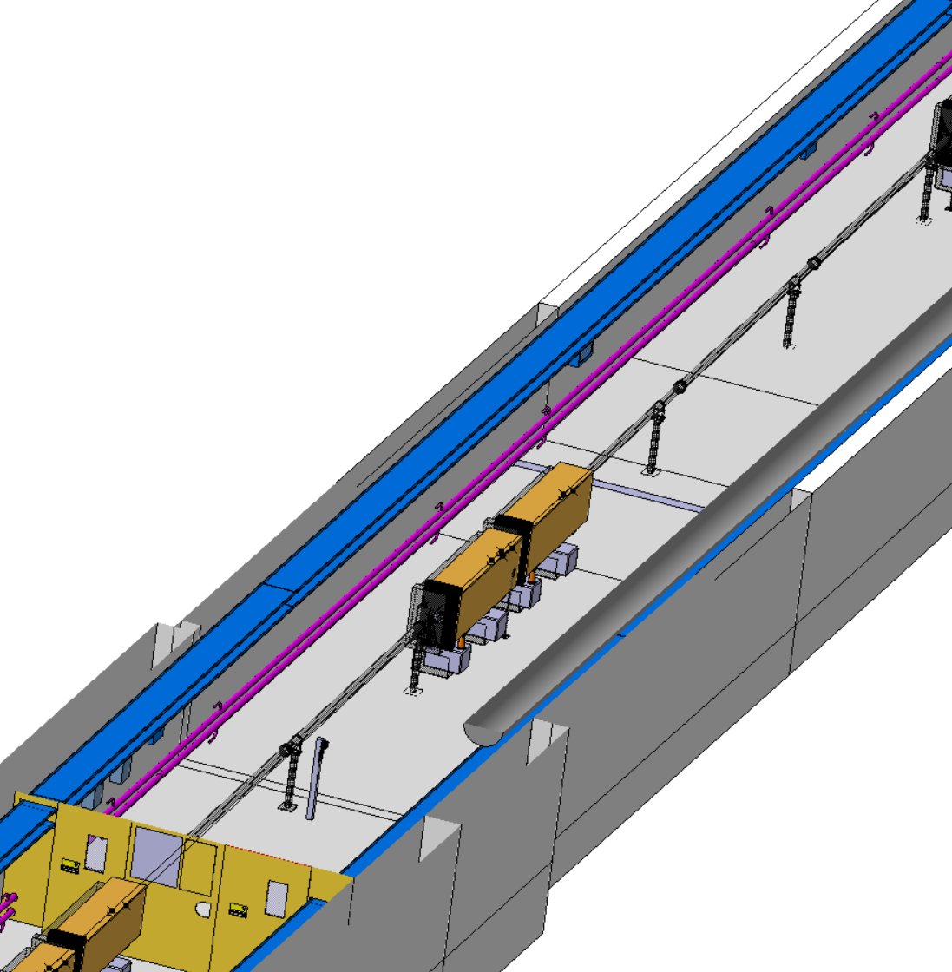
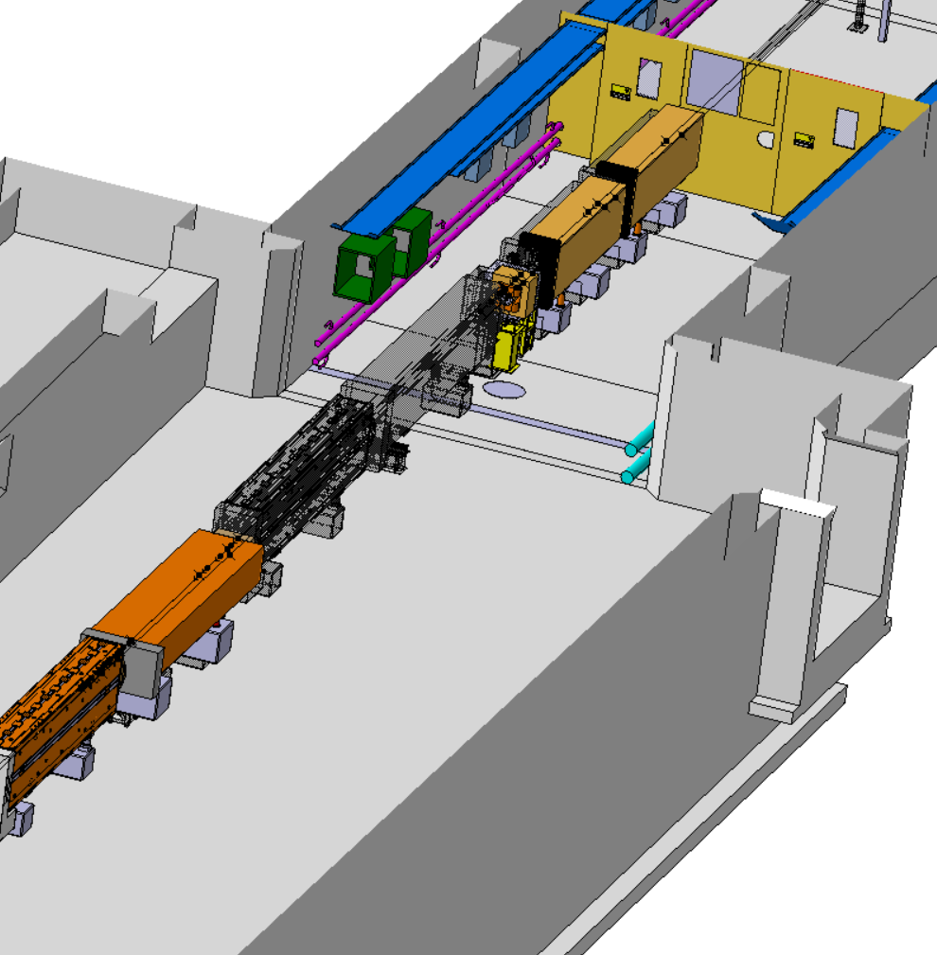
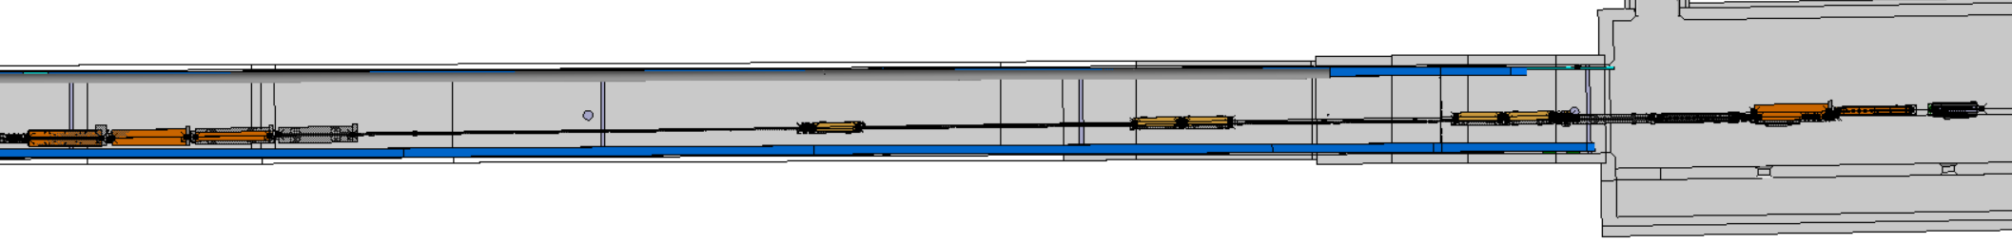
Integration
Integration: ST950060_01
Layout: ST194012_01

Slide 16
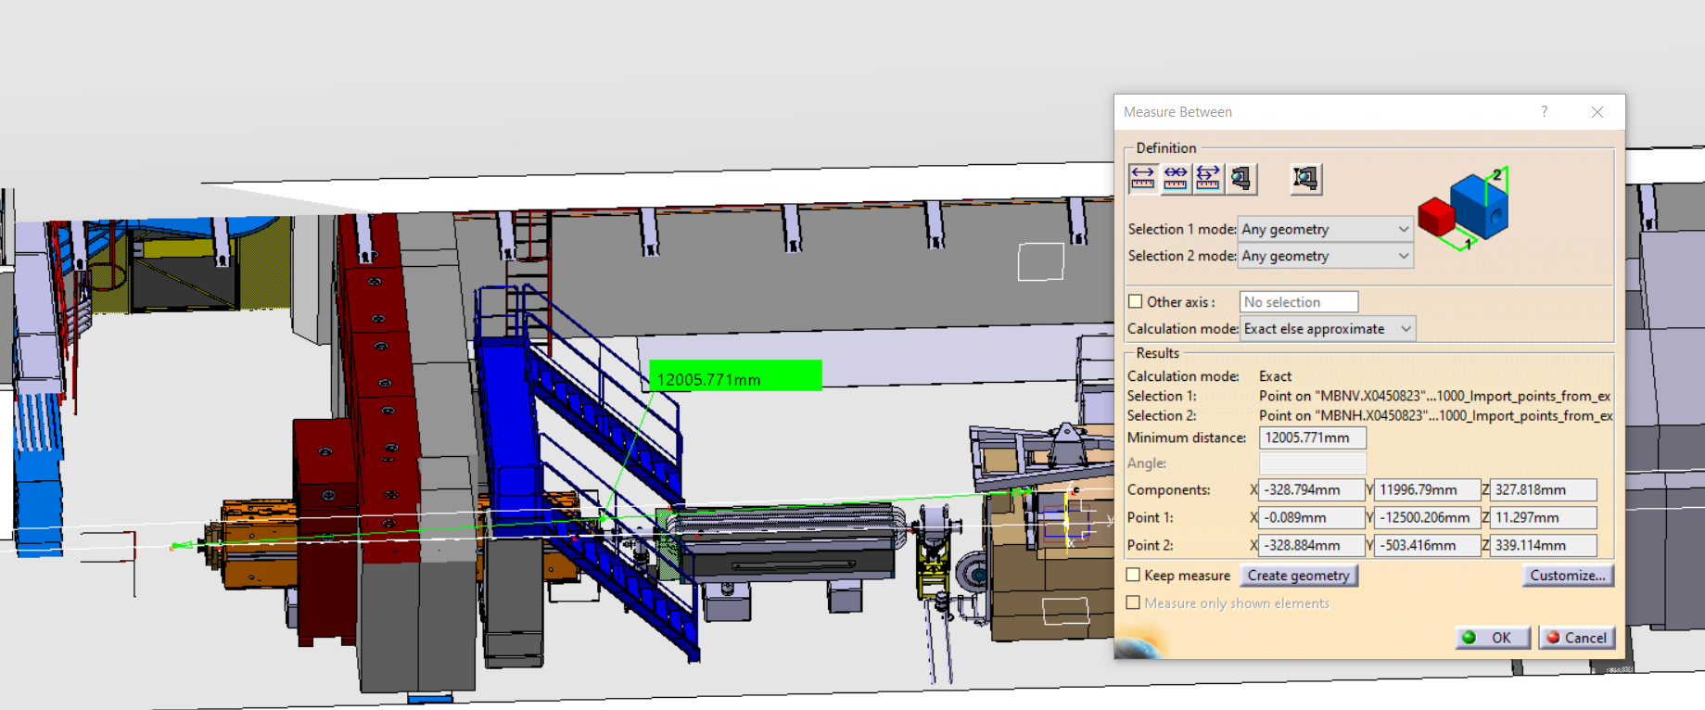
Integration

Slide 17
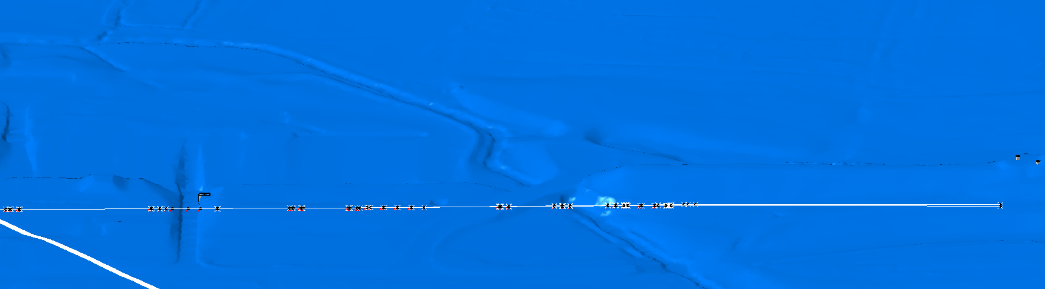
Integration
River
Bridge
Ramp
North area soil mesh – ST1949012_01
K.Buffet

Slide 18
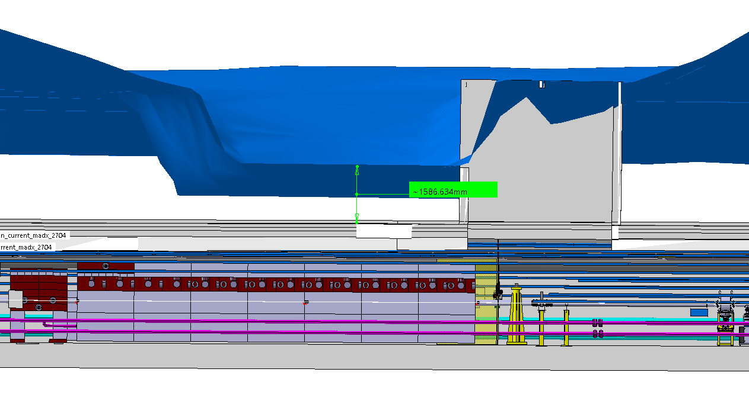
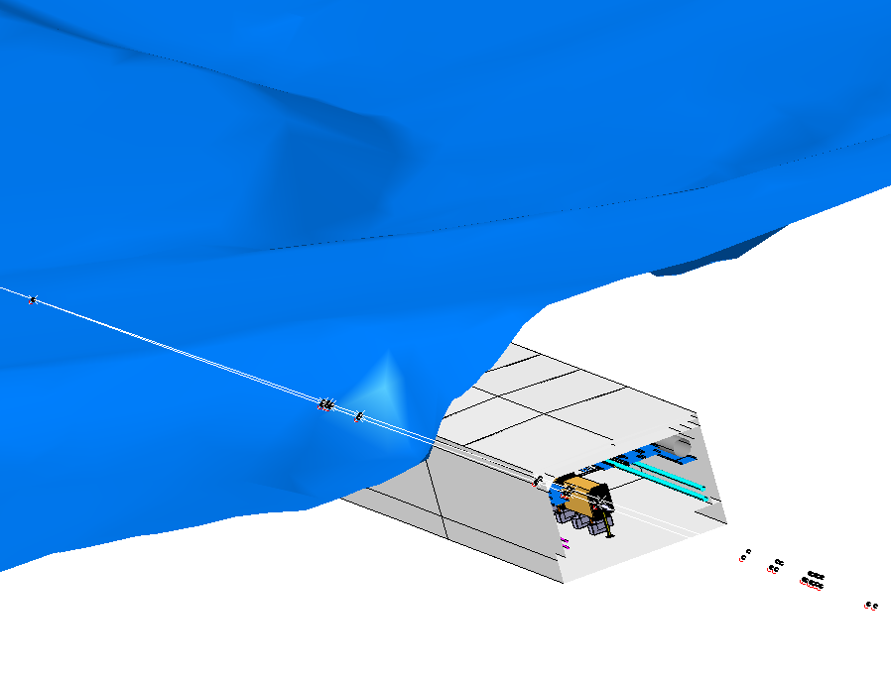
Integration
Ramp on top of shielding
Bridge on top of MBNH.X0450792 and MBNH.X0450795

