Slide 1



INTERNATIONAL DUAL CAREER NETWORK
19 September 2024
CERN
Spouse Welcome Event

Slide 2
Challenges faced by employee partners/spouses
Integration
Guidance
Language
Culture
Interview Preparation
Social Life
Networking
Work/Job
Overall Wellbeing

Slide 3
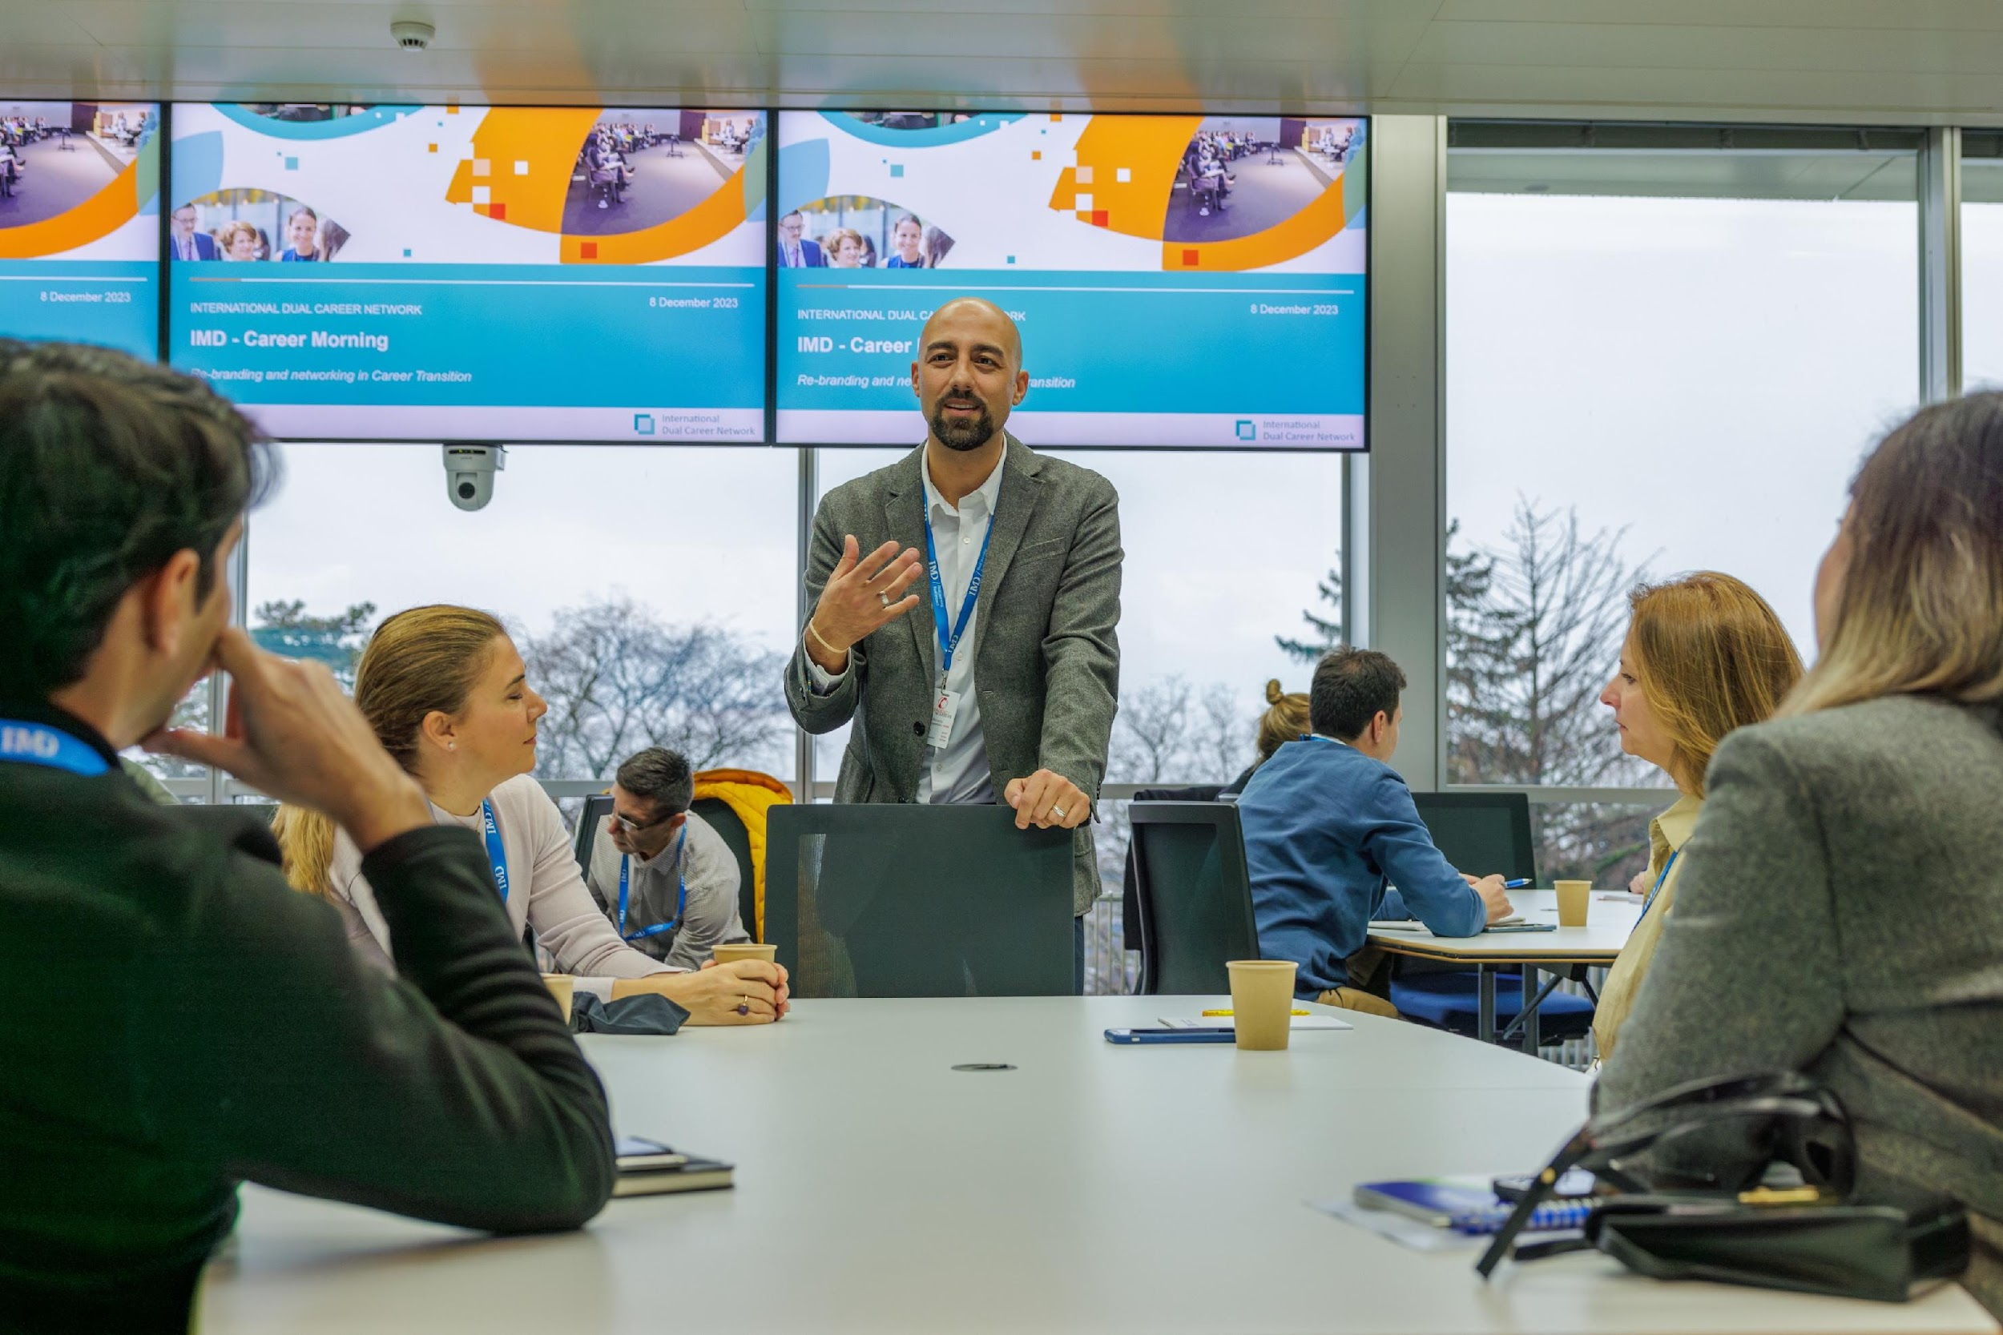
IDCN is an association of multinational and local organizations that aim to support the professional integration of employee partners and spouses by hosting a variety of professional and social networking events, both locally and globally.
By leveraging the talent available through dual-career partners and spouses, the IDCN emphasizes the importance of fulfilling organizational responsibilities towards inclusion, diversity, corporate social responsibility, environmental, social, and governance (ESG) standards, as well as sustainability initiatives.
OUR
MISSION
IDCN helps to make dual career assignments a success
Corporate
Events
Career
Mornings
Master
classes
Workshops

Slide 4

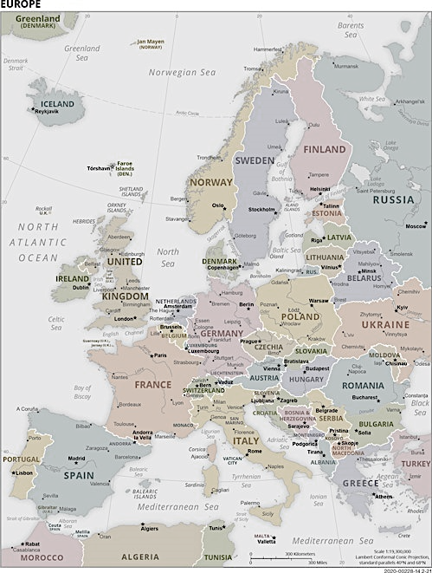


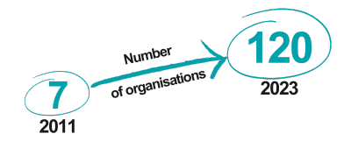
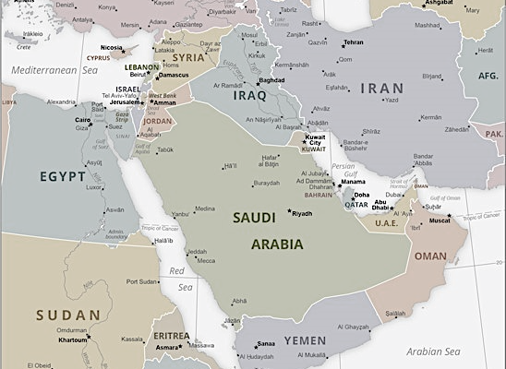
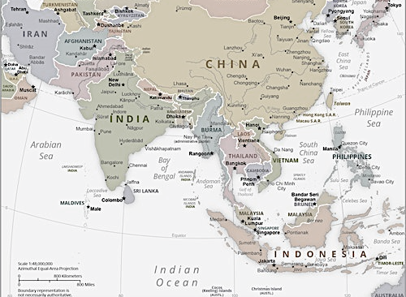
14 IDCN LOCATIONS
WORLDWIDE
Americas
New York
Mexico City
Europe
Lake Geneva
Basel-Zurich
Brussels
Copenhagen
Jutland-Funen (DK)
London
Luxembourg
Munich
Paris
ME & Asia
Dubai
Hong Kong
Singapore

Slide 5
IDCN Lake Geneva, Key Metrics
Corporate Partners - 24
Partner Members - 423
Volunteers 2024 - 15
Employment rate – XX %

Slide 6





Slide 7

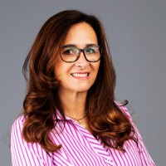

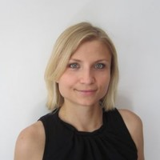

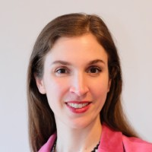

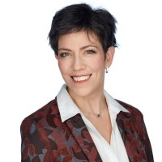

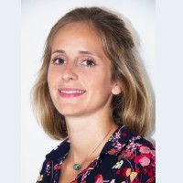

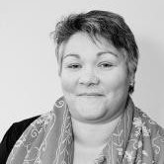
IDCN, Lake Geneva Steering Committee
Claudia Palm,
IDCN Network Lead
Provide guidance and advice to Partner Committee Office
Steering Committee meets quarterly
Veronika Beck
Laurine Chiarini
Homann Magali
Camille Pilet
Anne Meylan

Slide 8
IDCN, Lake Geneva Organization Chart
Partner Committee Office
IDCN Lake Geneva Partner President - Pragya Bhatnagar
IDCN Lake Geneva Vice President – Mykhailo (Misha) Kurochkin
Membership | Events | Communication | Measurement
Enhance the overall membership experience | Coordinate and Facilitate networking events | Facilitate internal & external communication | Track key performance metrics that drive overall strategy
Volunteer Manager | Team Leads Joreen Mufwaya & Jozi Rachman | Team Lead | Team Lead
Dipanwita Dash |  | Zeinab Hashmat | Priya Bhutada
 |  | LinkedIn Manager
Membership Manager |  | Zeinab Hashmat
 | Events Team
Zoi Mavrogonatou |  | Newsletter Manager
 | Momal Talha | Agnieszka Wiecek
Membership Backup | Mykhailo (Misha) Kurochkin | Creative Designer
 | Karnali Bose | Vacant
Vacant | Vacant | Photographer
 | Vacant | Diarmid Farquhar

Slide 9












IDCN Events Calendar 2024
2024
Jan
Feb
Mar
Apr
May
Jun
Jul
Aug
Sep
Oct
Nov
Dec
Career
Mornings
&
Corporate Events
Summer
Break
In Discussion
PMNL
October 29th
December 10th
Awareness Session
September 19th
Tentative
Awaereness Session
Awareness Session
Global Webinar
IDCN
Events
All Corporate Member Meeting
Welcome event
Masterclass
Global Webinar
Masterclass
All CM Meeting
Welcome Event + Training
Global Webinar
Steering Committee Meeting
Volunteer
Christmas
Lunch
Volunteer Picnic

Slide 10
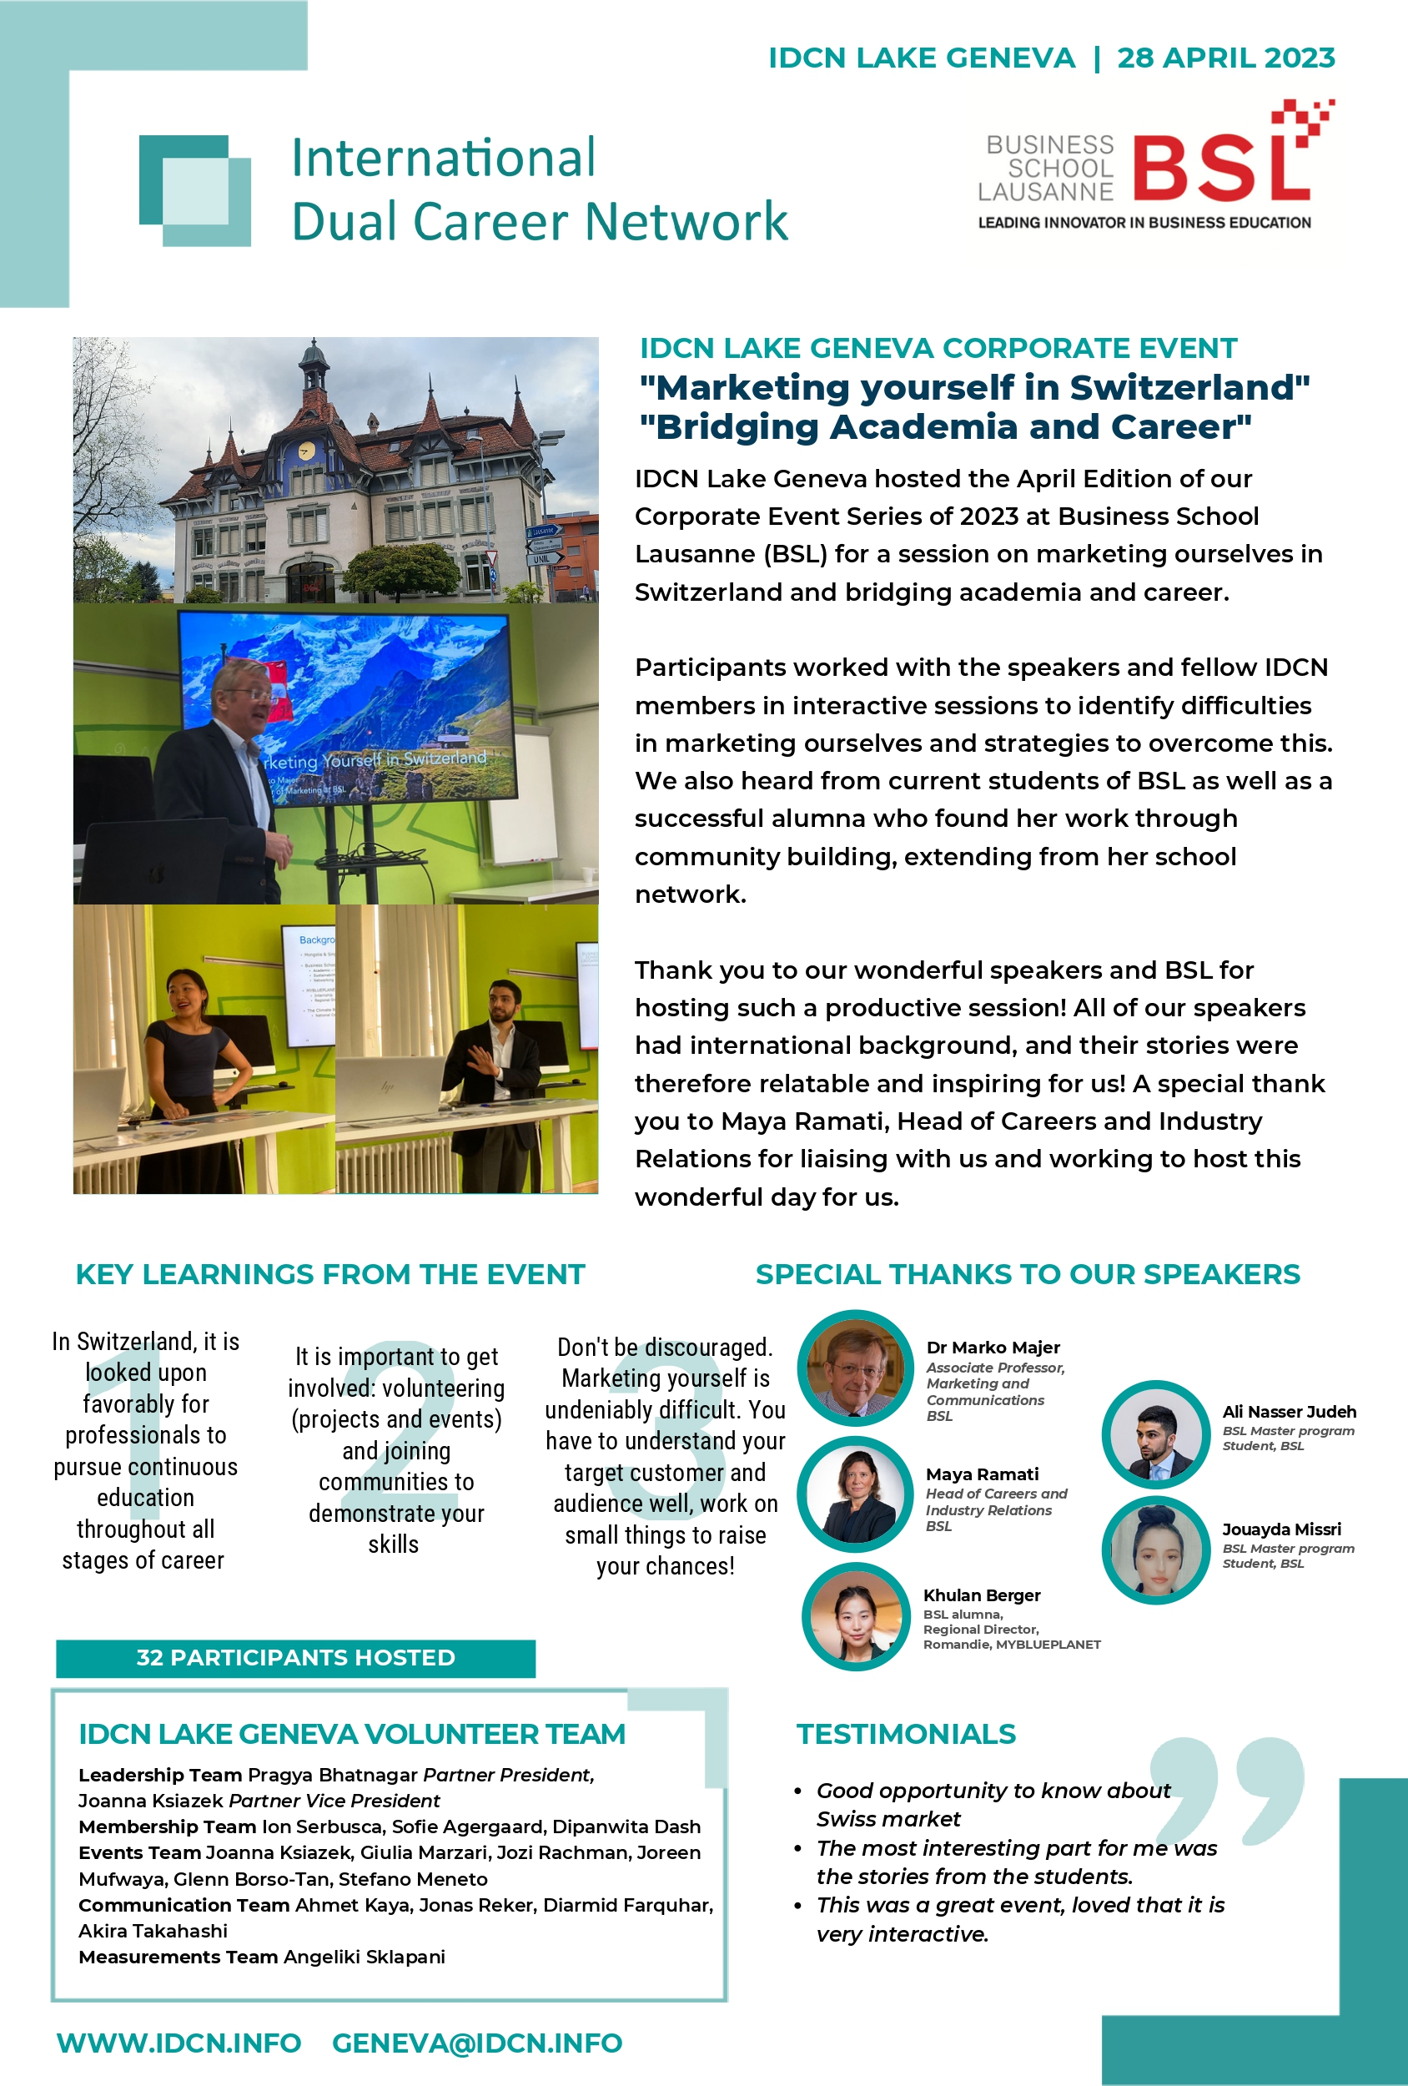

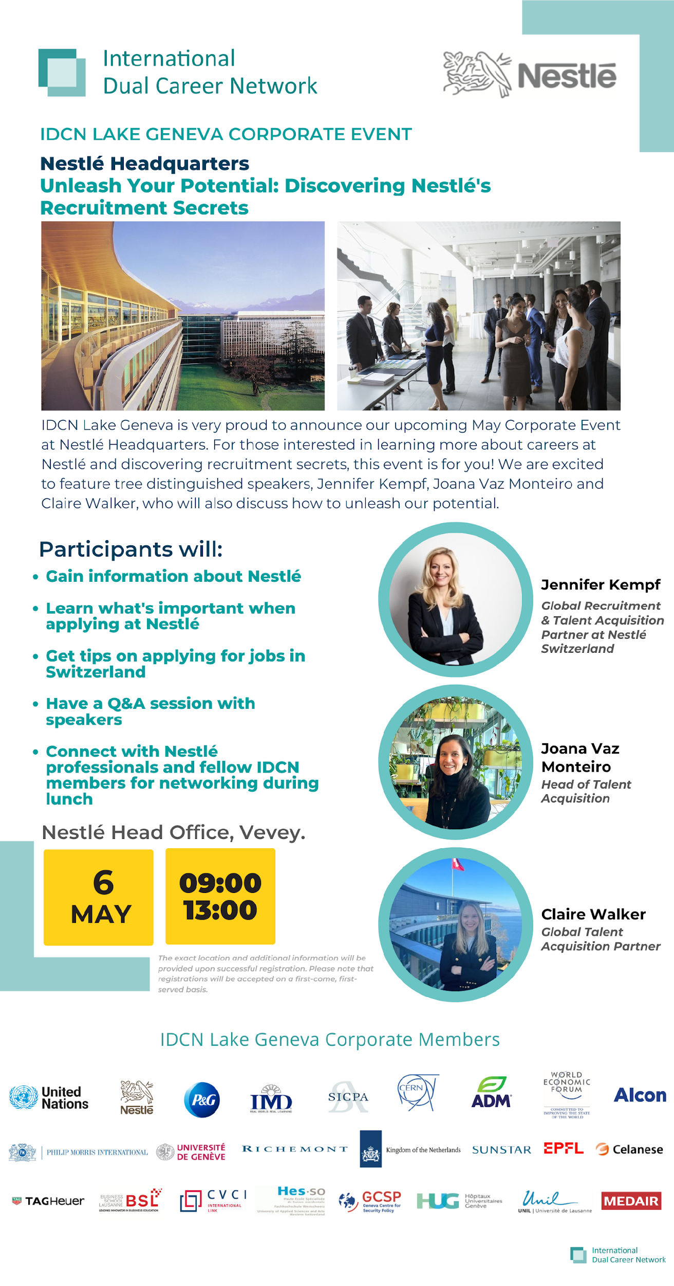
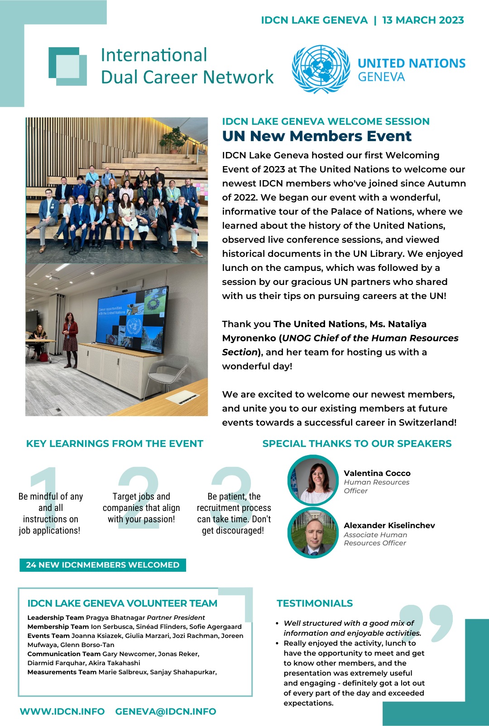
Newsletters, Posters, Success Stories
bi-annual report
success story
published newsletters
event posters

Slide 11
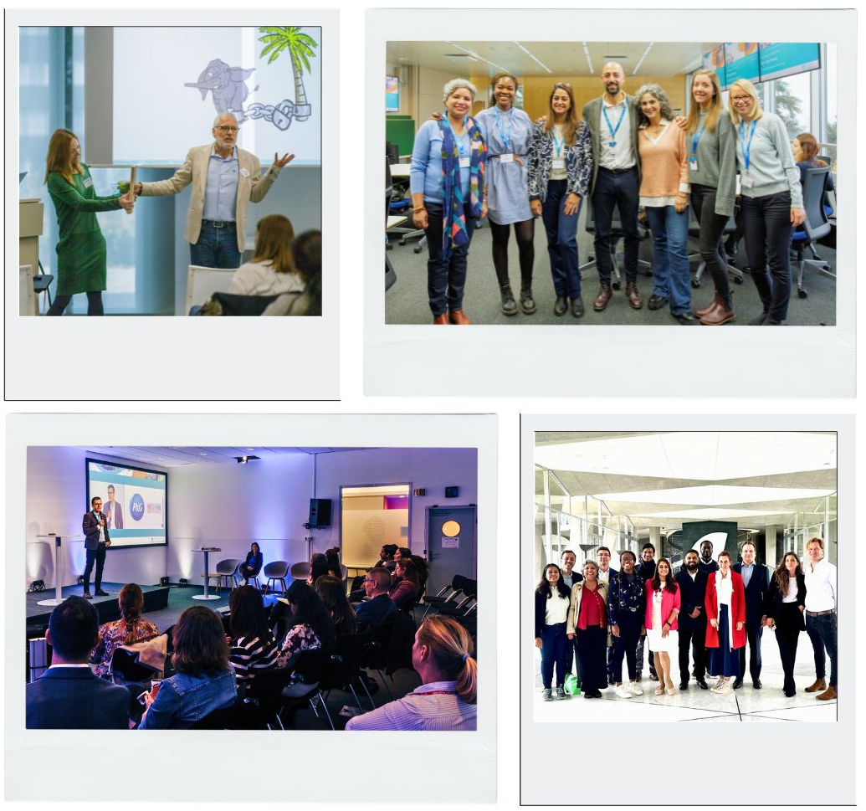



IDCN, Lake Geneva Activities
EXTERNAL EVENTS:
    Corporate Events
    Career Mornings
    Global Webinars
Feb 2023
Dec 2023
Nov 2023
May 2024

Slide 12
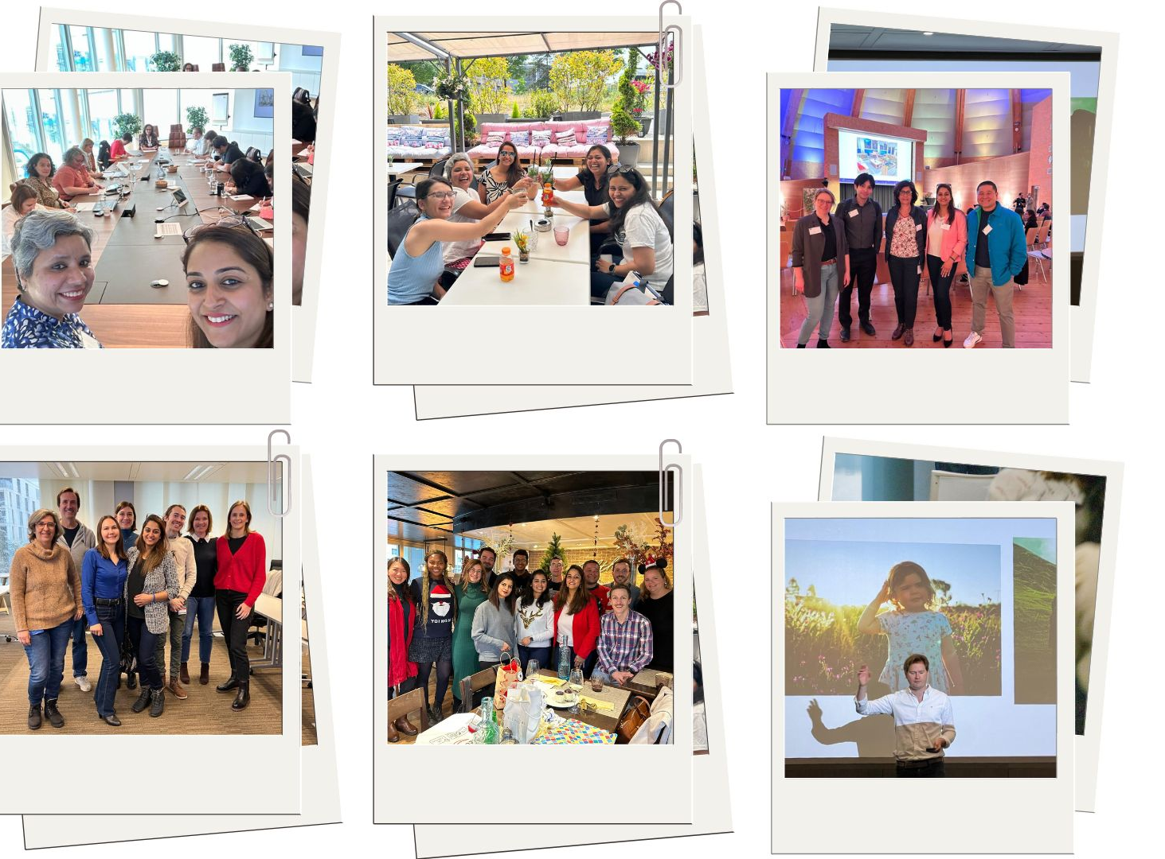





IDCN, Lake Geneva Activities
INTERNALS AND SOCIAL EVENTS:
    Welcome Events
    Masterclasses
    Spouse Welcome
Oct 2023
May 2023
Jun 2023
Jan 2023
Mar 2023
May 2024

Slide 13

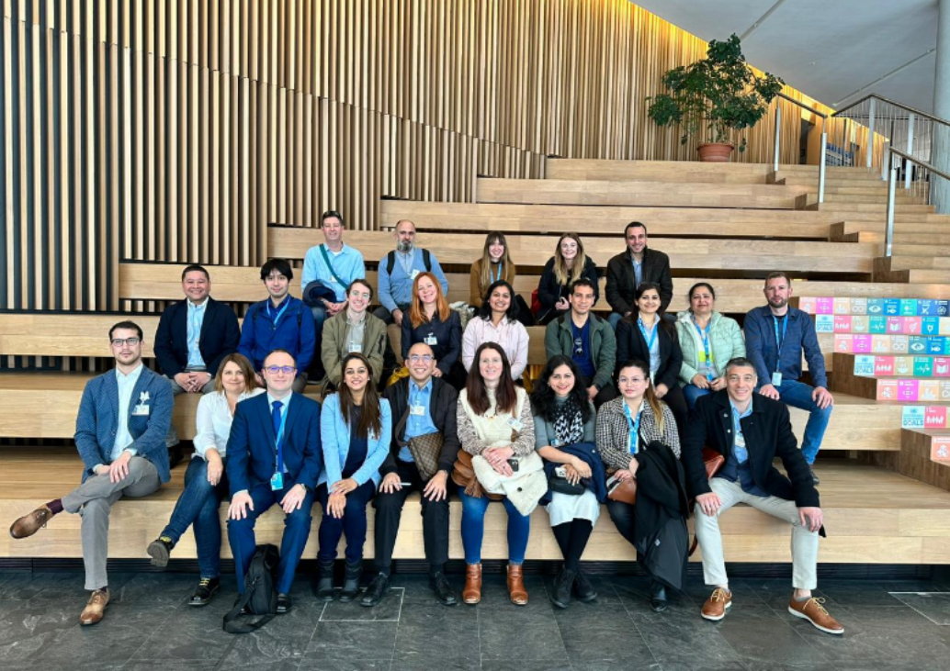
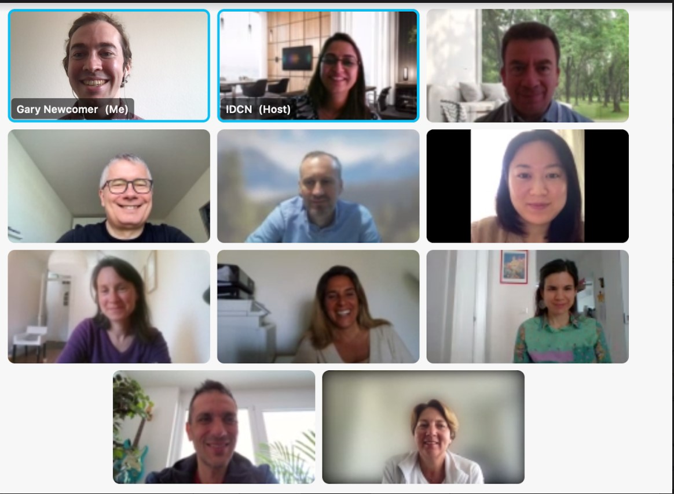
Welcome Events for new Partner Members
MAIN OBJECTIVES:
A warm, informative, and fun welcome session
Presentation and recruiting of volunteers
TIMING:
2-3 times a year
Online
On-site

Slide 14
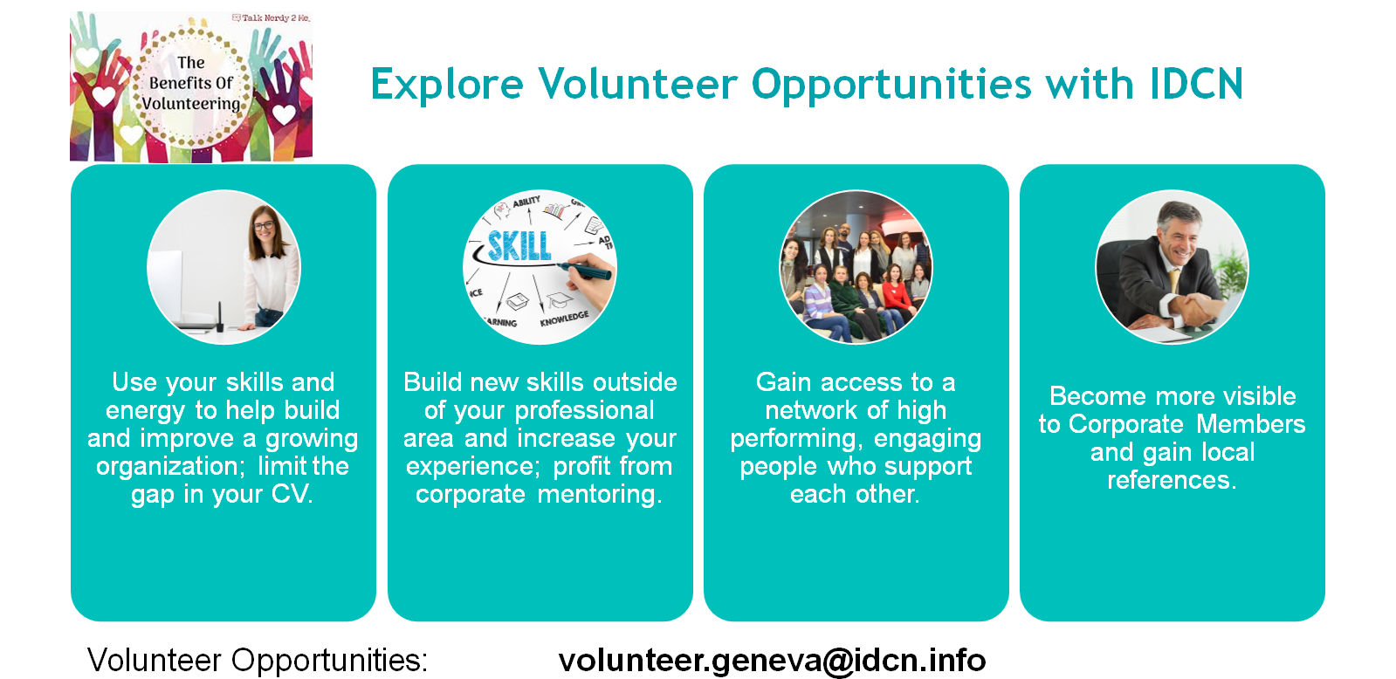

Slide 15

The Next Event
OCTOBER 29th, 2024
WIPO premises
“Spousal Employment Support Event – How to integrate into the local job market?”
Event Partners: UNOG, CAGI, IDCN, Université de Genève, Swiss Mission, Michael Page, Découvrir and GEM

Slide 16
Q and A!

