Slide 1
Public Event Advisory Board – 02 December 2024
Dante Larini – Zoe Nikolaidou
02 December 2024

Slide 2
Agenda
New Mandate of the Board
Autumn 2024 events overview
Presentation of the 2025 Quantum season
Events to be considered for next season
Other event proposals?
Discussion on the 2025/2026 theme

Slide 3
1. Advisory Board new mandate

Slide 4
Mandate Highlights
The purpose of the CERN Public Event Advisory Board (PEAB) is to advise the Public Event Curation Team in ensuring the quality and diversity of the public events programme and season, in line with the Public Event Strategy.
The Board is responsible for giving advice and views on proposals received from internal and external sources once feasibility has been established by the Science Gateway team, the CERN & Society Foundation and the Public Events team.
The PEAB is an advisory board chaired by the Public Event Curator. The decision-making powers rely ultimately with the ECO Group Leader, based on the views of the PEAB and the Public Events Team.
Members are invited to assist the Public Events team by helping towards the development of the content, including by suggesting speakers and partner organisations
Additional meetings may be called as needed on a voluntary basis, especially regarding the preparation of CERN’s flagship event, Sparks!

Slide 5
Members
Andreas Juttner (Content Advisor)
Antonella Del Rosso (Content Advisor)
Frederick Bordry (Content Advisor)
Manuela Cirilli (Content Advisor)
Mélissa Gaillard (Content Advisor)
François Briard or Loraine Massarotti (Technical Expert)
Melania Coletta (Diversity & Inclusion Advisor)
Paola Catapano (Technical Expert)
Pascale Goy (Financial Advisor & Treasurer)
Dante Larini (Chair)
Zoe Nikolaidou (Deputy Chair)
External person 1 (March 2025): Local France cultural scene (Ain or Haute Savoie)
External person 2 (March 2025): Geneva cultural scene

Slide 6
2. Autumn 2024 events overview

Slide 7
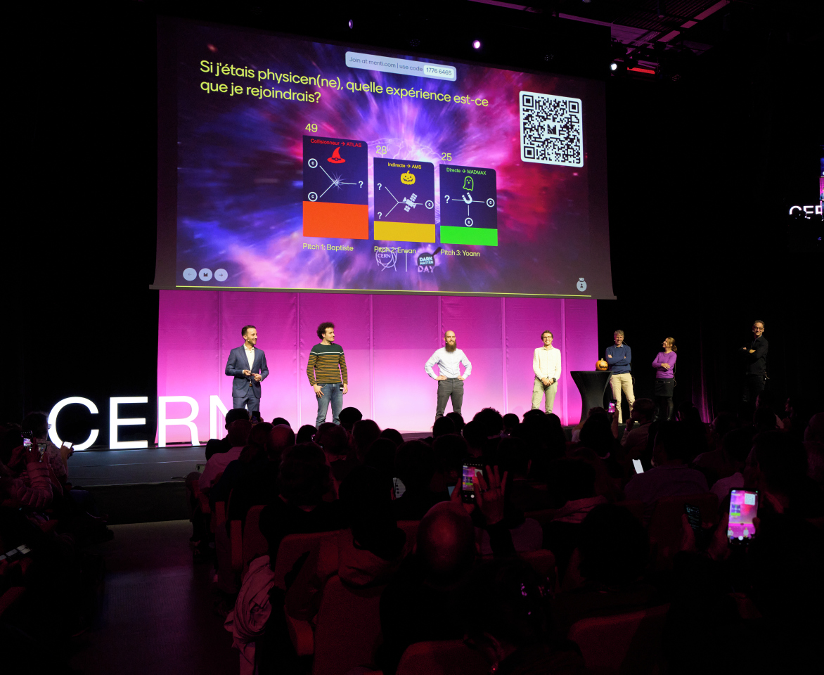

Dark Matter Day 2024 31 October

Slide 8
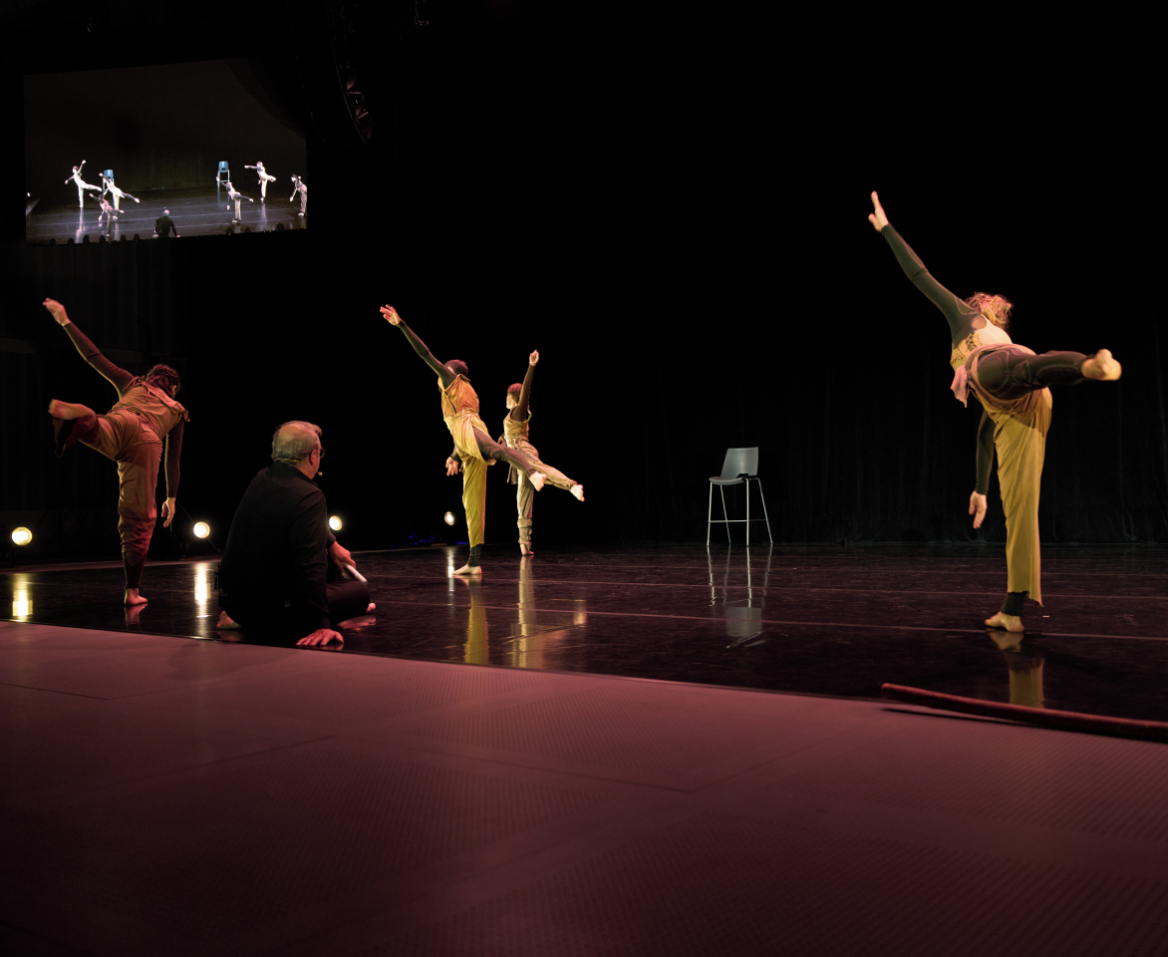
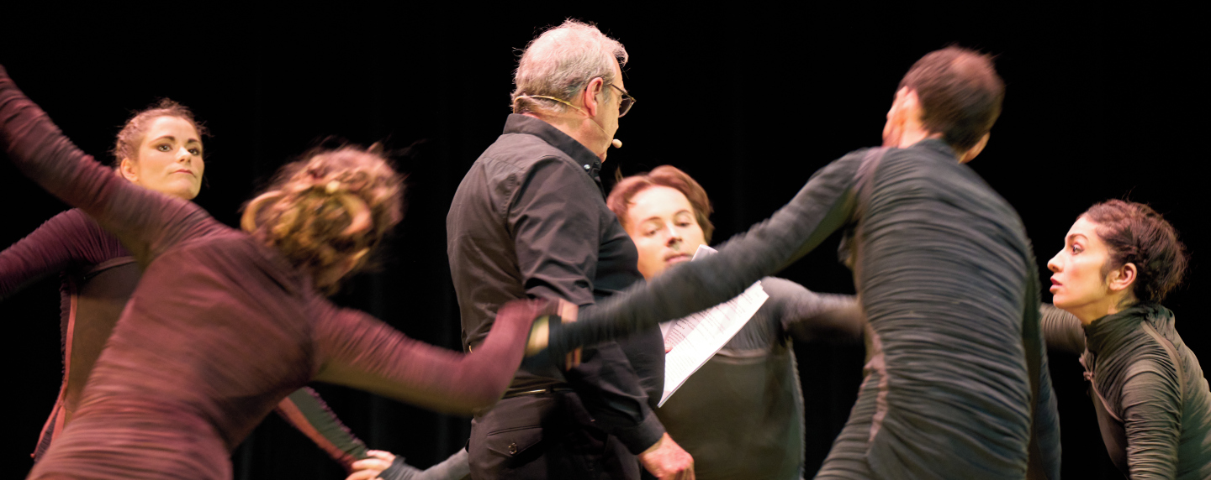
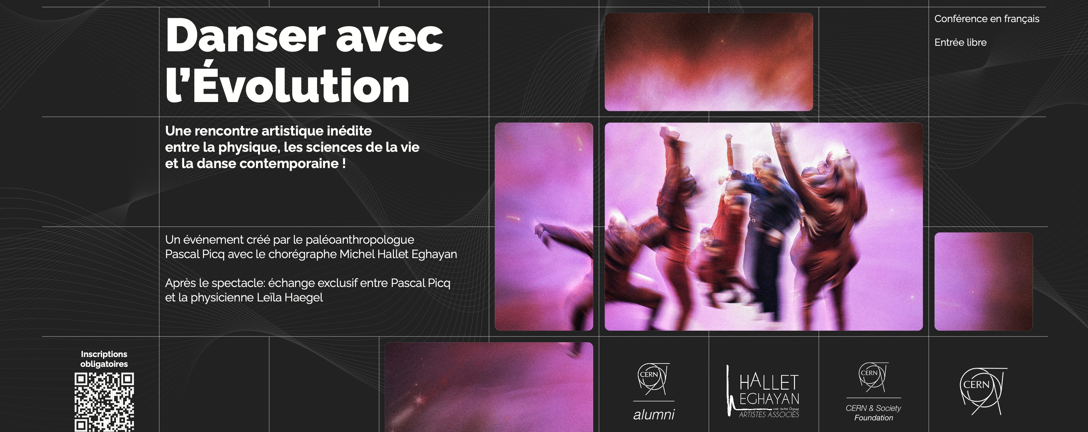
Danser avec l’Evolution - 19 November 2024

Slide 9
3. Presentation of the 2025 Quantum season

Slide 10
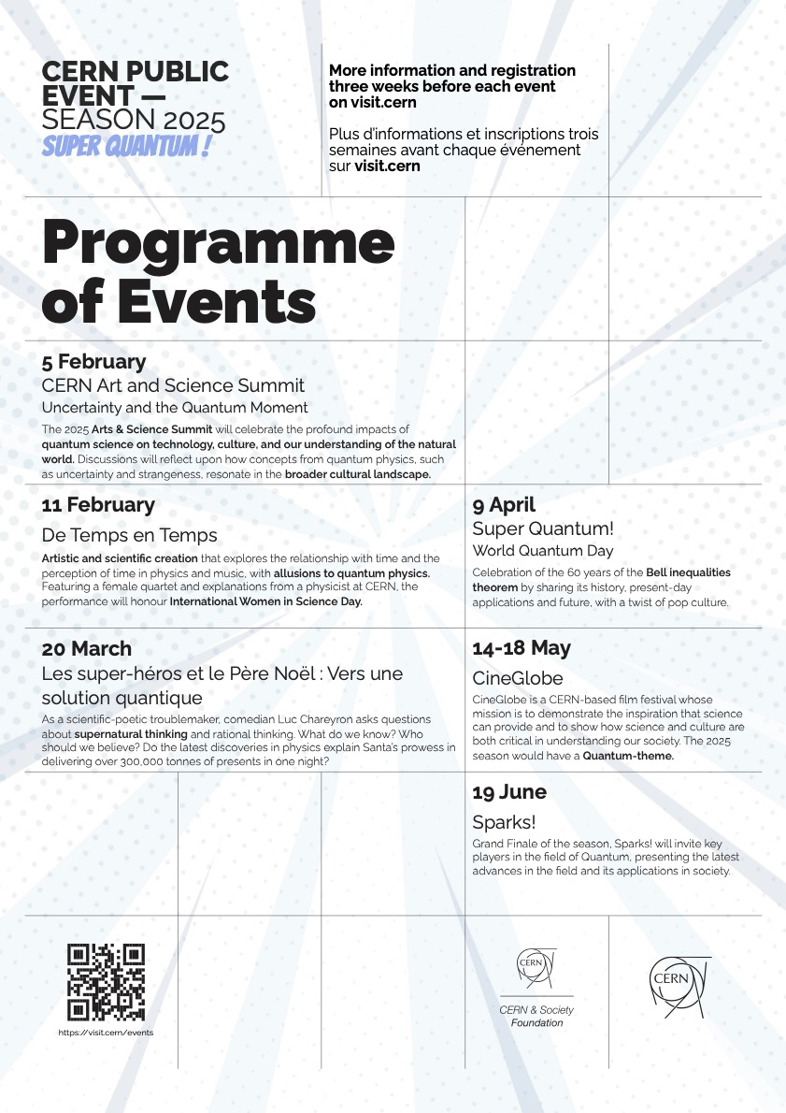

Super Quantum! Public Event Season 2025

Slide 12

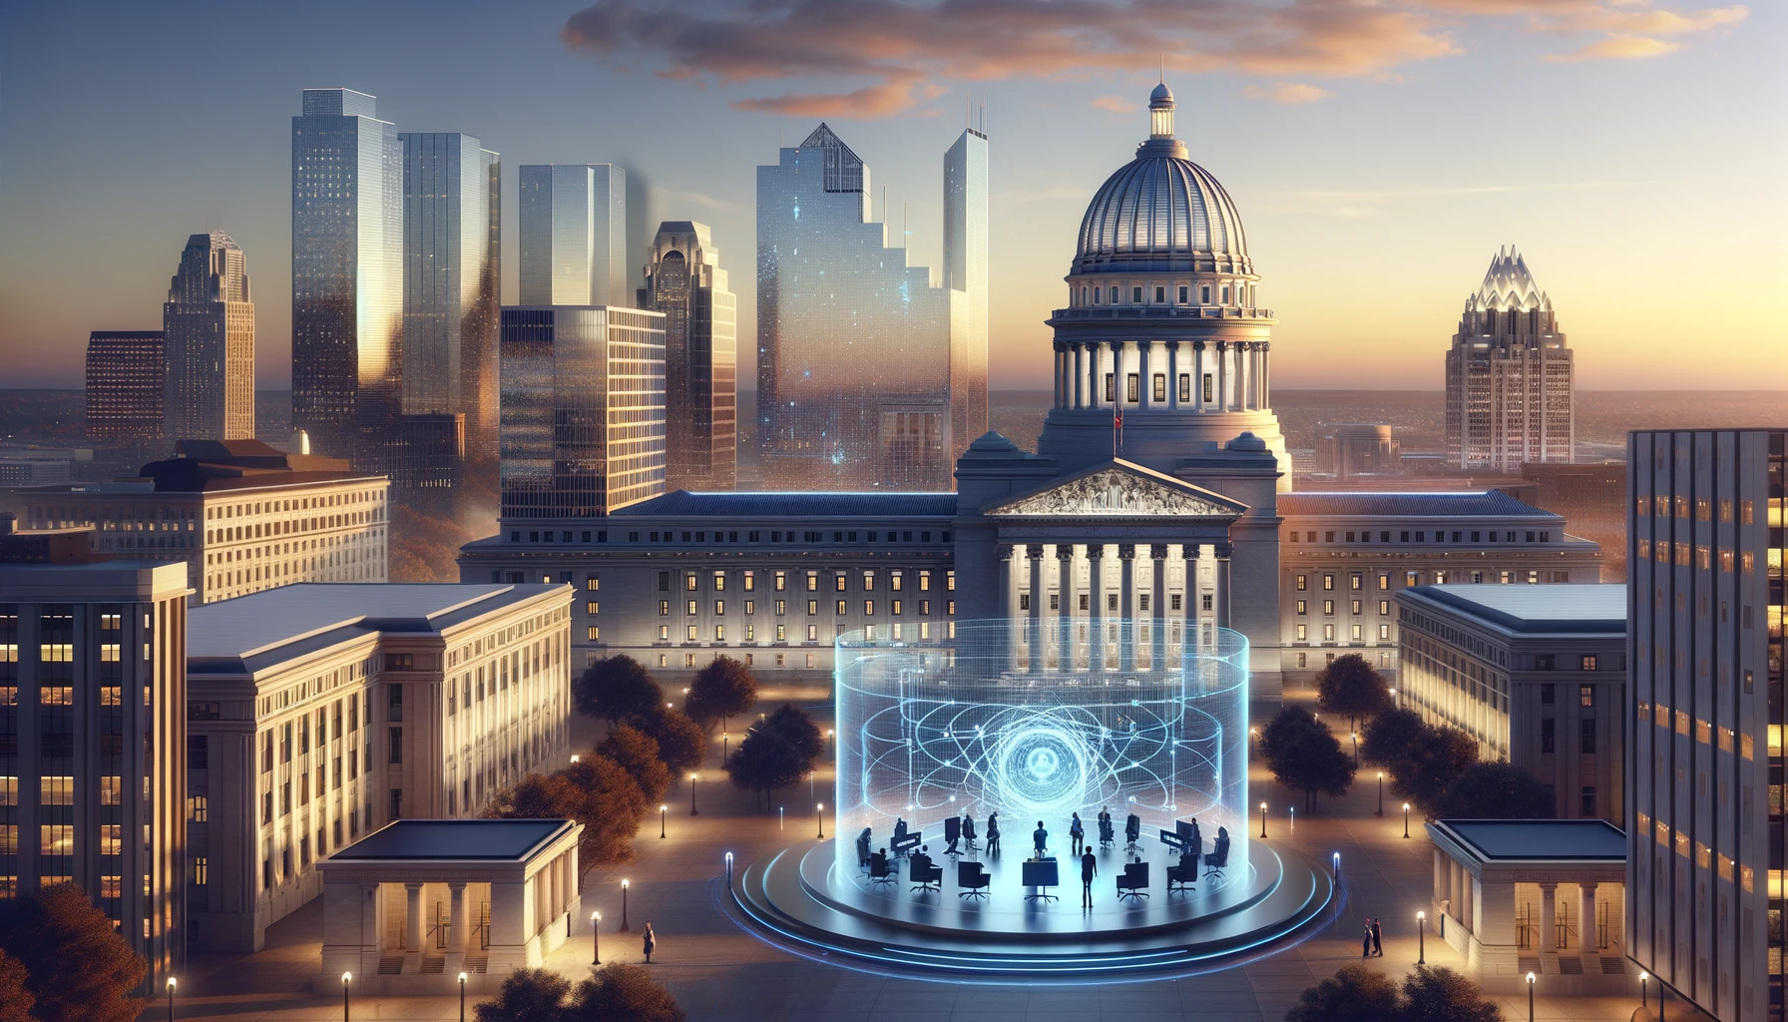
Imagining Quantum City Sparks! 2025 Serendipity Forum @CERN
Fully integrated to the season, serves as a «Grand Finale»
Concept:
Throughout history, cities have always served as clusters of innovation.
By 2050, it is estimated that 68% of the world population will be living in cities, compared with 57% today (2 billion extra people joining urban centres).
Question: Could Quantum Technology help plan the city of tomorrow?

Slide 13
Imagining Quantum City Sparks! 2025 Serendipity Forum @CERN
Discussion:
1 Expert in urban planning & innovaton (ex: Carlos Moreno, award-winning urban planner and architect, world-renown research on smart and sustainable cities.)
1 Expert in Quantum Technology (ex: Alain Aspect, Nobel Prize in Physics 2022)
3 Experts in key fields:
Climate mitigation (ex: Christine Fallet, Lead Scientific Coordinator for CARIOQUA, European consortium conceiving quantum space sensor)
Healthcare (ex: Rachel Mckendry, UCL & co-director of the UK Quantum Biomedical Sensing Research Hub, Q-BIOMED)
Communications (ex: Heike riel, Lead of IBM Research Quantum Europe)

Slide 14
4. Events to be considered for next season

Slide 15
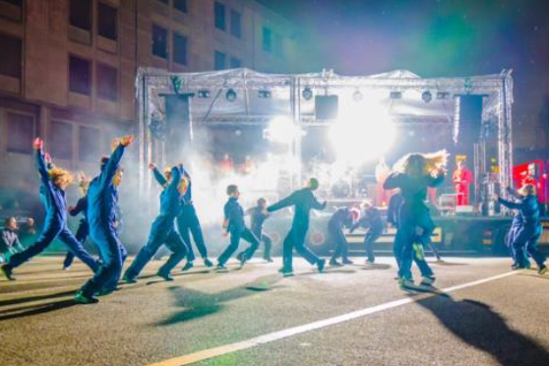
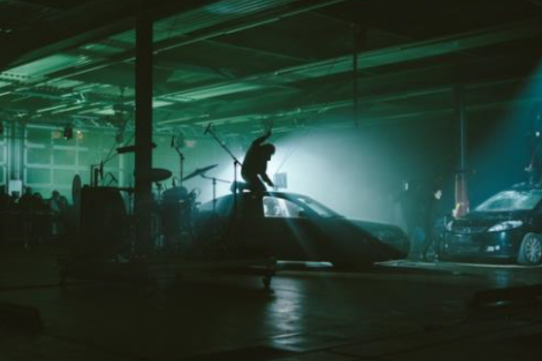







“Trip CERN”: custom-made event by Antigel
To be validated (suggested by Zoe Nikolaidou)
In February 2026 - 19h30 tbc
Interdisciplinary
90 min
French
Not known
Internal costs ( approx. 10 000.-)
The "Trip CERN" project invites guests to embark on an immersive bus journey through the CERN site. With headphones, they’ll experience a rich soundtrack and live narration, stopping at key locations where actors bring the story to life.
At its heart is the story of Maria and Giuseppe, two physicists whose love blossoms amid ground-breaking discoveries at CERN in 1955. Their journey blends science, emotion, and the quest to understand both the universe and human connection.
ANTIGEL 2024
One of the most prominent festivals of performing arts in Geneva
80% of their shows were sold out
46’000 participants in 54 different places

Slide 16
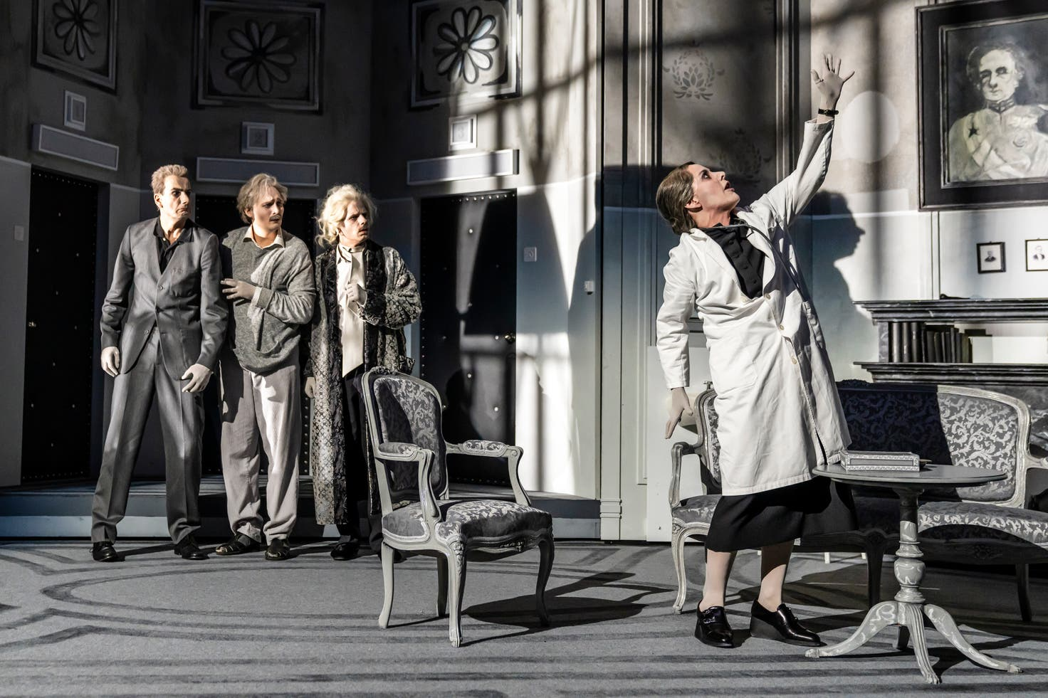

Die Physiker
Initial discussion
March 2026
Theatre
German
Not known
tbc
Die Physiker is a satiric drama/tragic comedy written in 1961 by Swiss writer Friedrich Dürrenmatt.
The play is about three scientists interned in a psychiatric clinic. But it turns out that none of them are actually mentally-suffering. Instead, they are all hiding the truth about a discovery which could radically benefit humanity… or destroy it!
Die Physiker examines the place of science in the world and the responsibility of scientists in the use of their discoveries.
Die Physiker
Award-winning play, sold out at the Bühnen Bern for each representation
Showcasing German language & Swiss culture at CERN
Reaching out to the German-speaking community in the region

Slide 17

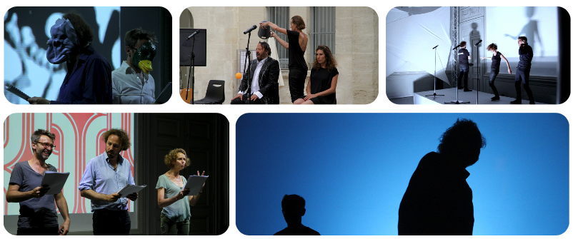
Binôme
Initial discussion
tbd
Theatre
French
Not known
3’500 EUR
In the concept of Binôme, a researcher becomes the object of study for a playwright after a 50 min encounter. This results in a play freely inspired by their encounter. The show is often emotional, funny, and offers an unusual look at science and the people who make it happen.
Since 2010: 56 shows created, more than 250 performances in were done in front of more than 20,000 spectators
Binôme
Collaboration with the ”Château Rouge” theatre in Annemasse
Opportunity to showcase a part of CERN we wish to choose in an interactive format

Slide 18
5.Other Event Proposals?

Slide 19
6.Discussion 2025-2026 theme

Slide 20
25-26 season theme?
Light (Hi-Lumi LHC upgrade)
New European Strategy for Particle Physics (January 2026)
Youth CERN host of honour for Cité des Métiers 2025
Future Social impact of CERN research in the years to come

Slide 21
Thank you!!!

