Slide 1
MDX 100 L design requirements
Aleksandr Gorn, Francesco Maria Velotti, Matthew Alexander Fraser (SY-ABT-BTP)
Laurie Nevay, Fabian Metzger (BE-EA-LE)
05.11.2024

Slide 2
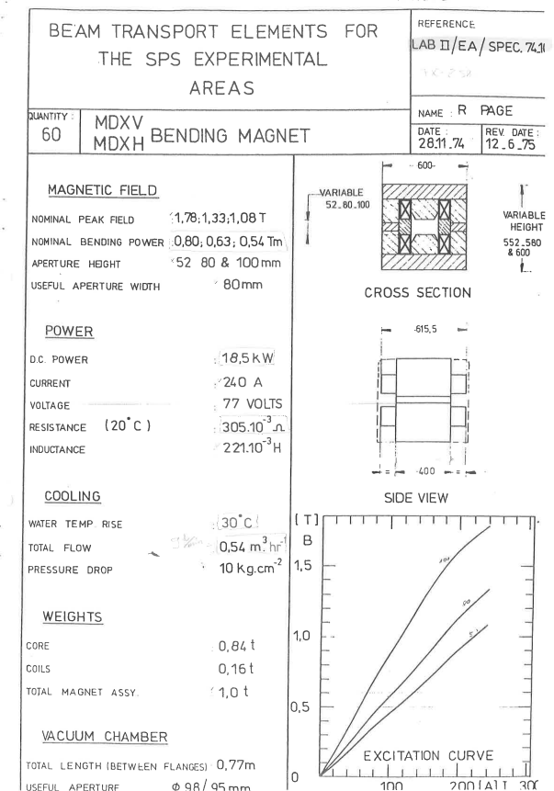
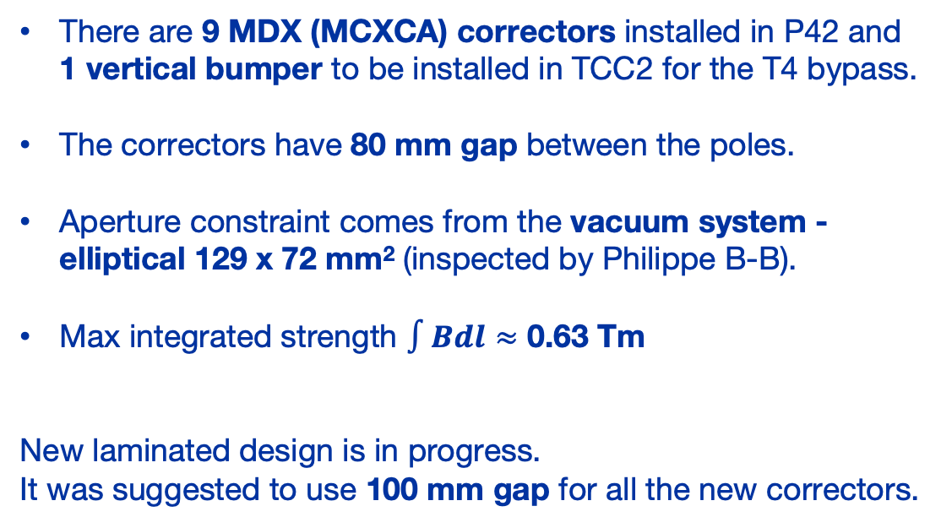
MDX specifications
There are 9 MDX (MCXCA) correctors installed in P42 and 1 vertical bumper to be installed in TCC2 for the T4 bypass.
The correctors have 80 mm gap between the poles.
Aperture constraint comes from the vacuum system -elliptical 129 x 72 mm² (inspected by Philippe B-B).
Max integrated strength $∫Bdl≈$ 0.63 Tm
New laminated design is in progress.
It was suggested to use 100 mm gap for all the new correctors.

Slide 3
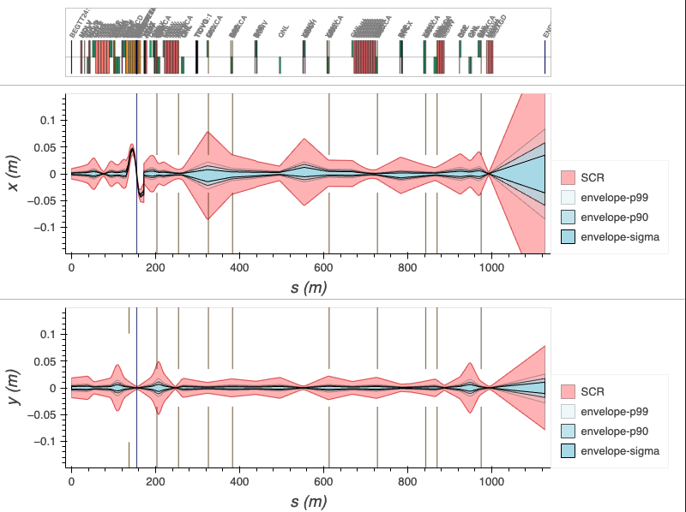
MDX correctors in P42
Three correctors in P42 may cause beam transmission issues, because SCR is larger than the vacuum system ø = 72 mm at these locations.
Slot | Max SCR [mm]
MCXCA.X0430048 (V) | 90.3
MCXCA.X0430100 (V) | 18.4
MCXCA.X0430171 (H) | 169.4
MCXCA.X0430228 (V) | 76.3
MCXCA.X0430458 (V) | 51.4
MCXCA.X0430573 (V) | 38.5
MCXCA.X0430688 (H) | 36.6
MCXCA.X0430715 (V) | 28.4
MCXCA.X0450820 (H) | 69.8
TT24 start
T4

Slide 4
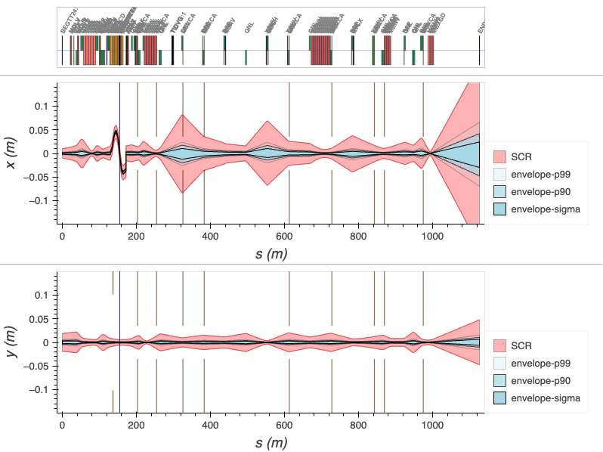
MDX correctors in P42
Three correctors in P42 may cause beam transmission issues, because SCR is larger than the vacuum system ø = 72 mm at these locations.
Slot | Max SCR [mm]
MCXCA.X0430048 (V) | 28.9
MCXCA.X0430100 (V) | 27.7
MCXCA.X0430171 (H) | 165.8
MCXCA.X0430228 (V) | 72.5
MCXCA.X0430458 (V) | 51.2
MCXCA.X0430573 (V) | 38.3
MCXCA.X0430688 (H) | 35.3
MCXCA.X0430715 (V) | 28.5
MCXCA.X0450820 (H) | 55.9
TT24 start
T4
However, this can already be fixed near T4 by the optics rematching. Dispersion reduction at MCXCA.X0430171 is being studied.
The new aperture should be ø ≥ 72 mm.

Slide 5
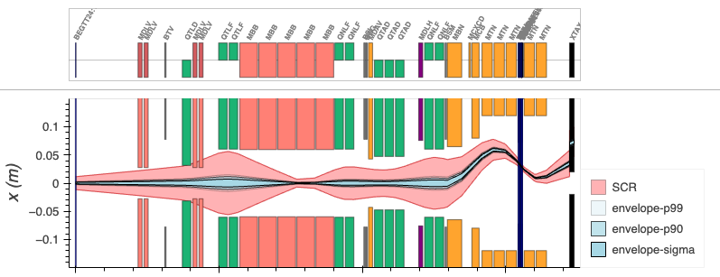
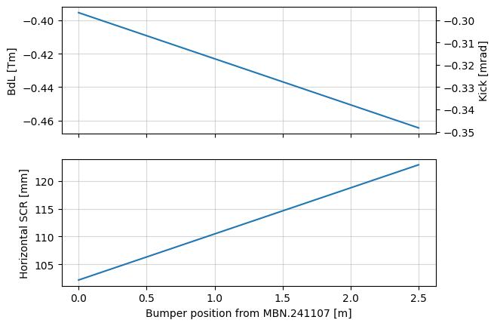
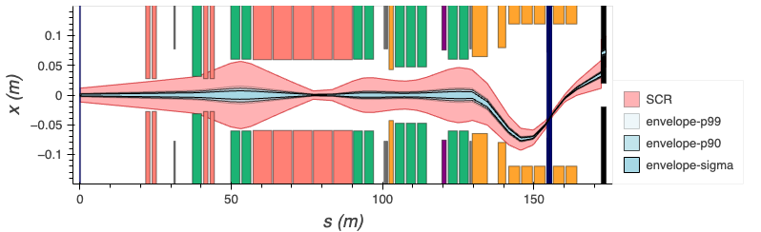
MDX upstream T4 for vertical bump
Positive wobbling
Negative wobbling
Moving the corrector closer to the MBN.241107 is reasonable, because it would reduce the SCR by 20 mm, while BdL does not change dramatically.
Maximum bending strength required is 0.46 Tm.
For comparison, MDX 100 has 0.54 Tm.
Corrector position is scanned between MBN.241107 and MCB.241110.
Bending strength is matched for the beam to have -5 mm vertical offset at T4.

Slide 6
Thanks for your attention!

Slide 7
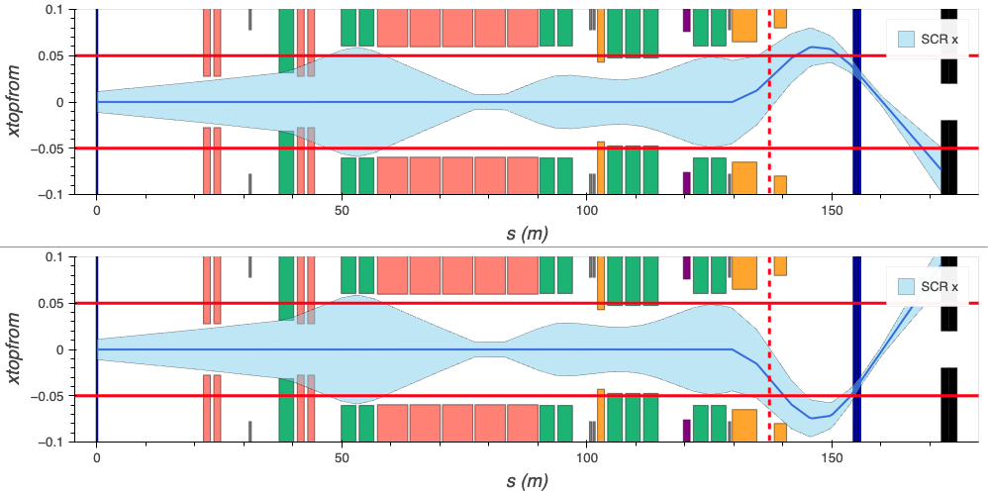
MDX upstream T4 for vertical bump
Stay clear region + wobbling is too big for 100 mm gap.

