Slide 1
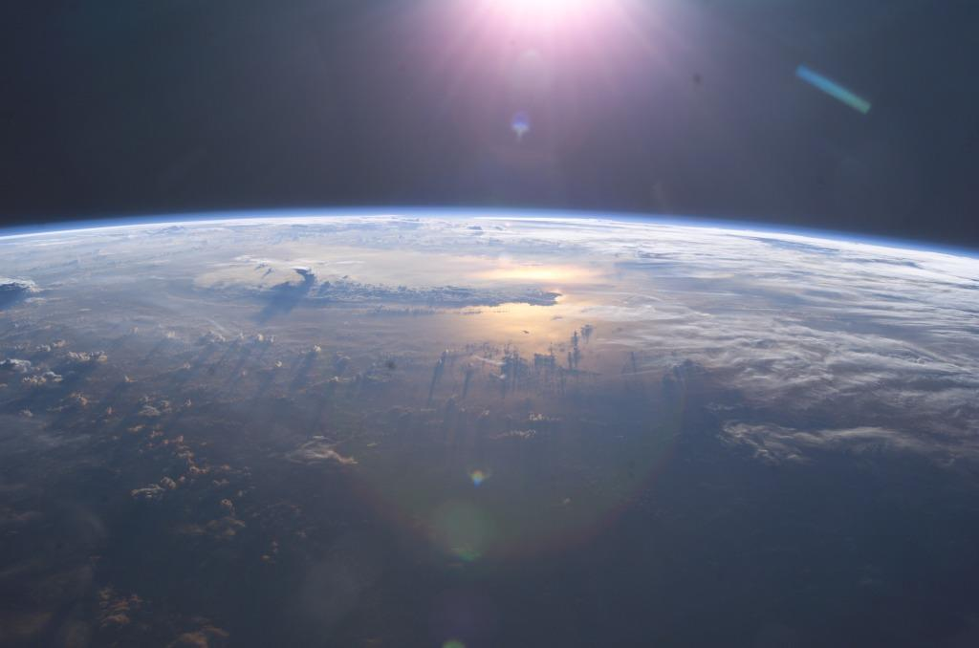
The CLOUD experiment
Cosmics Leaving Outdoor Droplets
Photo: NASA ISS007E10807

Slide 2
Agenda
Background: Earth’s climate, cosmic rays, aerosols and clouds
CLOUD Experiment: Concept, methods, results
(Visit to CLOUD, if visit schedule allows)

Slide 3
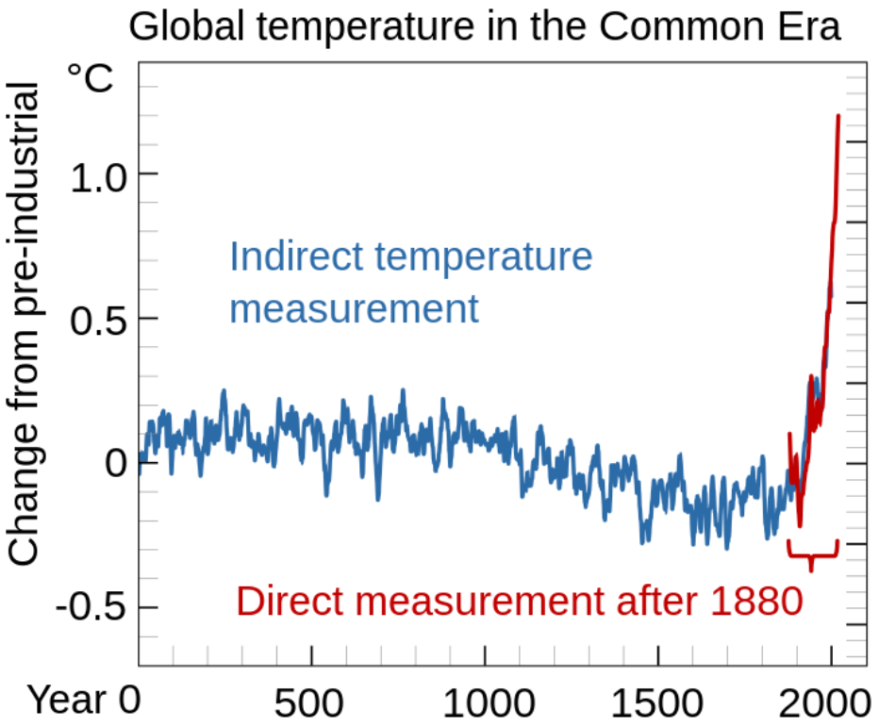
Earth’s temperature
Source: Wikipedia
Global surface temperature reconstruction over the last 2000 years using proxy data from tree rings, corals, and ice cores (blue) [1] and directly observed data (red) [2].
[1] Neukom, R., et al., (2019b), Consistent multidecadal variability in global temperature reconstructions and simulations over the Common Era. Nature Geoscience. 12 (8): 643–649. doi:10.1038/s41561-019-0400-0
[2] Global Annual Mean Surface Air Temperature Change“, https://data.giss.nasa.gov/gistemp/graphs_v4/, NASA. Retrieved 23 Feb 2020.

Slide 4
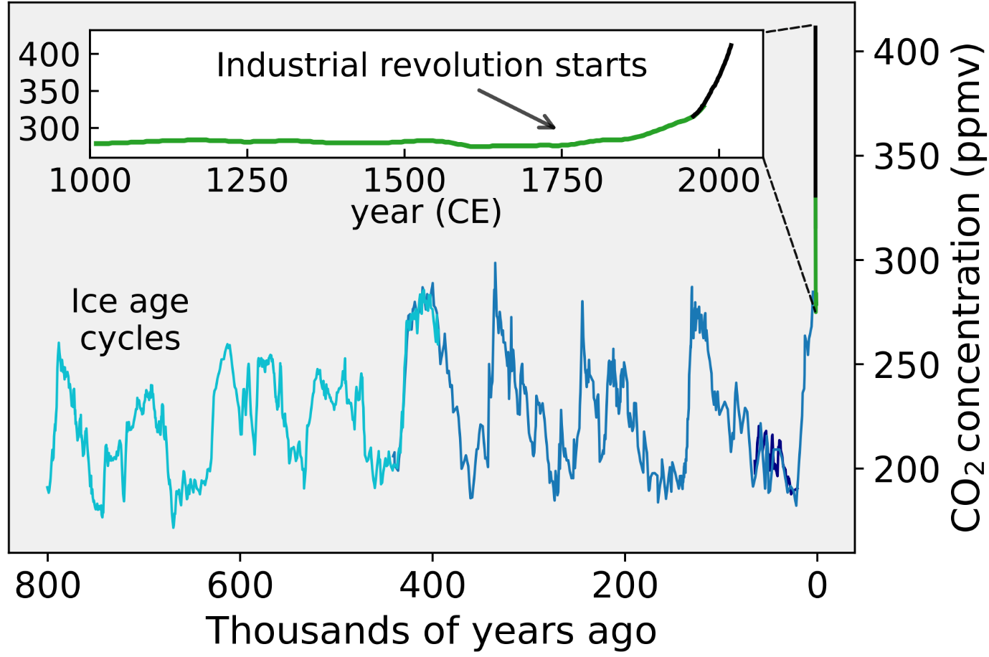
Recent major increase in CO₂
Source: Wikipedia
CO₂ concentrations over the last 800,000 years as measured from ice cores [3][4][5][6] (blue/green) and directly [7] (black)
[3] Lüthi, D., et al., (May 2005). High-resolution carbon dioxide concentration record 650,000–800,000 years before present, Nature, 453 (7193): 379-382 doi:10.1038/nature06949
[4] Fischer, H., et al, (12 March 1999), Ice Core Records of Atmospheric CO 2 Around the Last Three Glacial Terminations, Science, 283 (5408): 1712–1714. doi:10.1126/science.283.5408.1712
[5] Indermühle, A., et al. (1 March 2000), Atmospheric CO 2 concentration from 60 to 20 kyr BP from the Taylor Dome Ice Core, Antarctica, Geophysical Research Letters. 27 (5): 735–738. doi:10.1029/1999GL010960
[6] Etheridge, D., et al, (1998). Historical CO2 Records from the Law Dome DE08, DE08-2, and DSS Ice Cores. Carbon Dioxide Information Analysis Center, Oak Ridge National Laboratory. U.S. Department of Energy. Retrieved 20 Nov 2022.
[7] Keeling, C.; Whorf, T. (2004). Atmospheric CO2 Records from Sites in the SIO Air Sampling Network". Carbon Dioxide Information Analysis Center, Oak Ridge National Laboratory. U.S. Department of Energy. Retrieved 20 Nov 2022.

Slide 5
Increase of CO₂
Source: Wikipedia
Global surface temperature reconstruction over the last 2000 years using proxy data from tree rings, corals, and ice cores (blue) [1] and directly observed data (red) [2].
[1] Neukom, R., et al., (2019b), Consistent multidecadal variability in global temperature reconstructions and simulations over the Common Era. Nature Geoscience. 12 (8): 643–649. doi:10.1038/s41561-019-0400-0
[2] Global Annual Mean Surface Air Temperature Change“, https://data.giss.nasa.gov/gistemp/graphs_v4/, NASA. Retrieved 23 Feb 2020.
Source: Wikipedia
CO₂ concentrations over the last 800,000 years as measured from ice cores [3][4][5][6] (blue/green) and directly [7] (black)
[3] Lüthi, D., et al., (May 2005). High-resolution carbon dioxide concentration record 650,000–800,000 years before present, Nature, 453 (7193): 379-382 doi:10.1038/nature06949
[4] Fischer, H., et al, (12 March 1999), Ice Core Records of Atmospheric CO 2 Around the Last Three Glacial Terminations, Science, 283 (5408): 1712–1714. doi:10.1126/science.283.5408.1712
[5] Indermühle, A., et al. (1 March 2000), Atmospheric CO 2 concentration from 60 to 20 kyr BP from the Taylor Dome Ice Core, Antarctica, Geophysical Research Letters. 27 (5): 735–738. doi:10.1029/1999GL010960
[6] Etheridge, D., et al, (1998). Historical CO2 Records from the Law Dome DE08, DE08-2, and DSS Ice Cores. Carbon Dioxide Information Analysis Center, Oak Ridge National Laboratory. U.S. Department of Energy. Retrieved 20 Nov 2022.
[7] Keeling, C.; Whorf, T. (2004). Atmospheric CO2 Records from Sites in the SIO Air Sampling Network". Carbon Dioxide Information Analysis Center, Oak Ridge National Laboratory. U.S. Department of Energy. Retrieved 20 Nov 2022.

Slide 6
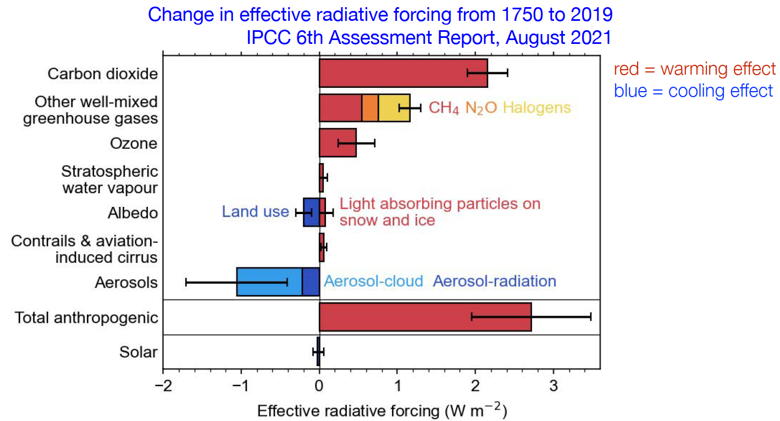
But the climate change is not only about CO₂ !
Anthropogenic
Natural

Slide 7
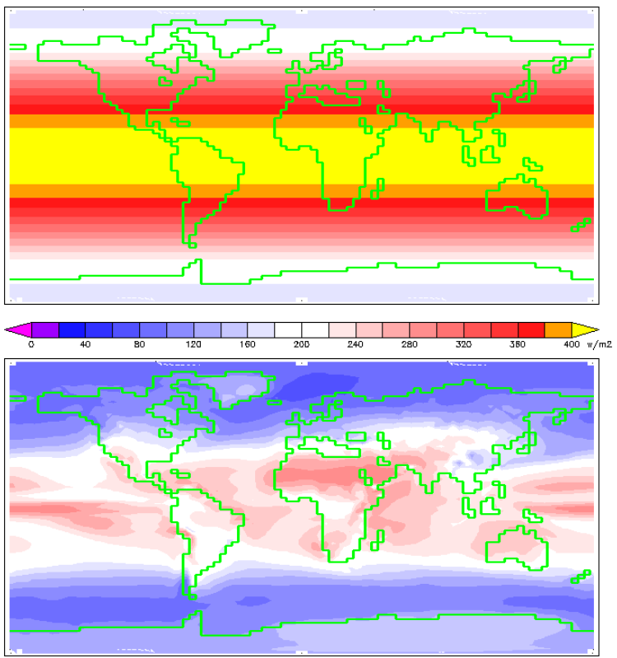
Solar irradiation in total
At the top of Earth’s atmosphere
At ground level
(uses the same colour scale)
Source Wikipedia:
William M. Connolley using HadCM3 data

Slide 8
Effect of aerosols
Anthropogenic
Natural
Aerosols have a cooling effect.
  They have counter-acted a large but poorly understood fraction of warming from greenhouse gases
  The uncertainty in total anthropogenic radiative forcing is dominated by aerosols
  Future emission reductions (e.g. SO₂) will reduce the cooling from aerosols/clouds. But by how much?

Slide 9
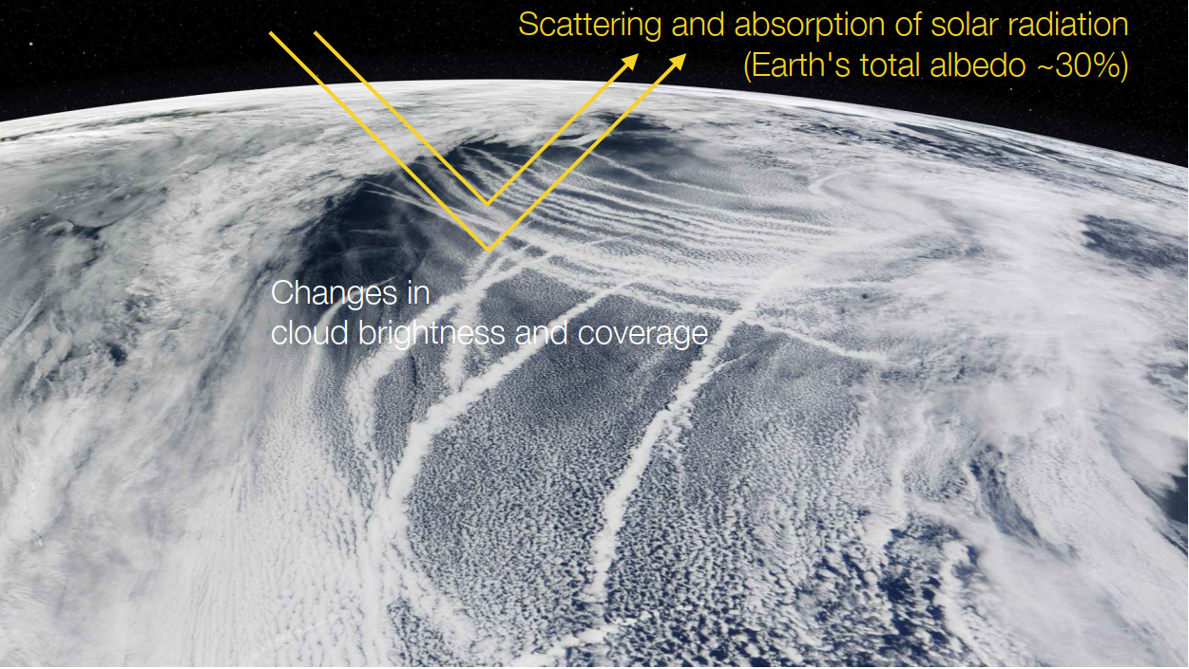
Aerosol and clouds
North Pacific, NASA MODIS satellite, 4 March 2009

Slide 10
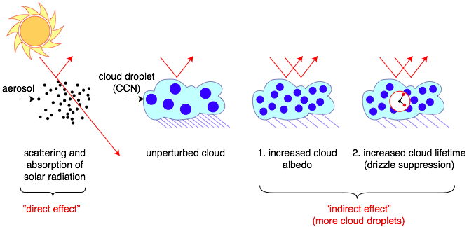
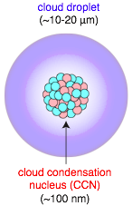
Role of aerosols on sun’s radiative forcing
All cloud droplets form on aerosol “seeds” known as cloud condensation nuclei - CCN
Cloud properties are sensitive to number of droplets
More aerosols/CCN:
  Brighter clouds, with longer lifetimes
Sources of atmospheric aerosols:
  Primary (dust, sea salt, fires)
  Secondary (gas-to-particle conversion)
See youtube: “No particles no fog” https://www.youtube.com/watch?v=EneDwu0HrVg

Slide 11
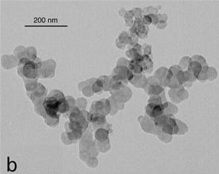
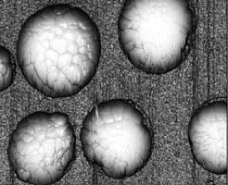
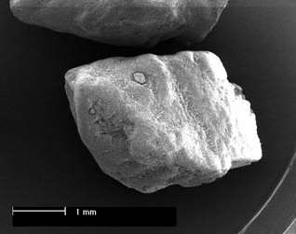
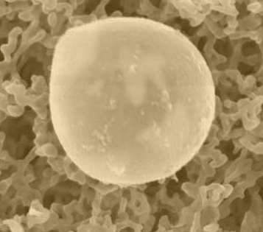

What is an aerosol?
Definition: Suspension of small (liquid or solid) particles in a gas
Diesel soot: ca. 0.1 μm
Ammonium sulfate: ca. 0.1 μm
Sea salt: 0.2 - 10 μm
Mineral dust: 0.2 - 10 μm
Pollen: 10 - 100 μm

Slide 12
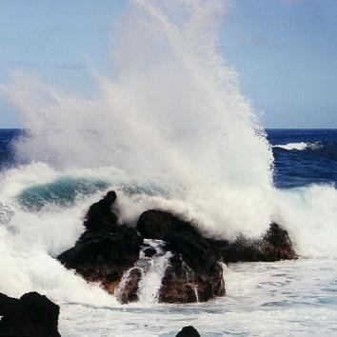
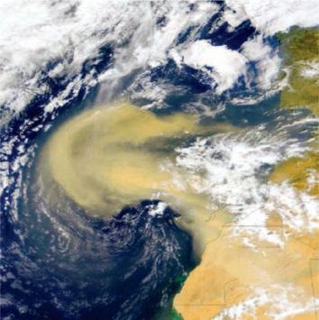
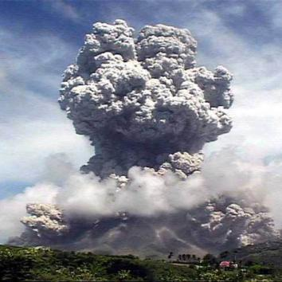
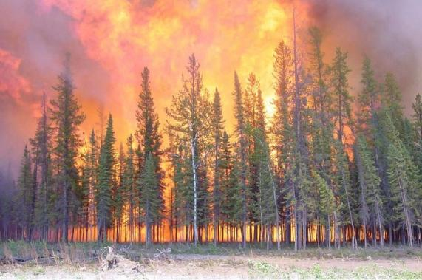
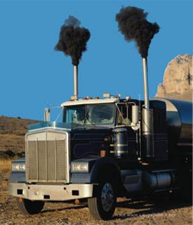
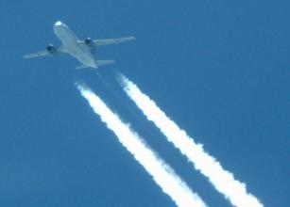
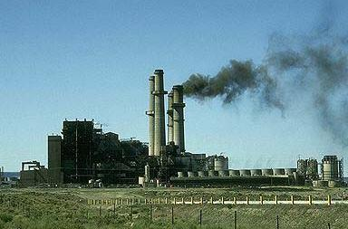

Primary Aerosol Sources
Sea spray
Mineral dust
Volcano ► Sulfates,
dust
Biomass burning ► Organics
Traffic emissions ► Soot
Industrial Emissions
Notes:
Primary Aerosol sources, meaning particles are directly emmitted into the atmosphere either from biogenic sources
Click
Or antrophogenic sources…
Actually there is a small misstake on the slide Volcanos don‘t emmit Sulfates, They emmit large amounts of SO2 emmitted as a gas which gets oxidized in the atmosphere to sulfuric acid which then forms particles.
Next slide

Slide 13
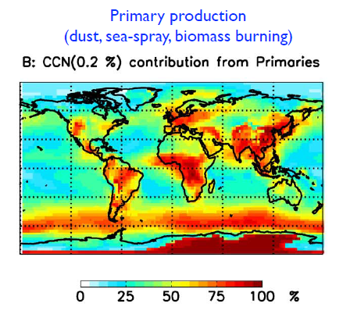
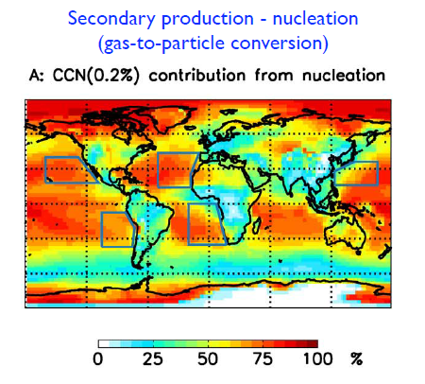
Primary vs. secondary aerosols
Origin of global cloud condensation nuclei, CCN, 500-1000 m above ground level
Merikanto et al., ACP, 2009
  About 50% of all cloud drops are formed on secondary aerosols
  Secondary aerosol formation – nucleation is poorly understood and
  is the key object of study in CLOUD

Slide 14
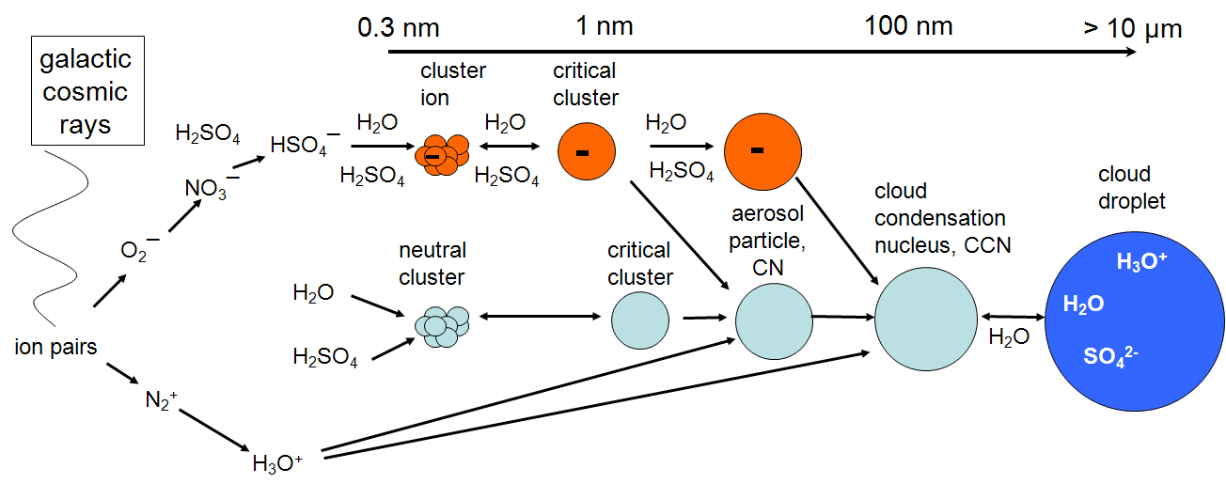
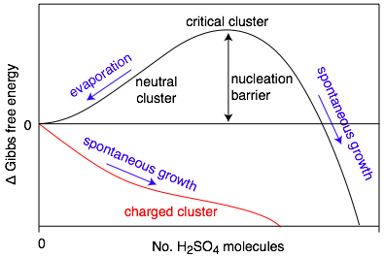
Secondary aerosol production:
Gas-to-particle conversion
Solar wind modulates
Trace condensable vapour → CN → CCN
Contributing vapors and nucleation rates poorly known
H2SO4 is thought to be the primary condensable vapour in atmosphere (sub ppt)
Ion-induced nucleation pathway is energetically favoured but limited by the ion production rate and ion lifetime
Candidate mechanism for solar-climate variability
  This secondary aerosol formation is the key object of study in CLOUD
  Studies on cosmic ray influence is the original reason to have CLOUD at CERN

Slide 15
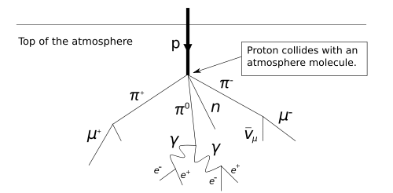
Cosmic rays
High energy particles from outer space
Mostly protons; ~90%
Helium nuclei (alpha particles); ~9%
Others: Electrons, heavy nuclei; 1%
Earth atmosphere protects from the cosmic rays
Lacking protection against cosmic rays is a major problem for long space travels.

Slide 16
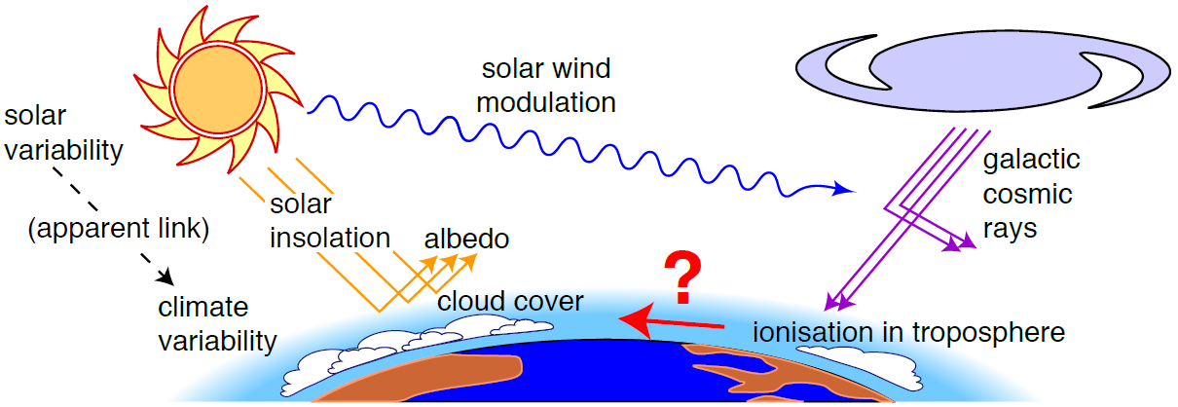
Solar → Cosmic ray → Climate mechanism?
?
Higher solar activity → reduced GCRs → reduced cloud cover → warmer climate

Slide 17
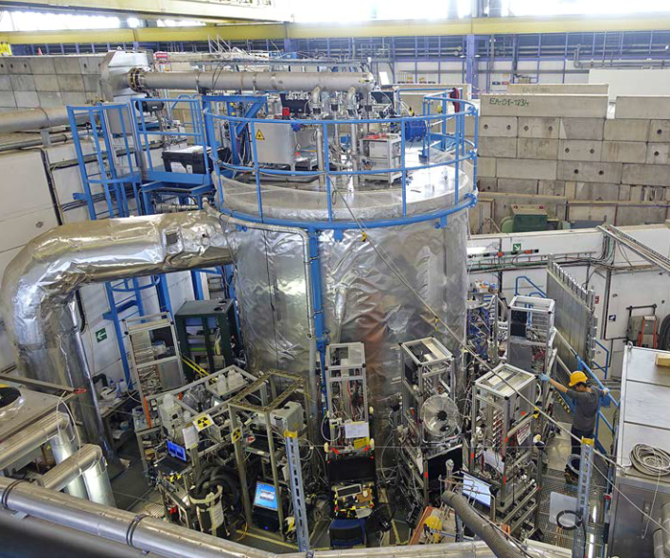
CLOUD
CLOUD studies the above topics by
  Recreating atmosphere in a large chamber to study aerosol particle formation and inﬂuence of ions
  Studying aerosol-cloud interactions by forming liquid or ice clouds
CLOUD’s unique features:
  As realistic as possible
  atmospheric conditions:
    Requires large chamber
    with contaminants < 1 pptv
    (10⁻¹² or 30 sec / 1 million years)
    World's cleanest large
    atmospheric chamber
  Measurement and control
  of ionizing radiation (cosmic rays
  and CERN’s beam)
  Controlled injection of UV light
  Over full tropospheric
  T range (+30°C → -65°C)
  State-of-art instruments analyse
  contents of chamber

Slide 18
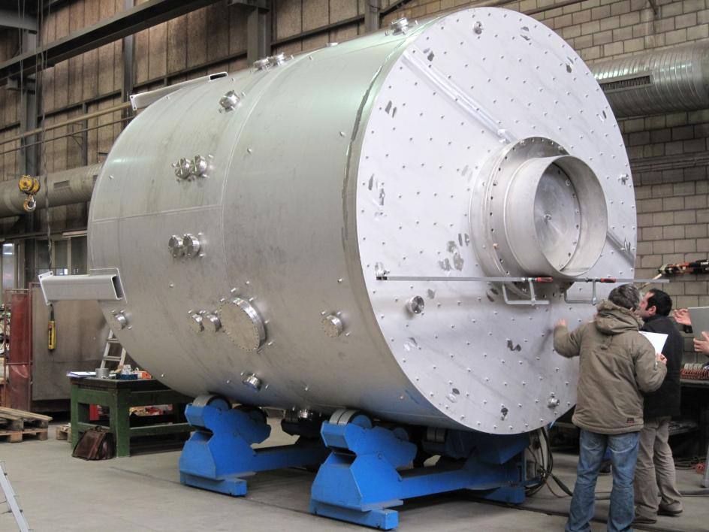
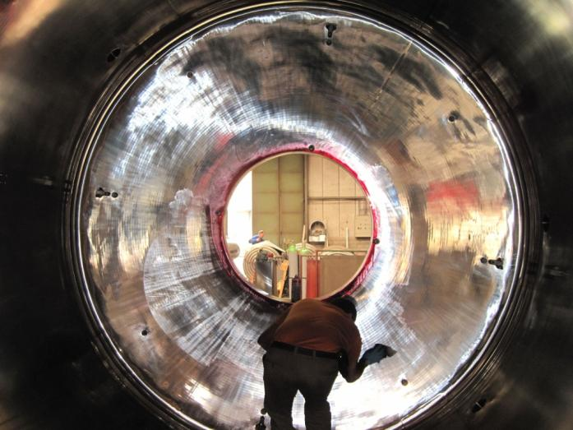
CLOUD Aerosol chamber
27 m³
Pressure: Atmospheric ± 0.3 bar
Only metallic seals
Electropolished inner surfaces

Slide 19
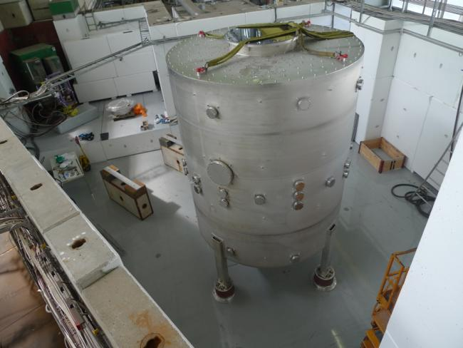
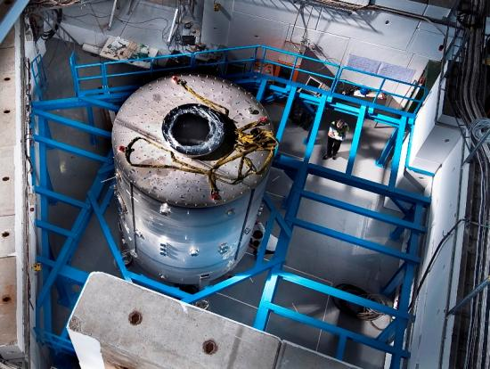
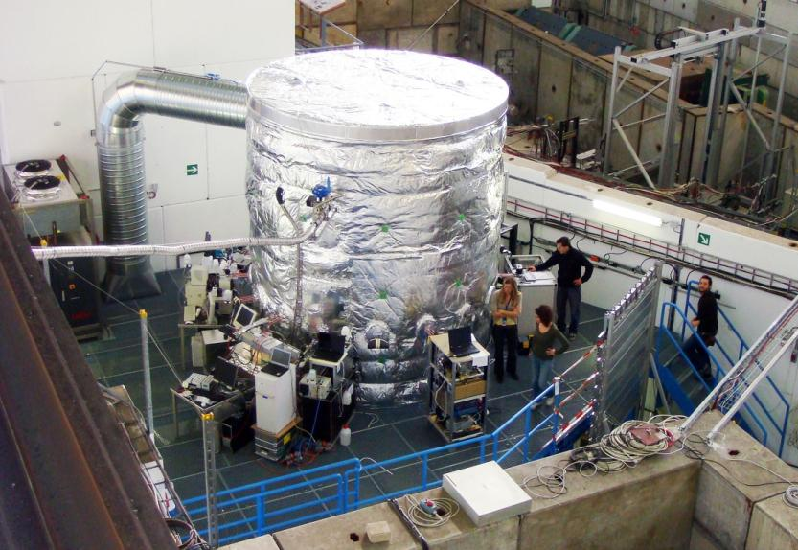
Aerosol chamber in T11
September 2009
July 2009
November 2009

Slide 20
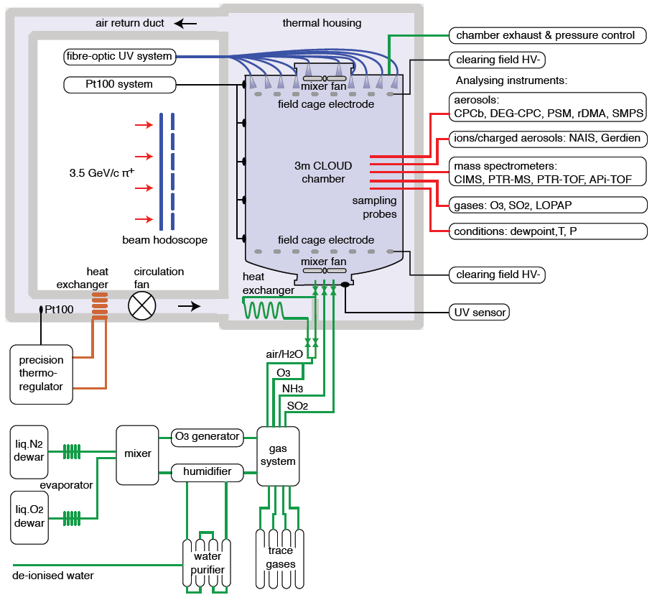
CLOUD

Slide 21
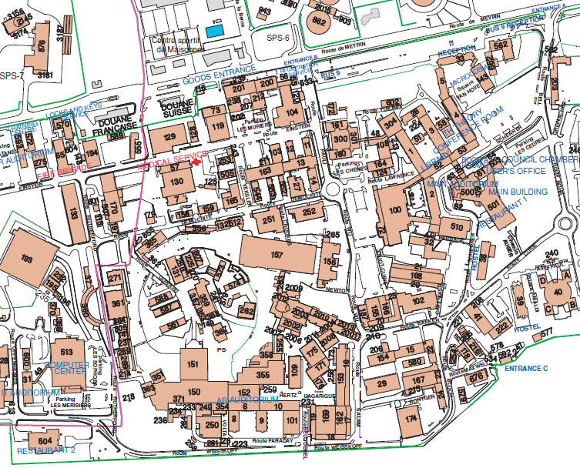
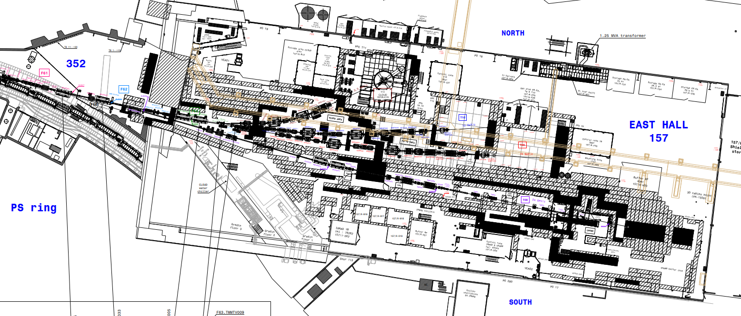
CLOUD in CERN PS East Hall
PS East Hall
CLOUD beam area in PS East Hall
Proton Synchrotron (PS)
accelerator, first operation in 1959

Slide 22
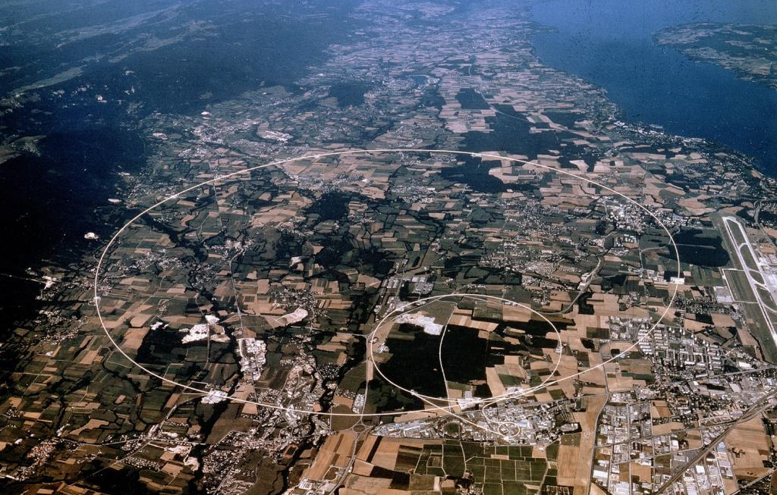
CLOUD in CERN PS East Hall
Here!

Slide 23
CLOUD measurement principle
1. Fill chamber with
clean air
+ water vapour
7. Carefully flush the chamber and clean the chamber walls between experiments
2. Set temperature and pressure
Chamber
Controlled experimental ‘sample’ of Earth’s atmosphere
6. Repeat experiment (typically some hours), possibly with varying parameters
3. Add trace gases,
condensable species
in atmospheric, extremely low concentrations
~1 molecule in 10¹² air molecules
5. Observe
Particle growth size distribution
Electrical charge distribution
Cloud droplet/ice particle concentrations,
etc.
4. Expose to ionizing beam,
and possibly to UV-light

Slide 24
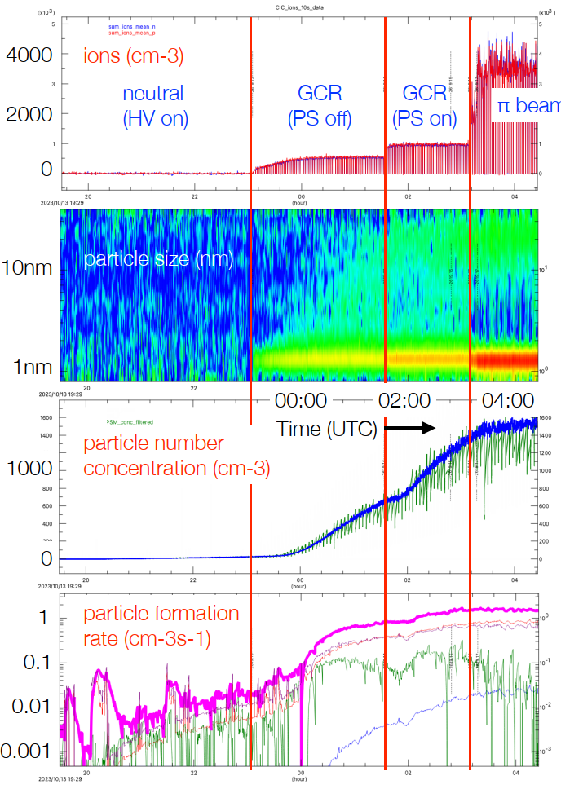
Example from CLOUD16
Aerosol particle formation in the tropical rainforest upper free troposphere
(CLOUD chamber at -50°C)

Slide 25
Each CLOUD contains many topics
(this example is from CLOUD16 run in 2023)
Tropical rainforest upper free troposphere:
  α-pinene, isoprene
  sulfuric acid
  NOx
Marine surfactants in the upper free troposphere:
  nonanal ((CH2)9O)
  sulfuric acid
  NOx
Cool boreal forest boundary layer:
  α-pinene
  sulfuric acid
Arctic boundary layer:
  dimethylsulﬁde (methanesulfonic acid, sulfuric acid)
  iodine (iodic acid, iodous acid)
  ammonia
  glyoxal (dialdehyde, CHOCHO)
Interaction of biogenic and anthropogenic vapours in urban environments:
  biogenic vapours (trees): α-pinene, isoprene
  anthropogenic vapours (automobiles, industry...): sulfuric acid, ammonia, dimethylamine, aromatic organics, NOx

Slide 26
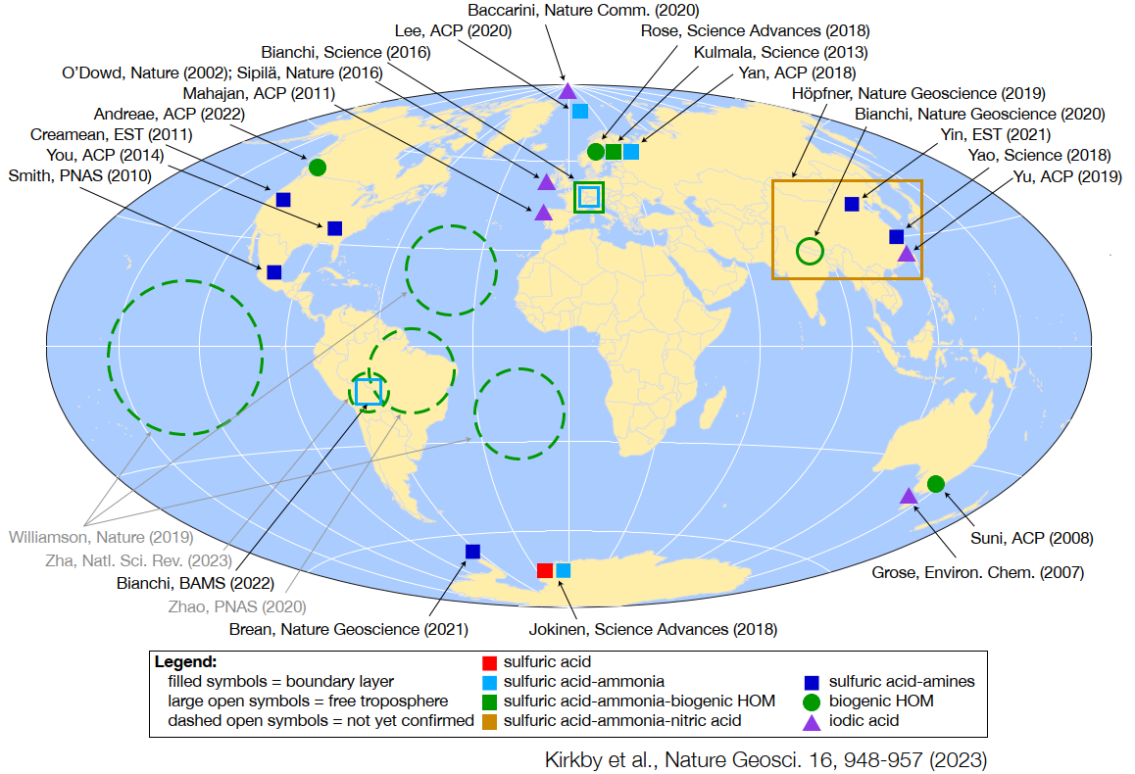
Geographical locations of nucleation mechanisms measured by CLOUD

Slide 27

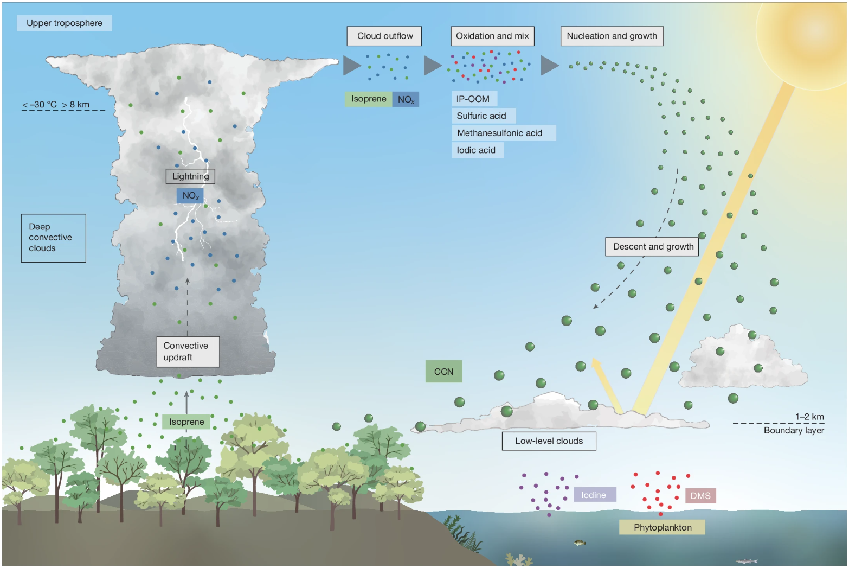
Latest main results
Role of isoprene emitted from tropical rainforest trees on cloud formation on sea area
Field measurements (by non-CLOUD teams) on Amazon and Southern Atlantic compared to laboratory measurements done at CLOUD

Slide 28
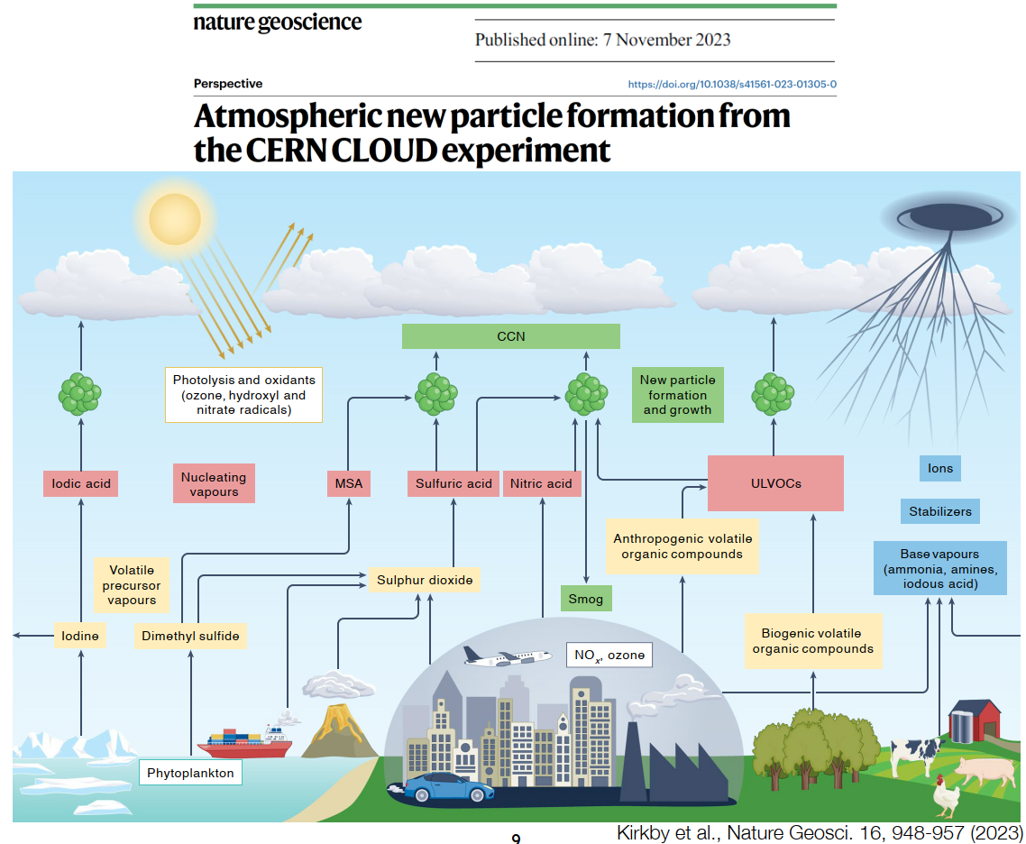
Results: Improved understanding of atmospheric processes

Slide 29
CLOUD's near-term future plans
Aerosol particle formation and growth in cold regions:
  Tropical Atlantic and Paciﬁc upper free troposphere
  Asian monsoon upper free troposphere
  Southern Ocean upper free troposphere
  Particle evaporation in passing from cold to warm environments
"CLOUDy" experiments:
  Effect of aerosol charge on cloud microphysics (aerosol scavenging)
  Asian monsoon ice nucleation from HNO3-H2SO4-NH3 particles
  Transport of vapours to the upper free troposphere: release of NH3 (and other dissolved vapours) upon supercooled droplet freezing or evaporation
Parameterise CLOUD measurements for global climate models, and evaluate the impact on present and future climates

Slide 30
CLOUD collaboration & Finland
20 institutions from
9 countries with
150 contributing
scientists and
technical staff.
Finnish institutes and scientists are centrally involved in CLOUD since the beginning:
State-of-the-art measurement instruments, operated at CLOUD.
Contributions to scientific studies and publications,
in lead role in many of them.
Essential links to field measurements done in Finland and elsewhere.
Country | Institution
 | European Organization for Nuclear Research (CERN), Geneva
Austria | University of Innsbruck, Institute for Ion and Applied Physics, Innsbruck
 | University of Vienna, Faculty of Physics
Cyprus | The Cyprus Institute, Climate & Atmosphere Research Center, Nicosia
Estonia | University of Tartu, Laboratory of Environmental Physics
Finland | Finnish Meteorological Institute, Helsinki
 | Helsinki Institute of Physics
 | University of Eastern Finland, Department of Applied Physics, Kuopio
 | University of Helsinki, Department of Physics
Germany | Goethe University Frankfurt, Institute for Atm. and Env. Sciences
 | Karlsruhe Institute of Technology, Institute for Meteorology and Climate Research
 | Leibniz Institute for Tropospheric Research, Leipzig
 | Max-Planck Institute for Chemistry, Department of Atmospheric Chemistry, Mainz
Portugal | University of Lisbon, Department of Physics and University of Beira Interior, Covilha
Sweden | University of Stockholm, Department of Applied Environmental Science
Switzerland | Paul Scherrer Institute, Laboratory of Atmospheric Chemistry, Villigen
United States | California Institute of Technology, Div. of Chemistry and Chemical Eng., Pasadena, CA
 | Carnegie Mellon University, Department of Chemical Eng., Pittsburgh, PA
 | Aerodyne Research Inc., Billerica, MA with Tofwerk AG, Thun, Switzerland
 | University of Colorado, Dep. of Chemistry and Biochemistry & CIRES, Boulder, CO

Slide 31
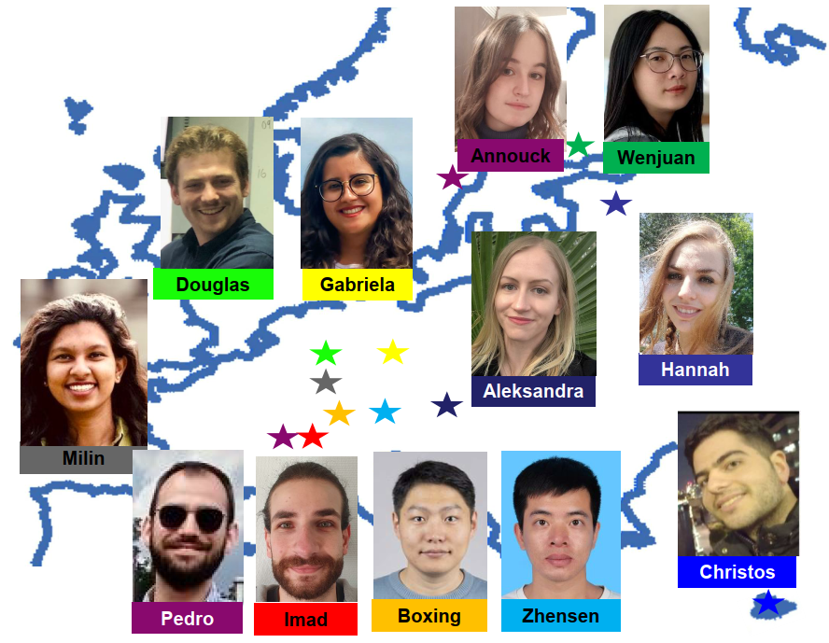
Young scientists are central at CLOUD
Some of them are financed by
EU Horizon Europe Marie Curie Doctoral Network: “CLOUD-DOC”
12 PhD students
at 12 CLOUD institutes (Frankfurt, CERN, Helsinki, Stockholm, Ionicon, Tropos, Cyprus Inst., Tartu, Vienna,
KIT, PSI, Tofwerk)
1Sep22-31Aug26 (2.7M€)

Slide 32
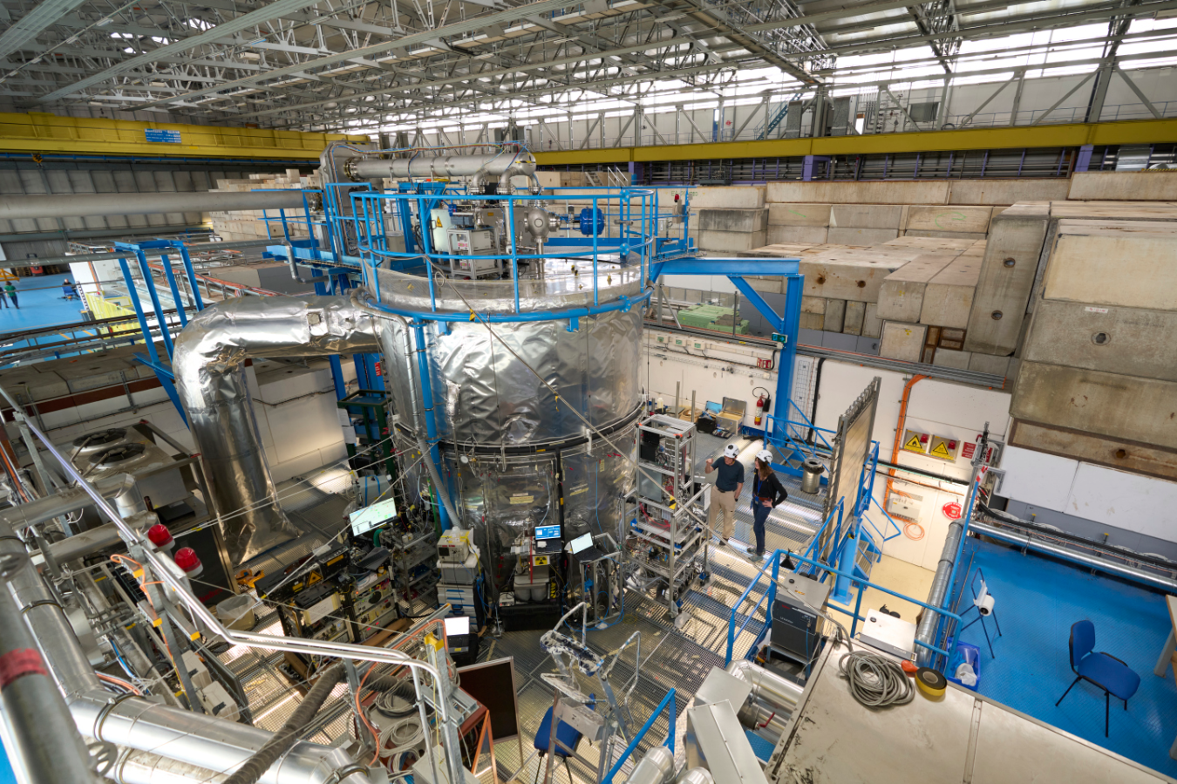
Thank you for your attention. Questions?

Slide 33
Spare slides

Slide 34
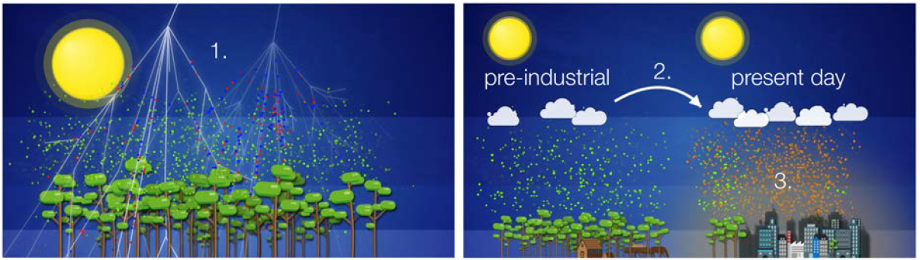
CLOUD in short
CLOUD experiment’s scientific goals:
Settling questions on cosmic ray – aerosol – cloud – climate links
Sharpening understanding on past & present aerosol – cloud radiative forcing
Understanding drivers for urban smog formation
2006: Approved in CERN’s scientific program.
2007-2009: Design and construction.
2009-2019: Operation and data taking. Between beam runs continuous adaptations
to improve and broaden the experimental measurement reach of CLOUD.
2020-2022: Major upgrade as part of CERN PS East Hall renovation.
2022- : Operation and data taking.
Peer-reviewed publications (2011-2022): ~75 papers, including 10 in Nature or Science
For more on CLOUD see: http://home.cern/science/experiments/cloud

Slide 35
Key questions addressed by CLOUD
For each system of precursor vapours and ambient conditions (T, relative humidity...):
What is the aerosol particle formation rate vs vapour concentrations?
What is the inﬂuence of ions from galactic cosmic rays between 0 and 10 km altitude?
How fast do the particles grow from molecular (~1 nm) to CCN sizes (~50 nm)?
Which chemical compounds are involved in a) nucleation and b) growth?
What are the gas-phase chemical pathways transforming volatile precursor vapours into ultra-low-volatility nucleating vapours?

Slide 36
Summary of CLOUD
CLOUD is providing a mechanistic understanding of aerosol particle formation and growth for global atmospheric chemistry and climate models
This is effectively catching up with gas-phase chemical kinetics where - since more than 40 years! - laboratory experiments have provided straightforward kinetic equations that could be inserted directly into models—that is, explicit mechanisms
In the aerosol world, a similar level of ‘nucleation kinetics’ has largely been achieved through CLOUD experiments over the past 12 years - but there is still much more to do
CLOUD has transformed how aerosols are represented in global climate models

Slide 37
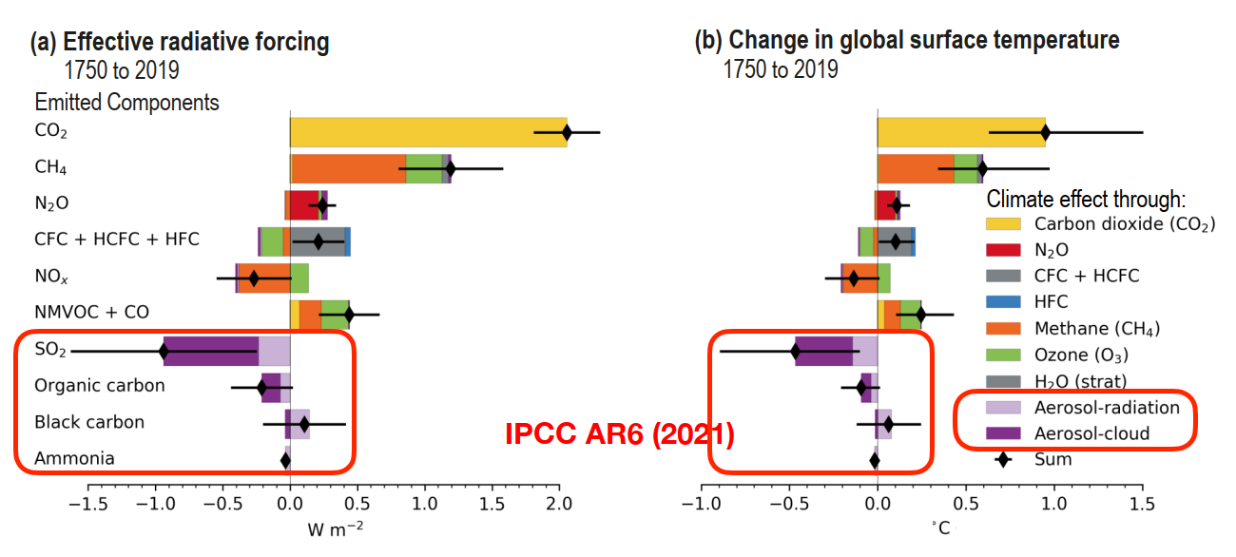
Radiative forcings since 1750 (IPCC AR6)
Estimated aerosol effective radiative forcing = -(1.3±0.7) W/m²
Effective radiative forcing from CO2 = (2.1±0.3) W/m²

Slide 38
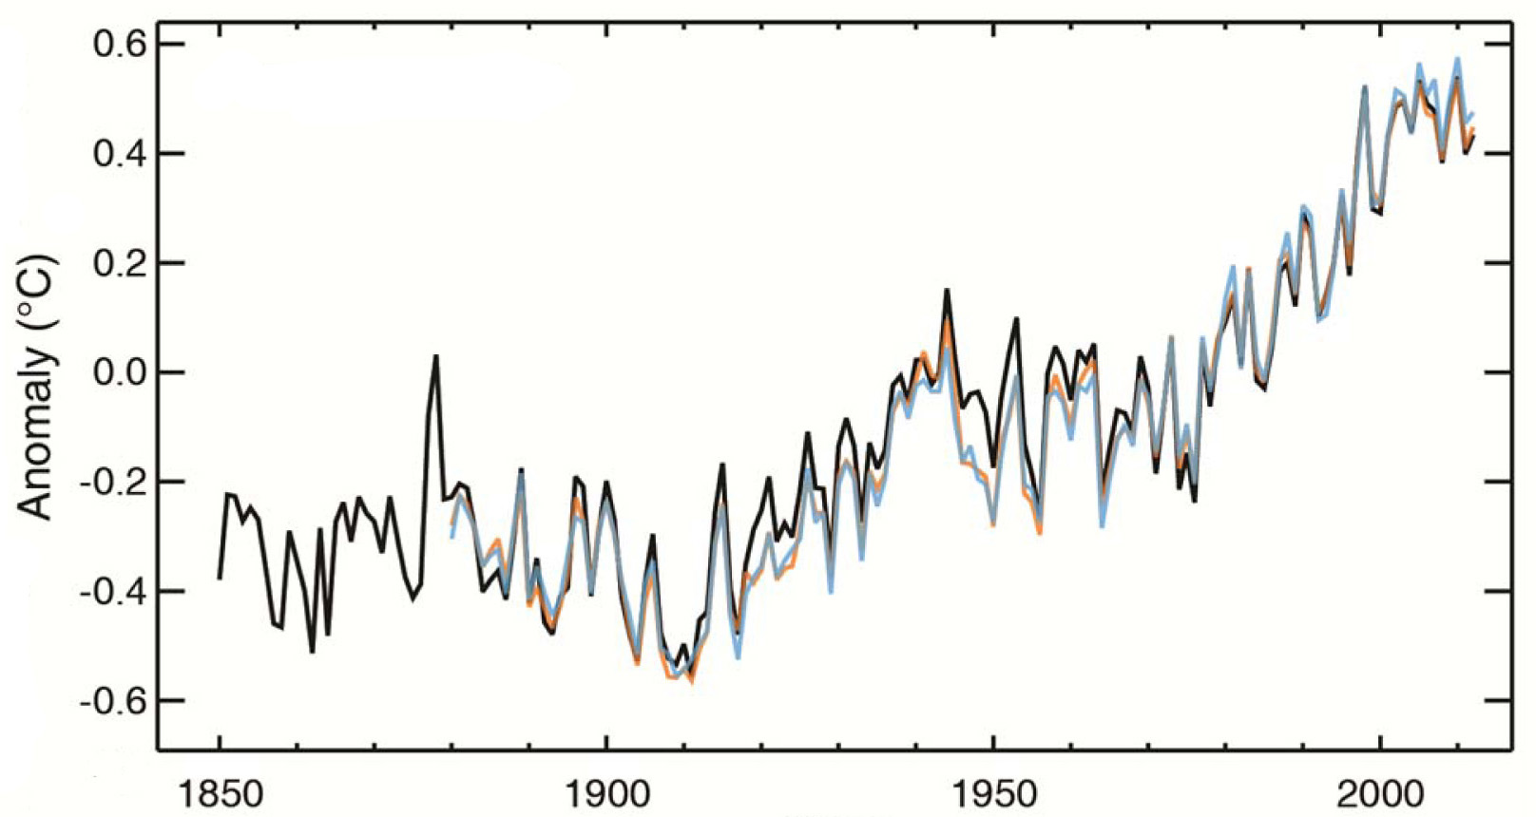
Global surface temperature
Source: IPCC, Summary for Policymakers, 2013
ΔT = 1 °C
since 1850
Predictions for next 100 years:
Increase of 1.5 to 4.5 °C
Goal of Paris climate agreement:
Limit increase to max 2 °C
Year

Slide 39
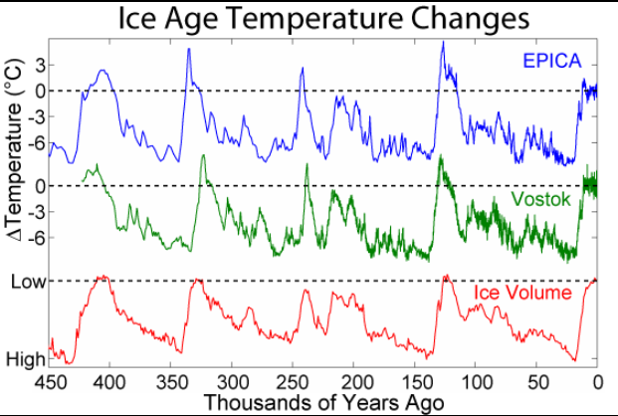
Global surface temperature
Source: IPCC, Summary for Policymakers, 2013
ΔT = 1 °C
since 1850
Predictions for next 100 years and doubling of CO2 in atmosphere:
Increase of 1.5 to 4.5 °C
Goal of Paris climate agreement:
Limit increase to max 2 °C
Year
Source: Wikipedia
ΔT = 6 °C
since last Ice age.
EPICA = European Project for Ice Coring in Antarctica
Vostok = Ice core measurements at Russian Vostok Antartic base
3 km thick ice on Northern Europe!

Slide 40
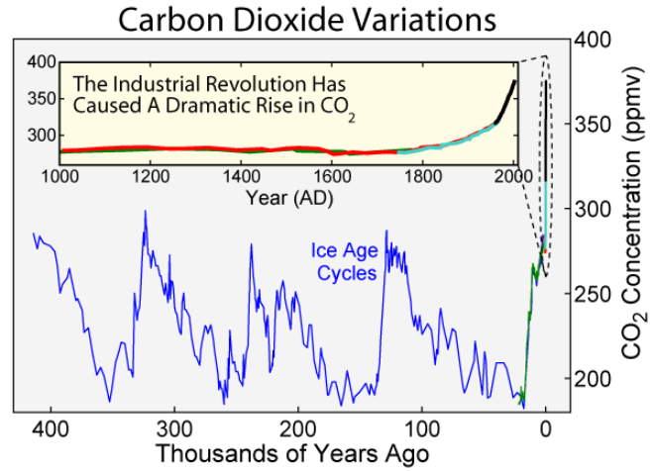
CO₂ in atmosphere
Source: Wikipedia

Slide 41
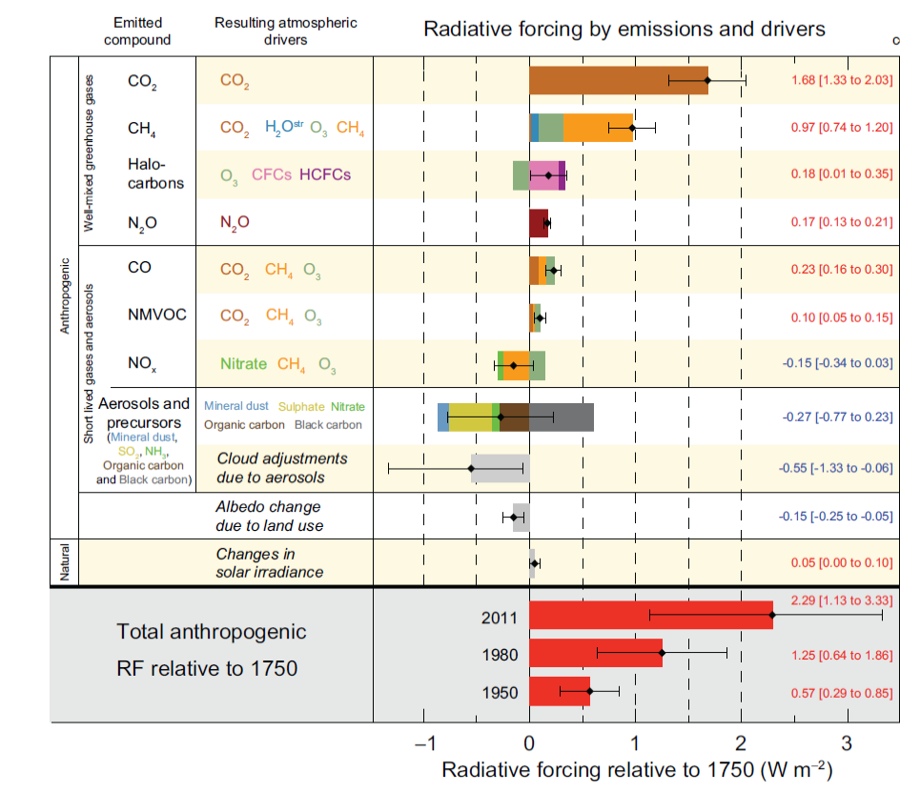
It’s not only about CO₂ !
A. Anthropogenic aerosol forcings are poorly understood.
B. Natural part is very small.
Is there a missing natural forcing?
Is that from varying cosmic ray flux, modulated by sun?
Source: IPCC, Summary for Policymakers, 2013
A + B → The CLOUD experiment

Slide 42
Original reason why CLOUD is at CERN:
Study link from Cosmic Rays via aerosols & clouds to Climate
Numerous correlations suggest GCR-climate connection.
But no established mechanism to explain this.
Several recent
observations,
e.g. by
Eichler et al.,
ACP, 2009:
Correlation
between
GCRs and
temperature
in Siberia
from glacial
ice core data.

Slide 43
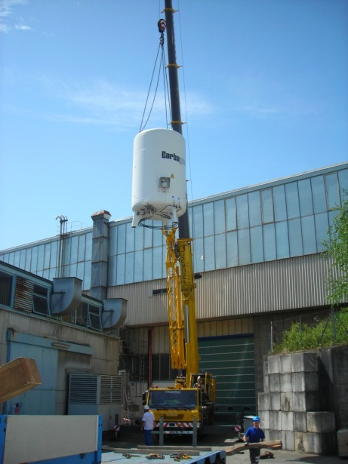
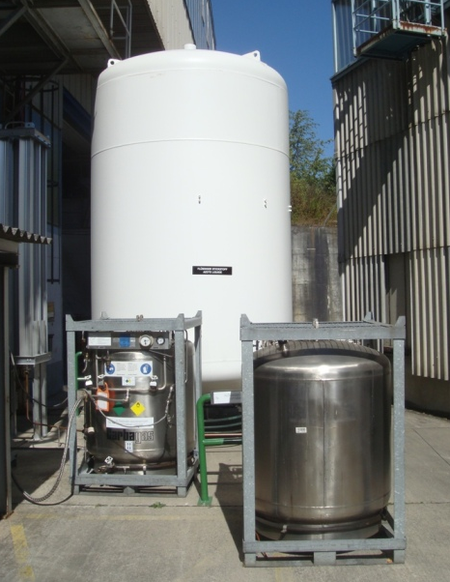
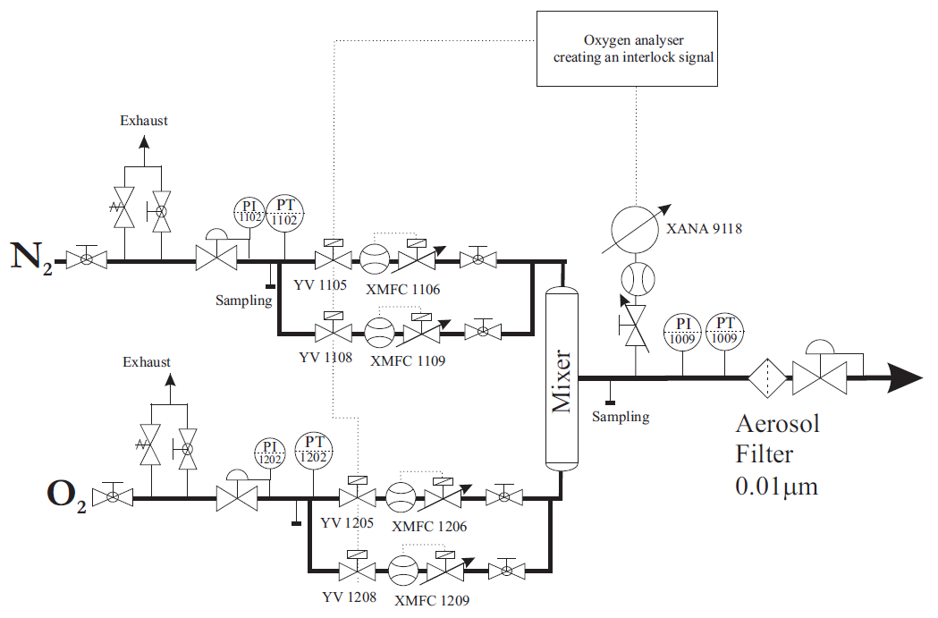
Ultra-pure air

Slide 44




UV system

Slide 45



HV field cage

