Slide 1

Q1/Q3 Cold Mass at CERN
H. Prin, T. Bampton, N. Bourcey, N. Eyraud, S. Straarup, O. Housiaux.
November the 13th 2024

Slide 2

Outline
Following the CERN cold mass assembly workflow, what is the tooling needed to assemble a LMQXFA cold mass? Mainly in terms of:
Handling
Alignment
Splicing
Fixed point anchoring
Welding
…

Slide 3
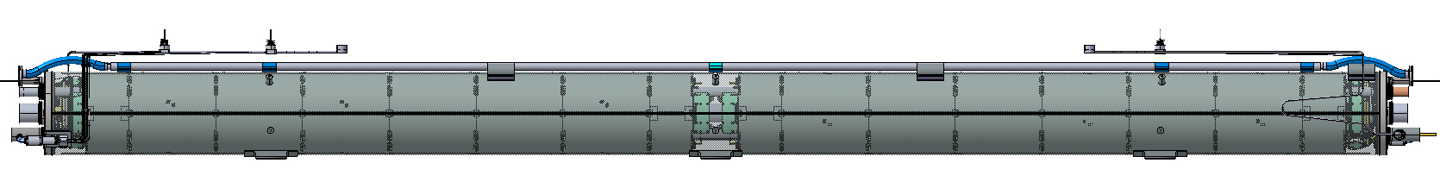
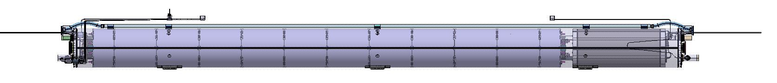
LMQXFA / LMQXFB
10.1m
Q1-Q3
LMQXFA
MQXFA
MQXFA
9.785m
Q2
LMQXFB
MQXFB
MCBXFB

Slide 4
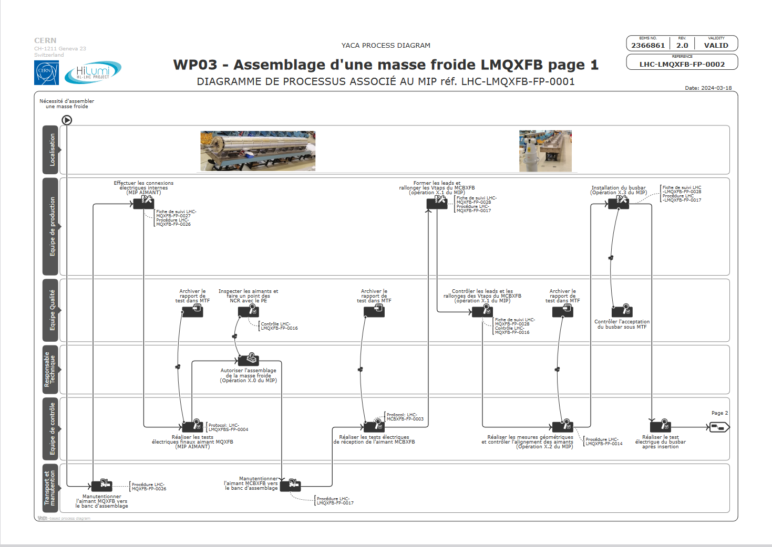

Slide 5
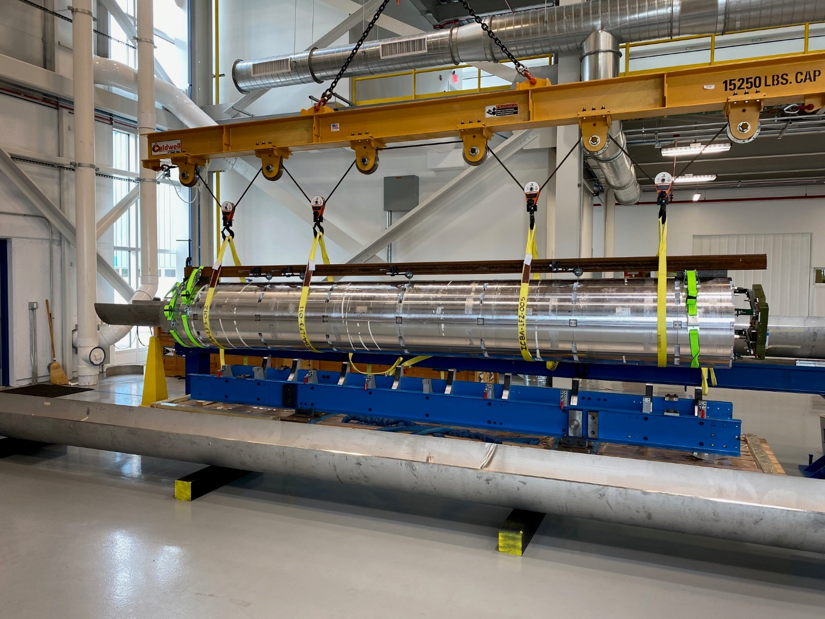
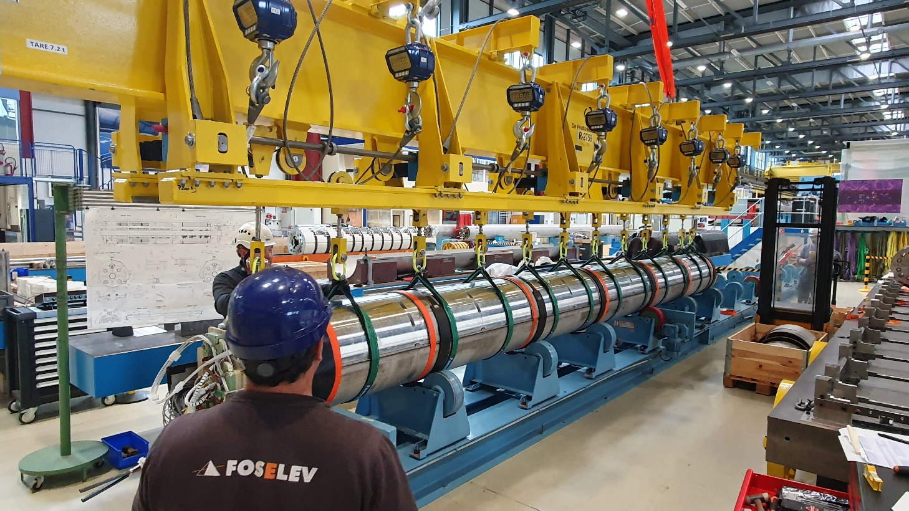
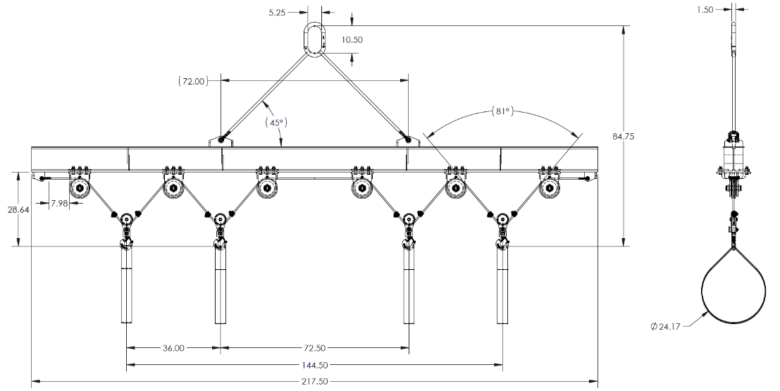
MQXFA Magnet handling
Lifting beam @Fermilab
Lifting beam @CERN
Only for MQXFB!
Possibility to recover from LBNL or Fermilab after the last MQXFA has been sent?

Slide 6
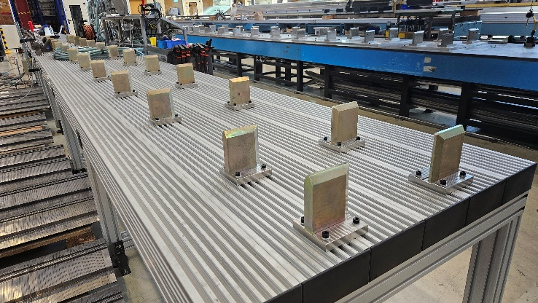
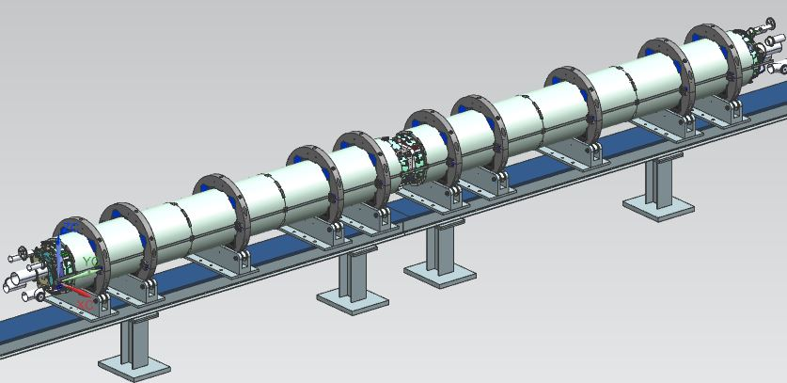
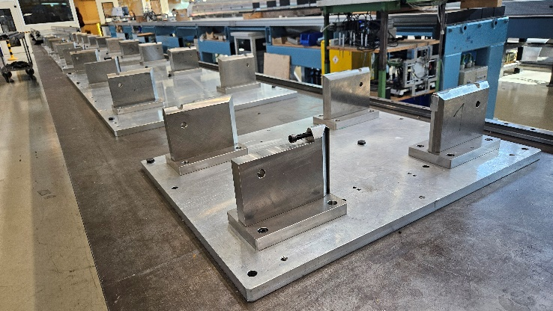
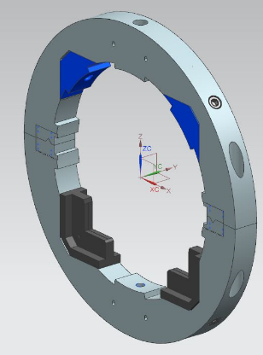
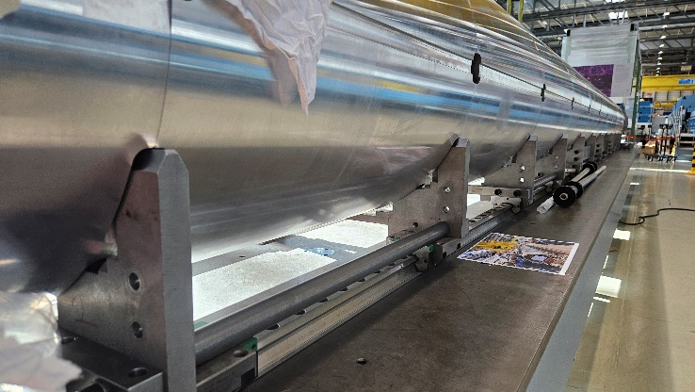
MQXFA Magnets Alignment
Tooling @Fermilab
Tooling that could be used
@CERN
Aluminum storage bench:
Full length available
Easy and cheep, additional supporting system already available
Does not interfere with MQXFB assembly and loading
Too soft and not stable (Al+plastic feet)
MQXFB loading bench:
Robust alignment
Existing supports could be adapted
Strong interference with MQXFB assembly
Cold mass assembly bench:
Robust alignment
Alignment features at the largest width
Adaptative longitudinal position of the supports and the magnets
Extension needed on the MCBXFB side (~2m)
Interference with LMQXFB assembly
Cold mass development AUP
Presented by S. Feher during the 9th LH-LHC Collaboration meeting at Fermilab

Slide 7
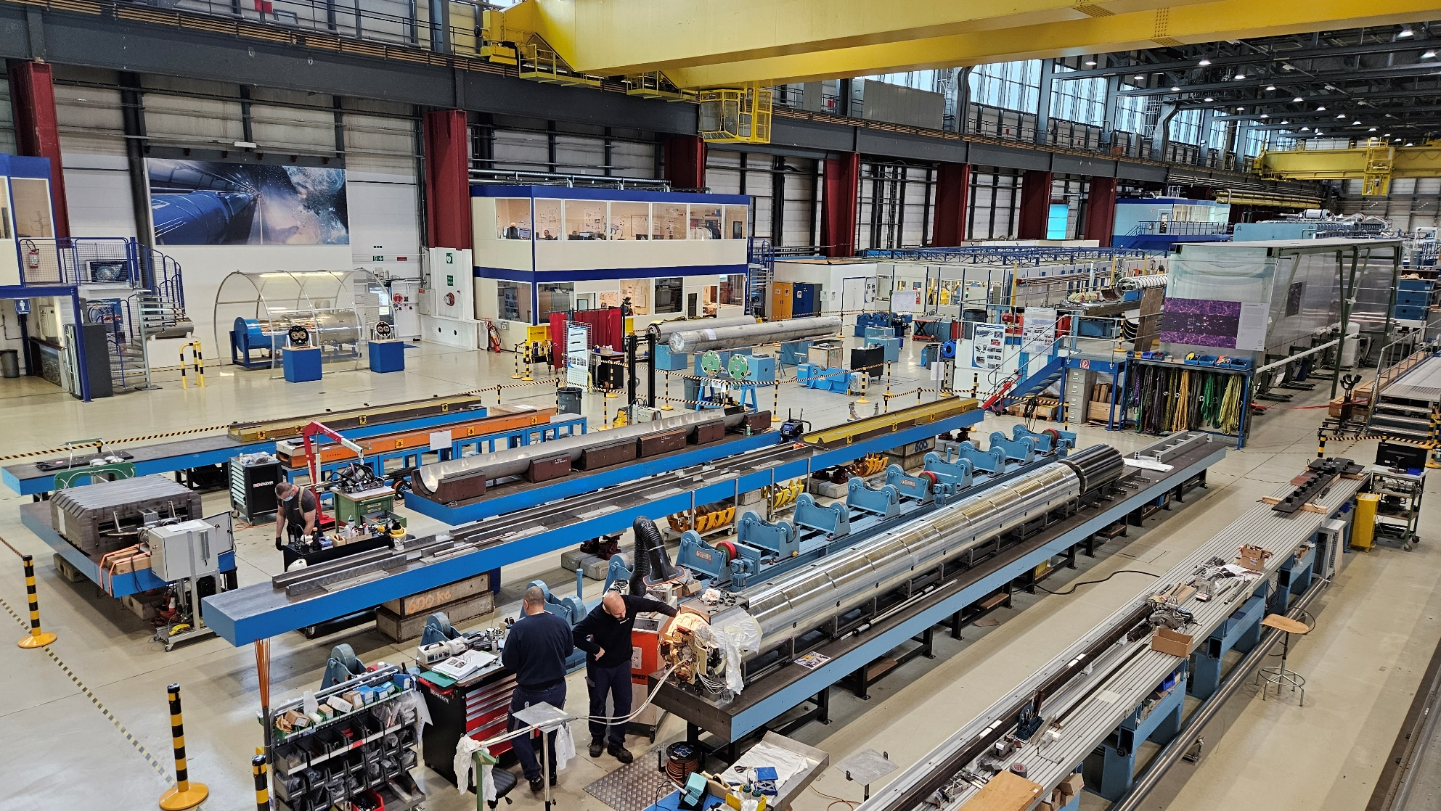
MQXFA magnets new alignment bench in the LMF
Transform the 8m preparation bench used for the CCT magnets, adding the 2m extension of the cold mass assembly bench:
Full length available
Realignment needed
Robust alignment
Adaptative longitudinal position of the supports and the magnets if the system is copied from the cold mass assembly bench.
Cheaper solution can be designed reusing the additional supporting system already available.
No interference with the other HL-LHC cold masses production
Alignment based on the magnet mechanics and the bench alignment precision.
No possibility to realign the magnets roll contrary to the bench in Fermilab.

Slide 8
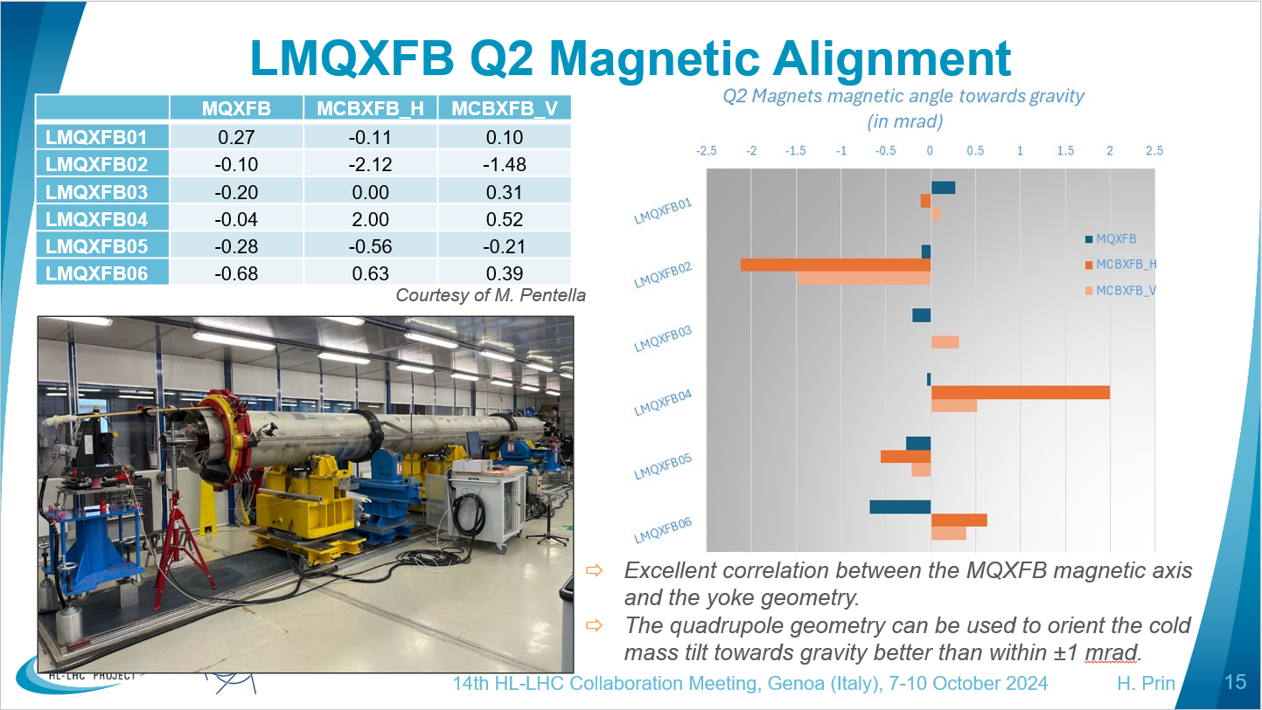
CERN experience using mechanics to align the MQXFB rolling angle toward gravity

Slide 9
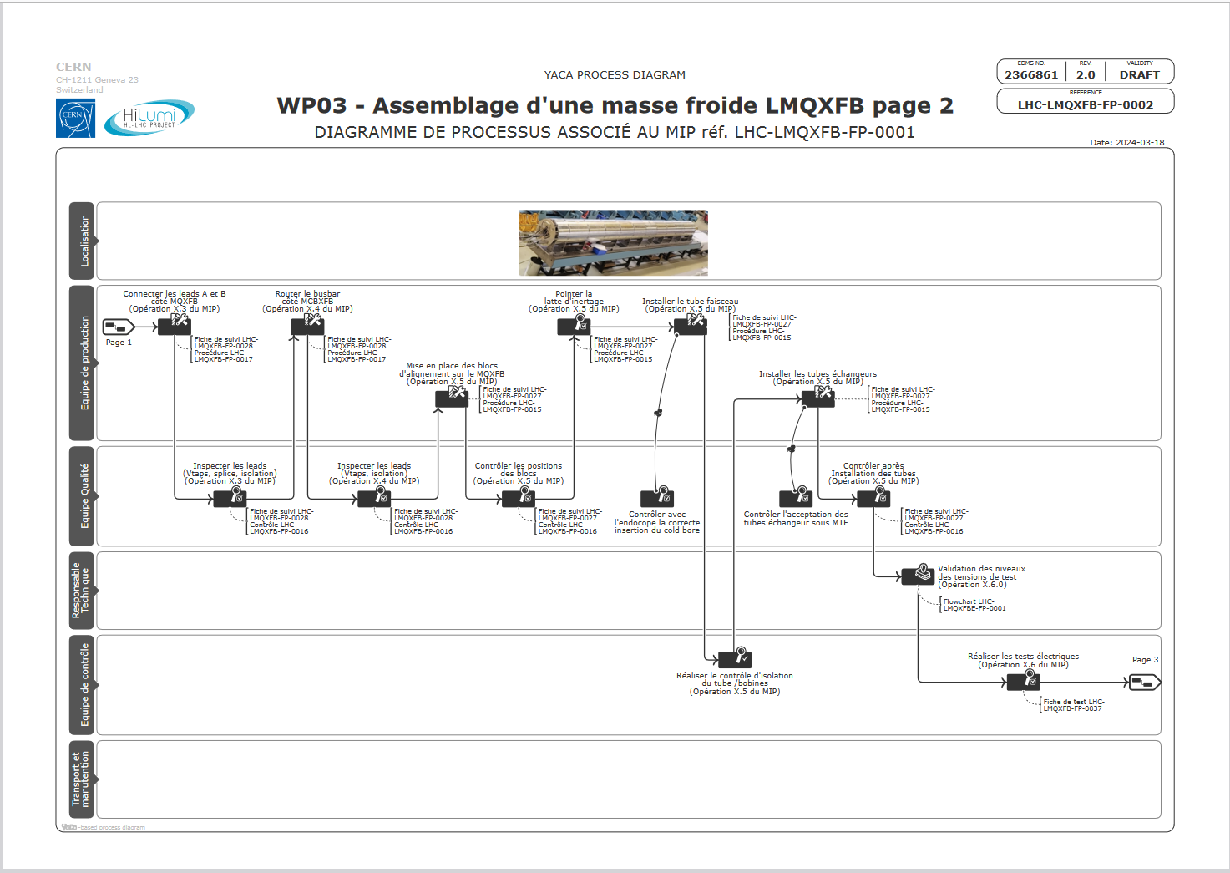
No insertion direction issue but special care due to insulation thickness
+
k-mod

Slide 10
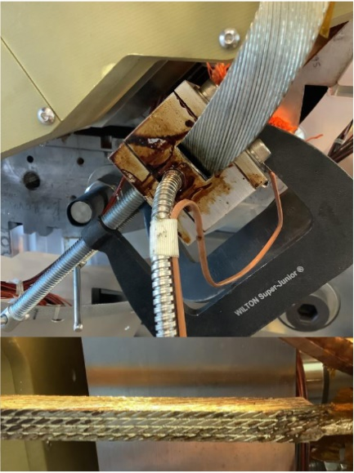
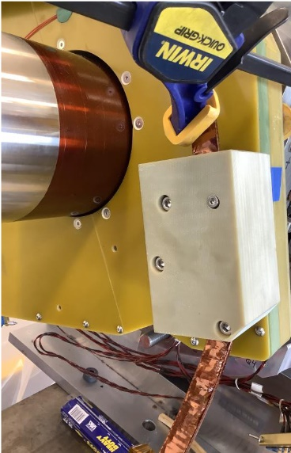
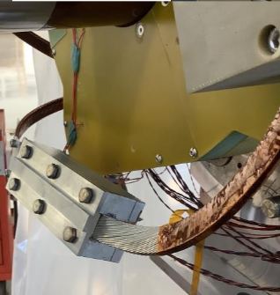
13kA circuit and k-mod leads splicing
@Fermilab
Proposal @CERN
Assuming that the MQXFA magnets are delivered to CERN with their coil leads already spliced.
Copy and used Fermilab tooling design to connect the busbars
OR
Adapt CERN tooling reusing the CLIQ cable splicing for the k-mod leads and redesign the busbar fixed point(s)
LMQXFA coldmass production experience and plan
Presented by T. Strauss during the 11th LH-LHC Collaboration meeting at CERN

Slide 11
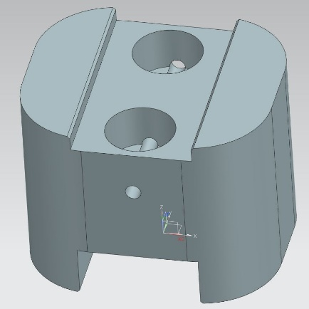
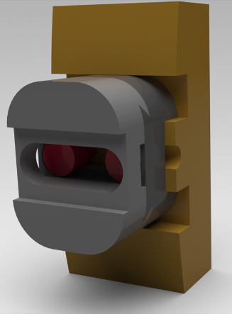
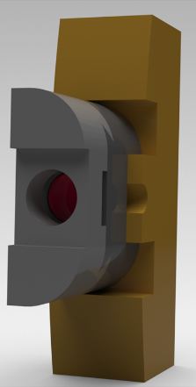
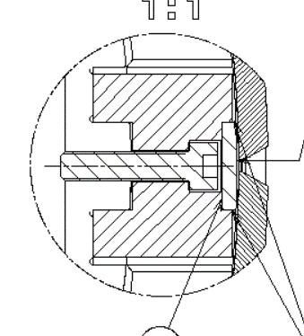
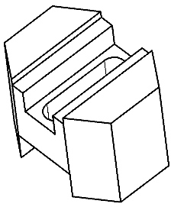
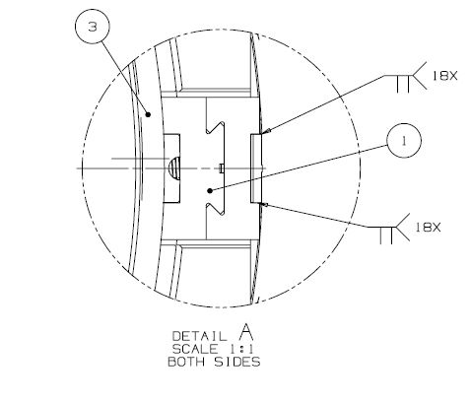
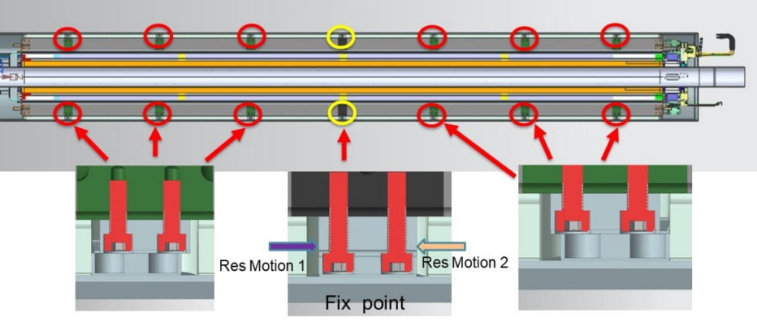
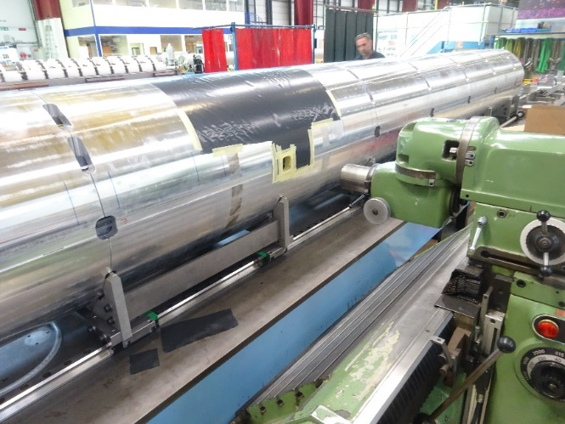
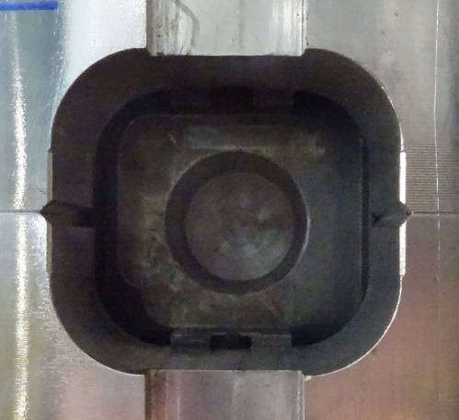
Tack welding blocks and fixed points
@Fermilab
Proposal @CERN
Sliding blocks: use LHCMQXFBS0030 standard MQXFB alignment block
Fixed point: see Susana’s presentation to use LHC standard MQXFB alignment block standard MQXFB fixed point inside a machined yoke plate like for P2 and P3.
OR
See next slide
Fixed
Wide Slidding
Narrow Slidding
LMQXFA design modification due to requirements change
Presented by A. Vouris during the 11th LH-LHC Collaboration meeting at CERN

Slide 12
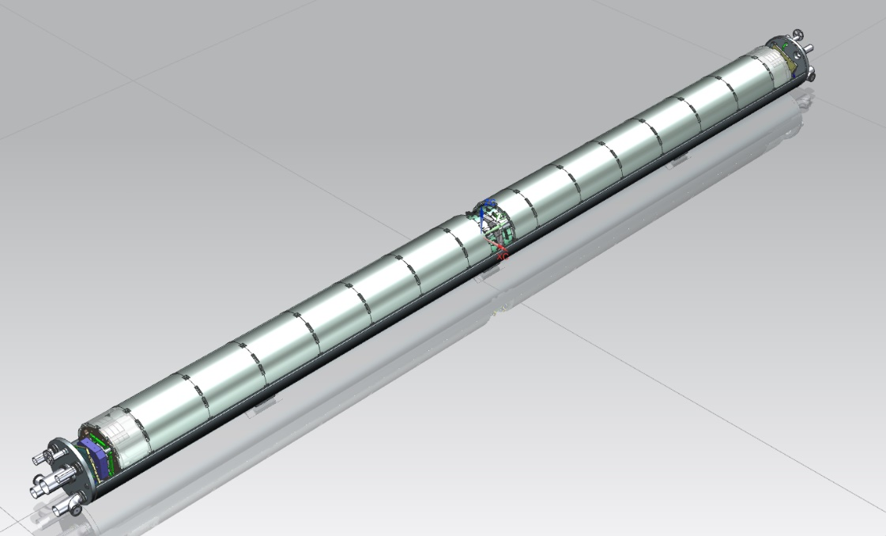
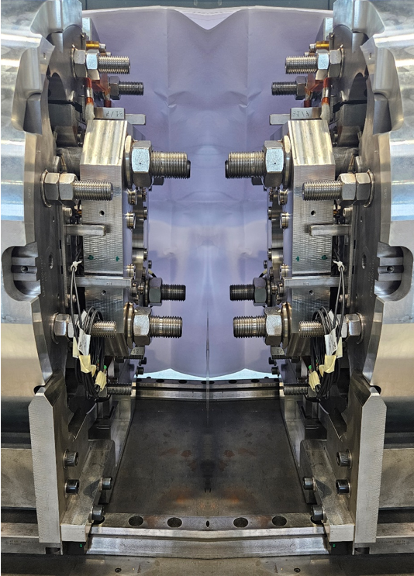
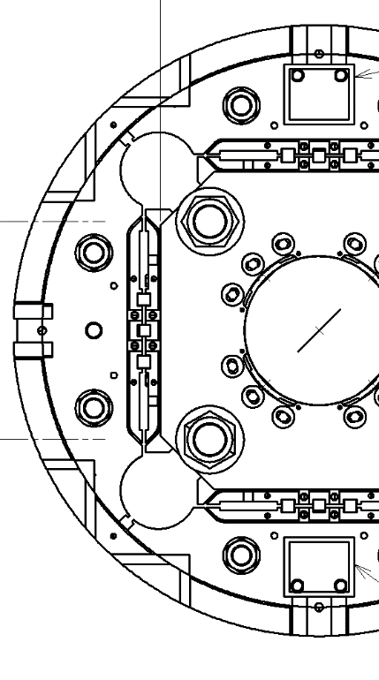
LMQXFA magnets fixing to the cold mass
Additional proposals:
Create an anchoring between the two magnets and the backing strips using either:
A junction between the yoke tie rods
One unique fixed point for both magnet aligned with the cold mass fixed point to the cryostat
No transmission of force through the end plates to the coils
M24 tie rods might imply multiple junctions
A junction between the collar packs tie rods
One unique fixed point for both magnet aligned with the cold mass fixed point to the cryostat
M36 tie rods stiffness
Transmission of force through the end plates to the coils
A junction between the magnet end plates on the NCS
One unique fixed point for both magnet aligned with the cold mass fixed point to the cryostat
Single piece, easiest to put in place
Keys must be shorten
Transmission of force through the end plates to the coils

Slide 13
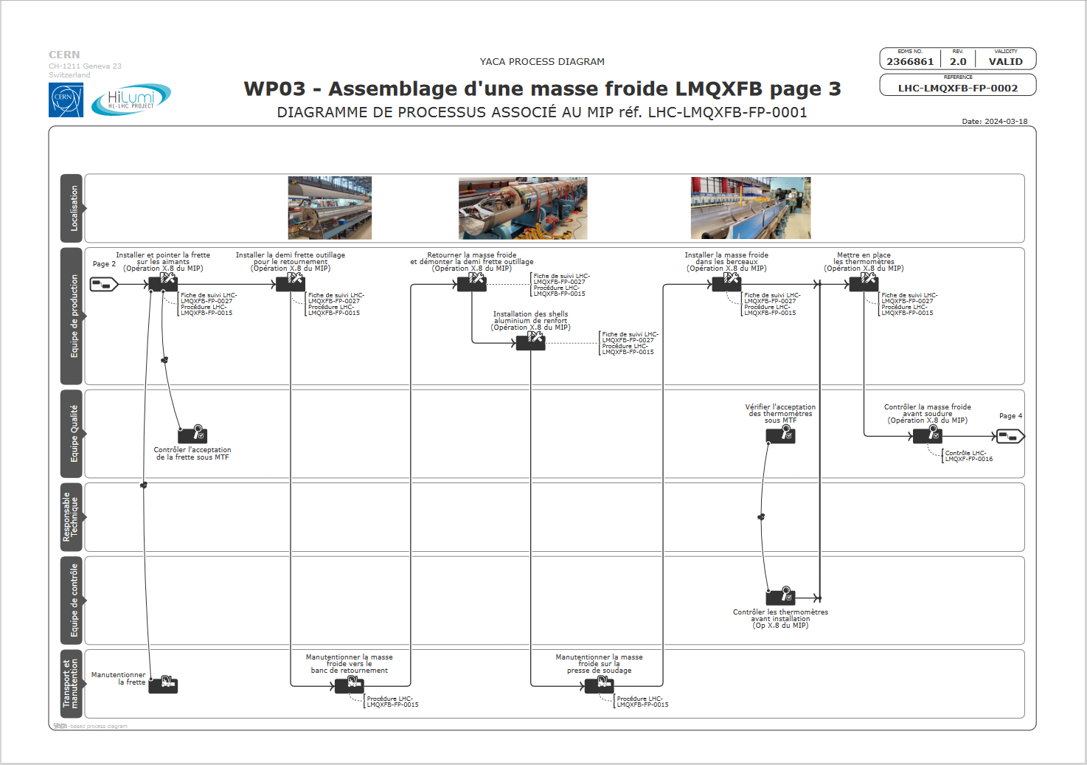

Slide 14
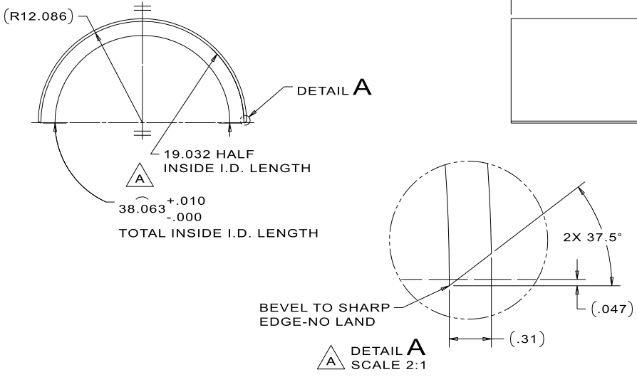
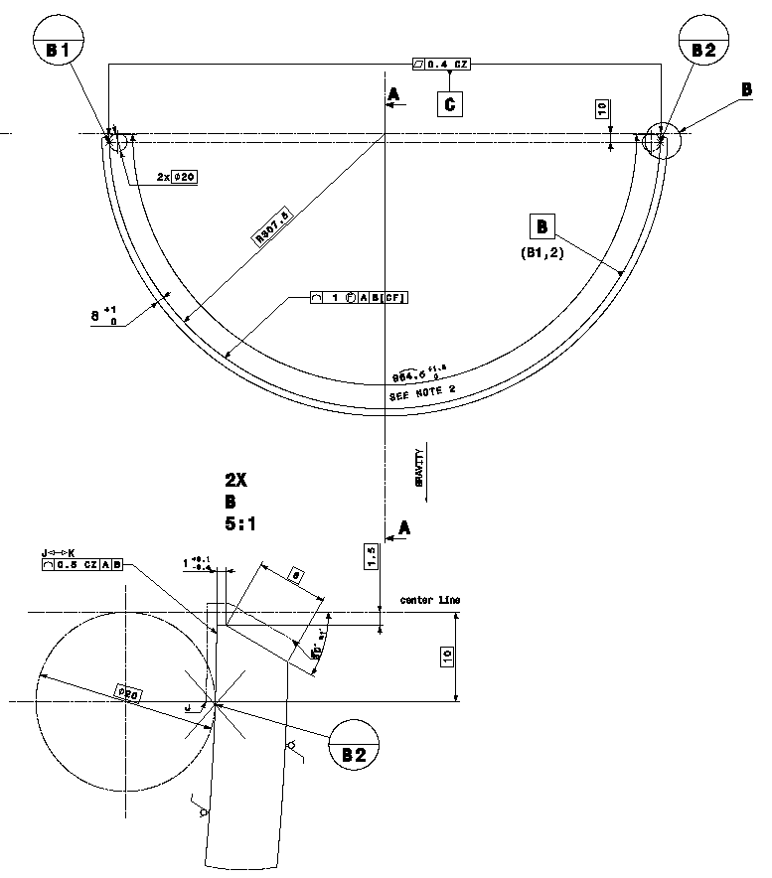
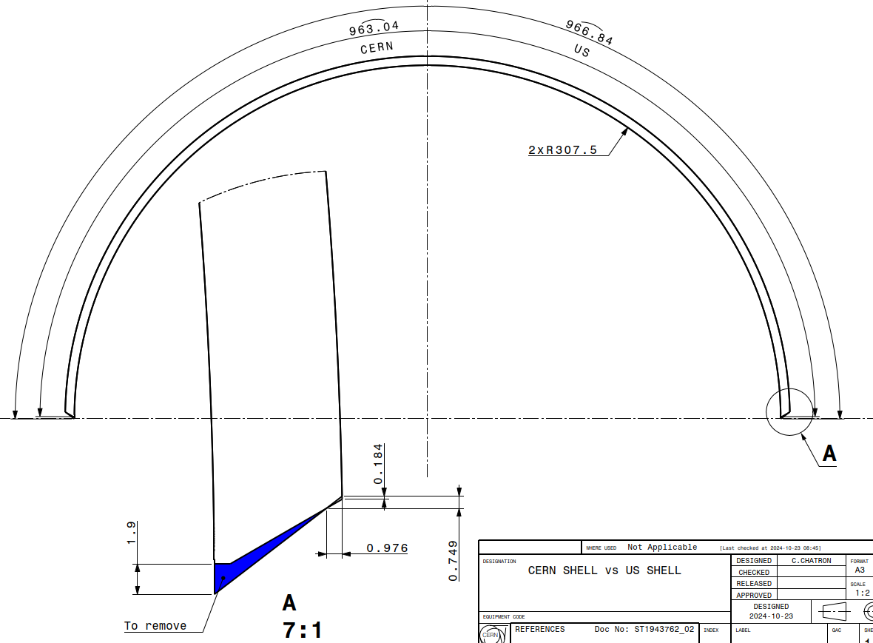
Shell bevel design
@Fermilab
@CERN
LHCLMQXFAS0002
LHCLMQXF_S0001
966.8mm

Slide 15
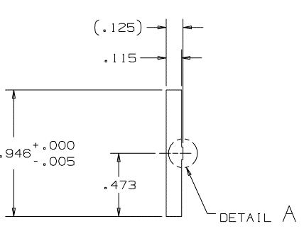
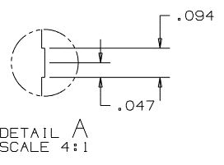
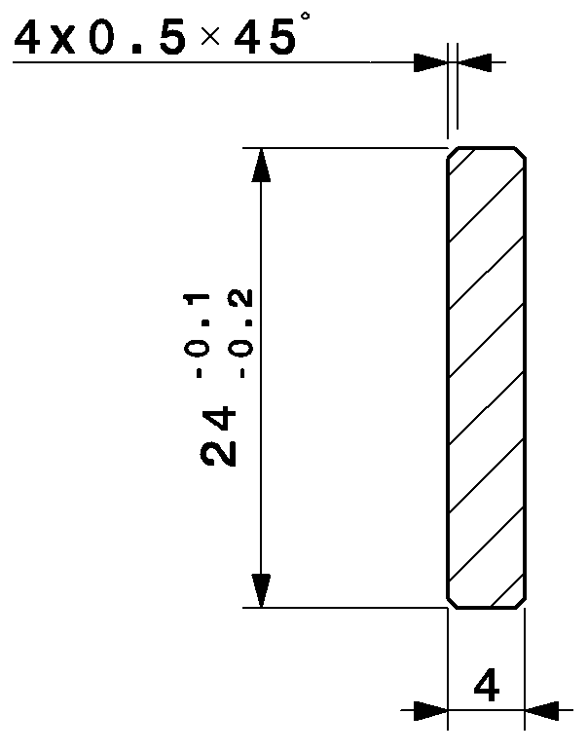
Backing strip design
@Fermilab
@CERN
3.2mm
3mm
24mm

Slide 16
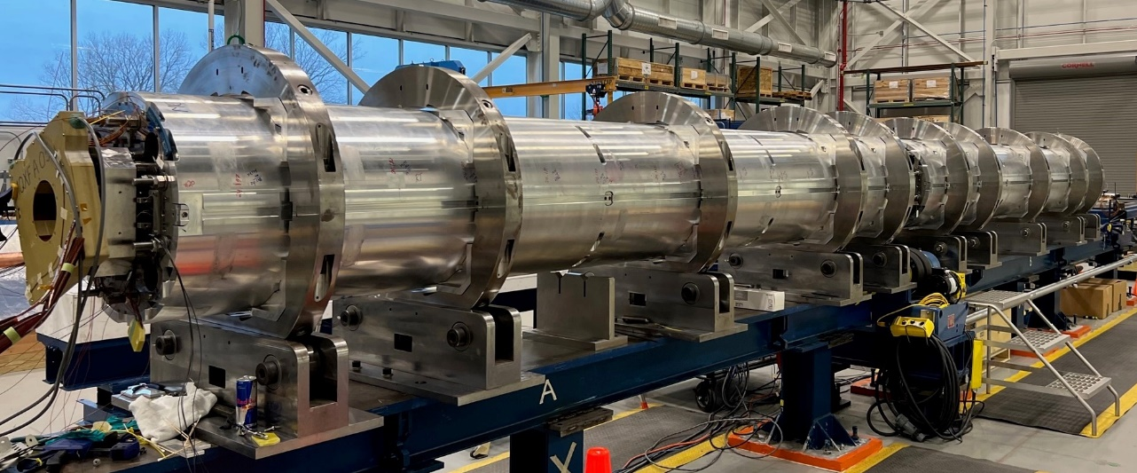
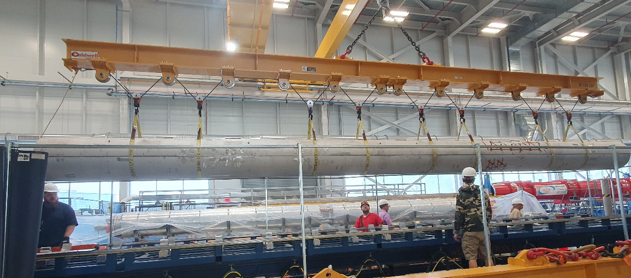
Lifting beam and cold mass rotation
@Fermilab
@CERN

Slide 17
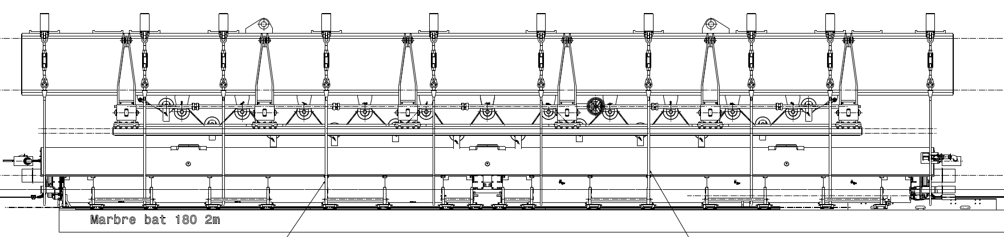
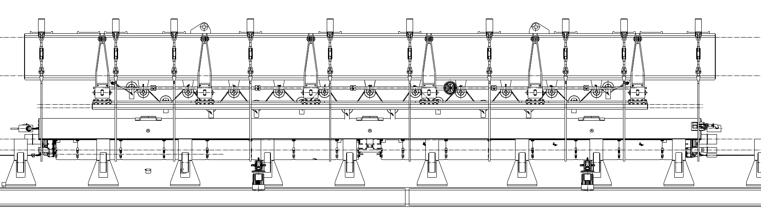
Transfer from the cold mass preparation bench to the rotation one
10cm
10cm
✓

Slide 18
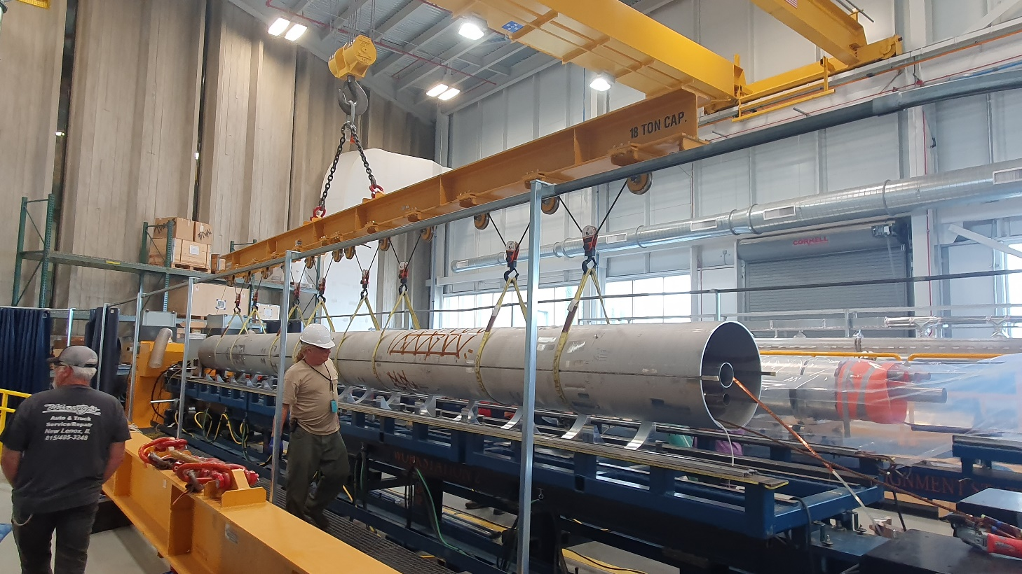
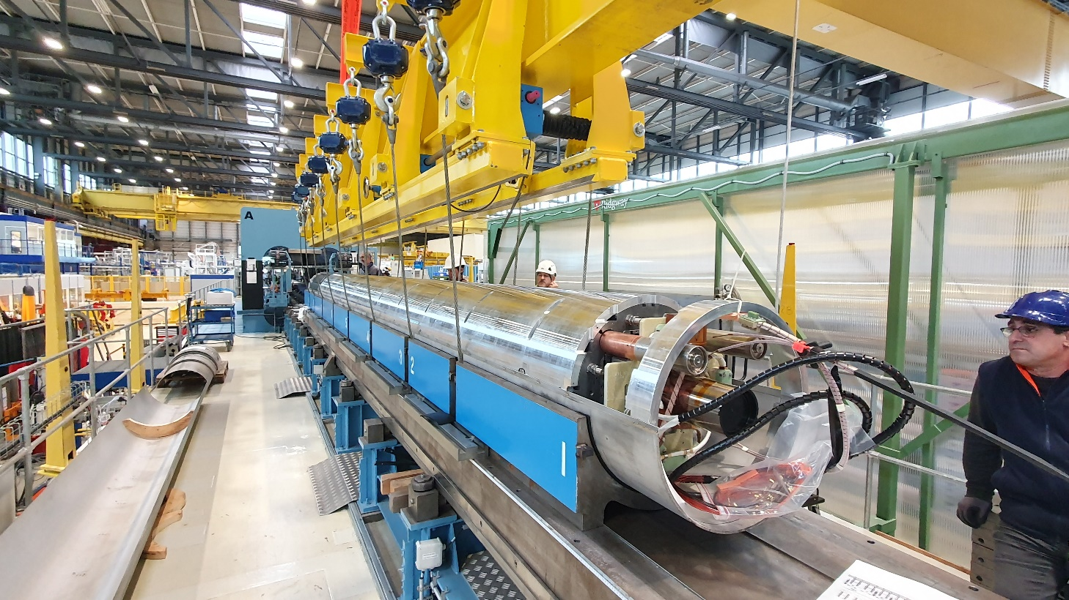
Lifting beam for transfer to the welding press conveyor
@Fermilab
@CERN

Slide 19
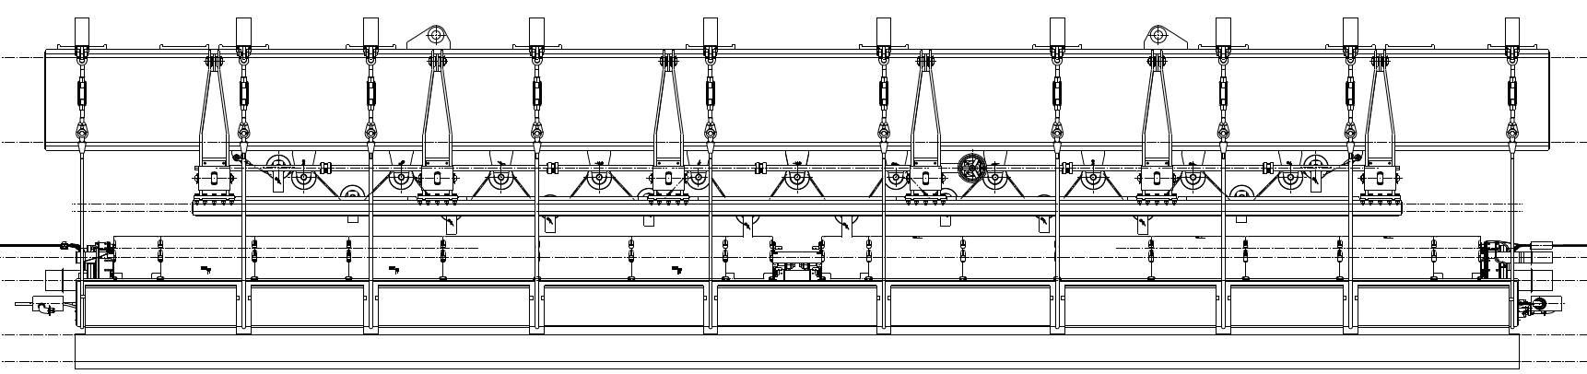
Transfer from the rotation bench to the press conveyor
✓

Slide 20
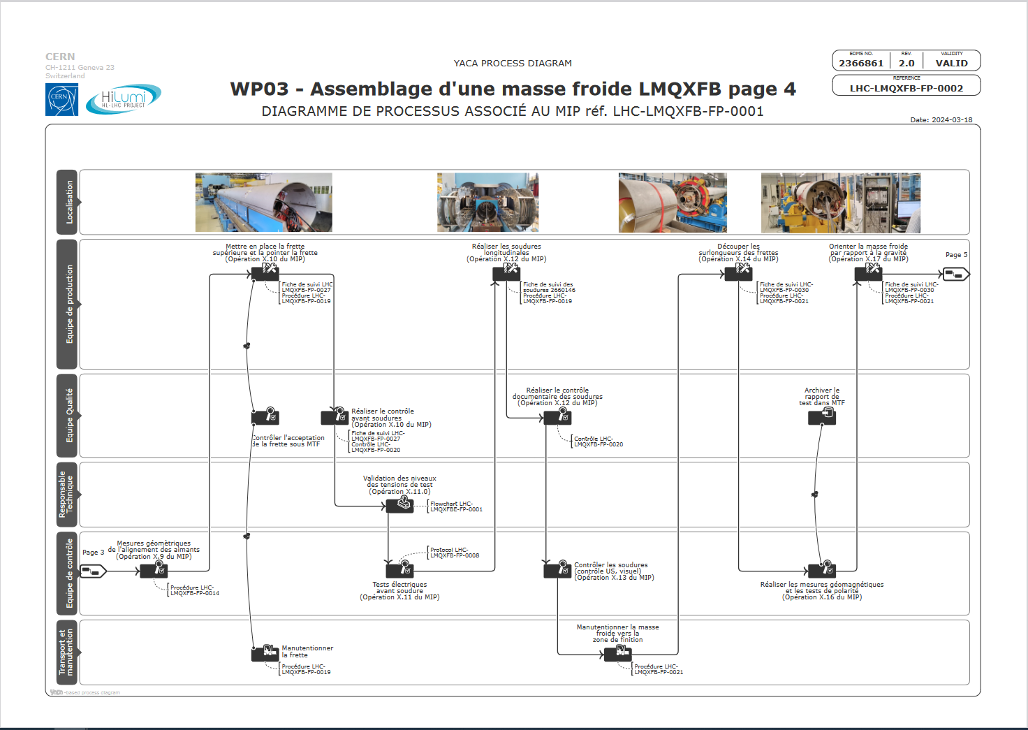

Slide 21
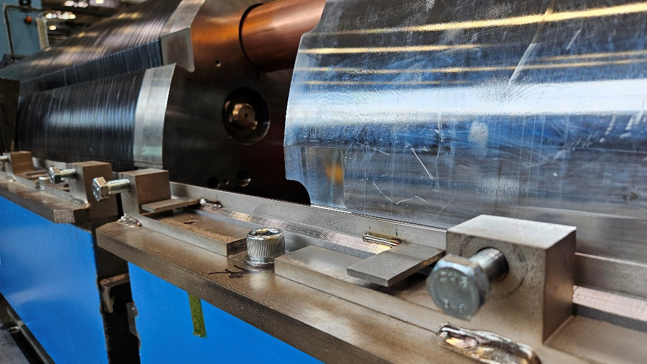
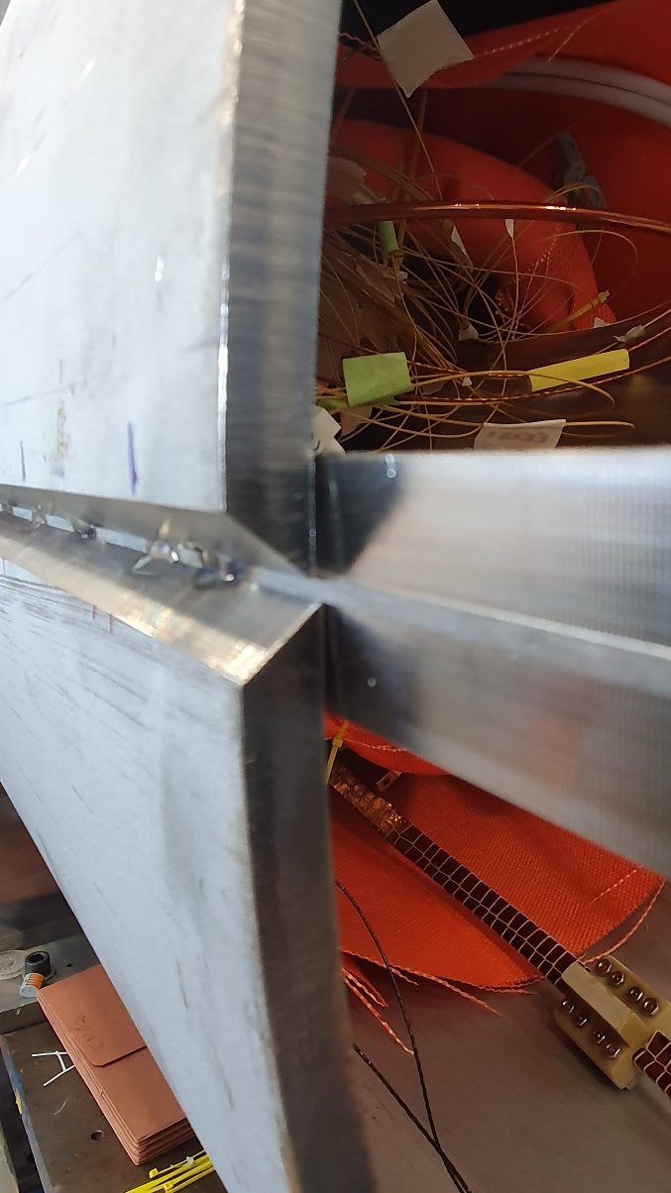
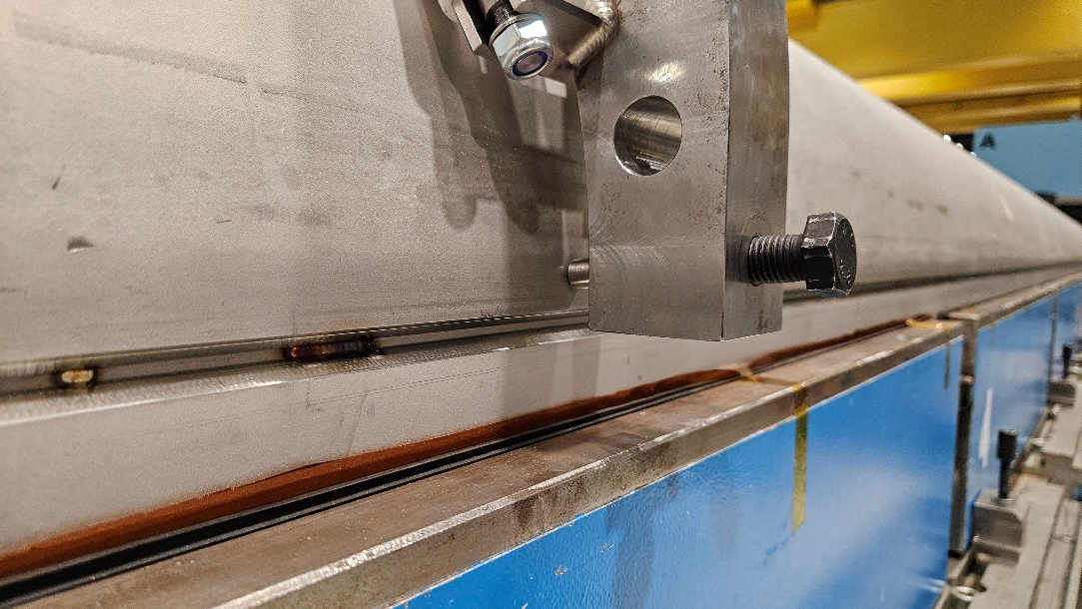
Longitudinal welding preparation
@Fermilab
@CERN

Slide 22
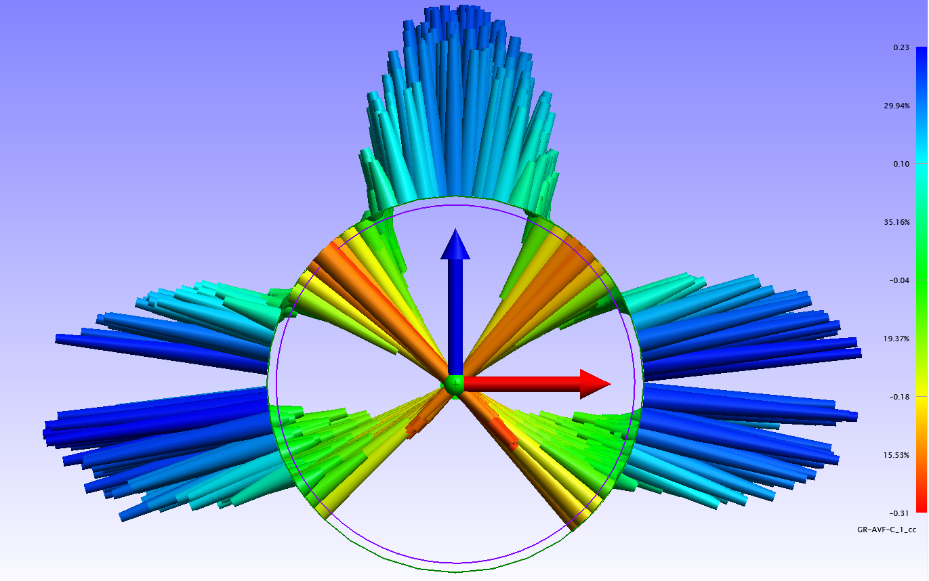
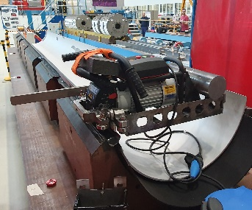
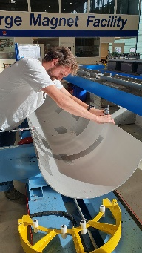


Developed length and welding shrinkage measurements
Measurements of the MQXFA magnets developed length at reception (after cold test)
Shell developed length adjustment in parallel to beveler welding preparation adjustment
Shell developed length control before assembly
Target gap determination

Slide 23


Cold mass orientation to align the magnetic field to gravity
@Fermilab
@CERN

Slide 24

From here, standard cold mass assembly process can be used

Slide 25


Slide 26
Conclusion
The study shows that it is possible to assemble a LMQXFA cold mass at CERN with the following tooling:
A lifting beam to handle MQXFA magnets.
Some modification to create a cold mass assembly bench or a new dedicated one to prevent disruption to the assembly of other types. Most of the material is available, orders can be passed for the rails and the supporting frames.
The accuracy using mechanical alignment to orient the magnetic field has been proven on the MQXFB magnets. Measurements within [-0.68,+0.27] mrad were obtained without major efforts. Alignment of the two MQXFA magnets is expected to be better using a rigid pre-aligned structure.
Splicing tooling could be copied, adapted or even redesigned to fit with CERN procedures.
Proposals related to fixed points have been elaborated. To be developed.
US shells could be machined at CERN to our standard developed length and bevel design. CERN configuration backing strips to be ordered.
Orientation to gravity of the cold mass (combining both MQXFA magnetic field) can be done according to the proven LMQXFB procedure.

Slide 27
Additional work to be considered
Reception tests and procedures to be written.
Assembly and control procedures to be written.
Preparation of subcomponents preparation has to be considered.
Fabrication drawings to be updated?
Duration of assembly is estimated to be 3 months as for the LMQXFB, except for the first cold mass that might require a few additional weeks.

