Slide 1
Options for longitudinal welding AUP cold masses at CERN
Herve Prin, Tavis Bampton, Simon Straarup, Susana Izquierdo Bermudez, Penelope Quassolo
CERN: November 2024

Slide 2
Outline
Requirements
Welding parameters and feedback from construction
Options for longitudinal welding:
  Option 1: AUP ‘MQXFA’ procedure
  Option 2: CERN ‘MQXFB’ procedure
  Option 3: CERN ‘modified’ procedure (see slides from Herve)
Conclusions

Slide 3
Outline
Requirements
Welding parameters and feedback from construction
Options for longitudinal welding:
  Option 1: AUP ‘MQXFA’ procedure
  Option 2: CERN ‘MQXFB’ procedure
  Option 3: CERN ‘modified’ procedure (see slides from Herve)
Conclusions

Slide 4
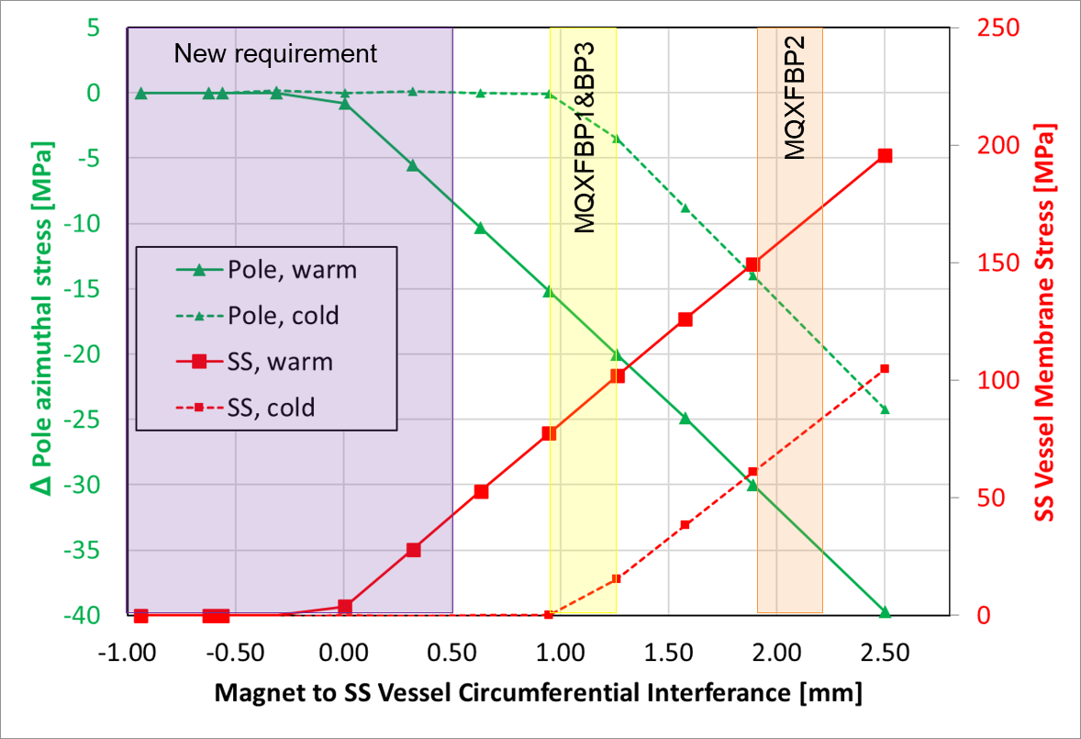
Requirements for welding interference
Welding requirements were modified, to assure no coupling of the SS vessel to the magnet (Same requirements for AUP and CERN)
  Previous target: 8 ± 8 MPa ∆Coil stress from welding
  New target: 0 + 8 MPa ∆Coil stress from welding
Technical Review of MQXFB Cold Mass: https://indico.cern.ch/event/1142636/

Slide 5
Fixed point – requirements (RT)
The fixed point (and the magnet components in contact) must withstand the loads appearing during handling/transport and during operation.
  During transport:
    MQXFB: 0.5 g. The estimated weight of the magnet is 11 tons, so the fixed point shall be designed for a minimum load of 55 kN.
    MQXFA:
      AUP Requirement: 2 g, since it will be shipped to CERN by boat → the fixed point shall be designed for a minimum load of 135 kN.
      Proposed requirement for re-worked cold masses at CERN: 0.5 g, same handling requirements as MQXFB magnets at CERN → the fixed point shall be designed for a minimum load of 32 kN.

Slide 6
Fixed point – requirements (operation)
The fixed point (and the magnet components in contact) must withstand the loads appearing during handling/transport and during operation.
During operation of the cryogenic system (EDMS 2675955)
  the MQXFB magnet inside the cold mass shall not move when subject to 4 bar differential pressure between the ends of each MQXFB magnet (induced by cryogenic operation or by quench of other magnets) and shall withstand this load without physical damage or performance degradation (4 bars to 96 kN).
  the MQXFA magnet inside the cold mass shall not move when subject to 2.5 bar differential pressure between the ends of each MQXFA magnet (induced by cryogenic operation or by quench of other magnets) and shall withstand this load without physical damage or performance degradation (2.5 bars to 62 kN).

Slide 7
“New” data from the definition of requirements in 2022
MQXFBP2 had identical magnet performance when assembled in a temporary cold mass (tight contact) and in Q2 cold mass (new welding procedure)
Pressure wave attempted to be measured in two cold masses:
  MQXFBP3 was equipped with special sensors, that were not read during test in spite of a reminder just before the cool down… hopefully they will be read in the string (added a comment to MAB assessment, and Marta was informed explicitly)
  AUP CA02 (MQXFA05&06), based on a test at 6 kA they extrapolate 0.32 bars, more tests are planned in the future link from Guram, slide 15

Slide 8
Outline
Requirements
Welding parameters and feedback from construction
Options for longitudinal welding:
  Option 1: AUP ‘MQXFA’ procedure
  Option 2: CERN ‘MQXFB’ procedure
  Option 3: CERN ‘modified’ procedure (see slides from Herve)
Conclusions

Slide 9
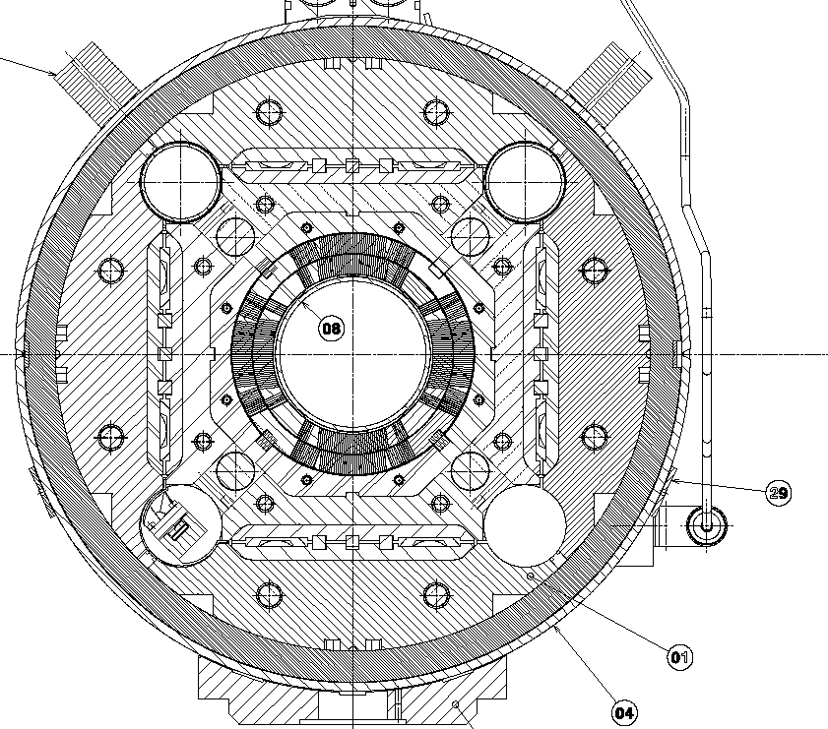
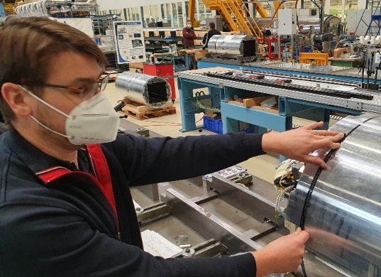
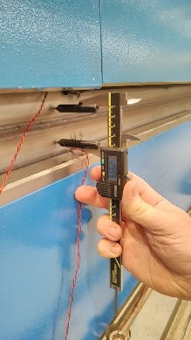
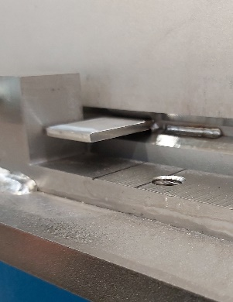
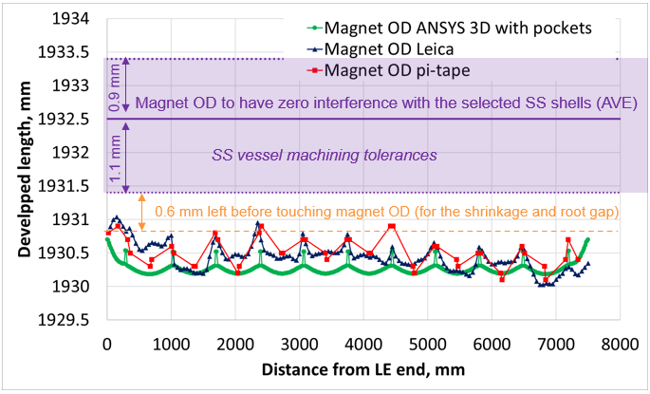
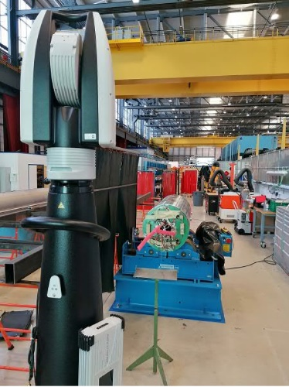
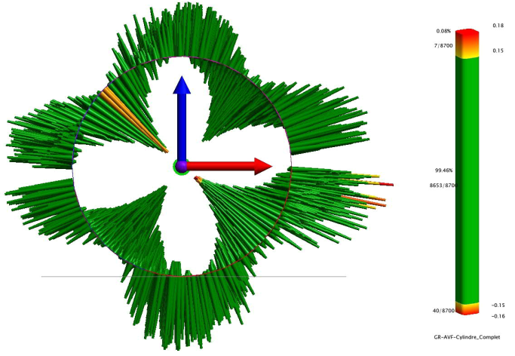
Determination of the shell developed length required after MQXFBP2 cold test
gap
Ldev_{Shells}= Ldev_{Magmax} + 2x shrinkage – 2x root gap
= 1931.3 + 2x 2.2 - 2x 3.4
= 1928.9mm ⇨ 1929mm
Root gap
Shell pairing for LMQXFBT04, the second cold mass with MQXFBP3:
Pairing of shells 5 and 102 according to their developed lengths
Courtesy of Susana

Slide 10
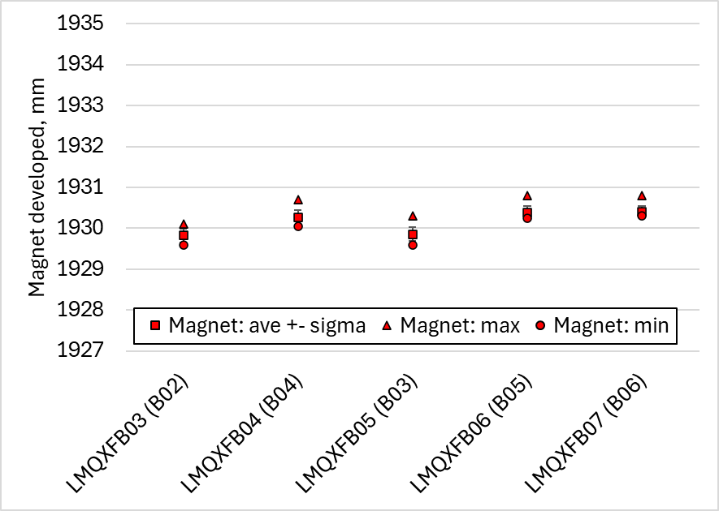
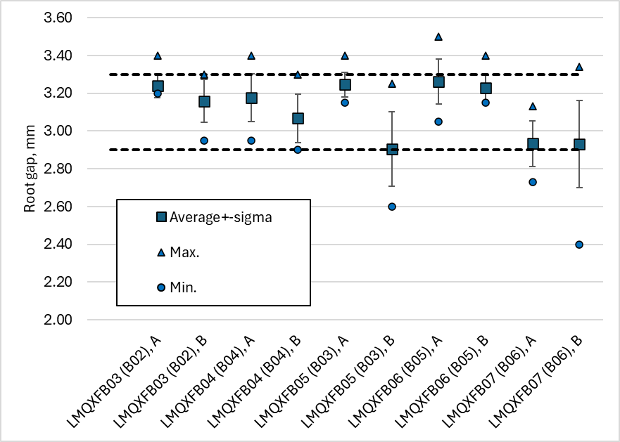
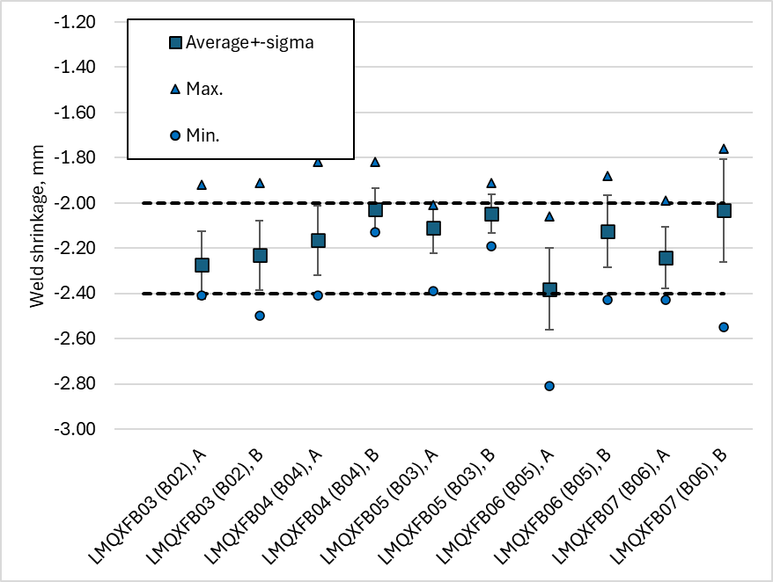
Geometrical tolerances: experience
Tested in temporary cold mass before Q2 cold mass assembly
Magnet OD very reproducible (std along the length 0.20 mm, max – min along the length = 0.5 mm). Nice tool to derive the coil pre-stress within 10 MPa see link.
We can control the average root gap and welding shrinkage within ± 0.2 mm. Along the length, we can have variations up to ± 0.4 mm.
 | Average, mm | STD, mm
Root gap | 3.12 | 0.14
Welding shrinkage | -2.12 | 0.09

Slide 11
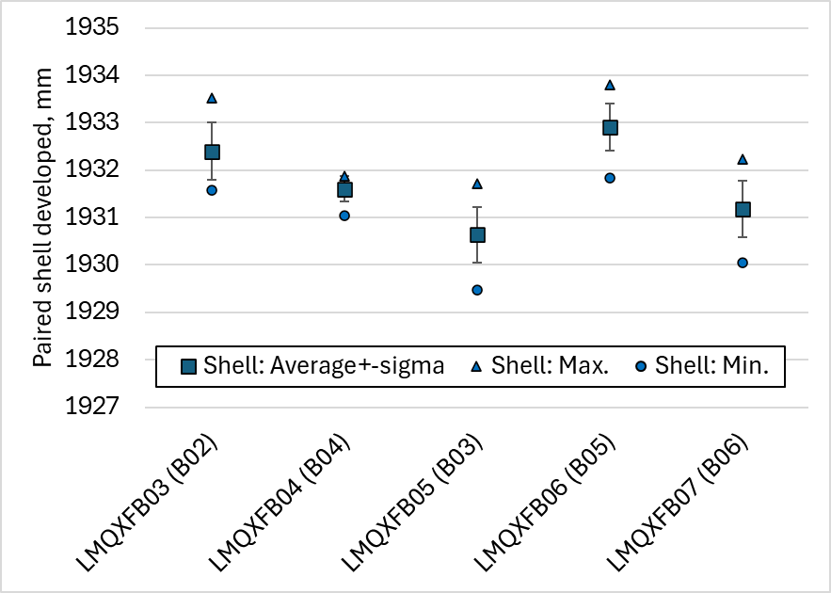
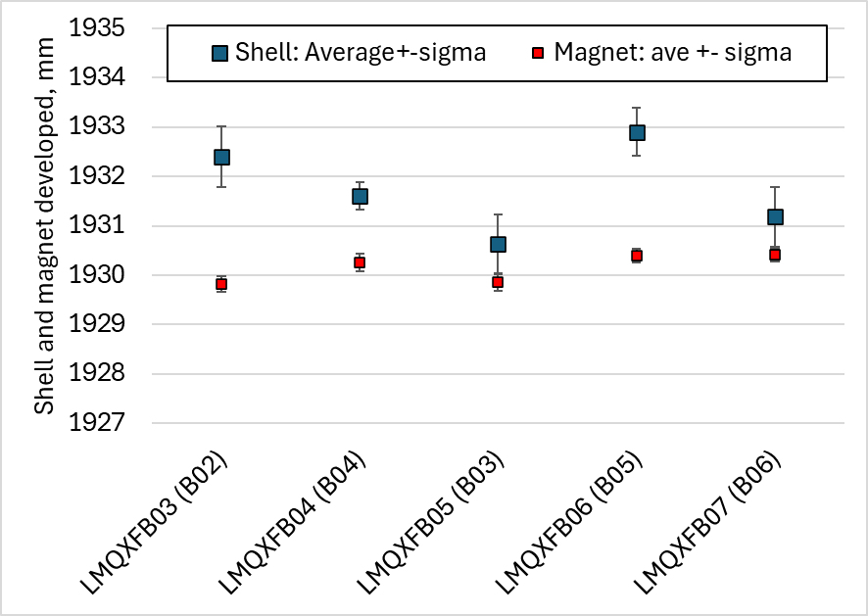
Shell-Magnet Pairing
The shell paired developed length (including root gap and welding shrinkage) is within the expected geometrical tolerances (std along the length 0.50 mm, max – min along the length = 2 mm).
The goal is to be ‘as close’ as possible to the magnet (minimize ‘micky mouse’ effect) but without touching.

Slide 12
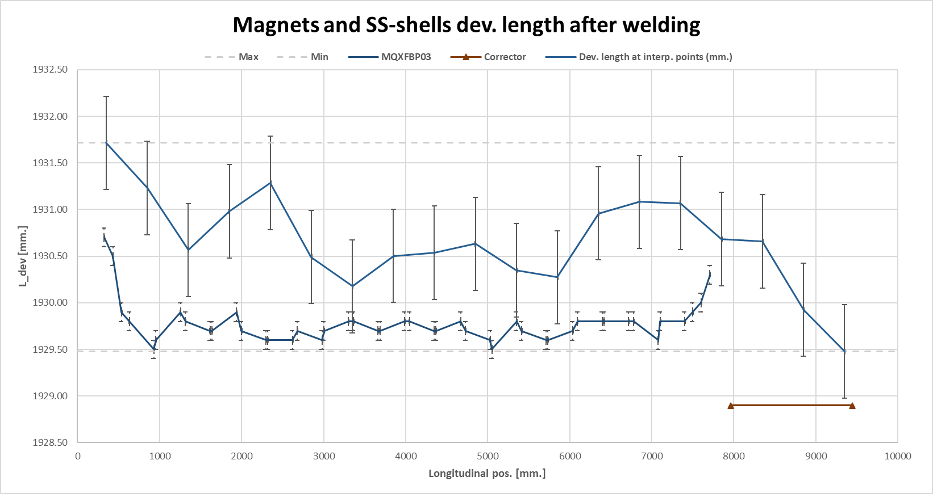
Shell-Magnet Pairing
Even in the case with ‘less margin’ we had always at least 0.5 mm margin
  Note that in case of welding repairs following PAUT inspection, one can expect a local increase of the welding interference
Only one case with a marginal interference in one longitudinal location (see EDMS 3180091)

Slide 13
Outline
Requirements
Welding parameters and feedback from construction
Options for longitudinal welding:
  Option 1: AUP ‘MQXFA’ procedure
  Option 2: CERN ‘MQXFB’ procedure
  Option 3: CERN ‘modified’ procedure (see slides from Herve)
Conclusions

Slide 14
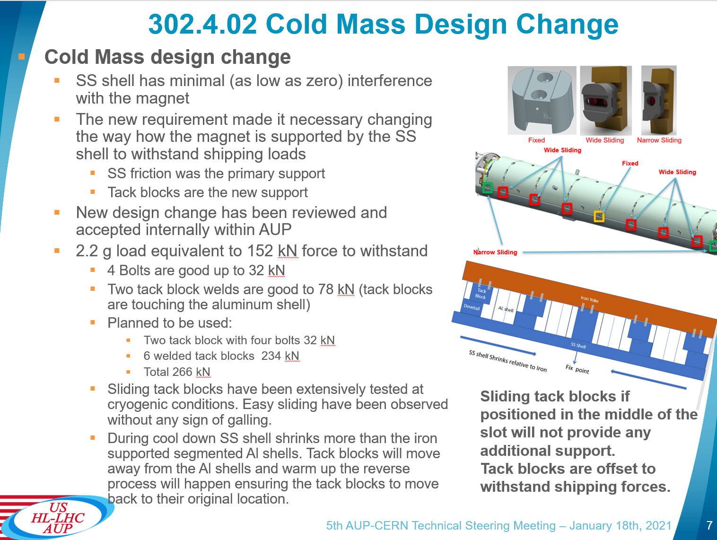
AUP ‘MQXFA’ procedure
A priory we are OK with the 4 bolts at warms (0.5 g)
At cold we are probably tight, load (2.5 bars) is 62 kN (62/32 = 1.9; 375/290* = 1.3)
  *R_{p0.2,SS} (RT) = 290 MPa
  * R_{p0.2, SS} (1.9 K) = 375 MPa
CA Series Production Readiness Review (6-September 8, 2023) · INDICO-FNAL (Indico)

Slide 15
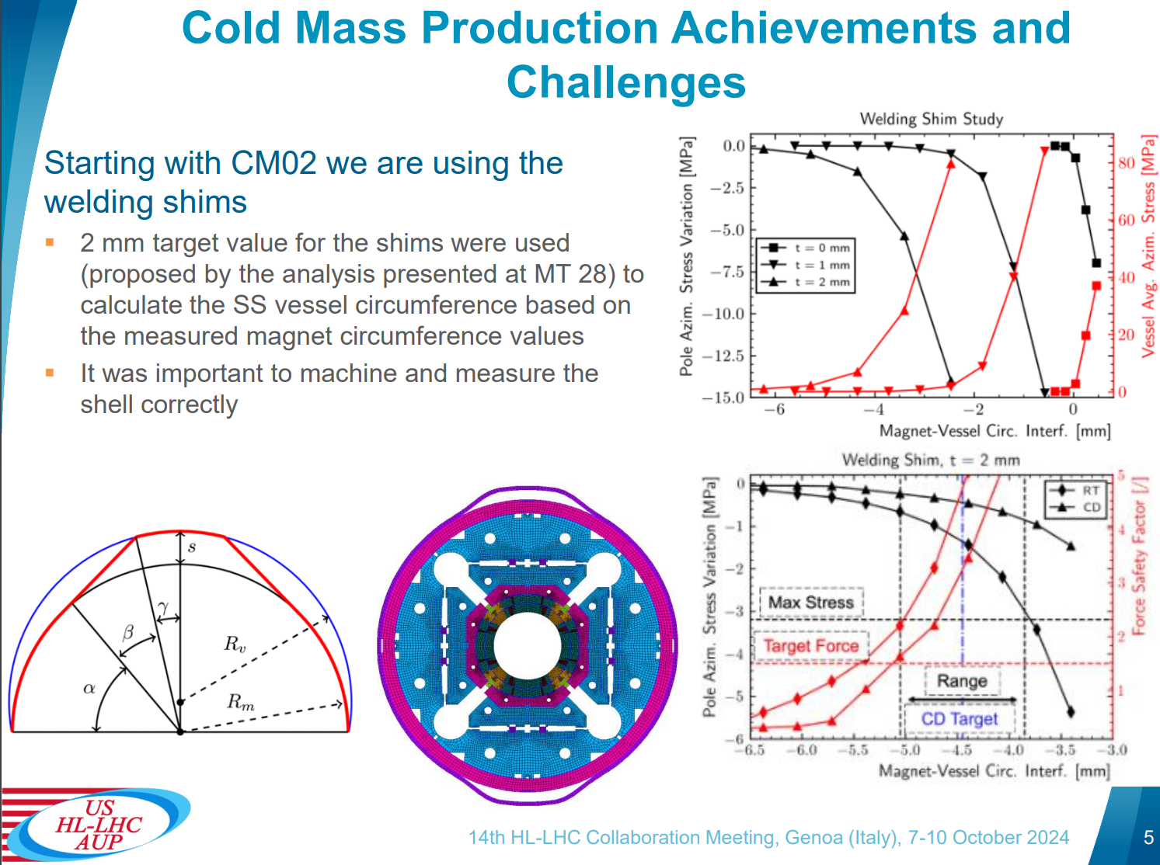
AUP ‘MQXFA’ procedure
Requires modification and re-qualification of our welding procedure

Slide 16
Outline
Requirements
Welding parameters and feedback from construction
Options for longitudinal welding:
  Option 1: AUP ‘MQXFA’ procedure
  Option 2: CERN ‘MQXFB’ procedure
  Option 3: CERN ‘modified’ procedure (see slides from Herve)
Conclusions

Slide 17
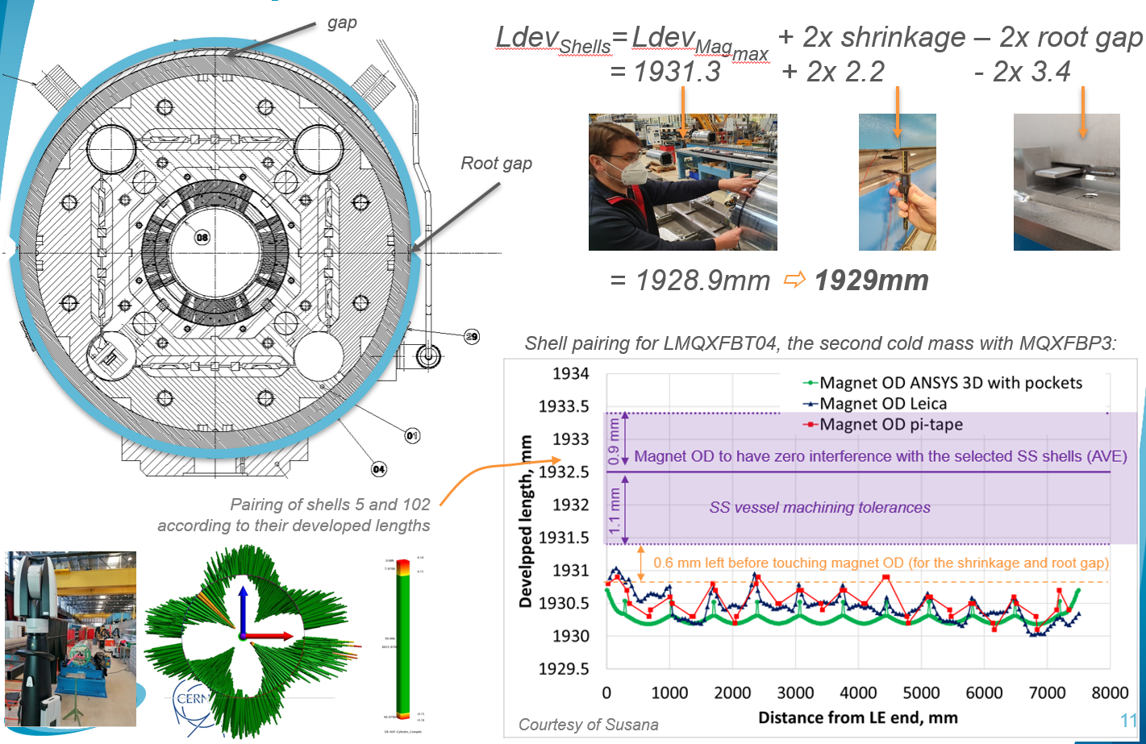
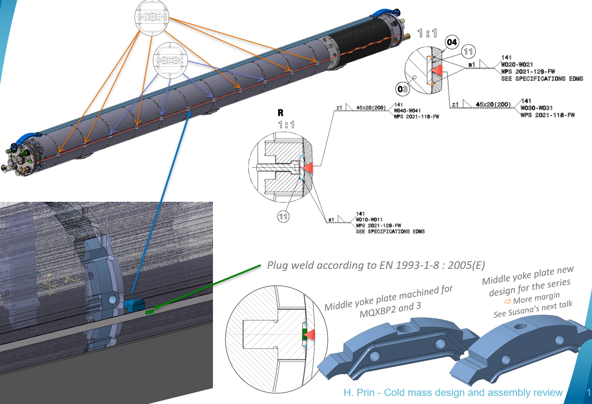
MQXFB approach
Shell pairing with a gap in the top of the shell, such that after welding we are not in full contact with the magnet OD
Fixed point from the SS shell to the yoke to handle the expected load warm/cold
Technical Review of MQXFB Cold Mass: https://indico.cern.ch/event/1142636/

Slide 18
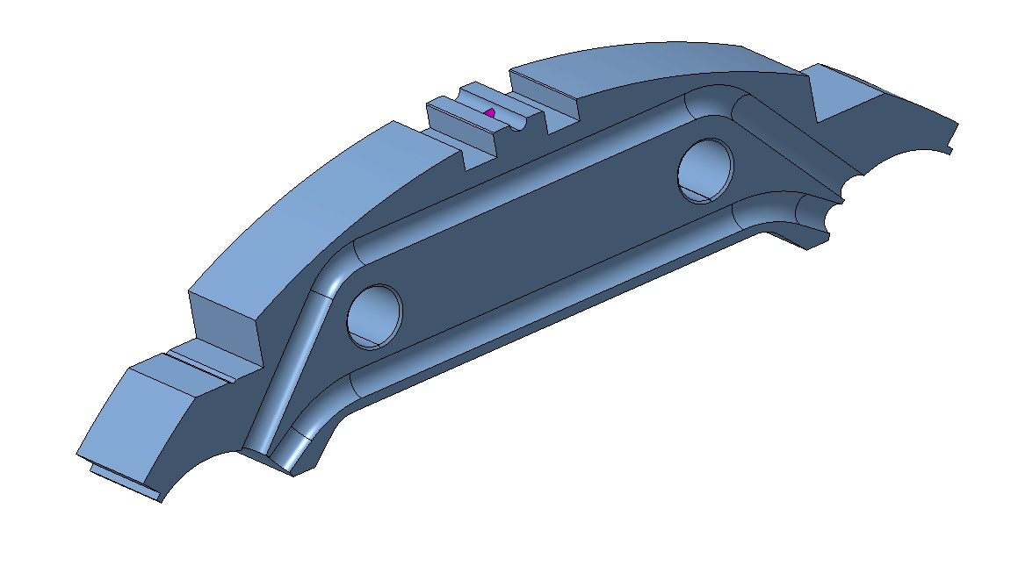
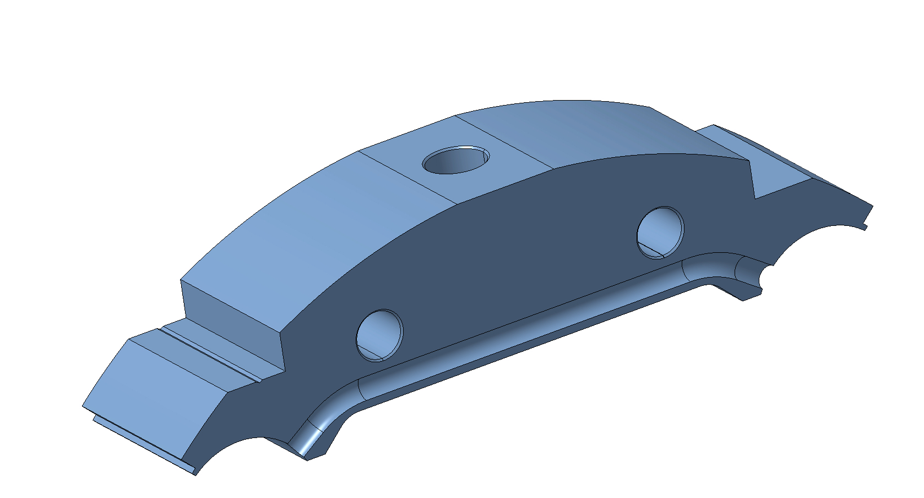
MQXFB – Fixed point
Machine new central yoke piece in ARMCO (2 per magnet), to optimize the iron geometry for the hosting of the pin:
  Upper cooling channels removed (approved by CRG, we are removing 4 out of 192 cooling channels)
  Removal of the tack welding block grooves
  The thickness of the lamination was increased from 45 mm to 91.4 mm such that even if the longitudinal stiffness provided by the adjacent thin laminations is neglected, the stand-alone yoke can hold the forces
Exception for existing prototype magnets (MQXFBP2&BP3), where the proposal is to re-machine the already assembled yoke
3D geometry for the old piece
3D geometry for the new piece
LHCMQXFBS0025
LHCMQXFBS0037
Technical Review of MQXFB Cold Mass: https://indico.cern.ch/event/1142636/
18

Slide 19
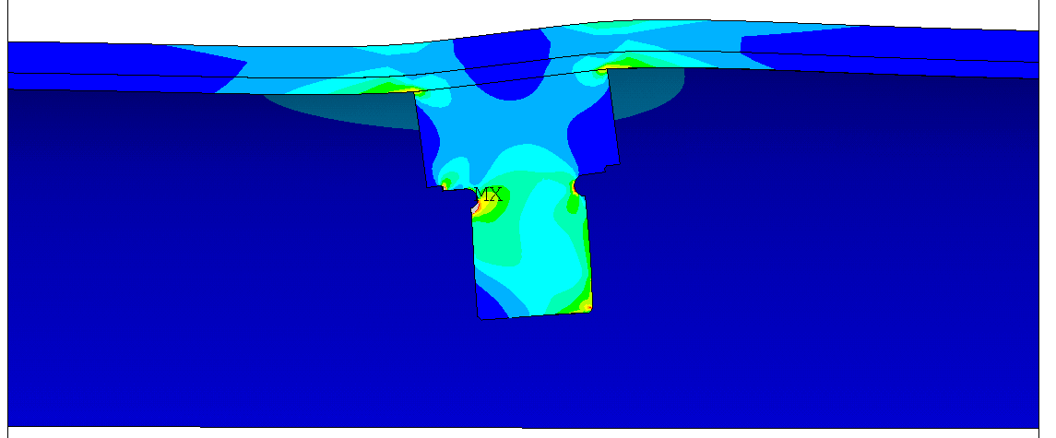
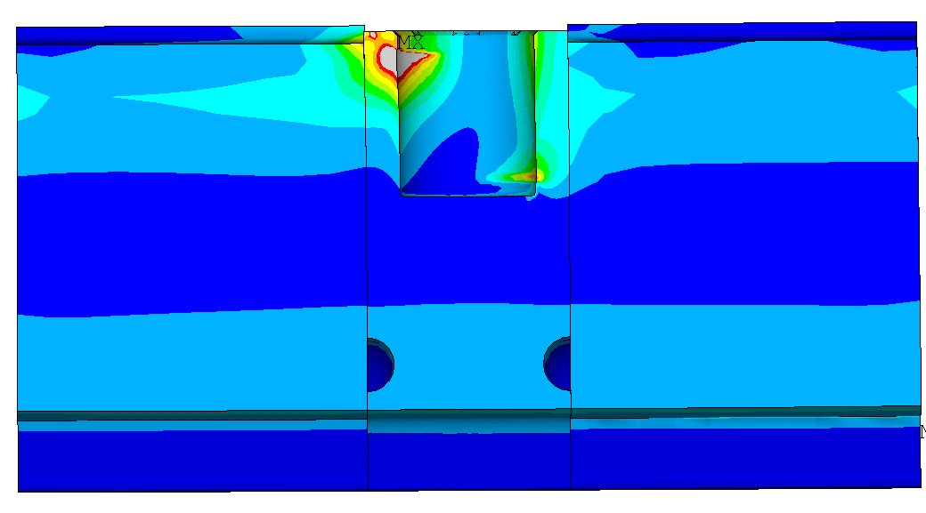
Overall system behavior and material limits
Jose Ferradas Troitino
Stress concentration on the upper and lower edge due to the bending of the pin. Inhomogeneous contact with a stress concentration region going above the yield limit
Pin, welding strip and vessel
  Material: Stainless-steel 316LN
  R_{p0.2} (RT): 290 MPa
  R_{p0.2} (1.9 K): 375 MPa
Iron yoke
  Material: ARMCO (brittle at 1.9 K!)
  R_{p0.2} (RT): 230 MPa
  R_{m} (1.9 K): 970 MPa
  K_{IC} (1.9 K): 25-29 MPa∙m^{0.5}
  See [1] for a full characterization of the material
Welds (see talk from Herve Prin)
[1] I. A. Santillana et al., "Mechanical Characterization of Low-Carbon Steels for High-Field Accelerator Magnets: Application to Nb₃Sn Low-β Quadrupole MQXF," in IEEE Transactions on Applied Superconductivity, vol. 32, no. 6, pp. 1-7, Sept. 2022, Art no. 4100507, DOI: 10.1109/TASC.2022.3149853. D
Technical Review of MQXFB Cold Mass: https://indico.cern.ch/event/1142636/

Slide 20
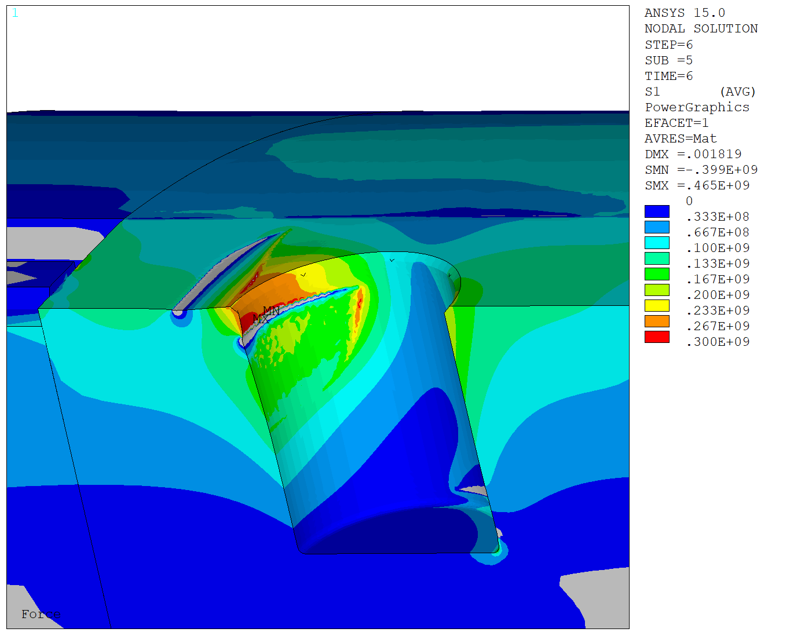
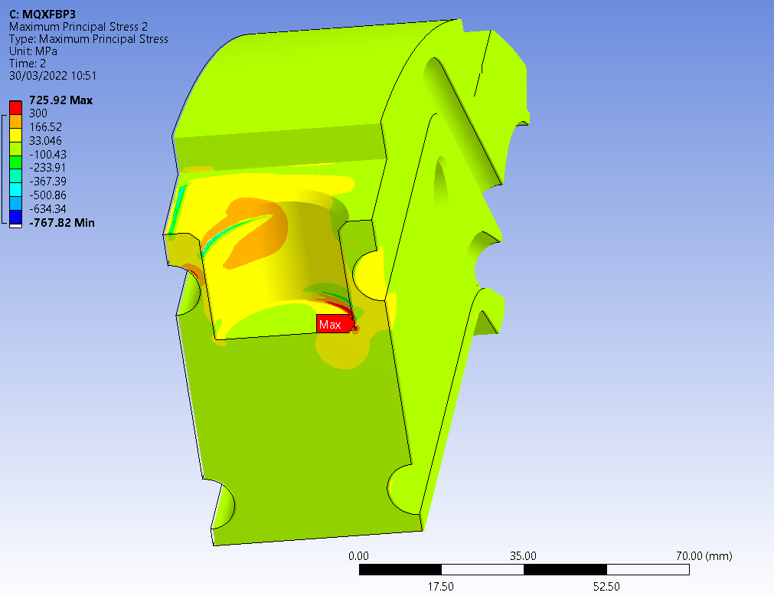
Yoke, cryogenic temperature BP2&BP3 cases
Jose Ferradas Troitino
For the existing magnets, the yoke will be re-machined after magnet assembly
  Central lamination will be 45 mm instead of 91.4 mm (stand alone yoke cannot hold the full load, longitudinal stiffness provided by the yoke laminations needed)
  Flattening of surfaces needed to avoid stress concentration singularities. Nevertheless, S1 ≈ 700 MPa ( 3 times the expected S1 for the series magnets); SEQV ≈ 1200 MPa (20 % higher than the limit in traction; assessment of the limit of the iron in compression on-going)
    As a back up, the depth of the pin can be increased to limit the bending of the pin
Series magnets configuration
MQXFBP2 & BP3 configuration
200 MPa S1 (4 bars)
4 bars load
5 bars load
First principal stress (S1)
Peak ~ 250 MPa (4 bars)
Due to the presence of the cooling hole channel, 360 MPa S1 (4 bars)
Due to the larger bending of the pin, 700 MPa S1 (4 bars)
*Thermal contraction the pin assumed to be as iron instead of stainless steel, to assure contact of the pin to the yoke after cool down
* ANSYS color maps for 120 kN (5 bars), with a linear elastic model; results for assessment of the maximum stress scaled to 4 bars (96 kN)

Slide 21
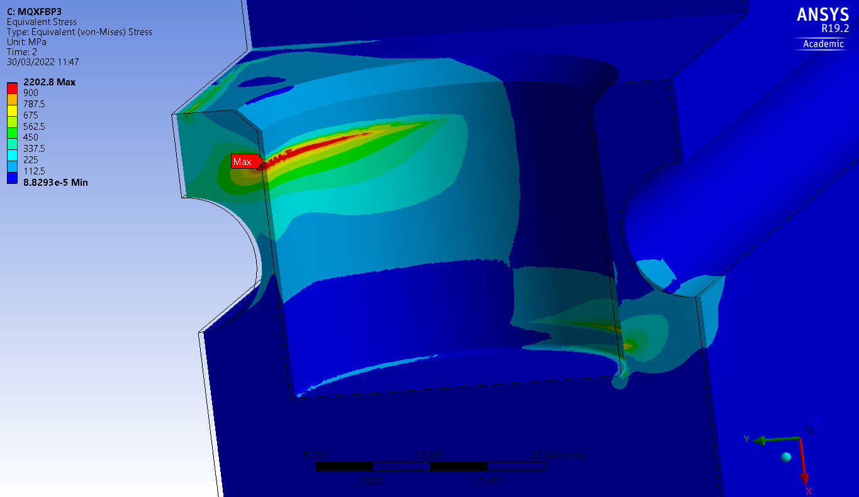
Yoke, cryogenic temperature BP2&BP3 cases
Jose Ferradas Troitino, Giorgio Vallone
Assuming that the stress along the crack length is equal to the peak stress, 700 MPa traction stress is not acceptable (see table in slide 13). FAD accounting for the actual stress profile along the most likely crack propagation path shows that the design has sufficient margin
The VM stress, mainly compressive, is very locally above R_{m} (traction tests)
200 MPa S1 (4 bars)
4 bars load
Due to the presence of the cooling hole channel, 360 MPa S1 (4 bars)
Due to the larger bending of the pin 700 MPa S1 (4 bars)
Due to the larger bending of the pin 1200 MPa SEQV (4 bars)
[1] I. A. Santillana, G. Vallone et al., "Mechanical Characterization of Low-Carbon Steels for High-Field Accelerator Magnets: Application to Nb₃Sn Low-β Quadrupole MQXF," in IEEE Transactions on Applied Superconductivity, vol. 32, no. 6, pp. 1-7, Sept. 2022, Art no. 4100507, DOI: 10.1109/TASC.2022.3149853. D

Slide 22
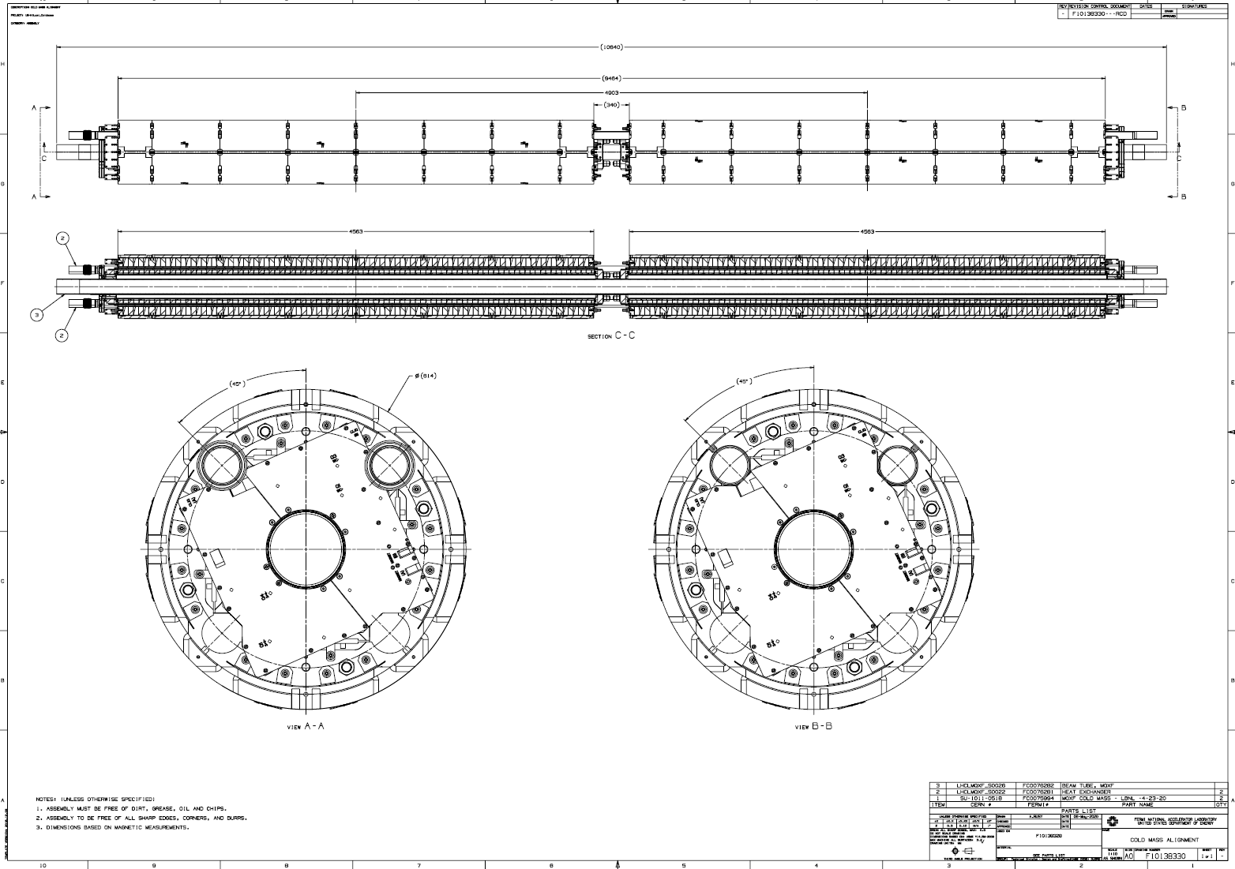
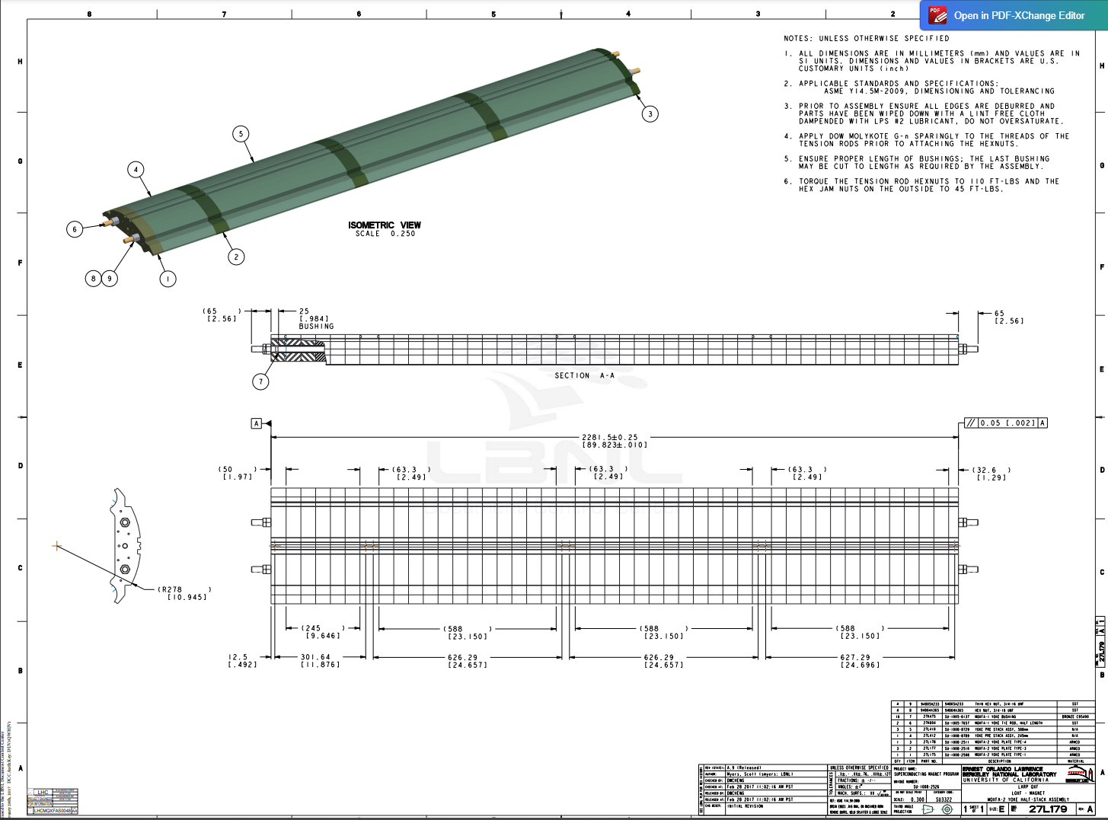
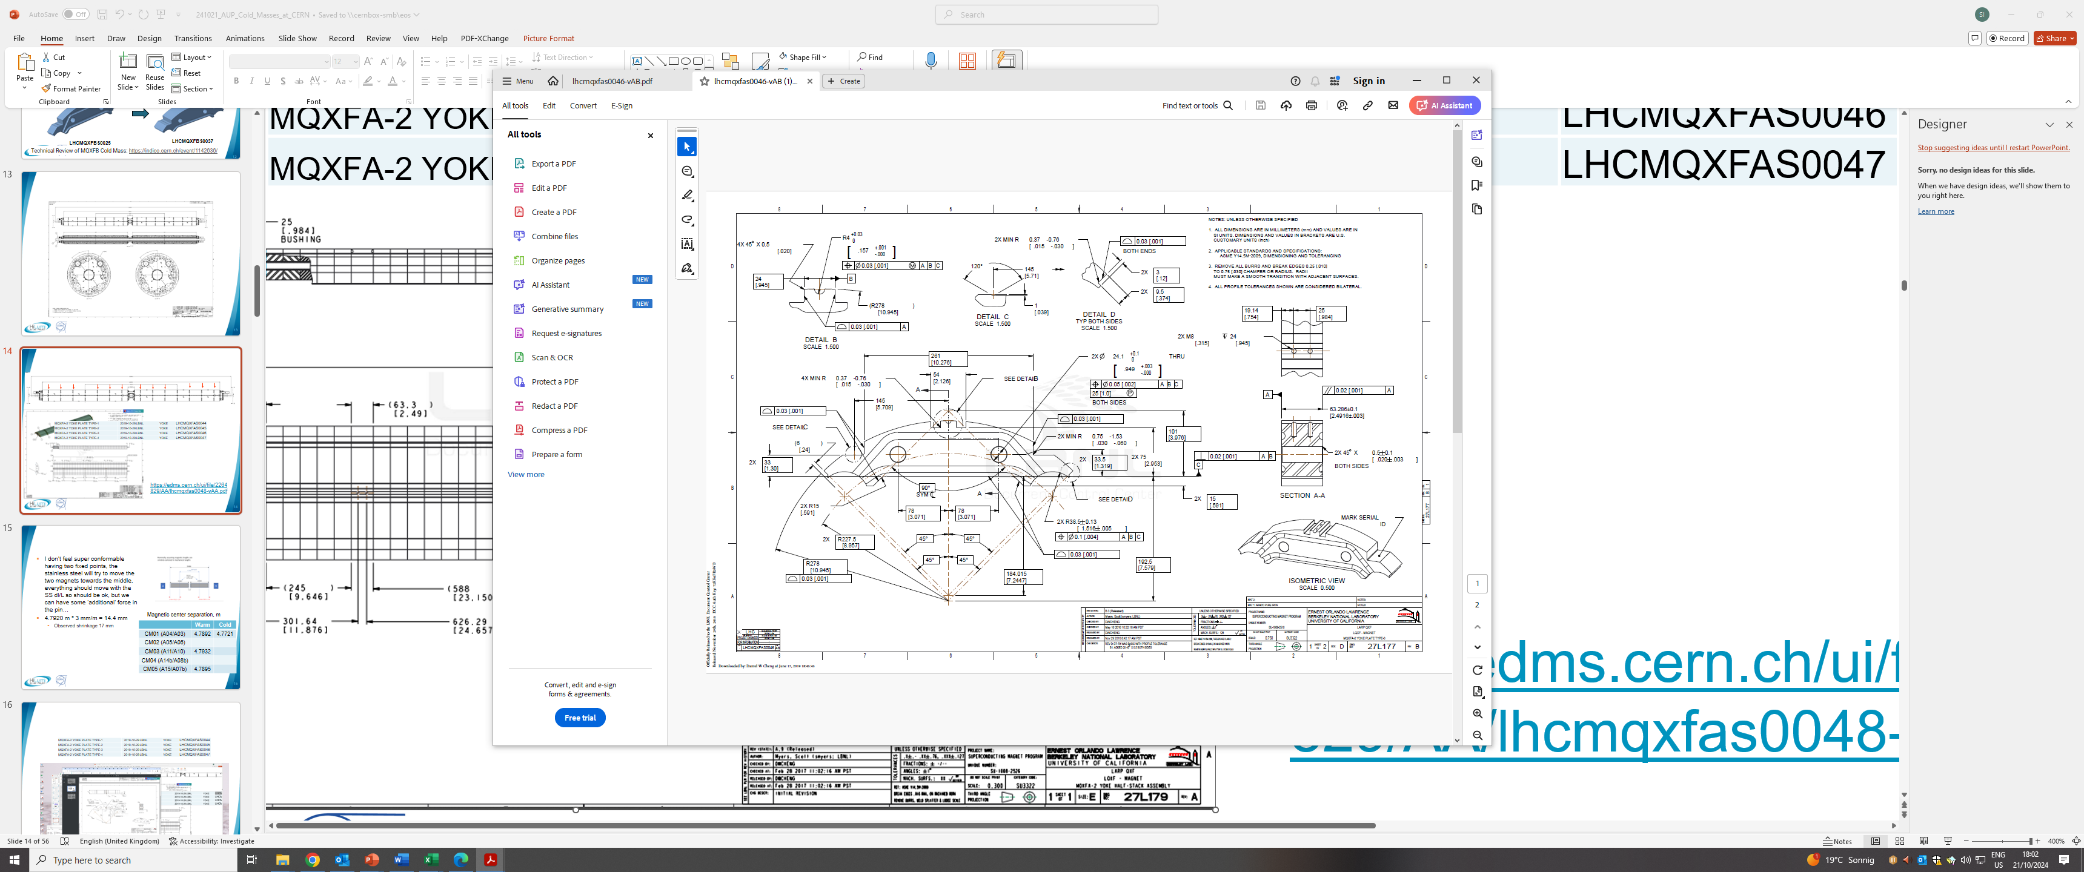
Implementing “MQXFBP” approach in MQXFA magnets
Yoke is 63 mm thick
MQXFA-2 YOKE PLATE TYPE-1 | LHCMQXFAS0044
MQXFA-2 YOKE PLATE TYPE-2 | LHCMQXFAS0045
MQXFA-2 YOKE PLATE TYPE-3 | LHCMQXFAS0046
MQXFA-2 YOKE PLATE TYPE-4 | LHCMQXFAS0047
https://edms.cern.ch/ui/file/2264829/AA/lhcmqxfas0048-vAA.pdf

Slide 23
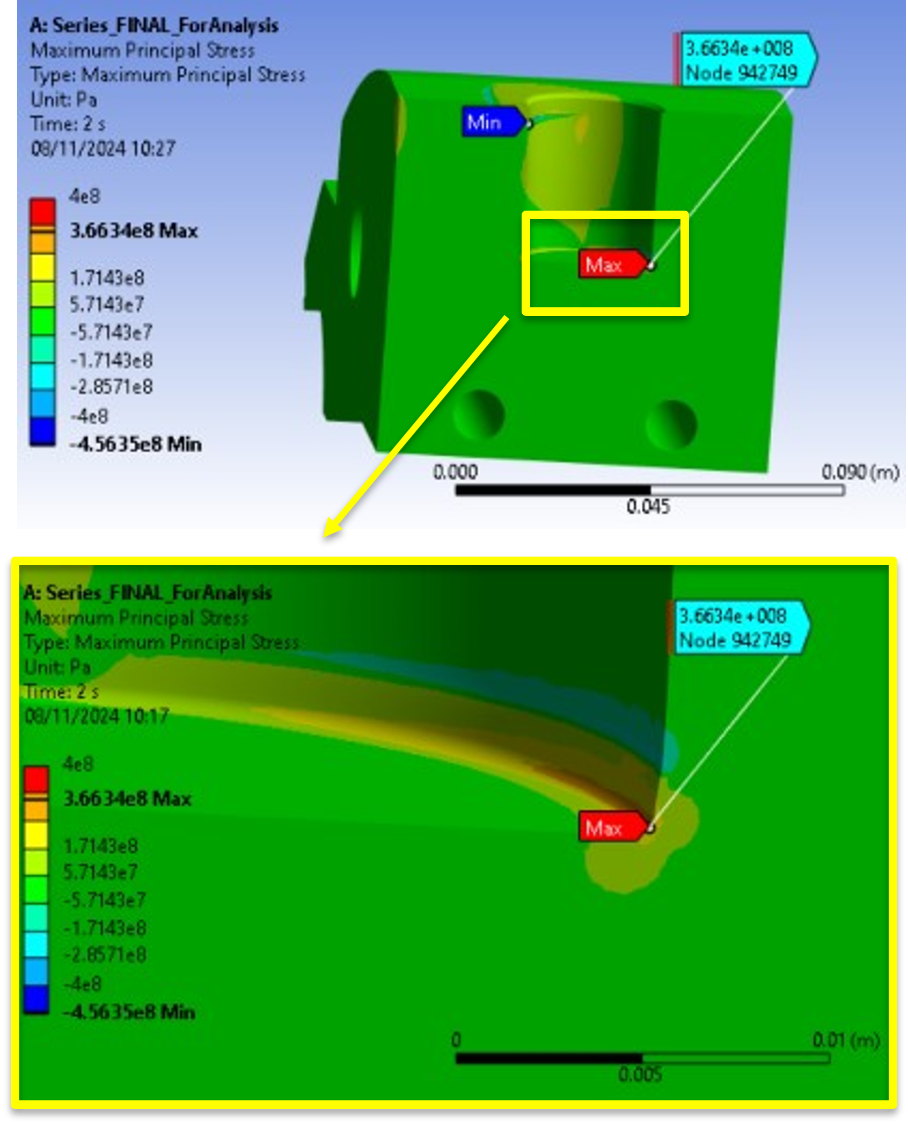
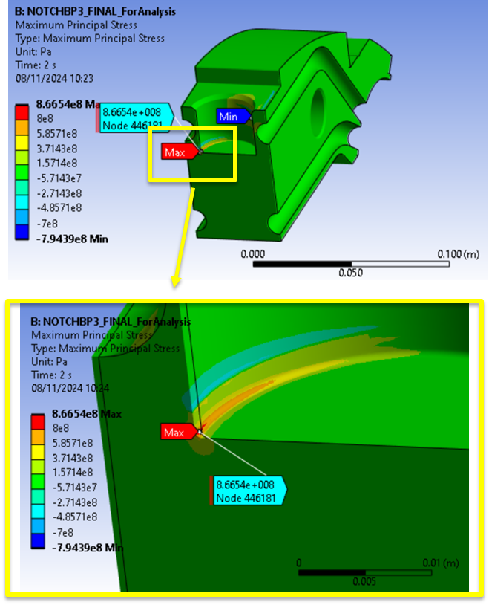
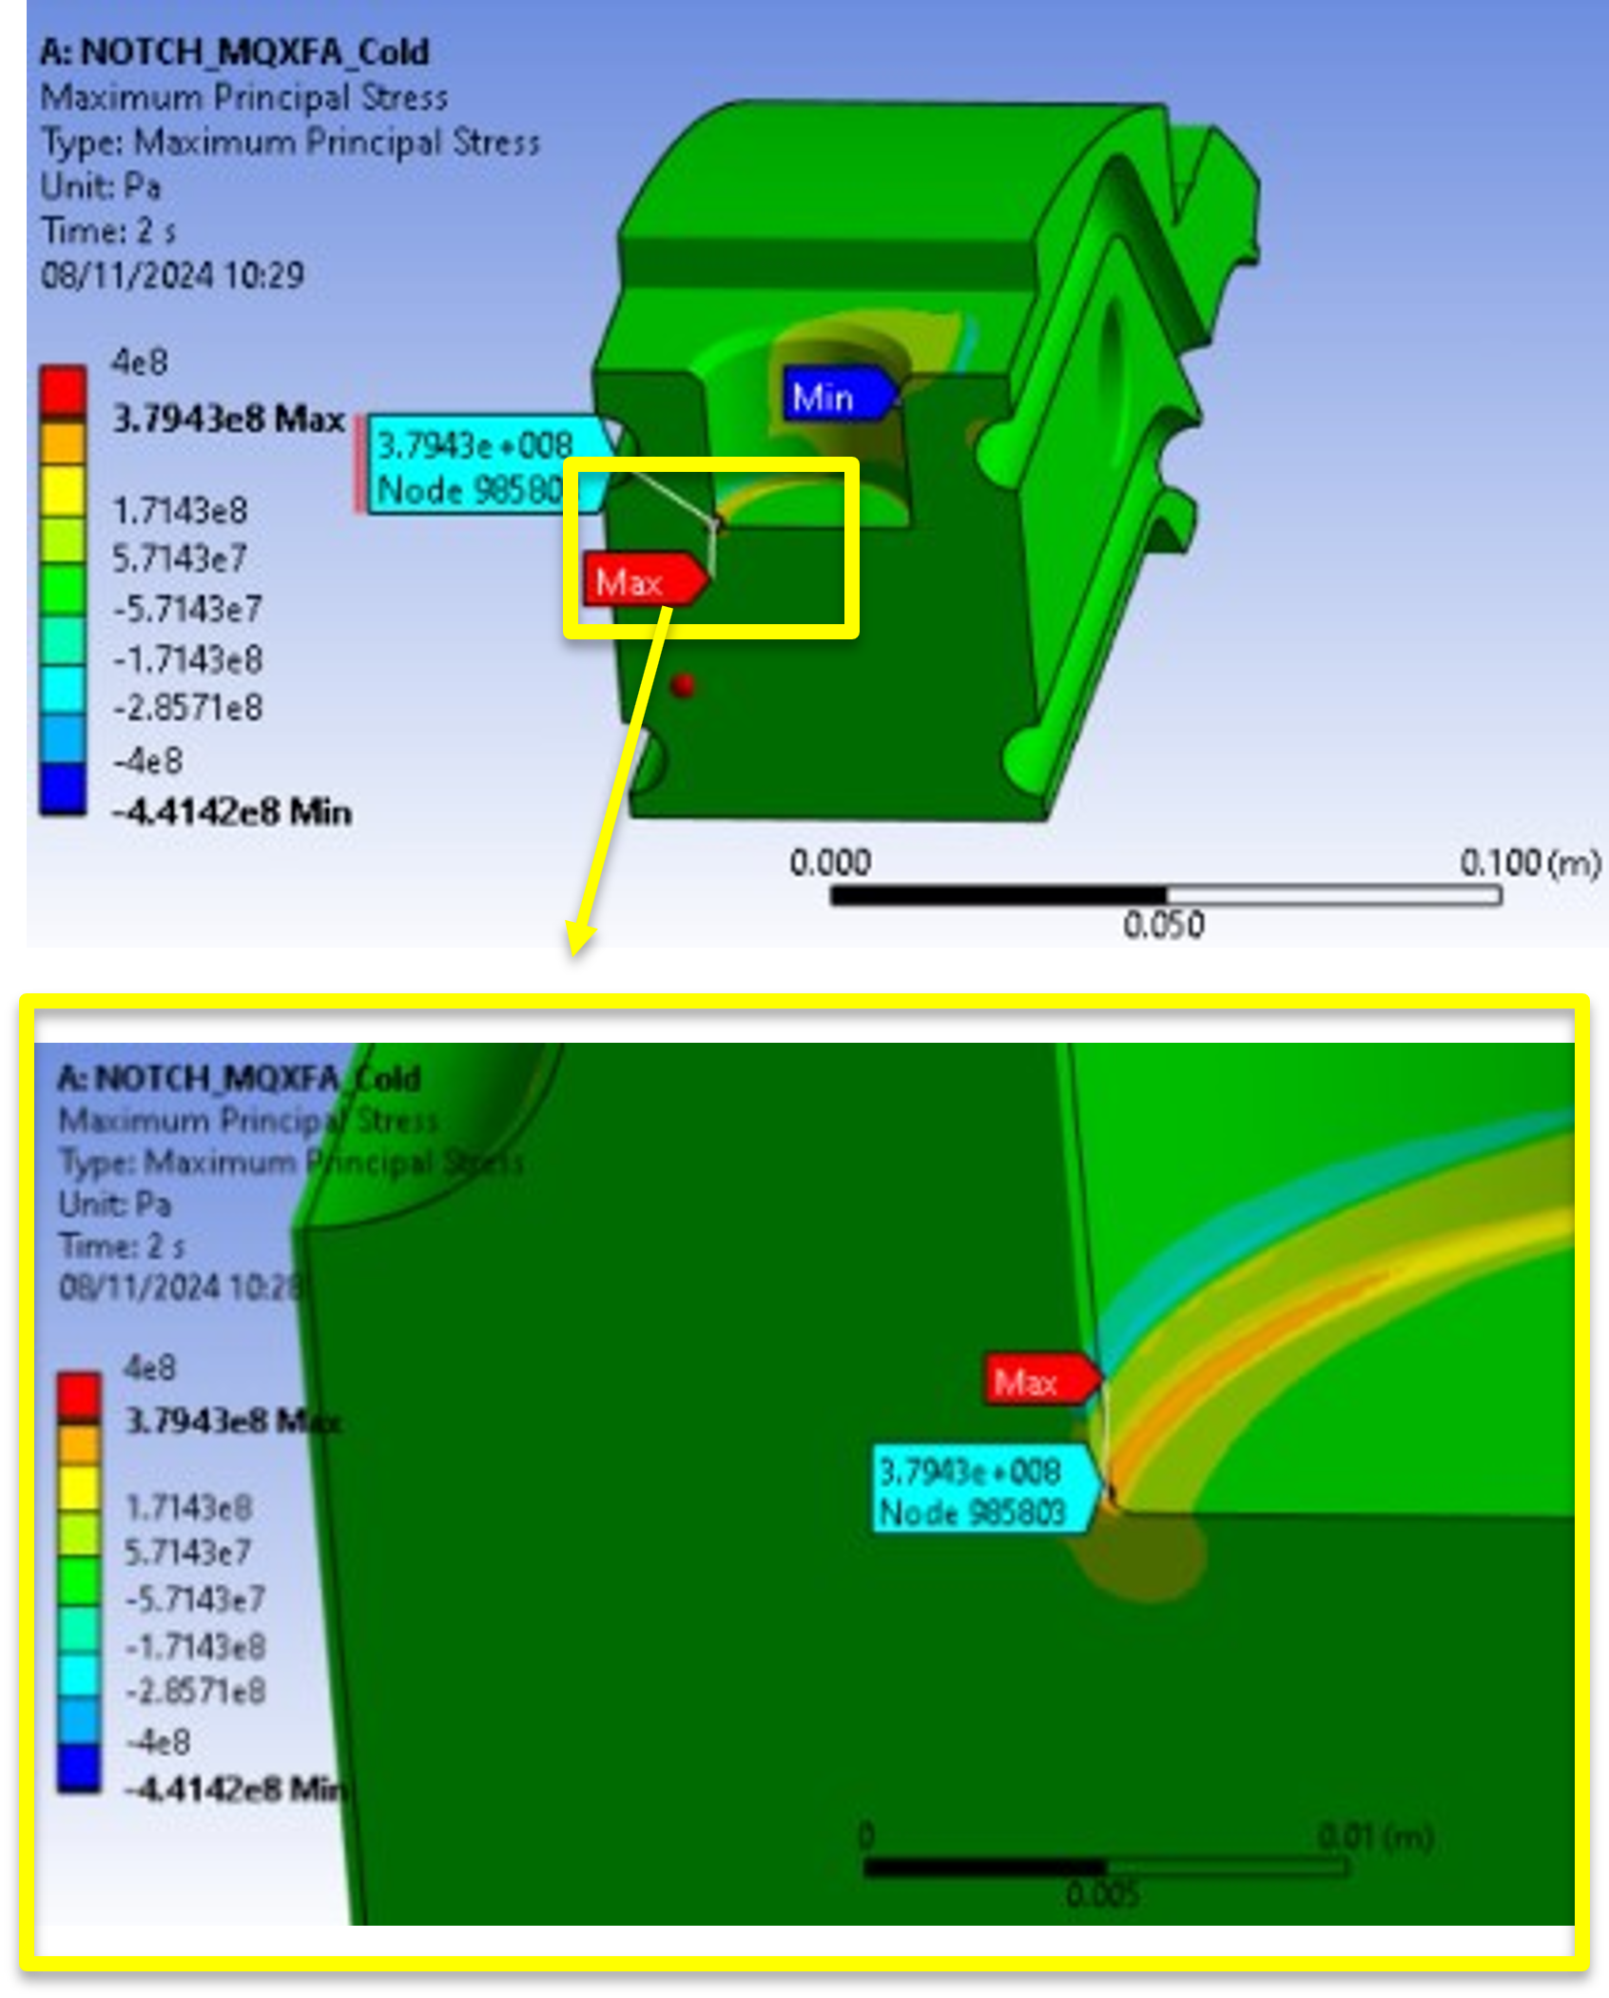
Comparing MQXFB/MQXFBP/MQXFA cases at cold
Penelope Matilde Quassolo
 | MQXFB | MQXFBP | MQXFA
Width of the central lamination, mm | 91.4 | 45 | 63
Max. load warm, kN | 55 (0.5g) | 55 (0.5g) | 32 (0.5g)
Max. load at cold, kN | 96 (4 bar) | 96 (4 bar) | 62 (2.5 bar)
Peak S1 stress, MPa | 366 | 866 | 379
MQXFB Series magnets configuration
MQXFBP2 & BP3 configuration
(different scale)
MQXFA configuration

Slide 24
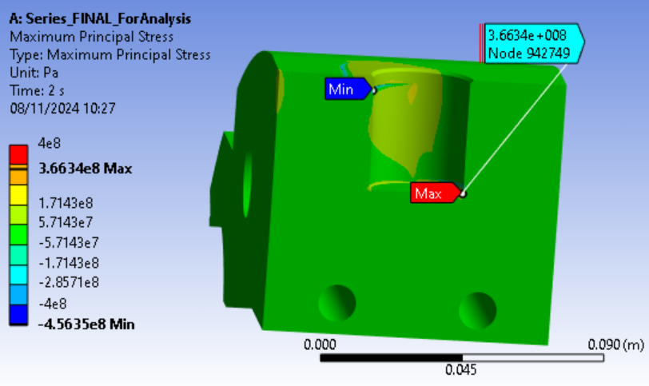
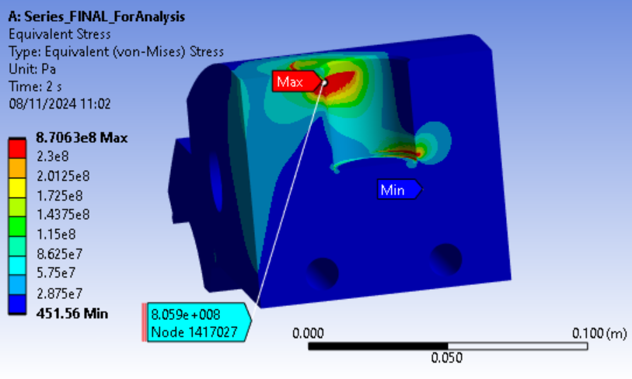
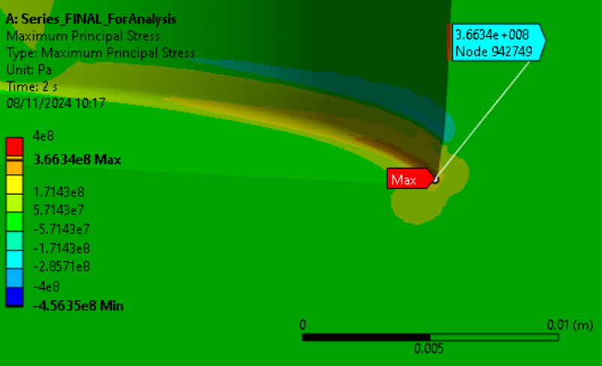
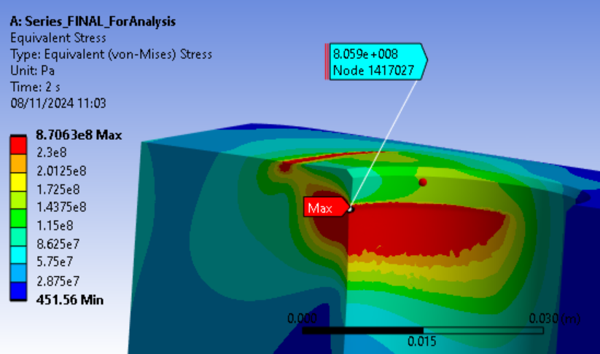
MQXFB results at cold
S1
Eqv stress

Slide 25
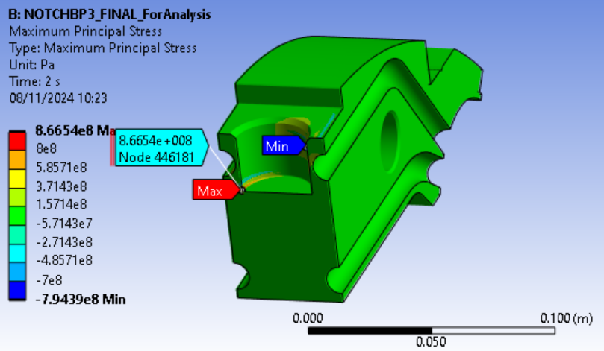
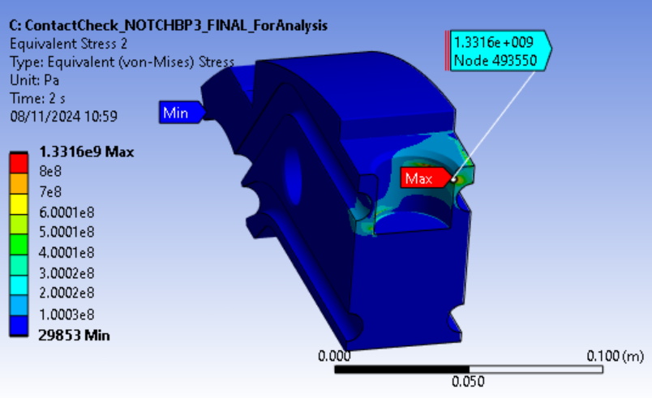
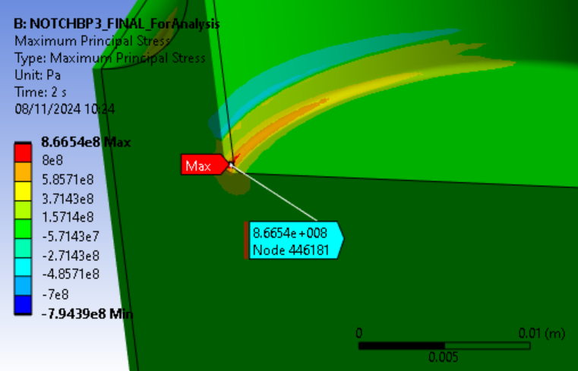
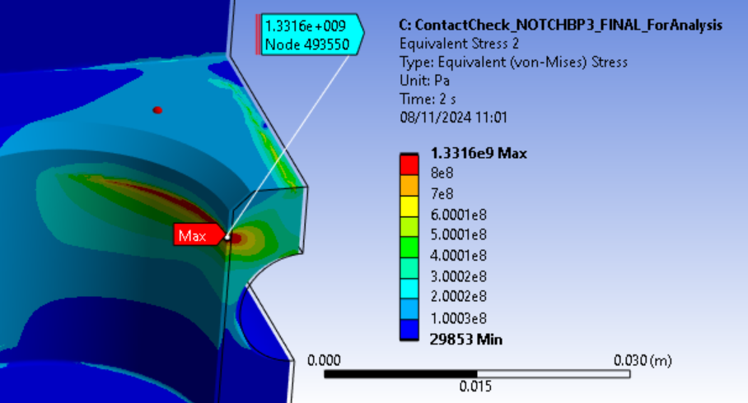
MQXFBP results at cold
S1
Eqv stress

Slide 26
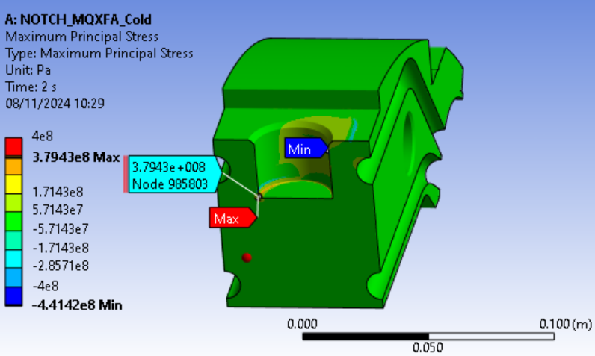
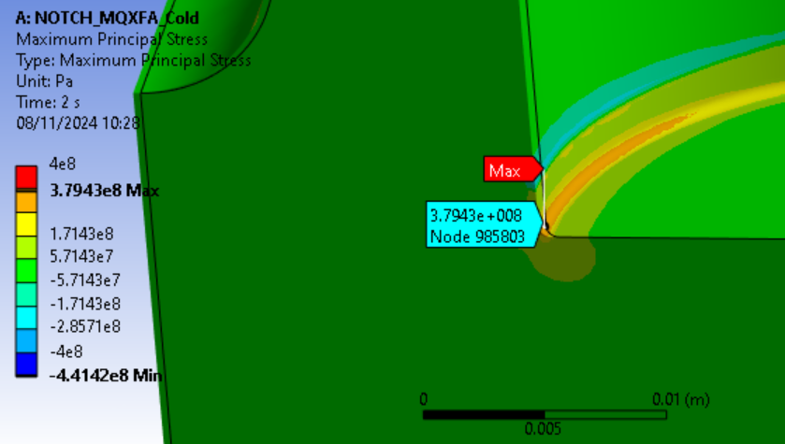
MQXFA results at cold
S1
Eqv stress

Slide 27
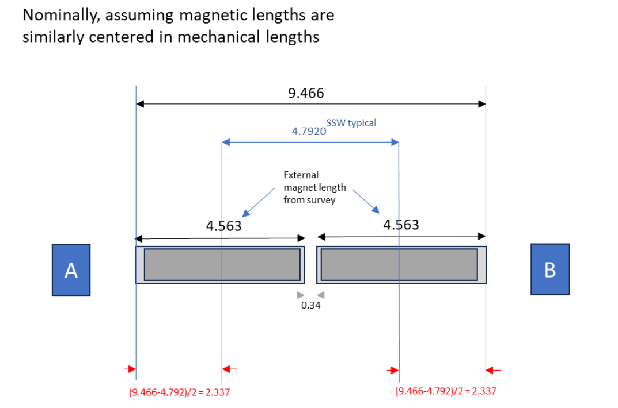
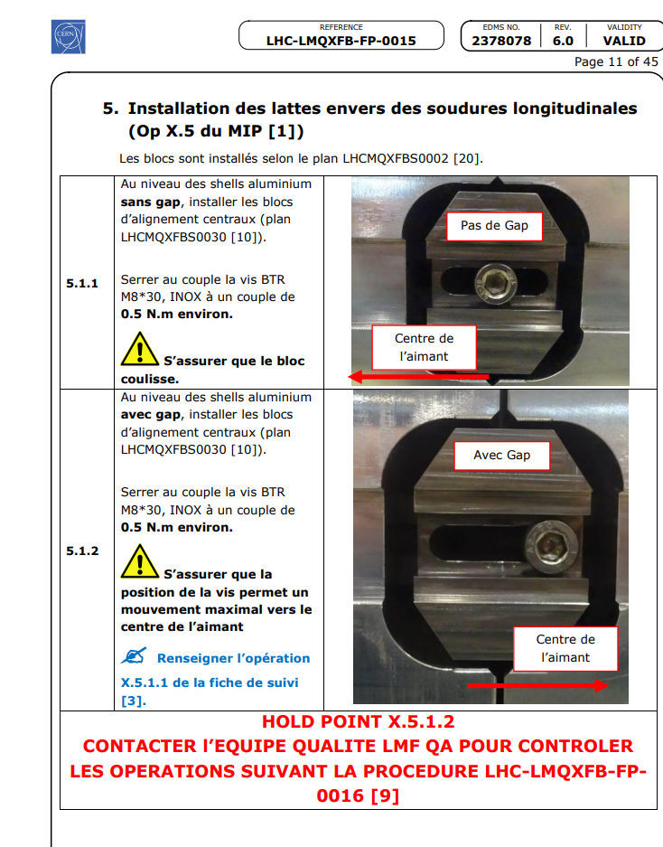
One cold mass, two fixed points…
A drawback with respect to MQXFB is that we will have two fixed points, the stainless steel will try to move the two magnets towards the middle, everything should move with the SS dl/L so should be ok, but we can have some ‘additional’ force in the pin… (4.792 m * 3 mm/m = 14.4 mm; measured shrinkage 17 mm (i.e., dl/l = 3.55 mm/m)
Nevertheless, AUP is having two fixed points, one per magnet, so it should not be critical
Magnetic center separation, m
 | Warm | Cold, I_{nom}
CM01 (A04/A03) | 4.7895 | 4.7721
CM02 (A05/A06) | 4.7930 | 4.776
CM03 (A11/A10) | 4.7933
CM04 (A14b/A08b) | 4.7928
CM05 (A15/A07b) | 4.7895

Slide 28
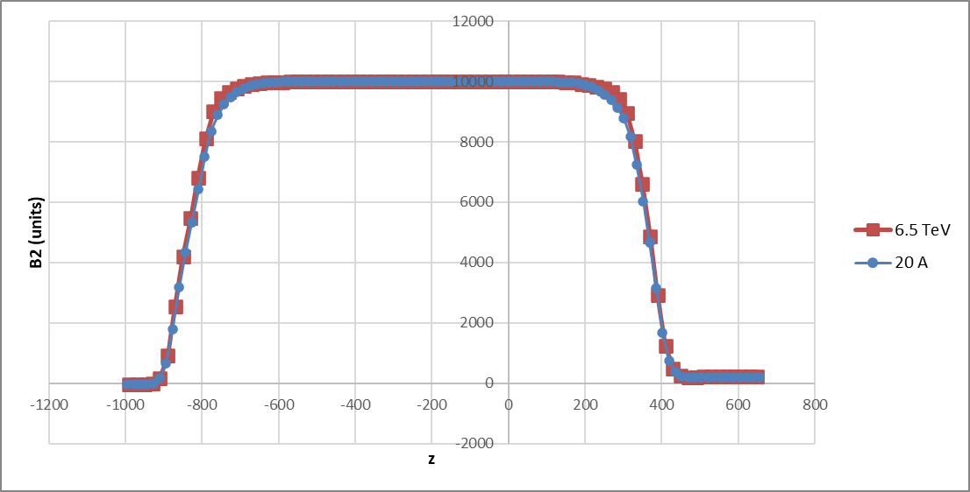
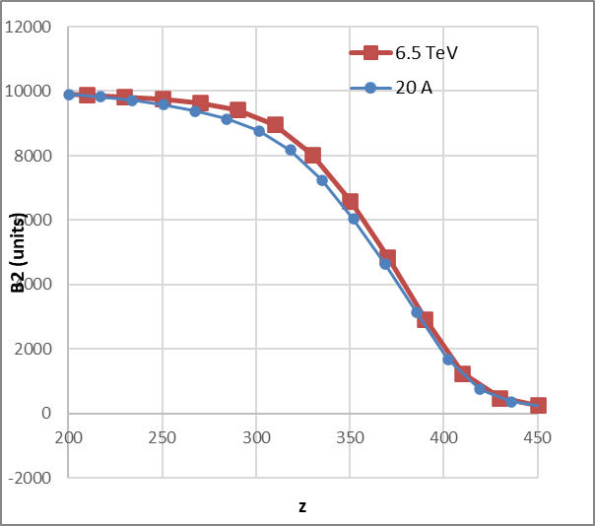
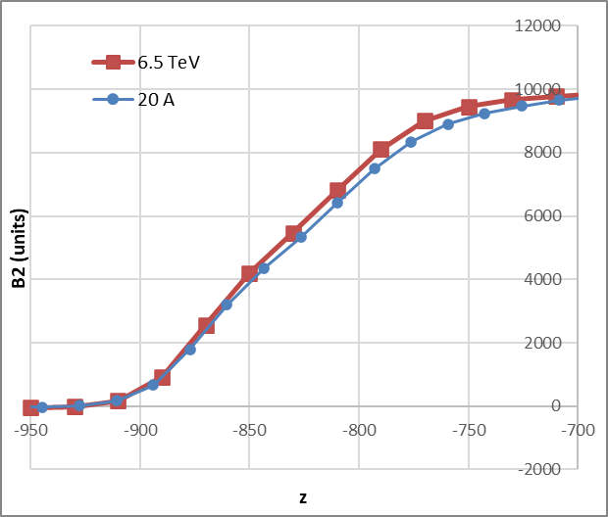
Can the 3D iron saturation effect explain the difference in magnetic centers?
Not really…
  There is an iron saturation effect in the magnetic length (magnetic length at Inom + 12 mm), but it is symmetric (only 0.2 mm shift on the axial magnetic center)
RE END
LE END

Slide 29
Outline
Requirements
Welding parameters and feedback from construction
Options for longitudinal welding:
  Option 1: AUP ‘MQXFA’ procedure
  Option 2: CERN ‘MQXFB’ procedure
  Option 3: CERN ‘modified’ procedure (see slides from Herve)
Conclusions

Slide 30
Conclusions
Longitudinal welding using AUP approach (shims) requires significant development on the welding process (different welding gap/shrinkage…)
  However, one might argue that the bolts in the central yoke are enough to keep the loads at warm, and that we will also have some help form friction: we could take AUP blocks but CERN welding (without shims)
No apparent showstopper on applying ‘MQXFB’ procedure, situation will be close to MQXFB series configuration. However, there will be two fixed points in one cold mass, and the pin will not be in the mechanical center of the magnet.
As an alternative, we could have only one fixed point in between the two magnets, joining mechanically the yokes of both magnets (see slides from Herve)

Slide 31
Additional slides

Slide 32
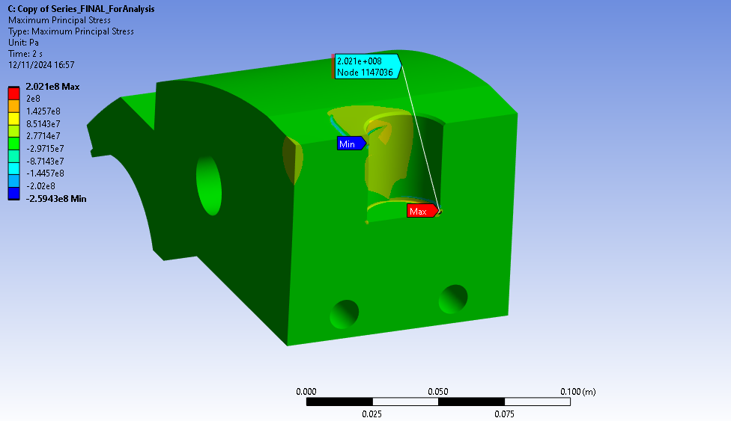
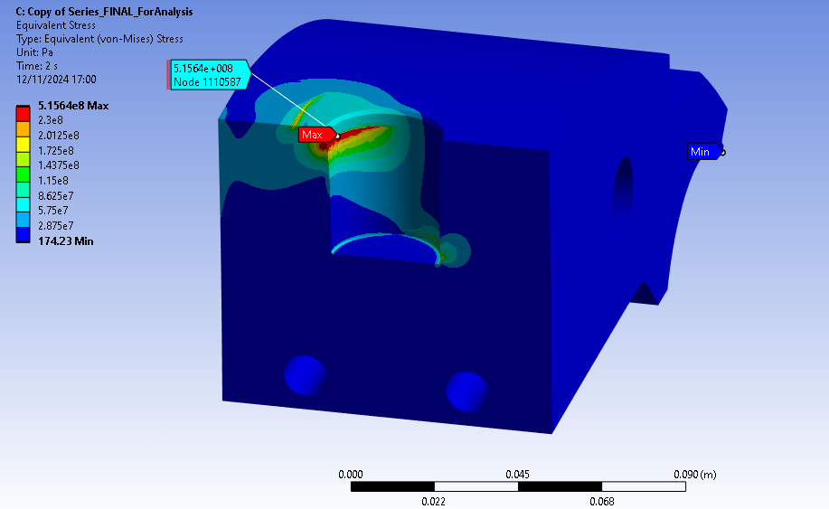
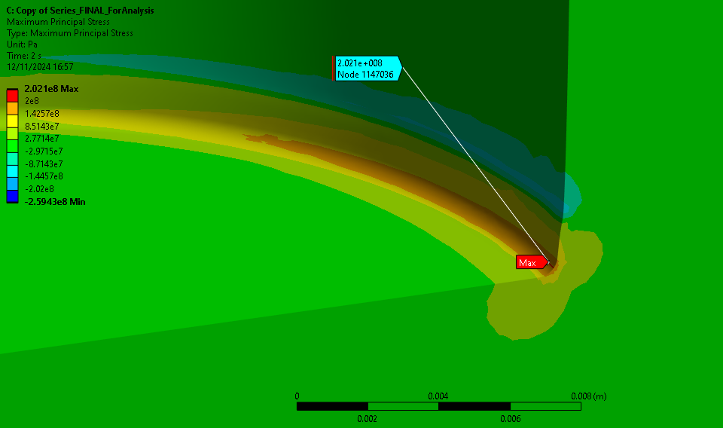
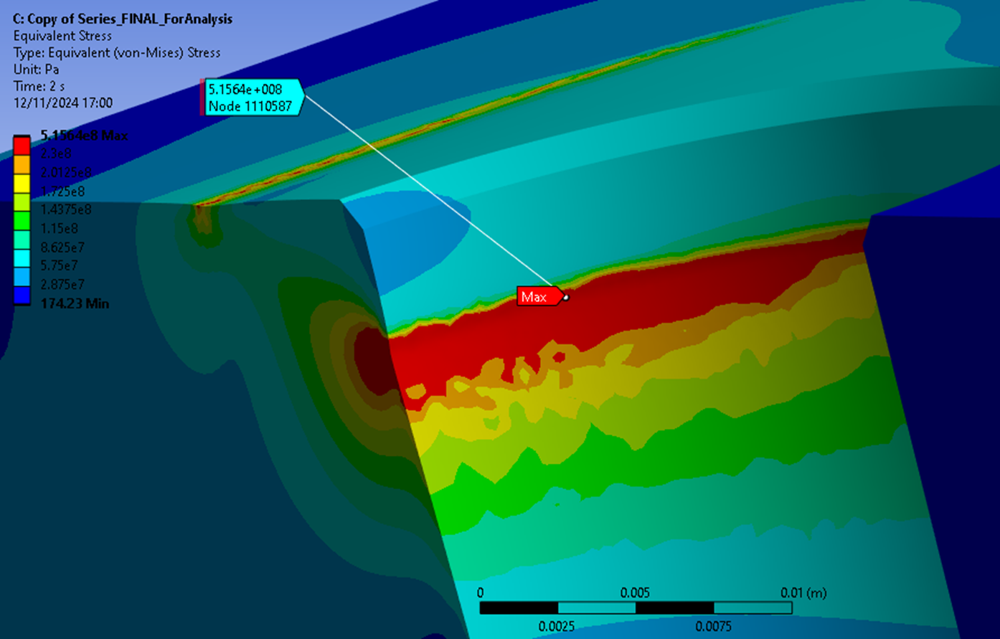
MQXFB results at warm
S1
Eqv stress

Slide 33




MQXFBP results at warm
S1
Eqv stress

Slide 34




MQXFA results at warm
S1
Eqv stress

Slide 35
Implementing “MQXFBP” approach in MQXFA magnets

Slide 36
https://edms.cern.ch/document/2264827

Slide 37

https://edms.cern.ch/document/2264827

Slide 38

Other yokes…
MQXFA-2 YOKE PLATE TYPE-1 | 2019-10-29 | LBNL | YOKE | LHCMQXFAS0044
MQXFA-2 YOKE PLATE TYPE-2 | 2019-10-29 | LBNL | YOKE | LHCMQXFAS0045
MQXFA-2 YOKE PLATE TYPE-3 | 2019-10-29 | LBNL | YOKE | LHCMQXFAS0046
MQXFA-2 YOKE PLATE TYPE-4 | 2019-10-29 | LBNL | YOKE | LHCMQXFAS0047

Slide 39

Other yokes…

Slide 40

Other yokes…

Slide 41

MQXFA approach
13th HL-LHC Collaboration meeting

Slide 42
References
Technical Review of MQXFB Cold Mass: https://indico.cern.ch/event/1142636/
Structural Analysis of WP3 Q2 LMQXFB Triplet Cold Masses
https://edms.cern.ch/document/2363726
HL-LHC-AUP Engineering Note for Q1/Q3 cold mass shell
https://edms.cern.ch/document/2659173
HL-LHC: Decision Management Differential longitudinal pressures across the HL-LHC Inner Triplet Cold Masses
https://edms.cern.ch/document/2675955
CA Series Production Readiness Review (6-September 8, 2023) · INDICO-FNAL (Indico)

