Slide 1
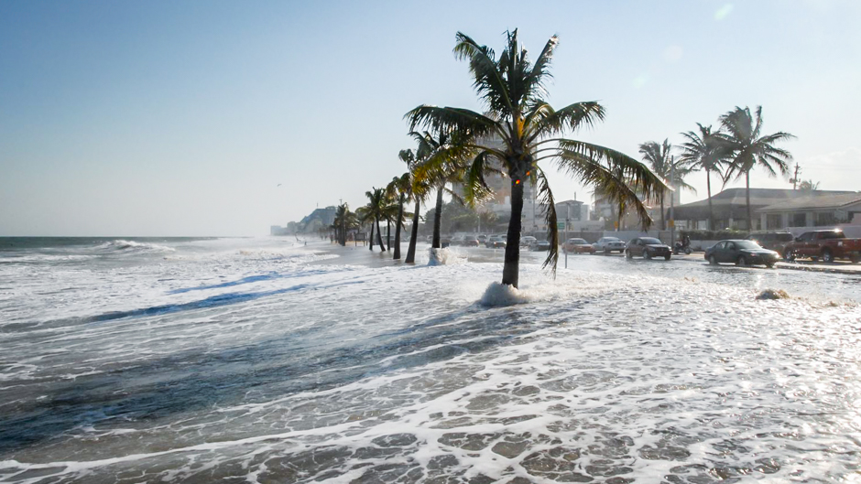

Detecting anomalous sea level rise events
Subhankar Ghosh & Aneesh Subramanian
w/ Shashi Shekhar, Vandana Janeja, Josephine Namayanja

Slide 2
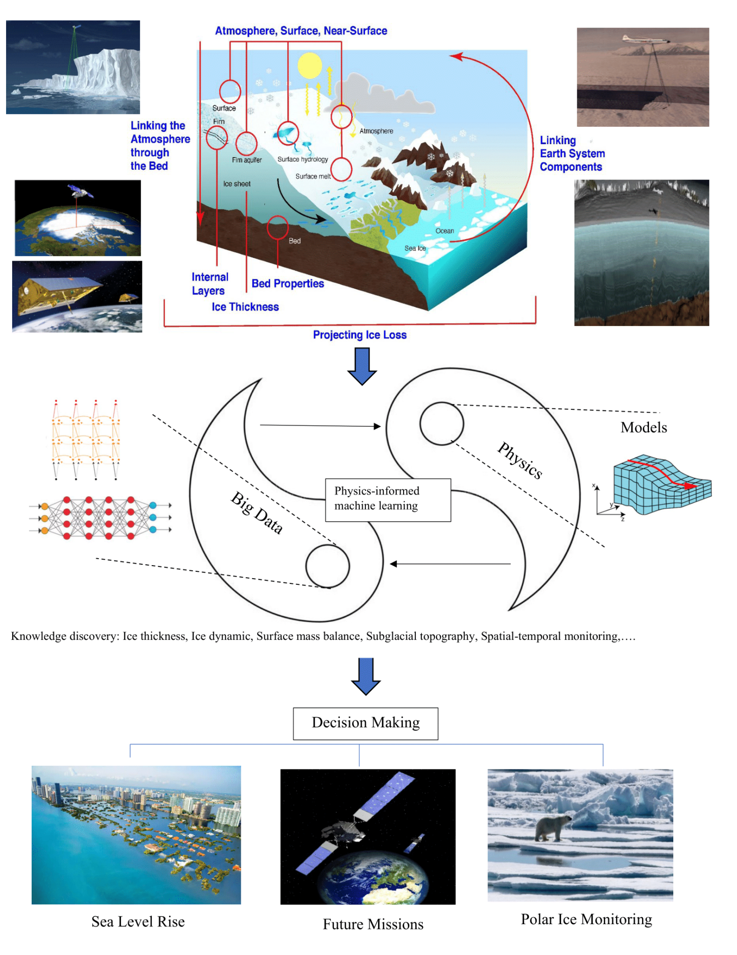
iHARP Vision
iHARP advances our understanding of the response of polar regions to climate change and its global impacts by deeply integrating data science and polar science to spur physics-informed, data-driven discoveries.
iHARP Mission
iHARP conducts data intensive research, education, outreach, and cyberinfrastructure development that will transform understanding of the effects of climate change in polar regions. This institute brings together stakeholders and leading scholars in data science and polar science to reduce uncertainties in projecting Greenland and Antarctica’s future mass balance, associated sea-level rise, and impacts on global communities.

Slide 3
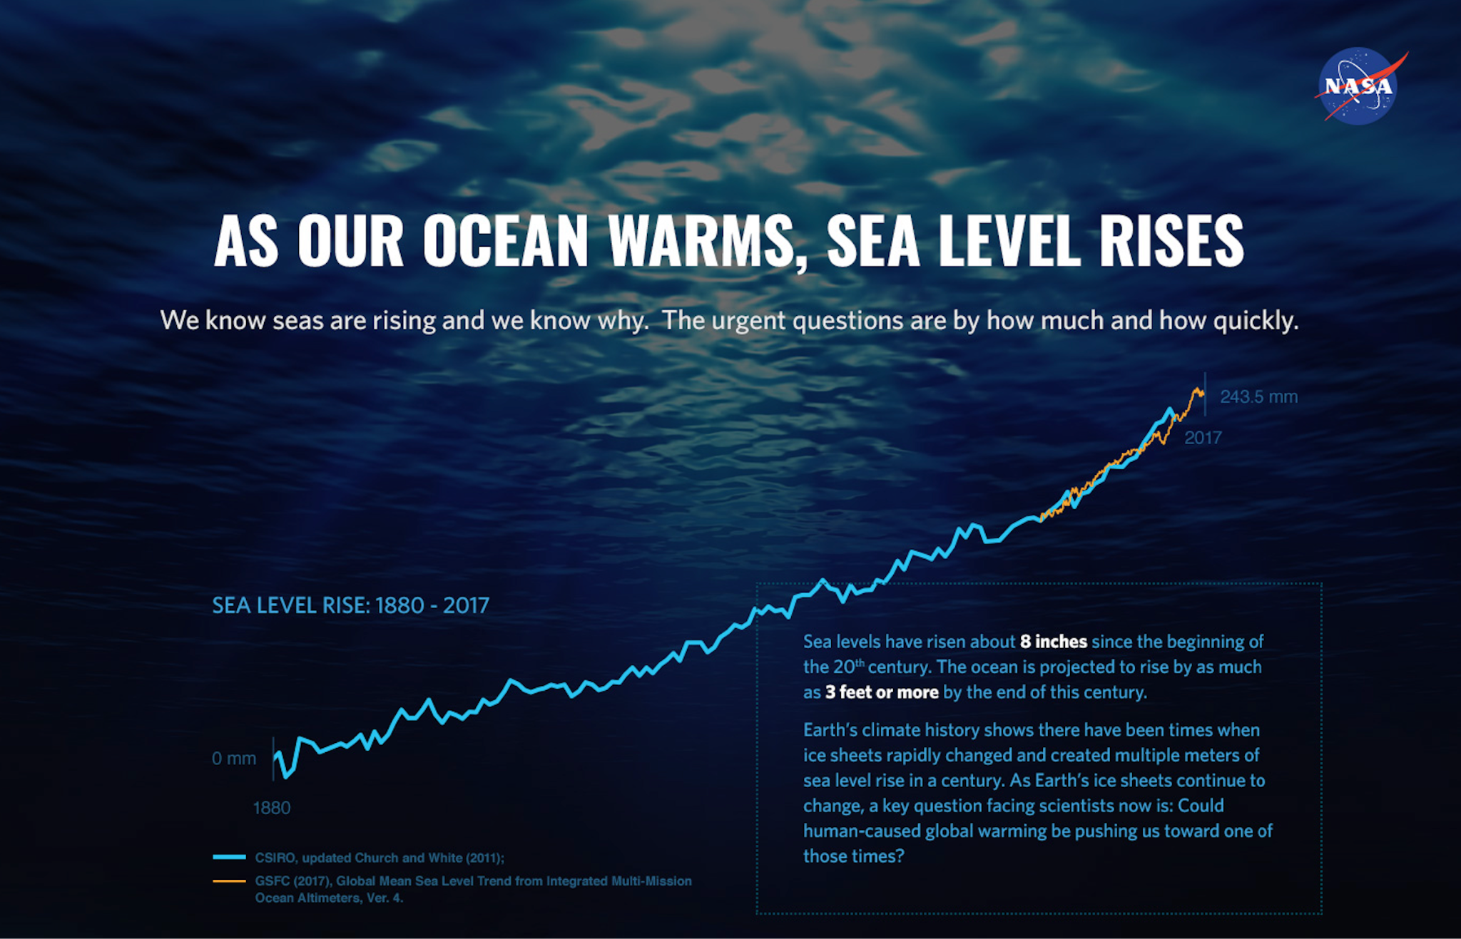

Slide 4
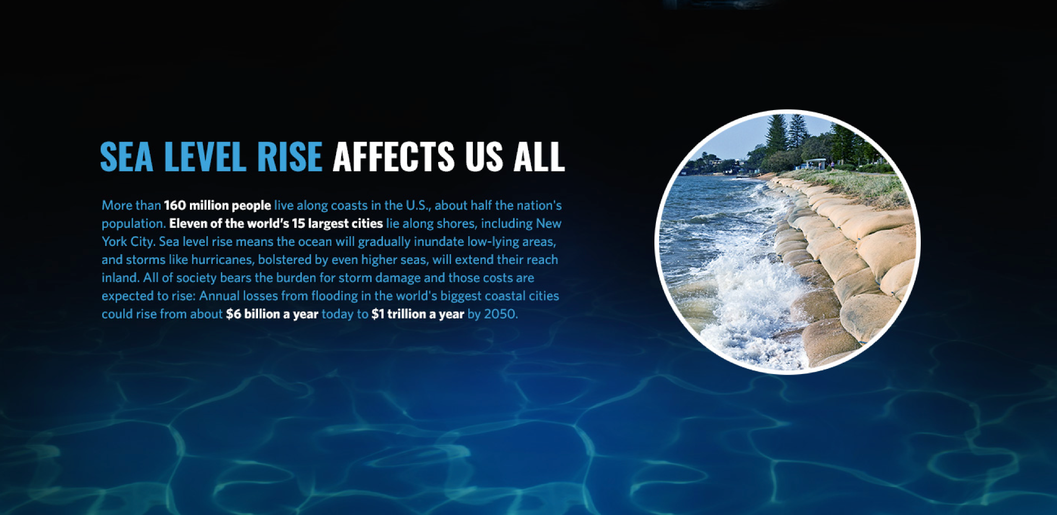

Slide 5
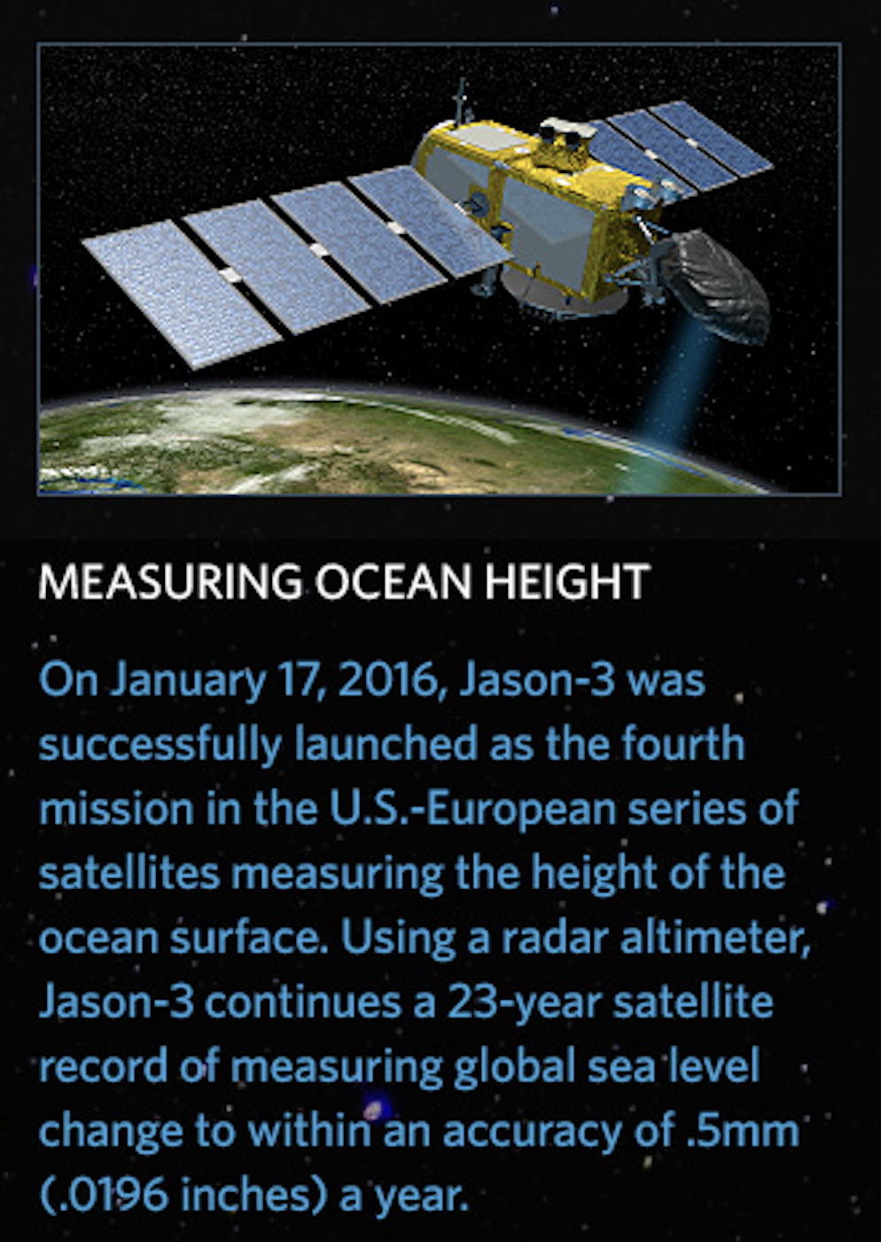
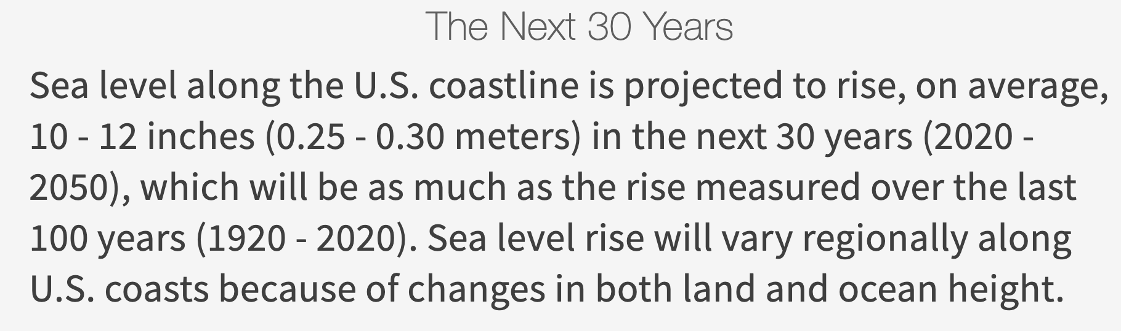
Making Better Predictions of Sea Level Rise
As the ocean rises, the ability to provide even more precise information about coastal sea level rise is crucial

Slide 6
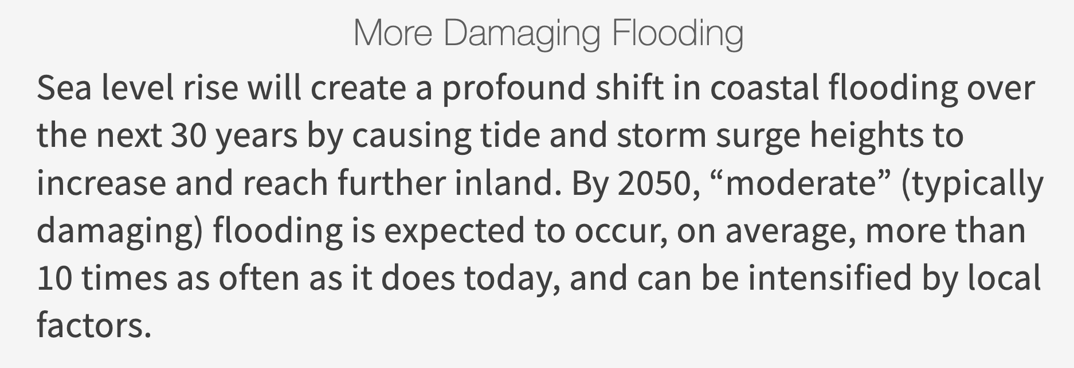
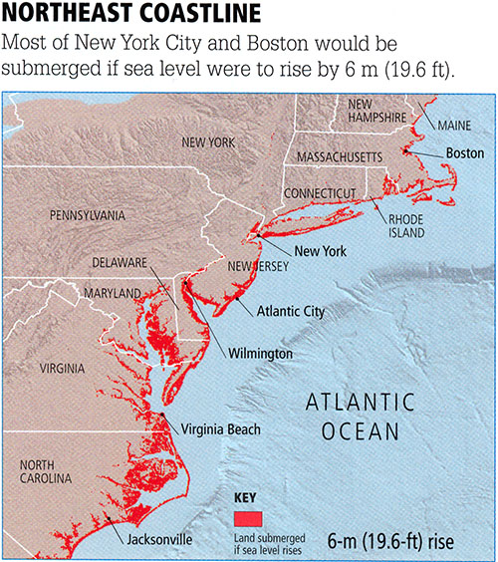
Making Better Predictions of Sea Level Rise
As the ocean rises, the ability to provide even more precise information about coastal sea level rise is crucial

Slide 7
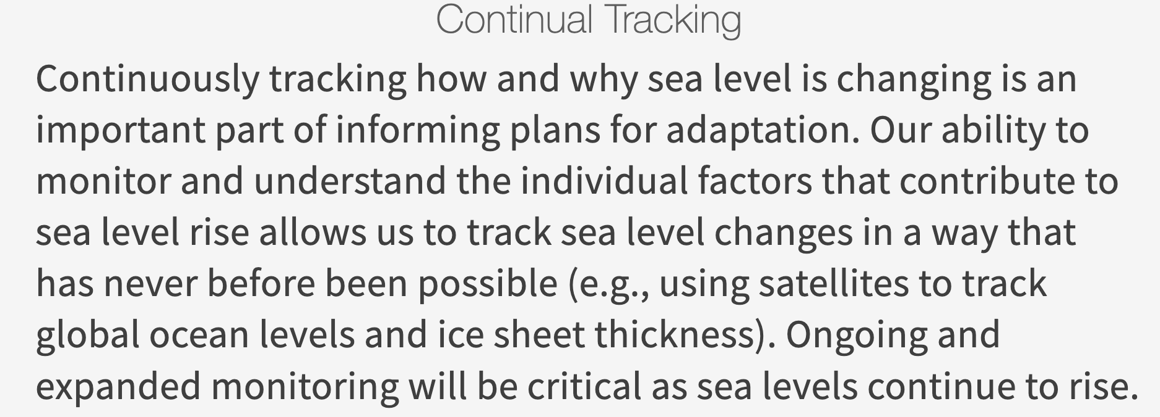
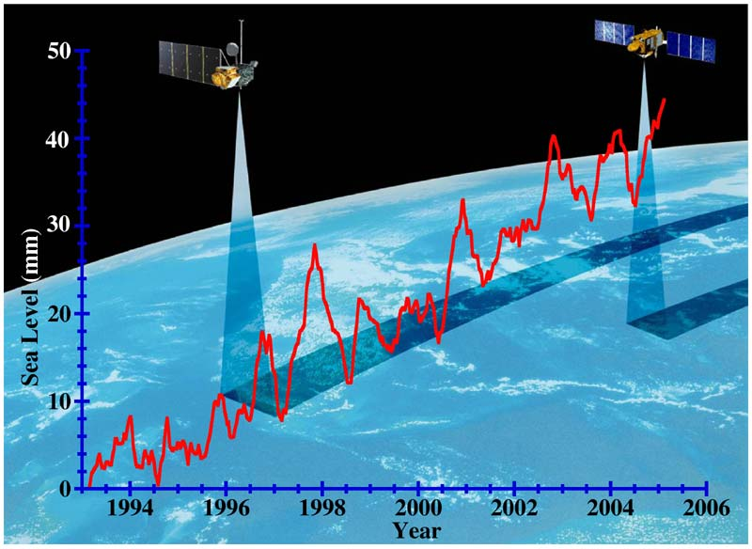
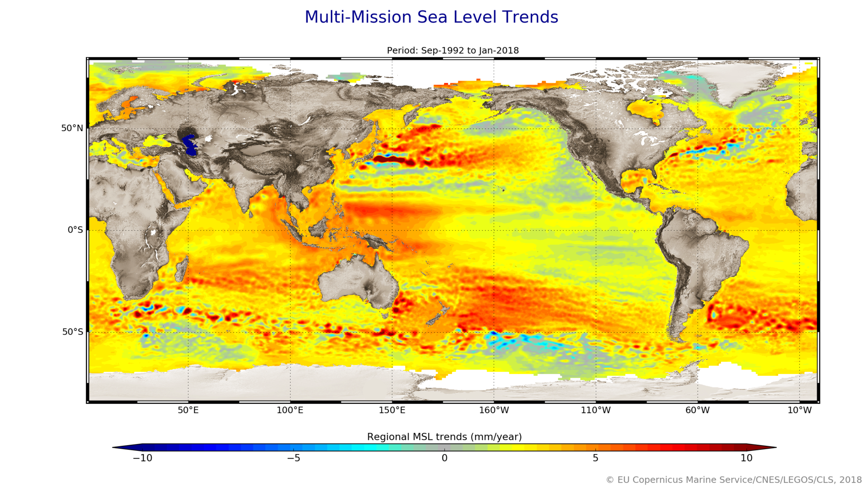

Slide 8
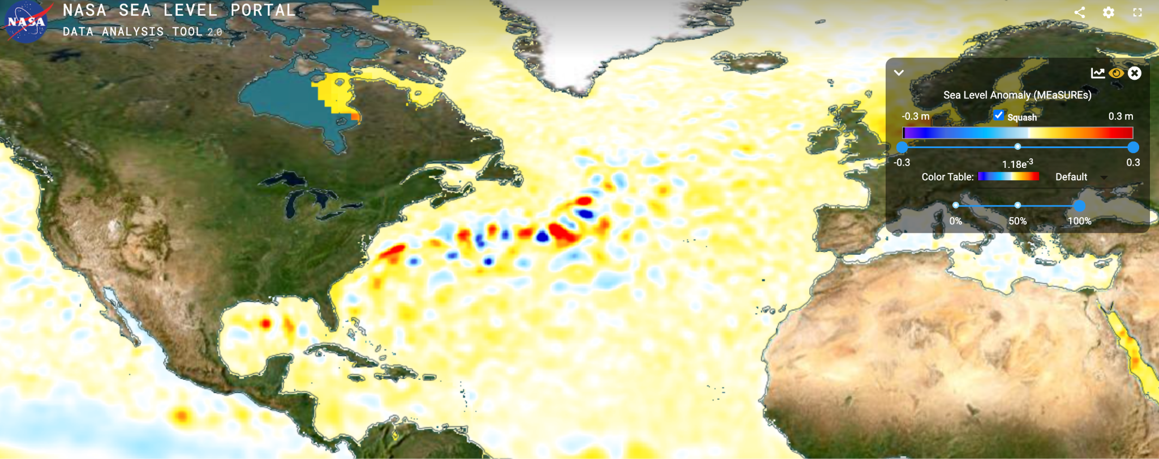
Machine Learning Challenge: Detect anomalous flooding events from satellite sea level maps

Slide 9
Machine Learning Challenge: Detect anomalous flooding events from satellite sea level maps
We provide daily satellite sea level anomaly data over the North Atlantic for the past 30 years
We provide dates of anomalous flooding along US East coast stations for the past 30 years
Challenge is to detect anomalous flooding events along the US East Coast with the maps of sea level over the North Atlantic

