Slide 1

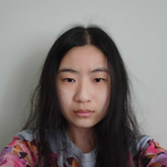


Anomaly Detection:
Hybrid Butterflies
Elizabeth G. Campolongo
and
The Imageomics ML Challenge Team
Special thanks to Lisa Wu, Ziheng Zhang, David Carlyn

Slide 2
Hybrid Detection
A brief history
Notes:
Hybrid detection slides adapted from earlier presentation of dataset ideas that Christopher & David helped put together: https://docs.google.com/presentation/d/1gAcpag5eVgvIGIJwWhKIwU-LBisa4NqNeOOSgvc4rP4/edit?usp=sharing

Slide 3
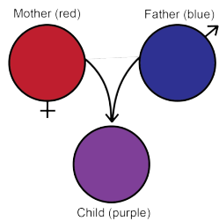
Hybrid Detection
Researchers have sought a means to detect hybrids since the creation of the field of taxonomy.
Detecting hybrids would give taxonomists the ability to determine what constitutes a true species or subspecies.
The question is how?
  How do we recognize a hybrid?
  What does a hybrid look like?
Notes:
Species are distinguished from subspecies in that they cannot produce fertile offspring, while subspecies hybrids can reproduce.
– This is where hybrid detection can help in classification of species or subspecies. If fertile offspring are produced, they cannot be species.

Slide 4
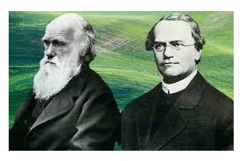
Hybrid Detection: History
Darwin first posed this question of “What does a hybrid look like?”
Mendel answered with his pea plant experiment.

Slide 5
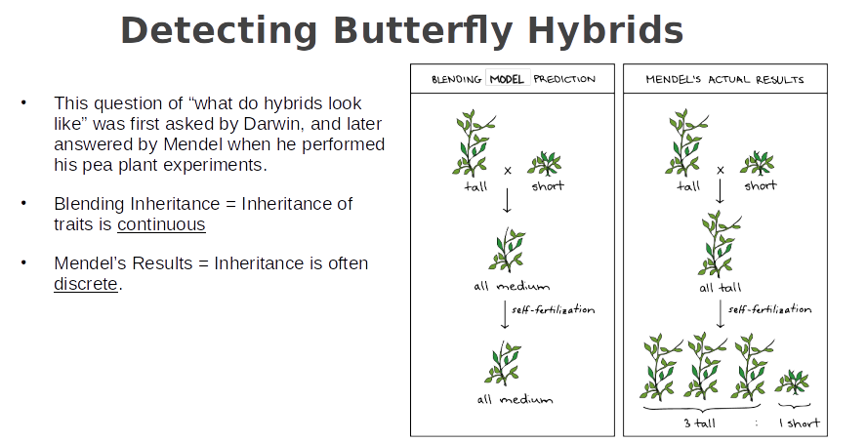
Hybrid Detection: History
Mendel’s Hypothesis:
Blending Inheritance
  Inheritance of traits is continuous.
Mendel’s Results:
Inheritance is often discrete.

Slide 6
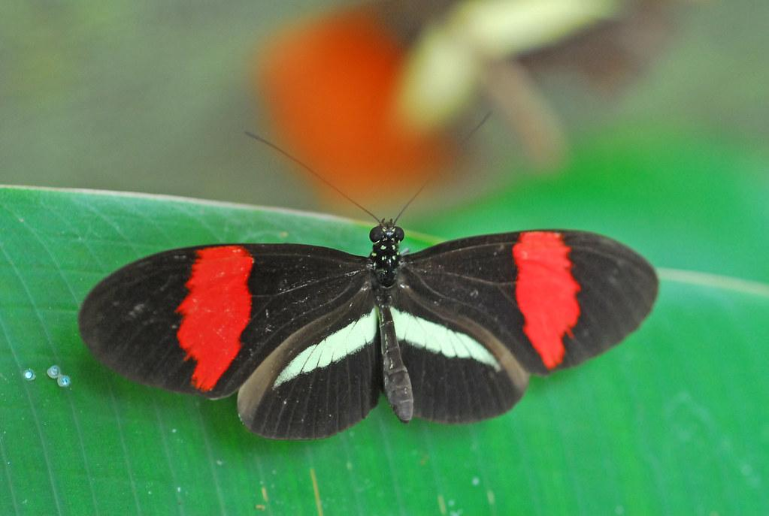
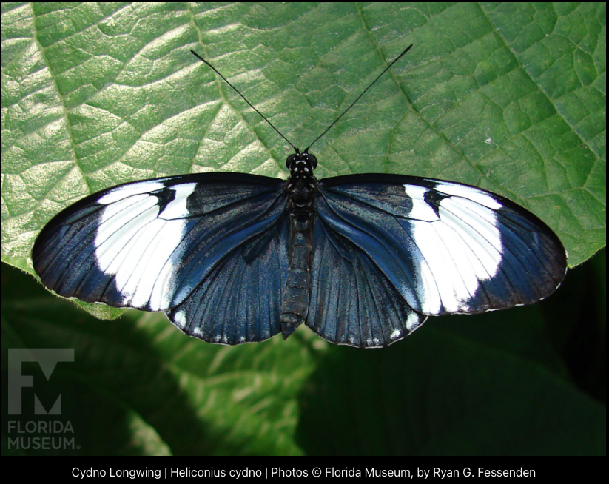
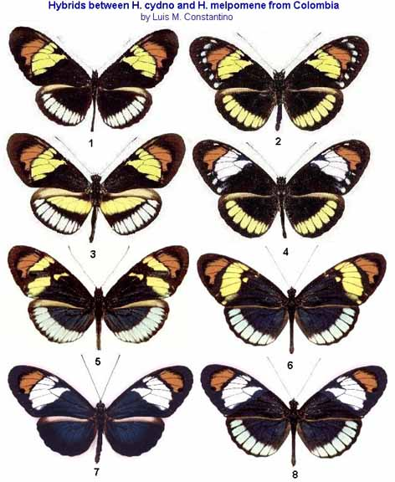
Hybrid Detection: Butterflies
Consider these two species:
Hybridization may lead to a variety of resulting patterns.
Peter Prokosch https://www.grida.no/resources/1906
There are several [dominant] genes that control color pattern on wings.
  Ex: red on hindwings is a dominant trait.
Dominance: hybrids may look like one parent.
In practice, identifying hybrids requires knowledge of their parent species/subspecies.
Notes:
Now, what does this mean for butterflies?
Hybrid examples: https://www.ucl.ac.uk/taxome/hyb/artif/constantino1.html
- source actually suggests that these may be H. heurippa hybrids with cydno, not melpomene; ex of the challenge
H. cydno example: https://www.floridamuseum.ufl.edu/exhibits/butterflies/cydno-longwing/
H. melpomene example: https://www.grida.no/resources/1906
- Photographer: Peter Prokosch

Slide 7
Anomaly Detection
A brief history
Notes:
Hybrid detection slides adapted from earlier presentation of dataset ideas that Christopher & David helped put together: https://docs.google.com/presentation/d/1gAcpag5eVgvIGIJwWhKIwU-LBisa4NqNeOOSgvc4rP4/edit?usp=sharing

Slide 8
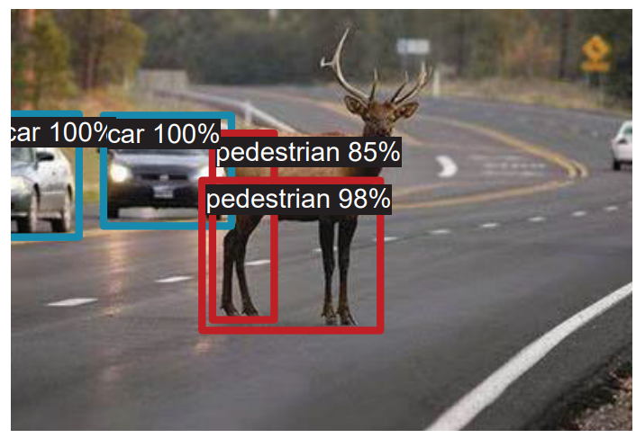
Anomaly Detection: History
Early topics include banking.
  Detecting fraudulent or irregular spending or requests.
In Machine Learning (ML), questions on classification:
  Is the object a new one that the classifier has not seen?
In Computer Vision (CV), questions for autonomous vehicles:
  Is that a pedestrian or a deer that just ran into the road?
Figure: Xuefeng Du, Xin Wang, Gabriel Gozum, and Yixuan Li. "Unknown-aware object detection: Learning what you don't know from videos in the wild." In Proceedings of the IEEE/CVF Conference on Computer Vision and Pattern Recognition, pp. 13678-13688. 2022.

Slide 9
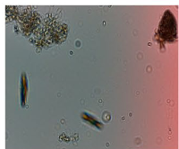

Anomaly Detection: History
In Biology, questions on:
  Gene function identification [1]
    What phenotype anomaly resulted from a gene knockout?
  Ecosystem health monitoring [2]
    Tracking plankton population.
Expert evaluation
Anomaly?
Yes
No
Population Count
[1] Ito, E. et al. (2022). Phenotype Anomaly Detection for Biological Dynamics Data Using a Deep Generative Model. In: Pimenidis, E., Angelov, P., Jayne, C., Papaleonidas, A., Aydin, M. (eds) Artificial Neural Networks and Machine Learning – ICANN 2022. ICANN 2022. Lecture Notes in Computer Science, vol 13530. Springer, Cham. https://doi.org/10.1007/978-3-031-15931-2_36
[2] Pastore, V.P., Zimmerman, T.G., Biswas, S.K. et al. Annotation-free learning of plankton for classification and anomaly detection. Sci Rep 10, 12142 (2020). https://doi.org/10.1038/s41598-020-68662-3
Notes:
There have been some applications in biology…
With our challenge, we’re adding another biological challenge to anomaly detection (NEXT SLIDE).
[1] Ito, E. et al. (2022). Phenotype Anomaly Detection for Biological Dynamics Data Using a Deep Generative Model. In: Pimenidis, E., Angelov, P., Jayne, C., Papaleonidas, A., Aydin, M. (eds) Artificial Neural Networks and Machine Learning – ICANN 2022. ICANN 2022. Lecture Notes in Computer Science, vol 13530. Springer, Cham. https://doi.org/10.1007/978-3-031-15931-2_36
[2] Pastore, V.P., Zimmerman, T.G., Biswas, S.K. et al. Annotation-free learning of plankton for classification and anomaly detection. Sci Rep 10, 12142 (2020). https://doi.org/10.1038/s41598-020-68662-3

Slide 10
Our Challenge
How you can contribute to answering this important biological question

Slide 11
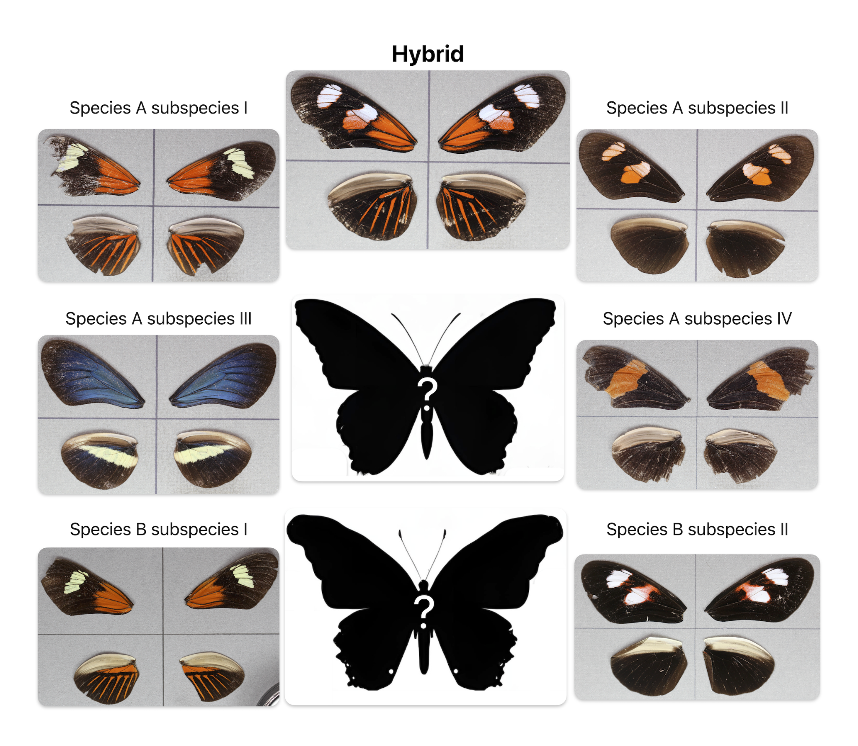
Images are from Zenodo records 2714333, 3082688, 2677821, 2686762, and 2549524, and are licensed under CC-BY 4.0.
Hybrid graphic generated using Canva Magic Media AI, then manually edited.
Images are from Zenodo records 2714333, 3082688, 2677821, and 2686762, and are licensed under CC-BY 4.0.
Hybrid graphic generated using Canva Magic Media AI, then manually edited.
Images are from Zenodo records 2714333 and 3082688, licensed under CC-BY 4.0.
Notes:
Emphasis on the subtlety of the differences in the anomalies:
Subspecies variation and mimicry!!
We know, see these 4 subspecies in training, and we get a view of this hybrid, but can we detect the hybrid of 3 & 4 when we don’t know what they look like? Similarly for the mimics of subspecies 1 & 2.

Slide 12
Images are from Zenodo records 2714333, 3082688, 2677821, 2686762, and 2549524, and are licensed under CC-BY 4.0.
Hybrid graphic generated using Canva Magic Media AI, then manually edited.
Notes:
Emphasis on the subtlety of the differences in the anomalies:
Subspecies variation and mimicry!!
We know, see these 4 subspecies in training, and we get a view of this hybrid, but can we detect the hybrid of 3 & 4 when we don’t know what they look like? Similarly for the mimics of subspecies 1 & 2.

Slide 13
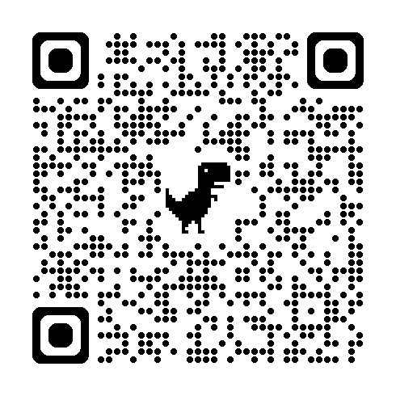
Our Challenge: Training Data
Training Data
~2200 images of Species A:
  Multiple subspecies.
  Selected signal hybrids of two subspecies.
Signal Hybrid
Images are from Zenodo records 2714333 and 3082688, licensed under CC-BY 4.0.

Slide 14
Our Challenge: Dev & Test Data
Includes:
  All Species A subspecies.
  Signal hybrids from training data.
Further introduces:
  Other Species A hybrids (non-signal).
  Species B: Mimics of Species A signal hybrid parents (& their hybrids).
The numbers:
  Validation Data (Dev): ~1100 images
  Test Data: ~2200 images

Slide 15
The Challenge: Find the Hybrids
  Species A non-signal hybrids?
Among Species A & B, can your algorithm find…
  Species A signal hybrids?
  Species B hybrids (mimics of Species A signal hybrids)?
Images are from Zenodo records 2714333, 3082688, 2677821, 2686762, and 2549524, and are licensed under CC-BY 4.0.

Slide 16
Our Challenge: Baselines
AUC of Precision-Recall Curve (PRC) - Test
 | Species A (overall) | Species A (signal) | Species A (non-signal) | Species B (Mimic)
BioCLIP | 0.92 | 0.96 | 0.06 | 0.73
DINOv2 | 0.92 | 0.97 | 0.14 | 0.75
Upper bound: 1.00
Notes:
Room to grow/improve
We provide two baseline models…
Shows challenge of this anomaly detection
Challenge will be evaluated based on recall, but thes scores also reported

Slide 17
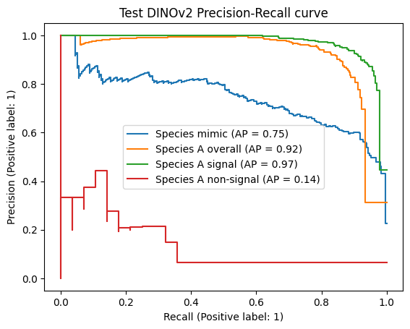
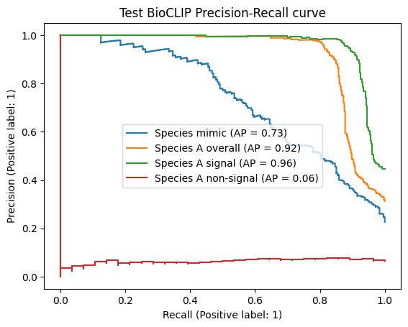
Our Challenge: Baselines
Notes:
Room to grow/improve
We provide two baseline models…
Shows challenge of this anomaly detection
Challenge will be evaluated based on recall, but thes scores also reported

Slide 18
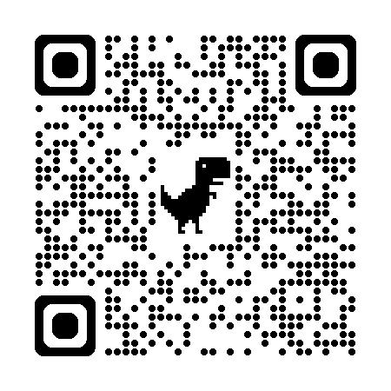
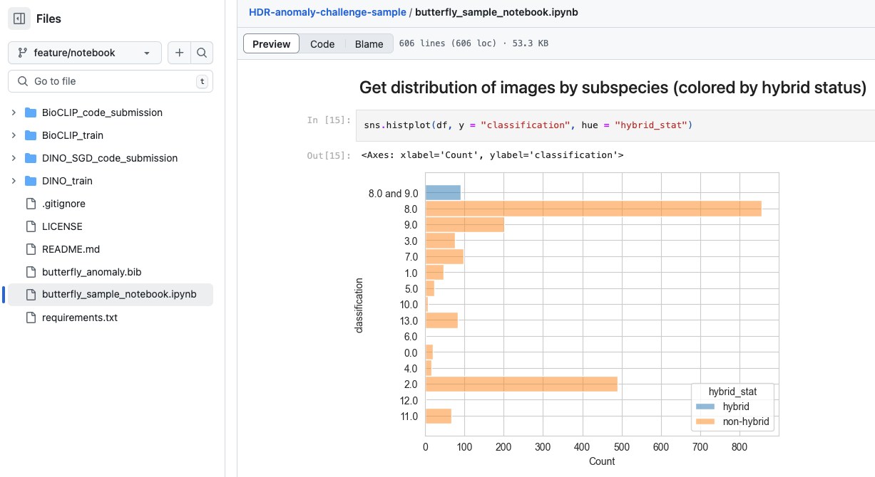
Sample Submissions Repository

Slide 19
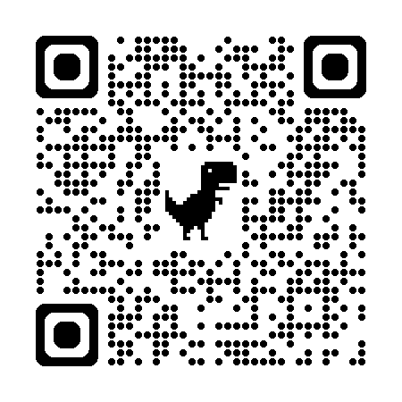
Thank you!
Join the Challenge!
Questions?

