Slide 1

Cosmic and beam-halo tracker
(with RPCs)
D.Boscherini (INFN-Bologna)
GIF++ User Annual Meeting - CERN, 03/12/2024

Slide 2
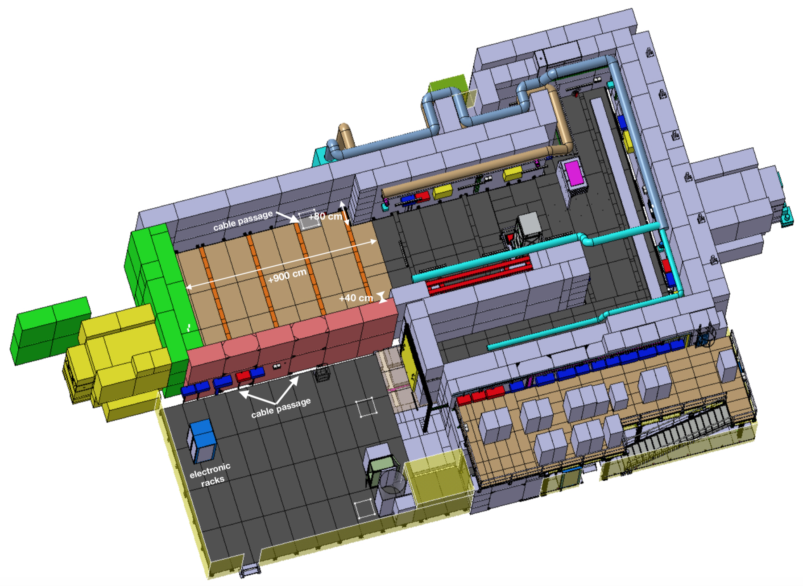
Cosmic tracker: setup
Based on Resistive Plate Chamber technology
bottom chambers
under the floor
top tracker
on the ceiling

Slide 3
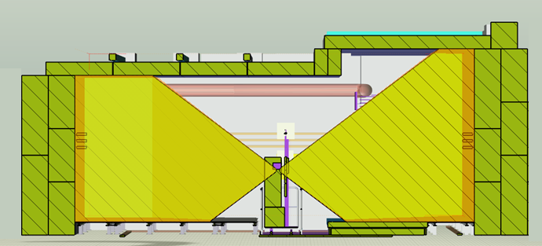
Extension of cosmic-ray tracker
First tracker coverage limited to downstream region
Proposed extension via installation of 4 RPC
chambers vertically on the bunker endcap walls
Extended coverage
Selection of harder momentum muons
Triggering on beam-halo muons
Downstream chamber position ok
New upstream positions
Current proposal for chamber upstream position (modified with bunker extension)

Slide 4
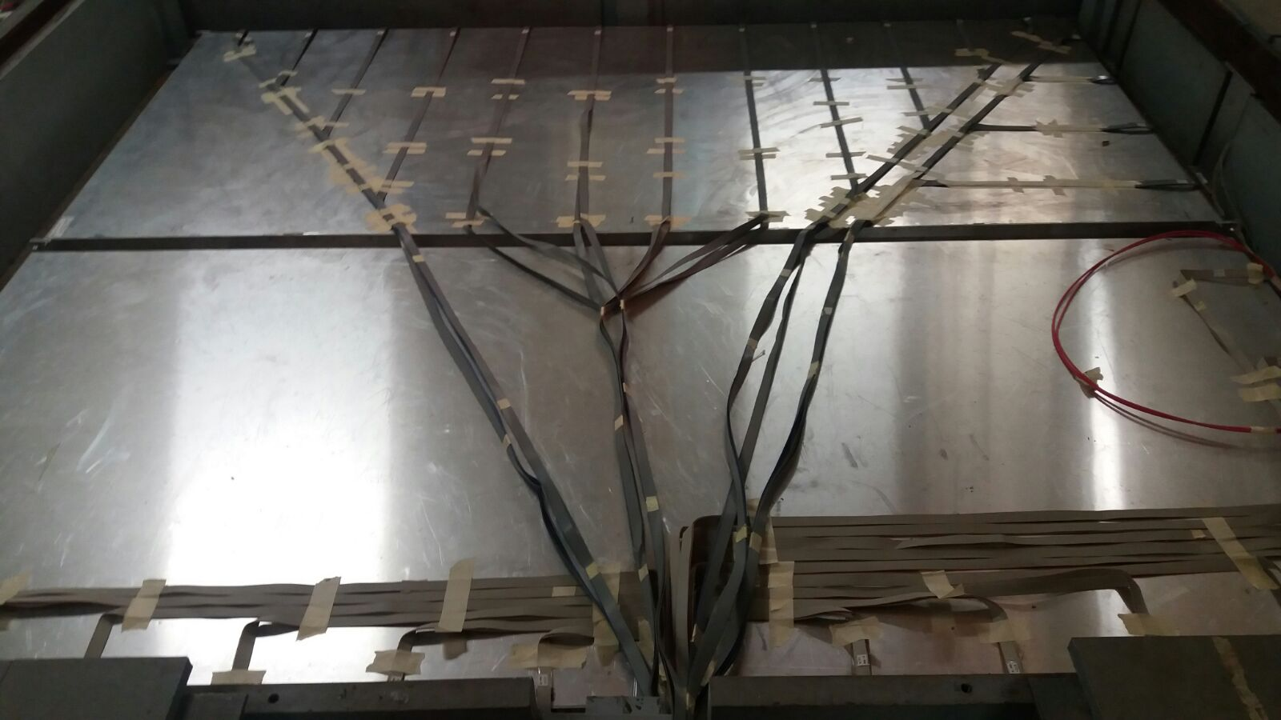
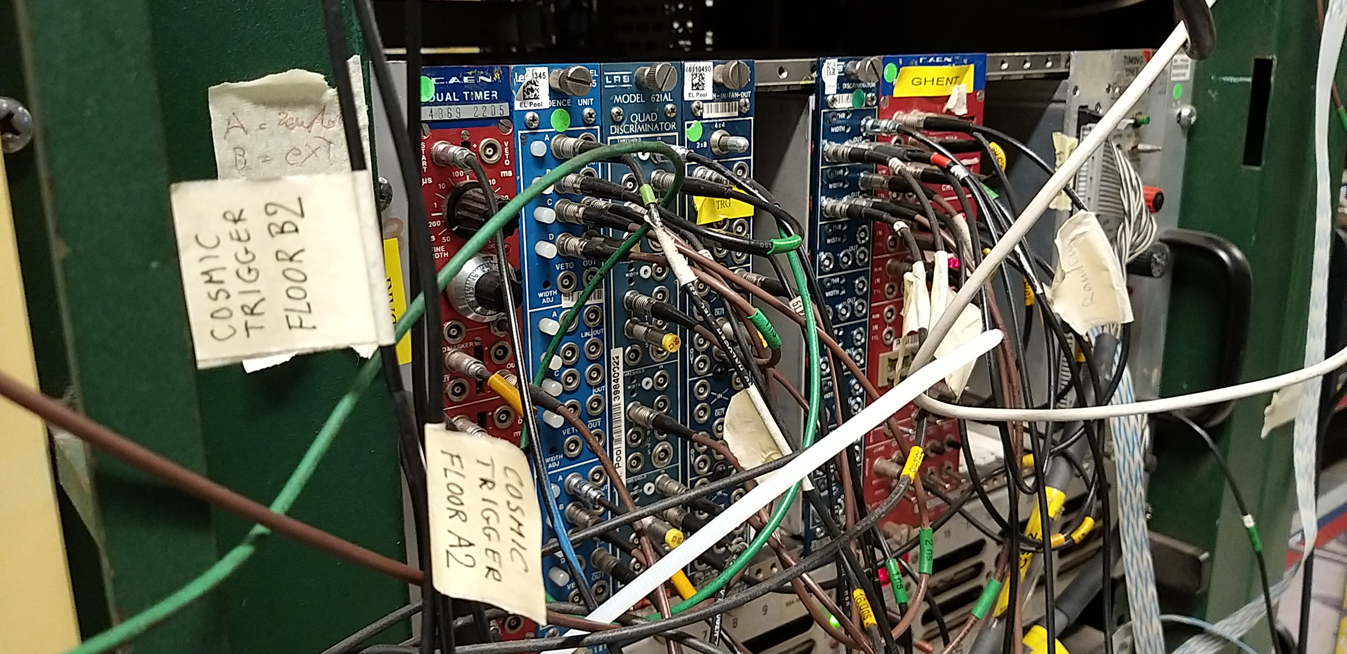
Cosmic tracker: bottom chambers
B2
Bottom chambers in place since years
High gap currents observed
Gas flow checked: ok
Further investigation needed
NIM crate with coincidence logic
between the two chamber layers
2 LEMO cables
Two trigger signals available
from central part of the chambers
Need additional crates with NIM modules
to provide trigger from entire chambers
A2

Slide 5
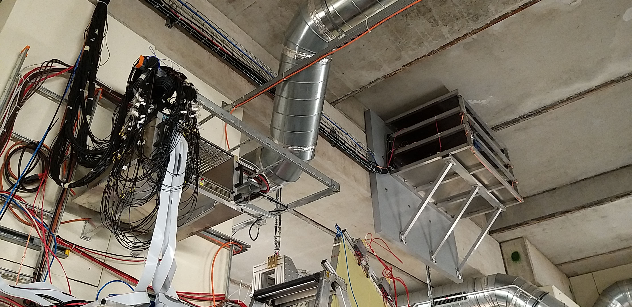
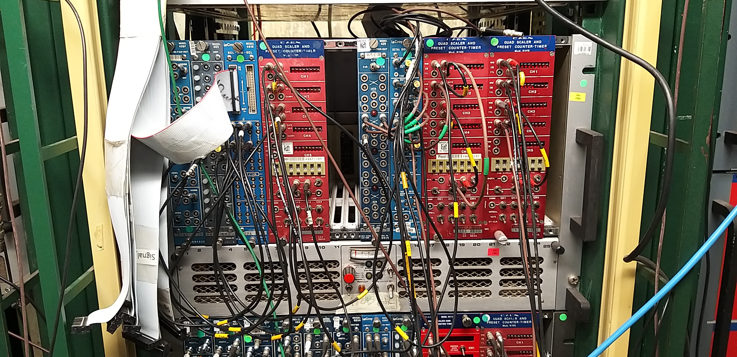
Cosmic tracker: top chambers
Discriminators in CAMAC crate
RPC roof chambers
Signals from RPC chambers discriminated in a crate inside the bunker
Electronics outside the bunker where
the trigger logics is being implemented
5

Slide 6
RPC chambers for tracker extension
Chamber status
4 chambers in Rome2
all gas volumes (16) with internal surface re-oiled at General Tecnica since last year
activity delayed by heavy renovation works of the lab
table for chamber re-assembling available again

Slide 7
Cosmic tracker: to do list
Bottom chambers
verify gas-volume functionality
complete electronics for trigger coverage when needed
Top chambers
check chamber signals in the service area
setup electronics implementing the trigger logic
External chambers
define position of upstream chambers
complete chamber refurbishment
plan shipping to CERN

