Slide 2
CERN Perspective on
Tape Technology Evolution
Vladimír Bahyl
CTA team
Notes:
How it is going to evolve , Roadmap and how How it is going to impact our operations

Slide 3
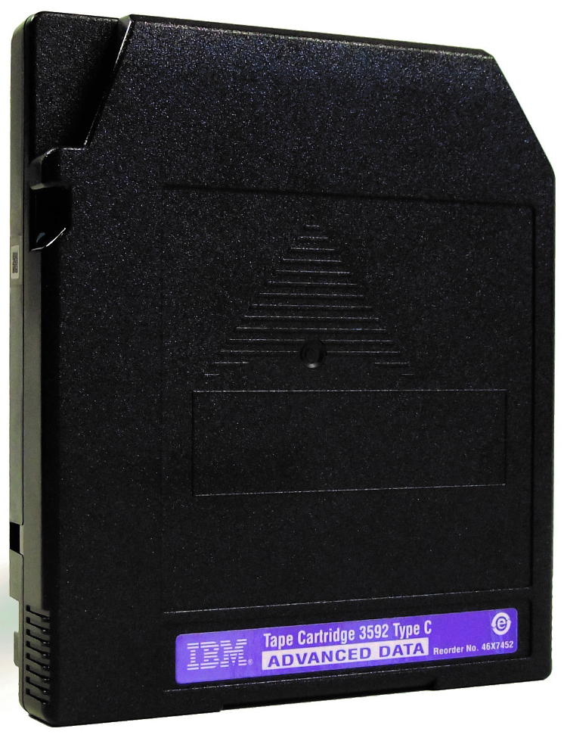
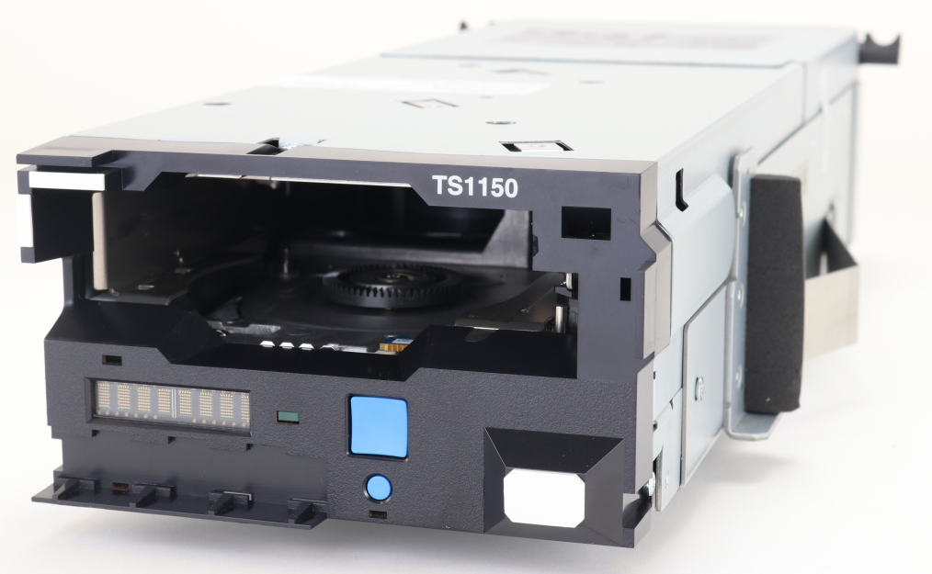
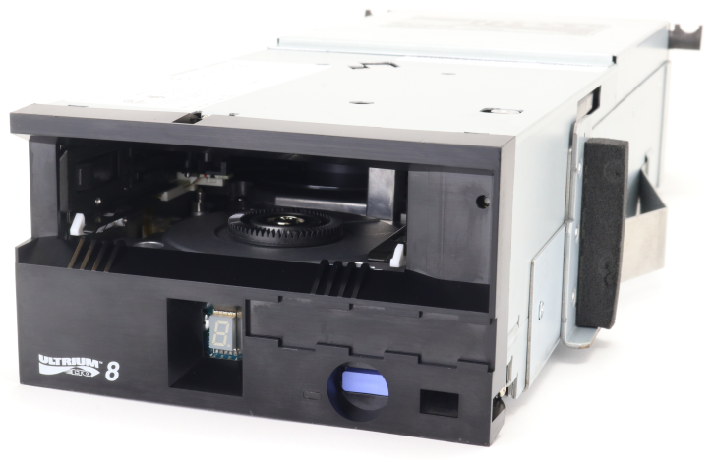
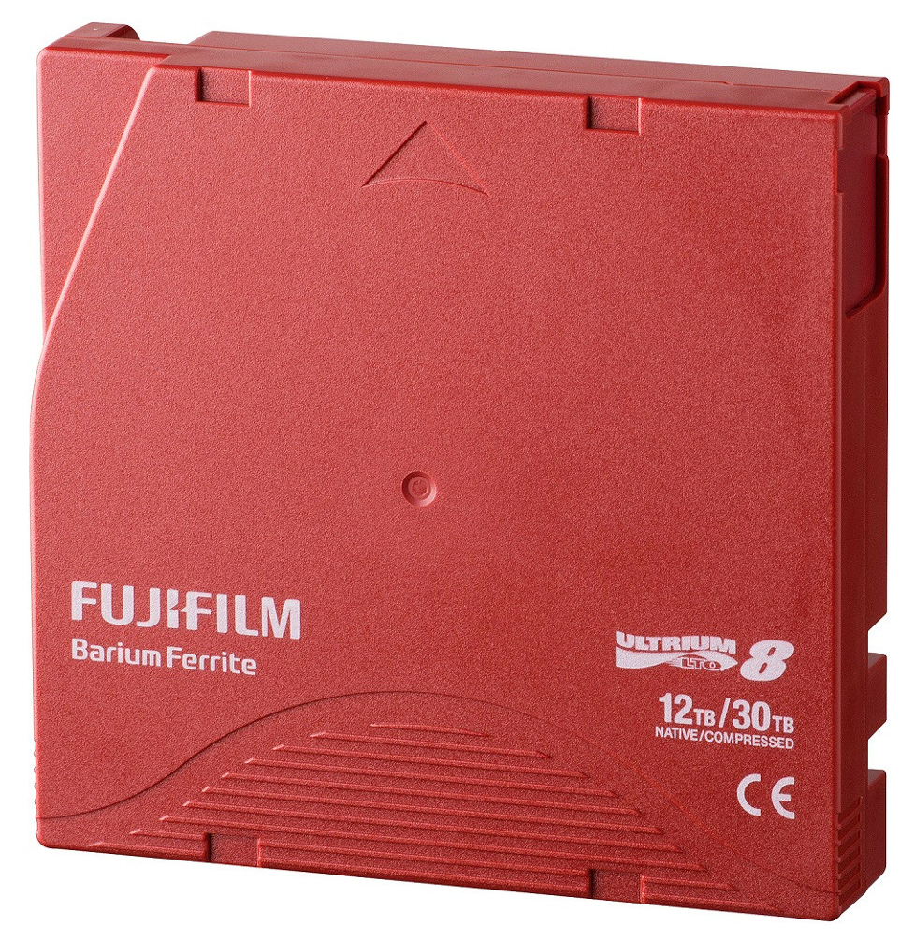
Overview of the tape technology 1/2
IBM TS11x0 enterprise
Proprietary
Higher capacity and throughput
Additional features, more robust
Manufacturers:
  Drives: IBM
  Media: Fujifilm
LTO (Linear Tape Open)
Consortium of HPE, IBM and Quantum
Focus on cost-effectiveness
Less features, less robust
Manufacturers:
  Drives: IBM
  Media: Fujifilm, Sony

Slide 4
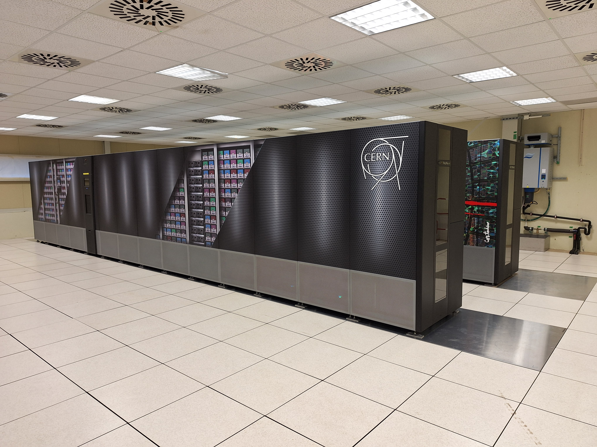
Overview of the tape technology 2/2
Tape libraries
<15 000 slots:
  IBM
  Spectra Logic
  Quantum
  BDT
>15 000 slots:
  IBM – TS4500
  Spectra Logic – TFinity Plus
OCP rack form factor:
  IBM – Diamondback
  Spectra Logic – Cube
  Quantum – Scalar i7 RAPTOR (?)

Slide 5
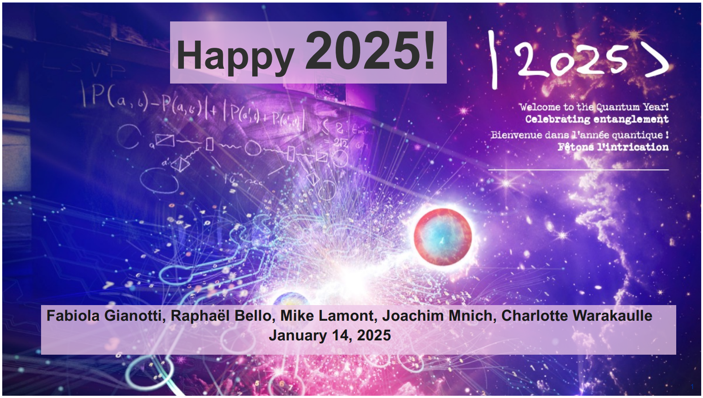
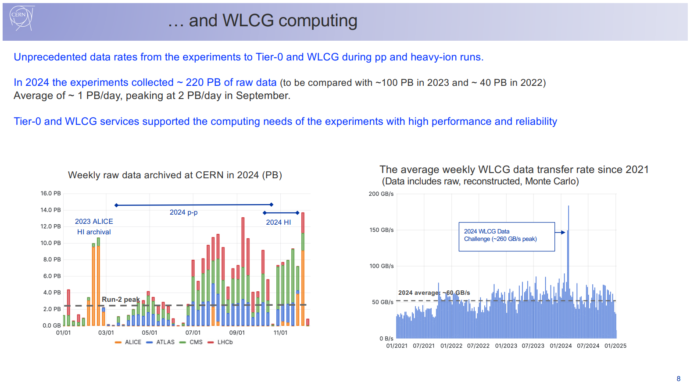
Tape data storage in the spotlight

Slide 6
Tape data storage is energy efficient
CERN Data Centre electricity consumption structure
Source: M. Schulz: CERN-IT Sustainability

Slide 7
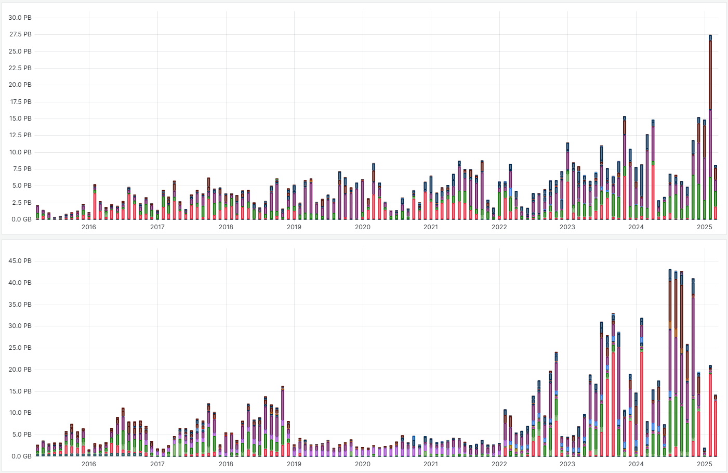
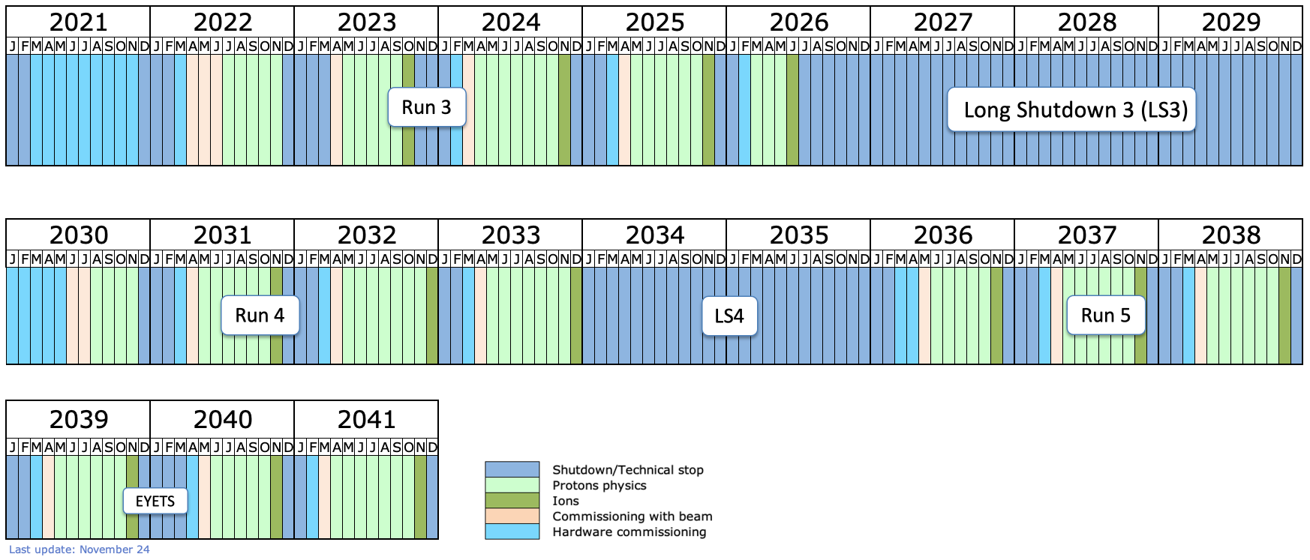
Monthly tape usage at CERN – past 10 years
READ
Constant upward READ trend
WRITE
Data taking period
Upgrading period

Slide 8


Tape Infrastructure – capacity (February 2025)
Archive of the physics
data
Provisioned capacity:
~1.25 EB
Backup of the business
data
Licensed capacity:
~15 PB

Slide 9


Tape Infrastructure – library slots (February 2025)
2 x IBM TS4500 – LTO
44362 slots
2 x IBM TS4500 – 3592
33876 slots
3 x TFinity – LTO
46800 slots

Slide 10
Tape Infrastructure – drives (February 2025)
Drives:
  40 x IBM TS1170
  46 x IBM TS1160
  88 x LTO-9
  10 x LTO-8
Drives:
  10 x LTO-9
  10 x LTO-8

Slide 11
Tape Infrastructure – media (February 2025)
Media:
  250 PB on 3592JF
  150 PB on 3592JE
  227 PB on 3592JD
  551 PB on LTO-9
  17 PB on LTO-8
  59 PB on LTO-7M
Media:
  12 PB on LTO-8
  11 PB on LTO-7M

Slide 12
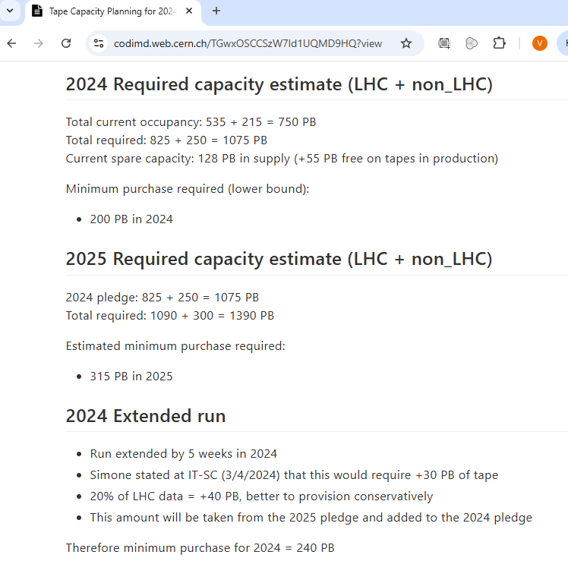
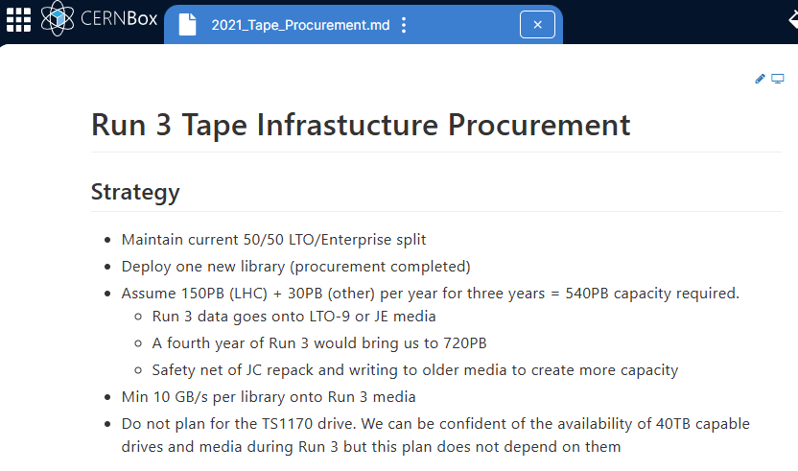
Evolution of the planing during Run 3
2021 – 180 PB/year planned for whole Run 3
2024 – 200 PB/year initially, but run extended
– 240 PB/year
2025 – 315 PB/year initially, but extra request
– 400 PB/year
Increase of more than 2x!
Notes:
Remove / simplify

Slide 13
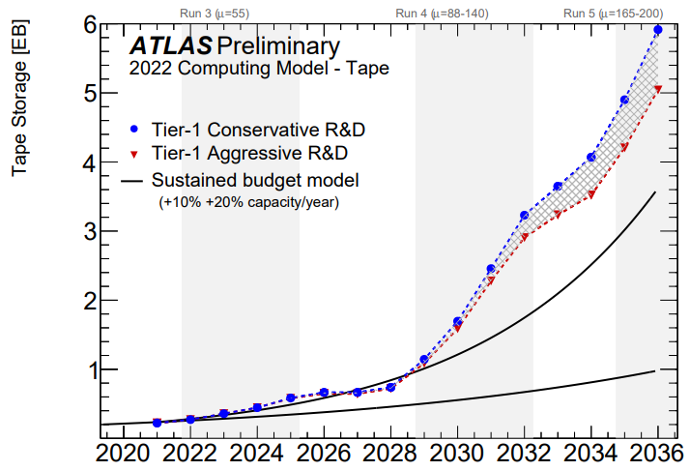
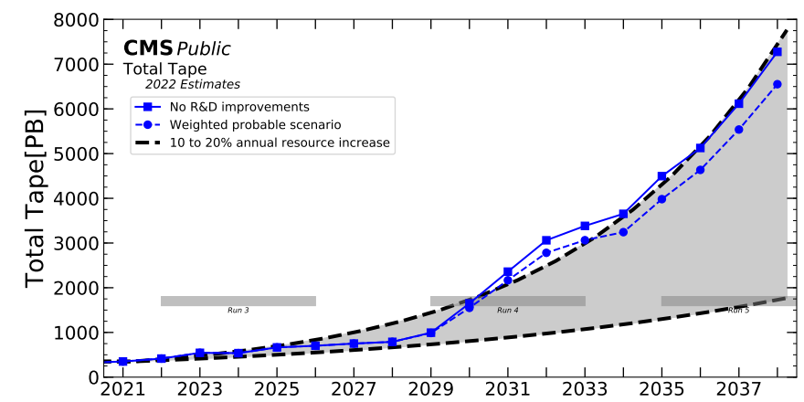
Archive Growth Projections after Run 3

Slide 14
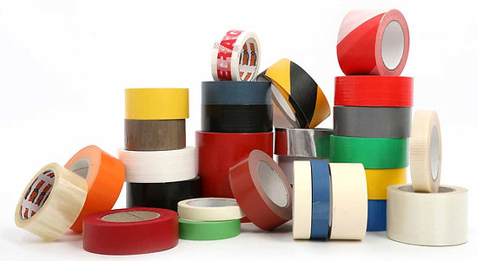
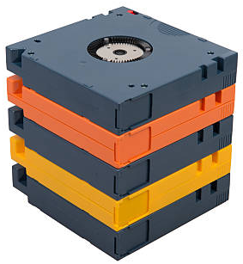
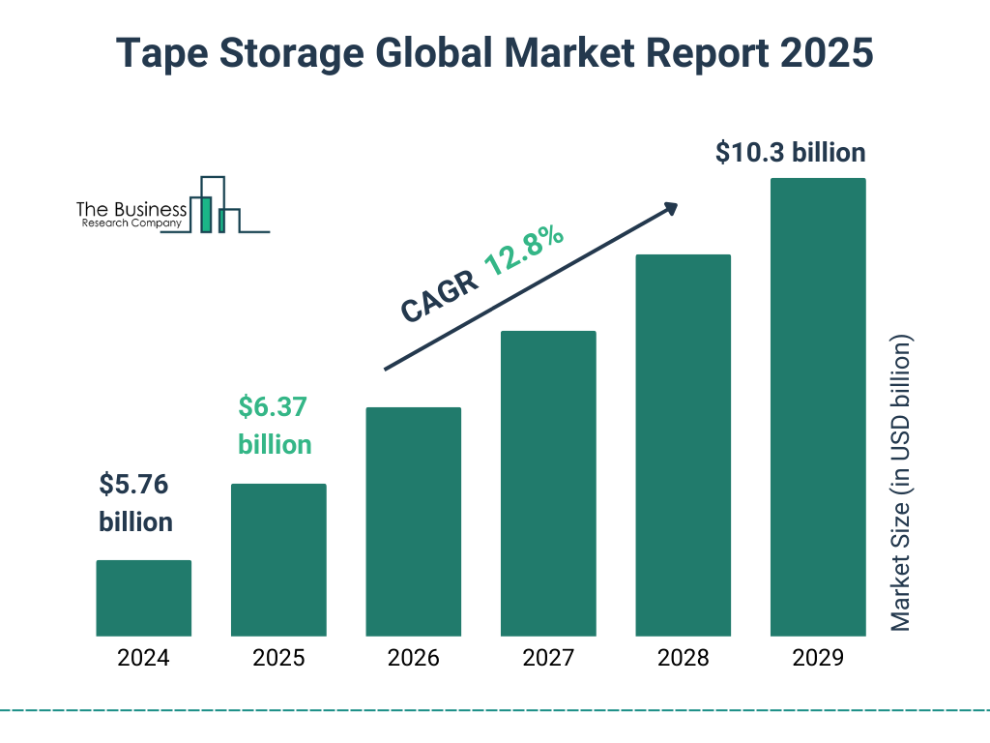
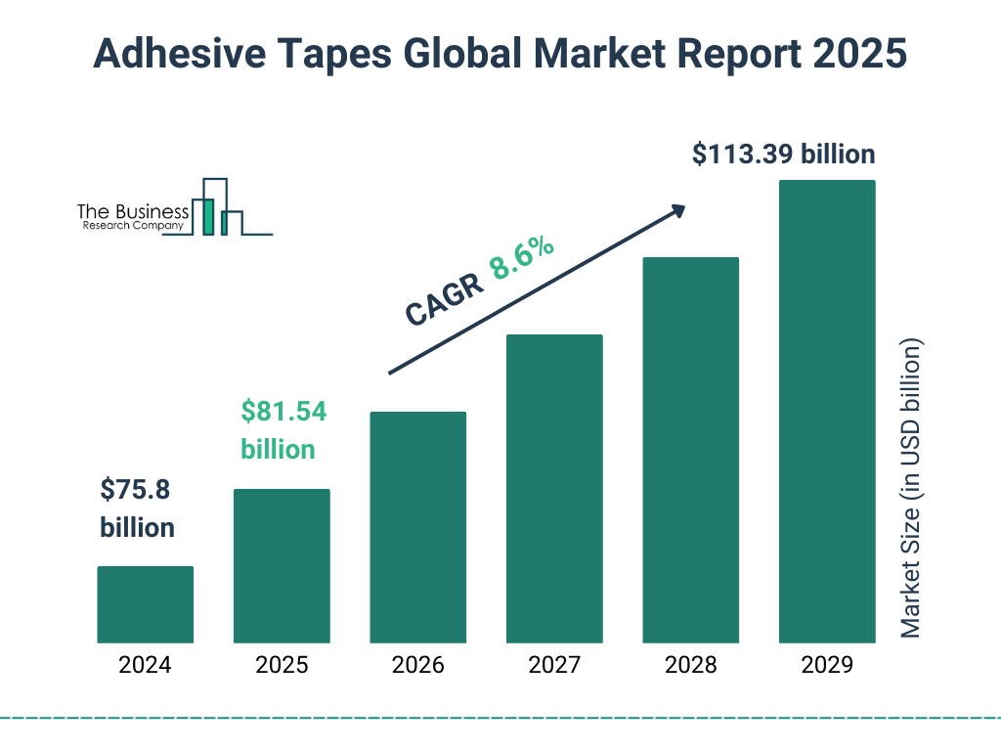
Market situation – size

Slide 15
Market situation – segments
Source: Physical Tape Trends & IBM Market Position, Carlos Sandoval (IBM WW Physical Tape Product Manager), 6 June 2023

Slide 16
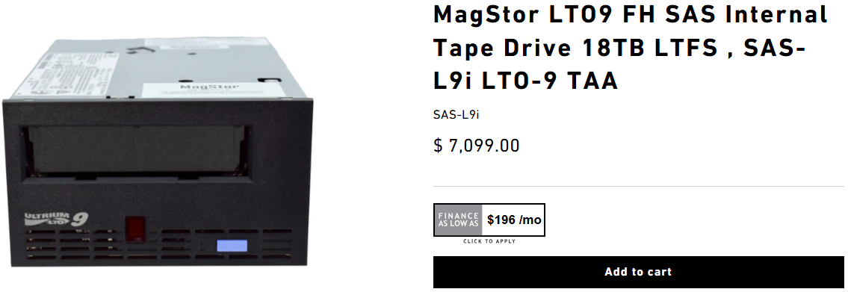
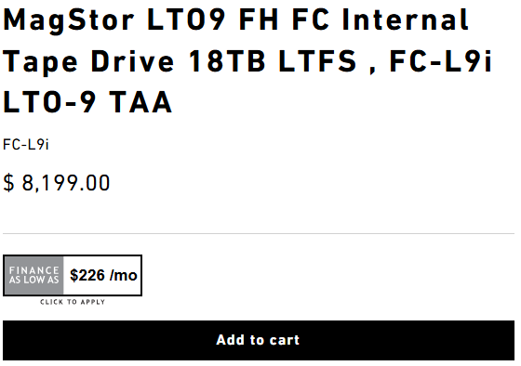
General (tape drive) trends and features
Focus on capacity growth = One kind of drive for one type of media
  No backwards compatibility (ability to read and/or write previous generation of media)
  No media upformating (possibility of reformating older media in newer tape drive at higher capacity)
SAS interface favored over the Fibre channel
  SAS drive ~12% cheaper but requires short (drive ↔ server) connections
  Savings offset by the need for additional rack (on top of each drive frame)
Absence of backwards compatibility forces us to keep the older drives for longer. These (old drives) occupy drive slots in the libraries preventing full rollout of new generation of tape technology as it becames available.
Absence of media upformating increases overall TCO of tape.
Fibre channel infrastructure at CERN (primarily optical cables) is amortized since a long time. We are moving to use multiple drives per server = need for smaller number of multiport FC HBAs.
Our overall costs are not dominated by the tape drive price. CTA does not need a FC switch.

Slide 17
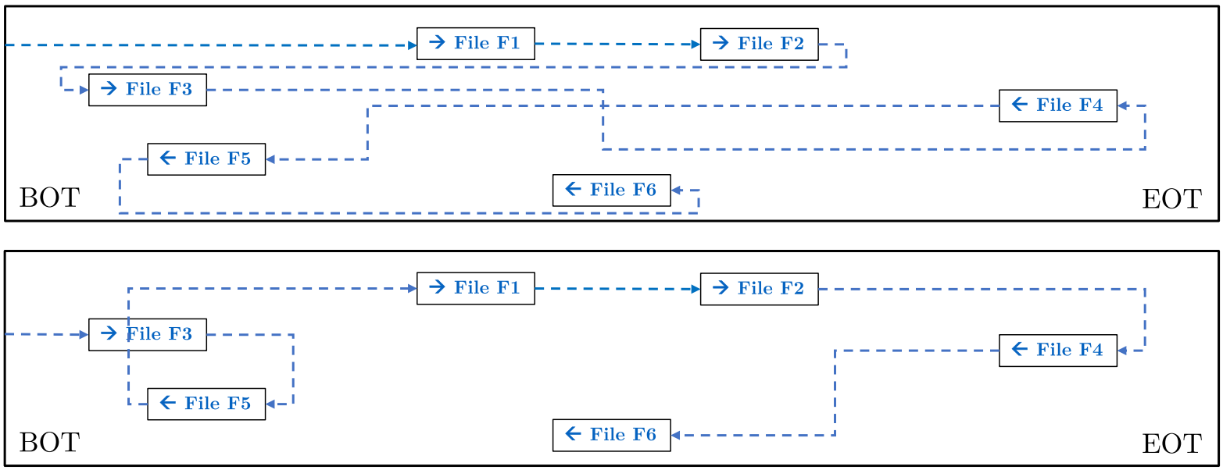
Recommended access order (RAO)
Over 1000 meters
12.65 mm
Source: https://doi.org/10.1145/3708997
Application can ask the tape drive for the best order / way to recall multiple files.
Significant gains in overall transfer rates by minimizing the positioning time between the files.
Now available for both LTO and IBM TS11x0 technologies.

Slide 18
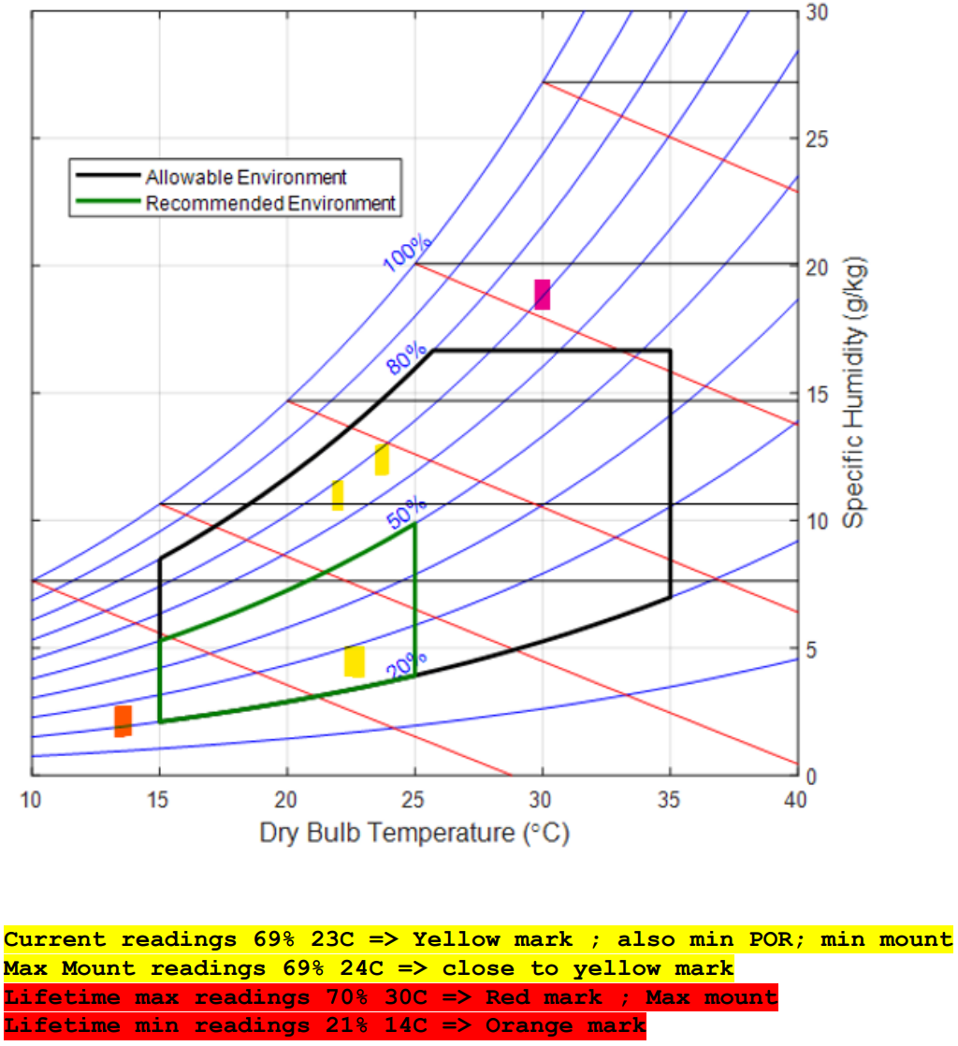
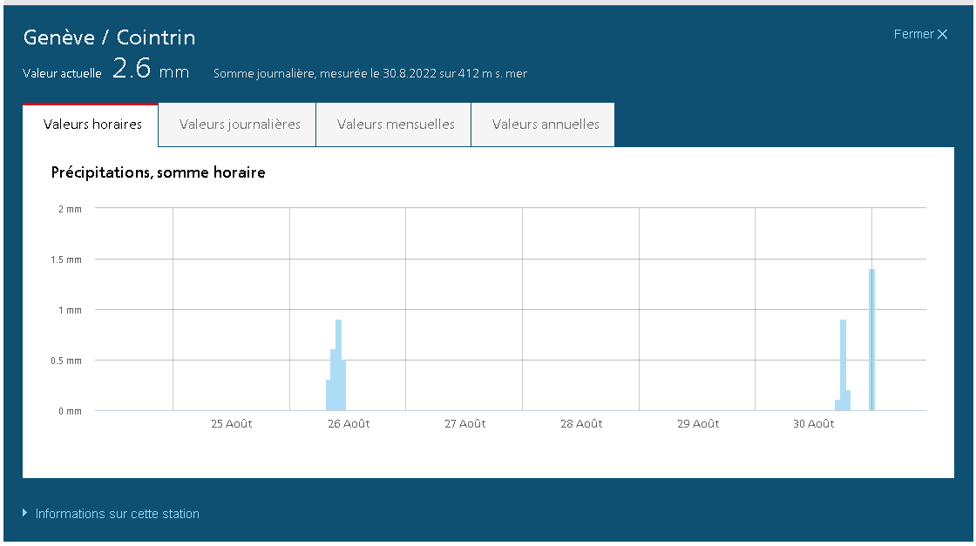
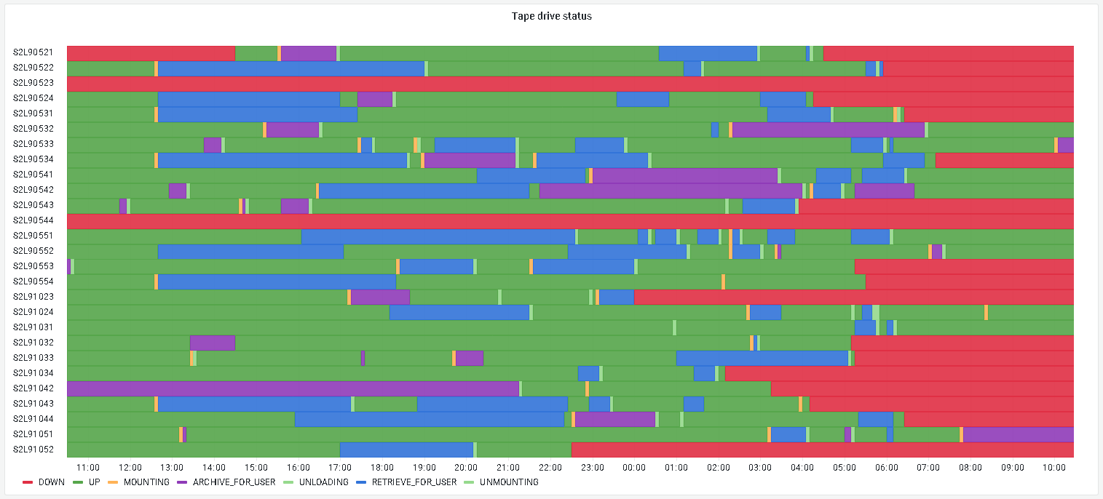
Sensitive to humidity
In case of high humidity a tape alert is triggered.
CTA is designed to refuse a WRITE session in case the drive reports any tape alert = is not 100% fit.
Monitoring will take the drive out of production.

Slide 19
New cartridges not ready for immediate use
Initialization of each new LTO9 tape cartridge takes around 50 minutes = blocking tape drive(s).

Slide 20
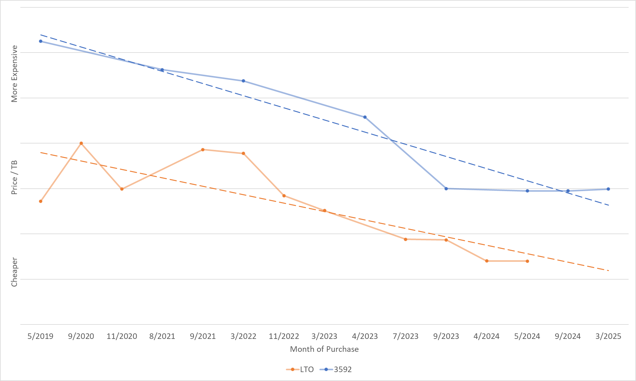
Tape media price trends evolve
Overall tape infrastructure costs at CERN are primarily dominated by the price of tape cartridges.
IBM TS11x0 / 3592 technology cartridges offer ~twice the storage density but it is ~twice as expensive as LTO.
IBM 3592
LTO

Slide 21
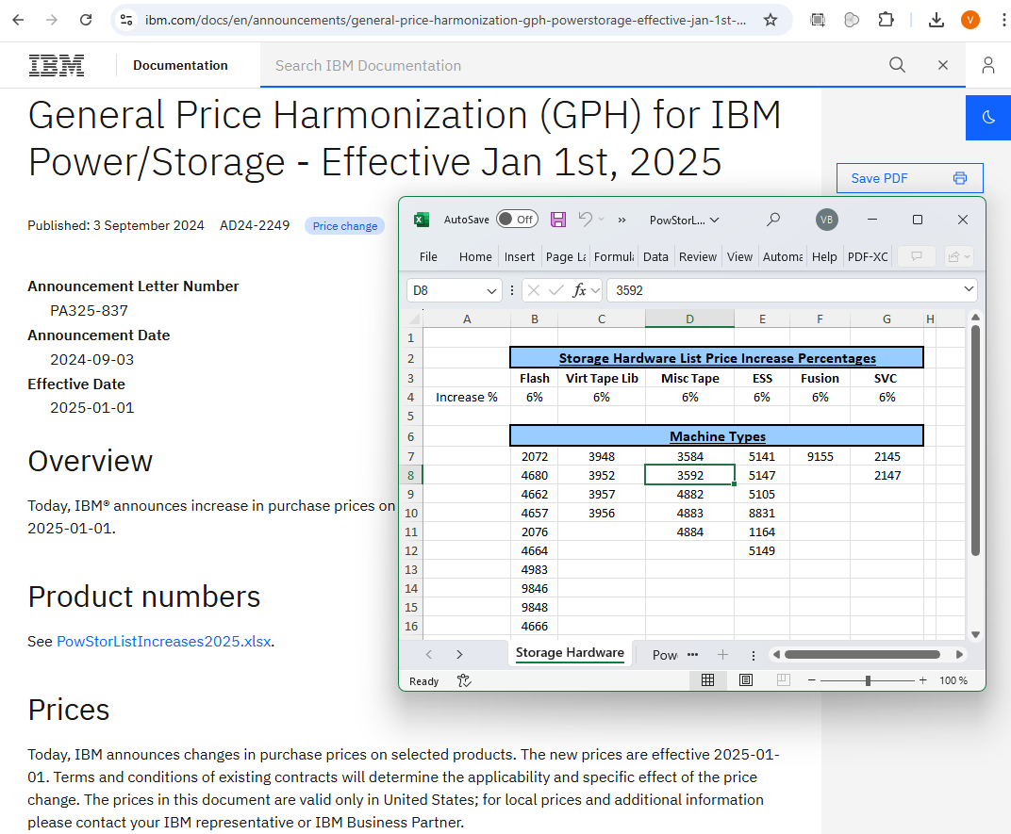
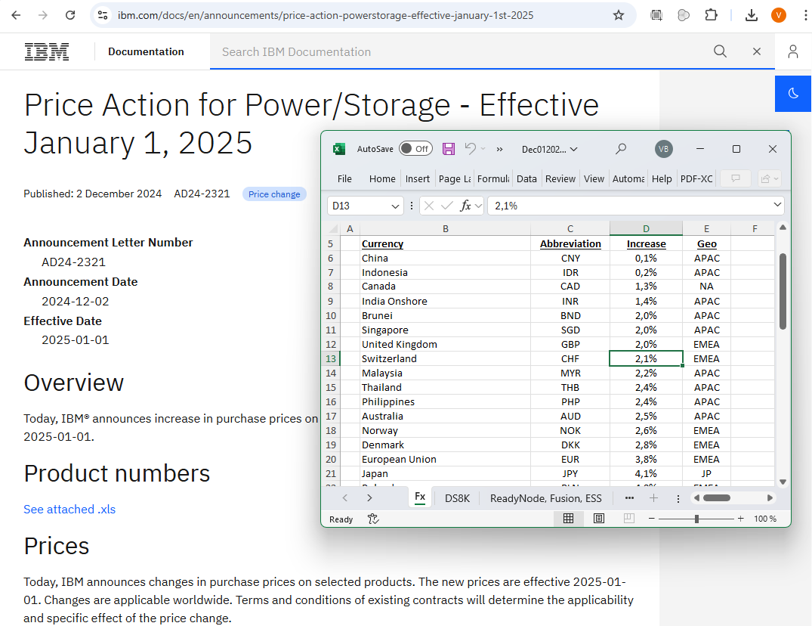
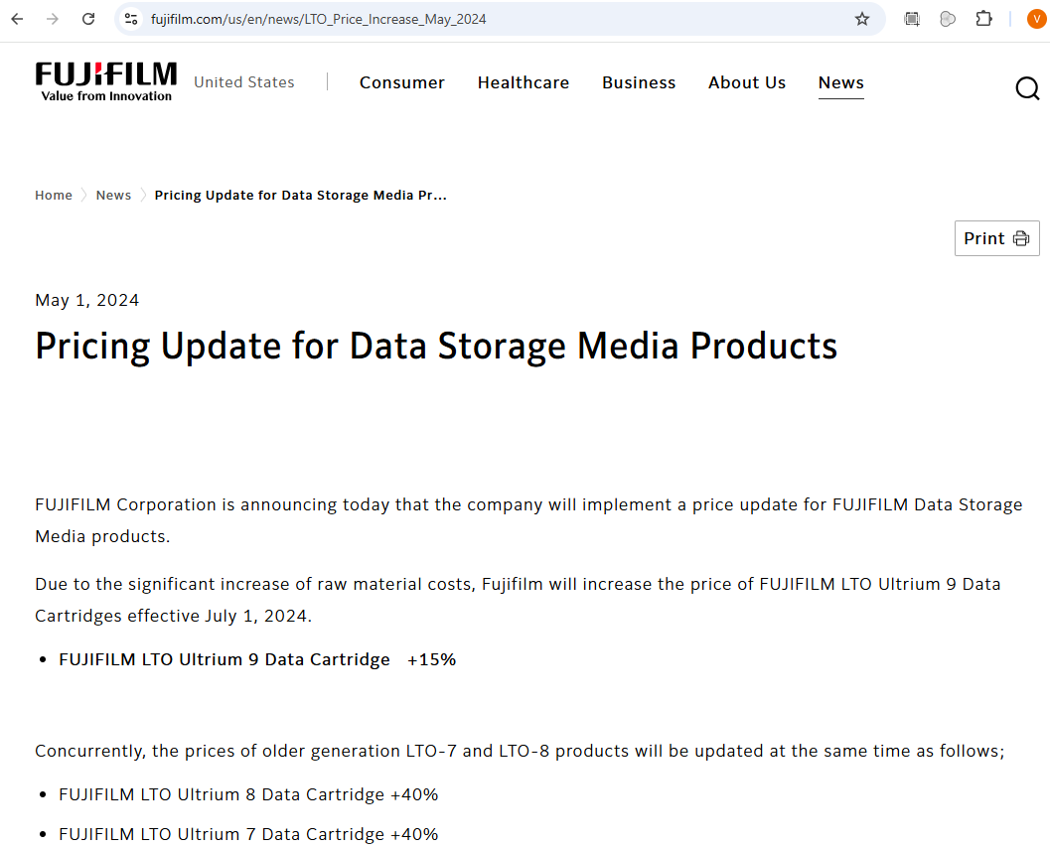
Tape media price increases
1 January 2025
IBM
3592 +6%
1 January 2025
IBM
CHF +2.1%
EUR +2.8%
1 May 2024
FUJIFILM
LTO9 +15%

Slide 22
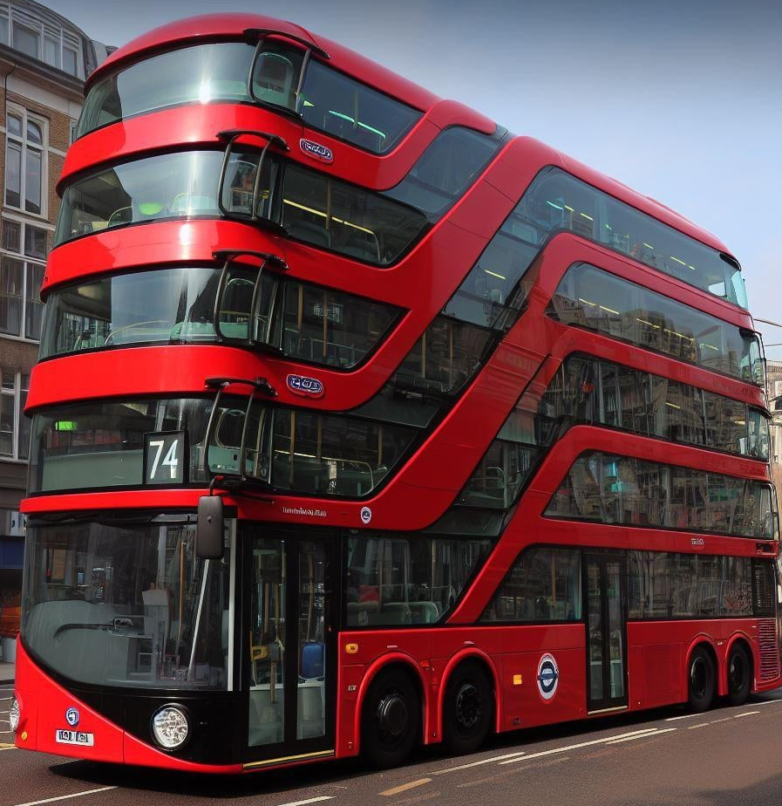
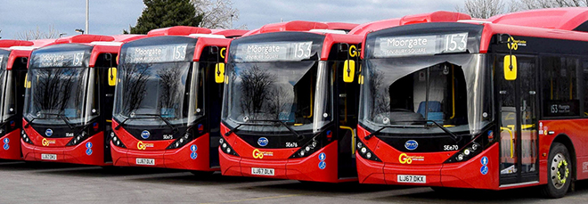
Scale UP vs. Scale OUT approach
Scale UP
Scale OUT

Slide 23
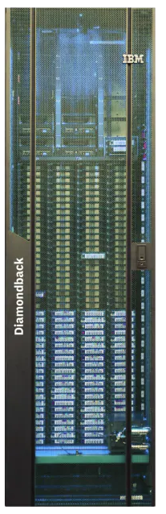
Tape libraries trends
  Non-standard (proprietary) form factor; Clearance around required
  Usually delivered empty, need to add drives and media later
  Flexible / higher cartridge to drive ratio
  Adding frames / capacity requires complete downtime of the library for several days
  Redundant complex robotics
  Serviced primarily by the vendor
  Open Compute Project (OCP) rack form factor; Simple clearance
  Usually delivered fully equipped = supposedly faster to deploy
  Range of slot to drive ratio: 1548:14 = ~110:1
  Danger of bottleneck if load not equally spread
  Adding more capacity / frames does not require downtime (alignment) of the other frames
  Not redundant simple robotics, purchased with each frame
  Easy to service by customer or the vendor
Tape libraries take months to purchase, deliver, install, connect and equip. That is why we plan well ahead.
We purchase fully sizes libraries (to avoid adding more frames) but with only minimal license. Adding more capacity does not require downtime.
Buy not purchasing many new tape cartridges upfront, we benefit from declining price trend.
Slot to drive ratio at CERN is around 330:1. Freedom to mount any cartridge in any drive.
We have manpower to move cartridges around, but not to service tape libraries.
In 2023 – comparing both solutions for equal number of cartridge slots, the multiple robotics (even if simple) make the rack like tape library more expensive.
We need to gain more experience with OCP rack like tape library.
Scale UP
Scale OUT

Slide 24
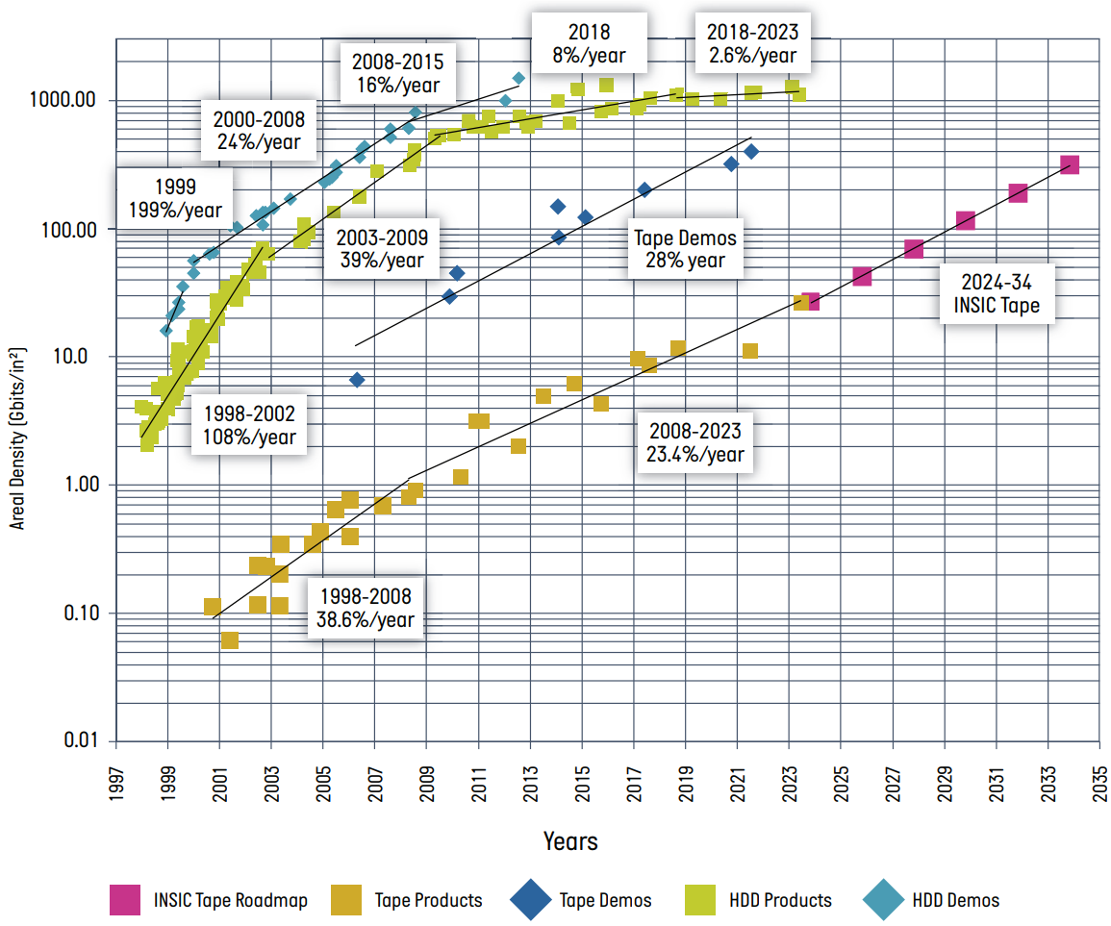

Technology predictions – INSIC tape roadmap
International Magnetic Tape
Storage Technology Roadmap
  Published March 2024
  https://insic.org/roadmap/
Members:
  IBM, HPE, Quantum, Oracle
  Fujifilm, Sony
  Western Digital

Slide 25
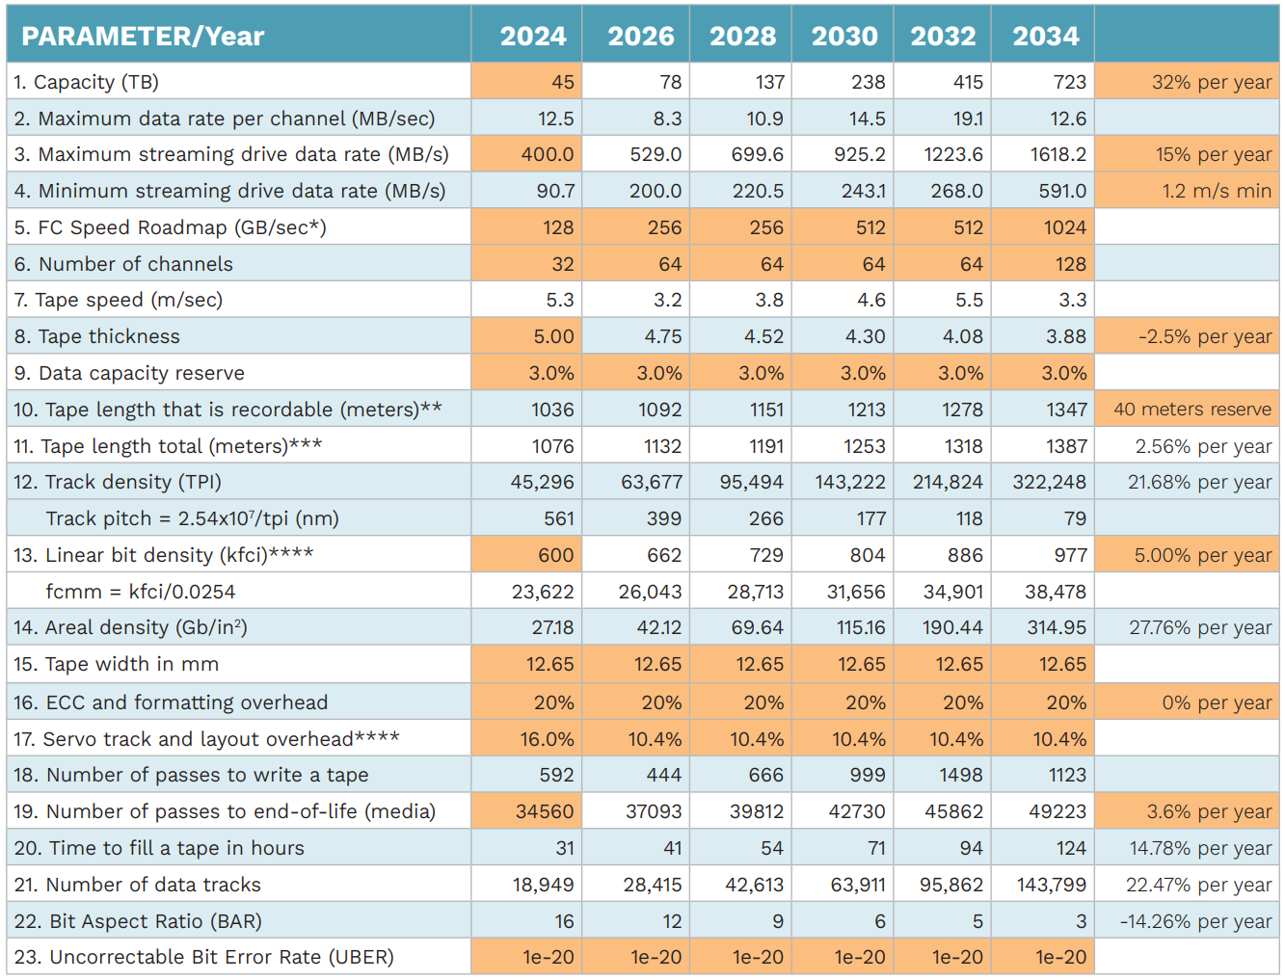
Technology predictions – INSIC tape roadmap
Notes:
Make the line more visible, extract relevant slides.
Plot the numbers into a graph.
Separate graphs, title willl be the text.

Slide 26
No change of the cartridge form factor
Cartridge form factor is not expected to change:
Tape width stable at 12.65 mm
2.5% gains in the tape thickness decrease allows for addition of 2.56% more tape into the cartridge per year
= Library cartridge slots stay the same
Notes:
Make the line more visible, extract relevant slides.
Plot the numbers into a graph.
Separate graphs, title willl be the text.

Slide 27
Exponential capacity growth
Cartridge capacity is expected to ~double with every generation. It will increase (on average) 50% faster than the transfer rates.
It means that time to fill a cartridge will also increase (more than double).
Recovering empty space after data deletion will be taking days and occupying 2 drives.
Notes:
The time to fill a tape considers the best possible theoretical transfer rates.
Reality will be much worse (because of the wraps).

Slide 28
Throughput to increase only 15% per year
By ~2030 streaming throughput of ~1 GB/s per tape drive is required.
If the (disk) storage / buffer system can not provide at least 200 MB/s per stream to the tape drive, the drive will stop and wait until the internal memory is filled. This significantly lowers the overall thrroughput.
Increase in the number of channels is the primary reason for transfer rate increase.
Physical tape speed fluctuates = initially decreases as number of channels increases.

Slide 29
Stable End-Of-Life Uncorrectable Bit Error Rate
UBER of 1e-20 = one error per 12.5 Exabytes Read
Therefore, in the 2024 Roadmap, we take the current state-of-the-art EOL UBER of 1e-20 as the starting point and project a constant error rate in the future. At the 45 TB cartridge capacity assumed at the start of the 2024 Roadmap, on average, only one out of 277,777 tape cartridges will contain an uncorrectable error event due to ECC failure.
For the projected 723 TB cartridge capacity in 2034, an EOL UBER of 1e-20 corresponds to one uncorrectable error event in 17,296 cartridges.

Slide 30
Conclusions
For large quantities of data, tape is the best currently-available technology for archival storage, in terms of cost, reliability, stability over long periods of time
  Solid roadmap for the next decade
CERN is investing in the tape technology as its primary archival storage medium for LHC Run–3 (2022–2026) and HiLumi LHC (2029–2032)
  Exponential capacity growth pattern matches expected HiLumi LHC requirements
Product offering is dominated by few vendors
  Monopoly on the tape drive manufacturing
  Duopoly on the tape media manufacturing
Overall market is dominated by hyperscalers that push vendors to focus on their requirements
  We (HEP community) have very little leverage to steer the development, instead, we need to adopt
Absence of crucial features such as backwards compatibility and media upformating has significant operational impact
(data migrations will take longer, more drive slots = less space for cartridges, increased TCO)
LTO and IBM TS11x0 technologies have very similar feature set
  The capacity difference does not justify the ~2x cost gap
  As things stand now, it is unlikely that CERN will purchase IBM TS11x0 tape library in the future
Recent price increases make tape technology less competitive

Slide 31

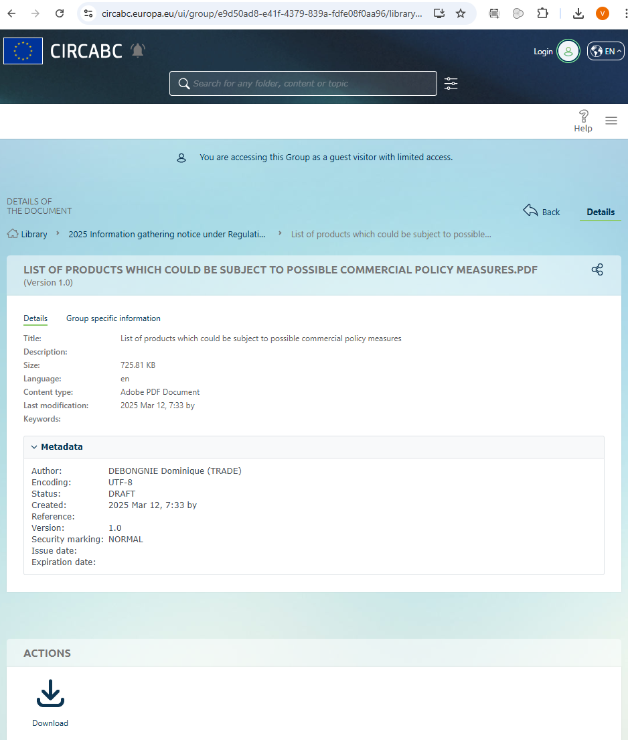
Tariffs on the tape equipment?

Slide 32
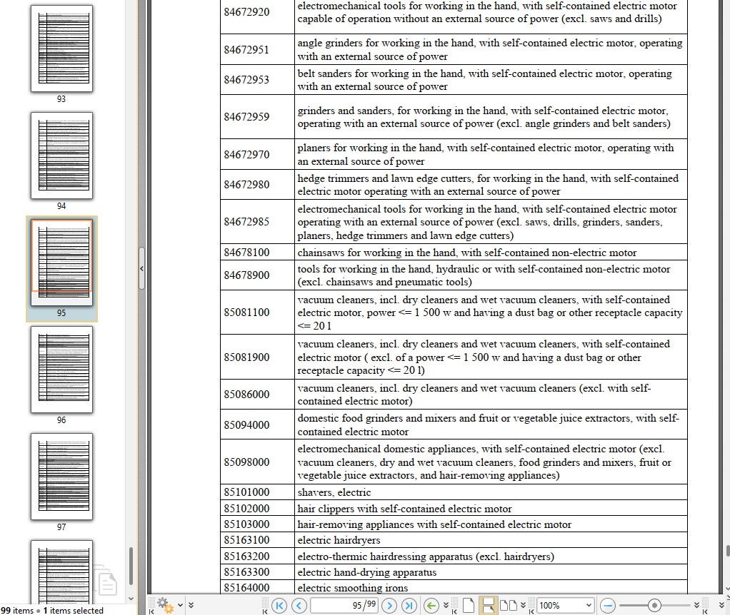
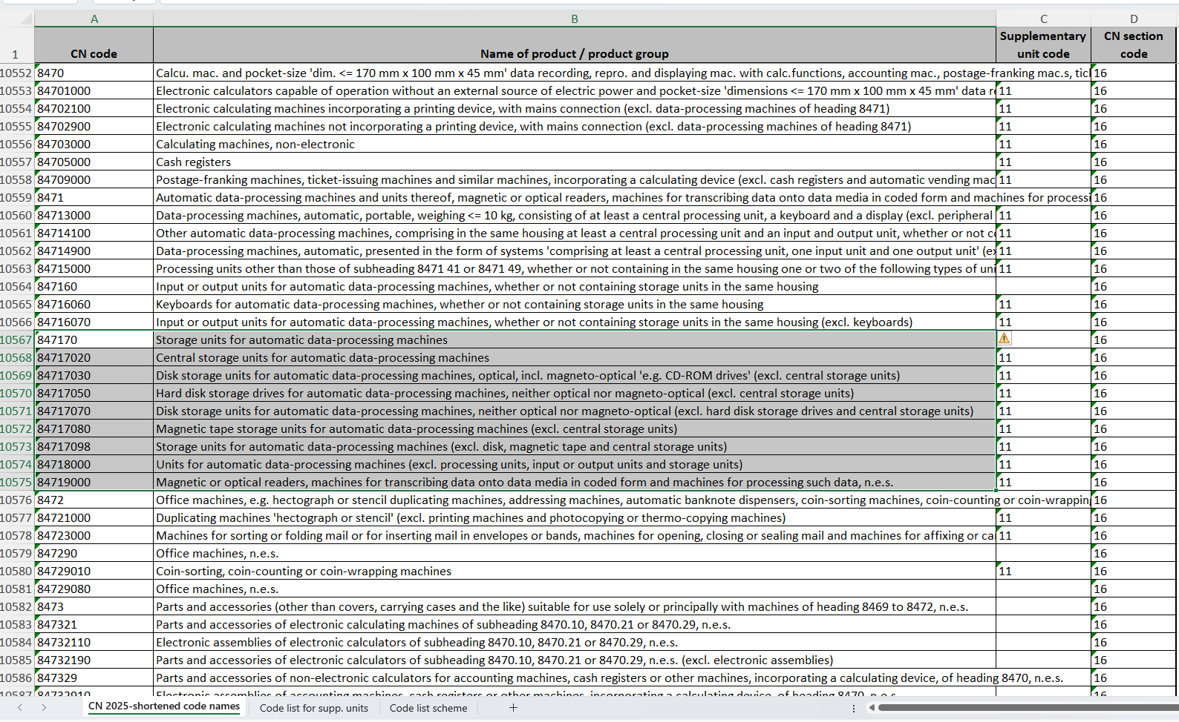
Tariffs on the tape equipment? – not for now
List of products which could be subject to possible commercial policy measures
Customs codes of all products
Storage units not included
Notes:
Left = document with items selected for tariffs
Right = document with all customs tariff codes
Storage units are excluded

