Slide 1
Managing Microsoft SQL Infrastructure at CERN
Ricardo Martins Gonçalves
HEPiX | April 2025

Slide 2
Team
IT
CD – Computer Devices
DPP – Device Provisioning and Productivity
Windows Servers/Infrastructure
Active Directory
Terminal Services
…
Microsoft SQL Server (MSSQL)

Slide 3
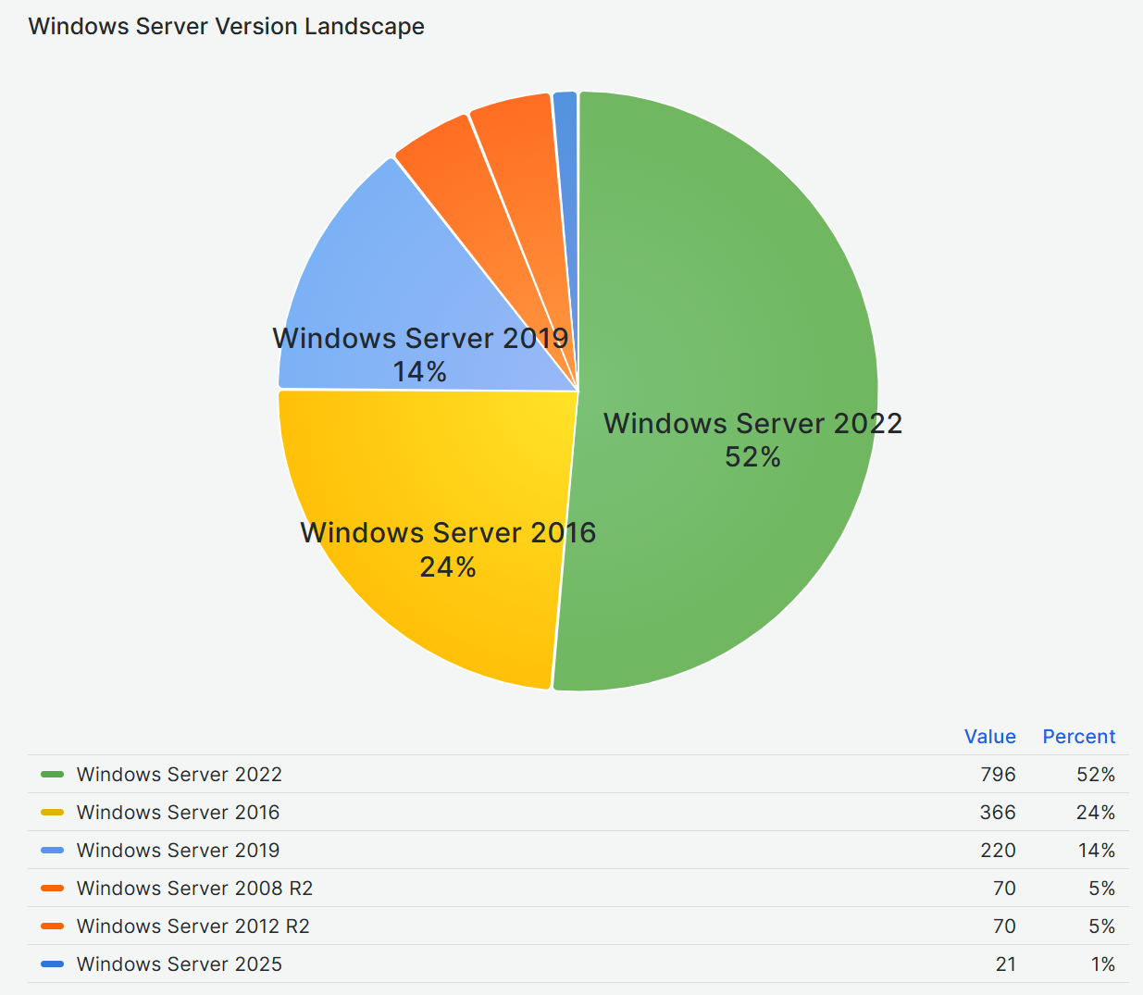
CERN Machines
Over 10000 Windows Devices
Over 1500 Windows Servers
Different Extensive range of applications and use cases
Several Relational Database Management Systems (RDBMS)
  ORACLE
  MySQL
  PostgreSQL
  MSSQL

Slide 4
MSSQL Editions
Enterprise
  Unlimited Cores, RAM, high scalability
  Always On Availability Groups
Standard
Developer*
Express edition*
*free editions

Slide 5
Reason for using MSSQL
Historical
Performance
Scalability
Seamless Integration with MS Tools
Active Directory Integration
Enterprise-Level Support

Slide 6
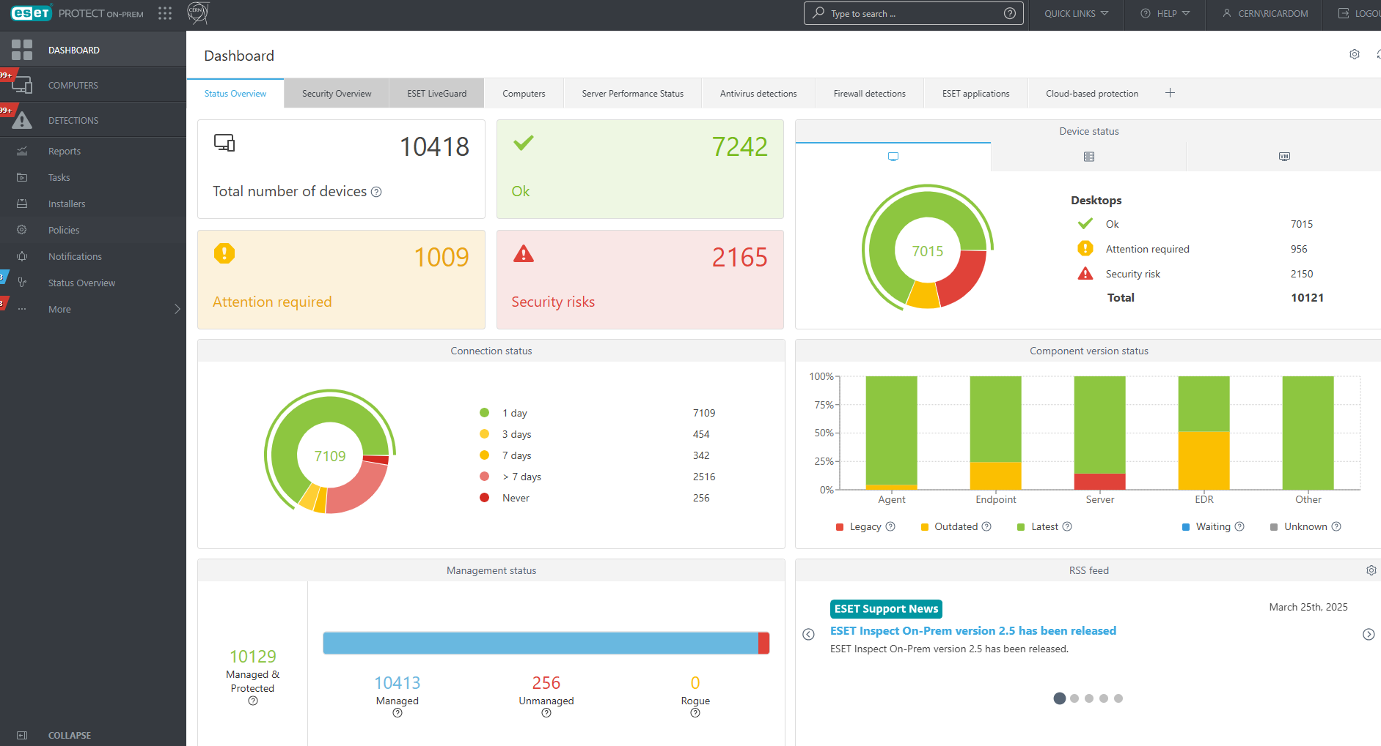
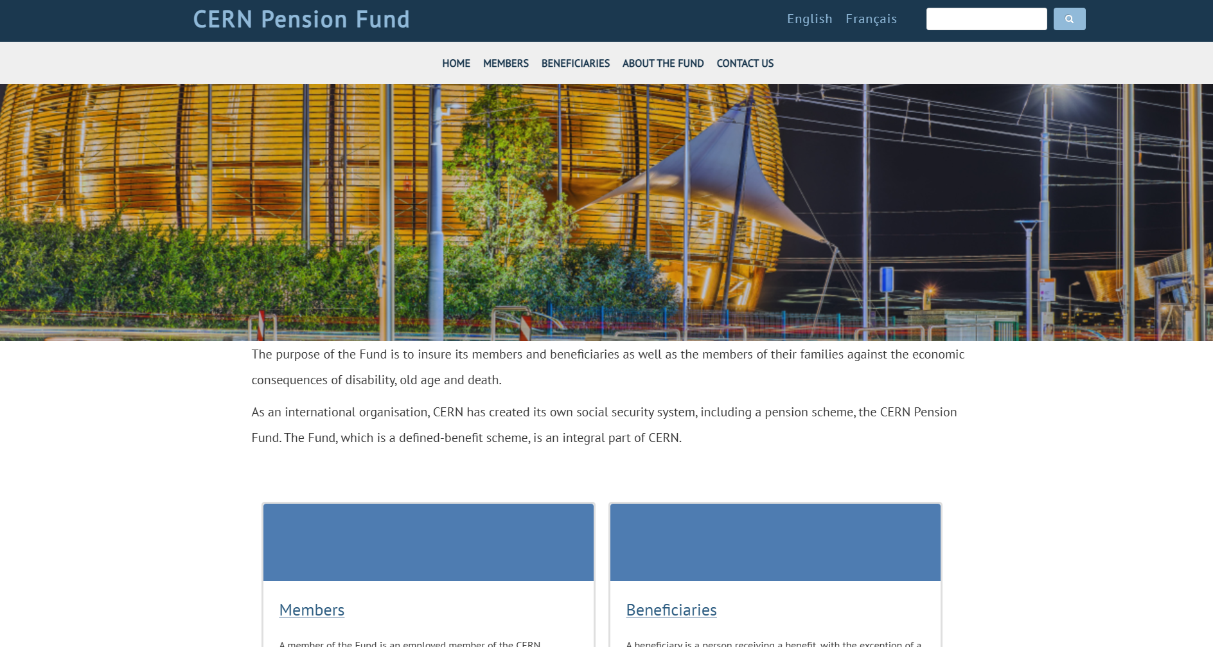
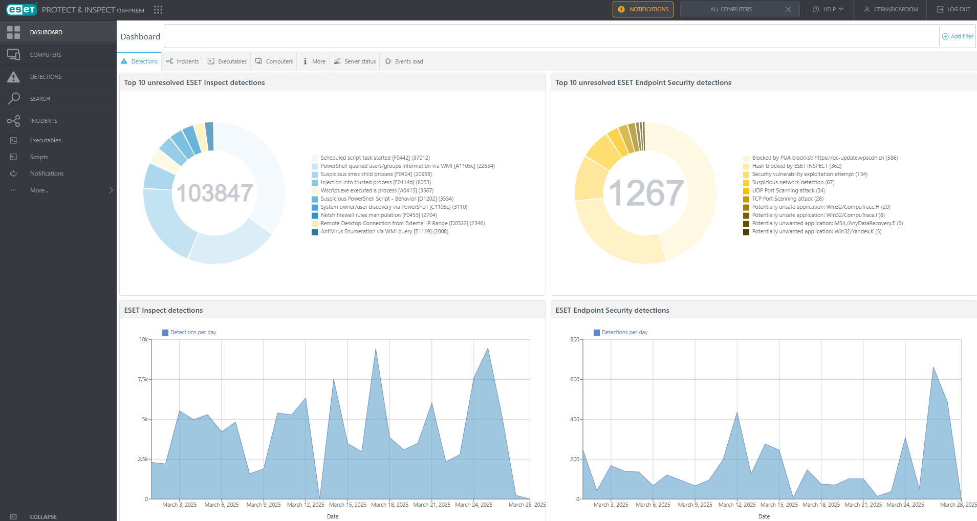

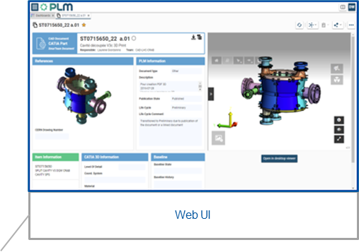
Reason for using MSSQL II – Hard Dependencies

Slide 7

Infrastructure
Clusters and single nodes
Databases in the same instance (alias)
Backups with IBM Tivoli Storage Manager (TSM)
  Integrity test on all our backups
    Verify backup when finished
    Perform checksum before writing to media
  High Availability

Slide 8
High Availability
Replication (Tables, Views, SP, etc)
  No automatic failover
Log Shipping
  Copy and uses transaction logs to update other DBs at scheduled intervals
  Overhead
Mirroring (Deprecated) (Copy of the DB and warm standby)
  No possibility of reading the secondary replica
Always-on Failover Clustering
  Entire Server Instance
  Requires Shared Storage
Always-on availability groups
  Automatic failovers between replicas
  Possibility of reading the secondary replica
  Possibility of adding DB separately
  Each machine has its own storage

Slide 9
Managing MSSQL Servers
Install, Update and Config
  Puppet
  Active Directory (GPOs)
  CMF
Monitoring
  Icinga
    Alarms: CPU load, Disk Space, RAM, Last Boot, Updates, SSL Certificates, etc
  Telegraf, InfluxDB and Grafana
  NxLog

Slide 10
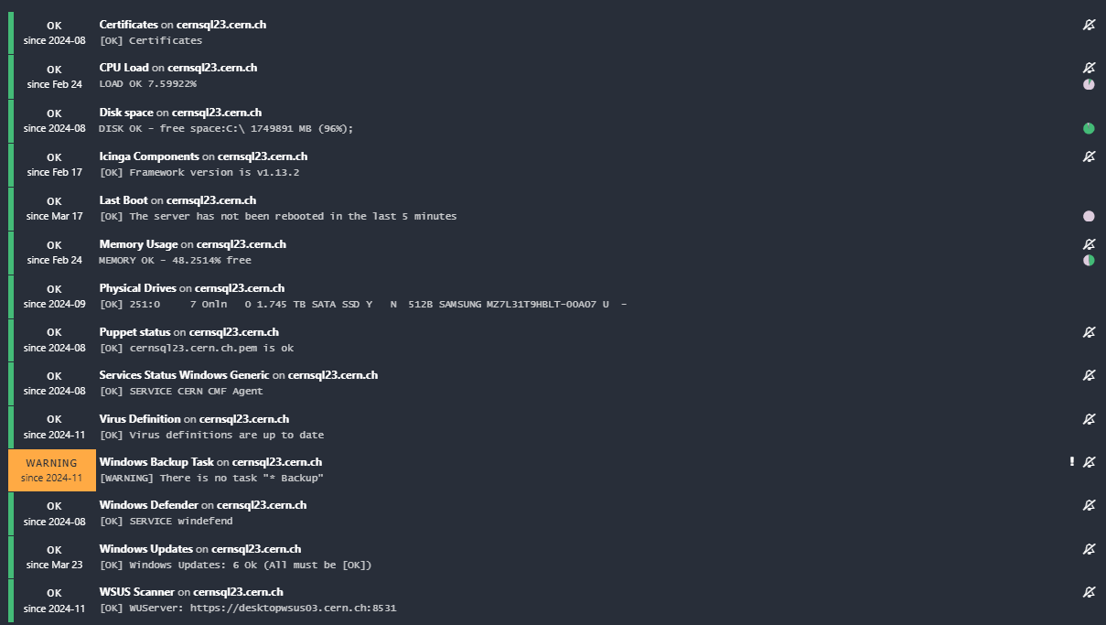
ICINGA

Slide 11
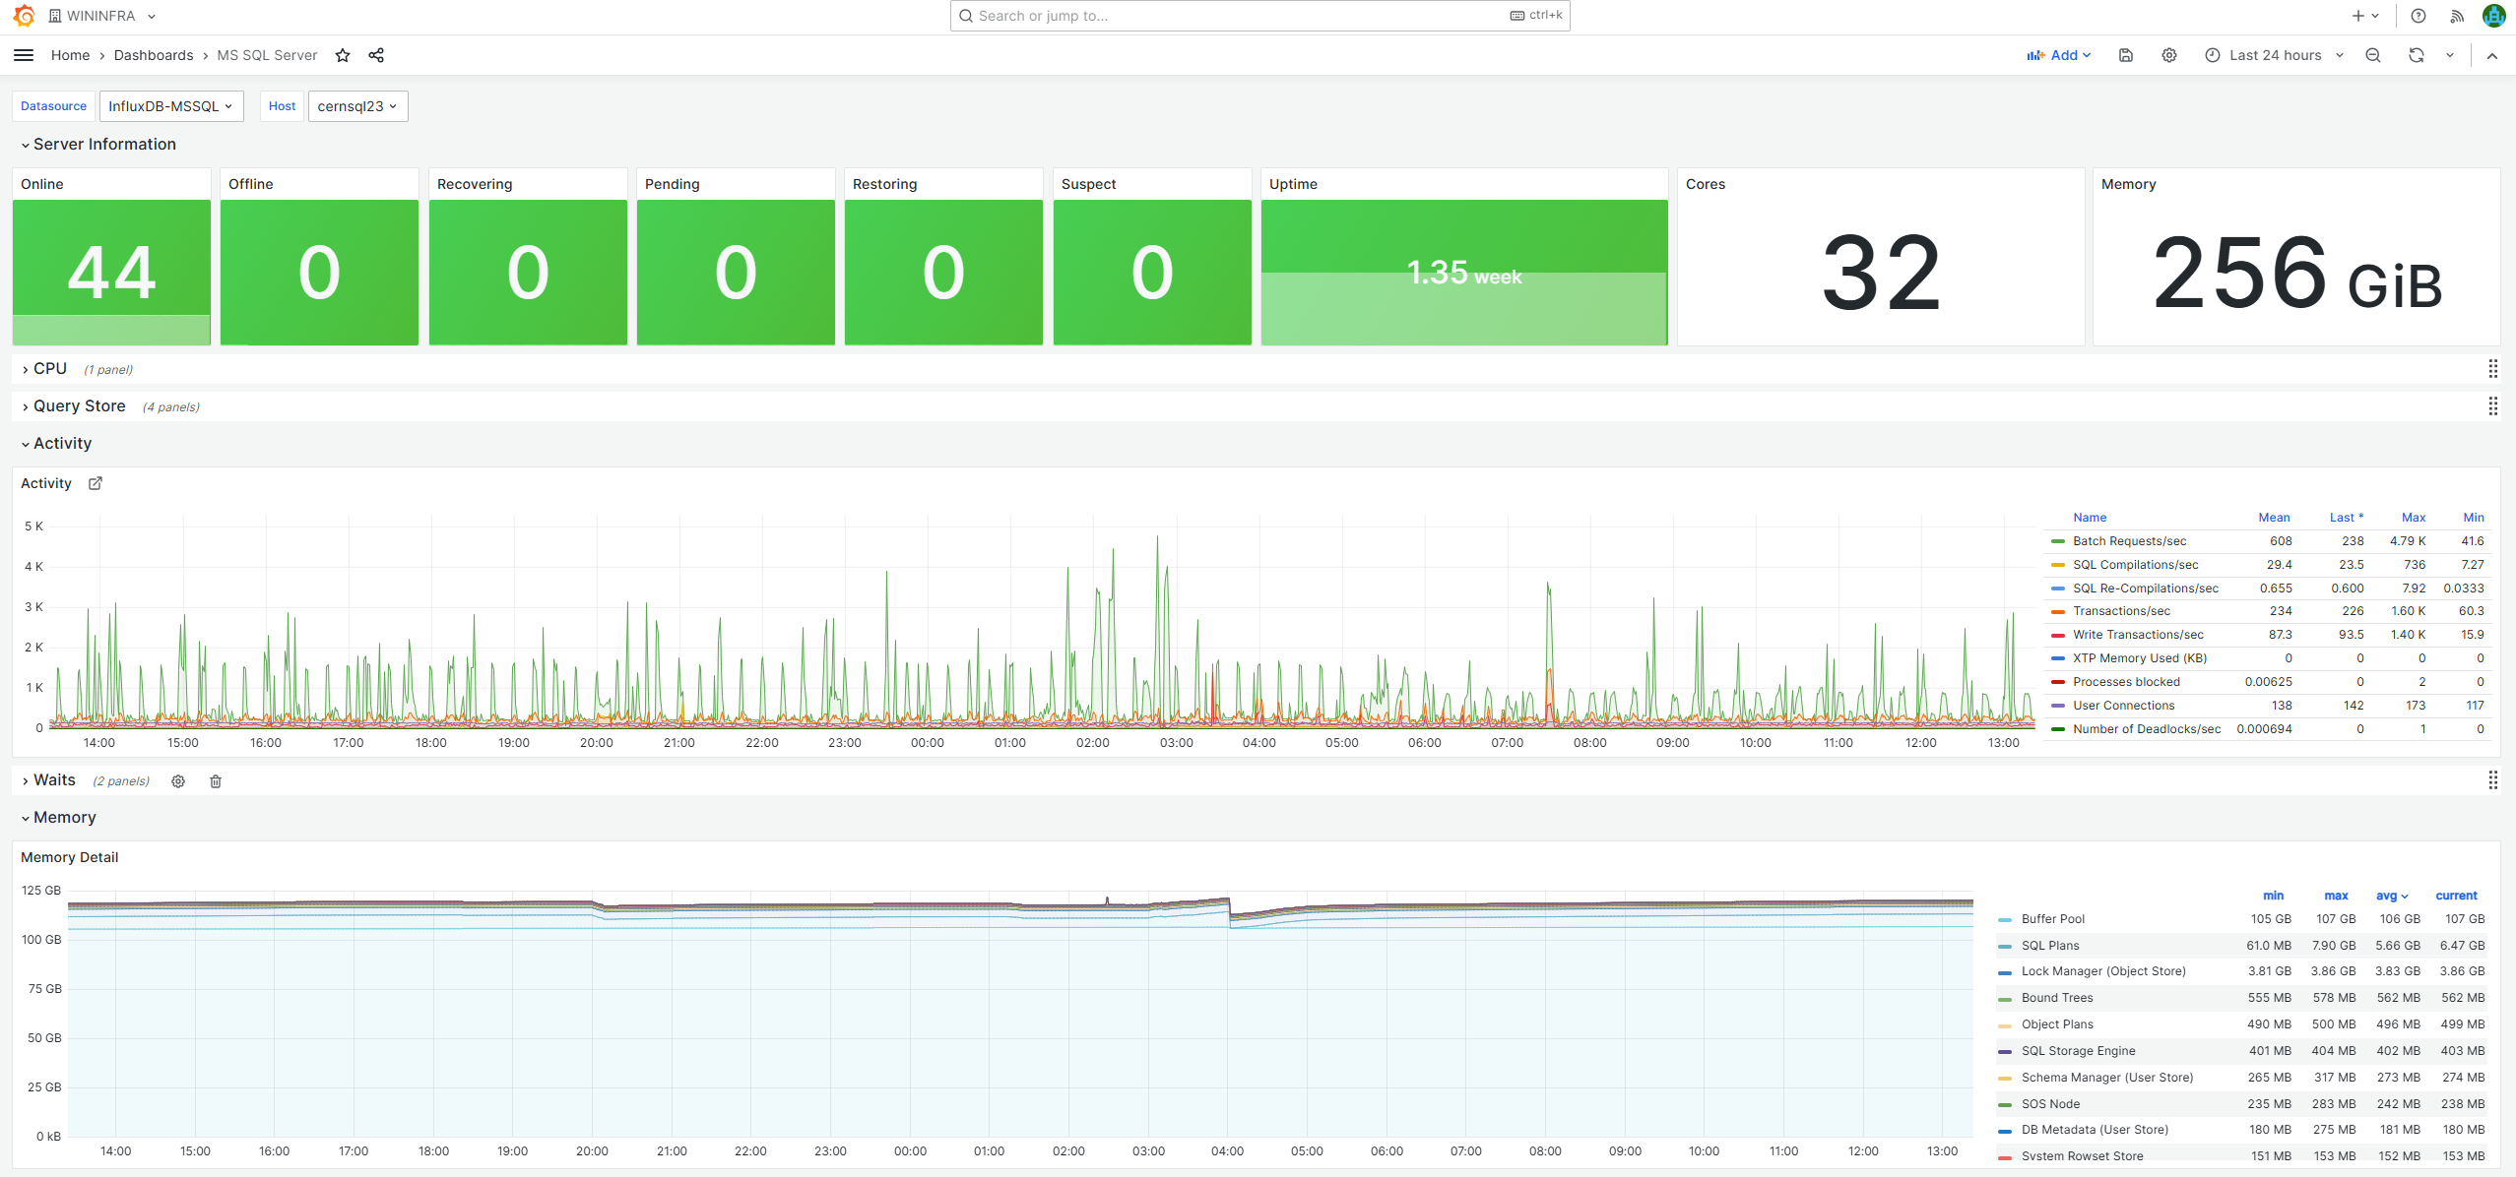
Grafana

Slide 12
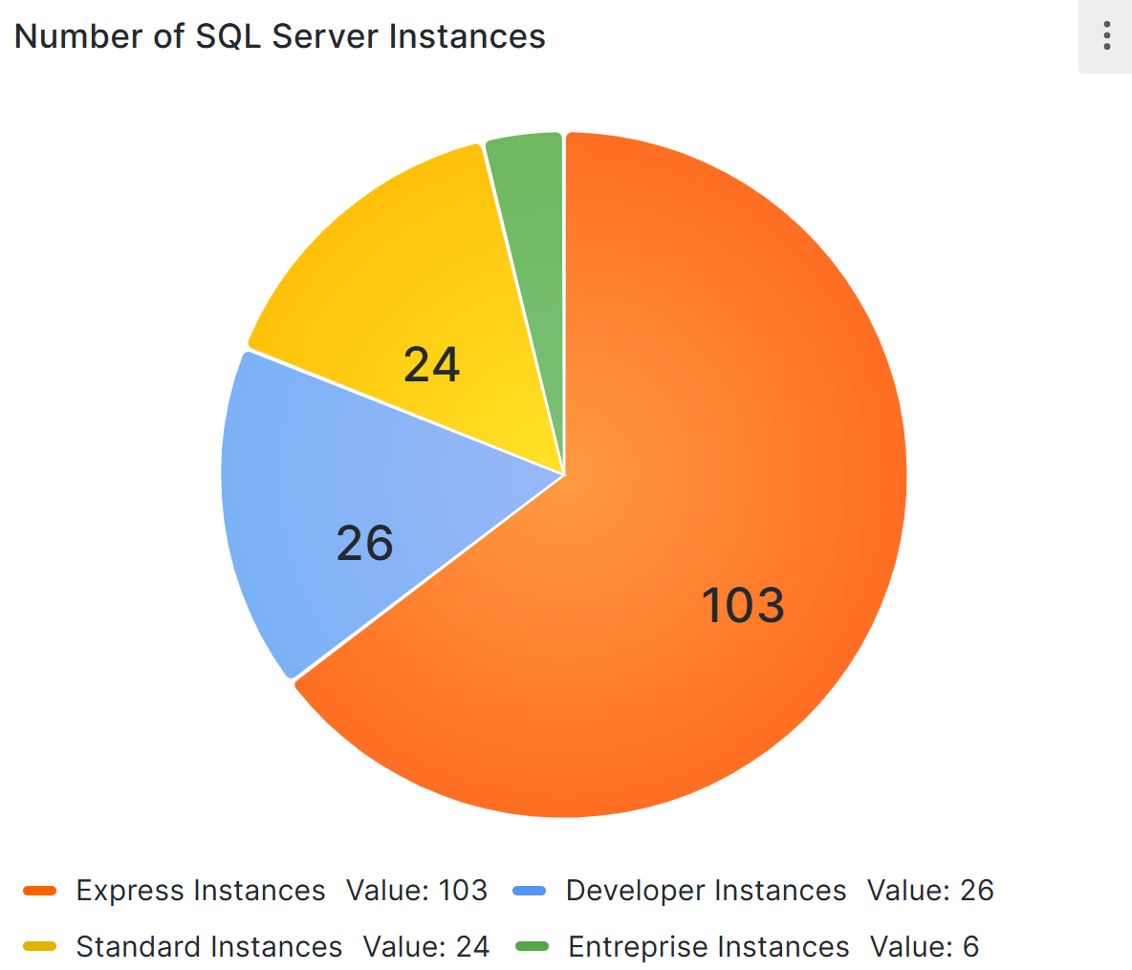
Tracking licenses
Microsoft Configuration Manager (MCM)
Script
  Edition
  Number of Cores
  Version, OS, etc.
InfluxDB -> Grafana
License Campaign
  Monitor license usage
  Consolidate databases in the same node/cluster
  Contact the users to change RDBMS, edition, delete.
MSSQL Editions

Slide 13
Onboarding
  Reason
    Backups
    High Availability
    Experts
    License Consolidation
  Procedure
    Justification
    On-board Database on a Cluster
    Create an environment (Connection string, DB size/Stability, Complexity of Application)
    Do or help in the migration
  Last year we on-boarded more than 30 DBs

Slide 14

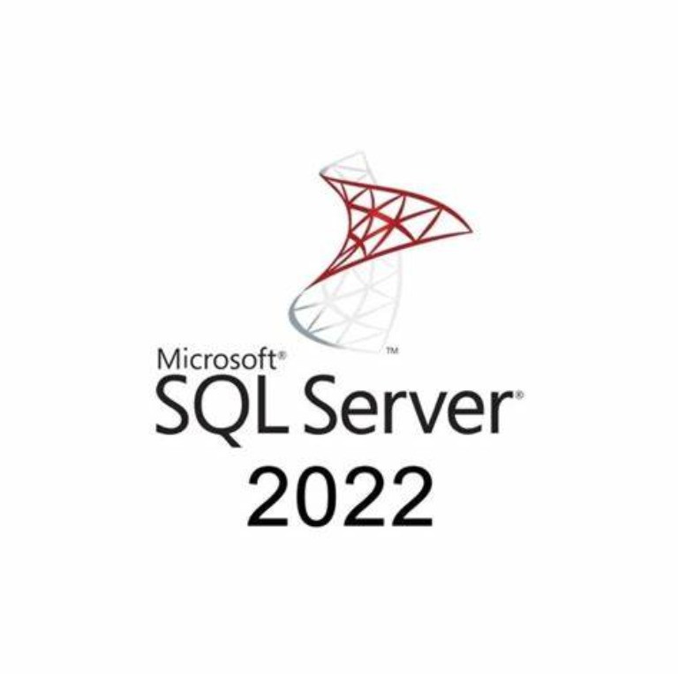
Migration MSSQL 2016 to 2022
Hardware procurement process
Configure New Machines
Install MSSQL
Best Practices
  RAM
  tempdb division, size and auto growth
  Max degree of parallelism
Test Servers and Backups
Updates
Security Patches
Migrate Databases from previous servers
  Database, User, Access, Special configurations, ALIAS change, adding to AG, BCDR
Decommission Old Servers

Slide 15
BCDR (Business Continuity, Disaster Recovery)
Geographic redundancy (Prévessin Data Centre)
Warm backup site
Restore backups (Every week)
  Schedule task
  Microsoft Integrity check
  Notifications in the case of error restoring (ICINGA)
BCDR Test
  Detailed procedure
  Timed
  Dependencies

