Slide 1

HEPiX Workshop Spring 2025 - Logistics

Slide 2
Welcome to Sunny Lugano
HEPiX in Switzerland
Back in Switzerland after 16 years and first time in Ticino!
Hotel de la Paix:
Located near Lake Lugano
1 kilometre from the city centre
  Transportation Options:
    Walking: The city center is about a 20-minute walk from the hotel
    Bus to the city center:
      Bus line 2 stops right in front of the hotel (Santa Birgitta) and goes via the train station
      Alternatively, bus line 1 from Paradiso at the lake (Debarcadero)

Slide 3
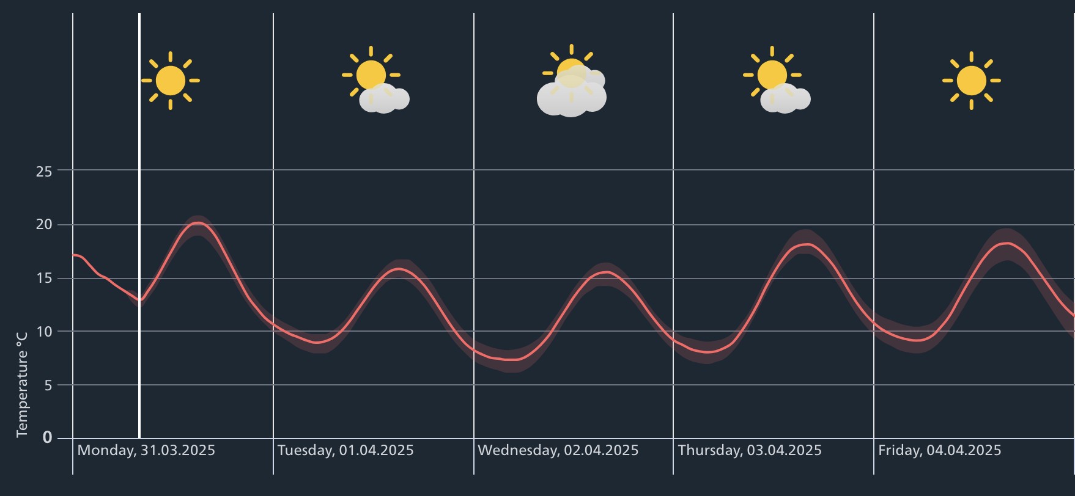
Welcome to Sunny Lugano

Slide 4
Ticino card
Ask for the Ticino Card at your hotel to enjoy free transportation on all public transport.
https://www.ticino.ch

Slide 5
Coffee breaks and Lunches
Coffee breaks are served in the room next to us
Lunches are served in the dining room upstairs

Slide 6
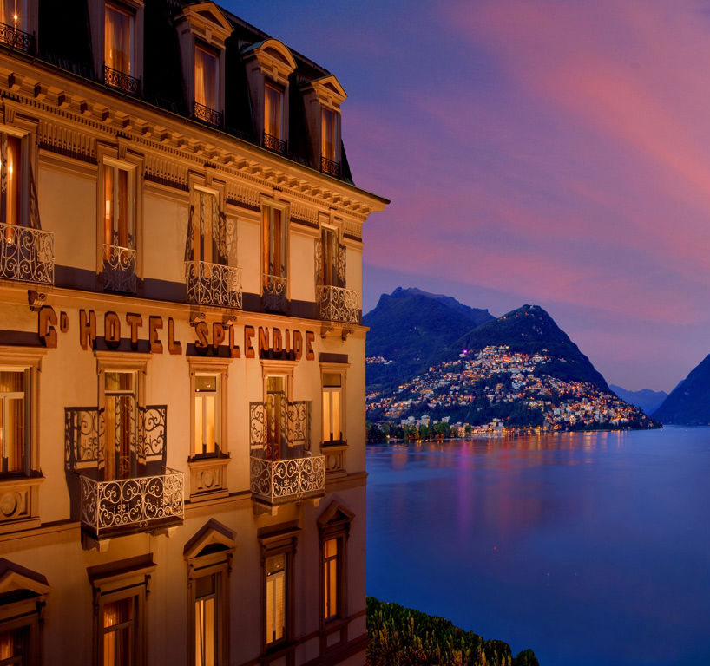
Welcome Reception - Hotel Splendide Royal
Tonight – Monday, March 31:
  Aperó from 18:00 – 19:00
  Dinner 19:00 – 23:00
Address:
  Riva Antonio Caccia 7, 6900 Lugano
10 minutes walking distance
Remember your badge

Slide 7
HEPiX Spring 2025 Workshop Visit of CSCS
shuttle bus will leave at 16:50 from the parking lot
Only for those who registered
Registration link

Slide 8
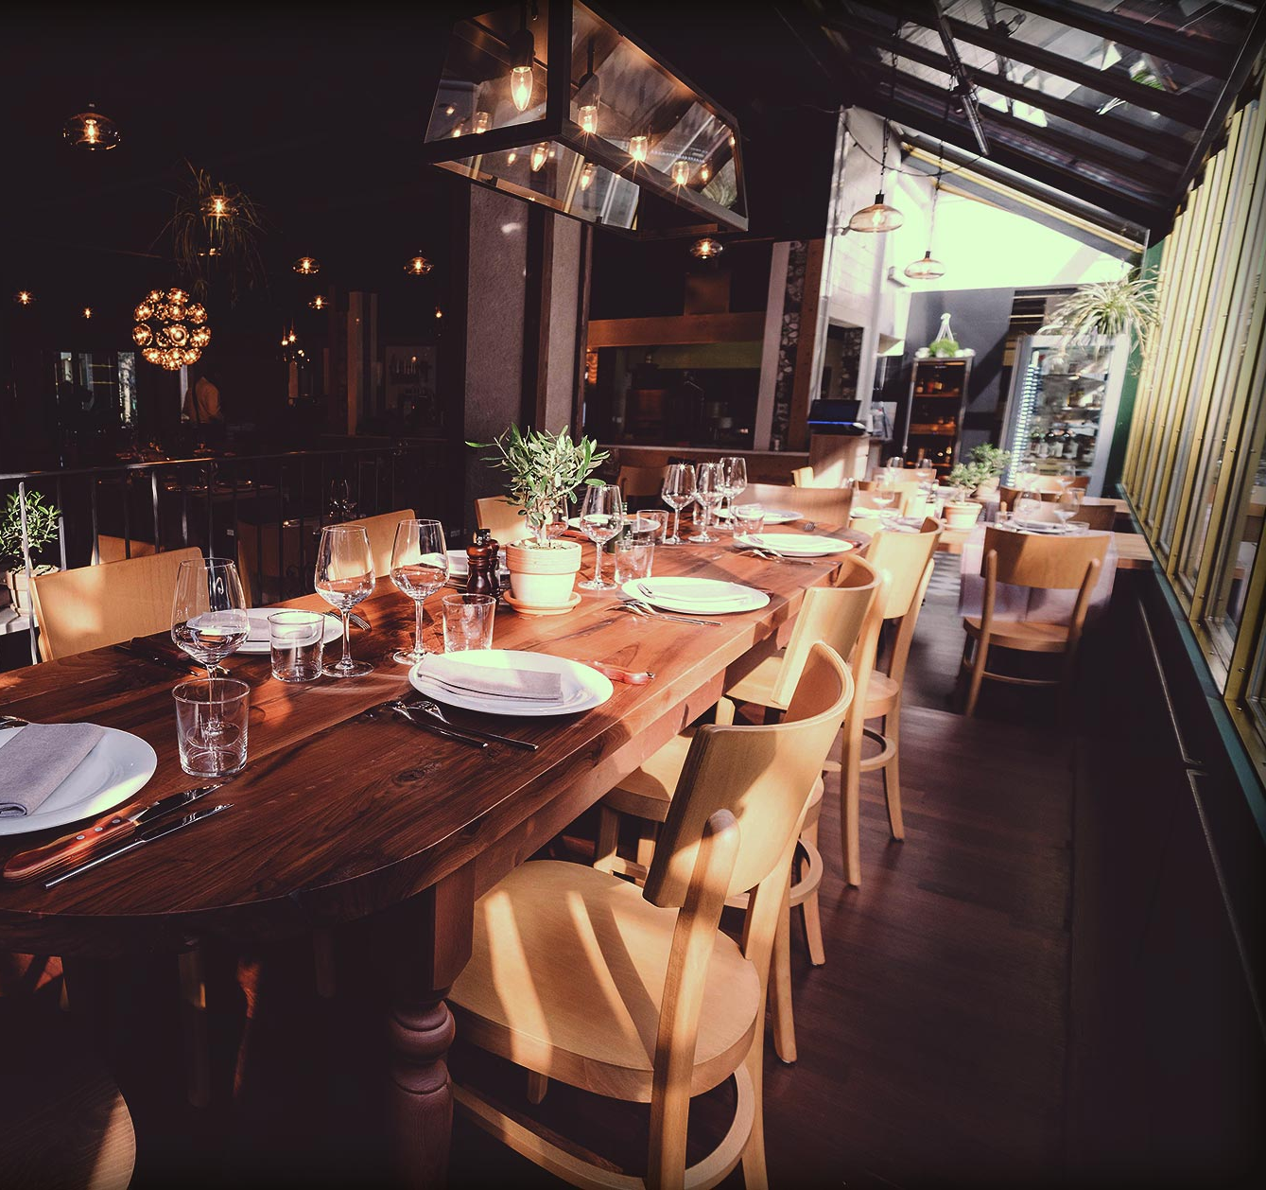
Social Dinner – Bracieria Elvetica
Right after the CSCS visit
Dinner - 19:30
Quartiere Maghetti, Lugano
Take bus number 7
  from: Lugano, Stadio
  To: Lugano, Centro
  + 5 min walking time
Remember your badge

Slide 9





THANK YOU FOR YOUR SUPPORT
GOLD SPONSOR
ACADEMIC COLLABORATIONS
BRONZE SPONSOR
CTAO-CH

