Slide 1
Improving CERN’s computer security with an Endpoint Detection & Response Solution
Alexandros Petridis
HEPiX, April 2025

Slide 2
Contents
Introduction
EDR Elements
Deployment
Pain points
Fears of IT admins
Key Takeaways
What is EDR?
Why is EDR important?
Capabilities of EDR
Isn’t anti-virus enough?
Future Work
On-Prem Architecture

Slide 3

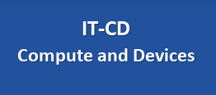
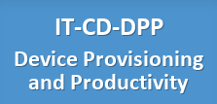
Introduction
Endpoints
Antivirus
Encryption
macOS
Windows
MCM
Intune
Printing
MDM
Productivity Software
Public PCs
Android
AppStore
Hardened PCs
CMF
iOS
Microsoft
EDR

Slide 4
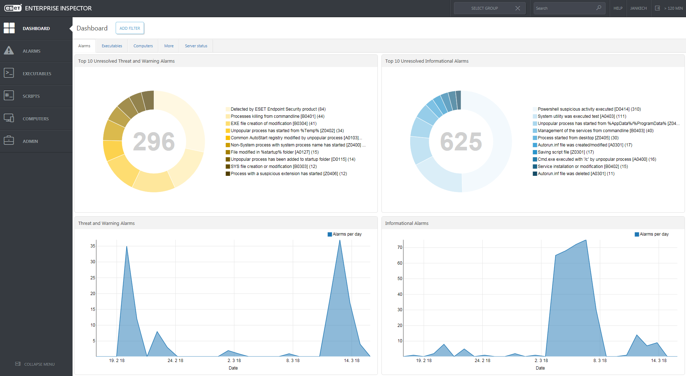
What is EDR ?
Endpoint Detection and Response (EDR) is a technology that continuously monitors endpoints for evidence of threats, performs automatic actions to mitigate them and helps security analysts to detect and remediate threats before they can spread throughout the network.
https://en.wikipedia.org/wiki/Endpoint_detection_and_response

Slide 5

Capabilities of EDR
Monitoring
Threat Detection
Incident Response
Threat Containment
Threat Hunting
Generated by DALL·E: A high-resolution, professional cybersecurity-themed illustration featuring a futuristic, glowing central shield symbolizing digital protection
Notes:
- Monitoring: Real-time tracking & logging of endpoints
- Threat detection: Identifying IoCs and provides the opportunity to analyze those data
- Incident Response: Alerts for security teams & ability for live forensics and actions through this tool
- Threat Containment: Isolating affected endpoints
- Threat Hunting: Proactive search for hidden threats

Slide 6
Why is EDR important?
Adversaries will find a way to get through your defenses
Prevention alone can’t ensure protection
Adversaries can be inside your network for weeks/months
Organizations lack visibility to effectively monitor endpoints
Remediation can be protracted and costly
Having the data is only part of the solution
https://home.cern/news/news/computing/computer-security-cost-compromise
Notes:
With enough money, time and motivation adversaries will always find a way to get through your defenses.
When prevention fail and it will fall at some point, the organization is left in the dark
That way the attackers can be in the network for weeks/months moving around, creating back doors and doing all kind of malicious activities
If/When a breach is finally discovered, an organization can spend months to remediate the incident with often the only solution is to reinstall from scratch your machines, which can disrupt your organization operations, degrade productivity and sometimes also cause financial loss
And a very important point is even when the data is available, security teams need the resources to analyze and take full advantage of it.

Slide 7
Isn’t anti-virus enough ?
Anti-Virus vs Endpoint Detection & Response
Feature | Antivirus | Endpoint Detection & Response
Primary Objective | Detects and blocks known malware using signatures. | Monitors endpoints to detect, investigate, and respond to advanced threats and attacks.
Detection Method | Relies on signature-based detection and heuristics. | Custom detection rules can be applied on EDR solutions
Response Capabilities | Blocks malware and quarantines files. | Isolates & remediates threats + provides live forensics during attacks.
Visibility | Limited visibility into endpoint health, threats and your network of devices. | Full visibility into endpoint activity, attack timelines, and root cause analysis.
Threat Hunting | No active hunting | Enables active threat hunting and proactive search for indicators of compromise (IOCs).
Notes:
Known malware: viruses, trojans, etc
advanced threats, including ransomware, fileless attacks, and advanced persistent threats (APTs) behavior.

Slide 8




EDR Elements
Endpoint Agent
Installed on devices (laptops, desktops)
Manage all client-server communications
Sends collected data to the server(s)
EDR Server(s)
Centralized system for managing data
Sending tasks to clients
and alerts to admins
Database(s)
Responsible for data storage
Security Software
Includes antivirus, anti-malware, behavioral analytics and much more

Slide 9
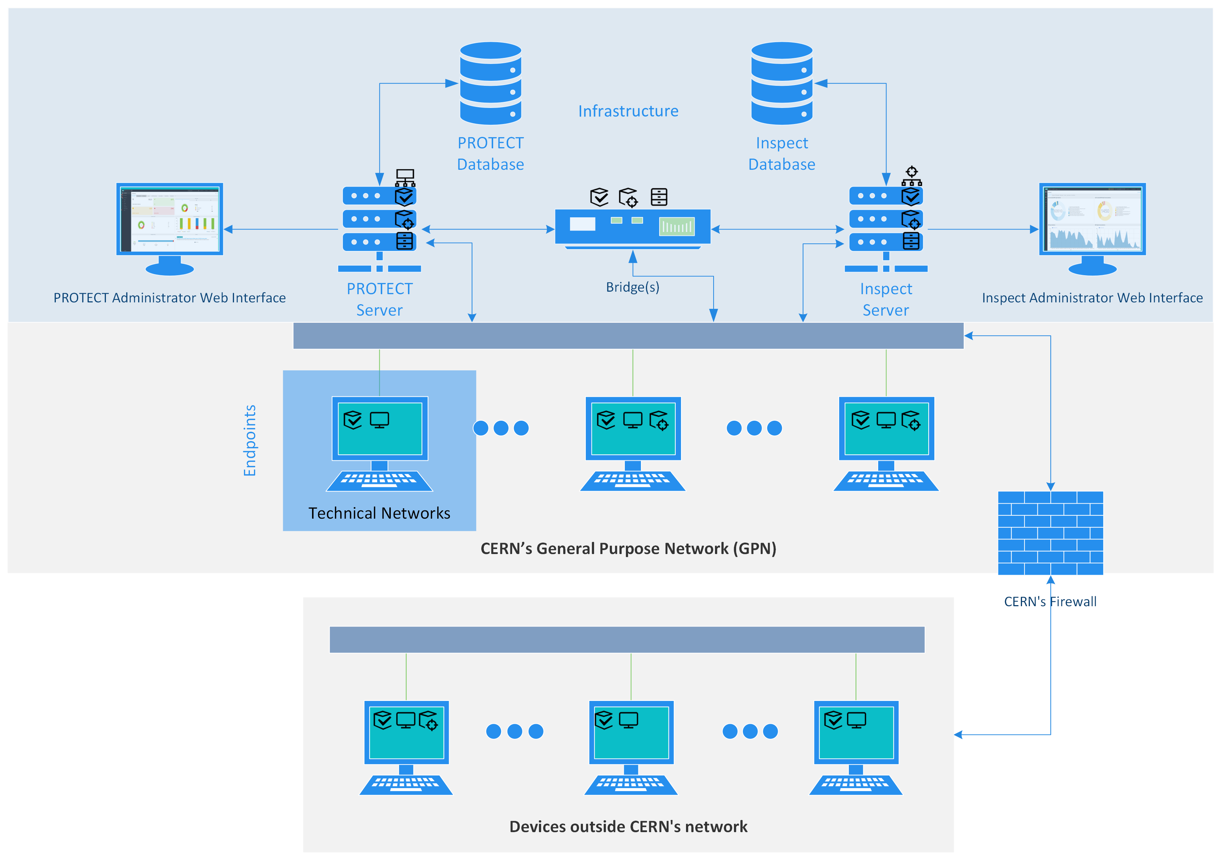
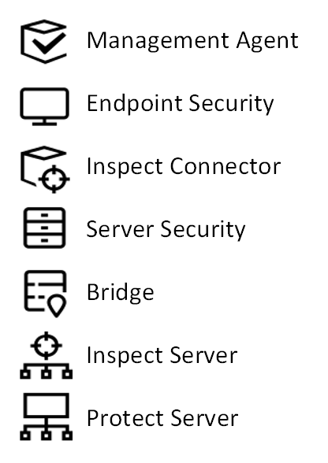
On-Prem Architecture
https://help.eset.com/protect_admin/12.0/en-US/
https://help.eset.com/ei_navigate/2.4/en-US/
https://help.eset.com/ebe/3/en-US/
https://help.eset.com/ees/12/en-US/
https://help.eset.com/efsw/12.0/en-US/
Notes:
Here we can see our on-prem infrastructure that consists of
4 Servers that they manage different things of the EDR solution and
2 Databases

Slide 10
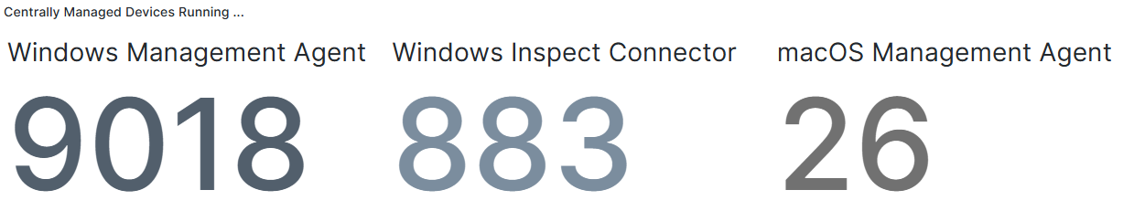
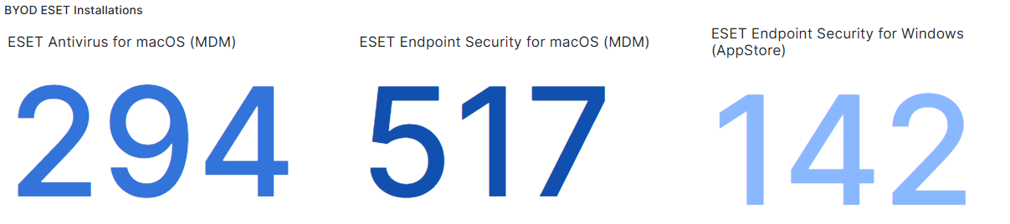
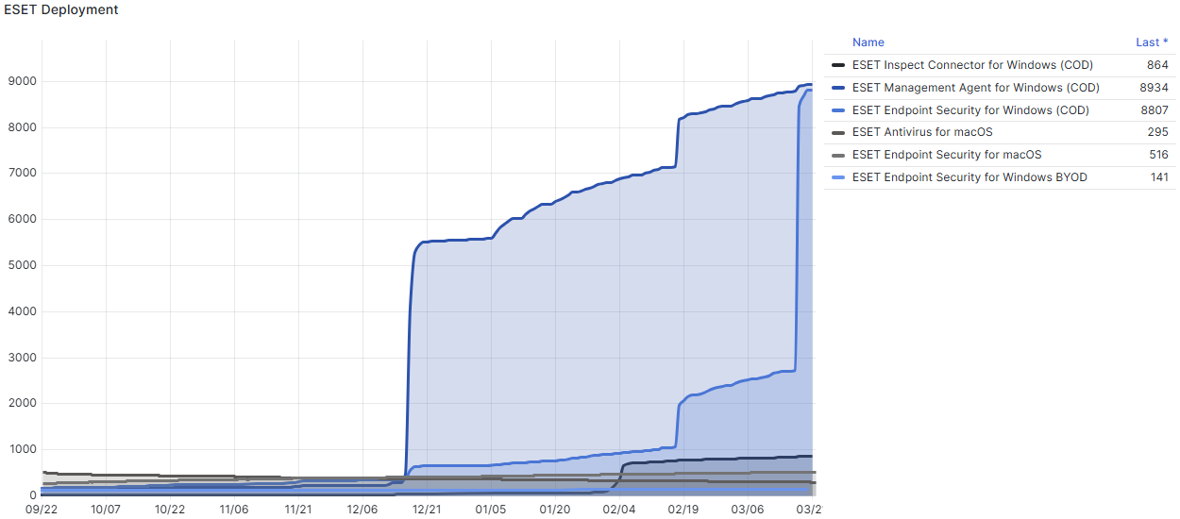
Deployment
Centrally Managed Devices
BYOD devices (w/o the Management Agent)
Notes:
For Windows deployment
Internal Deployment Tool: We utilized our internal tool, CMF, to streamline the deployment process.
Gradual Rollout: Instead of a mass deployment, we opted for a phased approach by rolling it out gradually across different departments.
Risk Mitigation: This allowed us to closely monitor and address any issues before full-scale implementation.
For the macOS devices the deployment is a bit different as we lately introduced the centrally Managed model. Before that we used to only have BYOD macOS devices and that’s why the numbers on mac BYOD are that much bigger that the ones on Centrally managed

Slide 11

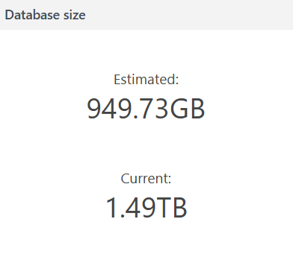
Pain points
Support Challenges
Vendor support, despite efforts, is often a struggle.
On-prem infrastructure adds complexity to support cases.
Fine-Tuning the Product
Nature and scale of CERN’s environment—spanning from IT and experimental software to HR and Administration—makes fine-tuning challenging
One of our DBs is 1.5x larger than the estimate size, but support couldn’t give a clear reason.
Not good because we need longer data retention
Notes:
Give example of PowerShell command to IT (day-to-day) while in HR it would almost always translate to a threat.

Slide 12

Pain points (2)
Terminal Servers Incident
Windows Update failures were likely caused by an ESET detection module
The issue was unique to our environment and couldn’t be reproduced—until now.
Microsoft was unable to determine the root cause.
ESET didn’t investigate but provided us with the outdated detection modules to help with reproduction.
  Reproducing such issues is extremely difficult, as modern antivirus solutions use multiple detection modules, some with ML, making rollbacks impractical or even impossible
Generated by DALL·E: A realistic digital illustration of a server room with multiple server racks and an IT professional trying to troubleshoot.
Notes:
Let’s go over a major challenge that we faced in our Terminal Servers infrastructure

Slide 13
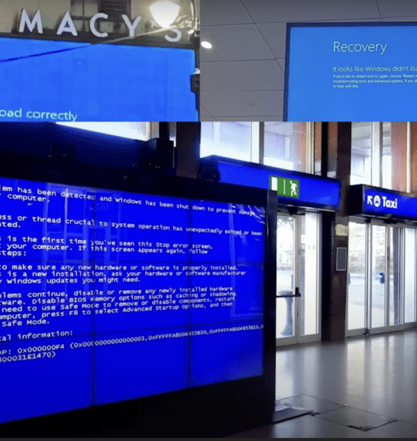


Fears of IT admins
Massive Outage
Anyone remember CrowdStrike’s incident?
The risk of security software causing massive outage
A single faulty update can take down entire infrastructures
Mitigation Strategy
Controlled update cycles to prevent unexpected disruptions
Monitoring vendor communications for critical update warnings
https://blog.taikun.cloud/the-crowdstrike-incident-a-global-wake-up-call-for-cloud-resilience/

Slide 14
Key Takeaways
Automated Threat Mitigation
EDR enhances endpoint security with more automated actions on endpoints.
Operational Impact
Transitioning to EDR may require a learning curve for teams accustomed to traditional AV workflows.
Deployment Considerations
Initial setup, particularly for custom rules, exclusions and specific software whitelisting can be resource-intensive
Reduced Support Overhead
Hopefully in the long-term it will be proven more efficient as more automation can take place

Slide 15
Key Takeaways (2)
Custom Rules & Detection
Enables security teams to define and enforce advanced detection rules for proactive defense.
Vendor Expertise & Specialization
Dedicated cybersecurity firms offer deeper threat intelligence and specialized protections beyond OS-native security solutions.
Expanded Security Modules Beyond AV
Network Attack Protection, Botnet & Malware Protection, LiveGrid Reputation System, Host-Based Intrusion Prevention (HIPS) and Advanced Email Security Protection might be some of the extras that usually security companies can offer extra

Slide 16
Future Work
Enhancing Coverage for CERN-Managed macOS
  Prepare for an increasing influx of macOS devices in our security monitoring.
Minimize False Positive Alerts
  Revising exclusions to reduce the noise
Integrate EDR with Security Operations

Slide 17

Thank you for your time!

