Slide 1
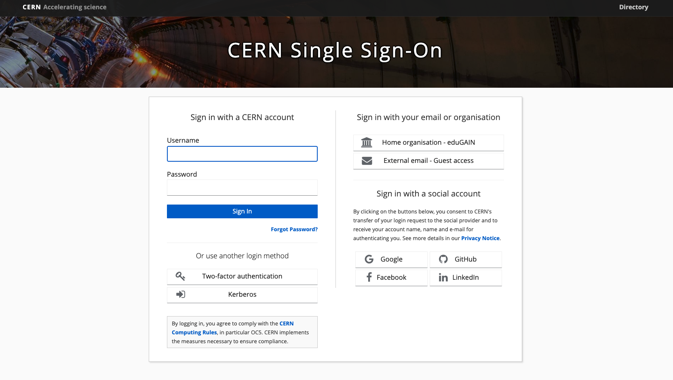
CERN SSO service evolution in the last two years
Paul Van Uytvinck
Thank you to Sebastian Łopieński, Antonio Nappi, Hannah Short
(CERN IT-PW)
HEPiX - 03 April 2025

Slide 3
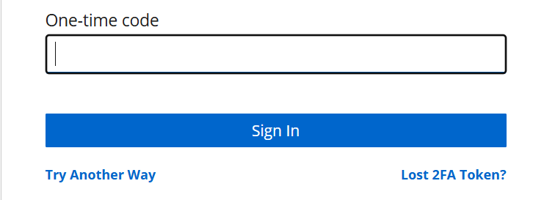


Slide 4
What we will talk about today
SSO at CERN
Evolution and consolidation of the service
Some good practice for a critical service

Slide 5
⟶ SSO at CERN

Slide 6

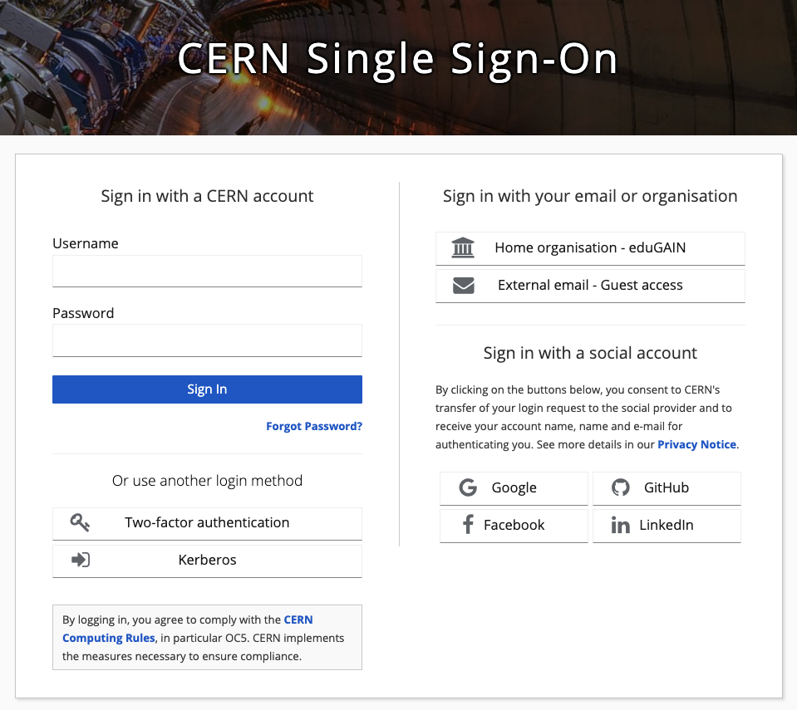


Why SSO (Single Sign-On)?
Usability (better user experience)
One set of credentials to access all
of organization’s computing resources
A single login per day
Security
A central place for enforcing 2FA and password complexity policies,
security monitoring and blocking, etc.
Credentials are not exposed to applications
Cost / efficiency
No need to implement authentication and authorization in each application separately

Slide 7
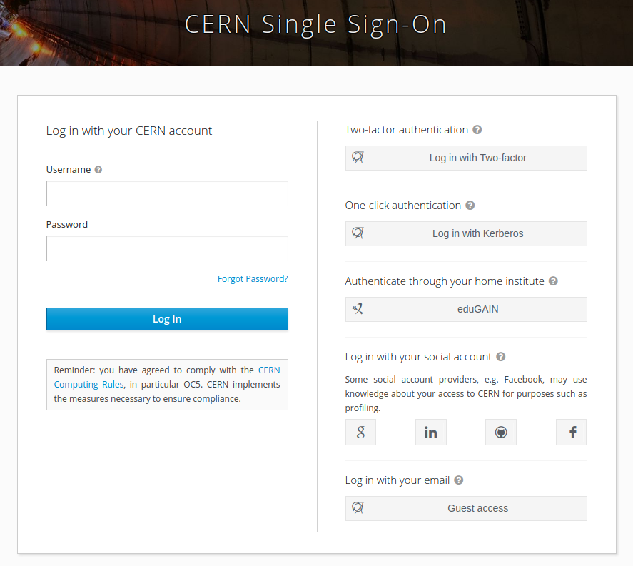
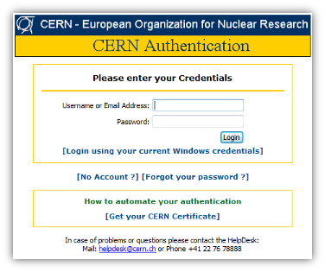
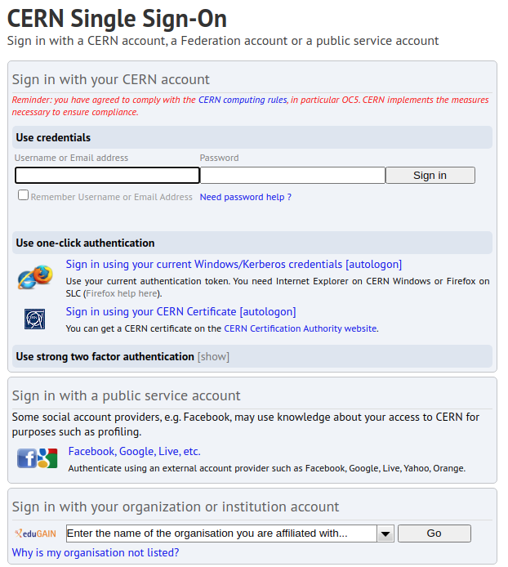
The history of SSO at CERN
Major outage
during DG talk,
focus on stability
& performance
Old SSO put behind firewall
Keycloak opened through firewall,
available to first
CERN adopters
First SSO introduced
(Microsoft ADFS), presented
at HEPiX
“CERN’s new and improved Single Sign-On”
presented
at CHEP
Moving from Puppet to Kubernetes hosting
Open-source project:
Keycloak testing begins
2007
2018
2019
2020
2021
2022
2023
2024

Slide 8


Keycloak
Keycloak is an open-source identity and access management (IAM) solution
Provides single sign-on (SSO) to organization’s applications / resources,
with 2FA authentication (OTP, WebAuthn) and role-based authorization
Allows user federation by connecting to LDAP or AD servers (including Kerberos)
Supports external Identity Providers (IdP) and social logins
Keycloak, initially developed by RedHat in 2014
Easier!
No local credentials!

Slide 9
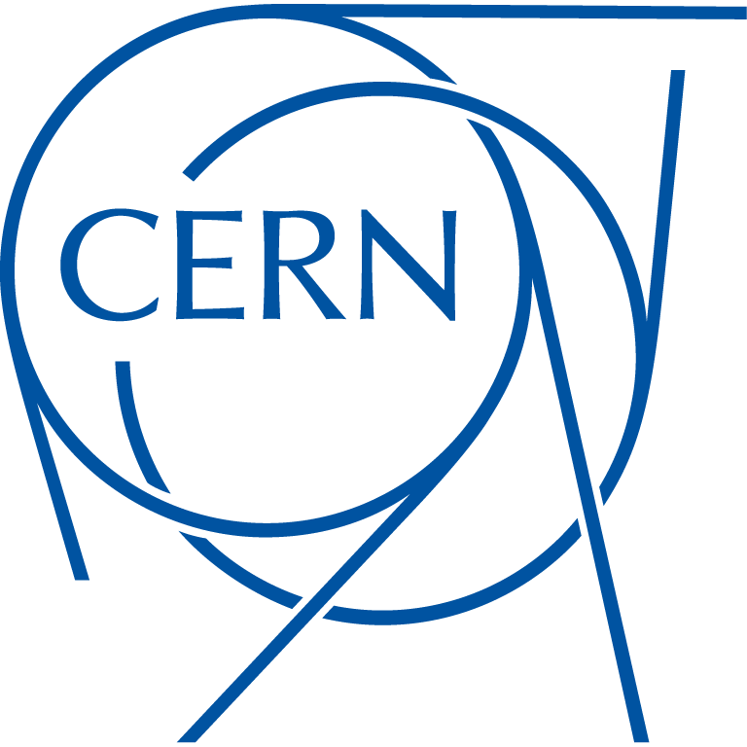
Why on-prem? Why Keycloak?
We operate particle accelerators and experiments
Full control over configuration, release and patching cycle
We value openness!
Open-source is compatible with Open Science / Open Access
No vendor lock-in, not subject to sanctions or export restrictions
+
Keycloak fits our needs
A lot of big adopters (works at scale)
A growing usage in academia and research institutes
Engaged user base, actively developed with frequent releases
Extensible - can be adapted to our needs
(More at https://auth.docs.cern.ch/documents/why-keycloak)

Slide 10
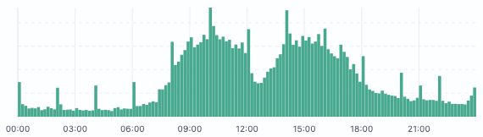
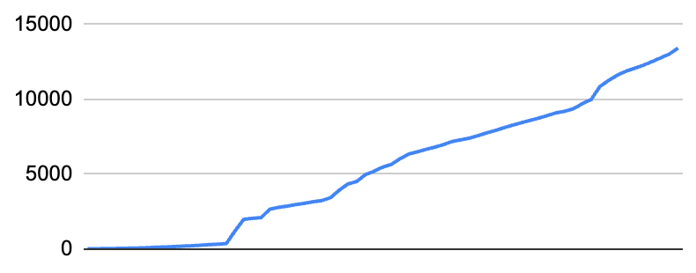
CERN SSO in a glance
Number of applications
Authentication
  password authentication
  Kerberos authentication
  2FA authentication (TOTP, WebAuthn)
  eduGAIN federated identities
  Social logins (Google, Facebook, GitHub, LinkedIn)
  Guest accounts
Role-based authorization
  Levels of Assurance
Delivers SAML assertions and OIDC tokens
300k users (including externals)
13k clients
10k logins per hour during office hours
Number of applications
2019 2021 2023 2025

Slide 11
⟶ Evolution and consolidation of the service in the last two years

Slide 12
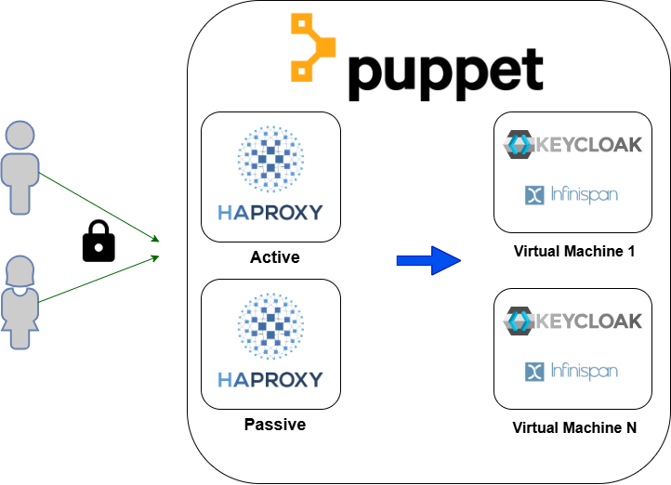
Legacy architecture
One proxy VM to serve Keycloak instances
Switch to passive could take up to 15/20 minutes
Multiple VMs running
Keycloak and Infinispan sharing same Linux process
Puppet module
not officially supported by Keycloak

Slide 13
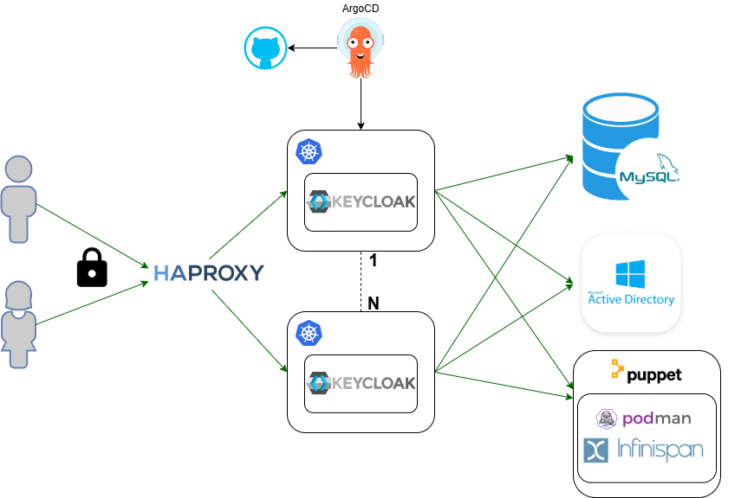
Modernize infrastructure to accelerate team operations
Git source of truth for deployment configuration
Operations and updates are traced and easily rolled back
GitOps components are NOT fundamental
Separation of Keycloak and Infinispan
Components can be scaled, tuned and monitored independently
  Infinispan, stateful, was limiting the scaling
  Keycloak, now independent, can restart in seconds
HA HAproxy cluster
HA cluster with automatic failover with no downtime

Slide 14
⟶ Some good practice for a critical service

Slide 15
Reviewing all elements of the service when taking over
A systematic effort to discover, learn, update, clean-up and document:
Keycloak configuration
  environments (dev/QA/prod)
  hidden and obsolete settings
  etc.
CERN Keycloak extensions (SPIs)
Docker images and deployment configuration
Databases
Certificates and keys
PaaS Cron Jobs
Integration tests
… and many more

Slide 16



Our Keycloak extensions
Compromised password detection
during the login process, SHA1 hash of user’s password is checked against
a huge list of known compromised passwords (from HIBP and other security sources)
CERN theme
CERN customisations and look & feel for user-facing login pages,
and guest account email template
“Message of the day” (usually, security or service announcements)
admin console: different header colors per environment
Dev QA Production

Slide 17
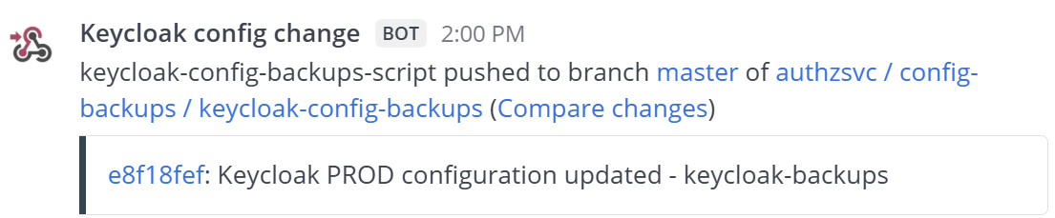
Managing and auditing Keycloak configuration changes
❓ The challenge: Losing track of changes
Most Keycloak configuration updates happen via the Admin Console
But manual changes leave no history—creating tracking challenges
📂 Our solution: Automated backups
Every hour, a script exports all realm configurations from Keycloak
The exported and processed JSON files are committed to a GitLab repository
Every change triggers an alert in our Mattermost channel

Slide 18


Security and hardening
(we don’t need it, until we need it)
Review, clean-up and document privileged access
Change/renew shared passwords, tokens, keytab files etc. Enforce 2FA
Review GitLab security settings
  project visibility
  members and their access
  secrets in GitLab variables, tokens
  security-related settings such as branch protection, push and merge restrictions etc.

Slide 19
BC/DR
🚨 Establish, document and test emergency procedures
  scale up/down Keycloak clusters (proved useful during Keycloak 24 upgrade)
  database backup, cloning and recovery
🔑 Prepare local breaking-glass accounts
  in ArgoCD, OpenSearch, Grafana, VM with internal tools etc.
  to avoid circular dependency on SSO
🥶 Cold-recovery test → ✅ mini SSO instance
  can be built anywhere, on a Linux machine, in one hour ⏳
  using a regularly synchronized offline backup of all SSO service components
  (Docker image, Keycloak extensions, configuration, secrets, certificate and docs)

Slide 20
⟶ Conclusion

Slide 21
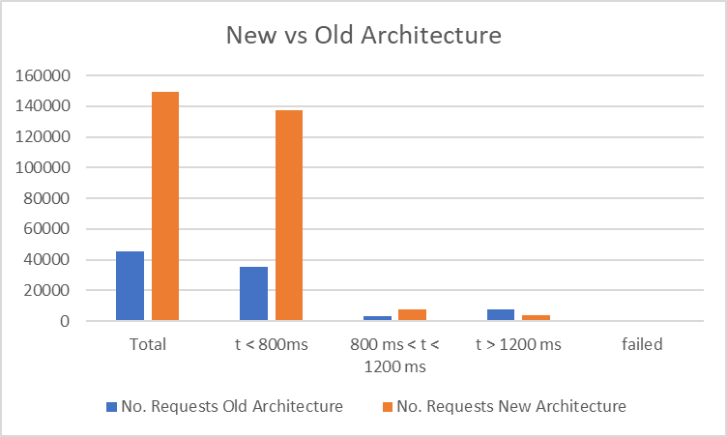
Stress tests on Keycloak 19 and results
Performance improved by 300%
could handle thrice as many requests
partly thanks to separate cache
Reduced infrastructure service incidents by 86% (7 vs 1 incident)
Authentication experts can focus on their own domain

Slide 22
Key messages from the past 2 years
SSO has seen huge improvements, reflected in performance and reliability
Slowing down and investing time in service management best practices seems to be worthwhile, though requires difficult compromises
We will be building on this stable, reliable, reproducible service to bring new features to Service Managers and End Users.

Slide 23
Thank you for your attention!

Slide 24
Backup slides
Notes:
Icons by Font Awesome Free (CC BY 4.0 license: https://fontawesome.com/license/free)

Slide 25
Modernize infrastructure to accelerate team operations
Monitoring and Logging improvements
Implement widely adopted standard tools such as:
  Fluent Bit
  Prometheus
Infinispan metrics
Log parsing simplified debugging.

Slide 26
Why upgrading
Users don’t request SSO upgrades
However, we want and need to upgrade regularly, for many reasons:
Keep up to date with Keycloak releases
Get minor bug fixes, various new features, usability improvements
Avoid technical debt (the longer we wait, the harder to upgrade)
Maintain security (patches to possible security vulnerabilities may not be backported to previous Keycloak versions)

Slide 27
Keycloak versions at CERN - what we learned
Don’t use version X.0.0 - wait for a more mature X.0.5+
Communicate ++
Always surprise breaking changes
Many client issues due to custom settings, obsolete libraries, not following standards…
QA testers hugely valuable
Keycloak 20
Keycloak 19
Keycloak 15
Keycloak 11
Keycloak 8
Keycloak 6
Keycloak 4
2018
2019
2020
2021
2022
2023
2024
2025

Slide 28
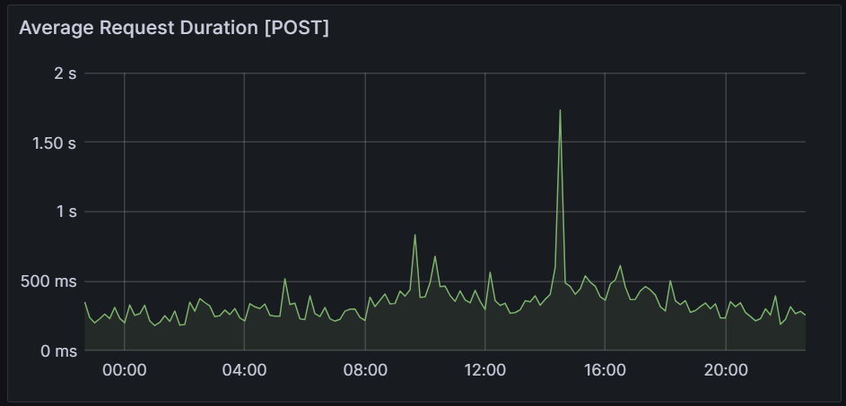
Monitoring and alerting
📊 Grafana: Proactive monitoring
Logs-based insights → Login trends, token exchange usage, …
Metrics-based insights → Node status, response time, DB & Infinispan health, …
⚠️ Alerting setup
Mattermost channel for real-time notifications
Canary test to monitor SSO status and send Telegram alerts
Automated SSO integration tests on PaaS with Selenium
📖Take-home message📖
Monitoring detects issues—but also provides data to optimize performance

Slide 29
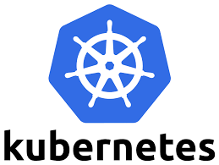
Why Kubernetes (K8s)
Red Hat direction clear
Jboss replaced by Quarkus (designed for Kubernetes)
Red Hat maintains Kubernetes operator for deployment
Portable, reproducible and Immutable
Speeds up operations, reducing team effort
  Kubernetes is not intended for improving performance!
Facilitate BC/DR
Easier to maintain and deploy in long term
Vibrant community supporting Kubernetes (Keycloak is CNCF incubating project)
Small community in Puppet world; one main maintainer for the Puppet module
Profiting of experience running production service on K8s since many years (2020)
Extended experience within CERN (this is a cross section collaboration)

Slide 30
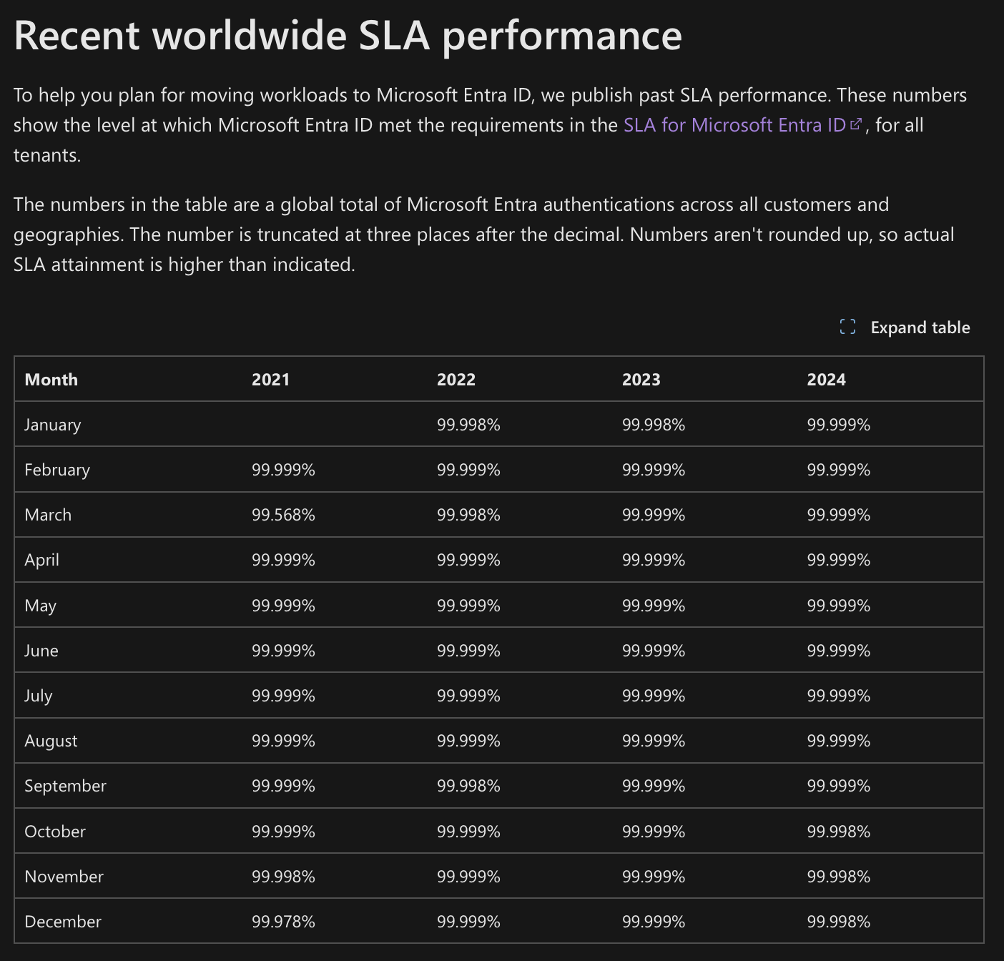
Uptime statistics
Market alternatives seem to aim for a max downtime of roughly 20 minutes per month.
In general, CERN SSO has consistently been equivalent or better over the past 18 months.
Recent incidents increasingly related to external factors rather than internal; e.g. Database service
Google Identity: “The Covered Service will provide a Monthly Uptime Percentage to Customer of at least 99.95%”
Entra: achieves roughly 99.998%
Service Incidents by Year | Self caused | Within IT | External to CERN | Other at CERN | Total
2023 | 15 | 2 | 1 | 1 | 19
2024 | 5 | 7 | 1 |  | 13

Slide 31
BC/DR dependencies
Strong dependencies:
DNS and Network
Active Directory
Database
All other dependencies are optional and can be easily bypassed

Slide 32
