Slide 1


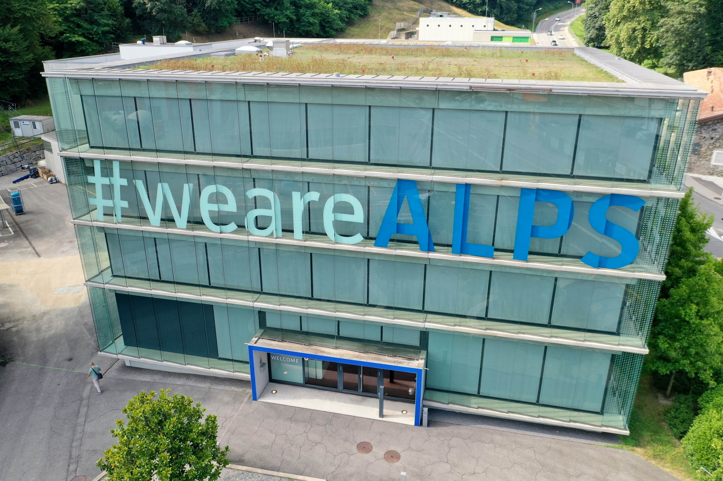
Techwatch working group: technology report
Andrea Chierici, Andrea Sciabà, Shigeki Misawa
HEPiX Spring 2025, Lugano, 31/3 – 4/4 2025

Slide 2
Outline
Introduction
Technology tracking in HEPiX
News from WLCG
Trends in semiconductor industry
Data center infrastructure covered by Eric Yen’s talk
Processing units and AI covered by Andrea Chierici and Michele Michelotto’s talk
Memory technology
Flash and disk storage
Tape covered by Vladimir Bahyl’s talk
Network
Sustainability and energy efficiency covered by Eric Yen’s talk
Conclusions

Slide 3
Introduction
Which technology?
  Hardware that matters for scientific computing
  Changes in technology may have a profound impact on data processing and analysis
What scientific computing?
  Mostly, but not limited to HEP
  Typical applications: event generation, simulation, reconstruction, data analysis, DAQ, trigger, etc.
  AI algorithms increasingly used
Two main (and quite different) domains
  Offline processing: HTC workloads: lots of CPUs, lots of storage, some GPUs
    Dedicated data centers (like WLCG sites) and HPC centers
  Online processing: CPUs, but also GPUs and FPGAs, very high bandwidth connections…

Slide 4


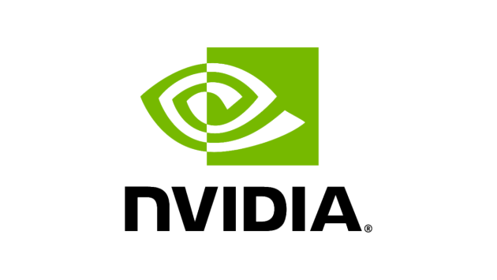







Technology tracking in HEPiX
HEPiX Techwatch working group
  Bi-annual reports at workshops to share knowledge about technology choices and practical experience
  Participants choose the areas closest to their interests and experience
  Delivers reports at other events (WLCG workshops, conferences, etc.)
  WLCG relies on us for technology tracking
Several participants from many sites
  Very few do something though ☹
  1-2 meetings per month, low attendance
Involvement in other technology tracking activities
  Some of us do this for their institutes
  Frequent contacts with vendors, but covered by NDA
    Still, useful to get a better feeling of where industry is going

Slide 5
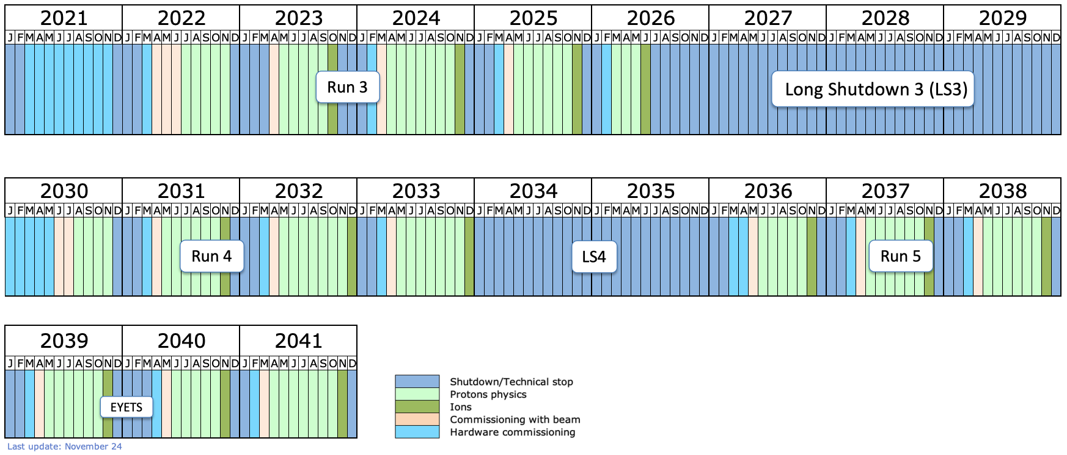
News from WLCG
New HL-LHC schedule, Run 4 to start in 2030
  More time to profit from long term price reductions!
Workshop on sustainability last December
  Identified actions, progress will be tracked
  Several ideas to optimize power consumption in the data center
Planning a workshop on GPUs for HEP this December
  Benchmarking and Techwatch WGs might be involved
Source: CERN

Slide 6
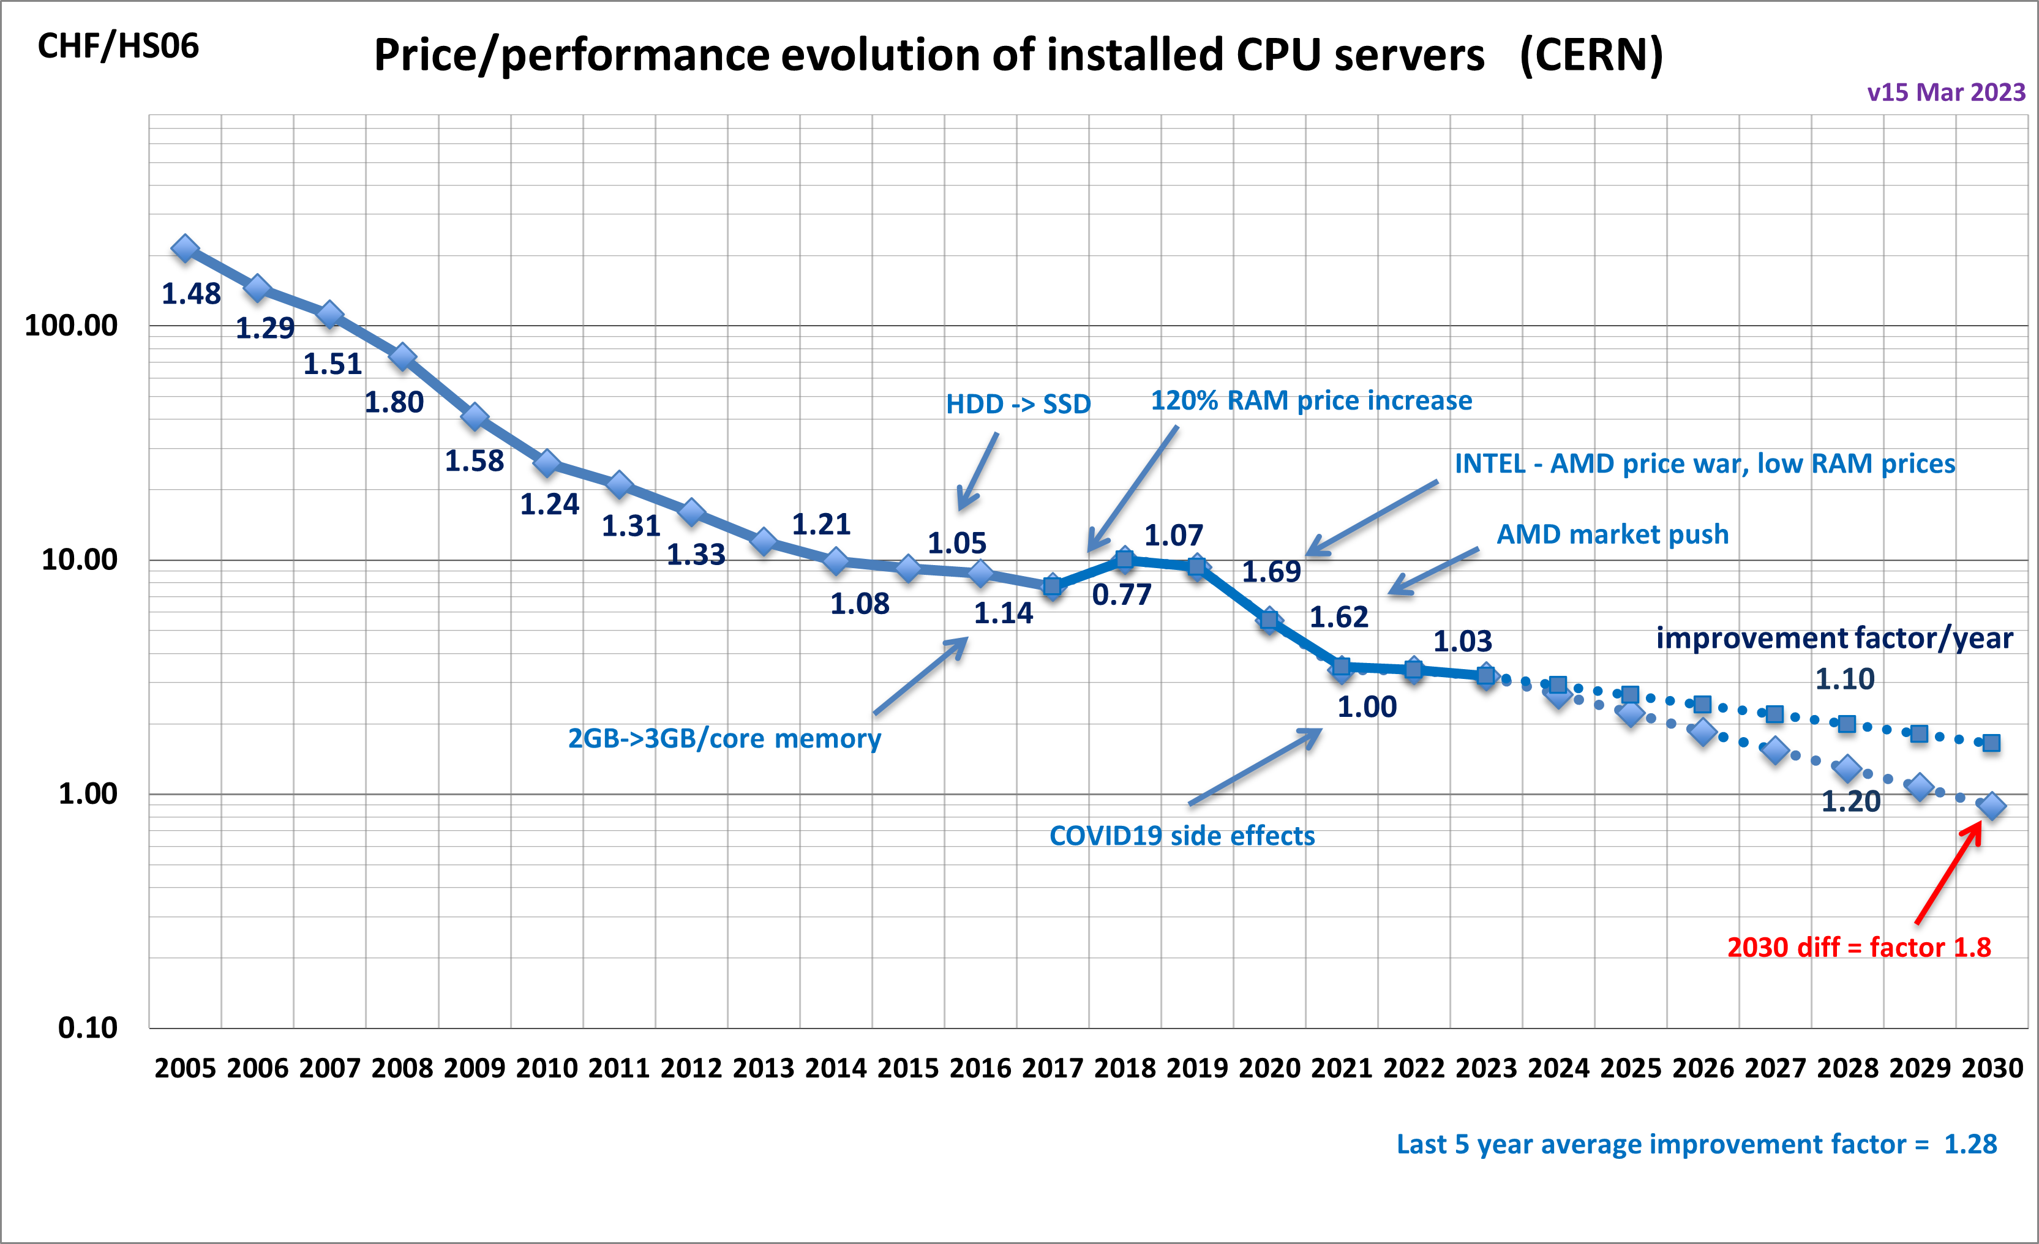
CPU cost extrapolation at CERN
CPU price decrease rate relatively stable over time
AMD becoming again competitive gave a boost
Stagnant recently
Questions:
  Is Intel going to be competitive again?
  When (if) will Arm start having an impact? Or RISC-V?
  When (if) will GPUs will make CPUs less relevant?
Source: B. Panzer-Steindel

Slide 7
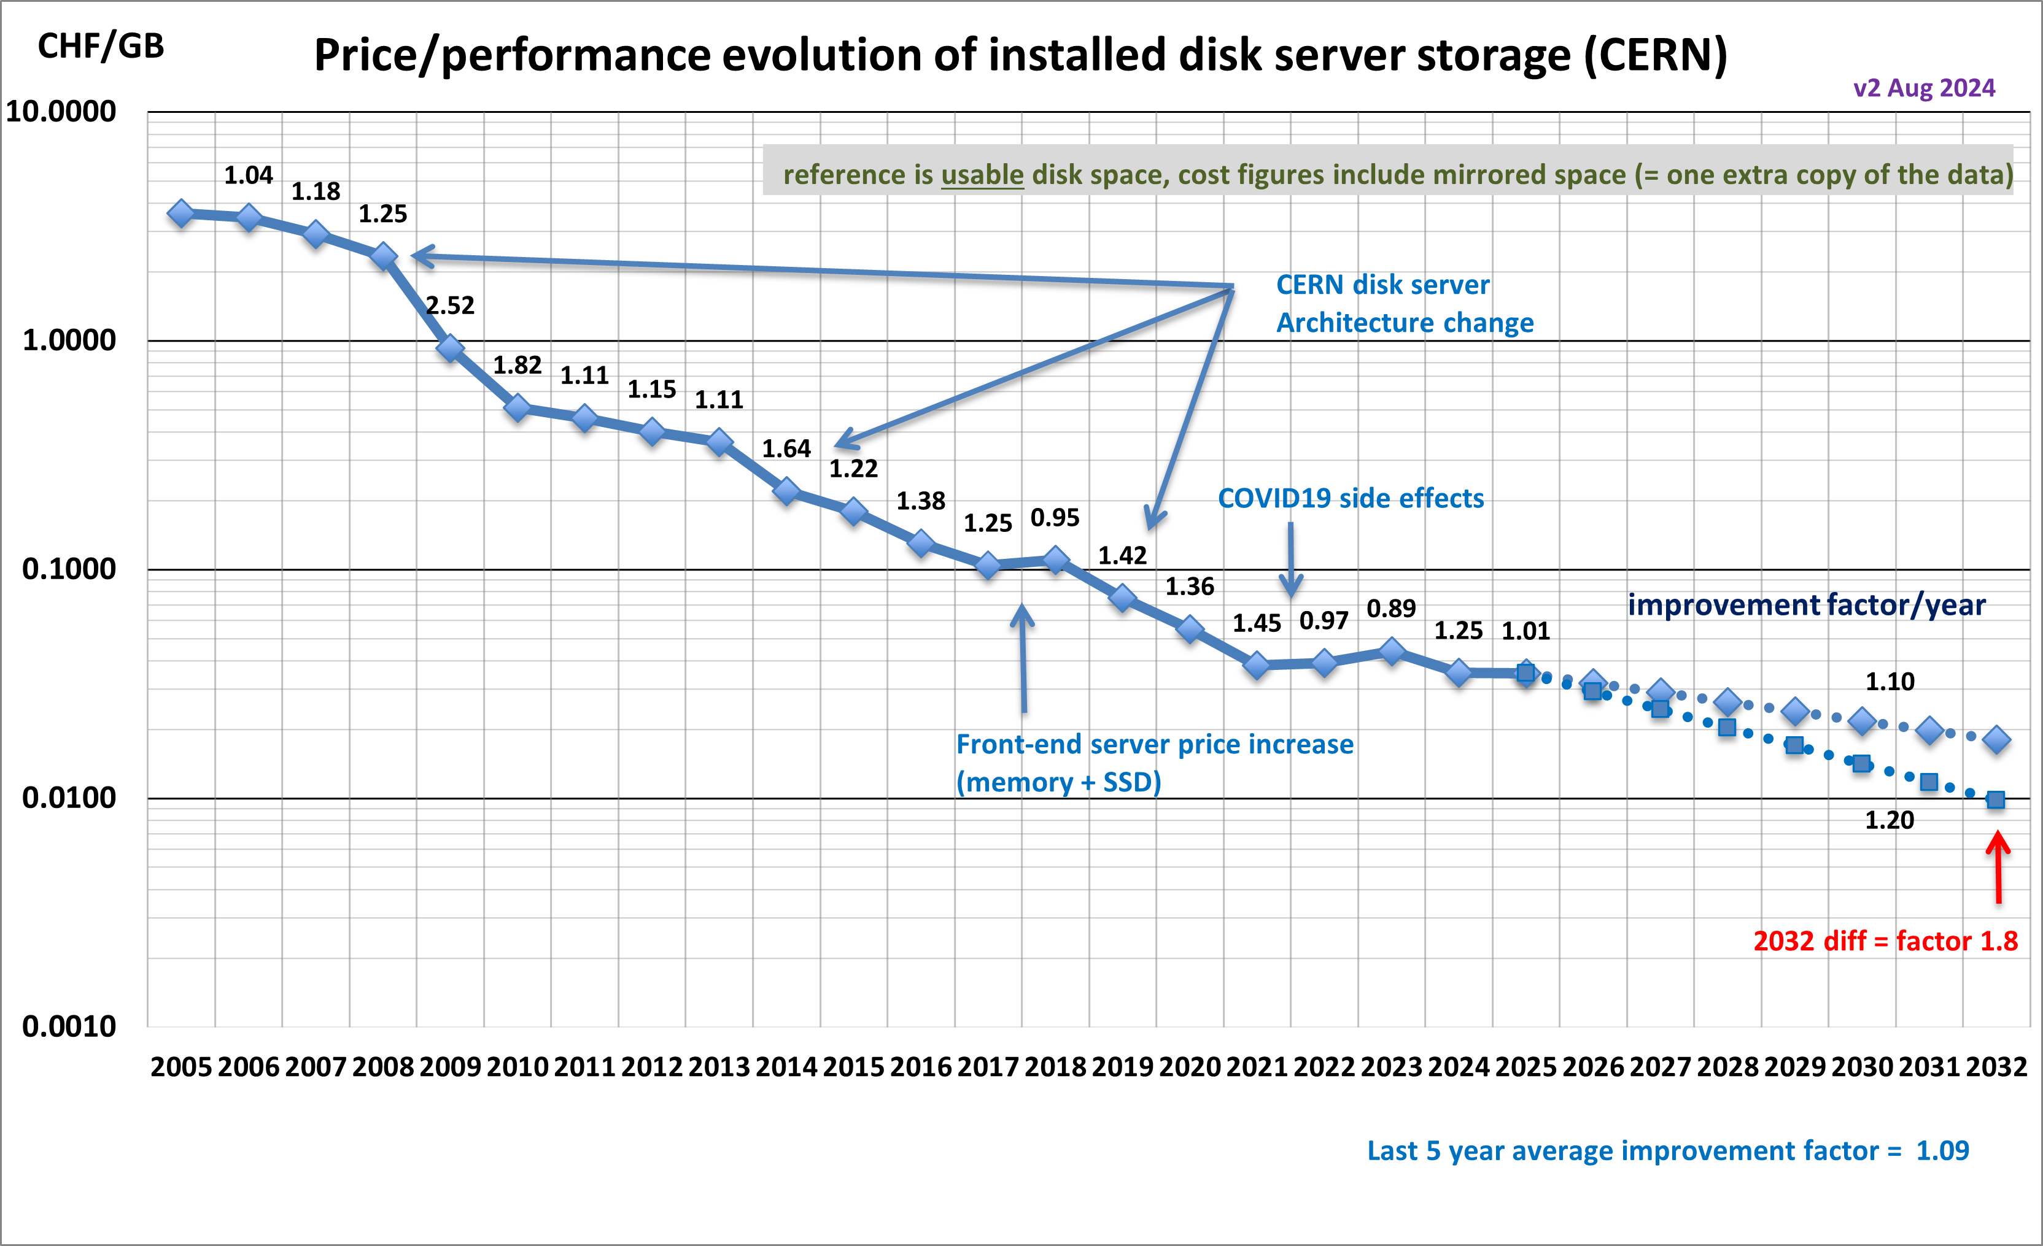
Disk cost extrapolation at CERN
Stable price decrease but also flattening out recently
Questions:
  When will energy-assisted magnetic recording HDDs will become commonplace?
  AI demand driving up demand for all storage. Any hope to get better prices in the next 2-3 years?
What about SSDs?
  Won’t completely replace HDDs, but usage will increase and negatively impact the overall cost of storage

Slide 8
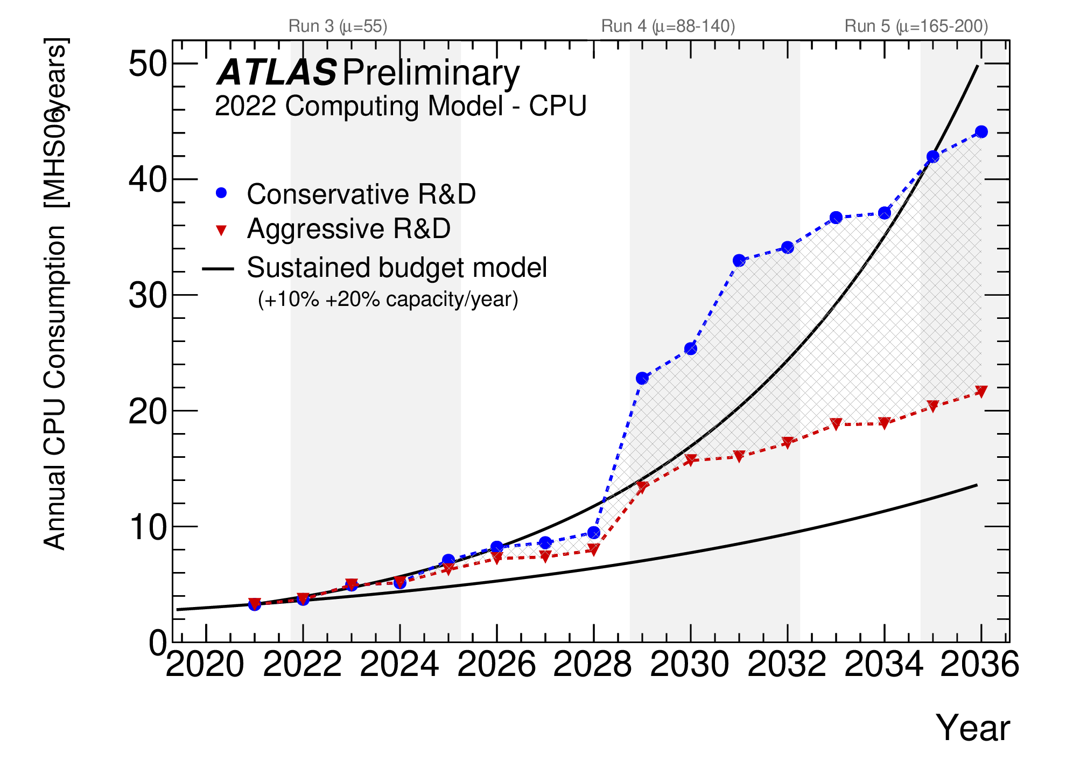
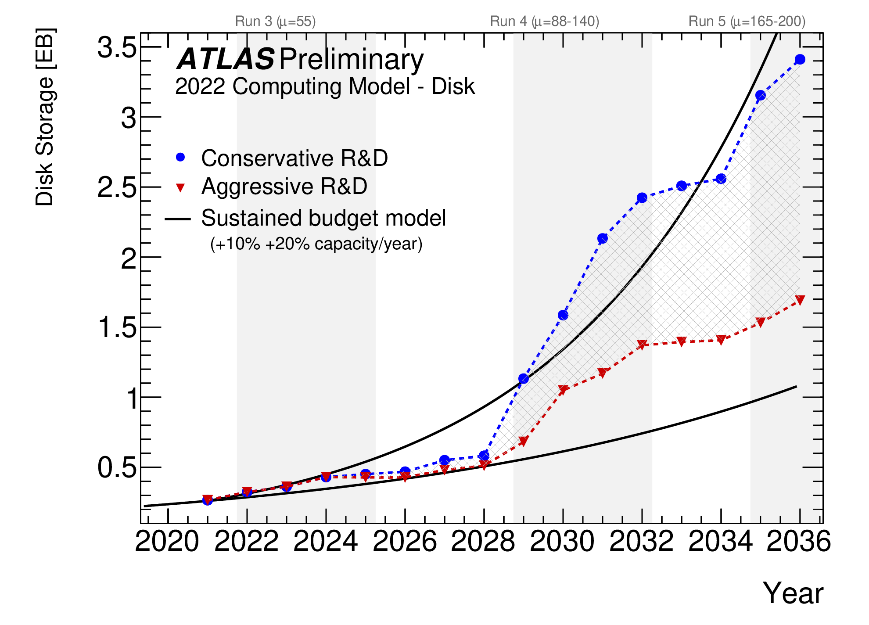
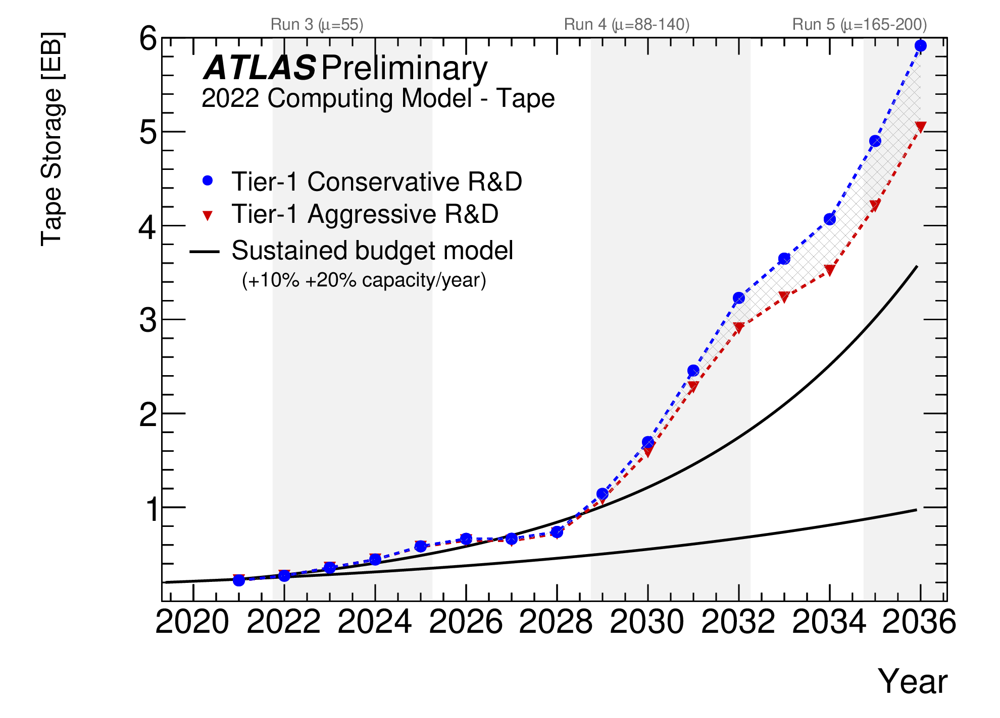
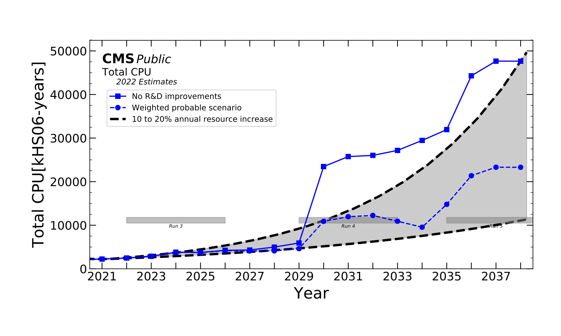
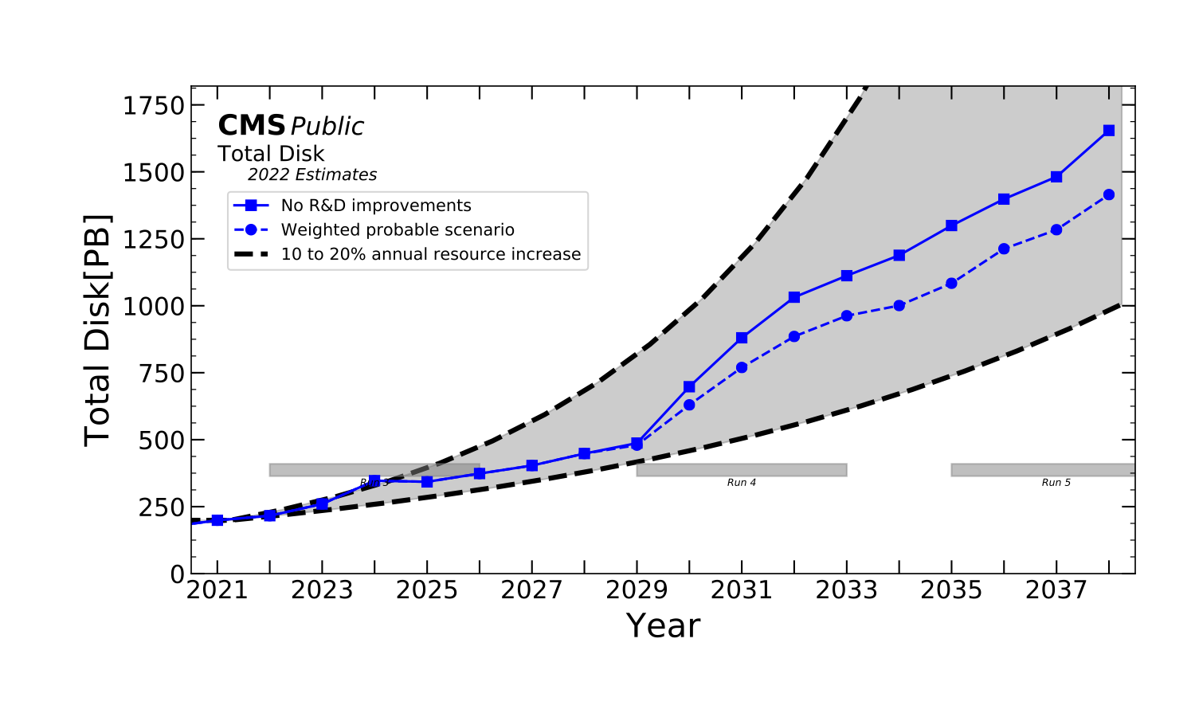
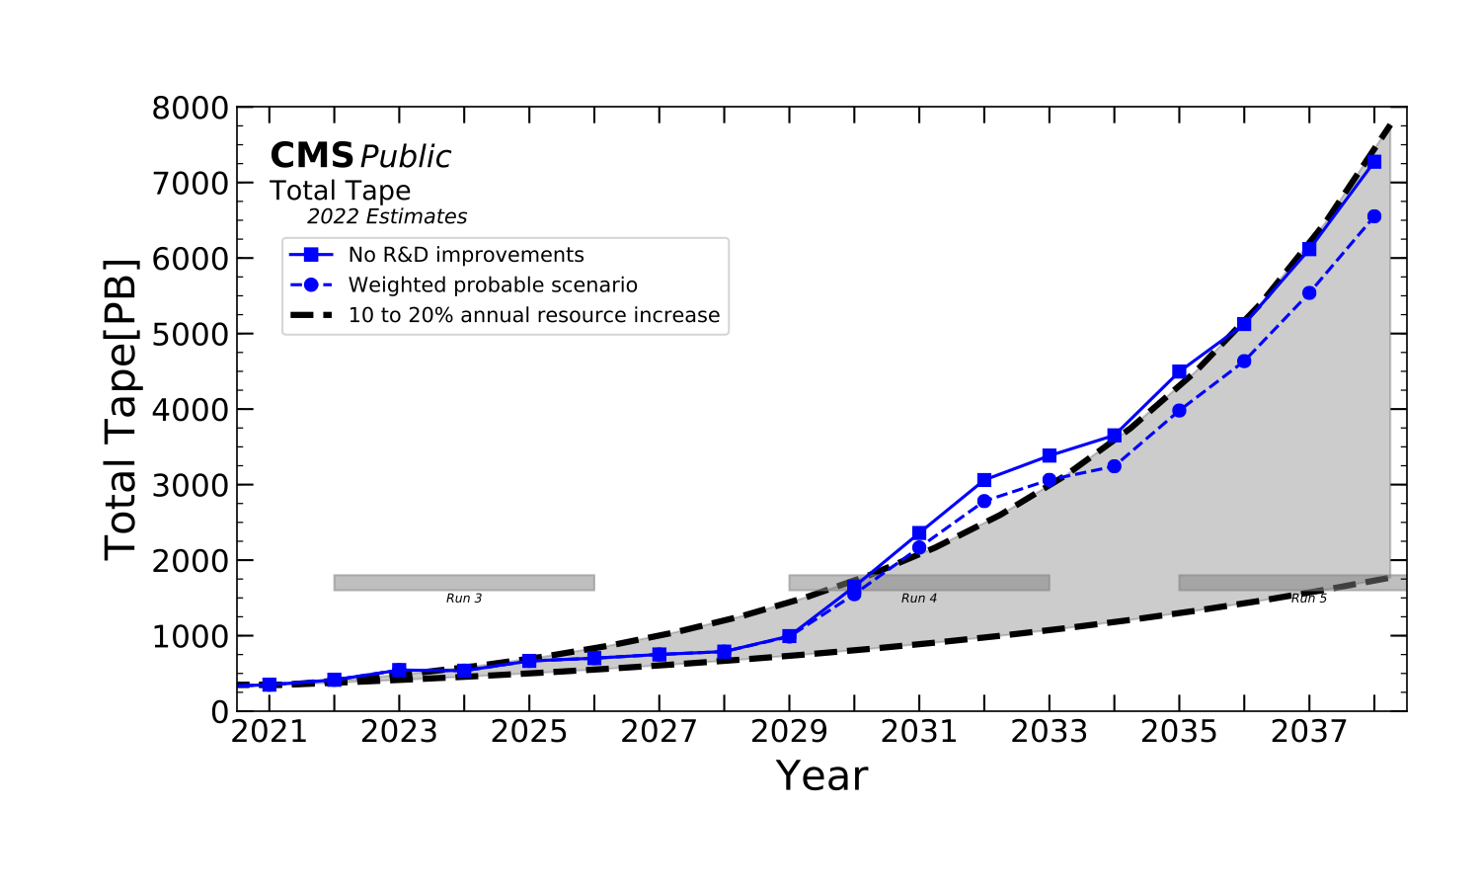
ATLAS and CMS resource needs up to HL-LHC
Sources: ATLAS and CMS
From the experiment plots, with a flat budget, a 15%/year price reduction is required even in the most optimistic case (for CPU and disk)
Situation much better than in the past, but still at the limit
Stressing the importance of technology awareness

Slide 9
Market trends

Slide 10
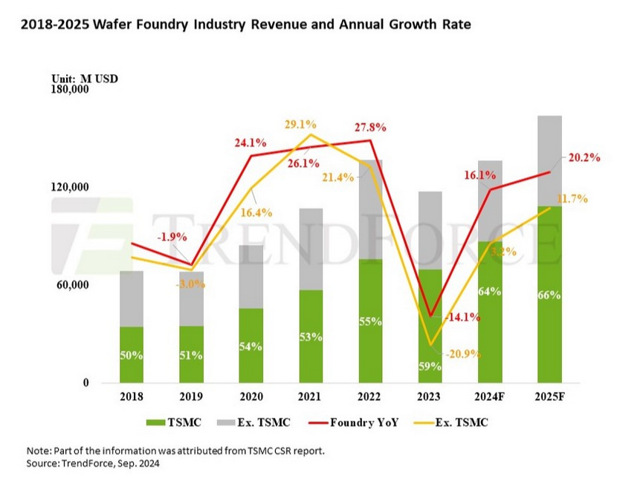
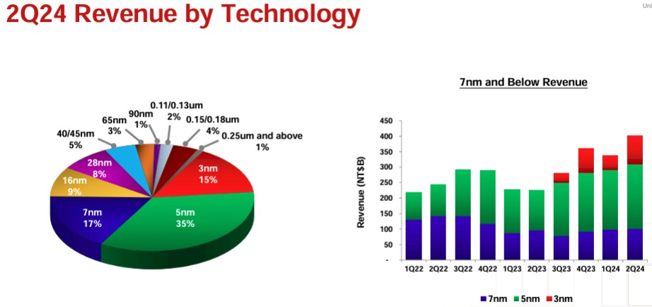
Foundry revenues
In 2024-2025 the market growth is primarily driven by the most advanced processes
  TSMC is the industry leader with > 60% of the market
    Makes all GPUs, all AMD and Apple CPUs
Different nodes for different products
  3 nm: high end CPUs
  5/4 nm: latest GPUs, ASICs
  7/6 nm: smartphone components
Source: Trendforce
TSMC Revenue for advanced nodes (Source: TheNextPlatform)

Slide 11
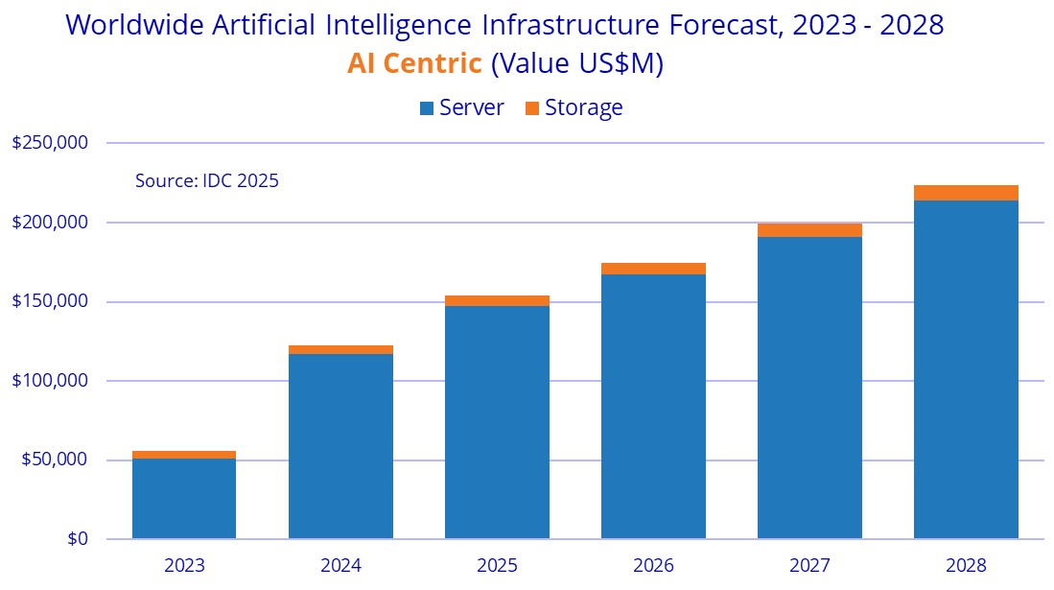
Server market
AI servers represent a rapidly increasing fraction of total servers delivered
  But only small margins for integrators, (~5%, typical for HPC hardware), while Nvidia, memory & flash makers make the highest profits
  Traditional servers (e.g. for databases) provide higher margins
Hyperscalers and cloud providers drive hardware market growth

Slide 12
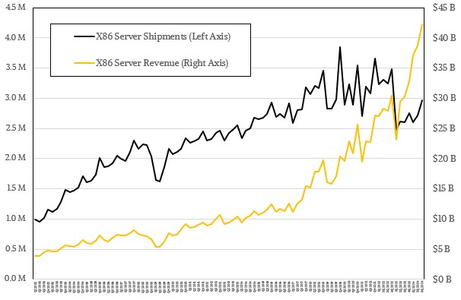
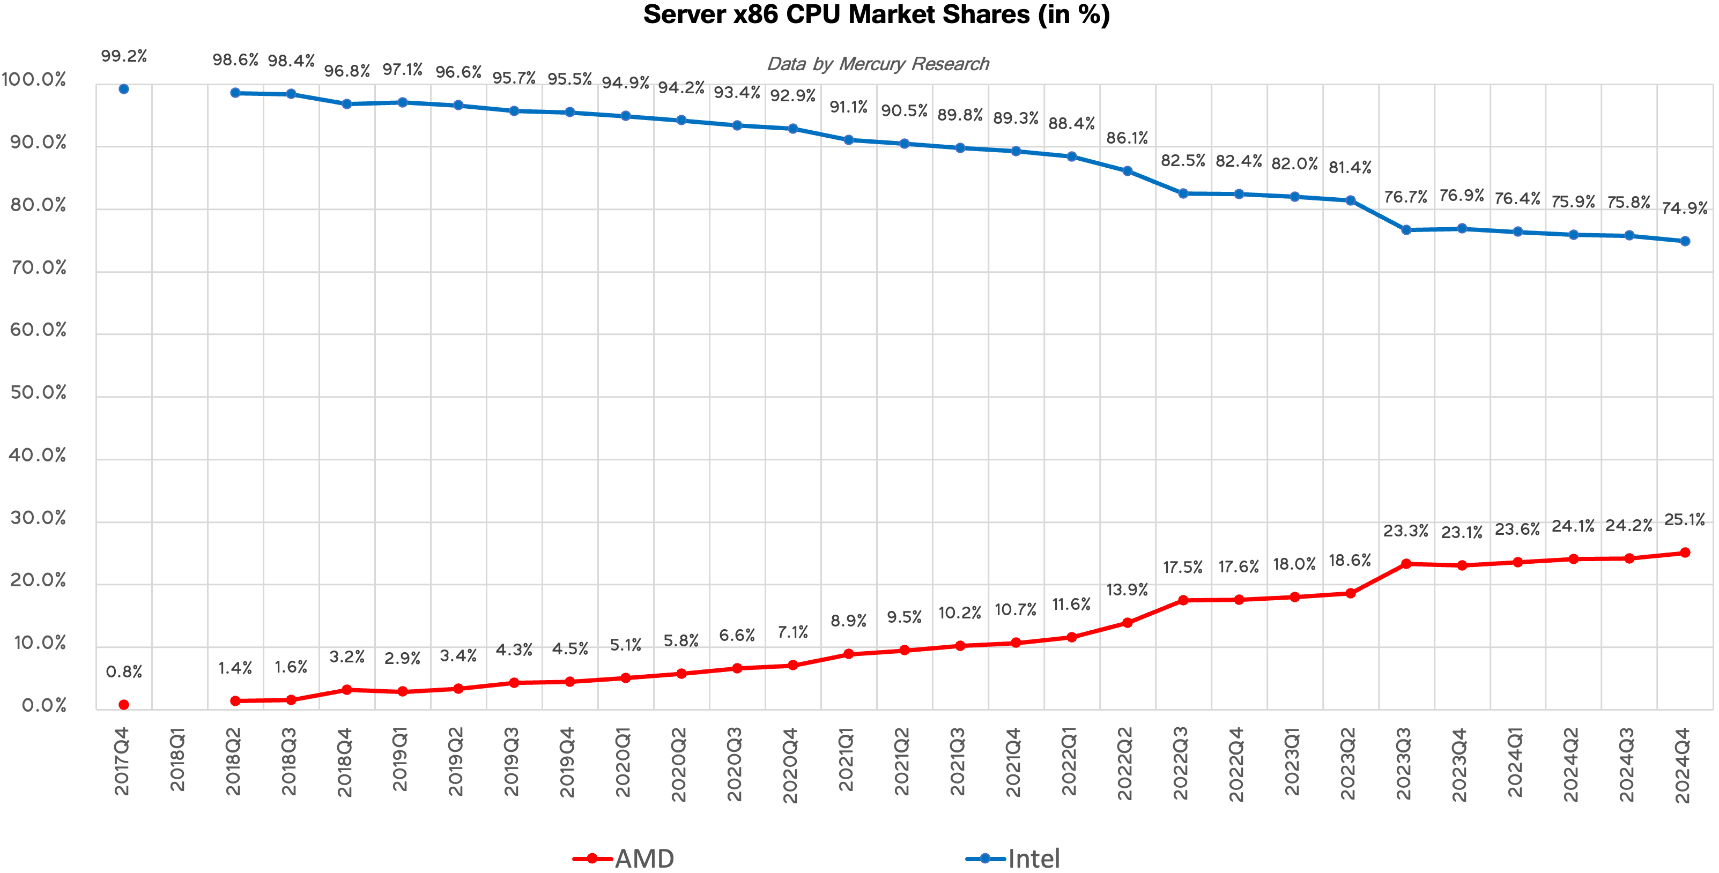
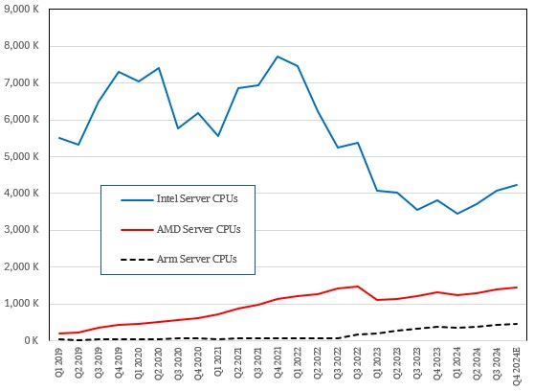
CPU server market
X86 server shipments and revenues increasing again
  Both for AMD and Intel
  Big drop in shipments was due to the GenAI boom, which made servers more expensive
AMD reached 25% server unit share, increasing at a steady rate
Arm is increasing due to the much lower server operational costs
  Ampere bought by Softbank, future (for us) not clear
RISC-V also gaining some traction
  Much cheaper than ARM (no licensing costs)
  Popular in China and in Europe for HPC
  E.g. Meta designing a RISC-V AI chip for training to reduce reliance on Nvidia
25% AMD

Slide 13
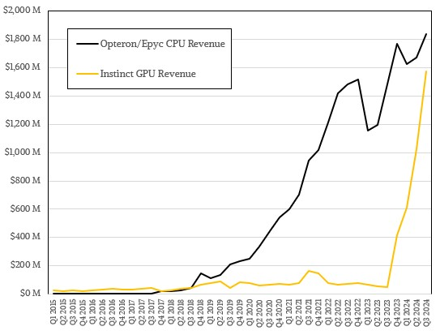
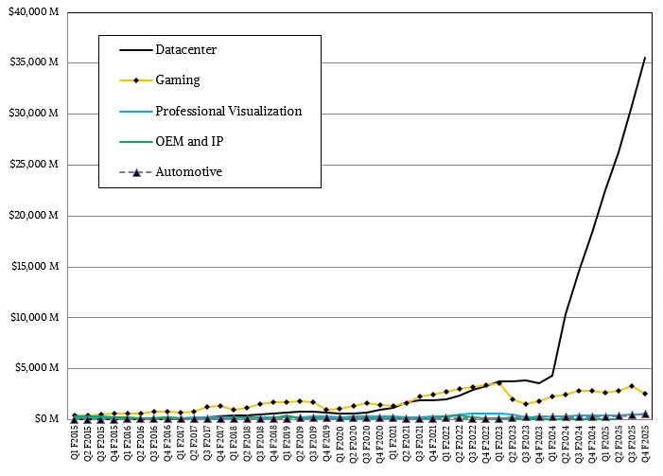
GPU market
AMD revenues
AMD doing very well, data center GPUs generating as much revenue as CPUs now
  30x increase in a year!
Nvidia ramping up Blackwell production
  Still producing a lot of Hopper GPUs
  Preparing to launch Blackwell Ultra (GB300) in March
    +50% FLOPS, +200 W, 288 GB of HBM3e, same bandwidth
Intel still offering only Gaudi AI accelerators
Potential new players
  Bolt Graphics Zeus GPU completely disregards AI to focus on HPC and rendering
    But FP64 at 5 TFLOPS is way too little for us
  Cerebras Wafer Scale Engine 3 “the fastest AI chip on Earth”, with 125 FP16 PFLOPS (B100 has 1.8) and 44 GB of SRAM
    Might be interesting for an R&D project
Performance evolution is not going in a direction we like
  FP32/FP64 performance will not increase much, or at all
  AI performance (FP16, FP8, INT8) has priority because is where most of the money is made!
Nvidia revenues

Slide 14
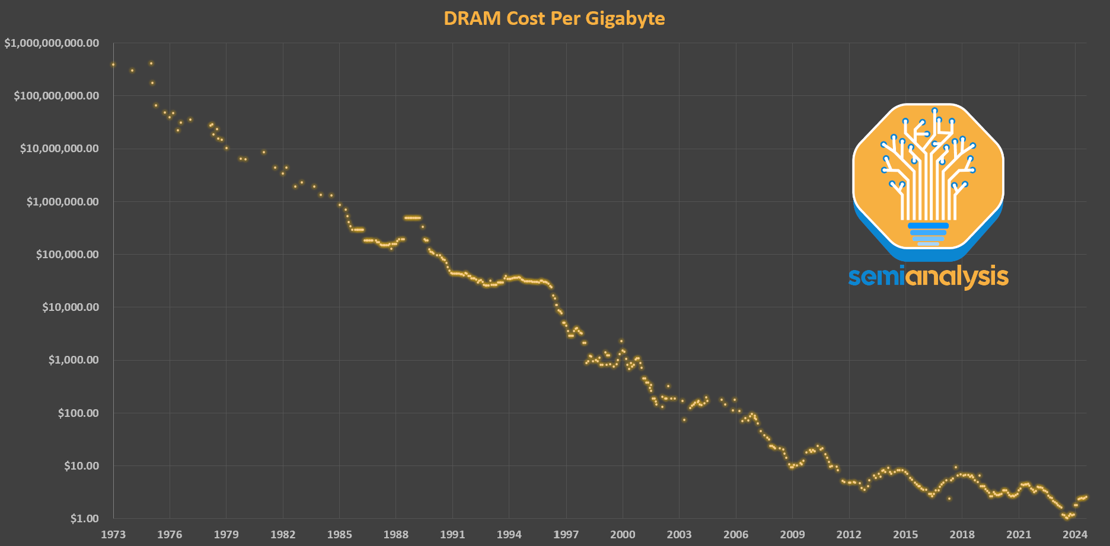
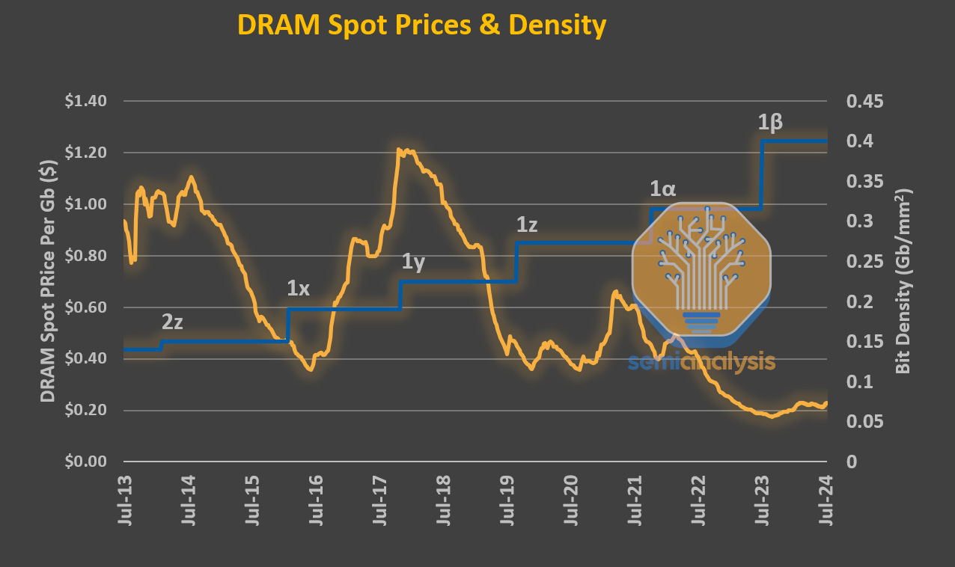
Memory market
DRAM is not scaling any more
  Bit density just doubled in the last 10 years
  Stuck at the 10 nm node
  Severely lagging behind logic, which improves by 30%-40% every 2 years
Price going down, but slower and slower and with wild fluctuations
  Being the technology static, prices just depend on demand and supply
All DRAM varieties share the same memory cell technology
  Differences only in packaging and circuitry
  New memory technologies (FeRAM, MRAM, ecc.) are not a viable alternative, mainly due to cost
Source: Semianalysis

Slide 15
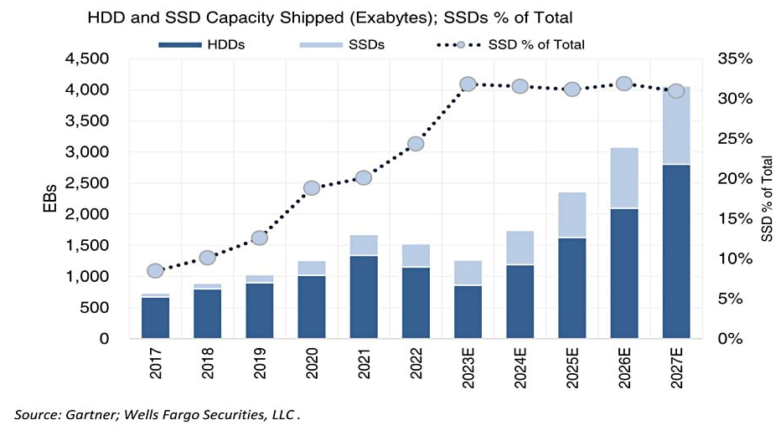
NAND Flash market
Globally, shipped NAND flash capacity amounts to 30% of the total (SSD+HDD)
  For HEP, it is much less: only as system drives and for certain high IOPS/bandwidth storage systems (data caches, tape buffers, analysis facilities…)
  Price gap with HDDs is still 3-4x, slowly decreasing
Growth rate for NAND flash less than predicted (less orders from PC, mobile and key buyers)
  10-15% instead of 30%, Samsung and SK Hynix will scale down production by 10%
  Weak pricing in 2025, but only for a few months, long term demand will go up again due to AI
Blocks and files

Slide 16
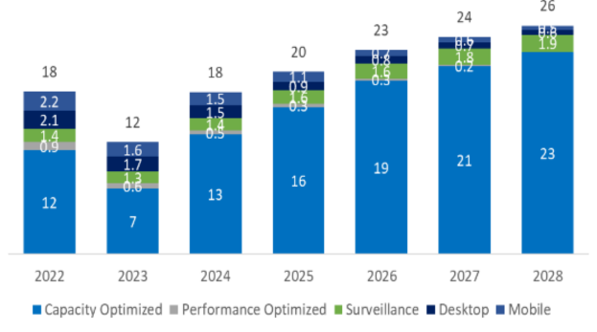
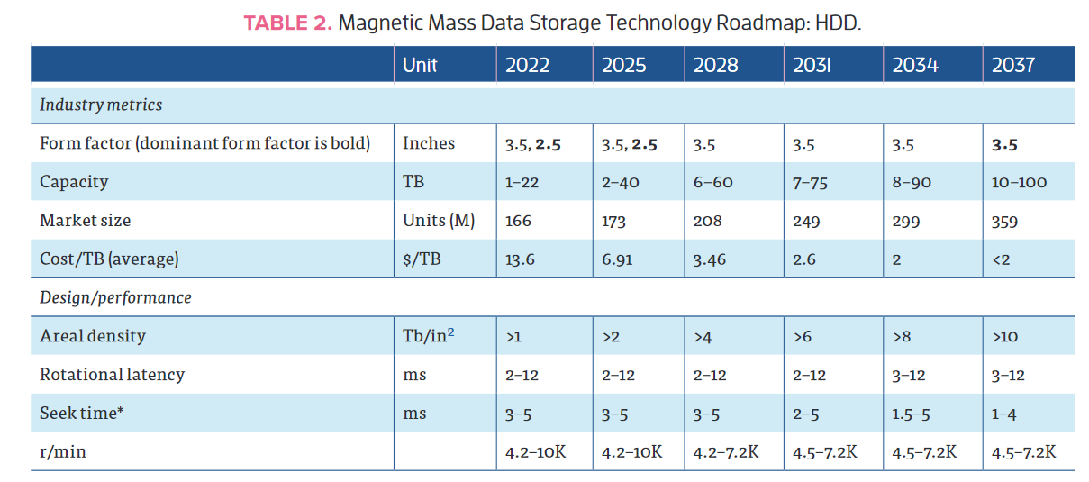
HDD market
Worldwide market amount
B$
Capacities still increasing, thanks to SMR and HAMR
  HDD shipments will soon be almost only nearline
  HAMR drives can finally be bought, (e.g. Seagate @ 36TB) but not cost effective for now, other vendors will come later
  SMR drives mostly bought by hyperscalers
    Significant investments in software required
  Further increases in capacity more constrained by marketability than underlying technology
    60 TB disks by 2028 using HAMR?
  Power consumption should stay around 10 W/drive, so Watt/TB will decrease
Performance is not increasing (fast enough)
  Might create a bottleneck for data access in WLCG
IEEE roadmap for Mass Digital Storage Technology

Slide 17
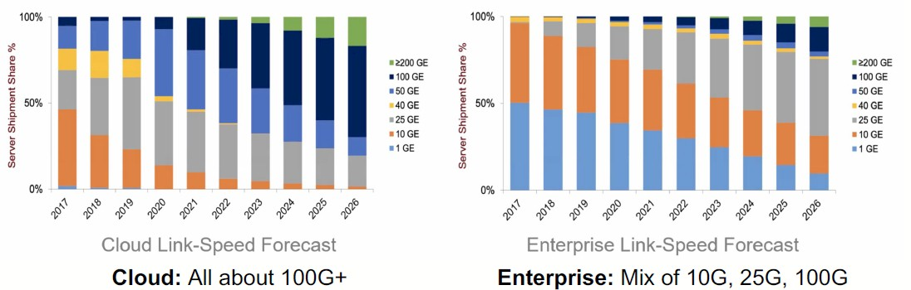
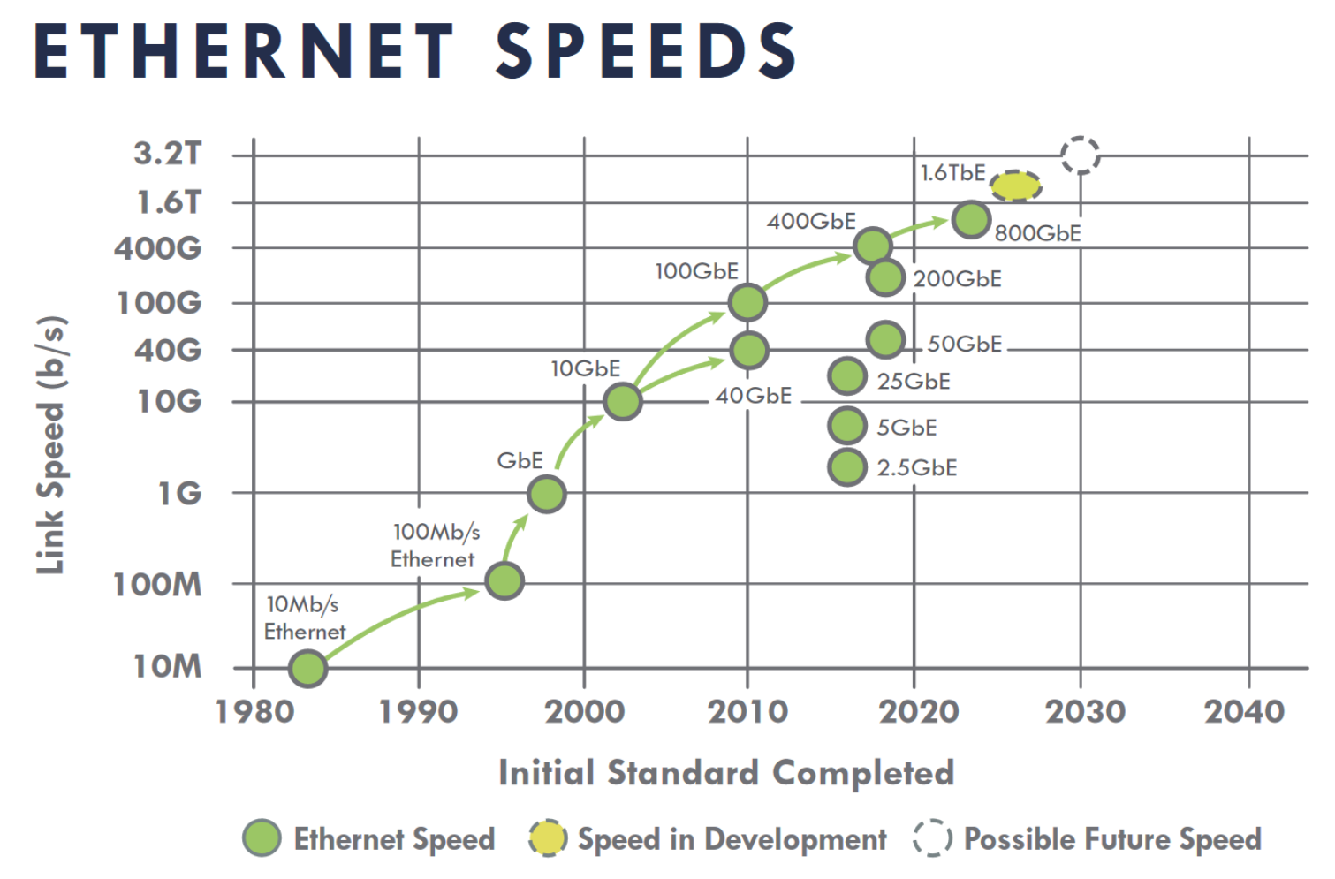
LAN and interconnect trends
Network interface port speeds
InfiniBand provides high throughput/low latency networking
  Useful for AI and HPC simulations, DAQ systems
  Can provide Remote Direct Memory Access (RDMA)
  Now controlled by Nvidia, cost may amount to up to 20% of an HPC cluster
  RoCE (RDMA over Converged Ethernet) is a much cheaper alternative that works over Ethernet and it is gaining ground
Ultra Ethernet consortium aims at producing an alternative to InfiniBand
  Open standard supported by AMD, Broadcom, Cisco, HPE, Meta, Microsoft, Oracle, Linux Foundation, and many others (> 60 companies so far, even Nvidia!)
  Improves the Ethernet protocol to allow for high bandwidth/low latency, would replace RoCE
Omni-Path is a competing standard originally from Intel
  It will be made compatible with Ultra Ethernet to stay relevant
The path to 800G+ requires optimizing power consumption at the optic level
  not yet clear which direction will be taken (pluggable optic modules vs everything internal to the switch/router)
Paving The Way For 800 Gb/sec Ethernet In The Enterprise (nextplatform.com)

Slide 18
Highlights from hardware technology

Slide 19
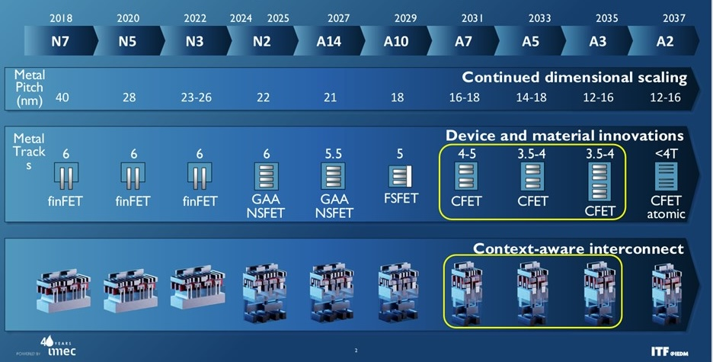
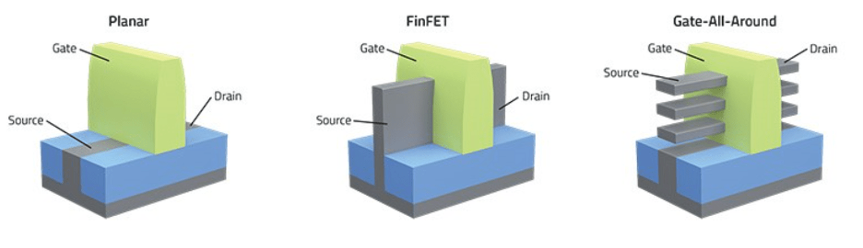
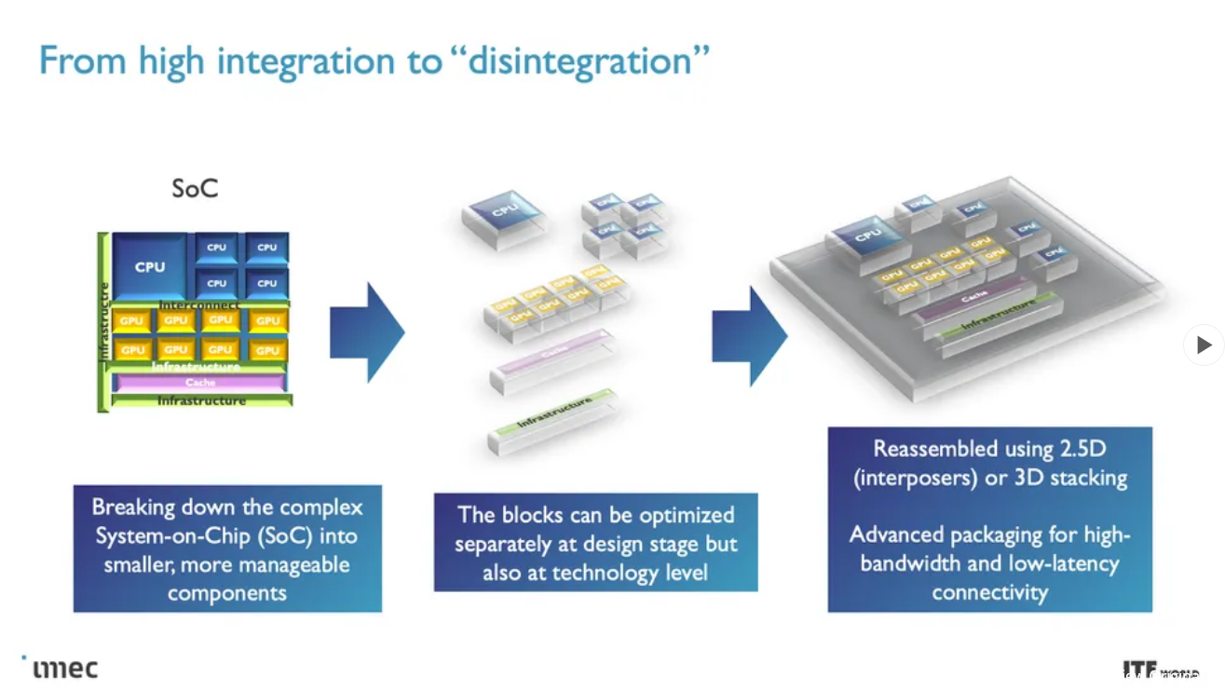
Roadmap for fabrication processes
Roadmap until 2036 (“More Moore”)
  Transition from FinFET transistors to GAA nanosheet designs for N2 and beyond (“Angstrom era”)
    Less leakage, faster transistor switching
    Near to volume production
  CFET transistors the next big thing, from 2031
Chiplet architectures (“More than Moore”)
  3D packaging used to compensate for the slower and slower transistor shrinking
  Voltages are not decreasing any more
Semiconductor technical advances focus on materials, rather than lithography
  E.g. 2D materials to replace silicon transistor channels
Photonic Integrated Circuits (PIC)
  Would improve reliability and reduce power consumption and packaging costs
  Still not viable due to difficulties in material growth

Slide 20
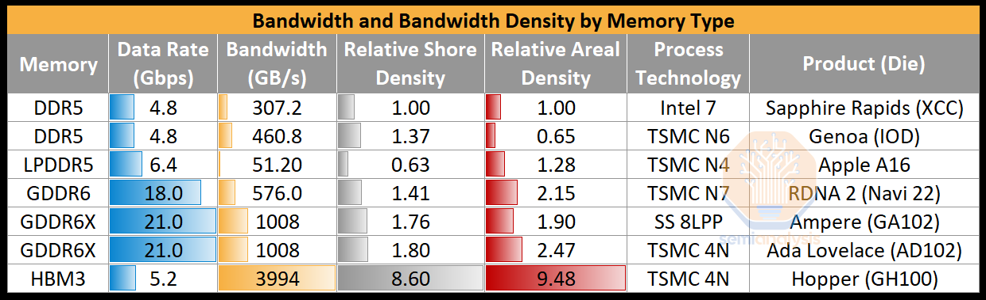
Memory technology
 | Max capacity | Bandwidth | Bus width | Used on
HBM3 | 24 GB per stack | ~820 GB/s per stack | 1024 bit | Hopper, MI300
HBM3E | 36 GB per stack | ~1.3 TB/s per stack | 1024 bit | Blackwell
GDDR7 | 64 Gbit per chip | 160 GB/s | 32 bit | RTX 50-series
MRDIMM | 256 GB per module | 8800 MT/s | 64 bit | System
Strong push towards high bandwidth, low latency for HPC and AI
  Wide range of types of DRAM for different applications
  Optimization via interconnecting different chiplets (logic, memory, IO)
System memory
  DDR5 current standard, up to 6400 MT/s
  LPDDR5X more power efficient, and cheaper than HBM, but has limitations
  MRDIMM (multi-ranked buffered DIMM) to achieve 8800 MT/s and more
  CXL (Compute Express Link) is a protocol on top of PCIe that allows to disaggregate memory and share it with many CPUs and GPUs, combining DRAM and non-volatile storage
Semianalysis

Slide 21
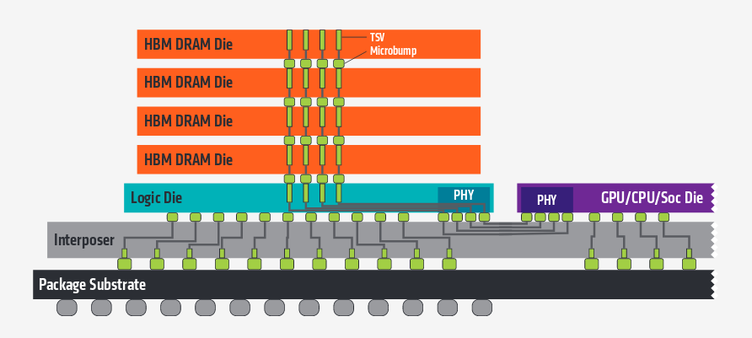
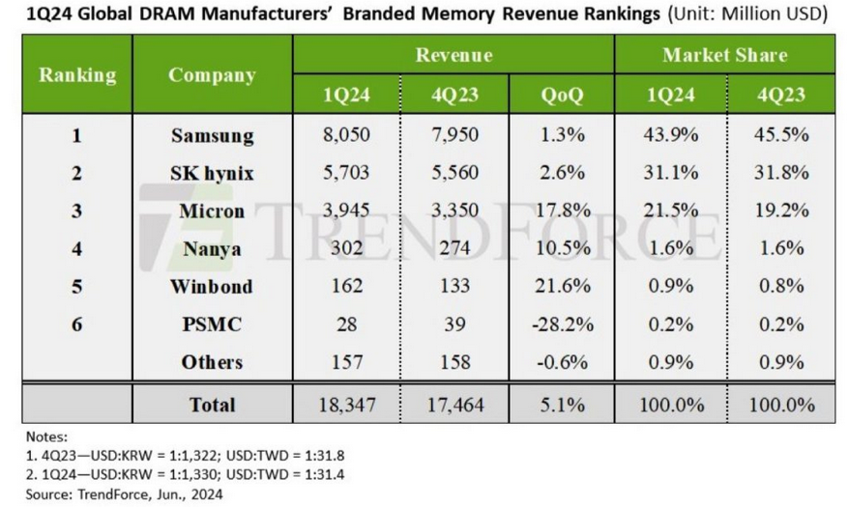
High bandwidth memory
HBM memory in increasing demand
  Stacks of DRAM dies (up to 12), 1024-bit wide interface
  Directly connected to the GPU (or CPU, FPGA)
  Latest is HBM3e, total bandwidth per stack > 1 TB/s
  Only viable solution for large model AI accelerators
  3x more expensive than DDR5
  HBM4 in production from 2025Q3 (SK Hynix, followed by Samsung and Micron), in time for NVIDIA’s Rubin
Memory market is recovering after collapsing in 2022-23
  Memory shortages still possible as HBM uses capacity at the expense of DRAM
  10% of capacity but 20-30% of market value in 2025
Beyond HBM?
  In-memory computing might provide 100x more bandwidth than HBM!

Slide 22
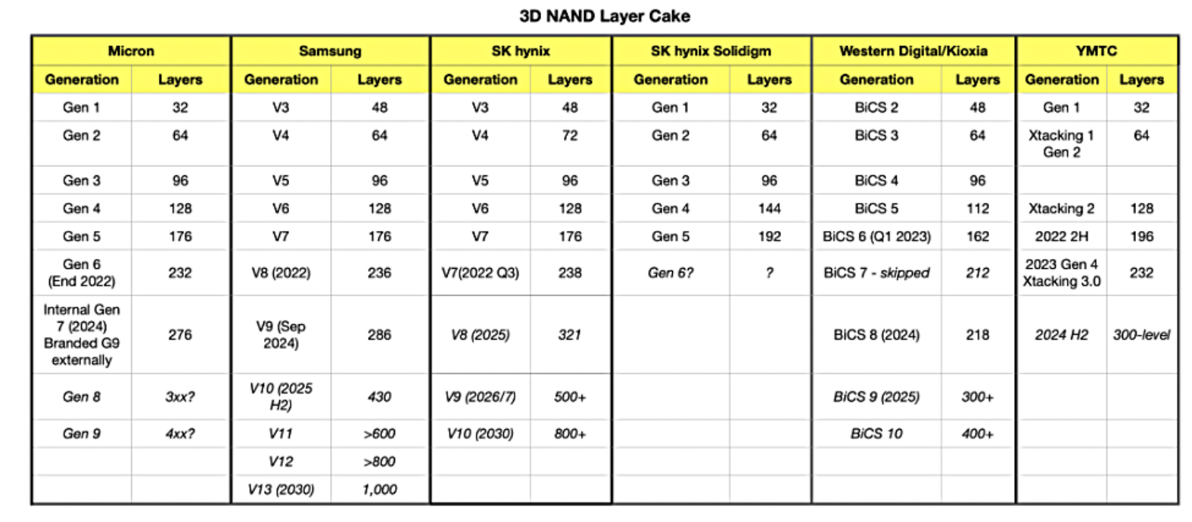
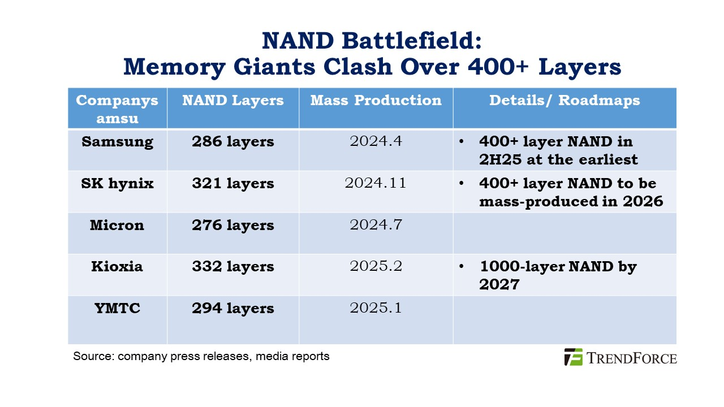
Flash storage
Capacity increasing in two dimensions
  Bits/cell: SLC → MLC → TLC → QLC → PLC?
    QLC for large SSD used for data serving
    TLC and lower for high R/W rates
  Number of layers: ~ 200-300 today, 400+ in 2025
  Drive capacity soon to exceed 120 TB!
Samsung confirms plans for 1000 layers by 2030
  Using a technique to bond multiple wafers, to break a manufacturing limit
  Mass producing NAND with ~400 layers this year
China’s YMTC is catching up, shipping products with ~300 layers
Performance will go up with PCIe 6
  Micron demoed an SSD reaching 27 GB/s!
Supplier 3D NAND layer count generations

Slide 23
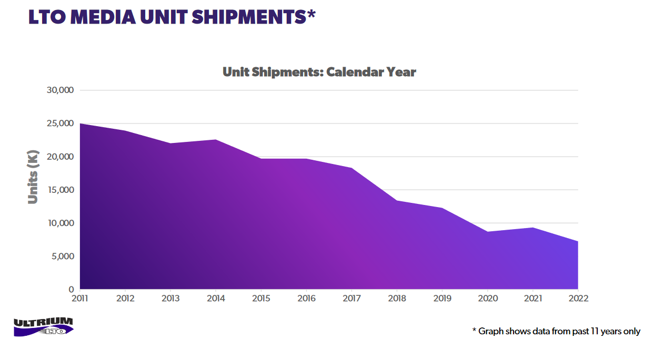
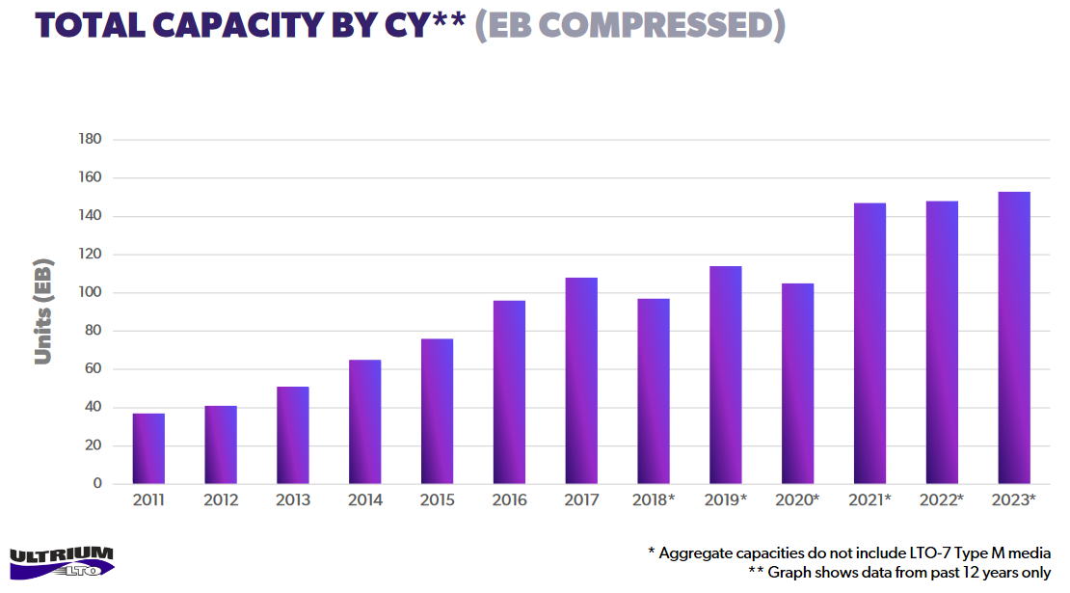
Archive storage
Magnetic Tape
  Still a lot of room for scaling
    30%-40% yearly increase in cartridge capacity
  Lots of technology advancements in both media and drives
  LTO the leading standard, smaller share for the IBM TS11XX format
  Total LTO cartridges shipped has been declining, but exabytes shipped is flat
Optical disk dead
  Panasonic and Sony discontinued Archival Disc drives and libraries
On the horizon
  Cerabyte “ceramic nano-memory” - Data etched in material via lasers
  Glass storage (Microsoft’s project Silica), similar concept, very sparse information
  DNA storage – Just too expensive to be practical
    Might serve the “write once / read never-or-seldom” use case
Source: LTO
Compression factor 2.5

Slide 24
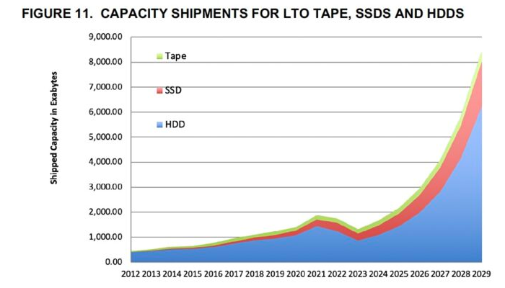
Storage evolution summary
To summarize:
  AI boom drives volume increase for all types of storage
  SSDs will not replace HDDs in data centers anytime soon
  Our usage of SSD will probably increase to cope with the performance bottlenecks of HDDs
  Tapes are not going anywhere either
Source: Blocks and Files

Slide 25
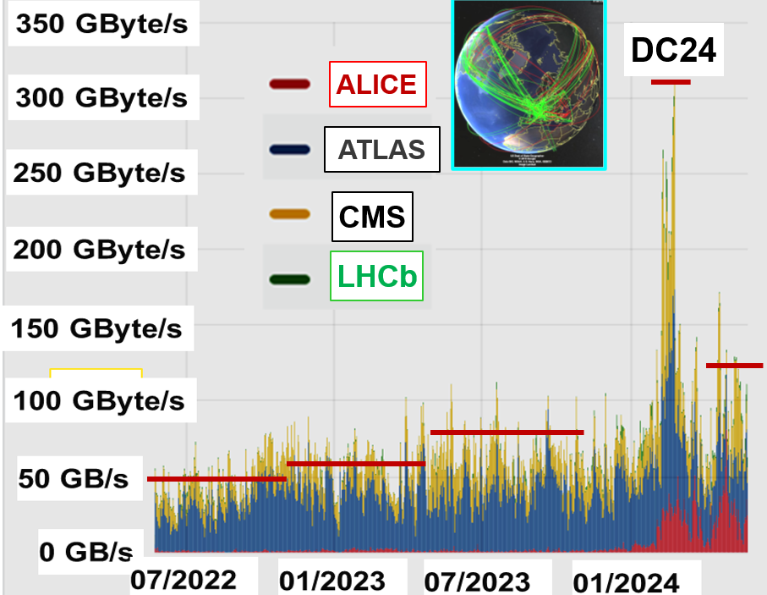
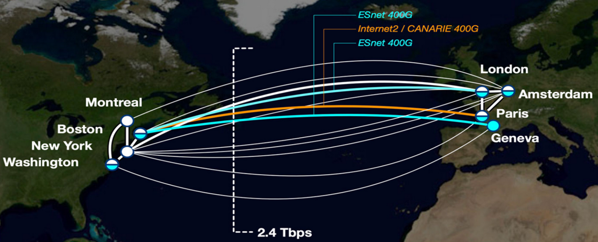
Developments in WAN connectivity
Key Achievements
  LHC Data Growth: From 30–85 GB/s (2015) to 170+ GB/s (2024)
  Global Network Expansion: Advanced North Atlantic (ANA) collaboration’s 2.4 Tbps transoceanic connectivity
Objectives for HL-LHC networking
  Coordination of network resources across world regions
  Network services to dynamically allocate resources to workflows
  A fully programmable ecosystem of networks and operations platforms

Slide 26
Future Innovations & Strategic Goals
Global Collaboration
  GNA-G volunteer group to support the development of intelligent network systems for data intensive science
    Esnet SENSE: SDN for end-to-end networked science at the Exascale
      Network services to build multidomain virtual circuits with bandwidth guarantees
      Advanced services via Site and Network Resource Managers and an Orchestrator
    10 Tbps networking in aggregate will be reached relatively early in the HL LHC era
      There will be further exponential growth between 2030 and 2040
  Partnerships across US, Europe, Asia, and Latin America
Intelligent Networking
  PolKA: Advanced source routing for dynamic traffic steering based on real-time network conditions
  HECATE: AI-driven network optimization to prevent congestion

Slide 27
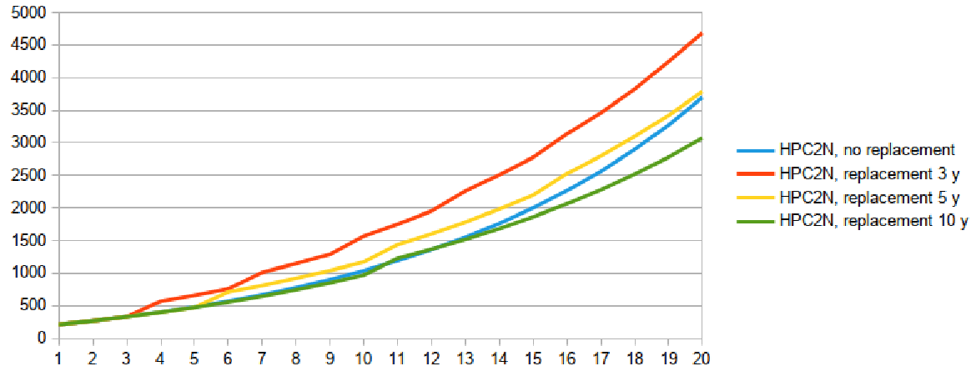
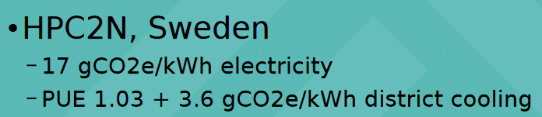
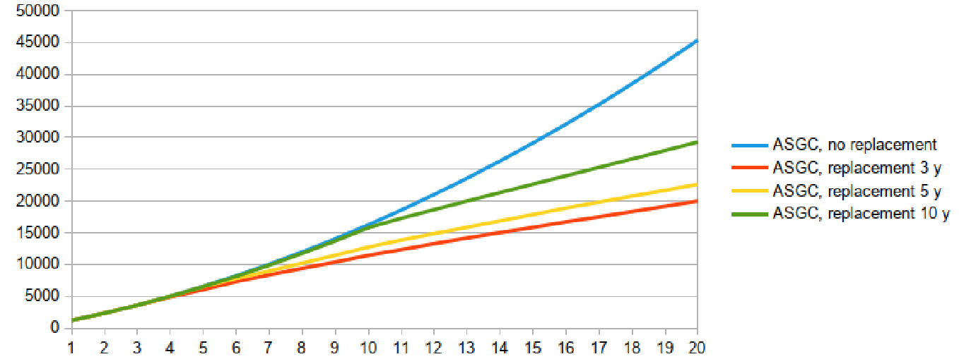
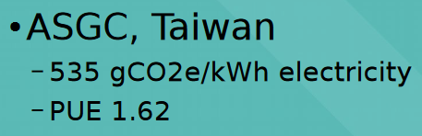
More on sustainability
Performance/Watt is now almost as important as performance/euro
  Electricity prices
  Limited cooling capacity of existing data centers
  Need to limit CO₂ emissions
HDD and tape much better than SSD in terms of emissions
  When embedded emissions are considered!
Arm CPUs are attracting a lot of interest
  Very power efficient, but not fully validated by LHC experiments
  Only two options: Ampere and Nvidia Grace
Many considerations enter into play
  “Embedded” emissions vs operational emissions: how often to replace hardware?
  Many new CPUs and GPUs will need liquid
Emissions (kg CO2) vs. time (y) per 1kHS23
M. Wadenstein, HEPiX Spring 2024

Slide 28
Conclusions
Technology tracking essential to make cost-efficient choices for HEP computing
  Done in different contexts in our community
Many server hardware components are rising in price due to the AI boom
  Memory, GPUs, flash, HDD are all affected
AMD, Arm and Intel show healthy competition
  A lot of attention to performance/Watt
Evolution of GPUs is not going in a direction very useful for us
  FP32/64 performance not increasing
Shipped storage capacity increasingly driven by the global trend
  SSDs, HDDs and tape all still relevant and making progress
Network bandwidth correspondingly increasing on LAN and WAN
  To cope with increase in cores and storage/server
  For LHC, driven by HL-LHC data rates
Sustainability is more important than ever
  CO2 emissions, liquid cooling, electricity costs and distribution

Slide 29
Acknowledgements
This work was made possible by many contributions from and discussions with
  The members of the HEPiX Technology Working Group
  The members of the HEPiX Benchmarking Working Group
  Luca Atzori, Eric Bonfillou, Vincent Ducret, Harvey Newman, Bernd Panzer-Steindel, Markus Schulz

Slide 30
Questions?

Slide 31
Backup slides

Slide 32
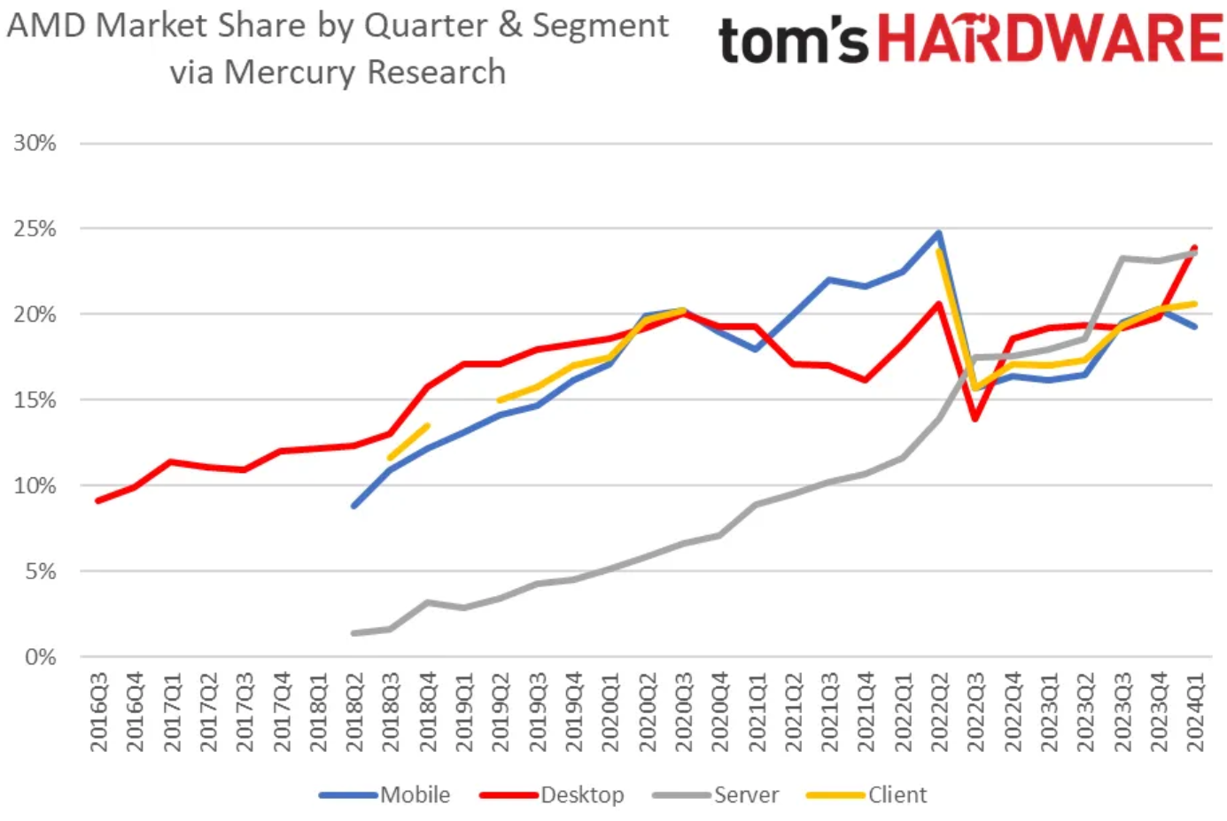
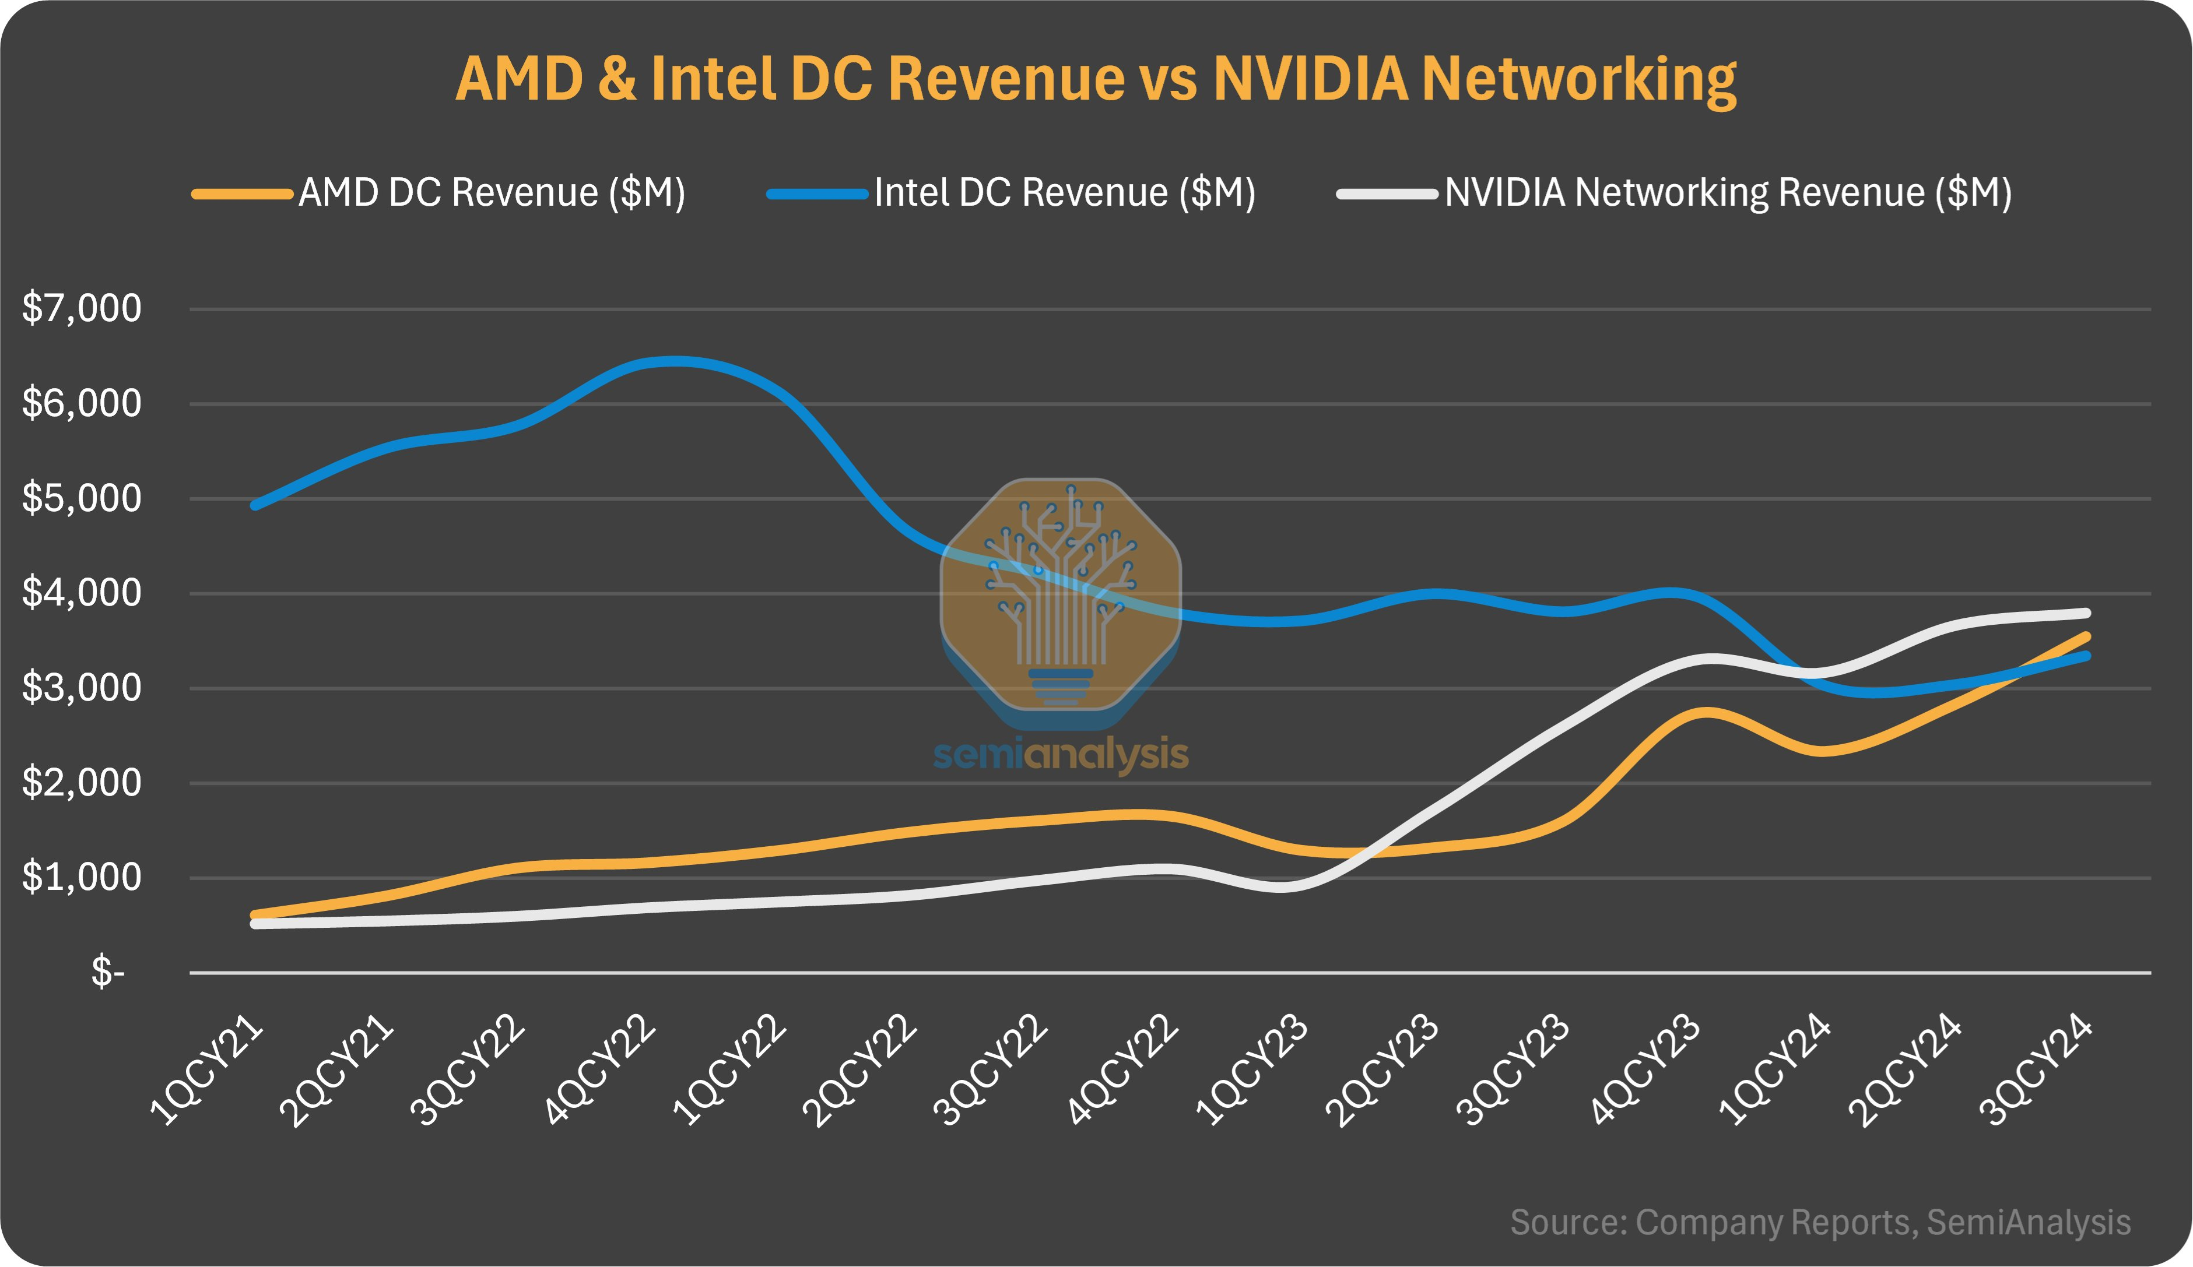
x86 CPUs
Intel’s situation still very concerning
  Losing ground to AMD in the data center, but nowhere close to collapsing
  Laptop and desktop CPU sector still going reasonably well
  No competitive GPU/AI products
  But it’s the Foundry that’s really losing money
  Many rumors over time, latest is takeover by Broadcom (Intel Products) and TSMC (Intel Foundry)
  Intel 18A process looks very promising (possibly faster than TSMC’s N2), being tested by Broadcom and Nvidia
AMD gaining significant market share
  Even making more money than Intel in the data center, as Intel has lower margins
Shipments increasing for both
  Driven by high demand

Slide 33
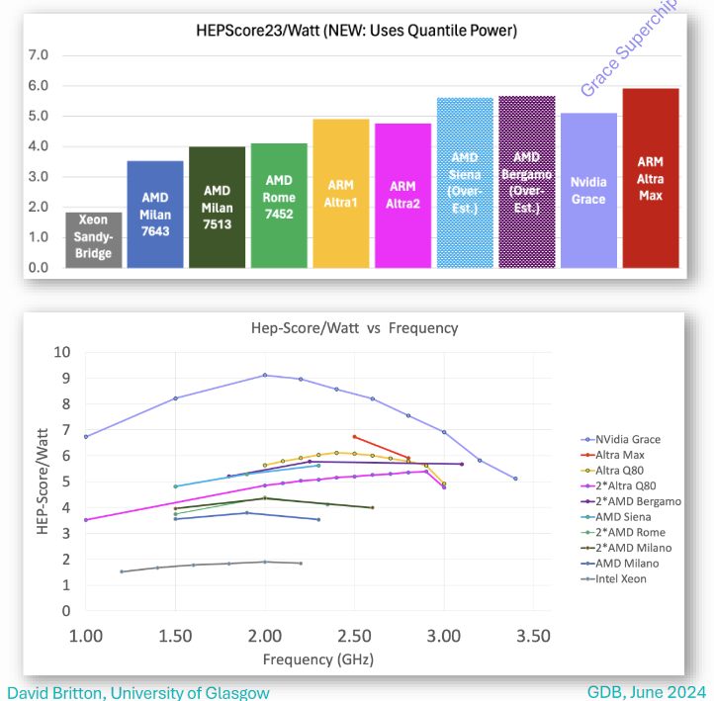
What about Arm?
Arm entered the server market in 2018 and sells CPU designs
  Neoverse N1 in 2019: Ampere Altra (80 cores), AWS Graviton2
  Neoverse N2 in 2020: Microsoft Azure Cobalt
  Neoverse V1 in 2020: AWS Graviton3
  Neoverse V2 in 2022: AWS Graviton4, Nvidia Grace, Google Axion
  AmpereOne in 2024: up to 192 cores (custom design)
Nvidia main competitor with the Grace CPU
  Combined with the Hopper GPU or two CPUs in a “superchip” (144c)
Ampere CPUs already deployed at a few WLCG sites
  Notably Glasgow, published several efficiency measurements and comparisons with x86
  Clearly better power efficiency!
Not quite yet a valid alternative for WLCG
  Not all experiment workloads are validated on Arm
  Ampere is a very small company, Grace is very expensive
  Arm bought by Softbank, future uncertain
  Both Intel and AMD are pushing strongly on power efficiency
And RISC-V??
  Not yet a viable platform for WLCG, but it is ramping up fast!

Slide 34
AI market
Incredibly rapid growth…
  ChatGPT got 1M users in 5 days and 100M users in 2 months
  Promises huge efficiency gains for organizations
  Last not least, fear of missing out (FOMO)
  Price and availability of GPUs constantly under pressure
… but concerns about a “bubble”
  Huge investments but little profit in return, so far (e.g. OpenAI’s value is $300 billion, never made a profit)
  Some observers thinks that AI spending is reaching a peak now
  Very high levels of hype may create inflated expectations
  Doubts about the scalability of LLMs
  Market volatility (e.g. the DeepSeek launch cost 1 trillion dollars)
  Increasingly serious infrastructure, supply chain and sustainability issues
For sure, AI is not going anywhere
  Maybe not a market collapse, but a readjustment is likely

Slide 35
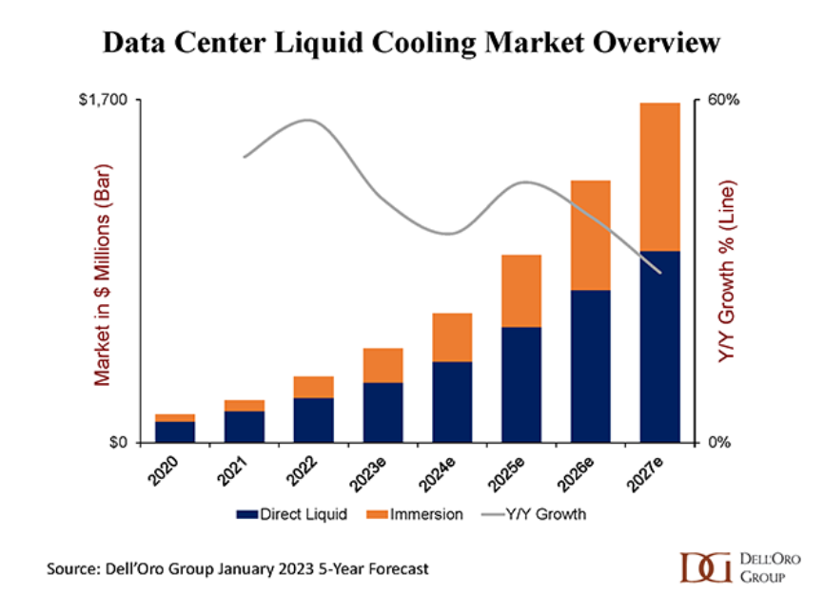
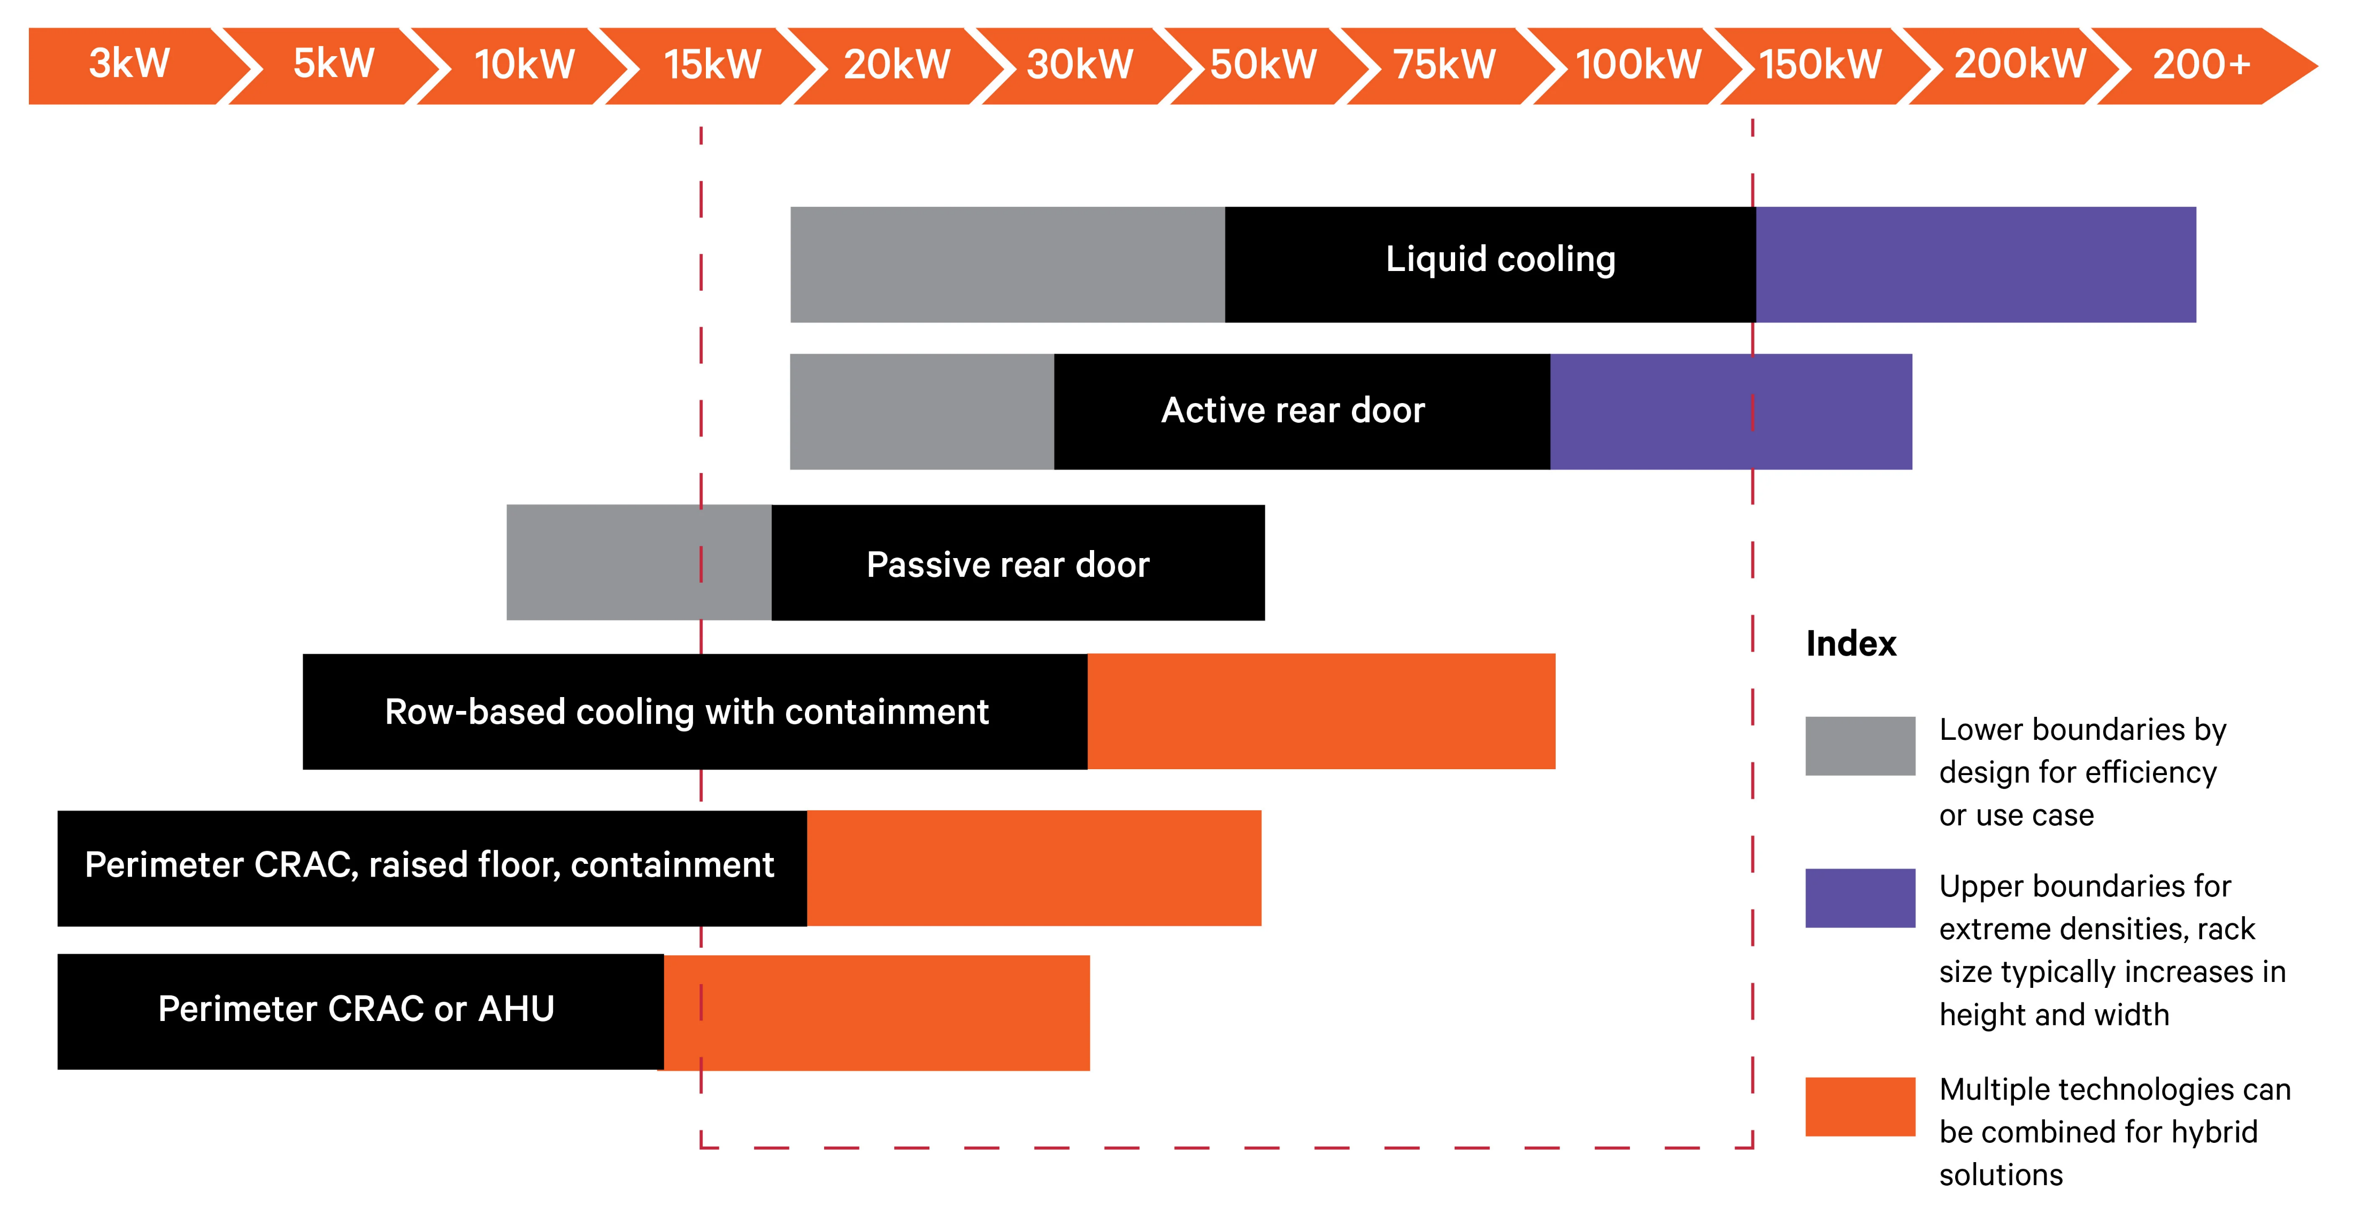
Trends in server design
High core counts make single socket servers a increasingly interesting option
  Simpler, cheaper, use less power
Liquid cooling destined to become mainstream
  Liquid cooling needed from 30 kW per rack
  With next-gen 500+ W CPUs, 1U systems will become rare and 2U or bigger will become the standard
  No standard yet for liquid cooling
  See Eric’s talk for more
Source: Vertiv

Slide 36
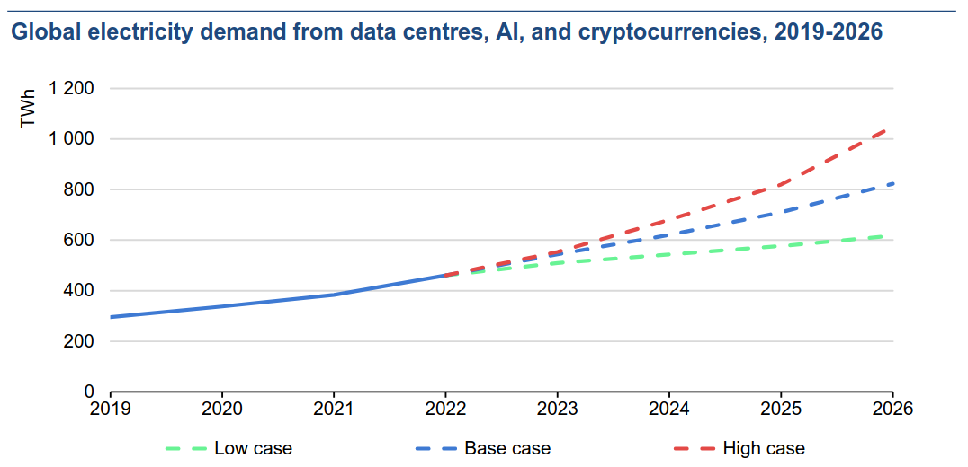
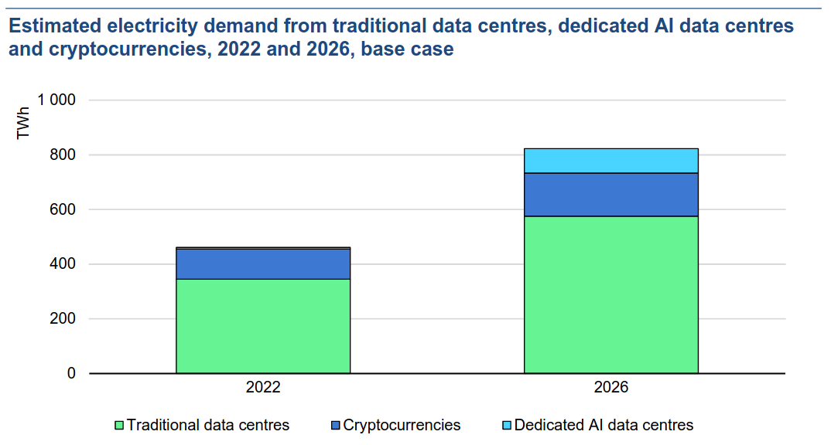
Power consumption
Data centers are proliferating due to the AI boom
  AI models increase by 1000x every three years
  A single GPU uses ~4 MWh per year, Nvidia sold ~4 million in 2023! And soon there will be 2 kW GPUs…
  Power constraints are a strong incentive to energy efficiency
  Data centers used ~2% of global electricity in 2022, estimated twice as much in 2026
The global IT market is increasingly focusing on sustainability
  This is becoming a hot topic also in our community
Source: IEA Report 2024

