Slide 1

RAL use case of
XRootD Managers
Jyothish Thomas, James Walder, Thomas Byrne
jyothish.thomas@stfc.ac.uk, james.walder@stfc.ac.uk, tom.byrne@stfc.ac.uk

Slide 2
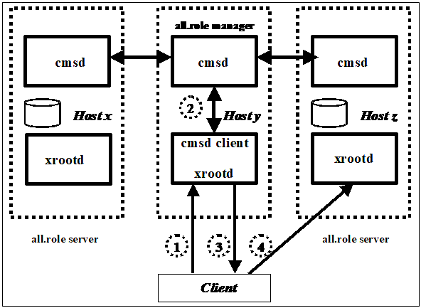
XRootD Cluster Management
XRootD has a native Cluster Management Service Daemon (CMSD)
This adds an XRootD manager that
manages a cluster of XRootD
data transfer servers
This includes features such as
load balancing and high availability
Active-active keepalived provides
HA for the service between 2 manager
hosts.
XRootD Cluster Management Service Configuration Reference (5.7)

Slide 3
XRootD Configuration
We explicitly state which servers can connect to the cluster in the config by adding the following line for each allowed host:
cms.allow host <host fqdn>
We also use a blacklist system with the following line:
cms.blacklist check 1m /etc/xrootd/cms.blacklist
by adding and removing hosts to the blacklist with appropriate delays we have scripts that can do transparent upgrades or changes to the service while maintaining the full quality of the service.

Slide 4

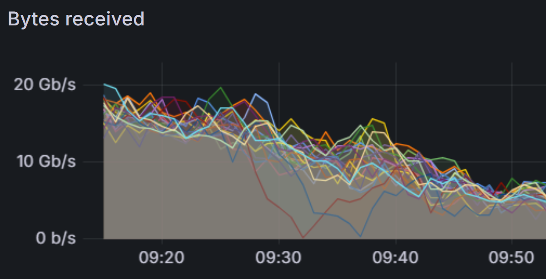
Drain, update and deploy

Slide 5
XRootD Configuration
As we’re running a single ceph storage cluster, with the XRootD servers acting as storage frontends, our load balancing uses a Weighted Random load balancing, with the following config:
cms.sched affinity randomized
cms.sched cpu 20 io 0 mem 0 pag 0 runq 80 space 0 fuzz 15
cms.sched maxload 80
The load is reported using a custom script:
cms.perf int 10s pgm /etc/xrootd/xrdload.sh
with a reporting frequency of 0.33Hz
cms.ping 3 log 1 usage 2

Slide 6
XRootD Load Reported metrics
Scripts available in https://github.com/stfc/xrootd/tree/master/utils/RAL
Calculates memory, CPU and network usage and applies further logic
Marks a server as maximum load if its disk space is full, taking it out of the Weighted Random selection.
Can override reported metrics for testing or experimental metrics

Slide 7
RAL Sysadmin Monitoring
Telegraf, influxdb, Grafana for system metrics
Icinga service monitoring
  Host level checks that can trigger alerts on failure
  Can be approximated with cron

Slide 8
RAL Sysadmin Monitoring
XRootD Managers are great at detecting hosts that go down cleanly,
not so much when servers are ‘ill’
We have general status check in icinga that attempts a basic functionality check and calls out in case of failures
As well as a general check of the service as a whole, targeting the managers
We have scripts parsing XRootD logs for denies as well to give a warning in case of unusually high number of permission denies in recent transfers.

Slide 9
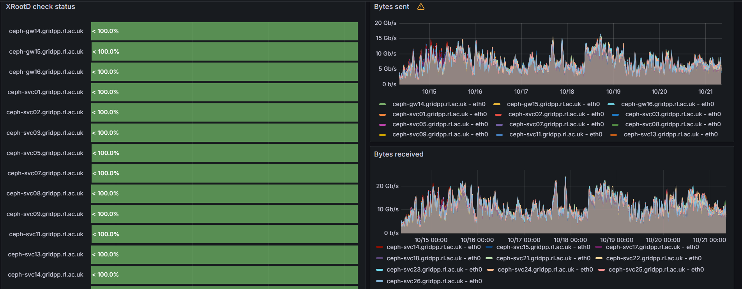
In Production

Slide 10
Thank You

