Slide 1

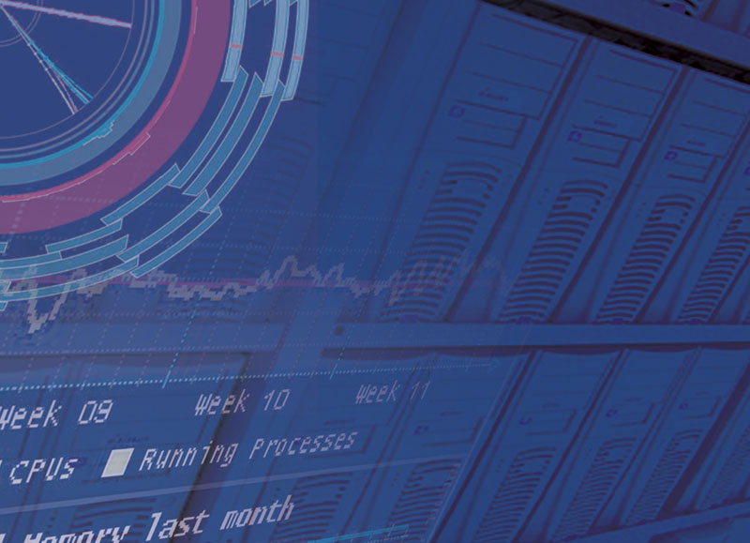

Energy Efficiency
Minor Update
David Britton, Emanuele Simili
HEPIX
Lugano
1st Apr 2025
David Britton
GridPP Project Leader
WLCG Deputy Leader

Slide 2
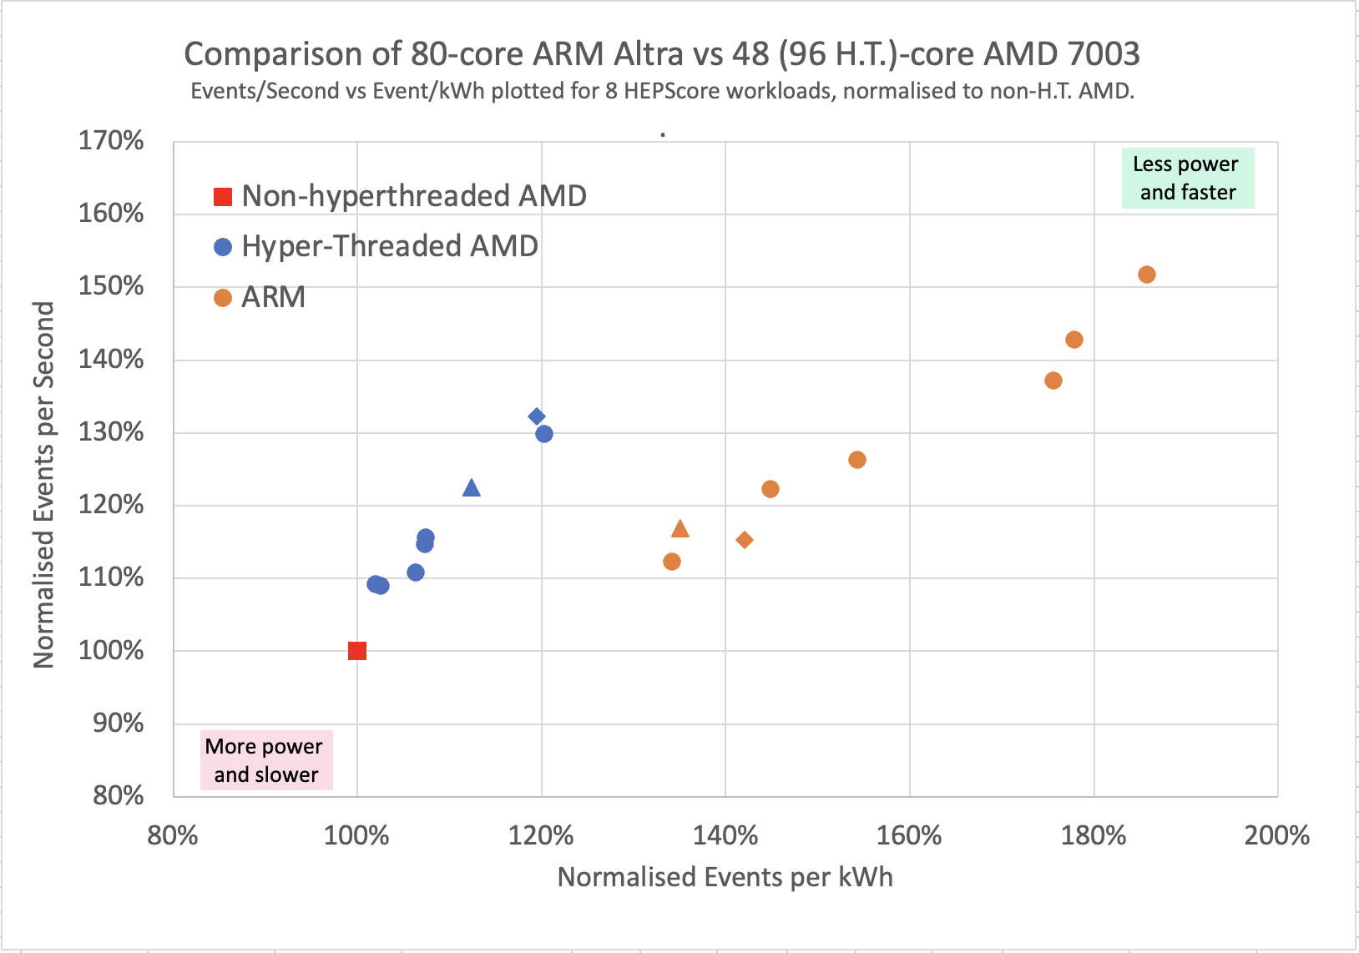
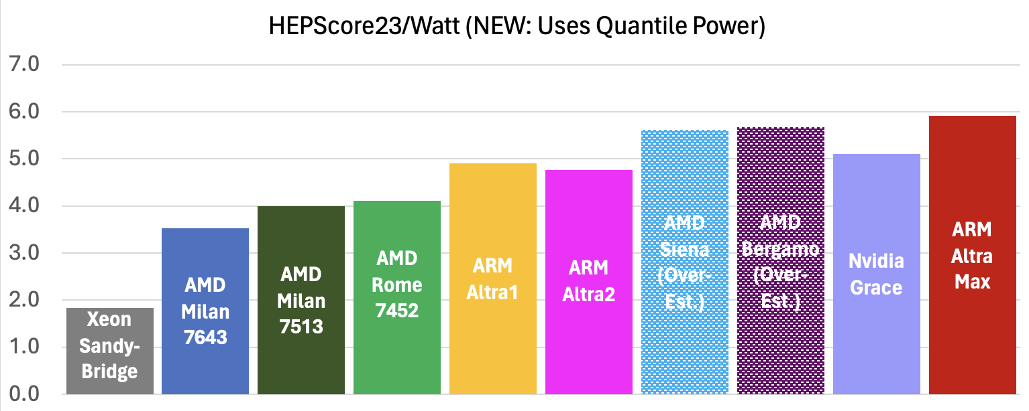
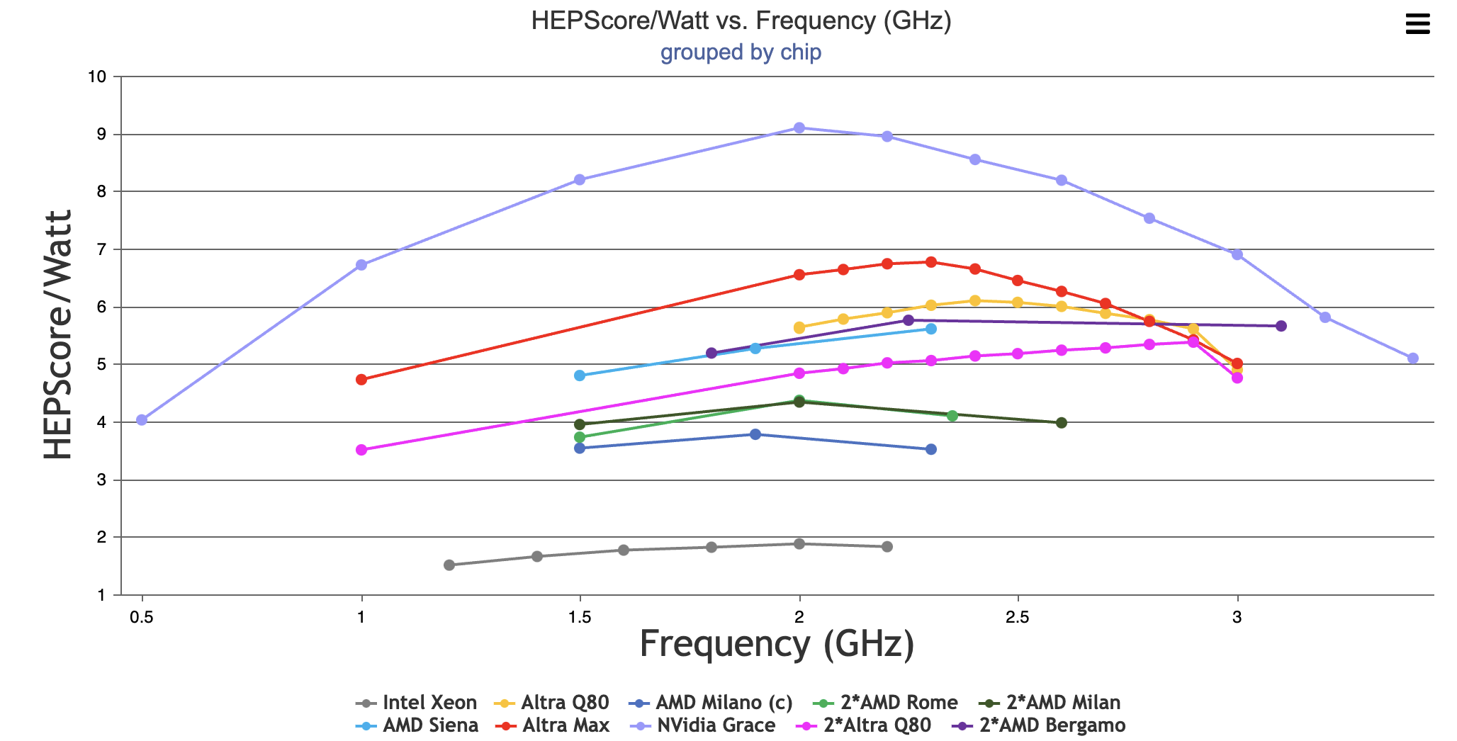
Context -1
HEPiX Victoria (October 2023):
Showed that in 2022-2023 ARM (Ampere Altra Q80) was significantly more energy efficient, and at least as fast, as a than same cost AMD 7003 (Milan with Zen-3 core).
HEPiX Paris (April 2024):
Showed results for HS23/Watt from a wider range of machines….
But noted that efficiency depends, particularly for ARM machines, on the operating frequency…
HEPiX Oklahoma (November 2024):
…therefore, cost-dimension also needs to be considered (demo of procurement utility).

Slide 3
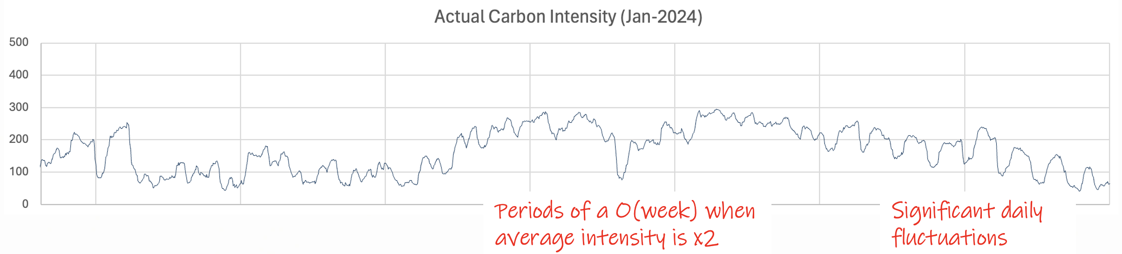
Context-2
 | 2018 Carbon Data |  | 2023 Carbon Data
 | 95% rate | 90% rate | 95% rate | 90% rate
NVidia Grace | 18.9% | 27.2% | 21.1% | 29.5%
Altra Max | 13.9% | 20.0% | 15.4% | 21.5%
Altra Q80 | 13.9% | 17.2% | 14.5% | 18.1%
2xAltra Q80 | 10.8% | 9.2% | 10.9% | 8.8%
Xeon | 2.4% | 3.5% | 3.7% | 5.2%
Milan | - | 5.7% | 4.6% | 8.3%
Genoa* | - | 2.5% | 2.8% | 4.7%
HEPiX Oklahoma (November 2024):
Also presented investigations of operating hardware at reduced frequency when carbon-intensity of local power was high.
gCO2/kWh

Slide 4
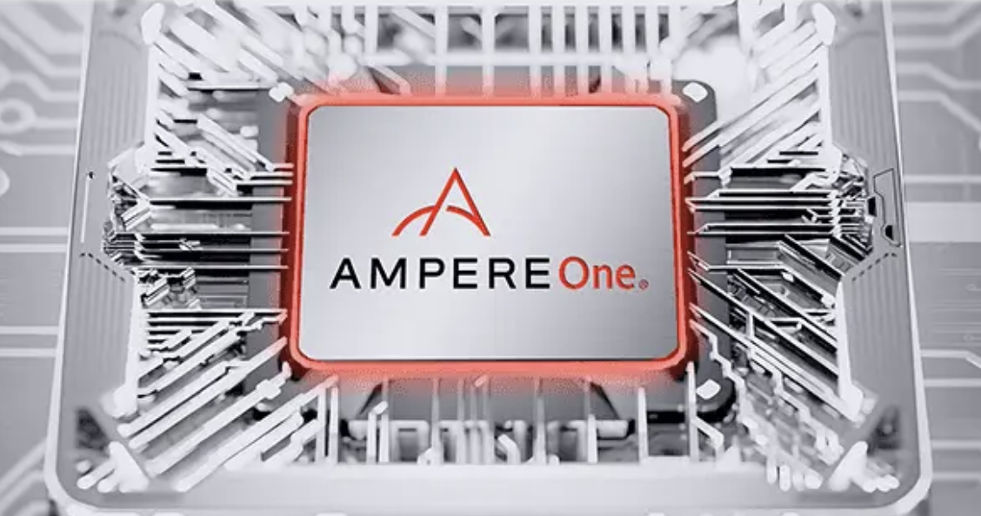
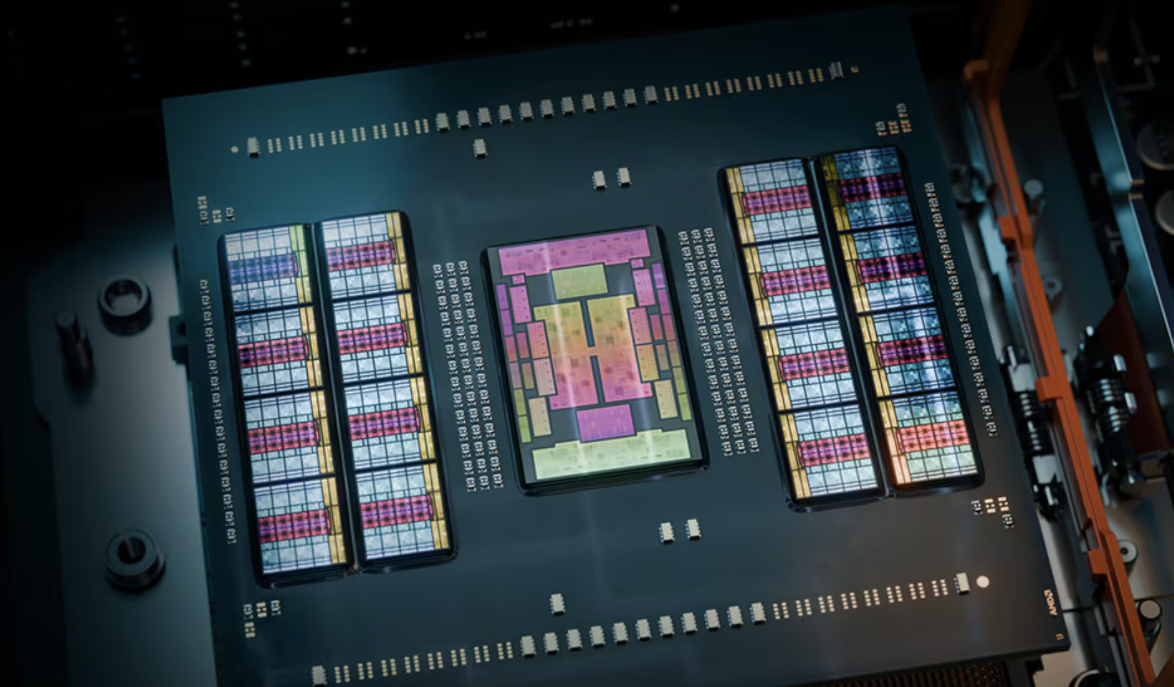
New Measurements
In house: AmpereOne
3rd generation CPU, with a custom in-house architecture.
Previously used Arm’s Neoverse core: Marks move from core, to architecture, licensing from ARM.
192 cores (512 core “Aurora” version in development), 1-socket.
1.0–3.2 GHz operating frequencies (settable with user-space governor).
Remote: AMD Turin
Zen-5 core (Genoa was Zen-4 and Bergamo Zen-4c).
2-sockets, each with 128 cores (256 HTs).
Only 3 frequencies settable: 1.5, 2.1, 2.7 GHz (apparently a turbo-boost up to 4.2 GHz, but this cannot be sustained).

Slide 5
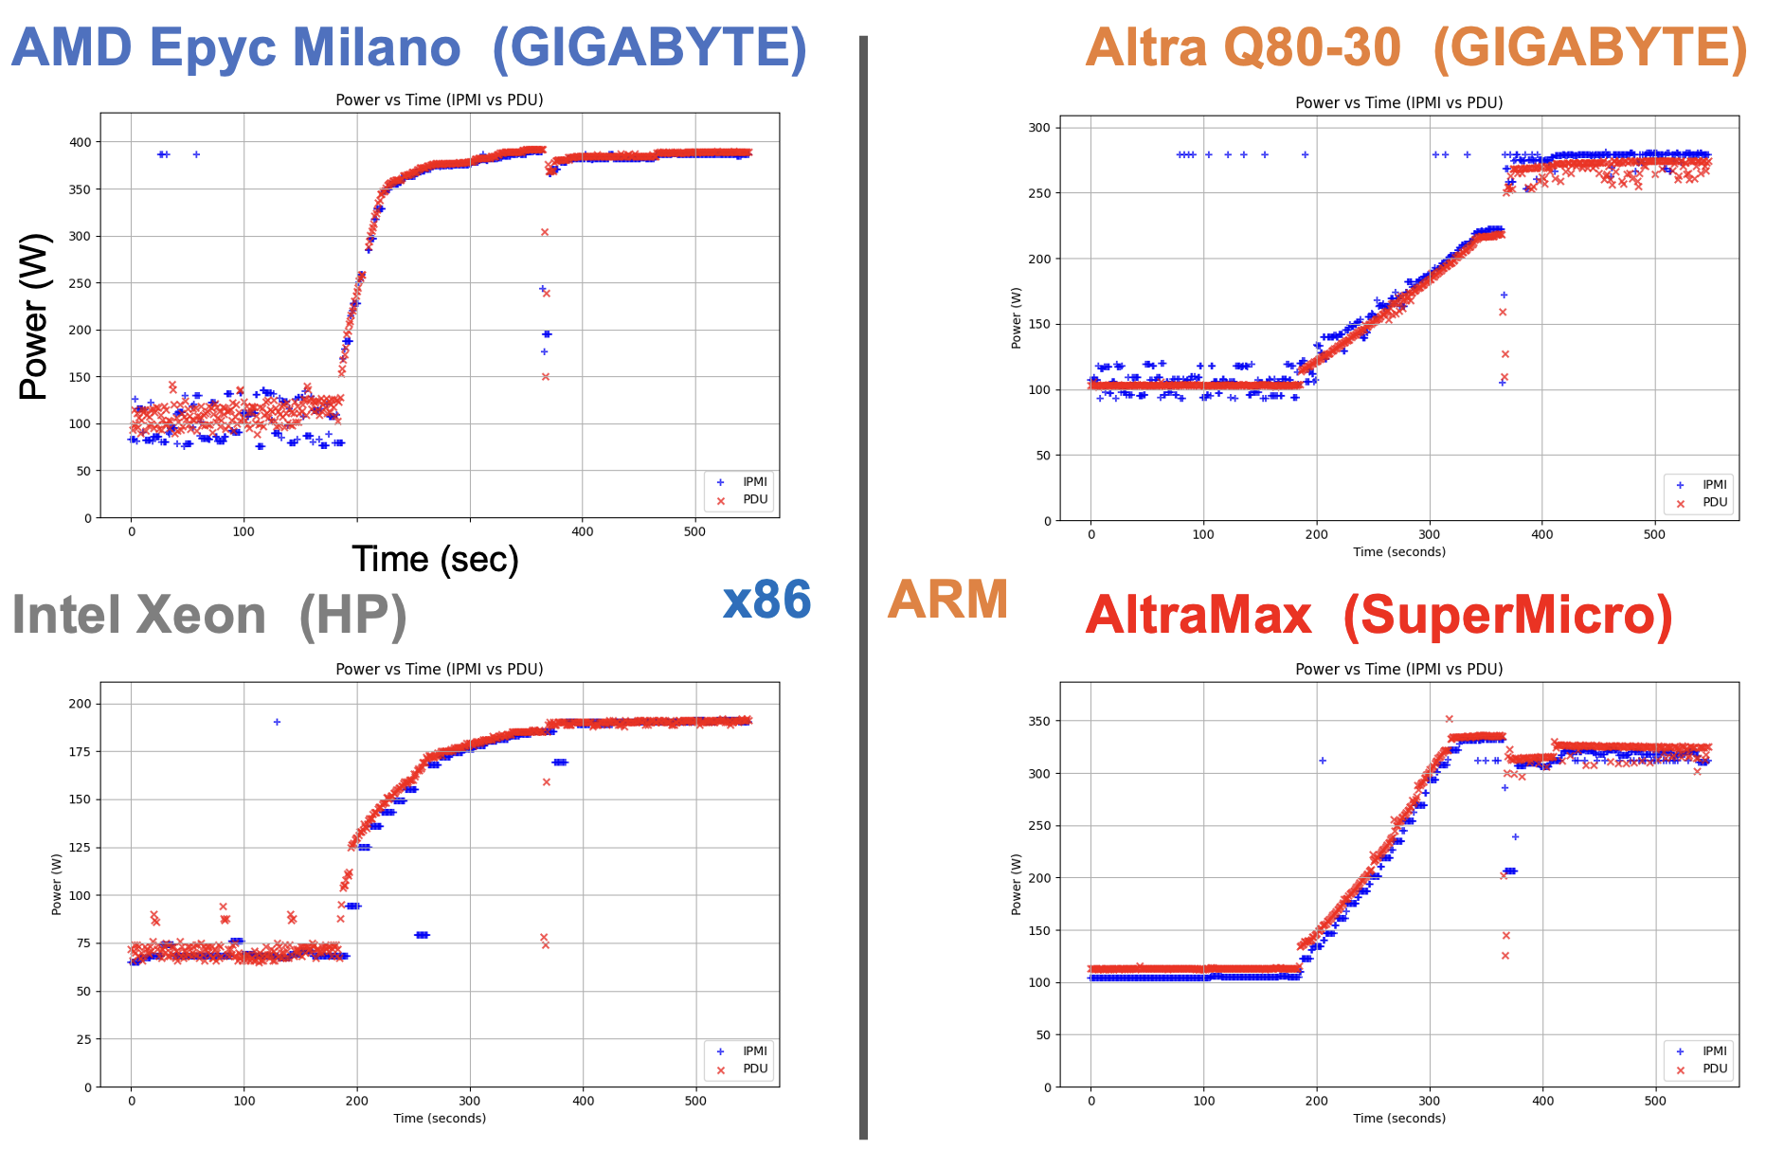

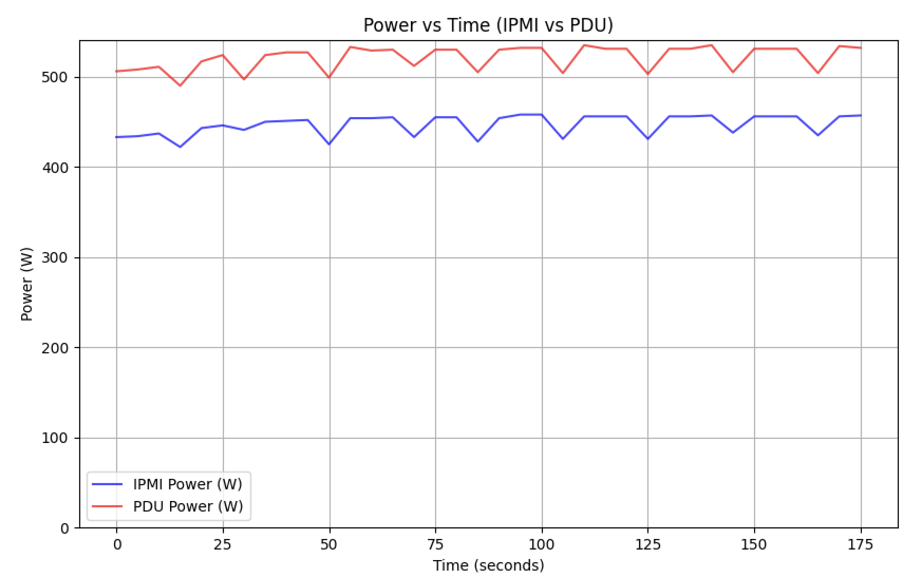
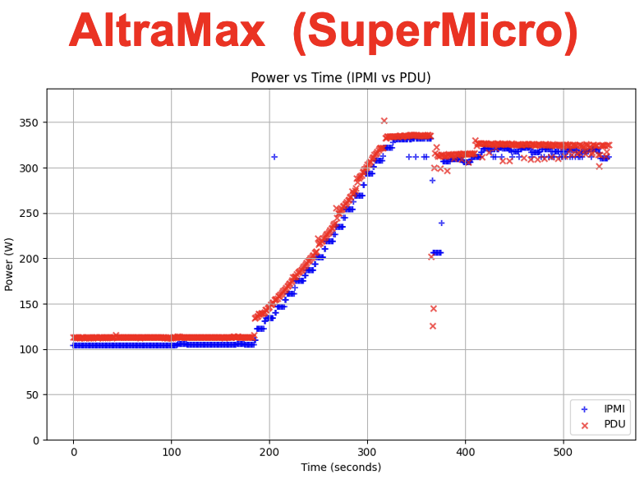
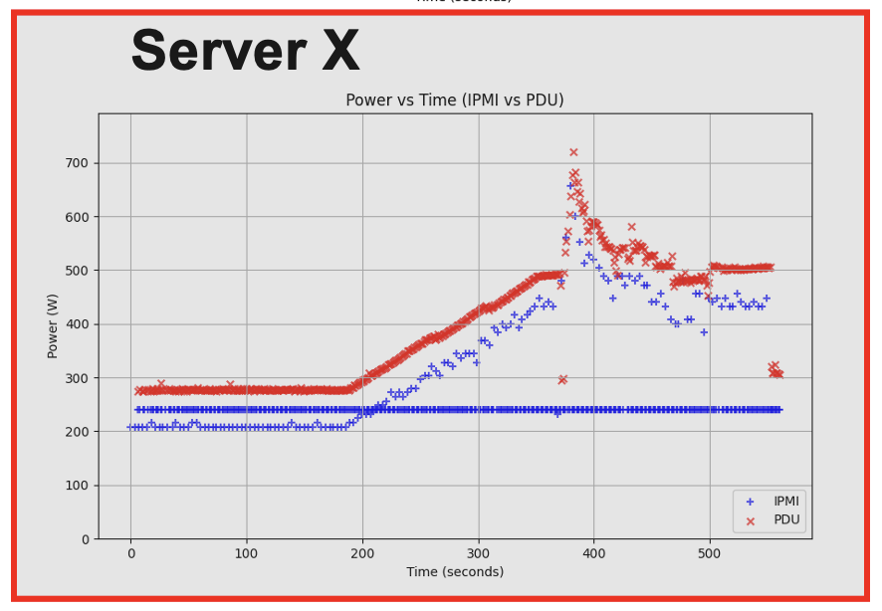
IPMI vs Power Meter
We previously validated IMPI measurements against meters – most agreed to ~5%.
But we have seen some odd effects (bottom right plot).
Can’t monitor this for machines we access remotely, which has been a slight worry.
For AmpereOne, we observed a significant difference: The IPMI tool consistently under-reported the power by 70-80 Watts (~15%) compared to the external PDU
What’s going on ???
AmpereOne

Slide 6
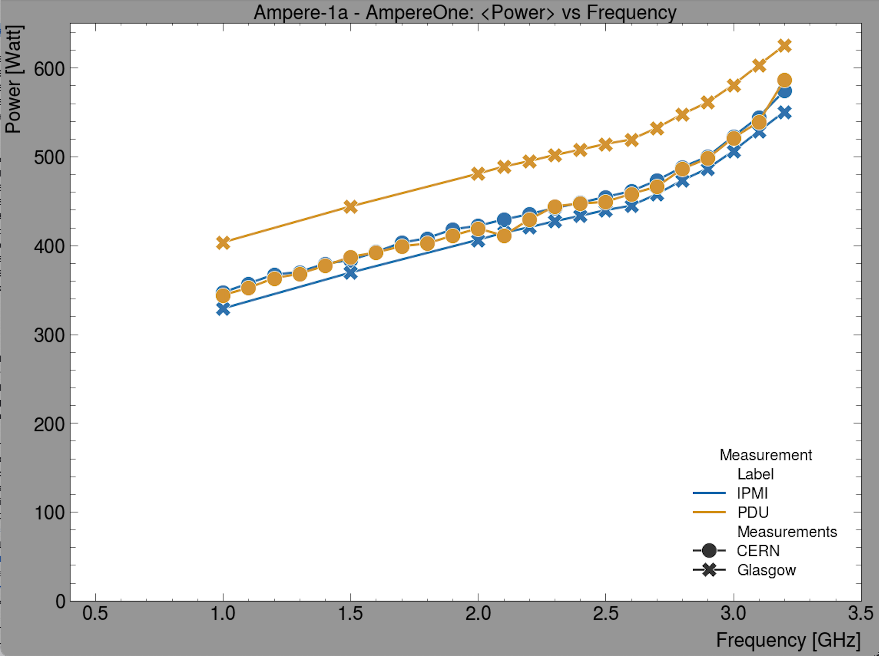
CERN Measurements
Fortunately, CERN (Natalia Szczepanek, Albane Carcenac) had already made similar measurements on the identical machine:
https://indico.cern.ch/event/1508924/contributions/6360848/attachments/3009458/5305640/AmpereOne192-FrequencycSan-20250205.pdf
Since the Glasgow PDU measurements are the odd-one-out, we currently presume they are the problem.
We are currently re-validating the PDU and will remeasure.
CERN has also seen odd behaviours like this.
Confirms the benefit of multiple investigations!

Slide 7
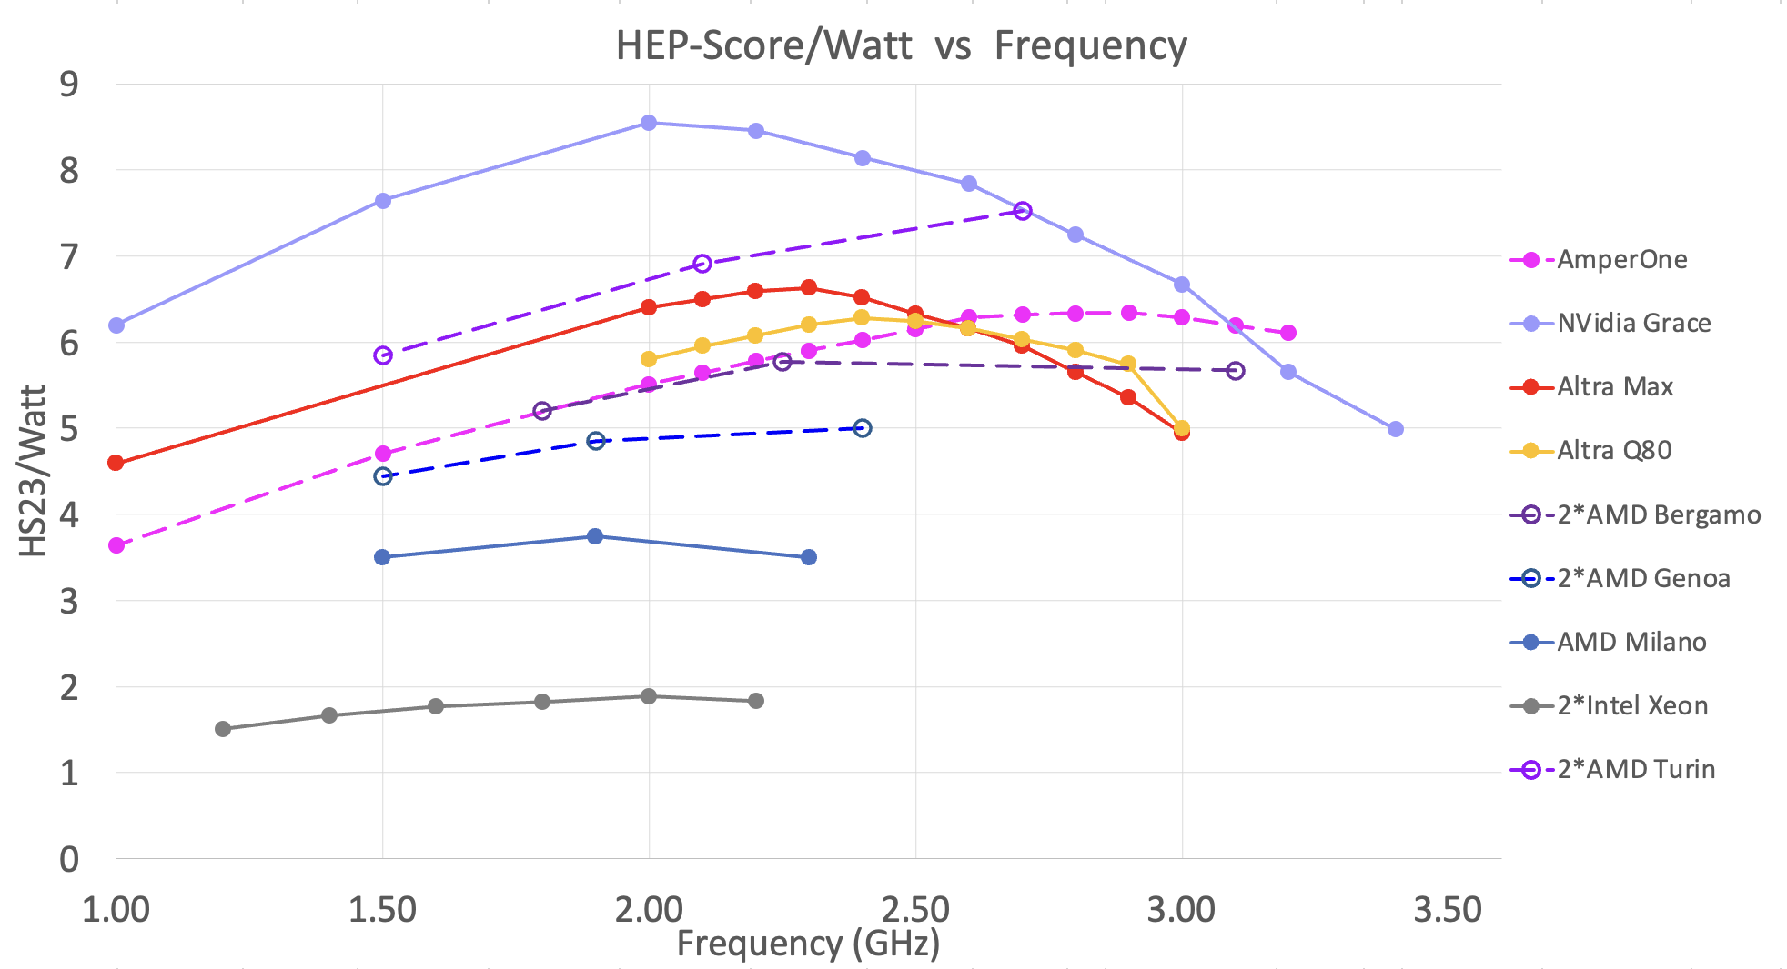
Frequency Scan Results
Solid lines: Corrected IPMI data
Dashed line: Uncorrected IPMI data

Slide 8
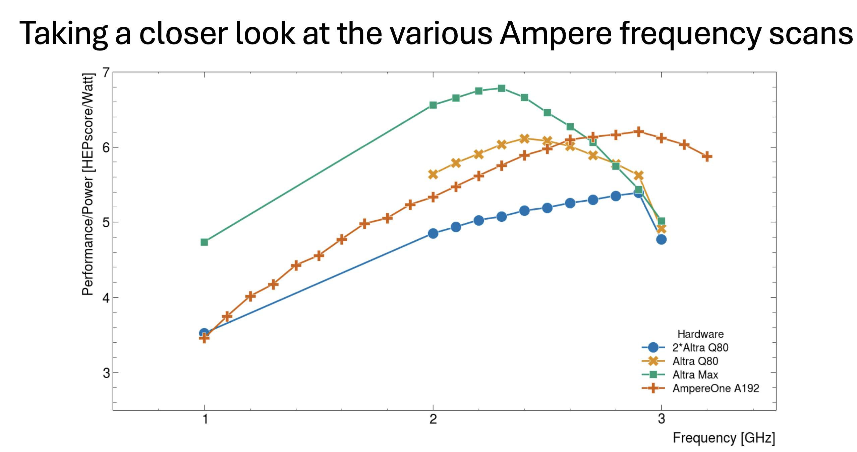
CERN Results
Similar results from CERN (will continue to try to understand the small differences with Glasgow – in the end there will be some spread).

Slide 9
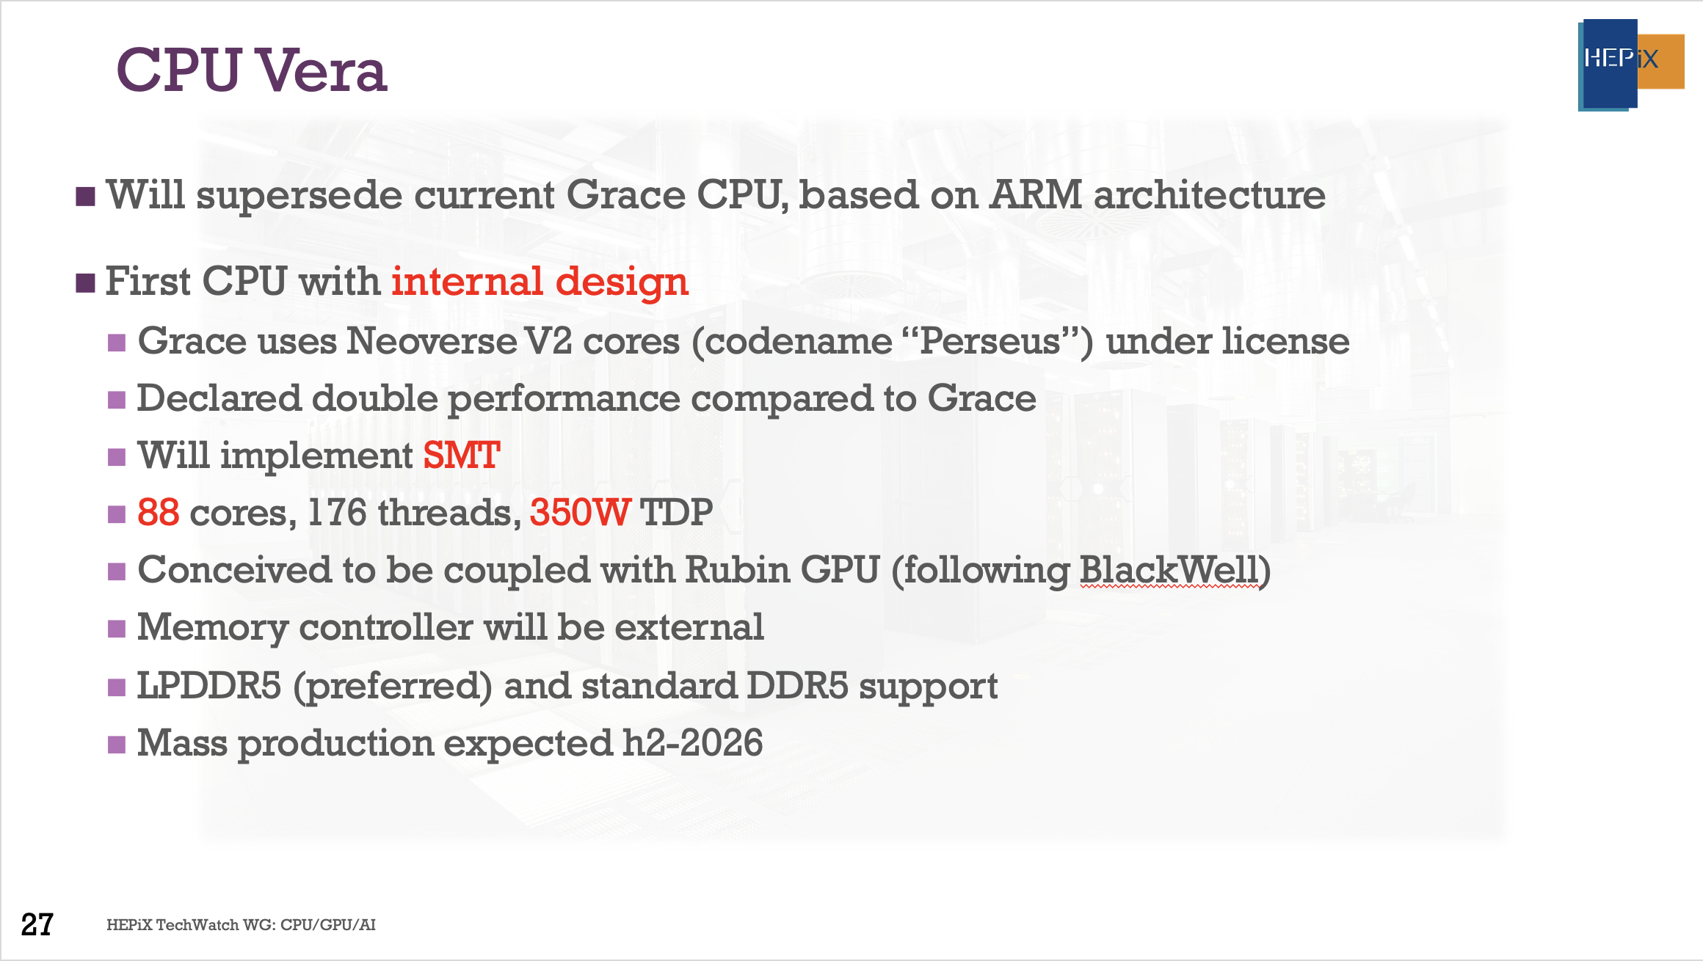
From yesterday’s TechWatch Talk
Landscape continues to develop… for now.

Slide 10
Procurement Util View?
To be done once we get indicative pricing…
From Ampere:
“I’d maybe ask for an extra graph – HEP Score / €. AmpereOne list price is ~⅓ that of Turin 😉”

Slide 11
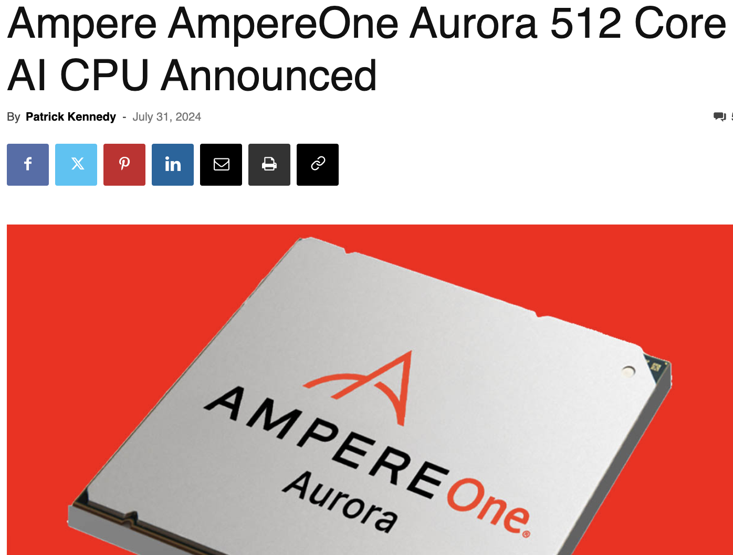

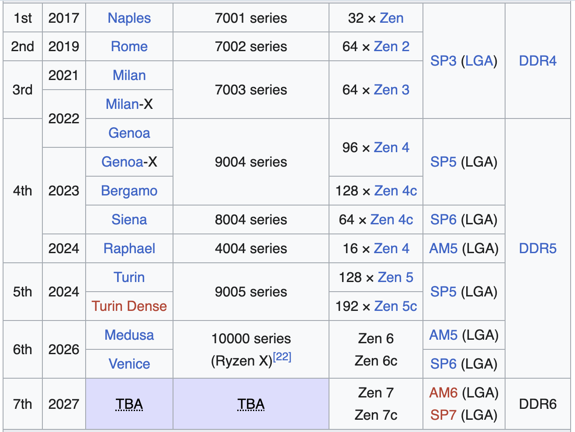
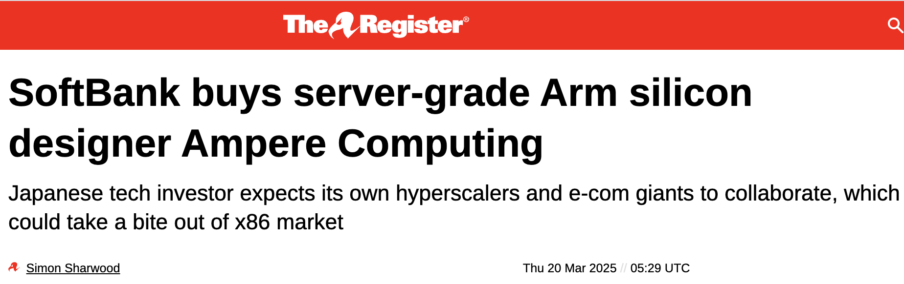
Press Clipping
The A192 isn't the world's fastest single-socket server. It's not even the most efficient! AMD's latest EPYC 'Turin Dense' CPU takes both of those titles. But this is the best value, in terms of performance per dollar. https://www.jeffgeerling.com/blog/2024/ampereone-cores-are-new-mhz December 2024.
Wikipedia

Slide 12
Conclusion
AMD EPYC chips now seem to have caught up with ARM in terms of energy efficiency.
The best solution depends on cost and choice of operating frequency.
Beyond energy-efficiency, the ability to use different architectures is beneficial because:
  Sites have more procurement options, which can translate into better value.
  Sites have more flexibility to work with other communities.
  Experiments can make use of a wider range of opportunistic resources
New machines on the horizon will are likely to show further efficiency gains.

