Slide 1
Hyper-converged cloud infrastructure at CSCS
Dino Conciatore – System Engineer
Elia Oggian – System Engineer
Wednesday, March 2, 2025
HEPiX Spring 2025 - Lugano

Slide 2
Background
Operating a multi-tenant Kubernetes cluster can be very complex
  Based on past experience with fulen, a multi-tenant cluster with multiple VLANs and users with varying requirements and workflows
Improvements were necessary to ensure a greater user experience
Simplify the deployment of CSCS internal services
Security and Isolation:
  network isolation should be implemented per cluster or purpose
Notes:
Around 2018 we started our journey with kubernetes
The first requirement was to have a big multi-tenat cluster to serve all users needs.
We had a lot of challenges:
Multiple vlans isolation
Complex Ingress/egress based on istio
Different workflows
Namespaces isolations
We quickly discovered that this is not sustainable and very difficult to scale and maintain

Slide 3
Introducing Key Components

Slide 4

Introduction to SUSE Virtualization (Harvester)
Harvester is an open-source hyperconverged infrastructure solution.
Kubernetes as orchestration engine
Based on KVM and KubeVirt, which enable virtualization and orchestration of VMs
Storage management through Longhorn to provide a persistent storage
Networking based on Multus enables isolation on multiple VLANs
Notes:
That uses Kubernetes as an orchestrator engine for kubeVIRT

Slide 5

Introduction to SUSE Rancher Prime
Rancher is an open-source Kubernetes clusters manager.
Centrally manage multiple Kubernetes clusters
Simplified provisioning and scaling of clusters, node management, and upgrades.
Strong security features, including role-based access control (RBAC), network policies and integration with identity providers to enhance security and compliance.
Rancher has its own Kubernetes distribution called RKE2
Notes:
It allows you to manage easily multiple kubernetes clusters
It helps you in provisioning and scaling
And also have very nice security features, like role-based access control

Slide 6

Introduction to ArgoCD
Argo CD is an open-source continuous delivery tool specifically designed for Kubernetes that follows the GitOps methodology.
Application deployments are declared using Kubernetes manifests or Helm charts stored in Git repositories.
  Argo CD then ensures that the actual cluster state matches the desired configuration
Graphical UI for visualizing and managing application deployments status. Additionally, it offers a command-line interface (CLI) for scripting and automation.

Slide 7
Hyperconverged Cloud Infrastructure at CSCS

Slide 8
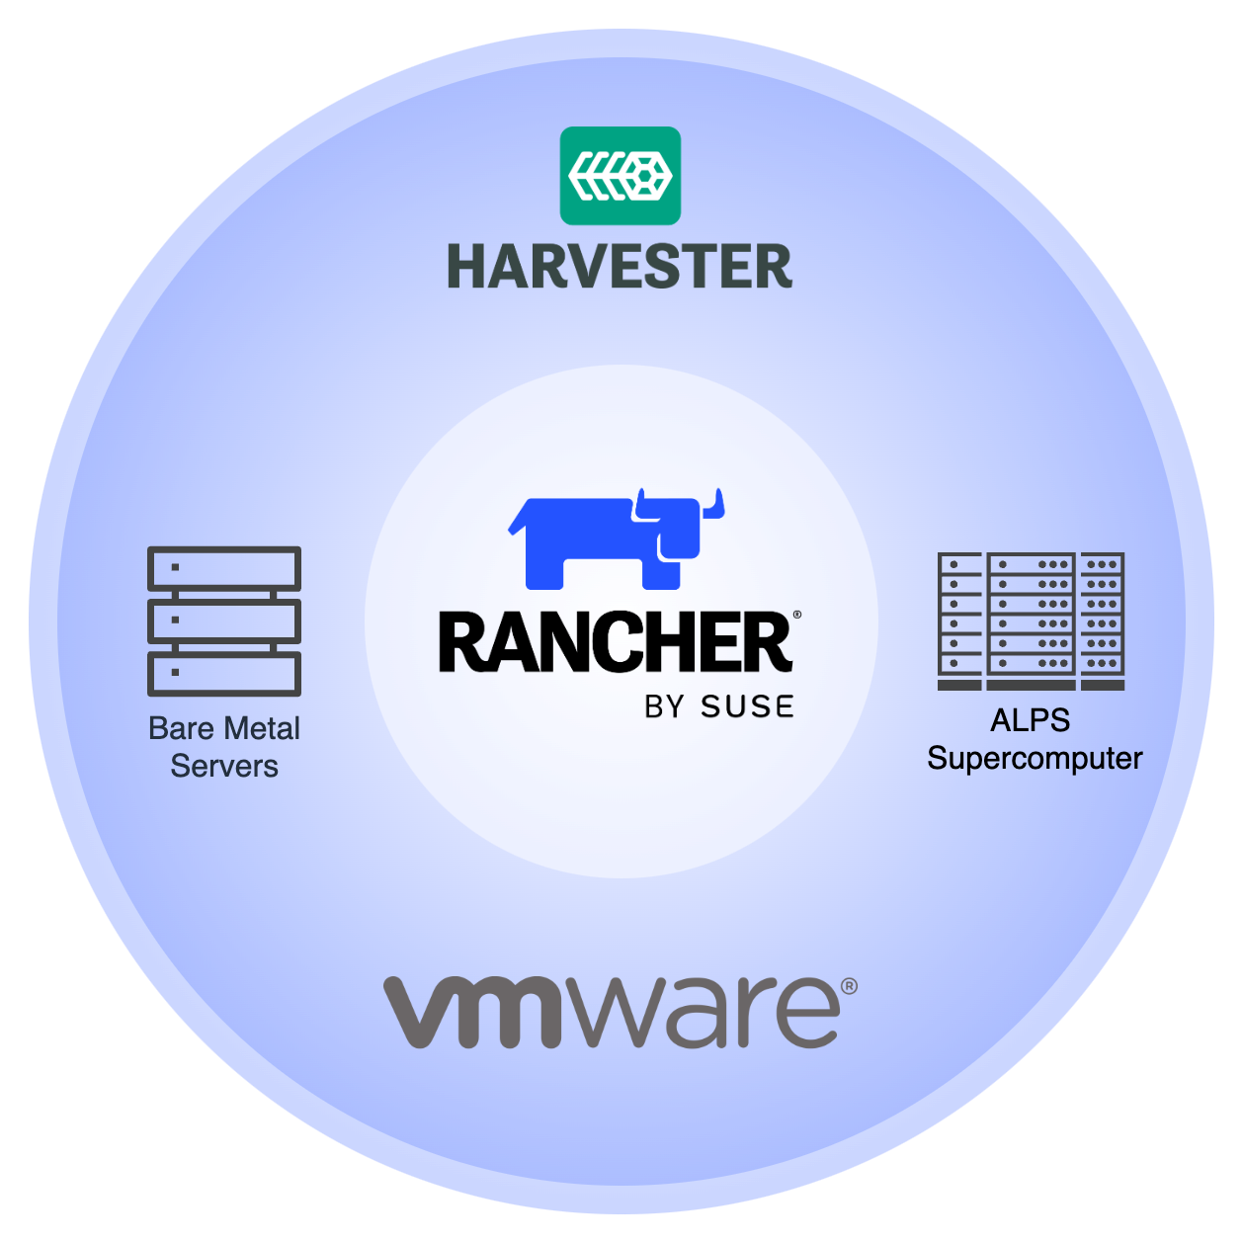
SUSE Rancher Prime Upstream cluster
3 nodes
  AMD EPYC 24 cores
  192G RAM
  2x 10G NIC (LACP)
~ 50 Downstream RKE2 Clusters
  SUSE Virtualization
  VMWare
  Bare Metal
  Alps (HPC)
Notes:
Direct deployment on Harvester and VMware, meaning Kubernetes nodes are spawned directly when cluster creation is triggered.
Deployment on Baremetal and HPC, nodes must already be running.

Slide 9
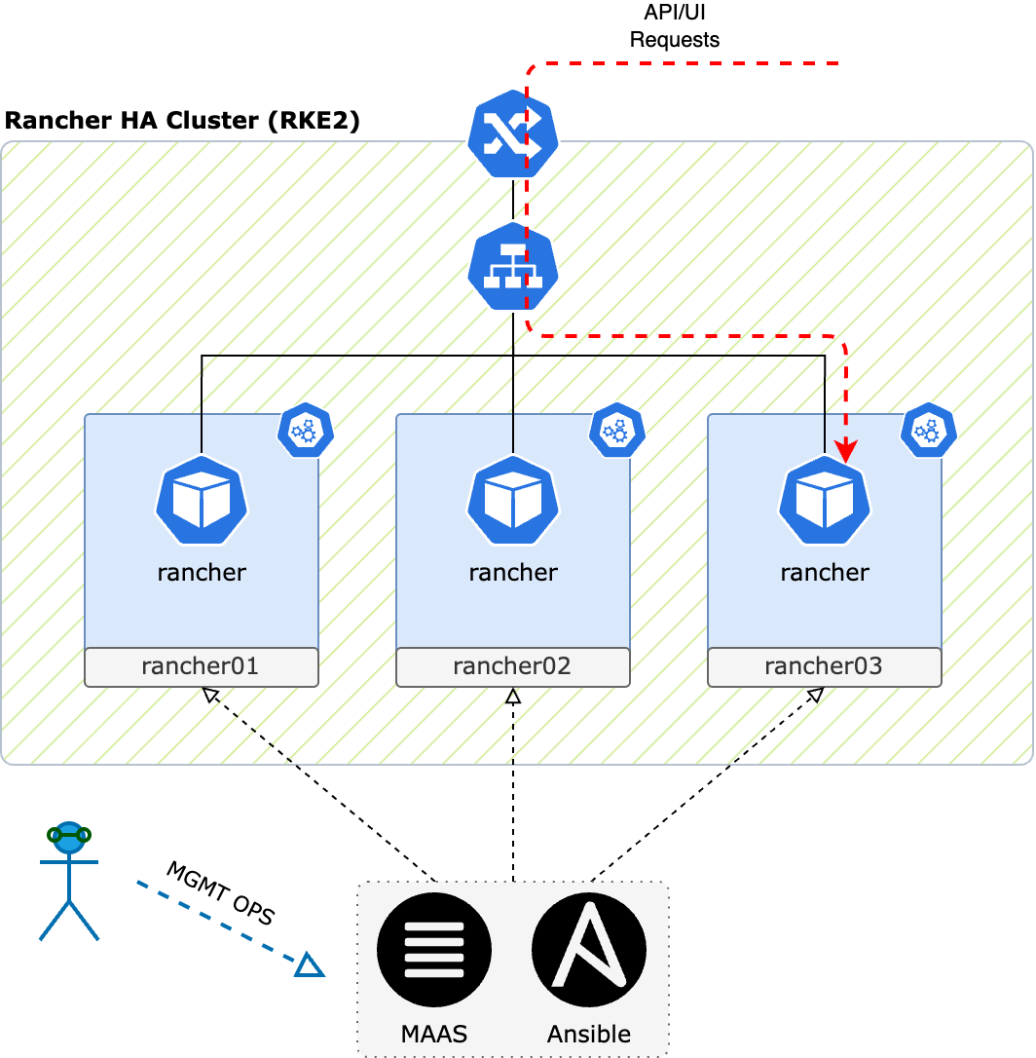
Rancher cluster architecture
Upstream Cluster
RKE2 (3 nodes)
kube-vip enables external access to the UI/API
Node lifecycle through Canonical MAAS
RKE2 managed with Ansible
Rancher deployment managed with Helm
Downstream Clusters
SUSE Virtualization (30 clusters)
VMWare vSphere (10 clusters)
Alps (5 clusters)
Bare Metal (2 clusters)

Slide 10
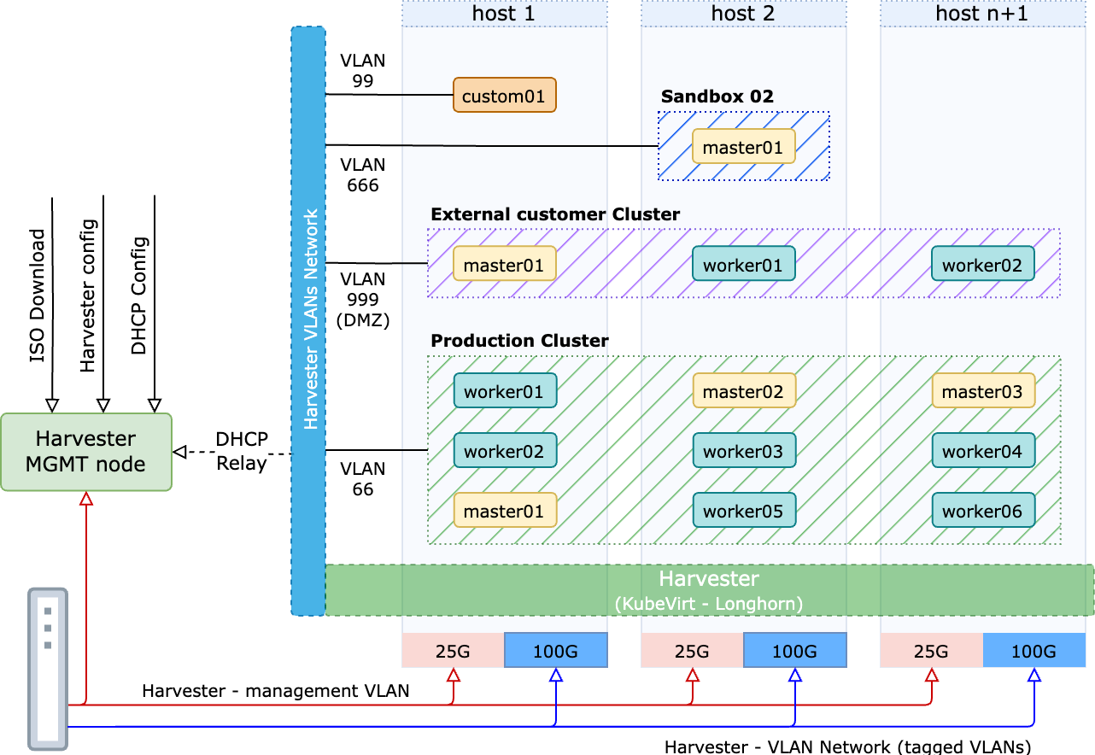
Harvester architecture
16 Hosts
Networks
  Management (25G)
  VLANs (100G)
Local 7.68TB NVMe SSD
512G/768G RAM
AMD EPYC 64 Cores
Management node:
  DHCP Relay for VMs
  iPXE Boot
  ISO Repository
  Hosts config

Slide 11
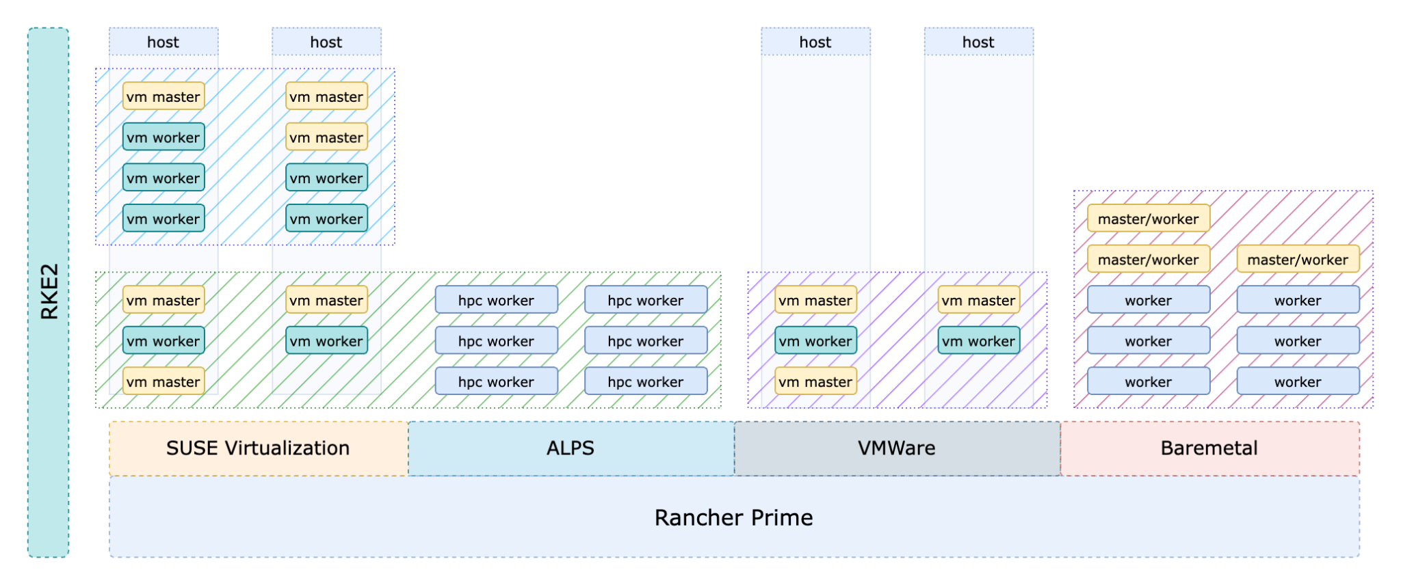
Tenants overview

Slide 12
Infrastructure as a code and GitOps

Slide 13
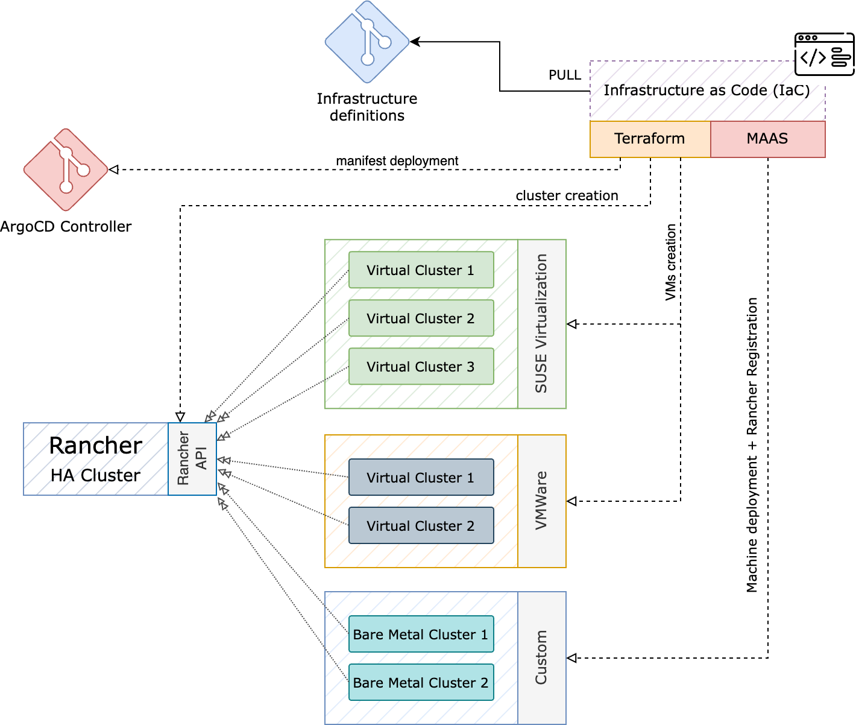
IaC cluster provisioning
Declarative approach
Define cluster
  Node specs
  Network isolation
Terraform
  Community providers
  CSCS cluster modules
  Bootstrap RKE2 clusters
Notes:
First of all we have to decide where to deploy.

Slide 14
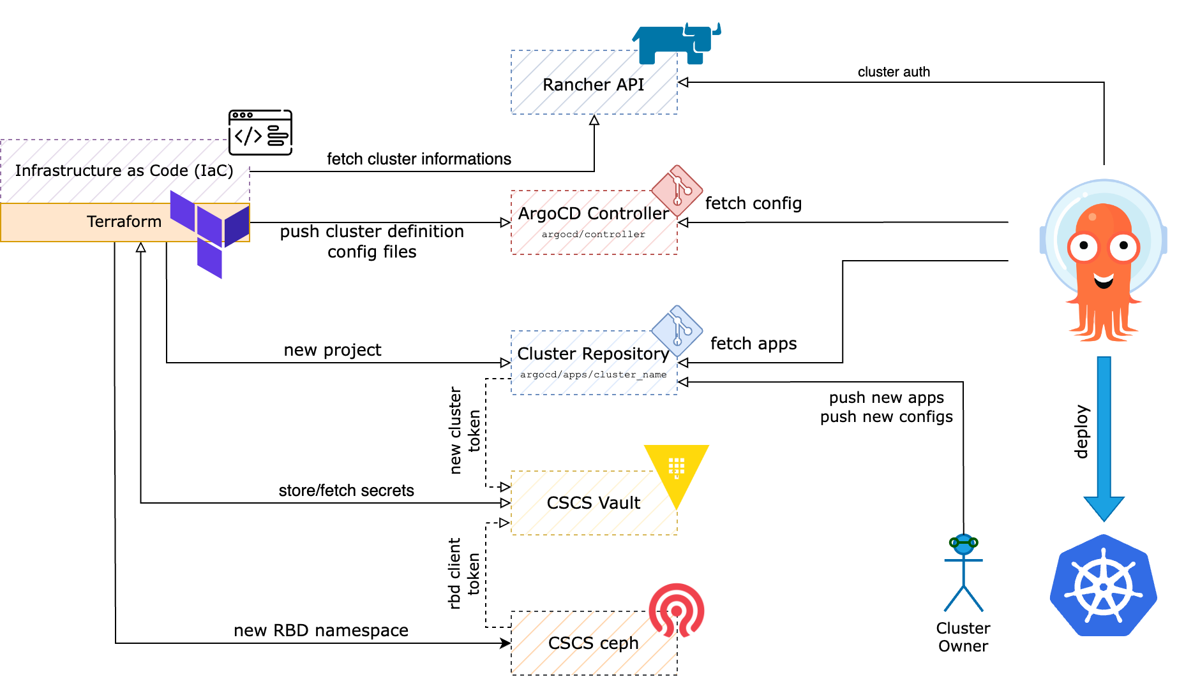
Cluster definition

Slide 15
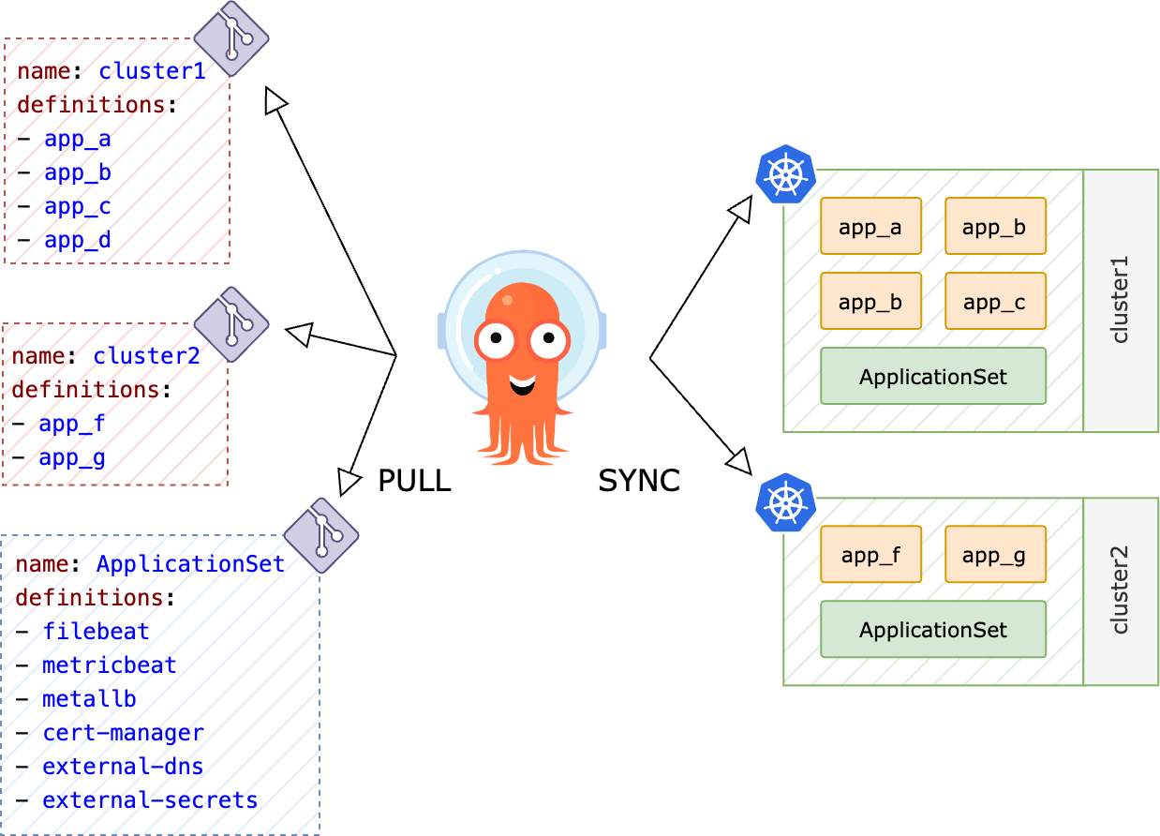
GitOps with ArgoCD
Controller (git repo)
  Clusters
  Repositories
  Projects
  Applications
ApplicationSets
  CSI
  Ingress Controller
  Certificate Management
  Observability
  External Secrets
  External DNS
  MetalLB
App of Apps
  Declarative deployments
  800 Applications across 50 clusters

Slide 16
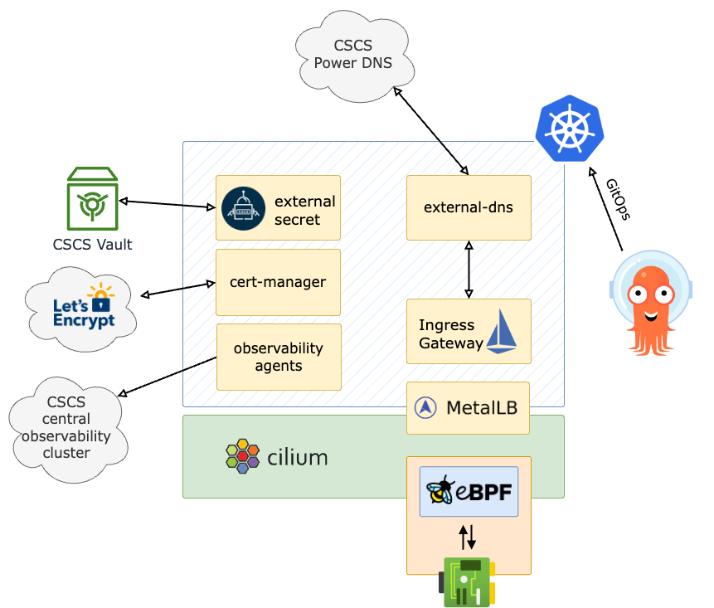
Kubernetes clusters common features
All clusters deployed have the following common services preconfigured:
CNI: Cilium
  Service mesh (eBPF)
  Hubble (observability UI)
CSI:
  cephfs
  ceph rbd
Ingress controller
  Istio (no sidecars)
    Started migration to Gateway API
  Nginx
MetalLB
  Gratuitous ARP
Automated DNS and Certs
External Secret
  For all Vault secrets
Observability agents
  Filebeat and Metricbeat
Notes:
With cilium service mesh enabled
Cilium is based on eBPF
all the networking is done at kernel level without the need of sidecars
Cilium also come with a nice observability UI
Istio only for ingress gateway and in the future API gateway
IP assignment, DNS entry and Let’s Encrypt Certificates are automated
Triggered when a new association Istio GW ←→ k8s Service is made
Using ArgoCD for GitOps automation. All new changes are pushed to a git repo and ArgoCD will apply them
External secret to interface HashiCorp Vault

Slide 17
Crossplane
Open-Source Control Plane
  Manage cloud resources and services
Kubernetes Native
  Extends Kubernetes with cloud-native capabilities
Infrastructure as Code
  Define and manage infrastructure using Kubernetes API and CRDs
Multi-Cloud Support
  Compatible with AWS, Azure, and more
Declarative API
  Use Kubernetes manifests to describe infrastructure
Composable Infrastructure
  Modular and reusable infrastructure components
Secure and Consistent
  Enforces policies and ensures consistent configurations
Scalable and Extensible
  Easily scales and integrates with other tools

Slide 18
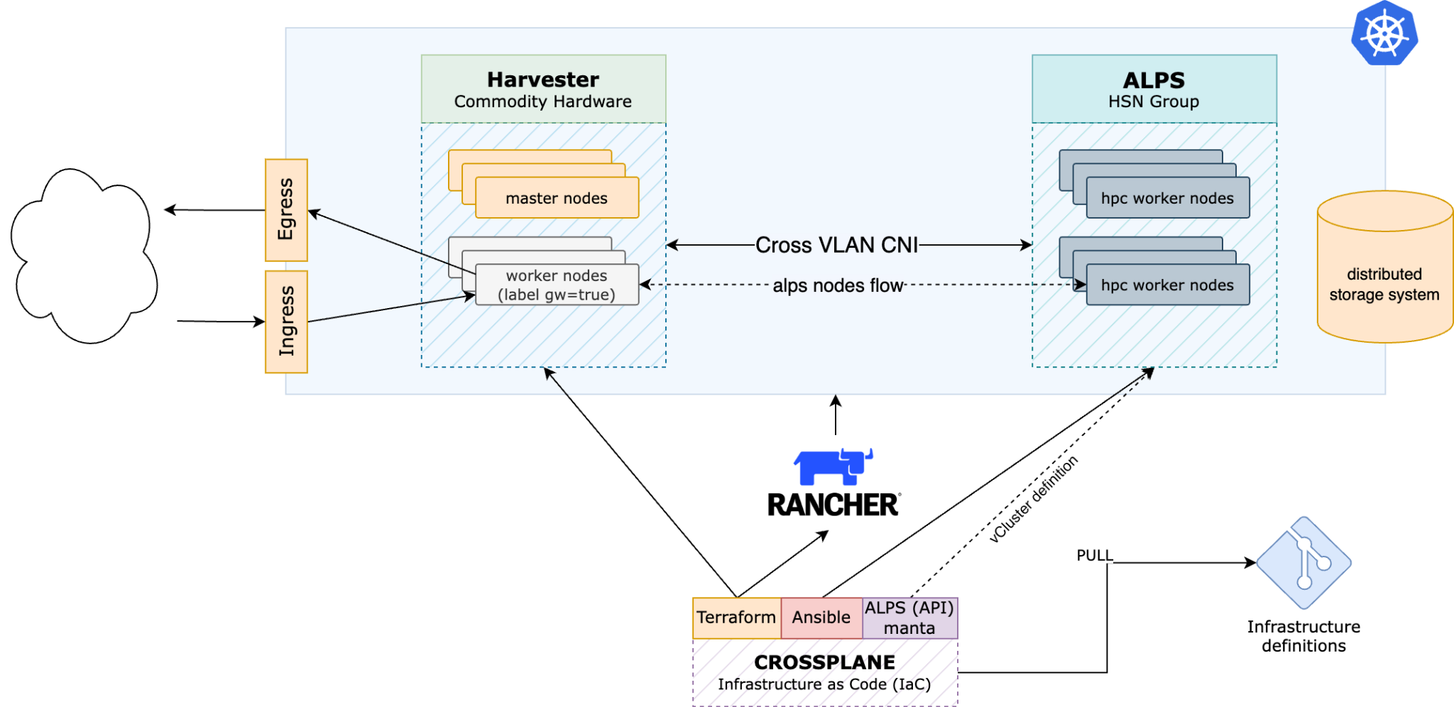
Alpernetes - Kubernetes on Alps

Slide 19
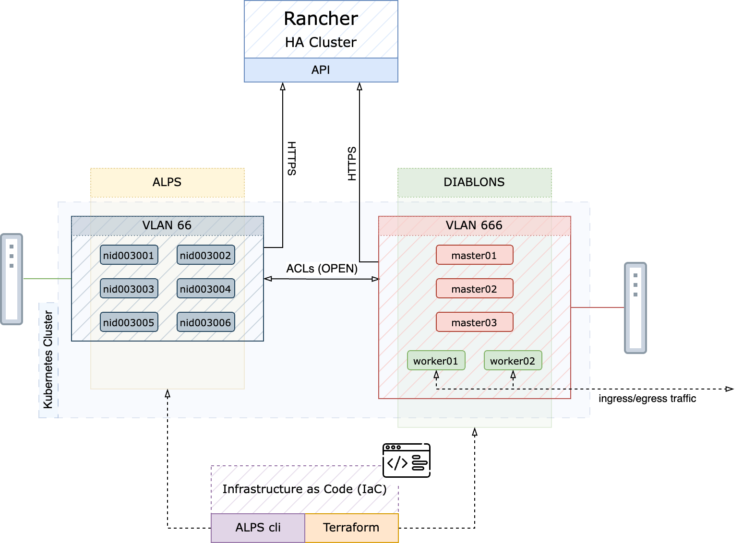
Kubernetes on alps details
Harvester (DIABLONS)
  Master nodes
  Specific workload workers
    Ingress Controller
    Egress Controller
    Low performance SVC
    Etc…
ALPS (HPC)
  Stateless workernodes

Slide 20
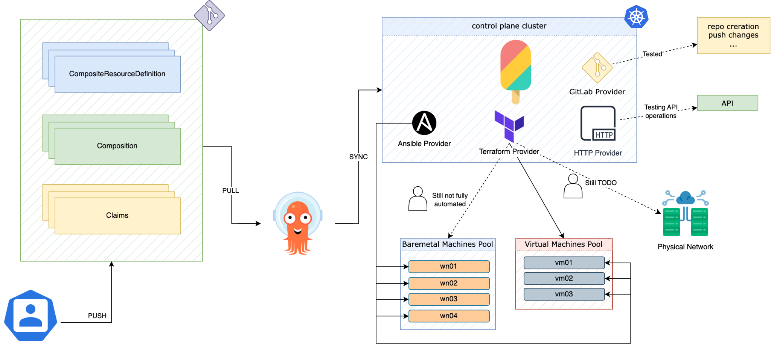
Alpernetes - Kubernetes on Alps

Slide 21
Operations

Slide 22
Infrastructure upgrade
Harvester
  Upgrade triggered automatically via the user interface.
    RKE2 upgrade
    Draining one host at a time
      VMs are live migrated
    OS Image replacement
Rancher
  Ansible managed nodes:
    Drain Kubernetes nodes one by one.
    Reinstall or upgrade the OS
  Rancher
    Upgrade done via Ansible (same playbook used for the installation)
      rke2_version: v1.26.9+rke2r1
      NOTE: Don't skip intermediate minor versions when upgrading, eg. : v1.28.x → 1.29.x
ArgoCD
  via Helm

Slide 23
Downstream clusters upgrade
Kubernetes
  Required RKE2 version can be changed using Terraform
    kubernetes_version = "v1.29.2+rke2r1"
    $ terraform apply
      NOTE: Don't skip intermediate minor versions when upgrading, eg. : v1.28.x → 1.29.x
    Rancher will handle draining nodes and upgrading
OS Upgrades
  Harvester nodes (VMs):
    Required OS can be changed using Terraform
      image = "default/ubuntu-jammy”
      $ terraform apply
  Ansible managed nodes:
    Drain Kubernetes nodes one by one.
    Reinstall or upgrade the OS based on your requirements

Slide 24
Use cases

Slide 25
Conclusion and Usecases
We are running a total of ~50 downstream clusters, with ~300 VMs and ~200 bare metal nodes
Here are some of the Kubernetes clusters:
dCache
  24 bare metal nodes
  350 pools
  PVCs on Ceph RBD (Total 17 PiB)
WLCG Services
  Frontier Squid
    With multus and whereabouts (IPAM)
  Nordugrid ARC CEs
  site-bdii
Observability cluster
  120 bare metal nodes
  Local NVMe storage
    Local Path for Elasticsearch data nodes
    Longhorn for all other persistent services
Central CSCS services
  Vault
  Jfrog
  Gitlab-runners
  ArgoCD
HPC Tests
  Multicores cluster
  GH200 cluster on RKE2

Slide 26

Questions?

Slide 27
Thank you for your attention.

Slide 28
Backup slides…

Slide 29
Cilium tuning
rke2-cilium:
bpf:
masquerade: true
egressGateway:
enabled: true
hubble:
enabled: true
relay:
enabled: true
ui:
enabled: true
ingressController:
enabled: true
k8sServiceHost: 127.0.0.1
k8sServicePort: 6443
kubeProxyReplacement: strict
Notes:
How the data is sent to Elasticsearch
Almos everything via Elastic Beats:
Clients are
Metricbeat
Filebeat
Auditbeat
The clients ingestion options:
Kafka (Preferred)
Logstash (depending on the requirements)
Application performance monitoring (APM) → APM Server → ES
Once everything is on ES we cand do analysis with Grafana or Kibana

Slide 30
Observability backup slides...

Slide 31
Observability
All clusters come with automatically deployed logs and metrics collectors (ArgoCD ApplicationSet), which send everything to our central Observability Infrastructure.
Currently we are using Elastic Beats
Autodiscovery
  Triggered on New, Modified and Deleted pod
Hint based
  Configure Beat modules via pod Annotations:
annotations:
  co.elastic.metrics/hosts: '"${data.host}:9404"'
  co.elastic.metrics/metrics_path: /metrics
  co.elastic.metrics/metricsets: collector
  co.elastic.metrics/module: prometheus
  co.elastic.metrics/processors.1.add_fields.fields.namespace: kafka
  co.elastic.metrics/processors.1.add_fields.target: data_stream

Slide 32
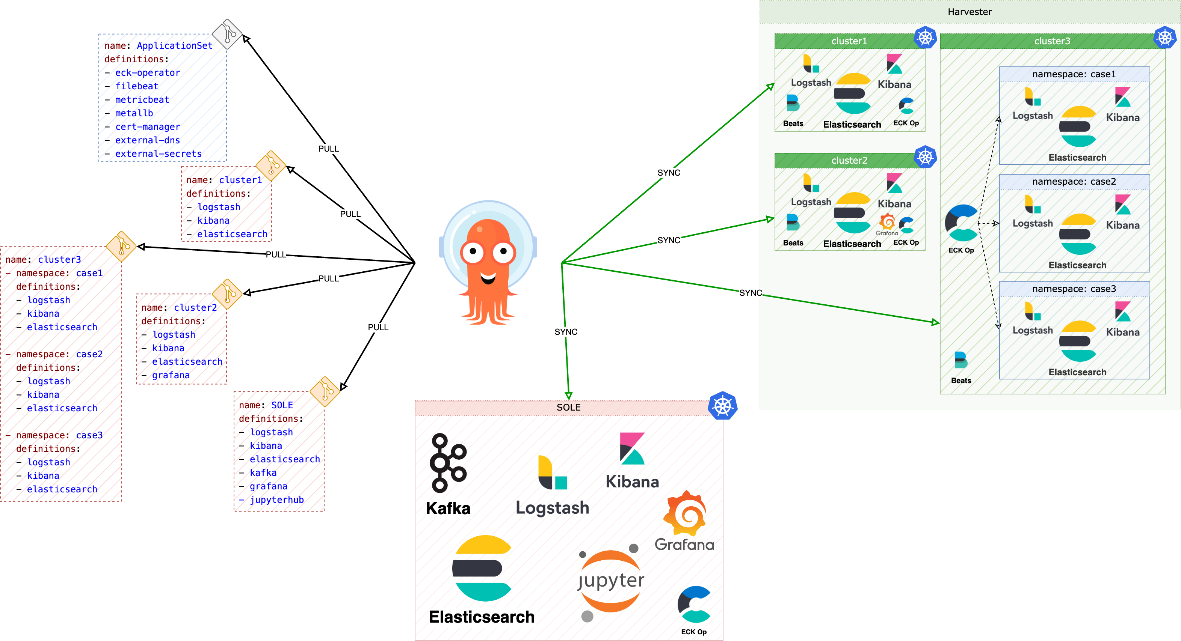
GitOps with ArgoCD
Application definitions
  Each cluster has its own Git repo with all application manifests (HELM or pure k8s manifests)
ApplicationSet
  Common applications can be deployed on all clusters or on clusters with specific labels

Slide 33
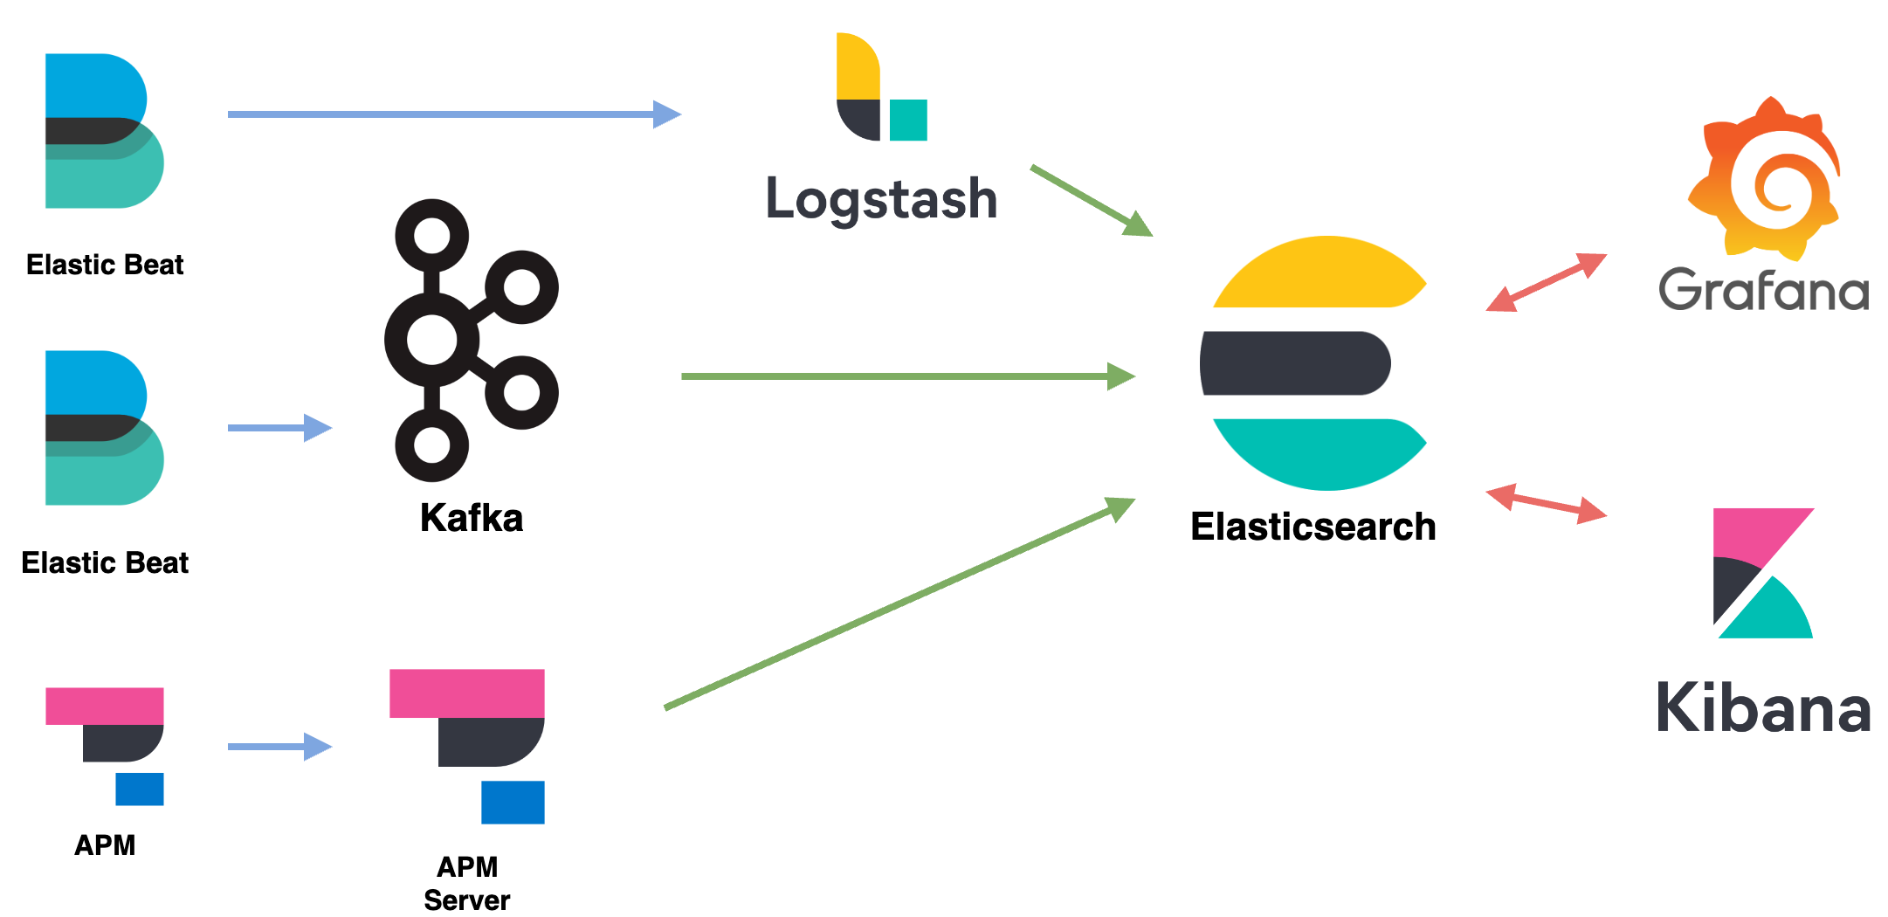
Backup slide: Elastic Stack flow
Notes:
How the data is sent to Elasticsearch
Almos everything via Elastic Beats:
Clients are
Metricbeat
Filebeat
Auditbeat
The clients ingestion options:
Kafka (Preferred)
Logstash (depending on the requirements)
Application performance monitoring (APM) → APM Server → ES
Once everything is on ES we cand do analysis with Grafana or Kibana

