Slide 1
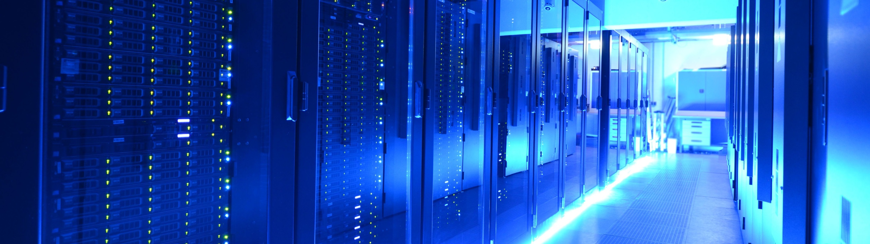
IDAF @ DESY:
Interdisciplinary
Data and AnalysisFacility
Status and Plans
Yves Kemp (for the DESY IDAF team)
… with slide input from Christian Voß, Thomas Hartmann, Christoph Beyer
HEPiX 2025 Spring meeting
Lugano, 1.4.2025

Slide 2
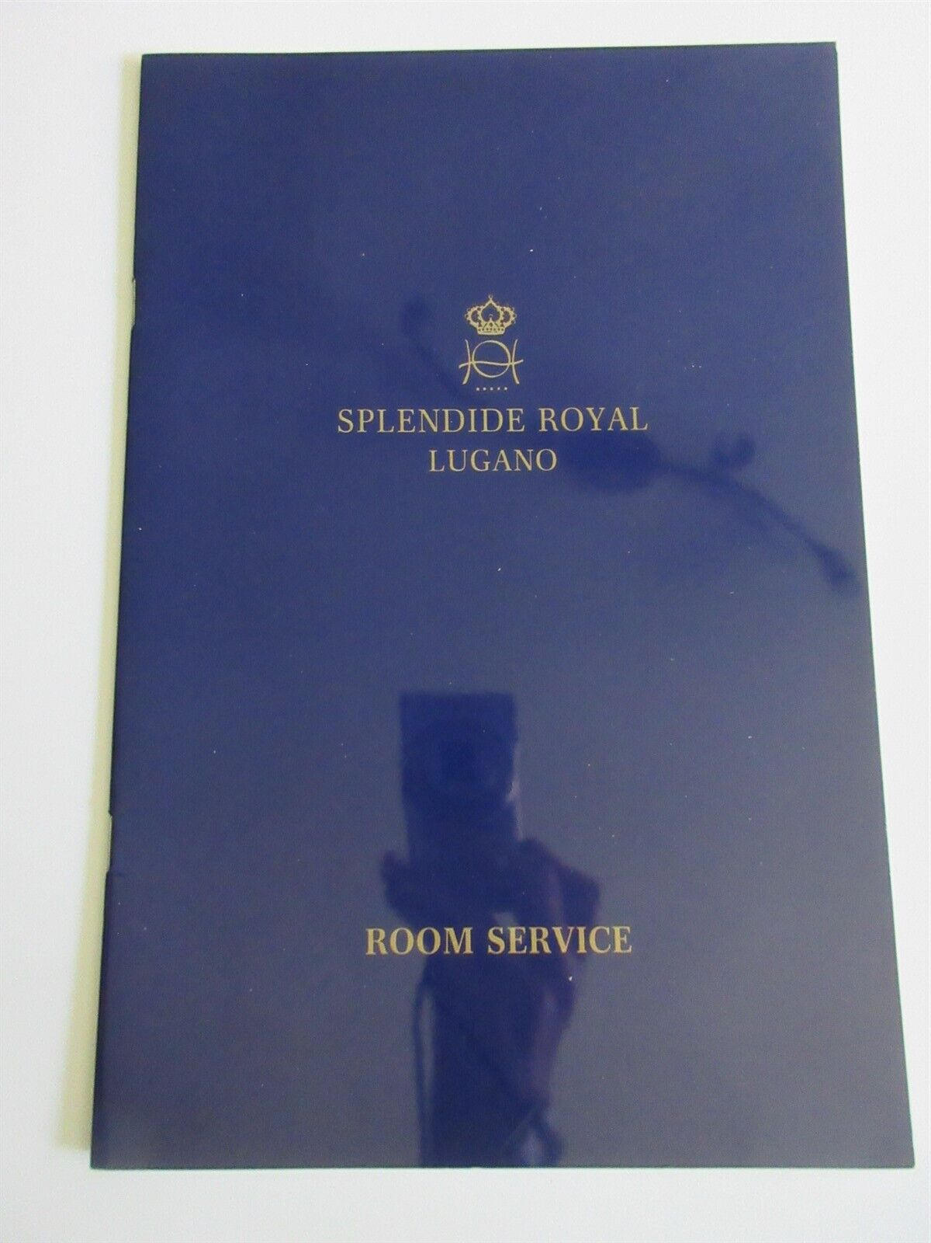
On the menu today
The IDAF: Some background, politics, numbers, nomenclature
The IDAF: Use cases and examples from the different communities
The IDAF: A focus on the NAF: National Analysis facility
NAF and Storage
NAF and Compute
NAF and Services
New developments on the NAF

Slide 3
Background, politics, nomenclature, numbers

Slide 4
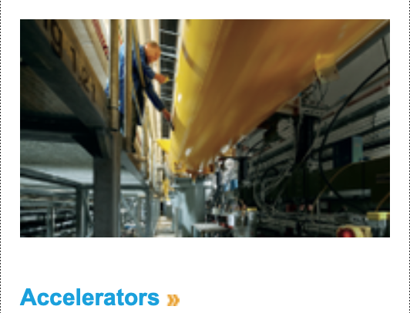
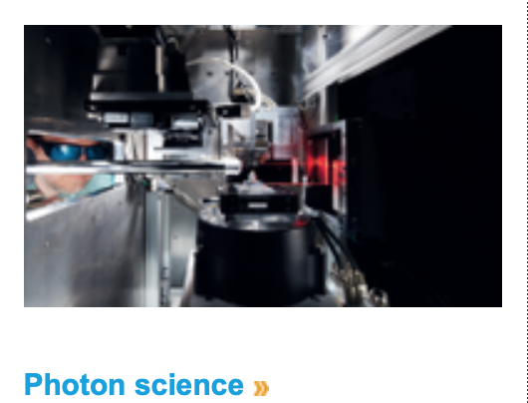

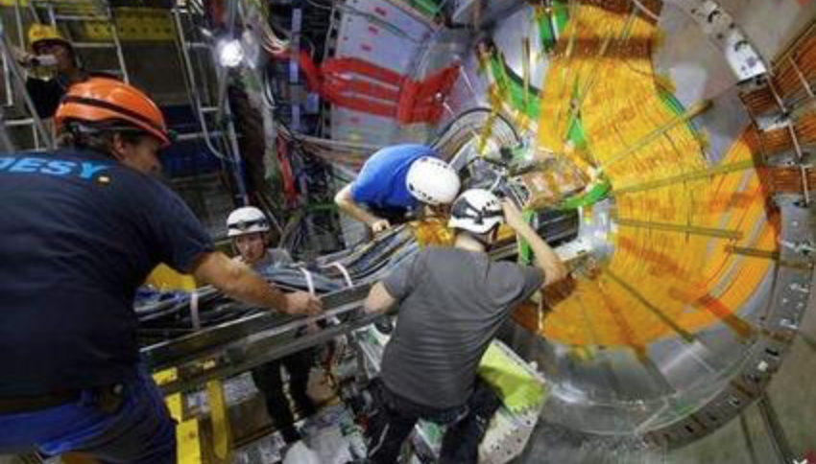
DESY research divisions ... In a nutshell
Running / Operating:
Petra III, FLASH, XFEL, ...
Planning:
Petra IV
General Accelerator R&D
Petra III, FLASH, EXFEL,
CFEL, CSSB, EMBL, HZG
LHC, HL-LHC
Belle II
ILC, ALPS, ....
Theory division

Slide 5
DESY research divisions ... IT involvment in scientific computing
... An incomplete view
Storage operational data
Simulation & computational
infrastructure for R&D
Support
Online DAQ
Offline storage & analysis
infrastructure
Simulation & computational
infrastructure for R&D
Support
Global and national tasks
within LHC and BELLE II
- Simulation & computiational
Infrastructure for ILC and detector
R&D
Support

Slide 6
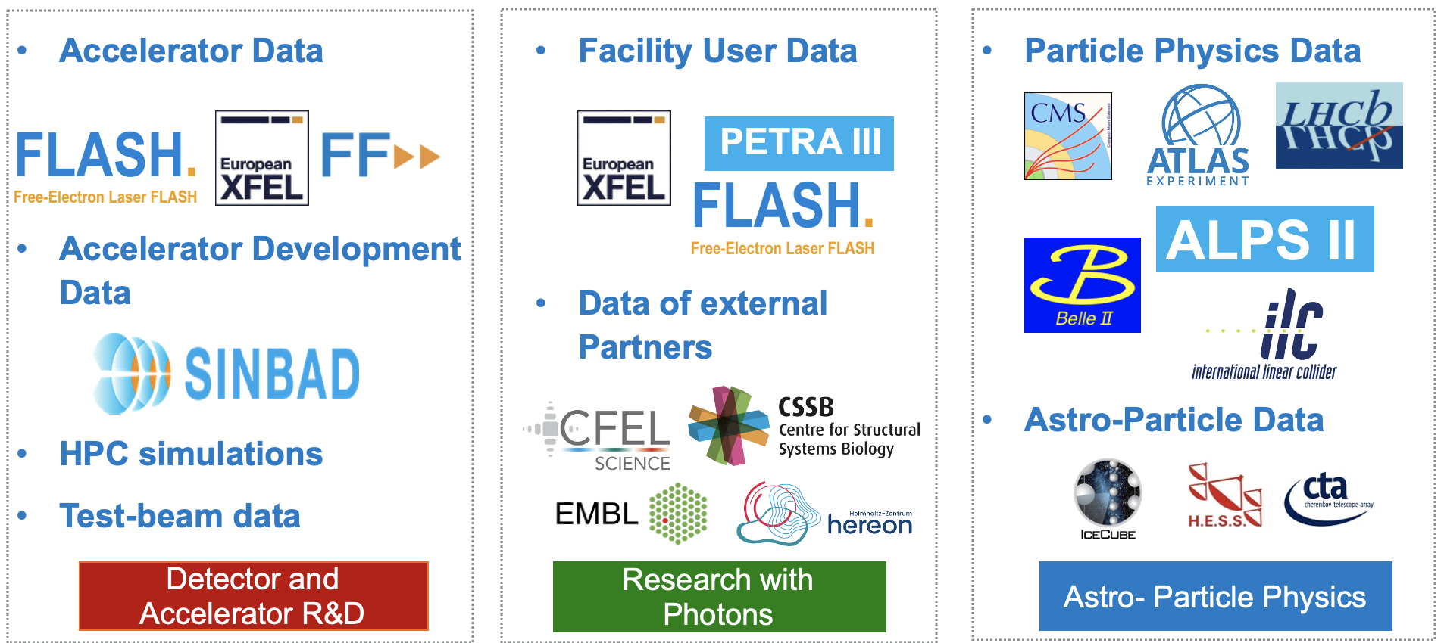
The IDAF is about people and experiments

Slide 7
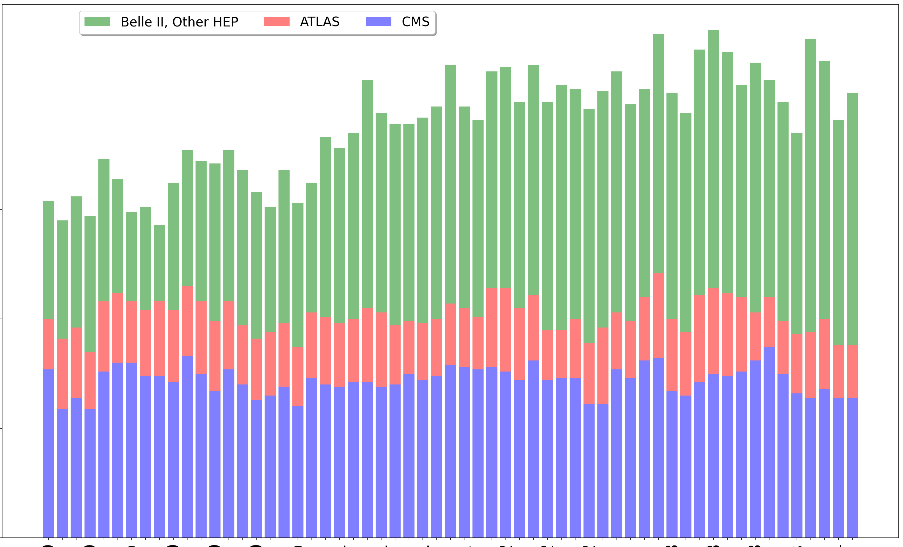
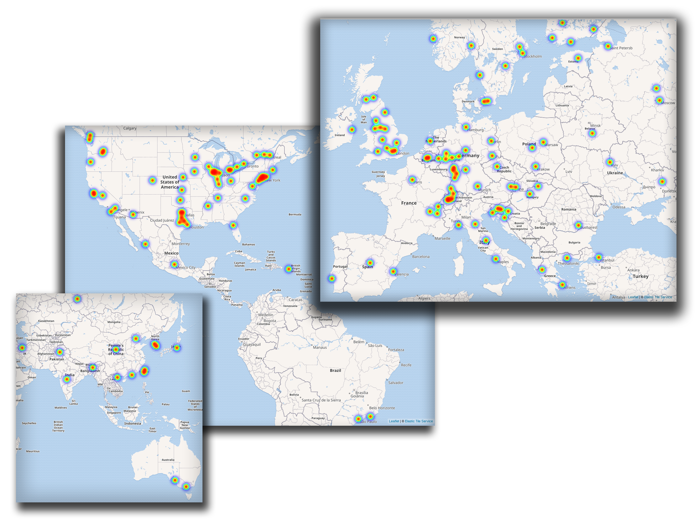
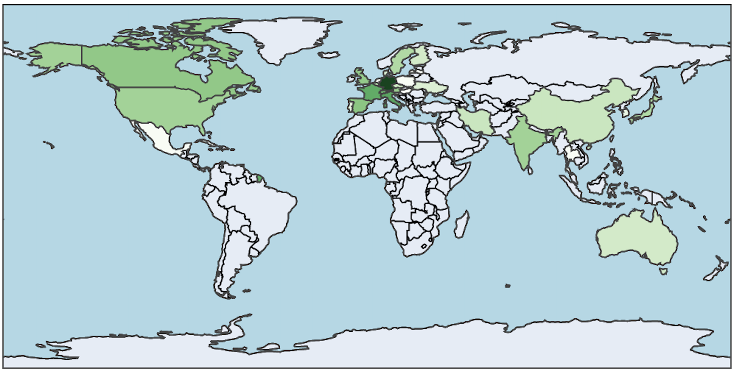
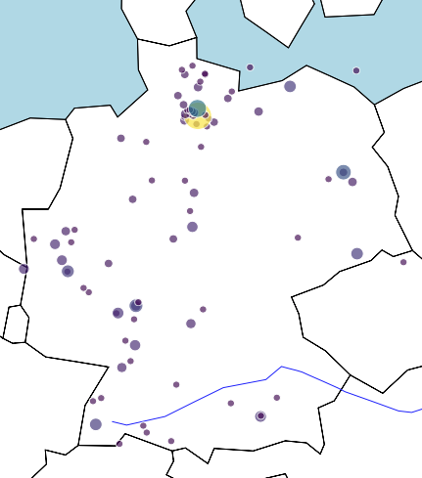
IDAF is available globally to a large and growing user base
Belle II, Other HEP
200
100
0
ATLAS
Remote dCache access
CMS
NAF users
Active NAF Users since 2019
2020 2021 2022 2023
Interactive NAF & Maxwell logins
(*preliminary)

Slide 8


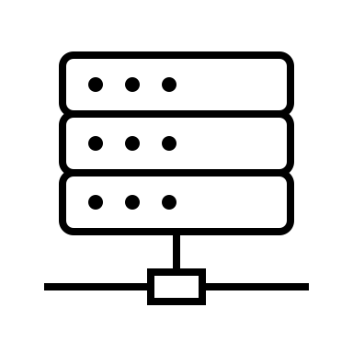





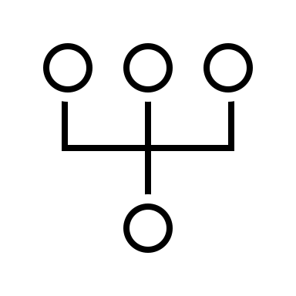
The IDAF is about services
Interactive
access and
compute
Federated
access to
compute &
data
Large-scale
compute and
workflows
Integration
with DAQ
Data
storage &
management
Metadata
management
Software
and
containers
Documentation,
support,
training
Code
management
and CI/CD

Slide 9







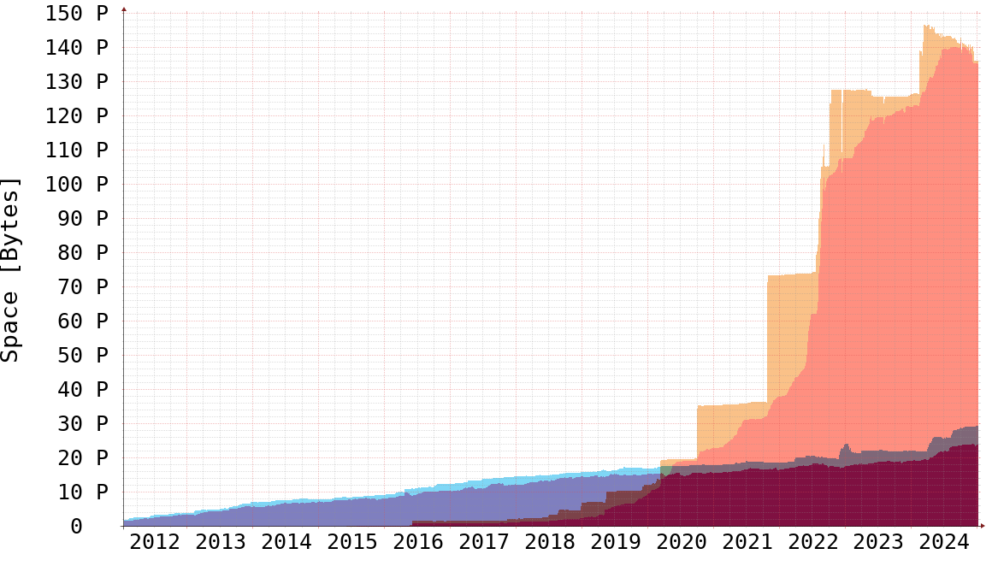
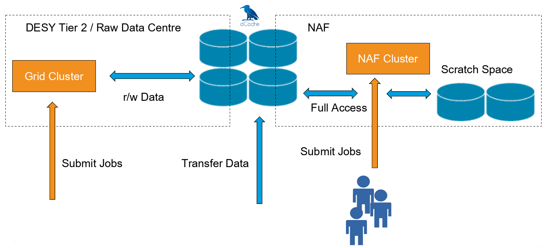
The IDAF is a data centric compute infrastructure
Maxwell HPC
IBM Storage Scale (GPFS)
FLASH.
PETRA III.
User Access layer:
Ssh,FastX, Juypter,
Portals, …
NAF
dCache
(Remote)
IDAF
users
dCache
Remote
Data access
dCache
Grid
 | IDAF specifications
Maxwell HPC | 45.000 cores & 400 GPU
NAF | 10.000 cores
Grid | 20.000 cores
Node IO | 10 Gbit/s (Ethernet) – 200 Gbit/s (InfiniBand)
WAN bandwidth | 2x 50 Gbit/s
Internal traffic | Up to 1 Tbit/s
dCache storage | ~160 PB on disk, 150 PB on tape
GPFS storage | ~80 PB
Communities
XFEL (main usage)
Petra III
CFEL
FLASH
Communties:
ATLAS
CMS
Belle II

Slide 10
Use cases and Science @ IDAF

Slide 11

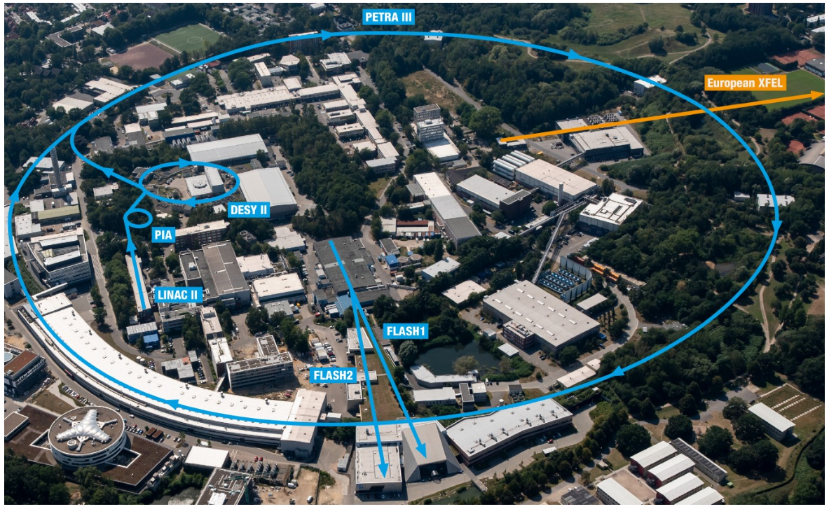
IDAF supports photon science
Integrated into data taking of:
PETRA III
EuXFEL
FLASH
… offering user access for offline analysis of the data

Slide 12
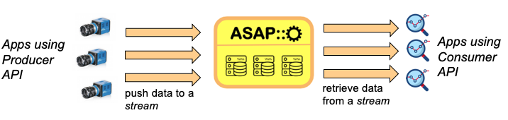
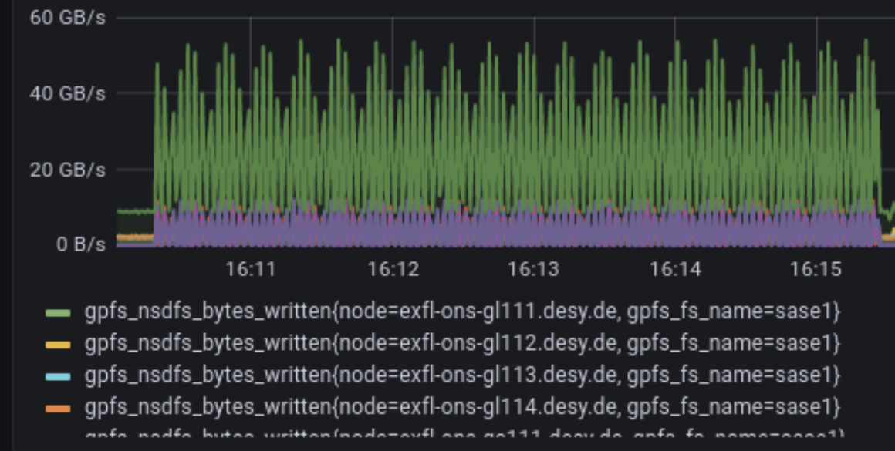
IDAF integrates into high demand data taking
Some key figures:
PETRA III
  Data amount per Beamtime: Up to ~100 TB in ~3 days
  Additional difficulty: Many small files
  Special software developments, e.g. ASAP::O
European XFEL
  Detector rates can reach 30 GByte/s in bursts
  → several PByte for a single experiment within 2-6 days
PETRA IV (projection)
  Total daily data generation will exceed 1 PByte per day
Example EuXFEL online data rates

Slide 13
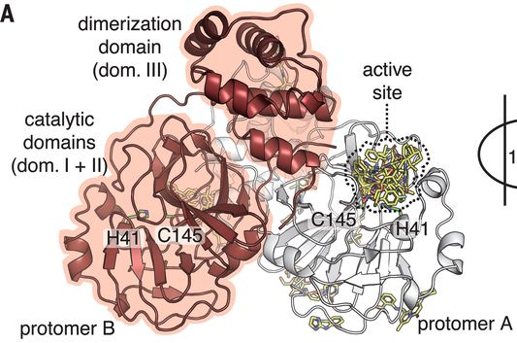
IDAF enables photon science data analysis
Example workflow: SARS-CoV-2 drug screening
Data taking at PETRA III: high-throughput, high-resolution structure determination (beamlines P11, P13, and P14)
  Detailed atomic-level binding information of main protease M^{pro}
On IDAF: Subsequent automated structure refinement followed by cluster analysis and pan dataset analysis of compounds in repurposing libraries
  Testing in-silico whether compounds act on M^{pro} : IDAF / Maxwell HPC
PETRA III.
“X-ray screening identifies active site and allosteric inhibitors of SARS-CoV-2 main protease”
Sebastian Günther et al.
Science 372(6542):642-646 (2021)

Slide 14
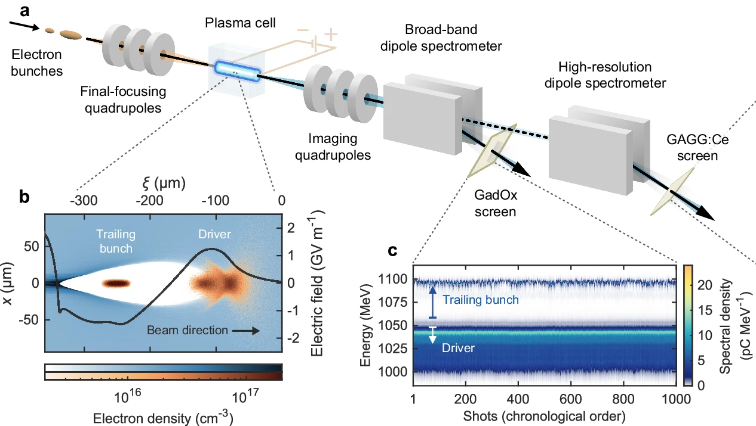
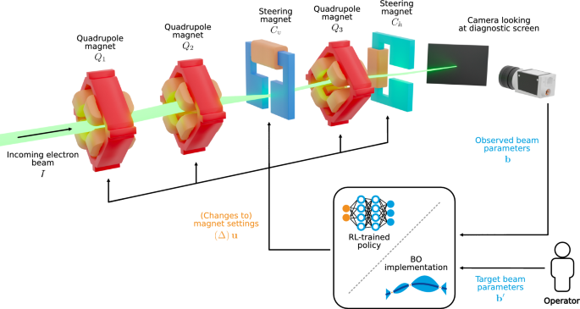
IDAF supports accelerator R & D as well as operation
Emittance preservation in a plasma-wakefield accelerator, (C. A. Lindstrøm et al., Nature 2024, https://doi.org/10.1038/s41467-024-50320-1)
  Main work carried out on LUMI (TOP500#8)
  Preparatory work as well as data analysis on IDAF
Data rates of operational data for PETRA III, EuXFEL, FLASH have increased → 5 PB of metrics store on IDAF
  Used e.g. for training LLM (Large Language Model) for autonomous accelerator tuning
  → Reinforcement learning-trained optimisers and Bayesian optimisation for online particle accelerator tuning. Jan Kaiser et al. Sci Rep 14, 15733 (2024)

Slide 15
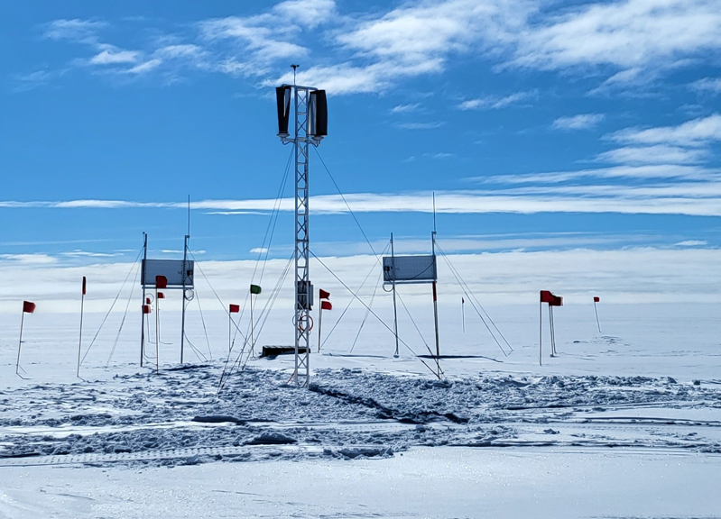














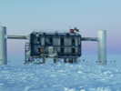
The IDAF supports (Astro-)Particle Physics
RNO-G
ULTRASAT
MAGIC
VERITAS (𝛄)
CTAO
H.E.S.S.
IceCube

Slide 16

DESY is a strong and reliable partner in the Grid
WLCG (Worldwide LHC Computing Grid) is a globally federated collaboration:
  42 countries, 170 computing centers, > 1 million CPU cores, > 2 ExaByte of storage
DESY Grid at Hamburg and Zeuthen plays a crucial part as a large WLCG Tier-2 center
More than WLCG: Belle 2 RAW data center, one of the offline data center for CTAO
Data hosting position in Germany will be enhanced with university Tier-2 fading out → Michael Böhler
Normalized delivered CPU for
ATLAS + CMS + BELLE II
Starting 2020, relative shares
#4

Slide 17
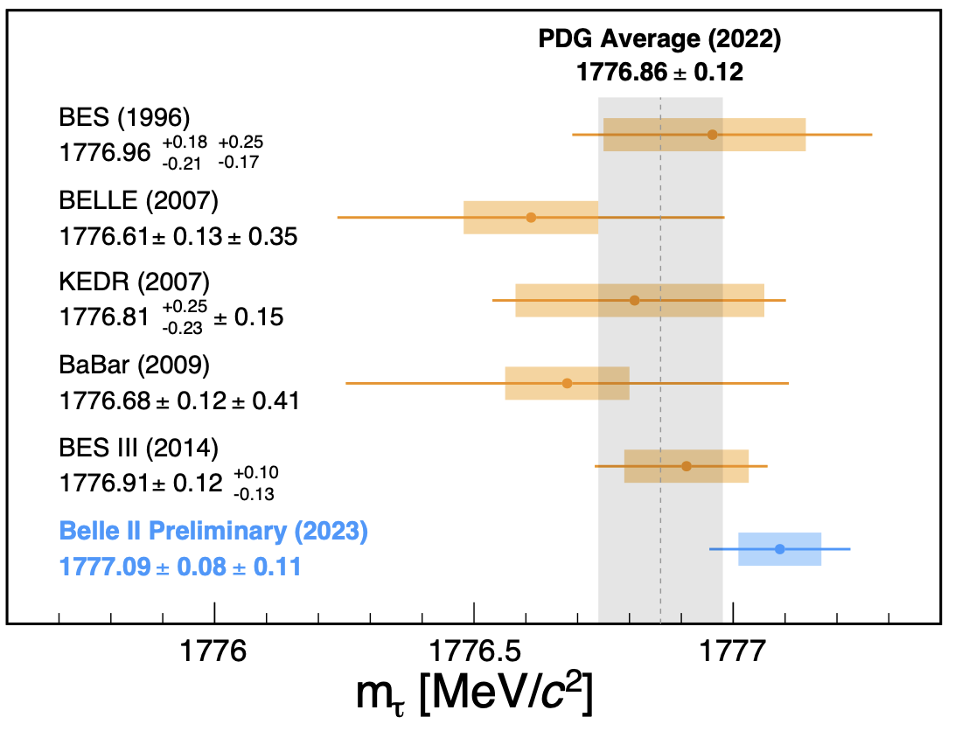
NAF: National Analysis Facility complements the Grid
DESY Grid: Federated into experiments data management workflows and software distribution
NAF: Fundamental concept from 2007 still holds: Offer additional services for accessing the DESY Grid data
  Interactive Login and easy, fast turn-around compute
  Additional project space
  Extensive software, support and consulting
Example analysis:
Measurement of the τ lepton mass with the Belle II experiment
I. Adachi et al.
Phys. Rev. D 108, 032006
Most precise measurement!

Slide 18


Comparing Maxwell HPC & GRID/NAF HTC systems
Feature | Maxwell | GRID/NAF
Size | ~950 nodes / 45k cores / 530 TB RAM ~200 nodes with GPU | ~ 600 nodes / ~30k cores / ~100 TB RAM
Network | InfiniBand for fast data & IPC, 10 GE Ethernet | 1 GE - 10 GE Ethernet
Storage | Access to GPFS data (IB), dCache (NFS, Ethernet). | dCache (NFS, Ethernet), GPFS (NFS, Ethernet)
Batch strategy | Whole/Multi-node-scheduling. Integration of private resources possible, with prioritized access. | Per-core-scheduling, no multi-node. Centrally procured resources. Fairshare on group basis.
Product

Slide 19
NAF Storage

Slide 20
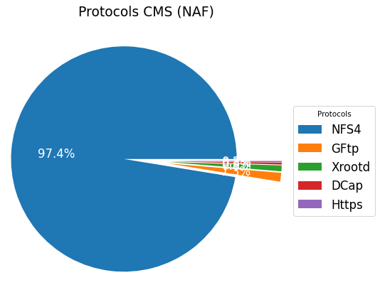
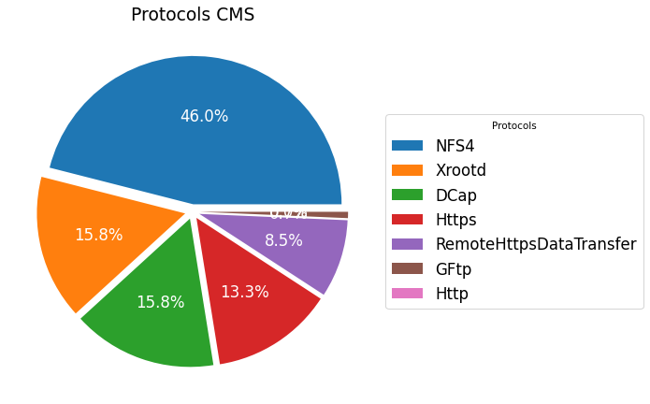
dCache integrates with the World – and with local access
dCache
dCache
Remote
Data access
dCache
Data Access CMS May 2023

Slide 21
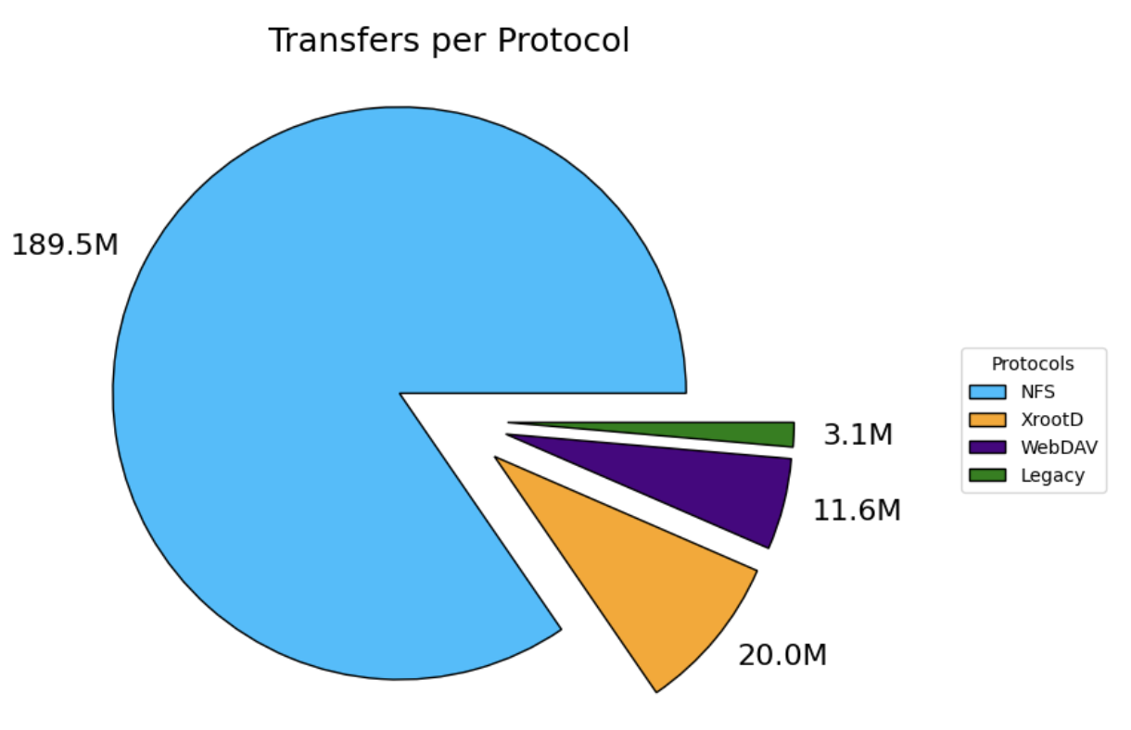
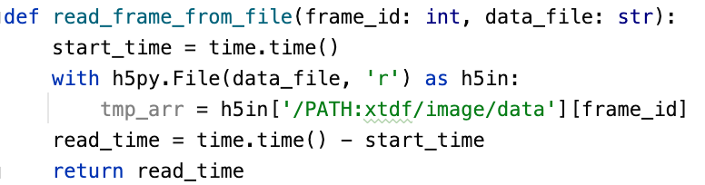

On local, mounted file systems
Transfers per protocol,
all dCache instances,
March 2025
Users Prefer to Use POSIX — IDAF Needs to Adapt to that Fact
Continued trend to access data ‘directly’
Usually only option for photon science, accelerator R&D and commercial software
Trend includes HEP despite remote read capabilities
  Technical advantages e.g. transparent client-side caching can drastically increase efficiency
Poses the challenge of having uniform name-space across the IDAF
POSIX filesystem disadvantage: one single hierarchy possible. Really?
  I would need to change my analysis depending on the cluster I’m on
  → SOLVED now: in heroic act, we unified the user/project areas to one single namespace

Slide 22
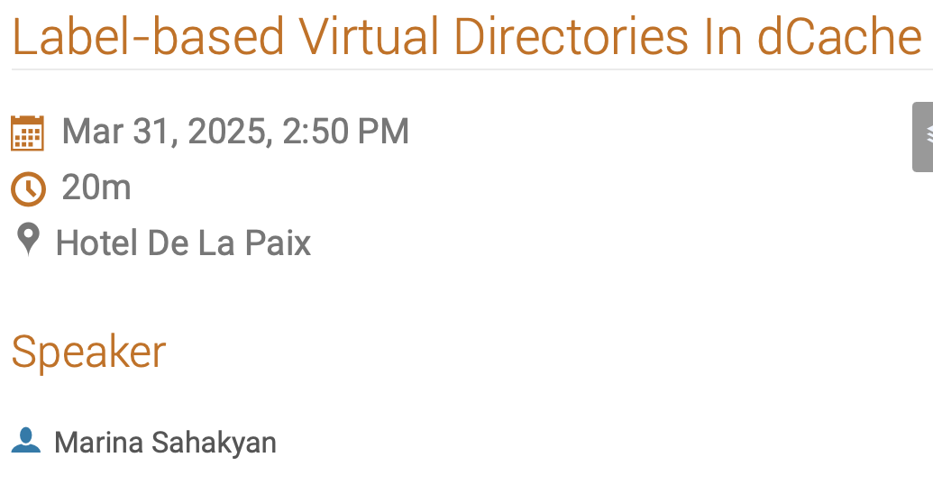
Virtual Directories: ATLAS@NAF example
Technical background:
dCache File Labels for bridging namespaces and managing files
Bridging VO Namespaces
Problem: VOs managing overlay namespaces, e.g., ATLAS Rucio NS
  ATLAS Rucio: files organized in datasets/containers (“object-store-like”)
  Grid storages mounted on the NAF via NFS
  Files available on the NAF under local paths
    Rucio file/dataset identifier have to be translated to local paths (historically via symlinks)
Example
Dataset
user.foobaz:user.foobaz.411046.PowhegPythia8EvtGen.DAOD_TOPQ1.e6696_a875_r9364_p4514.14-10-2022_output_root.454234882
contains 282 files
/pnfs/desy.de/atlas/dq2/atlaslocalgroupdisk/rucio/user/foobaz/e4/d5/user.foobaz.30845885._000197.output.root
/pnfs/desy.de/atlas/dq2/atlaslocalgroupdisk/rucio/user/foobaz/c4/03/user.foobaz.30845885._000198.output.root
...
/pnfs/desy.de/atlas/dq2/atlaslocalgroupdisk/rucio/user/foobaz/6c/2c/user.foobaz.30845885._000537.output.root
/pnfs/desy.de/atlas/dq2/atlaslocalgroupdisk/rucio/user/foobaz/69/b7/user.foobaz.30845885._000538.output.root

Slide 23
Virtual Directories: ATLAS@NAF example
Example: Bridging the ATLAS Rucio Namespace to the NAF
Solution: label all files with all dataset IDs they are part of
/pnfs/desy.de/atlas/dq2/atlaslocalgroupdisk/rucio/user/foobaz/e4/d5/user.foobaz.30845885._000197.output.root
- user.foobaz:user.foobaz.411046.PowhegPythia8EvtGen.DAOD_TOPQ1.e6696_a875_r9364_p4514.14-10-2022_output_root.454234882
- user.foobaz
- foobaz_mythesis
/pnfs/desy.de/atlas/dq2/atlaslocalgroupdisk/rucio/user/foobaz/c4/03/user.foobaz.30845885._000198.output.root
- user.foobaz:user.foobaz.411046.PowhegPythia8EvtGen.DAOD_TOPQ1.e6696_a875_r9364_p4514.14-10-2022_output_root.454234882
- user.foobaz
- foobaz_mythesis
→ make the alternative virtual directory available in the NFS mounts on the NAF
/pnfs/desy.de/atlas/lfs/foobaz_mythesis/user.foobaz.30845885._000197.output.root-1
/pnfs/desy.de/atlas/lfs/foobaz_mythesis/user.foobaz.30845885._000198.output.root-1
→ or any other label view
/pnfs/desy.de/atlas/lfs/user.foobaz:user.foobaz.411046.PowhegPythia8EvtGen.DAOD_TOPQ1.e6696_a875_r9364_p4514.14-10-2022_output_root.454234882/...
/pnfs/desy.de/atlas/lfs/fuser.foobaz/...

Slide 24
POSIX User Authentication is the glue between IDAF components
Maxwell HPC
IBM Storage Scale (GPFS)
User Access layer:
Ssh,FastX, Juypter,
Portals, …
NAF
dCache
(Remote)
IDAF
users
dCache
dCache
Grid
User: UID, a primary GID (and (several) secondary GIDs)
Data: belongs to a UID, group data magic performed on GID level
Processes: run under respective user UID
Network security: POSIX Mounts only on centrally managed IDAF systems
Kerberos: Used for AFS and HTCondor (some K5 magic under the hood)
… all this managed in central DESY registry (Federated AAI in preparation)

Slide 25
NAF compute

Slide 26
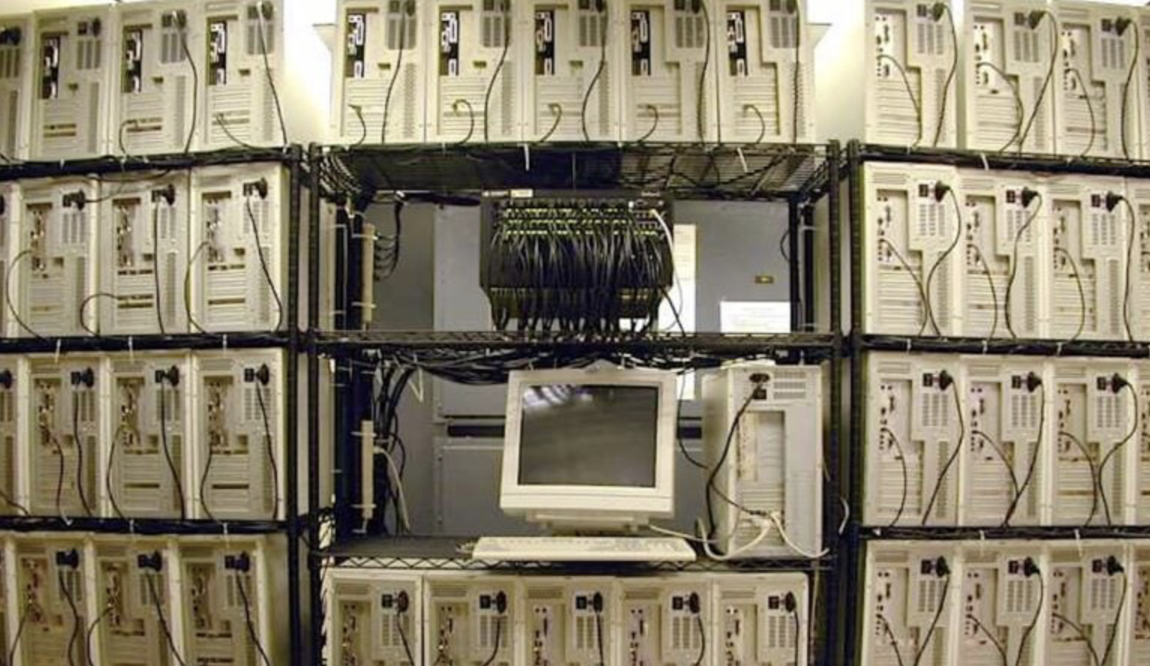
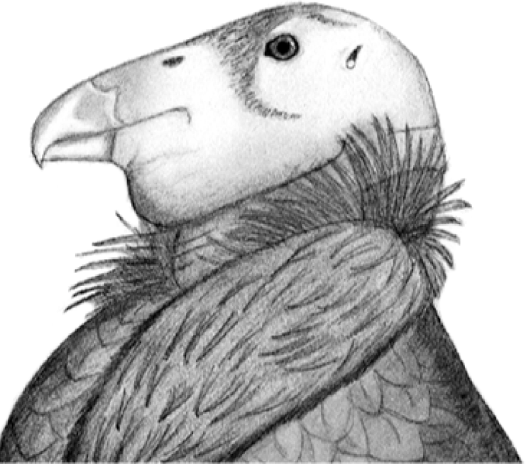




Batch + portal nodes are the concept for compute
NAF
batch
farm
(Several)
Scheds
Some portal
…
(VScode?)
ATLAS BELLE CMS

Slide 27

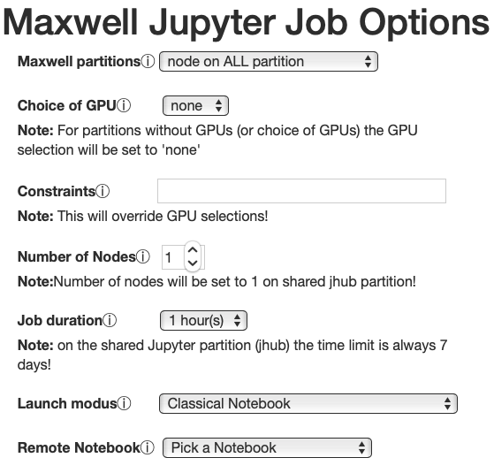
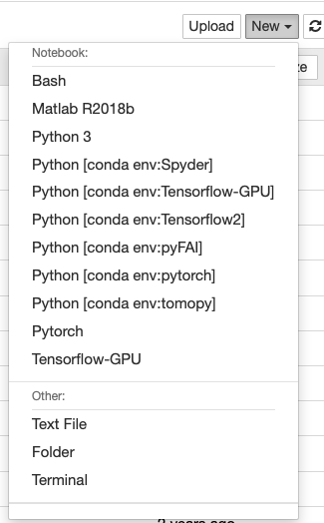
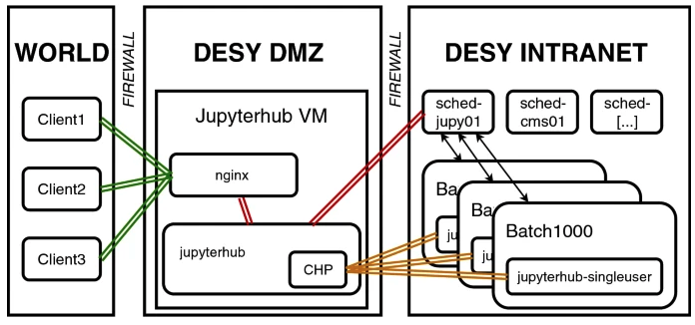
Jupyter: Interactive & easy remote access
Jupyter notebooks and Maxwell and NAF
What are Jupyter Notebooks? Data analysis and simulation in your browser
Python based interpreter for Python, Matlab, …
Access via web-browser through portal
Computation itself happens on Maxwell or NAF: Integration with SLURM / HTCondor scheduler
Interactive analysis notebooks on DESY batch resources
Johannes Reppin et al. (2021) , CSBS/Springer

Slide 28
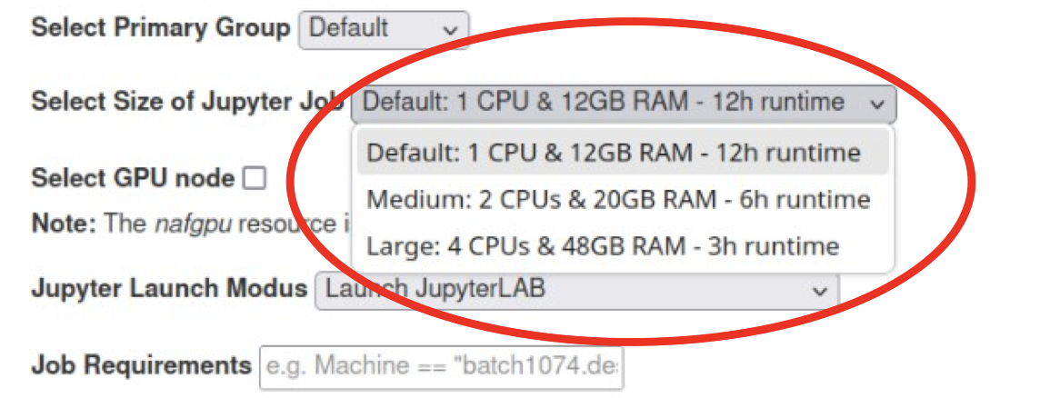
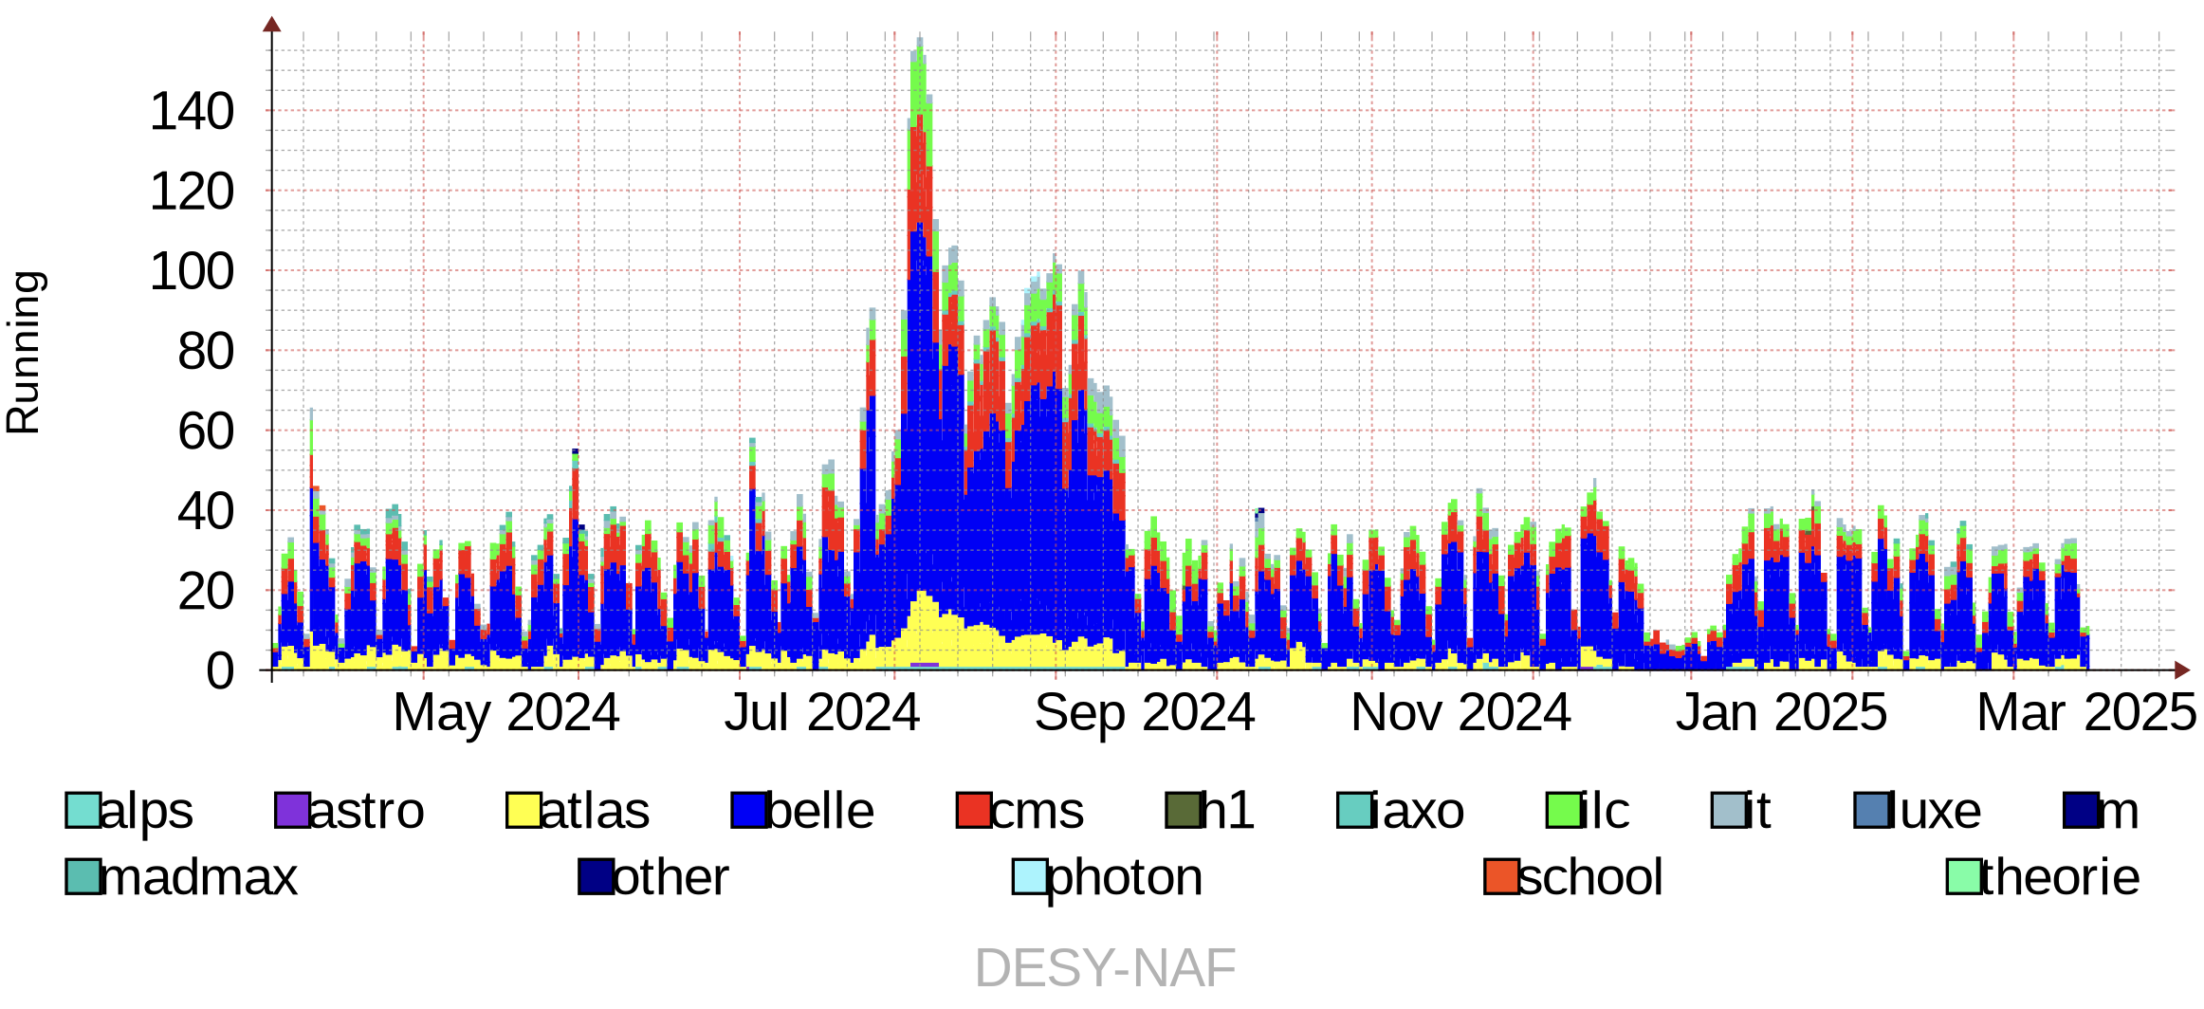
Jupyter usage early barometer for changes
Before ~fall 2024: Jupyter slots piggybacked to all NAF WNs … using overcommitment
Memory utilization has increased: Change
Now only “small” ones piggybacked, the others run on dedicated WNs
VisualStudioCode is similar in some respect
  Would like to integrate in a similar manner
  Anyone has gone that way?
The Jul-Sept bump was due to DESY summer student program

Slide 29
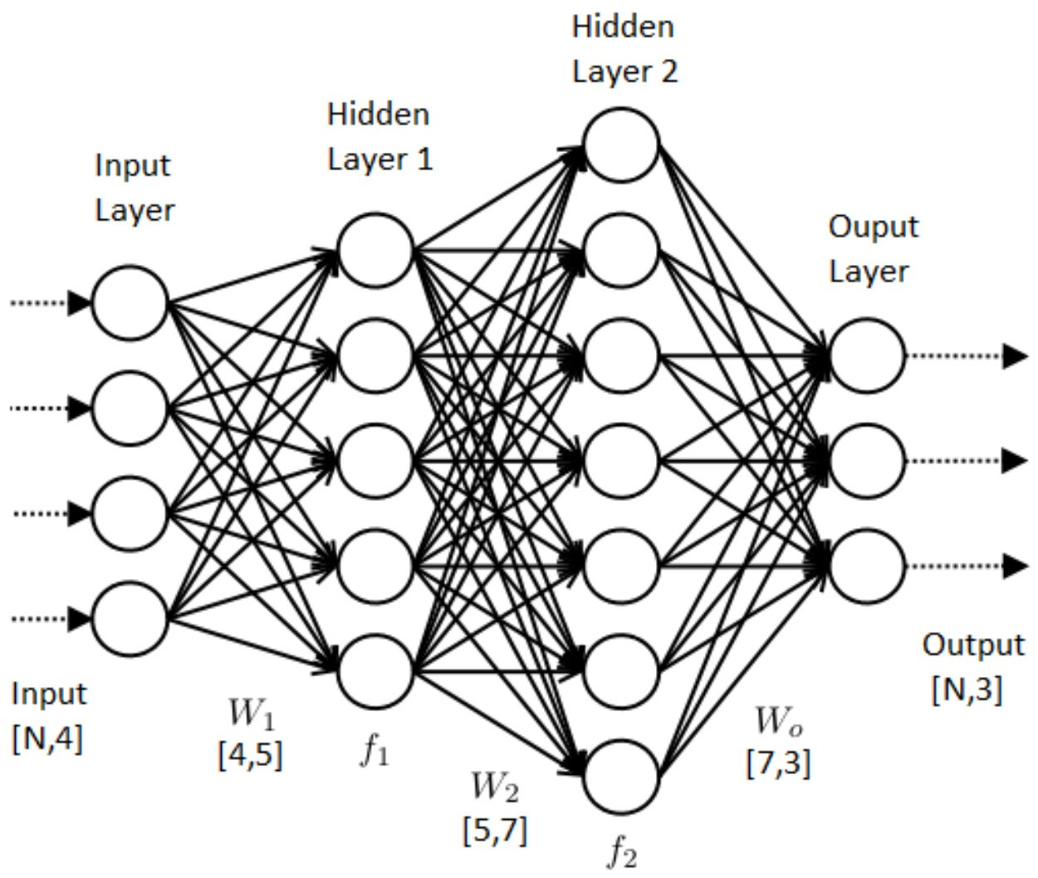
GPU computing & Machine Learning
General GPU computing established in HPC systems
  … so in Maxwell: ~200 nodes equipped with GPUs
  Different generations, different setups: From one GPU/Server to four GPU/Server
Maxwell HPC cluster natural candidate for hosting GPU computing
  Users have applications profiting from GPUs
  GPUs benefit from “HPC-like” environment
Machine Learning
  Boosted by the usage of GPUs for training (and inference)
  Benefits heavily from fast access to (large amounts of) data, and high-RAM machines
  Maxwell is natural environment: Call for NAF ←→ Maxwell interplay
Future of GPU computing & Machine Learning
  We see an increase in demand for “multi-GPU nodes” (~4 GPU/node)
    Expensive, few nodes, challenging from scheduling point of view
  Look for alternatives to NVIDIA. Have some examples in the lab. Dependency from CUDA challenging

Slide 30
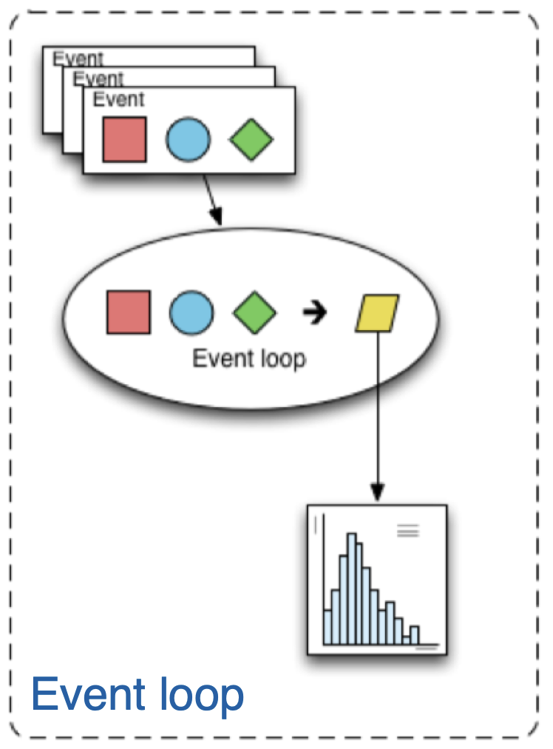
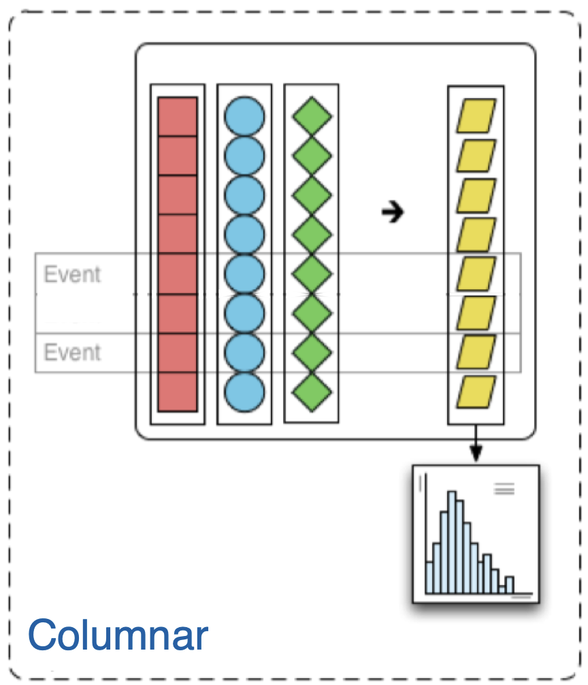
Columnar Analysis
Orthogonal ansatz to compute
Optimal with data stored in-memory
Poses radically new challenges
IDAF has pioneered columnar analysis on small scale
Currently seeing that users are taking up this techniques
  > 50% in some groups
  No coordinated effort!

Slide 31


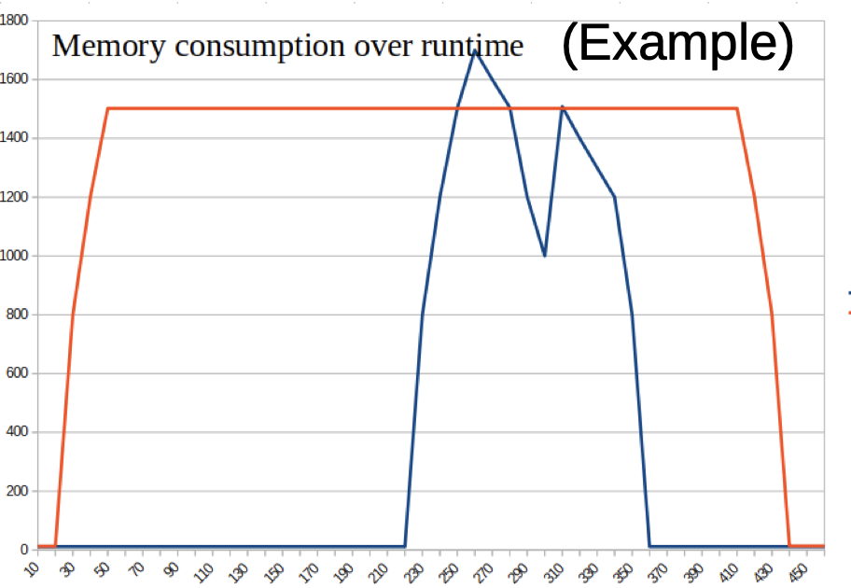
… but they break our Worker Nodes!!!
Reduced 3x RAM overcommitment → no overcommitment
… lots of debugging / support with columnar analysis users!
Long-term questions:
  Closely monitor RAM consumption
  New scheduling strategies ?
  New purchases with more RAM ?
  Which frameworks will be used ?
We saw many worker nodes crash: too much swap
DASK memory consumption fundamentally differs from normal jobs

Slide 32
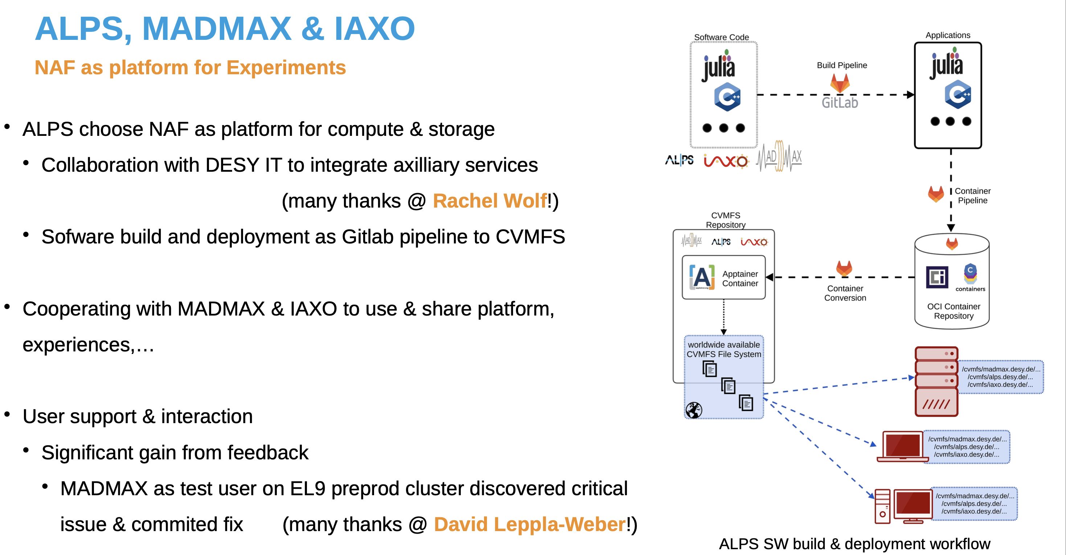

Slide 33
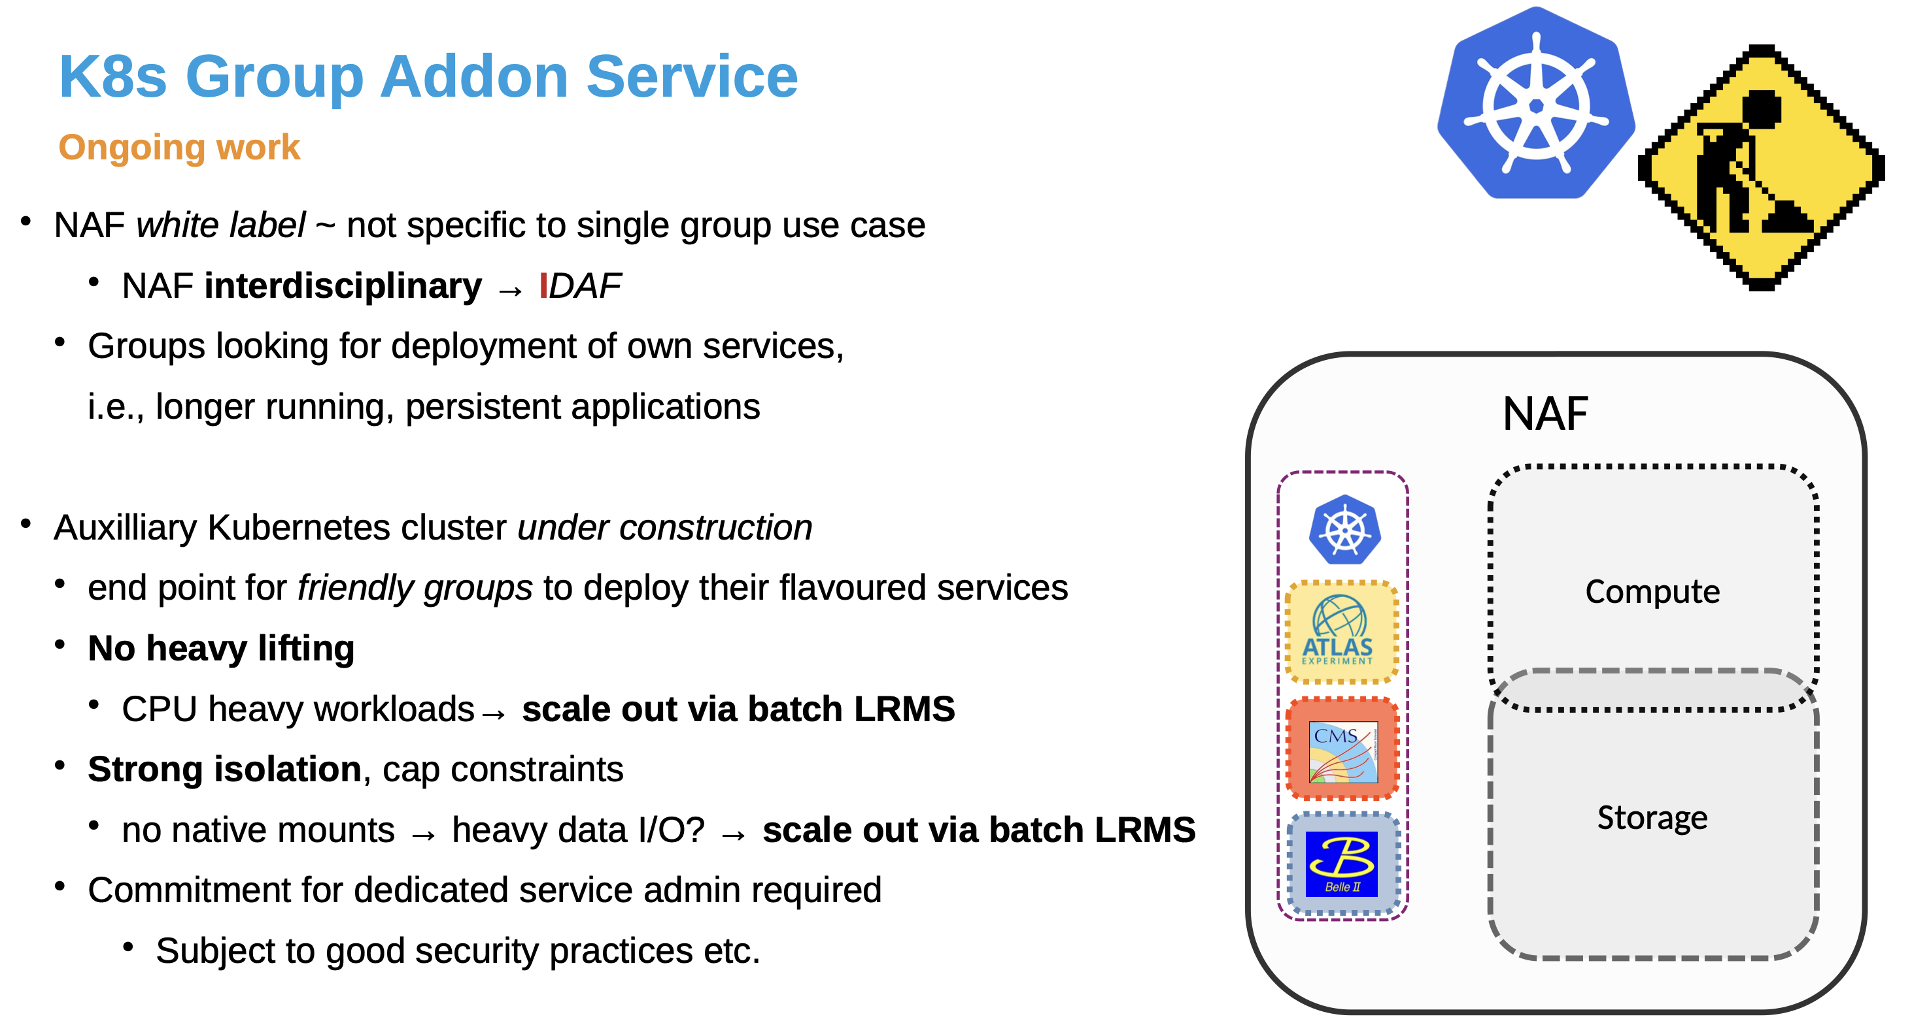

Slide 34
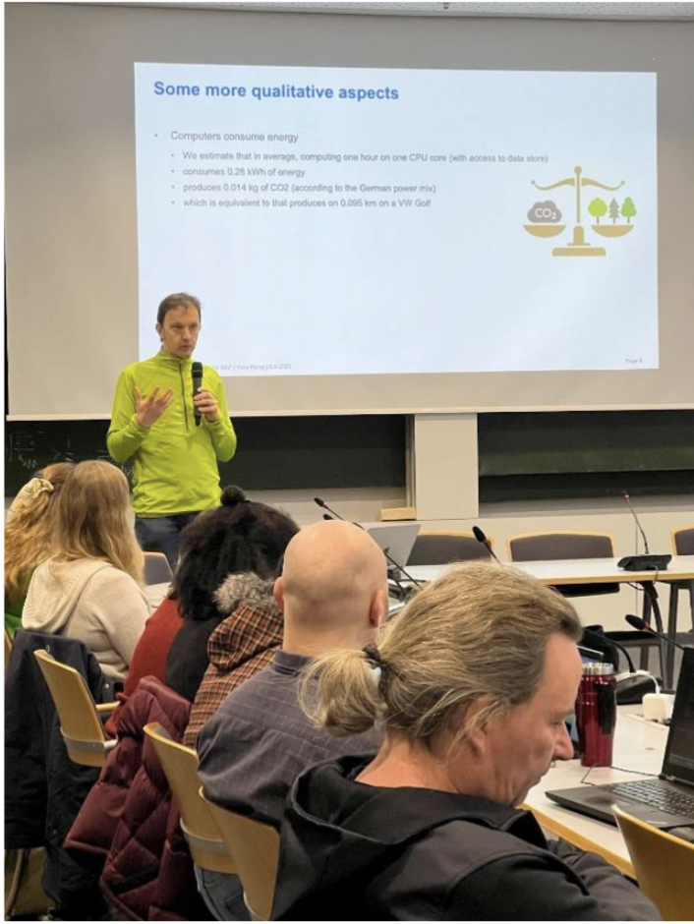
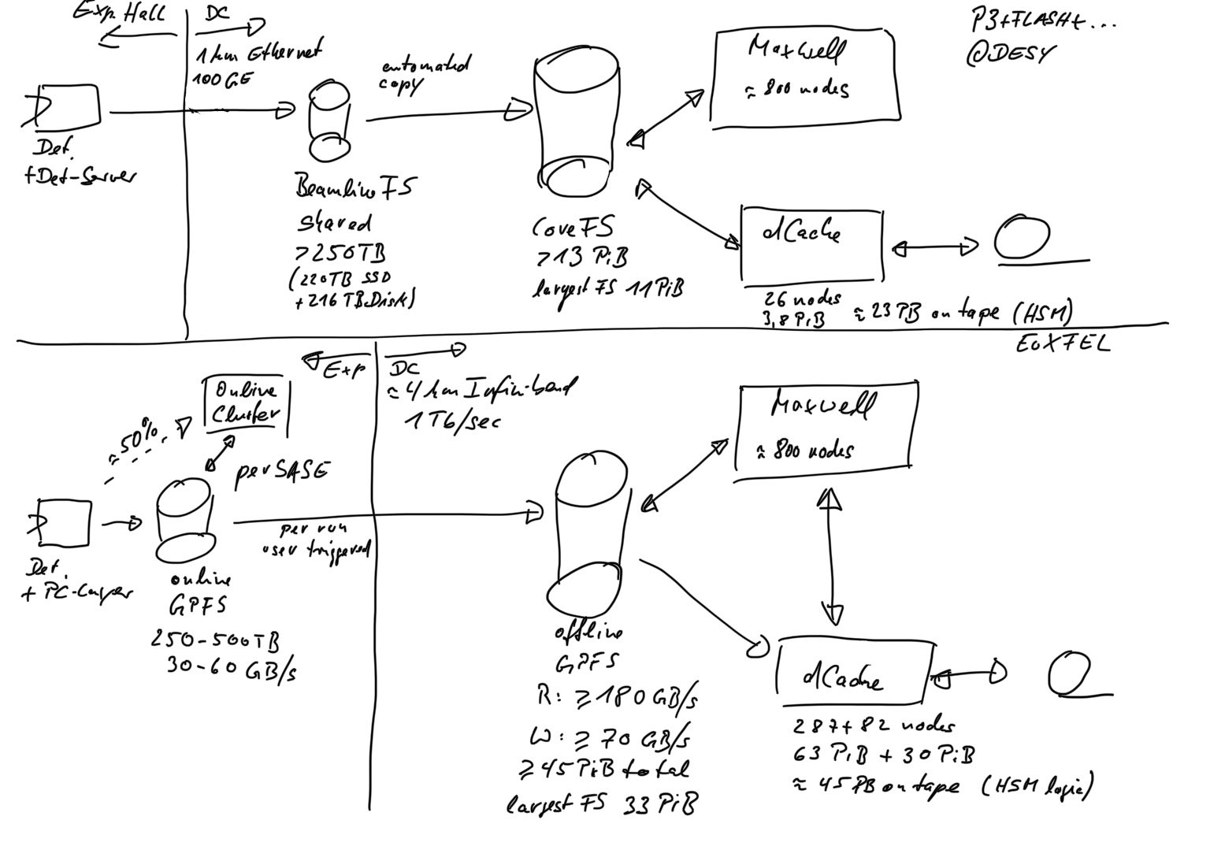






The People behind the IDAF
Support: ~1000 tickets / year
Training, consulting, strategic planning
Performing research for the IDAF
Connecting with other projects
Operating the IDAF on a day-to-day basis
→ Actually the most important factor for the success of a facility!
PETRA III initial DAQ scheme (2014)
Interactive analysis notebooks on DESY batch resources
Johannes Reppin et al. (2021)
CSBS/Springer

Slide 35

Summary, outlook
The IDAF – and with it the NAF – is well established in the German and international computing landscape
Many: users, communities, workloads
Well-known portal + storage + batch ansatz
  believed to fit future challenges
User support the key component for success of a facility

Slide 36
Backup Material

Slide 37

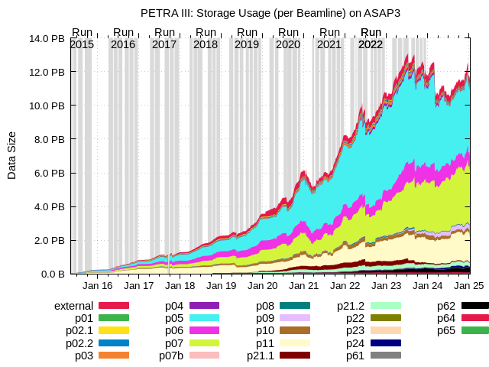
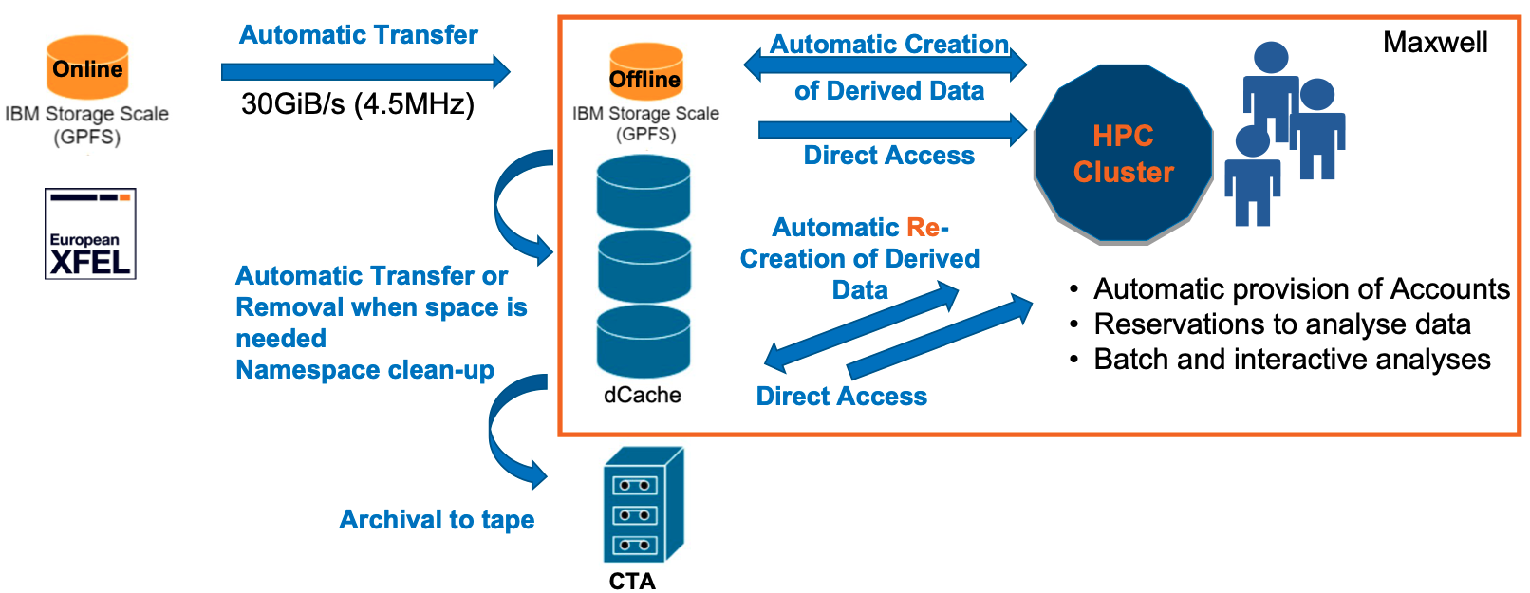
Complementing storage for DAQ and project use cases
Cooperation with IBM on GPFS / Spectrum Scale
→ Complementing using (previously: GPFS)
  ~17 PB (Petra-III), ~64 PB (E-XFEL), ~5 PB (project space)
  Collaboration with IBM
dCache storage is optimized for throughput
Several applications need different profiles:
Photon science data taking:
  Lots of small files, high bandwidth
  Integrated (e.g.) into ASAP::O
End user analysis
  Single file performance, many small files, meta data heavy
Example: E-XFEL data flow

Slide 38
What is an Analysis Facility?
Basic concept of the IDAF are:
  Data locality
  Access services and compute integrated with storage
  Present a holistic service to the analyst
With the advent of machine learning and new compute technologies and storage concepts:
  Does data locality still hold?
  Is current storage integration still OK?
  Do people need an integrated service, or rather flexible infrastructure?
Online access services
Scalable batch service
IDAF
High performance storage

Slide 39
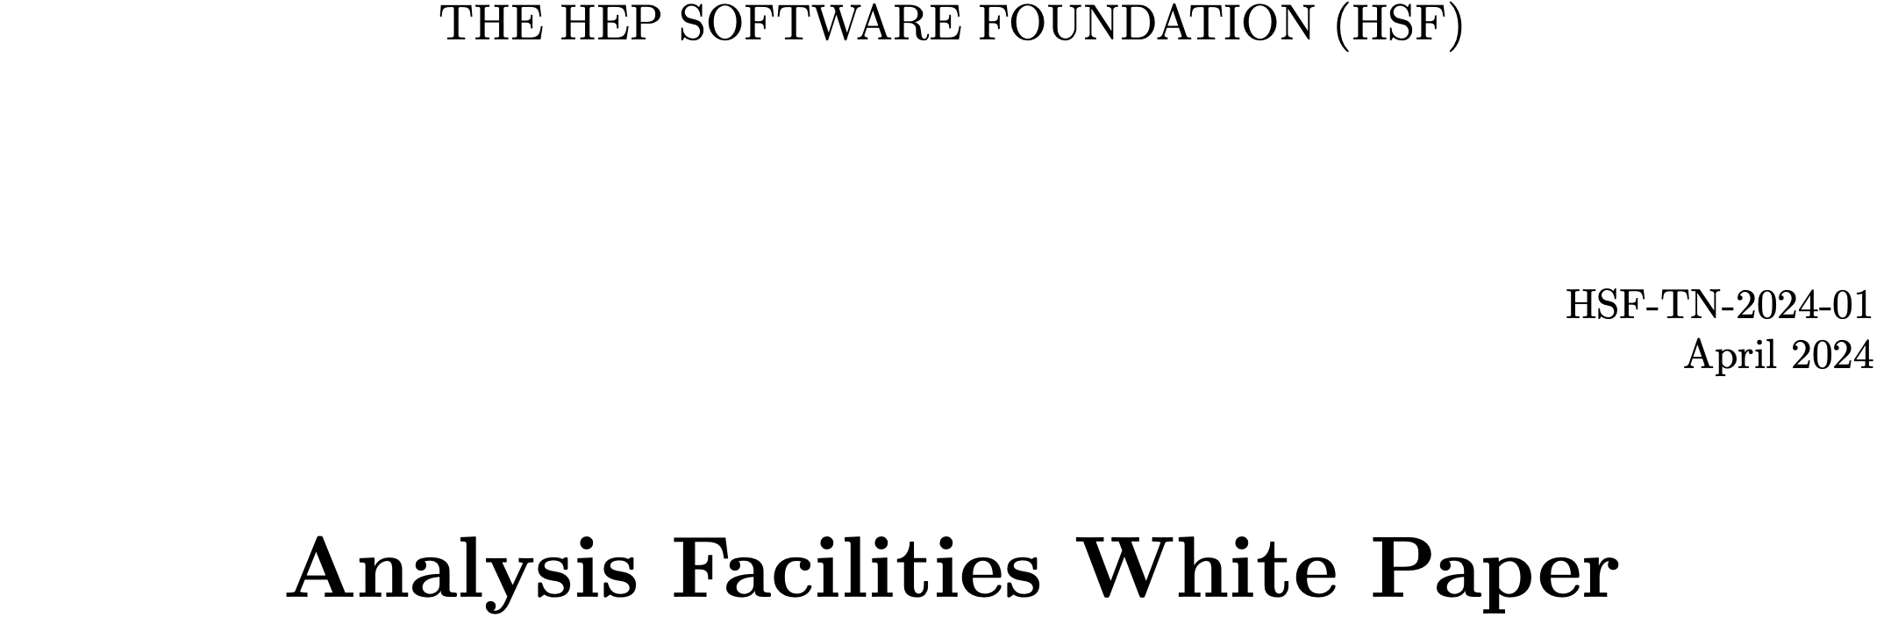
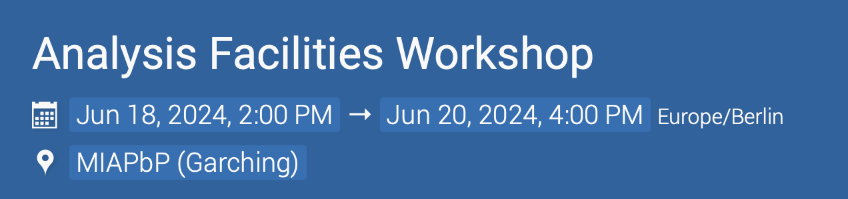
Discussions going on at different levels
Sometimes user driven … who drives?
  10% pioneer users?
  10% special requirements users?
  80% normal users?
Research at facilities needed:
  E.g. PhD students / young postdocs that spend some time doing their analysis in a novel way – in close interaction with IDAF experts
  Participation in ERUM data call on AF

