Slide 1
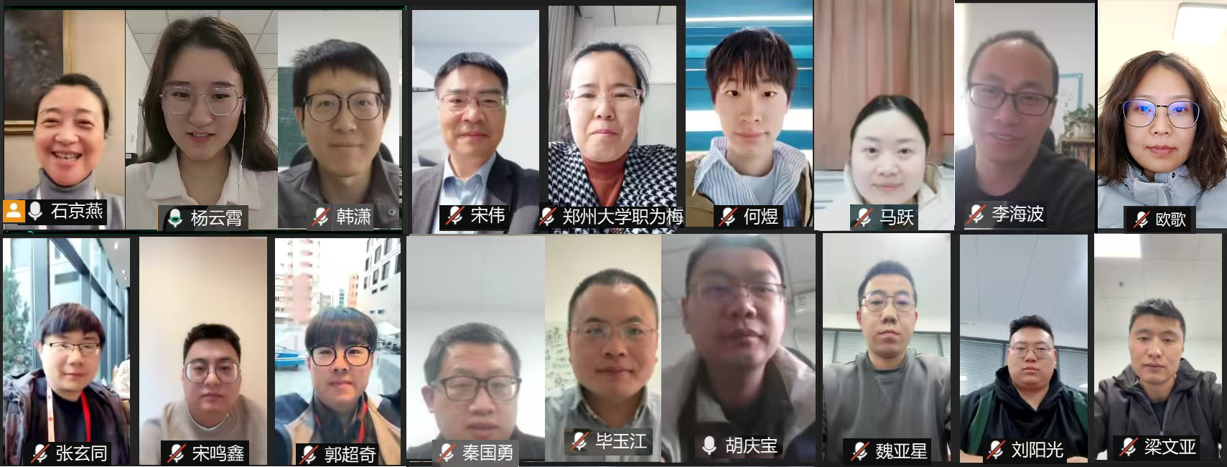
From Batch to Interactive
The “INK” for HEP Data Analysis
Jingyan Shi
shijy@ihep.ac.cn
On Behalf of the INK Team of IHEP-CC
HEPiX Spring 2025 Workshop
Notes:
、

Slide 2
Outline
1
Interactive aNalysis workbench (INK)
2
Current Status
3
Summary

Slide 3
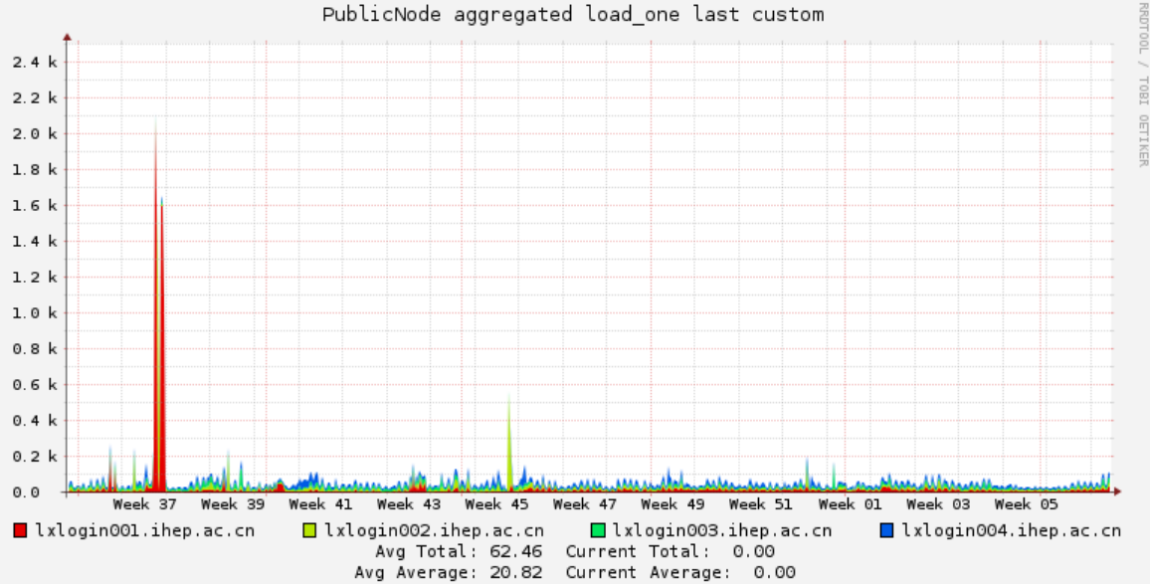
Motivation for “INK”
Traditional HEP Batch System: Offline & Closure & Backend resource
  Local cluster: HTCondor, Slurm, etc.
  Users write code at login node and submit jobs to the local cluster
  Jobs running in the background (worker node) with no user control after job submission
  Users must wait for result until the job is completed
Limitations of the traditional batch system
  Login nodes serve as coding workplace and require SSH access
  Direct data file access at login node
  Code tools (e.g., VSCode, Jupyter) bring additional load
  Limited login nodes lead to performance issues when multiple users run code tool simultaneously
Extra burden caused by “vscode“ at login node

Slide 4
New Requirements in HEP
Combine Offline & Interactive data analysis
  Users want real-time job tracking and parameter adjustments
    Examples:
      Partial Wave Analysis:
      Geant 4 Simulation:
  Popular code tools
    VSCode, Jupyter, Pycharm etc.
  User would like to access data file anytime, anywhere
Analysis facility
  Loosely definition: infrastructure and services that provide integrated data, software and computational resources to execute on or more elements of analysis workflow
  Batch system: infrastructure of AF
    Needs the transition from “Closed & Backend” to “Open & Frontend” system
Data clean
Parameter Optimization
Result Visualization
Taken from https://hepsoftwarefoundation.org/activities-archive/analysisfacilitiesforum.html

Slide 5
INK: Interactive aNalysis worKbench
Visionary goal
  Scientific research with just network connection
    Shift backend computing and storage resources to the frontend for better accessibility
    Enable flexible integration of resources and applications
    Provide customized interactive tools for HEP experiments
    Offer plus-and-play deployment solutions for the HEP computing sites
Immediate goal: Scientific research with just a web page
  Provide web-based interactive analysis tool at IHEP HEP cluster
    Leverage web technologies : VSCode, Jupyter, Rootbrowse, VNC, Enode
    Run on the dedicated user job slot of the cluster
      No interference between job slots (each has its own CPU & memory)
  Enable external file system access
    Files could be accessed via web page directly
    Upload / Download / Access
  Provide web-based Eshell terminal for command-line interactions

Slide 6
Challenges in Developing INK
Loose and flexible software architecture
  Customizable: each HEP experiments can configure its own INK with necessary apps
  Configurable: resources allocation, applications, default settings
  Ready-to-use: direct deployment at computing sites -- ready to use immediately
Secure authentication & authorization
  Support for SSO, grid certs, commercial account
  Efficient & secure file access
    Maintain consistent access policies for external/internal users
Resource & application integration
  Various resources can be integrated: HTCondor, Slurm, K8S, EOS, Lustre etc.
  Multiple app integration methods for flexibility

Slide 7



















Loose Architecture of INK
User Interface
SSO
Viewer adaptor
Layer
Web page Template
User interactive module
Info / Parameter Configuration
User Permission DB
User Identity
Menu Template
Image/table display
Plugin template
Bussiness Layer
Password Access
File Access API
App. Running API
Computing Usage API
File System Adapter
App. Adapter
Computing Resource Adapter
Endpoint Conversion/Transfer
Resource Supply Layer
Storage / Computing Pool

Slide 8
Authentication and Authorization
  INK does not handle authentication, but mapping authenticated users into the INK user
  Dedicate INK user permission database records:
    Available resources
    Allowed Applications
    Access right of the resources for each user
  Developed a mechanism of the authorization for IHEP HTCondor cluster
    Krb5 service provides short-term user ticket
    INK caches and refreshes user tokens during job execution

Slide 9
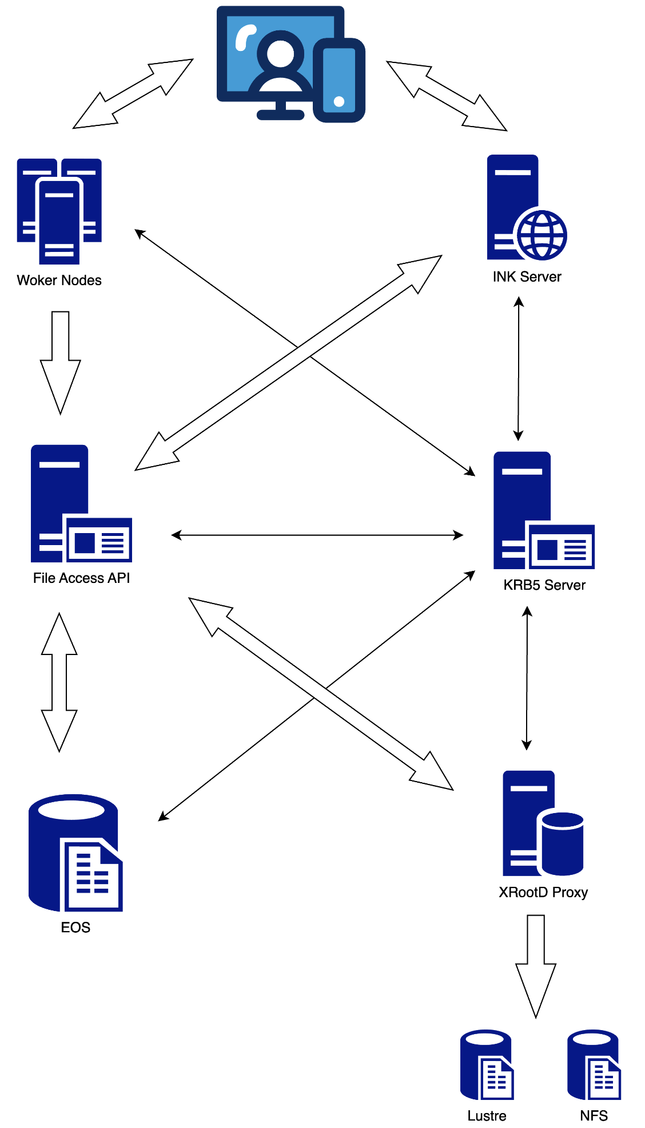
Computing Resource and File access Globally at IHEP
  IHEP cluster: based on krb5 tokens
    Cluster usage and file access based on Krb5 tokens
    Tokens are generated upon user login within duration
    User identity is proxies for access via token
  HTCondor cluster access
    Token checked before job submission
  File systems access
    EOS: Krb5 Tokens supported natively → add configuration
    Lustre, NFS: no krb5 supported at IHEP
      Deploy XRootD Proxy in front of the Lustre/NFS to support XRootD access
      XRootD supports access via krb5 token
      Access Lustre/ NFS go through XRootD proxy

Slide 10
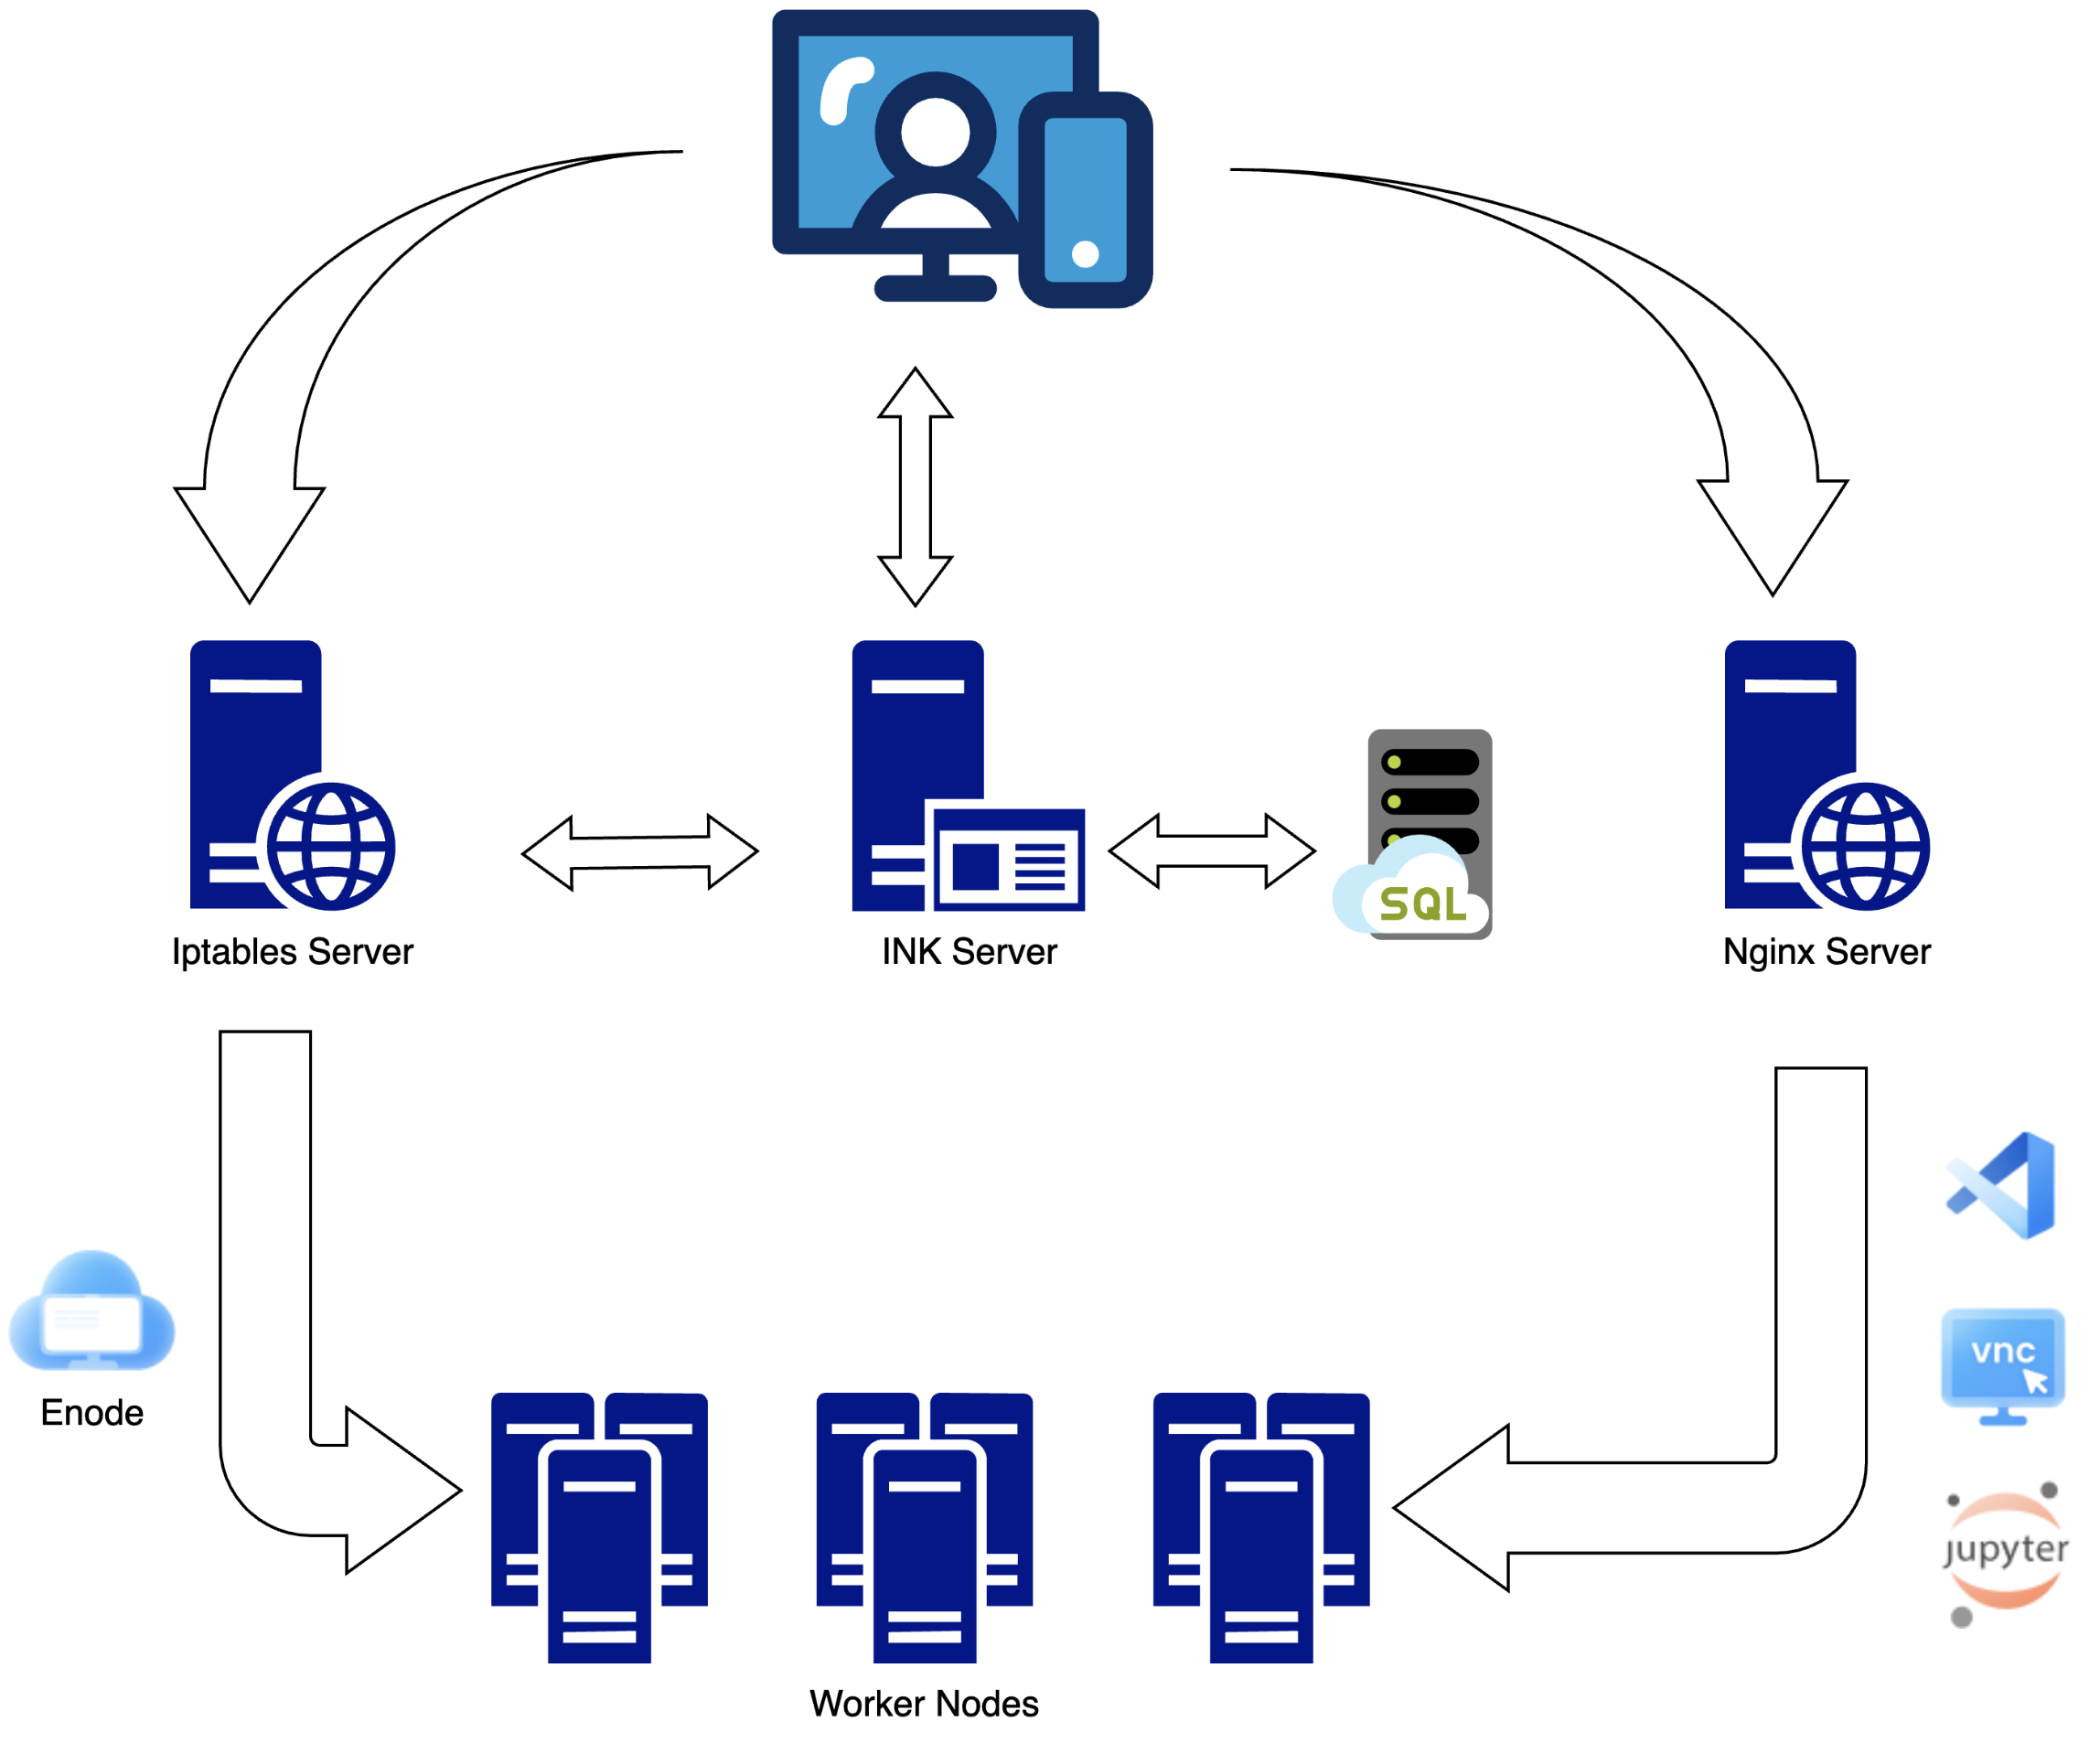

Run Application ON Worker Node
Connecting to Apps running on Worker Nodes via Port Forwarding
  Nginx Server: handle port forwarding for VSCode, Jupyter, VNC, and Rootbrows
  Iptable Server: handle port forwarding for Enode

Slide 11
Customization for Experiments (Ongoing Work)
Resources and applications database records:
  Resources of the experiments
  Applications of the experiments
User permission database
  the available resources and applications for each user →
Each experiments has its own web page
Each user has his own web page

Slide 12
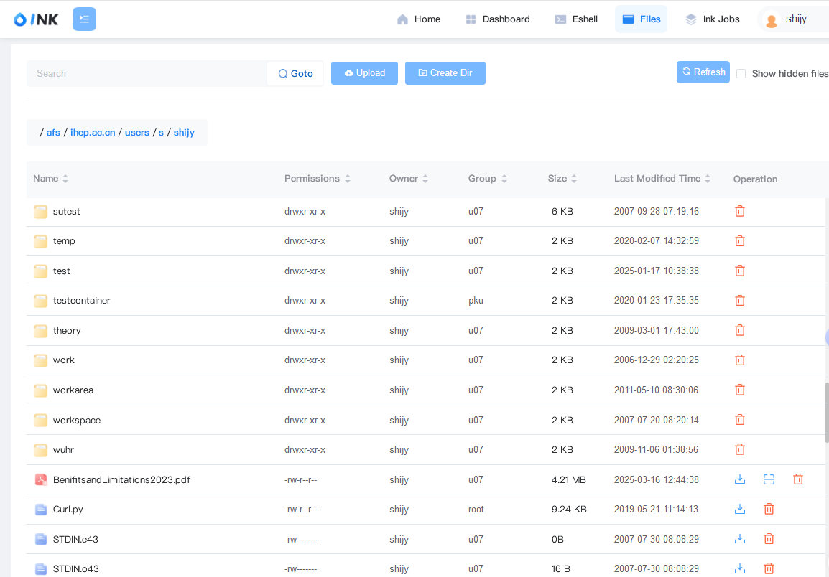


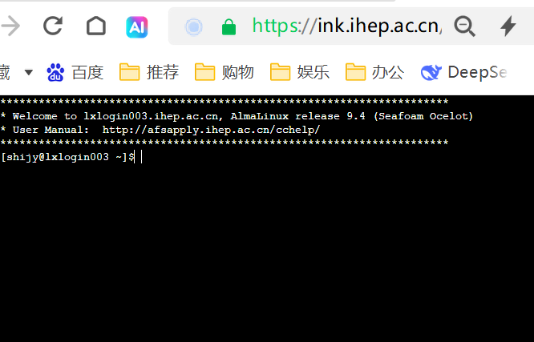



Current Status
INK is open for access at https://ink.ihep.ac.cn
Test release: February 2025
First official release: Mid-March 2025
Positive user feedback since lauch
INK
Simple manual：http://afsapply.ihep.ac.cn/cchelp/en/others/ink/

Slide 13
Summary
INK is designed based on the requirement of HEP users
Provides users with a “frontend usage” for “backend resources”
First official release received positive feedback from users
Further development is ongoing based on the HEP requirements
Lively show: http://ink.ihep.ac.cn
Thank You!
Questions?

Slide 14
Backup

Slide 15
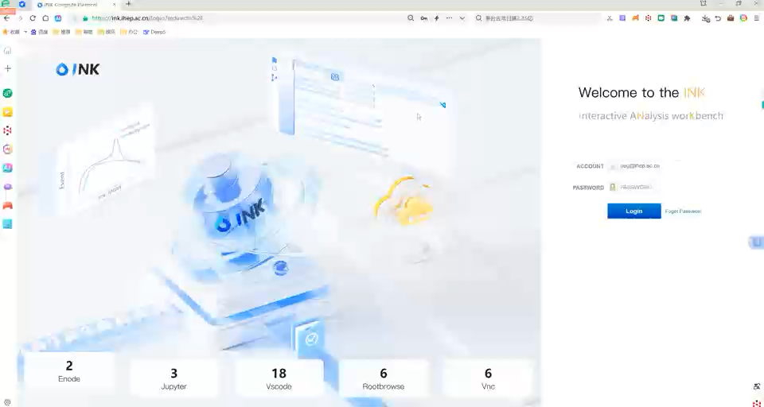
https://ink.ihep.ac.cn

