Slide 1

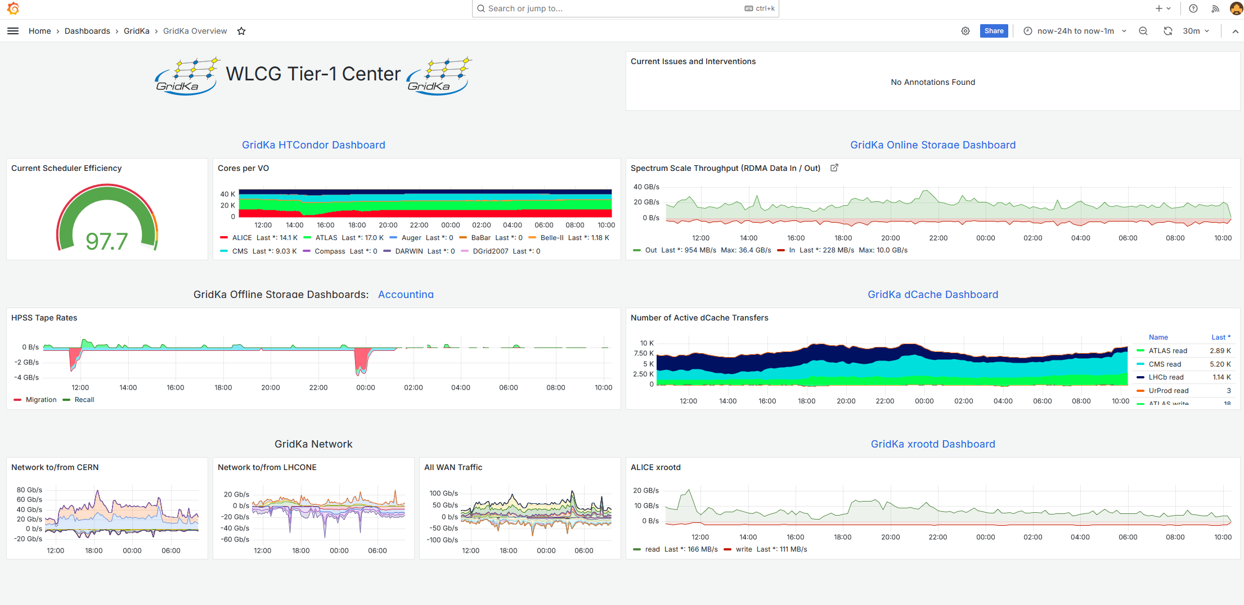
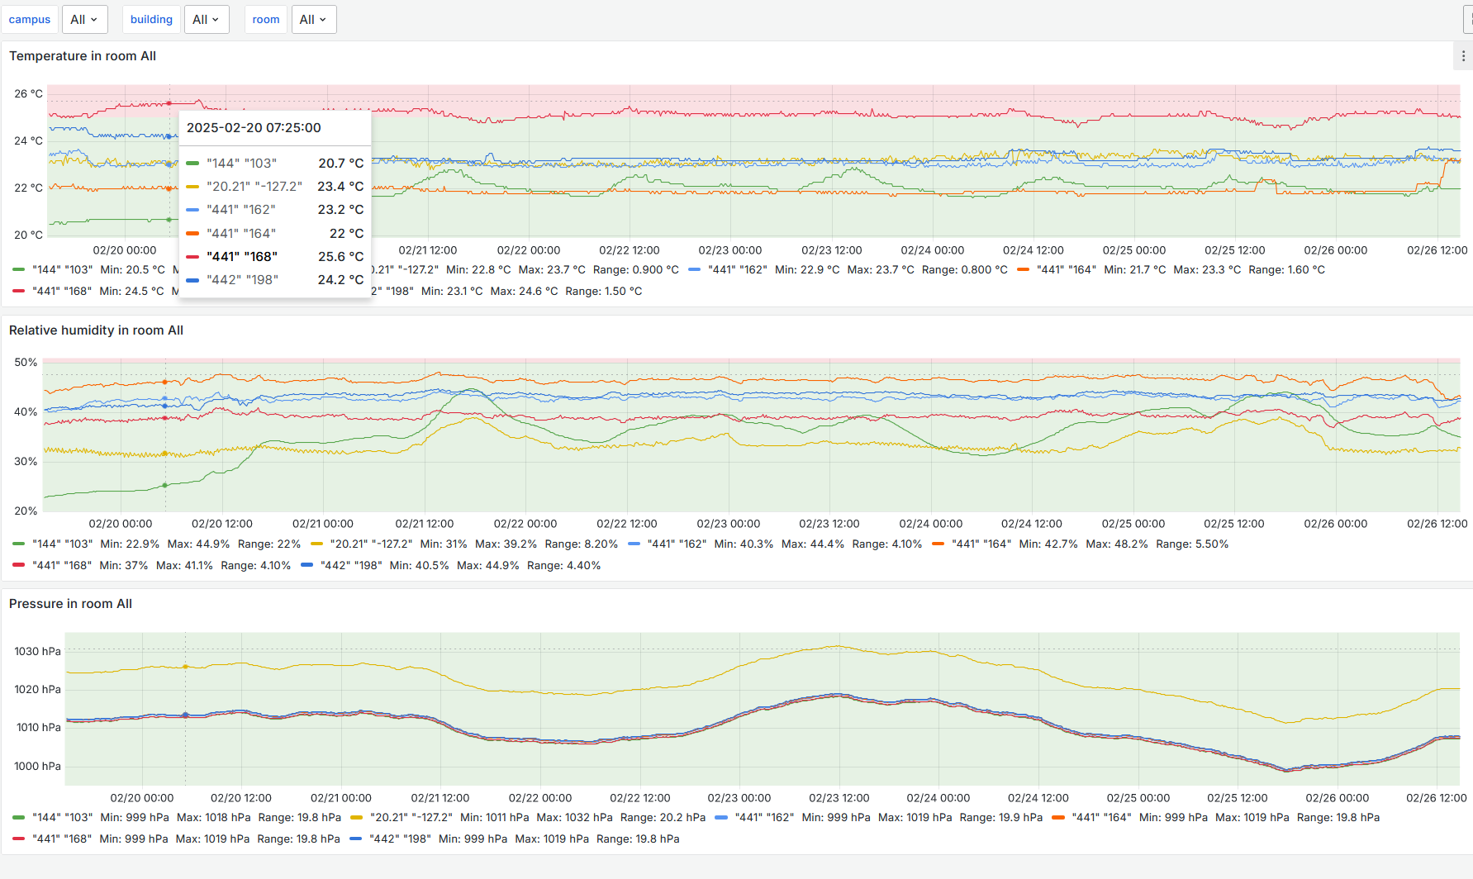
Infrastructure Monitoring for GridKa and beyond
Evelina Buttitta
Hepix Spring 2025 Workshop, 31 March - 4 April 2025, Lugano

Slide 2

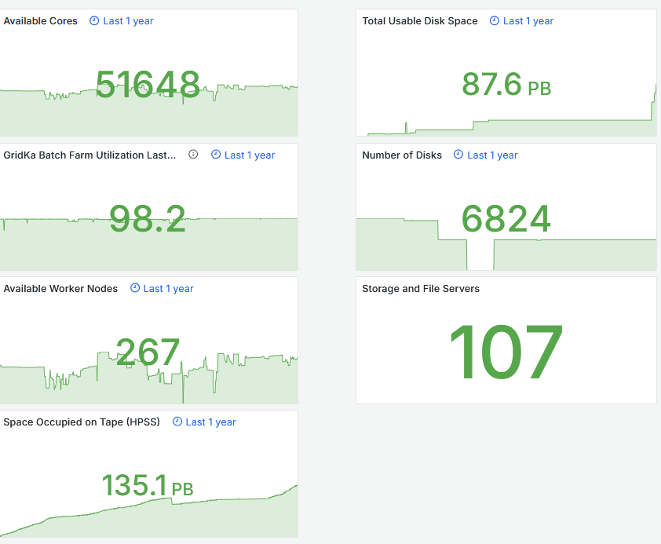
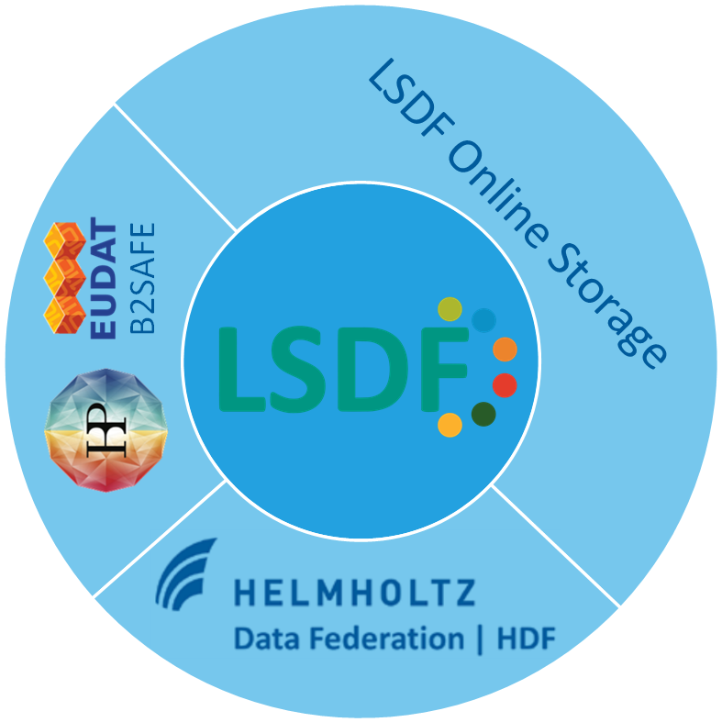
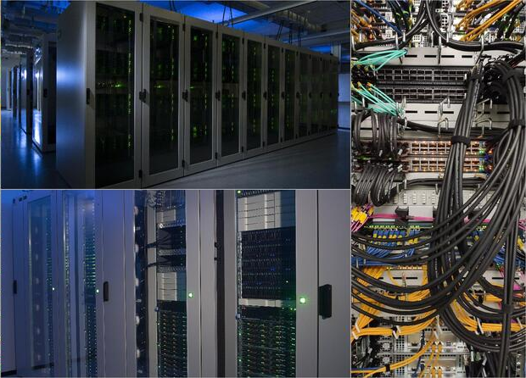





Infrastructure resources
Online Storage
GridKa Batch Farm
Offline Storage (Tape)
GridKa Network

Slide 3
Motivations
Constantly monitor health and availability of the services
Give users a fast overview of services/applications status
Detect and report issues fast and in detail
Centralize, search, analyze a large volume of data (e.g. logs)
The infrastructure monitoring provides insights and visibility into the health and status of all data center by tracking specific metrics and logs in real time

Slide 4







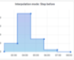






Monitoring architecture
Data collection
Data storage
Data visualization
line protocol
query
~ 700 machines (VM and bare)
Beats
Logstash

Slide 5
Collected metrics and logs
Host Metrics (Disk, CPU, Memory, Network…)
GridKa Experiments (Data Transfer, Disk usage per experiment)
HTCondor (Running jobs info)
Storage:
    dCache, XRootD (IO Metrics and Accounting)
    Storage Scale (GPFS) (IO Metrics)
    Disk Systems (controller, disk, raid status and IO metrics)
    Tape Monitoring
    LSDF Online Storage
Environmental Metrics (PDUs, humidity, temperature)
Logs of GridKa and LSDF storage, HTCondor, Tape HPSS, GridKa networks, dCache, XRootD
5

Slide 6


InfluxDB current and future plan
GridKa
Environmental
Metrics
GridKa WorkerNodes
LSDF
Running 4 InfluxDB instances OSS v2.7
Test the new version InfluxDB 3 Core with new capabilities and enhanced performances
Migrate InfluxDB to other timeseries databases like Grafana solutions (e.g. Mimir) or VictoriaMetrics
~4,8 TB data
~5,7TB data
~1,7 TB data
~700MB data
Suggestions and sharing of experiences are welcome!
6

Slide 7



VictoriaMetrics as alternative TSDB
Testing InfluxDB v2 migration to VictoriaMetrics
TSDB
High performance
Cluster version available
MetricsQL/PromQL query language
Challenges
  New data model for the metrics
  Import of large historical dataset from InfluxDB v2
  Translation of many InfluxQL/Flux queries in Grafana Dashboards to MetricsQL

Slide 8
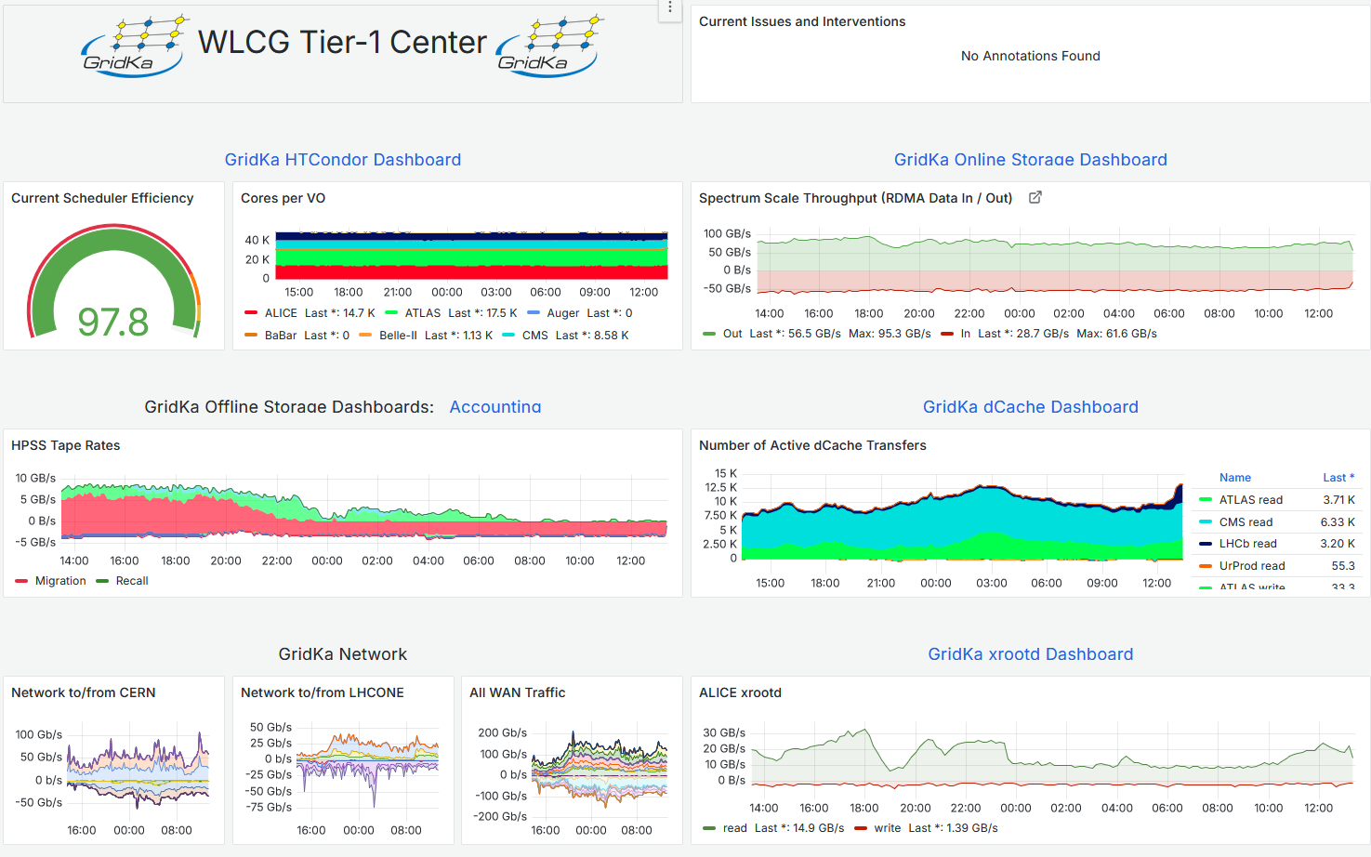



Grafana
https://grafana-sdm.scc.kit.edu
Auth/Authz via KIT OpenID
~ 60
dashboards
~ 40
active users
~ 20
provisioned datasources

Slide 9
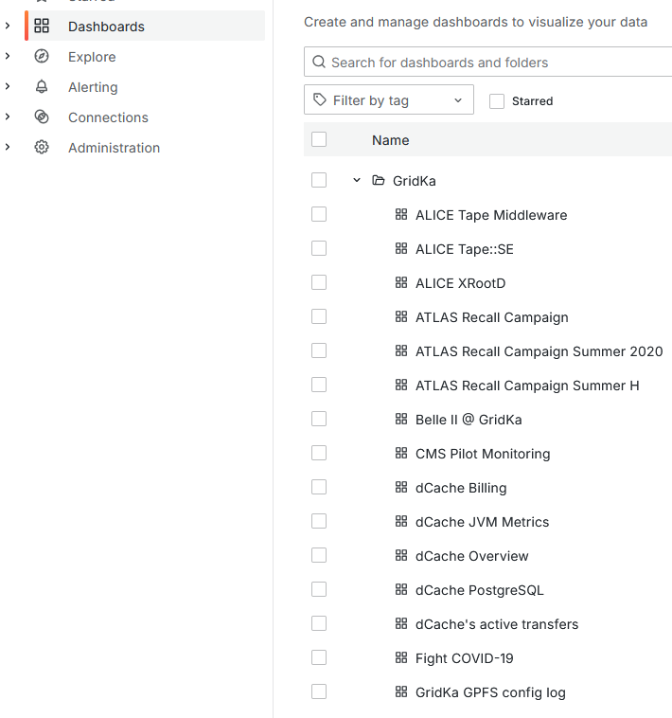
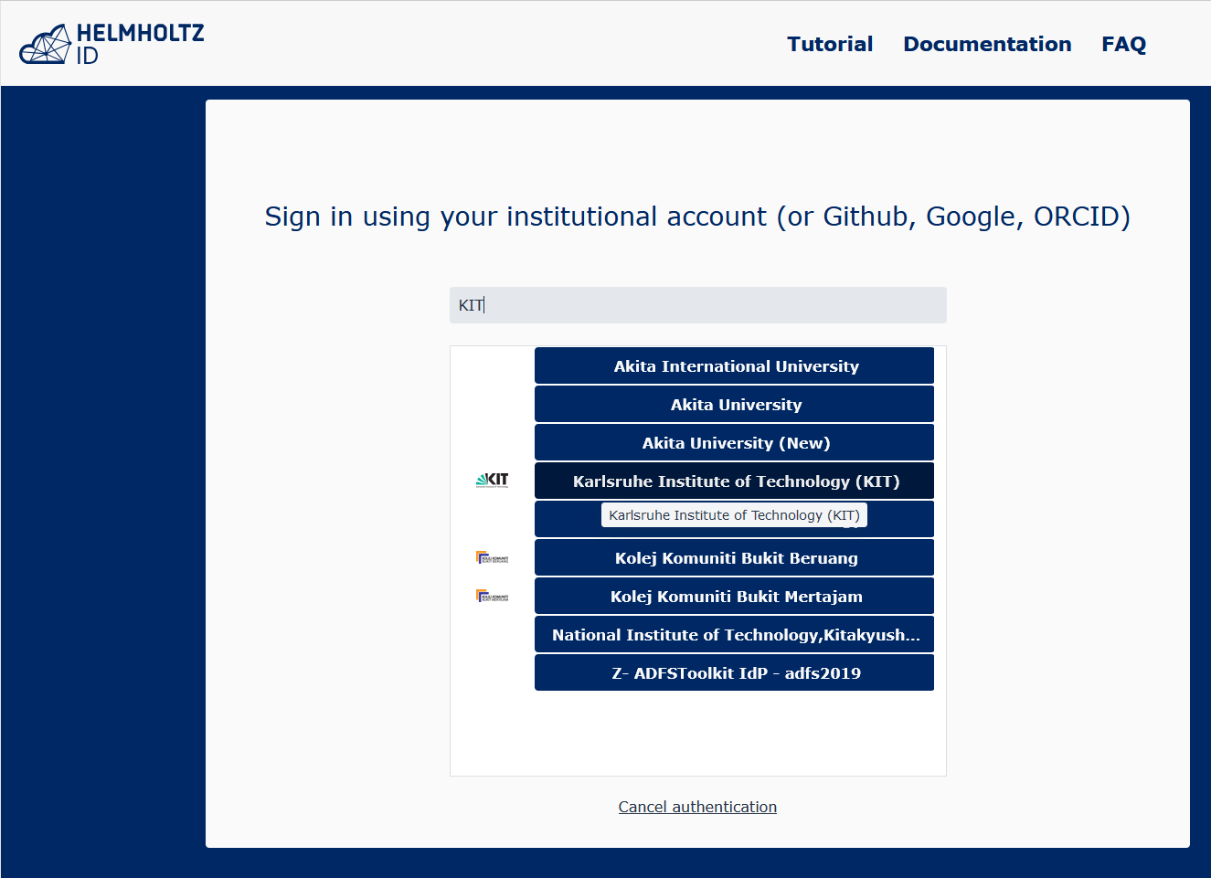
Grafana open instance
The problem: share specific dashboards with external (no KIT) users
What we have tried:
  Enable anonymous access: there are security implications we have experienced
  Use the Public dashboard feature: some inconvenient limitations
Our solution: run a separate Grafana instance
  Require auth, but allow auth from all of edugain (via Helmholz-ID AAI)
https://grafana-sdm-open.scc.kit.edu
Helmholtz Authentication and Authorization Infrastructure (AAI)

Slide 10
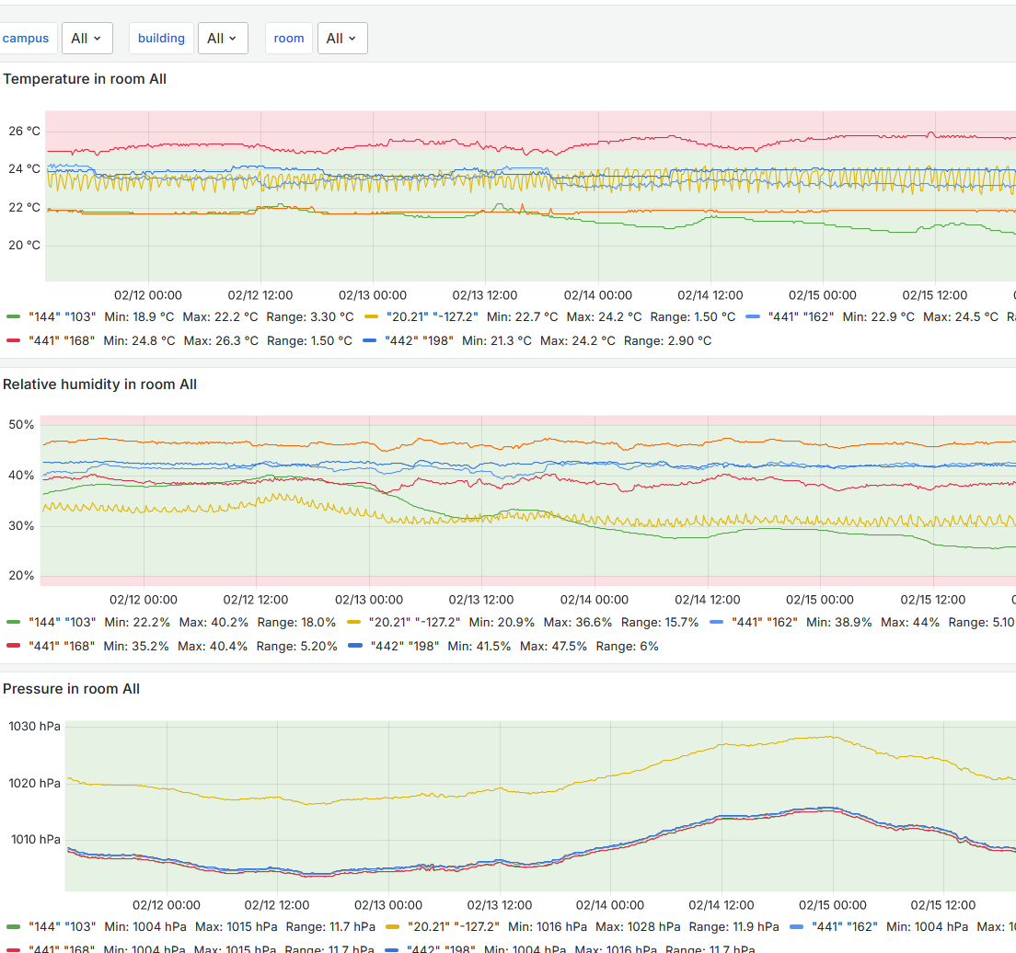
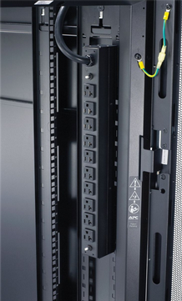
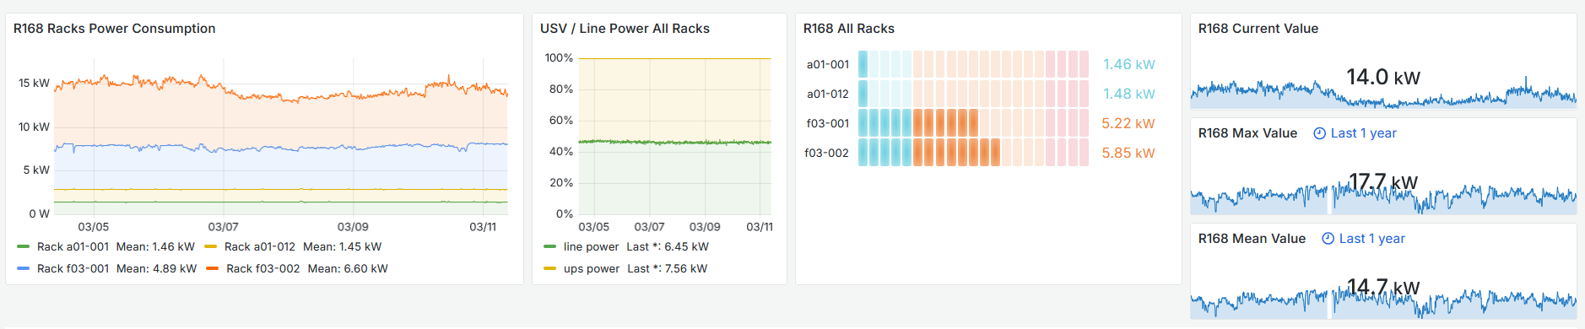
Grafana Datacenter Metrics
https://datacenter-metrics.scc.kit.edu
Visualization of environmental metrics:
Sensors metrics (temperature, humidity, pressure) from all server rooms
Water cooling temperature
Power consumption (UPS, Power distribution units (PDU))

Slide 11
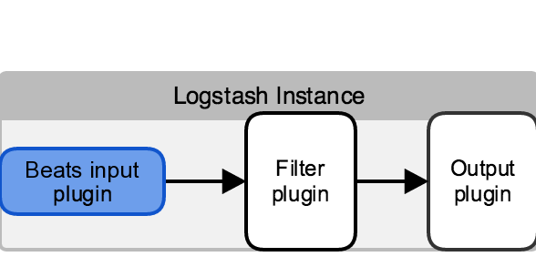
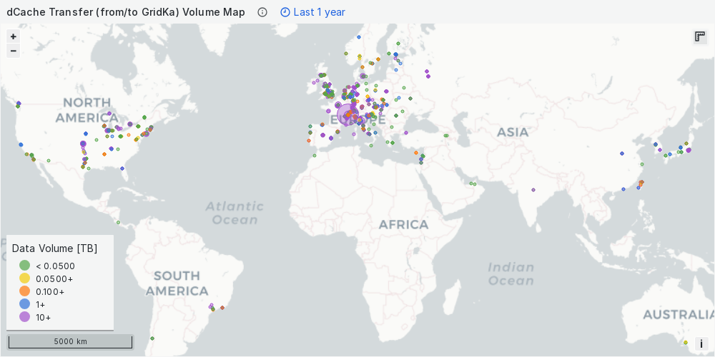
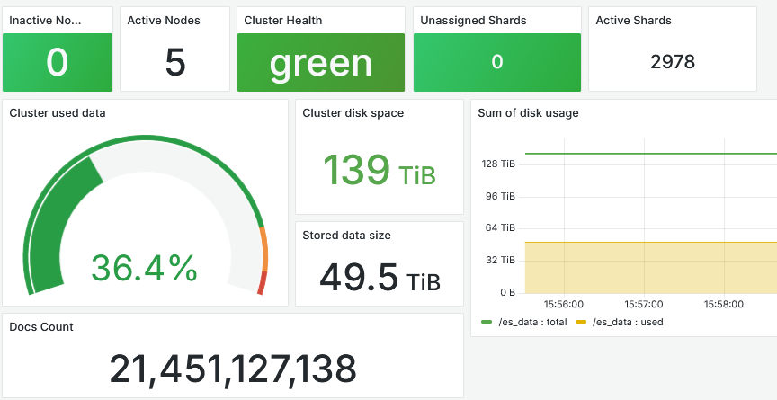
Monitoring with OpenSearch, Beats and Logstash
parse/transform data
collect data
Beats
…
logstash-1
logstash-2
logstash-3
Grok filter,
GEOIP
IP

Slide 12
Summary and outlook
The infrastructure monitoring plays a fundamental role in the operations of the whole infrastructure
It provides a real time (and historical) overview of all applications and ensures efficiency and reliability of services
Future of InfluxDB v2.x:
  Update to InfluxDB v3
  Replace InfluxDB with other timeseries databases (e.g. VictoriaMetrics)?
On-going research about a standard and consistent observability framework for collecting and storing telemetry data (logs, metrics, traces), e.g. OpenTelemetry

