Slide 1
CSCS - Swiss National Supercomputing Center
02.04.2025 CSCS Sustainability: Utilizing Lake Water for Cooling and Reusing Waste
Tiziano Belotti – Associate Director

Slide 2
Content of presentation
CSCS Lake water cooling (freecooling)
  Main data lake cooling system
  Self-generation of energy (micro turbines)
  Waste heat & cold utilisation
  Internal cooling loops
Energy saving and CO₂ emissions
  CSCS & school campus - cold utilisation (cooling)
  CSCS & school campus - waste heat utilisation (heating)

Slide 3
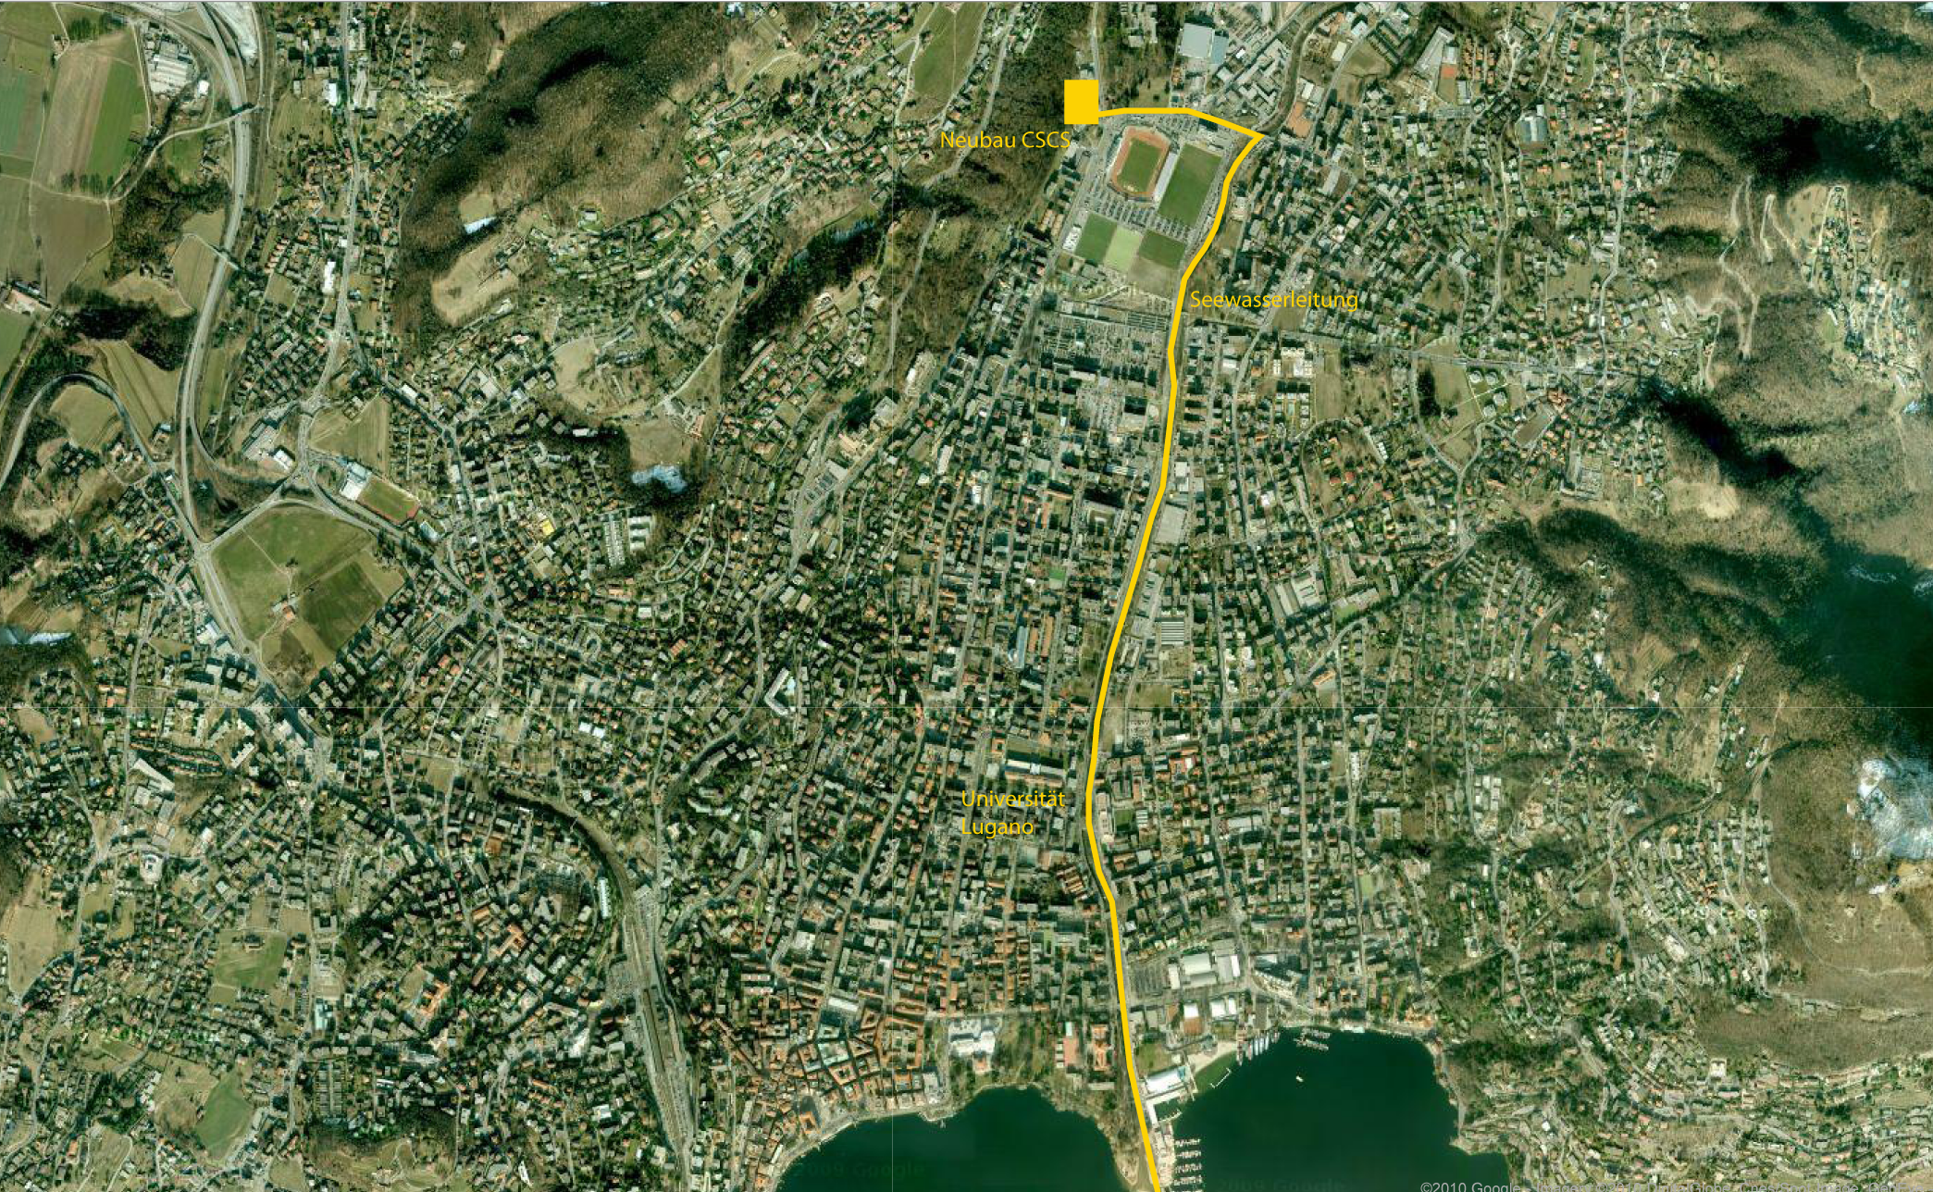
Main data lake cooling system
Dimensions of lake Lugano
Max depth : 288 m / 944 ft
Surface : 48,7 Km²
Pipeline length: 2800 m (3.5 mi)
Altitude difference: 30 m (94 feet)
Max. flow rate: 760 l/s (220 gal/s)
Suction strainer depth: 45 m (147 ft)
Water temperature: 6 C / 42.8 F °C
Notes:
As a reminder or brief introduction for those who do not yet know CSCS.
CSCS is situated in Lugano – southern Switzerland
We use free cooling from Lake Lugano to cool the entire heat load of the centre
We are still convinced that this choice was excellent, but it has raised some interesting challenges from which we have gained knowledge and experience that we would like to share with you.

Slide 4
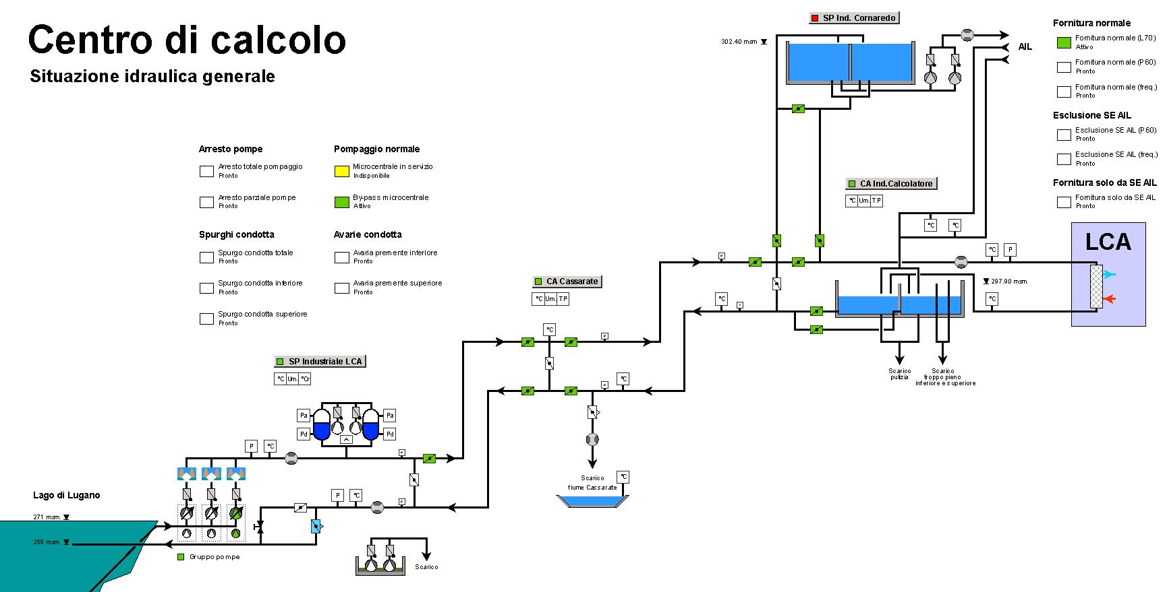
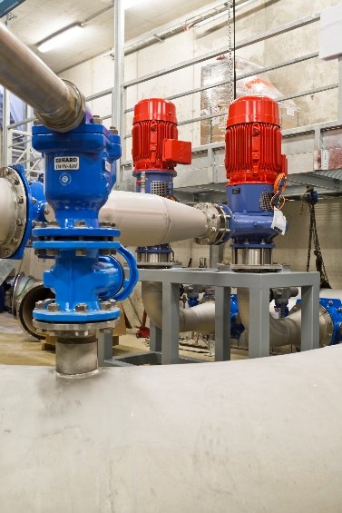
Self-generation of energy (micro turbines)

Slide 5
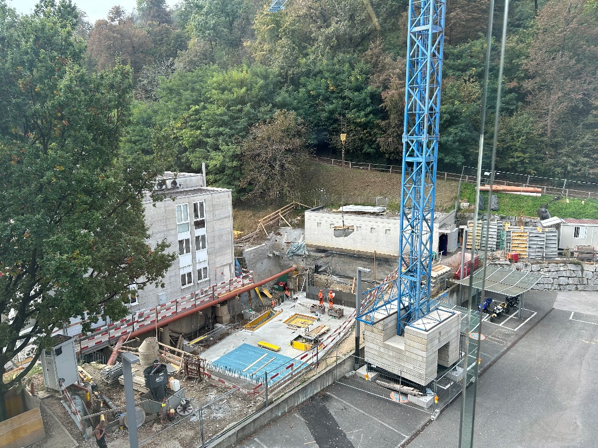
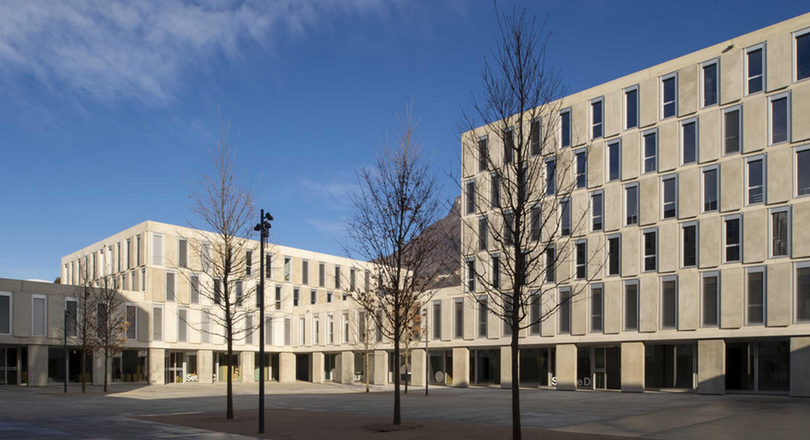
Waste heat & cold utilization

Slide 6
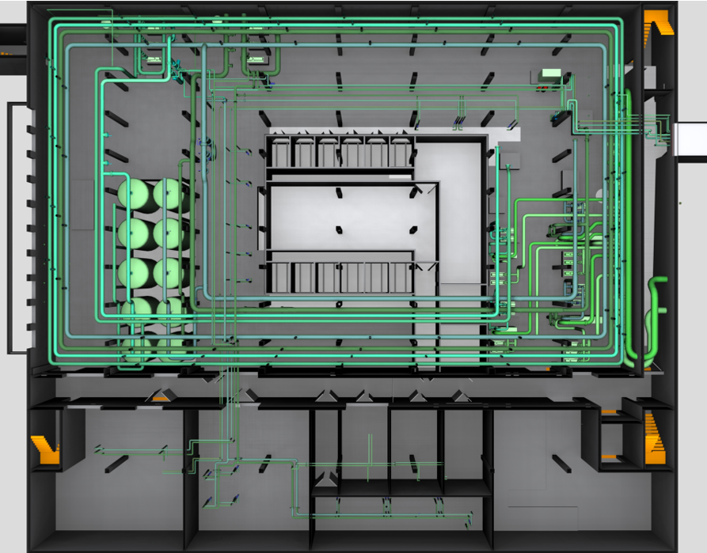
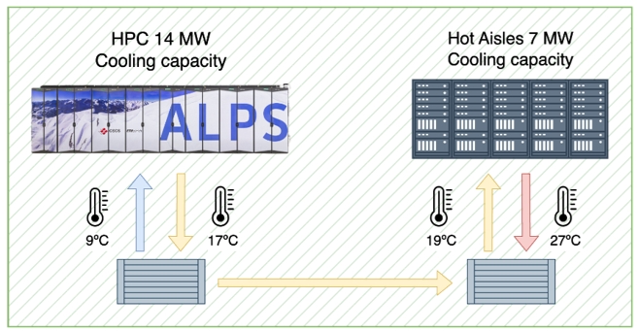
Internal cooling loops
- Cooling loop Low
temperature
- Cooling loop Medium temperature

Slide 7
CSCS & school campus cold utilisation (cooling)
CSCS (2012 – 2024)
Reduced electricity consumption 215 GWh
Avoided CO₂ emissions 602’000 t CO₂
School campus (annual)
Reduced electricity consumption 1.48 GWh
Avoided CO₂ emissions 4’144 t CO₂
Microturbine production (2021-2024)
Lower electricity consumption 1’46 GWh
Avoided CO₂ emissions 4’080 t CO₂

Slide 8
CSCS & school campus waste heat utililisation (heating)
CSCS (2012 – 2024)
Thermal energy required 882’000 KWh
Thermal energy used 572’527 KWh
Utilisation 64.9%
School campus (annual)
Thermal energy required 1’995’000 MWh
Thermal energy used: 1’295’000 KWh
Utilisation: 64.9%
Future Cornaredo district (thermal power 6.4 MW)
Thermal power 6.4 MW
Predicted thermal energy 16 GWh

Slide 9

Thank you for your attention
cscsch

Slide 10
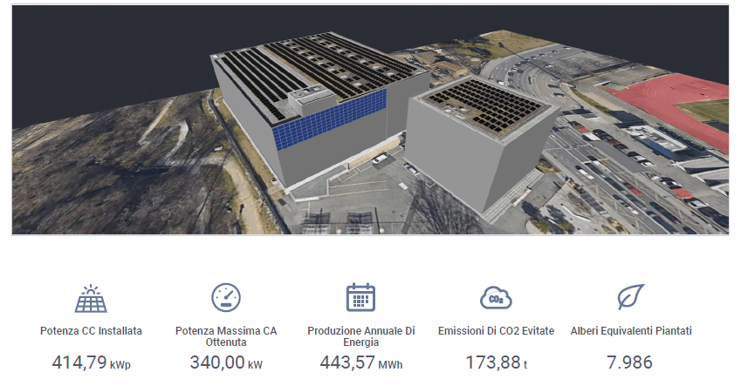
CSCS’s photovoltaic project (2027)

