Slide 1
Storage Technology Outlook
Ed Childers
April 2025

Slide 2
~30 years of HDD technology scaling with Data Demand has ended
Insert your favorite data growth chart here

Slide 3

What Are The Options?
Pour concrete, spend more $ on HDD
Delete Data
Hope for a storage technology breakthrough
Play the cards in your hand

Slide 4

What Are The Options?
Pour concrete, spend more $ on HDD
Delete Data
Hope for a storage technology breakthrough
Play the cards in your hand

Slide 5

The Bits Have No Intrinsic Value
Data is a:
Currency
representing underlying
Assets
(currencies can suffer from inflation)
2x Data ≠ 2x Asset Value

Slide 6
What Are The Options?
Pour concrete, spend more $ on HDD
  An answer IF budgets growing with data growth
Delete Data
Hope for a storage technology breakthrough
Play the cards in your hand

Slide 7

What Are The Options?
Pour concrete, spend more $ on HDD
  An answer IF budgets growing with data growth
Delete Data
Hope for a storage technology breakthrough
Play the cards in your hand

Slide 8

The Bits Have No Intrinsic Value
Data can be distilled only to:
Enlighten
or
Entertain
(are they the same thing?)
2x Data ≠ 2x Enlightenment

Slide 9

Representing an Asset
or
Distilled to Enlightenment
Data Enables a
Competitive
Advantage
(how much is that worth?)
More Data = More Competitive
(it’s just not a linear relationship)

Slide 10
What Are The Options?
Pour concrete, spend more $ on HDD
  An answer IF budgets growing with data growth
Delete Data
  Maybe, You go first.
Hope for a storage technology breakthrough
Play the cards in your hand

Slide 11

What Are The Options?
Pour concrete, spend more $ on HDD
  An answer IF budgets growing with data growth
Delete Data
  Maybe, You go first.
Hope for a storage technology breakthrough
Play the cards in your hand

Slide 12
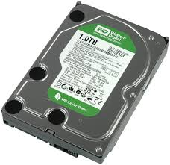
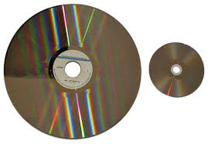
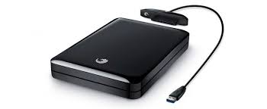

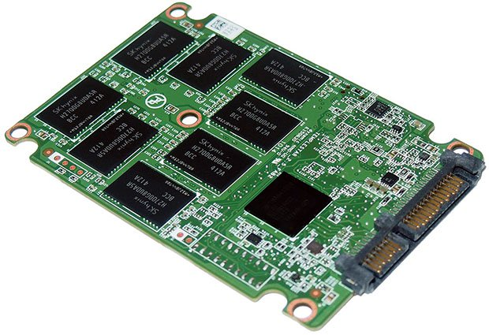
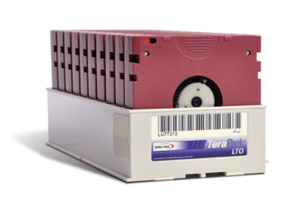
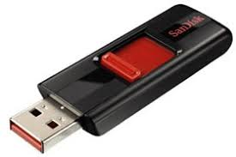
How Do You Store A Bit?
Whether in Hand, Traditional IT, or Cloud,
Data lives on:
Flash
HDD
Tape
Optical
Bits
Physical Things Obey The Laws Of Physics

Slide 13
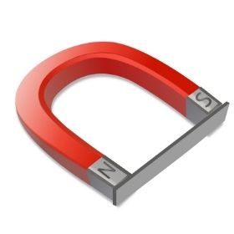
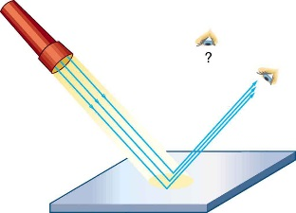

Capacity/active
How do you store a bit?
Low cost, archive
Cold/Deep archive
Via external magnetic field
Magnetize something
Tape & HDD
Align electron spin
Via electric current
“spintronics”
MRAM (non-volatile memory)
Change optical reflection
Phase change
ODA, BluRay, DVD
to create optical change
Change other characteristic
Holographic, magneto optical, ablative,
5D crystal
to create base pair molecule
Change structure of matter
DNA – base pair molecules
High density chemical storage
to create resistive change
by arrangement of atoms
Phase Change Memory
PCM (non-volatile memory)
Capture charge
Atom scale manipulation
High density atomic storage
In semiconductor structures
MLC & 3D structures
Flash

Slide 14

Storage Technology Improvement Recipe
Make smaller buckets in which to store bits
Make a smaller, more sensitive thing to R/W the smaller bits
Make a better, faster, more accurate thing to get the sensor located on the bits
Make a more efficient means of encoding data into the bits

Slide 15
Storage Technology Improvement Recipe
HDD
Make smaller buckets in which to store bits
Make a smaller, more sensitive thing to R/W the smaller bits
Make a better, faster, more accurate thing to get the sensor located on the bits
Make a more efficient means of encoding data into the bits

Slide 16
Noise and Magnetic Media Structure
~10 nm
~10 nm
Information is encoded in transition edge. Large grains → media noise
Courtesy Mark Lantz, IBM Zurich
To Increase Density You Have To Make Smaller Magnetizable Things

Slide 17
HDD - The Superparamagnetic “Limit”
Magnetic Media “Trilemma”:
Small particles (V)
~10 nm
~10 nm
Too Small of Magnetizable Things And They Don’t Stay Magnetized At Room Temperature
Writability
Thermal Stability
If grains become too small, magnetic state is unstable → = superparamagnetic effect
HDD has reached the limit of(current) materials to produce larger write fields.
Technologies to go beyond the superparamagnetic limit:
Heat Assisted Magnetic Recording (HAMR)
Microwave Assisted Magnetic Recording (MAMR)
Bit Patterned Media (BPM)
Courtesy Mark Lantz, IBM Zurich
All technologies increase cost of the brick

Slide 18


Storage Technology Improvement Recipe
HDD Technology
Make smaller buckets in which to store bits
Make a smaller, more sensitive thing to R/W the smaller bits
Make a better, faster, more accurate thing to get the sensor located on the bits
Make a more efficient means of encoding data into the bits
  Net
  Increased cost of mfg
  No new “S-curve” – just a roadblock in existing path
  HAMR coming…….

Slide 19
Storage Technology Improvement Recipe
Optical Disc
Make smaller buckets in which to store bits
Make a smaller, more sensitive thing to R/W the smaller bits
Make a better, faster, more accurate thing to get the sensor located on the bits
Make a more efficient means of encoding data into the bits

Slide 20
Optical Disc Storage Basics
Write here
Guard bands
Optical roadmap has traditionally made gains by decreasing wavelength of laser.
CD ➔ DVD ➔ BluRay
Red ➔ ➔ ➔ Blue
Can’t get to next step = UV “light”
Write with heat
Read with reflection
“Hottest” & “brightest” in center
Better areal density / higher capacity achieved by heating smaller spot on disc
Spots are put on embossed tracks in disc
1
Wavelength of light
2
Size of spot =
Numerical Aperture
(a measure lens capability)
3
The “spot” is fuzzy
By FDominec - Own work, CC BY-SA 3.0, https://commons.wikimedia.org/w/index.php?curid=3017519
A measure of how well the lens can focus the laser.
Limited by mfg – can’t get better!

Slide 21

Storage Technology Improvement Recipe
Traditional Optical Disc Technology
Make smaller buckets in which to store bits
Make a smaller, more sensitive thing to R/W the smaller bits
Make a better, faster, more accurate thing to get the sensor located on the bits
Make a more efficient means of encoding data into the bits
Track pitch limited by embossment patterns
Spot size limited by wavelength of light
Red-DVD, Blue-BluRay – UV not commercially feasible
Multi-layer limited by limitations of laser power or degradation of adjacent data
  Net – Traditional Optical Disc
  Can’t scale smaller
  Can’t scale deeper
  The light has gone out on traditional optics
  Interesting Alternatives Modifying the Recipe
  Don't push areal density, push on area (more layers) and cost = Folio
    Femtosecond lasers = Silica, Cerabyte

Slide 22
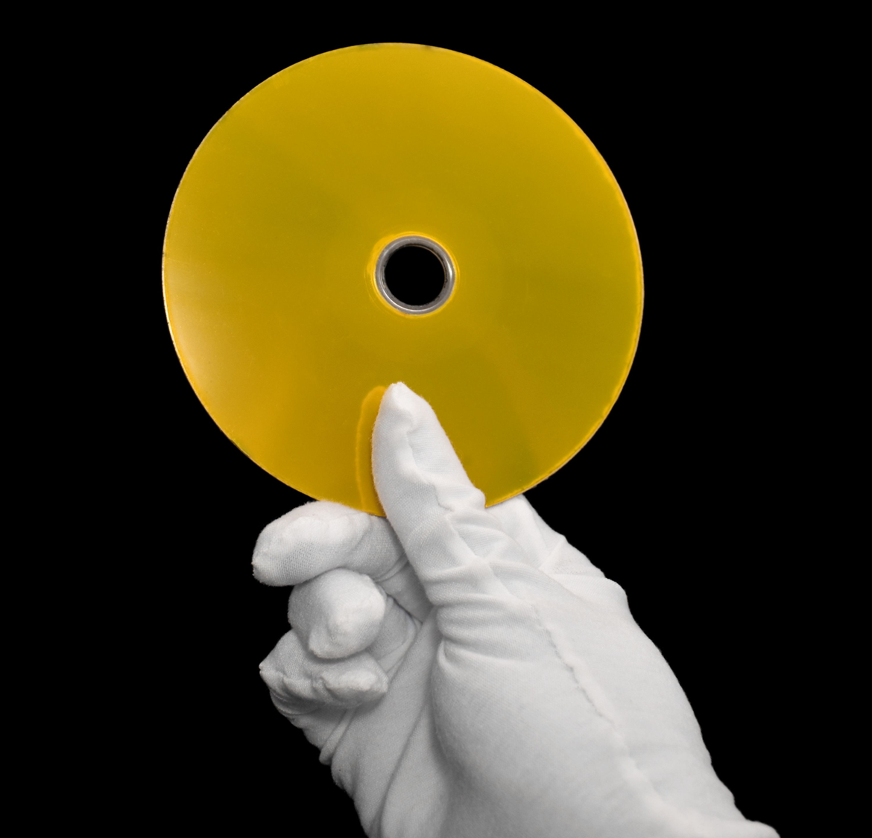

Storage Technology Improvement Recipe - Modified
Folio – $/TB via low-cost multilayer media
Make smaller buckets in which to store bits
Make a smaller, more sensitive thing to R/W the smaller bits
Make a better, faster, more accurate thing to get the sensor located on the bits
Make a more efficient means of encoding data into the bits
Make more “buckets” at a lower cost - not smaller “buckets”
Multilayer extruded optical media
Smaller not necessary as not pushing areal density (ie. smaller buckets)
Use of “blue” light eliminates need for new optics, lasers
Unknown – whitepaper lists 360MB/sec at system level parallel
  Net
  Potential for permanent Write Once archive
  Potential Challenges
    Scale up of media manufacturing ?

Slide 23
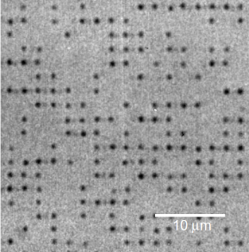
Storage Technology Improvement Recipe - Modified
Cerabyte – Immutable, “forever” Write Once
Make smaller buckets in which to store bits
Make a smaller, more sensitive thing to R/W the smaller bits
Make a better, faster, more accurate thing to get the sensor located on the bits
Make a more efficient means of encoding data into the bits
Make permanent “buckets” at a competitive $/TB, not smaller
Ceramic coated glass ablation by a femtosecond laser
Imaging of domains within capabilities of existing optics/CCDs
Femtosecond lasers required for ablation of domains
Unknown
Write - Single Femtosecond laser images ~1M domains via DMD
Read – imaging of blocks should be capable of reasonable datarates
  Net
  Potential for permanent Write Once archive
  Potential Challenges
    Future scaling of density / going to shorter wavelengths
    Scale up of media manufacturing ?
    Femtosecond laser ecosystem ?

Slide 24
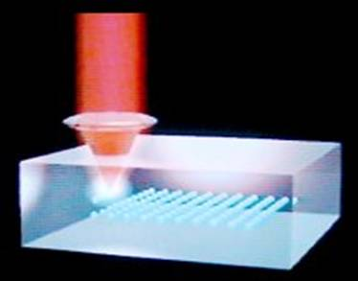
Storage Technology Improvement Recipe – Modified
5D Optical / Silica Technology
Make smaller buckets in which to store bits
Make a smaller, more sensitive thing to R/W the smaller bits
Make a better, faster, more accurate thing to get the sensor located on the bits
Make a more efficient means of encoding data into the bits
Make permanent “buckets” at a competitive $/TB, not smaller
3D recording in glass + 2 more Ds via nanograting polarity
Imaging of domains within capabilities of existing optics
Femtosecond lasers required for ablation of domains
Unknown
Write - Demo was slow, Superman Movie demo estimated to take ~110 days to write @ 8kB/sec
Read - ? Imaging of domains should be faster than write
  Net
  Potential for permanent Write Once archive
  Potential Challenges
    Datarate?
    Future scaling of density / going to shorter wavelengths
    Scale up of media manufacturing ?
    Femtosecond laser ecosystem ?

Slide 25

Storage Technology Improvement Recipe
DNA Technology
Make smaller buckets in which to store bits
Make a smaller, more sensitive thing to R/W the smaller bits
Make a better, faster, more accurate thing to get the sensor located on the bits
Make a more efficient means of encoding data into the bits
Very, very, very small
Demonstrated capability to R/W
Currently Slow
“Open source” data encoding – kind of…
  Net
  Potential for permanent Write Once deep archive
  Incredible densities possible - EB/in^3
  Extreme long life + low power
  Challenges
    Reading (aka sequencing) destroys the copy
    Slow Read/Writer speed

Slide 26
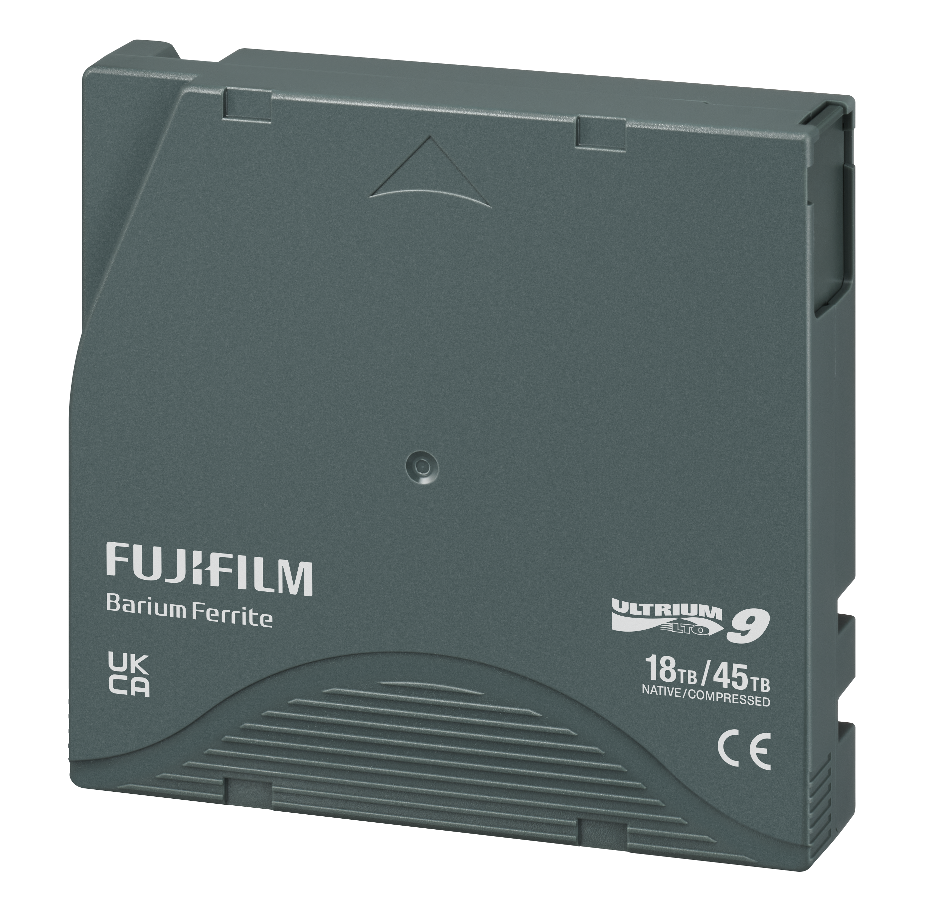
Storage Technology Improvement Recipe
Tape
Make smaller buckets in which to store bits
Make a smaller, more sensitive thing to R/W the smaller bits
Make a better, faster, more accurate thing to get the sensor located on the bits
Make a more efficient means of encoding data into the bits

Slide 27
Tape Improvement Recipe
Tape Construction
Mag Layer
Non-Mag Under Layer
MP particles are sintered and coated & magnetized linearly in media
Make smaller buckets to store bits
Smaller Magnetic Particles
Packed Tighter and Better Arranged
Substrate
Backcoat
BaFe particles are crystalline and grown & magnetized orthogonally in media
Dual Coat
BaFe
Cartridge
Perp Orient.
MP – MP+++
SSputtered
Reel-Reel
CrO²
SSrFe
Fe²O³
epsilon FeO²

Slide 28

Tape Improvement Recipe
Without messing up friction & wear
Make a more sensitive thing to R/W the smaller bits
Head
Head
Better Readers - AMR GMR TMR
Improved Writers – Trimmed, High Moment
Reduced Spacing = Smoother media & improved tribology
Media
Better
Media
Trimmed Wrt
High Moment
TMR
16 Chnl / 2 bump
SSmaller
8 Chnl / 2 bump
GMR
SPMR
AMR
32 Chnl / 3 bump
S64 Chnl
Wire Wound

Slide 29
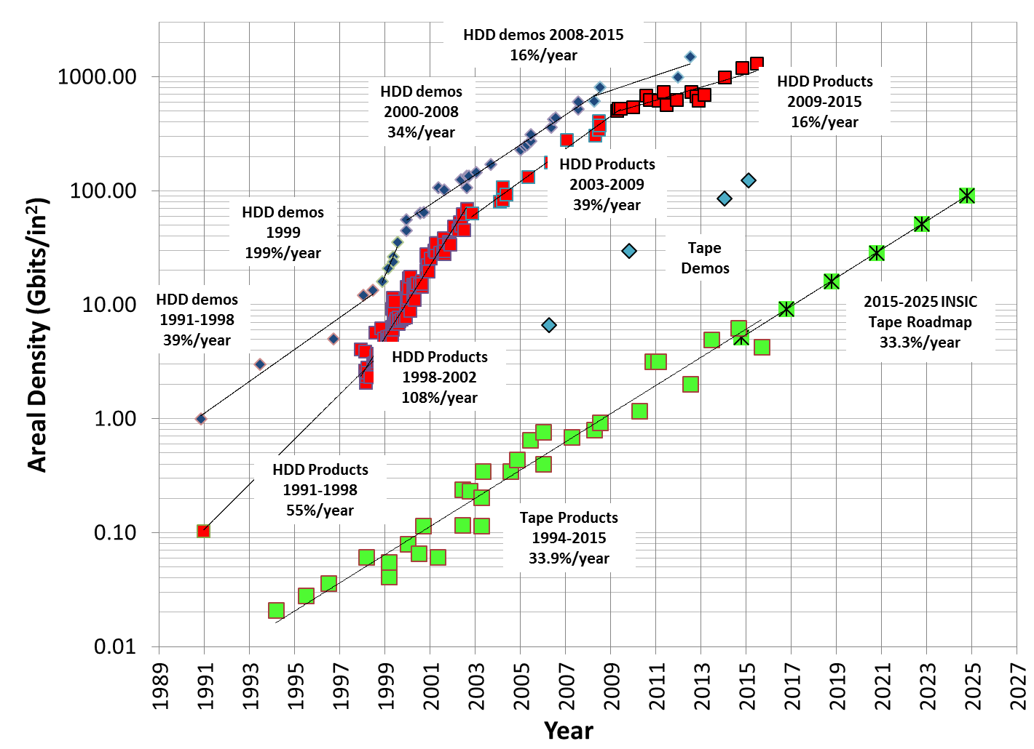
MR Sensor (aka Head) Technology
201 Gbit/in²
sputtered tape
123 Gbit/in²
BaFe tape
TMR
GMR
LTO8
TMR
GMR
32 track
8 track
AMR
16 track

Slide 30
Tape Improvement Recipe
Make a better thing to get the sensor onto the bits
Improved Servo Patterns
Improved Track Following Servo
Improved Skew Servo
Improved Tape Tension Servo
H Infinity comp
Tension Servo
Skew Servo
Track Following
Amp Based Servo
Coarse/Fine
SBetter
SEfficent
Fixed Head
3570
Improved
Timing Based Servo
Timing Based Servo

Slide 31
Tape Improvement Recipe
Make a more efficient means of putting data onto tape
Improved ECC
Improved data format
More efficient servo
Improved Rewrite Eff.
Improved ECC
Iterative C1
3570
PRML 32/33 mod
PRML 16/17 mod

Slide 32
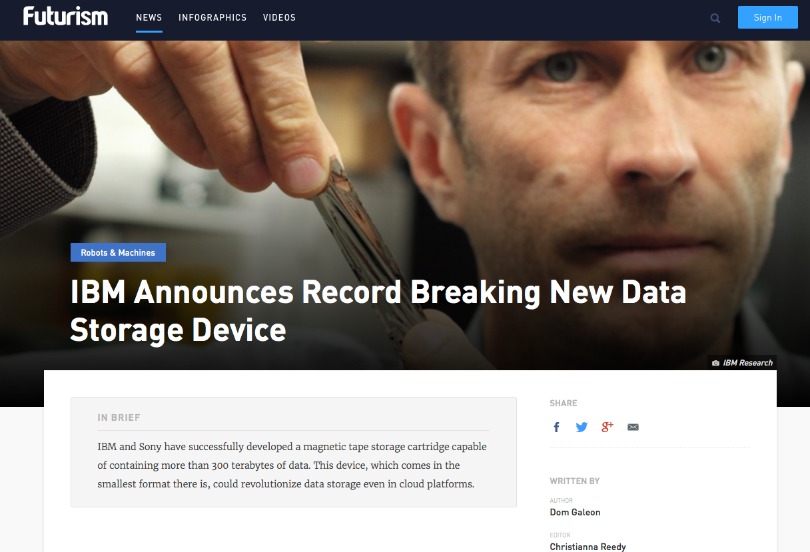
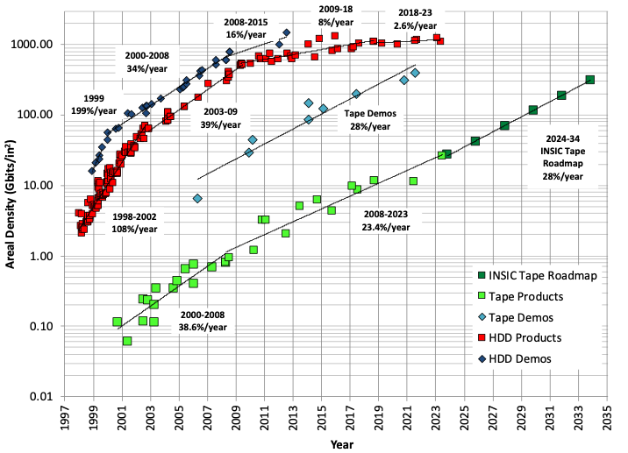
Storage Technology Improvement Recipe
Tape Technology
LTO 10 Coming!
Make smaller buckets in which to store bits
Make a smaller, more sensitive thing to R/W the smaller bits
Make a better, faster, more accurate thing to get the sensor located on the bits
Make a more efficient means of encoding data into the bits
  Net
  No looming fundamentals of physics limitations
  Technology roadmap supported by research demonstrations well into the 2030’s
  Rate of technology advancement outpacing HDD today
Mark Lantz – IBM Zurich Research

Slide 33
Tape Areal Density Scaling
Write with electro-magnet
Read with “MR” sensor
(“magneto-restrictive” sensor changes resistance in a magnetic field)
So why doesn’t tape have the same problems as HDD?
Better areal density / higher capacity achieved by shrinking the same basic technology to write smaller and smaller bits on disk
Smaller magnetic pieces to make smaller bits
Smaller write heads to magnetize smaller pieces
Better “MR” sensors to read smaller bits
1
The smaller the magnetic piece, the less stable. When a bit gets so small it’s unstable @ room temperature = “superparamagnetic limit”
2
3
Much, much bigger magnetic pieces
& much, much larger surface to store data

Slide 34

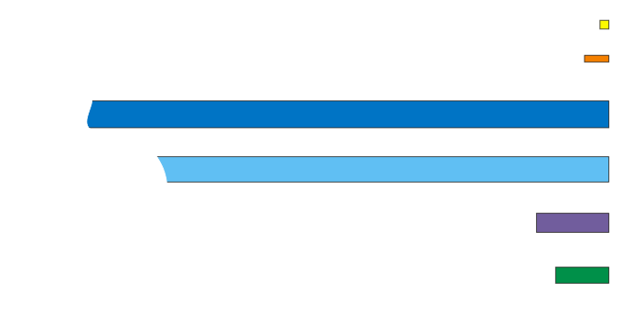
Storage Technologies Domain Sizes
Tape Technology Is Unique Among Storage Technologies As It Is Not Facing Fundamental Scaling Limitations
Scaled bit cells:
NAND Flash (3 bits) 2150 Gb/in²
17.3 nm x 17.3 nm
HDD 1000 Gb/in²
47 nm x 13 nm
LTO8 Tape ~8.6 Gb/in²
1560 nm x 48.4 nm
Jag5A Tape ~9.6 Gb/in²
1347 nm x 50 nm
BaFe Demo 123 Gb/in²
140 nm x 37 nm
Mark Lantz – IBM Research Zurich
Sputtered Demo 201 Gb/in²
103 nm x 31 nm

Slide 35

Tape vs HDD Surface Area
TAPE
Tape Makes Up For Larger Domain Sizes With Much Larger Surface Area
~12 sq m
Disk
8 platters ~0.09 sq m

Slide 36
What Are The Options?
Pour concrete, spend more $ on HDD
  An answer IF budgets growing with data growth
Delete Data
  Maybe, You go first.
Hope for a storage technology breakthrough
  Nothing new coming in big in near term
  Tape has strong technology pipeline
Play the cards in your hand

Slide 37

What Are The Options?
HD
TAPE
FL
Pour concrete, spend more $ on HDD
  An answer IF budgets growing with data growth
Delete Data
  Maybe, You go first.
Hope for a storage technology breakthrough
  Nothing new coming in big in near term
  Tape has a strong technology pipeline
Play the cards in your hand
  Increased Tape Use – Cost, Sustainability, Security
  New Tape models – scale out vs scale up (aka The Cube)

Slide 38
Storage Technology Outlook Take Aways
HDD is not keeping up with data growth.
  HAMR, MAMR, EAMR, etc. will not change the trend.
There is not a new technology coming to save the day tomorrow.
  There are some interesting femtosecond and low-cost optical possibilities, but you will see them coming with enough lead time to plan.
Tape Technology Outlook is Strong
  No looming fundamentals of physics limitations
  Technology roadmap supported by research demonstrations well into the 2030’s
  Rate of technology advancement outpacing HDD today

Slide 39
And now, a word from our sponsor..

Slide 40
Data Center Pain
Fibre Channel is the traditional connection
  Disk/SAN and Tape connectivity
  Switches with complex Zoning
Most Fibre has phased out for SAN in favor of Ethernet
Expense continues to grow
  64G switches $30-90K - plus HBAs, cabling, maintenance, expertise, etc
Tape underutilizes Fibre bandwidth per drive
Spectra customers openly vocal about wanting an alternative to Fibre Channel
SAS is also available for Tape Drive connectivity
  SAS is the highest volume tape drive ~70% of the market
  LTO-9 introduced FH-SAS , same with LTO-10 and beyond
SAS is cheaper by ~$1000 per Tape drive and direct connect so no switch needed or hassle
But… SAS is 3-4 meter max so the server has to be on top or RIGHT next to the library.
Until….

Slide 41
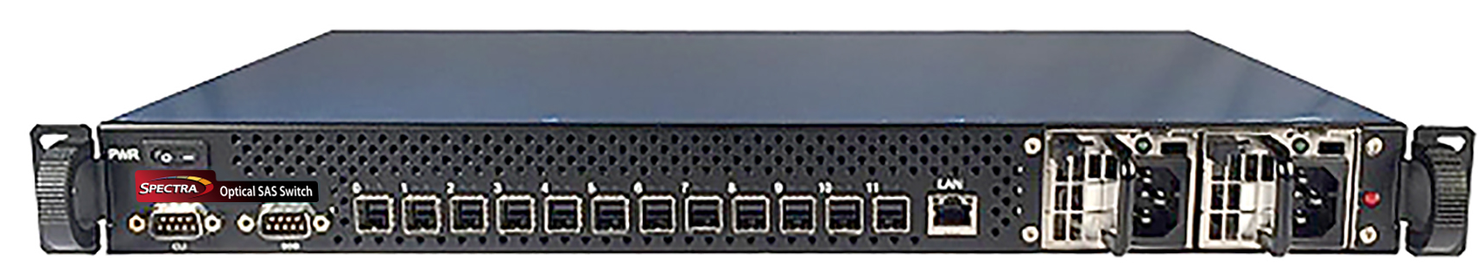
OSW-2448 Specifications
SAS Switch
Item | OSW-2448
SAS Host distance | 100m (AOC)
SAS ports | 12 (mini HD) 24G, 12G, 6G
SAS lanes | 48 (4 per port)
SAS Configurations | 12, 24, 36, or 48 lanes
FC ports | 0
Ethernet mgmt ports | 1 (1Gb)
Height | 1U (1.735”)
Width | 19in Rack (17.31”)
Length | Half depth (12”)
Weight | 12.9 lbs (unboxed)
Power (input) | 100-240 VAC
Power Supply | Dual Redundant 220W
Mount/Airflow | Front or Back of Rack
Throughput | OSW-2448
Max (system) | 108GB/s
Max SAS (per lane) | 2.25GB/s
Max Tape Drives (devices per system) Dual 24 | 40 connectivity
Max Tape Drive Bandwidth (full throughput per port at 24Gb) | 40 @ bandwidth
Max Tape Drive Bandwidth (full throughput per port at 12Gb) | 36 @ bandwidth
Tape Drives Supported | LTO-6 and newer, IBM TS1160 & TS1170
Tape Libraries Supported | Spectra Stack, Spectra Cube™, Spectra T950 and TFinity® Plus
Datasheet: PowerPoint Presentation

Slide 42
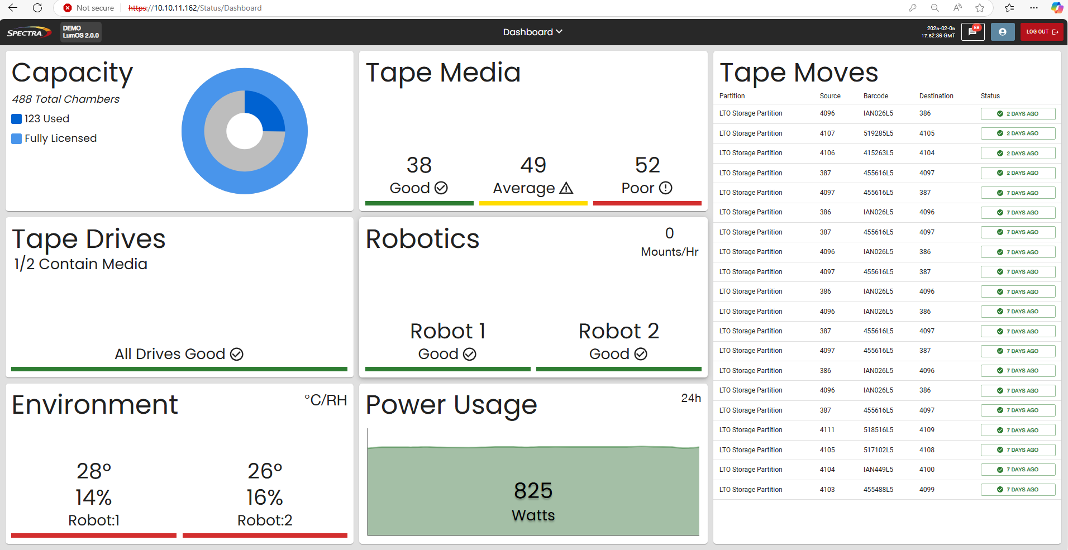
LumOS Library Management Software – Next Generation
LumOS is a new platform for Spectra Enterprise tape libraries
Released 1/11/2024 for Spectra TFinity
New Spectra TFinity, T950, and Cube tape libraries ship with LumOS installed
Available to install for Spectra T950 upgrades Now!
Currently running in over 50 Enterprise TFinity libraries in production environments
New Linux based UI with extensive roadmap of new features coming out quarterly

