Slide 1

Fabric-friendly
AI storage architectures.
Large dataset provisioning with NVMe hard drives for GPUDirect consumption.
Mohamad El-Batal
CTO Office, Seagate Technology
March 2025
Notes:
Hello and welcome to this GTC presentation on large dataset provisioning using TCO optimized NVMe storage for GPUDirect consumption.
My name is Mohamad El-Batal. I’m a technologist from the CTO office at Seagate; I’m also on the BOD of the NVMe consortium.
With me is Tom Prohofsky, also from the CTO office bringing a deep background in storage architectures and cloud native deployments.
We are excited to walk you through the details of our Seagate GTC booth AI-optimized NVMe-oF GPUDIrect storage demonstration with a DPU and a GPU.
This solution is aiming to reduce TCO and complexity when deploying mass capacity storage at scale yet maintaining superior performance.

Slide 2
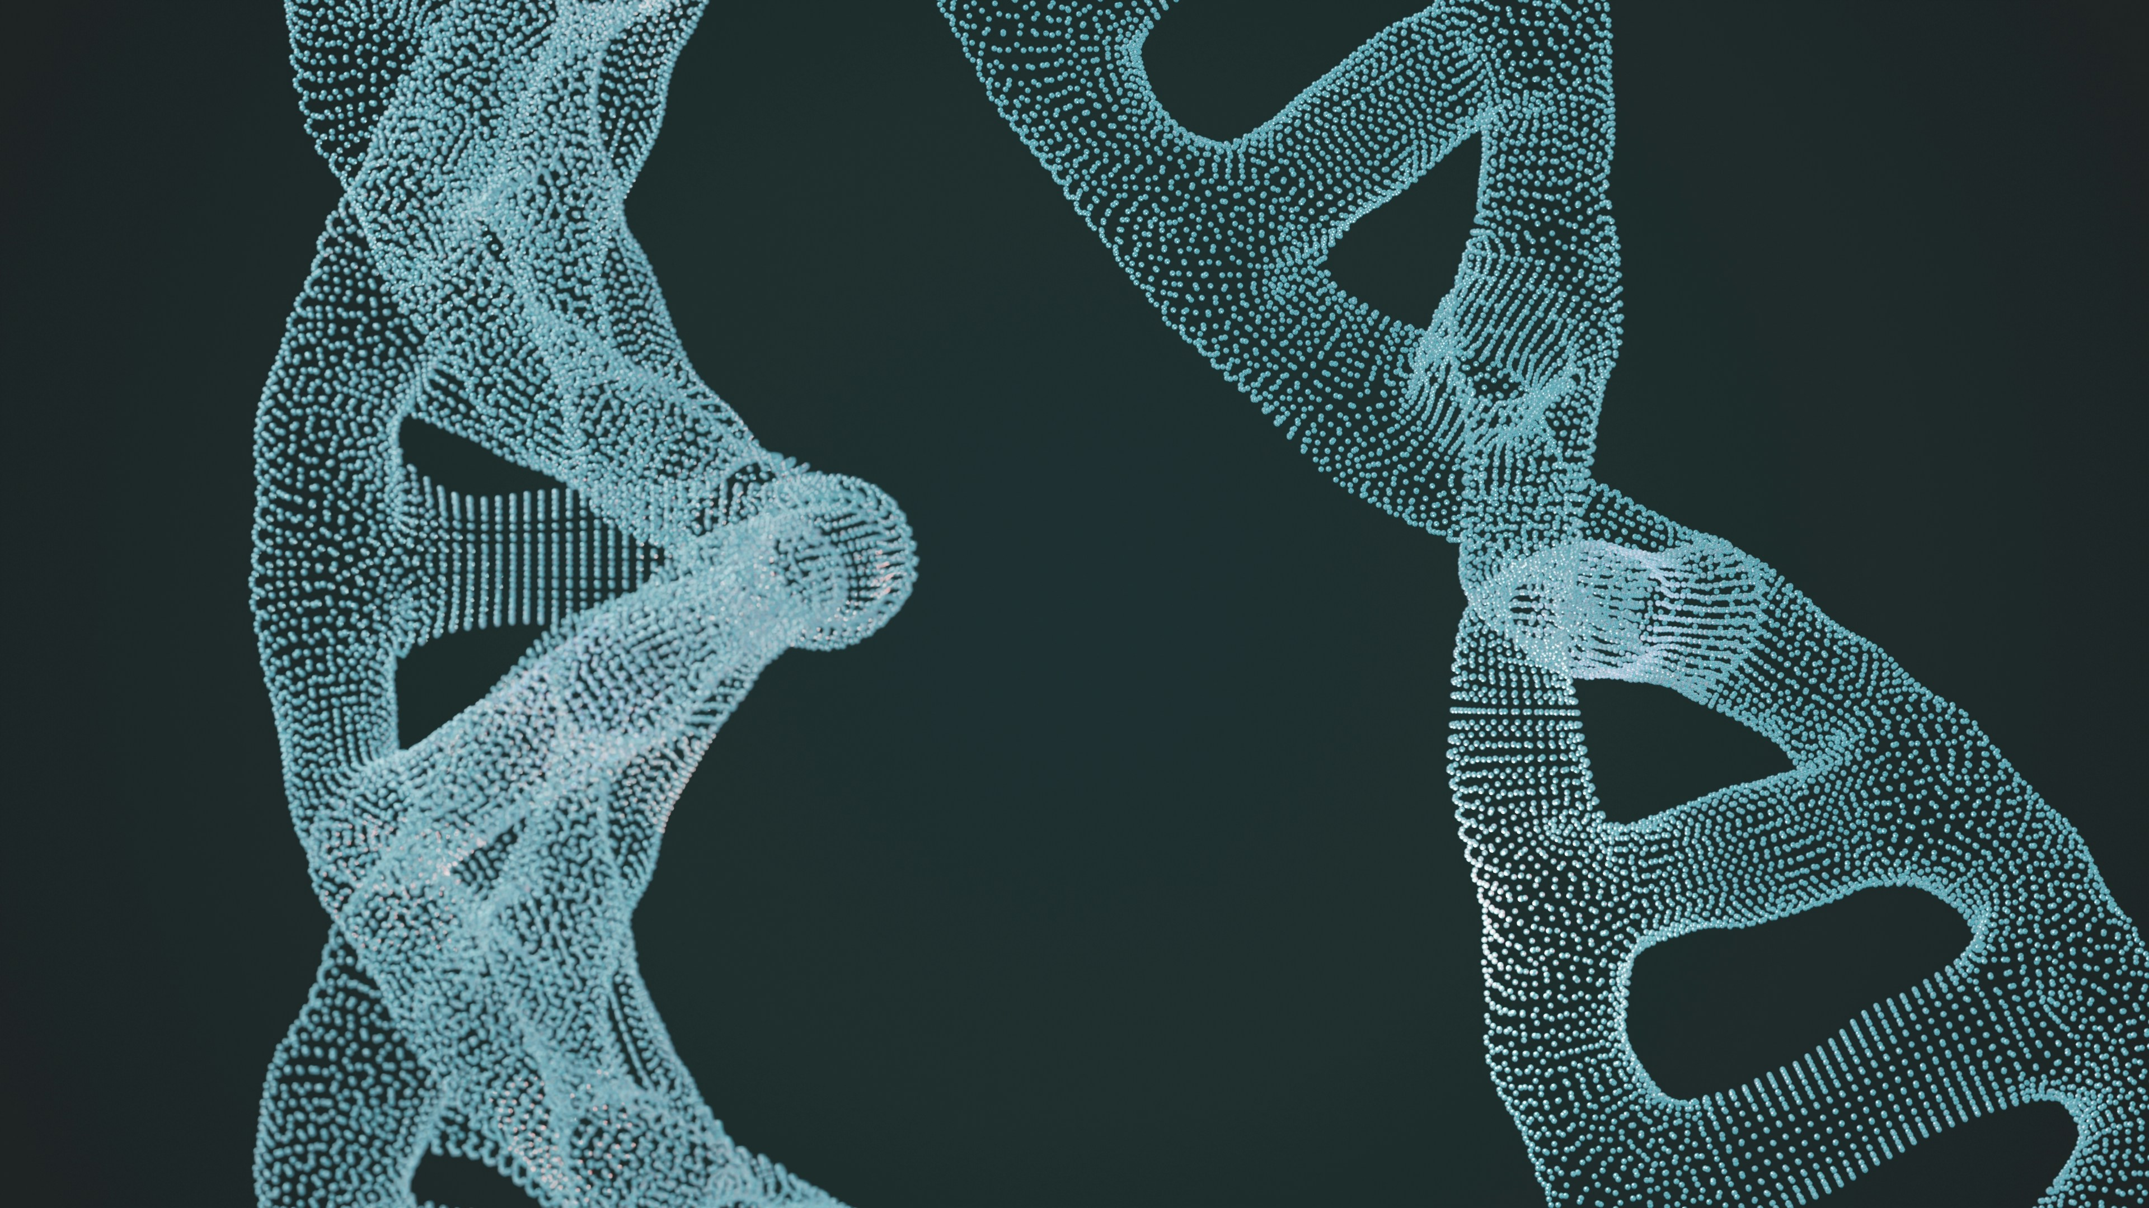
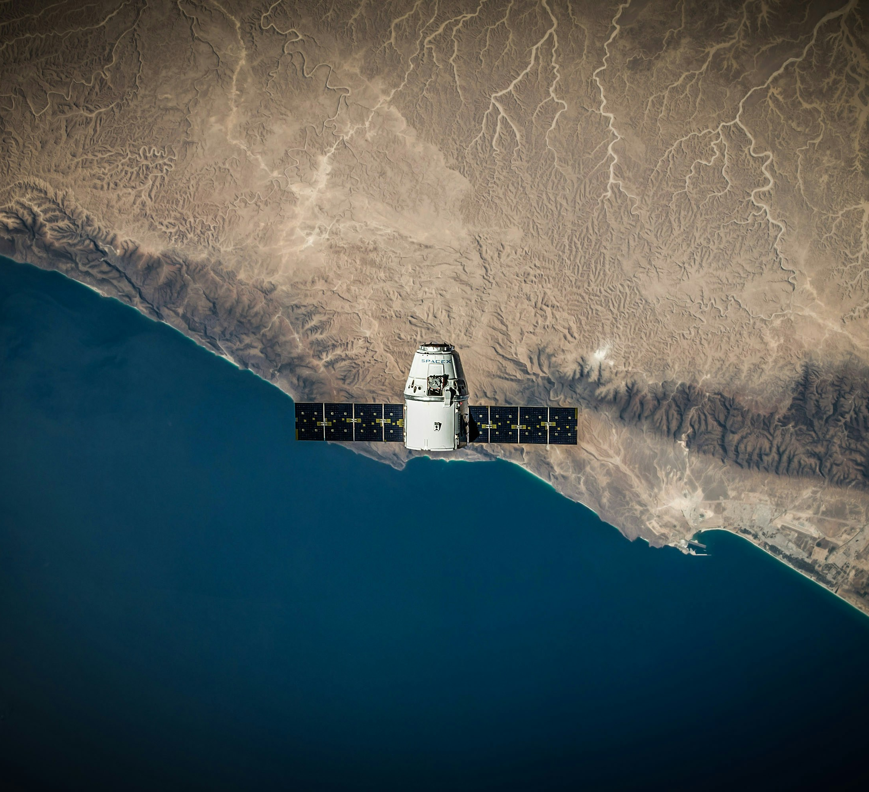
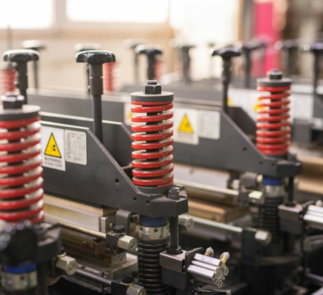
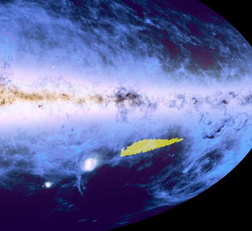
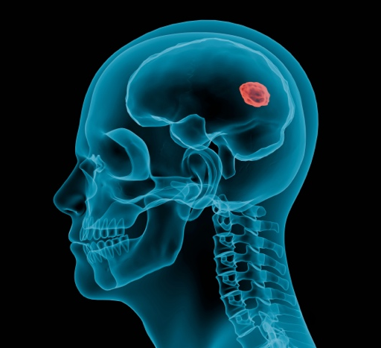

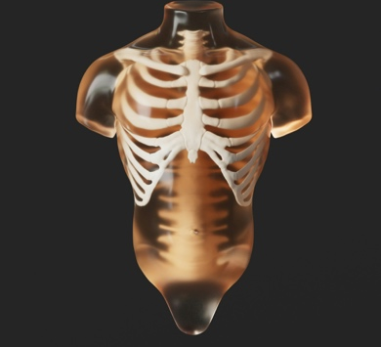
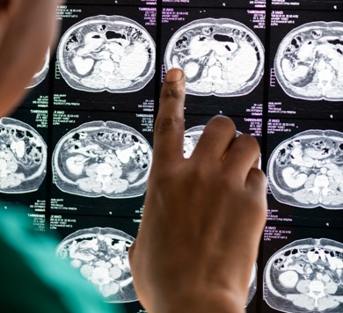

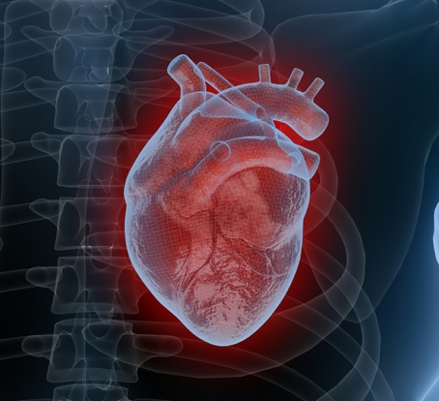
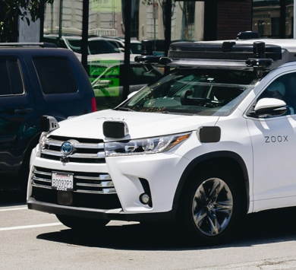
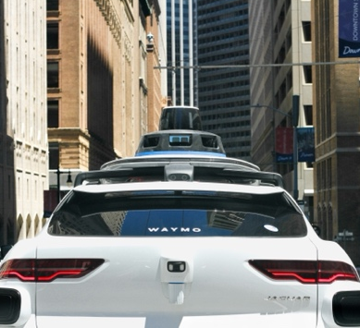
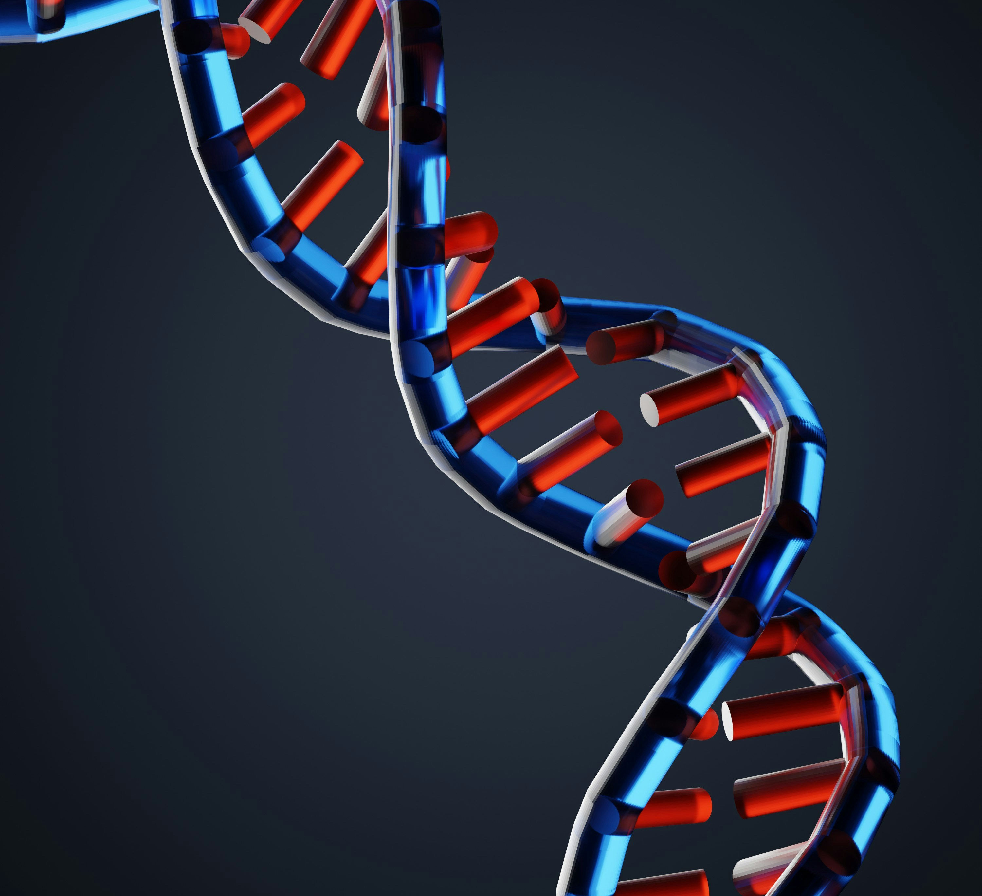
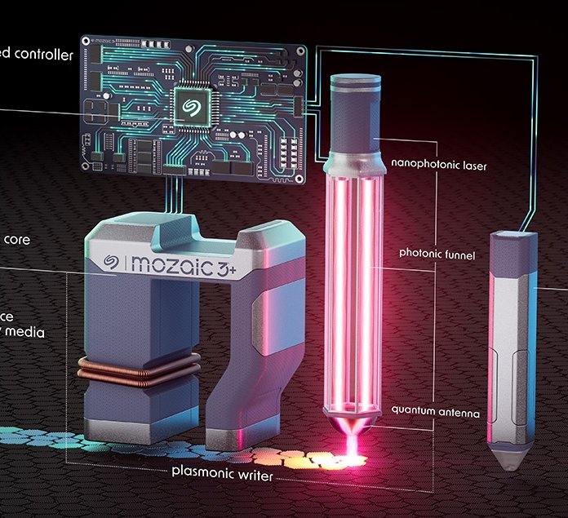
AI dataset capacity is exploding!
Notes:
Today, we are all witnessing an explosion in AI datasets as GPUs consume and produce staggering amounts of data during training Inferencing and archival cycles.
In just about every aspect of our lives, ML models are starting to more accurately provide better, faster inferences thus more data is ingested, and more data is produced faster than ever.
The importance of mass data storage is growing as the world develops, evolves and maintains models all around us

Slide 3
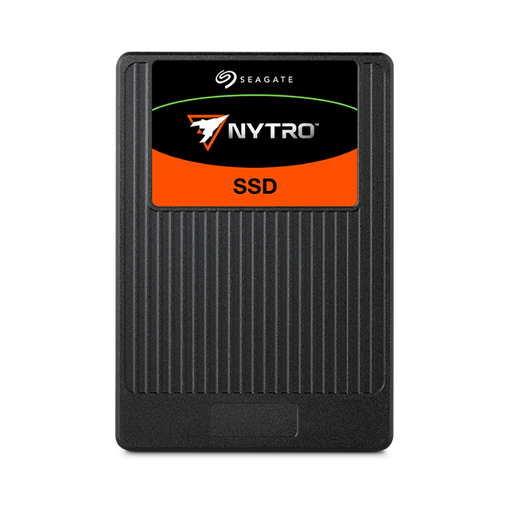
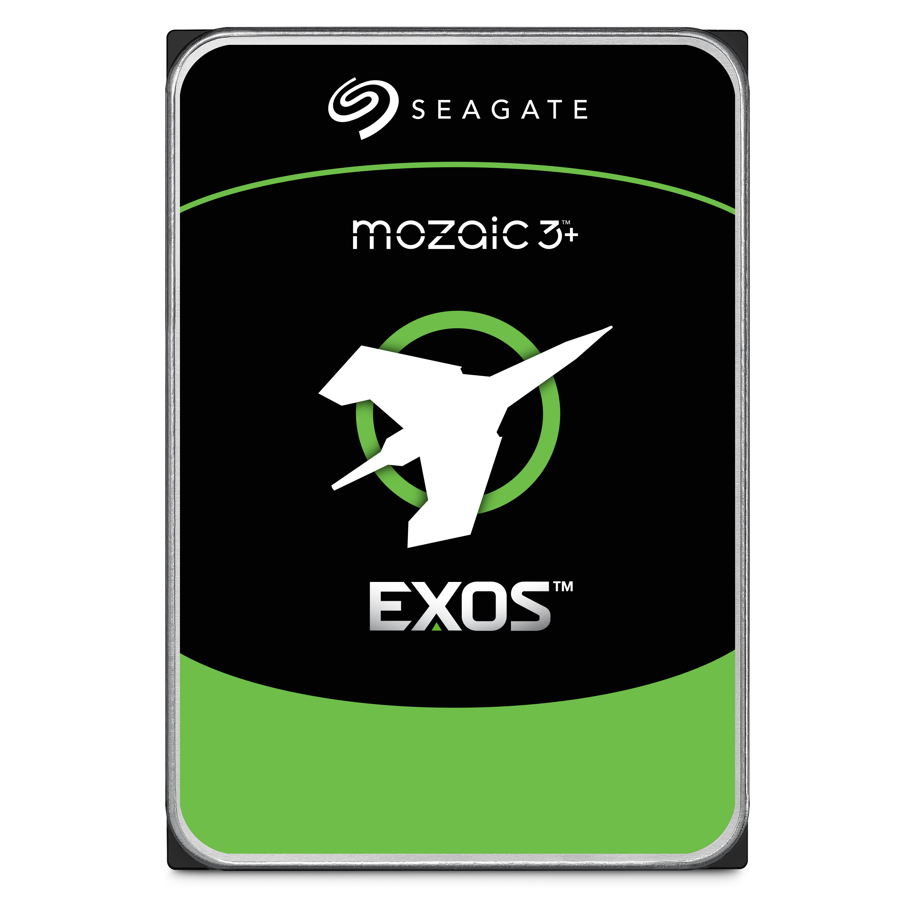
Optimized AI storage with complementary technologies.
Solid-state drives
Hard drives
Lower latency (1/100th to 1/1000th)
Higher throughput (> 10×)
Higher density (> 4×)
Lower cost​ per terabyte (1/6th to 1/9th)
Higher power efficiency per terabyte (> 4×)
Lower embodied carbon​ emission (< 1/10th)
Best for caches close to processors
Best for mass-capacity storage
and longer-term data retention
Notes:
To properly sustain such growth in data creation and data ingest, we need to optimize our AI storage architecture
The current storage ecosystem includes both Solid State Drives and Hard Disk Drives, and each play an essential role in the AI storage arena
SSDs provide Lower-Latency, Higher-Throughput and Higher-Density, capabilities which are critical to keep up with the fast GPUs as a cache layer. whereas
Most massive datasets are stored on HDDs which provide Lower-cost per TB, Higher power-efficiency, and Lower-embodied carbon footprint
Together these complementary storage technologies enable a sustainable storage model for the future of AI

Slide 4
TCO-optimized and less-complex unified AI storage protocol.
SAS
SATA
NVMe
Mature feature-rich protocol
Multiple lanes per port
High performance
Mature and budget-friendly
Mature feature-rich and budget-friendly protocol
Multiple lanes per port
High performance and low latency
Standard silicon and drivers
NVMe over fabric-ready
RDMA capable with GPUDirect Enablement
Native CPU chipset fanout with >100 lanes
PROS
Higher latency
Proprietary silicon and drivers
Requires lane limited host bus adapter
Requires expanders for most fanout
Higher latency
Single lane per port
Bandwidth limited at SATA2
No longer CPU/SOC chipset-enabled
Requires lane-limited host bus adapter
Require expanders for most fanout
Some PCIe solutions limit bifurcation to ×2
CONS
Notes:
SAS (Serial Attached SCSI) and SATA (Serial Advanced Technology Attachment) protocols have historically been the backbone of all storage connectivity for decades.
SSDs were eventually forced to transition to NVMe using the CPU/DPU native PCI Express physical layer, in order to optimize connectivity and reduce latency, Silicon glitches, and software bugs.
HDDs are also destined to follow this same path to enable a unified TCO optimized and more simplified homogeneous storage infrastructures for AI, and Seagate is leading this effort.

Slide 5
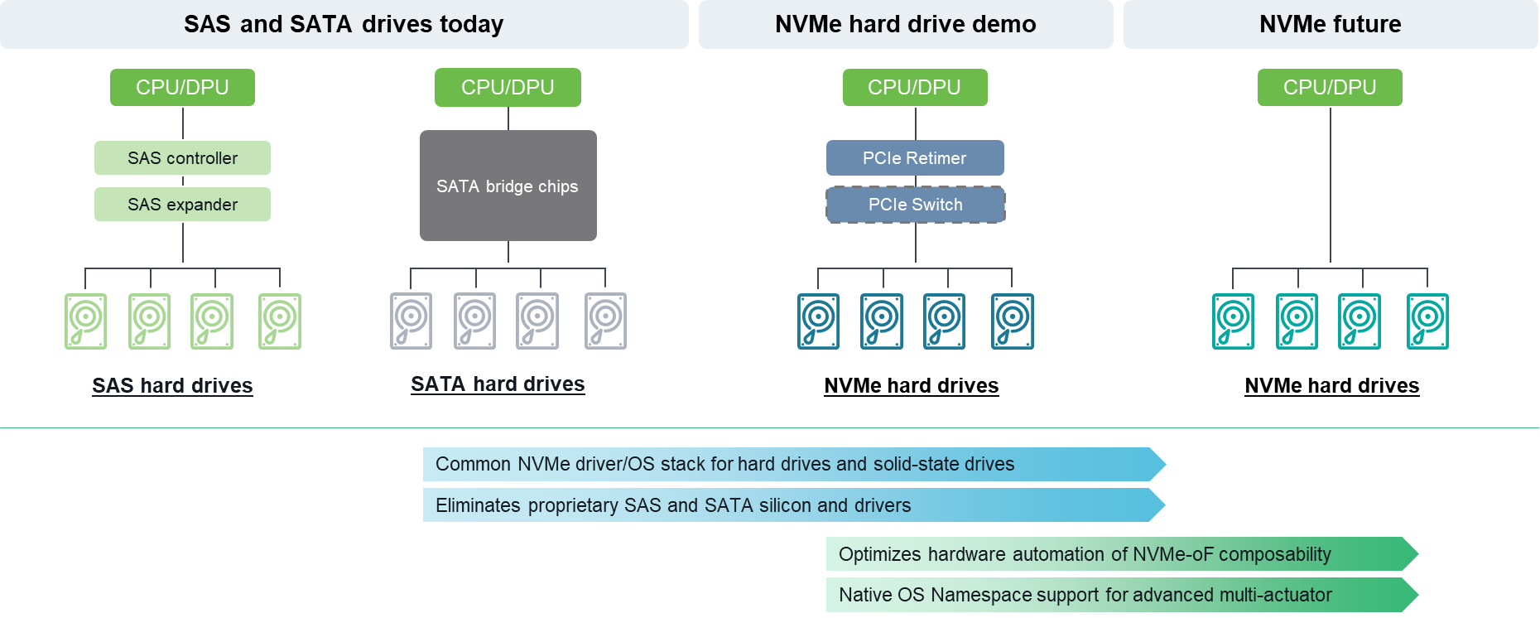
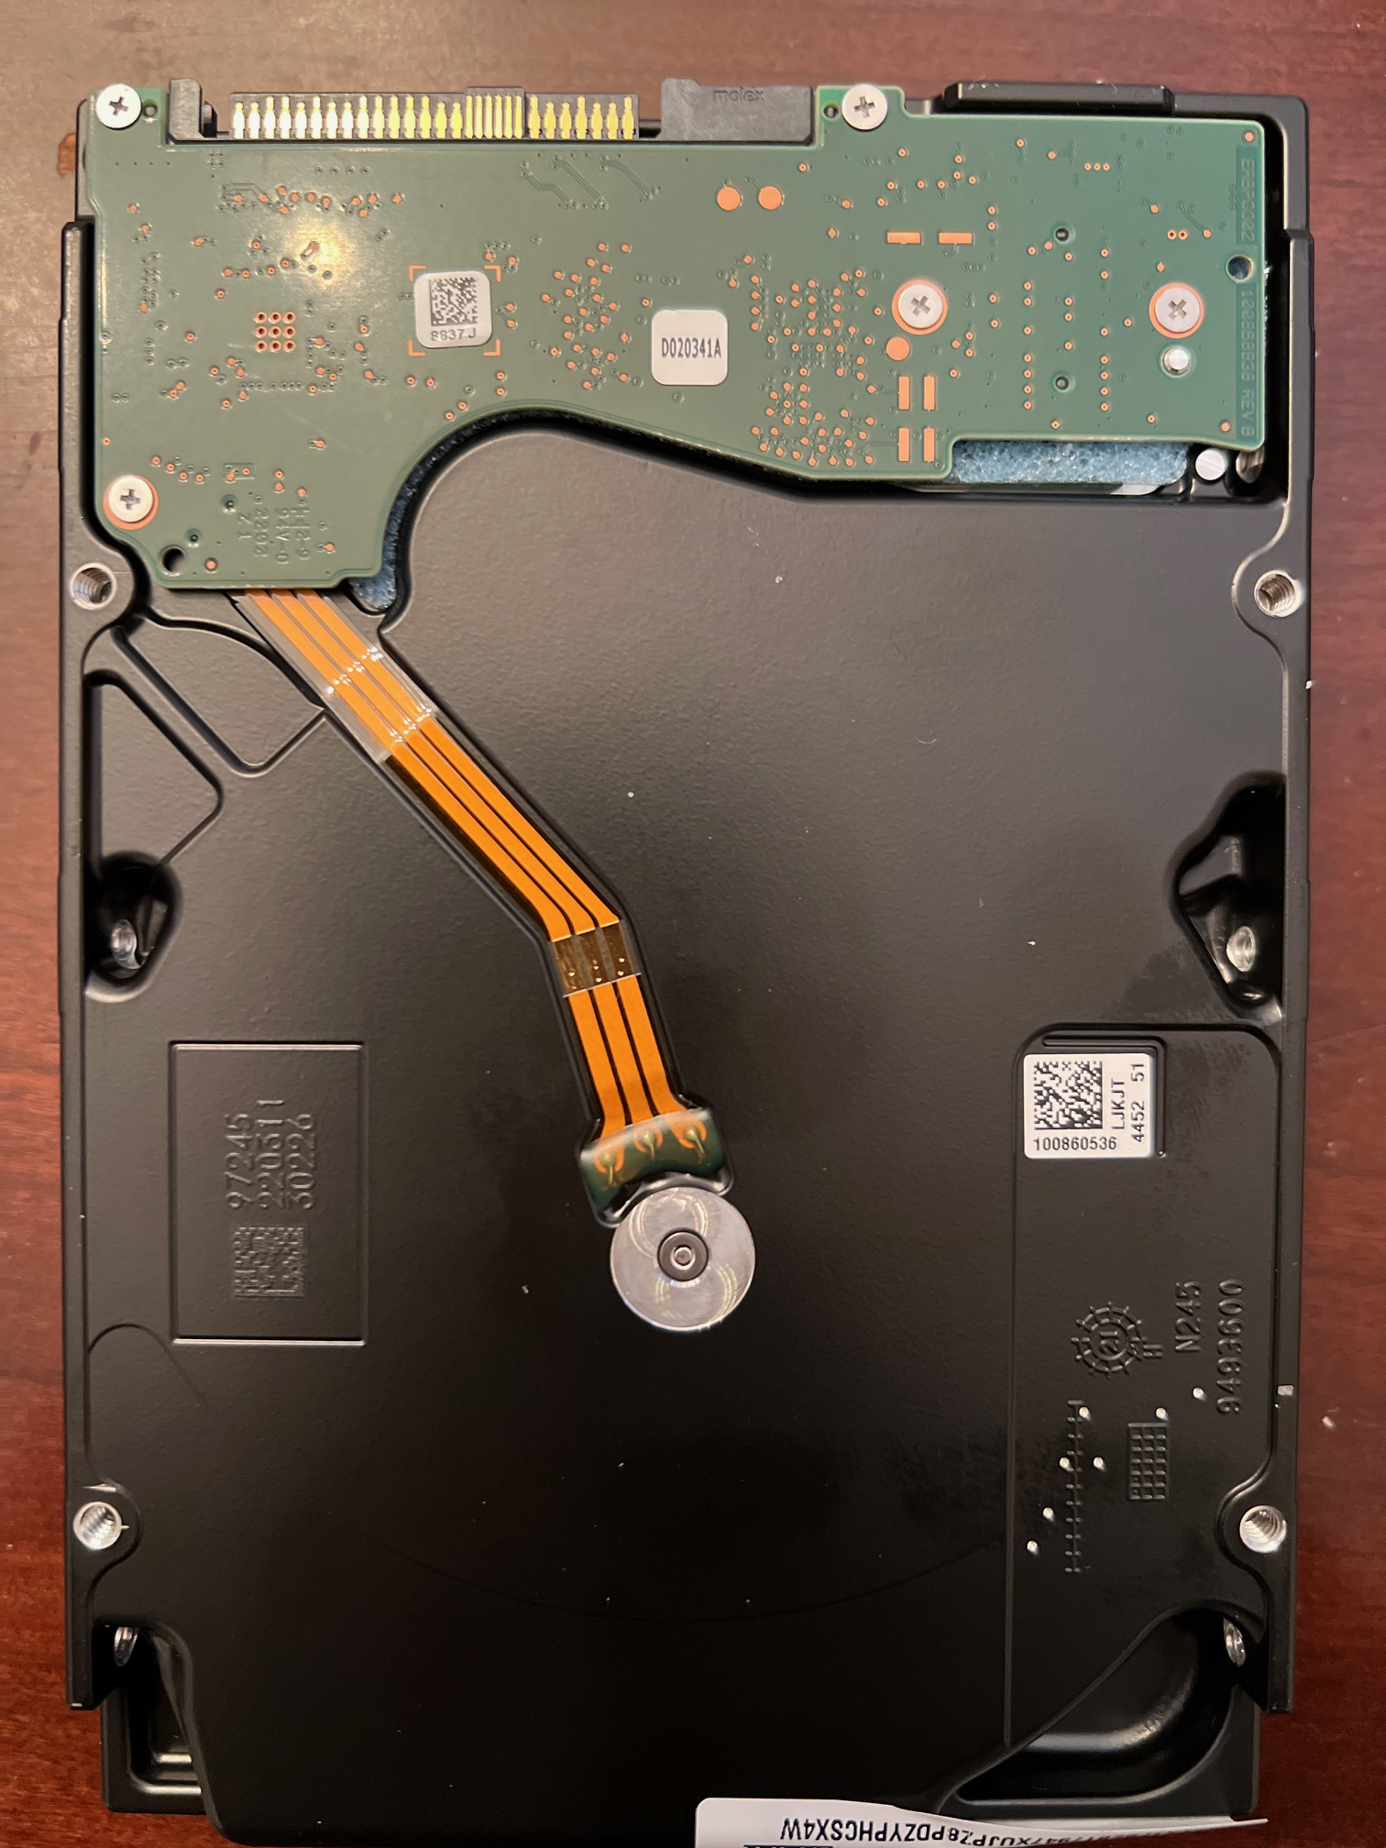
NVMe simplifies mass storage topologies.
OCP NVMe HDD Specification V1.0 Contributed in 2022 with 129 Active Members.
SATA cost replacement with SATA plug-connector Single-Port/Single-Lane customer demand.
EDU-3.5 Mozaic3+ – 4QCY2024 tor NVMe 2.0 validation.
Notes:
Think about the analogy of taking a roundtrip commercial airline flight from LA to NY, with two stops in Chicago and Denver during the holiday season! … What could go wrong? I personally prefer taking a direct chartered flight, especially if it happens to cost less! … I’m more likely to get to my destination rested and on time and have no lost luggage or missed flights along the way!
The simplification of the HDD mass storage stack from SAS and SATA to NVMe will likely come in two phases, initially we will leverage PCIe Retimers and PCIe Switches for large device fanout solutions, eventually followed by direct connectivity.
Standard and mature native OS NVMe drivers, combined with native Chipset/SOC PCIe root ports, can support both HDDs and SSDs to replace proprietary bridge and fanout silicon and proprietary protocol drivers between the AI and its storage
NVMe-oF enabled DPU provides optimized RDMA capable Ethernet storage composability, while preparing the storage datasets for GPU consumption and caching between the two storage tiers for optimal storage TCO

Slide 6
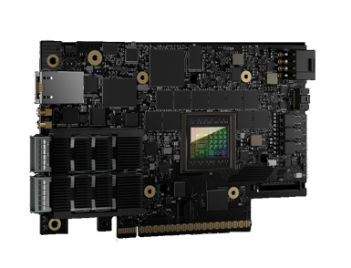
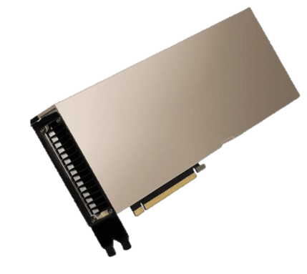
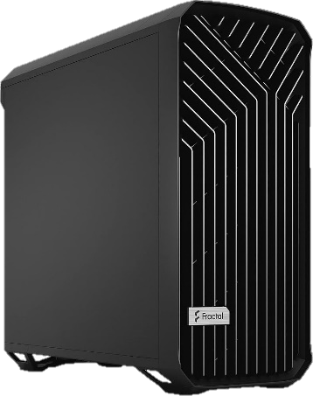
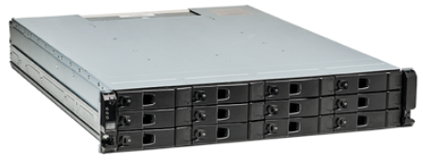
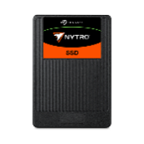
Seagate NVMe over Fabric AI/ML storage GTC-2025 demonstration.
GPU
DPU
Ethernet
NVMe-oF: GPUDirect
AIStore HTTP API
Seagate NVMe hybrid array
(concept design)
8× 30TB
Seagate
NVMe hard drives
(engineering eval units)
4× 4TB
Seagate NVMe SSDs
Linux workstation
NVMe Eval
Notes:
Our machine learning demonstration consists of a GPU in a Linux workstation connected to a Seagate NVMe storage arrays using 200Gbit Ethernet from a DPU.
The storage array has 12 NVMe bays in which we populated 8 hard drives, and 4 SSDs.
The Seagate storage enclosure’s imbedded DPU presents the PCIe root complex for all NVMe drives and connects to the Nvidia GPU using a high-bandwidth RDMA enabled Nvidia Ethernet RNIC
With this optionality we can use both the NVMe-oF protocol over ethernet for GPUDirect memory placement or the Nvidia Opensource AIStore HTTP objects puts and gets for dataloading.
Seagate has pioneered the NVMe hard drive specification and the engineering evaluation units, but more market pull is still needed to enable the production version, which is the next logical path for the AI industry.

Slide 7

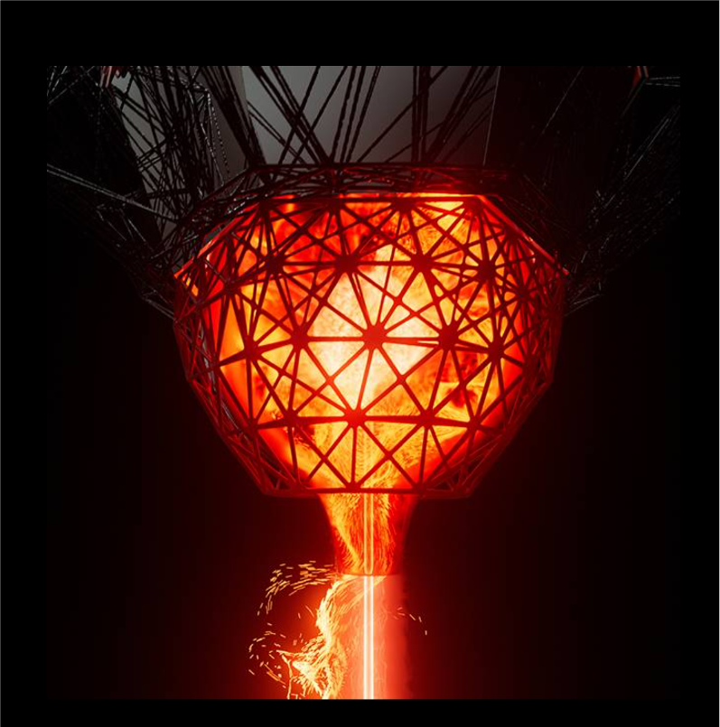
Scale-out AI/ML GPUDirect-optimized hybrid composable NVMe storage.
Composable and hardware-optimized for high-throughput, mass-capacity storage
GPU/CPU
NVMe-oF
Storage
High-speed Ethernet fabric
Notes:
The envisioned NVMe SSD and HDD composable storage racks (on the right side) with DPU based High-Speed Ethernet based NVMe over Fabric connectivity to the GPU/CPU racks on the left.
These storage racks create the building block for deploying the future TCO optimized high-performance mass-capacity storage.
They will deliver Terabytes/s throughput, and exabytes of capacity at Micro-second level latency, while managing costs, reducing bottlenecks and eliminating stranded/underutilized storage capacity.

Slide 8
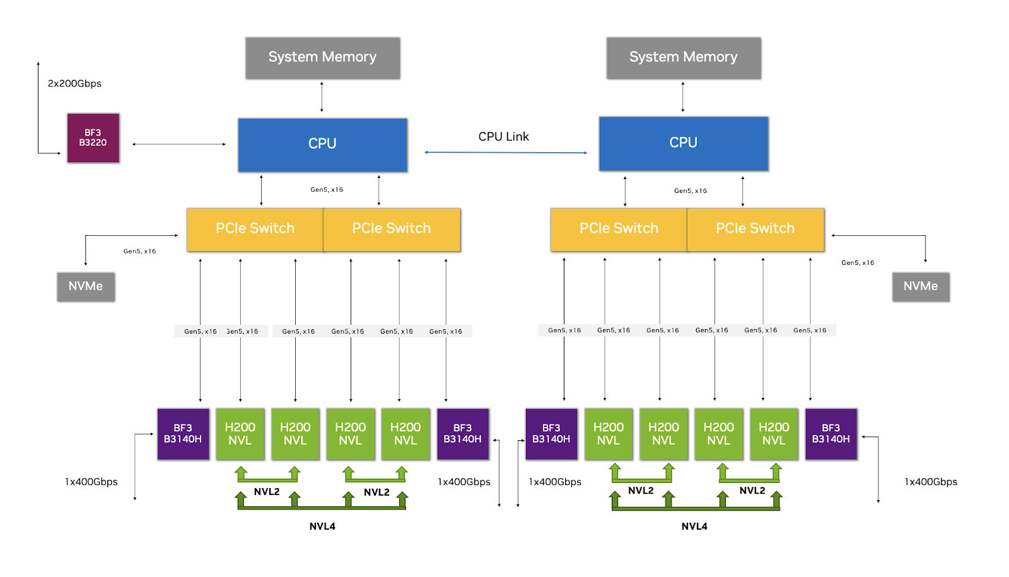
Mount each drive as NVMe namespace
CPU
XFS
LVM RAID + Cache
NVMe
NVMe
NVMe
NVMe
NIC
GPU
SSD
NVMe-oF RDMA
Storage array
DPU
NIC
CPU Cores
NVMe
target
offload
Kernel NVMET
PCIe switch
SSD
SSD
SSD
SSD
HDD
HDD
HDD
HDD
HDD
HDD
HDD
HDD
https://docs.nvidia.com/ai-enterprise/reference-architecture/latest/compute-node-hardware.html#h200-nvl-systems
GPUDirect
One writer per storage pool with multi-host
Notes:
The DPU offers acceleration of many storage solutions using an Ethernet fabric
The first approach is to simply present each drive both SSDs and HDDs as NVMeoF targets for the client workstation to consume. @
The client is free to aggregate and cache and tiers as in this example using software RAID and an XFS files system
Seagate has contributed to the shared volume groups feature of the Linux Volume Manager to improve block level clustering with multiple clients
Running Linux on the ARM CPUs in the DPU, a kernel module for NVMe over fabric sets up the target offload within the Network Interface Controller. @
This enables GPUDirect memory placement with hardware automation in the NICs in both the array and client.
The limitation is only 1 client can be active when writing the dataset, but all clients can be enabled for read only while marching through each epoch during training.

Slide 9
Mount each drive as NVMe namespace
Mount LVM2 volumes as NVMe namespaces
CPU
CPU
XFS
XFS
XFS
XFS
XFS
LVM RAID + Cache
NVMe
NVMe
NVMe
NVMe
NVMe
NVMe
NVMe
NVMe
NIC
GPU
SSD
NIC
GPU
SSD
NVMe-oF RDMA
NVMe-oF RDMA
Storage array
Storage array
DPU
DPU
NIC
CPU Cores
NIC
CPU Cores
NVMe
target
offload
Kernel NVMET
RDMA
Offload
SNAP
SPDK
NVMe
Ctrlr
LVM RAID + Cachc
PCIe switch
PCIe switch
SSD
SSD
SSD
SSD
SSD
SSD
SSD
SSD
HDD
HDD
HDD
HDD
HDD
HDD
HDD
HDD
Localized hot/cold
data tiering
HDD
HDD
HDD
HDD
HDD
HDD
HDD
HDD
GPUDirect
GPUDirect
1 Writer per Storage Pool With Multi-host
DataSet write ownership
One writer per dataset with multi-host
Notes:
The next option is to move some of the drive aggregation and caching to the storage array.
In this case we can use the NVIDIA Software-defined Network Accelerated Processing container or SNAP container to create the NVMeoF targets of raided volumes. @
This avoids performance concerns from mingling the data and metadata of unrelated datasets as seen with parallel file systems used for storage aggregation.
The hot/cold data caching stays within the array making it transparent to the user when exporting a NVMeoF target per dataset. @
Now we remove need of configuring the Linux clients to use shared volume groups for clustering, but we still can only have 1 client actively writing per dataset, which may be OK for many use cases.

Slide 10
Mount each drive as NVMe namespace
Mount LVM2 volumes as NVMe namespaces
AIStore aggregation with SSD cache
CPU
CPU
CPU
XFS
XFS
XFS
XFS
XFS
LVM RAID + Cache
AIS Client
NVMe
NVMe
NVMe
NVMe
NVMe
NVMe
NVMe
NVMe
NIC
GPU
SSD
NIC
GPU
SSD
NIC
GPU
SSD
NVMe-oF RDMA
NVMe-oF RDMA
HTTPS::/AIS
Storage array
Storage array
Storage array
DPU
DPU
DPU
NIC
CPU
NIC
CPU
NIC
CPU
NVMe
target
offload
Kernel NVMET
RDMA
Offload
SNAP
SPDK
RDMA
Offload
AIS proxy
NVMe
Ctrlr
AIS target mo
mount
LVM RAID + Cachc
LVM RAID + Cachc
PCIe switch
PCIe switch
PCIe switch
SSD
SSD
SSD
SSD
SSD
SSD
SSD
SSD
SSD
SSD
SSD
SSD
HDD
HDD
HDD
HDD
HDD
HDD
HDD
HDD
Localized hot/cold
data tiering
HDD
HDD
HDD
HDD
HDD
HDD
HDD
HDD
HDD
HDD
HDD
HDD
HDD
HDD
HDD
HDD
GPUDirect
GPUDirect
GPUDirect (future?)
1 Writer per Storage Pool With Multi-host
DataSet write ownership
Many to many read/write (get/put)
One writer per dataset with multi-host
Array scaling of performance, availability
Notes:
Block Level NVMeoF isn’t the only method to feed the GPUs. @
By switching the ethernet protocol for the storage traffic from NVMeoF to AIStore and running an AIStore server instance on the DPU the application can use object storage symantics for data GETs and PUTs.
We still get the RDMA offload enabled in the NICs and can use the same local volume management for drive fault tolerance and throughput aggregations. @
Yet we gain the ability to have many clients writing to the same dataset if needed.
Also AIStore is design to scale out to create large storage clusters with erasure coding as required to achieve availability objectives.
While AIStore doesn’t support GPUDirect today, there is nothing precluding the community of this open-source project from adding this feature.
These 3 examples are just a few from many storage services that can be used manage mass capacity and SSDs using NVMe hard drives.

Slide 11
AIStore as a fast-tier NVMe storage solution.
AIS cluster
Backend object storage
ML framework + model
LyveCloud
Amazon S3
AIS node
GCP
Azure
Proxy
Target
HTTP/s
(client side)
Load-
balancing
warm GET
Not found locally
cold GET
Backend NVMe over Fabric
AIS node
AIS node
SSD
HDD
Notes:
AIStore is all about speed by caching warm data close to the GPU which is especially noticed during model training which rereads shuffled datasets.
The HTTP proxy plays a key role in forwarding client request to the correct target node for each transactions
The AIS Nodes have local storage of SSDs and HDDs while also able to cache object storage and block storage of backend repositories
NVIDIA has released this project to the open-source community and has demonstrate throughput in the 100s of Gbytes/sec
https://aistore.nvidia.com/blog/2023/11/27/aistore-fast-tier
https://www.youtube.com/watch?v=N-d9cbROndg

Slide 12



ML application demonstrates use of common software layers.
Application
Seagate smart manufacturing anomaly detection model
GPU workstation
AI development platform
Storage Library
AIStore Python SDK
Networking
HTTP AIS API
Storage array with a DPU
Data lake service
AIStore target
Operating system
Ubuntu 22.04
Drive interface
NVMe
SSD
SSD
HDD
HDD
HDD
HDD
Millions of high-def images for quality checks
7%
93%
Storage Media Split
Notes:
To exercise the complete system, we selected one of our anomaly detection models out of many that come from Seagate’s smart manufacturing journey.
This model was generated and continues to evolve from millions of high-definition images. @
Using PyTorch libraries in a Jupyter notebook we can easily switch from NVMeoF to AIStore for dataset loading. @
The AIStore client library runs on the workstation with the GPU @ and issues HTTP requests over the 200GE network links @
An instance of the AIStore Server Node is running @ in the DPU using Ubuntu operating system @
Finally, the drives are endpoints for the Linux operating system on the DPU and peers with the smart NIC managing the ethernet ports.
This enables the RDMA hardware within the Smart NIC to offload data movement from the DPU’s ARM processors.

Slide 13
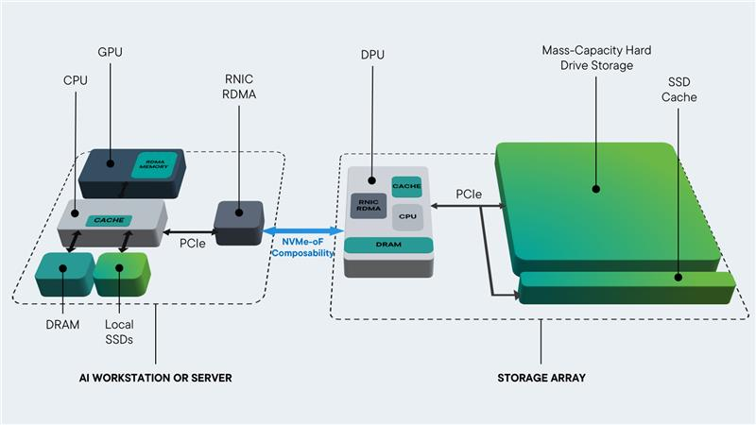
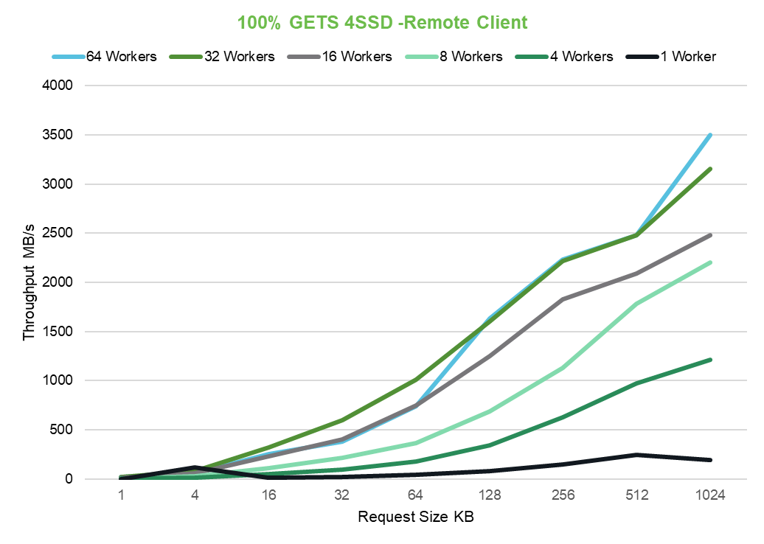
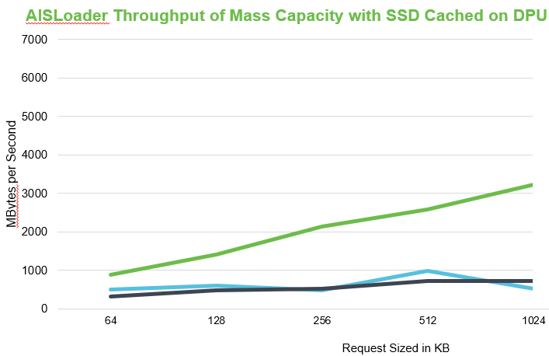
Cost & performance optimized AIStore cached topology.
Optimized AI storage solution with complementary NVMe SSD + NVMe HDD technologies.
Demonstrated at GTC-2025 NVMe-oF connected Nvidia AIStore object storage with optional GPUDirect capability.
4x NVMe 64TB SSD only performance = 4x NVMe 4TB SSD cache + 8x NVMe 30TB HDDs w/ 32-workers @ 1K requests.
$$$$$$
~3GB/s
200Gb
Ethernet
$
~3GB/s
GPU meets PCIe-based hard drives: Seagate and Nvidia demo NVMe HDDs | Tom's Hardware
Seagate begins work on NVMe HDDs for cost-effective AI workloads | TechSpot
Notes:
NVMe SSDs used as a fast cache in front of NVMe HDD based Mass storage.
Both managed by an Nvidia's BlueField-3 DPU connecting to an Nvidia GPU through a CX6 RNIC.
Training model is loaded on NVMe HDDs with encrypted Seagate’s Areal Density media and plasmonic transducer Mozaic head manufacturing image processing content.
The AI model training use Nvidia's AIStore PyTorch library fetches tensor creation then RDMA into the GPU memory over NVMe-oF with optional GPUDirect functionality.

Slide 14
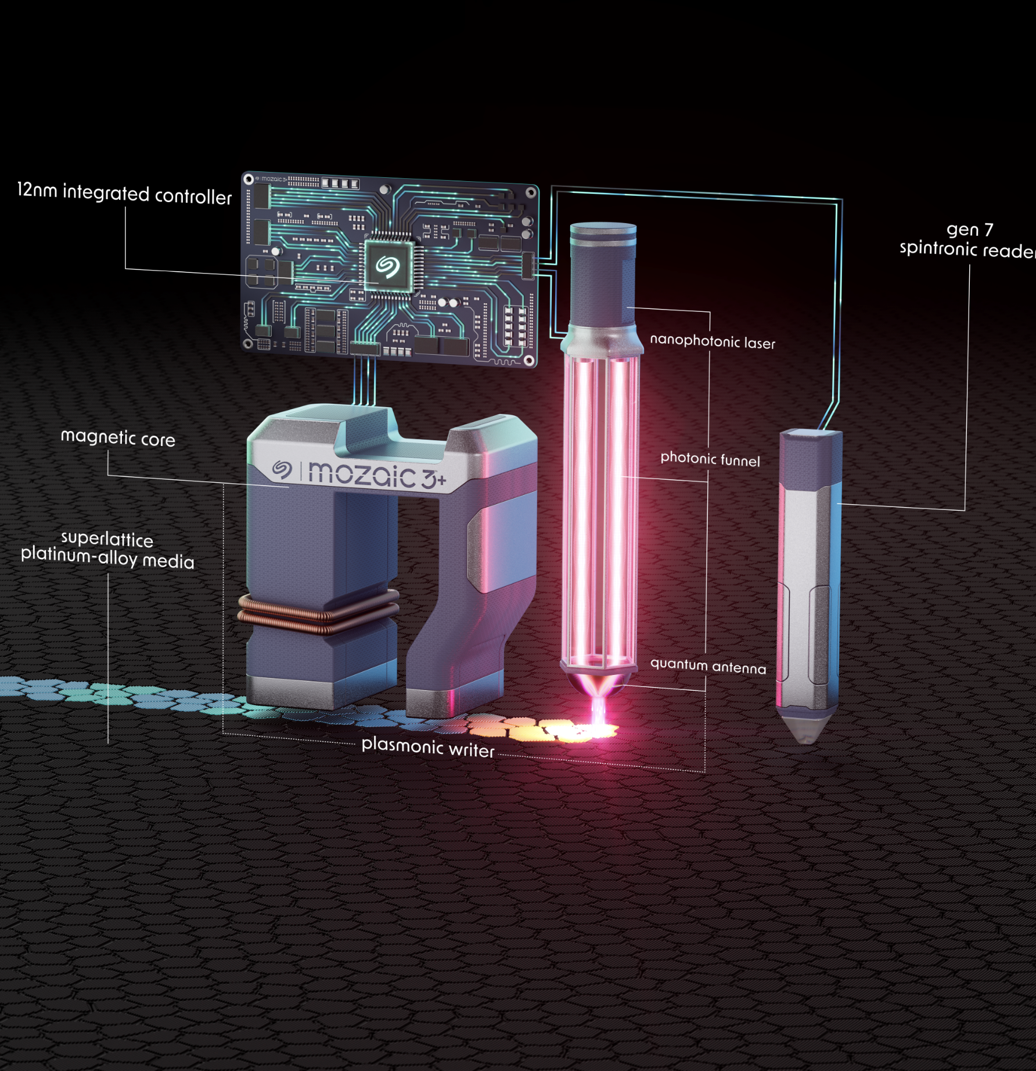
Seagate’s advancements in drive density come from ultra-precision manufacturing achieved from a decade of machine learning.
The nanophotonic laser provides energy for
micro heat placement.
https://www.seagate.com/innovation/mozaic/plasmonic-writer/
Notes:
Seagate’s market leading arial density is made possible by extreme high precision manufacturing of photonic controlling elements
While staggeringly small our challenge is to not just make a few of these, but millions devices that accurately control microbursts of energy enabling our writer to pack in more bits.
So instead of showing a demonstration with cat images, @ we selected a model and dataset from one of the key elements of our secret sauce controlling micro heat placement.

Slide 15
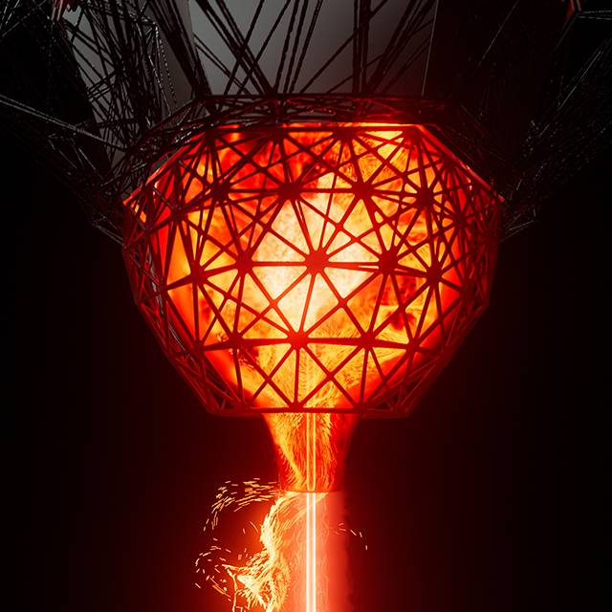
High-definition images of our quantum antenna are scanned for anomalies.
Images stay uncompressed (1500×1000) to capture subtle details.
AIStore PyTorch library fetches images and creates tensor for loading into GPU memory.
NVMe hard disk drives offer reduced complexity by direct attachment to a DPU running AIStore target server.
The quantum antenna converts laser energy into heat at an ultra-fine scale.
Inference model detects anomalous regions during wafer inspection.
Notes:
The quantum antenna is an element that converts laser energy into heat with ultra fine precision.
We have store over 100 thousand uncompressed image on the storage array for training and inference demonstrations.
The image of each quantum antenna device is scanned for anomalies by a model that generates a score and heat map overlay of anomalous regions during wafer inspection.
By pre-processing images to create tensors stored on the storage array, each tensor is loaded directly into GPU memory using NVMeoF and GPUDirect.

Slide 16


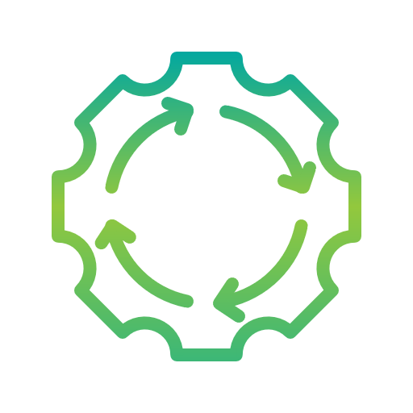
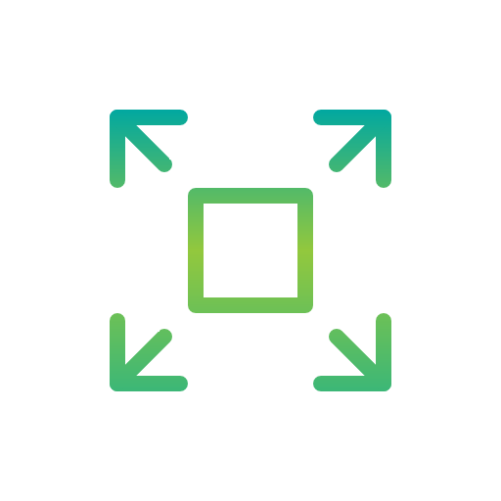
Recap.
This NVMe-oF POC paves the way for composable high-performance mass-storage for AI/ML.
DPU
Local primary and mass-storage clusters reduce WAN loading and data movement costs.
DPUs provide drive aggregation and resiliency while empowering GPUDirect memory placement.
Seagate NVMe hybrid array
(concept design)
AIStore offers open source and scalable data caching of local and remote storage.
8× 30TB
Seagate
NVMe hard drives
(engineering eval units)
4× 4TB
Seagate NVMe SSDs
NVMe Eval
NVMe hard drives offer improved storage deployment TCO and performance while lowering complexity.
Notes:
So to summarize, this NVMe over fabric demonstration using NVMe hard drives paves the way for composable mass storage for AI/ML workloads.
Offering optionality in locally deploying mass storage reduces wide area network loading and data movement costs.
DPUs sit at the intersection of network storage and offer many methods for drive aggregation will using GPU direct memory placement to feed the data hungry GPUs.
The AIStore open-source project brings a caching and scalability for local and remote storage.
NVMe hard drives lower the total cost of ownership while delivering mass capacity that scale to fit any dataset.
Being NVMe native the RDMA engines above the drive offload the heavy I/O traffic of data movement.

Slide 17
Thank you.
mohamad.elbatal@seagate.com
Notes:
We hope this demonstration has whetted your appetite for mass capacity storage near your GPUs.
We also want to the thank the NVIDIA DPU and AISTORE teams for their open-source and support.
Please stop by the Seagate both to see this demonstration in action and learn more about mass capacity for AI.

