Slide 1
Enabling Accessibility to CERN audiovisual content via Automated Speech Recognition
Ruben.Gaspar.Aparicio@cern.ch
On behalf TTaaS team
IT-CA-CTE
April 2025
https://ttaas.docs.cern.ch/

Slide 2
Agenda
Challenge statement
Use cases
Architecture
Results
Conclusions

Slide 3
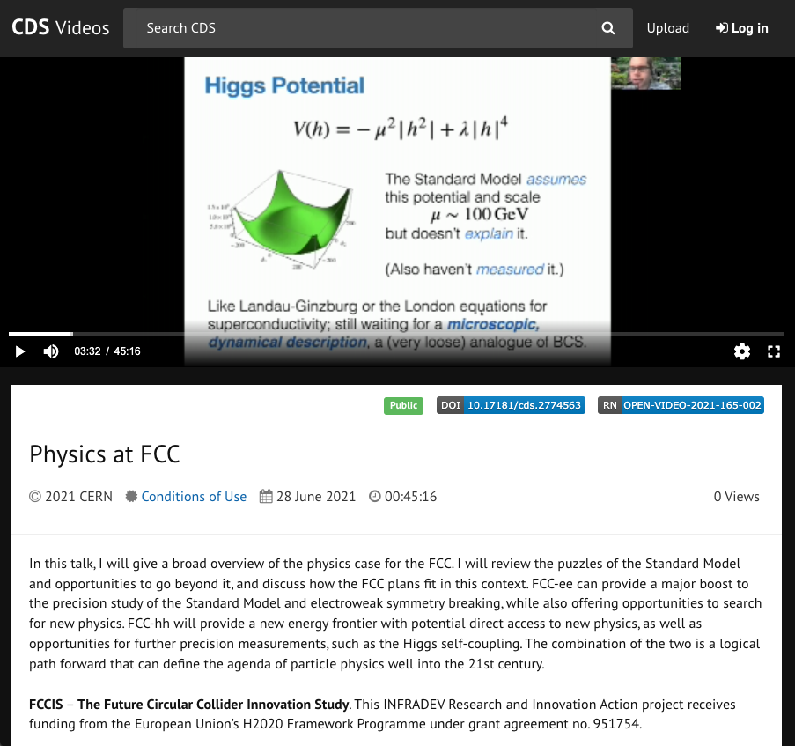
Challenge statement
Ensuring that multimedia content produced by CERN is accessible and meets the WCAG standards
Providing solutions for captions both offline and online (live) content
Streamlining the process through automation
Offering an API that can be utilized by multiple services
Obtaining transcripts and translations as high quality as possible to avoid re-edition
Offer the data in a machine-readable, indexable format (FAIR)

Slide 4
Use cases
High-profile meetings/conferences
HEP AV media: CDS, Digital Memory, Academic training, outreach media, etc.
Translation service
Specific use cases: ATLAS, CMS, AV-media, user community
Findability (F in FAIR)

Slide 5









Chronology
October 22: CUDA 11
September 22: ASR offline and online adapted models
March 23: punctuation
July 22: ASR offline and online French models
April 23: ASR/MT Core new version: callbacks new endpoints
June 22: Initial live streaming setup
Jun 23: live streaming integration
March 24: live streaming WebSocket
April 22: Initial setup ASR/MT core
Sept 24: Autotraining ASR EN model
Nov 24: CDS & Digital Memory backlog
2020
2021
2022
2023
2024
2025
Time
June 24: live conference
Evaluation of alternatives: Azure, WIPO (S2T), Amberscript, MLLP, Google Speech to Text, Deepgram, Mozilla Deepspeech, Ai-media.
Defining quality
Project started with Tender winner: MLLP (Machine Learning and Language Processing)
May 23: live conference
Oct & Nov 23: live ATLAS week event.
Dec 23: live CMS plenaries
CERN Tender process
Feb 24:Backlog of Weblecture processed. All Weblecture have CC!!
Aug 23: Weblecture integration. New Web lectures have captions!!

Slide 6








Architecture
CERN
Weblecture service
CDS
Digital Memory
Platforms:
TTaaS REST API
CERN extension
Frameworks:
CERN SSO
TTaaS
WebUI
ASR/MT Core
CERN development
Legend:
IT infrastructure
TTaaS Live
MLLP Core element
WebSockets
App

Slide 7
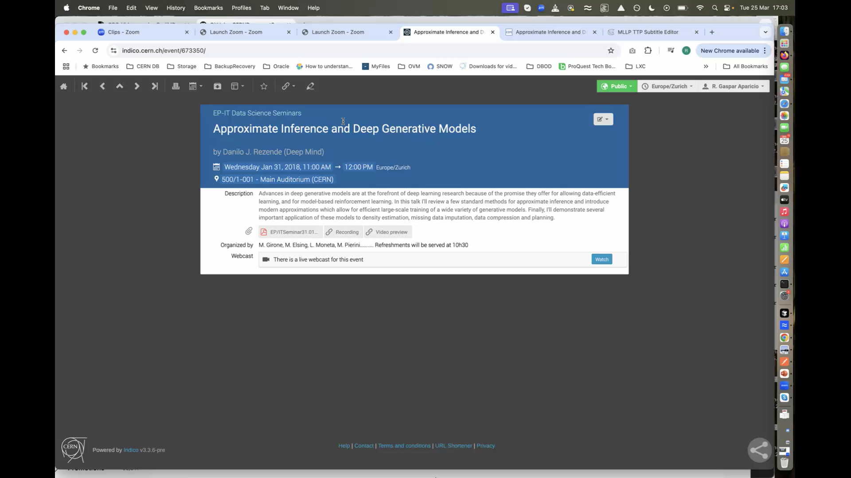
Offline use case: Editing/Correction of a transcript/translation (video)

Slide 8
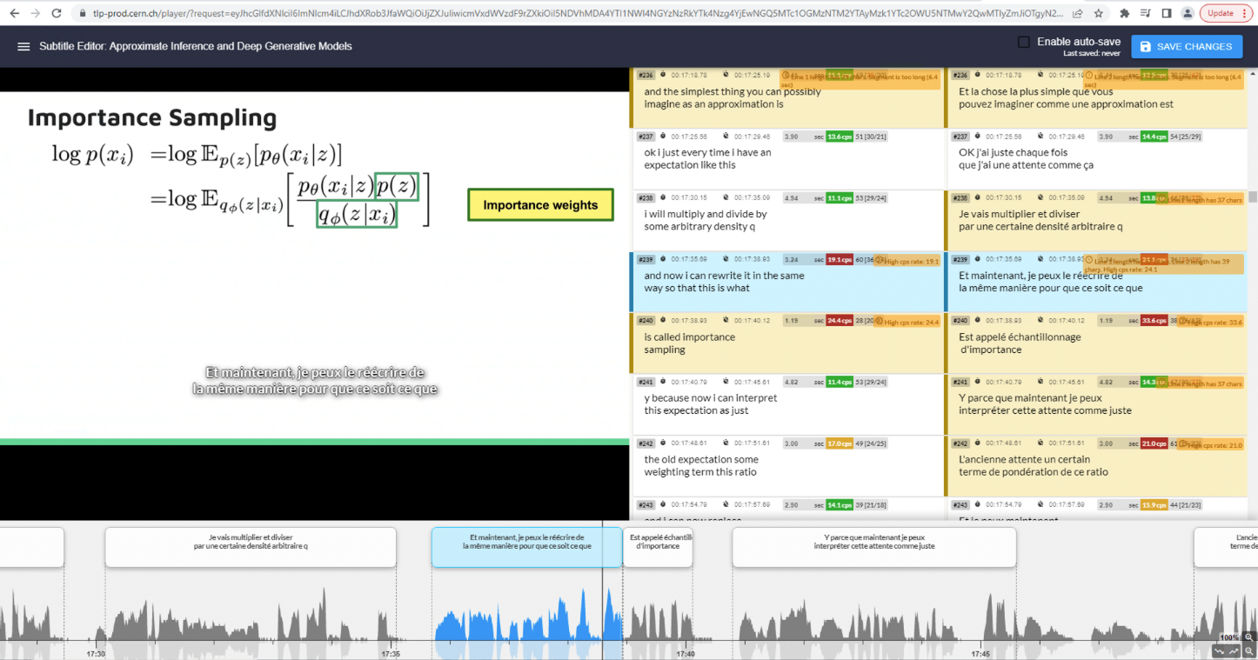
Offline use case: Editing/Correction of a transcript/translation
Indico: https://indico.cern.ch/event/673350/
CDS: https://cds.cern.ch/record/2302480
Weblecture player : https://lecturemedia.cern.ch/2018/673350/
Captions Editor
Client service retrieves new transcripts/
translation and does the necessary to display it
Get a link to the editor, possibilities:
As media owner via TTaaS WebUI
As service via REST API call on TTaaS API
SNOW ticket
callback
Integrations
TTaaS records the edition and considers it a reference → training models

Slide 9
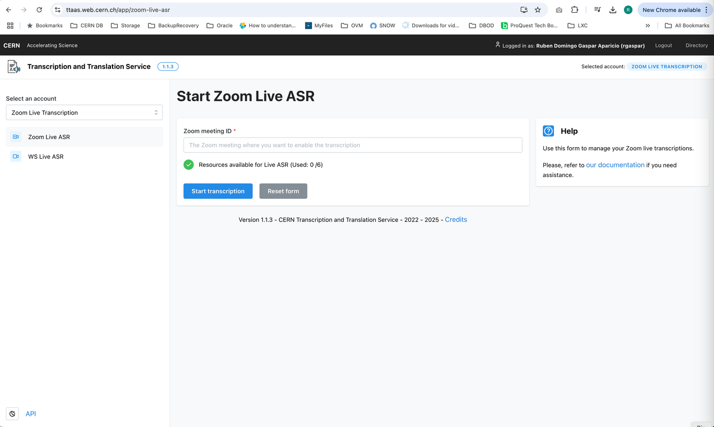
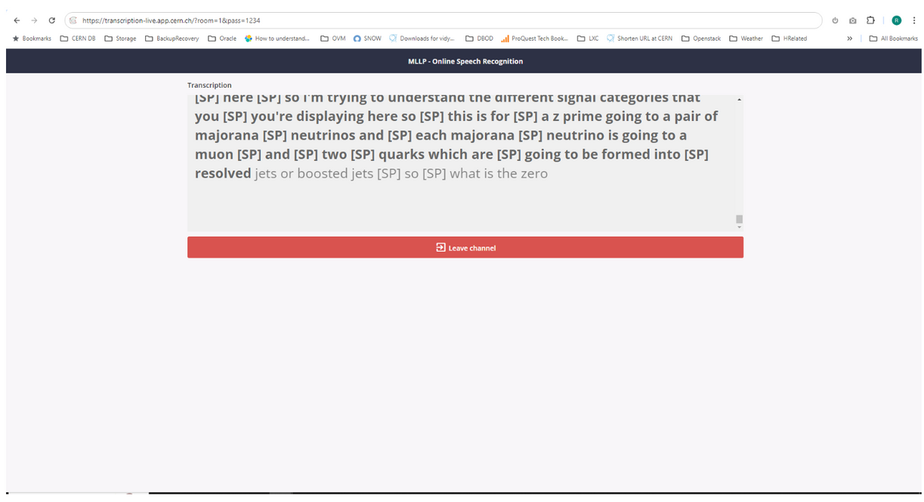
Online use case
WebSockets solution:
Zoom integration:
  Base on WebSockets and RTMP
  User is autonomous to manage on which meetings & when. She/he can pilot the process on the TTaaS website
  Just Zoom meeting/webinar ID is required, a channel name and password
  Audience get an URL to follow the captions
  Adapted to conference organizers demands
  Latency is < 1 second
  Based on REST API calls - KB0060368 & RTMP
  User is autonomous to manage on which meetings & when. She/he can pilot the process on the TTaaS website
  Just Zoom meeting/webinar ID is required
  The fact that Zoom REST API calls are involved, increases latency ~ 4secs
https://ttaas.web.cern.ch/app/zoom-live-asr
https://transcription-live.app.cern.ch/?room=1&pass=1234

Slide 10
Searchability PoC
Opens a new dimension of AV media content
Based on CERNSearch
Paella Player (FOSS) also extended with CERN plugin in order to jump into the occurrences
Data can be indexed with ACL’s for a particular service e.g. CDS-Videos

Slide 11
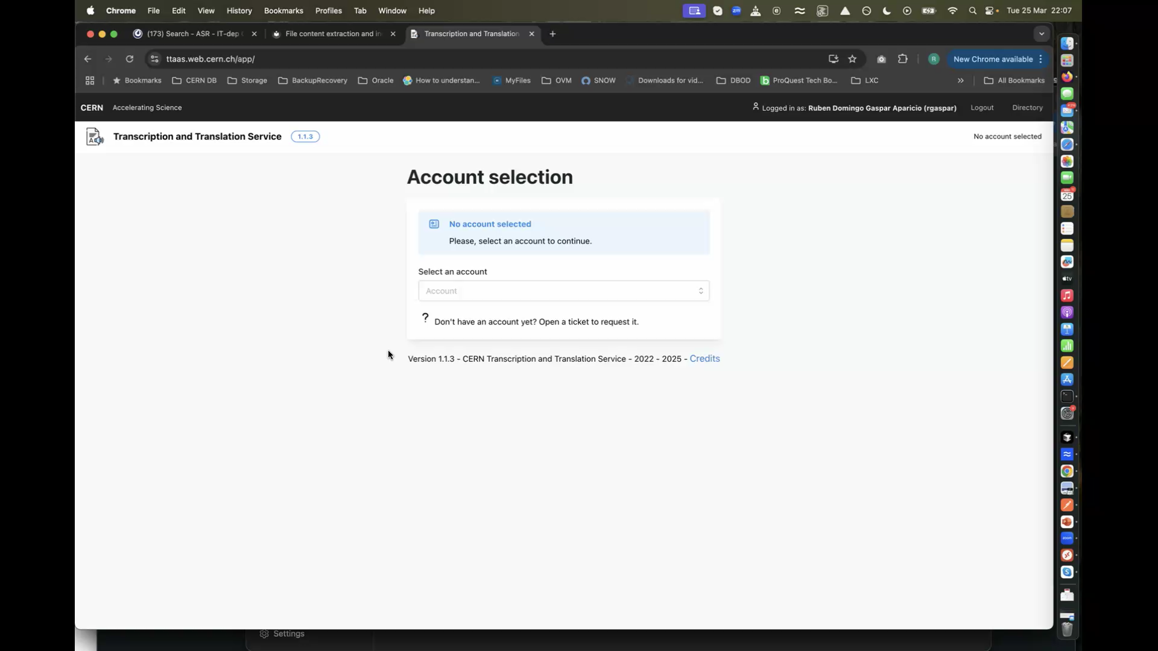
Demo: Searchability (video)
https://ttaas.web.cern.ch/app/search-weblectures

Slide 12
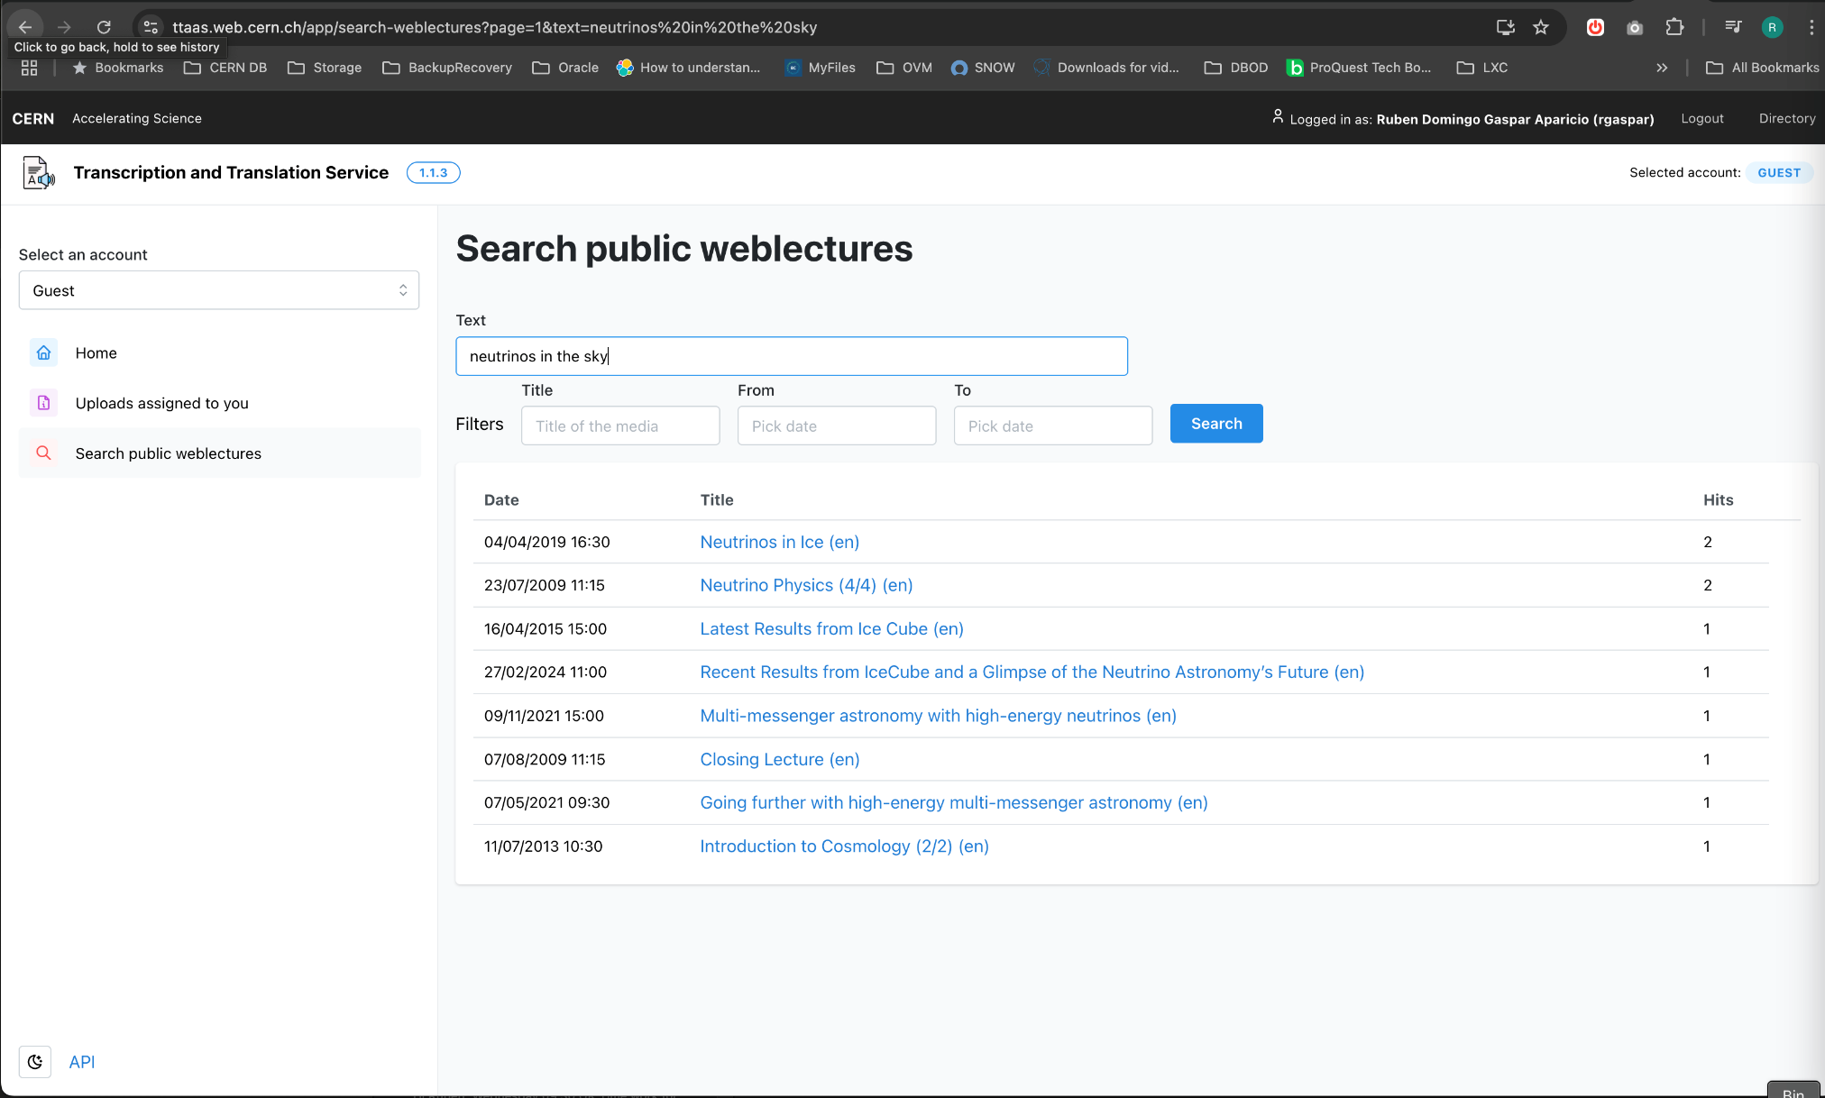
Demo: Searchability
https://ttaas.web.cern.ch/app/search-weblectures

Slide 13
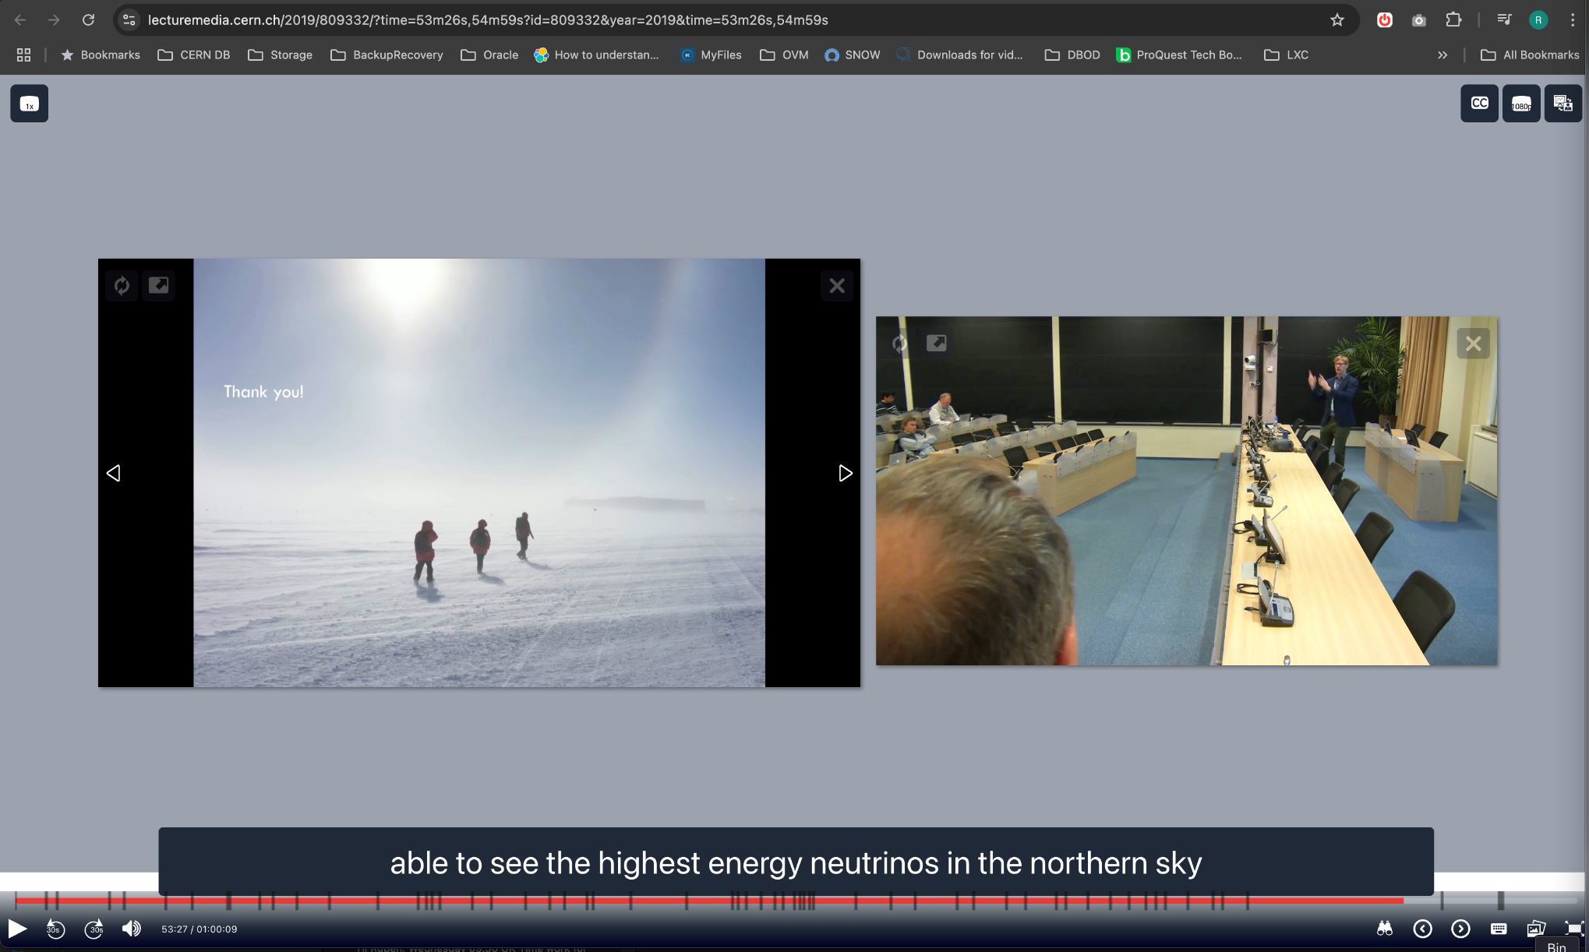
Demo: Searchability

Slide 14
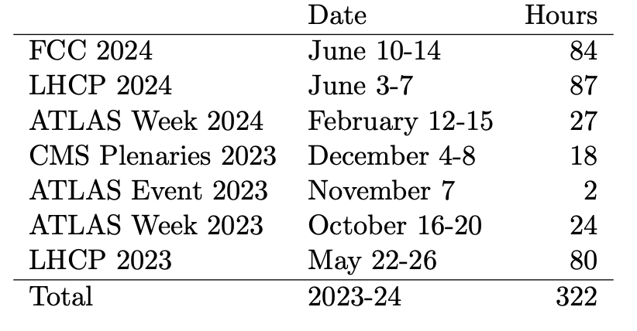
Service stats
Online use case
3
4
1
1
1
1
5
Total hours – offline use case:
29097 (en)
3880 (fr)
Parallel streams

Slide 15
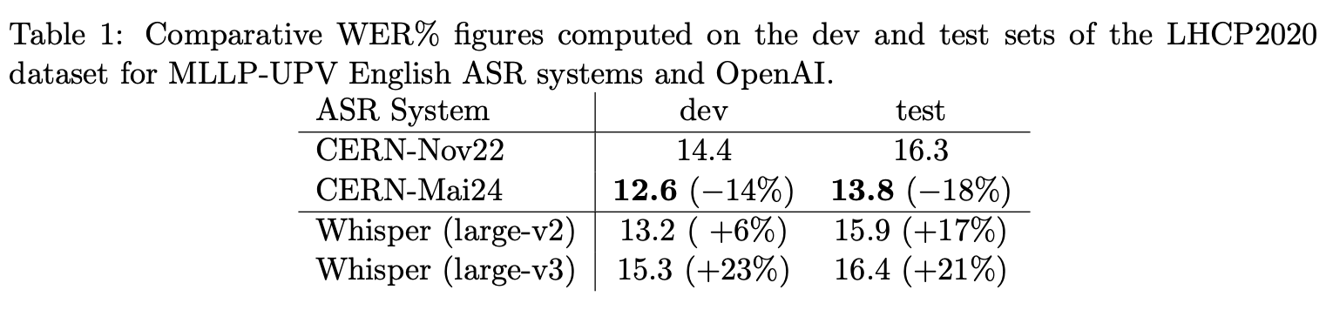
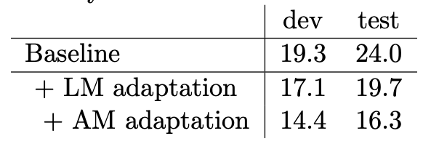
Quality measurements
Tender spec: WER (Word Error Ratio) < 20
Further info at: https://cernbox.cern.ch/s/7kFq62YNXkDwPCY
https://cernbox.cern.ch/s/uf2lBqhTug7MLn6

Slide 16
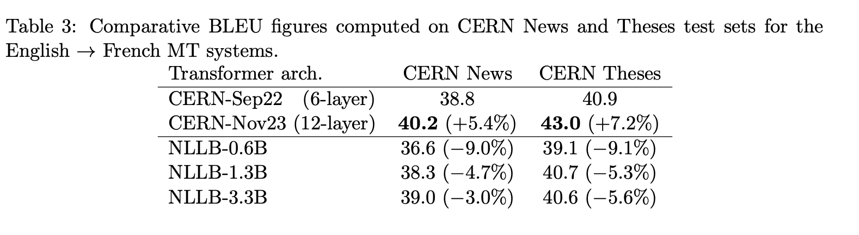
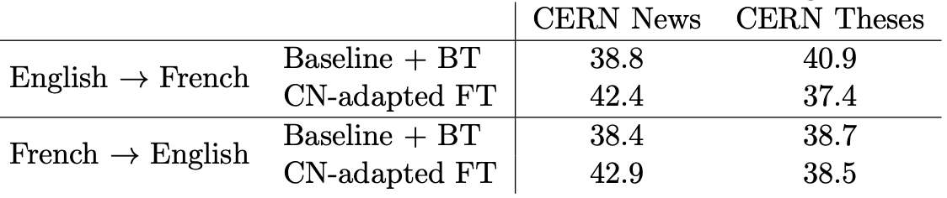
Quality measurements (II)
Tender spec: BLUE (Bilingual Evaluation understudy) > 40
Further info at: https://cernbox.cern.ch/s/7kFq62YNXkDwPCY
https://cernbox.cern.ch/s/uf2lBqhTug7MLn6

Slide 17
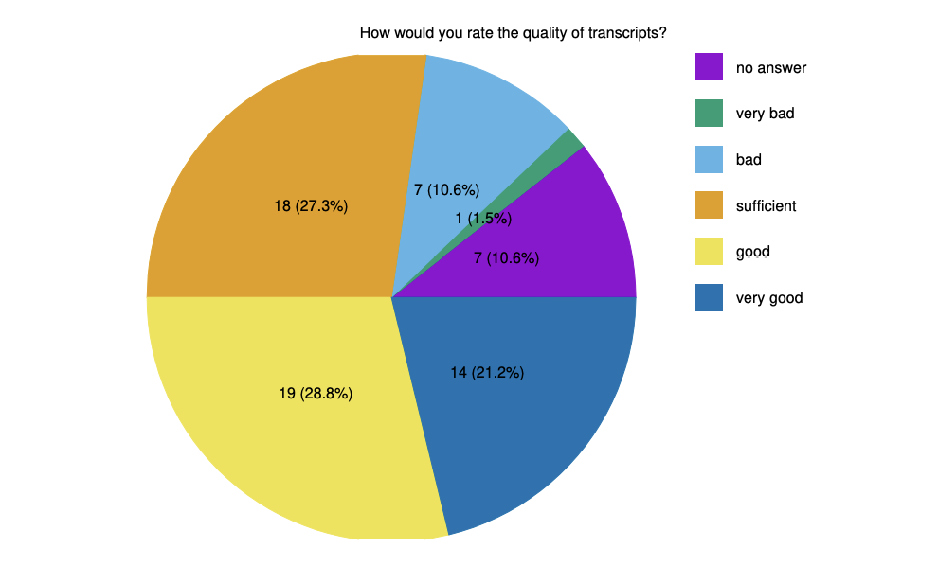
Quality measurements (III)
For live ASR we collected mostly positive feedback
Live ASR pilot ultimately discontinued due to concerns about scalability and future maintainability, following internal decision process.
  Research on commercial Live ASR solutions is being carried out.
Poll at LHCP 2023 Belgrade
Further info at: https://cernbox.cern.ch/s/PKxbgKiOr9tieIF

Slide 18
Autotraining
Only available for En ASR model. Process is fully automated.
Model is operational for offline and online workloads
SLT (static look-ahead table, 4-gram model) and transformer LM is fine-tuned with new words and expressions from deltas of new documents (taking last model as baseline)
  Acoustic model based on automatic transcripts will likely introduce noise, as transcript will contain errors
Two sources of new documents from a given PIT: CDS (9 categories) and CERN News
Perplexity is used to estimate if new model is valid
We generate a new model every ~9 months
Further information in MLLP delivery report.

Slide 19
Conclusions
Very intense and productive project, leading to TTaaS service
A lot of things learnt and experience acquired, on a domain that is evolving every day
Most AV media (~34k hours) has CC in En and Fr. Accessibility improvement is a fact.
  This is happening automatically for the user.
Human quality translation and transcripts for in-domain jargon (HEP) still a few years away.
  MLLP has published a HEP corpus, so other ASR research groups could use that HEP dataset on their ASR models
Research on commercial Live ASR systems as a potential providers for VIP events or CERN Webcast
Looking into how AI shall help also on searchability and accessibility of AV media

Slide 20
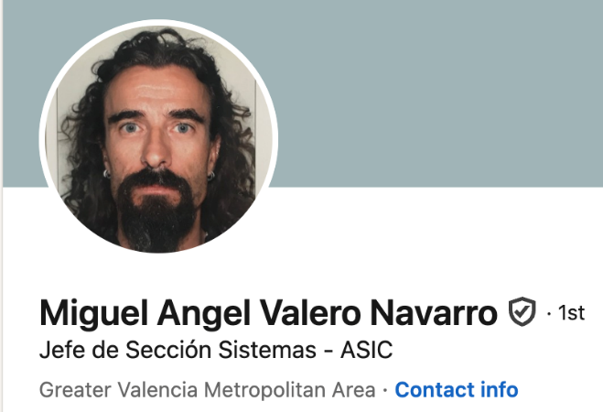
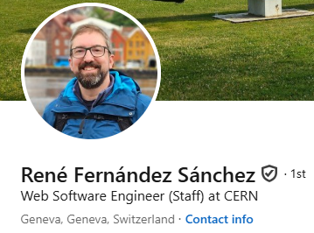
Last but not least!
Worked with us till March 2023
Main developer
IT colleagues from different groups specially those involved on Openshift, Openstack and Storage
Our supportive user community
Looking forward to hearing from anyone facing similar challenges!

Slide 21


Thank you!
Questions?

