Slide 1
WP3 tasks
Status update & planning

Slide 2
Summary and outcomes of the GAM
Summary available here: https://warehouse.inab.certh.gr/index.php/f/4527967. A non-exhaustive summary here for WP3:
On-going focused effort to converge on the Quality Dimensions ➔ To finish in the coming week(s)
Agreement: start with the ones from ISO, add sustainability, fairness and community support
It will shape the indicators and metadata framework. Please participate to discussions in TF2 and stay tuned for the outcome.
Technology Watch: discussion and feedback on the TechRadar and required curation/selection process
→ Define curation expert group to review and merge Github issues
→ Will define the selection criteria for the TechRadar and curation process
→ Connect to T3.1 bi-weekly meeting if you want to be part of the expert group and have say in the process
→ The design of the TechRadar dashboard will evolve as a function to selection criteria and metadata framework
Assessement metadata as part of the metadata framework
Output of quality pipelines = input of quality dashboard
Proposal by Faruk, got some early feedback for improvement. Need to test and try to get valuable feedback.
→ 4 tools identified to create a first quality pipeline spanning over several dimensions and indicators.

Slide 3
Objectives for WP3 in the coming months
2 major milestones and deliverables this summer:
Deliverable D3.2, month 18 - Catalog of RSQkit Tools for Assessing and Improving Software Quality and FAIRness
Milestone 9, month 18 - First version of a metadata framework for software quality indicators and of actionable pipelines based on community selected use-cases to assist software developers and maintainers assessing and improving software quality, metadata and FAIRness
Objective for these deliverables and beyond:
We have a clear vision for the TechRadar, Metadata Framework, Quality Pipelines and Dashboard in place and to propose to the outside world
After September 2025:
  we can start receiving feedback and improving on these existing deliverables and prepare for year 3 of EVERSE
  outsiders (and EVERSE members) can push new tools, services, indicators and pipelines to EVERSE

Slide 4
Tentative timeline
Counting for summer delays and required time to format the deliverables:
End of June:
(at least) one end-to-end quality pipeline using a few tools from the TechRadar and producing software quality indicators
the tools in the TechRadar are curated
a dashboard (not necessarily deployed online!) displays actual indicators from the pipeline
End of May:
a 2nd version of the schemas has been produced thanks to the feedback received
the selected tools produce a set of quality indicators in a common metadata format
the curation process for the TechRadar is in place in the RSQKit and tools are being curated
End of April:
each of the selected tools (1 person per tool working in parallel) produces one indicator in a common assessement metadata schema
each indicator is described following the metadata schema (→ feedback loop to improve the schemas)
a clear selection and curation process for the TechRadar has been decided

Slide 5
T3.1: Technology Watch
Task 3.1 (M01-M36): Technology watch for tools and services to assess, curate and improve scientific software, code, and workflows quality in the Science Clusters. This task aims to assess and document the existing tools and services used in the Science Clusters and elsewhere to improve software quality, metadata, and FAIRness, align them with best practices, and include them in the RSQkit paired with guidelines and best practices. Tools for security checks, licence infringements and green benchmarking are also considered.
A. Assess existing tools and services (e.g. from EOSC Synergy) usable by the science clusters to evaluate, curate, and improve software quality, metadata, and FAIRness, as well as for security checks, licence | Prepares a first list of tools and services Assesses the tools and services : partly done by understanding roles and usage of tools and services in science clusters MS8: workshop to evaluate tools and services against WP2 best practices Report and outcomes in prep
B. Document the identified tools and services, aligning them with the best practices and recommendations of the pilot communities, and provide guidance on their use within the software life cycle while following the three-tier research software model. | Provides metadata for tools and services aligned with WP2 and TF2 recommendations Curates and organises the list of tools and services using these metadata Matches tasks in the RSQKit to tools and services
C. Incorporate the catalogue of tools and services into the RSQkit along with guidelines and best practices to enhance the quality, metadata, and FAIRness of research software. | Provides mechanisms to keep the list up-to-date Handles new contributions by curating and aligning with the metadata schema

Slide 6
T3.2: Integrated pipelines
Task 3.2 (M07-M36): Consolidation of tools and services to ease their implementation and use in research communities. This task aims to develop integrated quality indicators and a common metadata framework for software quality, containerize tools and services, develop actionable pipelines to assess and improve software quality, and integrate software quality pipelines into widely used platforms for research software engineering and code archival.
A. Develop integrated quality indicators and a common metadata framework for software quality by leveraging and extending existing schemas (such as CodeMeta, Bioschemas Computational workflow/tools) to facilitate the assessment and management of software quality. | Workshop to understand the existing pipelines and indicators used in science clusters Matches tools/services to indicators (or vice-versa) Metadata framework for software quality
B. Containerize the tools, services, and pipelines to enable easy integration with EOSC and other services for improved software quality.
C. Create actionable automated pipelines using CI/CD to help assess and enhance software quality, curate and enrich metadata, and provide authors with recommendations for FAIR compliance. When possible, these pipelines provide badges and indication of code maturity within the software life cycle. | A first pipeline based on a few tools
D. Integrate the software quality pipelines with widely used platforms for research software engineering (such as GitHub, GitLab) and code archival (such as Zenodo) to improve the overall quality of research software.

Slide 7
T3.3: Dashboards
Task 3.3 (M12-M36): To provide the means to measure globally the software quality in the Science Clusters. This task aims to develop dashboards to collect integrated indicators of software quality and FAIRness in the Science Clusters, integrate them with existing platforms used in the communities, and add specific indicators when needed. Indicators defined at multiple levels reflecting the three tier software classification: basic developer guidelines (EURISE), maturity of Software (CESSDA SML), maturity of Services (EOSC TRLs), FAIRness (FAIR4RS, Software Observatory, ELIXIR SMP)
A. Develop dashboards to collect integrated indicators of software quality and FAIRness in the catalogues and repositories used by the Science Clusters, enabling community members to monitor the performance of their software. | Draft of dashboard architecture Dashboard prototype using mock data Dashboard using real indicators from pipeline
B. Integrate the dashboards with existing platforms used in the Science Clusters, leveraging APIs RO-Crate FDO (EOSC-Life) and other available means, and surface the quality metadata in community-specific platforms using the metadata framework defined in task 3.2.
C. Integrate specific indicators from the Science Clusters in their respective dashboards, when required, to ensure that the performance of software can be tracked effectively.

Slide 8
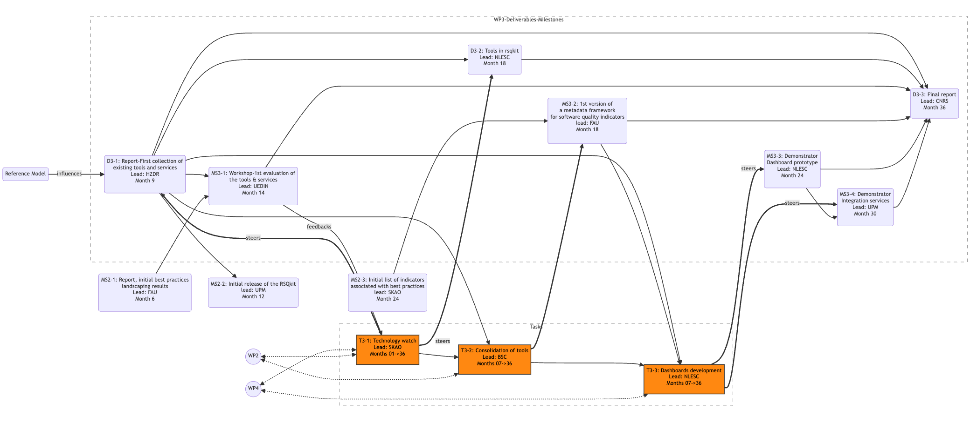
Connections between tasks and deliverables

