Slide 1

An Introduction to Medical Imaging Devices
Martin L. Purschke

Slide 2

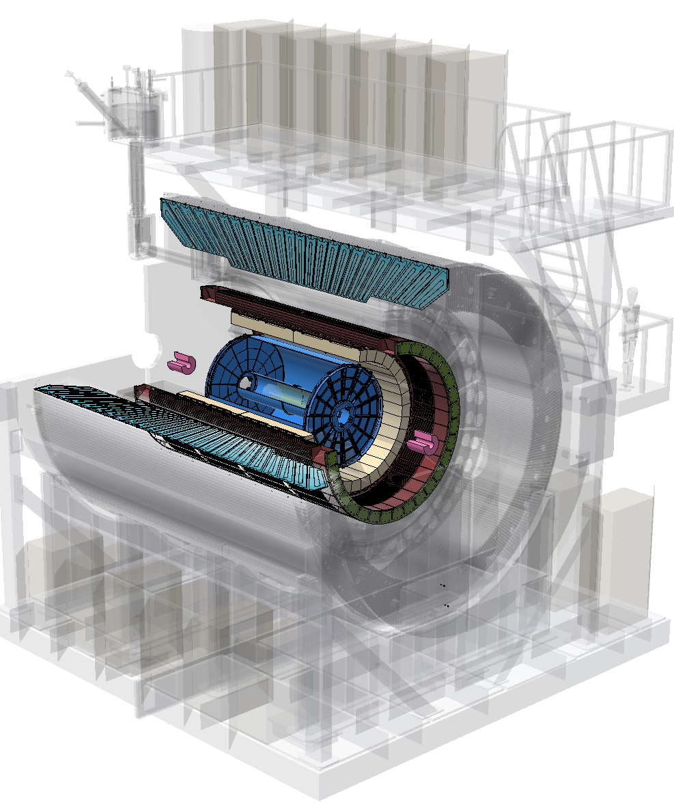
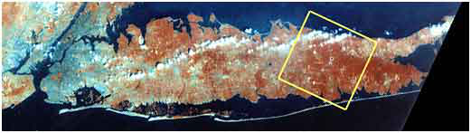
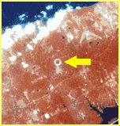
Who am I? A nuclear physicist working on the sPHENIX experiment at BNL’s Relativistic Heavy Ion Collider (RHIC)
Manhattan
Long Island, NY
RHIC from space

Slide 3
Wait, what?
So this guy is a collider phycisist?
What qualifies me to talk about Medical Imaging?

Slide 4
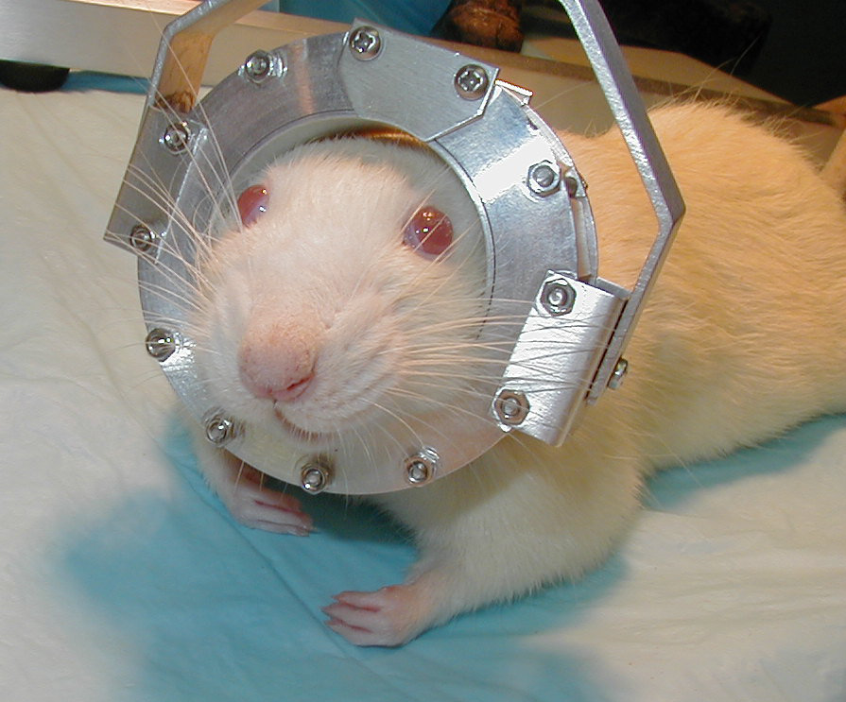
Medical Imaging
Medical Imaging has a lot in common with nuclear physics (and accelerator/beam physics)
Yes, there is the part where an actual M.D. comes in and wants to see something in particular, but up to that point, it’s physics and engineering
Radiotracers, nuclei, detector technology, readout, analysis, …. All the natural habitats of physicists and engineers.
As a matter of fact, the by far most common diagnostics method using Te⁹⁹ was developed at Brookhaven National Lab – you have accelerators, nuclear physicists, and the infrastructure
But also, I was deeply involved what I think is until today the coolest
application of PET (Positron Emission Tomography) – the RatCAP
For the first time, the RatCAP allowed the imaging of the brain of an awake rat
I’ll talk about this later some more, but this is my foray into Medical Imaging, and why I know all this stuff.

Slide 5
Medical Imaging Technologies
Without any claim to completeness (and some of what I’ll cover)
SPECT (a little)
PET
MRI
X-Ray
CT
Multi-modality imaging
(there are many more, often variants of a common theme)
You will see that nuclear physics, DAQs, and data processing plays a prominent role.
There is a place for you in this field if you can do TDAQ, or are a “data engineer”

Slide 6
Medical Imaging Technologies grouped by other metrics
Not using ionizing radiation
MRI
Using ionizing radiation
X-Rays
CT
SPECT
PET
It’s ironic that the only technology here NOT using ionizing radiation, formerly known as Nuclear Magnetic Resonance Imaging (NMR), had to be renamed because people were freaking out over the word “nuclear” in the name

Slide 7
What does one want, and how does one choose a technology?
Sensitivity - How well can you actually see what you are after?
Selectivity - How well does your method distinguish between, say, benign and malicious tissue?
Contrast - What is the dynamic range between the different features in your image?
For example, if you want to see if a bone is broken, X-rays (and by extension, CT) gives you a high value on all three – the contrast between bone and tissue is large
X-ray for a mammogram has a low value on all three

Slide 8
Each modality has strengths and weaknesses
For example, MRI has excellent position resolution but is “blind” to metabolic processes
PET can show the metabolism but the position resolution is poor
Think of different modalities as looking at the same thing in different ways
MRI by and large images the density of protons (think water in tissue)
X-ray and CT image the electron density in tissue (that’s why bones show up so nicely)
SPECT and PET can be tailored to show metabolic processes in tissue

Slide 9
Why PET is so cool
PET can be tailored to show metabolic processes in tissue
Remember, the chemical properties of a radioactive isotope are the same as the stable isotope – it will be used by the body indiscriminately
So you take a molecule that is used in your body for some process – sugar, dopamine, what have you, swap out an atom for a radioactive one
You get “hot spots” where lots of said molecules are used by the body
For example, a tumor that grows uses a lot of energy (sugar), so radioactively tagged sugar will accumulate a lot of activity there
Or tag molecules that the brain burns when it “thinks” – active areas show up as hot spots
Frequently used radiotracers are ¹¹C and ¹⁸F (all beta+ = positrons)

Slide 10
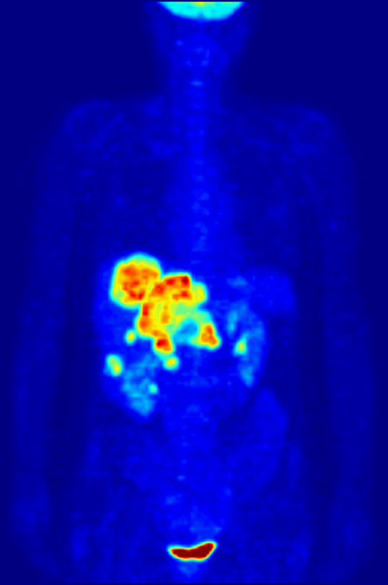
An Example - ¹⁸F
¹⁸F-FDG - Fludeoxyglucose is one of the commonly used radiotracers
It is a sugar, so it accumulates where the body burns a lot of energy (“uptake”)
Unusual “hot spots” can point to cancer
Whole-body PET scan using 18F-FDG to show liver metastases of a colorectal tumor

Slide 11
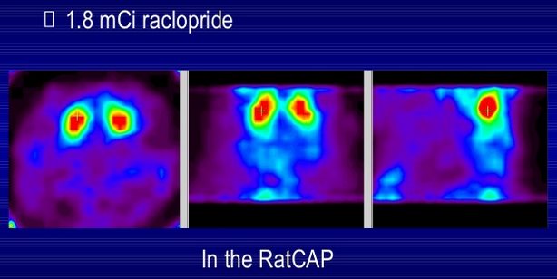
¹¹C Raclopride – Brain activity
Raclopride is a molecule that binds to dopamine receptors in the brain
Can show which part of the brain does what
Different activities stimulate different areas in the brain (singing, reading, listening, etc)
Image of a rat brain taken with the RatCAP using ¹¹C-tagged raclopride
(I actually took those data!)

Slide 12
SPECT (Single Photon Emission Computed Tomography)
Ring of Photon
Detectors
Radionuclide decays, emitting γ rays.
Gamma lies on line defined by detector and collimator (known as a line of response or a LOR).
Single Photons are detected
Low efficiency (next slide)
Can cherry-pick the photon-emitting isotope ( ¹²⁵I, ⁶⁰Co) (not that much of a menu though)
I have never worked with SPECT, but I see most groups abandoning this
Some Alzheimer’s-related research still shows up

Slide 13
SPECT - collimation and low efficiency
Without a collimator, there’s no sense of “direction” of the photon – the photon could come from anywhere in the field of view
Only the Collimator selects a direction
Dramatic reduction in efficiency – most photons are lost in the collimator

Slide 14
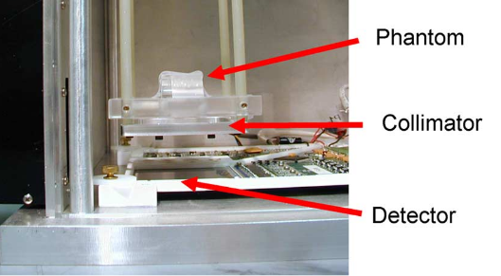
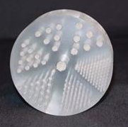
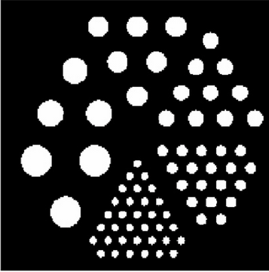
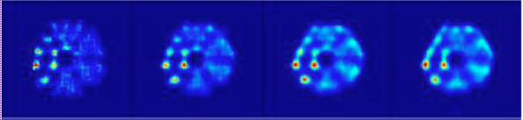
SPECT Image Examples
Example of a phantom – the holes are filled with radiotracers (similar to what was used in these images)
sense
3rd-largest bores can no longer be resolved
S. Shokouhi, Vanderbilt U
Different collimator configurations

Slide 15
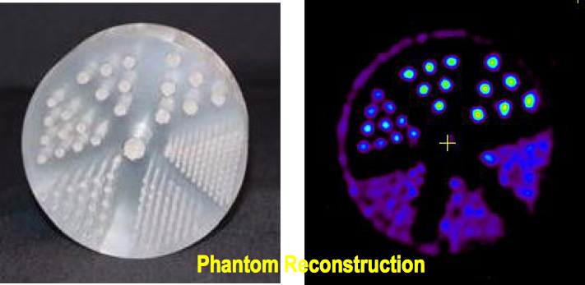
PET – Positron Emission Tomography
Ring of Photon
Detectors
Radionuclide decays, emitting β^{+.}
β⁺ annihilates with e– from tissue, forming back-to-back 511 keV photon pair.
511 keV photon pairs detected via time coincidence.
Positron lies on line defined by detector pair (known as a line of response or a LOR).
Back-to-back 511KeV photons are detected
No collimator needed
LOR defines the direction
Best I can tell, all the action today is in PET,
not SPECT

Slide 16
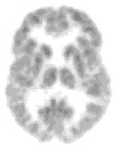
The PET principle
PET measures coincident photons from an electron-positron annihilation
Each such coincidence establishes one “Line Of Response” (LOR)
It is mostly intuitive for folks working with accelerators
Commercial scanners often have sophisticated electronics or firmware for coincidence processing
Or you record all photon counts with detector element info and a time stamp (“list mode”)
When two photons are measured “simultaneously” within a certain time window, you consider them a coincident pair
You can either record all the data and do the analysis offline, or the PET scanner has that ability built in and reports only the coincidences (commercial scanners usually do)
511 KeV
511 keV
e⁺
e⁻
511 keV
511 KeV

Slide 17
Offline Coincidence Processing
Coincidence window
✔
✔
✔
✕
✔
✕
✕
✕
✔
✔
time
You cannot know which ones are true and which ones are random coincidences
But you can get an estimate of the random rate and their contribution by adding a delay to the window and destroying all true coincidences
time
When all is done, the output from the coincidence processing is a sinogram
There are more corrections, such as scatter corrections, attenuation, etc…

Slide 18
Photon Detection
511KeV is a tiny amount of energy when it comes to detection
High-Energy physics tends to ignore anything below a few 100 MeV
The resolution of a detector is primarily determined by the “count” of what you measure – the famous sqrt(N) error formula
511 KeV produce between 2000 and 20000 photons, the latter in the workhorse scintillator, NaI
NaI falls flat in basically every other metric – much too slow, it’s very hygroscopic, not very dense
Many new scintillators on the market, some are fantastically expensive – sometimes hundreds of dollars per cubic millimeter
Readout through PMTs, APDs, SiPMs…
We are looking for fast signals so the coincidence detection works.
For that a few hundred picoseconds timing resolution is enough
Keep that number in mind for later…

Slide 19
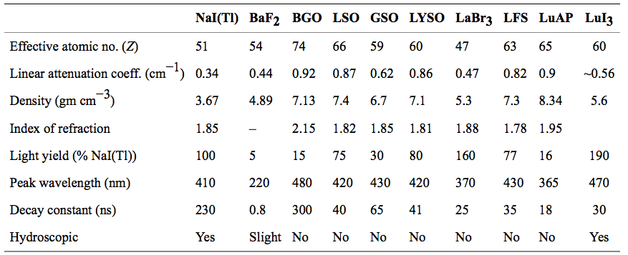
A selection of scintillators

Slide 20
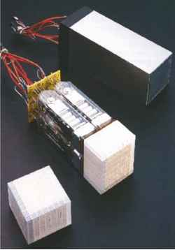
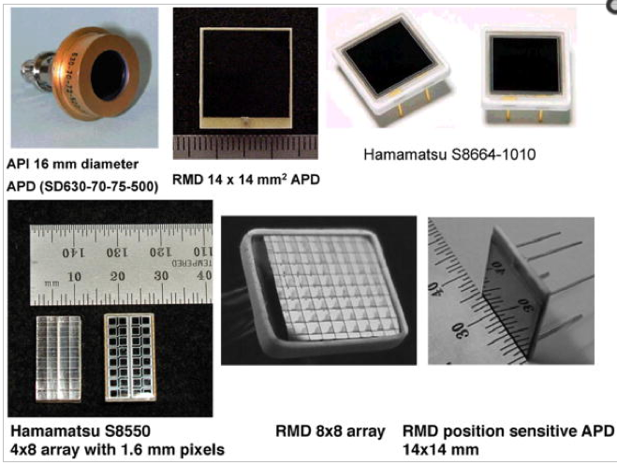
Readout
Photomultipliers
Avalanche Photon Detectors
Heat Dissipation – needs cooling
Bulky
Needs High Voltage (~ 2KV)
Useless in a magnetic field
Excellent linearity and noise
Small footprint
Works in a magnetic field
Modest supply voltage ( ~400V)
Significant noise

Slide 21
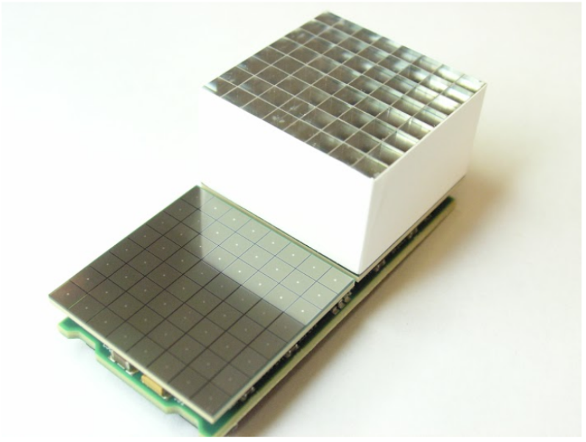
SIPMS
Silicon Photomultipliers are slowly taking over
Lower operating voltage (~ 70V)
Faster
Cheaper
Silicon base can allow for additional electronics features

Slide 22
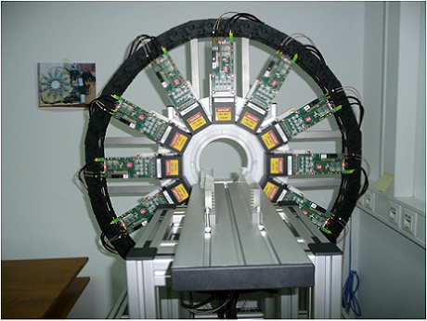
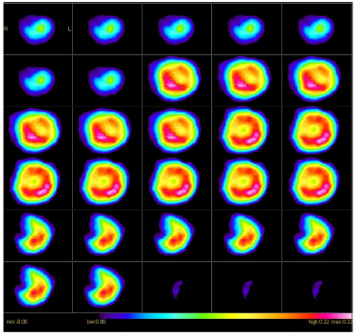
A Real-Life Pet scanner – MiniPET (KTH, Sweden)
206mm opening
Hamamatsu H9500 Position-sensitive PMT
LYSO Crystals 1.27 x 1.27 x 12 mm³
32 x 32 crystals per module, 12 modules
FPGA-based data processing
readout through Ethernet
Image of a rat heart

Slide 23
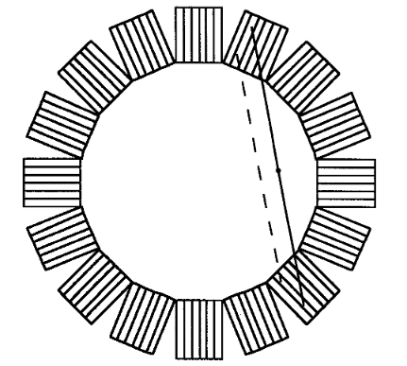
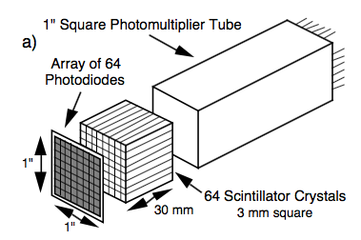
Depth of Interaction – DOI measurement
The Parallax Problem
DOI can resolve the LORs better
Usually requires some dual-ended readout for light-sharing
More complex readout
These LORs will
give the same signal
The parallax effect limits the position resolution
Problem in particular in smaller scanners
Miyaoka, R.S.; Lewellen, T.K. Nuclear Science Symposium, 1997. IEEE , vol.2, no., pp.939-943 vol.2, 9-15 Nov 1997

Slide 24

Image Reconstruction - Sinogram
We are “looking” at the object from many angles instead of just one
This is what you do inadvertently with your eyes to see sharper
0 degrees

Slide 25
Image Reconstruction - Sinogram
0 degrees
22.5 degrees

Slide 26
Image Reconstruction - Sinogram
0 degrees
22.5 degrees
45.0 degrees

Slide 27
Image Reconstruction - Sinogram
0 degrees
22.5 degrees
45.0 degrees
67.5 degrees

Slide 28
Image Reconstruction - Sinogram
0 degrees
22.5 degrees
45.0 degrees
67.5 degrees
90.0 degrees

Slide 29
Image Reconstruction - Sinogram
0 degrees
22.5 degrees
45.0 degrees
67.5 degrees
90.0 degrees
112.5 degrees

Slide 30
Image Reconstruction - Sinogram
0 degrees
22.5 degrees
45.0 degrees
67.5 degrees
90.0 degrees
112.5 degrees
135.0 degrees

Slide 31
Image Reconstruction - Sinogram
0 degrees
22.5 degrees
45.0 degrees
67.5 degrees
90.0 degrees
112.5 degrees
135.0 degrees
157.5 degrees

Slide 32

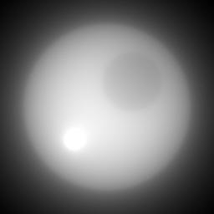

Image Reconstruction – Sinogram and reconstruction
It’s called a sinogram because any feature traces a sine wave
Filtered back projection
Back projection

Slide 33
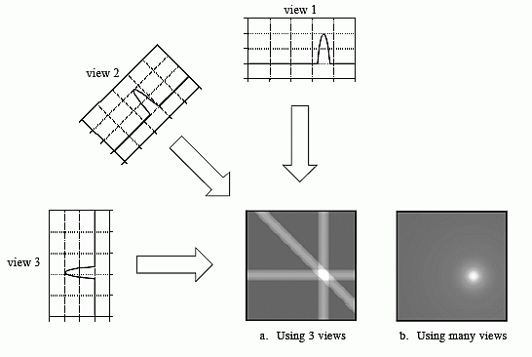
Image Reconstruction: Back Projection
Remember each projection only gives you a line
You fill the different projections in a histogram (each line)
Sources in the same spot in different projections accumulate

Slide 34
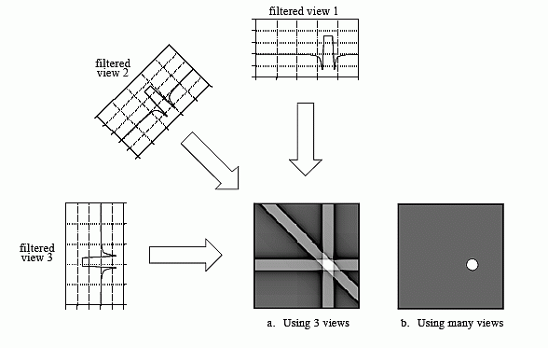
Image Reconstruction: Filtered Back Projection
A naïve back projection adds a lot of noise and artifacts to the image
The BP is the equivalent of a Fourier transformation
The filter clips “harmonics” that are beyond the Nyquist resolution and reduces noise
There a lot of different filters in use
A lot of papers written about that
You can get your PhD for finding a better one…
I’ll get to another (and for folks like us, more interesting, I think) image reconstruction method in a minute… but first:

Slide 35
The RatCAP and Derivatives
One wants to use PET to study the neurophysiological activity and behavior in laboratory animals
Understand and treat illnesses in humans.
However, animals needed to be anesthetized during PET imaging.
Anesthesia can greatly depress the very brain functions and affect the neurochemistry that one is trying to study
Cannot study animal behavior while under anesthesia
The “Holy Grail” – study brain processes in the awake animal using PET

Slide 36
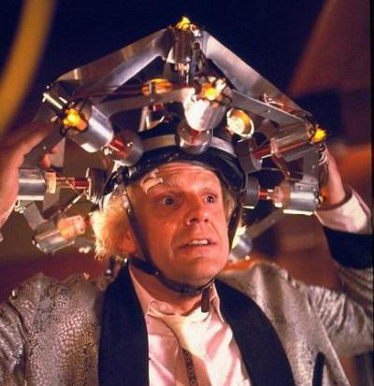
The Quest
To convert something like this…
… into something like this…

Slide 37
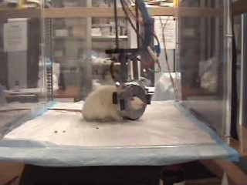
RatCAP: Rat Conscious Animal PET
A miniature, complete full-ring tomograph mounted to the head of an awake rat.
Compact, light weight (< 200 g), low power detector
Small field of view (38 mm dia. x 18 mm axial)
Attached to the head of the rat and supported by a tether which allows reasonable freedom of movement for the animal

Slide 38
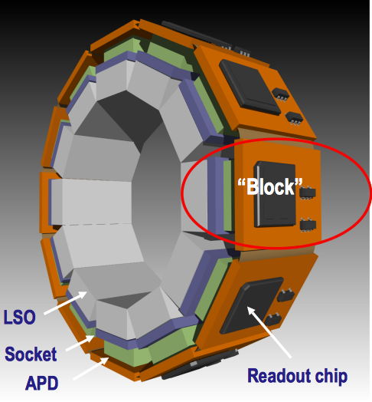
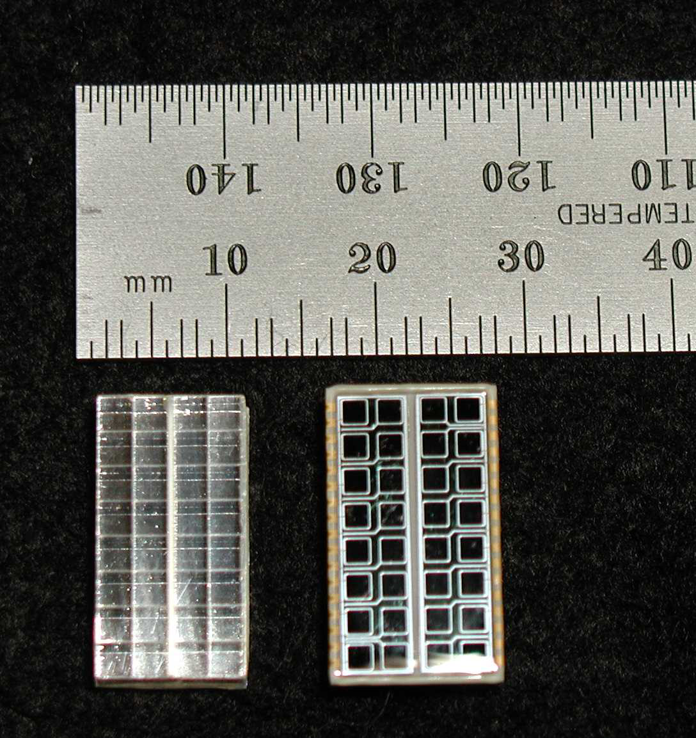
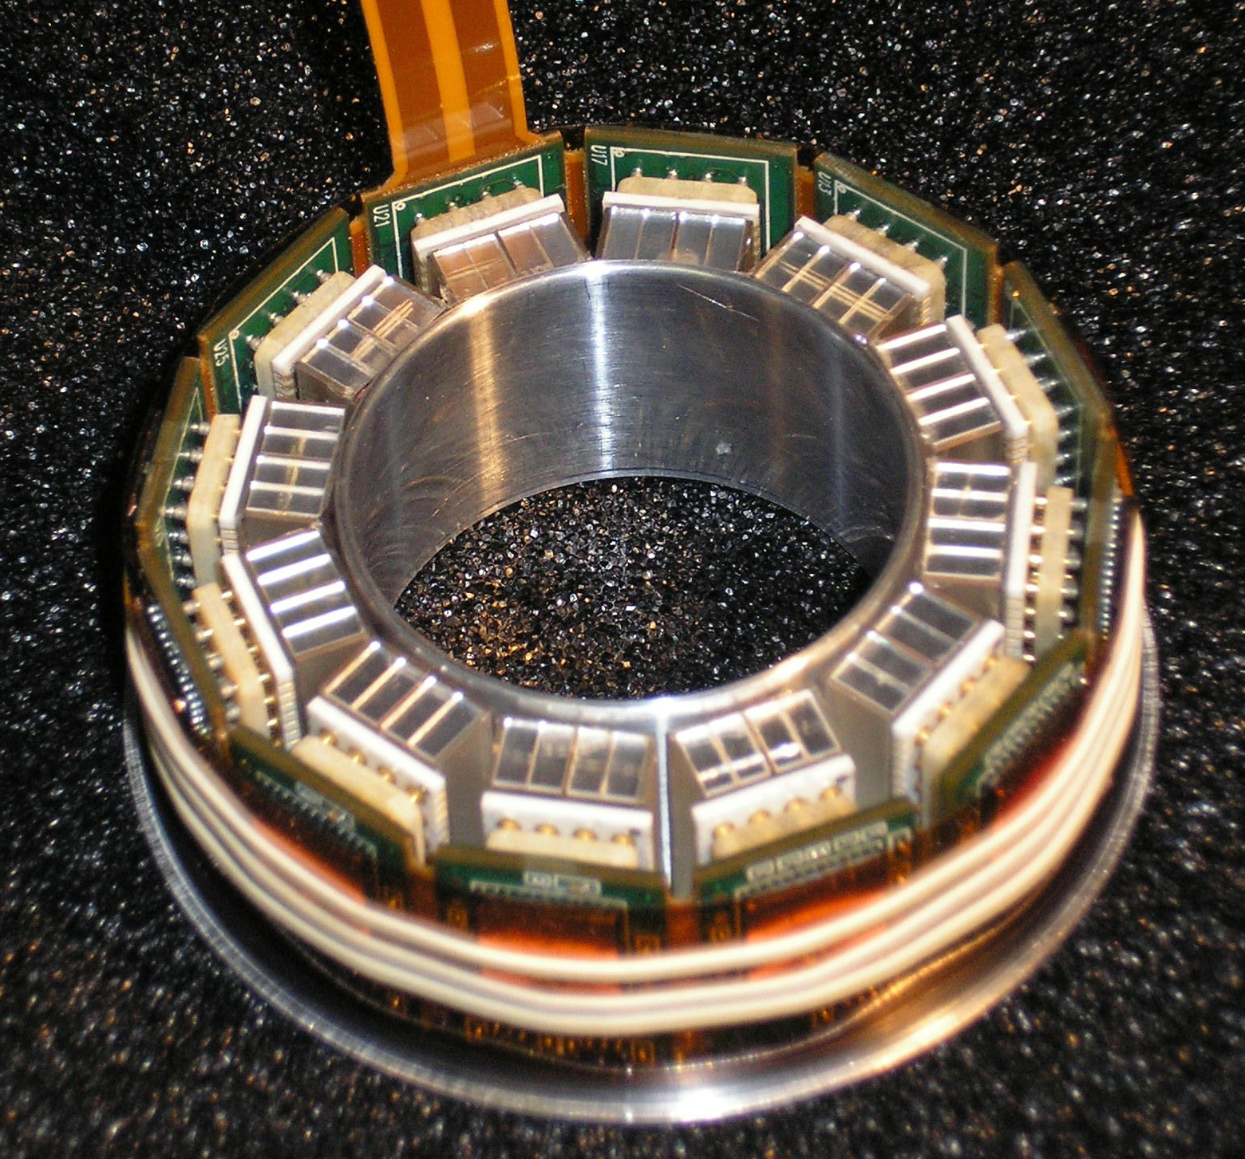
RatCAP: Rat Conscious Animal PET
Ring containing 12 block detectors of 32 2x2 mm² x 5 mm deep LSO crystals with APDs and integrated readout electronics
4x8 array of
LSO crystals
(2x2x5 mm³)
APD
(Hamamastu
S8550)
Actual RatCAP Ring
All the magic lies in the RatCAP ASIC, which takes care of all the signal processing. Reports channel # with timestamp

Slide 39
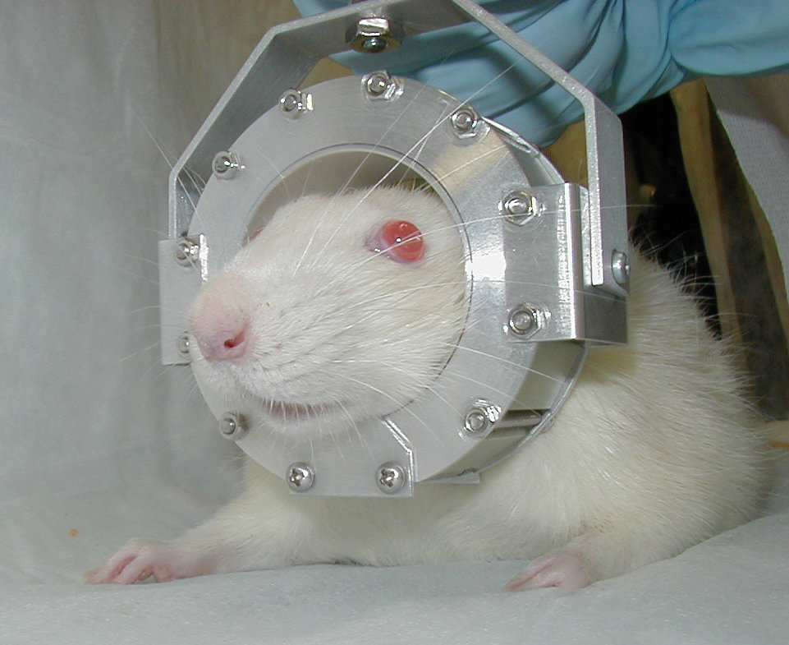
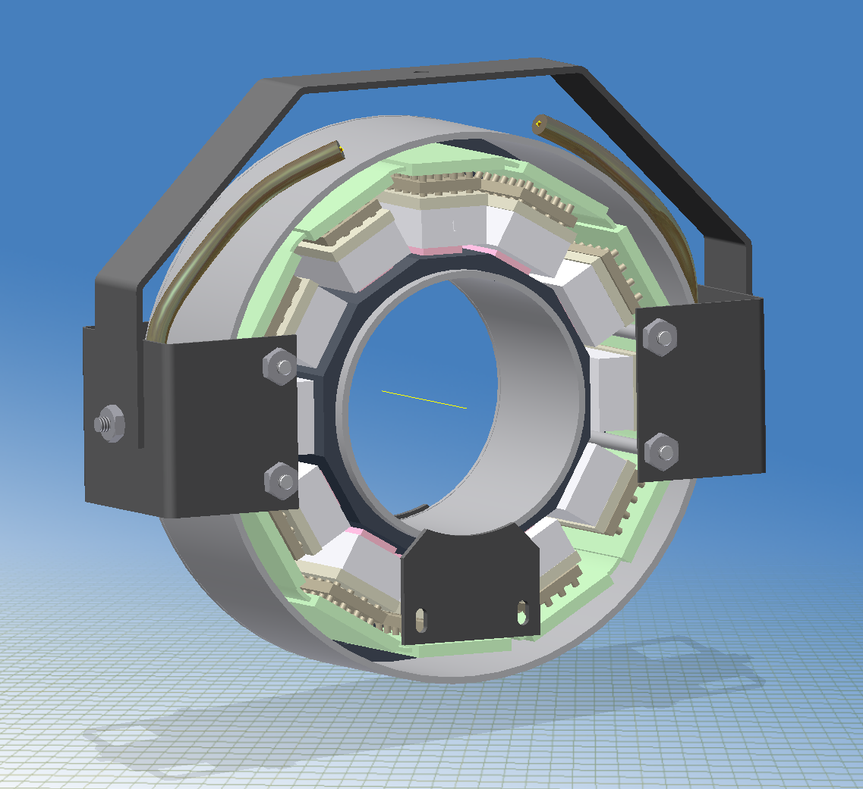
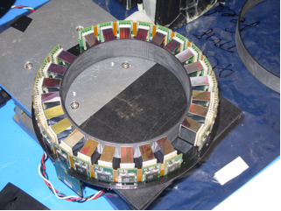
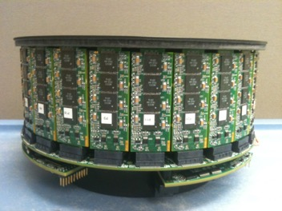
RatCAP Derivatives
Once you have a working ASIC, you try to re-use it for all kinds of other cool things…
This “MRI compatible” was a major piece of work – no ferromagnetic material anywhere
Original RatCAP V1
RatCAP V2
MRI compatible
Breast Scanner
Prototype
Breast Scanner
UPenn Scanner

Slide 40

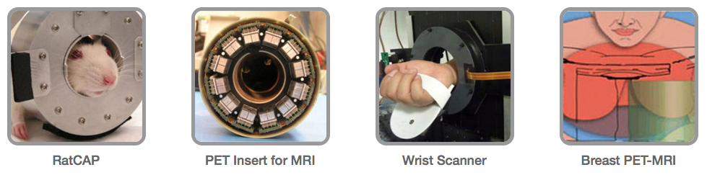
The Technology went commercial
BNL licensed the technology to an upstart company

Slide 41
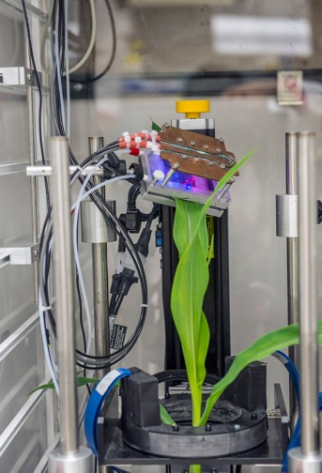
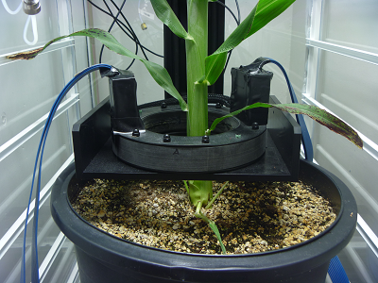
Other opportunistic applications – Plant Scanner
Here, the plant is fed 11C-labled CO₂ with a cuvette
The large opening is needed mostly to allow the plant to fit into the scanner.
Most of the FOV is just empty
This supports research for better biofuels
You can track where the produced sugar is going in the plant

Slide 42
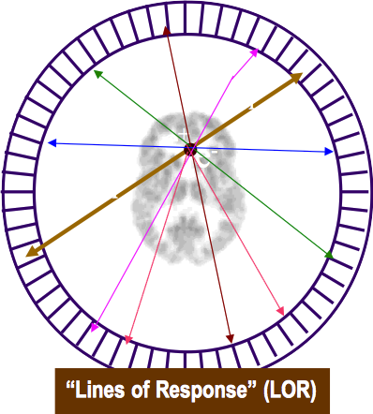
Alternate Iterative MLEM-based Image Reconstruction
“Maximum Likelihood Expectation Maximization”
One divides the Field of View (the active area of the scanner) in small “voxels”. Ours are 1mm³ cubes
The System Matrix A describes the probabilities that the decay at a given voxel position results in the photons ending up in a given pair of detector elements (“LOR”)
Number of LORs go ο(N²) for N detector elements
FOV size = number of voxels goes ο(N^{3/2})
Matrix has dimensions number voxels x number of LORs
Each matrix is specific for a particular geometry
This is what you measure
This is what you want
So all it takes is to invert the matrix, and we are set
So: Activity Distribution x A = Detector Response
Great! Activity Distribution = A ⁻¹ x Detector Response
Not so fast!

Slide 43
The System Matrix is HUGE
 | Ratcap | BS proto | UPenn/BS
Voxels | 15113 | 194427 | 1328360
LORs | 72192 | 342784 | 22444800
Matrix elements | 109 mill | 66646 mill | 29814774 mill
No way to invert such huge matrices
So we resort to an iterative process that “sculpts” an activity distribution until it matches the measured detector response
This method beats Filtered Back-Projection hands-down
But it is really computing intensive – we cannot yet do this for the full Breast Scanner

Slide 44
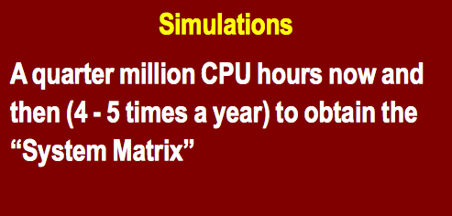
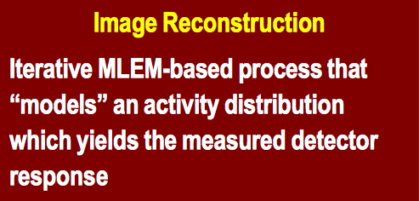
Computing Challenges
As small as the detectors look, they produce a lot of data
The largest UPenn / Breast Scanner can produce 450MB/s ( 1.5 TB/hour )
The computing challenge is two-fold:

Slide 45
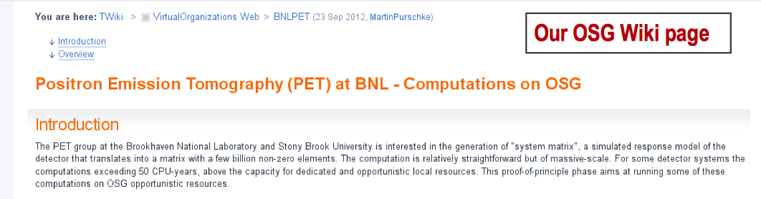
Computing Challenges
The ~250,000 CPU hours for a system matrix is actually the smaller problem
The simulation of any voxel is independent of all others
You can distribute the workload as much as you like over as many CPUs as you like
We have been using an online cluster (of my day-job at the PHENIX experiment at the Relativistic Heavy Ion Collider) opportunistically
We have joined the Open Science Grid (OSG) to disentangle us from the seasonal availability of our local cluster
We can get about 1000 CPUs / day and can get a new matrix in about 2 weeks
We do this only a few times a year

Slide 46
Reconstruction Times
The iterative, “activity-sculpting” process yields a usable image after about 100, a good one after 500...1000 iterations. Each iteration involves 2 matrix multiplications
At one point, in 2004 or so, the small RatCAP reconstruction was perceived to be a big problem
No more, we really have that optimized, 10-15 minutes per image.
Caveat: it's not just one image. We do dynamic images, time-sliced, 2-15 minutes depending on the experiment. They get correlated with external events. Like a movie of the activity distribution.
The plant scanner takes about 6-8 hours per image on a multi-core CPU. Multiple machines can work in parallel on independent images
The Breast Scanner? We don't know, we cannot presently do it “our way”. Estimated 400 hours, but we didn't bother to make a system matrix yet
If you think of clinical mammography applications, the patient expects to walk out of the facility with a preliminary result
No way this can be done – results come weeks later

Slide 47
Switching gears…
I have been going on about MRI-compatible scanners now for a while…
Let’s talk about MRI for a few minutes.

Slide 48
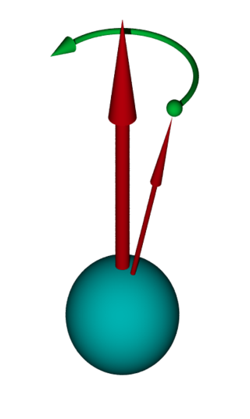
MRI in 5 minutes ☺
Protons have a magnetic moment “built in” [ not only protons, btw ]
Normally, that momentum vector can point whatever which way
Apply a magnetic field, and those momenta align their directions along the field
If you “push” them out of alignment, the a-momentum vectors start to precess
They precess with a characteristic Larmor frequency ω= g x B₀
g is the gyromagnetic ratio, 42.58MHz/T for a proton
By setting the right field strength, you can dial in a particular Larmor frequency
For example, with 1.5T, you get 65.16 MHz

Slide 49
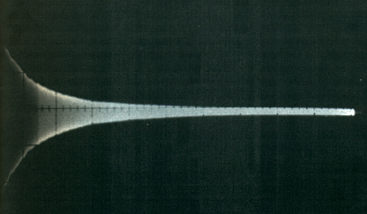
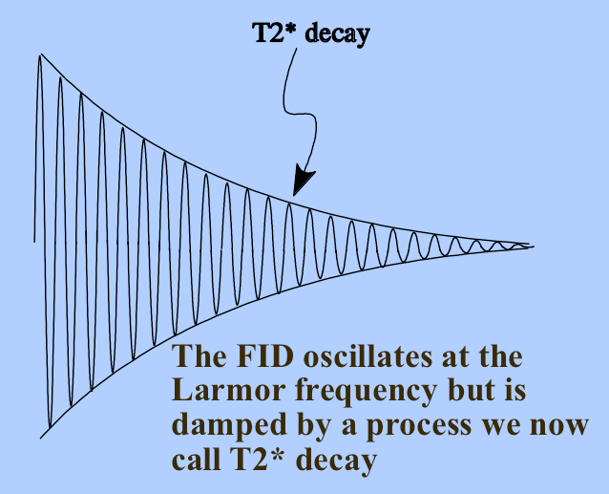
MRI in 5 minutes ☺
If you apply a radio wave with the exact Larmor frequency, you “tip” the momentum vectors in a coherent way
As they relax, they emit RF at the same frequency
If there are many protons -> strong signal; not so many –> no or weak signal
you can use this to measure the proton density

Slide 50
MRI is hard
Why didn’t I think of that, and get the Nobel Price! Well…
First of all, if you have a totally homogeneous field, all protons have the same Larmor frequency – not very useful
On top of your homogenous field, you apply a small gradient so the frequency becomes position-dependent – now we are getting somewhere
You could send a number of pulses which “scan” the frequency range and measure the response – was done in the early days, way too slow, but it would work
Rather, one sends a pulse with a narrow “white” frequency band, and measures the response for each frequency at the same time
One shot gives you the proton density along the field gradient (one axis of a picture)

Slide 51
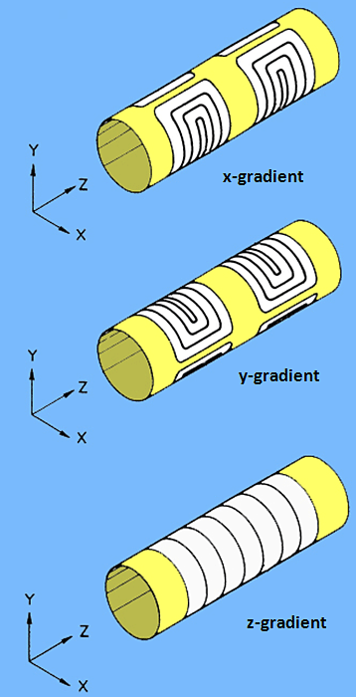
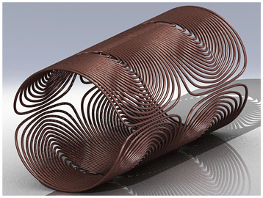
Making Gradients
3 sets of coils let you make any gradient direction you want – loops for z, and “saddles” for x and y
Modern scanners use “fingerprint” designs with high efficiency
Remember, that’s on top of a static high-strength field

Slide 52
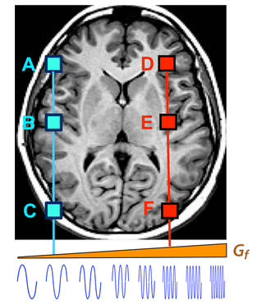
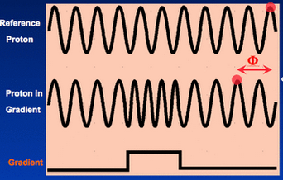
But Wait! We are missing one dimension!
Gradient
The points {A,B,C} and {D,E,F} radiate at different frequencies according to the field strength
However, A,B and C are indistinguishable! (and D,E,F, too)
Throw in a phase-encoding gradient:
By momentarily “speeding up the clock” for a region, you gain a phase shift for protons there
And you can assign a particular phase shift to a region

Slide 53
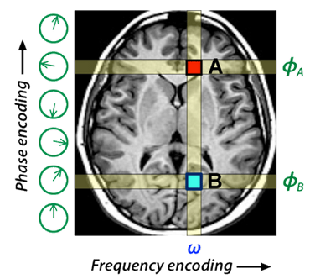
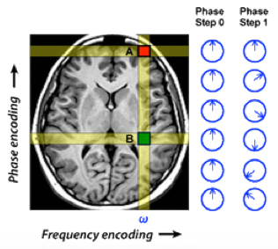
Phase and Frequency Encoding
Now you can get x by frequency and y by phase.
N pixels in y form an equation system with N variables (so a 100x200 image takes 200 measurements)
You need N measurements with different phase encodings to solve this
Remember: by the time you measure, A and B have the same frequency again (only a phase difference)
2 pixels A and B take two “shots” S₀ and S₁
S₀ = A sin ( ωt ) + B sin ( ωt ) = (A + B) sin ( ωt )
S₁ = A sin ( ωt ) - B sin ( ωt ) = (A - B) sin ( ωt )
A = ½ ( S₀ + S₁)
B = ½ ( S₀ – S₁)
This is easy only for a 180⁰ phase shift

Slide 54
Back to the MRI-compatible PET scanners
The trend in modern medical imaging goes to multi-modal imaging
Combine two different modalities to combine their strengths
PET-MRI – MRI gives you sub-millimeter resolution, PET gives you the metabolic information

Slide 55
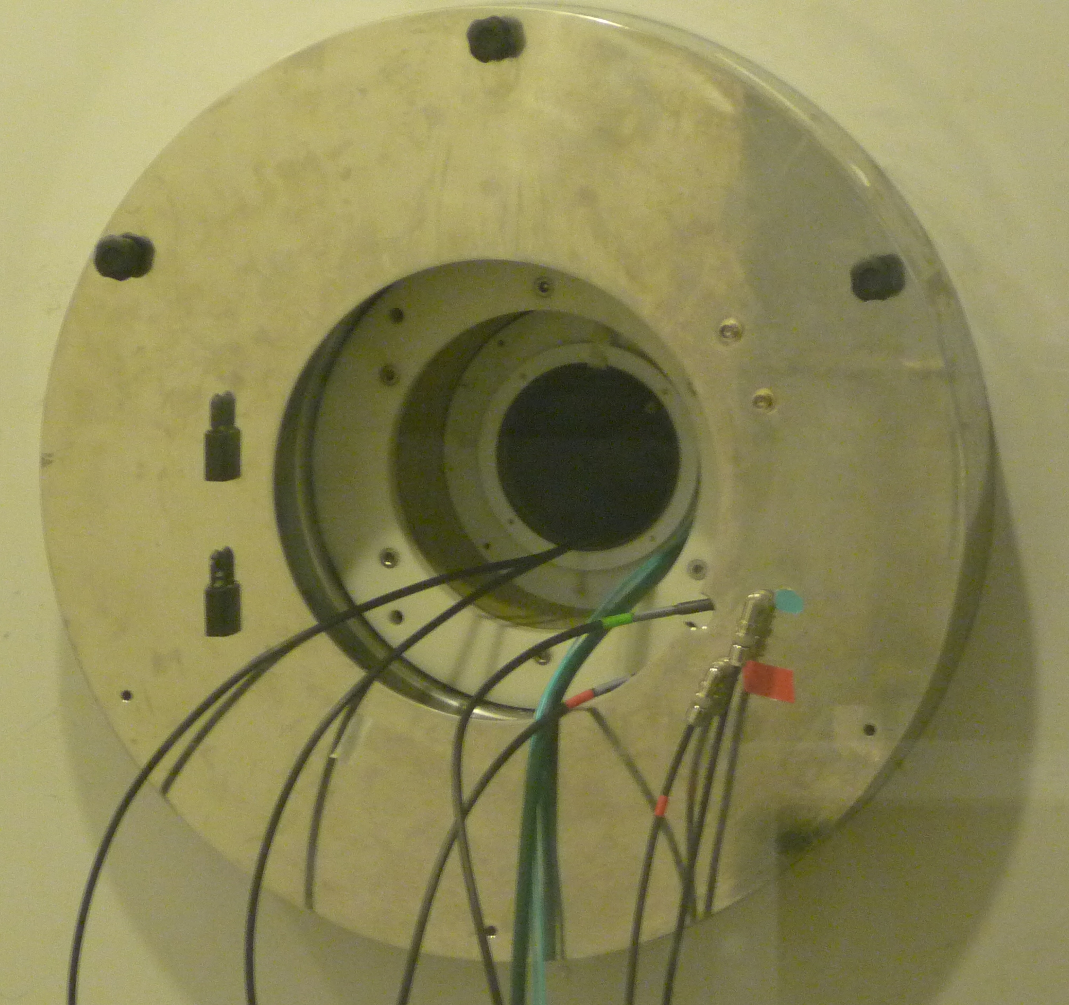
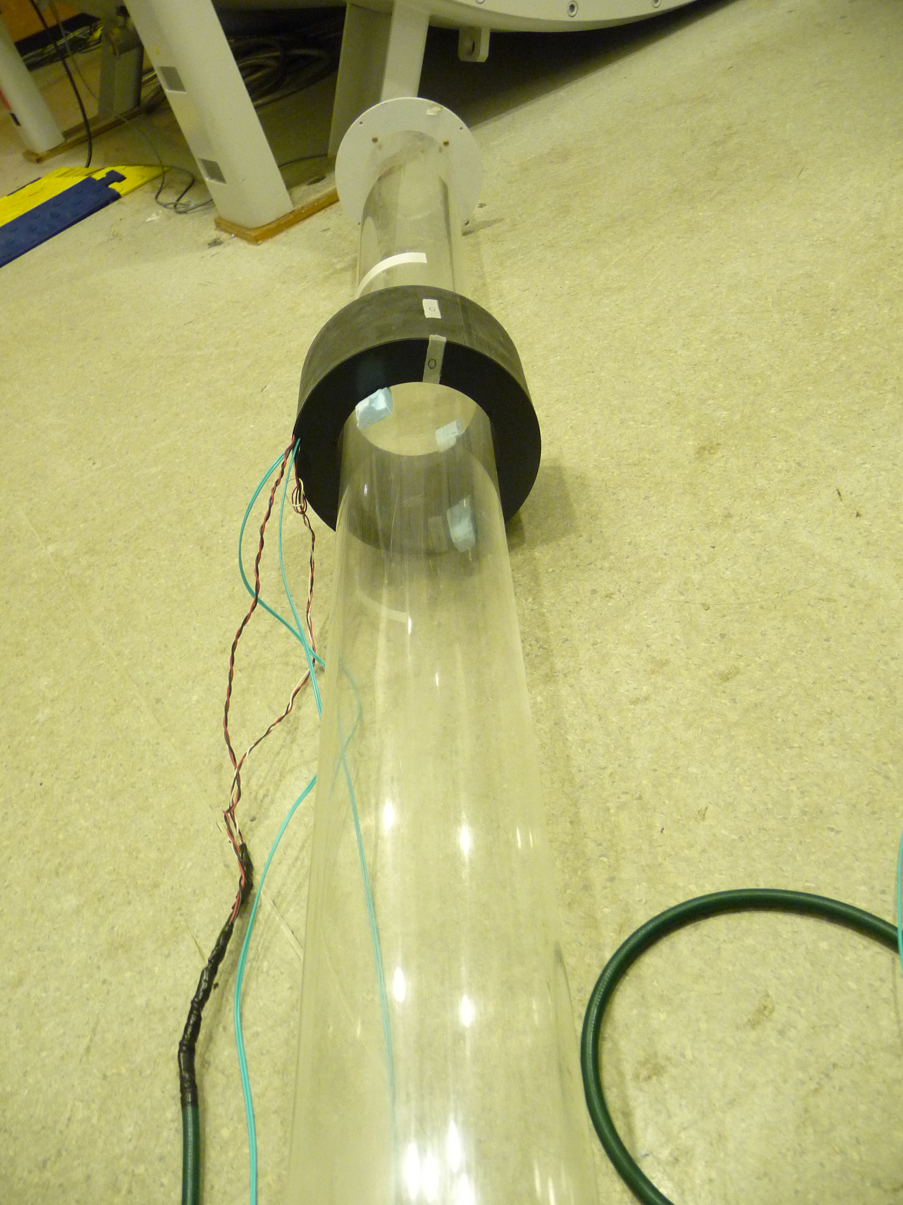

The 9.4T UPenn MRI for small animals
Magnet bore
Scanner
Our “UPenn” PET scanner mounted on the MRI tube
RF Coils and pickups
Our UPenn PET scanner was designed to fit into the bore of the Varian 9.4T (as strong as they come)
BTW – 9.4T -> 400MHz Larmor. You can buy them “by frequency” – 7T (300) etc
Going in

Slide 56

The Brutally Hostile Environment inside a MRI Magnet
If you were to get too close to the bore with a steel screwdriver, you would not be able to hold on to it
A number of early versions of boards got ripped apart because some ferromagnetic material was present in unexpected places ( e.g. Ni in solder joints)
The RF pulses totally overwhelm the PET electronics.
The plot shows counts registered in the PET scanner as a function of time – the spikes are the interference from the RF pulses
Still:
It did work!

Slide 57

Simultaneous PET-MRI Rat Brain Images
This is sort of the “money shot” – one of the all-out-everything-worked scans of a rat
What you want is simultaneous PET and MRI. If you do it sequentially, it’s much harder to combine the images
MRI
PET
Overlay

Slide 58
Wrapping up with 3 quick items
Out of a stroke of good luck we were able to make an actual clinical test on human patients in Taiwan
Volunteering women who had already been diagnosed with breast cancer were scanned with our breast scanner prototype and MRI
Breast Scanner
Prototype
The protocol and MRI magnet /gantry design didn’t allow for simultaneous scans though
We had to resort to sequential PET-then-MRI scans
Our about 3cm deep FOV in the prototype allows to only image a thin “slice” of tissue
FDG scans – sugar uptake by the tumor
Fantastic images despite some compromises

Slide 59

Human trials
Subject 3 –
8.67 mCi injection
Silicone Implant
MRI
PET
PET-MRI
(sequential)
Transverse
Sagittal
Coronal

Slide 60
Human trials
Subject 3 –
8.67 mCi injection
Silicone Implant
The volunteering women already knew they had breast cancer
In one patient, our scanner detected a 2nd tumor that had been missed (same breast)
Once / if the full-sized scanner can get FDA approval, new tools for breast cancer detection will be available

Slide 61









Time-Of-Flight PET – the Holy Grail of PET
Remember my “a few 100 ps” timing resolution to be able to find coincidences?
Well, there is another front. If we could use TOF to restrict the decay position along the LOR, the images would dramatically improve
A human scanner is ~30cm
10ps timing resolution – 3mm spatial resolution
Sub-100ps timing is hard! Especially if you have just 511KeV to work with.
Time of Flight
Stop
Δ time= Δ position
PET Scanner
Patient
Chronometer
+
-
Start

Slide 62

TOF-PET – the Holy Grail of PET
If you manage to restrict the position to just ½ of the LOR, you gain a factor of 4 in image quality (or can use ¼ of the radiation dose)

Slide 63



SPAD – Single Photon Avalanche Diodes
At its core, a diode operated above its breakdown voltage
Avalanche == high current == healthy signal == good timing characteristics
You need to control the breakdown, need circuitry to prevent damage
In my book, the most promising TOF-PET technology

Slide 64


SiPMs and dSiPMs – digital Silicon Photomultiplier
dSiPMs – SiPMs with full digital readout and control
Control for individual pixels!
Google it..

Slide 65
People who helped
Special thanks to
David Schlyer, BNL, USA
Paul Vaska, Univ. of Stony Brook, USA
Réjean Fontaine, Univ. of Sherbrooke, Canada
Steve Pickup, Univ. of Pennsylvania, USA
Sepideh Shokouhi, Vanderbilt University, USA
Fine Fiedler, Helmholtz-Zentrum Dresden-Rossendorf, Germany
Thank Y’all!

Slide 66

In-Beam PET
Trend in cancer therapy: Proton beams (or even light-ion beams)
More complicated, expensive (hadron beams are much harder to make)
But: much superior to treatments with photon or electron beams
Why?
Photons and electrons cause damage all along their path
Protons and ions cause damage at one narrow point
Energy Deposition as function of tissue depth:
Photons or electrons
Protons or ions
Energy Loss
Cell Damage
“Bragg Curve”
Depth
Using protons or Ions, you can target a particular depth in the tissue
(read: where the tumor is located)

Slide 67



Hadron Beams are hard
This is the Paul Scherrer Institute’s Proton Treatment Facility
Way beyond the capabilities of a typical hospital!
https://www.psi.ch/protontherapy/

Slide 68


Brain Tumors
Here you can usually not afford to cause damage along the entire beam path
Proton beams ideally suited!
You “wiggle” the depth of the Bragg peak quickly by either adding more material in front, or changing the beam energy
Proton Beam
Absorber
Now you have a very powerful weapon!
And a new problem: “Friendly Fire”
If you miss your target area, that part of the brain (or the optical nerve, or whatever you hit) is dead

Slide 69


Throw in in-beam PET
The idea: Use the positrons produced by the beam to image the “target area”
More energy loss = more positrons
Therapy Verification
Mispositioning
Correct for individual “body types” (tissue density)
Organ movement correction

