Slide 1


An Introduction to
Neural Networks
Satchit Chatterji
PhD Candidate
Artificial Intelligence
University of Amsterdam
s.chatterji@uva.nl
ISOTDAQ, June 21st, 2025
Notes:
Introduce myself
How many of you have used ….
Know what an nn is already
Understanding the nature of human intelligence. We are symbolic creatures that can string together symbols to make symbolic stories, despite everything in our heads being just these strange, complicated series of cells with distributed information flowing through in the form of chemistry, electricity and black magic.
During the next hour, I’ll be your guide to the realm of artificial abstractions or approximations of neurons, unsurprisingly called artificial neural networks, and try and answer why, as physics students, may want to use them for trigger and data acquisition. You can also ask questions whenever you have them during the lecture. There’s a lot to cover, so strap in! Let me know if I’m going too fast.

Slide 2
A Titular History
2022
2023
2024
2025
Why you should consider Neural Networks
An Introduction to Neural Networks
I don’t need to convince you to use Neural Networks
You Already use Neural Networks

Slide 3
The short answer
They’re useful!

Slide 4
The short answer
They’re useful!
They’re fast!

Slide 5
The short answer
They’re useful!
They’re fast!
They’re (now) easy to implement!

Slide 6


The short answer
https://twitter.com/gdb/status/1512521912064229377
Prompt:
“Dall E dreams of becoming an AGI”
SOTA 2022
They’re useful!
They’re fast!
They’re (now) easy to implement!
They’re cute improving!
SOTA 2025
Notes:
Does anyone know where this image is from?

Slide 7
The short answer
https://twitter.com/gdb/status/1512521912064229377
Prompt:
“Dall E dreams of becoming an AGI”
SOTA 2022
They’re useful!
They’re fast!
They’re (now) easy to implement!
They’re cute improving!
They’re definitely not going to take over the world!
SOTA 2025
Notes:
Does anyone know where this image is from?

Slide 8
The short answer
The long answer
https://twitter.com/gdb/status/1512521912064229377
Prompt:
“Dall E dreams of becoming an AGI”
SOTA 2022
They’re useful!
They’re fast!
They’re (now) easy to implement!
They’re cute improving!
They’re definitely not going to take over the world!
SOTA 2025
It’s a bit more complicated than that…
Notes:
Does anyone know where this image is from?

Slide 9
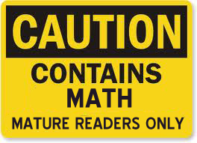
Introduction to the introduction
Goals of this lecture:
The whats, hows, whys, whichs and wheres
- Teach you what a neural network is and how it works
- Why you should use them, and why not
- Which neural networks are used today
- Where neural networks are headed next
Along with:
- A demo in a simulated environment
- A few tips on building and training your own networks

Slide 10
Introduction to Supervised Machine Learning
Given: Input-output examples of the form:
Slides adapted from Jaeger, H. (2022) Neural Networks Lecture Notes
Notes:
Indeed when we have IO pairs like this to train from, we, more often than not, are talking about SUPERVISED ML

Slide 11
Introduction to Supervised Machine Learning
Given: Input-output examples of the form:
Slides adapted from Jaeger, H. (2022) Neural Networks Lecture Notes

Slide 12


Introduction to Supervised Machine Learning
Given: Input-output examples of the form:
Assumption: Data is generated by a “true ” function, with some added noise :
Slides adapted from Jaeger, H. (2022) Neural Networks Lecture Notes

Slide 13

Introduction to Supervised Machine Learning
Given: Input-output examples of the form:
Assumption: Data is generated by a “true ” function, with some added noise :
Goal: Learn an approximation of the generator function to use on new data:
Slides adapted from Jaeger, H. (2022) Neural Networks Lecture Notes

Slide 14

Introduction to Supervised Machine Learning
Given: Input-output examples of the form:
Assumption: Data is generated by a “true ” function, with some added noise :
Goal: Learn an approximation of the generator function to use on new data:
Loss function: A distance between and such that we can say is “good”
if L is low across many given instances of S.
Slides adapted from Jaeger, H. (2022) Neural Networks Lecture Notes

Slide 15
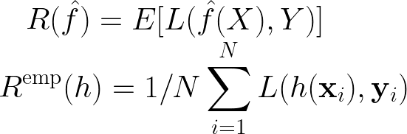
Aim: Learn a function with low “risk”
Risk: What we want to minimize
Empirical Risk: What we can actually calculate with data
(for a “candidate” model h, averaged over N training examples)

Slide 16
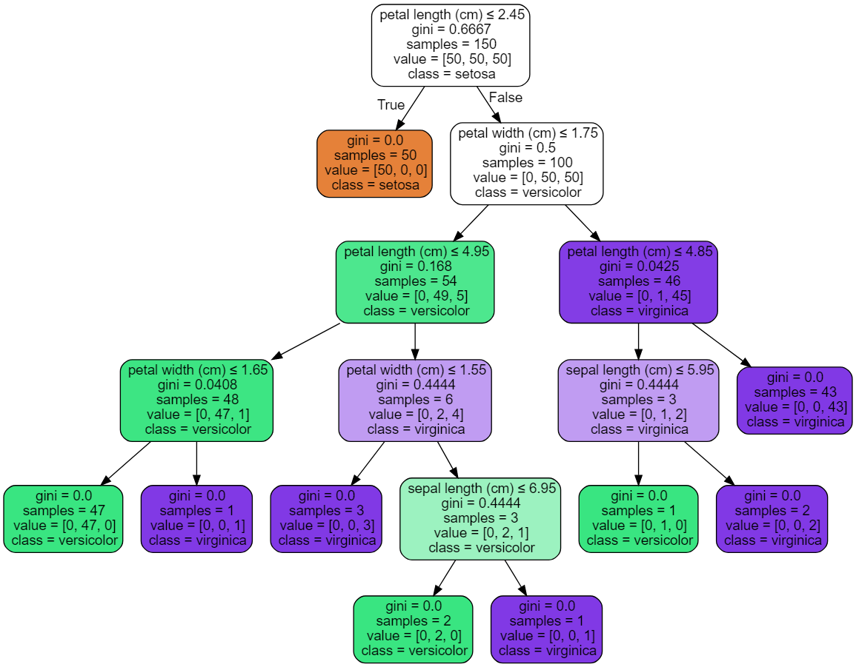
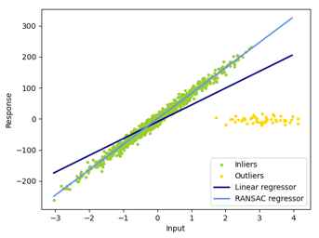
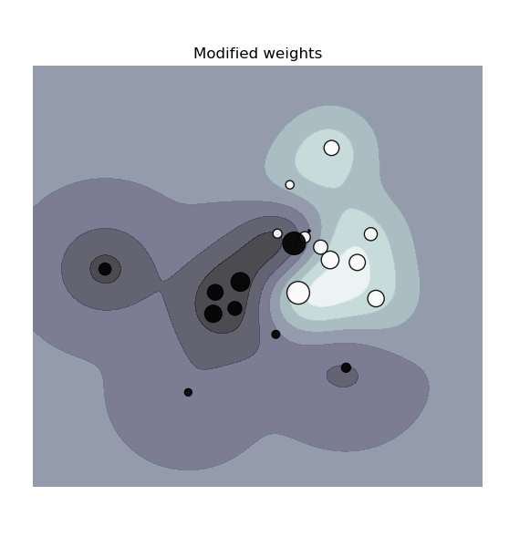

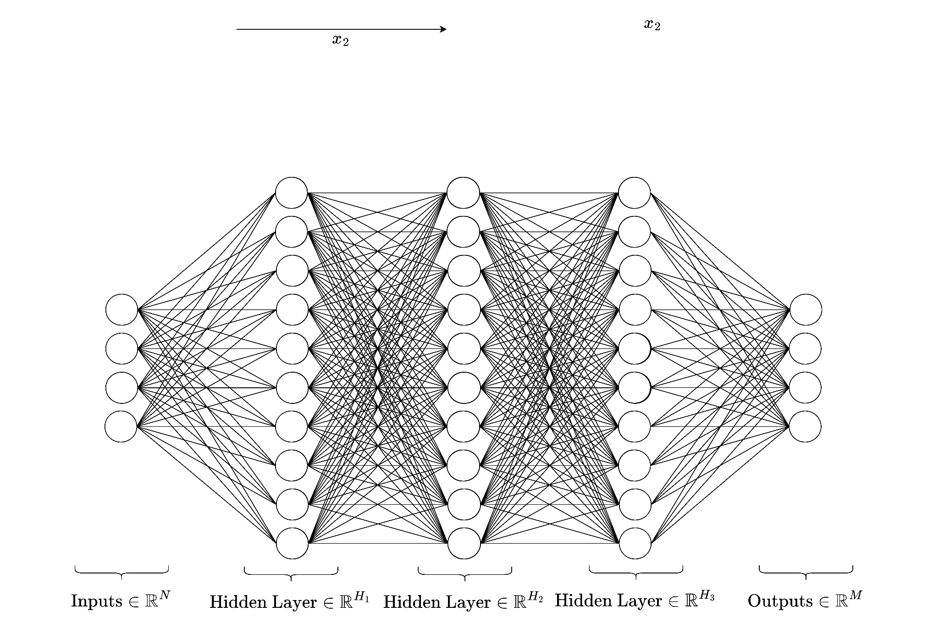
Common Approaches
(Generalized) Linear/Logistic Regression
(Boosted) Decision trees/Random Forests
Support Vector Machines
Naive Bayes Classifiers
Neural Networks
…
Images of regressions, decision tree, and SVM from scikit-learn.org
Notes:
But where do neural networks come from?

Slide 17
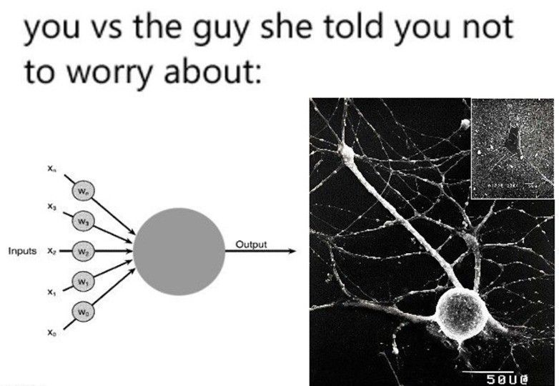
Artificial vs Biological NNs
ANNs initially inspired by the brain:
Alexander Bain (1873), William James (1890)
Electrical connections/flow of neurons result in thought
and movement
McColloch & Pitts (1943)
Modern mathematical “artificial” NN models (not the only neural network model!)
Rosenblatt (1958)
Description of the perceptron
Rumelhart, Hinton & Williams (1986)
Multi-layer perceptrons and error backpropagation (learning principle)
Modern:
- ANNs used everywhere for everything!
- Simplified, abstracted version of “synaptically”-connected “neurons”
- Biologically implausible
Source: linkedin.com/company/deeplearningai

Slide 18
Building a Neural Network
From Scratch (mathematically)
Notes:
Timestamp: 00:10

Slide 19
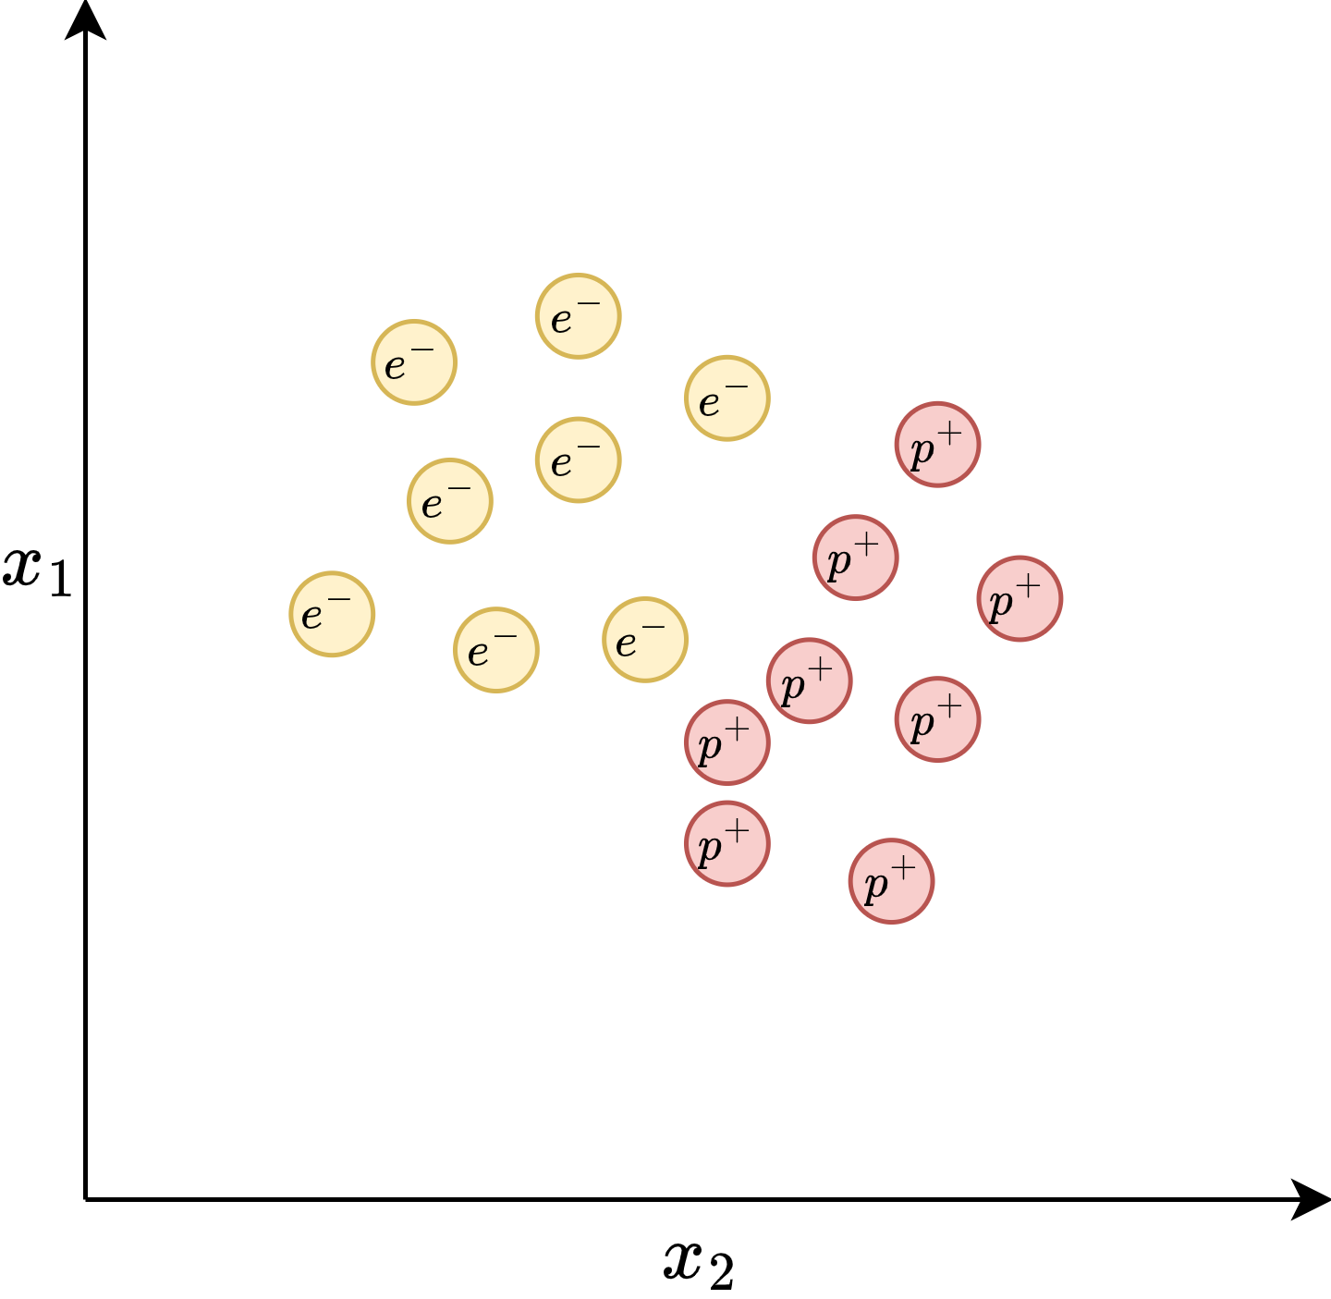
Notes:
x1 and x2 are the variables that relate to these classes, and the particles lie on the observations we make on them. Maybe masses, maybe charge, maybe opinions on how physicists feel about them.

Slide 20
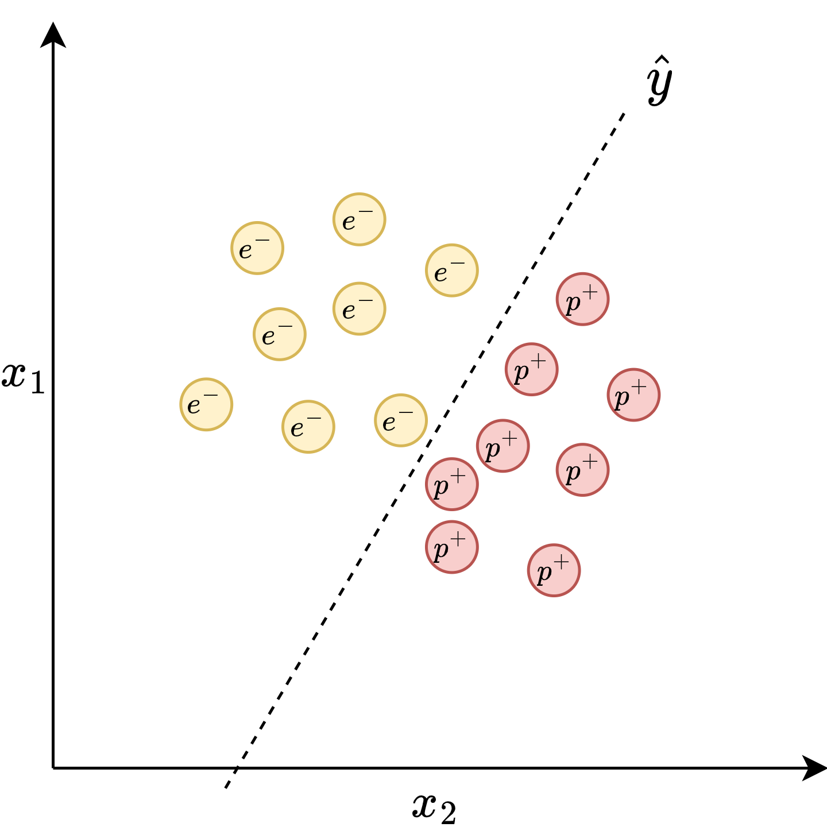

Classes are “linearly separable”

Slide 21
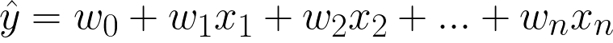


Notes:
y hat can be modelled as a simple line

Slide 22
Classes are “linearly separable”

Slide 23
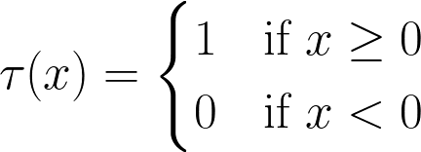
Notes:
Let’s say if y is greater than 1 it’s an electron, else a proton. So we define this “wrapper function” that checks if something is above or below the line. I’d like to now propose a diagrammatic representation of the calculation, since what is a technical lecture without a good diagram?

Slide 24
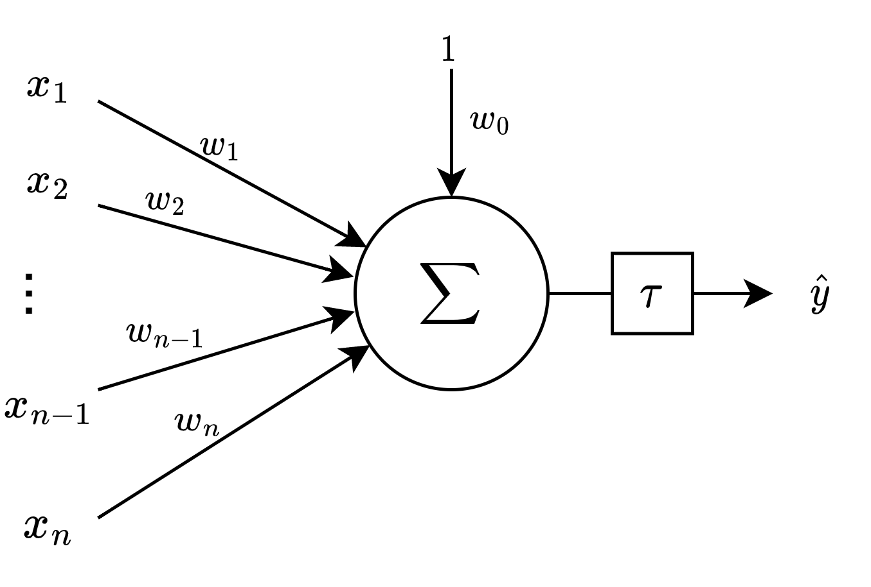
Notes:
Ha! I’ve tricked you! This isn’t just a simple sum, it’s…

Slide 25
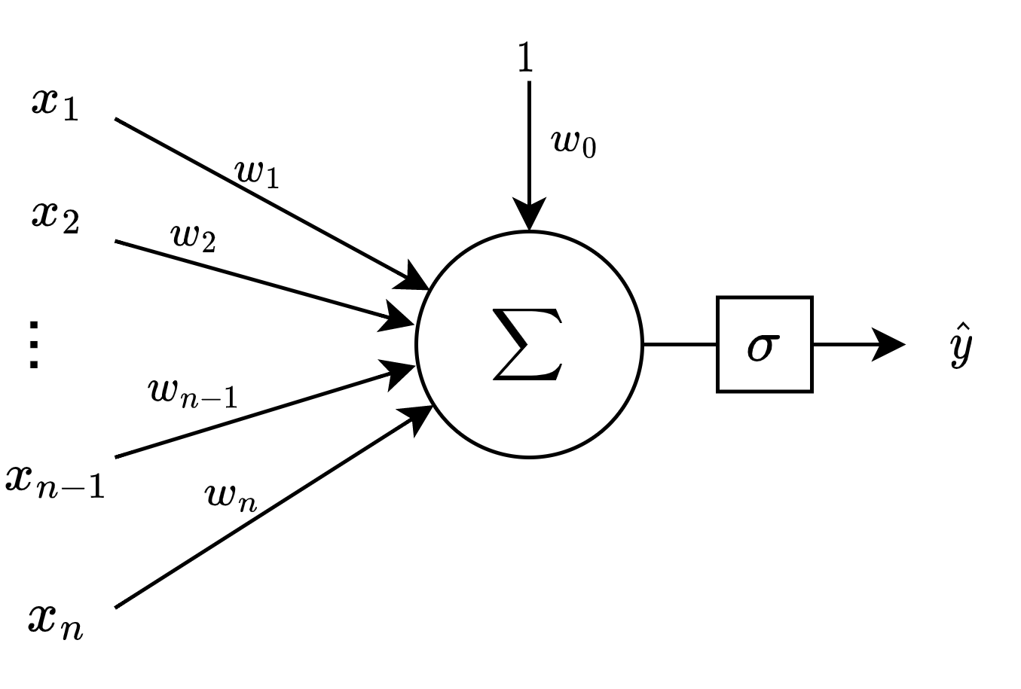
The “Perceptron”
Generalized “activation function”
The modern notion of a single “neuron”
BUT: Only works on linearly separable classes

Slide 26
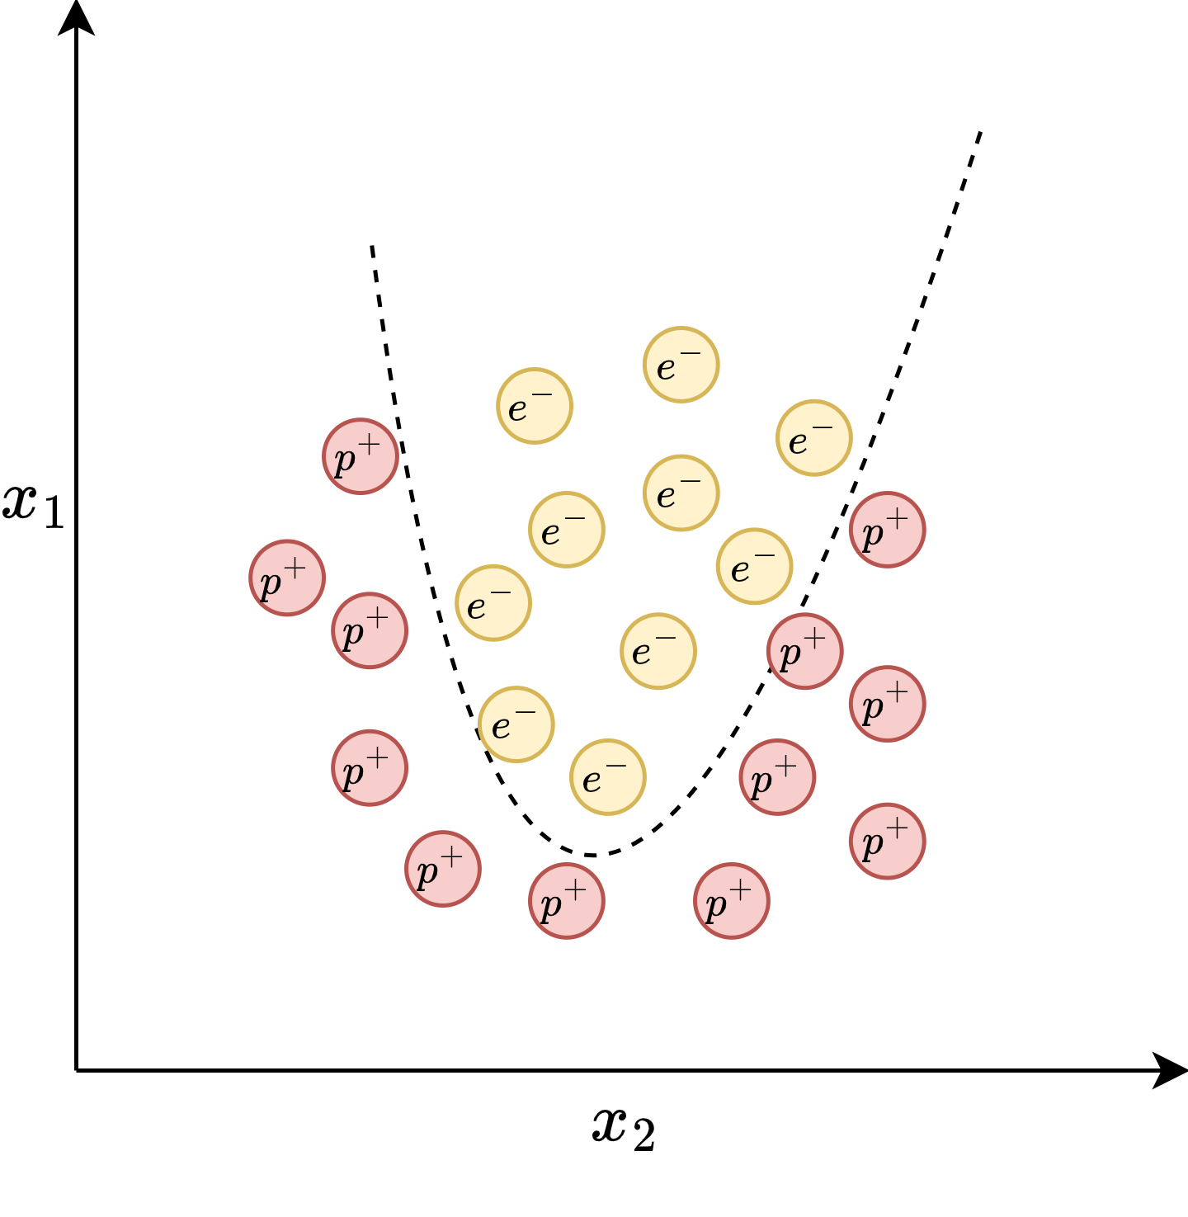
Notes:
In reality we often get things that are not approximable with lines. What if you want to model a more complex function?

Slide 27
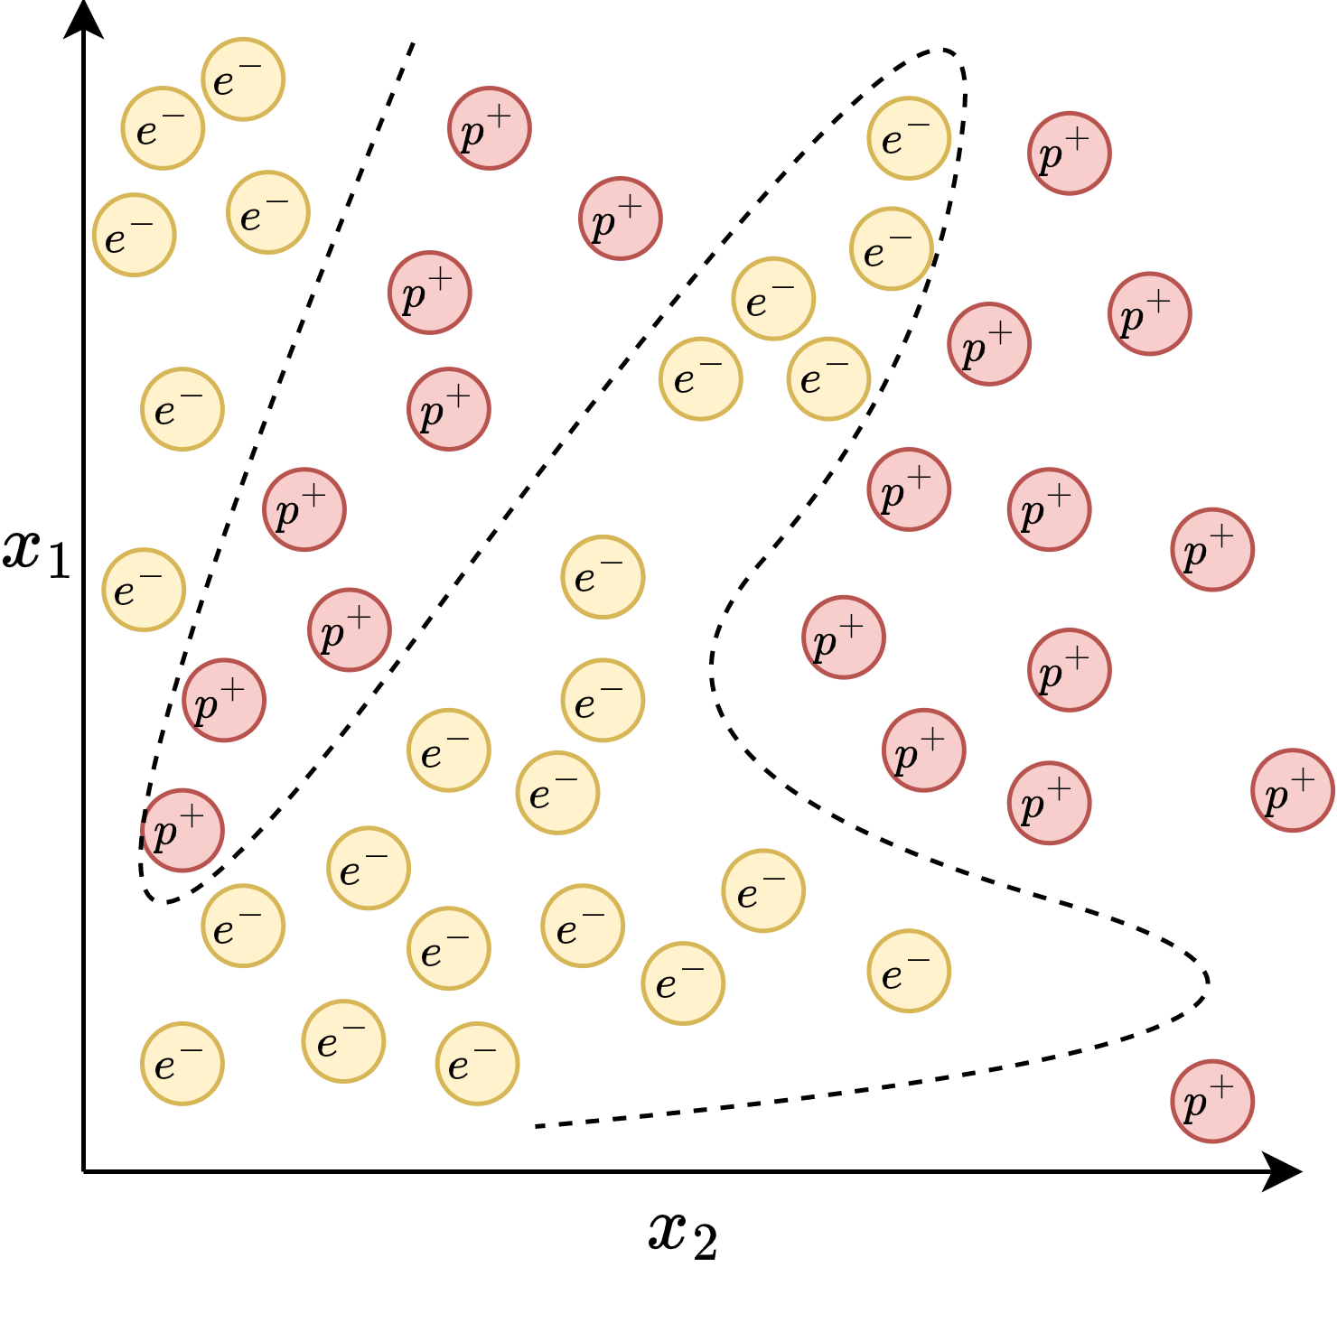

Slide 28
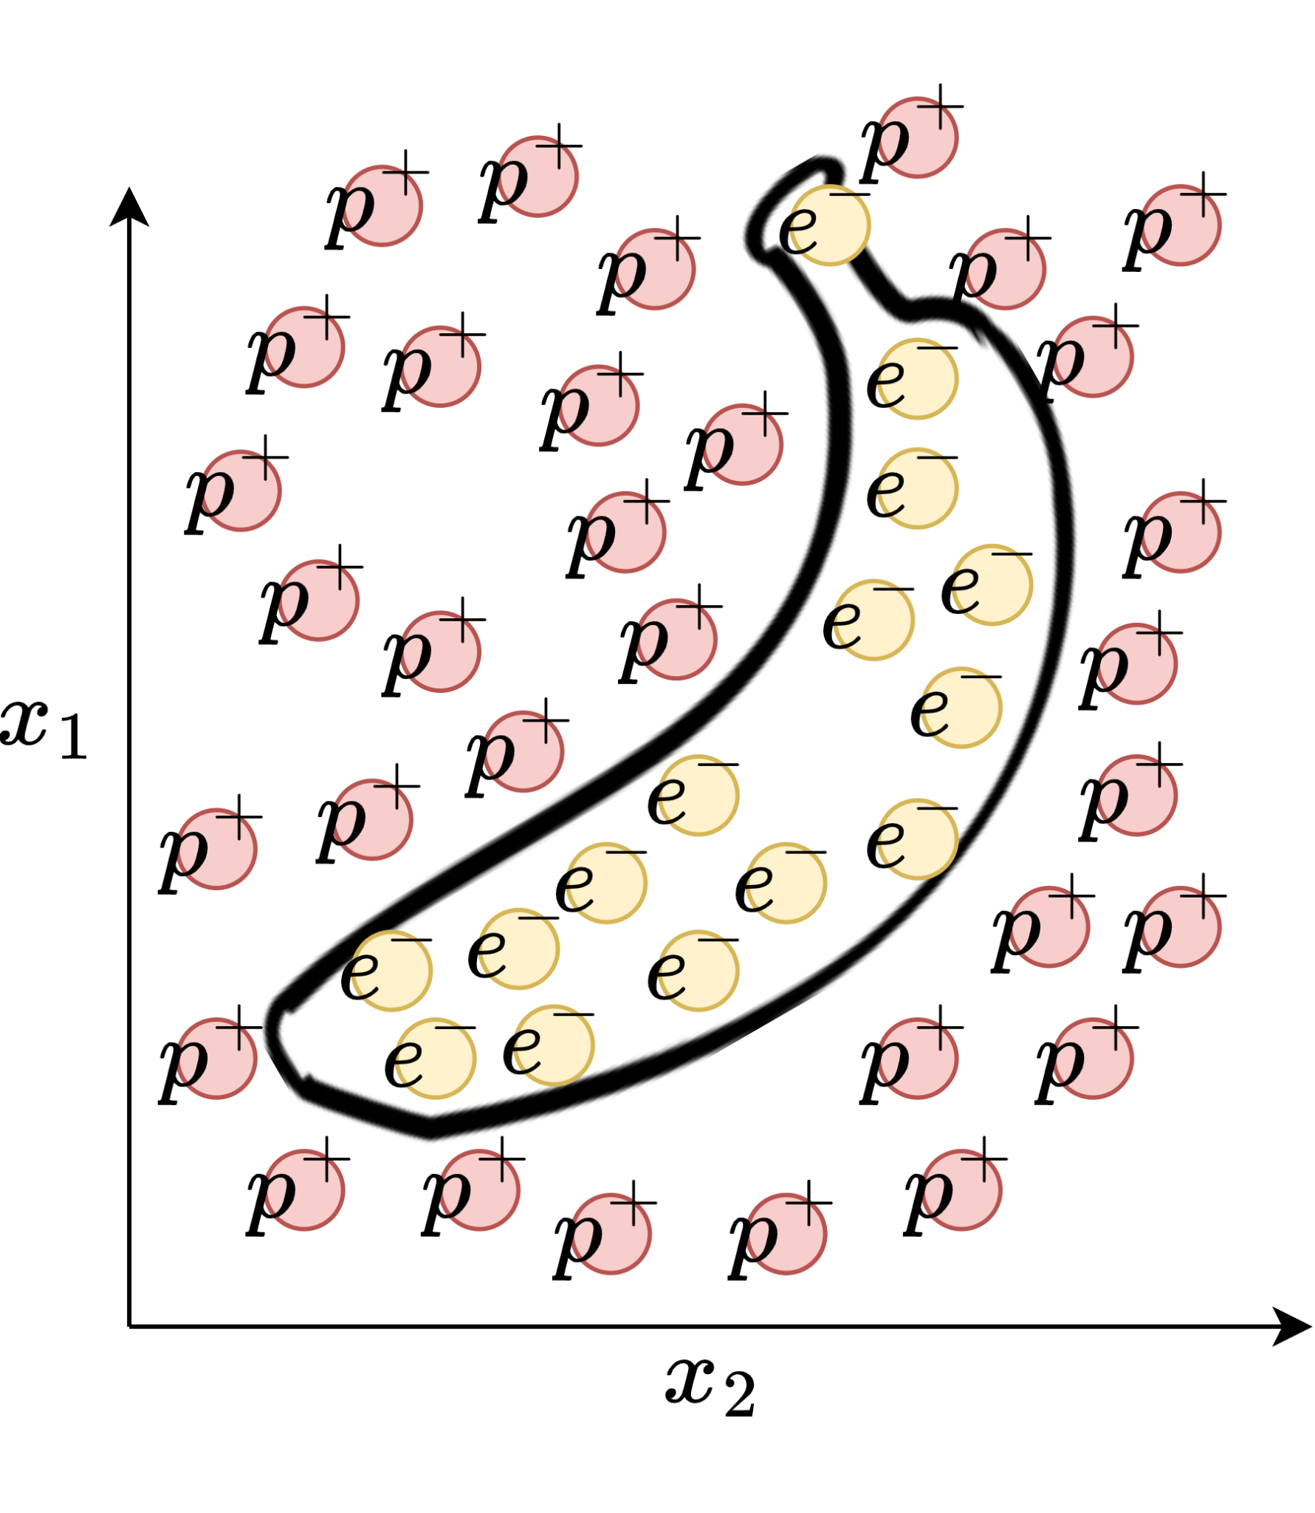

Slide 29
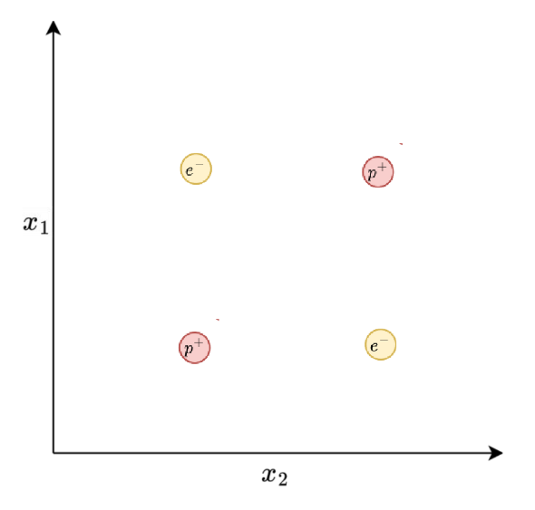
Minsky, M., & Papert, S. (1969). Perceptrons: An Introduction to Computational Geometry.
Notes:
In reality we often get things that are not approximable with lines. What if you want to model a more complex function?

Slide 30
Minsky, M., & Papert, S. (1969). Perceptrons: An Introduction to Computational Geometry.
Notes:
In reality we often get things that are not approximable with lines. What if you want to model a more complex function?

Slide 31
Minsky, M., & Papert, S. (1969). Perceptrons: An Introduction to Computational Geometry.
Notes:
In reality we often get things that are not approximable with lines. What if you want to model a more complex function?

Slide 32
…
Notes:
Let’s get back to the perceptron. What if we could chain them together in something like a layer? Maybe we could approximate little bits of our complicated functions as little lines and combine them to get a sort of complicated piecewise function?

Slide 33
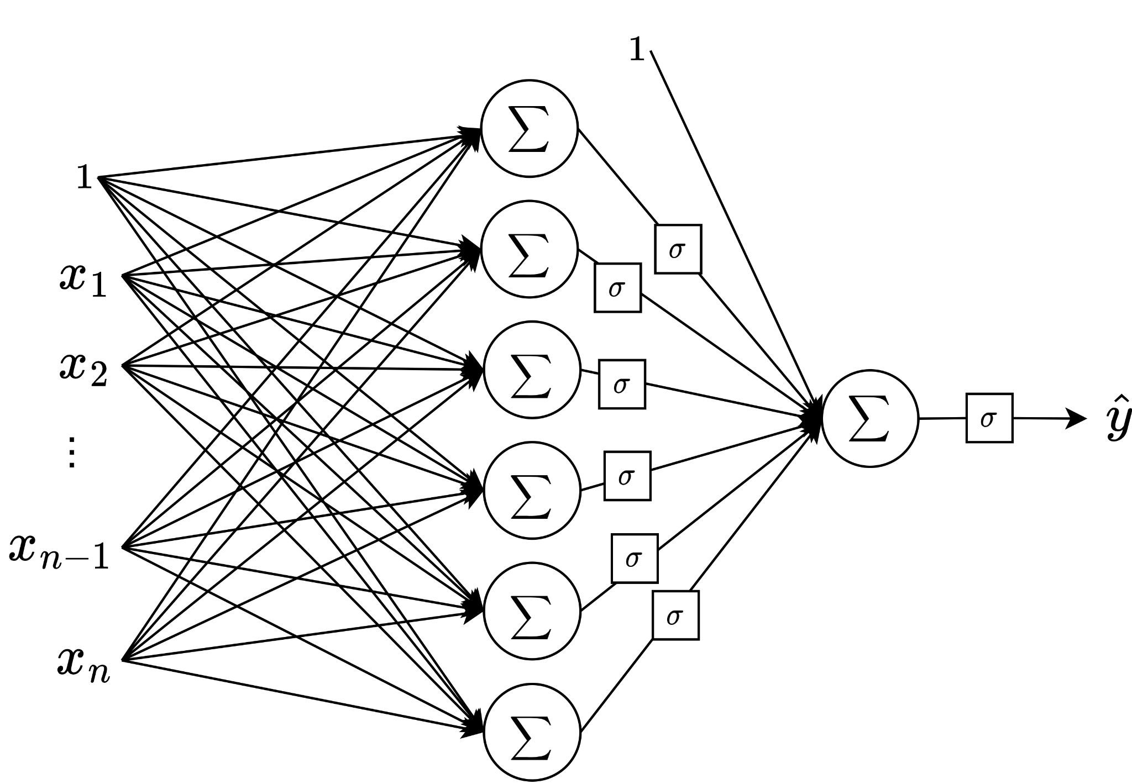
Notes:
Let’s do just that. For the sake of clarity, I’ll remove the redundant nodes of the graph, remove the weight labels and add in another perceptron at the end to sum up our tiny linear approximations. This diagram may look familiar to some already. Ha! I tricked you again!

Slide 34
Multi-layer Perceptrons (MLPs)
Notes:
Okay now let’s back to how we can implement this mathematically and perhaps more efficiently

Slide 35
Notes:
Back to a single neuron. Can someone suggest a more compact representation of this?

Slide 36
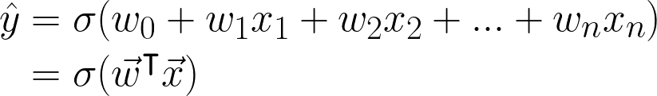
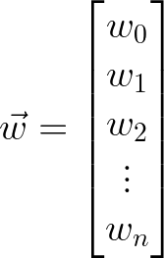
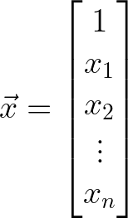
Notes:
Now to add in some buzzwords

Slide 37
“Activation”
“Bias”
“Activation function”
“Weight vector”
“Feature vector”

Slide 38
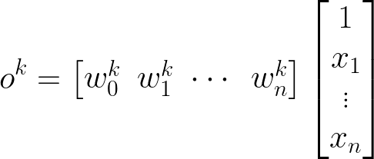
Activation/
output
of neuron k
K "hidden” neurons
in layer L

Slide 39
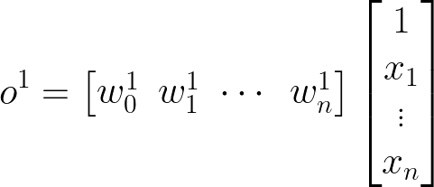

Slide 40
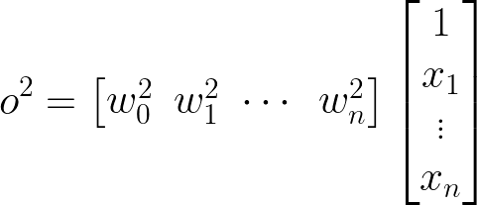

Slide 41
Notes:
Can you see what’s gonna happen next?

Slide 42
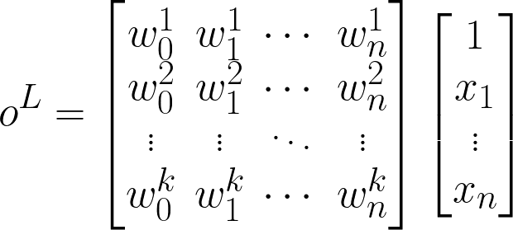
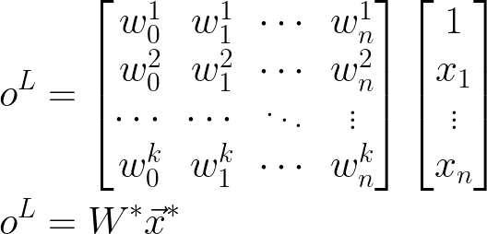

Slide 44
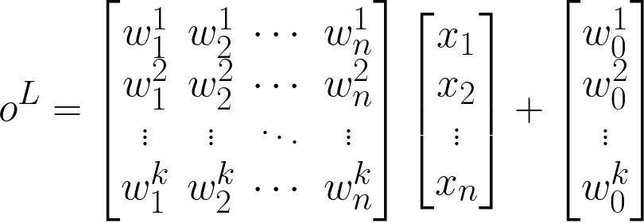
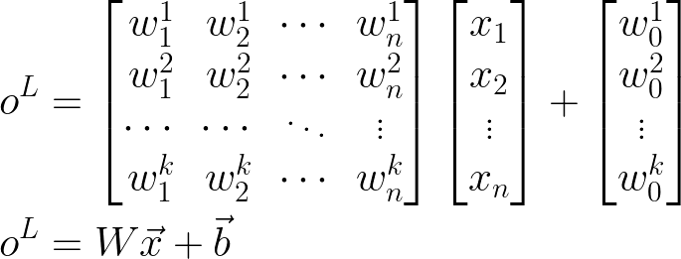
Most common way of writing out the activation of a layer of an MLP

Slide 45
Notes:
We’re still missing a vital component though. Any ideas?

Slide 46
Notes:
Exactly, the activation function.

Slide 47
Notes:
Exactly, the activation function.

Slide 48

The output of each layer is the product of its weight matrix and the input vector plus its bias vector, all wrapped in a non-linear activation function.
Notes:
What this means is

Slide 49
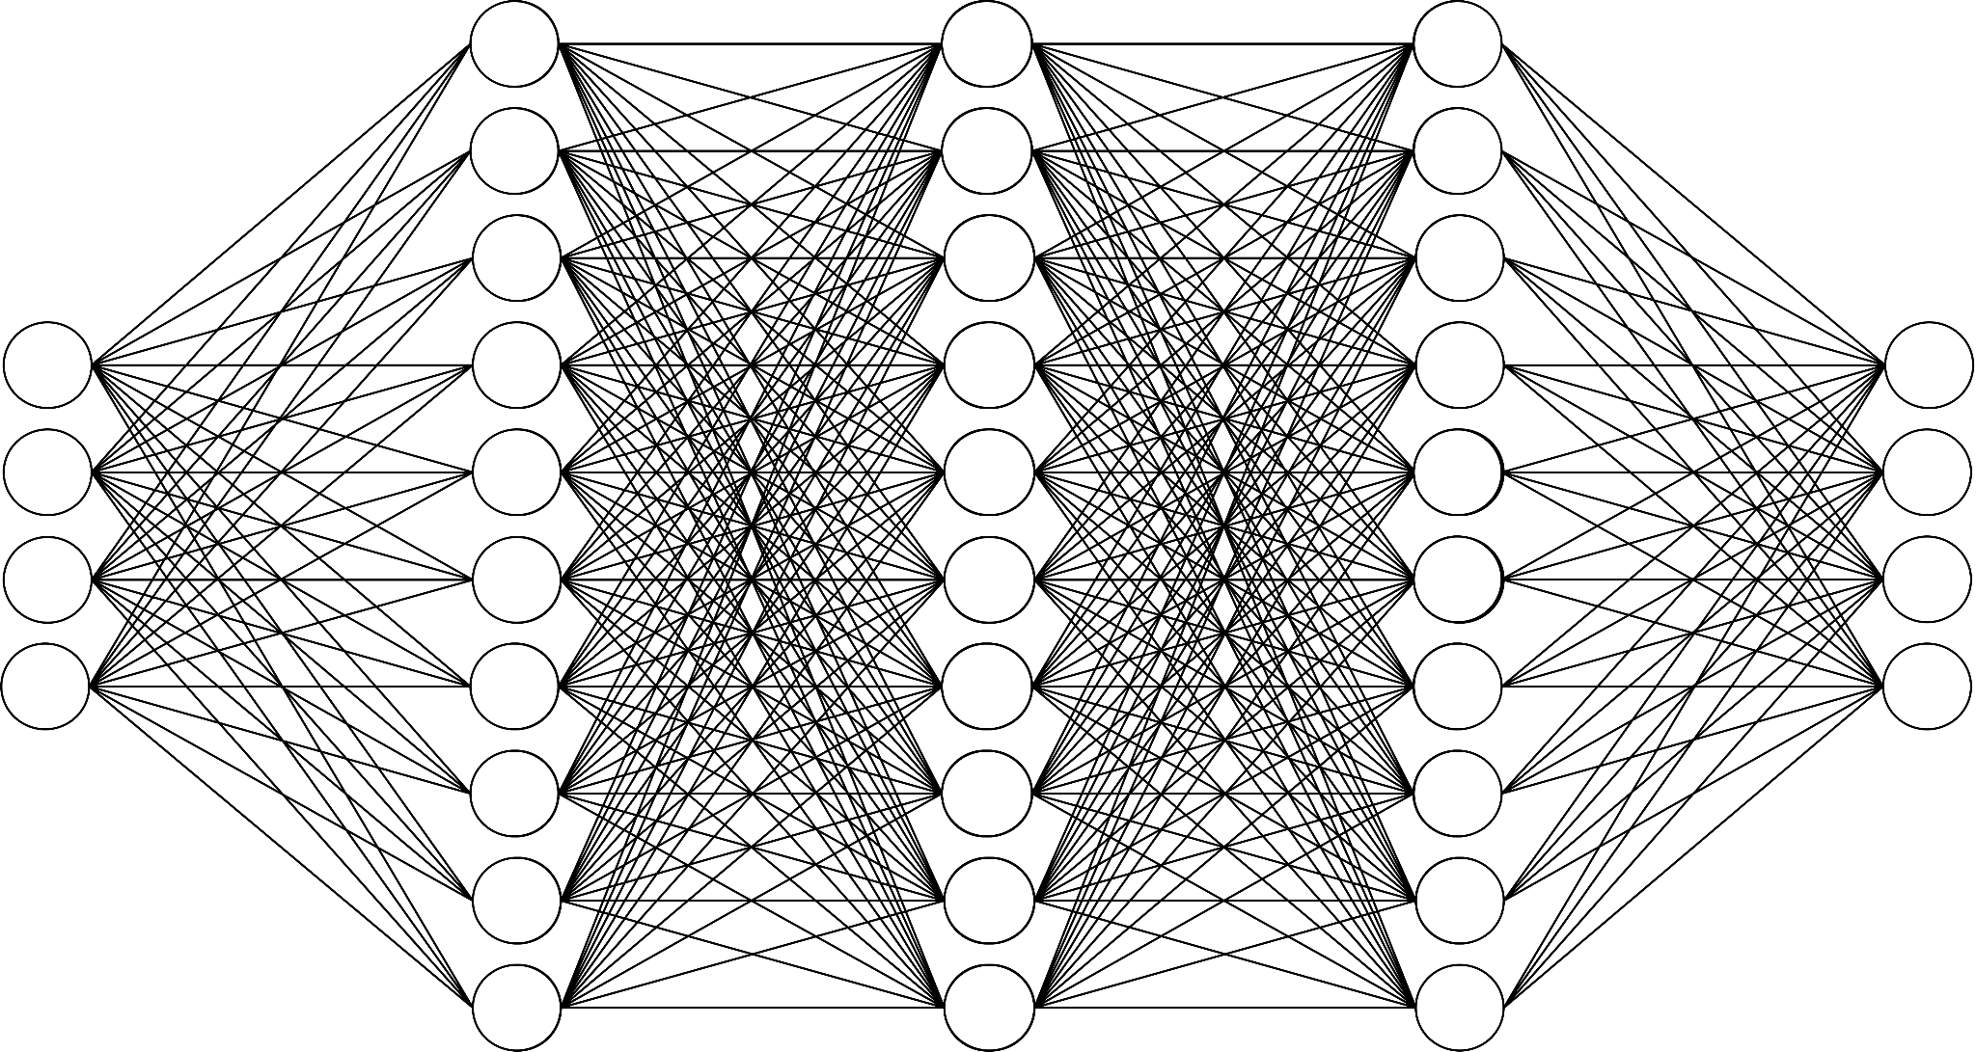
⇒
Inputs
⇒
Outputs

Slide 51
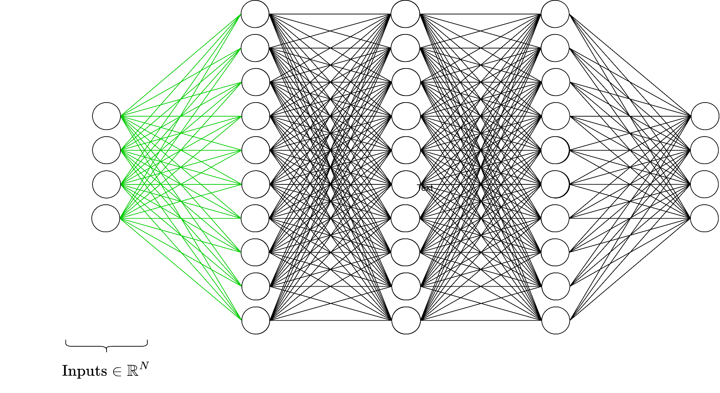

Slide 52
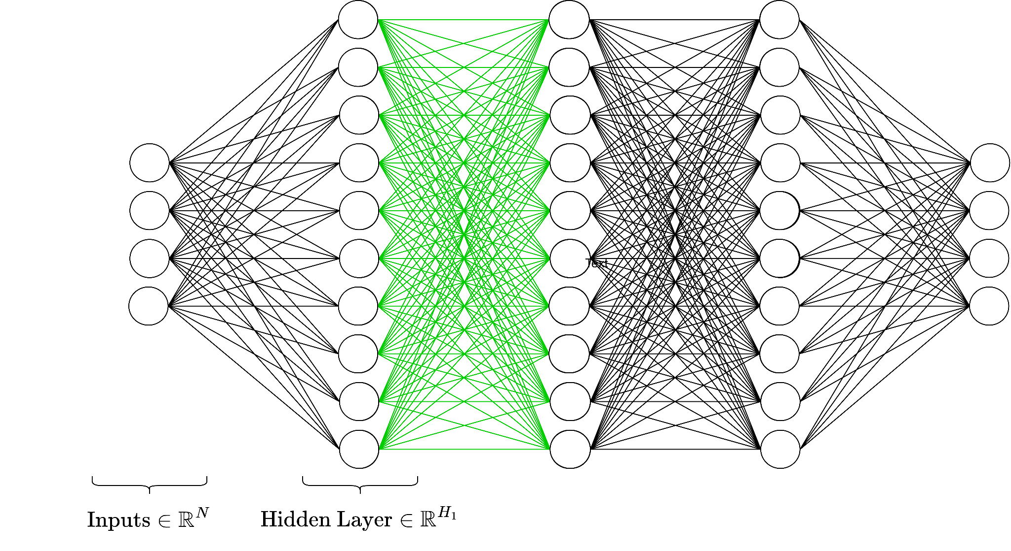

Slide 53
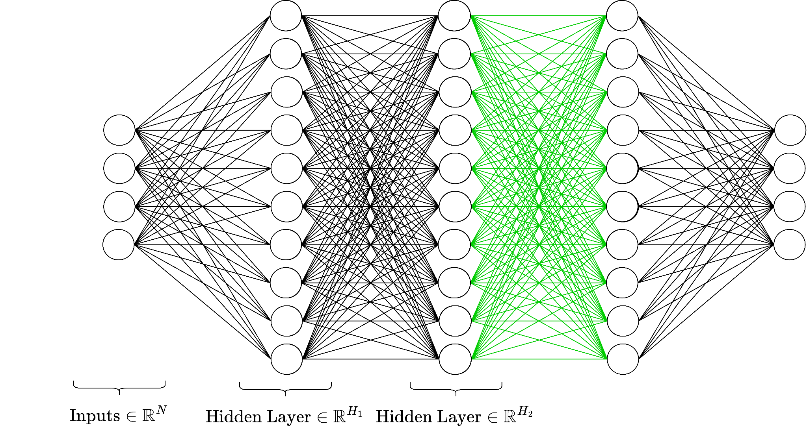

Slide 54
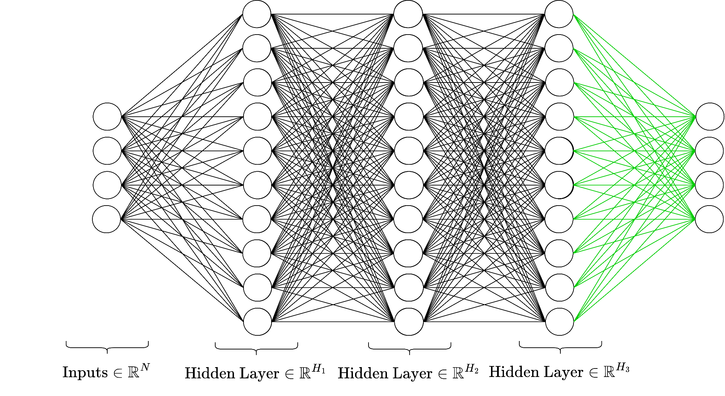

Slide 56
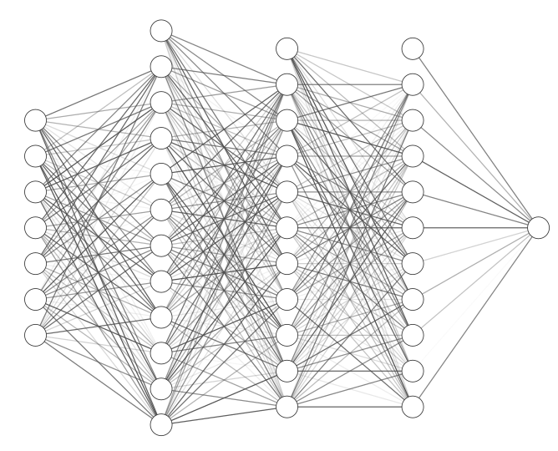


A multi-layer perceptron is a series of affine transformations of an input vector, each of which is wrapped in a non-linear activation function.
(Translation: an MLP is a fancy function)
Notes:
Okay just to recap

Slide 57
A Note on Nonlinearity
Without a non-linear activation function, a series of linear transformations would result in just a linear transformation of the input to the output.
We would still be stuck in the land of linear separability!

Slide 58
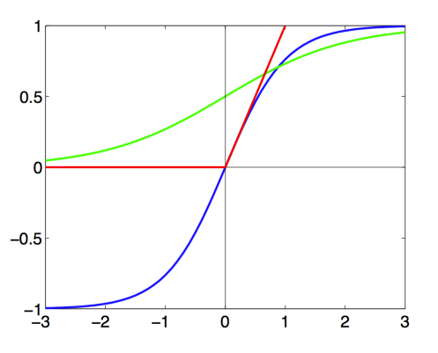


Common nonlinear functions

Slide 59
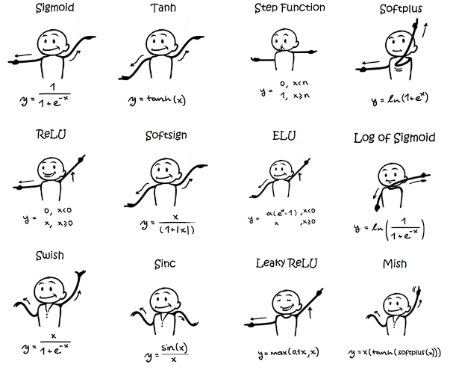

Slide 60
Learning in Neural Networks (quickly)

Slide 61
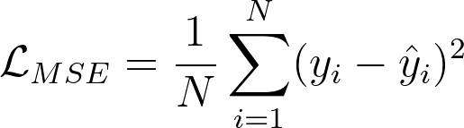
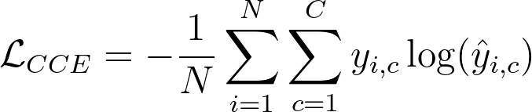
Loss functions
Loss function: A distance between and such that we can say is “good”
if L is low across many given instances of S.
Depends on the task!
Mean Squared Error
Used for regression tasks
Cross Entropy
Used for classification tasks
Define your own!
Note: Must be differentiable for gradient descent based methods

Slide 62

Implementing learning: Gradient Descent
Given:
Family of parameters (e.g. possible weights of a NN)
Differentiable risk function
Goal:

Slide 63
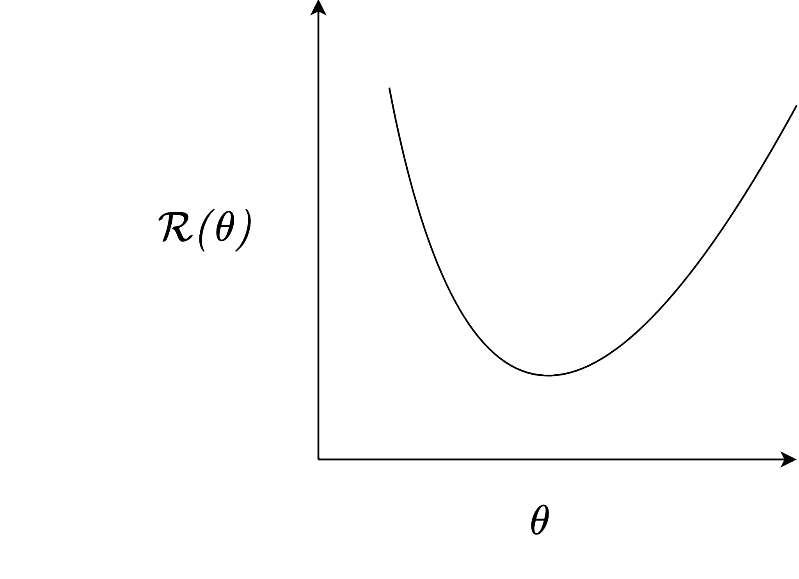
Backprop: Gradient descent

Slide 64
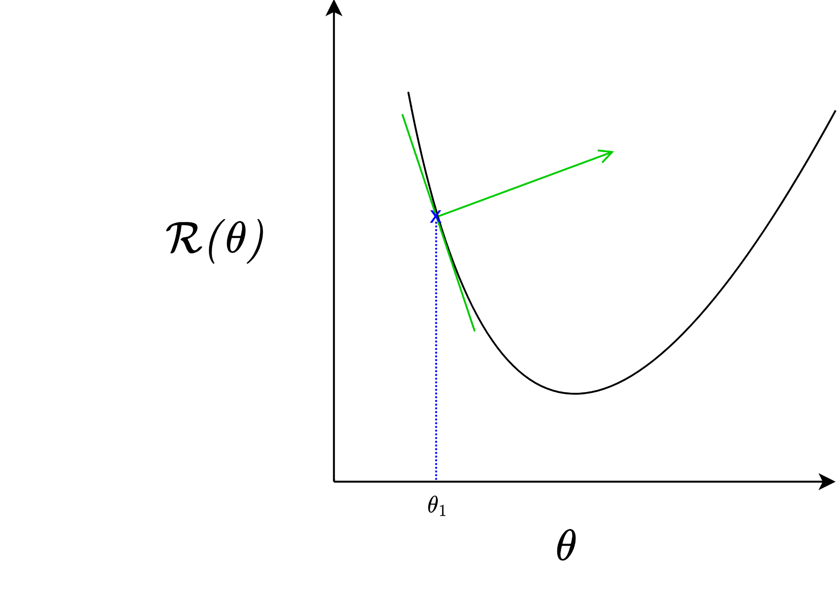

“Learning rate”
“Guess”

Slide 65
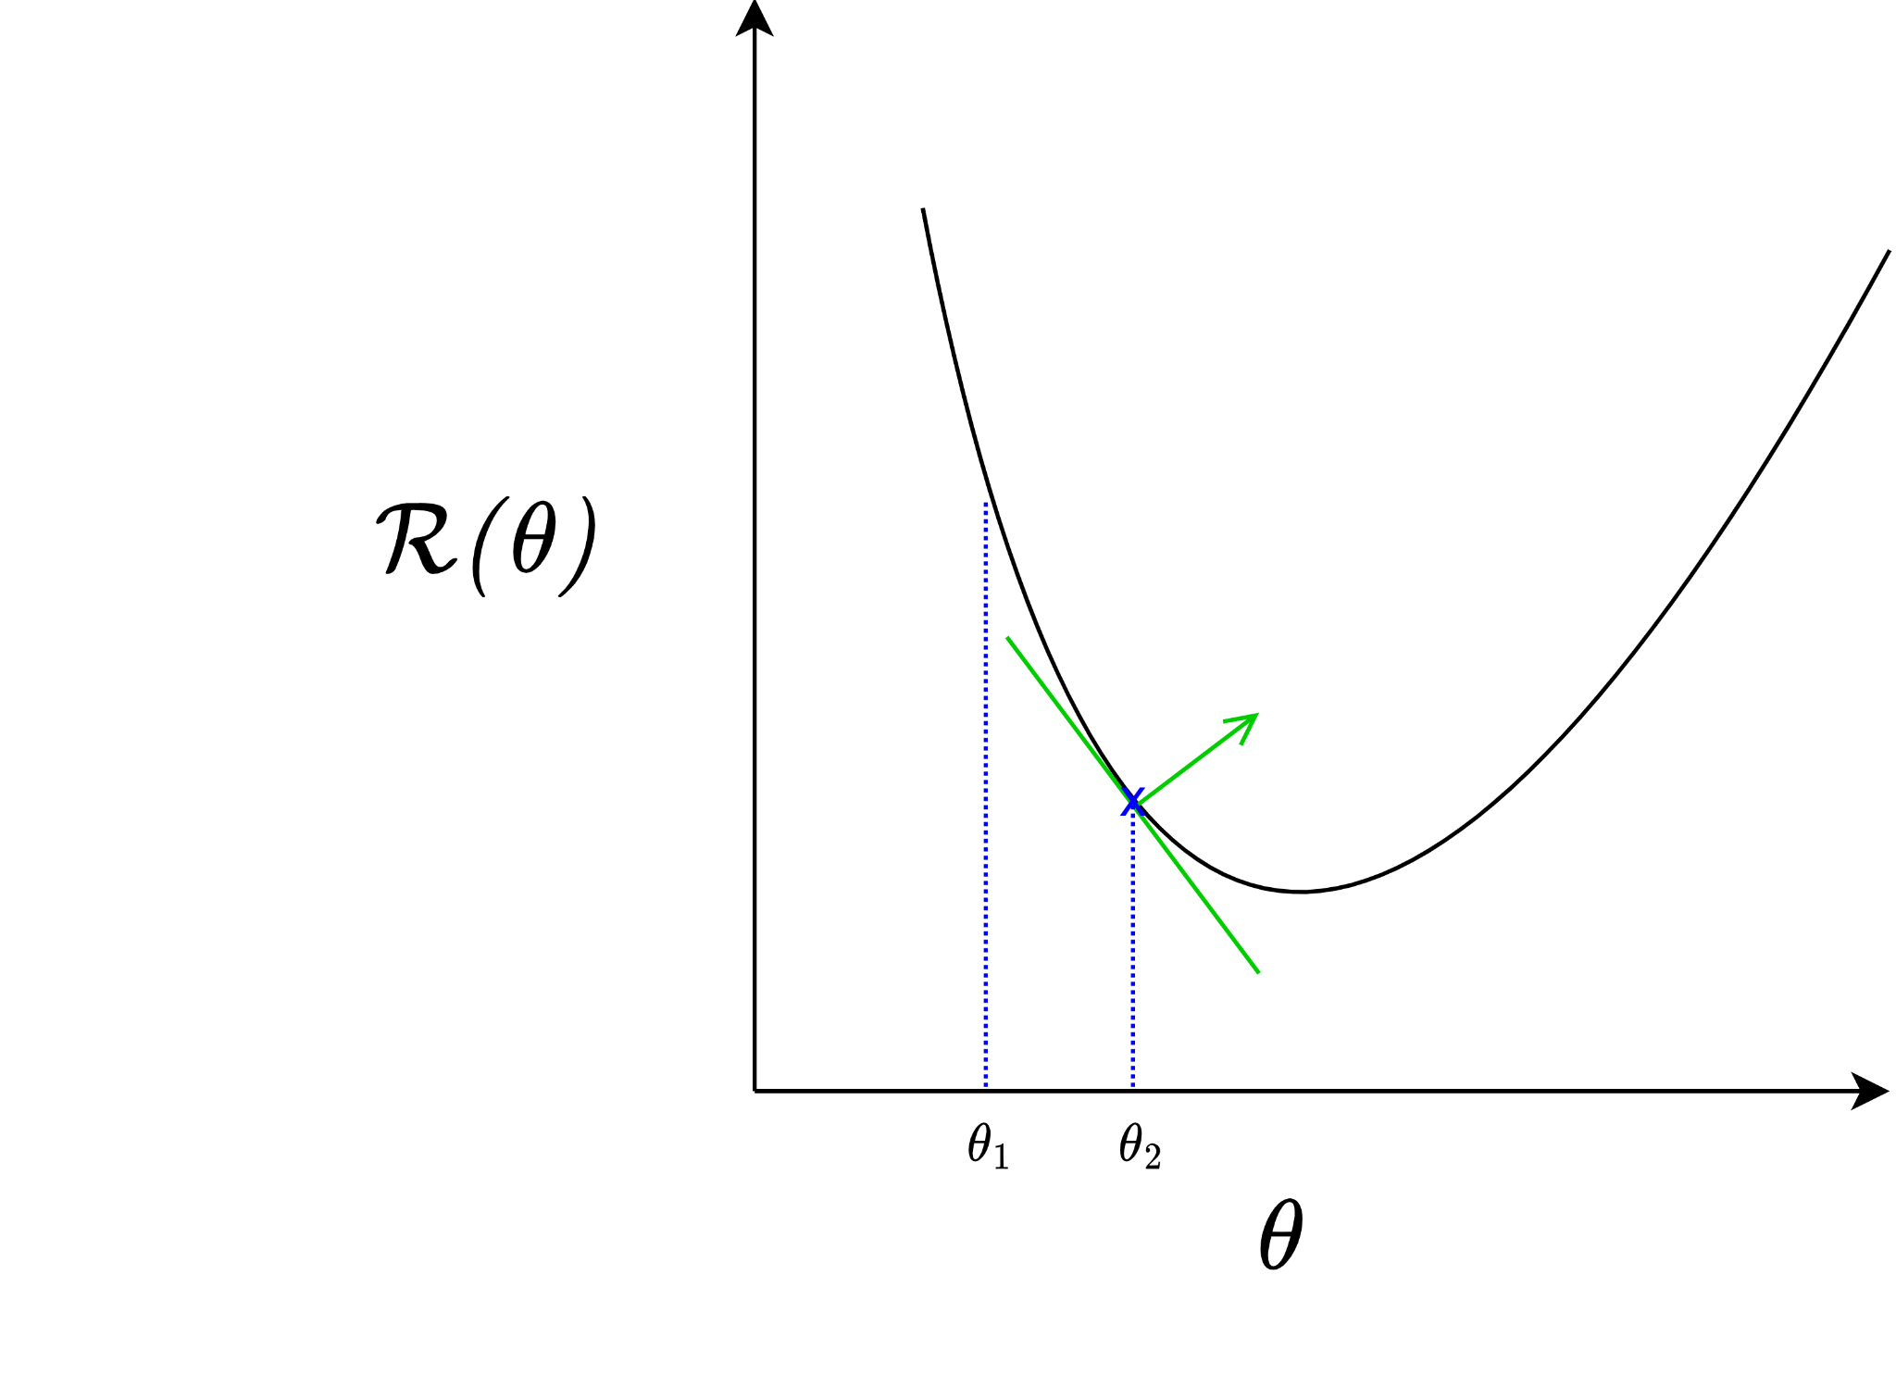

Slide 66
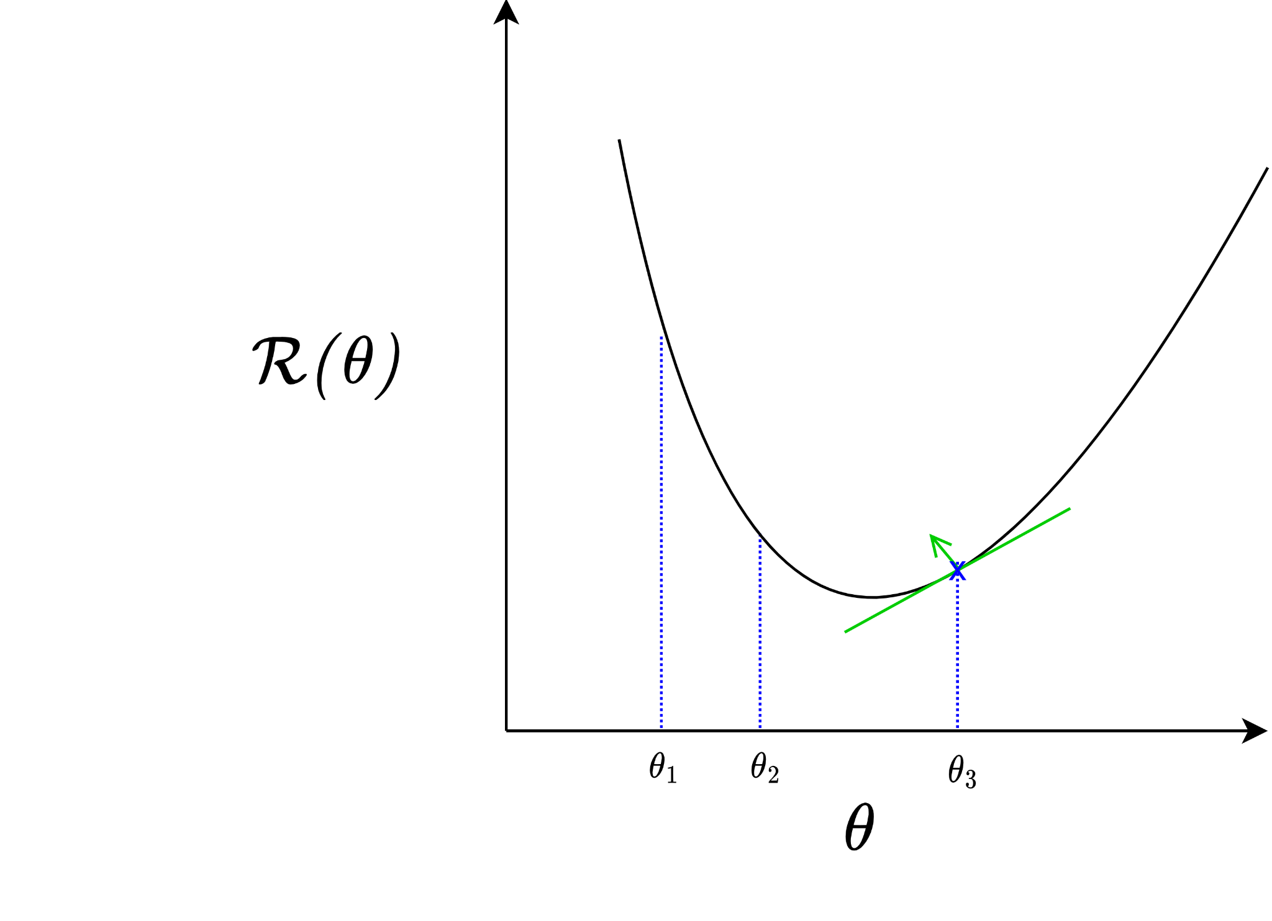

Slide 67
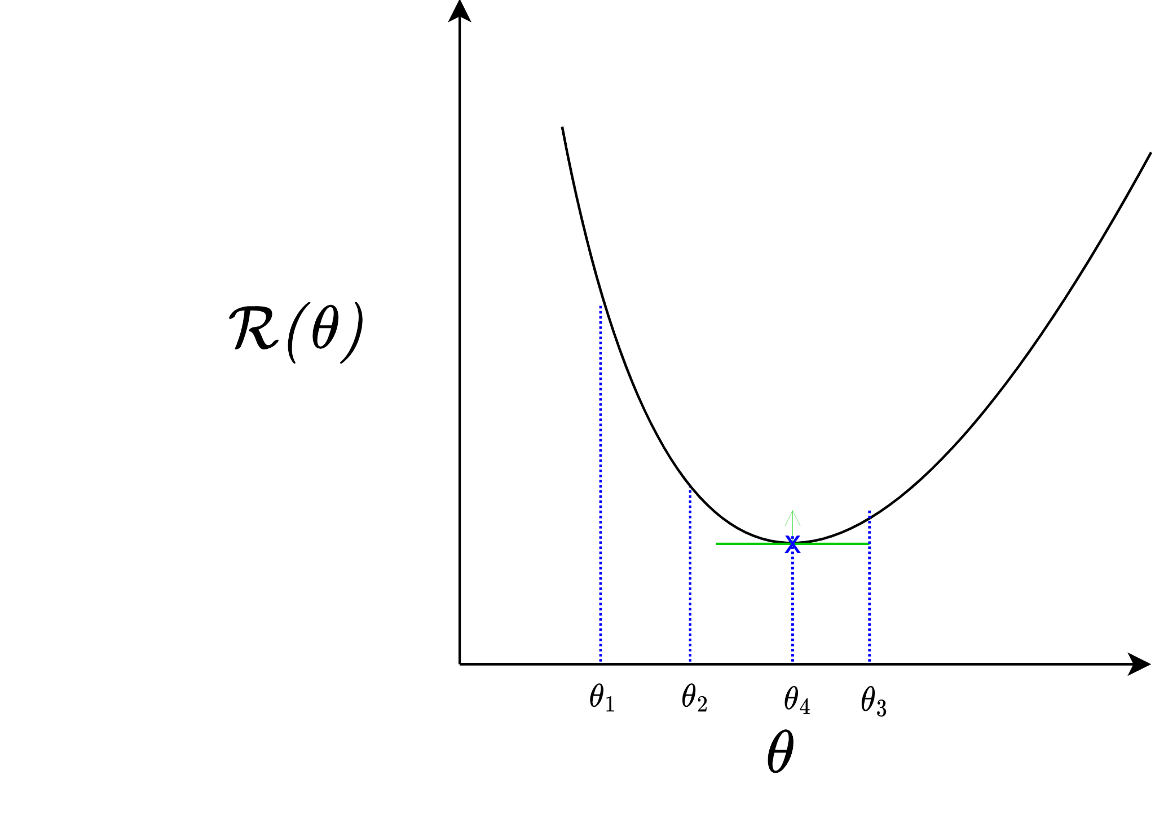
Converges to local minima

Slide 68


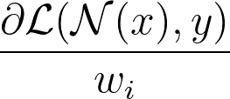
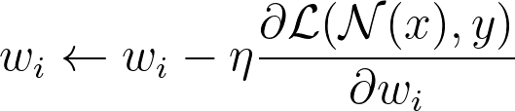

Backprop: Efficient NN GD
Goal: change optimization from to
Recall an MLP:
Use the chain rule to compute the derivatives from output to input
“Backpropagation of errors”

Slide 69
Backprop: Efficient NN GD
Goal: change optimization from to
Recall an MLP:
Use the chain rule to compute the derivatives from output to input
“Backpropagation of errors”
output
input

Slide 70
Backprop: Efficient NN GD
Goal: change optimization from to
Recall an MLP:
Use the chain rule to compute the derivatives from output to input
“Backpropagation of errors”
“forward pass” / “inference”

Slide 71
Backprop: Efficient NN GD
Goal: change optimization from to
Recall an MLP:
Use the chain rule to compute the derivatives from output to input
“Backpropagation of errors”
compute loss

Slide 72
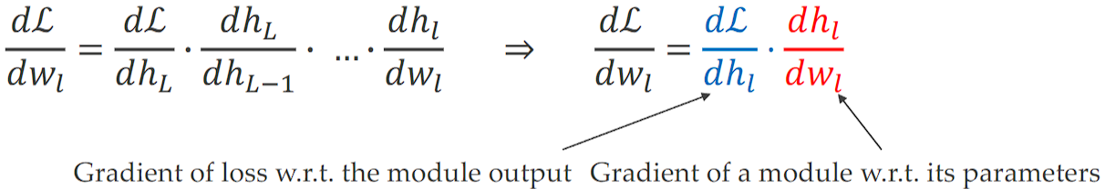
Backprop: Efficient NN GD
Apologies for different notation
Goal: change optimization from to
Recall an MLP:
Use the chain rule to compute the derivatives from output to input
“Backpropagation of errors”
compute gradients

Slide 73
Backprop: Efficient NN GD
Apologies for different notation
Goal: change optimization from to
Recall an MLP:
Use the chain rule to compute the derivatives from output to input
“Backpropagation of errors”
compute gradients

Slide 74
Backprop: Efficient NN GD
Apologies for different notation
Goal: change optimization from to
Recall an MLP:
Use the chain rule to compute the derivatives from output to input
“Backpropagation of errors”
compute gradients

Slide 75
Backprop: Efficient NN GD
Apologies for different notation
Goal: change optimization from to
Recall an MLP:
Use the chain rule to compute the derivatives from output to input
“Backpropagation of errors”
compute gradients

Slide 76
Backprop: Efficient NN GD
Apologies for different notation
Goal: change optimization from to
Recall an MLP:
Use the chain rule to compute the derivatives from output to input
“Backpropagation of errors”
compute gradients

Slide 77
Backprop: Efficient NN GD
Apologies for different notation
Goal: change optimization from to
Recall an MLP:
Use the chain rule to compute the derivatives from output to input
“Backpropagation of errors”
compute gradients

Slide 78
Backprop: Efficient NN GD
Goal: change optimization from to
Recall an MLP:
Use the chain rule to compute the derivatives from output to input
“Backpropagation of errors”
update weights

Slide 79
Backprop: Efficient NN GD
Goal: change optimization from to
Recall an MLP:
Use the chain rule to compute the derivatives from output to input
“Backpropagation of errors”
One “weight update step”

Slide 80
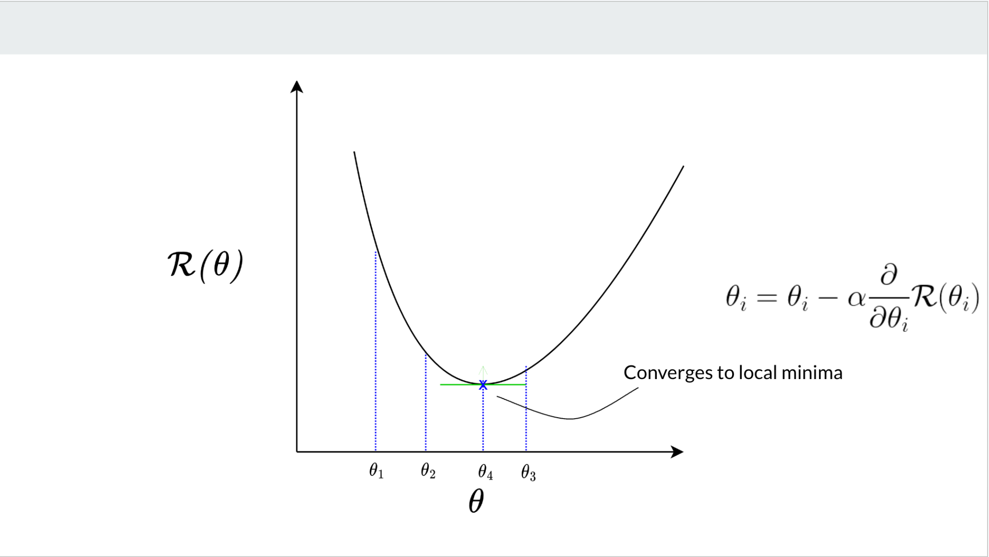
Loss Landscapes
Loss from earlier example:

Slide 81
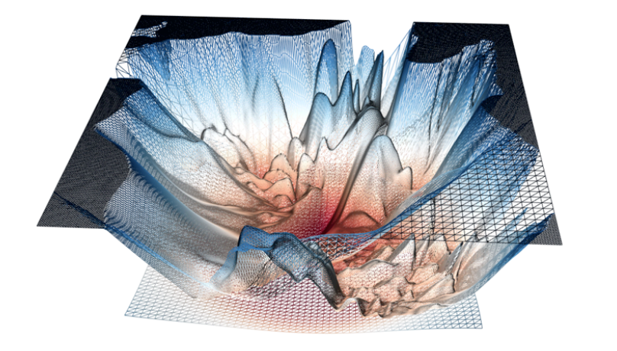
Loss Landscapes
Loss from earlier example:
A “real” loss landscape (right):
Many (many many) local minima
Saddle points
http://www.telesens.co/2019/01/16/neural-network-loss-visualization/
zero gradient = no learning!

Slide 82
Optimizers
Stochastic/Mini-batch GD: Speed improvement!
Perform backprop on errors of batches of training samples instead of all at once
- Reduces the number of expensive backward passes
- Helps with getting out of local minima (due to higher gradient noise)
Optimizers determine exactly how backpropagation is implemented
- Stochastic Gradient Descent (most common)
- RMSProp
- Adaptive Momentum Estimation (“Adam”)

Slide 83

Optimizers
Stochastic/Mini-batch GD: Speed improvement!
Perform backprop on errors of batches of training samples instead of all at once
- Reduces the number of expensive backward passes
Helps with getting out of local minima (due to higher gradient noise)
Optimizers determine exactly how backpropagation is implemented
- Stochastic Gradient Descent (most common)
- RMSProp
- Adaptive Momentum Estimation (“A’dam”)

Slide 84
ML Training paradigms (a selection)
Supervised
  Train a model with explicit input-output pairs
Unsupervised
  Learns “patterns” from unlabelled data
Semi-supervised learning
  Learn a few things with input-output pairs, relate them to patterns learnt unsupervised
Reinforcement Learning
  Learn an optimal “policy” that gives you the best action to take at any given state space by taking random actions and learning through positive or negative reinforcement.
Evolution
  Optimize parameters through (Darwinian) evolution; e.g. genetic algorithms.
Notes:
Okay let’s get back to neural networks

Slide 85
Types of Neural Networks
Notes:
Timestamp: 00:25

Slide 86
Multi-layer Perceptrons
Useful for static input-output relations
More hidden layers ~ better approximation of more complicated functions
Quick to design and implement

Slide 87
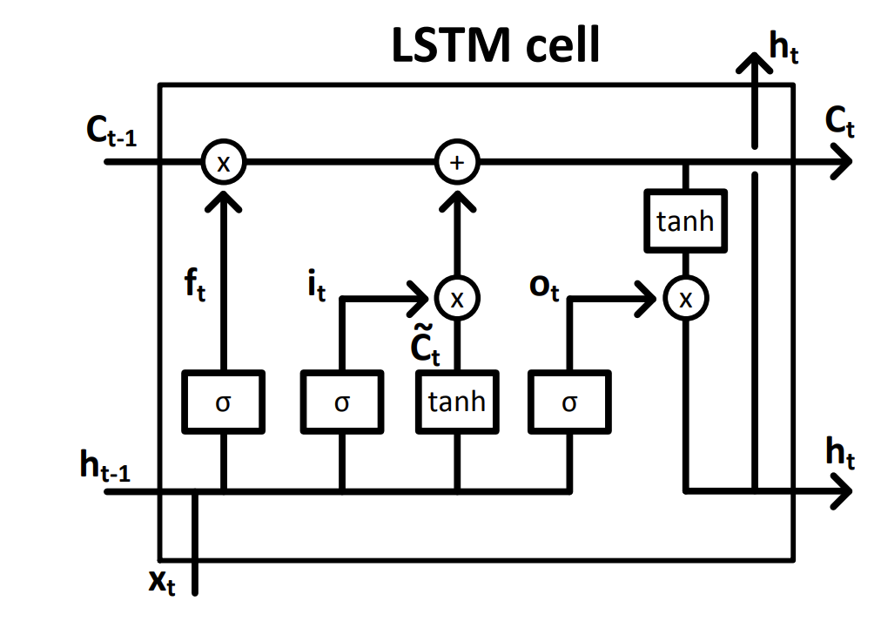
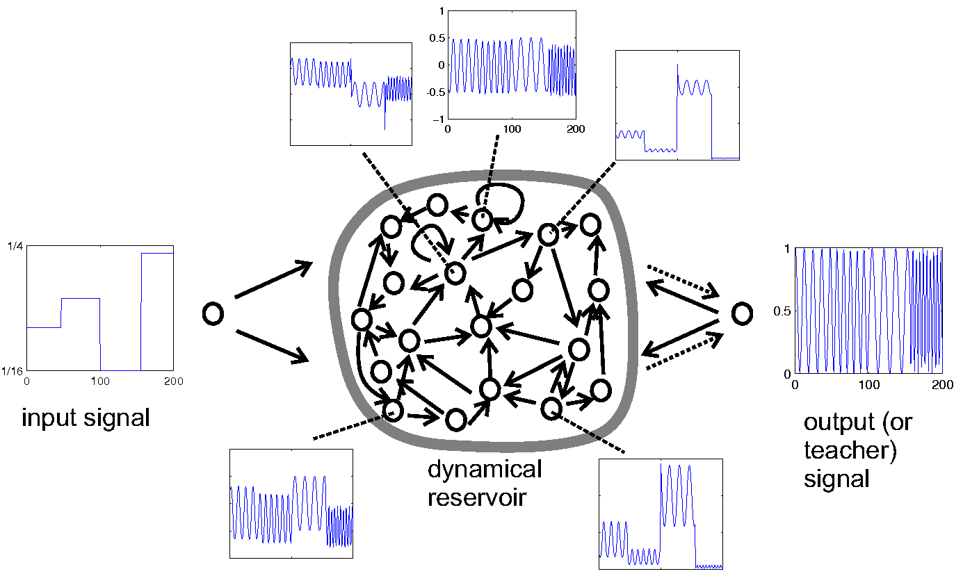
Recurrent Neural Networks
Outputs go back and forth between neurons (loops exist in the graphs)
Approximates dynamical systems
- Any time-based function
- Any data that can be modelled as being “ordered”
Used often in time-series tasks like signal processing, natural language processing
Several types: Fully-connected, LSTMs, GRUs, reservoirs
An LSTM cell schematic. Adapted from: doi.org/10.4233/uuid:dc73e1ff-0496-459a-986f-de37f7f250c9
Echo state network schematic. Adapted from www.scholarpedia.org/article/Echo_state_network

Slide 88
Geometric DL Models
Models or uses ‘manifold embeddings’ on non-Euclidean domains like graphs, meshes and manifolds - geometric inductive bias
Captures various forms of invariance and equivariance (e.g. Grids, Groups, Graphs, Geodesics, and Gauges)
Used in e.g. 3D object recognition, protein structures, medical imagine, etc.

Slide 89

Convolutional Neural Networks
Learn “kernels”, i.e. ‘tensors’ (multi-dimensional arrays) that convolve over n-dimensional data to extract abstract, lower-dimensional features.
Used often in image and signal processing tasks such as object detection and segmentation.
Inductive bias: translational variance: the object can be anywhere in the image and still be found
LeNet’s architecture: One of the first CNNs
https://doi.org/10.1162/neco.1989.1.4.541

Slide 90

Graph Neural Networks
Models any system that can be modelled as a graph
Learns relations between nodes,
edges, global properties
Used in e.g. image segmentation,
chemistry and pharmacy models,
NLP, hierarchically-related data
Inductive bias: relational inductive bias, node invariance, others
Image adapted from this excellent intro to GNNs: https://distill.pub/2021/gnn-intro/

Slide 91


Transformers
Vaswani, A., Shazeer, N., Parmar, N., Uszkoreit, J., Jones, L., Gomez, A. N., ... & Polosukhin, I. (2017). Attention is all you need. Advances in neural information processing systems, 30.
Do not use recurrence or convolutions: rather,
✨attention mechanisms✨
Highly parallel by processing all inputs at once
- Learns relationships between inputs
- Good at long-range dependencies
Used extensively in sequence modelling tasks like translation, image captioning, text generation, anything that can be translated to a sequence.
Several types: Encoder-decoder (e.g. T5), Encoder-only (e.g. BERT), Decoder-only (e.g. GPT); also Visual Transformers for images

Slide 92


Diffusion Models
Learn to generate (complex) data by reversing a gradual noising process
Core idea: Denoising
- Gradually add noise to data (forward process)
- Learn to reverse it step-by-step (reverse-process)
Examples: Denoising Diffusion Probabilistic Models, Stable Diffusion, Imagen, DALL-E family
Yang, L., Zhang, Z., Song, Y., Hong, S., Xu, R., Zhao, Y., ... & Yang, M. H. (2023). Diffusion models: A comprehensive survey of methods and applications. ACM Computing Surveys, 56(4), 1-39.
Rombach, R., Blattmann, A., Lorenz, D., Esser, P., & Ommer, B. (2022). High-resolution image synthesis with latent diffusion models.CVPR

Slide 93
What NNs can and can’t do

Slide 94

Universal Approximation Theorem
⇒ We can approximate any function we want with a one-layer MLP!
More effective with more layers than just one (“deeper” networks)
Easier said than done in practice
Schematic borrowed from Jaeger, H. (2022) Neural Networks Lecture Notes, https://www.ai.rug.nl/minds/uploads/LN_NN_RUG.pdf
Collection of proofs: https://ai.stackexchange.com/questions/13317/where-can-i-find-the-proof-of-the-universal-approximation-theorem

Slide 95

Where NNs thrive
> Statistical/correlation inference needed
> There exists a lot of good quality (labelled) training data
> Parallelizable training and deployment
> Tasks without expansion (input-output fixed)
> Specialized tasks
> Good in-range performance IRL
https://lasp.colorado.edu/home/minxss/2016/07/12/minimum-mission-success-criteria-met/

Slide 96

Limits of NNs
NO.
> No causal relations possible (yet)
> Very data hungry - “Garbage in, garbage out”
> Often expensive to train (depending on size)
> Nonextensible and specialized to a range and task
- Add one more neuron → needs fine-tuning
- Undefined behaviour on out-of-domain test examples
Note on specialization: rf. ‘Foundation Models’
NO MOAR DATA.
https://knowyourmeme.com/memes/grumpy-cat

Slide 97
Training tips

Slide 98
Overfitting & Underfitting
The real troublemakers in ML in general!
Underfitting: When the model fits the training data not well enough
- Empirical risk is high, actual risk is high
- Training loss is high, testing loss is not optimal
Overfitting: When the model fits the training data too closely (incl. noise)
- Empirical risk is low, actual risk is high
- Training loss is low, testing loss is not optimal
- e.g. An D-degree polynomial can fit D-1 training points with zero error

Slide 99

Overfitting & Underfitting
More complex models (e.g. more layers, neurons per layer) -> higher likelihood of overfitting
Image source: https://docs.aws.amazon.com/machine-learning/latest/dg/model-fit-underfitting-vs-overfitting.html

Slide 100
Validation
Split your training set into two!
- New train set
- Unseen-by-the-model “validation”set
Train Set
Test Set (unseen)

Slide 101
Validation
Split your training set into two!
- New train set
- Unseen-by-the-model “validation”set
- e.g. 80-20 split (Note: split ratio depends on the model, task and data)
Train Set
Validation Set
Test Set (unseen)
80%
20%

Slide 102
k-fold Cross-validation
Split training set into k-segments, iteratively train and validate with each segment.
- Accounts for irregularities in training set
- “Gold standard” for evaluating generality of neural network models
Train Set

Slide 103
k-fold Cross-validation
Split training set into k-segments, iteratively train and validate with each segment.
- Accounts for irregularities in training set
- “Gold standard” for evaluating generality of neural network models
e.g. k=5 (5-fold cross-validation)
Train Set
Train Set
Train Set
Train Set
Train Set

Slide 104
k-fold Cross-validation
Split training set into k-segments, iteratively train and validate with each segment.
- Accounts for irregularities in training set
- “Gold standard” for evaluating generality of neural network models
e.g. k=5 (5-fold cross-validation)
Validation Set
Train Set
Train Set
Train Set
Train Set

Slide 105
k-fold Cross-validation
Split training set into k-segments, iteratively train and validate with each segment.
- Accounts for irregularities in training set
- “Gold standard” for evaluating generality of neural network models
e.g. k=5 (5-fold cross-validation)
Train Set
Validation Set
Train Set
Train Set
Train Set

Slide 106
k-fold Cross-validation
Split training set into k-segments, iteratively train and validate with each segment.
- Accounts for irregularities in training set
- “Gold standard” for evaluating generality of neural network models
e.g. k=5 (5-fold cross-validation)
Train Set
Train Set
Validation Set
Train Set
Train Set

Slide 107
k-fold Cross-validation
Split training set into k-segments, iteratively train and validate with each segment.
- Accounts for irregularities in training set
- “Gold standard” for evaluating generality of neural network models
e.g. k=5 (5-fold cross-validation)
Train Set
Train Set
Train Set
Validation Set
Train Set

Slide 108
k-fold Cross-validation
Split training set into k-segments, iteratively train and validate with each segment.
- Accounts for irregularities in training set
- “Gold standard” for evaluating generality of neural network models
e.g. k=5 (5-fold cross-validation)
Result = average over all validation passes
Train Set
Train Set
Train Set
Train Set
Validation Set

Slide 109


Training curves
Important to plot!

Slide 110
Training curves
Important to plot!(!!!!)

Slide 111
Training curves
Important to plot!(!!!!)
Shows if and how fast your model is learning on task-relevant metrics
- e.g. loss, accuracy, AUC, F1 score
- Plot scores over training epochs

Slide 112
Training curves
Important to plot!(!!!!)
Shows if and how fast your model is learning on task-relevant metrics
- e.g. loss, accuracy, AUC, F1 score
- Plot scores over training epochs
May indicate potential over and underfitting

Slide 113

Reading training curves
If
validation loss > training loss
then often the model is good!
Low loss == Better

Slide 114

Reading training curves
If
validation loss >> training loss
then often the model is overfitting
Low loss == Better

Slide 115

Reading training curves
If
validation loss ~ training loss
then often the model is underfitting
Low loss == Better

Slide 116

Reading training curves
If
validation loss < training loss
then something is very wrong, or totally expected!
Low loss == Better

Slide 117


Regularization
L1/L2 Regularization
Added losses:
Dropout (on when training, off when testing/deploying)
Early stopping

Slide 118

Parallelization:
Speeding up NNs
Main math operation in NNs:
- Matrix-vector multiplications
- Element-wise nonlinear activation functions
Parallelization can be used to massively speed up learning and deployment!
- Multi-core CPUs
- Graphics processing units (GPUs)
- Tensor processing units (TPUs)
- FPGAs
Image from https://cloud.google.com/blog/products/ai-machine-learning/an-in-depth-look-at-googles-first-tensor-processing-unit-tpu

Slide 119
Frontiers
Deep learning
- Models with hundreds of layers, billions of weights
- Transformers, generative adversarial networks, autoencoders
- Foundation models, self-supervised learning, generative AI
- AutoMLs: a tool to automatically generate good ML models for a task
Explainable AI (XAI)
- Explainable+interpretable+controllable models
- Human-like and human-understandable reasoning
- Neurosymbolic:
Semantic losses, logic tensors, symbolic regression, conceptors…
Others: Physics Informed NNs
Neural ODEs, PDEs
Quantum ML, Geometric DL
Me: Neurosymbolic-constrained multi-agent reinforcement learning

Slide 120
Reference Material
- Hastie, T., Tibshirani, R., Friedman, J. H., & Friedman, J. H. (2009). The elements of statistical learning
- Bishop, C. M. (2006). Pattern recognition and machine learning
- LeCun, Y., Bengio, Y., & Hinton, G. (2015). Deep learning
- Goodfellow, I., Bengio, Y., & Courville, A. (2016). Deep learning
- Chollet, F. (2021). Deep learning with Python
- Géron, A. (2022). Hands-on machine learning with Scikit-Learn, Keras, and TensorFlow
- Erdmann, M., Glombitza, J., Kasieczka, G., & Klemradt, U. (2021). Deep learning for physics research.
- Bronstein, M. M., Bruna, J., Cohen, T., & Veličković, P. (2021). Geometric deep learning
- Raissi, M., Perdikaris, P., & Karniadakis, G. E. (2019). Physics-informed neural networks: A deep learning framework for solving forward and inverse problems involving nonlinear partial differential equations
- Kipf, T. N., & Welling, M. (2016). Semi-supervised classification with graph convolutional networks
- Vaswani, A., Shazeer, N., Parmar, N., Uszkoreit, J., Jones, L., Gomez, A. N., ... & Polosukhin, I. (2017). Attention is all you need
- Kingma, D. P., & Welling, M. (2013). Auto-encoding variational bayes. arXiv preprint arXiv:1312.6114.
- UvA Deep Learning 1 (Graduate) Tutorials https://uvadlc-notebooks.readthedocs.io/en/latest/ (see also the DL2 lectures)
- University of Groningen ML and NN lecture notes https://www.ai.rug.nl/minds/teaching/ln/
- …many many more

