Slide 1



TDAQ for space experiments
ISOTDAQ 2025
International School Of Trigger and Data AcQuisition
Valentina Scotti
scottiv@na.infn.it
Università degli Studi di Napoli Federico II
INFN - Sezione di Napoli

Slide 2
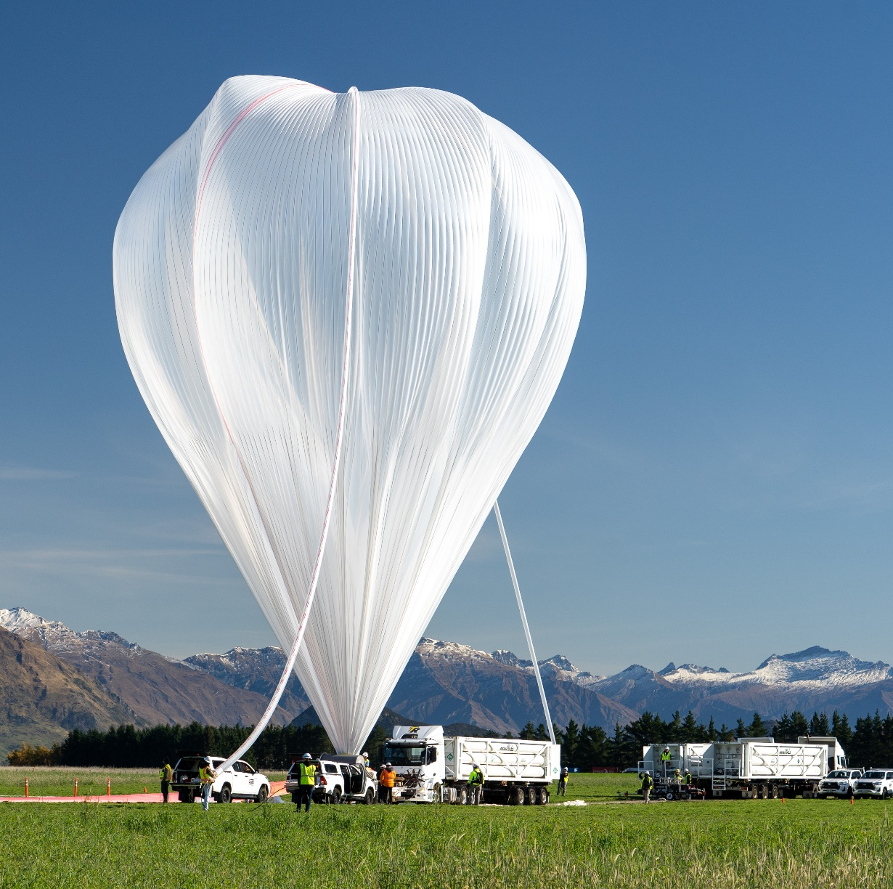
Outline
Why space?
Cosmic rays
Challenges for electronics in space
Space qualification
Examples of TDAQ in space

Slide 3
Why space?
Cosmic rays
Challenges for electronics in space
Space qualification
Examples of TDAQ in space

Slide 4
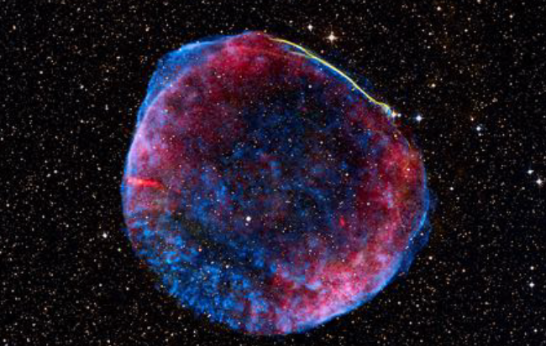
Space: why bother?
Deep connection between very small and very high distances!
Notes:
One overarching objective of science is to further our understanding of the universe, from its early stages to its current state and future evolution. This depends on gaining insight on the universe’s most macroscopic components, for example galaxies and stars, as well as describing its smallest components, namely elementary particles and nuclei and their interactions.
Measuring the properties of cosmic rays, or astroparticles, in space provides a unique window to investigate the frontiers and open questions of fundamental physics in an approach that is synergic, yet complementary, to that pursued by the research at ground facilities and at particle accelerators.

Slide 5
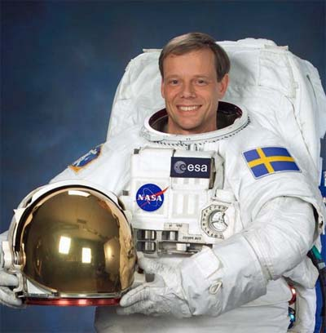
Accelerator Vs Space
Particle physics developed by studying CR in the Earth’s atmosphere: positrons, muons, pions and strange particles were revealed detecting CR or their interaction products
40 years of technological efforts to reproduce CR energies with accelerators and to compete in intensity
Accelerators based experiments
o Rapid evolution
o Huge technological effort
o Huge number of channels
o Power limitation mainly to reduce thermal problems and heating
o Radiation hardness is a real challenge
o Reliability in the harshest and not accessible parts
o Cost/large scale applications
Space-based experiments
o Traditionally used to ‘old and safe technologies’: significant ‘philosophical changes’ in the last decades
o Reduced power consumption
o Limited radiation hardness: Single Event Effects
o Reliability
o Harsh environment
- Launch phase
- Thermal environment
Shared software and hardware solutions and common challenges:
Ever-increasing volume of data
Need for fast and close-to-real-time analysis of the data
Notes:
Another example of a common challenge for different fields is the ever-increasing volume of data available to different fields of research. Examples of current “data firehoses” are the LHC and upcoming astrophysics surveys. Similar challenges in data acquisition and recording are present in neutrino physics experiments, in the case of their supernova detection data streams. In all these cases, a fast and close-to-real-time analysis of the data is necessary, so that events of interest can be recorded or investigated further in a timely and cost-effective way, and common real-time analysis solutions are being investigated and deployed by multiple experiments.
Another point of contact is when software solutions are shared across fields, for example in the case of gravitational waves and high energy physics with the CernVM software appliance and the RUCIO distributed data management system that is in use by LHC experiments and will be adopted by neutrino experiments as well.

Slide 6
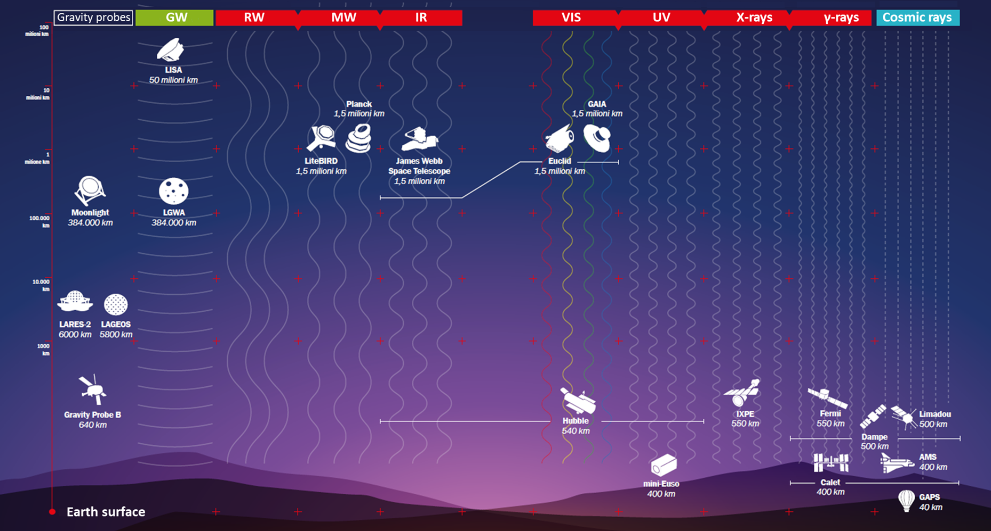
Notes:
During the last decades, thanks to the development of new technologies, telescopes provided more precise observations of the Universe and enabled us to explore it further in unprecedented ways.
Cosmic rays, together with photons, neutrinos and gravitational waves, are an essential part of the multi-messenger approach to unveiling the structure of the Universe and its cosmological evolution.
Space observations have been crucial to study primary cosmic rays at lower energies and explore the rich astrophysical implications of their characteristics, but the origin of Ultra-High Energy Cosmic Rays is still unknown.

Slide 7
Why space?
Cosmic rays
Challenges for electronics in space
Space qualification
Examples of TDAQ in space

Slide 8
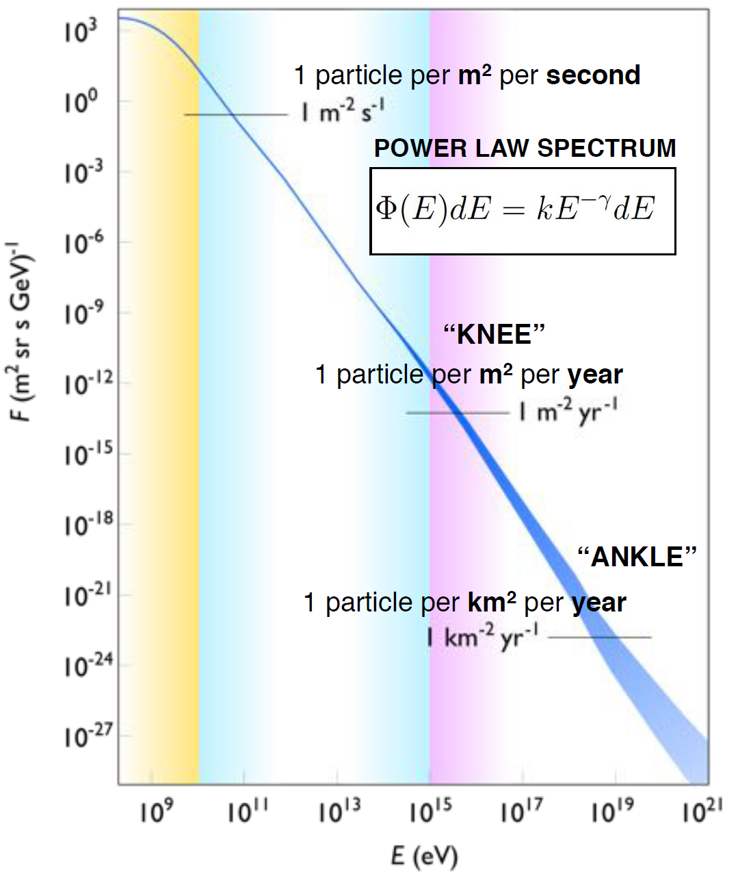
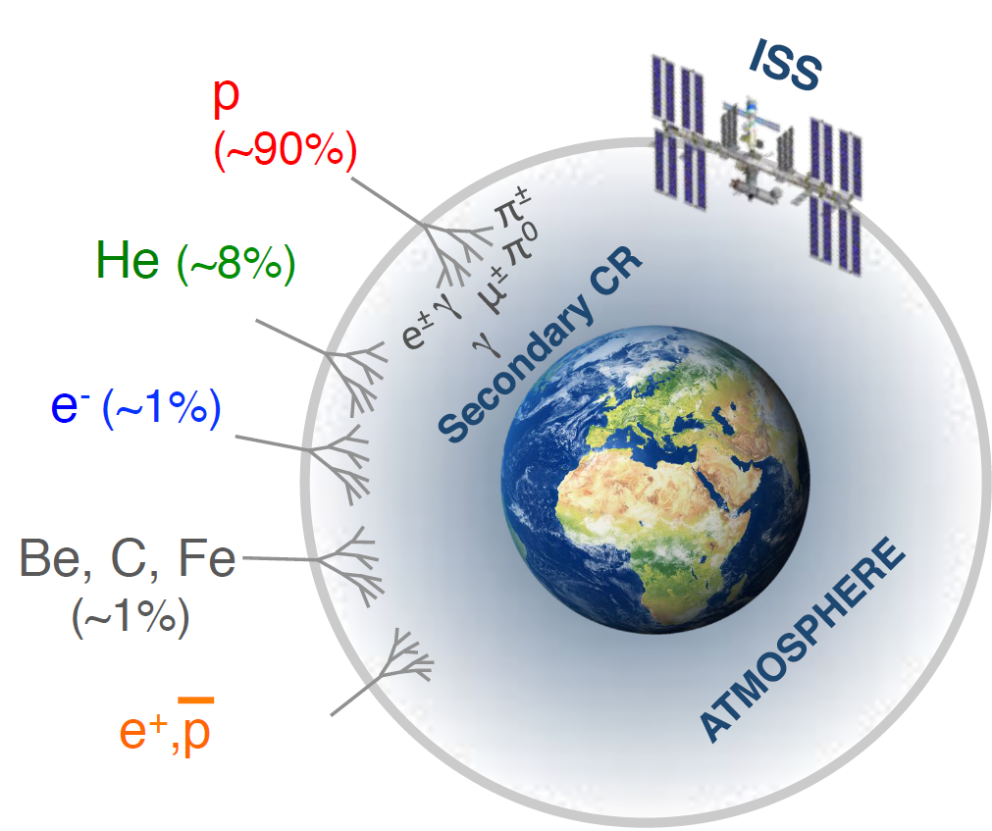
Cosmic rays
Energy range up to 10²⁰ eV
Intensities spanning 30 orders of magnitude
Most of cosmic rays are protons and nuclei
Notes:
Cosmic ray Flux: Intensity of CR in space per unit of area, solid angle, time and energy
Solar / galactic / extragalactic
Measuring the properties of cosmic rays, or astroparticles, in space provides a unique window to investigate the frontiers and open questions of fundamental physics in an approach that is synergic, yet complementary, to that pursued by the research at ground facilities and at particle accelerators.

Slide 9
What can we learn from CR?
Astrophysics
• Origin of cosmic rays
• Acceleration of charged particles up to PeV energies (“Pevatrons”)
• Peculiar sources (pulsars, quasars, black holes, ….)
• Star and solar system evolution
• Solar physics
Particle physics & cosmology
• Hadronic interactions and X-sections (above LHC energies)
• Matter/Antimatter asymmetry
• Dark Matter searches
Notes:
the challenge of elucidating the nature of 27% of the matter-energy content of the universe, commonly called “dark matter”. Pursuing these scientific goals also requires mastering challenges related to instrumentation (e.g. beams and detectors), data acquisition, selection and analysis, and making data and results available to the broader science communities.

Slide 10
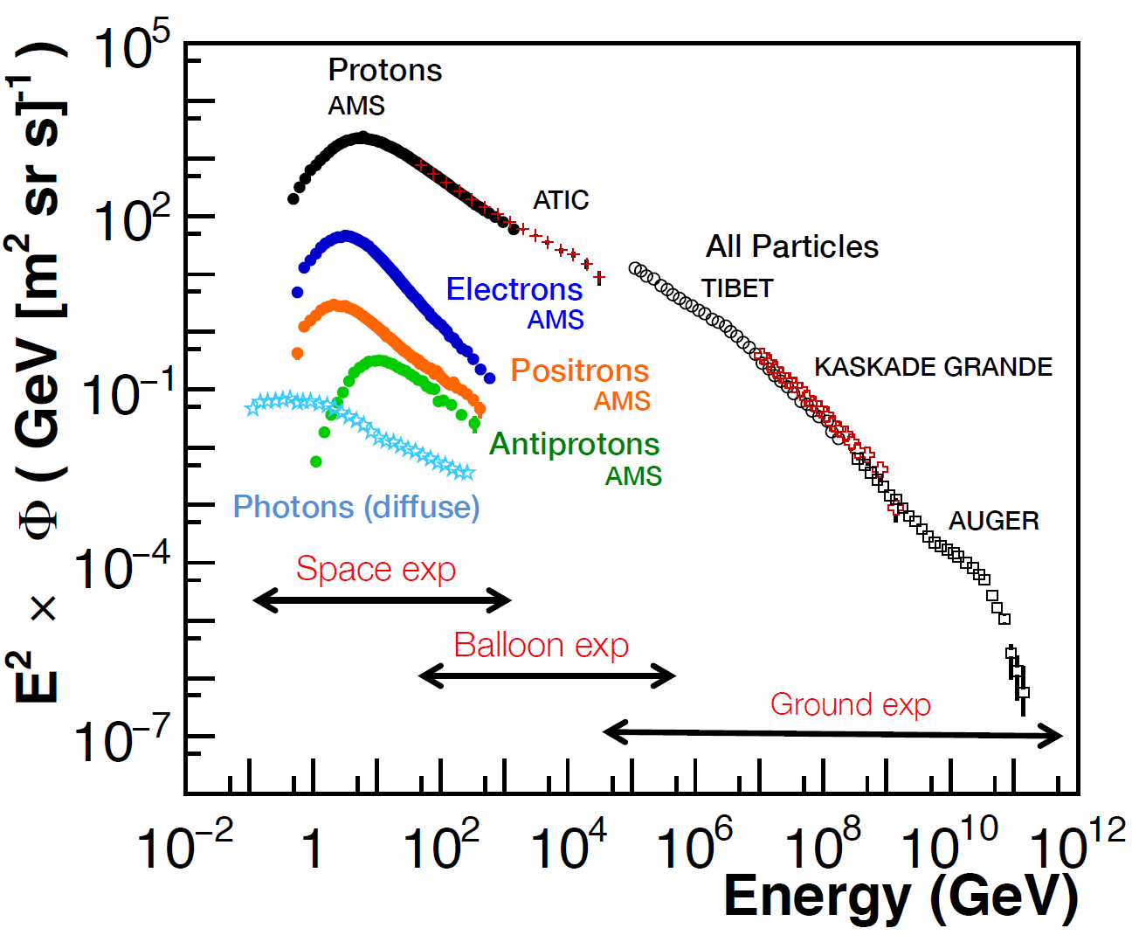
Experimental detection
Primary CRs interact with atmosphere: only secondary CRs reach the ground
Flux steeply falling as function of energy: need large collection areas
Ground based experiments:
large collection areas, needed for TeV –Eev CR
only indirect measurements (highly reliant on MC simulations)
Notes:
Ground experiment can only perform indirect measurements: primary CR identified via the analysis of shower shapes and composition at ground (highly rely on MonteCarlo simulations). The main systematics are the parametrization of X-sections at very high energies
Atmosphere as a ≪ calorimeter ≫ :

Slide 11
Satellite experiments
Direct measurements outside atmosphere
Continuous duty cycles, typically many years of lifetime
Field of view covering the whole sky
Smaller acceptances
Operation in space and communications not trivial
Expensive
“Use once and destroy”

Slide 12
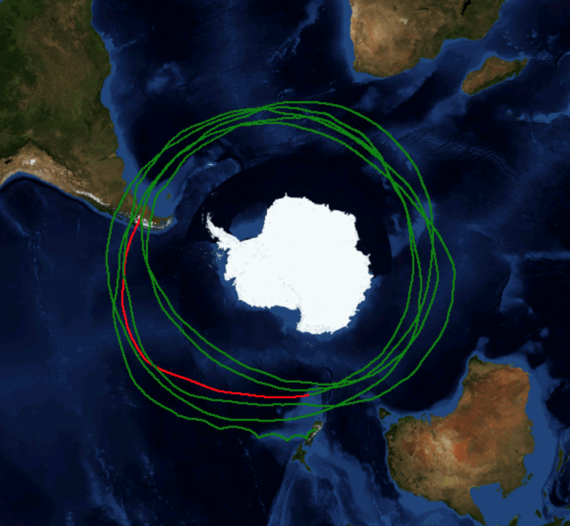
Balloon experiments
Larger acceptances than space borne experiments
Direct measurements
The payload can be recovered
Orbit limited at poles for maximum 1 month
Residual atmosphere above the payload

Slide 13
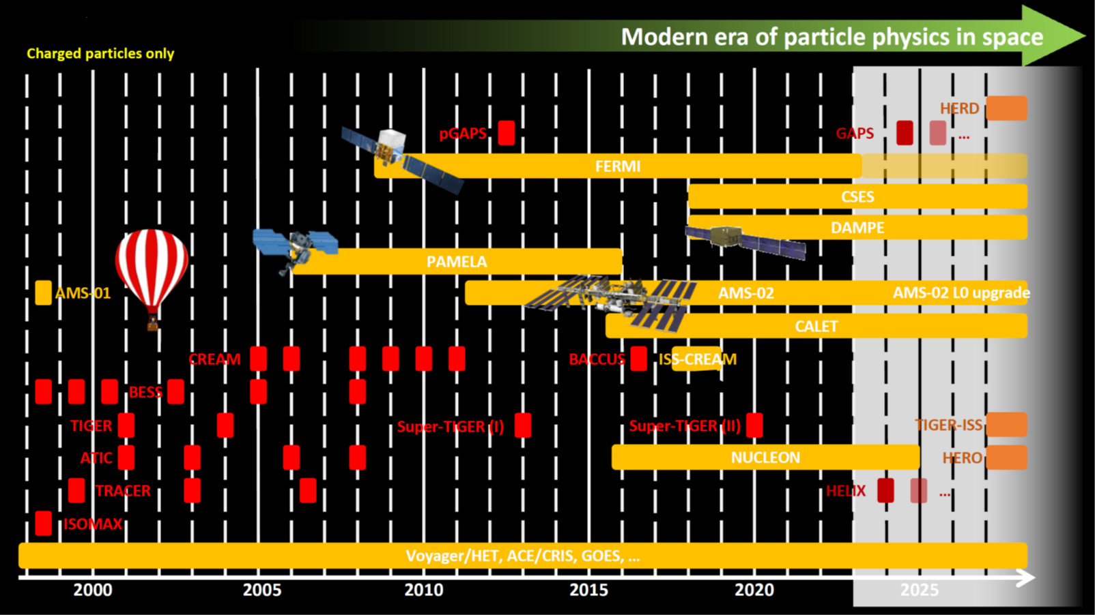
Cosmic rays from space since 2000
Slide from V. Vagelli

Slide 14
Why space?
Cosmic rays
Challenges for electronics in space
Space qualification
Examples of TDAQ in space

Slide 15
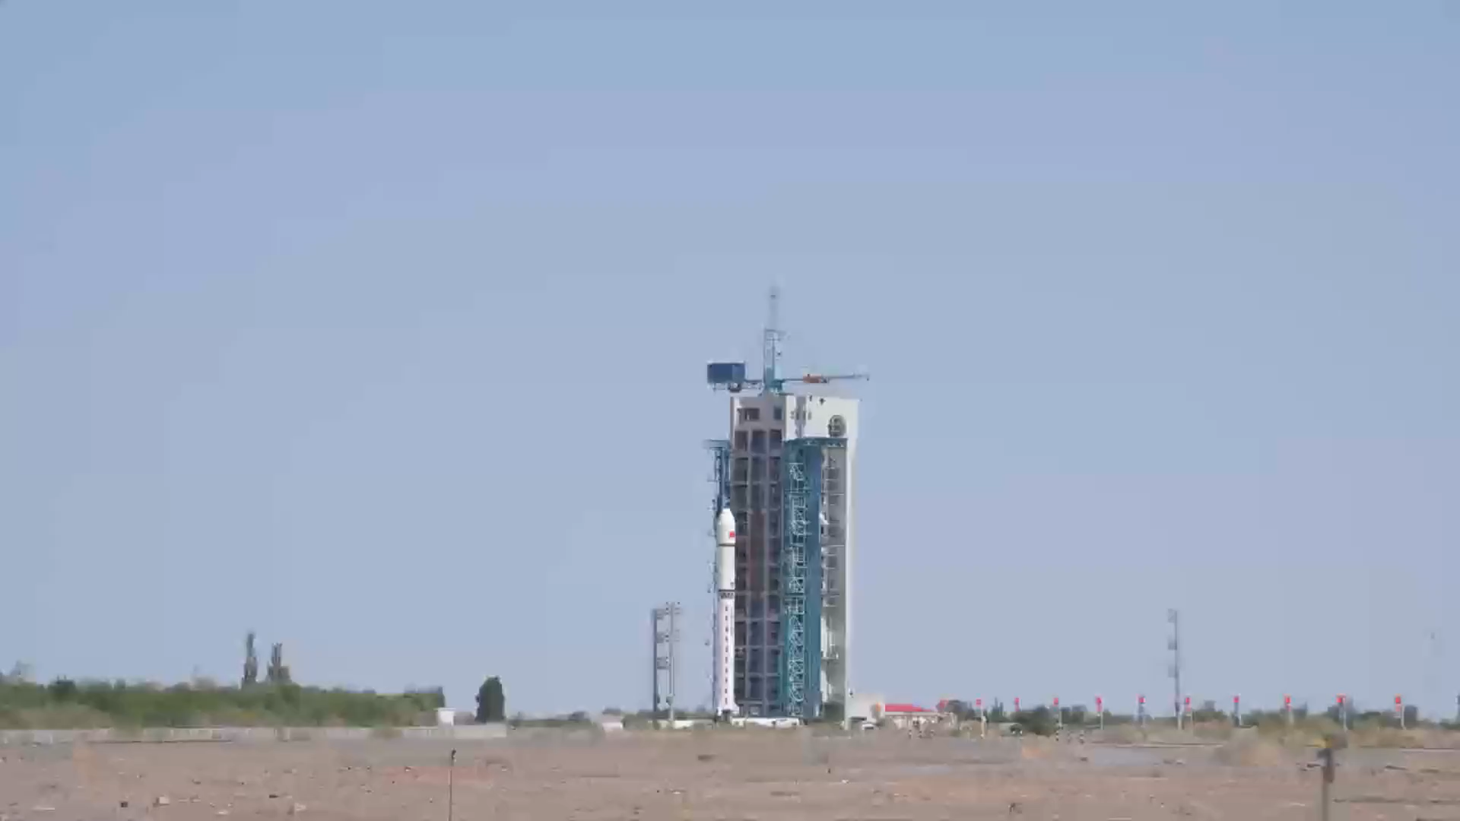
Getting to space
Mechanical stress at launch: huge mechanical vibrations can cause problems, such as resonance, in the electronic components
Static acceleration up to 3g
Random and sinusoidal vibration: 20-2000 Hz 3,2 grms
Depressurization: pressure drop from 1 bar to 0 in less than 2 minutes
Pyroshock >1000Hz
Notes:
Pyroshock is the response of the structure to high frequency, high magnitude stress waves that propagate throughout the structure as a result of an explosive charge, like the ones used in a satellite ejection or the separation of two stages of a multistage rocket.
Pyroshock exposure can damage circuit boards, short electrical components, or cause all sorts of other issues.

Slide 16
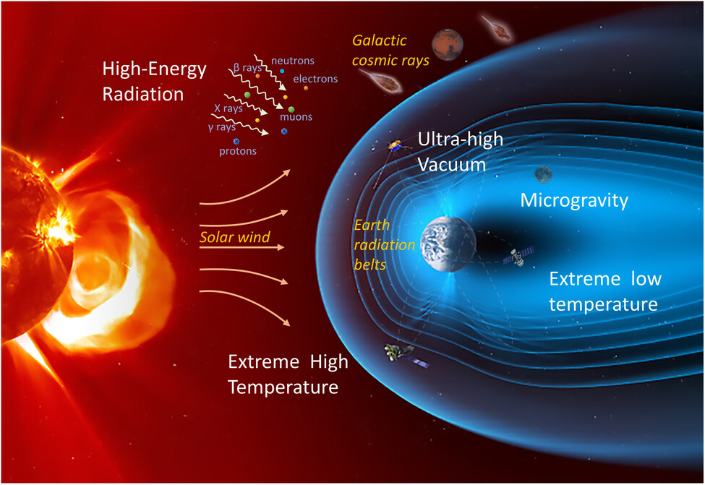
The hard life of electronics in space
Space is a harsh environment from many points of view:
Thermal: extreme temperature variations due to Sun-light (seasonal, day-night effects): no atmosphere, hence no heat dissipation
Vacuum: prevents heat dissipation, can cause outgassing and it’s a favorable environment for tin whiskers
Electromagnetic: high levels of contamination on surfaces can contribute to electrostatic discharge
Notes:
Outgassing: trapped gas is released from a material such as plastic,glues and adhesives. The air or vapor that is released can deposit material on other devices and obstruct or reduce their working.
tin whiskers: electrically conductive, crystalline structures of tin that sometimes grow from surfaces where tin is used as a final finish. Pure tin, zinc, and cadmium plating are prohibited on IEEE parts and associated hardware in space

Slide 17
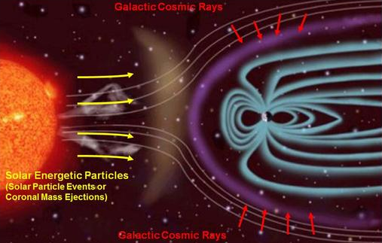
Cosmic rays, aren’t they dangerous?
Radiation: large variations in the levels of and types of radiation a spacecraft may encounter (Low Earth Orbit, Geostationary Orbits or Interplanetary Missions). The radiation levels also vary with the solar cycle.
The radiation environment close to Earth is divided into two categories:
particles trapped in the Van Allen belts: energetic protons, electrons, and heavy ions
transient radiation: galactic cosmic ray particles and particles from solar events (coronal mass ejections and solar flares)
There are two primary ways that radiation can affect satellite electronics:
Total Ionizing Dose (TID): long-term failure mechanism
Single Event Effects (SEEs): instantaneous failure mechanism
Notes:
SEE is expressed in terms of a random failure rate, whereas TID is a failure rate that can be described by a mean time to failure.
TID is a time dependent, accumulated charge in a device over the lifetime of a mission. A particle passing through a transistor generates electron hole pairs in the thermal oxide. The accumulated charges can create leakage currents, degrade the gain of a device, affect timing characteristics, and, in some cases, result in complete functional failure. The total accumulated dose depends on the orbit and time. In LEO, the main source of radiation is from electrons and protons (inner belt) and in GEO, the primary source is from electrons (outer belt) and solar protons. It is worth noting that device shielding can be used to effectively reduce the accumulation of TID radiation.
SEEs are caused by a single, high-energy particle passing through a device and injecting a charge in the circuit. Typically, SEEs are divided into soft errors and hard errors.

Slide 18
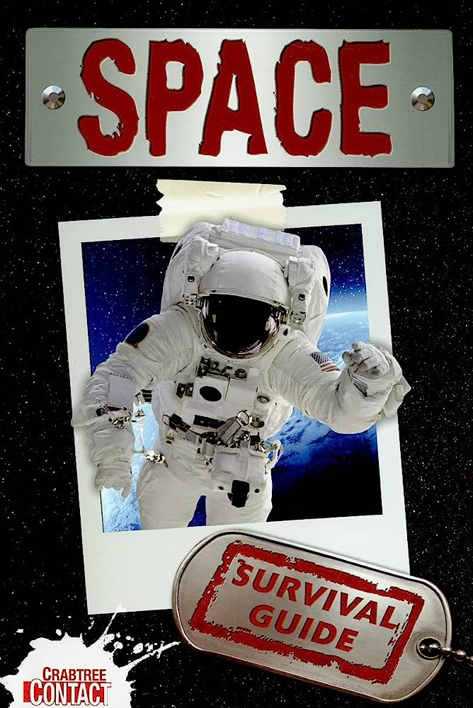
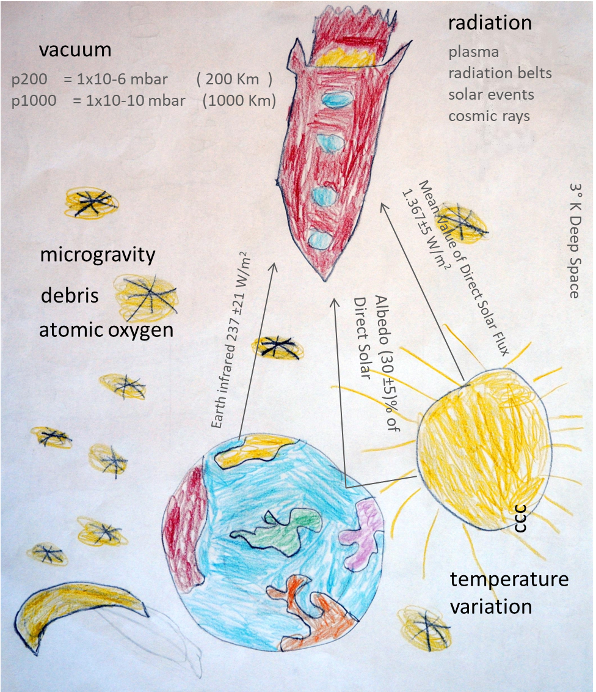
Electronics in space, how to survive
Careful design, model validation and qualification are needed to ensure highest possible reliability
Conductive/radiative heat transfer
Ceramic rather than plastic components to avoid outgassing (PCBs without serigraphy)
Lead-based solder to eliminate the risk of electrical shorts
Coating/potting to prevent discharge and improve mechanical resistance
Use of polyimide material for the manufacturing of PCBs to improve resistance to mechanical stresses
Hot/cold redundancy (i.e., two identical copies of the circuit completely independent of each other that cannot be powered at the same time) to increase overall reliability during flight against hard errors
High reliability: devices with heritage or beam tested
Notes:
JEDEC defines a hard error as an irreversible change in operation that is typically associated with permanent damage to one or more elements of a device or circuit (for example, gate oxide rupture, or destructive latch-up events). The error is hard because the data is lost and the component or device no longer functions properly, even with a power reset. SEE hard errors are potentially destructive. Examples of hard errors are single event latch-up (SEL), single event gate rupture (SEGR), and single event burnout (SEB). SEEs hard errors can destroy the device, drag down the bus voltage, or even damage the system power supply.

Slide 19
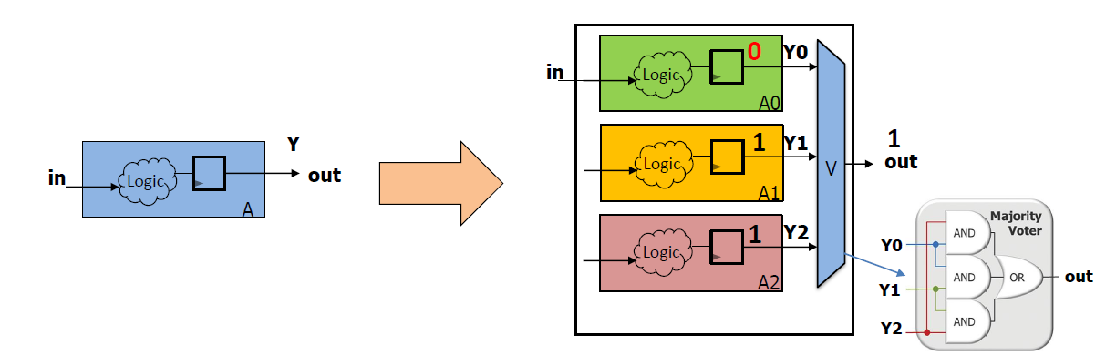
Programmable electronics in space
More complex electronics, greater risk from radiation effects
Thinner IC are less sensitive to TID radiation
Reduced IC scaling increases SEEs: less energy is required to produce Single Event Transient (SET) and Single Event Upset (SEU)
With higher frequency devices, SETs can turn into more SEUs, increasing the number of functional interruptions. Mitigation techniques for higher speed transient signals are more challenging
Design choices the increase the tolerance to radiation at primitive, macrocell and functional level [area, power and speed penalties]
  triple-modular design (time/space): comparison logic to provide the output before performing a recovery operation on the failed system
  EDAC
Protection and recovery mechanisms of memories
  Error checking and correction for ensuring that memory arrays affected by SEEs do not cause SEUs
Notes:
Examples of soft errors would be bit flips or changes in the state of memory cells or registers. A SET is a transient voltage pulse generated by a charge injected into the device from a high energy particle. These transient pulses can cause SEFIs. SEFIs are soft errors that cause the component to reset, lock-up, or otherwise malfunction in a detectable way, but does not require power cycling of the device to restore operability. A SEFI is often associated with an upset in a control bit or register.
single-event latch-up (SEL). This is caused by the formation of a parasitic bipolar transistor in the wells of a CMOS transistor, creating a temporary low resistance path between power and ground. High currents passing through this path will result in permanent damage.

Slide 20
Why space?
Cosmic rays
Challenges for electronics in space
Space qualification
Examples of TDAQ in space

Slide 21
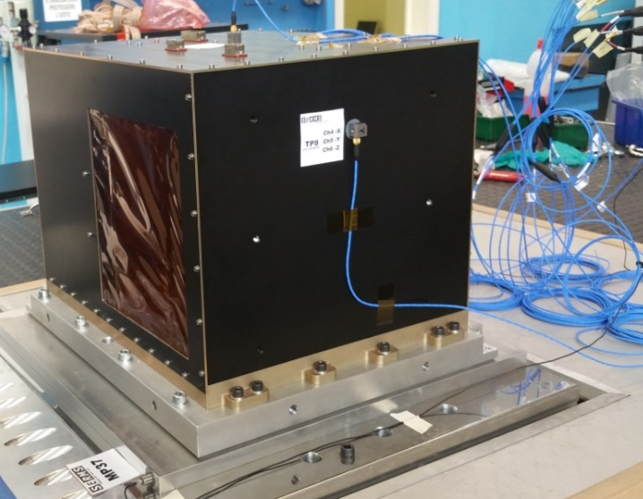
Space qualification
Functional/electrical tests of prototypes to assure that the behavior of the component satisfies all the expected functional performances and specifications after each stress test
Mechanical tests:
  shock (only for QM)
  sinusoidal vibration
  random vibration
Thermal tests:
  ambient-pressure thermal-cycles
  in-vacuum thermal-cycles
  burn-in
ElectroMagnetic Compatibility test
Calibration/beam test (hopefully)
Satellite communication system compatibility test
Thermal, vacuum and communication test
are mandatory also for ballons

Slide 22
Payload models
Electrical Model (EM): mock-up of the payload with all electric and electronic interfaces (power bus, TM/TC, CAN-bus and RS422) with satellite
  demonstrate HW and SW design
  verify electric and electronic compatibility w/ satellite
  test the compatibility w/ Electrical Ground Support Equipment
Structural and Thermal Model (STM): complete mechanical mock-up with dummy sensors and electronics to emulate the real heat dissipation
  validate the structural and mechanical design
  test the payload thermal control design
Qualification Model (QM): identical to the Flight Model (FM), developed and submitted to a complete qualification test campaign to assess the design and the technological solutions, and to demonstrate its performance

Slide 23

Additional requirements on TDAQ for space
Low power
Lightweight/small volume
Limited bandwidth for data transfer (and command broadcasting too!)
Guarantee reliability and performance over a very long time
Reliable communication protocols (not the fastest) and connectors
ITAR constraints
Rad-hard parts generally lag the state of the art by about 10 years
Can’t shield from cosmic rays
DAQ operations depend on orbit position: increase of trigger rate in polar region (low magnetic field and trapped particles) and in the South Atlantic Anomaly
SPACE ELECTRONICS
REQUIREMENTS FOR TDAQ IN SPACE
Additionally… everything has to work unattended in total autonomy: no shifters, no possibility to fix anything
  Safety and recovery procedures in case of system failures/issues
  Watchdog for reset and power procedures
  Short data-acquisition runs
Notes:
radiation hard parts generally lag the state of the art by about 10 years or more

Slide 24
Generic DAQ hardware (for space)
Gbit TX/RX avoided
Front-end ASICs
On-chip nonvolatile flash EEPROM to store the configuration of the FPGA logic structure
  no susceptibility to TID
  cross-section for SEE of the order of 10⁻⁴ cm²/kbit, w/ negligible SEL/device
Storage of non-volatile data (firmware and run-time data) on FRAMs and flash type memories:
  Lower voltage to perform a write operation, which implies lower power consumption (1:21)
  write operations are faster (16:1)
  SEU response is good
  Elevated device endurance: larger number of write cycles. Endurance is crucial issue because FRAMs are used to store the program codes of the DSPs, and detector calibration data calculated at every satellite orbit
R. Ferrari’s talk on Sat.
D. Rabady’s talk on Mon.

Slide 25
Why space?
Cosmic rays
Challenges for electronics in space
Space qualification
Examples of TDAQ in space

Slide 26
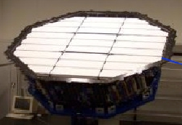
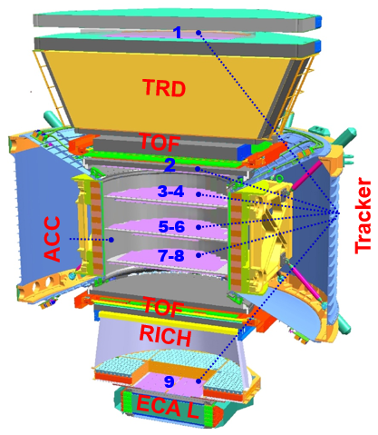

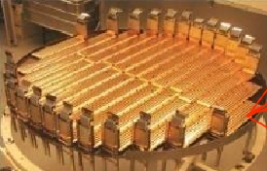
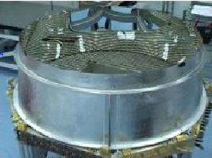
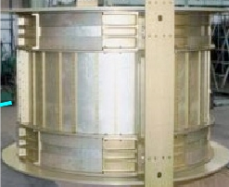
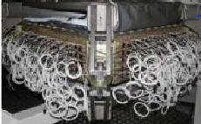
AMS: TeV precision spectrometer
TRD:
identifies e+/e-
ToF:
Z, E
Silicon tracker:
Z, P
RICH:
Z, E
Ecal:
E of e+/e-
Particles and nuclei are defined by their charge (Z), energy (E) and momentum (P) which are measured independently
Magnet:
±Z

Slide 27
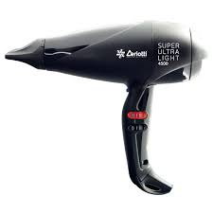
AMS characteristics
ISS orbit period ~ 90min
+/- 50 deg latitude covered
Mission duration from 2011 until the end of the ISS life (it underwent some refurbishment from the ISS crew)
Data Readout 300’000 channels
<Data Downlink> ~ 12 Mbps
Magnetic Field 0.14 T
Size 5 x 4 x 4 m³
7500 kg
Power 2500 W

Slide 28
AMS Data AQuisition
DAQ operations depend on orbit position: increase of trigger rate in polar region and in the SAA
For each trigger, the DAQ:
freezes the analog information on all the sensors (~300’000)
digitizes them
packages data to send them to ground
The flux of CR through the detector is higher than the digitization capabilities: only a fraction of the CR crossing the detector has to be recorded
    Average rate ~700 Hz
    DAQ efficiency: 85%
    DAQ processing: O(100 μs – 1 ms)
    60 millions particles/day
    39 TB raw data/yr
Notes:
(typically, particles crossing the interesting detector fiducial volume and above a certain energy threshold)

Slide 29
AMS trigger
the trigger needs to be fast enough to trigger readout system of the other sub-detectors
a compromise between the maximum number of events stored with respect to the capabilities of data storage and transfer and event pileup
largest efficiency while keeping the detector rate < 2kHz (bandwidth limitation)
AMS uses information from fast detectors combining it in a simple AND-OR logic:
the fast information of the TOF for charged CR
the external anticoincidence to veto CR outside the acceptance
the fast ECAL information for photons (which don’t release any energy in the TOF)

Slide 30
AMS trigger topology
Global Trigger = OR between 4 triggers:
unbias: TOF 3/4, scaled by 100: efficiency close to 100%, no energy dependence, use to estimate the efficiency of other triggers
proton: TOF 4/4, Nacc = 0
ion: TOF 4/4 Signal>(Z=1), Nacc < 3
electron: TOF 3/4 HT, ECAL shower
AMS can identify 1 positron from 10⁶ protons, unambiguously separate positrons from electrons up to a TeV

Slide 31
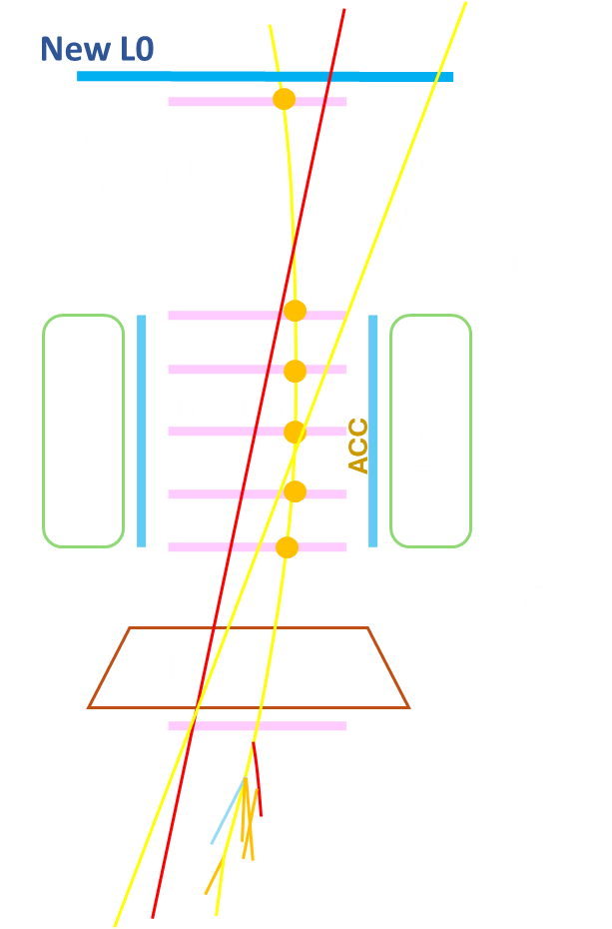
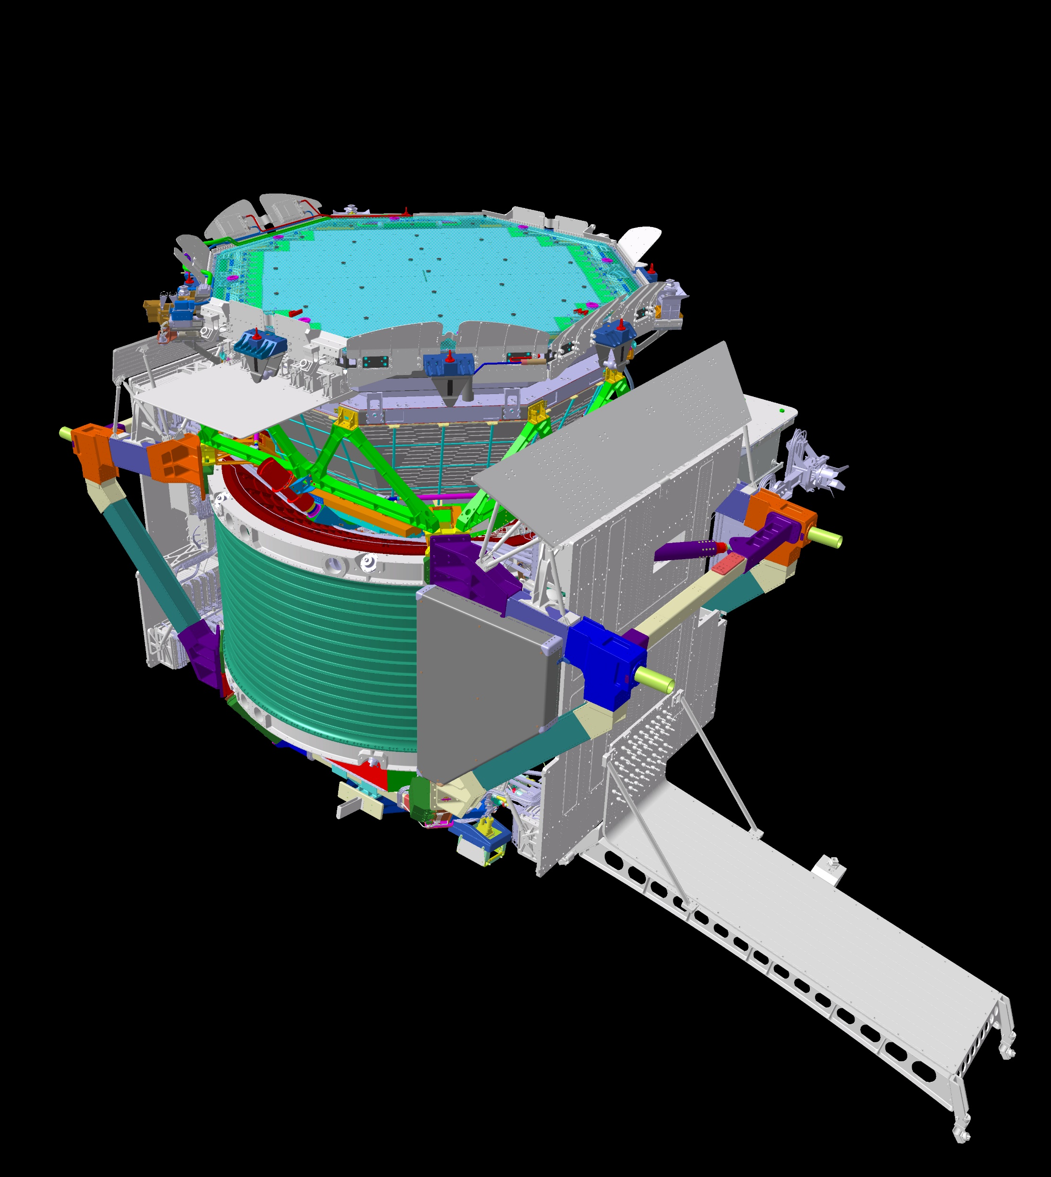
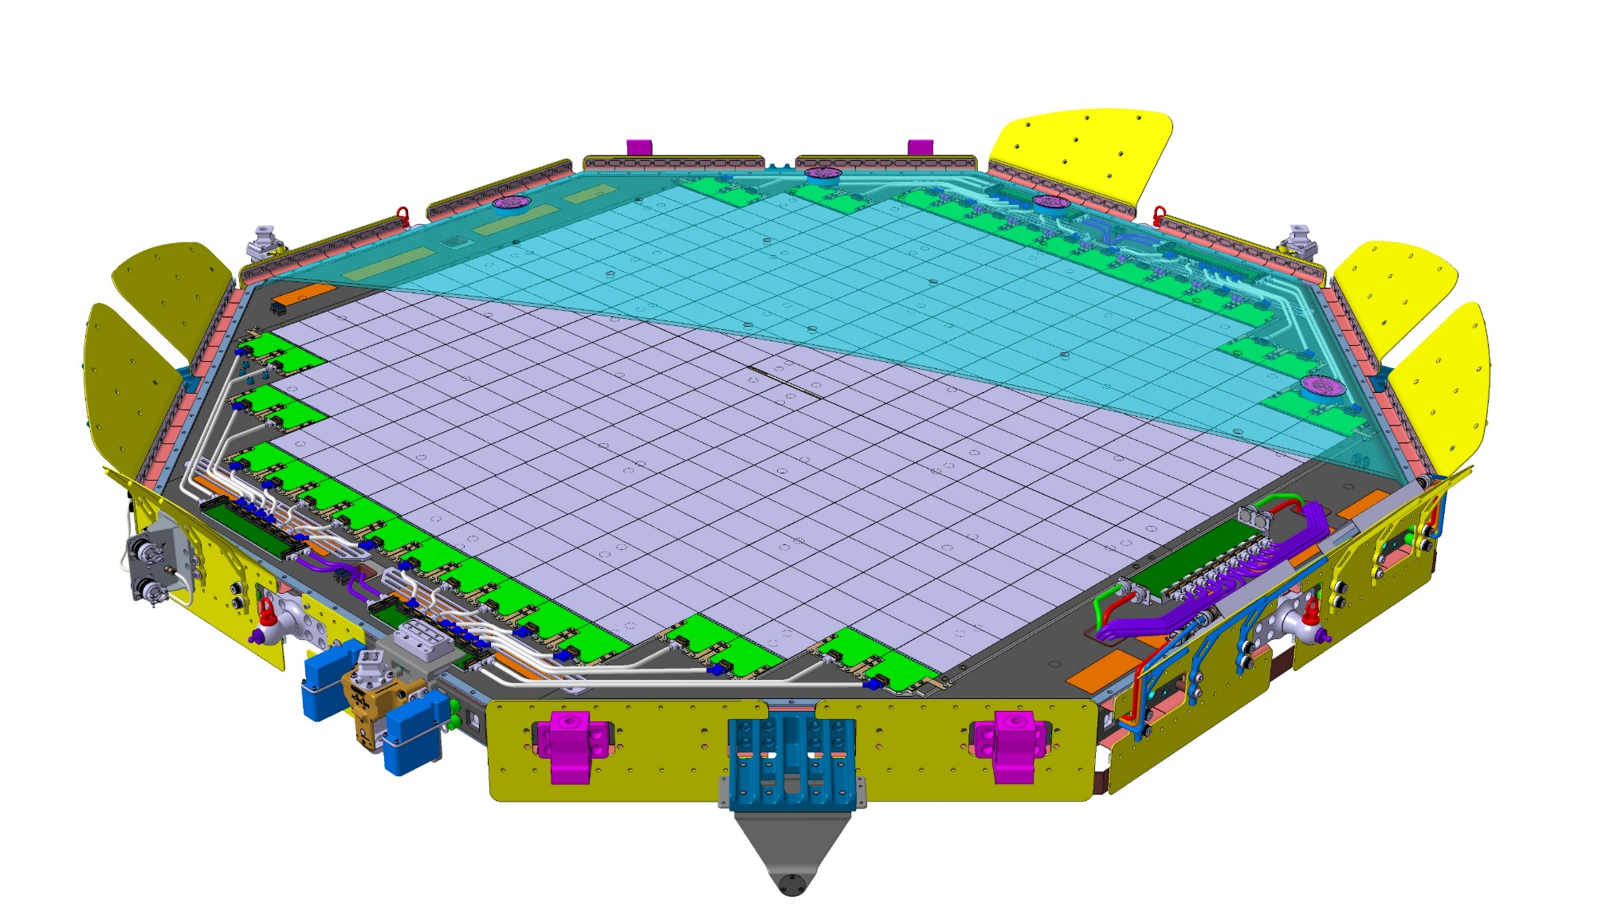
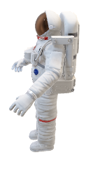
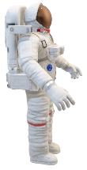
AMS upgrade
Improve detector acceptance by 300%
New large detection plane with high stability
EVA EVR installation
Dimensions: ~2.6m diameter, ~ 0.5 m thick, ~ 350 Kg
Sensor: silicon strip, the same technology is already in AMS
Compact, low power read-out electronics

Slide 32
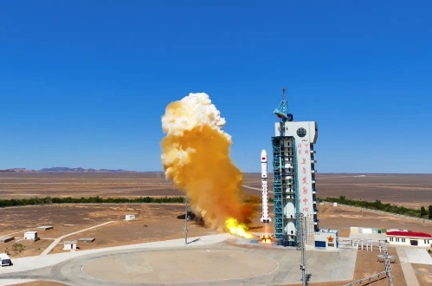
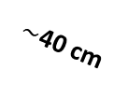


HEPD: multipurpose, precise compact detector
CSES-02: China Seismo-Electromagnetic Satellite
Total Mass: 900 kg
Orbit: 500 km, sun-synchronous, 97° inclination
Launched on June 14th 2025 (design life cycle > 6 y)
Several payloads for electromagnetic and plasma measurements in the Van Allen belts
zenith
TR1
VETO
cosmic ray
Low energy Cosmic Rays with energy 3 ÷ 300 MeV
  For each particle:
Goal: maximize geometrical acceptance while respecting weight and power budgets constraints
  identification (proton, electron, nucleus)
  energy
  pitch angle
$\sim$20 cm
TRACKER
TR2
$\sim$40 cm
CALO
$\sim$20 cm
Notes:
Low energy Cosmic Rays with energy 3 ÷ 300 MeV
For each particle: type, energy, pitch angle
The instrument is designed to maximize the geometrical acceptance respecting weight and power budget constraints

Slide 33
HEPD tracker
3 sensitive planes of 5 independent tracking modules Monolithic Active Pixel Sensor (MAPS):
  based on the MAPS developed for ALICE experiment at LHC
  reduces systematic uncertainties on tracking: up to 6x single-hit resolution
  no multi-hit degeneracy
  Each plane has 10 sensors of 512x1024 pixels in 15x30 mm²
  Control and read-out based on ultra-thin (180 mm) flexible printed circuits
Challenges for use in Space:
Tradeoff for mechanical supports: avoid multiple scattering but withstand launch acceleration and vibrations
Heat dissipation and material outgassing in vacuum
Limited power budget
15 staves
150 MAPS
80 Mpixel
Huge technological effort to spatialize the technology
Notes:
The main difference with the instrument which is already flying is the tracker based on 3 planes of CMOS pixel chips developed for ALICE experiment at LHC.
this technology reduces systematic uncertainties on tracking giving a single-hit resolution up to 6 times better and do not suffer from multi-hit degeneracy
HEPD has 5 independent tracking modules, whose control and read-out are based on ultra-thin flexible printed circuits
the use in Space of this technology poses some challenges:
Light support (no multiple scattering)
• Support must withstand launch acceleration and vibration
• Heat dissipation and material outgassing in vacuum
• Limited power budget

Slide 34
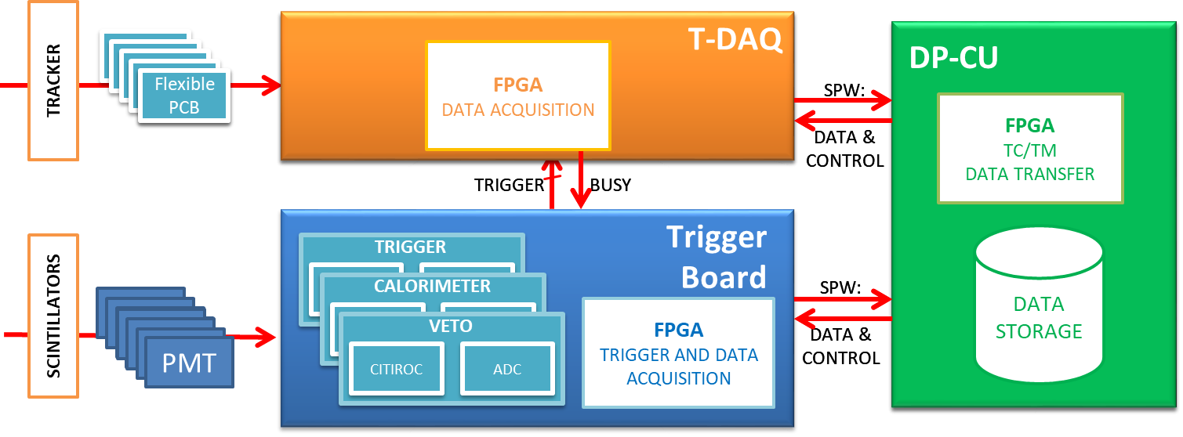
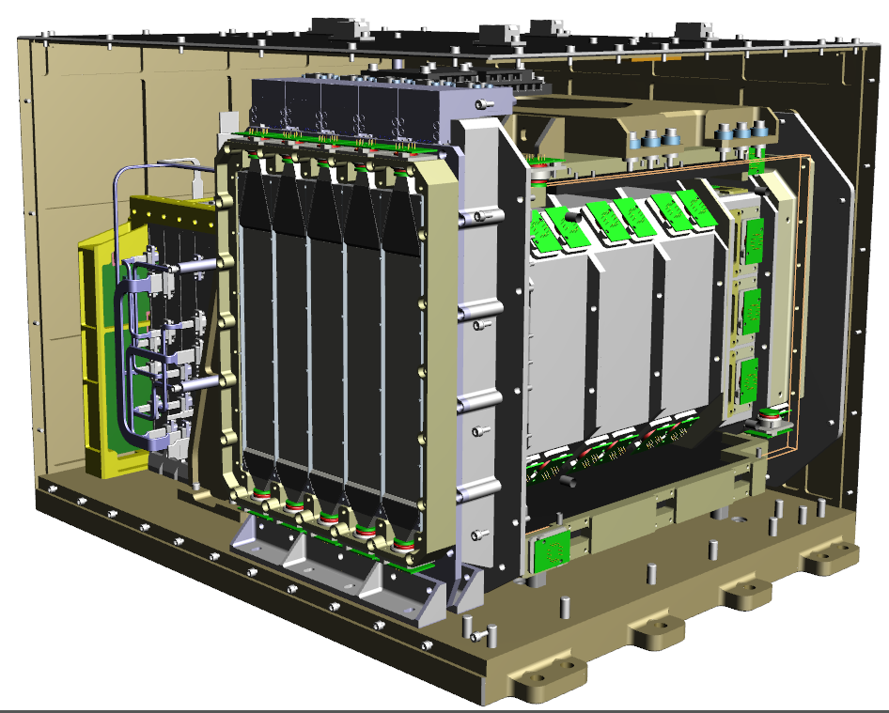
HEPD DAQ
Data acquisition:
Tracker detector (T-DAQ)
Scintillator detectors: trigger,
calorimeter and veto (Trigger Board)
Design driven by power consumption limits
Managing and control
Control and data managing (DP-CU)
LV-PS and HV-PS
Dedicated mechanics that allow anchoring to the HEPD-02 base plate and heat dissipation
Communication via SpaceWire Light protocol
Embedded “HOT/COLD” redundancy
-30°C to +50°C qualification temperature range
Max data transfer rate from satellite = 100 Gb per day
Notes:
The electronics can be divided into data acquisition and managing and control.
For the data acquisition one board collects data from the tracker, while another reads out all the scintillator detectors.
Each detector block includes a power chain for bias distribution and a data acquisition processing chain.
The main power supply provides the low voltages to all the electronics and the high bias voltages for PMTs.
The electronics is hosted in a dedicated mechanics box which allows anchoring to the HEPD-02 base plate and heat dissipation
Embedded “Hot/Cold” redundancy
-40°C to +85°C operating range
Max data transfer rate from satellite = 50 GB per day
All scintillating detectors are readout by a single board which also issues and manages the
trigger signals for the whole apparatus

Slide 35
HEPD tracker-DAQ board
Custom tracker readout system developed to respect the tight power budget:
Readout performed from the chip slow control port (~40 Mbps), still acceptable for the low trigger rate sustainable by HEPD-02
Clock gating: clock signal is provided to a turret only when a trigger is received and then disabled after readout ( typically 3 turrets enabled each time)
Modular structure to implement a sparse readout
To deal with the slow data rate from the slow-control line, a custom FPGA-based (low power Xilinx Artix7) firmware was developed using as strategies:
Parallelization
Pipelining
Redundant and modular design
COLD HOT
FPGA
Notes:
17 mW / cm2 Vs 7 mW/cm2

Slide 36
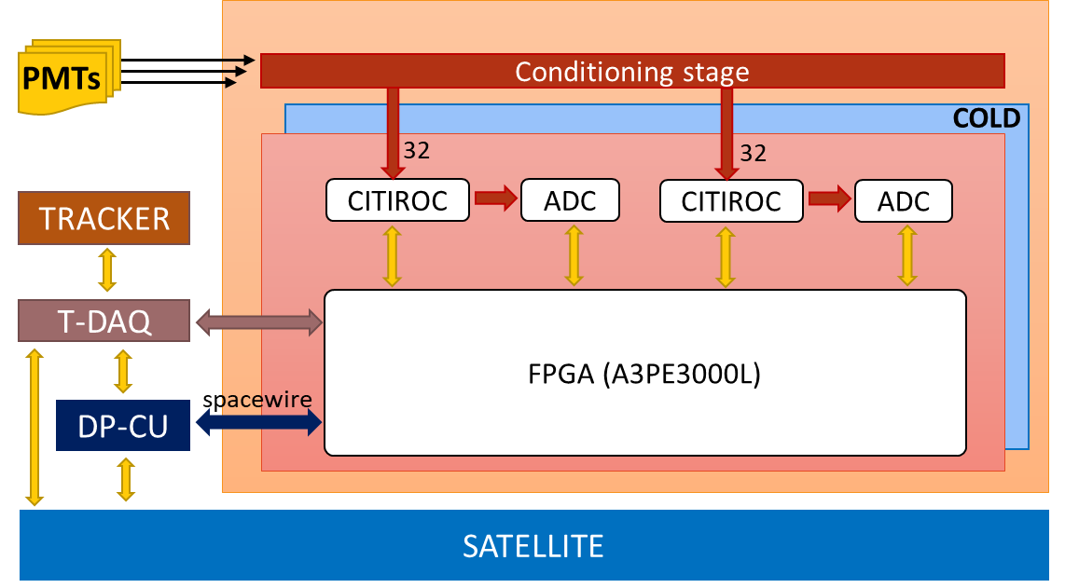
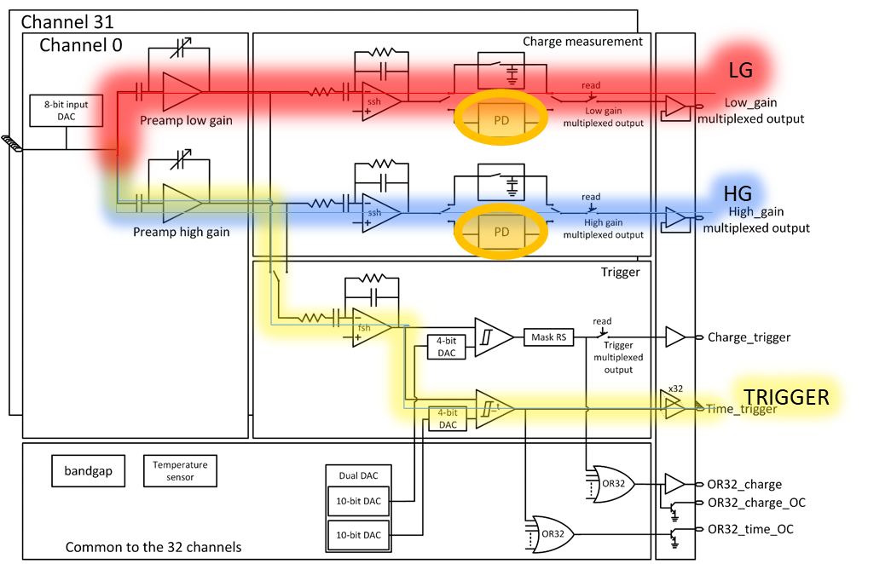
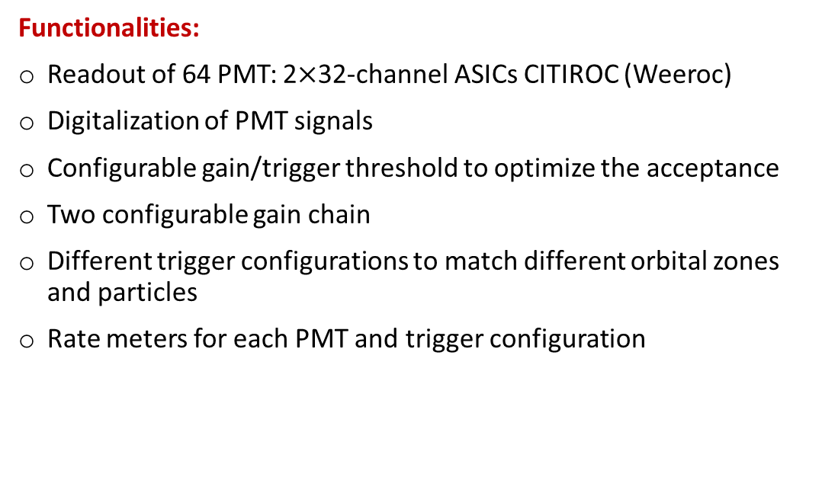
HEPD trigger board
Functionalities:
Readout of 64 PMT: 2$×$32-channel ASICs CITIROC (Weeroc)
Digitalization of PMT signals
Configurable gain/trigger threshold to optimize the acceptance
Two configurable gain chain
Different trigger configurations to match different orbital zones and particles
Rate meters for each PMT and trigger configuration
CITIROC
From HEPD-01 to HEPD-02:
High trigger rate at polar regions: improved trigger logic and pre-scaling
Larger amount of acquired data: mass memory on board for buffering

Slide 37
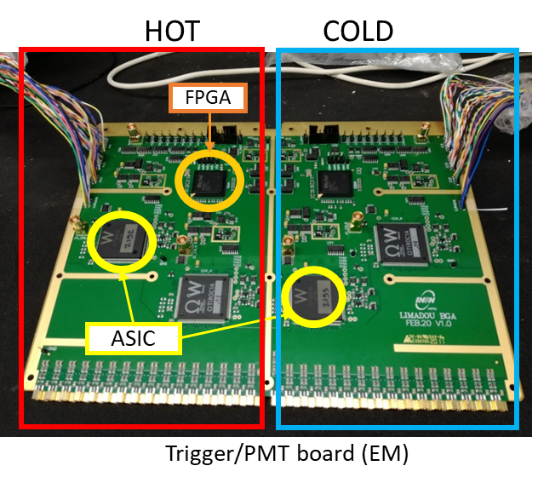
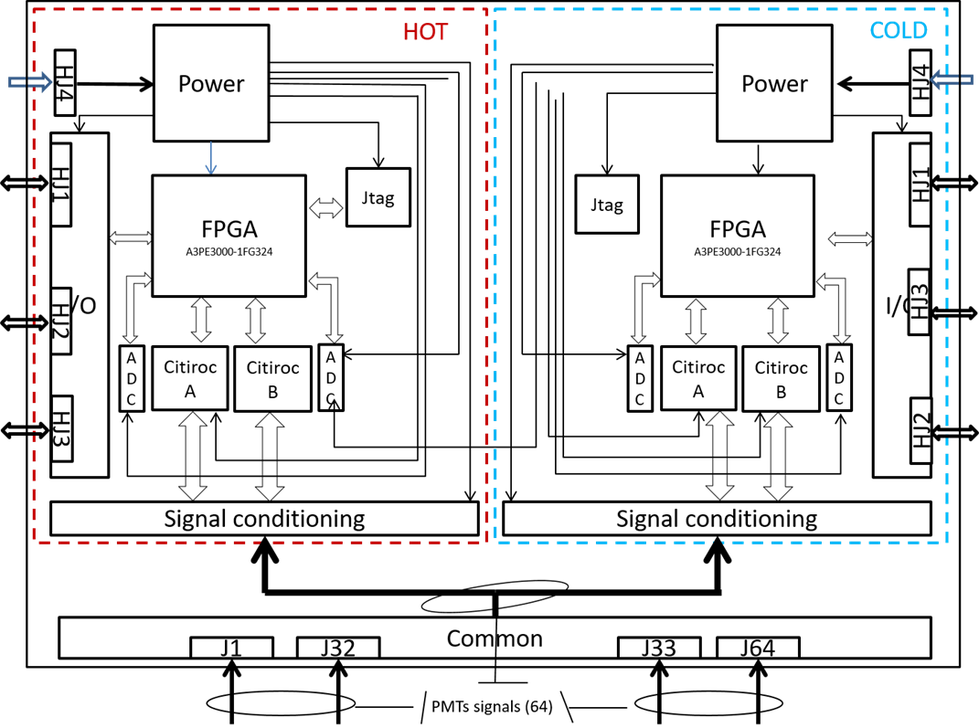
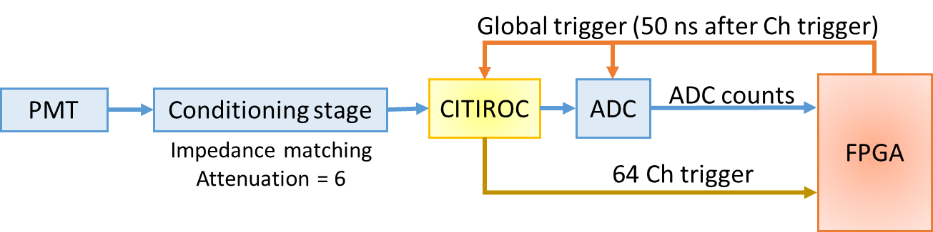
HEPD trigger board architecture
Custom designed
64 channels in common for HOT and COLD sides
On each side (H&C):
  FPGA: MicroSemi ProASIC A3PE3000
  2 ASIC: CITIROC 1A Weeroc
  4 ADC: AD7274 (12 bits, 24 MHz)
Signals coming from the last dinode of PMTs
  Reduce power consumption
  Simplify design (no inverters)
Coaxial cables RG178 to improve noise immunity

Slide 38
HEPD trigger requirements
Along the orbit of CSES-02 particle fluxes span several orders of magnitude
Expected rates up to 10 MHz (SAA), not compatible with data budget nor with event acquisition dead time
Low-energy triggers would determine the saturation of HEPD-02
Data acquisition must guarantee the measurement of energy spectra with a high duty cycle
Flexible: combinations of signals from TR1, TR2 and CALO form trigger configuration selectable in flight
Strong: to cope with increased fluxes of particles at polar orbits
Trigger logic:
Notes:
Fluxes vary over 6 order of magnitude
Abrupt changes on the SAA
Capability to acquire data on the SAA by selecting appropriate trigger masks

Slide 39
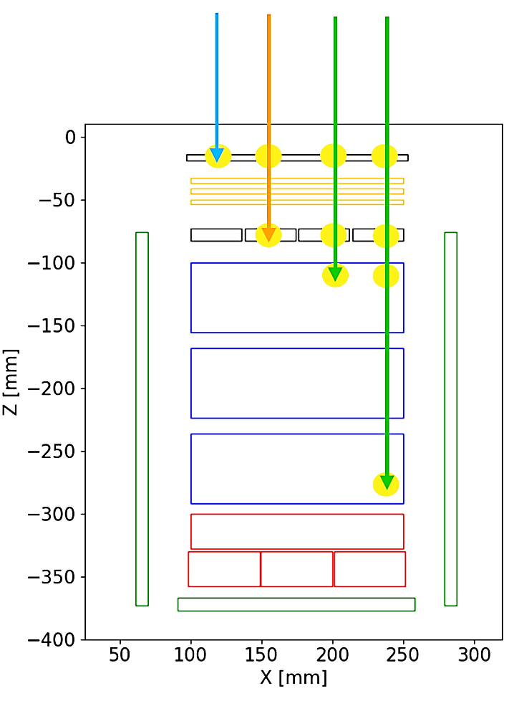
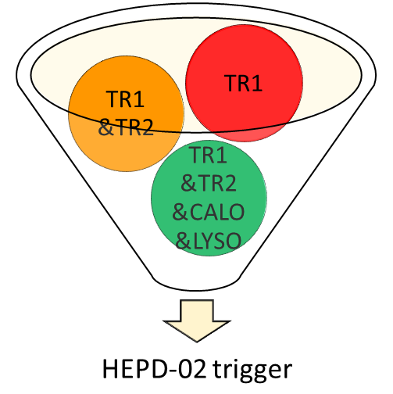
Concurrent trigger masks and orbital zones
trigger patterns for different particle penetration (i.e. different energy thresholds)
Preliminary
Capability to acquire data on the SAA by selecting appropriate trigger configurations
Notes:
concurrent trigger system allowing for lower energy measurements over the poles and on the SAA
• sensitivity to gamma-rays

Slide 40
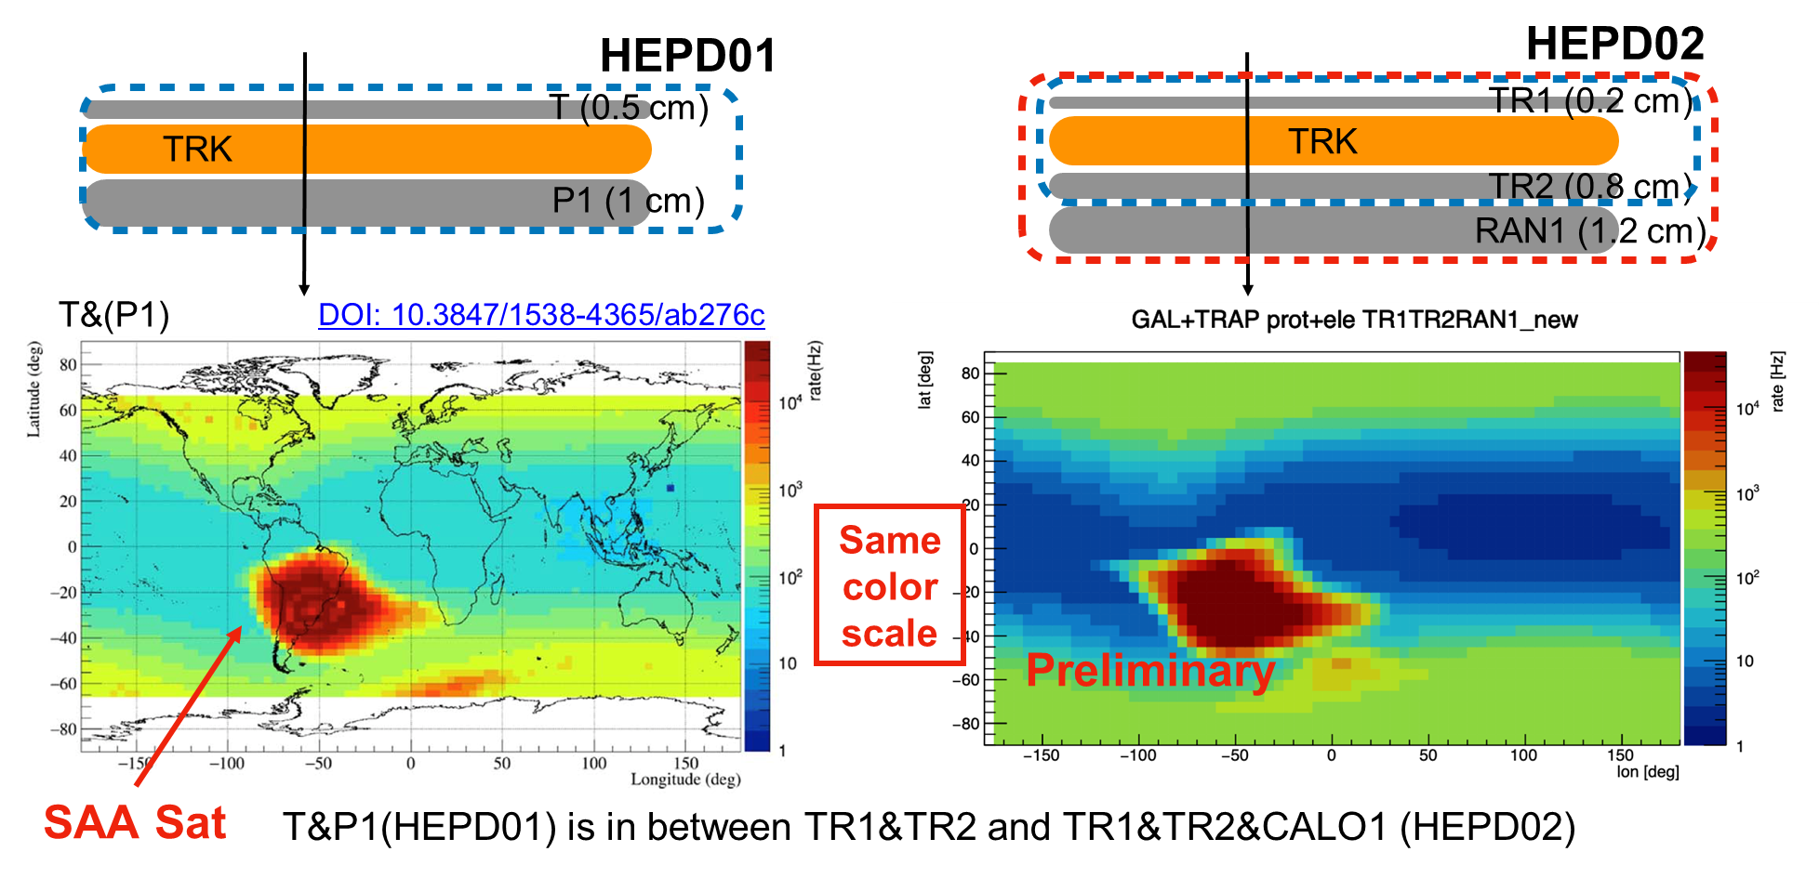
Concurrent trigger and prescaling
Usual approach: global prescale factor to prevent saturation keeping a “calibration” data-stream
HEPD-02 approach:
concurrent trigger system allowing for measurements over the poles and on the SAA
Scale factors adjusted for each trigger pattern to share resources among different physics cases, optimized after scientific requirements about FoV and kind of particle
Data throughput shared among different physics channels via online selection: concurrent trigger configurations prescaled to avoid bandwidth saturation.
Notes:
Fluxes vary over 6 order of magnitude
Abrupt changes on the SAA
Capability to acquire data on the SAA by selecting appropriate trigger masks

Slide 41
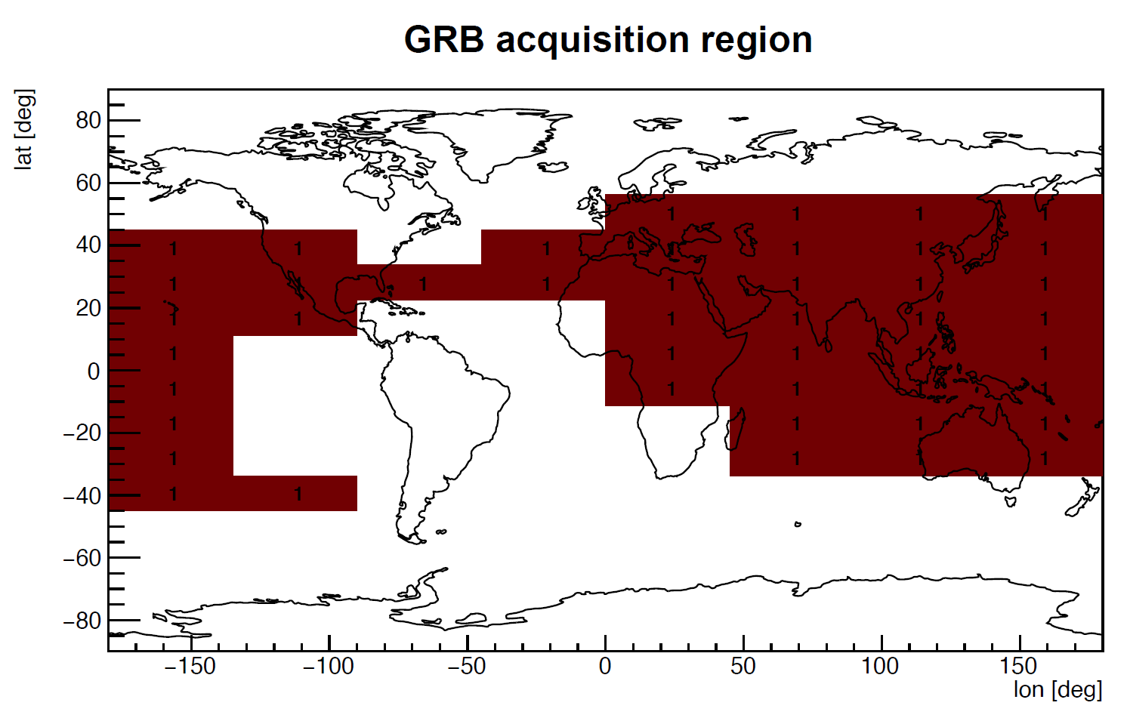
Trigger masks and gamma-ray observation
3 classes of trigger masks:
Event acquisition: validate the acquisition of the event and use the TR1, TR2 and CALO planes
Event monitor: provide information about the efficiency of the detector
Gamma Ray Burst: 6 LYSO bars as large as 150x25x50 mm³ → excellent opportunity to detect MeV photons
Trigger configuration dedicated to γ-rays tracked on a time basis of 5 ms
2nd level trigger introduced to consider veto
Moving average and MAD calculated in the DP/CU for GRB trigger rates on different time intervals (10, 40, 160, 360 ms)

Slide 42

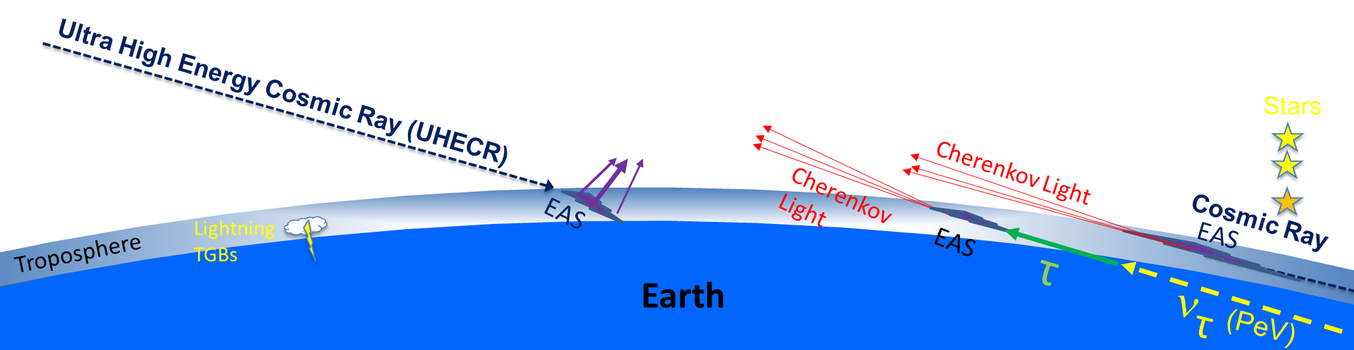
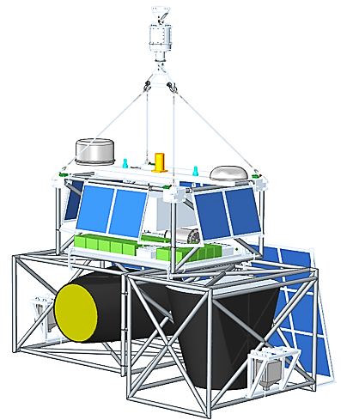
EUSO-SPB2: a pathfinder for UHECR and ν from space
using the Earth as a particle detector
Fluorescence: UHECR, EeV
First observation of UHECRs from space with the fluorescence technique
Search for upward event candidates
Cherenkov: UHECR, PeV
Above Limb:
First observation of CR from space with the direct Cherenkov technique
Below Limb:
Search for tau neutrino (ν_{τ})
Measure optical backgrounds for earth-skimming technique
Floating altitude: 33 km, 7 mbar
Target duration: 100 days
EUSO-SPB2
Wanaka NZ
2023
Notes:
The Extreme Universe Space Observatory on a Super Pressure Balloon 2 is a second-generation stratospheric balloon instrument designed to be a precursor mission for future space observatory for multi-messenger astrophysics
The idea is to use the Earth as a giant particle detector, studying from the edge of the space fluorescence and Cherenkov light and tau neutrino background.
EUSO-SPB2 will study Ultra High Energy Cosmic Rays via the fluorescence technique and Ultra High Energy (UHE) neutrinos via Cherenkov emission
The instrument will operate at a floating altitude of 33 km and the target duration of the flight is 100 days

Slide 43
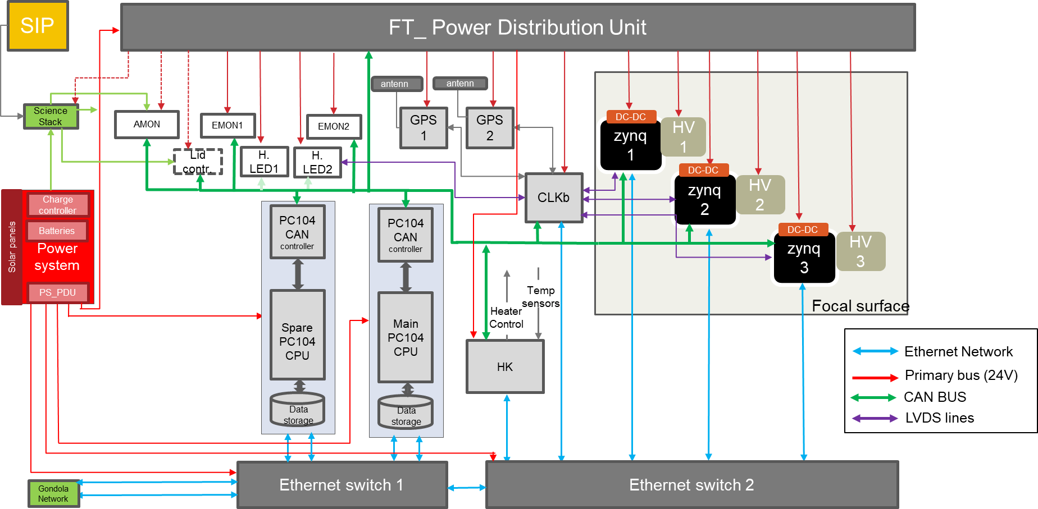
EUSO-SPB2 DAQ
MAPMT w/ single photoelectron counting
1 µs time bins, 1 “video clip” = 128 time bins
~15 watts
New integrated digitization
Mass < 25 kg
Peak Power consumption < 135 W
7000 channels
BGA packaged Spaciroc3 ASIC

Slide 44
EUSO-SPB2 trigger
Physics:
UHECR induced signals are rare: 1 event every 13 hours expected
Low signal relative to background: 10 Hz trigger rate
Technological:
Difficult environment: high altitude in unpressurised box
Power and mass budget restrictions
Balloon and data stored on board may be lost, but the data bandwidth is limited: telemetry budget/Day: 1GB
  Need to prioritize data for downloading
  Want to only record and transfer high quality events
  To be done on board with minimal intervention from ground
  10 MB max compressed science file size for downlink
eventually Starlink saved us!
Synchronous trigger evaluated every µs
Asynchronous data transfer
SOC: Xilinx Zynq 7, FPGA for trigger/DAQ, microprocessor for communication/data storage

Slide 45
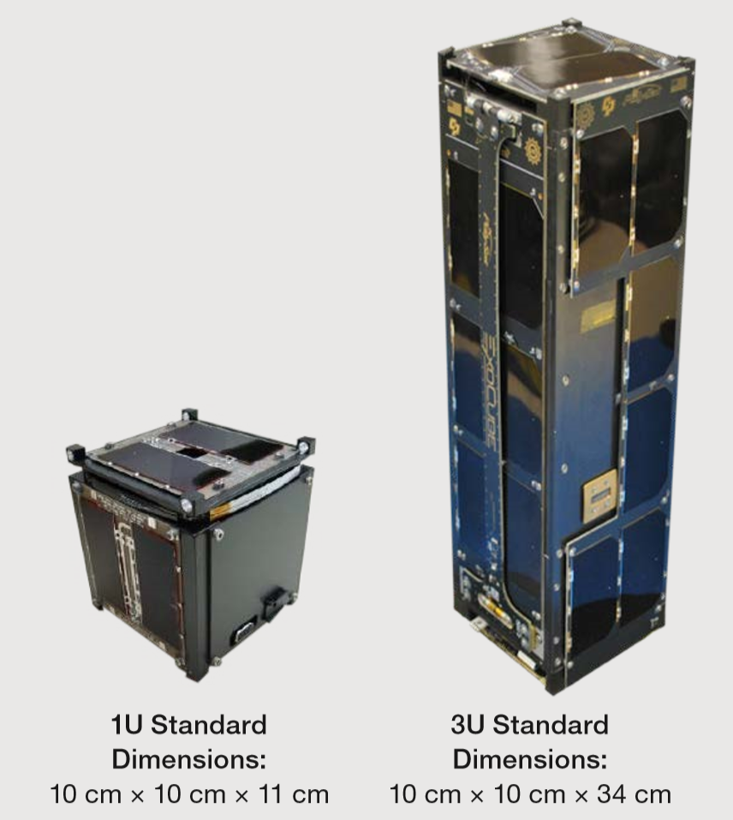
The future in space
Nano Satellites and Mega Constellations
  “1U” CubeSat is 10 cm³ and weighs around 1 to 1-1/3 kg
  1.5U, 2U, 3U, and 6U, and more
  CubeSats contain ARM, Atmel, Texas Instruments’ MSP430, and Microchip Technology PIC microcontrollers
  Call from Space Agencies for “Fast” missions: small payloads, not necessarily CubeSat
  Cost reduction
  Low risk/high benefit missions
  Useful to measure quantities which scale with area (X, gamma, low energy charged), to sample in different points, to reduce the statistical error, to ensure full solid angle coverage
The Space Race has started again: the next frontier is the Moon (again!)
Maybe stratospheric ballooning
Notes:
the hardware necessary to execute the ML model is highly complex. A single fault can have unpredictable effects on the software execution. Simply considering memory errors or single-bit flip is too naive and is likely to largely underestimate the impact of faults in the field. The complexity of the hardware is such that requiring a full understanding of radiation effects from the transistor to the tensor output could be impractical (if not impossible). Novel strategies to bind the error rate and the fault effects are then required
To implement an efficient and effective hardening solution, it is necessary to study the model implementation and the hardware response to radiation. By identifying the faults that are more likely to cause misdetections or misclassifications, it is possible to design specific mitigation solutions reducing the overhead. In addition, exploiting ML potential is likely to significantly reduce the impact of faults in the network prediction, maintaining performance unaltered.

Slide 46
The future (of particle detectors) in space
Beam measurements to measure nuclear cross sections for Cosmic Rays Experiments
Monolithic Active Pixel Sensors (MAPS) = sensitive volume + in-pixel front-end + readout electronics
  Adaptable technology that can be tuned to specific requirements
  Driven by the commercial availability of CMOS imaging sensor processes
  The main challenge is the power consumption
Notes:
the hardware necessary to execute the ML model is highly complex. A single fault can have unpredictable effects on the software execution. Simply considering memory errors or single-bit flip is too naive and is likely to largely underestimate the impact of faults in the field. The complexity of the hardware is such that requiring a full understanding of radiation effects from the transistor to the tensor output could be impractical (if not impossible). Novel strategies to bind the error rate and the fault effects are then required
To implement an efficient and effective hardening solution, it is necessary to study the model implementation and the hardware response to radiation. By identifying the faults that are more likely to cause misdetections or misclassifications, it is possible to design specific mitigation solutions reducing the overhead. In addition, exploiting ML potential is likely to significantly reduce the impact of faults in the network prediction, maintaining performance unaltered.

Slide 47
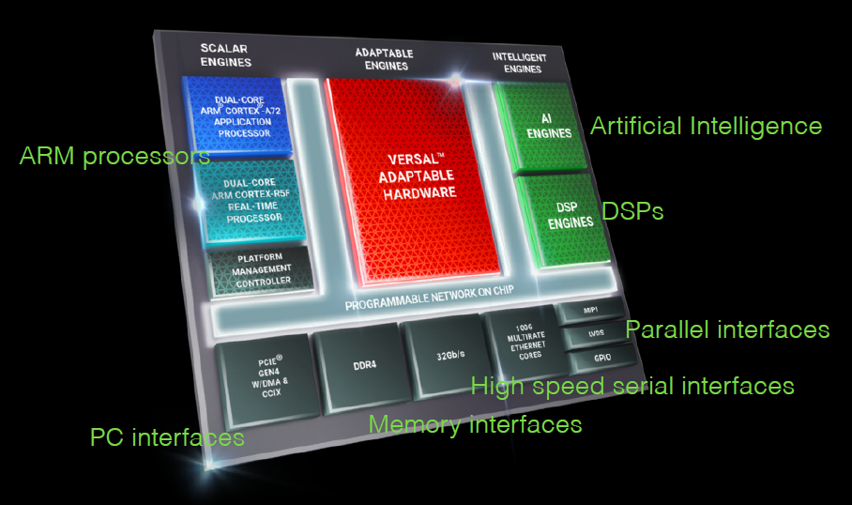
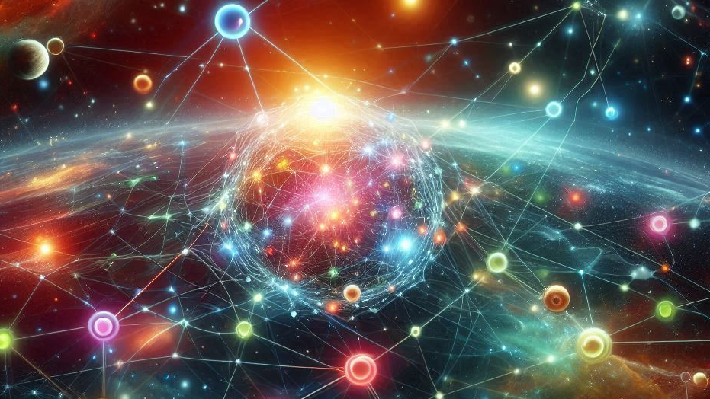
The future ((of TDAQ) for particle detectors) in space
Advanced «FPGA»
ML for trigger algorithms (CNN)
  Data handling and downlink optimization:
    Reduced data volume transmitted to the ground: onboard pre-processing, filtering, and prioritization
    Adaptive data compression: selection of relevant events based on scientific priorities and spacecraft resources
  Real-time detection and alerting: faster event localization and autonomous decision-making for follow-up observations
  Necessity to study the model implementation and the hardware response to radiation
  In a power-scarce environment, optimization is key; the model size must be reduced with clever network optimization techniques: a tradeoff between power consumption and performance
FPGAs are highly suited to ML tasks:
Massive parallelism, high memory bandwidth
Outperform GPUs at maintaining high-throughput & low latency with (often) best “performance per Watt”
Deterministic latency - requirement for low-level trigger
T. James’s talk on Wed.
Notes:
the hardware necessary to execute the ML model is highly complex. A single fault can have unpredictable effects on the software execution. Simply considering memory errors or single-bit flip is too naive and is likely to largely underestimate the impact of faults in the field. The complexity of the hardware is such that requiring a full understanding of radiation effects from the transistor to the tensor output could be impractical (if not impossible). Novel strategies to bind the error rate and the fault effects are then required
To implement an efficient and effective hardening solution, it is necessary to study the model implementation and the hardware response to radiation. By identifying the faults that are more likely to cause misdetections or misclassifications, it is possible to design specific mitigation solutions reducing the overhead. In addition, exploiting ML potential is likely to significantly reduce the impact of faults in the network prediction, maintaining performance unaltered.

Slide 48
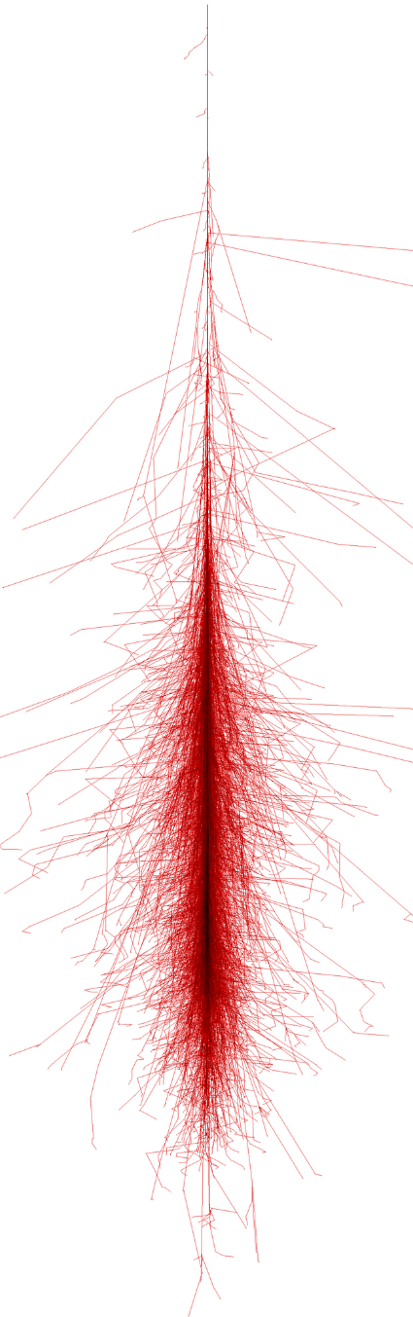
Summary
Cosmic Rays are an important piece of the puzzle for our understanding of the Universe
Studying direct CR calls for detectors in space
Designing a detector and its electronics for space is a tradeoff between cost, reliability and performance
Space qualification process is cumbersome, but necessary
time-consuming, expensive, dangerous
TDAQ for space is
  fun: can touch almost every part of the stack and learn to understand the whole system
  challenging: “easy” tasks on ground become nontrivial due to reliability issues and limitations on weight, power, data-bandwidth
We’re always on a hunt for new ideas are for the next generation of space detectors!

Slide 49
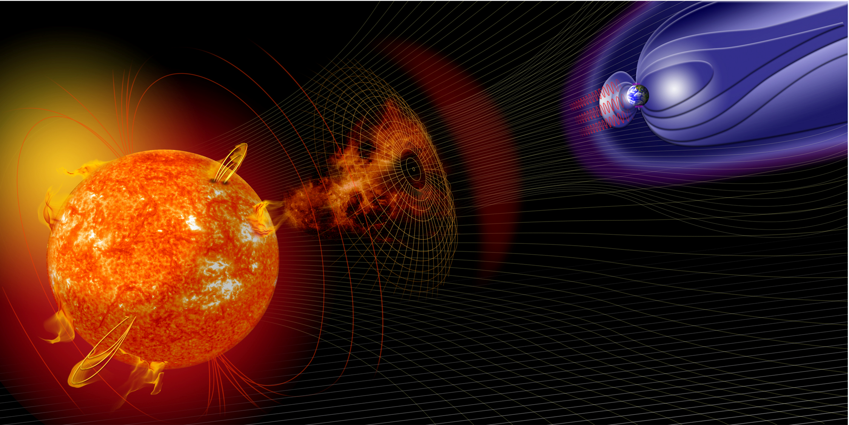
Thank you!
Any question?

Slide 50
Some (non-exaustive) references
Why space?
  O. Adriani, ASAPP2023
Cosmic rays
  10.1016/j.ppnp.2020.103765
Challenges for electronics in space
  10.1109/IPFA.2018.8452608
  https://l.infn.it/w1
  https://l.infn.it/w2
Space qualification
  10.1109/NSSMIC.2004.1462214
  https://l.infn.it/w3
Examples of TDAQ in space
  AMS: https://ams02.space/detector/electronics
  HEPD: 10.1016/j.nima.2021.165639
  EUSO-SPB2: 10.48550/arXiv.2208.07466

Slide 51
Orbital zones
The trigger masks allows to study different physics cases depending on the orbital zone of the satellite. Four orbital zones are defined:
SAA: trapped electrons (dominant at 1MeV) and protons (dominant above)
Equatorial: re entrant and cosmic protons
Outer belt: low energy trapped electrons (below 10MeV)
Polar: primary electrons and protons and heavier nuclei

Slide 52

Radiation in space

Slide 53

Machine learning techniques utilized with the PBR mission aim at lowering detection thresholds and increase the accuracy of reconstructing events.

Slide 54

TDAQ for space - V. Scotti

Slide 55


