Slide 1
Overview of the work ongoing at CERN for ET vacuum
Carlo Scarcia
20.11.2024

Slide 2
CERN activities on ET beampipe vacuum
Since September 2022, a collaboration between CERN-INFN-NIKHEF-IFAE has been established
(management has been assigned to ETO).
The main objectives are:
Coordinate the contributions of all parties involved in the study of ET beampipes.
Design, manufacture, assemble, and test a pilot sector of the selected ET beampipe vacuum systems.
Preparing and writing the ‘Technical Design Report’ for the vacuum systems of the ET’s arms, including cost estimations.
Contact and sharing of information with the Cosmic Explorer community.

Slide 3
Main areas for cost reduction and potential solutions
Design
Materials
Vacuum layout & operations
Fast and lean beampipe production
(~8000 – 15 m modules required)
Easy to handle in an underground environment
Less expensive bakeout
(bakeout typically done via direct joule effect)
Low H₂ content/outgassing rate
Lower cost than 304L
Possibility to avoid high temperature degassing treatments
(e.g. vacuum firing or air bakeout)
Bakeout temperature & duration optimisation
Insulation material selection
Vacuum sectorization
Pumping modules design
…
Objectives
Thin-walled corrugated beampipe
Ferritic alloys
Mild steels and ferritic StS
Potential
solution

Slide 4
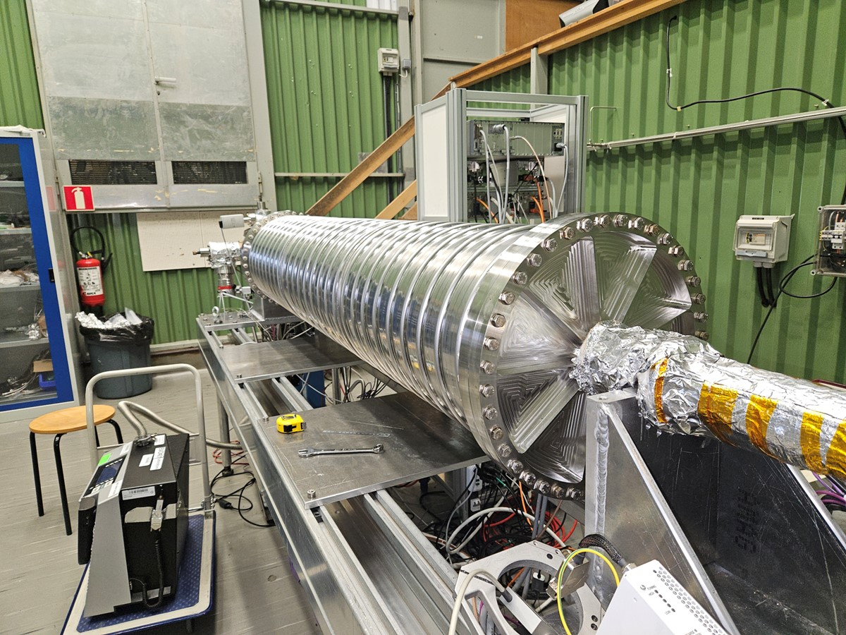
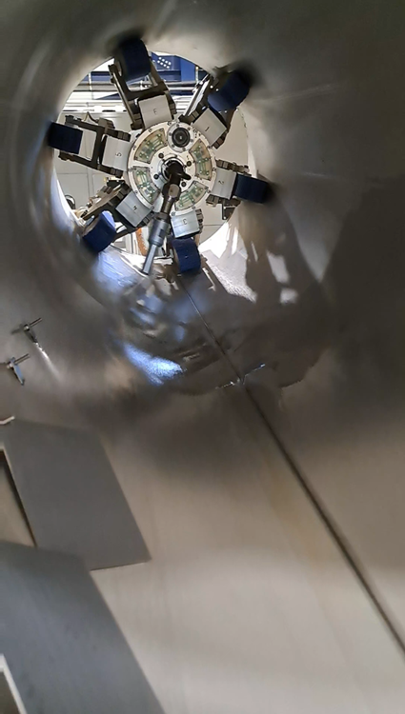
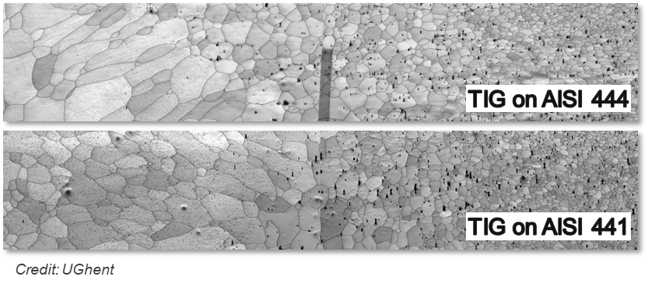
Completed ET beampipe studies
Examples of completed studies
(not exhaustive list)
Design
Corrugated beampipe profile design
Supporting system and transfer function
Materials
UHV characterisation of ferritic alloys
Welding parameters optimisation
Magnetic properties of ferritic alloys
Corrosion studies (ongoing with UGhent)
Post-manufacturing treatments
Industrial facilities cleanliness assessment
Robot cleaning performance
Vacuum
Bakeout simulation and optimisation
Insulation performance studies
Preliminary vacuum system design

Slide 5
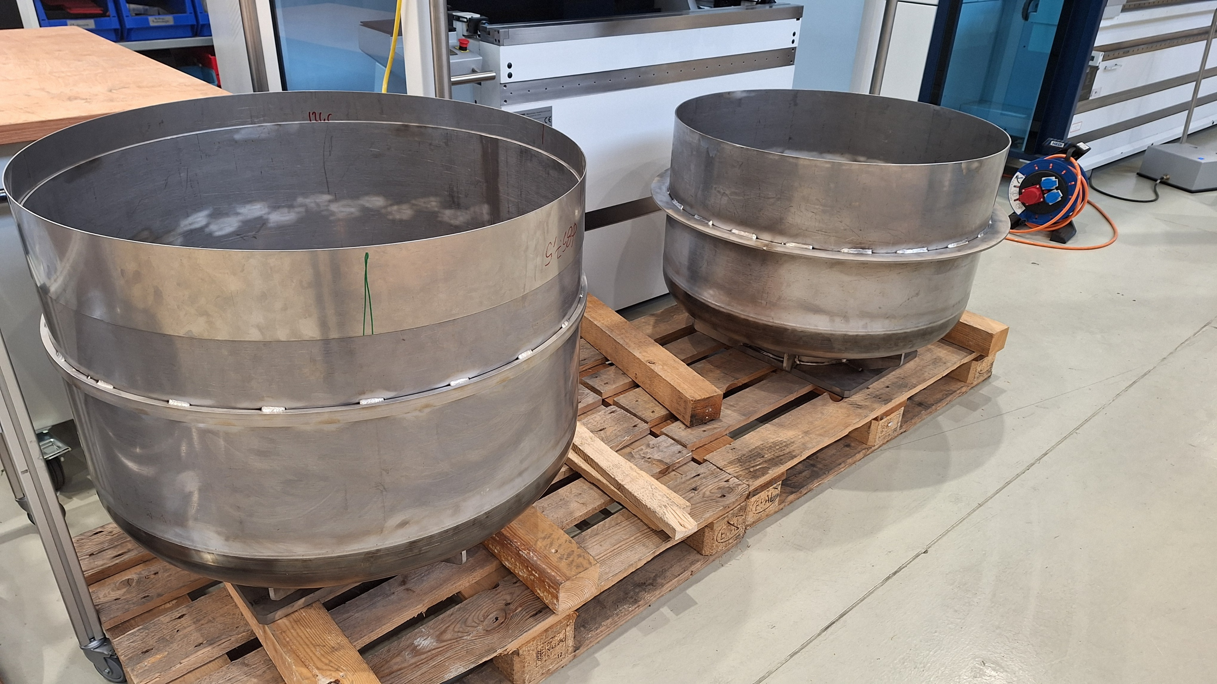
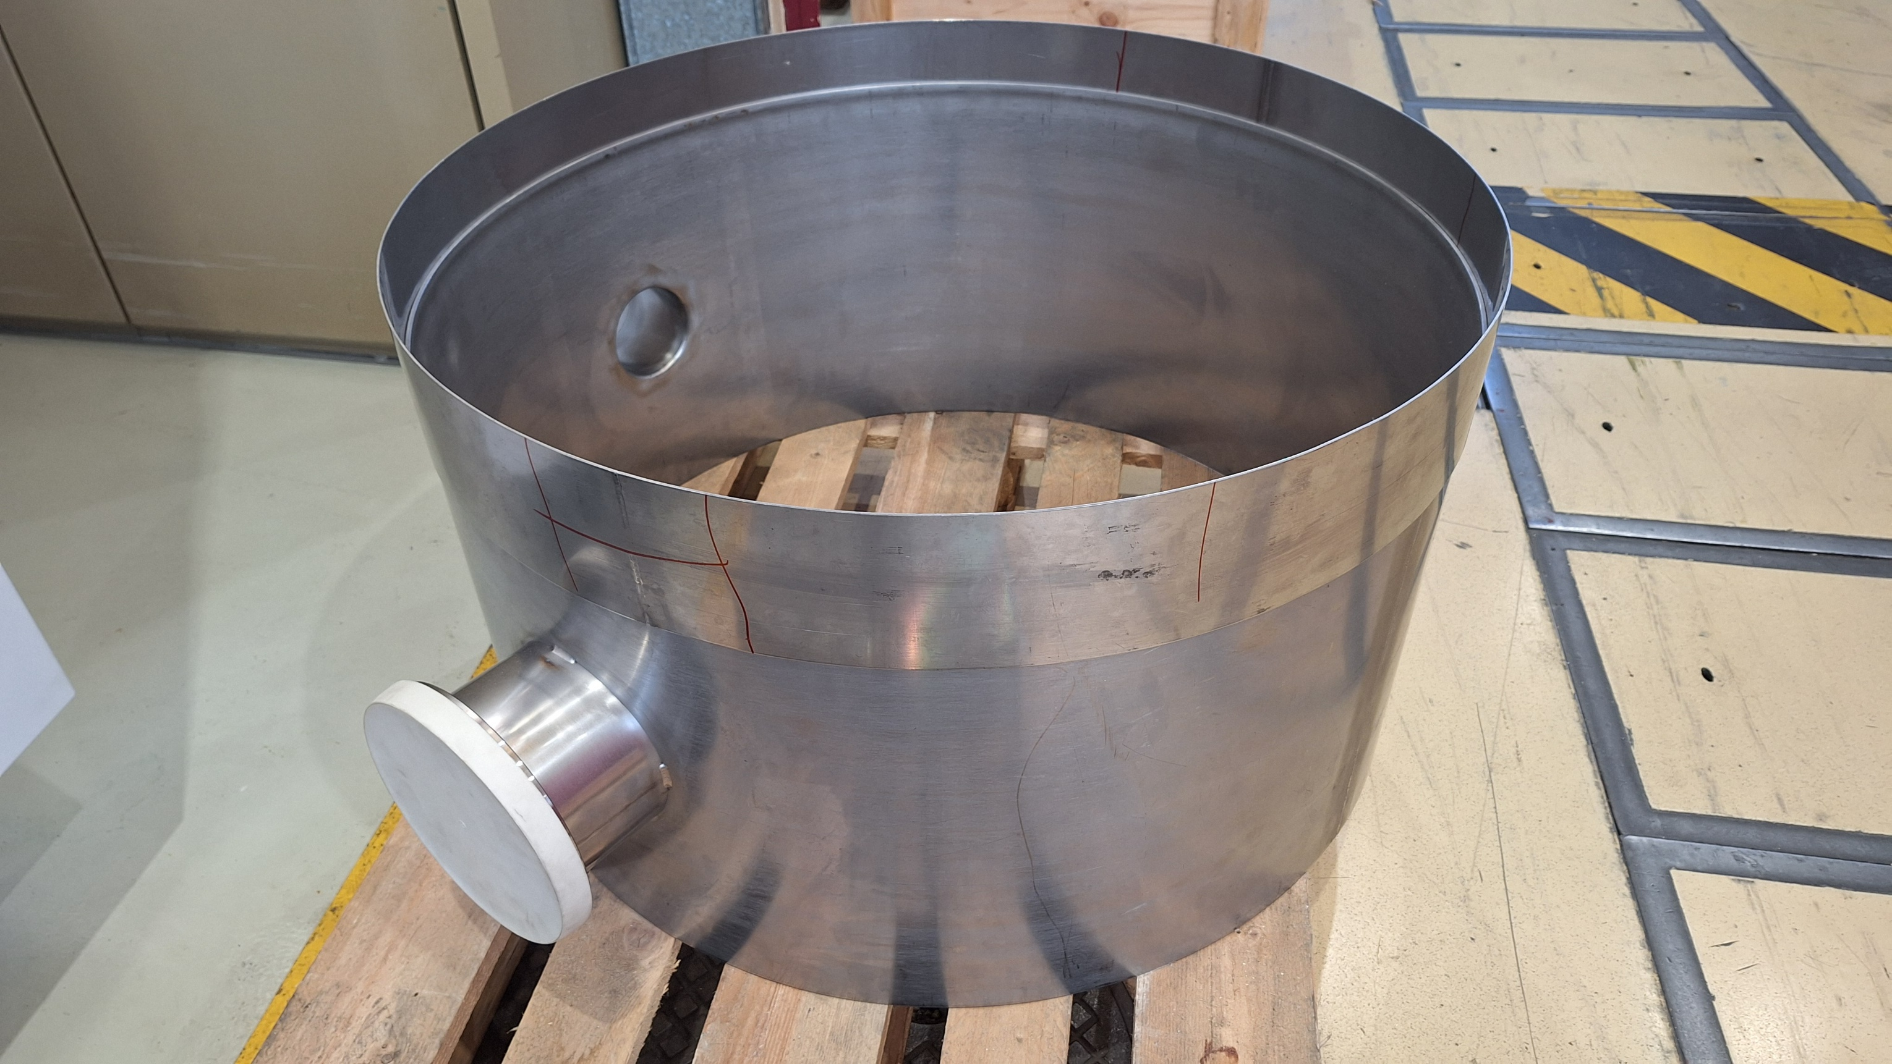
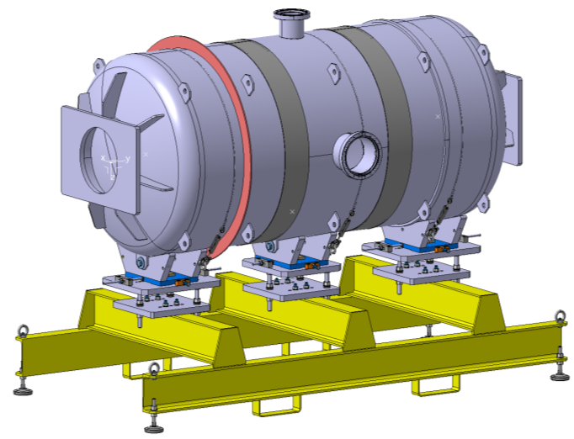
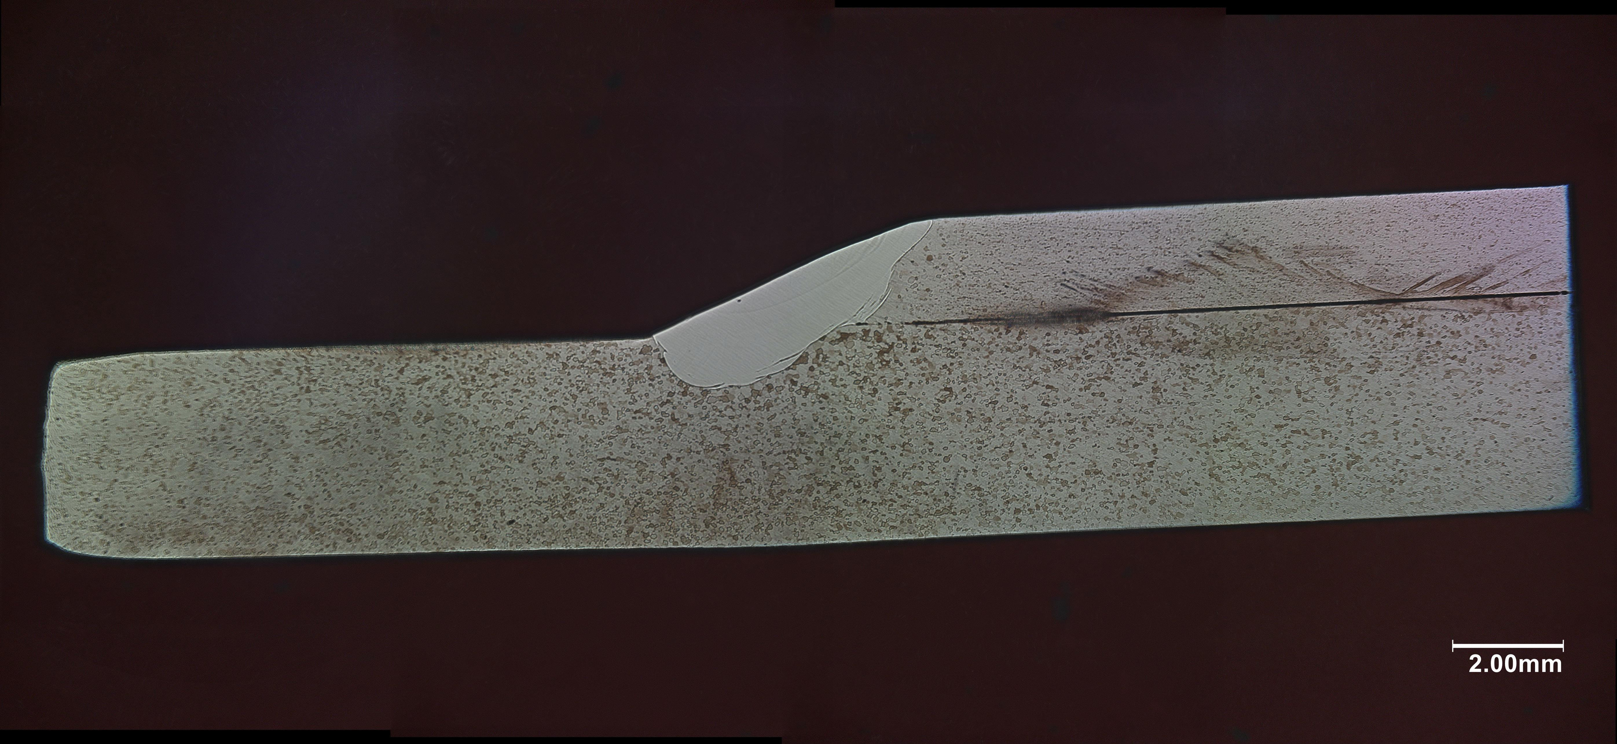

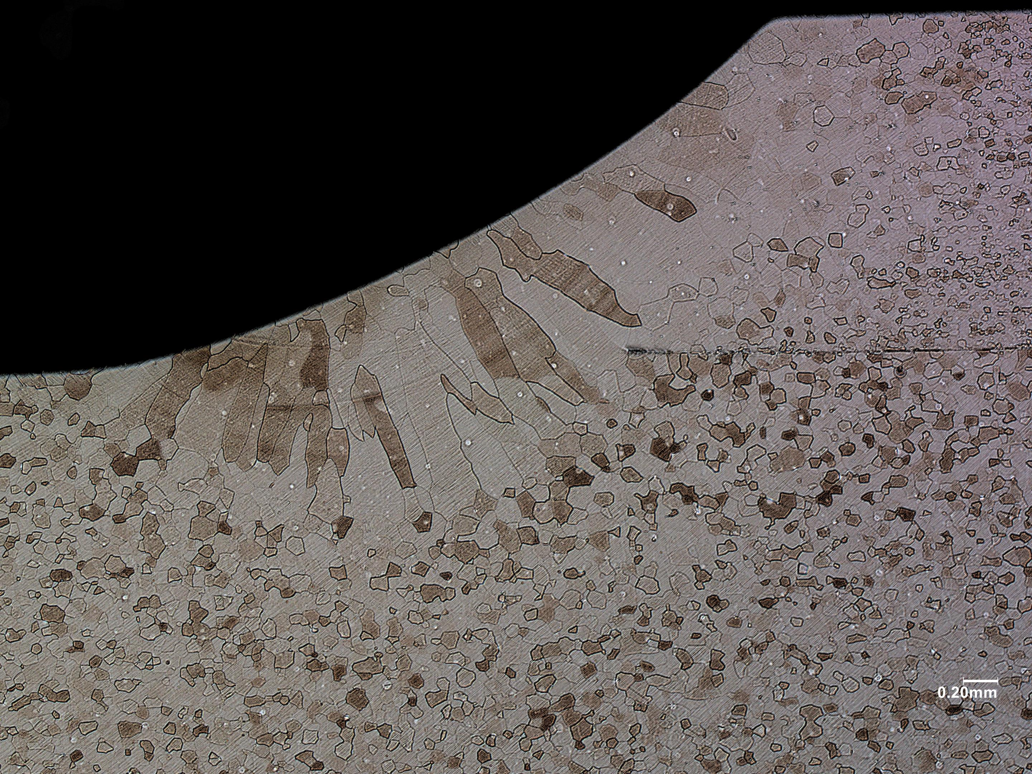
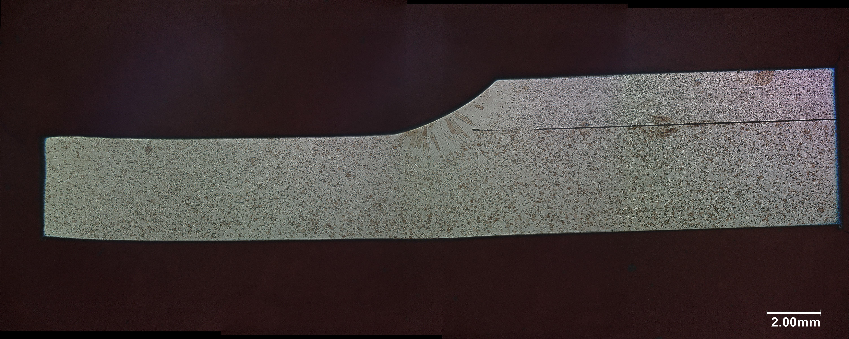
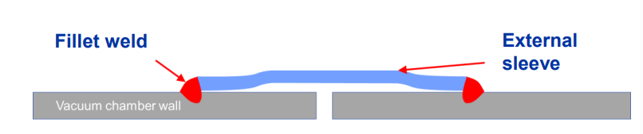
The ET pilot sector mock-up
Objectives: Test sleeve joints for welding and cutting, including cleanliness and dust assessment during welding.
DN850 x 1.5 m
All components but flanges in AISI 441
(proposed material for ET)
With filler material (AISI 317)
Sleeve joint (CERN proposal)
Autogenous weld

Slide 6
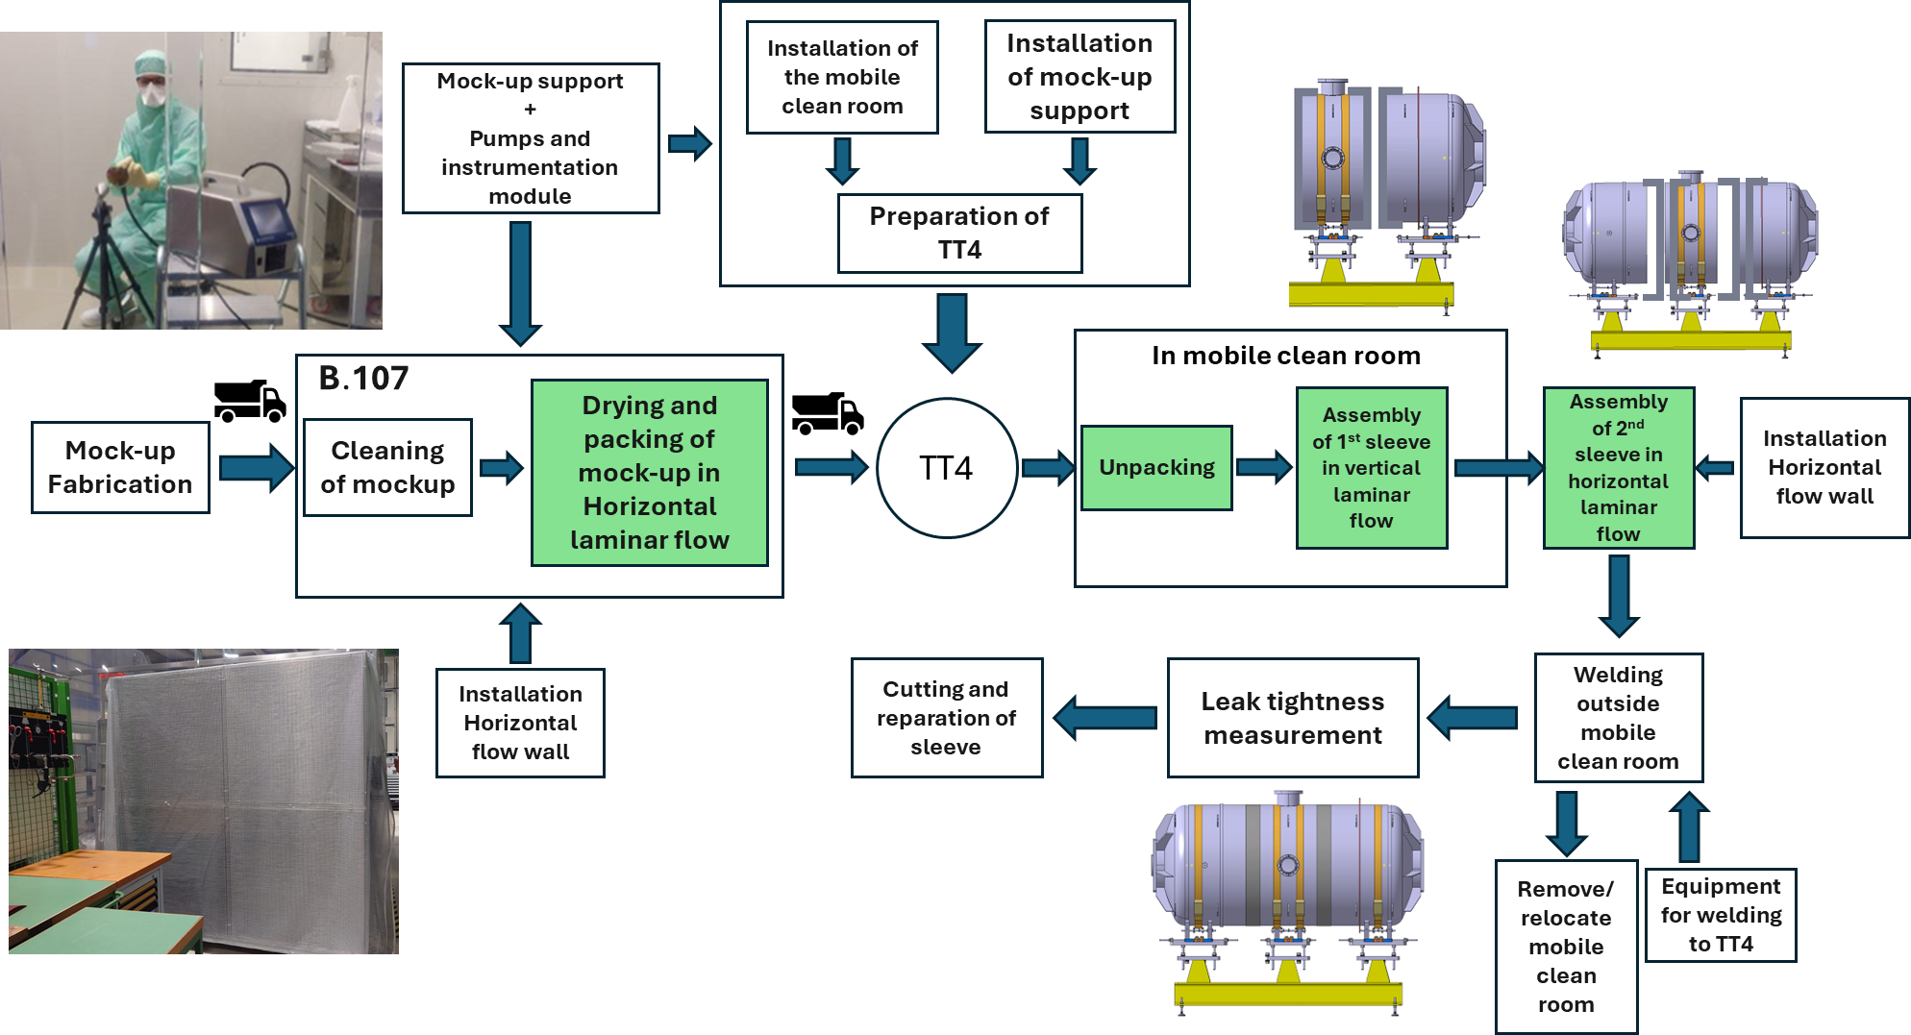
The ET pilot sector mock-up – Workflow
Cleanroom conditions
TT4: installation site
B.107: cleaning site
Start of the activities: End of November 2024

Slide 7
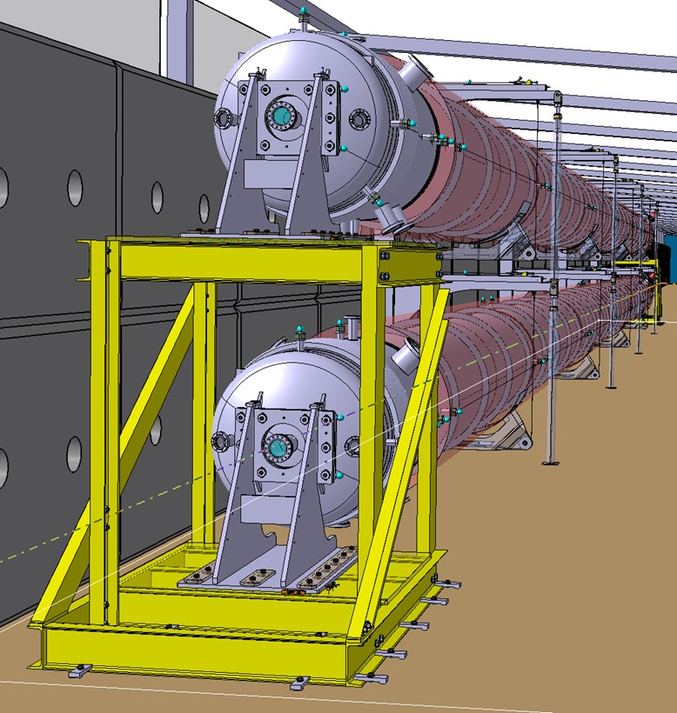
The ET Pilot Sector (ET-PS)
The pilot sector aims to test the design, fabrication, installation and commissioning of the proposed beampipes and support system. It also aims to compare the feasibility of a selected number of technical choices.
Q1 2024 (January)
Project peer reviewed (international experts panel).
Material and vacuum system validated.
Q2-Q4 2024
Manufacturing and procurement of the ancillary components/equipment.
From Q4 2024/Q1 2025
Start of installation of a
AISI 441 VIRGO-like pipe Ø 1.08 m x 4 mm x 36 m

Slide 8
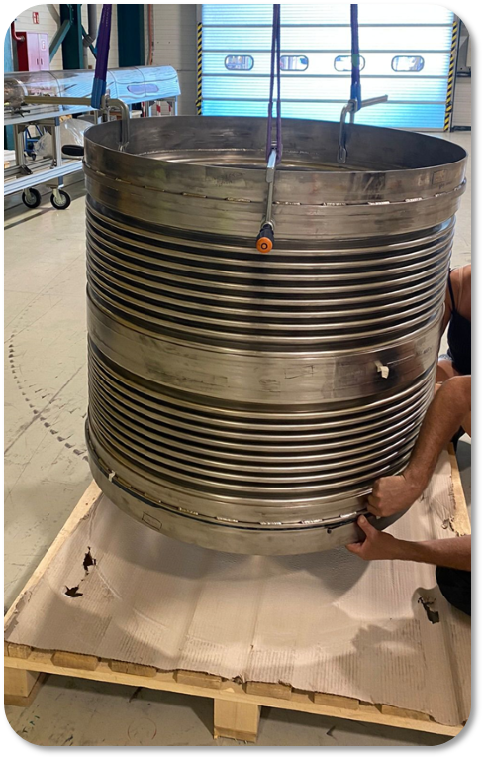
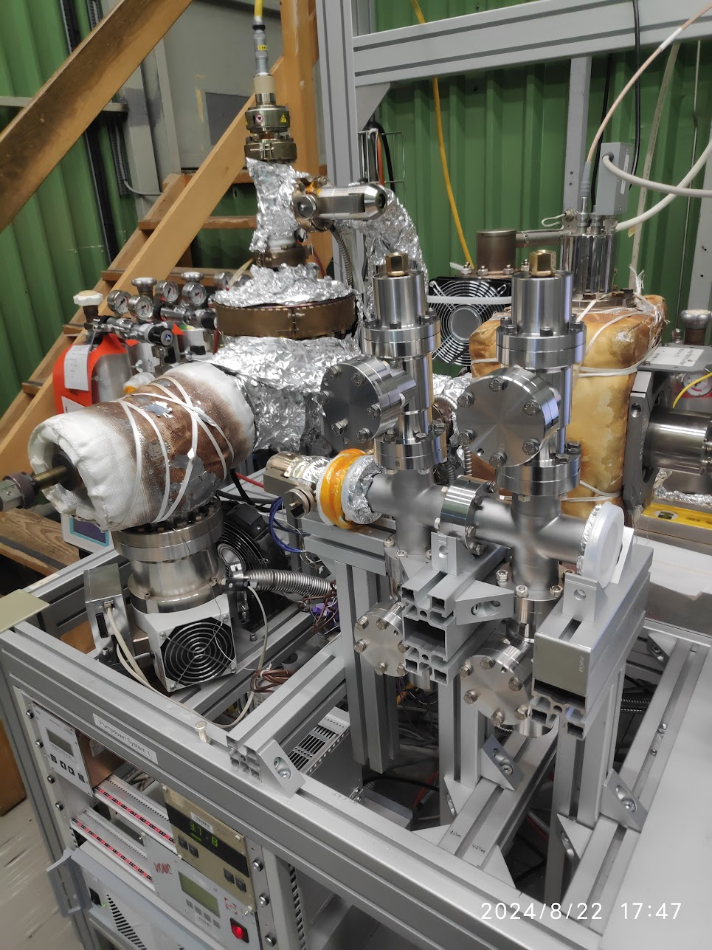
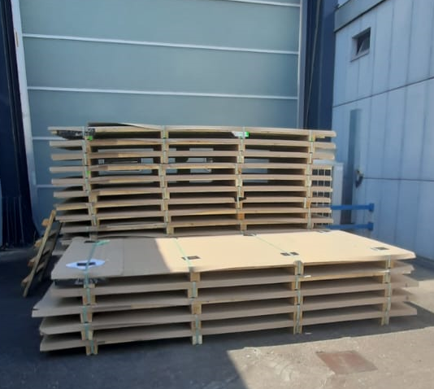
The ET Pilot Sector (ET-PS) - Status
The procurement of components is completed, and productions are launched.
All raw materials and ancillary vacuum components are at CERN.
DN1000 AISI 316L bellows
(internal convolutions)
Ancillary vacuum components acceptance test / conditioning
Raw material (AISI 441) for beampipe and extremities production

Slide 9
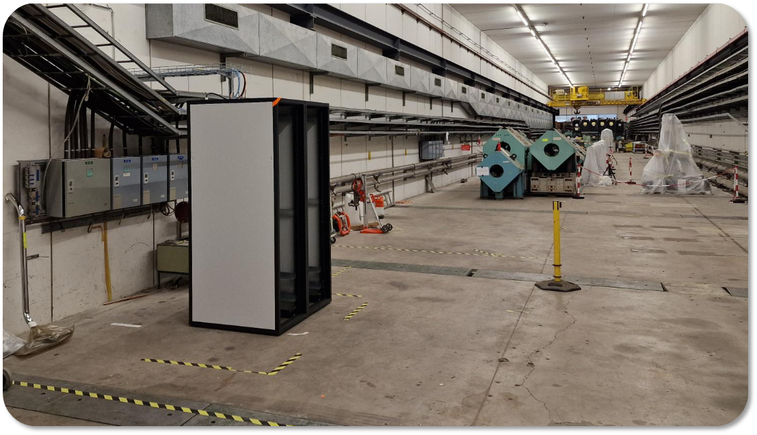
The ET Pilot Sector (ET-PS) - Status
The procurement of components is completed, and productions are launched.
All raw materials and ancillary vacuum components are at CERN.
The premises have been serviced (Wi-Fi, bakeout returning cables, cleaning etc.) and will be available from Dec. 2024.
The hosting tunnel: TT4

Slide 10
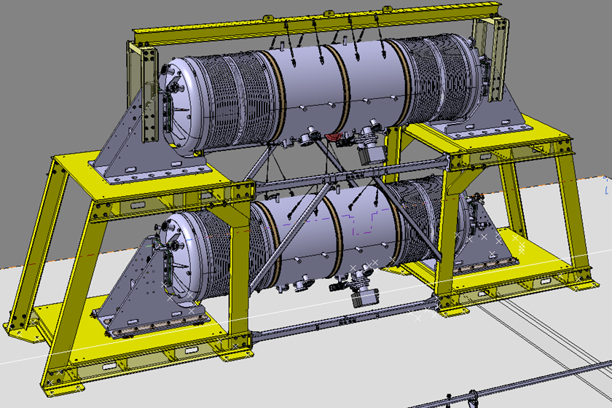
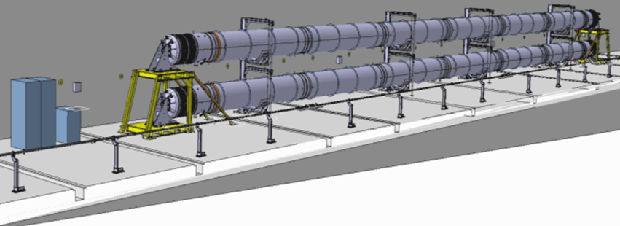
The ET Pilot Sector (ET-PS) - Master schedule
2024 | 2025
Q4 | Q1 | Q2 | Q3 | Q4
Assembly and leak detection
Test programme
Extended TDR writing
Phase 2
Beampipe measurements
Phase 1
“Background” measurements

Slide 11
The ET Pilot Sector (ET-PS) - Extended schedule
2024 | 2025 |  |  |  | 2026 |  |  |  | 2027
Q4 | Q1 | Q2 | Q3 | Q4 | Q1 | Q2 | Q3 | Q4 | Q1 | Q2 | Q3 | Q4
Assembly and leak detection
Test programme
Extended TDR writing
Extended test programme
Final TDR writing
The extended test programme aims to test alternative solutions not included in the first amendment:
New insulation materials.
Different pumping schemes.
Leak detection tools.
Alternative beampipe manufacturing solutions (continuous welded pipe from Aachen, corrugated beampipe from NL consortium, etc..).
Test of large sector valves.
Venting and tube section dismounting impact on dust content.

Slide 12
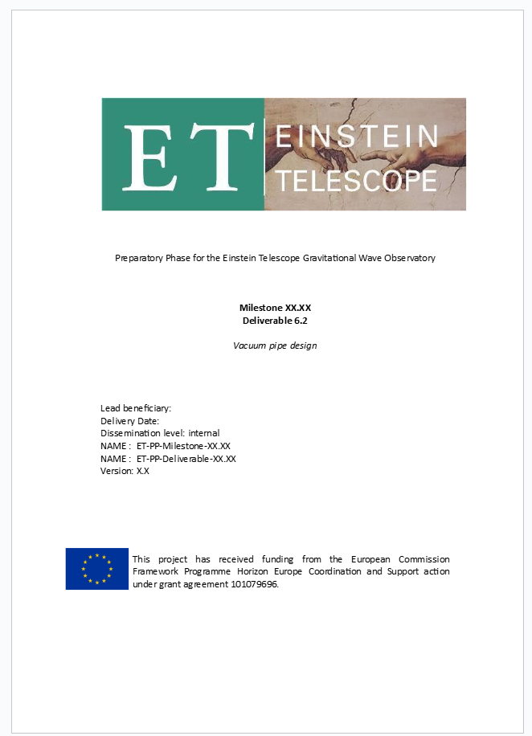
Preliminary Technical Design Report (TDR)
In the framework of ET-PP, a preliminary Technical Design Report (TDR) has been produced.
The prelimary TDR includes:
Overview and assumptions.
Functional specifications, scientific requirements and technical constraints.
Materials for the vacuum pipes.
Mechanical design of the vacuum pipes.
Fabrication and surface treatments.
Vacuum layout.
Installation.
Bakeout: thermal insulation, electrical configuration and procedure.
Vacuum control system.
Vacuum commissioning.
Vacuum operation and maintenance.
Quality assurance plan.
Risk management.
Logistics and sustainability.
~ 70 pages

Slide 13
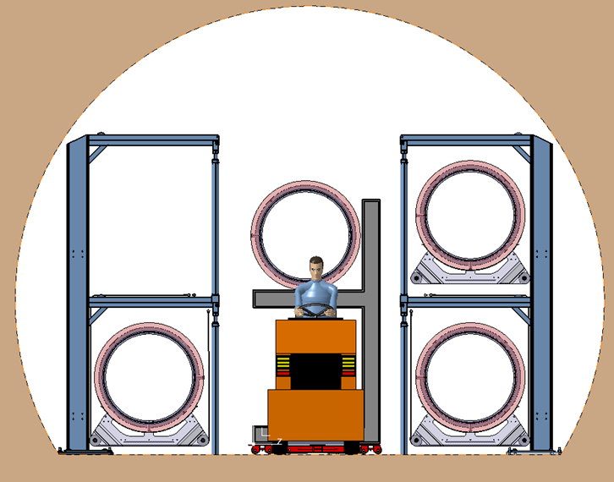
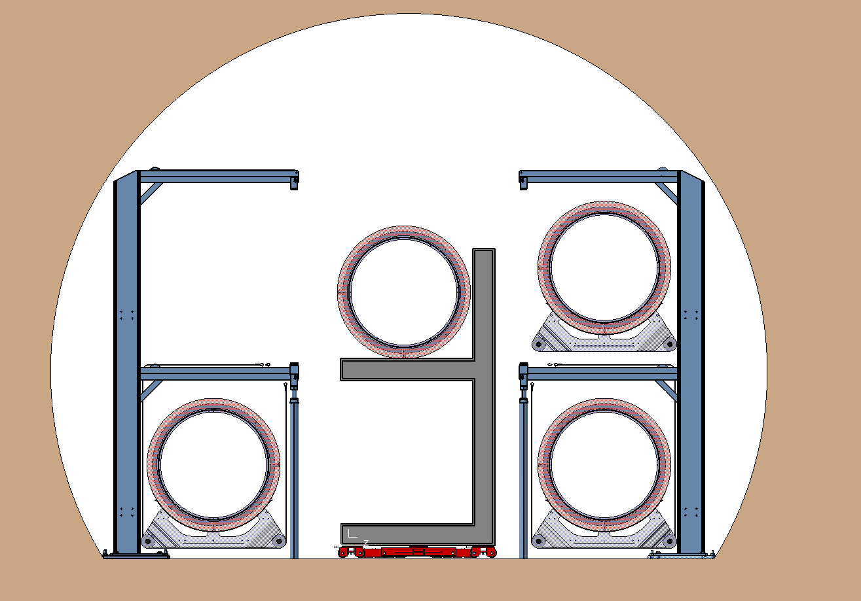
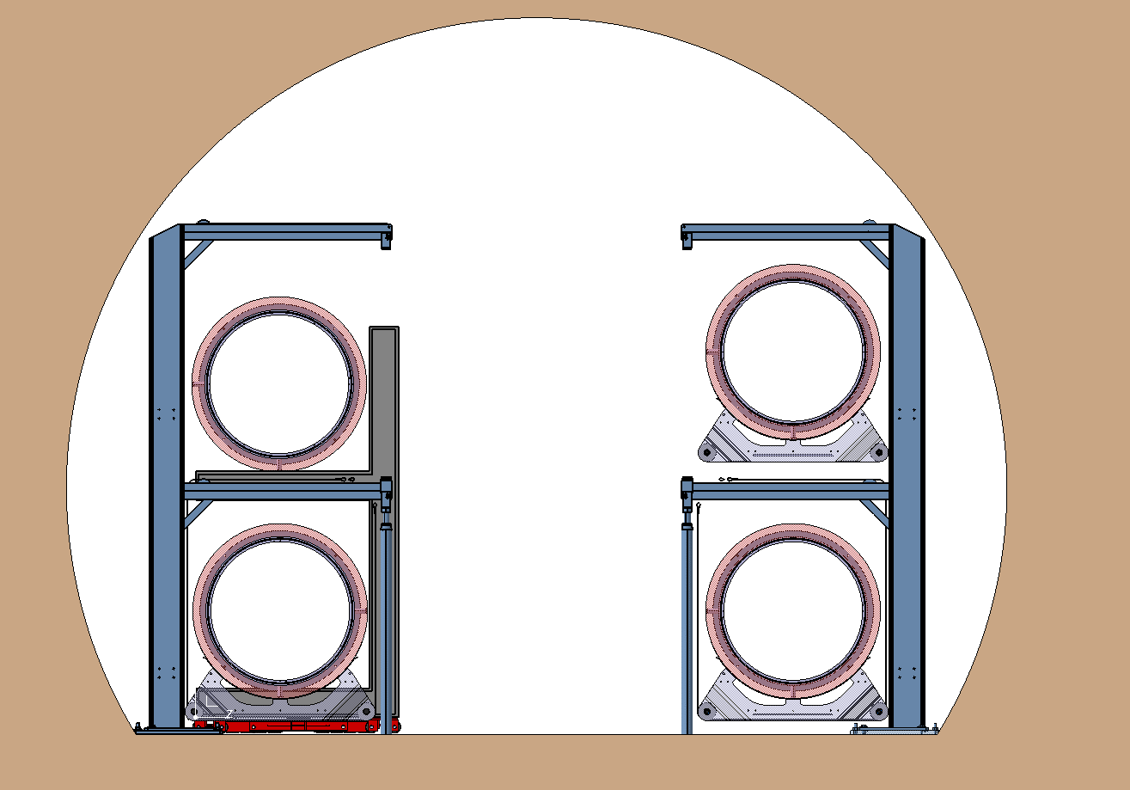
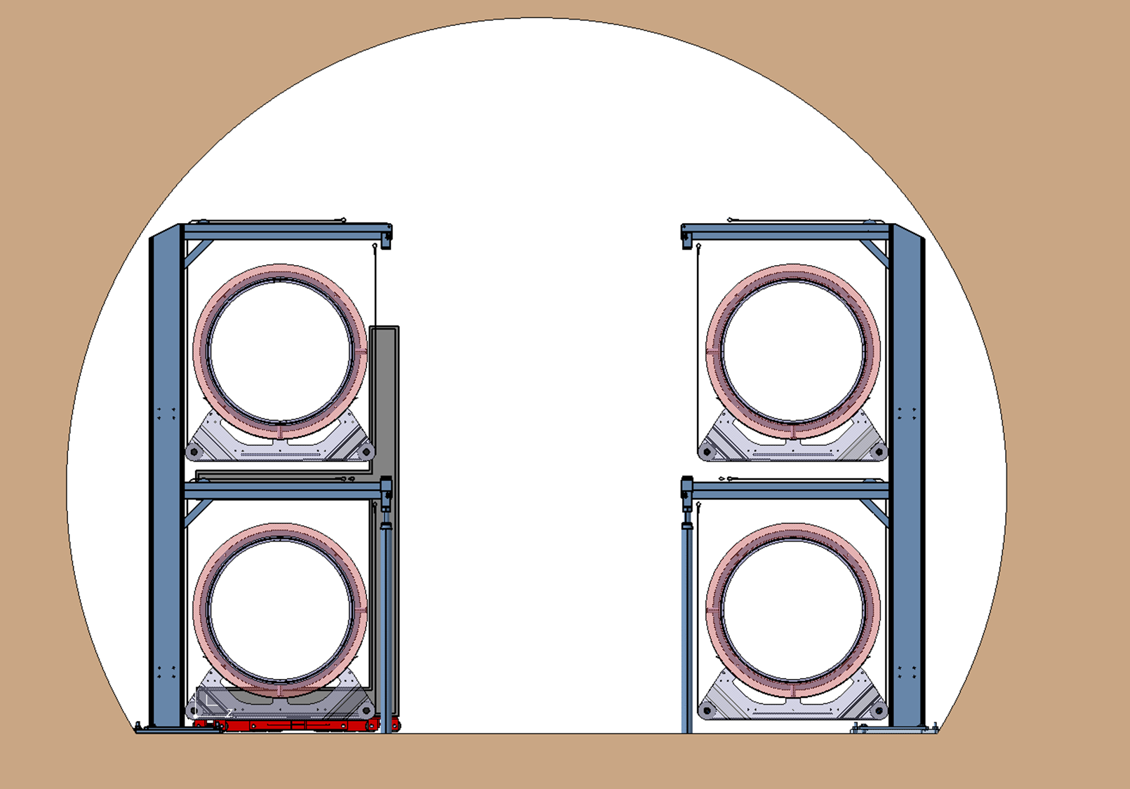
Preliminary Technical Design Report (TDR)
The prelimary TDR includes:
Overview and assumptions.
Functional specifications, scientific requirements and technical constraints.
Materials for the vacuum pipes.
Mechanical design of the vacuum pipes.
Fabrication and surface treatments.
Vacuum layout.
Installation.
Bakeout: thermal insulation, electrical configuration and procedure.
Vacuum control system.
Vacuum commissioning.
Vacuum operation and maintenance.
Quality assurance plan.
Risk management.
Logistics and sustainability.
Installation and repair procedure

Slide 14
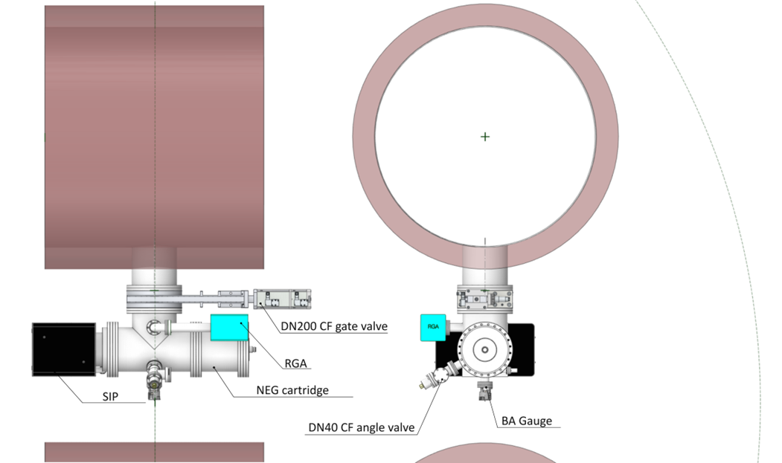
Preliminary Technical Design Report (TDR)
The prelimary TDR includes:
Overview and assumptions.
Functional specifications, scientific requirements and technical constraints.
Materials for the vacuum pipes.
Mechanical design of the vacuum pipes.
Fabrication and surface treatments.
Vacuum layout.
Installation.
Bakeout: thermal insulation, electrical configuration and procedure.
Vacuum control system.
Vacuum commissioning.
Vacuum operation and maintenance.
Quality assurance plan.
Risk management.
Logistics and sustainability.
Compact UHV pumping system

Slide 15
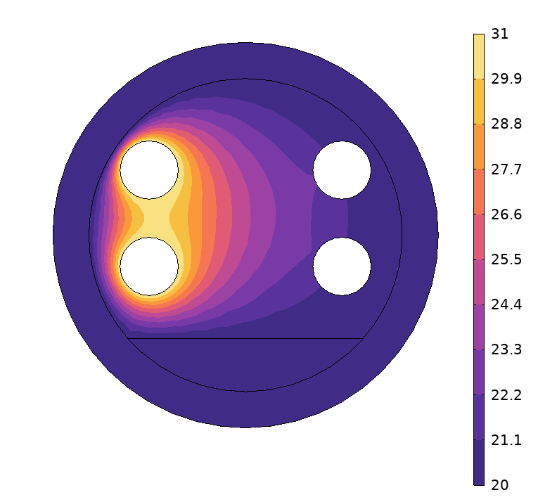
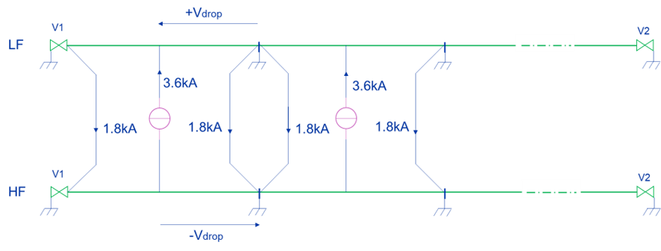
Preliminary Technical Design Report (TDR)
The prelimary TDR includes:
Overview and assumptions.
Functional specifications, scientific requirements and technical constraints.
Materials for the vacuum pipes.
Mechanical design of the vacuum pipes.
Fabrication and surface treatments.
Vacuum layout.
Installation.
Bakeout: thermal insulation, electrical configuration and procedure.
Vacuum control system.
Vacuum commissioning.
Vacuum operation and maintenance.
Quality assurance plan.
Risk management.
Logistics and sustainability.
Temperature distribution at the end of the bakeout (150°C, 7d)
Current distribution during bakeout

Slide 16
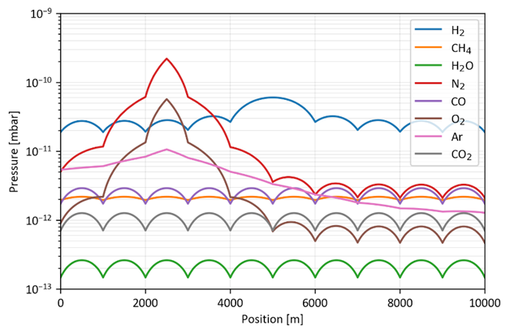
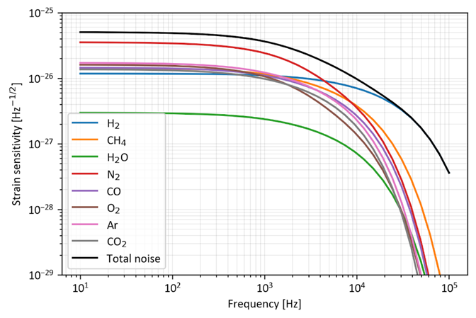
Preliminary Technical Design Report (TDR)
The prelimary TDR includes:
Overview and assumptions.
Functional specifications, scientific requirements and technical constraints.
Materials for the vacuum pipes.
Mechanical design of the vacuum pipes.
Fabrication and surface treatments.
Vacuum layout.
Installation.
Bakeout: thermal insulation, electrical configuration and procedure.
Vacuum control system.
Vacuum commissioning.
Vacuum operation and maintenance.
Quality assurance plan.
Risk management.
Logistics and sustainability.
Air leaks impacts and recovery

Slide 17
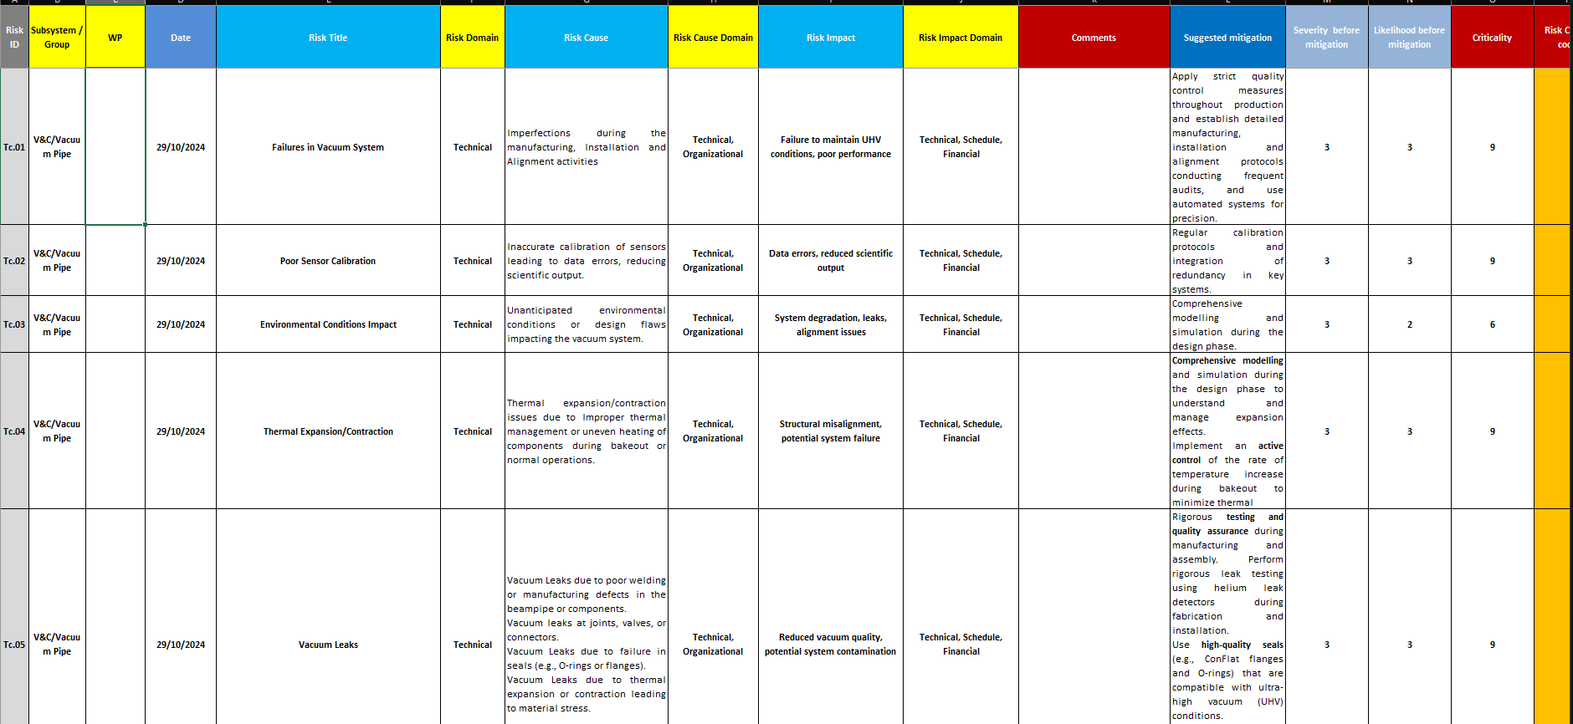
Preliminary Technical Design Report (TDR)
The prelimary TDR includes:
Overview and assumptions.
Functional specifications, scientific requirements and technical constraints.
Materials for the vacuum pipes.
Mechanical design of the vacuum pipes.
Fabrication and surface treatments.
Vacuum layout.
Installation.
Bakeout: thermal insulation, electrical configuration and procedure.
Vacuum control system.
Vacuum commissioning.
Vacuum operation and maintenance.
Quality assurance plan.
Risk management.
Logistics and sustainability.
Identification of risks of different categories:
Technical
Financial
Safety
Scope
Schedule

Slide 18
Technical Design Report (TDR)
New schedule allows the TDR to be updated for changes:
Preminary TDR (Q4 2024) [ET-PP]
Description of the system, materials, assembly, commissioning and risks identification.
Extended TDR (Q4 2025)
Detailing of all the chapters of the preliminary version (with in-depth reports). Logistics and sustainability further investigated. Preliminary cost estimation. Integration with civil engineering.
Final TDR (Q4 2027)
Final version with optimal solutions. Full detailing of chapters. Full integration with civil engineering considering all the other services (HVAC, fire safety, …).

