Slide 1
Materials and manufacturing for Einstein telescope
Prepared by: M. Dakshinamurthy and A. T. Pérez
Contributions: S. Sgobba, G. Favre, C. Scarcia, C. Garion

Slide 2
Overview
Material selection for UHV beampipe
    Alternative materials
Fabrication challenges and solutions
    Welding, Forming, Corrugation
    Characterization of fabrication
Corrosion
    Testing and characterization of welds
Prototypes
    Fabrication possibilities
Summary

Slide 3
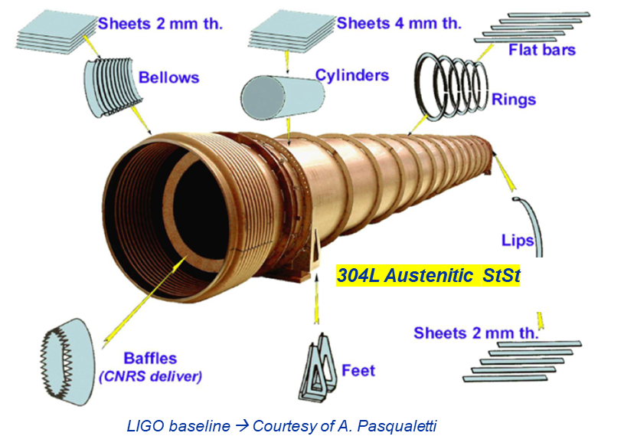
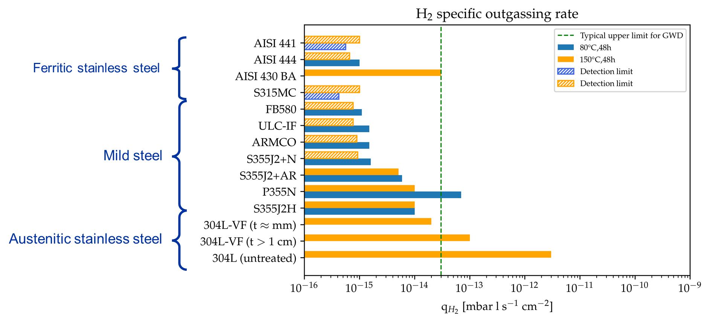
Material selection
LIGO, Virgo, KAGRA used 304 L
Excellent UHV properties but require Vacuum firing to achieve required Outgassing rate. → Additional cost, production bottle neck
Direct scale up of 304L for ET will have huge implications on project cost
Alternative materials (Steel): Ferritic SS and Mild steel
Benefits:
  H₂ outgassing rate in line with ET requirement
  No need for Air bakeout/vacuum firing
  Cost of raw material per mass unit is lower compared to Austenitic SS (304L)
Cost reduction
Table credits: work of Carlo Scarcia

Slide 4
Material selection
Development:
Selection of suitable grade of ferritic stainless steel
    Availability, Thickness, formability, weldability, strength, ductility, surface finish.
    Understand corrosion resistance
Optimizing the fabrication method
    Selection of suitable welding method(UHV compatible: TIG, Plasma arc, Laser).
    Performing corrugation
 | Structure | C | Mn | P | S | Si | Cr | Ni | N | Cu | Nb+Ti+V | Fe
AISI 304L | Austenitic | < 0.03 | ≤ 2.0 | ≤ 0.030* | ≤ 0.015* | ≤ 1.0 | 17.0-20.0* | 10.0-12.5 | 0.1 | - | - | balance
S315MC | Ferritic | ≤ 0.12 0.042 | ≤ 1.3 0.45 | ≤ 0.025 0.0055 | ≤ 0.020 0.0023 | ≤ 0.5 0.027 | - 0.05 | - 0.07 | - 0.007 | ≤ 0.22 0.17 | ≤ 0.22 0.0121 | balance
Type | Structure | C | Mn | Si | P | S | Cr | Mo | Ni | N | Ti | Nb
AISI 444 | Ferritic | 0.011 | 0.30 | 0.38 | 0.029 | 0.0150 | 18.89 | 1.89 | - | 0.016 | 0.80 | 0.80
AISI 441 | Ferritic | 0.015 | 0.38 | 0.58 | 0.025 | 0.001 | 17.57 | - | 0.242 | 0.014 | 0.16 | -
AISI 430 | Ferritic | 0.044 | 0.320 | 0.370 | 0.027 | 0.001 | 16.05 | 0.07 | 0.22 | 0.042 | - | -

Slide 5
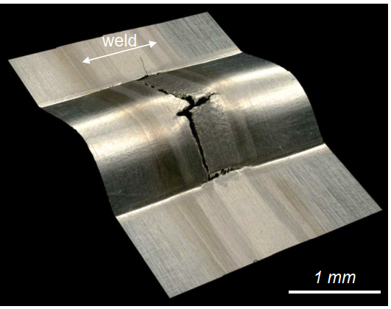
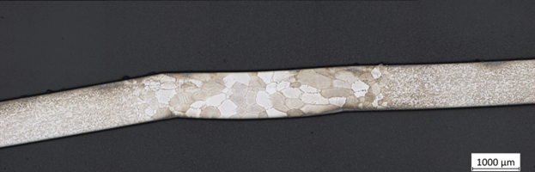
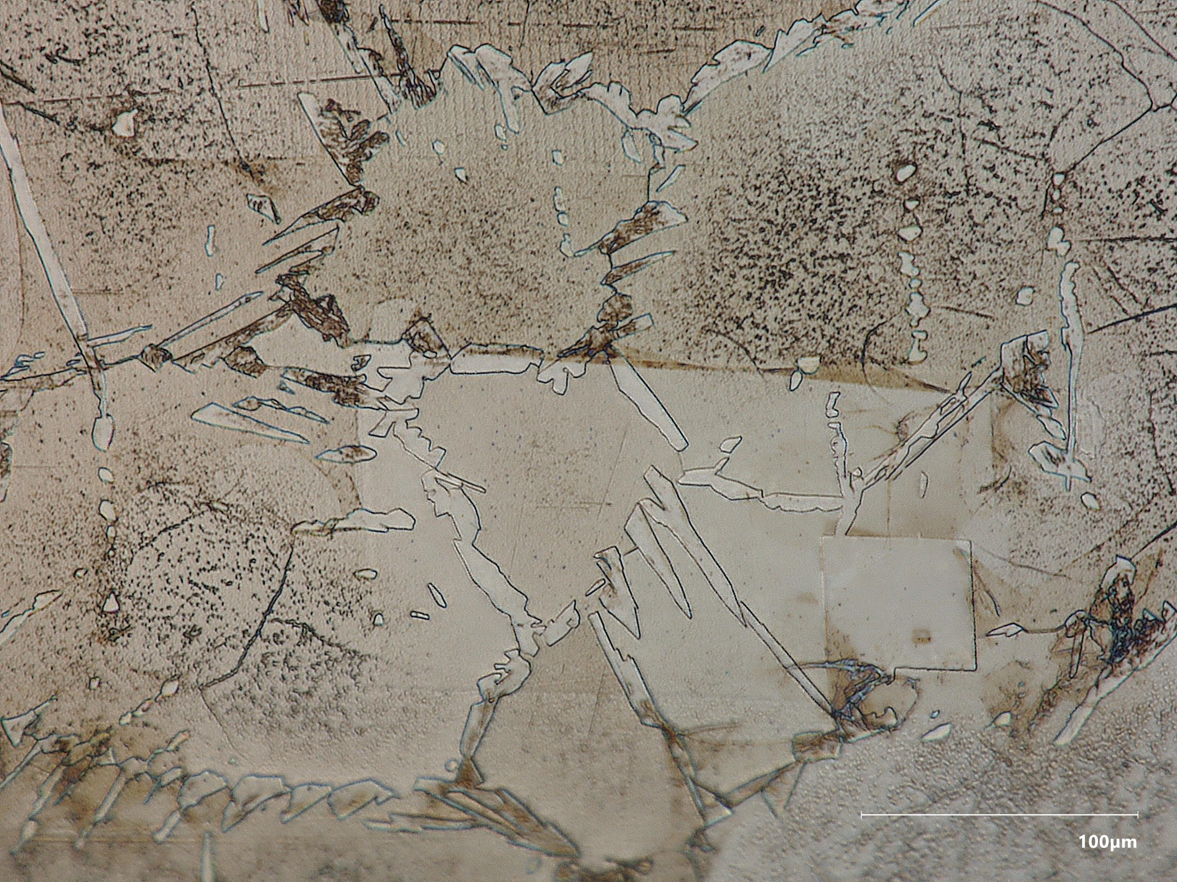
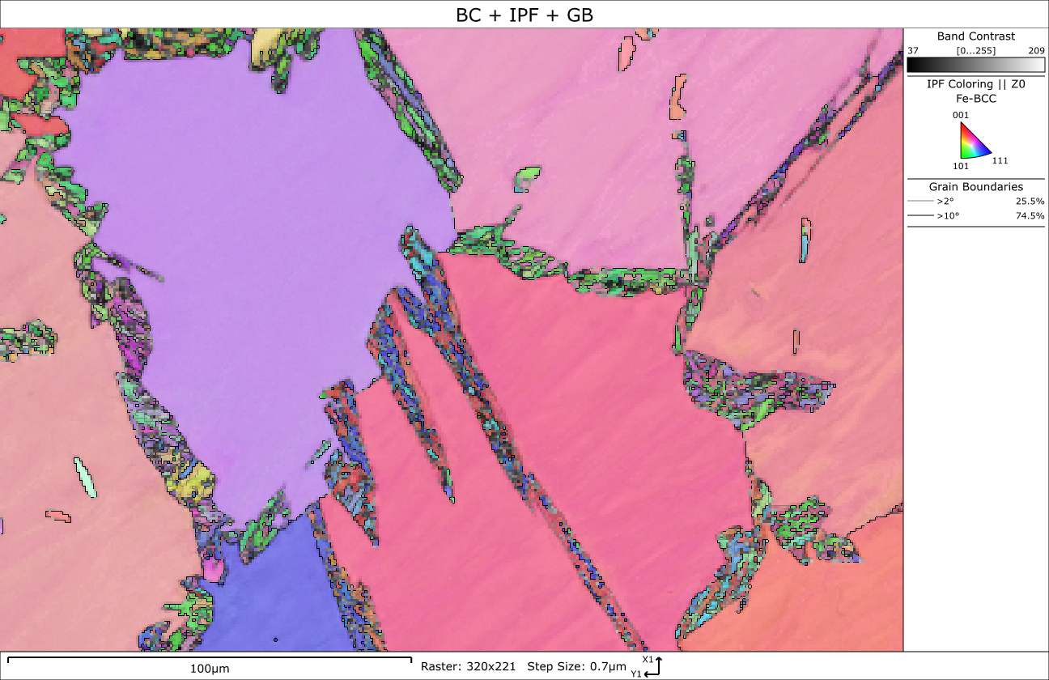
Material selection
Case study: AISI 430 TIG Autogenous weld
  Failure during corrugation
  Grain coarsening and presence of martensite
  Advanced characterization study to understand failure
Weld
Optical image: Grain coarsening in weld
Results presented at ET beampipes for GWT 2023
Two-Phase microstructure: δ Ferrite + intergranular Martensite
δ-Ferrite grains
Martensite
Martensite
Optical Image
SEM and EBSD
Nano indentation

Slide 6
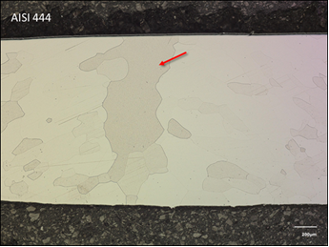
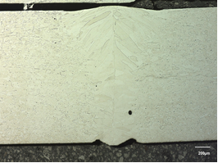
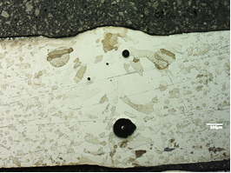
Welding optimization
Compatible welding approaches:
  Tungsten inert gas (TIG), Laser
  Autogenous welding
Optimized welding parameters :
  Reduce grain coarsening
  Reduce welding defects : to be compatible for UHV application
Case study: AISI 444
Not acceptable
TIG welding
Laser welding
Presence of large pores
**ISO 13919-1 level B

Slide 7
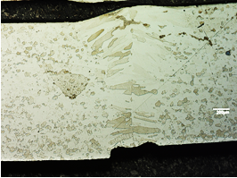
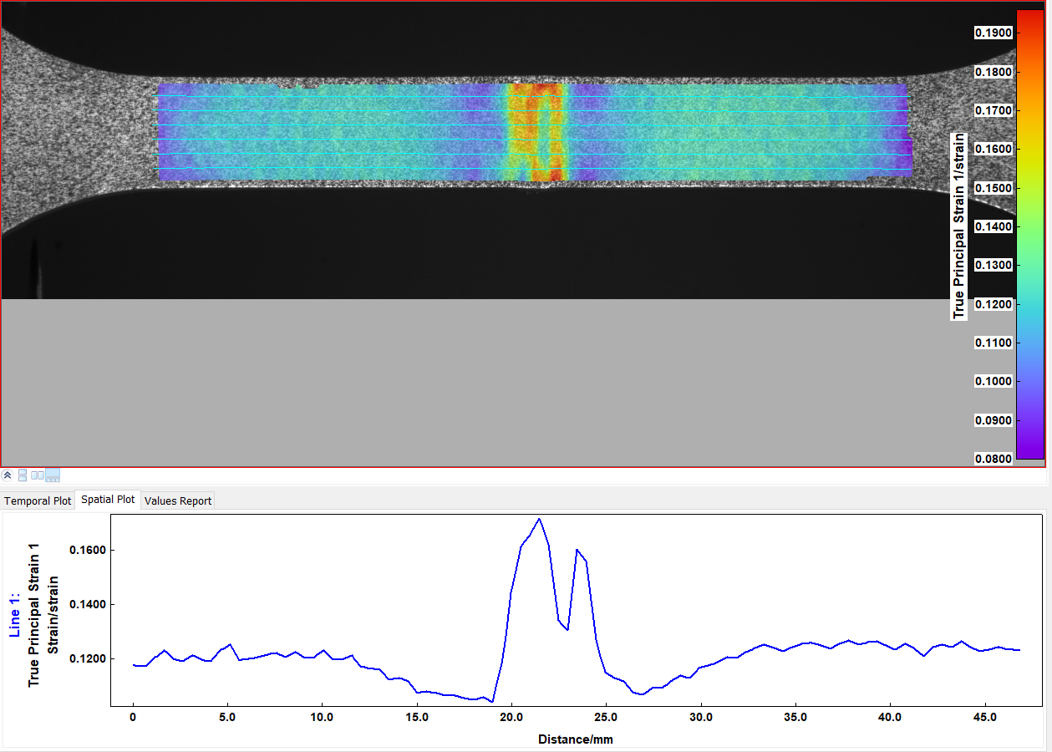
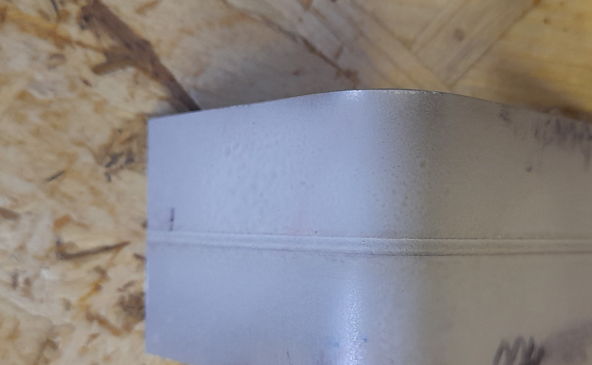
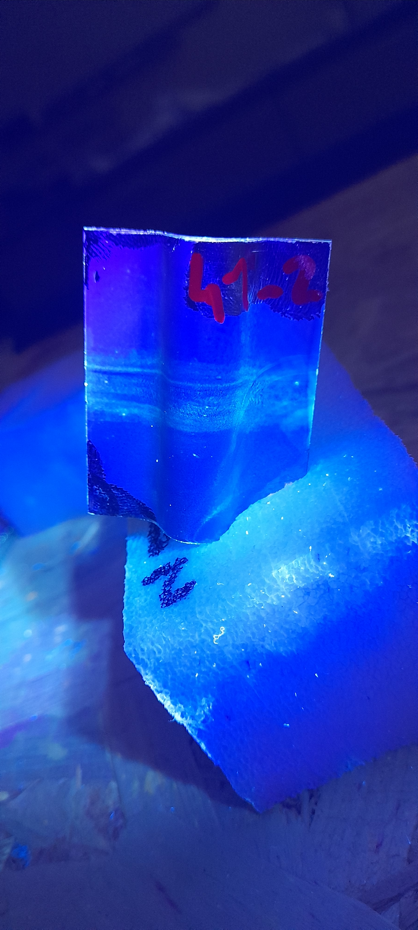
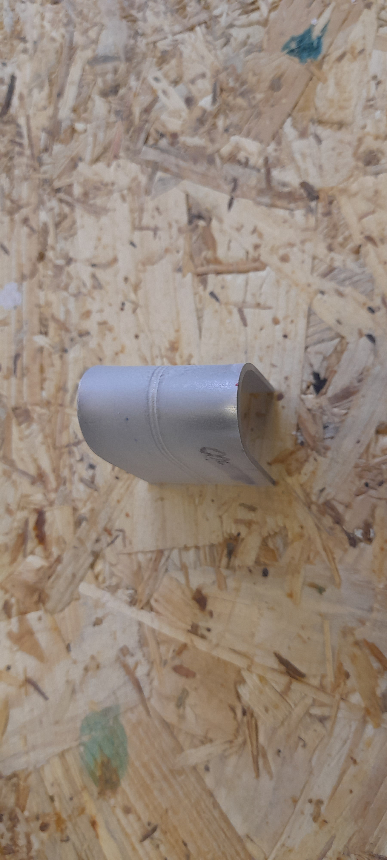
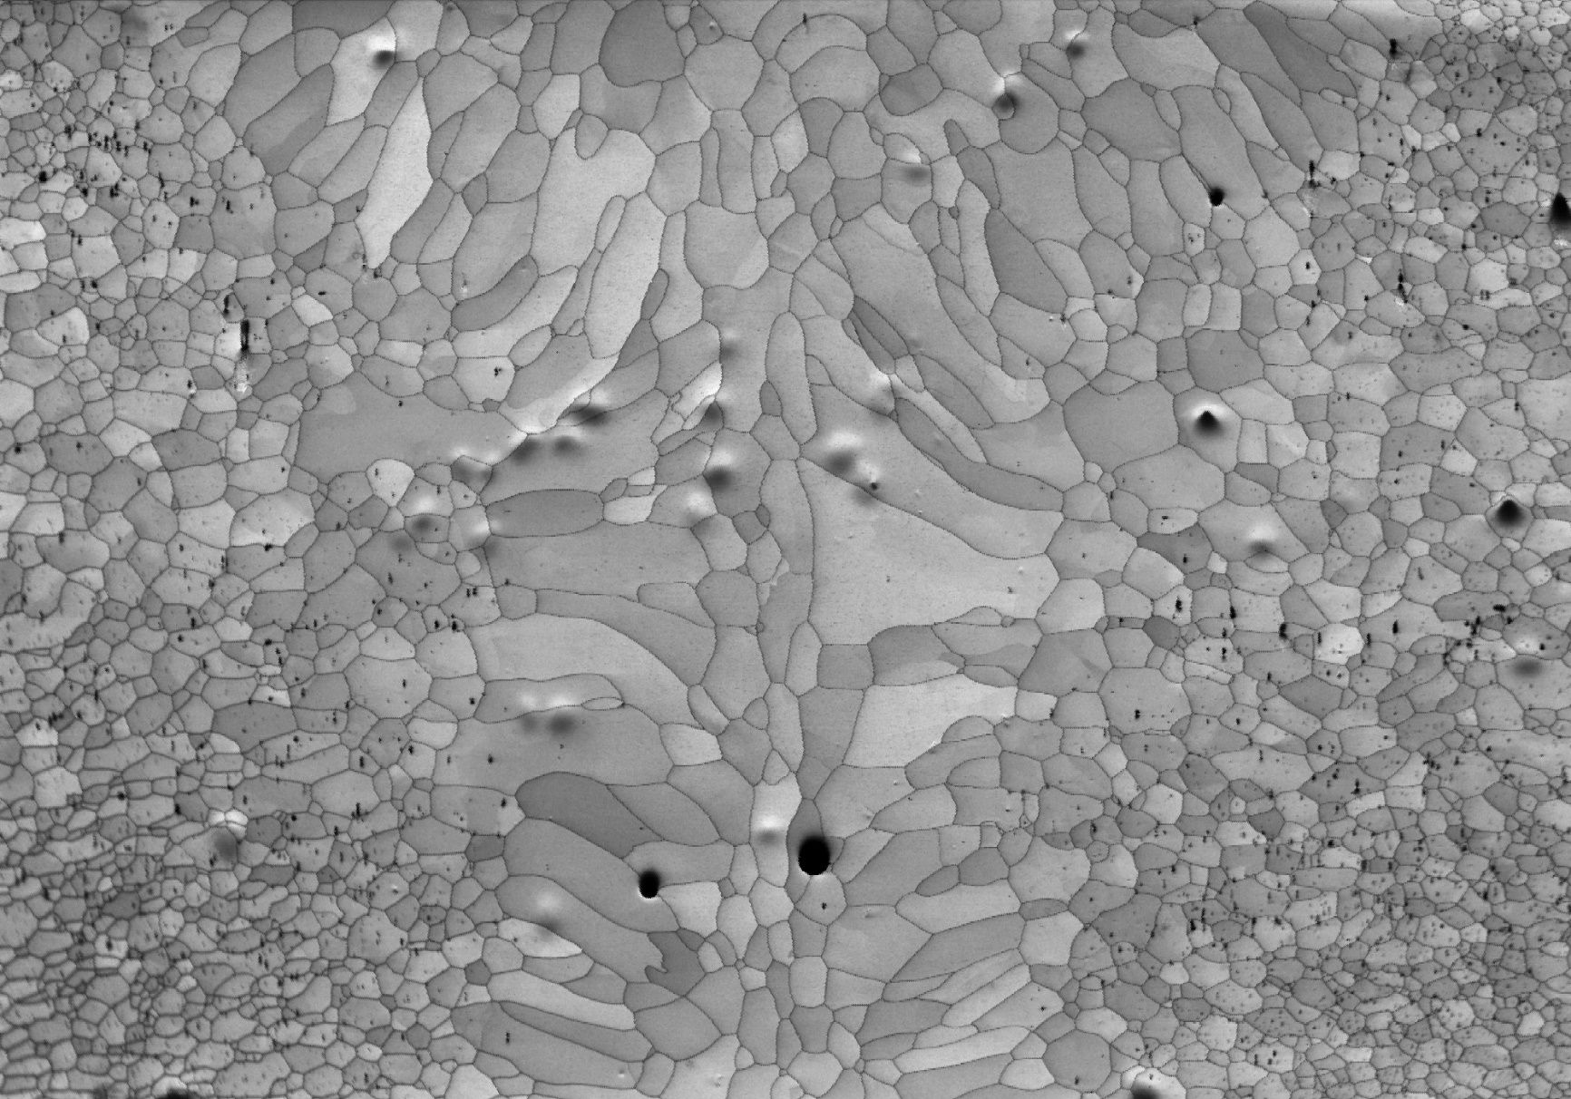
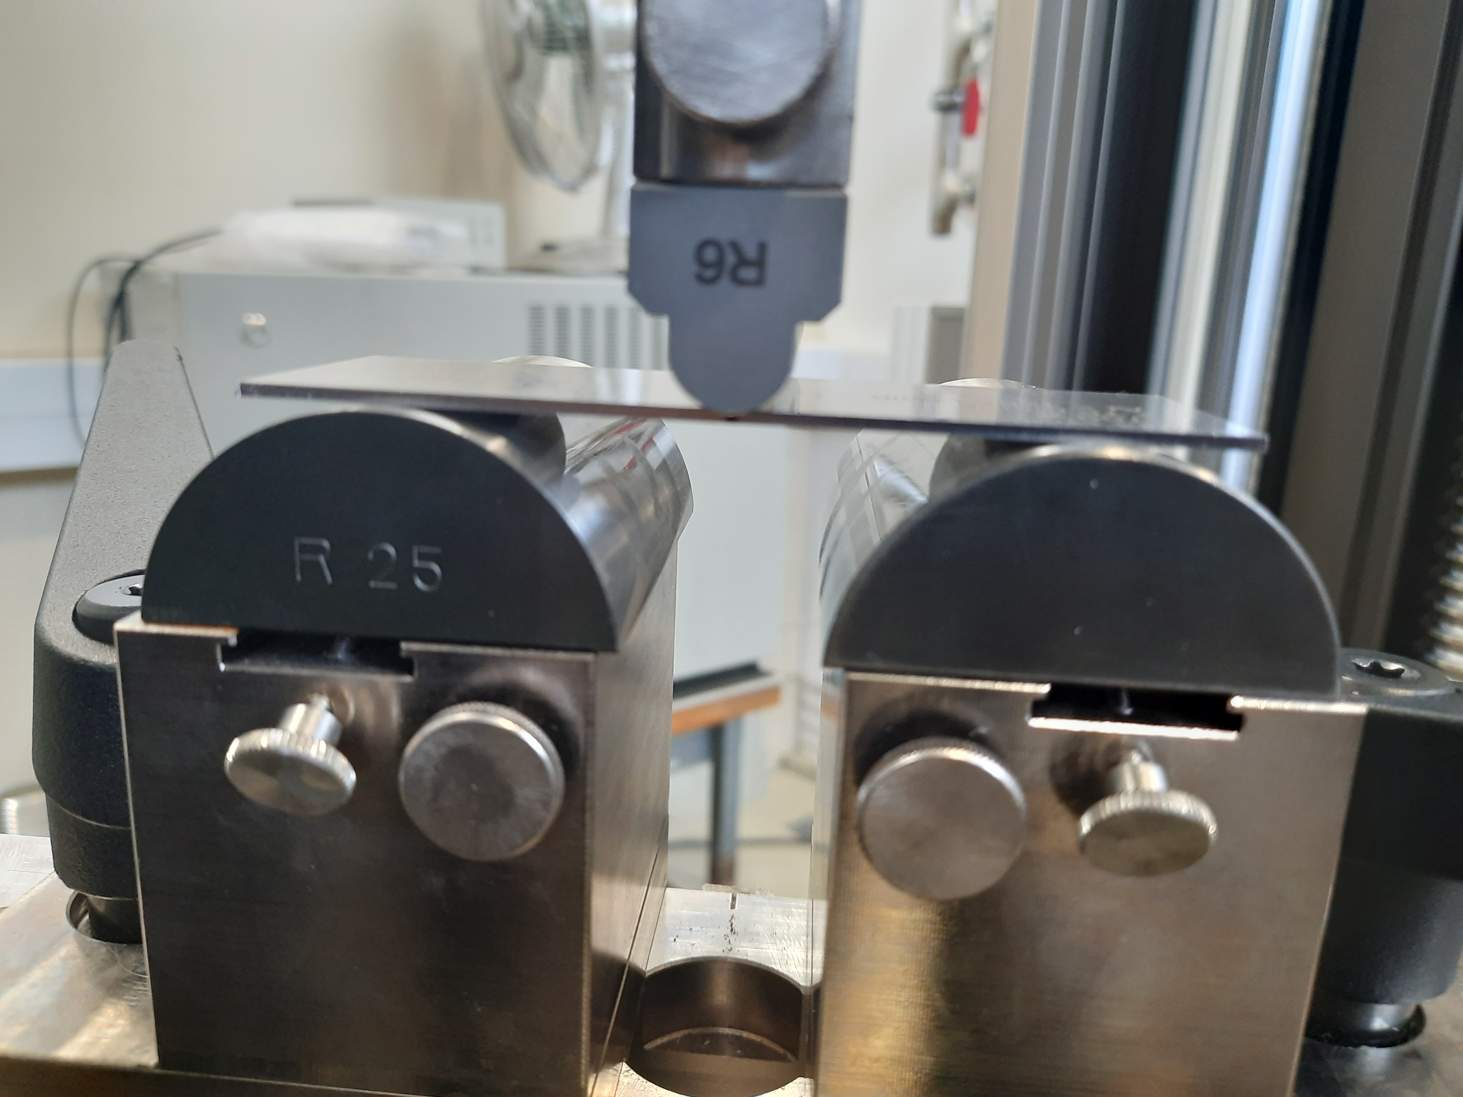
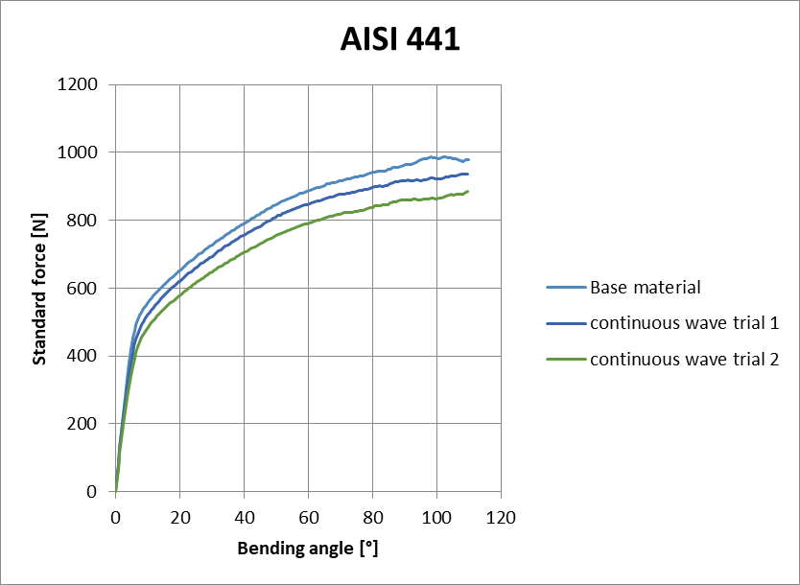
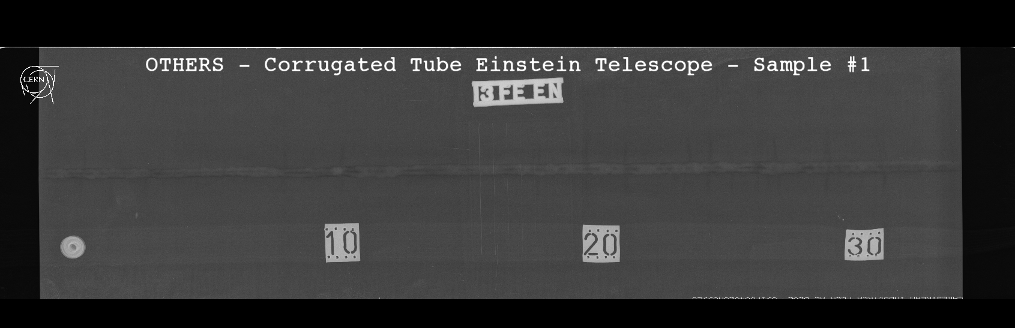
Welding characterization
Microscopic analysis
Mechanical testing
Nondestructive testing
110°
180°
Optical image of the cross section of the weld
Tensile testing with DIC
Dye penetrant testing
SEM images
credits : Alexey Gervasyev, Ghent university
Flexural test
Radiography testing

Slide 8
Material testing
In general, the results are slightly better in grade 441 samples (finer microstructure, hardness, flexural, A%...)
 |  | Weld characterization
 | Welding methods | RT | Metallurgy | Tensile trans. | Tensile long. | Flexural long. | corrugation test
441 | TIG auto | - | Large grains | A= 17% | A=26% | PT OK | PT OK**
 | Laser CW | OK | OK¹ | A=30% | A= 29% | PT OK | PT OK²
 | Laser Pulsed | - | OK¹ | A=28% | A= 31% | PT OK | PT OK
444 | TIG auto | - | Large grains | A= 18% | A=22% | PT OK | PT OK**
 | Laser CW | - | OK¹ | A=22% | A= 30% | PT OK | PT OK
 | Laser Pulsed | - | OK¹ | A=27% | A= 28% | PT OK | PT OK
NOTES:
Elongation at break (A) in the BM~ 30%
¹The compliance to be checked according ISO 13919-1 level B
Flexural test (ISO 5173 Longitudinal face bend test specimen for a butt weld - LFBB) 110 and 180°
Dye Penetrant Testing (PT) report EDMS 2932126, 2932126-1 for flexural and corrugation samples respectively
All the parts have been inspected by Penetrant Testing, and found to be conforming the standard ISO 23277 level 2x
² This is the only sample without any indications from PT
**Micro cracks observed on the surface of corrugation

Slide 9
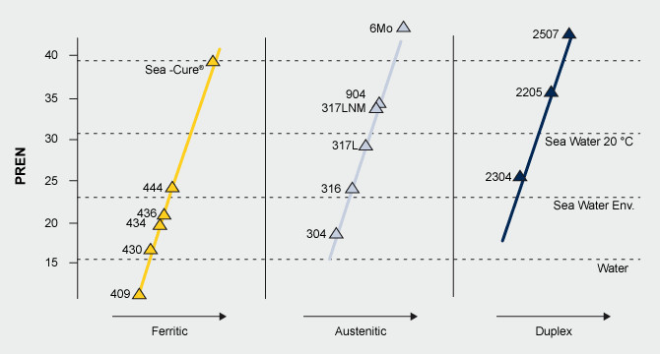
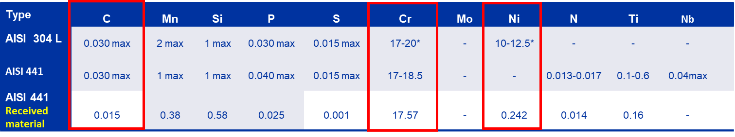
Corrosion resistance of stainless steels
Corrosion resistance can be assessed based on the working environment
  Acidic or hot alkaline environment
  Presence of chlorides, fluorides, iodides in the environment
  pH, temperature, humidity in the environment
Pitting resistance equivalent number (PREN):
  Estimates resistance to localized corrosion
    PREN = %Cr + (3.3 x %Mo) + (16 x %N)
    AISI 304L PREN ~ 17-20
    AISI 441 PREN ~ 17-18.5 (17.8)
Low carbon content of the AISI 441 is favourable point for the corrosion resistance compared to other FSS grades
Additionally, its high Cr content is comparable to 304L
In general, FSS have good heat and corrosion resistance. They are highly resistant to Cl stress corrosion cracking especially important in components like ET pipes with welded areas (in case of local sensitization in HAZs)
Also, their performance is superior to austenitic for use in sulphurous atmospheres for example, in which the presence of nickel reduces the resistance to corrosion, and in environments with modest chloride concentrations, where ferritic steels have better resistance to stress corrosion cracking

Slide 10
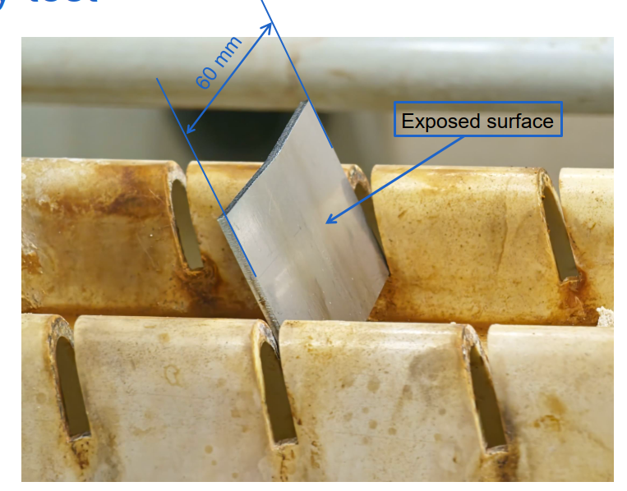
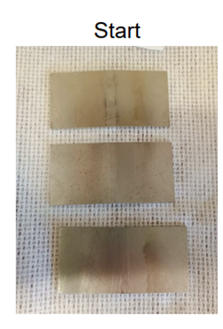
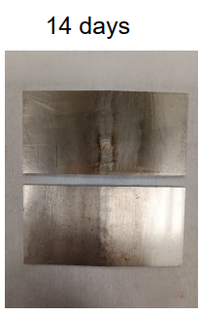
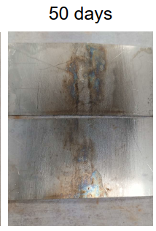
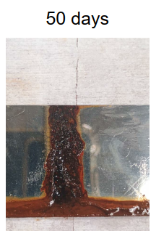
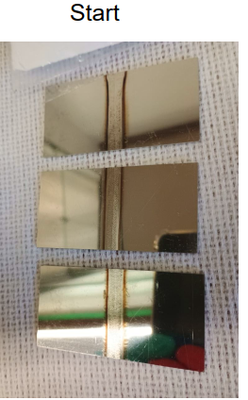
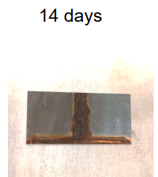
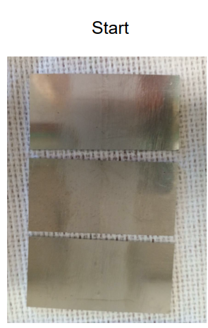
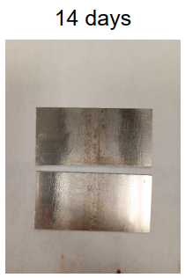
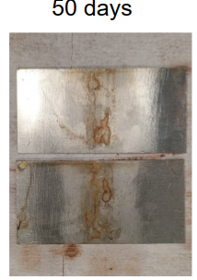
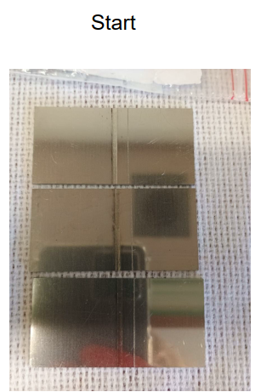
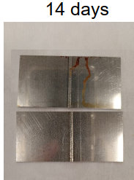
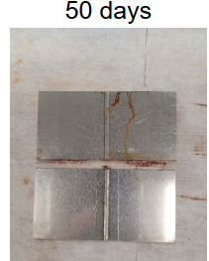
Corrosion resistance of stainless steels
Samples | Material | Welding process
Sample 1 | 304L | TIG
Sample 2 | AISI 430 | TIG
 | AISI 430 | LASER
Sample 3 | AISI 441 | TIG
 | AISI 441 | LASER
 | AISI 441, t=4mm | TIG with filler
Sample 4 | AISI 441 and AISI 304L | TIG/MIG
 | AISI 441 and AISI 316LN | TIG/MIG
Proposed Studies to characterize corrosion
  Comparison of welded AISI 304L and AISI 441: Precipitation and chemical segregation (Using SEM/EBSD)
  Test in environmental chambers simulating tunnel conditions
  Standard corrosion tests: In collaboration with Ghent university
    ASTM B117:Salt spray Test
AISI 304 L: TIG
AISI 430: TIG
AISI 441: TIG
AISI 441: Laser

Slide 11
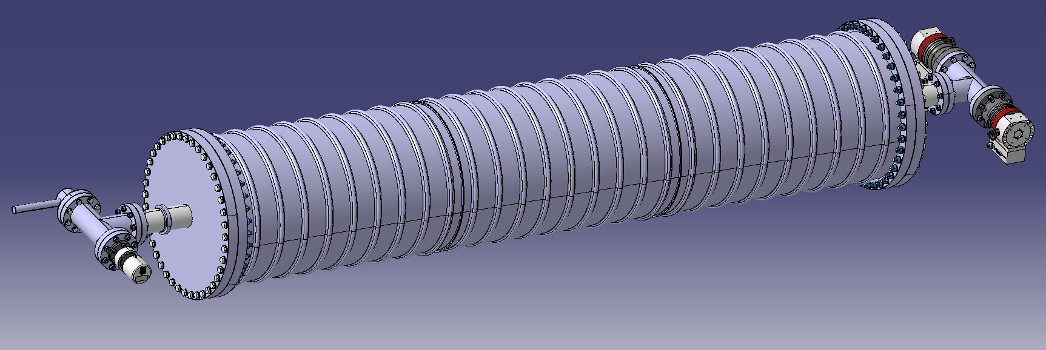
Pre-prototypes: corrugated pipes
Ø 400 mm x 2000 mm
Plate thickness < 1.5 mm
Corrugated pipe with thin wall
Standard (AISI 304L)/Alternate material
Accessories
Manufacturing
AISI 304L
AISI 441
S315MC
Manufacturing
WQ
Manufacturing
WQ
Manufacturing
WQ
Cu orifices
Supports
316LN flanges
316LN end covers
Cleaning
Small flanges machining
Welding flange-pipe-cover
Longitudinal welding (TIG)
Forming/corrugation
Cleaning
Thermal treatment
Circular welding
Flanges welding
NDT
Metallurgy
Tensile testing
bending test
Longitudinal welding(Laser)
Forming/corrugation
Cleaning
Circular welding
Flanges welding
Metallurgy
Tensile testing
Bending test
NDT
Longitudinal welding (TIG)
Forming/corrugation
Cleaning
Circular welding
Flanges welding
Metallurgy
Tensile testing
NDT
Vacuum test

Slide 12
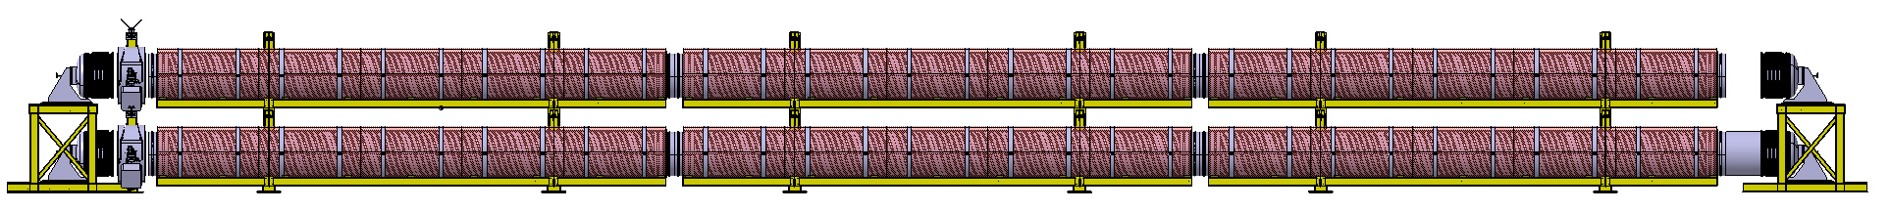
Pilot sector
  Two pipes with total length of 36 m and 1 m diameter.
  Three independent sectors of around 12m.
  Goal:
  Functioning of Supporting system, pumping modules, heating modules.
  12 m
  36 m
Pumping module
Instrumentation module
3x independent supports
End cover

Slide 13
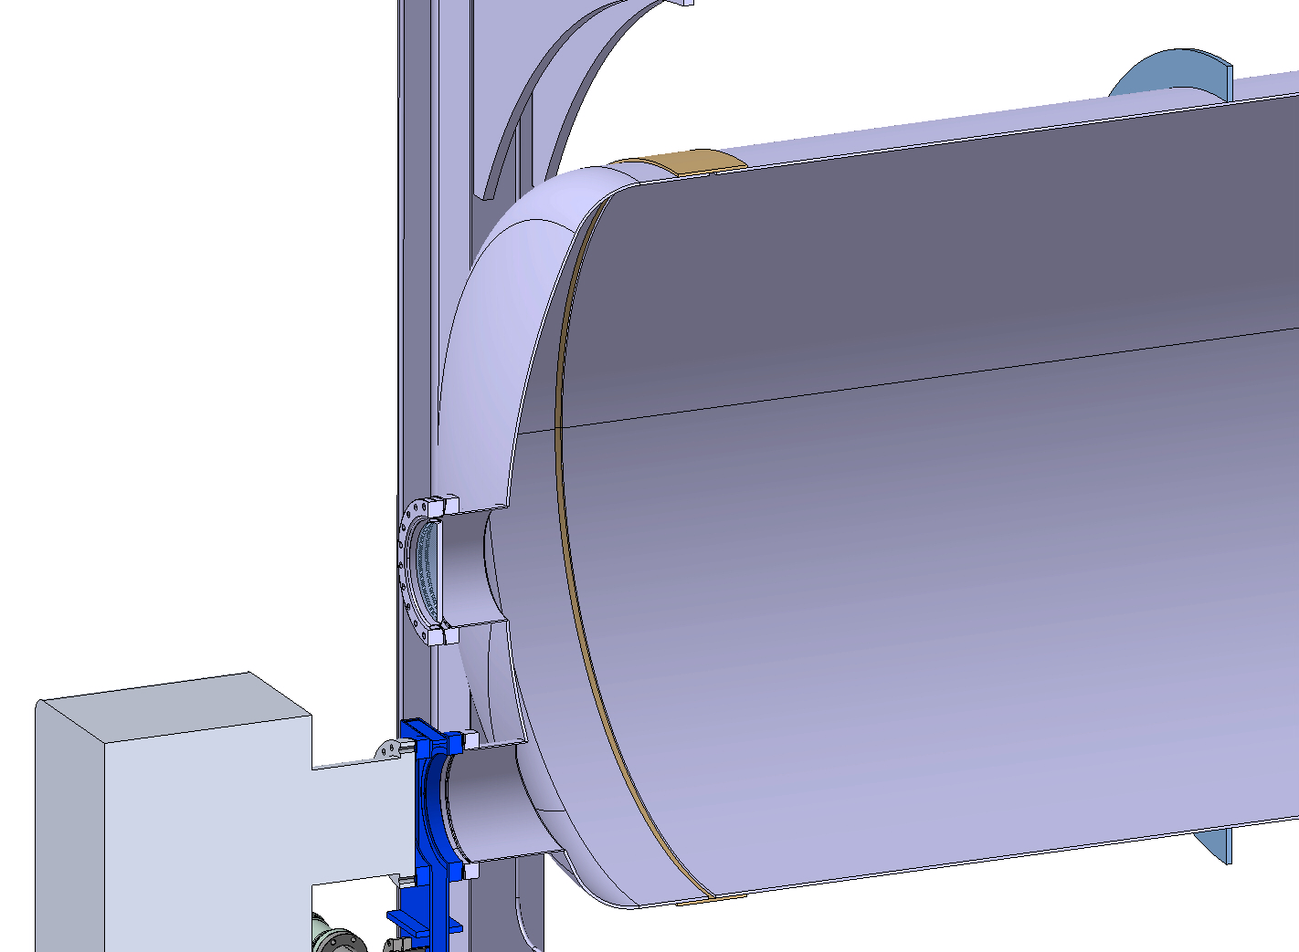
Pilot sector : Choice of Material
Materials | ET Vacuum requirements | Manufacturability (Welding and forming) | Corrosion resistance | Air bakeout/ vacuum firing | Cost
AISI 304 L | Good | Good | High | Necessary | High
S 315 MC | Good | Good | Low | Not necessary | Low
AISI 441 | Good | Good | High | Not necessary | Low
Components | Material
Vacuum chamber and end caps | AISI 441, 2B surface, up to 4 mm thickness, width of coil ~1500 mm
Stiffeners | AISI 441 / 304L, 4-8 mm thickness, width 45-60 mm, length ~3.5m
Sleeves(connection between chambers) | AISI 441, ~2mm thickness
S315 MC | AISI 441 | 304L
~1100 €/ton | ~2100 €/ton | ~4000 €/ton

Slide 14
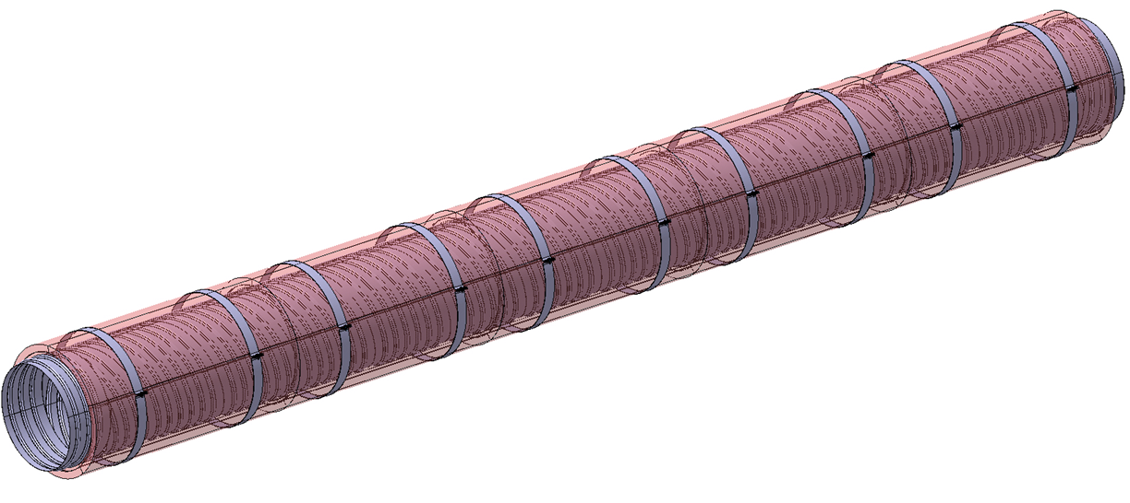
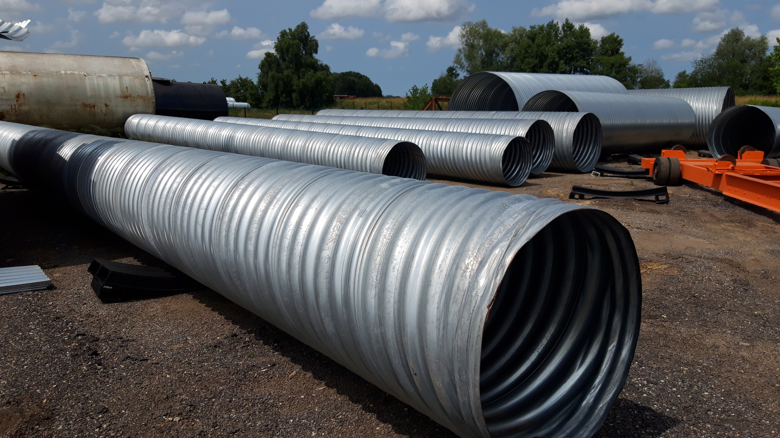
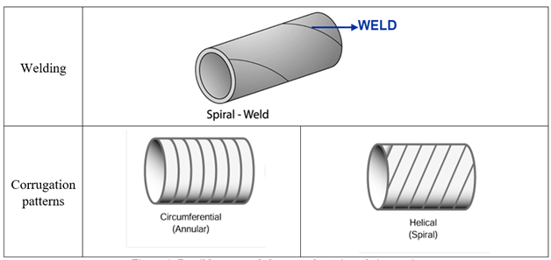
Phase 2: Pilot sector
Longitudinal welds | Spiral welds
Multiple small sections (max 1.5m length) Fabrication (forming and welding) possible both in CERN and externally Easy for NDT inspection Time and cost for fabrication More welds – more time Higher NDT inspection time | Continuous process and large sections can be fabricated CERN fabrication not possible, must rely on external companies NDT inspection in line with production Time and cost for fabrication Quick process Lesser welds inspection time (inline inspection possible)
Ø 1 m x 36 m
Corrugated solution
Smooth solution*
Thickness = 2 mm
TIG welding
External partners
Thickness = ~ 4 mm
Longitudinal/Spiral welded tubes
In-house/ External partners
Technology already available
Produced Internally at CERN
CERN production: Not compatible
Technical developments required for scale up

Slide 15
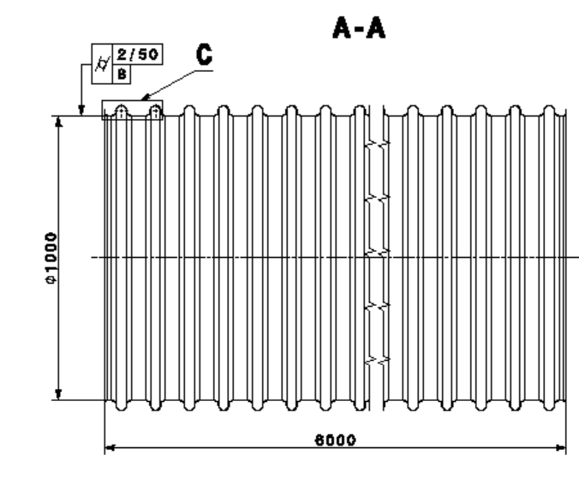
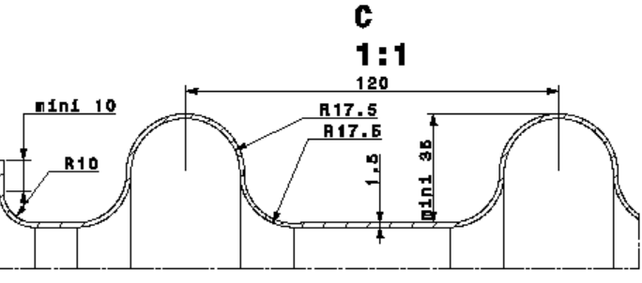

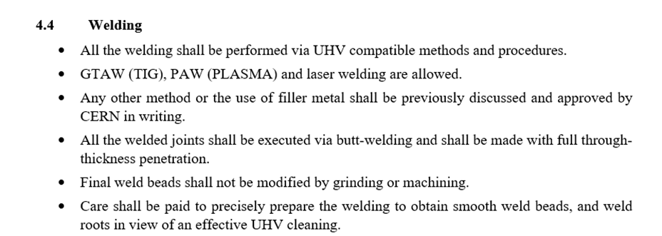
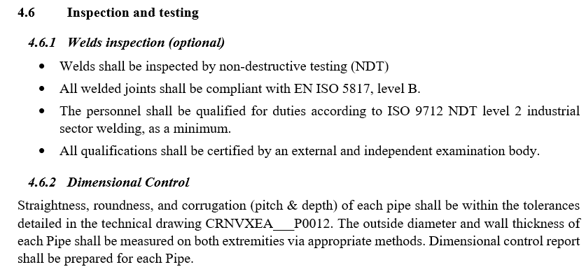
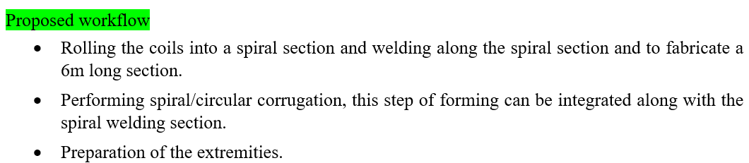
Technical specification Corrugated pipes
Material: 1-2 mm thick AISI 441
Design and tolerances
Welding and forming
  Spiral welding compatible for mass production
  Discretion of the provider : To be compatible with UHV applications
  Corrugation: 2 approaches proposed by CERN with workflow
Inspection and testing
  Prototype: Weld inspection, dimension control and
  leak tightness test to be according to ET requirements

Slide 16
Summary and perspective
Material selection:
  Ferritic SS AISI 441: Competitive alternative to Austenitic SS(304 L)
  Fabrication: Welding and forming compatible for UHV
  Corrosion resistance comparable to 304L
  Cheaper than 304L and readily available in the market
  Excellent H2 outgassing and UHV compatible
Welding and forming
  TIG and Laser can be used for welding
  Retains good formability after welding →Important for corrugation
Large scale production: Pilot sector and ET
  Selection of material (AISI 441) and design (smooth pipe with stiffeners) for the pilot sector
  Development of technology for corrugation solution → Scalable for ET

Slide 17
Thank you for your attention

Slide 18
Material properties
 | Structure | C | Mn | P | S | Si | Cr | Ni | N | Cu | Nb+Ti+V | Fe
AISI 304L | Austenitic | < 0.03 | ≤ 2.0 | ≤ 0.030* | ≤ 0.015* | ≤ 1.0 | 17.0-20.0* | 10.0-12.5 | 0.1 | - | - | balance
S315MC | Ferritic | ≤ 0.12 0.042 | ≤ 1.3 0.45 | ≤ 0.025 0.0055 | ≤ 0.020 0.0023 | ≤ 0.5 0.027 | - 0.05 | - 0.07 | - 0.007 | ≤ 0.22 0.17 | ≤ 0.22 0.0121 | balance
Type | Structure | C | Mn | Si | P | S | Cr | Mo | Ni | N | Ti | Nb
AISI 444 | Ferritic | 0.011 | 0.30 | 0.38 | 0.029 | 0.0150 | 18.89 | 1.89 | - | 0.016 | 0.80 | 0.80
AISI 441 | Ferritic | 0.015 | 0.38 | 0.58 | 0.025 | 0.001 | 17.57 | - | 0.242 | 0.014 | 0.16 | -
AISI 430 | Ferritic | 0.044 | 0.320 | 0.370 | 0.027 | 0.001 | 16.05 | 0.07 | 0.22 | 0.042 | - | -

Slide 19
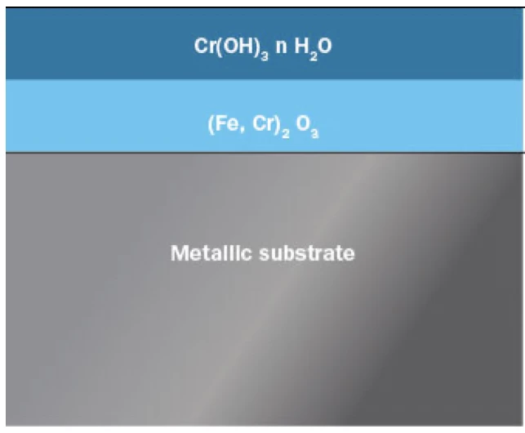
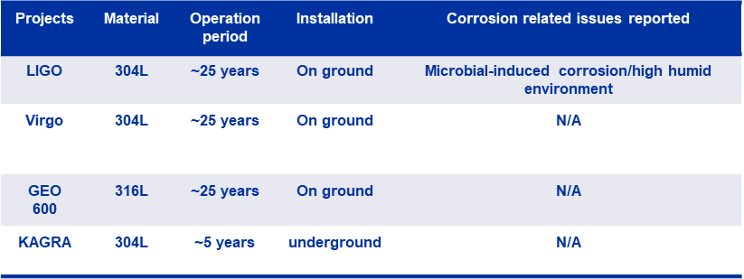
Corrosion resistance of stainless steels
Corrosion resistance in SS is due to presence of self-healing passive oxide layer
Based on the working environment passive layer can be destroyed leading to corrosion
  Acidic or hot alkaline environment
  Presence of chlorides, fluorides, iodides in the environment
  pH, temperature, humidity in the environment
Comparison of AISI 304L and AISI 441 base material
  High quality, long service and durability have been proven for gravitational detector applications based on austenitic stainless steels chambers such as 304L and 316L grades
  Low level of carbon, nitrogen in solid solution and high Cr, Ni and as applicable Mo provides high corrosion resistance in Austenitic grades
  Traditional ferritic stainless-steel grades had comparatively lower corrosion resistance compared to austenitic grade
  Early grades easily sensitized, hence limiting corrosion resistance
  Modern generation of ferritic SS (e.g. AISI 441, 444) have reduced carbon content with the help of Argon Oxygen Decarburization process

Slide 20
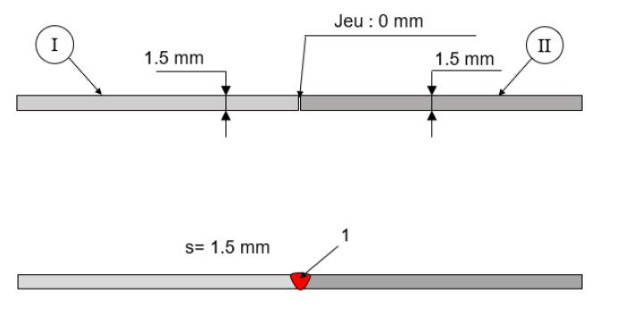
Welding parameters
Per prototype 1 : 304 L thickness 1.5 mm
TIG Autogenous weld : High intensity = 64A; Low intensity = 25A; Voltage = 10.7V; Welding speed = 164mm/min; Time pulsed = 0.15s
Per prototype 2 : 315 MC thickness: 1.35 mm
TIG Autogenous weld : High intensity = 100A; Low intensity = 25A; Voltage = 10.7V; Welding speed = 164mm/min; Time pulsed = 0.15s
Per prototype 3 : AISI 441 thickness=1.5 mm
Laser Autogenous weld : High intensity = 100A; Low intensity = 40A; Voltage = 12 V; Welding speed = 145mm/min; Time pulsed = 0.15s

Slide 21
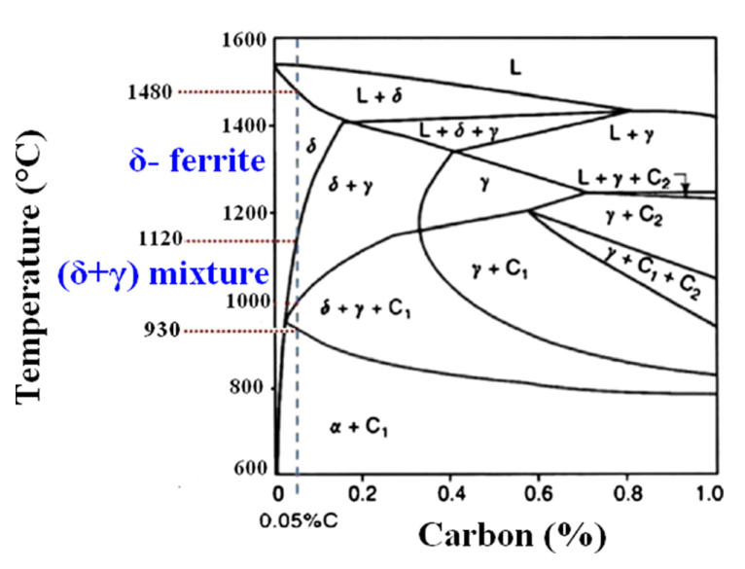
Weldability of AISI 430
In the pseudo-binary diagram for a Cr content of 17 wt. % and C within the 0.05 - 0.15 wt. % range (corresponding to the AISI 430), some austenite (γ) forms at elevated temperature along the δ-ferrite GB
This austenite transforms to M as the weld fusion zone cools to RT
The Kaltenhauser ferrite factor (K-factor) is commonly used to predict if the microstructure is fully ferritic but does not provide information regarding the amount of M that will be present
In our raw material the K-factor = 13.3 (17.0 is the minimum value determined by Kaltenhauser for AISI 430)
This factor is normally achieved by reducing C, adding ferrite stabilizing elements (Ti, Nb) or both
Other ferritic stainless steels can present better weldability
L → L + F → F → F + A
→ F + M
From Castro and Tricot
AISI 444/441
How to improve weldability on AISI 430?
It is good practice in medium-Cr types to limit heat input to minimise grain growth and optimize the cooling rate to reduce the martensite presence preventing the degradation of the ductility and toughness at the weld region
The use of austenitic consumables → Weld qualification plate performed using TIG with 308L as filler metal is for the moment RT and PT compliant
Composition, heat input and cooling rate are characteristics of welding process and thickness
Feasibility and cost to be evaluated…

Slide 22
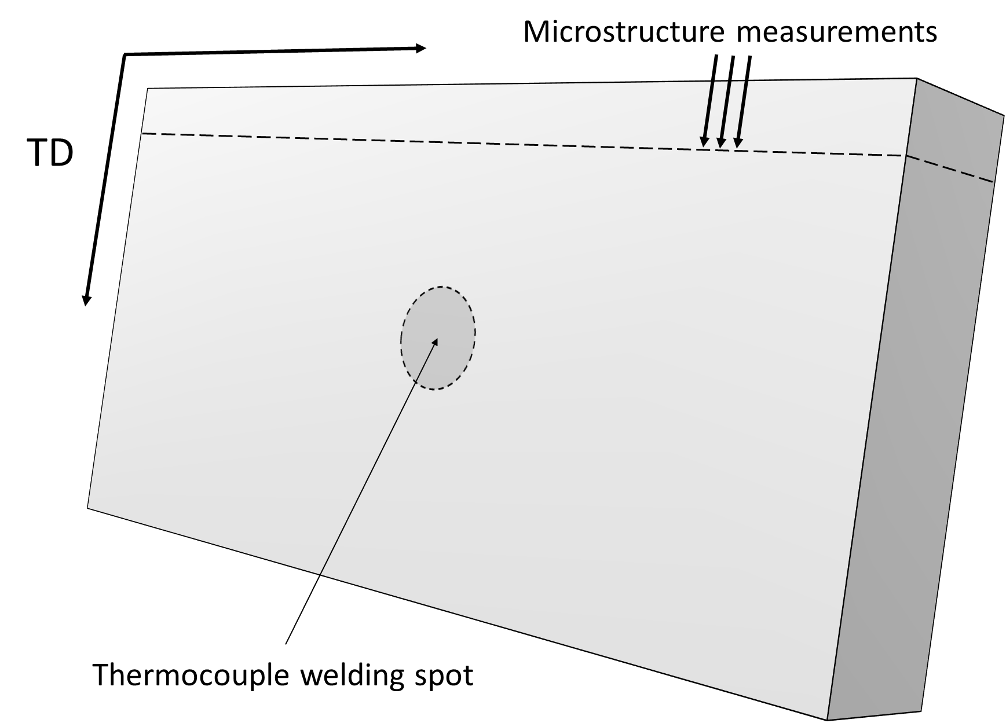
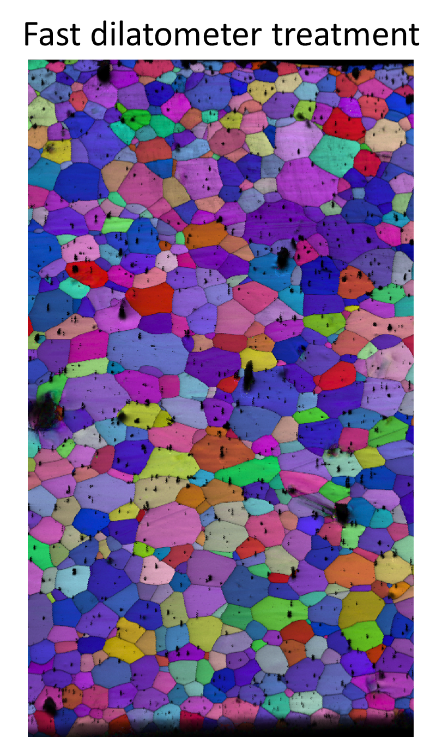


Dilatometry study
Dilatometer measures dimensional changes in material as a function of temperature.
It can implement complex temperature-time programs with high heating and cooling rates using induction heating and cooling by inert gas stream.
Two treatments: much faster and much slower cooling rates compared to the model estimation
Dilatometer specimen: 10 mm × 5 mm × sheet thickness (1.5 mm)
Grain size comparison

Slide 23

Phase 1 : Pre-prototypes → AISI 441 manufacturing
AISI 441
Manufacturing
WQ
Longitudinal welding
Forming/corrugation
Cleaning
Circular welding
Flanges welding
Metallurgy
Tensile testing
Bending test
NDT
Laser welding with corrugation

