Slide 2
Design inputs and concept
Specifications:
  Geometry:
    Aperture of 1000 mm
    About 100 km long
  Vacuum: 10⁻⁹ mbar
    Low outgassing materials
    In-situ bake out at 150 °C
  Mechanics:
    Vacuum/atmospheric pressure
    Gravity
  Environment
    Corrosion resistant
  As cheap as possible

Slide 3
Design inputs and concept
  Mechanical aspects of thin-walled corrugated tubes
    Withstand external pressure
    Stainless steel material
    No need of bellows
    Easier bake out
    Less raw material
    lighter forming equipment (thinner wall)

Slide 4
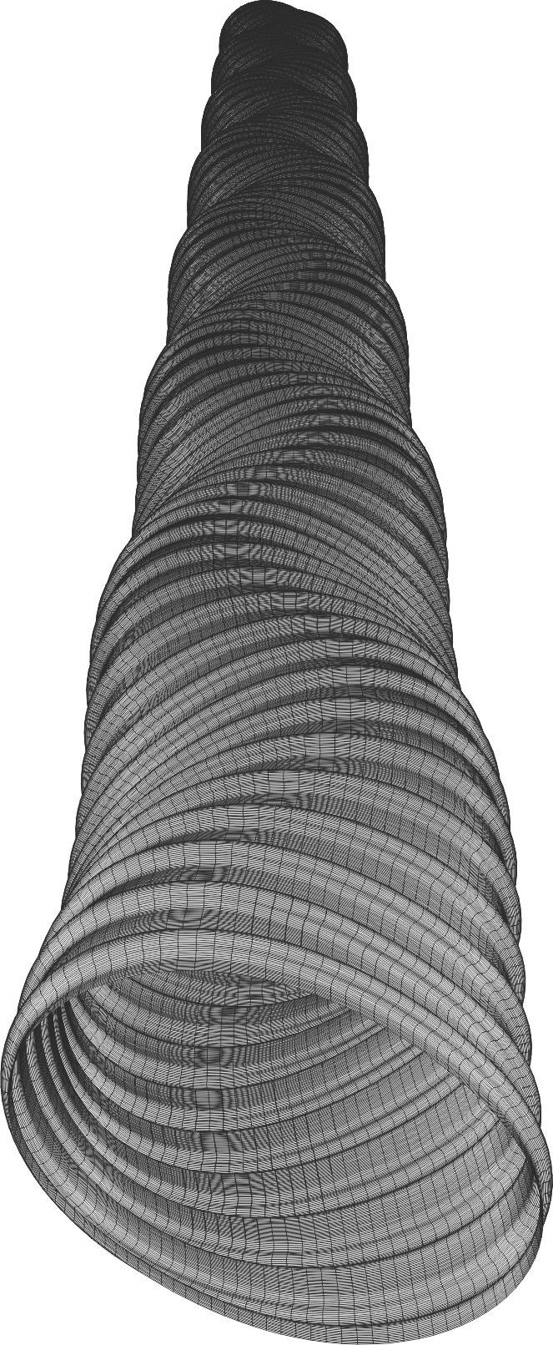
Mechanical aspects
The design is driven by the buckling pressure of a corrugated tube.
Simplified geometry with two parameters.
p
Unfolded length of one pitch: Lr
t
h
Equivalent thickness for the material quantity: t_{eq}=t*L_{r}/p
2h
A flat section between each corrugation accommodates baffle interfaces and simplifies tooling insertion if required
For long thin tube, typical buckling mode 2 is observed.
Safety coefficient of 3 is included.

Slide 5
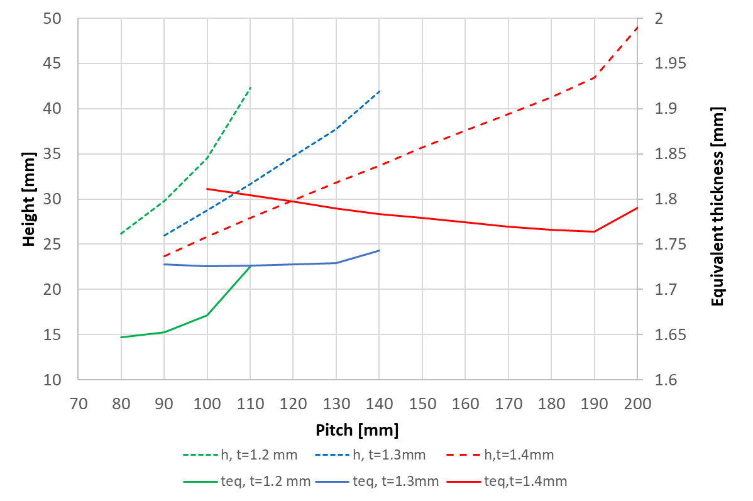
Mechanical aspects
Wall thickness in the range 1.2-1.5 mm can be considered for a buckling differential pressure of 3 bars.
p
t
h
2h
1.5 mm thick wall chamber could be a good starting point considering welding, convolution height.

Slide 6
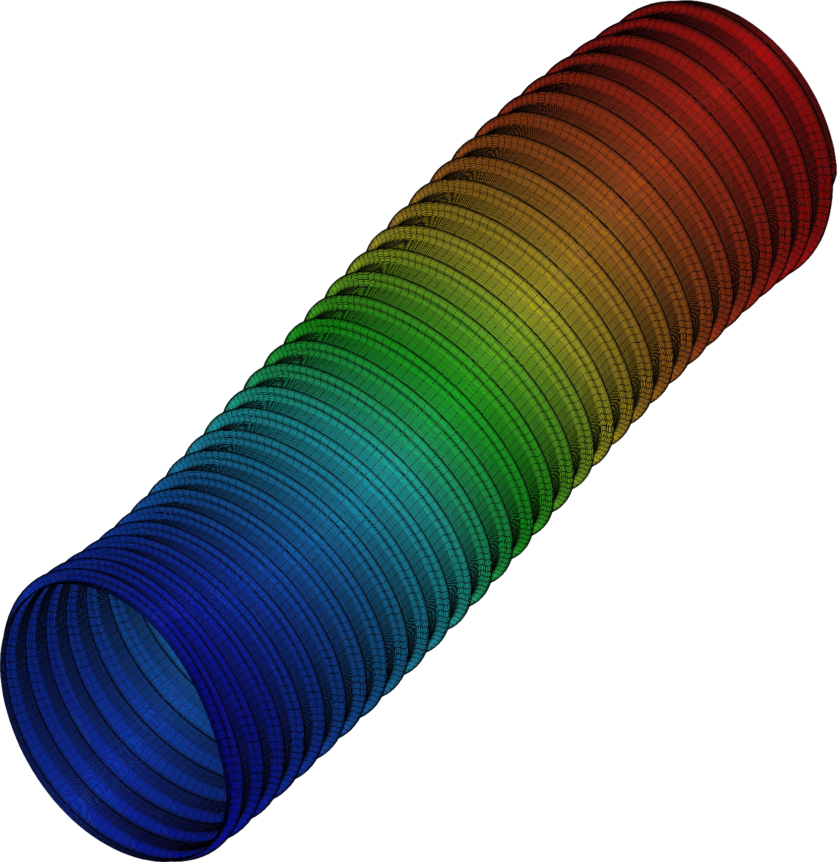
Mechanical aspects
1 mm ↔ 425 N
Specific stiffness:
Axial (E.S): 1.53E6 N
Transversal (E.I): 2.4E11 N.mm²
3600 mm
Specific weight: 48 kg/m
Bakeout induced axial force: -3.3 kN
(< 95 kN thrust force)
Euler buckling force (in case of accidental venting during bakeout), assuming simple supports distanced by 7.5 m : -42 kN
1 mm ↔ 61.5 N
1.3 mm thick, 120 mm pitch, 35 mm convolution height.
→ Global column instability not expected.

Slide 7
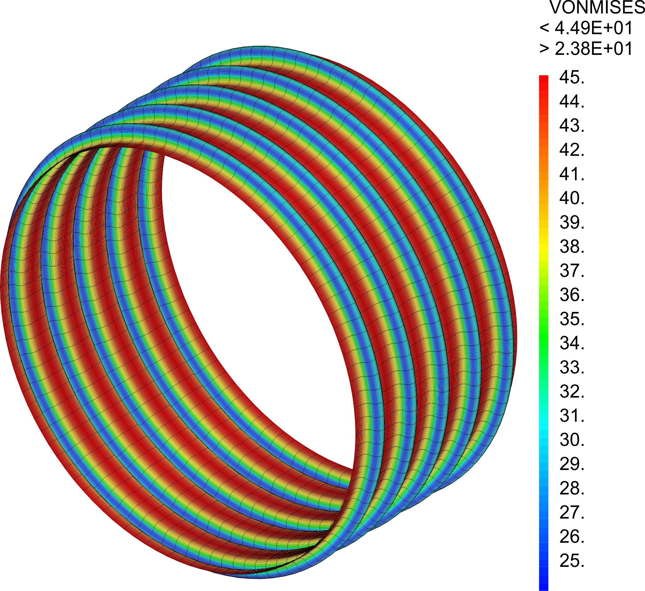
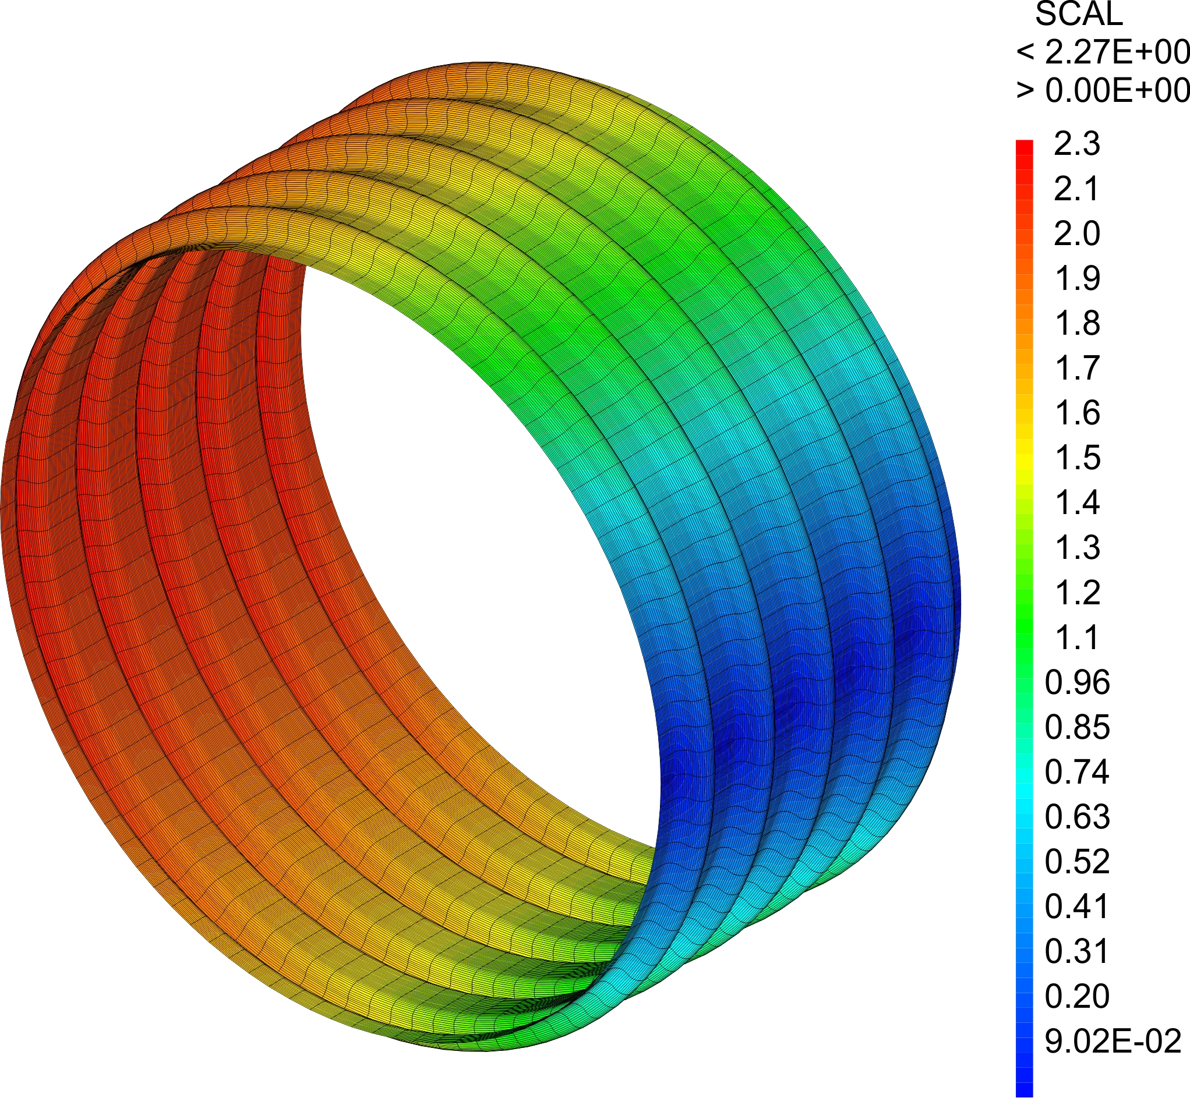
Mechanical aspects
Behaviour during bakeout (150°C) :
Stress of about 50 MPa
Diameter dilatation of about 2.3 mm
Von Mises equivalent stress field during bakeout
Transversal displacement induced by bakeout
Von Mises equivalent stress during bakeout under gravity (singularity at support removed)

Slide 8
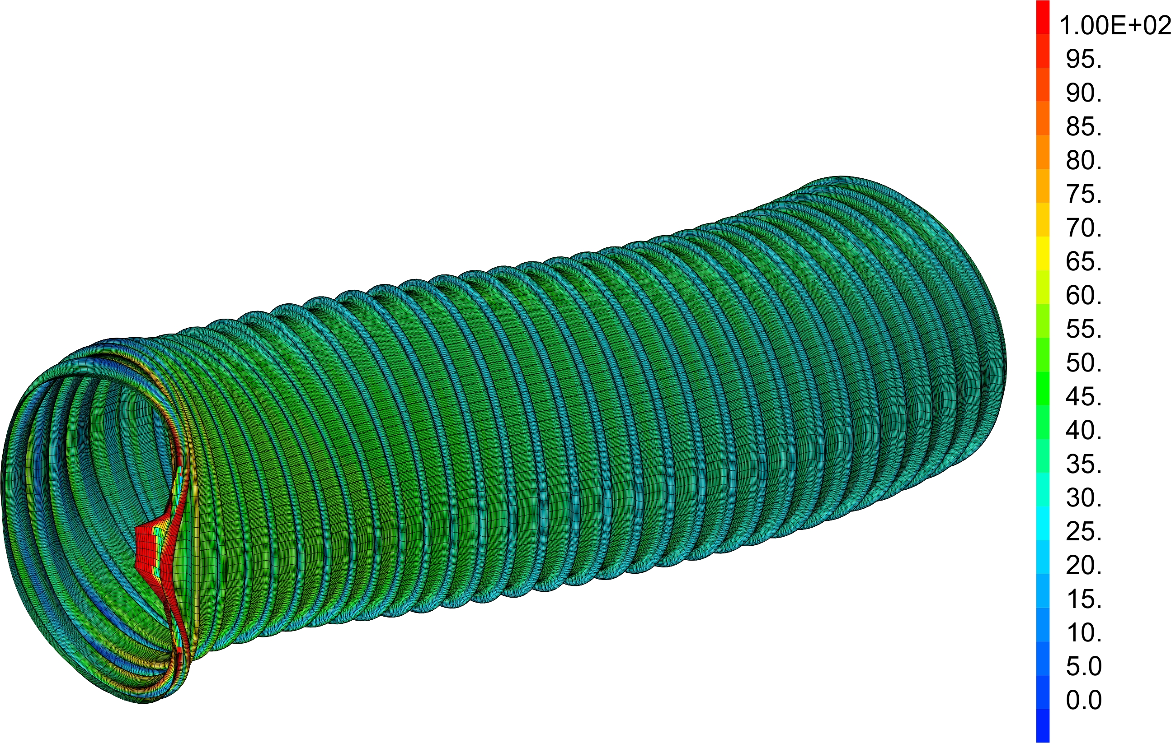
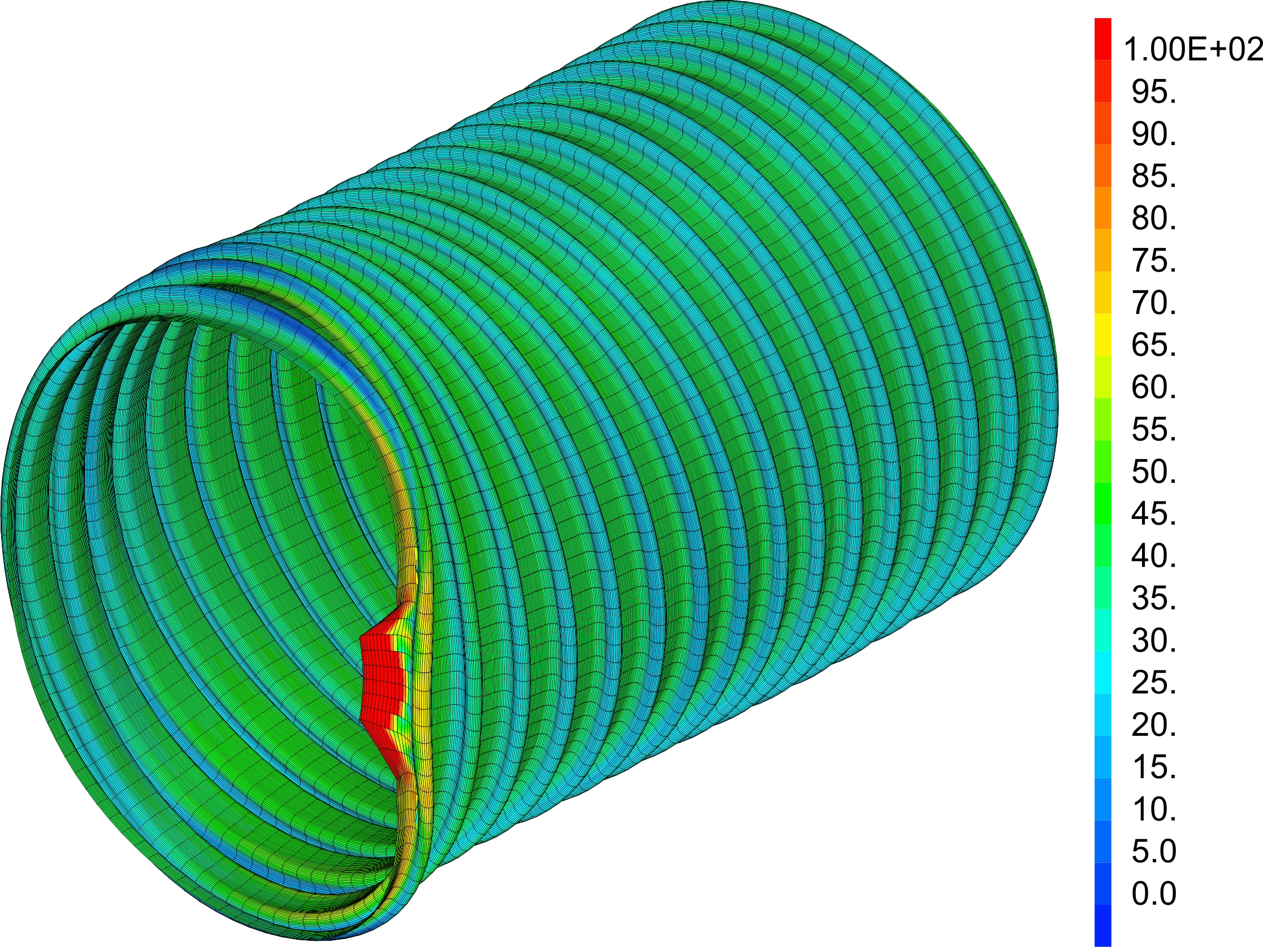
Mechanical aspects
Behaviour during bakeout with gravity:
Assumption of a 14 m long tube
  Supported at 3.25 m from the extremities
    Sag ~ 18.3 mm
    Stress in the 60 MPa (support area excluded)
  Supported at 3.25 m from the extremities with central crutch
    Sag ~ 2.5 mm
    Stress in the 50 MPa (support area excluded)
Von Mises equivalent stress field during bakeout under gravity with supports distanced by 7.5 m (deformed shape factor: 100)
Von Mises equivalent stress field during bakeout under gravity with additional central support (deformed shape factor: 100)

Slide 9
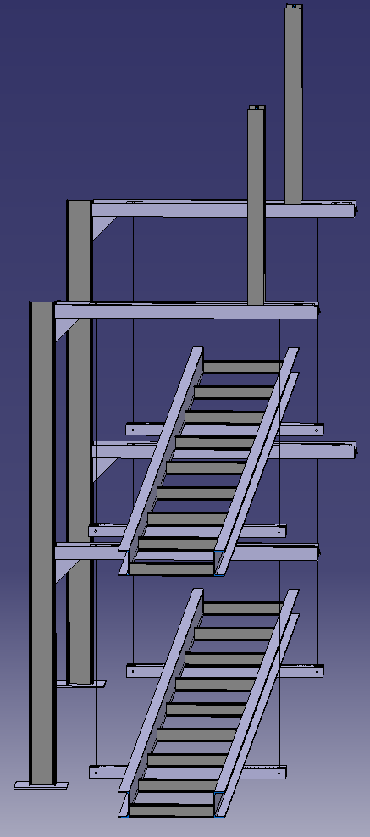
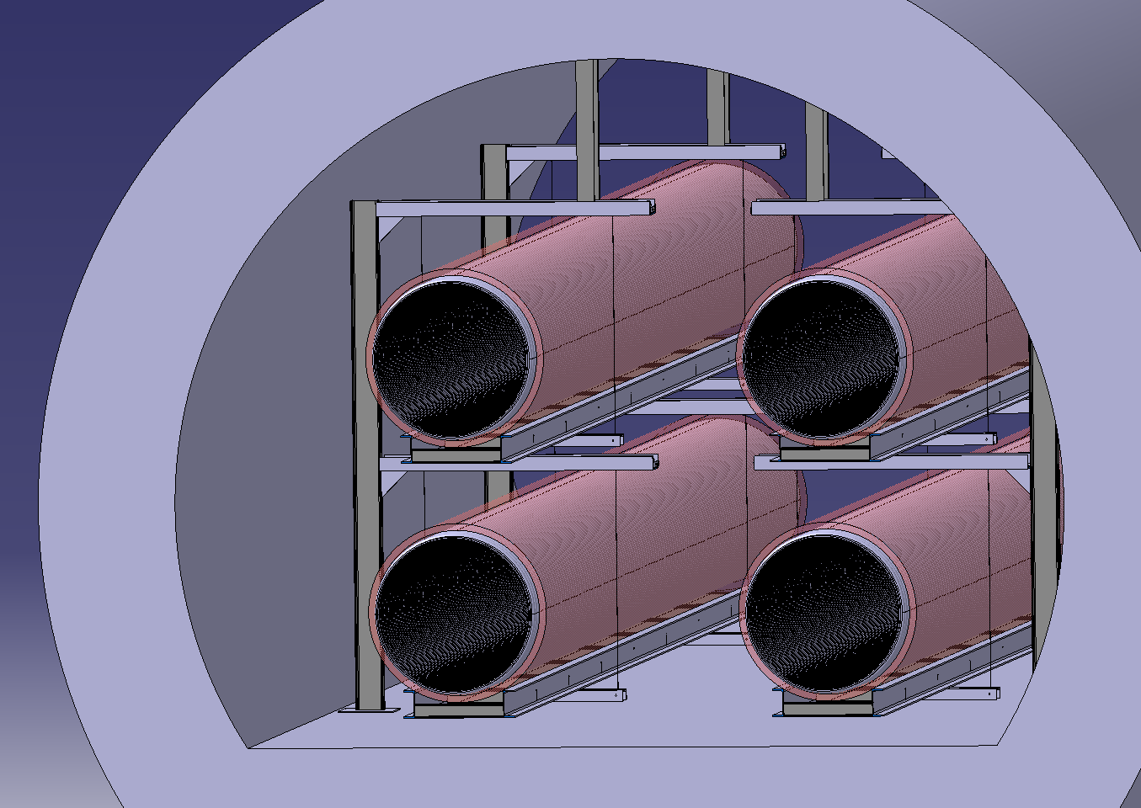
A support proposal
The proposed design, based on a suspended vacuum chamber, aims at reducing vibrations on the baffles.
Basic concept is based on harmonic oscillator and aims at lowering the first eigen frequencies.
Supporting beam
Insulated vacuum chamber
Supporting frame
Aramid fibre ropes

Slide 10
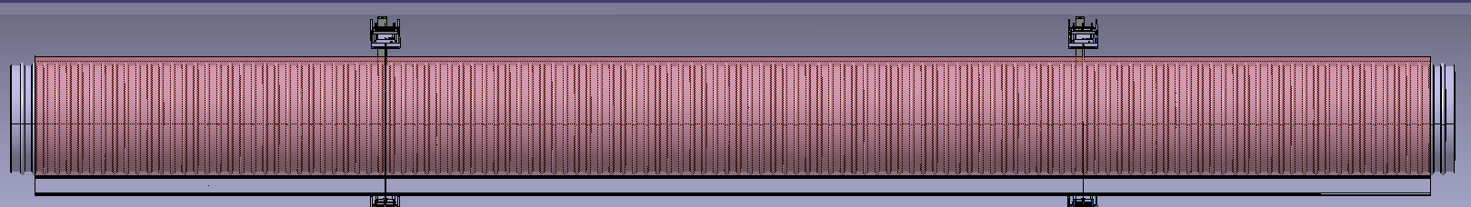
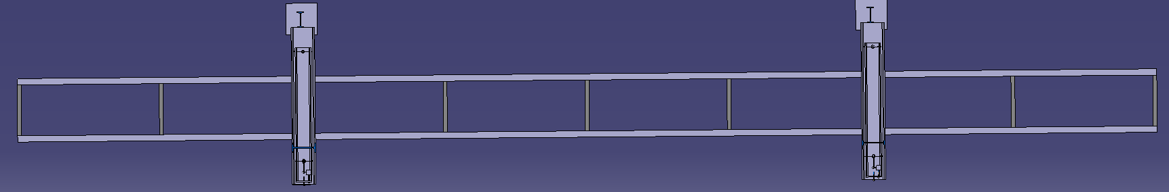
A support proposal
Elementary module would be composed of a ~15m long chamber, insulated and installed on a the supporting frame.
Supporting beam would be mounted and pre-aligned before module installation.
~15m
Space for tube module interconnection – insulation mounted subsequently
1/4
Assembly side view
1/8
Support top view

Slide 11
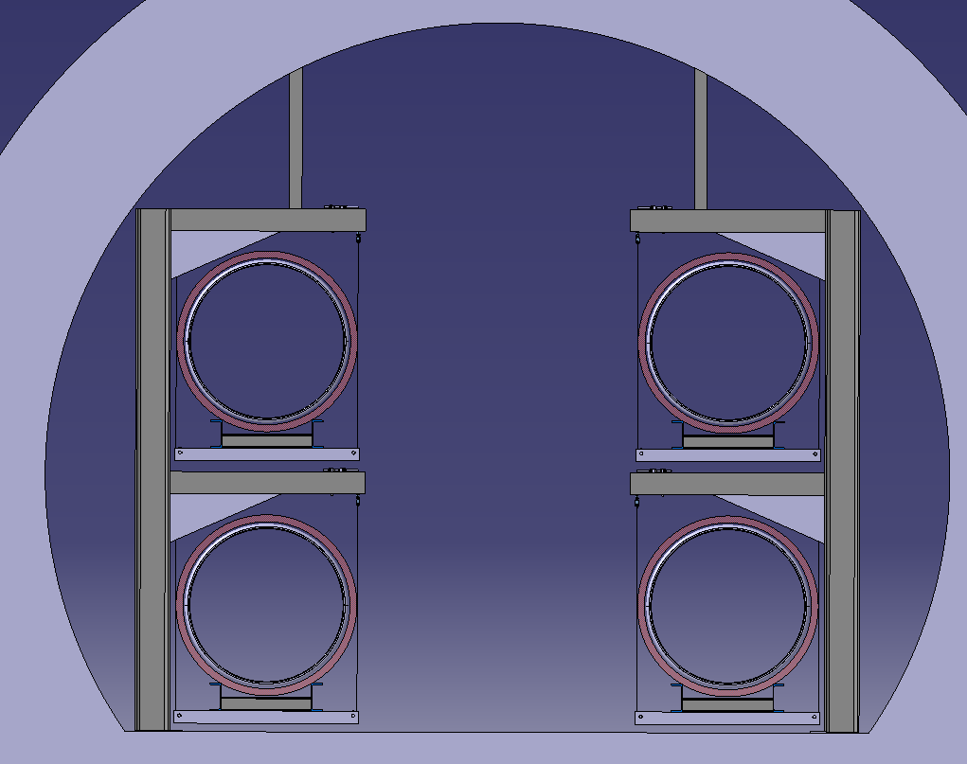
Preliminary implementation in a tunnel cross-section
Passage width: 1,8 m
Depending on the tunnel floor heigh
~ 1.7 m
~ 1.8 m
~3.72m

Slide 12
Mechanical aspects
Column Stability for hanging structure
During the thermal treatment, the chamber is in compression without vacuum → subjected to column buckling.
Support/wheel
Rope
h
y
y
Chamber
The chamber behaves as a pendulum that corresponds in lateral direction to an elastic foundation.
Specific mass
Specific foundation stiffness: $K_{s}=\frac{m_{l}∙g}{h}$
Pendulum height
Expected buckling force for infinitely long column on elastic foundation:
$F_{cr}=\sqrt{4∙K_{S}∙E∙I}$
For h = 1 m, EI = 2.4E11 N.mm² and m= 48 kg.m⁻¹: F_{cr} ~ 21.25 kN

Slide 13
Mechanical aspects
Column Stability for hanging structure
Two models:
Beams in 2D with equivalent springs to model the pendulum effect; eigen mode study
Beams in 3D with gravity and initial imperfection; non linear large displacement study
g

Slide 14
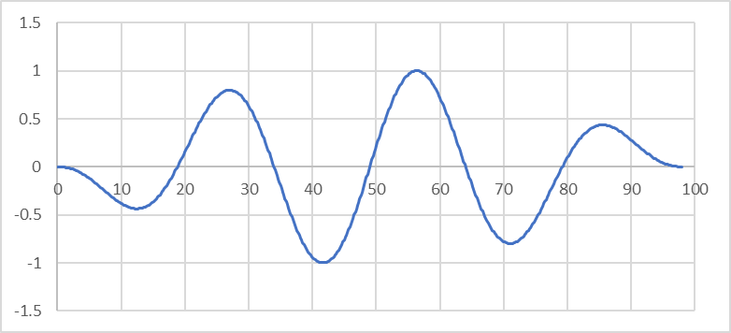
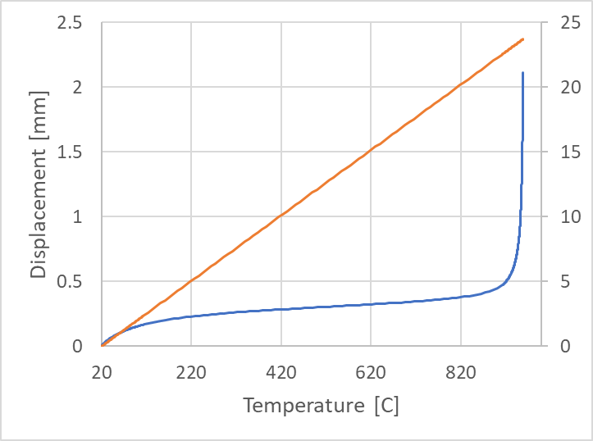
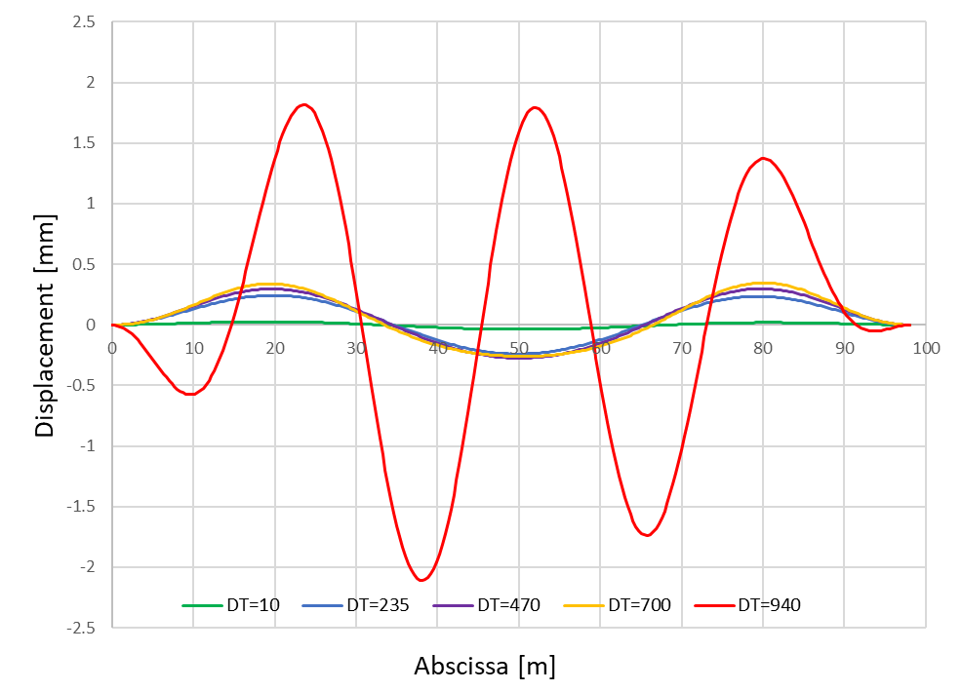
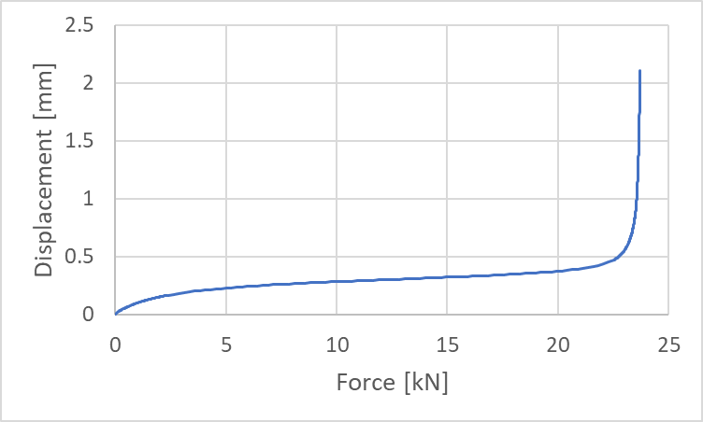
Mechanical aspects
Column Stability for hanging structure
100 m model:
2D eigen value model: buckling force: 22.15 kN
3D non linear model:
  Instability at ~ 23 kN (930 C)
  Plateau with stable deformation related to initial imperfection

Slide 15
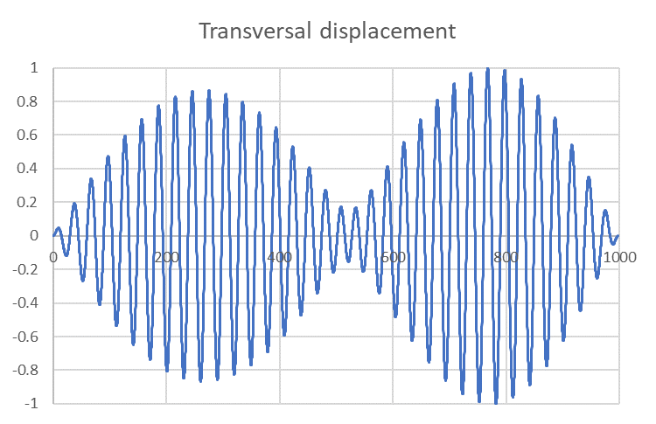
Mechanical aspects
Column Stability for hanging structure
1000 m model:
2D eigen value model: buckling force: 21.3 kN
No significant difference between the 100 and 1000 m models.
Very good agreement between the two models and the theoretical values.
The chamber remains stable during the heat treatment in the 200-300 C range (Safety coefficient: 3-4).

Slide 16
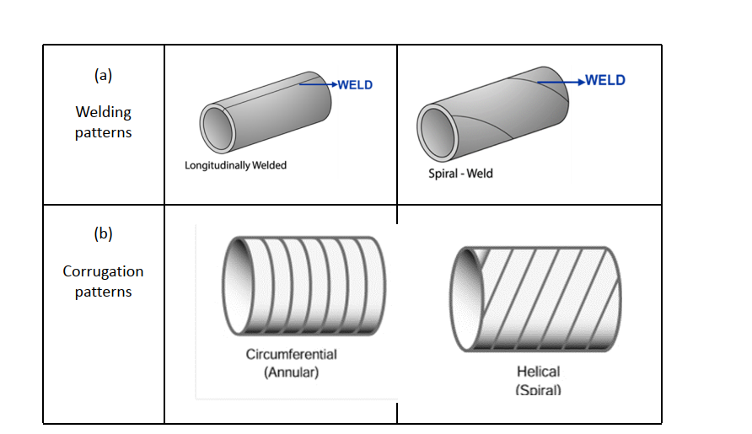
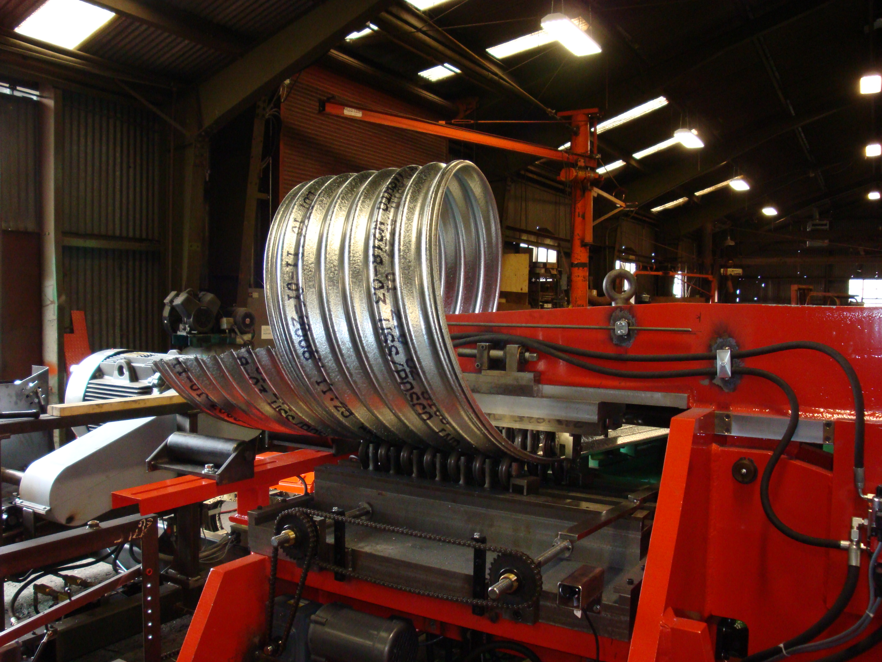
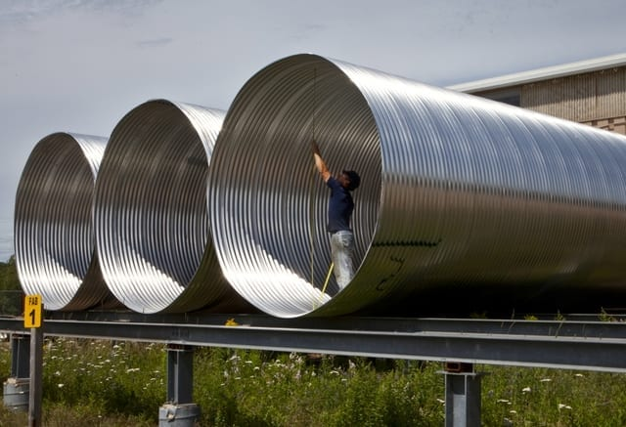
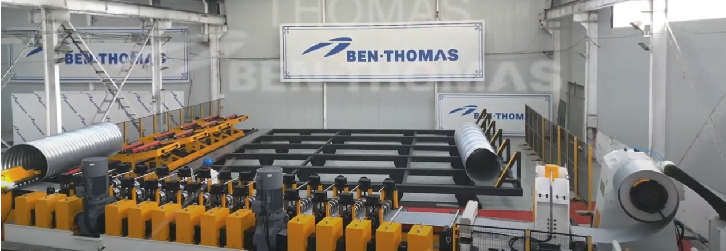
Annular vs spiral corrugations
https://www.prdcompany.com/corrugated-metal-pipe/
https://www.ail.ca/product/corrugated-steel-pipe/
Spiral corrugations

Slide 17
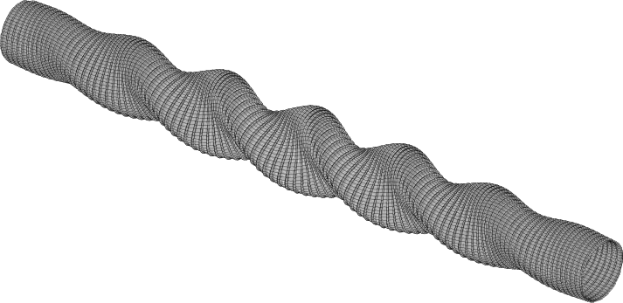
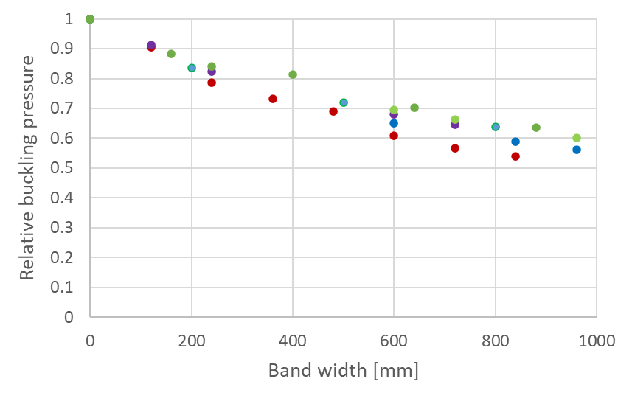
Spiral corrugations
Drawbacks
Decrease of mechanical performance:
Higher longitudinal stiffness
Lower buckling strength
Influence of band width (helice angle) on the relative buckling pressure for different convolution parameters

Slide 18
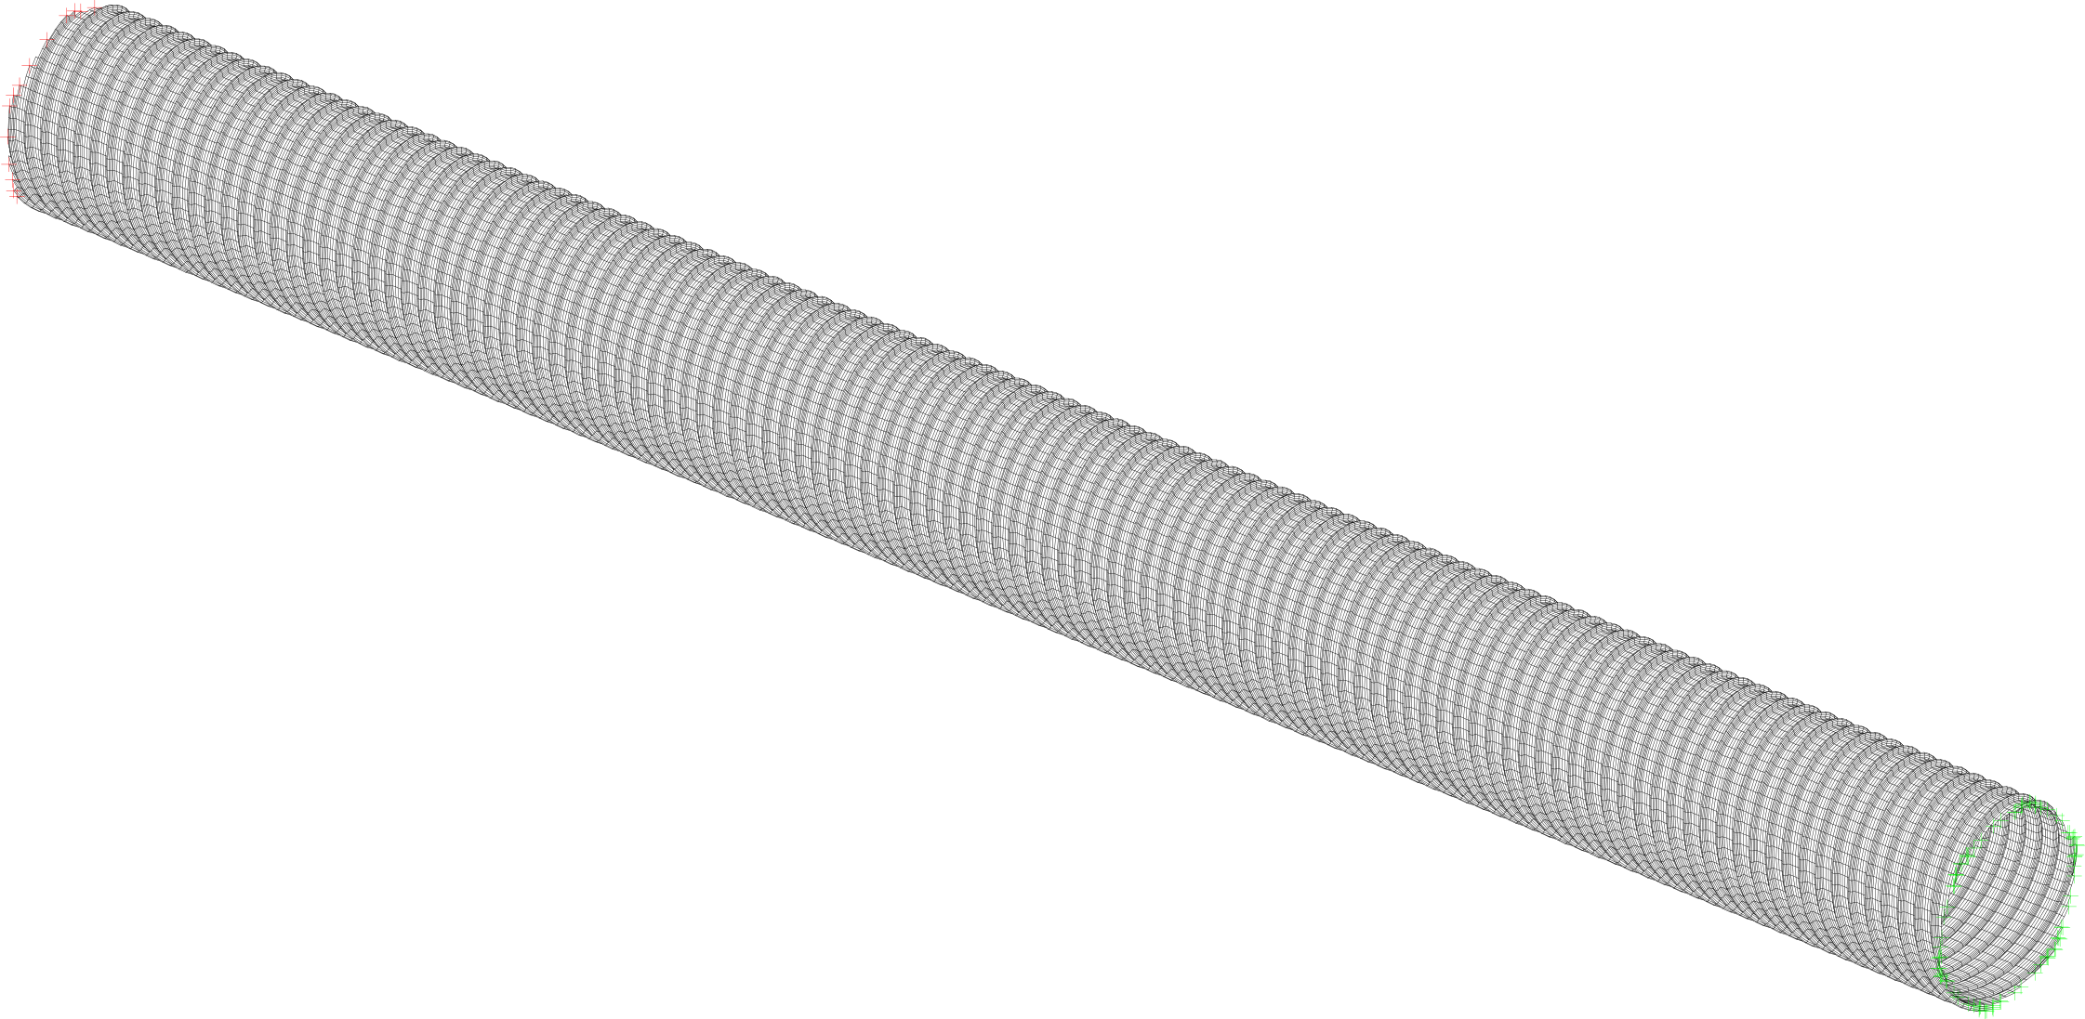
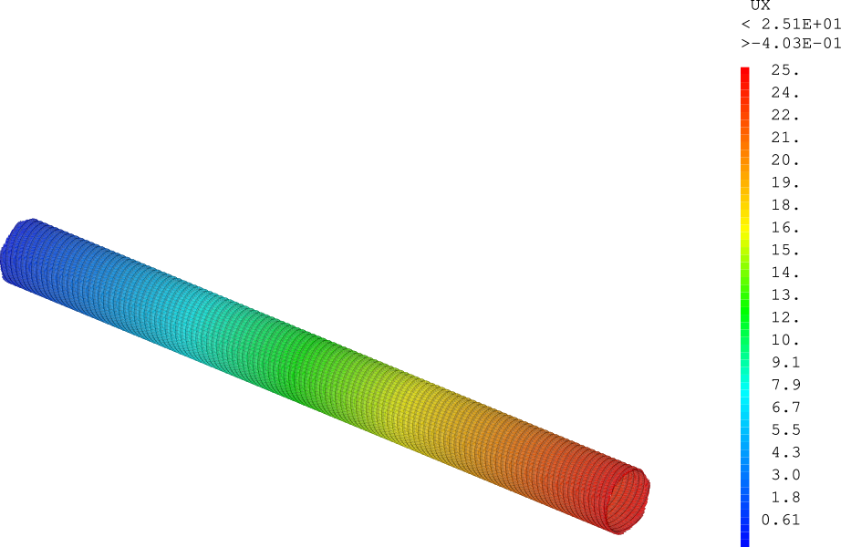
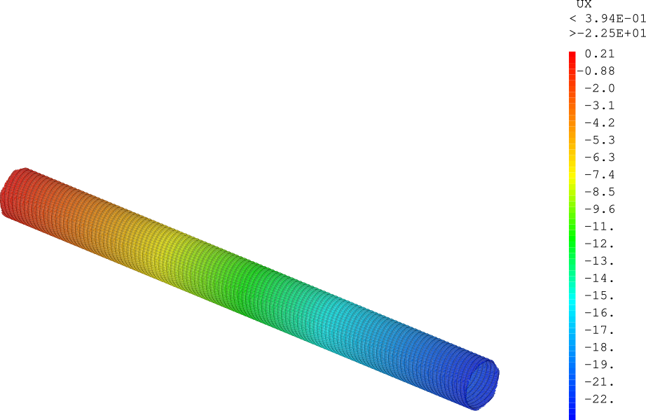
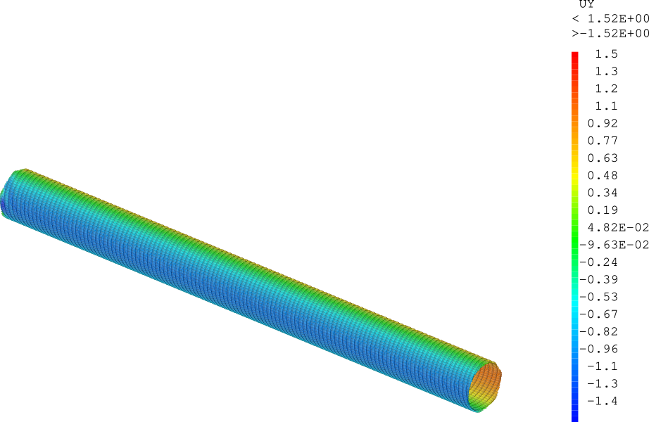
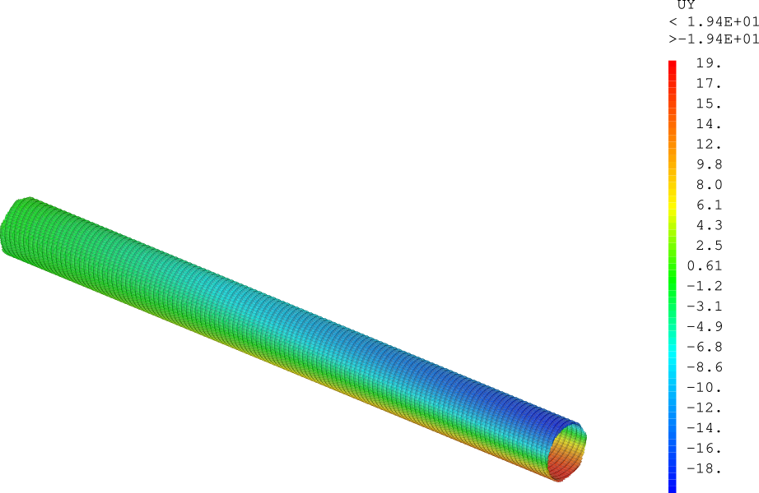
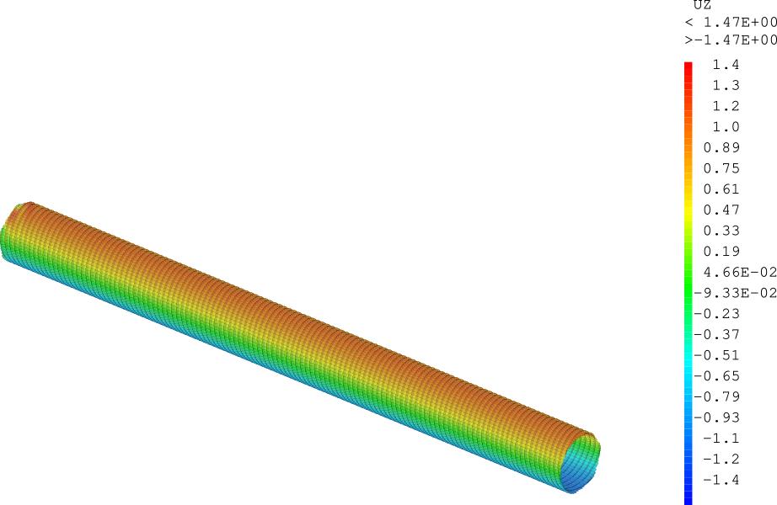
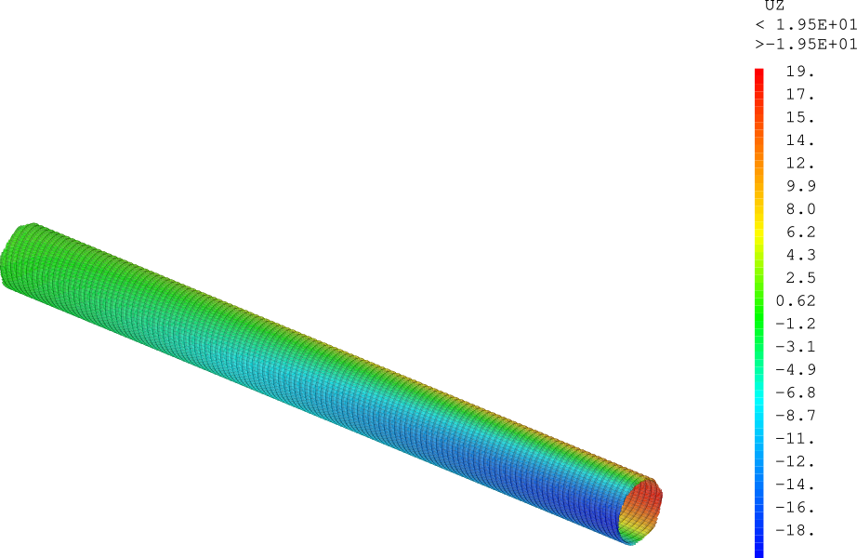
Spiral corrugations
Drawbacks
Axial/torsional coupling:
Axial force induces rotation or torque.
Fixed
z
y
12 m
x
Only thermal expansion
Thermal expansion & 1 bar external pressure
Free
Case 1.5 mm thick, 100 mm pitch, 30 mm convolution height, 6 convolutions/band

Slide 19
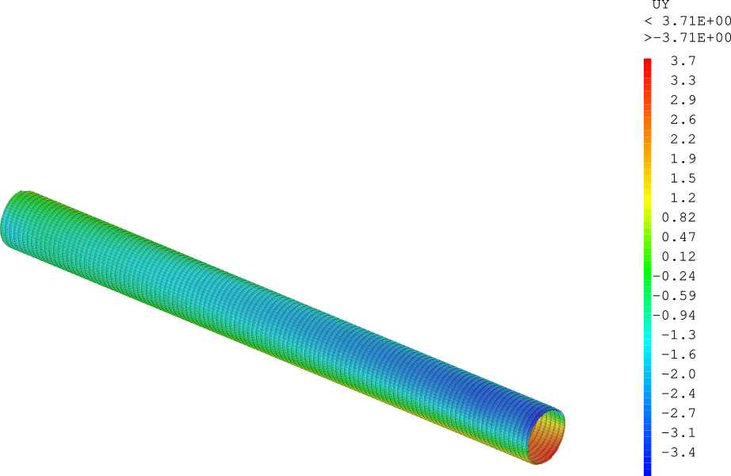
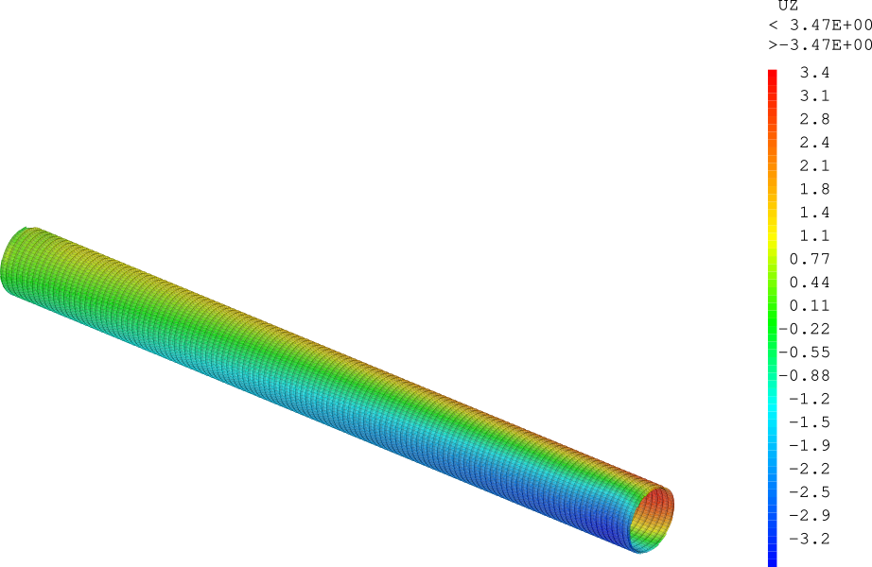
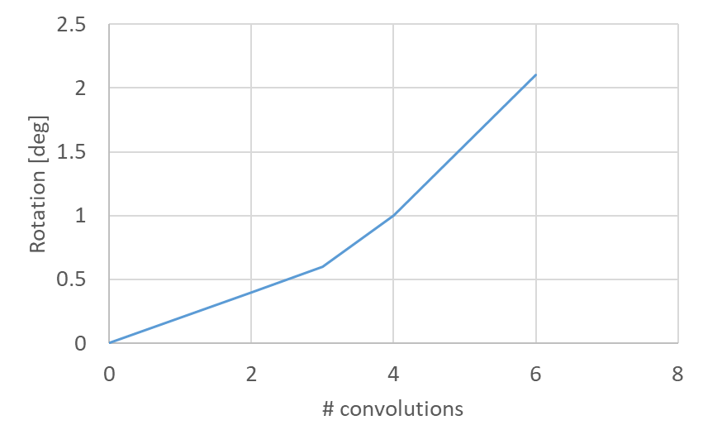
Spiral corrugations
Drawbacks
Axial/torsional coupling:
Axial force induces rotation or torque.
Case 1.5 mm thick, 100 mm pitch, 30 mm convolution height, 6 convolutions/band
Case 1.5 mm thick, 100 mm pitch, 30 mm convolution height, 2 convolutions/band

